Slide 1
Usefulness of velocity profiles based on 3D cine PC MR used as boundary conditions for computational fluid dynamics of an intracranial aneurysm : investigation with the aid of simulated data set
Haruo Isoda ¹, Yuki Onishi ², Yasuo Takehara ³, Toshiyasu Shimizu ⁴,
Kohei Aoki ², Takashi Kosugi ⁴, Kenji Amaya ², Harumi Sakahara ⁵
1 Department of Radiological and Medical Laboratory Sciences, Nagoya University Graduate School of Medicine, Nagoya, Japan
2 Department of Mechanical and Environmental Informatics, Tokyo Institute of Technology, Graduate School of Information Science and Engineering, Tokyo, Japan;
3 Department of Radiology, Hamamatsu University Hospital, Hamamatsu, Japan;
4 Renaissance of Technology Corporation, Hamamatsu, Japan;
5 Department of Radiology, Hamamatsu University School of Medicine, Hamamatsu, Japan

Slide 2
BACKGROUND
Hemodynamics, especially wall shear stress (WSS), plays a very important role in the initiation, progression and rupture of intracranial aneurysms.
Human hemodynamic analysis mainly includes MR fluid dynamics (MRFD) based on 3D cine phase-contrast MR imaging and Computational fluid dynamics (CFD). They have several merits and deficits.
MR-based CFD, which uses flow information of 3D cine PC MR as boundary conditions, provides us with intracranial aneurysmal hemodynamics with high spatial resolution and high temporal resolution. However, adequate inlet region length can not be obtained, because imaging slab of 3D cine PC MR is limited due to relatively longer imaging time.
Inlet velocity profile boundary conditions (BC) or flow volume BC are thought to affect the results of MR-based CFD.

Slide 3
PURPOSE
The purpose of our study was to perform CFD with velocity profile inlet BC and flow volume inlet BC with the aid of simulated 3D cine PC MR data set of an intracranial aneurysm, and to compare velocities, streamlines and WSS obtained from the two types of CFD, using the true 3D data set as a gold standard.

Slide 4
Materials and Methods

Slide 5
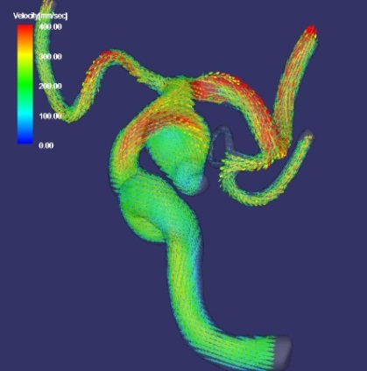
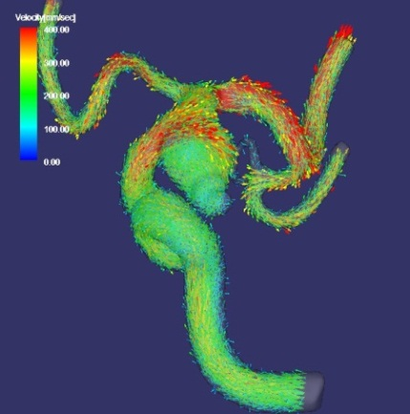
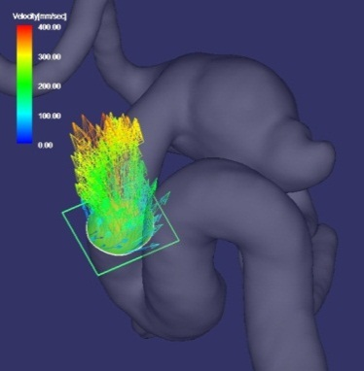
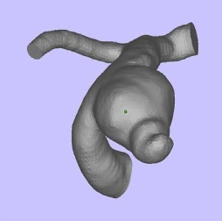
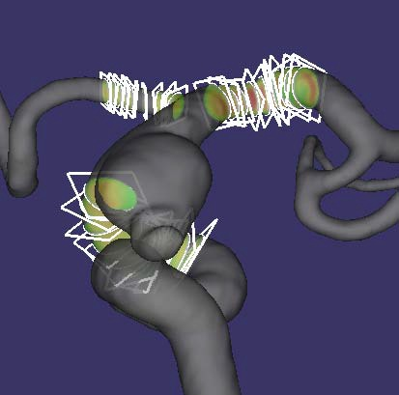
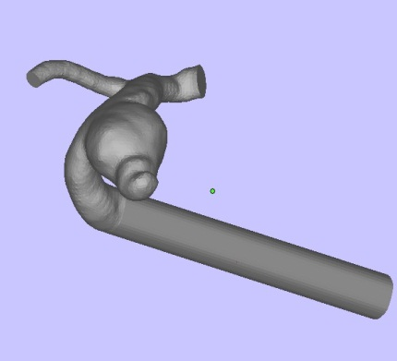
Overview of this study
CFD
Calculation condition
Blood density: 1054[kg/m3]
Blood viscosity: 0.00384[kg/(m・s)]
Inlet boundary condition:
flow volume, 0.003[kg/s]
Outlet boundary condition:
Pressure, 0[Pa]
Newtonian fluid
Steady flow
Non-slip boundary condition
Vascular wall: rigid
+ Gaussian noise
STL data from digital angiogram (DA) of a lt. IC-PC aneurysm with a 15mm diameter obtained from 70 year old pt. with SAH
Simulated 3D cine PC MR data
Gold standard
CFD with volume corrected velocity profile inlet BC
Volume corrected velocity profile inlet BC
Flow volume outlet BC
CFD
Comparison
・Flow vector
・Streamlines
・WSS
Velocity profile
Calculation domain
Flow volume information
CFD
CFD with flow volume inlet BC
Flow volume inlet and outlet BC
Elongation
of inlet region
Flow volume for 10 sections each 3 segments
Calculation domain
Notes:
This slide shows the overview of “Materials and Methods” of this study.

Slide 6
Overview of this study
CFD
Calculation condition
Blood density: 1054[kg/m3]
Blood viscosity: 0.00384[kg/(m・s)]
Inlet boundary condition:
flow volume, 0.003[kg/s]
Outlet boundary condition:
Pressure, 0[Pa]
Newtonian fluid
Steady flow
Non-slip boundary condition
Vascular wall: rigid
+ Gaussian noise
STL data from digital angiogram (DA) of a lt. IC-PC aneurysm with a 15mm diameter obtained from 70 year old pt. with SAH
Simulated 3D cine PC MR data
Gold standard
CFD with volume corrected velocity profile inlet BC
Volume corrected velocity profile inlet BC
Flow volume outlet BC
CFD
Comparison
・Flow vector
・Streamlines
・WSS
Velocity profile
Calculation domain
Flow volume information
CFD
CFD with flow volume inlet BC
Flow volume inlet and outlet BC
Elongation
of inlet region
Flow volume for 10 sections each 3 segments
Calculation domain
Notes:
This research was approved by IRB and IC was obtained from the patient.
STereo Lithography (STL) data from digital angiogram of a lt. internal carotid-posterior communicating artery aneurysm with a 15mm diameter obtained from a 70 year old patient with subarachnoid hemorrhage.

Slide 7
Overview of this study
CFD
Calculation condition
Blood density: 1054[kg/m3]
Blood viscosity: 0.00384[kg/(m・s)]
Inlet boundary condition:
flow volume, 0.003[kg/s]
Outlet boundary condition:
Pressure, 0[Pa]
Newtonian fluid
Steady flow
Non-slip boundary condition
Vascular wall: rigid
+ Gaussian noise
STL data from digital angiogram (DA) of a lt. IC-PC aneurysm with a 15mm diameter obtained from 70 year old pt. with SAH
Simulated 3D cine PC MR data
Gold standard
CFD with volume corrected velocity profile inlet BC
Volume corrected velocity profile inlet BC
Flow volume outlet BC
CFD
Comparison
・Flow vector
・Streamlines
・WSS
Velocity profile
Calculation domain
Flow volume information
CFD
CFD with flow volume inlet BC
Flow volume inlet and outlet BC
Elongation
of inlet region
Flow volume for 10 sections each 3 segments
Calculation domain
Notes:
We created meshes in the 3 dimensional aneurysmal model using ANSYS GAMBIT.
We solved Navier-Stokes equations with the aid of ANSYS FLUENT.
Calculation condition is as followes;
Blood density: 1054[kg/m3]
Blood viscosity: 0.00384[kg/(m・s)]
Inlet boundary condition: flow volume, 0.003[kg/s] (2.85×10-6[m3/s])
Outlet boundary condition: Pressure, 0[Pa]
Newtonian fluid
Steady flow
Non-slip boundary condition
Vascular wall; rigid
We converted this data set into a linearly-interpolated lattice data set with the spatial resolution of 0.5mm similar to that of intracranial 3D cine PC MR. We regarded this 3D velocity vector field data set as the Gold standard, true hemodynamic information in a human body.

Slide 8
Overview of this study
CFD
Calculation condition
Blood density: 1054[kg/m3]
Blood viscosity: 0.00384[kg/(m・s)]
Inlet boundary condition:
flow volume, 0.003[kg/s]
Outlet boundary condition:
Pressure, 0[Pa]
Newtonian fluid
Steady flow
Non-slip boundary condition
Vascular wall: rigid
+ Gaussian noise
STL data from digital angiogram (DA) of a lt. IC-PC aneurysm with a 15mm diameter obtained from 70 year old pt. with SAH
Simulated 3D cine PC MR data
Gold standard
CFD with volume corrected velocity profile inlet BC
Volume corrected velocity profile inlet BC
Flow volume outlet BC
CFD
Comparison
・Flow vector
・Streamlines
・WSS
Velocity profile
Calculation domain
Flow volume information
CFD
CFD with flow volume inlet BC
Flow volume inlet and outlet BC
Elongation
of inlet region
Flow volume for 10 sections each 3 segments
Calculation domain
Notes:
We created a simulated 3D cine PC MR data set whose errors with the standard deviation of 0.035m/s was normally-distributed.
This standard deviation was based on our unpublished experimental data.

Slide 9
Overview of this study
CFD
Calculation condition
Blood density: 1054[kg/m3]
Blood viscosity: 0.00384[kg/(m・s)]
Inlet boundary condition:
flow volume, 0.003[kg/s]
Outlet boundary condition:
Pressure, 0[Pa]
Newtonian fluid
Steady flow
Non-slip boundary condition
Vascular wall: rigid
+ Gaussian noise
STL data from digital angiogram (DA) of a lt. IC-PC aneurysm with a 15mm diameter obtained from 70 year old pt. with SAH
Simulated 3D cine PC MR data
Gold standard
CFD with volume corrected velocity profile inlet BC
Volume corrected velocity profile inlet BC
Flow volume outlet BC
CFD
Comparison
・Flow vector
・Streamlines
・WSS
Velocity profile
Calculation domain
Flow volume information
CFD
CFD with flow volume inlet BC
Flow volume inlet and outlet BC
Elongation
of inlet region
Flow volume for 10 sections each 3 segments
Calculation domain
Notes:
We obtained velocity profile at one cross section at the C2 segment of the lt. internal carotid artery.
We also calculated flow volumes of 10 sections at three segments of the lt. ICA, ACA, and MCA. We averaged flow volumes of each segment of the vessels.
We corrected flow velocity profile based on these volume.
We used volume corrected flow velocity profile at the ICA as inlet BC and flow volumes of MCA and ACA as outlet BC for CFD.
Computational domain for CFD was set at actual 3D cine PC MR imaging.
Calculation conditions except for inlet and outlet boundary conditions and geometry were the same as those used in calculation for Gold standard.
We converted this CFD result data set to a linearly-interpolated lattice data set with the spatial resolution of 0.5mm similar to that of intracranial 3D cine PC MR. We regarded this 3D velocity vector field data set as the results of CFD with flow volume corrected velocity profile inlet BC.

Slide 10
Overview of this study
CFD
Calculation condition
Blood density: 1054[kg/m3]
Blood viscosity: 0.00384[kg/(m・s)]
Inlet boundary condition:
flow volume, 0.003[kg/s]
Outlet boundary condition:
Pressure, 0[Pa]
Newtonian fluid
Steady flow
Non-slip boundary condition
Vascular wall: rigid
+ Gaussian noise
STL data from digital angiogram (DA) of a lt. IC-PC aneurysm with a 15mm diameter obtained from 70 year old pt. with SAH
Simulated 3D cine PC MR data
Gold standard
CFD with volume corrected velocity profile inlet BC
Volume corrected velocity profile inlet BC
Flow volume outlet BC
CFD
Comparison
・Flow vector
・Streamlines
・WSS
Velocity profile
Calculation domain
Flow volume information
CFD
CFD with flow volume inlet BC
Flow volume inlet and outlet BC
Elongation
of inlet region
Flow volume for 10 sections each 3 segments
Calculation domain
Notes:
CFD with flow volume inlet BC was carried out based on inlet and outlet flow volume.
We also added 4cm inlet region at the 11mm upper stream portion from the aneurysm to obtain fully developed flow at the inlet.
Calculation conditions except for inlet and outlet boundary conditions and geometry were the same as those used in calculation for Gold standard.
We converted this CFD result data set to a linearly-interpolated lattice data set with the spatial resolution of 0.5mm similar to that of intracranial 3D cine PC MR. We regarded this 3D velocity vector field data set as the results of CFD with flow volume inlet BC.

Slide 11
Overview of this study
CFD
Calculation condition
Blood density: 1054[kg/m3]
Blood viscosity: 0.00384[kg/(m・s)]
Inlet boundary condition:
flow volume, 0.003[kg/s]
Outlet boundary condition:
Pressure, 0[Pa]
Newtonian fluid
Steady flow
Non-slip boundary condition
Vascular wall: rigid
+ Gaussian noise
STL data from digital angiogram (DA) of a lt. IC-PC aneurysm with a 15mm diameter obtained from 70 year old pt. with SAH
Simulated 3D cine PC MR data
Gold standard
CFD with volume corrected velocity profile inlet BC
Volume corrected velocity profile inlet BC
Flow volume outlet BC
CFD
Comparison
・Flow vector
・Streamlines
・WSS
Velocity profile
Calculation domain
Flow volume information
CFD
CFD with flow volume inlet BC
Flow volume inlet and outlet BC
Elongation
of inlet region
Flow volume for 10 sections each 3 segments
Calculation domain
Notes:
We calculated streamlines and WSS of Gold standard, CFD with flow volume corrected velocity profile inlet BC and CFD with flow volume inlet BC using a flow visualization and analysis software (Flova).
We compared velocities, streamlines and WSS obtained from Gold standard and the two types of CFD.

Slide 12
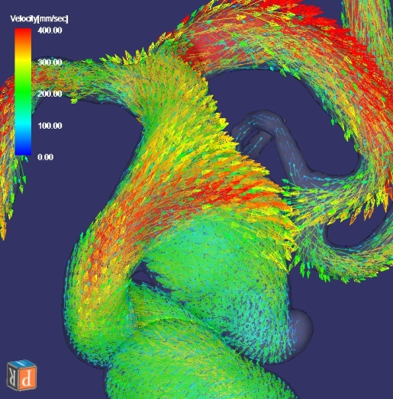
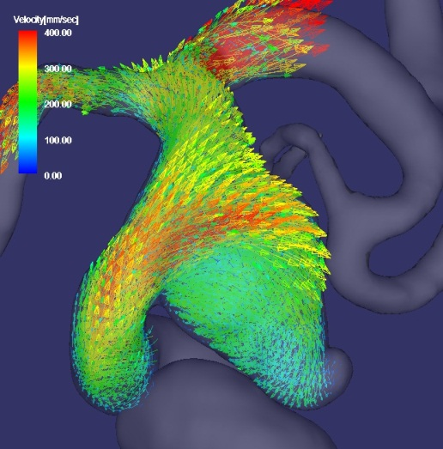
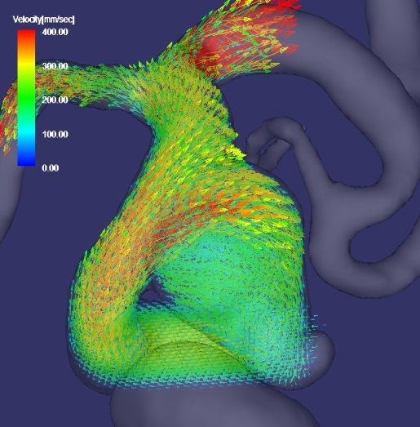
RESULTS 1
CFD with flow volume corrected velocity profile inlet BC
Gold standard
CFD with flow volume inlet BC
Comparison of velocity vector maps
Notes:
This slide shows the overview of the 3D velocity vector maps of the gold standard, the CFD with velocity profile inlet BC and the CFD with flow volume inlet BC. There is a small amount of differences between the CFD with velocity profile inlet BC and CFD with flow volume inlet BC.
Higher velocities of both results are lower than those in Gold standard.

Slide 13
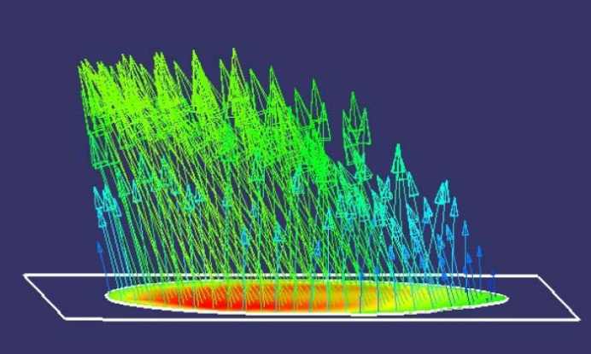
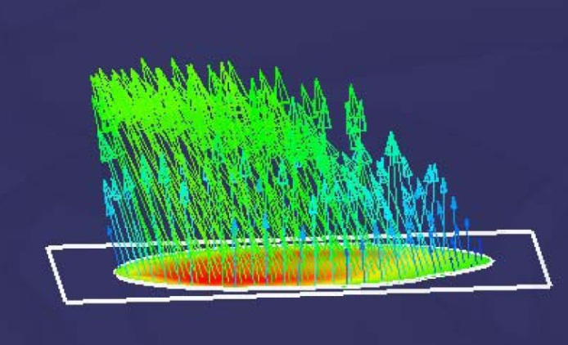
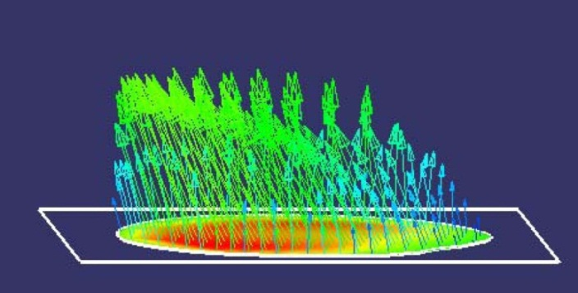
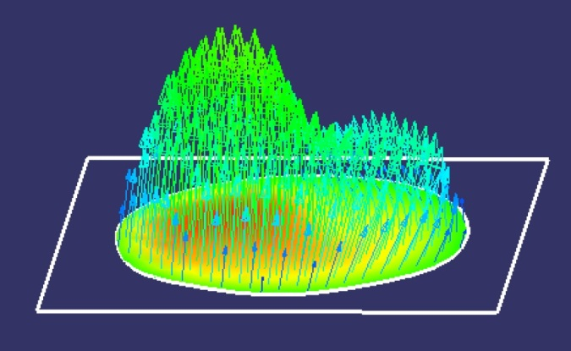
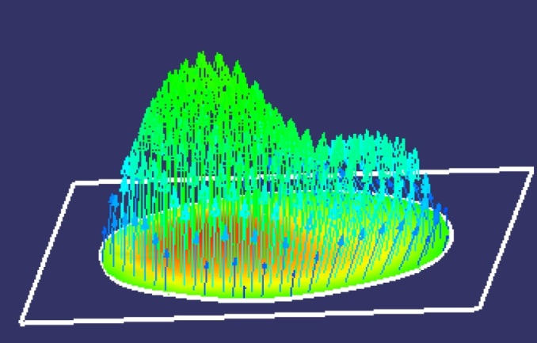
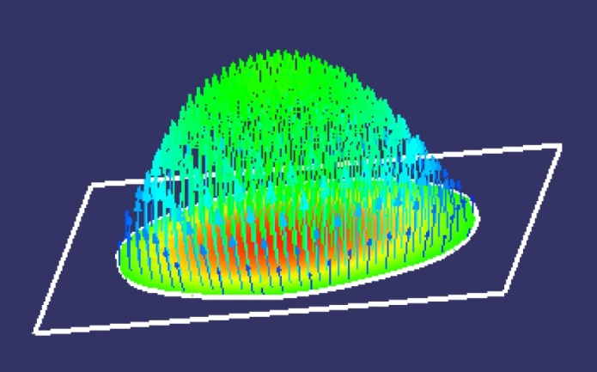
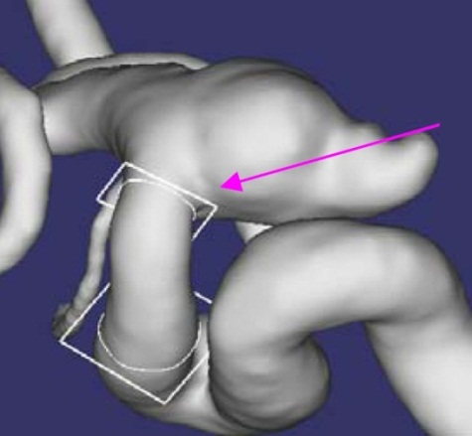
RESULTS 2
A
B
Gold standard
CFD with flow volume corrected velocity profile inlet BC
CFD with flow volume inlet BC
A
Comparison of flow velocities at the inlet and at the portion 11mm down stream from the inlet
B
Notes:
At the inlet, there are great differences in boundary conditions between CFD with velocity profile inlet BC and CFD with flow volume inlet BC. There is less difference in velocity vectors between Gold standard and CFD with velocity profile inlet BC.
At the down stream portion 11mm from the inlet, there is less difference in velocity vectors between CFD velocity profile inlet BC and CFD with flow volume inlet BC. We think that differences in velocity vectors between the two types of CFD seem to be smaller along the stream.

Slide 14
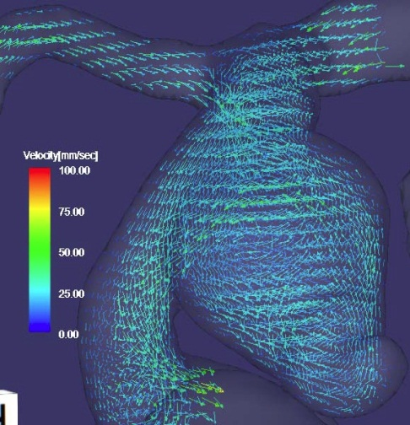
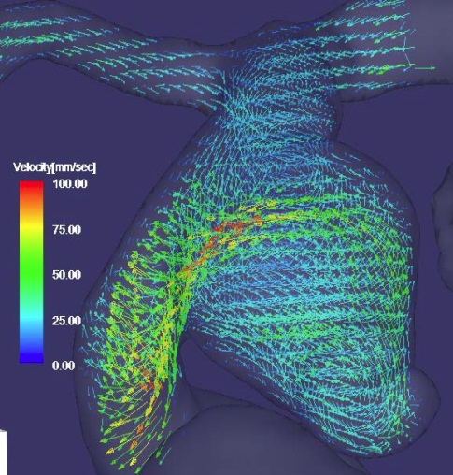
REAULTS 3
Subtraction vector map of CFD with flow volume corrected flow velocity inlet BC from Gold standard
Subtraction vector map of CFD with flow volume inlet BC from Gold standard
Comparison of the velocity differences between two types of CFD and gold standard
Notes:
Velocity differences between the gold standard and CFD with velocity profile inlet BC are at most 20 mm/s. On the contrary, velocity differences between the gold standard and CFD with flow volume inlet BC are approximately 80 mm/s at the parent artery, aneurysmal neck and in a part of the aneurysm.

Slide 15
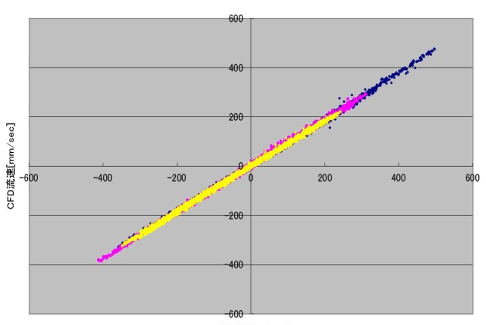
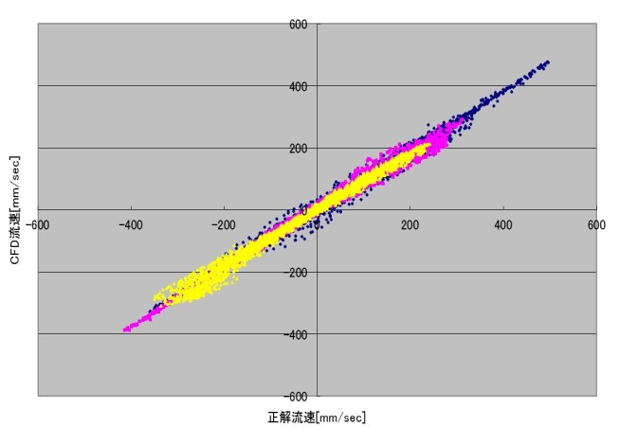
RESULTS 4
Correlation coefficients in three velocity components
X: 0.99929
Y: 0.999175
Z: 0.998979
Correlation coefficients in
three velocity components
X: 0.999317
Y: 0.996258
Z: 0.995104
CFD (mm/s)
CFD (mm/s)
Gold standard (mm/s)
Gold standard (mm/s)
Correlation chart between gold standard and CFD with flow volume corrected velocity profile inlet BC
Correlation chart between gold standard and CFD with flow volume inlet BC
Comparison of correlation coefficients of velocities in in three velocity components between gold standard and two types of CFD
Notes:
Regarding comparison of correlation coefficients of velocities in three velocity components between gold standard and two types of CFD at corresponding point, CFD with velocity profile inlet BC is superior to CFD with flow volume inlet BC.

Slide 16
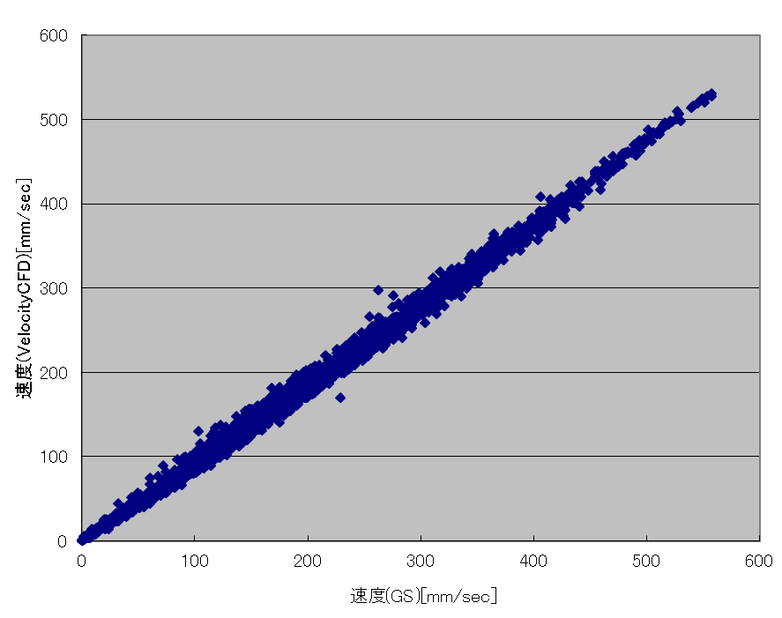
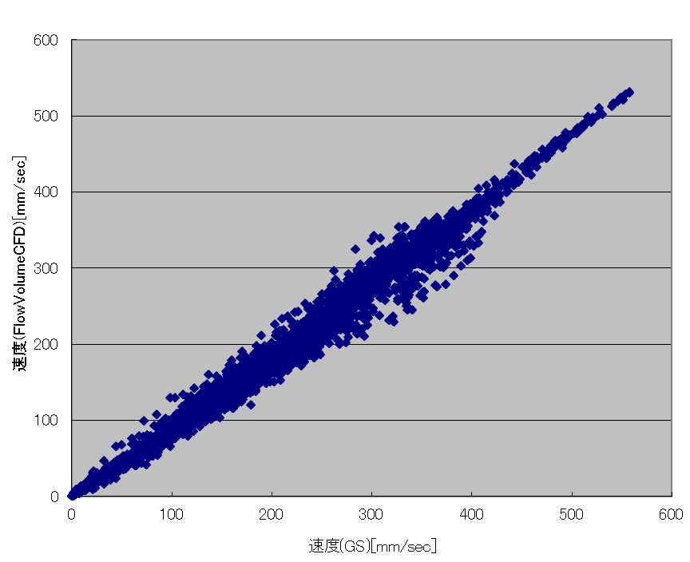
RESULTS 5
Correlation coefficient in vector length, 0.998213
Correlation coefficient in vector length, 0.992992
CFD (mm/s)
CFD (mm/s)
Gold standard (mm/s)
Gold standard (mm/s)
Correlation chart between gold standard and CFD with flow volume corrected velocity profile inlet BC
Correlation chart between gold standard and CFD with flow volume inlet BC
Comparison of correlation coefficients of vector length between gold standard and two types of CFD
Notes:
Regarding comparison of correlation coefficients of vector length between gold standard and two types of CFD. CFD with velocity profile inlet BC is superior to CFD with flow volume inlet BC.

Slide 17
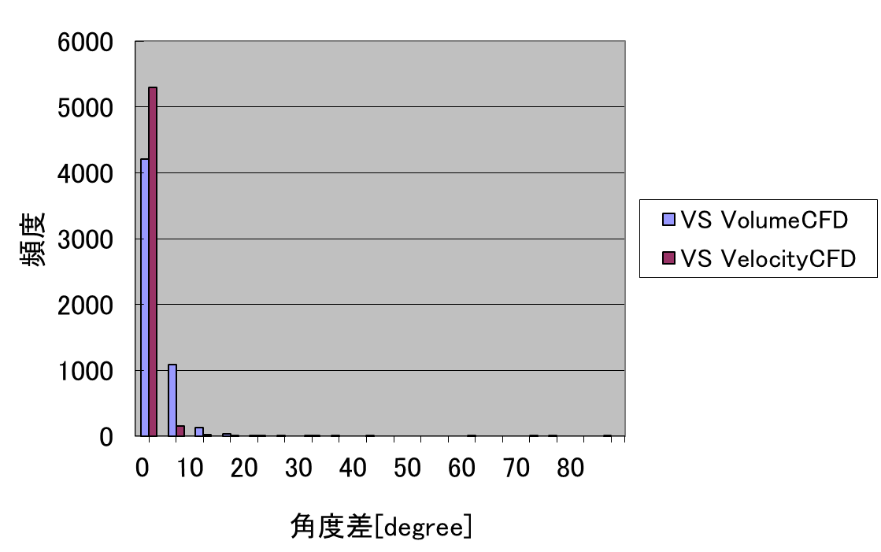
RESULTS 6
Number of vector point
Angle difference (degrees)
Angle differences of vectors of two types of CFD from those of gold standard at each corresponding point
Notes:
This slide shows that angle differences of vectors of two types of CFD from those of gold standard at each corresponding point. Horizontal axis means that the angle differences and vertical axis indicates the number of vector point. Red shows the angle differences between CFD with velocity profile inlet BC and gold standard. Blue indicates the angle differences between CFD with flow volume inlet BC and gold standard. More velocities obtained by the CFD with velocity profile inlet BC show similar directions to those of the gold standard than CFD with flow volume inlet BC.

Slide 18
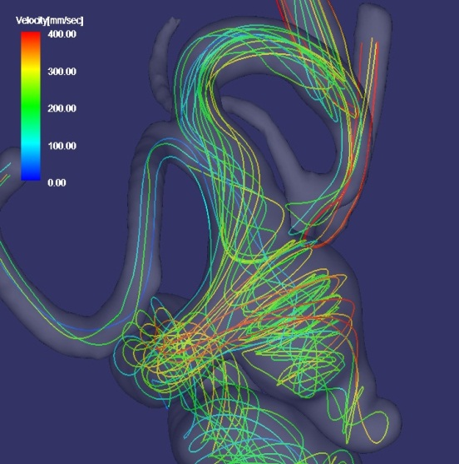
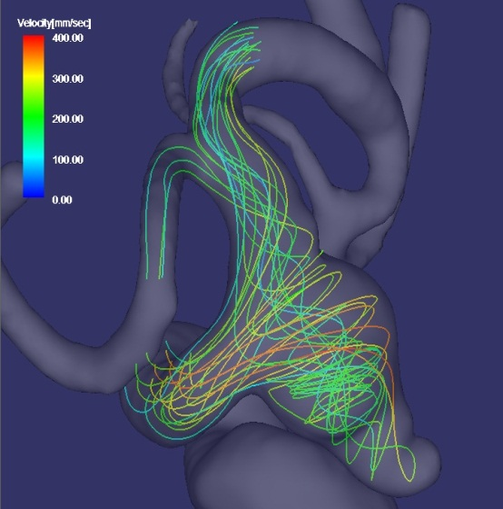
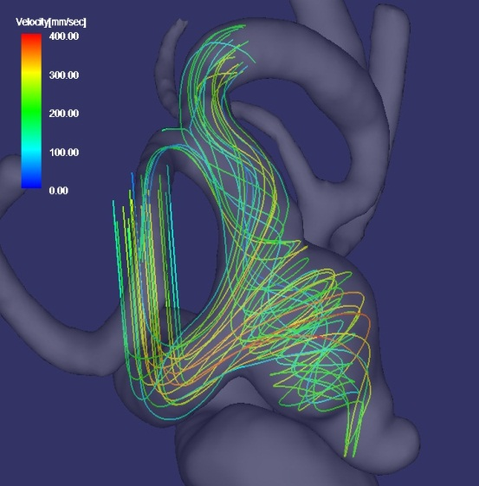
RESULTS 7
CFD with flow volume corrected velocity profile inlet BC
CFD with flow volume inlet BC
Gold standard
Comparison of streamlines
Notes:
In the visual inspection, there are almost no differences in streamlines among the Gold standard and CFD with velocity profile inlet BC and CFD with flow volume inlet BC.

Slide 19
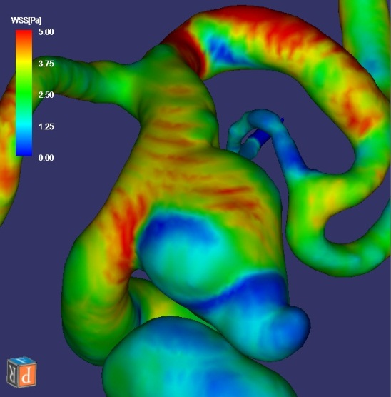
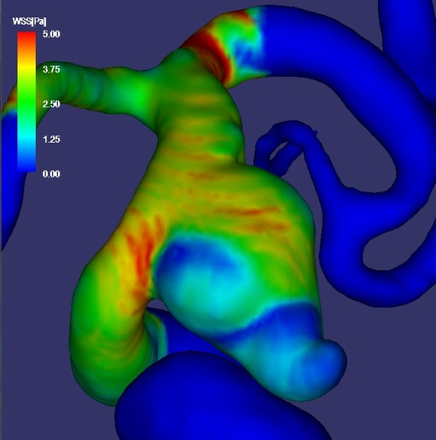
RESULTS 8
CFD with flow volume corrected velocity profile inlet BC
CFD with flow volume inlet BC
Gold standard
Comparison of WSS
Notes:
This slide shows the overview of WSS contour maps of gold standard, two types of CFD. In the visual inspection, there are almost no differences in WSS distribution between CFD with velocity profile inlet BC and CFD with flow volume inlet BC. Slight differences are present between the Gold standard and the two type of CFD.

Slide 20
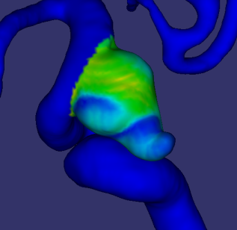
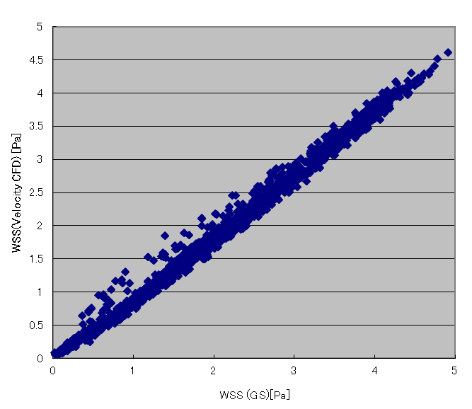
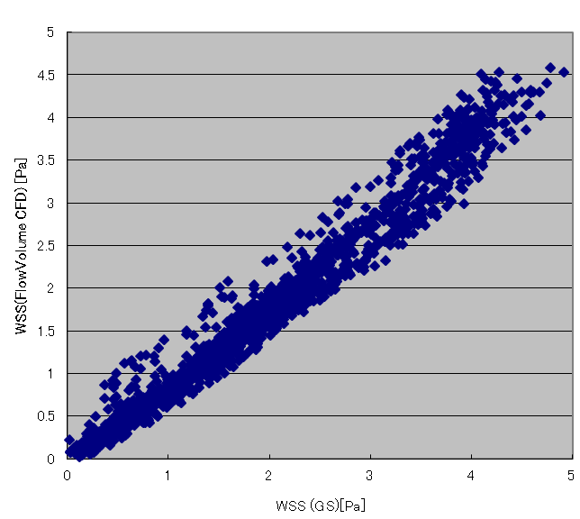
RESULTS 9
Correlation coefficient
in WSS of the intracranial aneurysm, 0.995496
Correlation coefficient
in WSS of the intracranial aneurysm, 0.981925
CFD
CFD
Gold standard
Gold standard
Correlation chart between gold standard and CFD with flow volume corrected velocity profile inlet BC
Correlation chart between gold standard and CFD with flow volume inlet BC
Comparison of correlation coefficients in WSS of the intracranial aneurysm between gold standard and two types of CFD
Notes:
This slide shows the comparison of correlation coefficients in WSS of the intracranial aneurysm between gold standard and two types of CFD. Regarding the aneurysmal WSS, CFD with velocity profile inlet BC is superior to CFD with flow volume inlet BC.

Slide 21
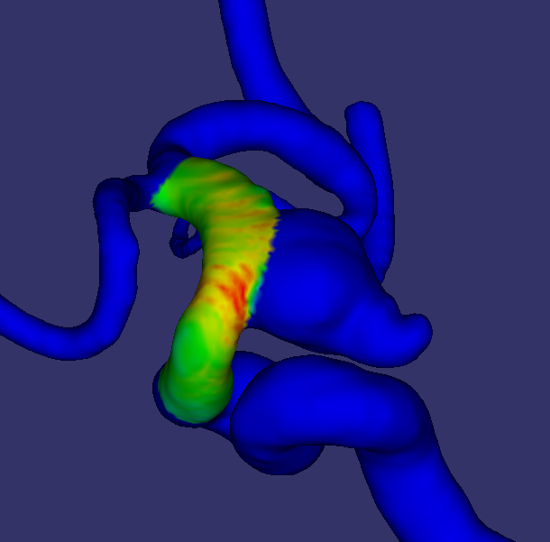
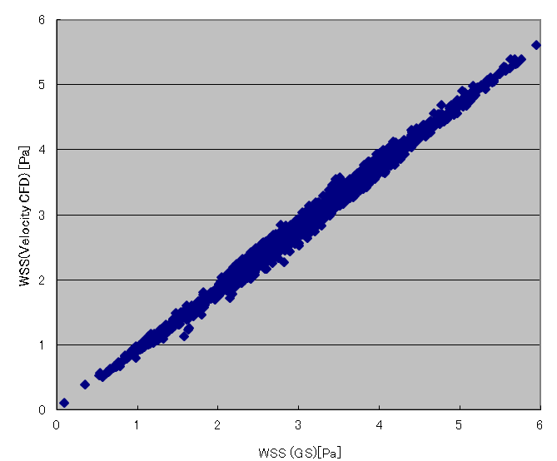
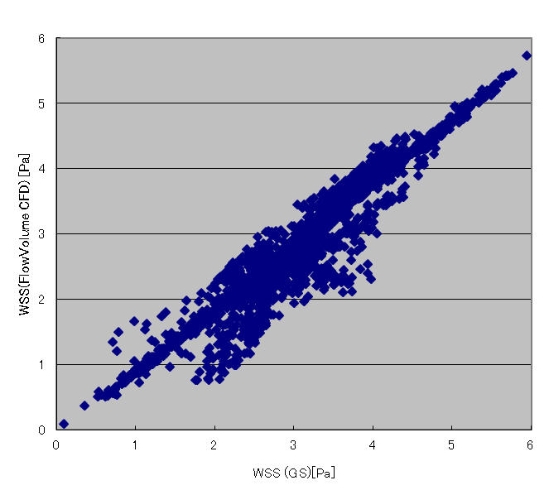
RESULTS 10
Correlation coefficient
in WSS of the parent artery, 0.996069
Correlation coefficient
in WSS of the parent artery, 0.952791
CFD
CFD
Gold standard
Gold standard
Correlation chart between gold standard and CFD with flow volume corrected velocity profile inlet BC
Correlation chart between gold standard and CFD with flow volume inlet BC
Comparison of correlation coefficients in WSS of the parent artery between gold standard and two types of CFD
Notes:
This slide shows the comparison of correlation coefficients in WSS of the parent artery between gold standard and two types of CFD. Regarding the parent artery WSS, CFD with velocity profile inlet BC is also superior to CFD with flow volume inlet BC.

Slide 22
DISCUSSION 1
In practical MR-based CFD, adequate inlet region length can not be obtained, because imaging slab of 3D cine PC MR is limited due to relatively longer imaging time.
In this simulation study, CFD with flow volume corrected velocity profile inlet BC was superior to CFD with flow volume inlet BC for accurate velocity vectors and WSS in and around the aneurysm.

Slide 23
DISCUSSION 2
There were several limitations in this study.
Number of patients and the location of the inlet was limited.
Not pulsatile flow but steady flow
Intracranial aneurysmal geometry for simulated MR-based CFD calculation in this study was the same as the true geometry used for Gold standard. In practical CFD, we usually can’t help but use different geometry from true vascular shape. We thought that such geometric differences from the true may affect the CFD results much more than boundary conditions.

Slide 24
CONCLUSION
CFD with flow volume corrected velocity profile inlet BC was superior to CFD with flow volume inlet BC in this simulation study for an intracranial aneurysm. Therefore, flow volume corrected velocity profile inlet BC should be used for MR-based CFD of intracranial aneurysms.
According to our results, we can obtain accurate 3D velocity vector fields from MR-based CFD using flow volume corrected velocity profile inlet BC, whereas 3D cine PC MR data sets from the human body contain errors.

