Slide 1
Performance Evaluation of Edge-Based Smoothed Finite Element Method for 4-node Tetrahedral Meshes on Electrodeposition Simulation
Kai KITAMURA⁽¹⁾, Yuki ONISHI⁽¹⁾, Takeshi KASHIYAMA⁽²⁾,
Kenji AMAYA⁽¹⁾
(1) Tokyo Institute of Technology (Japan)
(2) SUZUKI MOTOR CORPORATION (Japan)

Slide 2
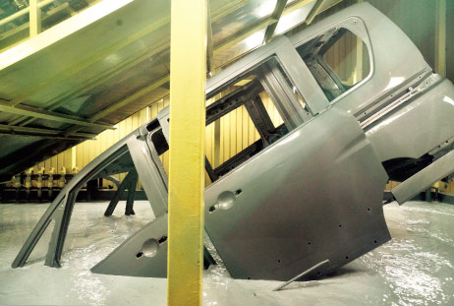
What is electrodeposition (ED) ?
Most widely-used basecoat methods for car bodies.
Making coating film by applying direct electric current
in a paint pool.
Relatively good at making uniform film thickness
but not satisfactory uniform in actual production lines.
ED simulator is necessary for the optimization of
carbody design and coating conditions in actual lines.
+
-
Paint
＋
Anode
＋
Cathode
http://n-link.nissan.co.jp/NOM/PLANT/

Slide 3
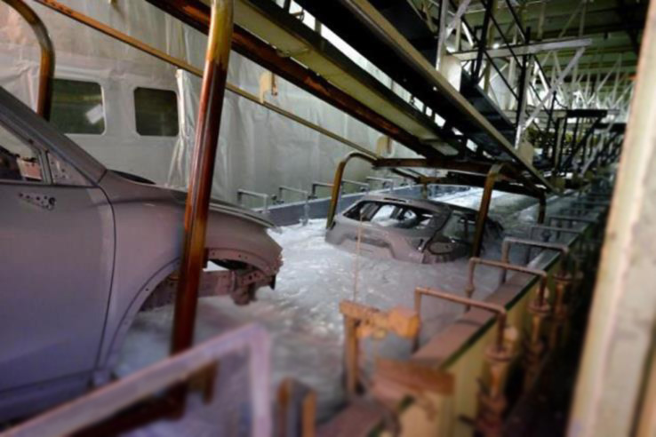
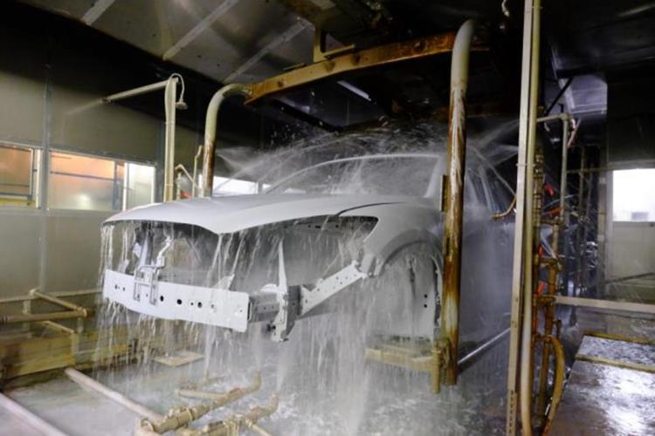
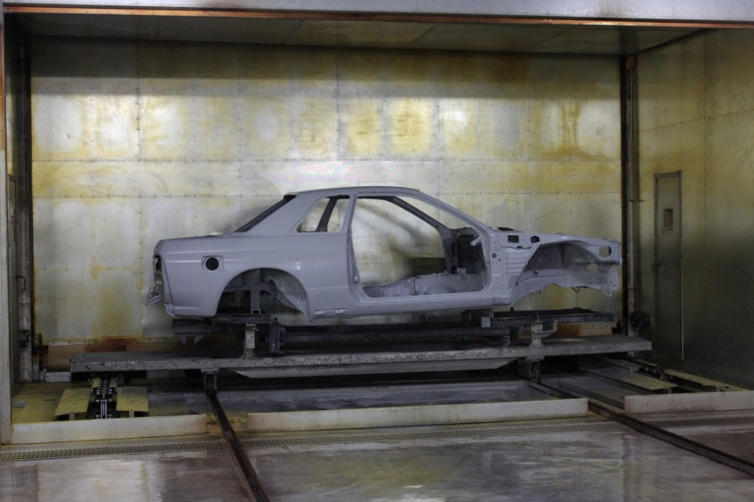
Photos of ED process line
1. dipping and deposition process
2. water rinse process
We focus on
this process.
3. baking process

Slide 4
Mechanism of Electrodeposition
Positively charged paint ions are attracted to the cathode.
Paint ions gradually lose their electrical charge and are aggregated into paint particles.
Some of the paint particles diffuse and dissolve.
Voltage is applied
Deposition
Electrophoresis
-
+
-
+
Coating
Film
-
-
+
When the particle gets big enough
Carbody
（Cathode)
Aggregated into paint particles
Paint Ions

Slide 5
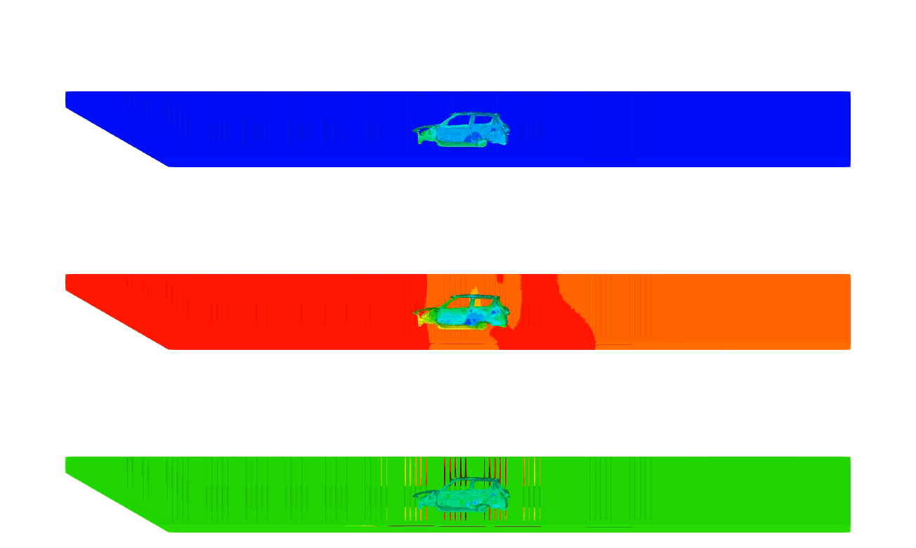
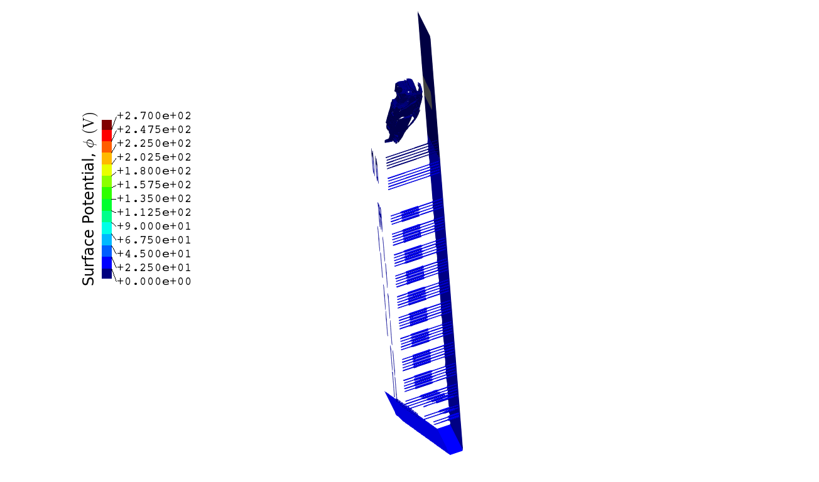






What is ED Simulation ?
ED simulation provides film thickness, surface potential,
surface current density and so on.
Film Thickness
$$30 μm$$
You can see that the paint film starts to be deposited
from the outside surface.
$$0 μm$$
Surface Potential
$$270 V$$
$$0 V$$
Surface Current Density
$$20 A/m^{2}$$
$$−20 A/m^{2}$$

Slide 6
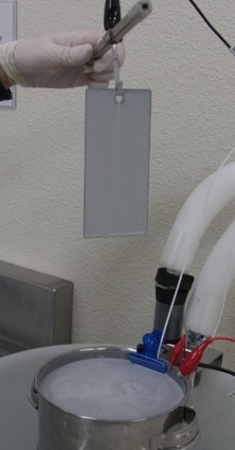
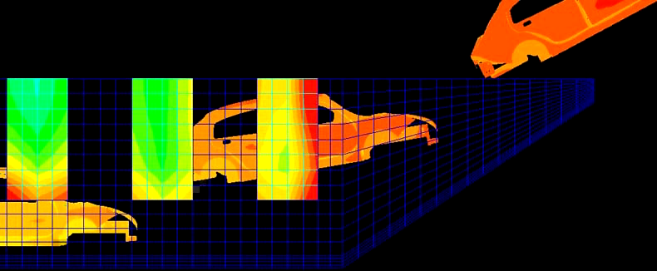
How to Develop an ED Simulator
Experiments at lab in various coating conditions.
Identification of ED boundary model
and its parameters.
Implementation to a FE code.
One-Plate Test
Plate
Paint
On the analogy of
solid mechanics,
Step 1: material tests
with MTS,
Step 2: identification of
elastoplastic model.
DELIGHT web page,
https://delightcfd.com
ED simulation for actual lines

Slide 7
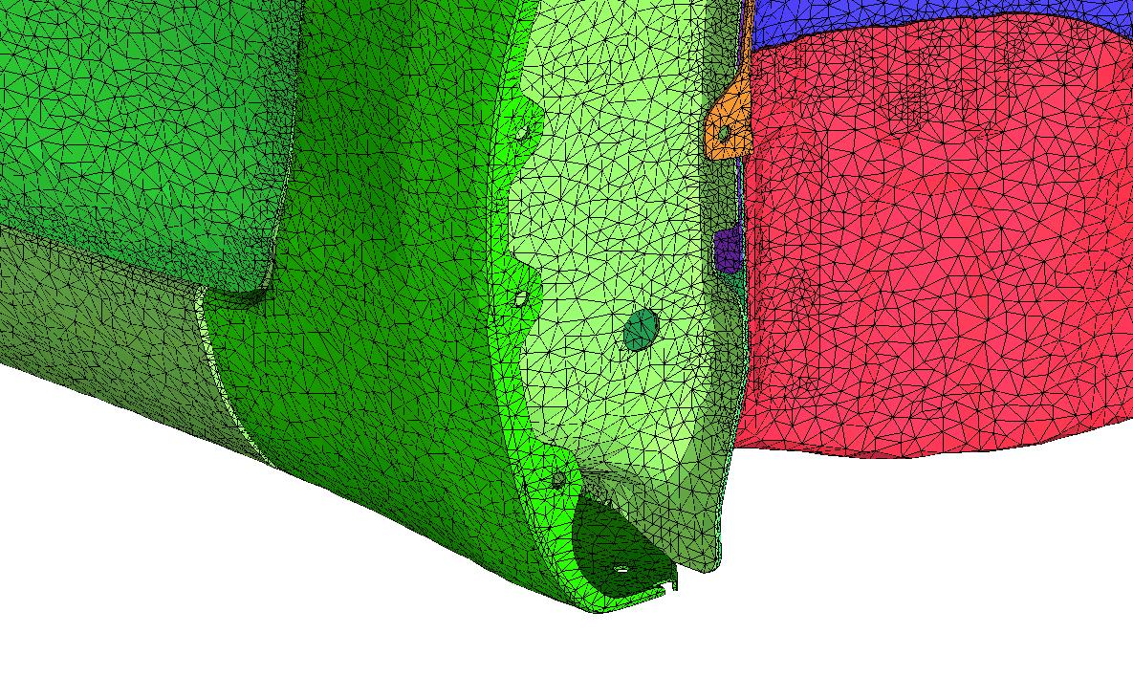
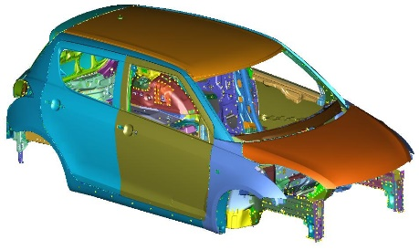
Issues in Meshing (1)
✗ It is difficult to discretize complex shapes
such as car bodies with hexahedral meshes.
→ We have to use tetrahedral meshes in ED simulation.
However…
✓
✗
Only surface
mesh is shown.
Accuracy of the standard FEM-T4 is insufficient
in complex shapes.

Slide 8
Issues in Meshing (2)
✗ 10-node tetrahedral (T10) mesh without kink generally
requires more large number of nodes than T4 mesh.
T4 T10 without kink
Carbody
Carbody
hole
hole
For the same shape representation, T10 mesh
without kink leads to massive increase in DOF.

Slide 9
Issues in Meshing (2) Cont.
✗ 10-node tetrahedral (T10) mesh with kink causes
severe accuracy loss.
T4 T10 with kink
Carbody
Carbody
Kinked T10
hole
hole
T10 mesh with kink does not increase DOF
but induces severe accuracy loss.

Slide 10
Motivation
Hexahedral elements:
✗ It is difficult to discretize complex shapes.
T10 elements without kink:
✗ It leads to massive increase in DOF.
T10 elements with kink:
✗ It causes severe accuracy loss.
→ We want to realize high accuracy analysis with T4 mesh.
ES-FEM-T4 could be a solution to these issues.

Slide 11
Objective
Development of ED simulator using ES-FEM-T4
and its performance evaluation
by comparing with FEM-T4.
Table of body contents:
Outline of ED Simulation
Formulation of ES-FEM for ED Simulation
Analysis Results

Slide 12
Outline of ED Simulation

Slide 13

Fundamental Equations
+
-
Governing equation
The electrostatic Laplace equation
$∇^{2}φ=0$ in the paint pool domain.
Boundary conditions (BCs)
Insulation BC
Anodic (Electrode surface) BC
Cathodic (Carbody surface) BC
ED boundary models are identified with experimental data
at a laboratory.
＋
Paint
Anode
＋
Cathode
Solving the Laplace equation for potential, the current density distribution on a carbody is determined and then the film thickness distribution is time-evolutionally calculated.

Slide 14
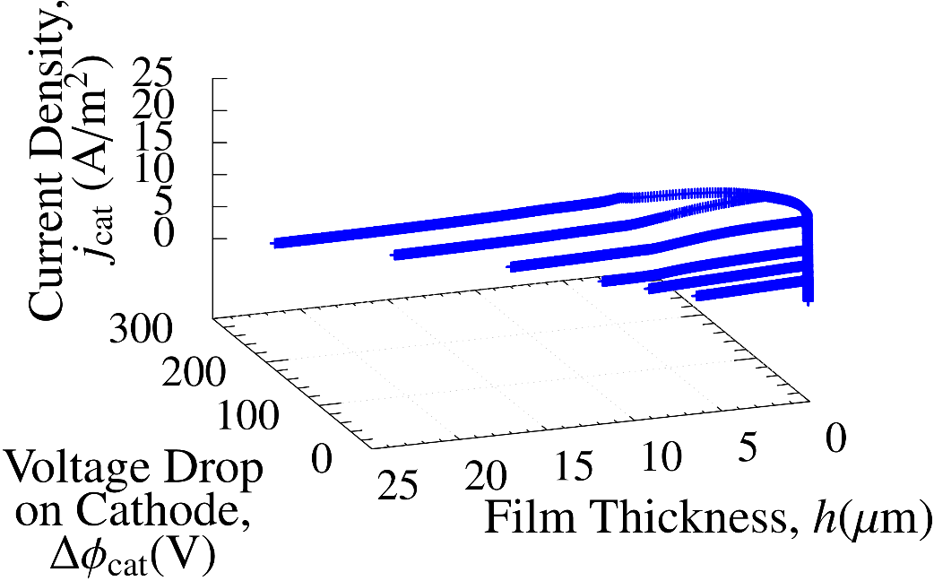
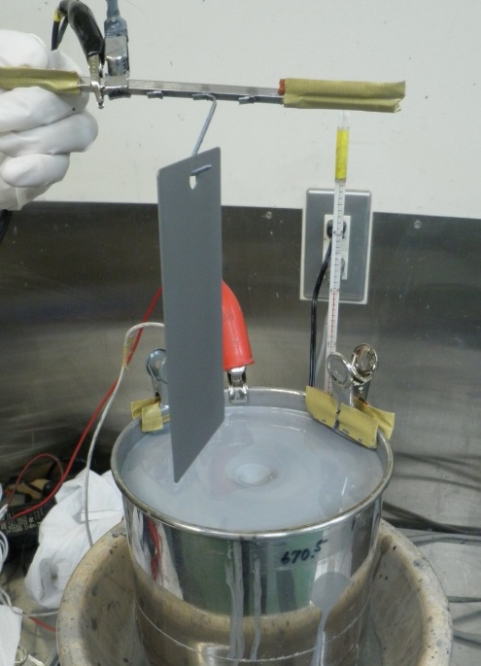
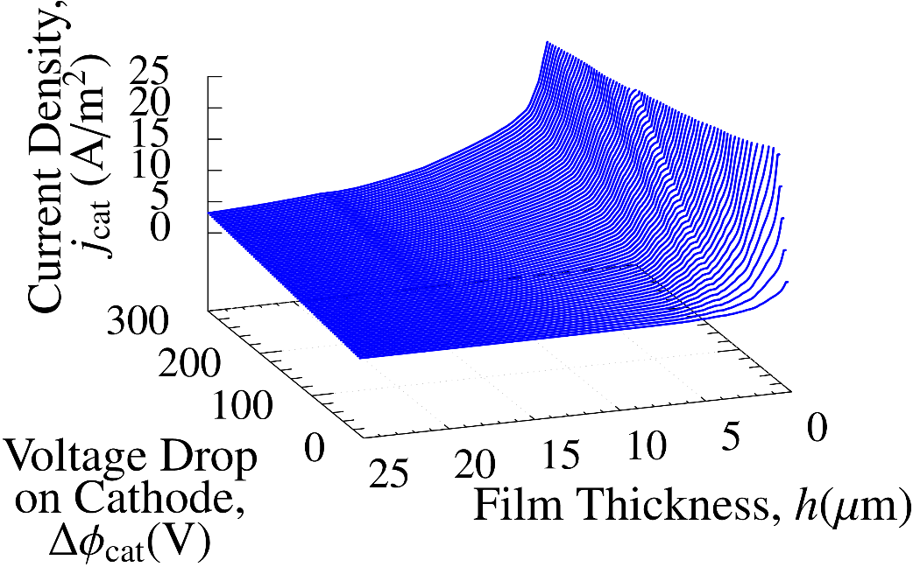
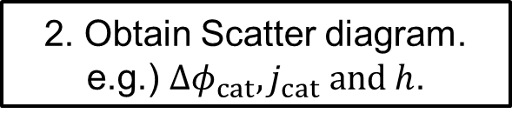
How to Identify ED Boundary Models
1. Conduct a lab experiment called one-plate tests.
2. Obtain Scatter diagram.
e.g.) $Δφ_{cat}, j_{cat} and h$.
Plot
3. Generate approximated surface for each ED Boundary Model.
Data
fitting

Slide 15
Formulation of ES-FEM for ED Simulation

Slide 16
Outline of ES-FEM
What is ES-FEM-T4?
A kind of strain smoothing method.
Using element edges as Gauss points.
Robust against element skew.
Super-linear mesh convergence rate with T4 mesh.
ES-FEM can suppress the accuracy loss by smoothing.
Standard FEM ES-FEM
FEM assembles
each element’s value.
ES-FEM assembles
each edge’s value.
Integration domain
Integration
domain is
different !!
Element
Node

Slide 17
Analysis Results

Slide 18
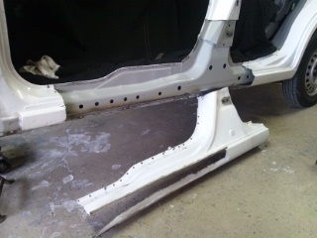
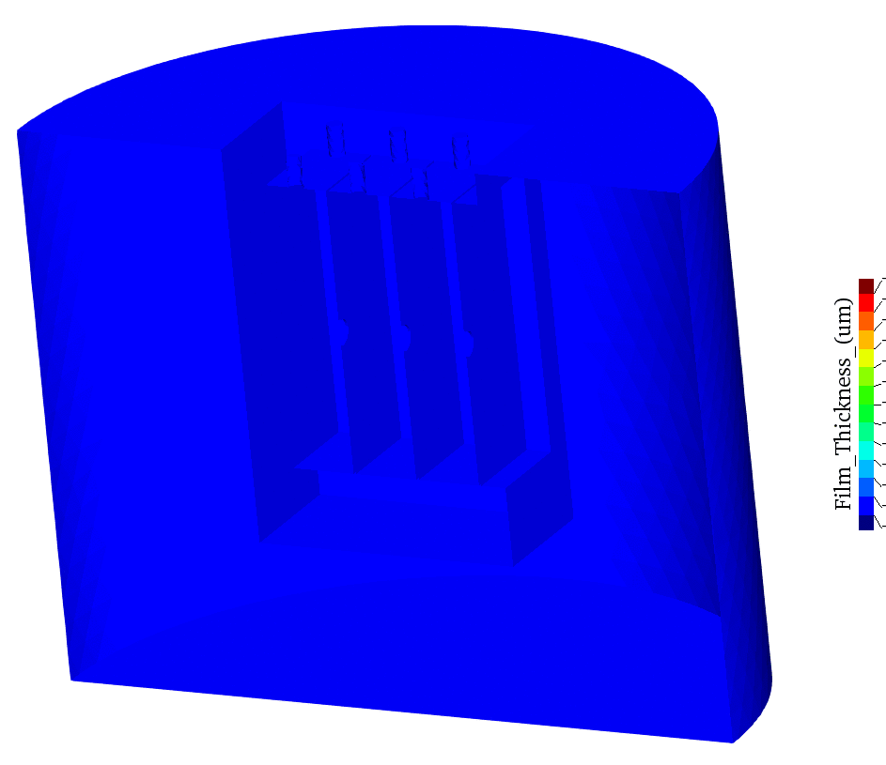
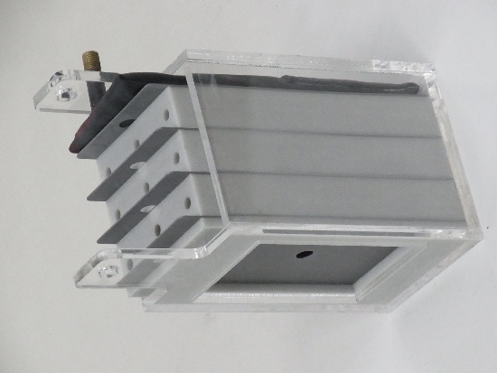
4-Plate BOX Simulation
Outline
Imitating a bag-like structure such as side sill in a carbody.
Accuracy on the innermost surface (leftmost plate surface) is the most important; i.e., “maximize the minimum”.
Film thickness is calculated with 4 different mesh seed sizes
and compared between FEM-T4 and ES-FEM-T4.
Film Thickness
Side Sill
(http://plaza.rakuten.co.jp/heroc)
4-P BOX

Slide 19
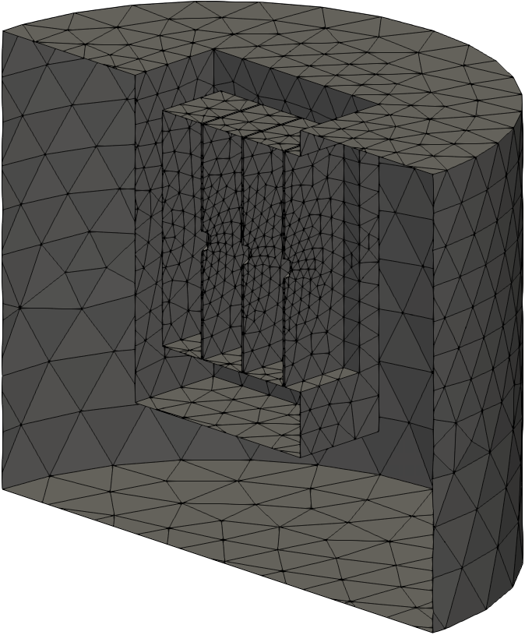
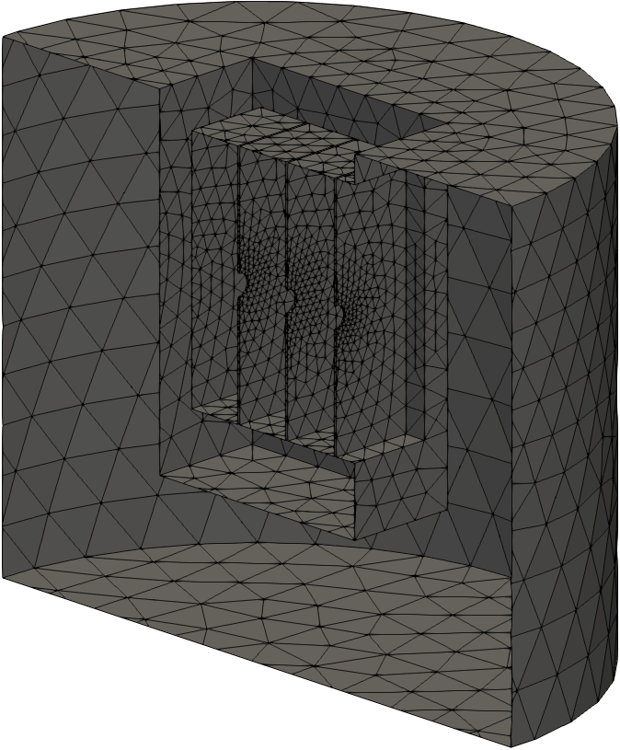
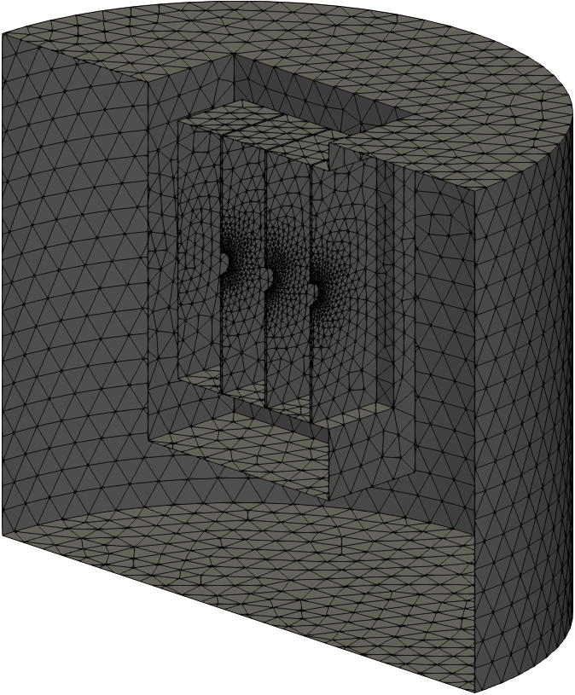
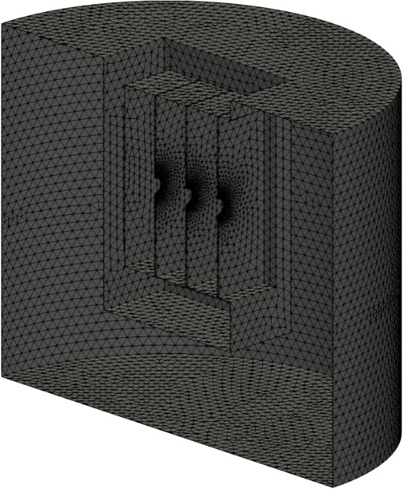
4-Plate BOX Simulation
Overview
of
Meshes
Only the
surface meshes
are shown.
3.2 mm Mesh
Seed Size
(31k T4 elem.)
1.6 mm Mesh
Seed Size
(65k T4 elem.)
0.8 mm Mesh
Seed Size
(169k T4 elem.)
0.4 mm Mesh
Seed Size
(716k T4 elem.)

Slide 20
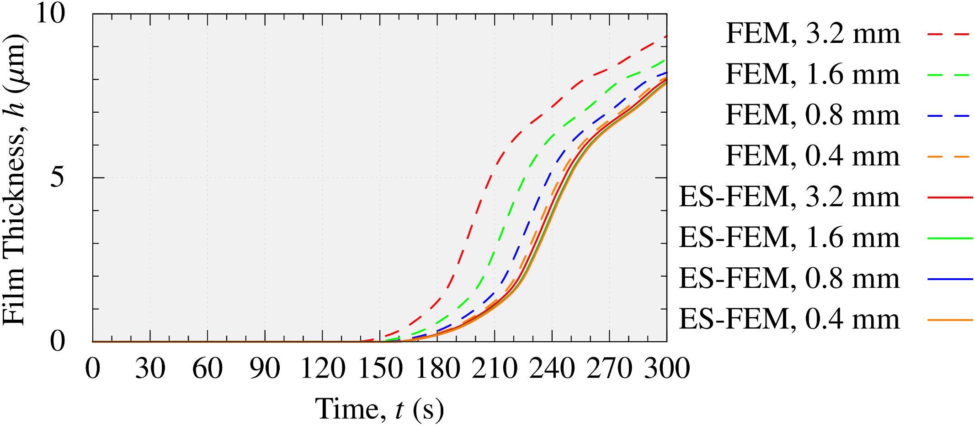
4-Plate BOX Simulation
Film Thickness on G-Plate (innermost surface)
Mesh seed size
FEM results (dashed lines) have large errors
due to mesh coarseness.
Meanwhile, ES-FEM (solid lines) results have no such errors.

Slide 21
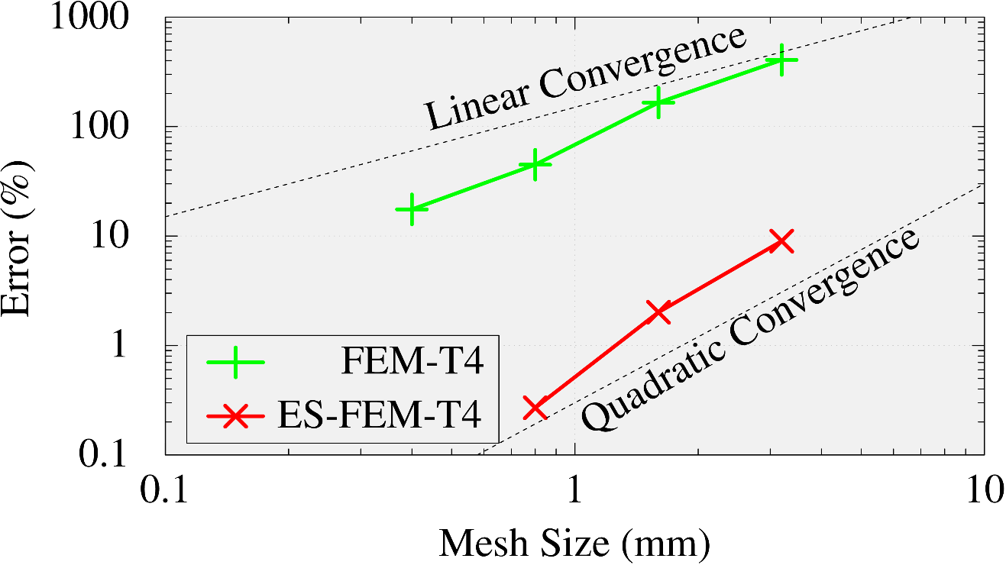
4-Plate BOX Simulation
Comparison of Convergence Rate on G-Plate
The result of ES-FEM with the minimum mesh seed size (0.4 mm) is used as the reference.
FEM-T4 shows a linear convergence.
Meanwhile, ES-FEM-T4 almost shows a quadratic convergence.
ES-FEM-T4 has much better mesh convergence rate
than FEM-T4.

Slide 22
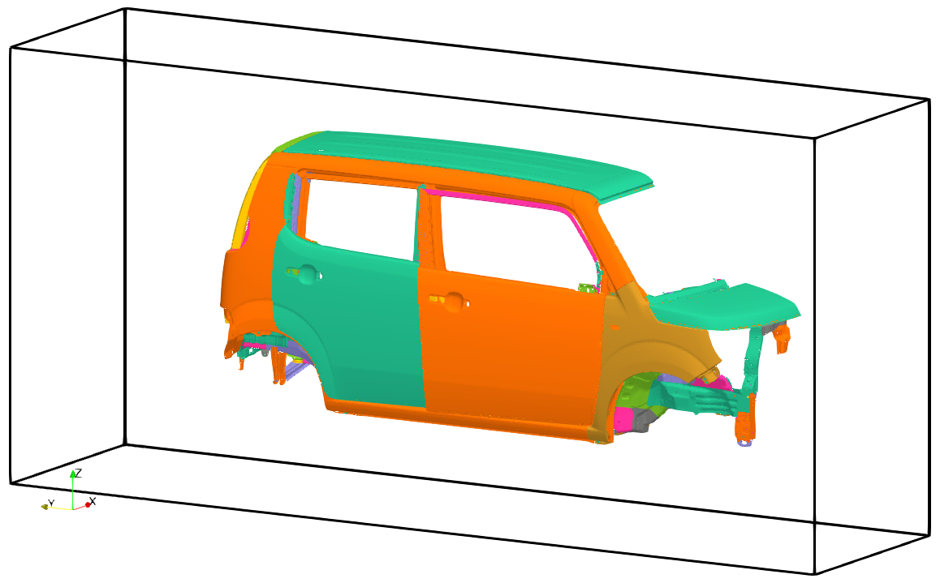
Carbody Simulation
Outline
A half carbody is fixed in a box pool.
The side wall is treated as an anode surface.
Applied Voltage
270 V
0 30 180 (s)

Slide 23
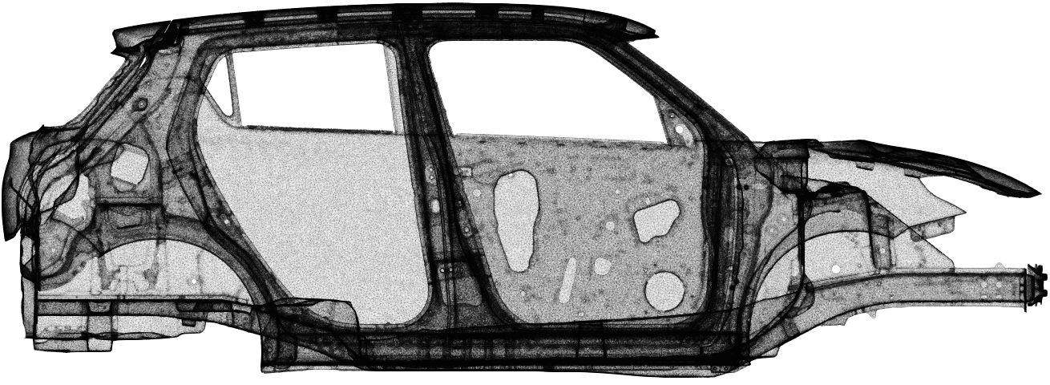
Carbody Simulation
Overview of Surface Mesh with 10M Elems.
Compare the time-developed film thickness between FEM-T4 and ES-FEM-T4 with 3 different size meshes.
Each mesh has 10M, 16M and 50M T4 elements.

Slide 24
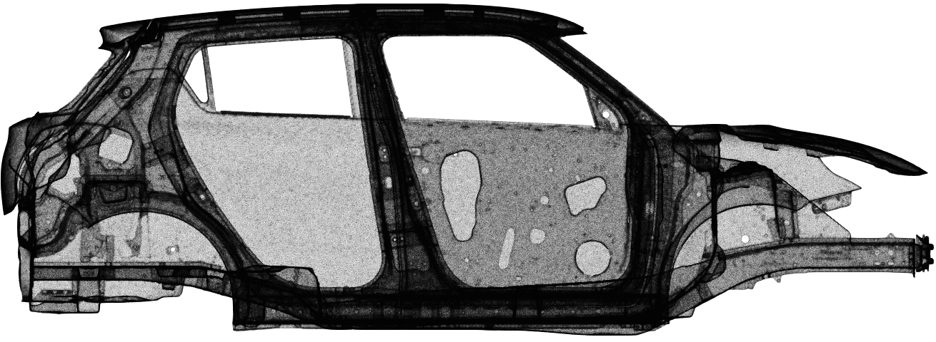
Carbody Simulation
Overview of Surface Mesh with 16M Elems.
Compare the time-developed film thickness between FEM-T4 and ES-FEM-T4 with 3 different size meshes.
Each mesh has 10M, 16M and 50M T4 elements.

Slide 25
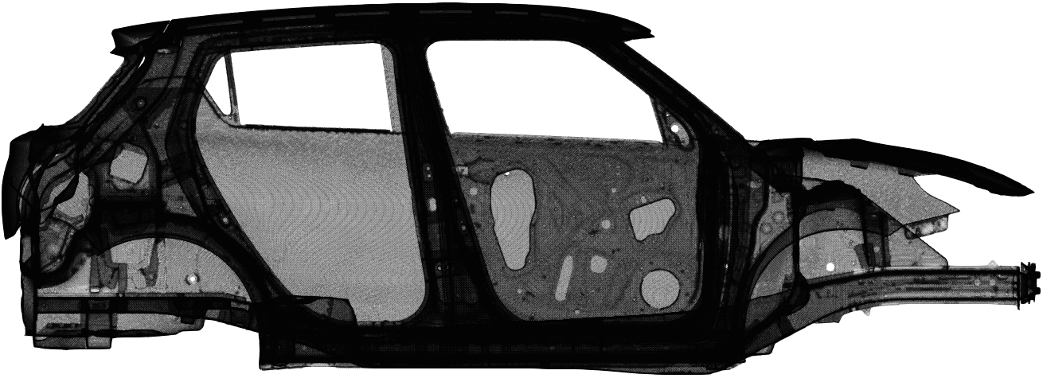
Carbody Simulation
Overview of Surface Mesh with 50M Elems.
Compare the time-developed film thickness between FEM-T4 and ES-FEM-T4 with 3 different size meshes.
Each mesh has 10M, 16M and 50M T4 elements.

Slide 26
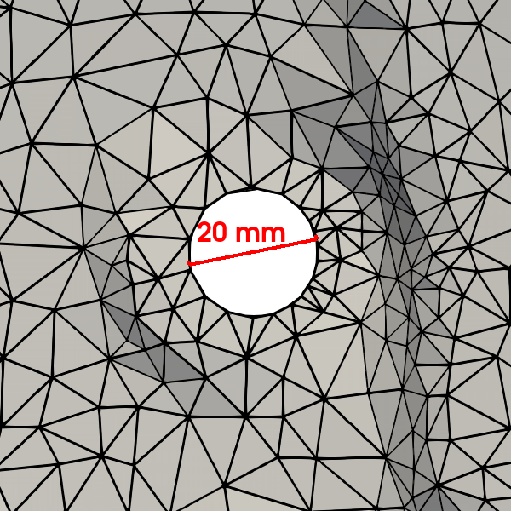
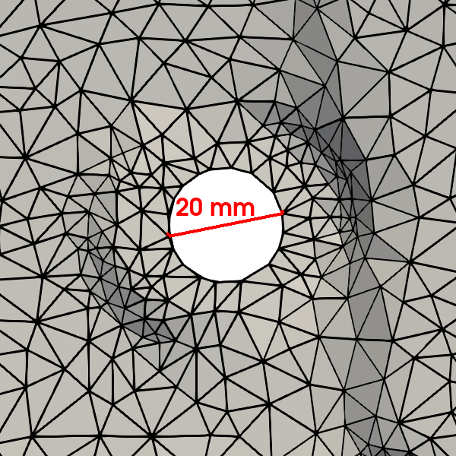
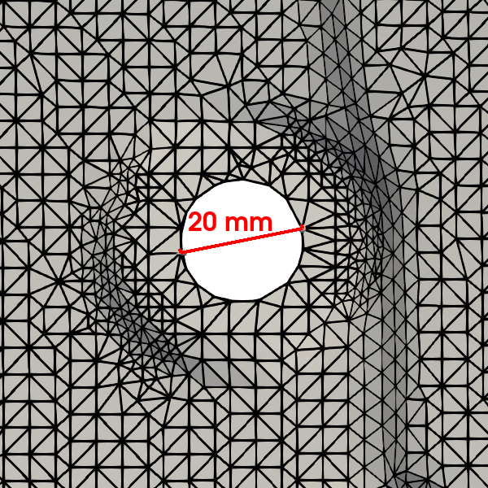
Carbody Simulation
Zoom in View around a Hole on Carbody
Compare the time-developed film thickness between FEM-T4 and ES-FEM-T4 with 3 different size meshes.
Each mesh has 10M, 16M and 50M T4 elements.
10M
16M
50M

Slide 27
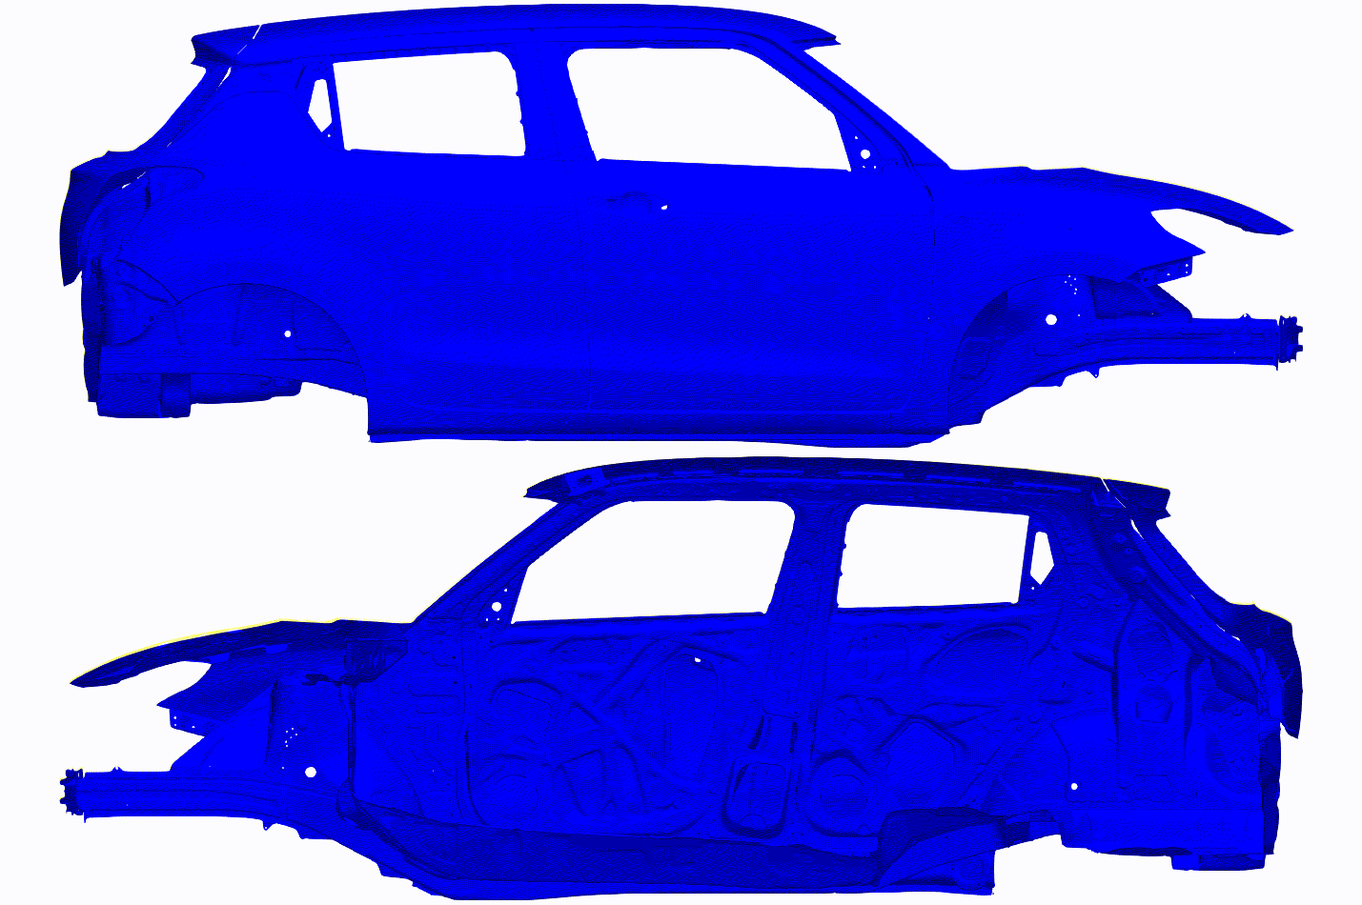
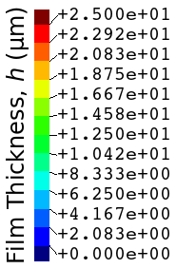
Carbody Simulation
Overview results of Film Thickness Distribution
The results of ES-FEM with 50M elements. (Reference results)
Outer View
Inner View

Slide 28
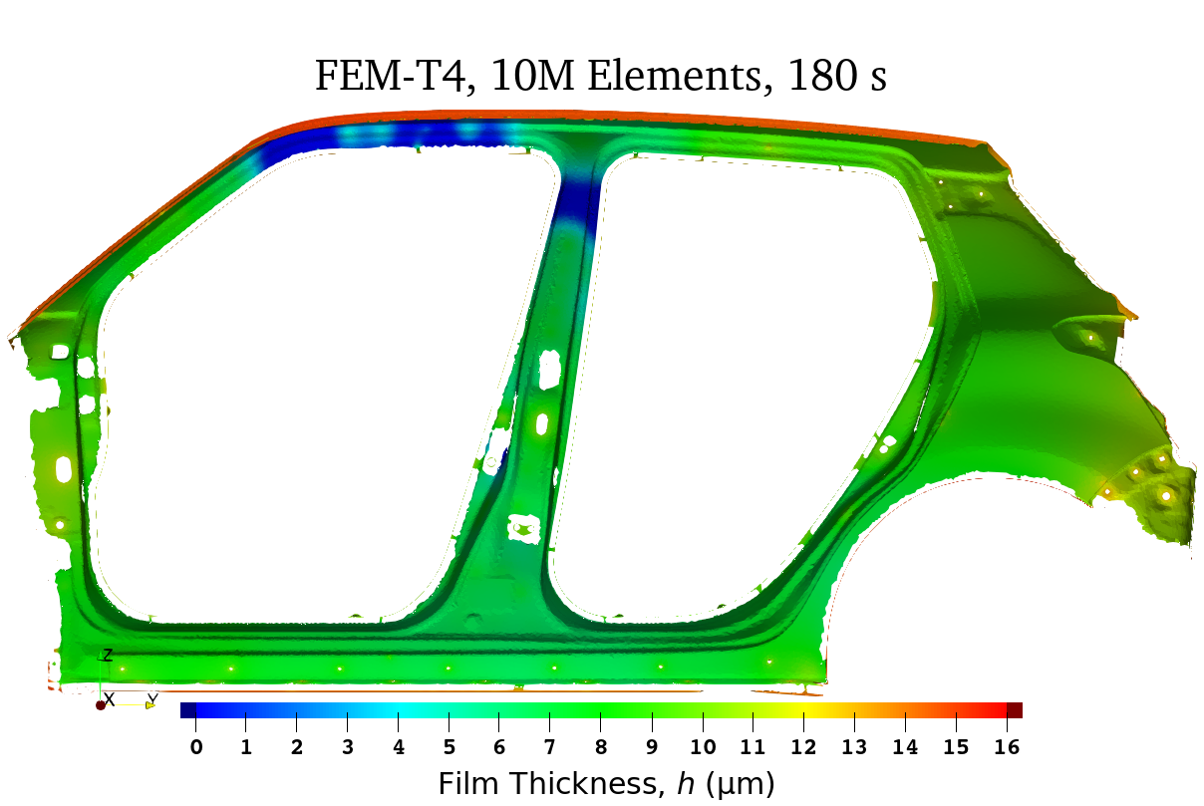

Carbody Simulation
Film Thickness Distribution with 10M Elems. Mesh
(Clipped View on Side Sill)
FEM-T4
ES-FEM-T4
FEM-T4 requires 50M elements to obtain the converged solution. Meanwhile, ES-FEM-T4 requires only 16M elements.

Slide 29

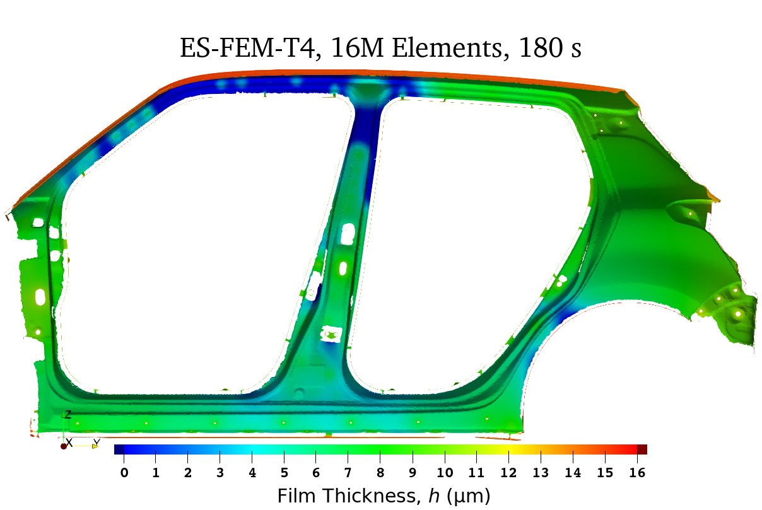
Carbody Simulation
Film Thickness Distribution with 16M Elems. Mesh
(Clipped View on Side Sill)
FEM-T4
ES-FEM-T4
FEM-T4 requires 50M elements to obtain the converged solution. Meanwhile, ES-FEM-T4 requires only 16M elements.

Slide 30
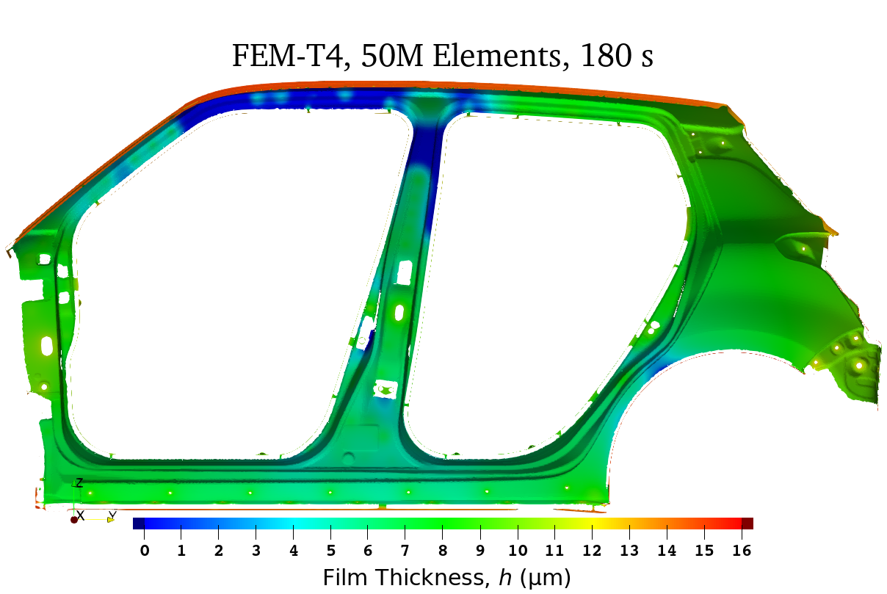

Carbody Simulation
Film Thickness Distribution with 50M Elems. Mesh
(Clipped View on Side Sill)
FEM-T4
ES-FEM-T4
FEM-T4 requires 50M elements to obtain the converged solution. Meanwhile, ES-FEM-T4 requires only 16M elements.

Slide 31
Carbody Simulation
Film Thickness Distribution with 50M Elems. Mesh
(Clipped View on Side Sill)
FEM-T4
ES-FEM-T4
FEM-T4 requires 50M elements to obtain the converged solution. Meanwhile, ES-FEM-T4 requires only 16M elements.

Slide 32
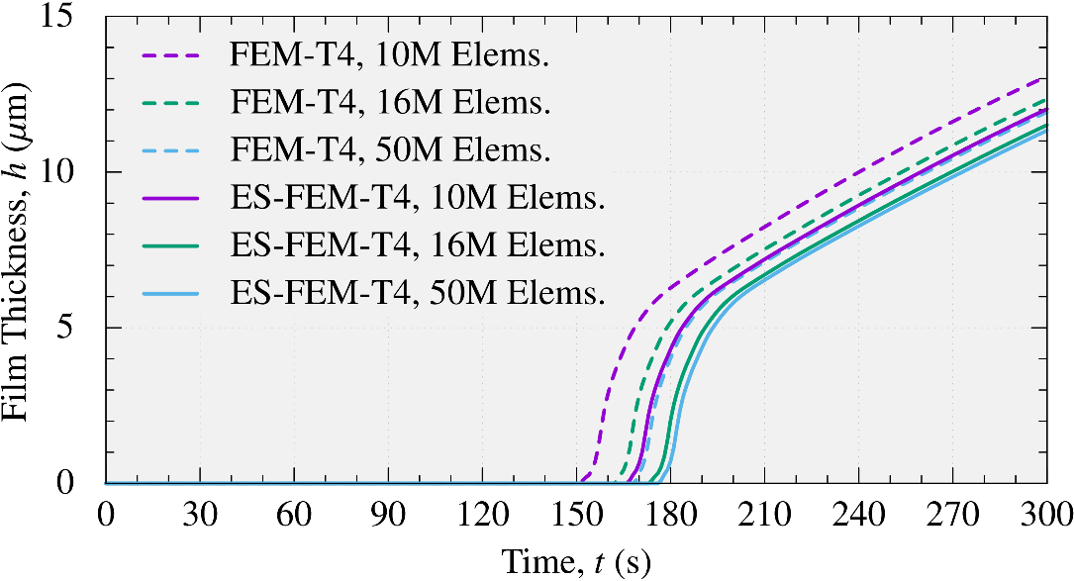
Carbody Simulation
Comparison of Time-histories of Film Thickness
FEM-T4 with 50M elems. and ES-FEM-T4 with 10M elems. show almost the same results.

Slide 33
Comparison of Computational Costs
Calculation Time
on a PC with Intel i9-9960X using 8 cores
 | Mesh / Elements | FEM-T4 | ES-FEM-T4
4-P BOX | 3.2 mm | 0.3 min | 0.5 min
 | 1.6 mm | 0.5 min | 0.9 min
 | 0.8 mm | 1.2 min | 2.4 min
 | 0.4 mm | 6.3 min | 12.2 min
Carbody | 10M Elements | 1.5 h | 3.0 h
 | 16M Elements | 2.4 h | 4.7 h
 | 50M Elements | 6.9 h | 15.4 h
Same
Accuracy
Same
Accuracy
There is no big difference in calculation time
although the accuracy of ES-FEM-T4 is much better.

Slide 34
Summary

Slide 35
Summary
Conclusion
ES-FEM-T4 was applied to actual ED simulations.
High accuracy of ES-FEM-T4 because of its super-linear (almost quadratic) mesh convergence rate was confirmed in comparison to the poor accuracy of FEM-T4.
Future Works
Validation of the ED models on the actual manufacturing lines.
Calculation speed-up with distributed memory parallelization.
Thank you for your kind attention.

