Slide 1
SelectiveCS-FEM-T10:
Selective cell-based smoothed finite element methods with 10-node tetrahedral elements
Yuki ONISHI
Tokyo Institute of Technology, Japan

Slide 2
What is S-FEM?
Smoothed finite element method (S-FEM) is a relatively new FE formulation proposed by Prof.
G. R. Liu in 2006.
S-FEM is one of the strain smoothing techniques.
There are several types of classical S-FEMs depending on the domains of strain smoothing.
For example in 2D triangular mesh:
Edge-based S-FEM
(ES-FEM)
Node-based S-FEM
(NS-FEM)
Standard FEM

Slide 3
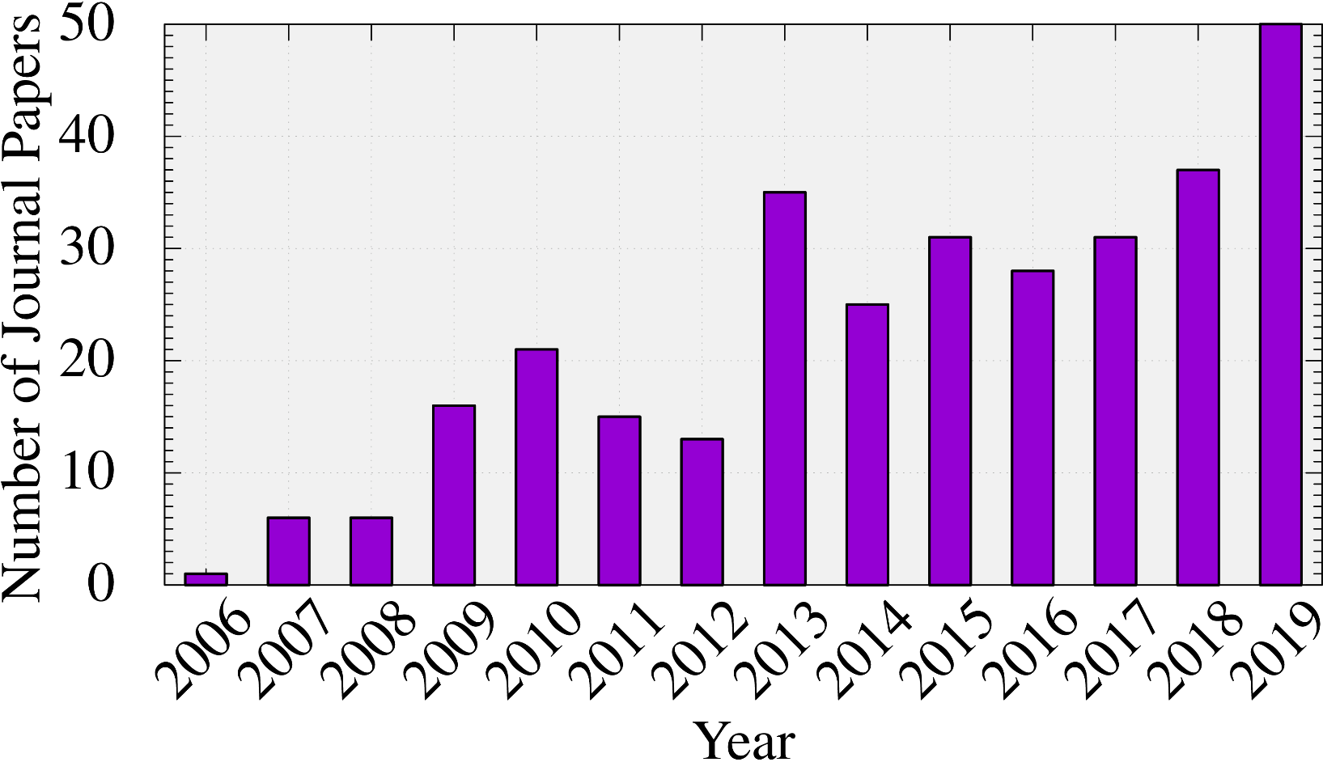
How popular is S-FEM?
Number of journal papers written in English
whose title contains “smoothed finite element”:
(inquired at Google Scholar)
The attraction of S-FEM is expanding continuously.

Slide 4
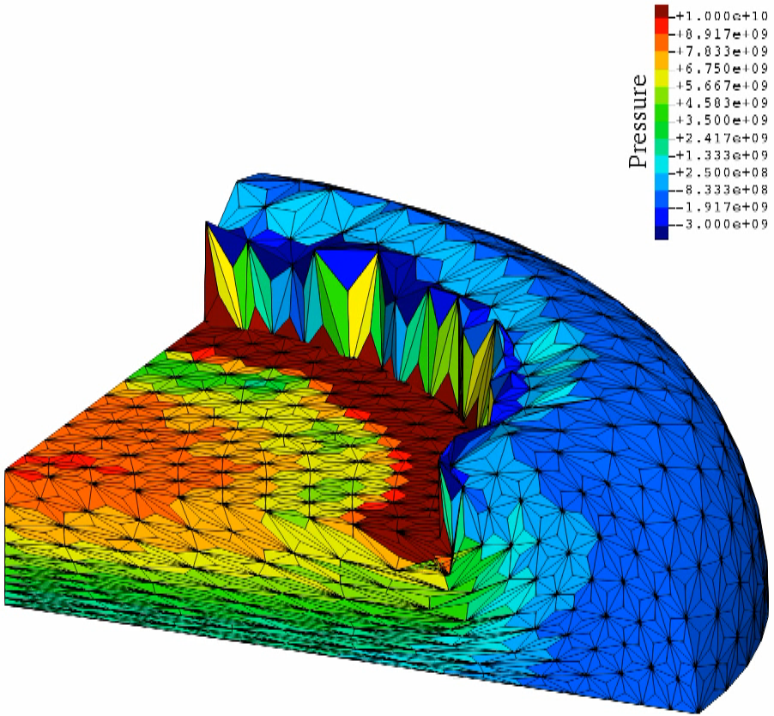
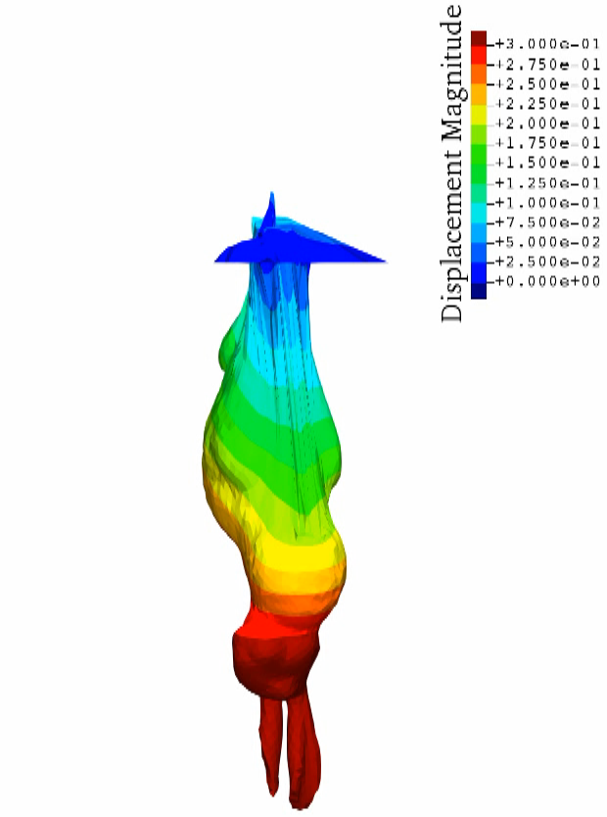
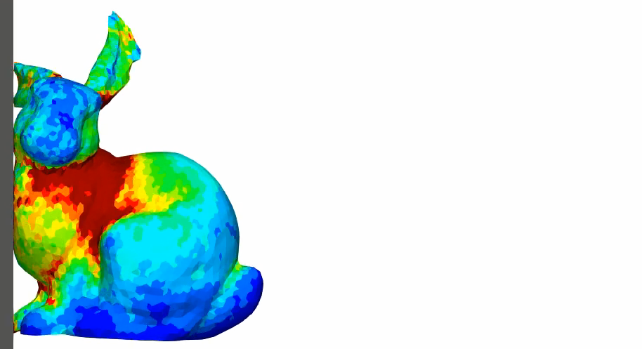
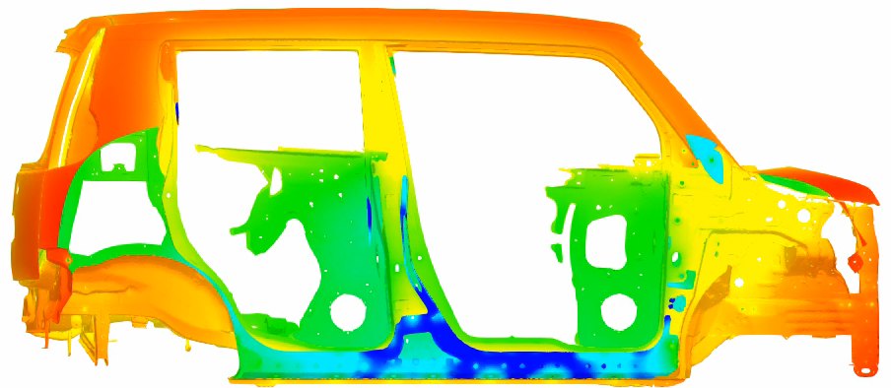
Applications of S-FEMs in Our Lab
Solid mechanics
Static Implicit Dynamic Explicit Viscous Implicit
Electrostatic

Slide 5
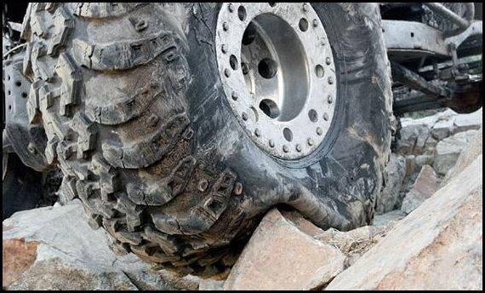
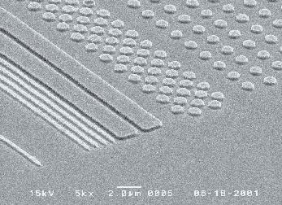


Motivation
What we want to do:
Solve hyper large deformation
analyses accurately and stably.
Treat complex geometries
with tetrahedral meshes.
Consider nearly incompressible materials $(ν≃0.5)$.
Support contact problems.
Handle auto re-meshing.
Rubber
Metal
Plastic/Glass

Slide 6
Issues
Conventional tetrahedral (T4/T10) FE formulations
still have issues in accuracy or stability
especially in nearly incompressible cases.
2nd or higher order elements:
✗ Volumetric locking.
Accuracy loss in large strain due to intermediate nodes.
B-bar method, F-bar method, Selective reduced integration:
✗ Not applicable to tetrahedral element directly.
F-bar-Patch method:
✗ Difficulty in building good-quality patches.
u/p mixed (hybrid) method:
(e.g., ABAQUS/Standard C3D4H and C3D10MH)
✗ Pressure checkerboarding, Early convergence failure etc..
F-bar type smoothed FEM (F-barES-FEM-T4):
✓ Accurate & stable ✗ Hard to implement in FEM codes.

Slide 7
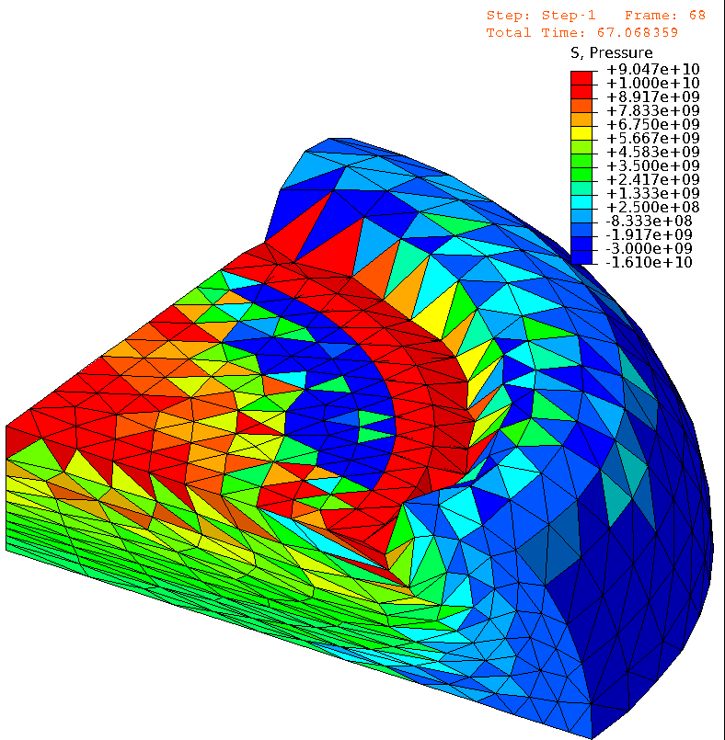
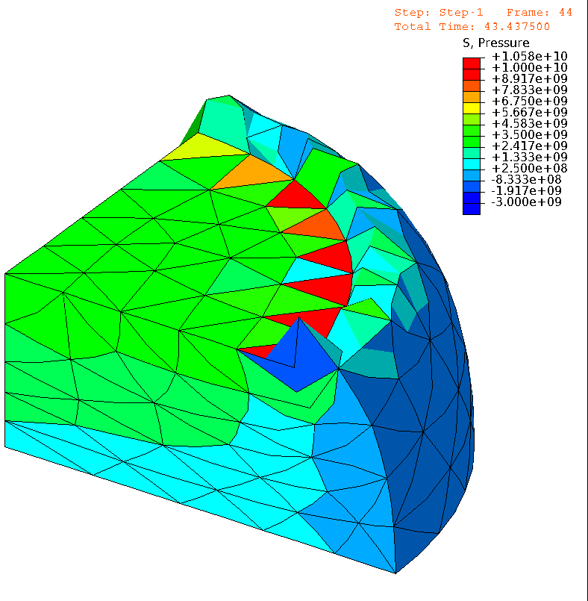

Issues (cont.)
E.g.) Compression of neo-Hookean hyperelastic body with $ν_{ini}=0.49$
Pressure
Pressure
# of Nodes is
almost the same.
1st order hybrid T4 (C3D4H)
✓ No volumetric locking
✗ Pressure checkerboarding
✗ Shear & corner locking
2nd order modified hybrid T10 (C3D10MH)
✓ No shear/volumetric locking
✗ Early convergence failure
✗ Low interpolation accuracy

Slide 8

Issues (cont.)
E.g.) Compression of neo-Hookean hyperelastic body with $ν_{ini}=0.49$
Pressure
Although
F-barES-FEM-T4 is accurate and stable,
✗ it cannot be implemented in general-purpose
FE software
due to the adoption of ES-FEM.
Also, it cosumes
larger memory & CPU costs.
Same mesh
as C3D4H
case.
F-barES-FEM-T4
✓ No shear/volumetric locking
✓ No corner locking
✓ No pressure checkerboarding
✓ No increase in DOF
Another approach
adopting CS-FEM with T10 element would be effective.

Slide 9
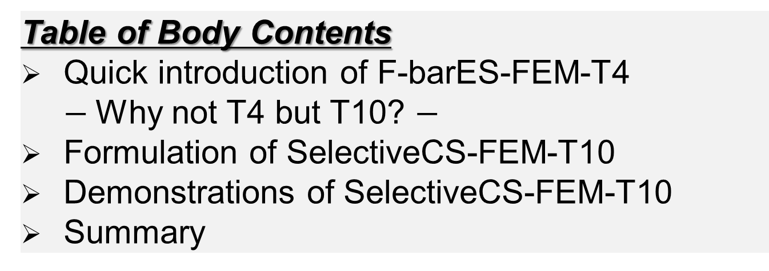
Objective
To develop an S-FEM formulation using T10 mesh (SelectiveCS-FEM-T10)
for severe large deformation analyses.
Table of Body Contents
Quick introduction of F-barES-FEM-T4
$−$Why not T4 but T10? $−$
Formulation of SelectiveCS-FEM-T10
Demonstrations of SelectiveCS-FEM-T10
Summary

Slide 10
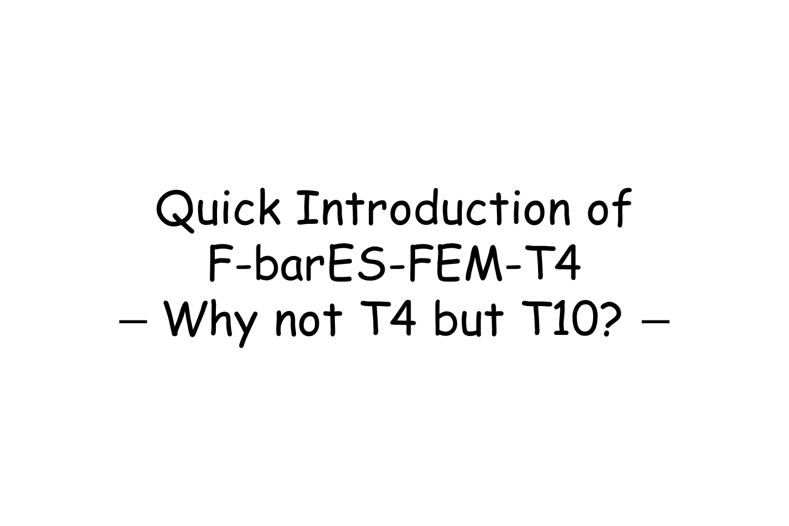
Quick Introduction of
F-barES-FEM-T4
$−$Why not T4 but T10? $−$

Slide 11
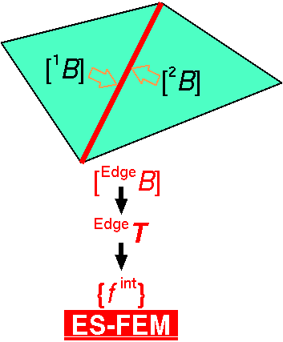

Brief of Edge-based S-FEM (ES-FEM)
Calculate $[B]$ at each element as usual.
Distribute $[B]$ to the connecting edges with area weight
and build $[ ^{Edge}B]$ .
Calculate $F, T, \left\{f^{int}\right\}$ etc. in each edge smoothing domain.
As if putting
an integration point
on each edge center
ES-FEM can avoid shear locking.
However,
it cannot be implemented in ordinary FE codes due to the strain smoothing across
multiple elements...

Slide 12
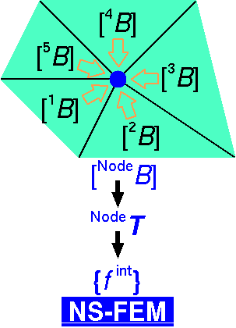

Brief of Node-based S-FEM (NS-FEM)
Calculate $[B]$ at each element as usual.
Distribute $[B]$ to the connecting nodes with area weight
and build $[ ^{Node}B]$.
Calculate $F, T, \left\{f^{int}\right\}$ etc. in each node smoothing domain.
As if putting
an integration point
on each node
✗ Spurious low-energy mode
(or hour-glass mode)
Less pressure
checkerboarding
No shear locking
No volumetric locking

Slide 13
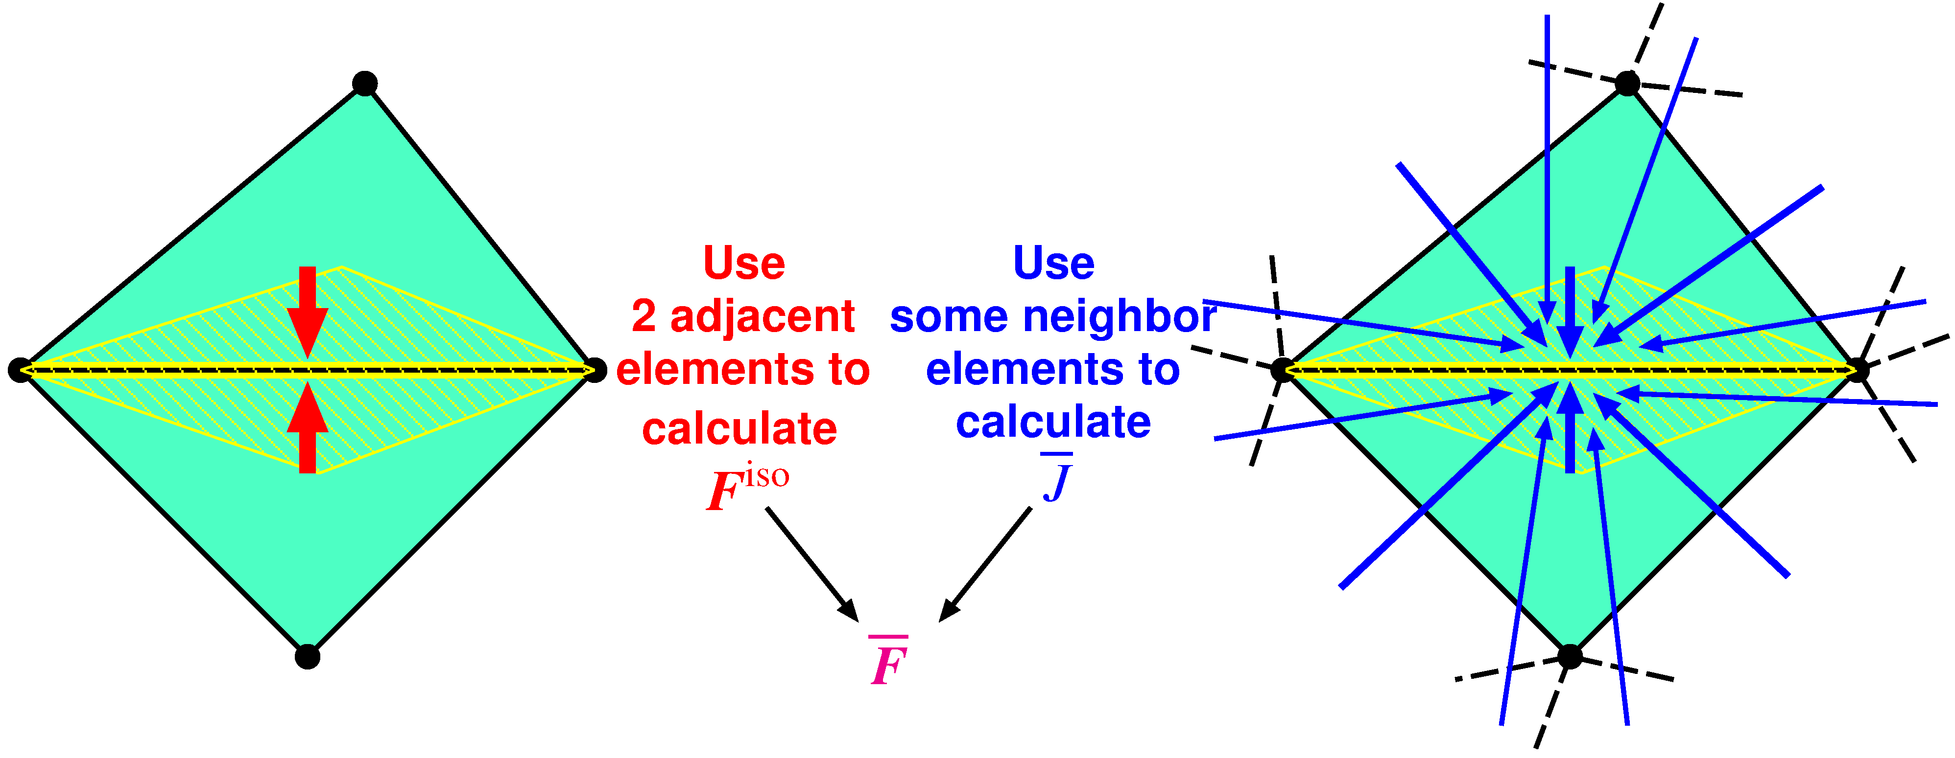

Concept of F-barES-FEM
Outlline
$^{Edge}{\tilde{F}}^{iso}$ is given by ES-FEM.
$^{Edge}\overline{ J }$ is given by cyclically applied NS-FEM.
$^{Edge}\overline{F }$ is calculated in the manner of F-bar method:
$^{Edge}\overline{F }=$ $^{Edge}{\overline{ J }}^{1/3}$ $^{Edge}{\tilde{F}}^{iso}$.
Concept: combining ES-FEM and NS-FEM using F-bar method

Slide 14
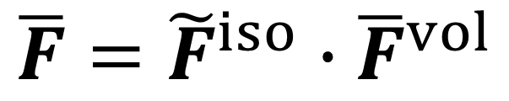

Formulation of F-barES-FEM (1 of 2)
Deformation gradient of each edge ($\overline{F}$) is derived as
in the manner of F-bar method.
$$\overline{F}={\tilde{F}}^{iso}∙{\overline{F}}^{vol}$$
ES-FEM

Slide 15

Formulation of F-barES-FEM (2 of 2)
Each part of $\overline{F}$ is calculated as
$$\overline{F}={\tilde{F}}^{iso}∙{\overline{F}}^{vol}$$
Isovolumetric part
Volumetric part
(1)
(2)
Smoothing the value of adjacent elements.
(same manner
as ES-FEM)
(1)Calculating node’s value by smoothing
the value of adjacent elements
(2)Calculating elements’ value by smoothing
the value of adjacent nodes
(3)Repeating (1) and (2) a few times

Slide 16
Advantages of F-barES-FEM
This formulation is designed to have 3 advantages.
$$\overline{F}={\tilde{F}}^{iso}∙{\overline{F}}^{vol}$$
Isovolumetric part
Volumetric part
Like a ES-FEM
1. Shear locking free
Like a NS-FEM
2. Little pressure oscillation
3. Volumetric locking free
with the aid of F-bar method

Slide 17
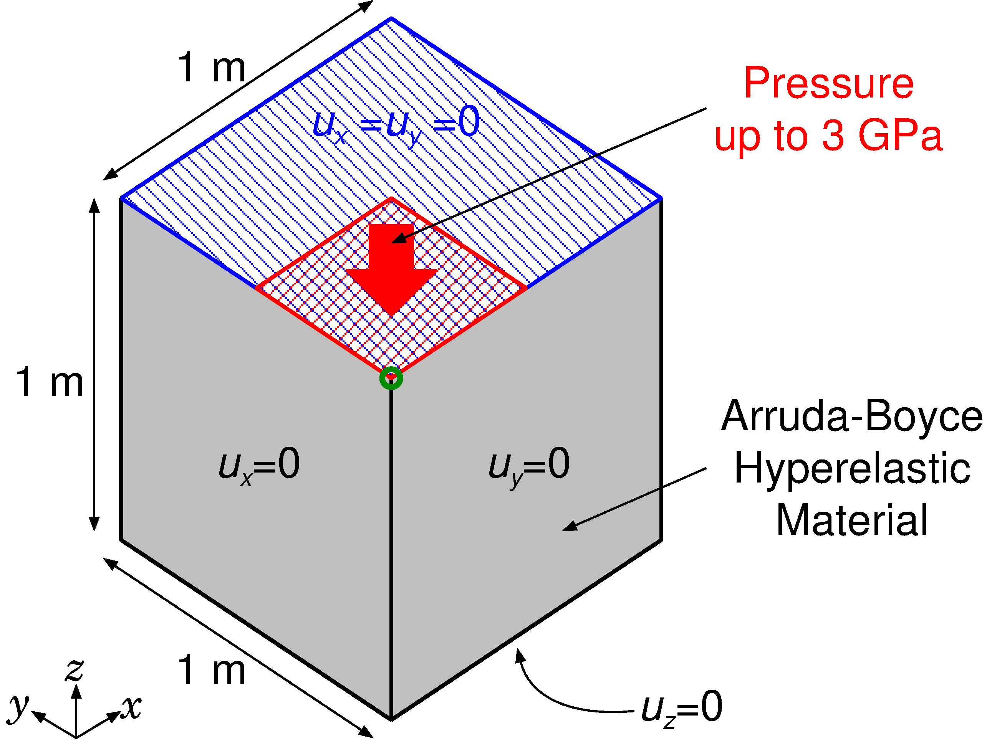

Compression of Rubber Block
Static
Implicit
Outline
Arruda-Boyce hyperelastic material ($ν_{ini}=0.499$).
Applying pressure on ¼ of the top face.
Result of F-barES-FEM-T4 is compared to ABAQUS C3D4H with the same unstructured T4 mesh.
Load

Slide 18
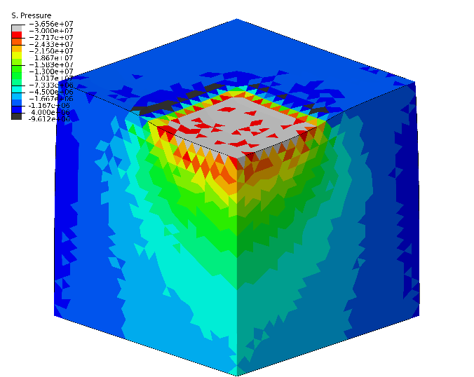
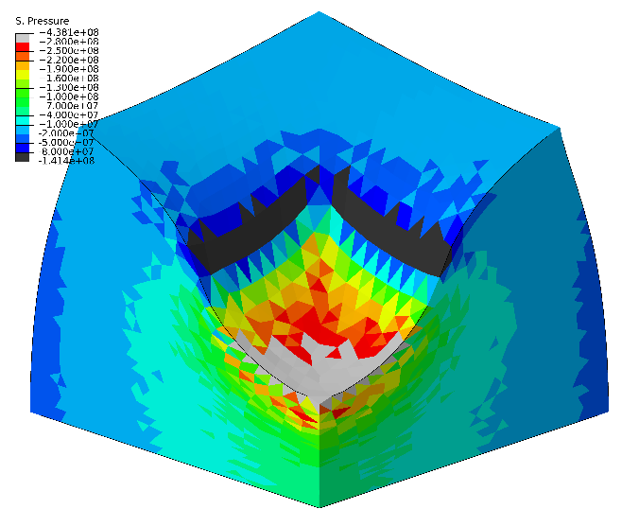
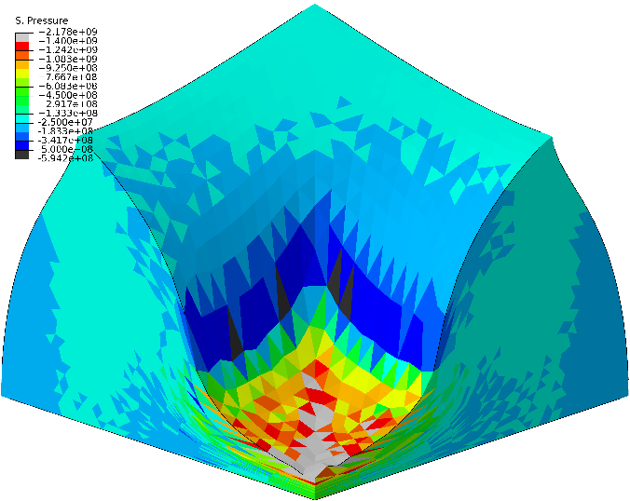
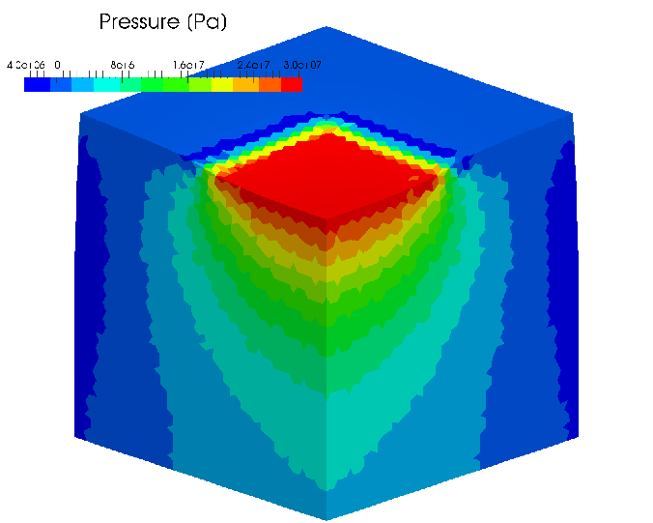
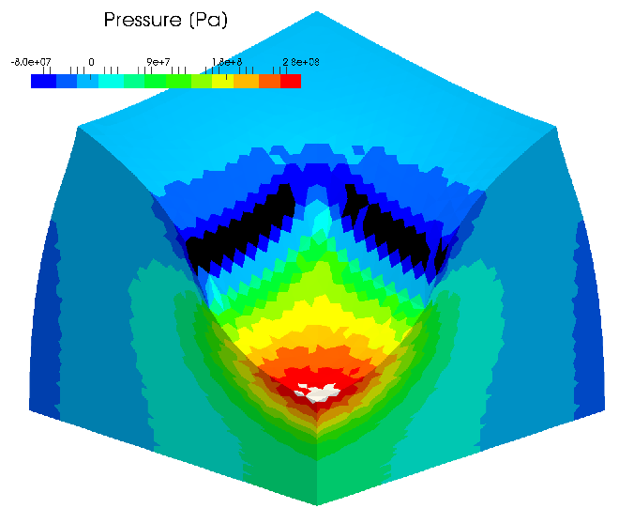
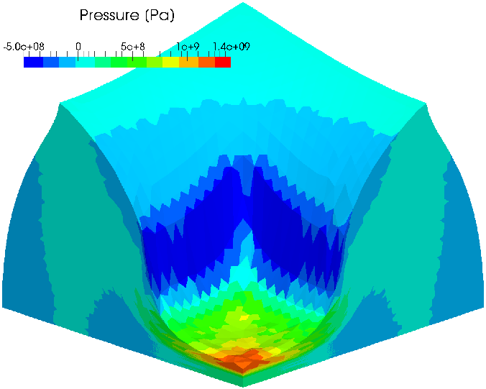
Compression of Rubber Block
Static
Implicit
Pressure dist.
Early stage Middle stage Later stage
ABAQUS
C3D4H
F-bar
ES-FEM-
T4(3)
Smooth pressure distributions are obtained.

Slide 19
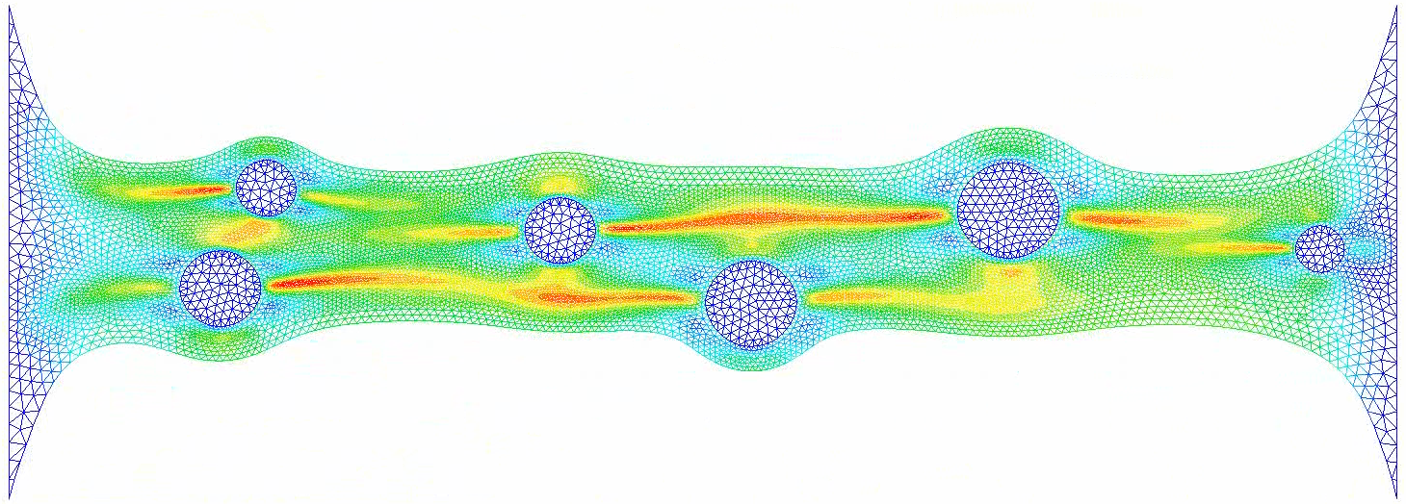

Stretch of Filler-containing Rubber with 2D Remesing
Static
Implicit
Several hard circular fillers are distributed in a square soft matrix rubber (neo-Hookean hyperelastic with $ν_{ini}=0.49$).
$E_{ini}$ of the filler is 100 times larger than $E_{ini}$ of the matrix.
Left side is constrained and right side is displaced.
Valid Mises stress dist. is obtained after many time remeshings.

Slide 20
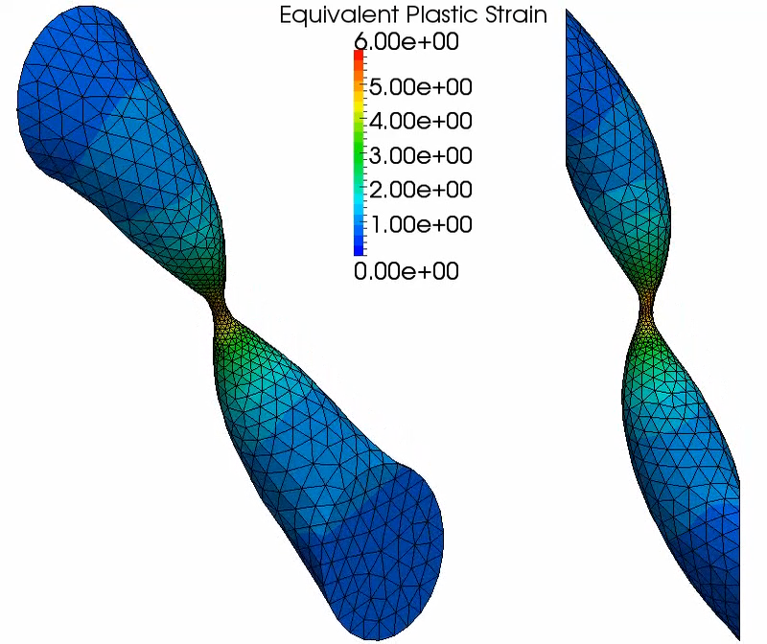
Shear-tensioning of Elasto-plastic cylinder with 3D Remeshing
Static
Implicit
Aluminium
cylinder subjected to
enforced disp..
Pure shear at
the initial stage, but stretch dominates at
the later stage.
Necking occurs in the end.
Final stretch at the
neck is more than
7000%.
Valid plastic strain dist. is obtained after many time remeshings.

Slide 21
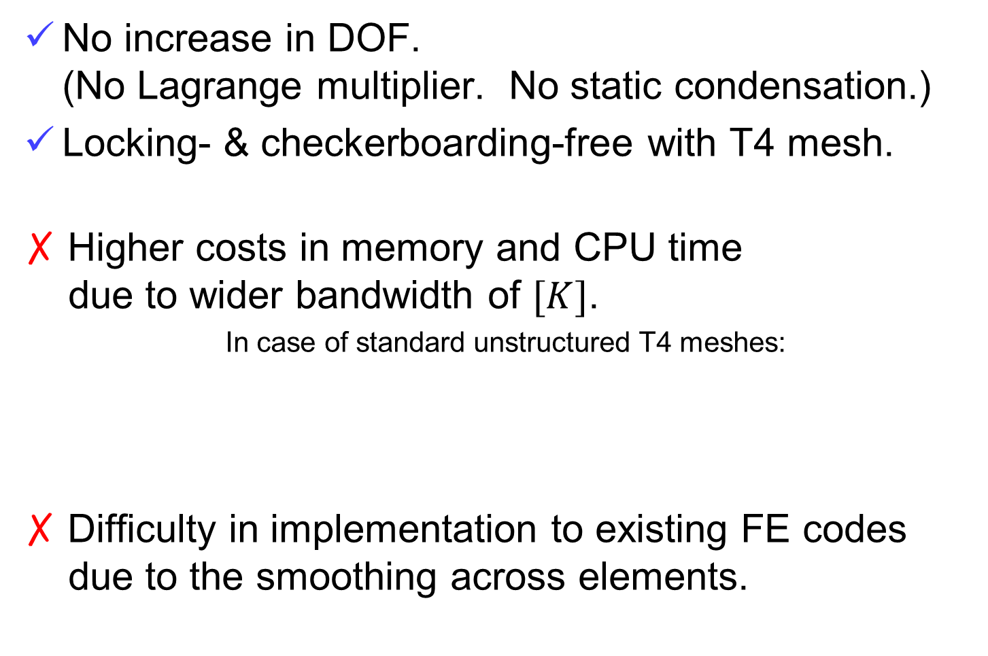
Characteristics of F-barES-FEM-T4
No increase in DOF.
(No Lagrange multiplier. No static condensation.)
Locking- & checkerboarding-free with T4 mesh.
✗ Higher costs in memory and CPU time
due to wider bandwidth of $[K]$.
In case of standard unstructured T4 meshes:
✗ Difficulty in implementation to existing FE codes
due to the smoothing across elements.
Method | Approx. Bandwidth
Standard FEM-T4 | 40
F-barES-FEM-T4(1) | 390
Critical Issue!!

Slide 22
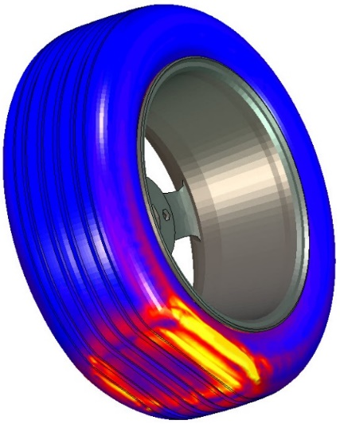
Why Not T4 But T10?
For example in tire analyses:
Material constitutive models,
Structural elements,
Cohesive elements,
Contact functionality and so on.
Therefore, choosing S-FEM-T4 leads us
to the long and winding road…
If we cannot implement F-barES-FEM-T4
to existing FE codes, then we have to code everything in our in-house code for practical use.
MSC Software
web page
We gave up T4 and chose T10
for solid mechanics analyses.

Slide 23
Formulation of
SelectiveCS-FEM-T10

Slide 24
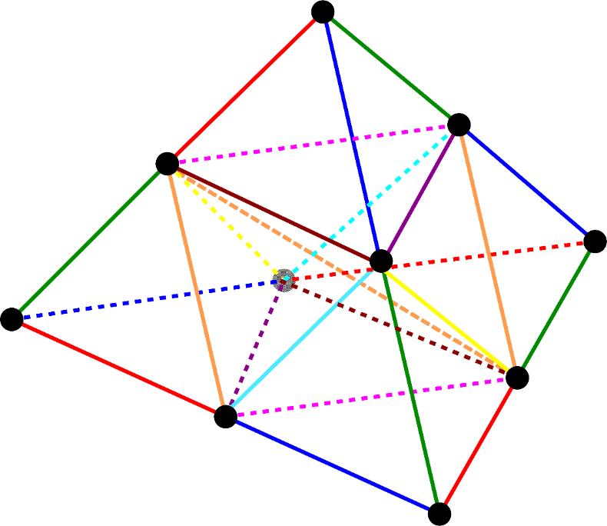

Concept of SelectiveCS-FEM-T10
Our new approach using T10 mesh.
Adopting CS-FEM having no smoothing across multiple elements, SelectiveCS-FEM-T10 becomes an independent finite element.
$⟹$ We can implement it as an element of existing FE code.
Same memory & CPU costs as the T10 elements.

Slide 25
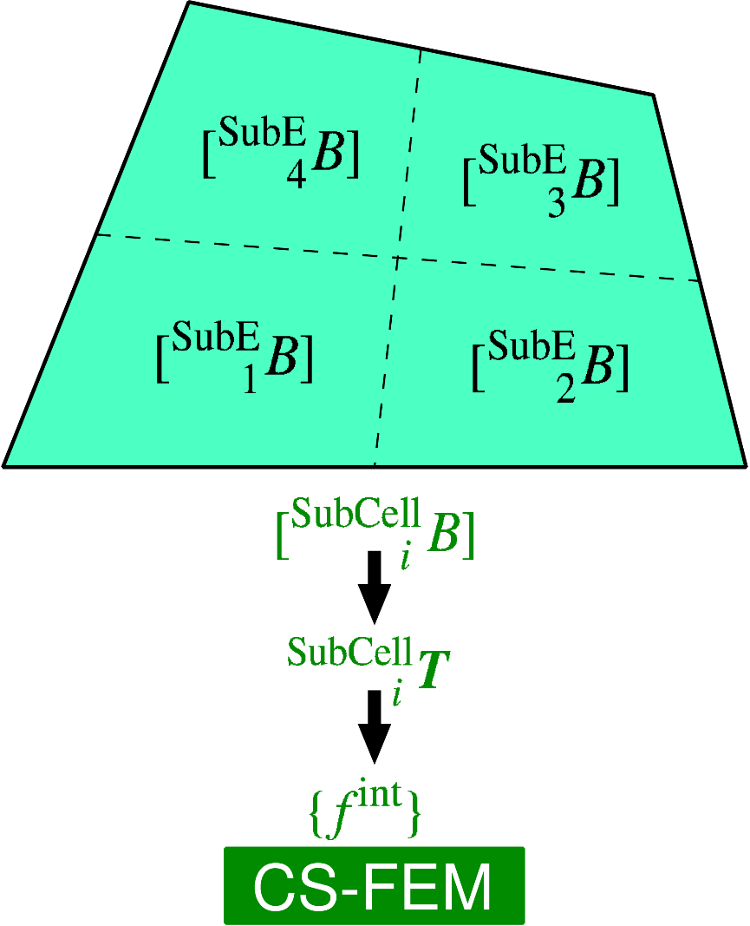
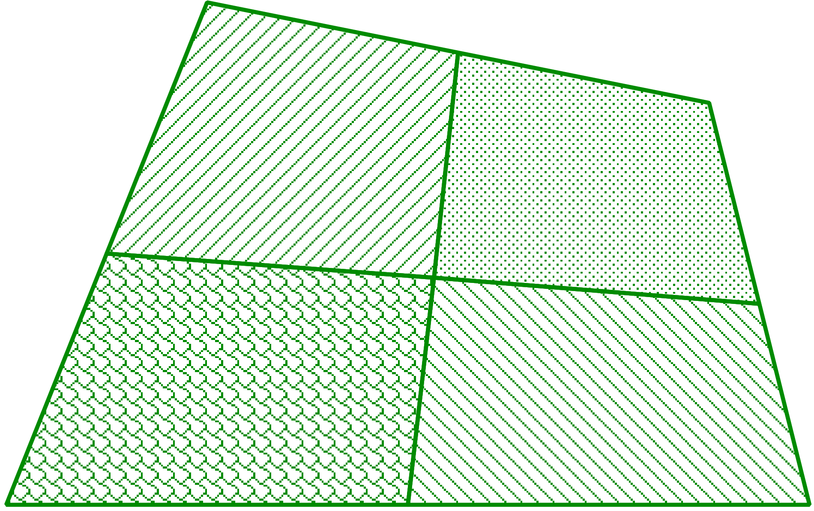

Brief of Cell-based S-FEM (CS-FEM)
Subdivide each element into some sub-element.
Calculate $[ ^{SubE}B]$ at each sub-element.
Calculate $F, T, \left\{f^{int}\right\}$ etc. in each sub-element.
As if putting
an integration point
on each sub-element
Implementable as an independent finite element.
Locking can be avoided with SRI etc..

Slide 26
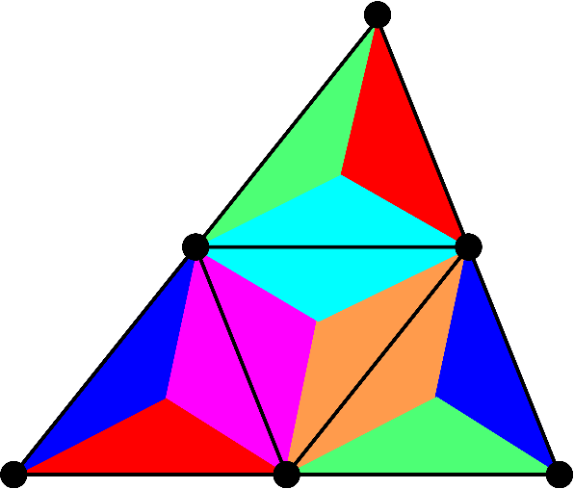
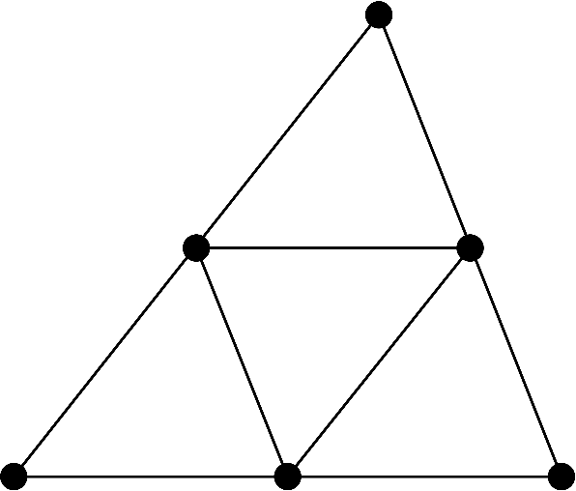
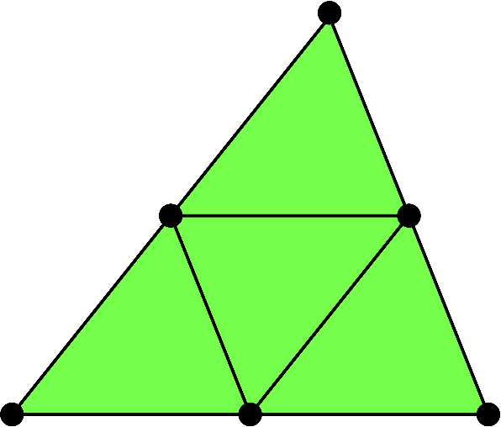

Flowchart of SelectiveCS-FEM-T10
Explanation in 2D (6-node triangular element) for simplicity
ES-FEM
(2) Dev. strain smoothing at edges
Overall
mean
SRI
(1) Subdivision without
dummy nodes
(4) $\left\{f^{int}\right\} and [K]$
(3) Vol. strain smoothing with all sub-elements

Slide 27
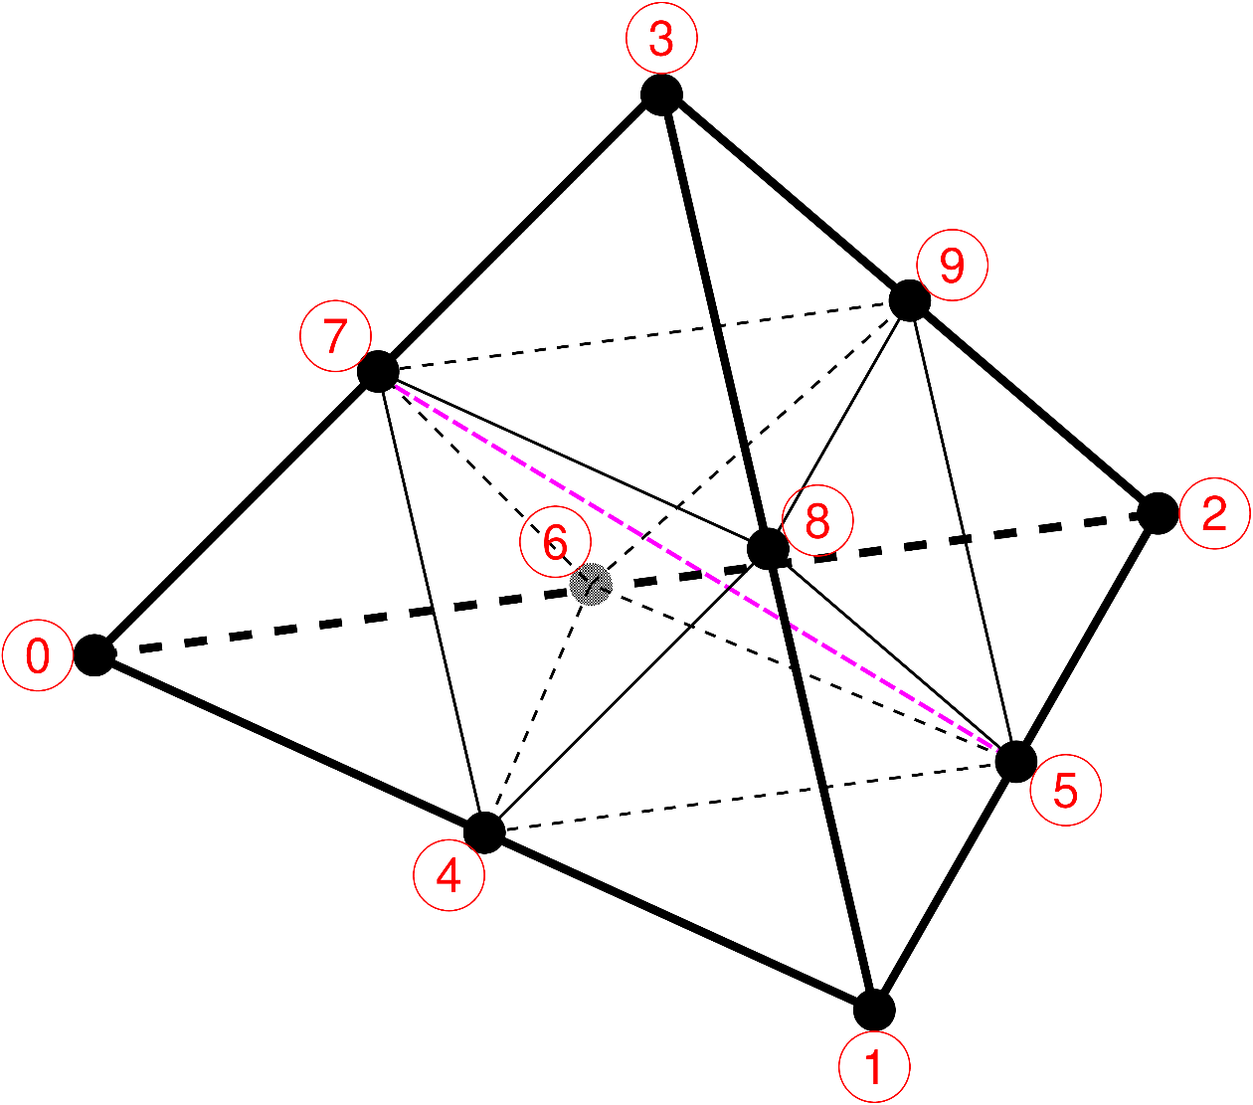
(1) Subdivision into T4 Sub-elements
Introduce no dummy node (i.e., asymmetric element).
Subdivide a T10 element into eight T4 sub-elements and calculate their B-matrices and strains.
The shape function
should not be quadratic
in large deformation analyses.

Slide 28

(2) Deviatoric Strain Smoothing
Perform strain smoothing in the manner of ES-FEM
(i.e., average dev. strains of sub-elements at edges).
Evaluate deviatoric strain and stress at edges.
T4 sub-elements cause
shear locking and thus
strain smoothing is
necessary.
From 8 sub-elements
to 25 edges

Slide 29
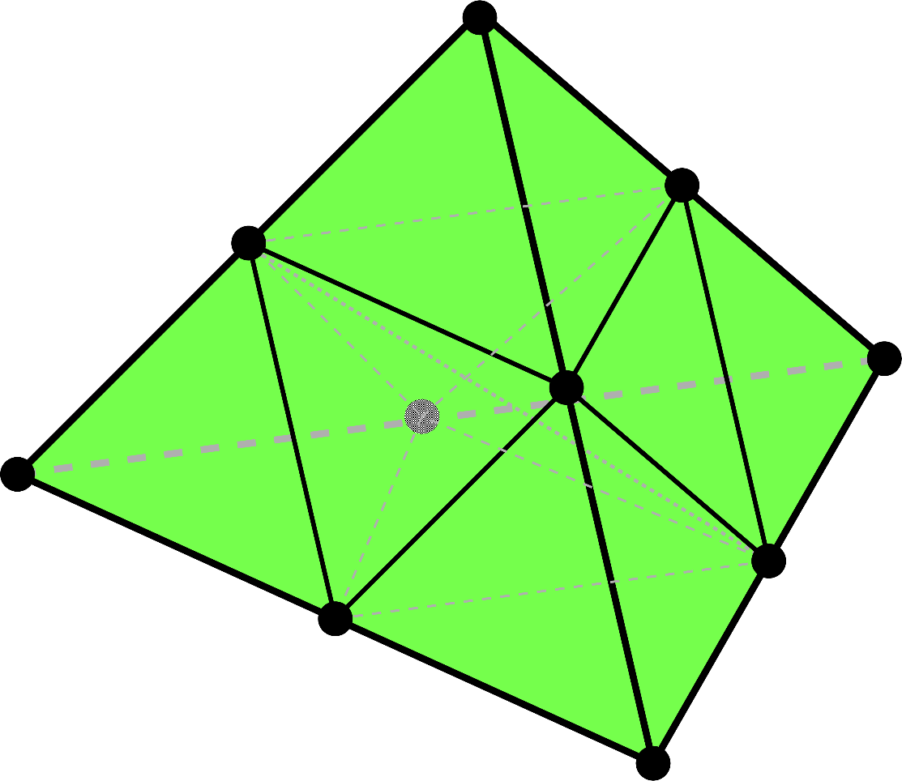
(3) Volumetric Strain Smoothing
Treat the overall mean vol. strain of all sub-elements
as the uniform element vol. strain (i.e., same approach as SRI elements).
The spatial order of
vol. strain should be
lower than that of
dev. strain to avoid
volumetric locking.

Slide 30



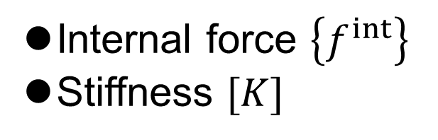
(4) Combining with SRI Method
Apply SRI method to combine the Dev. & Vol. parts
and obtain $\{f^{int}\}$ and $[K]$.
Deviatoric
Internal force $\left\{f^{int}\right\}$
Stiffness $[K]$
SRI
Volumetric

Slide 31
Demonstration of
SelectiveCS-FEM-T10

Slide 32
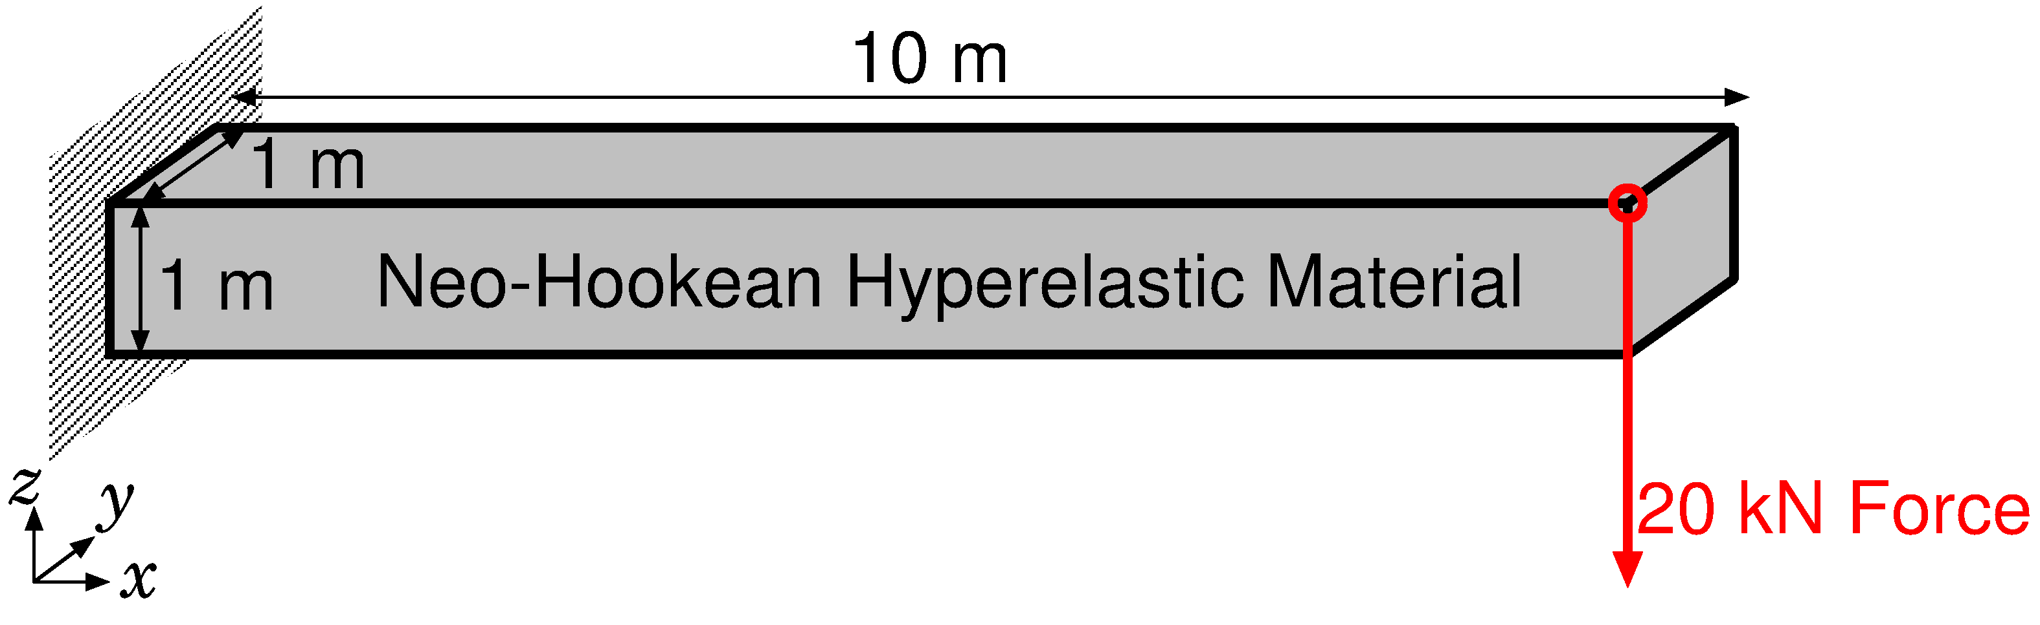
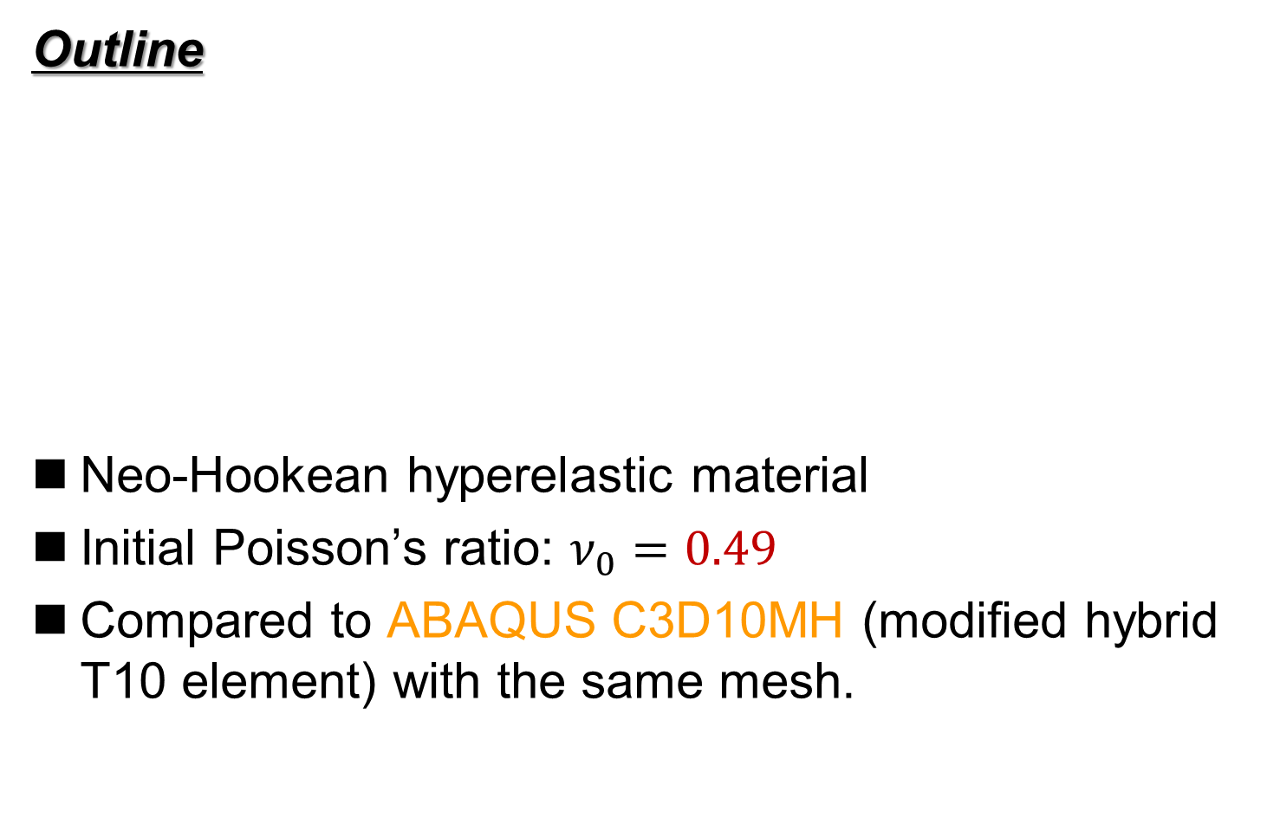
Bending of Hyperelastic Cantilever
Static
Implicit
Outline
Neo-Hookean hyperelastic material
Initial Poisson’s ratio: $ν_{0}=0.49$
Compared to ABAQUS C3D10MH (modified hybrid T10 element) with the same mesh.
Dead Load

Slide 33
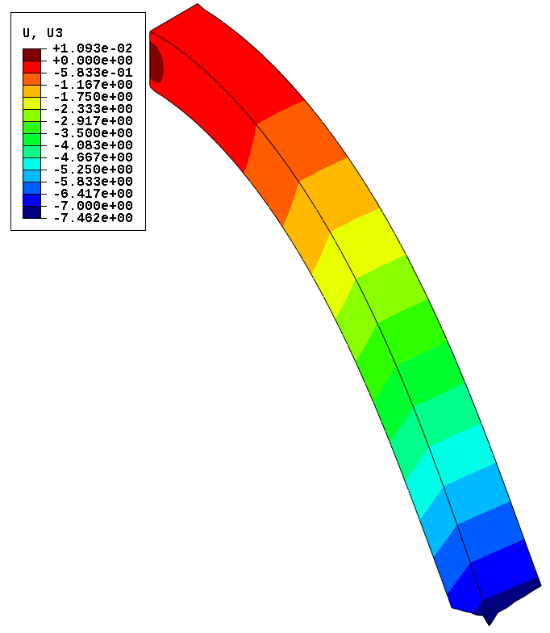

Bending of Hyperelastic Cantilever
Static
Implicit
Comparison of the deflection disp. at the final state
ABAQUS
C3D10MH
Selective
CS-FEM-T10
No volumetric locking is observed.

Slide 34


Bending of Hyperelastic Cantilever
Static
Implicit
Comparison of the pressure dist. at the final state
ABAQUS
C3D10MH
Selective
CS-FEM-T10
Almost the same pressure distributions
with no checkerboarding.

Slide 35


Bending of Hyperelastic Cantilever
Static
Implicit
Comparison of the Mises stress dist. at the final state
ABAQUS
C3D10MH
Selective
CS-FEM-T10
ABAQUS
C3D10MH
Selective
CS-FEM-T10
Almost the same Mises stress distributions.

Slide 36


Barreling of Hyperelastic Cylinder
Static
Implicit
Outline
Enforce axial displacement on the top face.
Neo-Hookean body with $ν_{ini}=0.49$．
Compare results with ABAQUS T10 hybrid elements (C3D10H, C3D10MH, C3D10HS) using the same mesh.

Slide 37

Barreling of Hyperelastic Cylinder
Static
Implicit
Animation
of
Mises
stress
(ABAQUS
C3D10MH)
Convergence
failure at 24%
compression
Unnaturally
oscillating
distributions
are obtained
around
the rim.

Slide 38

Barreling of Hyperelastic Cylinder
Static
Implicit
Animation
of
Mises
stress
(Selective
CS-FEM-T10)
Smooth
distributions
are obtained
except around
the rim.
Convergence
failure at 43%
compression
The present
element
is more
robust than
ABAQUS
C3D10MH

Slide 39




Barreling of Hyperelastic Cylinder
Static
Implicit
Comparison of Mises stress at 24% comp.
Selective
CS-FEM-T10
ABAQUS
C3D10H
ABAQUS
C3D10MH
ABAQUS
C3D10HS
All results are similar to each other
except around the rim having stress singularity.

Slide 40




Barreling of Hyperelastic Cylinder
Static
Implicit
Comparison of pressure at 24% comp.
Selective
CS-FEM-T10
ABAQUS
C3D10H
ABAQUS
C3D10MH
ABAQUS
C3D10HS
All results are similar to each other
except around the rim having stress singularity.

Slide 41




Barreling of Hyperelastic Cylinder
Static
Implicit
Comparison of nodal reaction force at 24% comp.
Selective
CS-FEM-T10
ABAQUS
C3D10H
ABAQUS
C3D10MH
ABAQUS
C3D10HS
ABAQUS C3D10H and C3D10HS
suffer from nodal force oscillation.

Slide 42

Compression of Hyperelastic Block
Static
Implicit
Outline
Arruda-Boyce hyperelastic material ($ν_{ini}=0.499$).
Applying pressure on ¼ of the top face.
Compared to ABAQUS C3D10MH with the same unstructured T10 mesh.
Load

Slide 43

Compression of Hyperelastic Block
Static
Implicit
Animation
of
pressure
dist.
(ABAQUS
C3D10MH)
Convergence
failure at
0.7 GPa
pressure

Slide 44

Compression of Hyperelastic Block
Static
Implicit
Animation
of
Mises stress
dist.
(ABAQUS
C3D10MH)
Convergence
failure at
0.7 GPa
pressure

Slide 45

Compression of Hyperelastic Block
Static
Implicit
Animation
of
pressure
dist.
(Selective
CS-FEM-T10)
Convergence
failure at
1.3 GPa
pressure
The present
element
is more
robust than
ABAQUS
C3D10MH

Slide 46

Compression of Hyperelastic Block
Static
Implicit
Animation
of
Mises stress
dist.
(Selective
CS-FEM-T10)
The present
element
presents Mises stress oscillation.

Slide 47


Compression of Hyperelastic Block
Static
Implicit
Misess stress dist. at 0.7 GPa pressre
ABAQUS C3D10MH SelectiveCS-FEM-T10
Less smoothed Mises stress is observed in SelectiveCS-FEM-T10.
Further improvement is still required.

Slide 48
Characteristics of SelectiveCS-FEM-T10
Benefits
  Accurate
  (no locking, no checkerboarding, no force oscillation).
  Robust (long-lasting in large deformation).
  No increase in DOF (No static condensation).
  Same memory & CPU costs as the other T10 elements.
  Implementable to commercial FE codes
  (e.g., ABAQUS UEL).
Drawbacks
✗ Mises stress oscillation in same extreme analyses.
✗ No longer a T4 formulation.
SelectiveCS-FEM-T10 is competitive
with the best ABAQUS T10 element, C3D10MH.

Slide 49
Summary

Slide 50
Summary
One-sentence summary
SelectiveCS-FEM-T10 is already good enough for practical use as compared to ABAQUS Tet elements.
Take-home message
Please consider implementing
SelectiveCS-FEM-T10 to your in-house code.
It’s supremely useful & easy to code!!
Thank you for your kind attention!

Slide 51
Appendix

Slide 52
Differences between Old and New
The new formulation has NO dummy node at the center of an element.
  Fewer sub-elements and edges.
  Asymmetric element.
The new formulation has No ES-FEM⁻¹ after ES-FEM.
  Strain & stress evaluation at edges.
  No strain smoothing at frame edges.
Its reason has not revealed yet.
Intuitively, the lack of element symmetry and frame edge smoothing is not good for accuracy and stability; however, the new formulation is better in fact.

Slide 53


Collapse Analysis of Viscoelastic Bunny
Viscous
Implicit
Outline
Applying gravity to the Stanford Bunny and let it collapsed by its self-weight.
Soft viscoelastic material ${(ν}_{0}=0.3, ν_{∞}=0.49, τ=10 s)$.
Contact is NOT considered.
Comparing F-barES-FEM-T4(2) and ABAQUS C3D4H.
# of nodes: 24136
# of elems: 126231

Slide 54
Viscous
Implicit
Animation
of
Deformation
Because contact
is not considered,
the body penetrates
the feet and
finally becomes
upside downside.
The analysis lasts
till the necking.

Slide 55


Collapse Analysis of Viscoelastic Bunny
Viscous
Implicit
Mises stress dist. when C3D4H get a convergence failure
ABAQUS C3D4H shows a stiffer result due to shear locking.
The result of F-barES-FEM-T4 would be better.
F-barES-FEM-T4(2)
ABAQUS C3D4H

Slide 56


Impact of Rubber Bunny
Dynamic
Explicit
Outline
A bunny made of rubber (Neo-Hookean) is crushed to a rigid wall.
Compared with ABAQUS/Explicit C3D4 using a same T4 mesh.
Note that neither Hex mesh nor hybrid elements is not available in this problem.
Initial velocity
10 m/s
(uniform)
Rigid Wall
Contact condition
free-slip, free-separation
Rubber body
$E=6.0 \text{M}P\text{a}$
$ν=0.49$
$ρ=920 kg/m^{3}$

Slide 57

Impact of Rubber Bunny
Dynamic
Explicit
Animation of Pressure Dist.
ABAQUS/Explicit
C3D4
✗ Pressure
Checkerboarding
✗ Shear Locking
SymF-barES-
FEM-T4(1)
✓ Smooth pressure
✓ No Locking

Slide 58



Impact of Rubber Bunny
Dynamic
Explicit
Sign of Pressure at Initial Phase
✗ Pressure
Checkerboarding
✔ Pressure Wave
ABAQUS/Explicit C3D4
(Standard T4 element)
SymF-barES-FEM-T4(1)
The proposed S-FEM captures the pressure wave
in a complex body successfully!!

Slide 59

Issues (cont.)
E.g.) Compression of neo-Hookean hyperelastic body with $ν_{ini}=0.49$
As other S-FEMs,
SelectiveCS-FEM-T10
has many varieties
in the formulation.
The proposed method last year was
not an optimal formulation yet.
Same mesh
as C3D10MH
case.
SelectiveCS-FEM-T10 (Old Ver.)
✓ No shar/voluemetric locking
✓ Little corner locking
✓ Little pressure checkerboarding
✓ Same cost & userbility as T10 elements.

Slide 60


Shear-tensioning of Elasto-plastic Bar
Static
Implicit
Outline
Blue face is perfectly constrained.
Red face is constrained in plane and pressed down.
Compared to ABAQUS C3D4H with the same unstructured T4 mesh.
1.2 k nodes & 4.8 k elems.
Elasto-plastic material:
Hencky elasticity with $E=1 GPa$ and $ν=0.3$.
Isotropic von Mises yield criterion with
$σ_{Y}=1 MPa$and$H=0.1 GPa$ (constant).
P. 60

Slide 61

Shear-tensioning of Elasto-plastic Bar
Static
Implicit
Result of
F-bar
ES-FEM(2)
(Equiv.
plastic
strain)
Extreme large
deformation
with smooth
strain dist. is
successfully
achieved.

Slide 62






Shear-tensioning of Elasto-plastic Bar
Static
Implicit
Equivalent plastic strain dist. in middle states
$$u_{z}=0.5 m$$
Smooth distribution.
There is minor oscillation.
$$u_{z}=1.0 m$$
F-barES-FEM-T4(2)
ABAQUS C3D4H
P. 62

Slide 63






Shear-tensioning of Elasto-plastic Bar
Static
Implicit
Pressure dist. in middle states
$$u_{z}=0.5 m$$
Smooth distribution.
There is major oscillation.
$$u_{z}=1.0 m$$
F-barES-FEM-T4(2)
ABAQUS C3D4H
P. 63

