Slide 1
Electrodeposition Coating Simulation Based on Lab Experiments and Manufacturing Line Monitoring for Automotive Design
Yuki ONISHI (Institute of Science Tokyo)

Slide 2
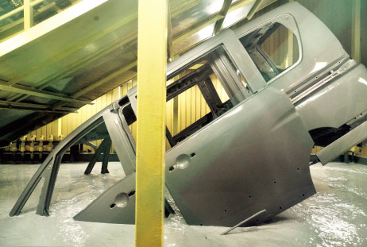
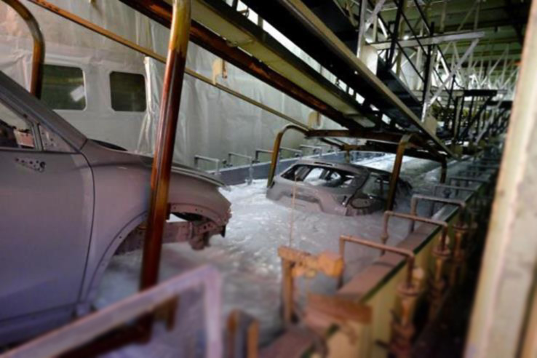


What is Electrodeposition (ED) ?
Most widely-used anti-rust base-coat methods for various metal products including auto carbodies.
Depositing coating film by applying direct electric current in a paint pool.
In the actual car manufacturing line, the carbodies are moving in the paint pool.
Relatively good at depositing a uniform film on complex shapes such as carbody.
$$+$$
$$−$$
＋
＋
Paint
Anode
Cathode
http://n-link.nissan.co.jp/

Slide 3
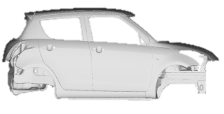
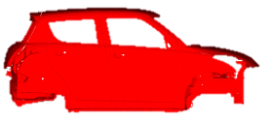
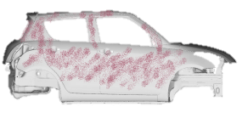
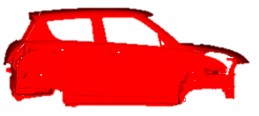

What is Electrodeposition (ED) ?
We focus on this process.
Simplified Overview of the Entire Carbody Paint Shop
Degrease
Preparation
Electrodeposition (ED)
ED Oven
Base-coat
Intermediate -coat
Top-coat
Intermediate Oven
Intermediate Coat
Sealing/Undercoat
Top Coat
Topcoat Oven
To Assembly Line

Slide 4
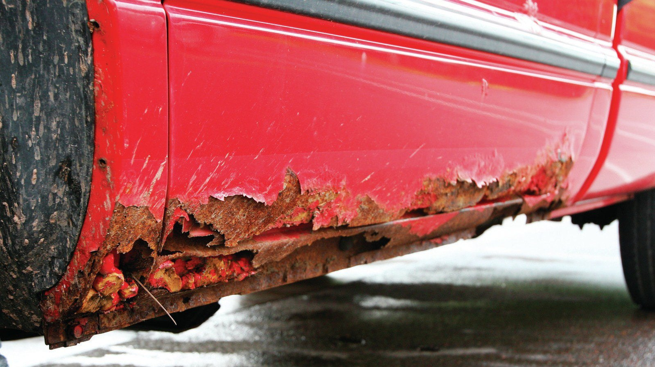
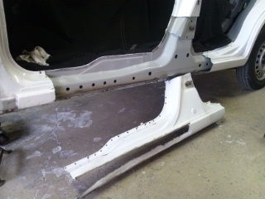
Impact of ED Process on Carbody Design
Undercarriages are exposed to severe corrosive environments.
ED film thickness must be above minimum over the entire surface of the undercarriages.
Some undercarriage parts (e.g., side sills) have bag-like structures with multiple plates.
It is necessary to drill many ED holes to allow the electric current to pass through in the paint pool.
Side Sill
ED Hole
https://www.goauto.ca/
∴ Carbody designers should understand and consider the ED process, including the location, size, and number of ED holes.

Slide 5
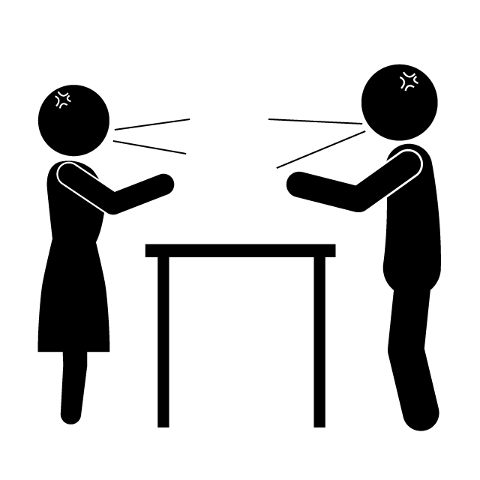
Need for ED Simulation
ED holes are essential for corrosion protection, but they are NOT welcome for strength or stiffness.
Thus, the following conflict always occurs between carbody designers.
More ED holes!
Fewer ED holes!
Designer in Corrosion Section
Designer in Strength/Stiffness Section
In such a case, ED simulation can resolve the conflict based on quantitative evidence data and lead to the optimal carbody design.

Slide 6
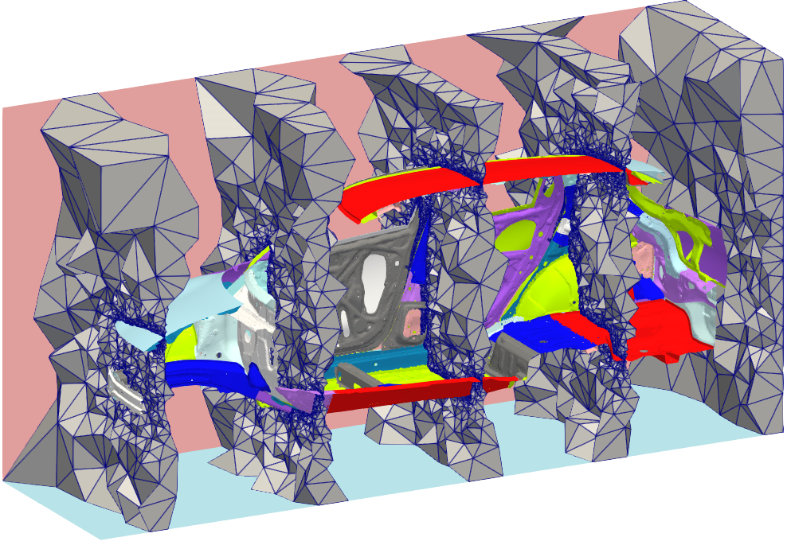
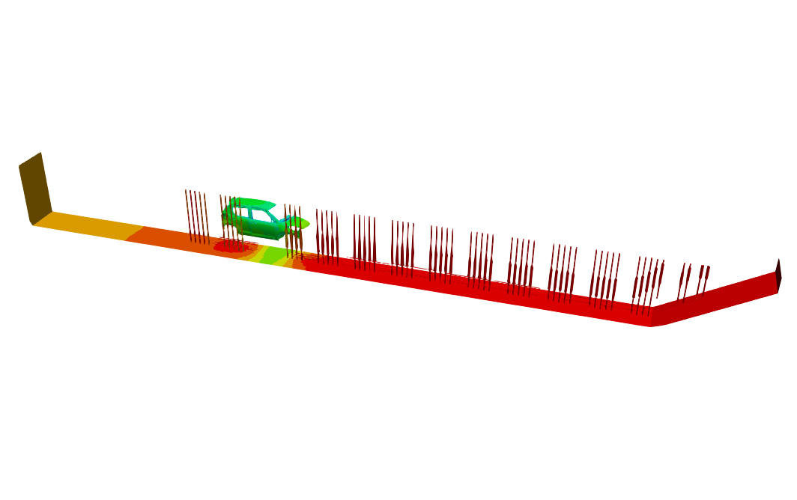
What is ED Simulation?
Actual ED Line Carbody Mesh
ED Simulation
Paint Pool
Carbodies w/ Motion
Electrodes (Anodes)
5 slices of a carbody mesh
Total length: about 30 m

Slide 7
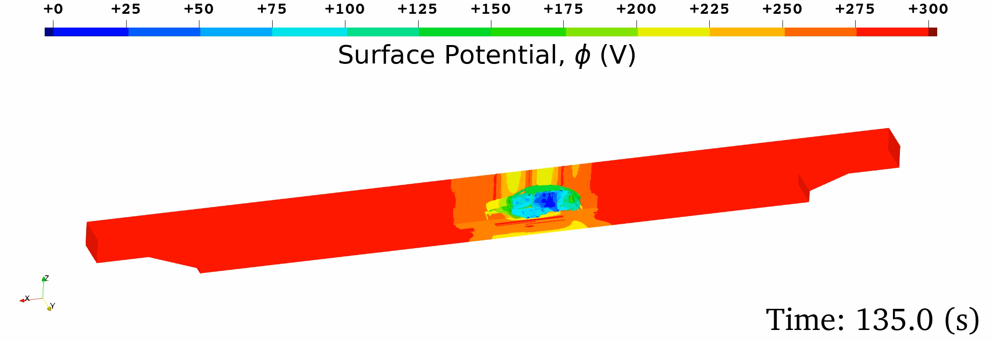


What is ED Simulation?
Governing equation: Electrostatic Laplace equation ($∇^{2}φ=0$) in the paint pool domain.
Boundary conditions:
Wall (insulation) BC，
Anodic (electrode surface) BC,
Cathodic (carbody surface) BC: ED constitutive models for film initiation / resistance / growth.
Mesh: 4-node tet (T4) mesh for complex carbody shape.
Motion: Overset mesh method
Outputs: Time-histories of $∘$ Surface potential, $∘$ Current density, $∘$ Film thickness.
Need for accurate FEM-T4
Need to identify them via lab experiments
Need for validation before deployment

Slide 8
Objective
Development of a practical ED simulator using the next-gen FE formulation (ES-FEM) with the ED constitutive models based on lab experiments and its validation for actual manufacturing.
Table of body contents:
Methods: ES-FEM, Lab Experiment, Actual Line Measurement
Results: Validation at an Actual Manufacturing Line
Summary

Slide 9
Methods: ES-FEM, Lab Experiment, and Actual Line Measurement

Slide 10
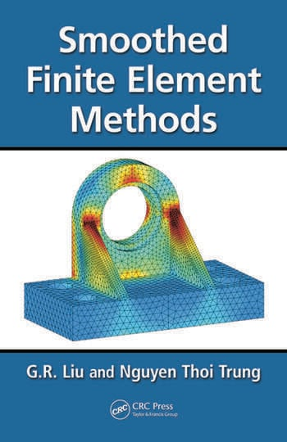
The next-gen FE formulation: ES-FEM
Edge-based Smoothed Finite Element Method (ES-FEM) is a relatively new FE formulation proposed in 2006 by Prof. G. R. Liu (the 1st plenary speaker of APCOM2025).
S-FEM is one the gradient/strain smoothing techniques.
ES-FEM is a method as if putting a Gauss point at each edge center.
For example, in a 2D triangular mesh:
Edge-based S-FEM (ES-FEM)
Standard FEM
G.R. Liu et al., CRC Press
The red area shows the domain for gradient smoothing.
Search
S-FEM wiki
Using ES-FEM-T4, a super-linear mesh convergence rate in electrostatic analyses is expected.

Slide 11
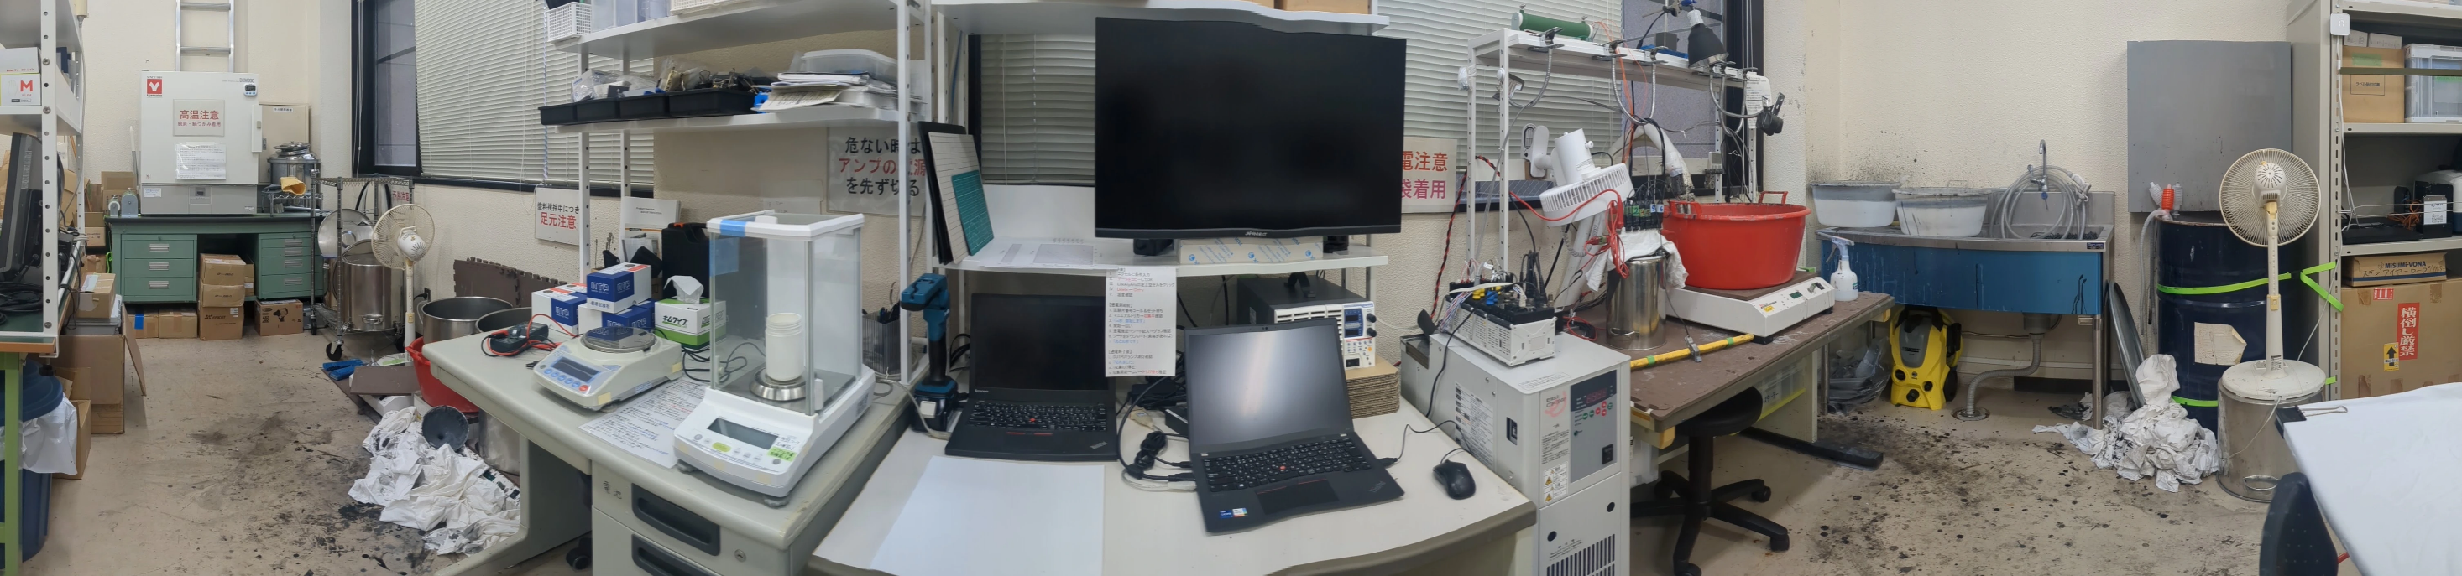
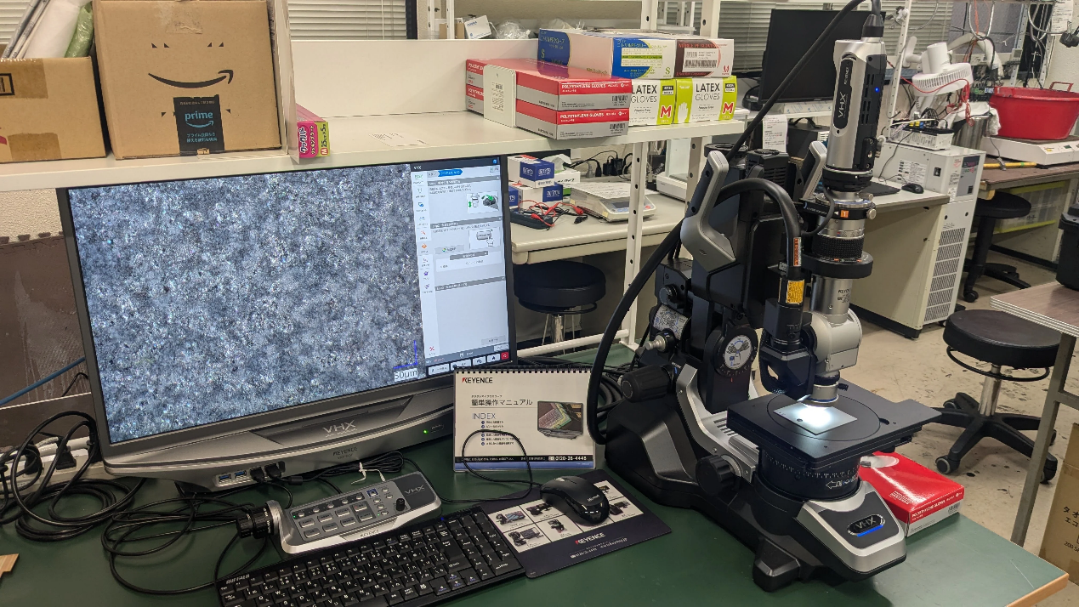
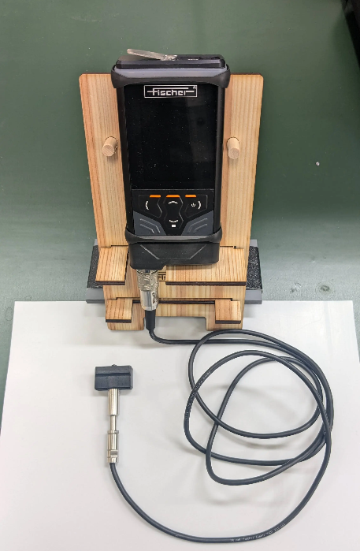
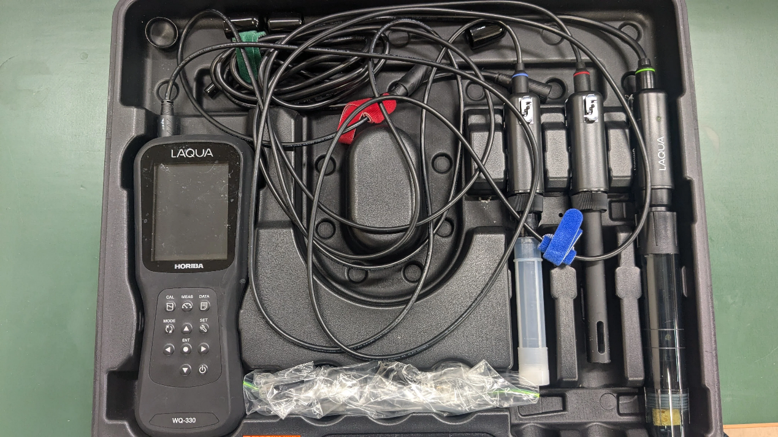
Overview of Our ED Experiment Lab
Contant Temp. Water Bath
Waste Tank
Control PC
Electric Balance
Data Logger
Oven
Tank
Water Rise Sink
High Voltage Power Source
Contant Temp. Water Circulator
We have sufficient ED testing facilities in the central area of Tokyo!!
Digital Microscope
Film Thickness Meter
Water Quality Meter

Slide 12
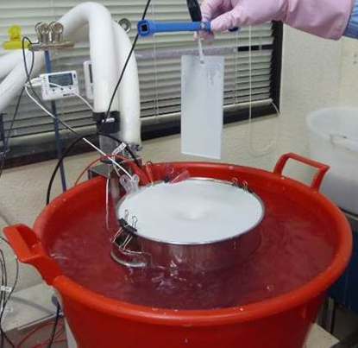
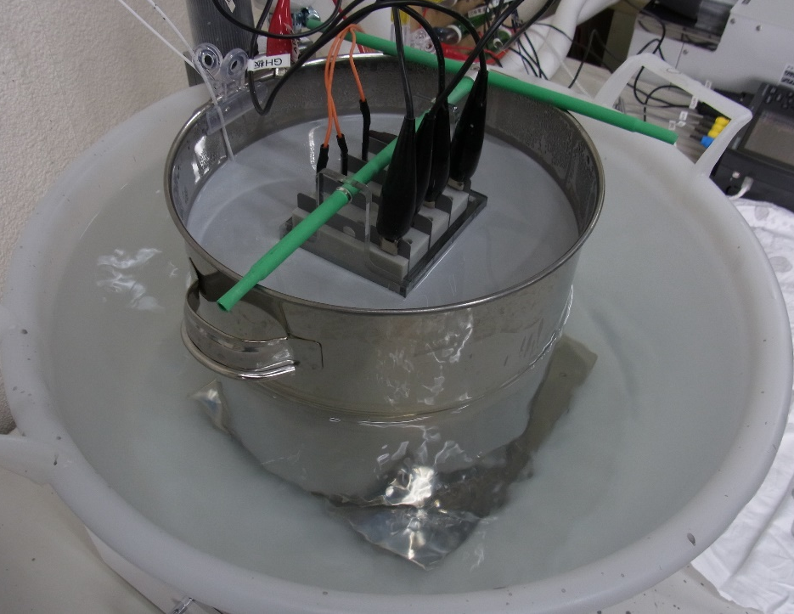
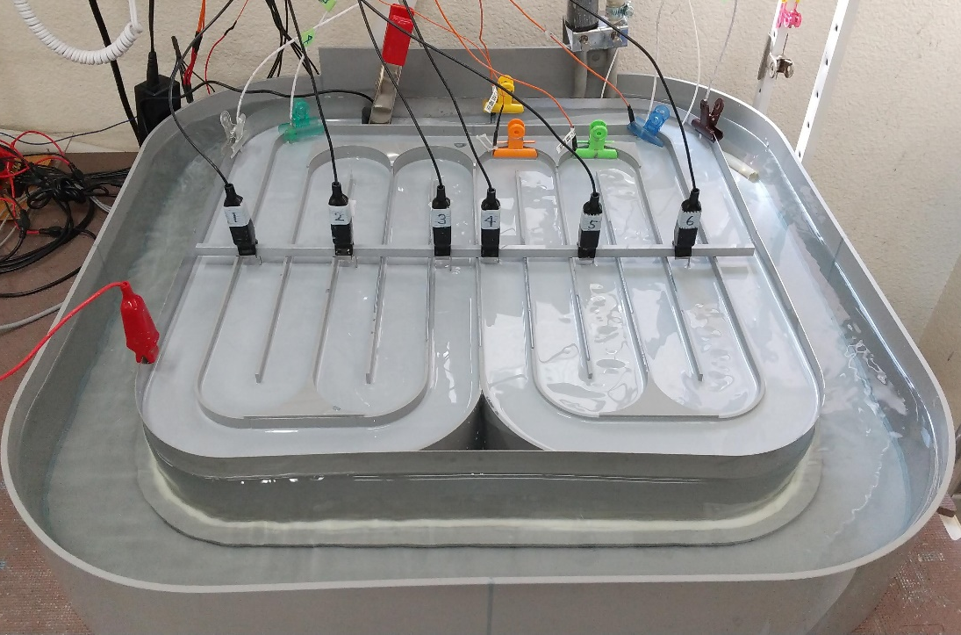
3 Major Lab Tests
The one-plate test is used to identify the numerical ED constitutive models:
Film initiation model,
Film resistance model,
Film growth model.
The other tests are used for the validation of the identified ED constitutive models.
One-Plate Test
4-Plate Box Test
Circulating Pool Test
All strongly non-linear models… It takes 200 tests at least.

Slide 13
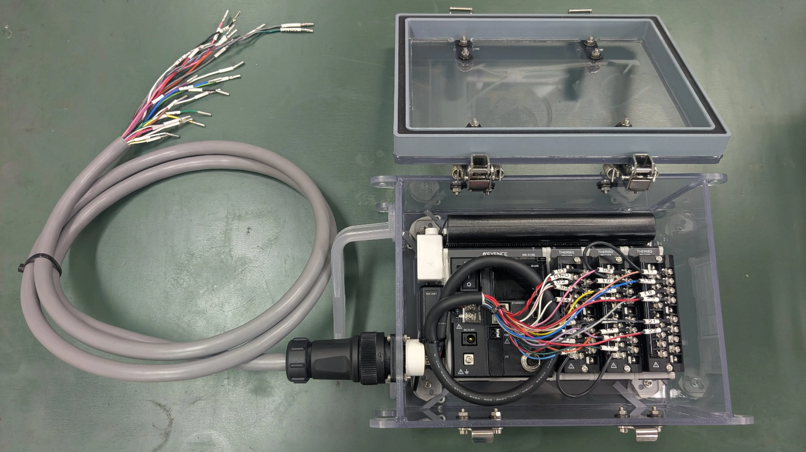

One of the Actual Line Monitoring Devices
Carbody Surface Potential Measurement Device
Hang this device in the middle of carbody.
Put electric probes on the carbody surface.
Let is sink in the paint pool to measure the electric potential during the ED process.
$⟹$ We can obtain the time-histories of electric potential on the carbody surface.
connected to probes
Watertight Box
Battery
Copper Cable
Data Logger
Getting time-history monitoring data is very important for the validation of a line simulator, in addition to the final state data.
Making real devices by yourself for actual manufacturing line is sometimes necessary to motivate factory engineers, even though you are a computational engineer.

Slide 14
Result: Validation Test at an Actual Manufacturing Line

Slide 15
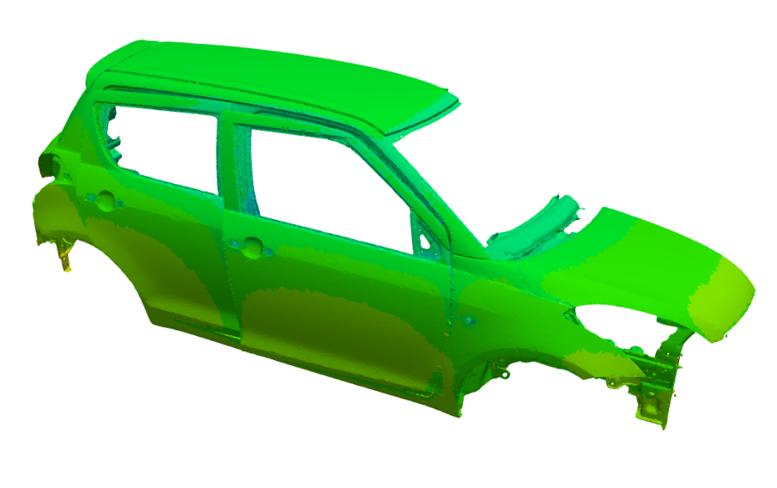
Validation Test
Measured 6 Points (Ch.2 - 7):
Outline
Measurement
A surface potential logging device with 6 probes was mounted on a car running on an actual ED line.
After baking, the film thickness was measured at the probe points.
Simulation (Same as the mesh convergence test.)
Half-body analysis (only right-hand side).
The entire line shape, carbody motion, and standard electrode conditions are input.
Surface potential time history and final film thickness at the 6 points are compared.
Ch.7：Back Door
Ch.4：Roof
●
●
Ch.2：Hood
●
●
●
Ch.3：Side Door
Ch.5：Side Sill
Ch.6：Floor (not visible on this Fig.)

Slide 16
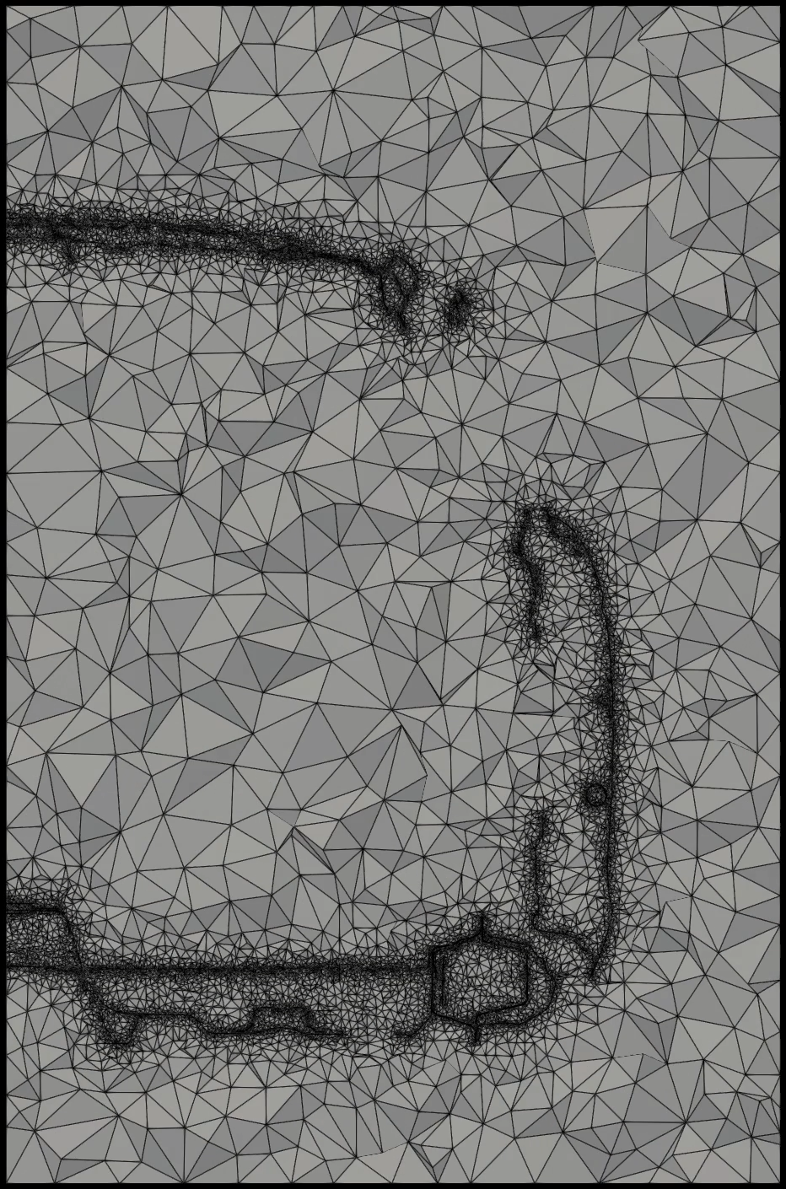
Validation Test
Carbody Mesh with 4-node Tetrahedron
An ED simulation requires a mesh for the space around the carbody like CFD.
In contrast to CFD, an ED mesh should include the room space and many narrow spaces among plates (such as inside of the side sill).
Animated slices of a carbody mesh from rear to front
# of Elements
25M for carbody
7M for pool
(32M in total)
CPU Cost 7 hours with AMD EPYC 9274F x 1, MPI/OpenMP Hybrid.
5 slices of a carbody mesh

Slide 17
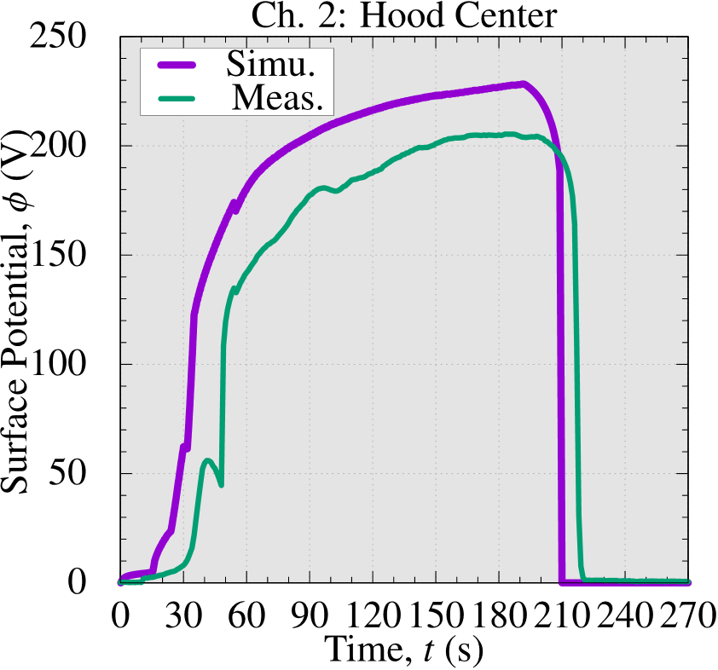
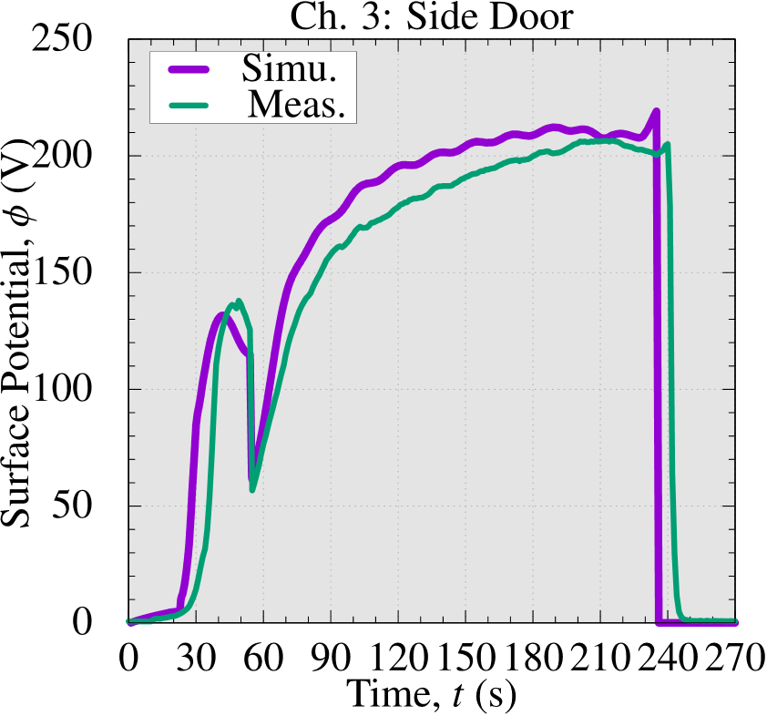
Validation Test
Validation of Time-history of Surface Potential (Ch. 2 and 3)
The simulated surface potential is a little high because the degradation of the membranes of electrodes was not precisely simulated; yet, the results generally agree with measured data in practical accuracy.

Slide 18
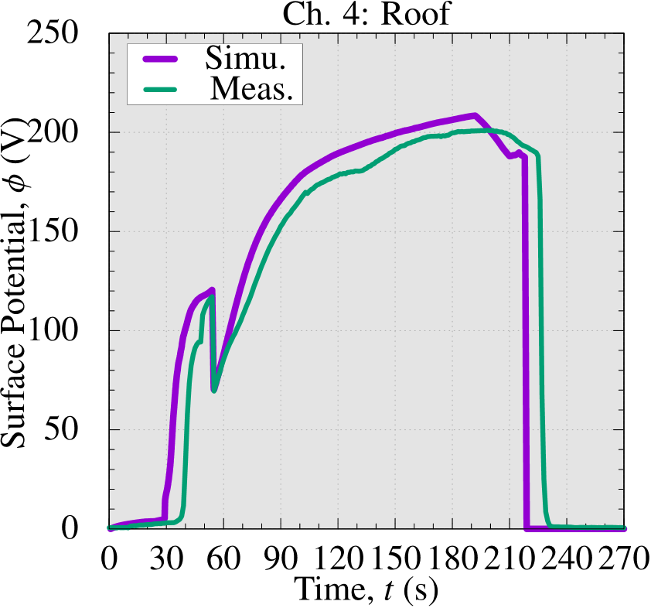
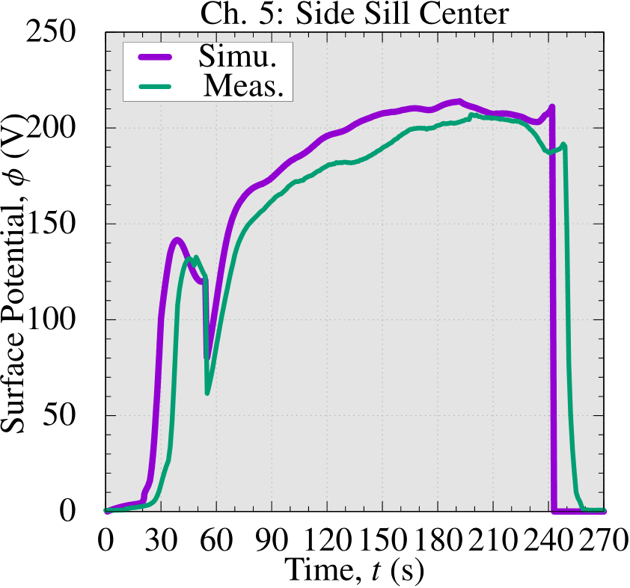
Validation Test
Validation of Time-history of Surface Potential (Ch. 4 and 5)
The simulated surface potential is a little high because the degradation of the membranes of electrodes was not precisely simulated; yet, the results generally agree with measured data in practical accuracy.

Slide 19
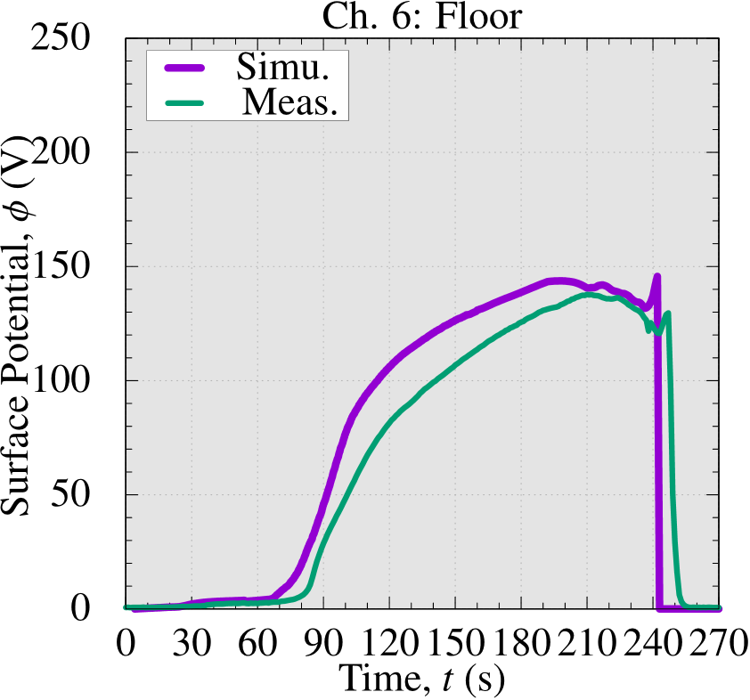
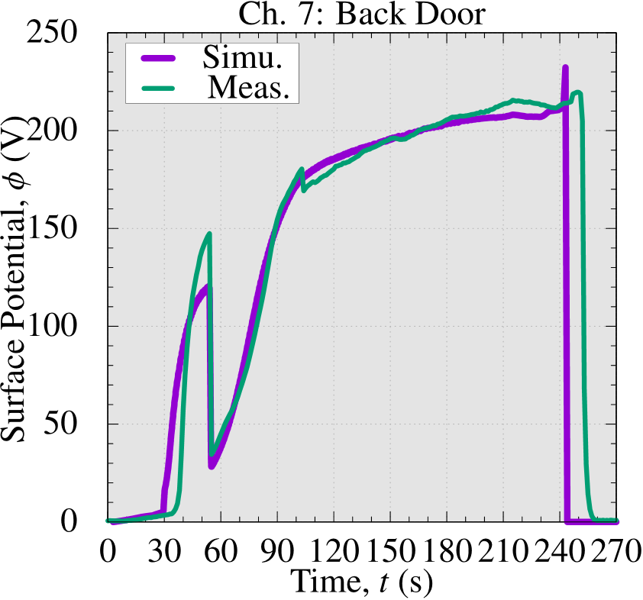
Validation Test
Validation of Time-history of Surface Potential (Ch. 6 and 7)
The deposition delay at the floor, an inner part, is reproduced successfully.
The simulated surface potential is a little high because the degradation of the membranes of electrodes was not precisely simulated; yet, the results generally agree with measured data in practical accuracy.

Slide 20
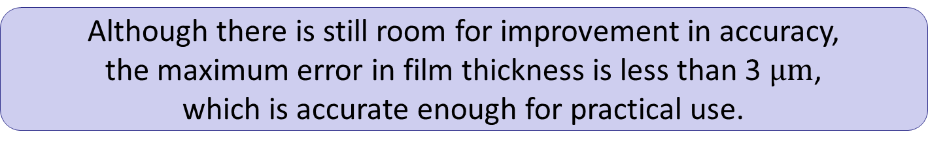
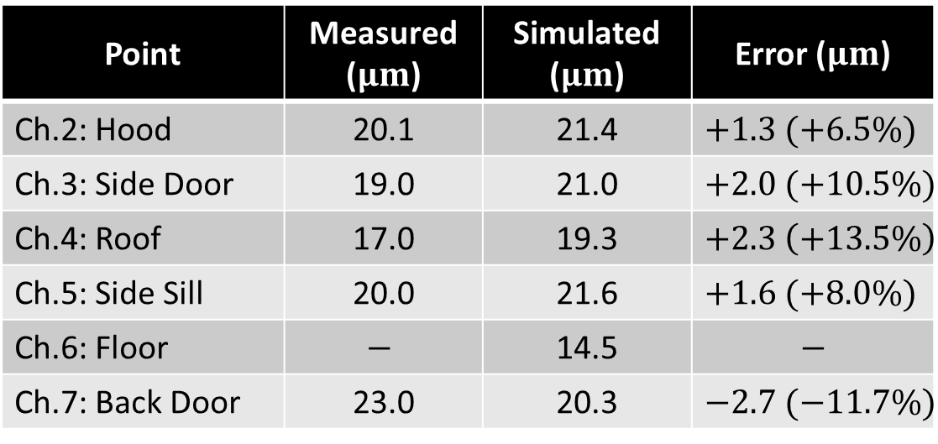
Validation Test
Validation of Final Film Thickness
Point | Measured ($μm$) | Simulated ($μm$) | Error ($μm$)
Ch.2: Hood | 20.1 | 21.4 | $+1.3 (+6.5\%)$
Ch.3: Side Door | 19.0 | 21.0 | $+2.0 (+10.5\%)$
Ch.4: Roof | 17.0 | 19.3 | $+2.3 \left(+13.5\%\right)$
Ch.5: Side Sill | 20.0 | 21.6 | $+1.6 (+8.0\%)$
Ch.6: Floor | $$−$$ | 14.5 | $$−$$
Ch.7: Back Door | 23.0 | 20.3 | $−2.7 (−11.7\%)$
Although there is still room for improvement in accuracy, the maximum error in film thickness is less than 3 $μm$, which is accurate enough for practical use.
The validation example presented here is from about 10 years ago.
Due to confidentiality reasons, we cannot disclose the latest results.

Slide 21
Summary

Slide 22
Summary
An electrodeposition (ED) simulator was developed.
The simulator adopts the next-gen FE formulation (ES-FEM) with 4-node tetrahedral meshes for complex carbody shapes.
A series of lab experiments are conducted to identify the ED constitutive models.
A novel device to measure the time-histories of electric potential on the carbody surface was developed and utilized in actual manufacturing lines.
A test on an actual manufacturing line validated the effectiveness of our ED simulator.
Our commercial ED simulator is already in practical use in major Japanese car companies.
If you are interested in our ED simulator, please check the website.
Search
edesfem
Thank you for your kind attention!

