Slide 1
A Meshfree Approach for Large Deformation Analysis in Thermal Nanoimprint
Yuki ONISHI and Kenji AMAYA
Tokyo Institute of Technology

Slide 2
Background
Thermal nanoimprinting and micro hot embossing have been in industrialization stage.
Effective method for process design (temperature, pressure, time, etc.) is required.
  Current situation
  Repetitive experiments for process optimization.
  Repetitive experiments cost high!!
  Numerical simulation should help.
Final Goal
Establishment of numerical technique
for thermal nanoimprint process optimization.

Slide 3
Choice of Numerical Method
Choice1: Continuum or Molecular
  If the target size is over several tens of nms, the number of molecules is large enough to be modeled as a continuum.
  The problem is huge for MD.
Choise2: Solid or Fluid
  In thermal imprints, temperature is around Tg at most.
  Rheology effect can be consolidated in viscoelastic model.
Choise3: Meshfree or Mesh
  “Mesh”(=FEM) is usually used and has achievements.
  “Meshfree”(=SPH, EFGM, etc.) is expected to be a good method to treat extremely large deformation, but still under development and yet has no achievements.
  Most of the researches use FEM.

Slide 4
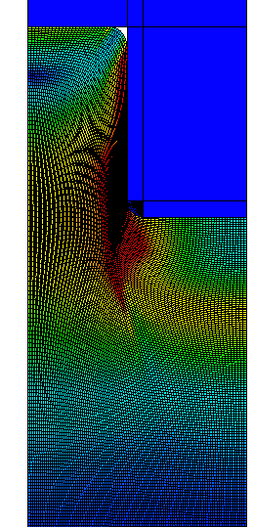
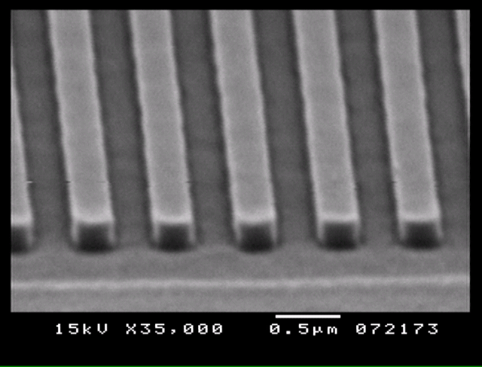
Our Previous Work (Outline)
Finite element Analysis
  Geometric nonlinear
  (Large deformation)
  Material nonlinear
  (thermo-viscoelastic polymer)
  Contact nonlinear
  Quasi-static analysis
Mold
（rigid）
Polymer
(thermo-viscoelastic)
FE analyses agreed
with experiments
in case of
line-and-space
up to AR=1
Onishi et al.,
JVST B (2008) etc.‏

Slide 5

Our Previous Work (Viscoelastic)
Generalized Maxwell Model
When a forced displacement x(t)=sin(ωt) applied at the temperature θ,
reaction force f(t) become
τ₁
τ_{n}
G_{inf}
G₁
G_{n}
G_{inf}：Long-term shear modulus
G0=G_{inf} +∑G_{i}：
Instantaneous shear Modulus
τ₁~τ_{n}：Relaxation time
G' ：Shear storage modulus
(same phase)
G’’ ：Shear loss modulus
(90º shifted)

Slide 6
Our Previous Work (Material Test)
Uniaxial tension-compression tests
at various temperatures and frequencies
heater
device：01dB-METRAVIB VA2000
frequency range：0.001～200(Hz)‏
load range：±100(N)‏
temperature range：-150～450(degC)‏

Slide 7
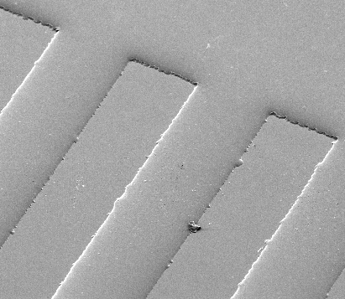
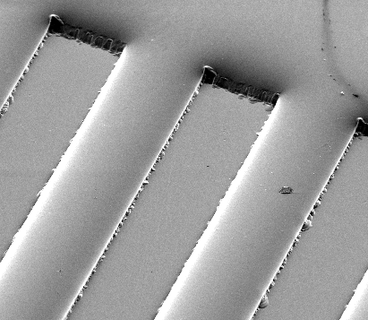
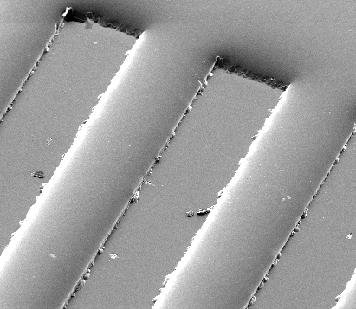
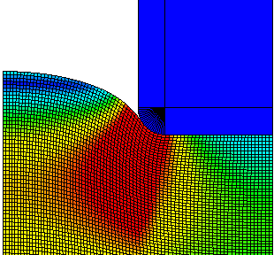
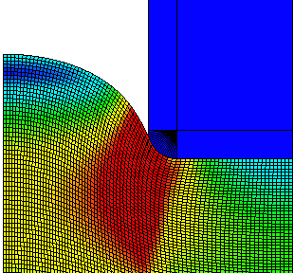
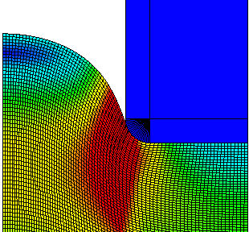
Our Previous Work (Example2)
10sec
30sec
60sec

Slide 8
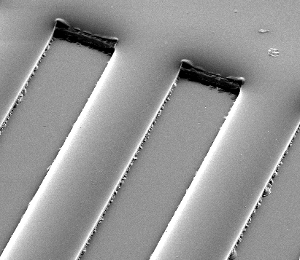
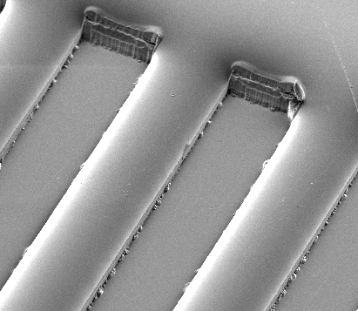
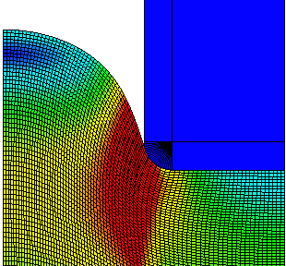

Our Previous Work (Example2)
90sec
120sec

Slide 9
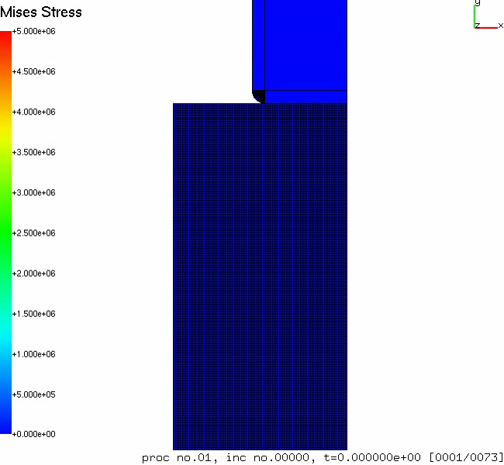
Our Previous Work (Example1)

Slide 10
Our Previous Work (Example2)
160
140
Experiment
Simulation
120
100
Pattern Height [μm]
80
60
40
20
0
0
10
30
60
90
120
Pressure Holding Time [sec.]
Simulated deformations of the line-and-space imprinting agreed with experiments.

Slide 11
Our Previous Work (Summary)
Time evolutional deformation behavior was successfully simulated with FEM in cases of line-and-space patterning.
The thermo-viscoelastic constitutive model we chose was appropriate.
It has potential to simulate any deformation in thermal nanoimprintings.

Slide 12
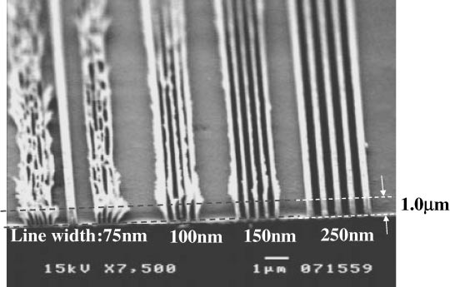
Objective
Our previous work hit the wall…
In practical applications,
AR over 1 is not uncommon.
(even AR>3 is usual.)
FEM cannot treat the extremely large deformation without adaptive meshing. (Adaptive meshing is difficult to implement.)
Objective
Development of a meshfree method
for viscoelastic large deformation analysis
(utilize it for thermal nanoimprint process optimization in the future)
Hiral et. al

Slide 13
Difference between FEM and Meshfree
Way of domain integration
  FEM (element base)
OK
integration
point
node
BAD
concave
Frequently happens
especially in case of
compression analysis
BAD
volumetric
locking
nearly
incompressible

Slide 14
Difference between FEM and Meshfree
Way of domain integration
  Meshfree (collocation type) ---- SPH
  Meshfree (Petrov-Galerkin type) ---- MLPG
  Meshfree (Galerkin type) ---- EFGM
    background cell integration
    nodal integration
    stress point integration (SPI)
    (No standard formulation of SPI)
    *No element
  *Less locking
  *Fair integration accuracy
  *Requirement of stabilization
close to FEM
node
stress
point

Slide 15
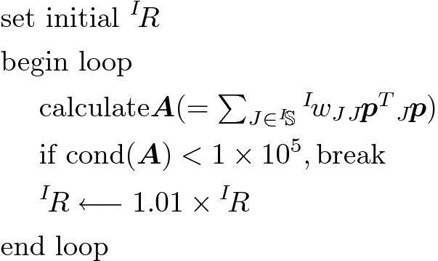

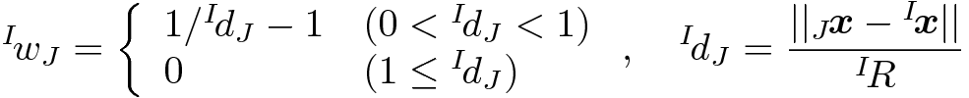
Robust MLS Approximation
Moving Least Squares (MLS) to build shape function
Support radius
Weight function
(small)
^{I}R
^{I}R
^{I}R

Slide 16

Update of SP States
Location
x: current location, S: set of nodes in the support,
φ: shape function
Volume
V^{initial}：initial volume，F：deformation gradient

Slide 17
Viscoelastic Material Properties
material constants used in example analysis
instantaneous Young’s modulus（E₀）： 9 GPa
instantaneous Poisson’s ratio（ν₀）： 0.333・・・
instantaneous shear modulus（G₀）： 3.375 GPa
bulk modulus（K）： 9 GPa
dimensionless shear modulus（g）： 0.9
relaxation time（τ）： 5 s
long-term Young’s modulus（E∞）： 1 GPa
long-term Poission’s ratio（ν∞）： 0.481
long-term shear modulus(G∞): 0.3375 GPa
behavior at
room temperature
behavior
around Tg

Slide 18
Bending of Cantilever
Force
200 kN
Time
1s
100s
Elastic/Viscoelastic body
0.1m
1m
Static/Quasi-static, Plane strain
50x5 structured grid nodes
Concentrated force at right-top node
Compared to FEM(ABAQUS/Standard) with same node arrangements and selective reduced integration quadrangle elements

Slide 19
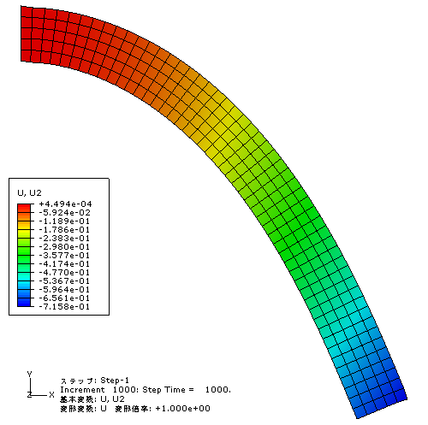
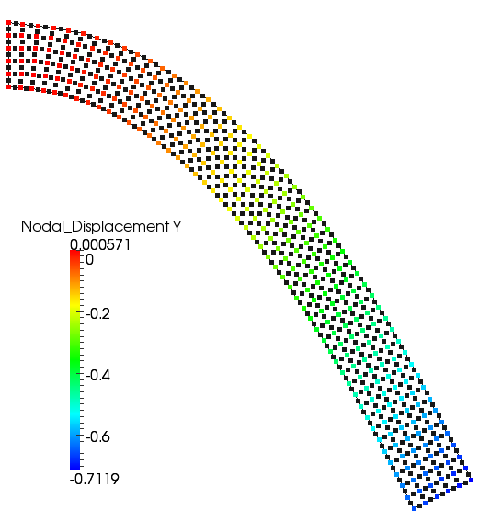
Bending of Cantilever (elastic)
E=1GPa, ν=0.49
ABAQUS/Standard Proposed Method
Less than 1% error of displacement
No problem in elastic large deflection analysis

Slide 20
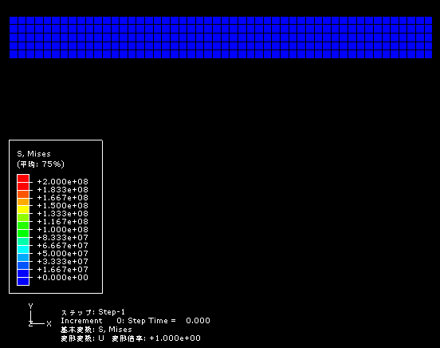
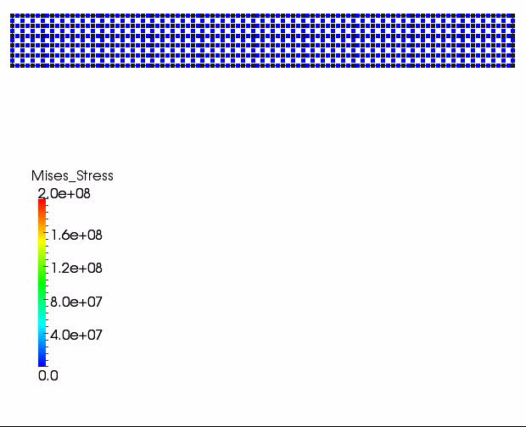
Bending of Cantilever (viscoelastic)
E₀=9GPa, ν₀=0.333, E_{inf}=1GPa, ν_{inf}=0.481
ABAQUS/Standard Proposed Method

Slide 21
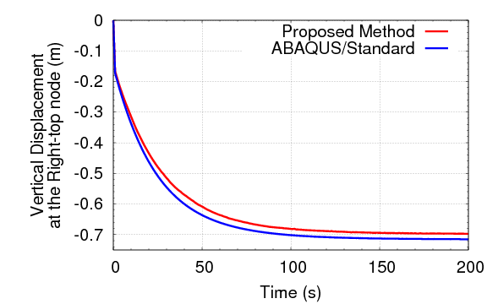
Bending of Cantilever (viscoelastic)
2.5% error of displacement
Error decreases as dt decreases
Further improvement of time-advancing scheme is necessary

Slide 22
Imprinting-like Analysis
Quasi-static, plane strain
Horizontal bounding for left and right side
Vertical bounding for bottom side
Enforced displacement for right half of top side toward downward with horizontal bounding
Unstructured grid with fineness and coarseness
0.6μm disp.
in 80s
1μm
1μm

Slide 23
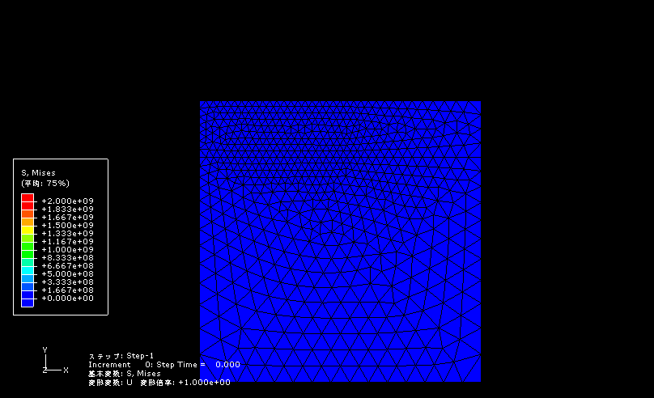
Imprinting-like Analysis (FEM)
Inappropriate deformation because of the locking under the corner

Slide 24
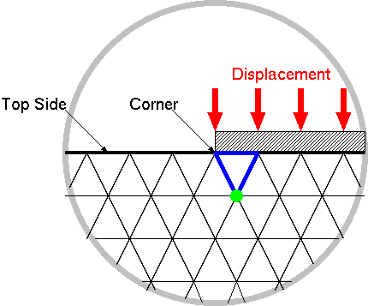
Imprinting-like Analysis (FEM)

Slide 25
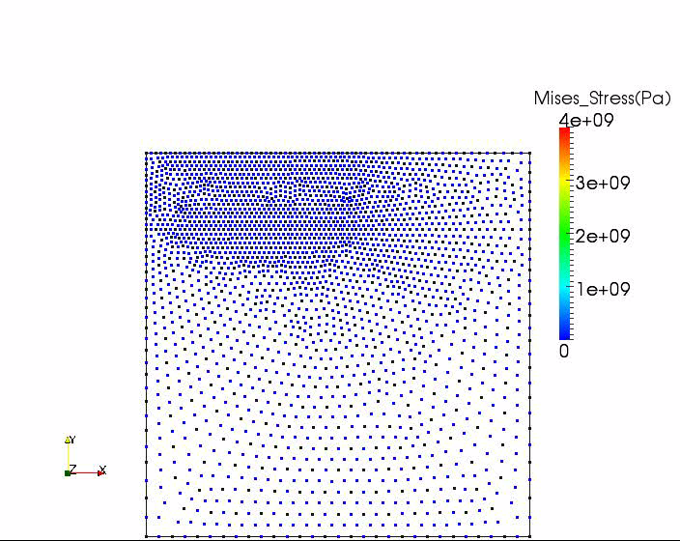
Imprinting-like Analysis (animation)
An appropriate result was obtained.

Slide 26
Summary & Future Work
Summary
  A Meshfree formulation of large deformation of viscoelastic body was proposed.
  It has fair accuracy in large deflation analysis.
  Appropriate result is obtained in imprinting-like analysis.
  Further modification is required to apply it to thermal nanoimprint simulation.
Future work
  Improvement of time advancing scheme
  Verification with experiments or FEM with adaptive meshing
  Insertion of additional nodes and SPs during analysis
  Contact analysis
  Cooling and demolding analysis

Slide 27
Appendix

Slide 28
SP Integration (initialization)
(currently) SPs are generated from FE meshes
[Note] meshes are only for initialization!!!
Locate every SP in the middle edges
(Belytschko’s SP integration has master and slave SPs.)
Corresponding SP volume is calculated with meshes
：node
(has only x and u)
：stress point (SP)
(has x, T, E, E ^{v}, etc.)

Slide 29
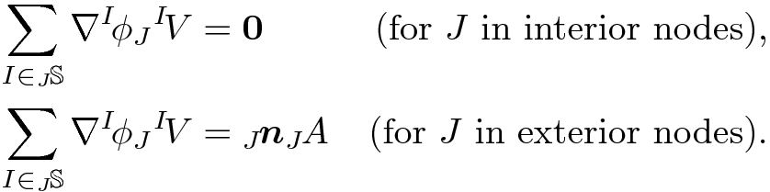

Integration Correction
Integration constraint
n: outward normal unit vector, A: correspoiding nodal area
_{J}S: set of SPs that include node J in the support
Integration correction (IC)
determine γ s so that modified ψ s satisfy reproducing constraints
including integration constraint

Slide 30
Quasi-implicit Time Advancing
Start of time increment loop
  Start of Newton-Raphson loop
    update support, w, φ, etc.
    calc f ^{int.} and K
    calc r = f ^{int.} -f ^{ext.}
    solve K δu = r
    update node locations
    update SP locations
  End of Newton-Raphson loop
End of time increment loop
Typical fully-implicit time advancing

Slide 31
Quasi-implicit Time Advancing
Start of time increment loop
  update support, w, φ, etc.
  renew f ^{virtual}
  Start of Newton-Raphson loop
    update support, w, φ, etc.
    calc f ^{int.} and K
    calc r = f ^{int.} -f ^{ext.} -f ^{virtual}
    solve K δu = r
    update node locations
    update SP locations
  End of Newton-Raphson loop
End of time increment loop
Constant shape function
in each
Newton-Raphson loop
Enforcement of
temporal continuity of the
mechanical equilibrium

Slide 32
FEM
  Integration points are pseudo-Lagrange points.
  Elements must be convex.
  1st order triangular element has volumetric locking.
Meshfree with BG cells
  Integration points are Euler points.
  Difficulties in treating free surfaces.
  Difficulties in convection of state quantities.
Meshfree without cells
  Integration points are Lagrange points.
  Difficulties in precise domain integration.

Slide 33
Shear Behavior of Polymer
Generalized Maxwell Model
When a forced displacement x(t)=sin(ωt) applied at the temperature θ,
reaction force f(t) become
τ₁
τ_{n}
G_{inf}
G₁
G_{n}
G_{inf}：Long-term shear modulus
G0=G_{inf} +∑G_{i}：
Instantaneous shear Modulus
τ₁~τ_{n}：Relaxation time
G' ：Shear storage modulus
(same phase)
G’’ ：Shear loss modulus
(90º shifted)

Slide 34
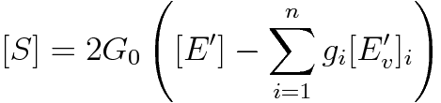

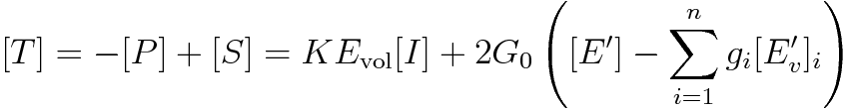
Constitutive Equation of Polymer
Constitutive equation
1)Volumetric Behavior
2)Shear Behavior
[P] : hydrostatic stress tensor
K : bulk modulus
Evol: volumetric strain
[I]: identity tensor
[S]: deviatoric stress tensor
G0: instantaneous shear modulus
(=Ginf +G1+ ... + Gn)
[E’]: deviatoric strain tensor
gi: ith dimensionless shear modulus
(=Gi/G0)
[Ev’]i: ith viscous strain tensor
Combining [P] and [S], We obtain stress tensor [T] as:

Slide 35


Temperature Dependency of Polymer
WLF law (temperature-time conversion)
WLF law
temperature increase
reduced time increase
t: real time
t’: reduced time
θref, C1, C2: material constants

Slide 36
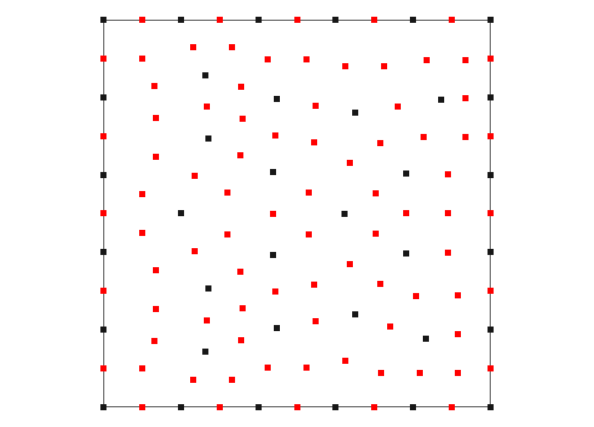

Patch Test
：node
：stress point
(SP)
Elastic body, Static, Plane-strain
Irregularly-arranged nodes and SPs
Displacement BC for every external nodes

Slide 37
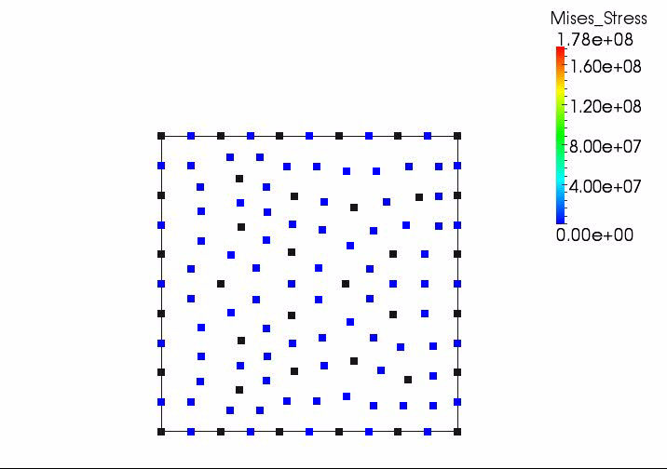
Patch Test (animation)

Slide 38
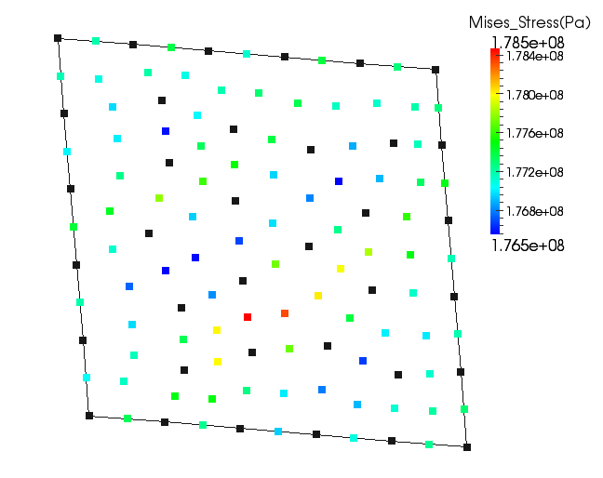
Patch Test (result)
within 1% error of Mises stress
Proposed method passes the patch test

