Slide 1
Numerical Method for Analyzing Time-dependent Localized Corrosion under Accumulated Rust
Koichi Masuya, George Ochiai, Yuki Onishi, Kenji Amaya
Tokyo Institute of Technology (Japan)
Notes:
Thank you chairperson.
Today, I’d like to talk about Numerical Method for Analyzing Time-dependent Localized Corrosion under Accumulated Rust.

Slide 2
Classification of Corrosion
General corrosion
  Corrosion dissolving metal uniformly and slowly in electrolyte.
Localized corrosion
  Corrosion dissolving metal locally and quickly.
More important issue
for safety !
Electrolyte
Electrolyte
Metal
Metal
Notes:
First of all, I explain some features of corrosion briefly, and show the actual incidents.
Corrosion can be classified into two types.
One is general corrosion, and the other is localized corrosion.
As shown in the left figure, general corrosion is the corrosion dissolving metal uniformly and slowly in electrolyte.
As shown in the right figure, localized corrosion is the corrosion dissolving metal locally and quickly such as pitting corrosion, crevice corrosion, etc.
Therefore, localized corrosion is a more important issue for safety of structures.

Slide 3
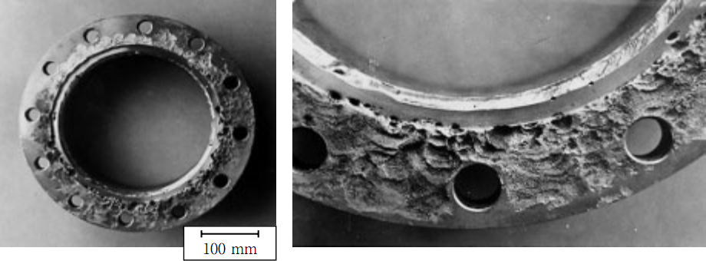
Localized Corrosion in Plants
Localized corrosion occurs in corrosion-resistant alloy such as stainless steel, and shorten a life of structures.
For example, Crevice corrosion of several millimeters occurred at a flange of a seawater pump after 5 years operation.
Fig. Crevice corrosion occurred at a flange of a seawater pump^{[1]}
[1]Matsuho MIYASAKA, Lecture on Corrosion and Corrosion Protection of Seawater Pumps-,
Ebara Engineering Review No.224 pp.28-37 (2009)
Notes:
About Localized Corrosion in Plants
Localized corrosion occurs in corrosion-resistant alloy such as stainless steel, and shorten a life of structures.
For example, Crevice corrosion of several millimeters occurred at a flange of a seawater pump after 5 years operation.

Slide 4
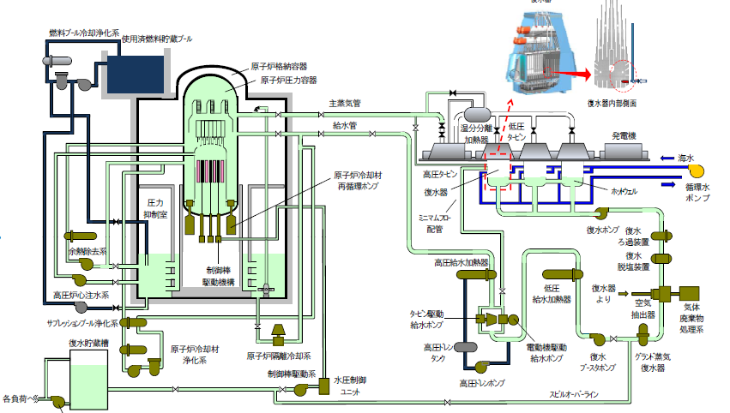
Localized Corrosion in the Nuclear Plant
In Hamaoka nuclear power station on May 14, 2011, damage to the main condenser tubes resulted in an inflow of seawater into the condensate storage tank.
Condensate storage tank
Fig. Outline of Hamaoka Nuclear Power Station Reactor No. 5 ^{[2]}
[2]Ministry of Economy, Trade and Industry: Reporting causes of corrosion holes in condensate storage tank lining and Measures to prevent recurrence in Unit 5 Chubu Electric Power Co., Inc. Hamaoka Nuclear Power Station, 2012.
Notes:
About localized corrosion in the nuclear plant
In Hamaoka nuclear power station on May fourteenth, twenty eleven, damage to the main condenser tubes resulted in an inflow of seawater into the condensate storage tank.

Slide 5
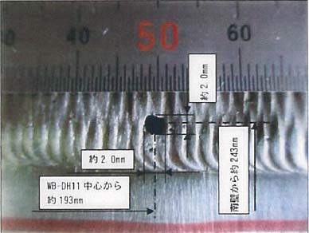

Localized Corrosion in the Nuclear Plant
Crud had built up in the condensate storage tank. (Crud is formed mainly by iron rust from the inner walls of the pipes, etc.)
Crevice environment created by the inflow of seawater and rust caused pitting corrosion in less than 5 months.
Seawater
Iron rust
Passive film
$${\text{H}}^{+}$$
Stainless steel
Fig. Pitting corrosion occurred under accumulated rust.^{[2]}
[2]Chubu Electric Power Co., Inc., 2012.
Notes:
Crud had built up in the condensate storage tank.
Crud is formed mainly by iron rust from the inner walls of the pipes, etc.
Crevice environment created by the inflow of seawater and rust caused pitting corrosion in less than 5 months.
Details of localized corrosion under accumulated rust will be described later.
In this way, localized corrosion can lead to a serious accident.

Slide 6
Methods for Localized Corrosion Evaluation
It is difficult to estimate the corrosion rate by experiments because localized corrosion is a multiphysics problem.
Numerical evaluation of localized corrosion is expected to be an effective approach to this issue.
Notes:
About methods for localized corrosion evaluation
It is difficult to estimate the corrosion rate by experiments because localized corrosion is a multiphysics problem.
Accordingly, numerical evaluation of localized corrosion is expected to be an effective approach to this issue.

Slide 7
Objective
Developing a numerical method for analyzing time-dependent localized corrosion
under accumulated rust
Contents
Mechanism of localized corrosion under accumulated rust
Analysis method
Example of analysis
Summary
Notes:
In our study, we aim at developing of numerical method for analyzing time-dependent localized corrosion under accumulated rust.
Here is the contents of my talk.
First, I will explain the mechanism of localized corrosion under accumulated rust.
Second, I will explain the analysis method of localized corrosion.
Third, I will show the example of analysis of corrosion progress.
Finally, I will conclude by saying the summary.

Slide 8
Mechanism of localized corrosion under accumulated rust
Notes:
I explain the mechanism of localized corrosion under accumulated rust from this slide.

Slide 9


Mechanism of corrosion under rust
1. Passive film is locally destroyed at a micropit on stainless steel surface.
No rust
Under accumulated rust
Seawater
Micropit is a spot at which anodic regions of microcells are concentrated incidentally.
$${\text{Cr}}^{3+}$$
Seawater
$${\text{Cr}}^{3+}$$
Iron rust
Micropit
Passive film
Micropit
Passive film
Stainless steel
Stainless steel
Notes:
These figures represent stainless steel in seawater.
Passive film is formed on stainless steel surface.
In the left figure, there is no rust, and in the right figure, there is accumulated rust over stainless steel.
In the first step, passive film is locally destroyed at a micropit on stainless steel surface.
Micropit is a spot at which anodic regions of microcells are concentrated incidentally.
Stainless steel containing chromium ions dissolves in seawater from a micropit.

Slide 10
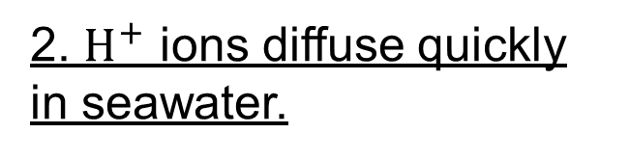


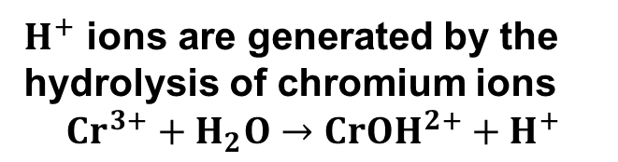
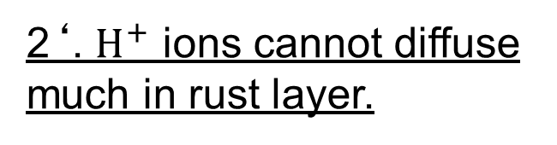
Mechanism of corrosion under rust
2. $H^{+}$ ions diffuse quickly in seawater.
2‘. $H^{+}$ ions cannot diffuse much in rust layer.
No rust
Under accumulated rust
$H^{+}$ ions are generated by the hydrolysis of chromium ions
$${Cr}^{3+}+H_{2}O→{CrOH}^{2+}+H^{+}$$
Seawater
$${\text{H}}^{+}$$
$${\text{H}}^{+}$$
Seawater
Iron rust
Loss of passive film
Passive film
Loss of passive film
Passive film
Stainless steel
Stainless steel
Notes:
In the second step, $H^{+}$ ions are generated by the hydrolysis of chromium ions described with this reaction.
In case of no rust, $H^{+}$ ions diffuse quickly in seawater.
On the other hand, in case of under rust, $H^{+}$ ions cannot diffuse much in rust layer,
and thus pH between the iron rust and stainless steel decreases,
that means the solution around this part becomes acid.

Slide 11

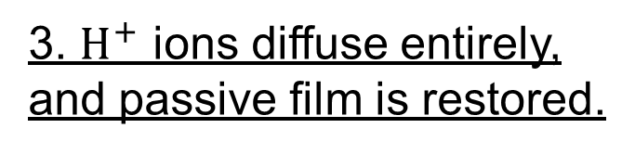
Mechanism of corrosion under rust
3. $H^{+}$ ions diffuse entirely, and passive film is restored.
3‘. Passive film is destroyed more.
No rust
Under accumulated rust
Seawater
Seawater
$${\text{Cr}}^{3+}$$
Iron rust
Passive film
Loss of passive film
Passive film
Stainless steel
Stainless steel
Notes:
In the third step
In case of no rust, $H^{+}$ ions diffuse entirely in seawater, and passive film is restored.
In case of under rust, passive film is destroyed more, which leads to more chromium ions dissolved.
This is a kind of chain reaction.

Slide 12
Mechanism of corrosion under rust
4. Stable passive film is maintained.
4‘. Pitting corrosion is initiated under rust.
No rust
Under accumulated rust
Seawater
Seawater
Iron rust
Passive film
Passive film
$${\text{H}}^{+}$$
Stainless steel
Stainless steel
Notes:
As a result, in case of no rust, stable passive film is maintained.
on the other hand, in case of under rust, pitting corrosion is initiated under rust.

Slide 13
Analysis method
Notes:
I explain our analysis method from this slide.

Slide 14
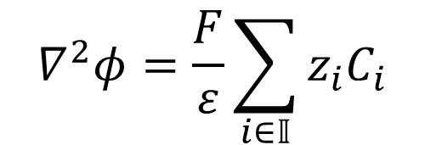
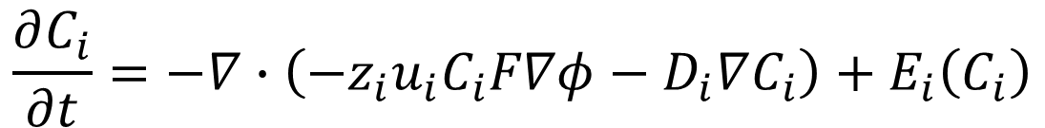
Governing equations
Φ | Electrostatic potential [V]
F | Faraday’s constant [F m⁻¹]
ε | Permittivity [(Ωm)⁻¹]
z_{i} | Charge number of ion i
C_{i} | Molar concentration of ion i [mol m⁻³]
D_{i} | Diffusion coefficient of ion i [m² s⁻¹]
u_{i} | Mobility of ion i [m² mol J⁻¹ s⁻¹]
Poisson equation of the electric field
$$∇^{2}φ=\frac{F}{ε}\sum_{i∈𝕀}{z_{i}C_{i}}$$
Mass transport equation
$$\frac{∂C_{i}}{∂t}=−∇∙\left(−z_{i}u_{i}C_{i}F∇φ−D_{i}∇C_{i}\right)+E_{i}\left(C_{i}\right)$$
electrophoresis
Mass diffusion
Chemical reaction
Solve these 2 equations with the weak-coupling method
Notes:
These two equations are the governing equations in the analysis.
Poisson equation of the electric field gives the distribution of the electrostatic potential.
Mass transport equation gives time-dependent change of the concentration of chemical species.
It consists of the electrophoresis term, the mass diffusion term, and the chemical reaction term.
In this study, we solve these two equations with the weak-coupling method.

Slide 15
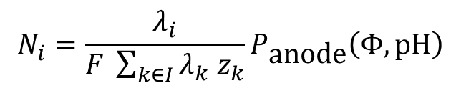


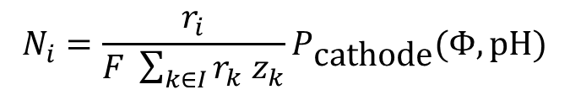
Boundary conditions
Cathodic boundary
Target
Solution
Electrostatic analysis
$$J=P_{\text{anode}}\left(Φ,\text{pH}\right)$$
Metal
$$J=P_{\text{cathode}}(Φ,pH)$$
Polarization curves represent relationship between potential and current density for each pH.
J | Current density [A m⁻²]
Φ | Electrostatic potential [V]
Ni | Ionic molar flux density vector of ion i [mol m⁻² s⁻¹]
λ_{i} | Composition ratio of metal of ion i
F | Faraday’s constant [F m⁻¹]
C_{i} | Molar concentration of ion i [mol m⁻³]
z_{i} | Charge number of ion i
r_{i} | Cathodic reaction ratio
Mass transport analysis
$$N_{i}=\frac{λ_{i}}{F \sum_{k∈I}{λ_{k} z_{k}}}P_{\text{anode}}\left(Φ,\text{pH}\right)$$
$$N_{i}=\frac{r_{i}}{F \sum_{k∈I}{r_{k} z_{k}}}P_{\text{cathode}}(Φ,pH)$$
Ionic molar flux density as a function of a polarization curve
Notes:
Boundary conditions are defined on metal and a cathodic boundary.
In the electrostatic analysis, boundary conditions are given by polarization curves.
Polarization curves represent relationship between electrostatic potential and current density for each pH.
In the mass transport analysis, boundary conditions are given by ionic molar flux density as a function of a polarization curve.

Slide 16
Numerical Analysis Method
Localized corrosion is calculated with voxel-based finite volume method (Voxel FVM).
FVM
Form metal surface and calculate surface area in cells
Corrosion rates are calculated with considering multiphysics problem.
Solve electrostatic problem
Calculate mass transports
Voxel method
Metal shape and surface area are updated.
Consider chemical reactions
Update VOF of cells
Notes:
About Numerical Analysis Method
Localized corrosion is calculated with voxel-based finite volume method also known as Voxel FVM.
In FVM, corrosion rates are calculated with considering multiphysics problem including electric field, electrophoresis, mass diffusion, and chemical reactions.
In voxel method, metal shape and surface area are updated.
This chart shows the flow of the analysis.

Slide 17
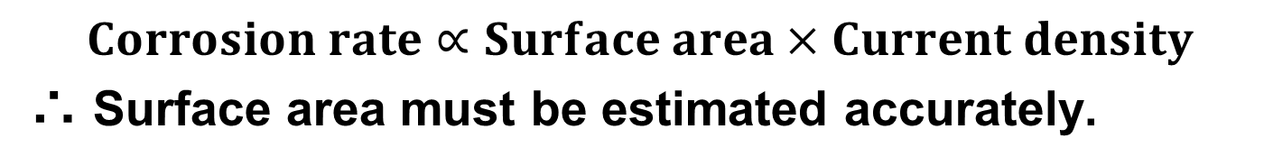
Representation of metal surface
$$Corrosion rate∝Surface area×Current density$$
∴ Surface area must be estimated accurately.
Surface area is estimated with level set method using volume of fluid (VOF) of cells.
Notes:
About representation of metal surface
A corrosion rate is proportional to the product of surface area and current density.
Therefore, surface area must be estimated accurately.
In this study, surface area is estimated with level set method using volume of fluid namely VOF of cells.
A smooth metal surface can be represented by this method.

Slide 18
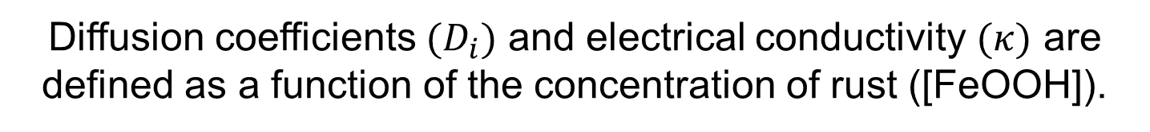
Modeling of accumulated rust
The spatial distribution of iron rust is defined as the distribution of concentration of iron rust in each cell.
Solution
Rust
Metal
Fig. The actual triangular distribution of rust
Fig. The virtual distribution of rust
represented by concentration of rust
Diffusion coefficients $(D_{i})$ and electrical conductivity $(κ)$ are defined as a function of the concentration of rust ([FeOOH]).
Notes:
About modeling of accumulated rust
The spatial distribution of iron rust is defined as the distribution of concentration of iron rust in each cell.
For example, the actual triangular distribution of rust like the left figure is represented by concentration of rust in each cell like the right figure.
Diffusion coefficients $(D_{i})$ and electrical conductivity $(κ)$ are defined as a function of the concentration of rust which is composed by FeOOH.

Slide 19
Example of analysis
Notes:
I show an example of analysis from this slide.

Slide 20
Example of analysis
The progress of corrosion simulating the actual through hole caused by localized corrosion under accumulated rust
The target is the initiation of the through hole detected in Hamaoka nuclear power station.
Iron rust
Through hole
Stainless steel
Fig. Overview of localized corrosion under accumulated rust
Through hole detected in Hamaoka nuclear power station^{[2]}
[2]Ministry of Economy, Trade and Industry: Reporting causes of corrosion holes in condensate storage tank lining and Measures to prevent recurrence in Unit 5 Chubu Electric Power Co., Inc. Hamaoka Nuclear Power Station, 2012.
Notes:
For the example of analysis, we have analyzed the progress of corrosion simulating the actual through hole caused by localized corrosion under accumulated rust.
The target is the initiation of the through hole detected in Hamaoka nuclear power station.

Slide 21


Analysis conditions
Configuration
Cathodic boundary
Rust
Plane
symmetry
1mm
Micropit
$$100 μm$$
$$100 μm$$
1mm
Analysis conditions on metal
Boundary condition : Polarization curves (SUS304)
      Composition ratio : Fe 80%, Cr 20%
      Density : 20 [kg m⁻³] (0.25% of the actual
      density to emphasize the change in shape)
Metal
Notes:
About analysis conditions
Configuration of the analysis domain is shown as this figure.
Analysis conditions on metal were defined as shown here.
Boundary conditions were given by polarization curves of SUS304.
Metal density was defined to be zero point two five percent of the actual density to emphasize the change in shape.

Slide 22


Analysis conditions
Configuration
Cathodic boundary
Rust
Plane
symmetry
1mm
Micropit
$$100 μm$$
Anodic polarization curve of stainless steel
$$100 μm$$
1mm
Metal
Cathodic polarization curves of stainless steel
Notes:
Polarization curves on metal are defined as shown these graphs.

Slide 23
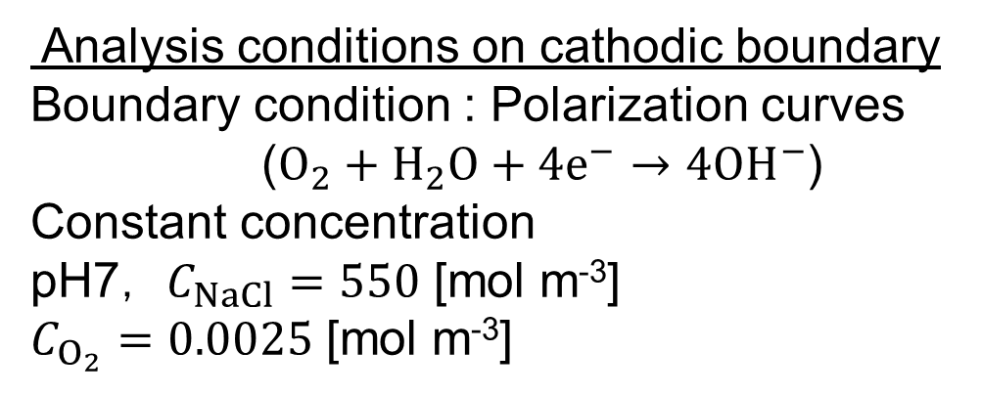
Analysis conditions
Configuration
Cathodic boundary
Rust
Plane
symmetry
1mm
Micropit
Polarization curve of cathodic boundary
$$100 μm$$
$$100 μm$$
Analysis conditions on cathodic boundary
Boundary condition : Polarization curves ($O_{2}+H_{2}O+4e^{−}→4{OH}^{−}$)
Constant concentration
pH7， $C_{NaCl}=550$ [mol m⁻³]
$C_{O_{2}}=0.0025$ [mol m⁻³]
1mm
Metal
Polarization curve including the effect of all cathode in the tank was draw and used.
Notes:
Analysis conditions on cathodic boundary were defined as shown here.
Polarization curve corresponding to actual cathodes is given for boundary conditions.
Polarization curve including the effect of all cathode was draw and used.
mole per cubic meter

Slide 24
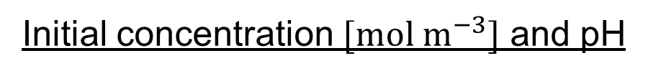
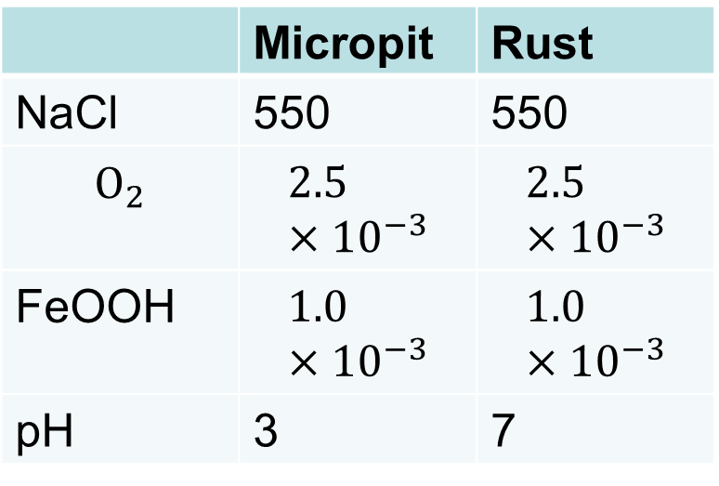
Analysis conditions
Configuration
As the initial condition,
we set the micropit of pH 3 in the cell of the lower left corner in the solution.
Cathodic boundary
Rust
Plane
symmetry
1mm
Micropit
$$100 μm$$
Initial concentration $[mol m^{−3}]$ and pH
$$100 μm$$
 | Micropit | Rust
NaCl | 550 | 550
$$O_{2}$$ | $$2.5×{10}^{−3}$$ | $$2.5×{10}^{−3}$$
FeOOH | $$1.0×{10}^{−3}$$ | $$1.0×{10}^{−3}$$
pH | 3 | 7
1mm
Metal
Notes:
Initial concentration and pH were defined as shown in this table.
As the initial condition, we set the micropit of pH 3 in the cell of the lower left corner in the solution.

Slide 25
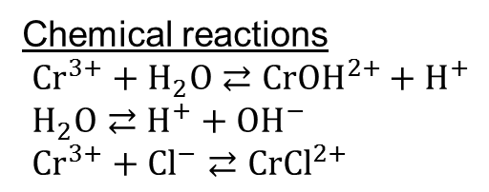
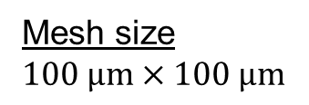
Analysis conditions
Configuration
Cathodic boundary
Time step
1 ×10⁻² s
Rust
Plane
symmetry
Mesh size
$$100 μm×100 μm$$
1mm
Micropit
$$100 μm$$
$$100 μm$$
Chemical reactions
${Cr}^{3+}+H_{2}O⇄{CrOH}^{2+}+H^{+}$
$H_{2}O⇄H^{+}+{OH}^{−}$
${Cr}^{3+}+{Cl}^{−}⇄{CrCl}^{2+}$
1mm
Metal
Chemical species
Cr³⁺ Fe²⁺ H⁺ OH⁻ FeOOH O2 Cl⁻ Na⁺ CrOH²⁺ CrCl²⁺
Notes:
Time step and mesh size were defined as shown.
In the solution, there are these chemical species, and these chemical reactions occur.

Slide 26
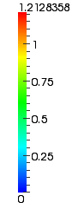
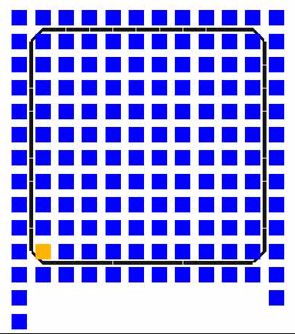
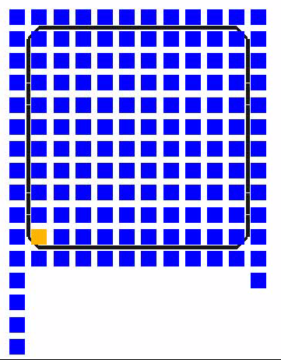
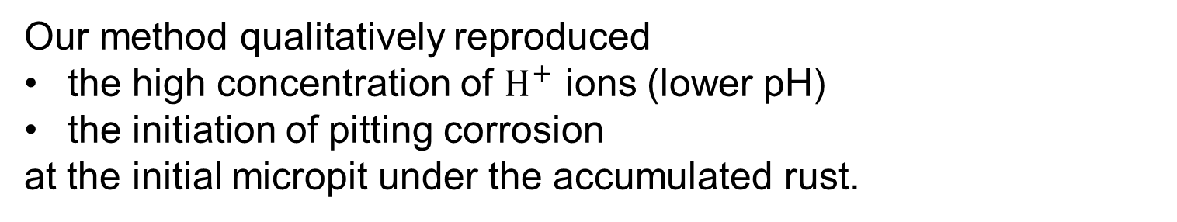
Analysis results
Concentration of H+ ions
No rust
Under rust
Our method qualitatively reproduced
the high concentration of $H^{+}$ ions (lower pH)
the initiation of pitting corrosion
at the initial micropit under the accumulated rust.
Notes:
About analysis results
These lower lines are the metal surfaces.
This color legend represents concentration of H+ ions.
In case of no rust, H+ ions on the micropit diffused quickly, and so, localized corrosion didn't occur.
In case of under rust, corrosion progressed, and concentration of H+ ions around the micropit increased.
As a result, Our method qualitatively reproduced
the high concentration of H+ ions, which means lower pH
and the initiation of pitting corrosion
at the initial micropit under the accumulated rust.

Slide 27
Summary
A numerical method for analyzing time-dependent localized corrosion under accumulated rust was developed.
It considers the multiphysics problem including electrostatics, electrophoresis, mass diffusion, chemical reactions, and moving boundaries.
The effect of accumulated rust was modeled as diffusion inhibition of chemical species.
An example of analysis showed that our method qualitatively reproduced the initiation of pitting corrosion under the accumulated rust.
Notes:
This is the summary.
Thank you for your attention, and I’d be happy to take your questions.

