Slide 1
Locking-Free
Smoothed Finite Element Method with Tetrahedral/Triangular Mesh Rezoning in Severely Large Deformation Problems
Yuki ONISHI, Kenji AMAYA
Tokyo Institute of Technology (Japan)

Slide 2
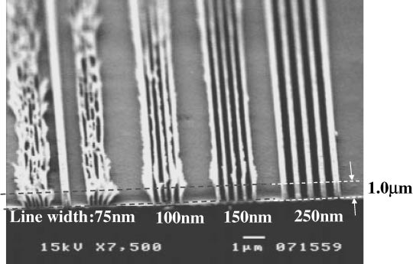
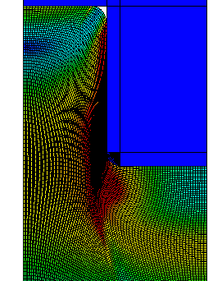
Motivation and Background
Motivation
  We want to solve severely large
  deformation problems
  accurately and stably!
  (Target: automobile tire, thermal nanoimprint, etc.)
Background
  Finite elements are distorted
  in a short time, thereby resulting
  in convergence failure.
Mesh rezoning method (h-adaptive
mesh-to-mesh solution mapping)
is indispensable.
Mold
Polymer

Slide 3
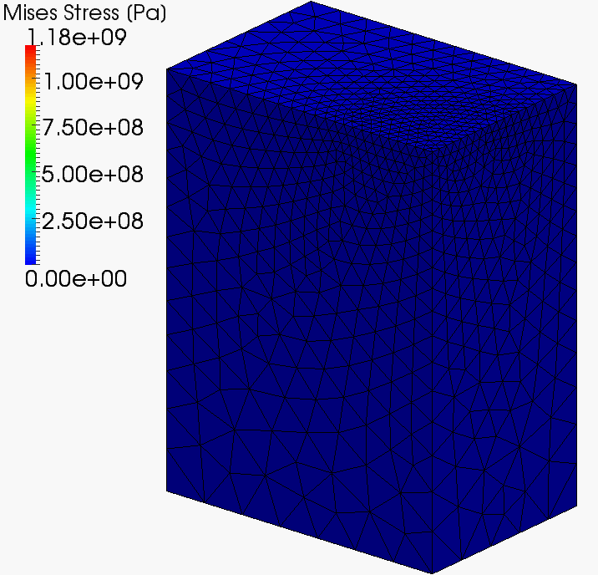
Our First Result in Advance
static-implicit
large deformation
analysis
with
mesh rezoning

Slide 4

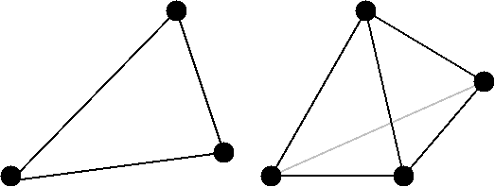
Issues
The biggest issue
in large deformation mesh rezoning
It is impossible to remesh arbitrary deformed 2D or 3D domains with quadrilateral or hexahedral elements.
However, the standard (constant strain) triangular or tetrahedral elements induce shear and volumetric locking easily, which leads to inaccurate results.
NO
YES
We have to use triangular or tetrahedral elements...

Slide 5
Conventional Methods
Higher order elements:
✗ Not volumetric-locking-free; Not effective
in large deformation due to intermediate nodes.
EAS elements:
✗ Unstable.
B-bar, F-bar and selective integration elements:
✗ Not applicable to triangular/tetrahedral.
F-bar patch elements:
✗ Difficult to construct patches
u/p hybrid elements
✗ No sufficient formulation for triangular/tetrahedral is
presented so far. (There are almost acceptable hybrid
elements such as C3D4H of ABAQUS.)
Selective smoothed finite elements:
? Unknown potential. Let’s try!

Slide 6
Objective
Develop a locking-free
modified selective S-FEM
for large deformation problems
with mesh rezoning
Table of Body Contents
- Part 1: Introduction of our modified selective S-FEM
without mesh rezoning
- Part 2: Introduction of our modified selective S-FEM
with mesh rezoning
- Summary

Slide 7
Part 1:
Introduction of Our Modified selective S-FEM
without Mesh Rezoning

Slide 8
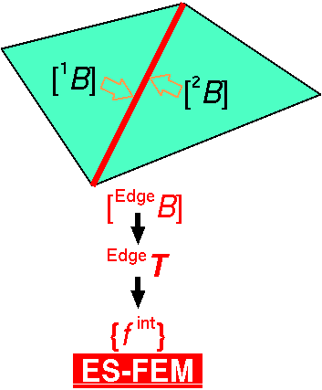

Review of Edge-based S-FEM (ES-FEM)
Calculate $[B]$ at element as usual.
Distribute $[B]$ to the connecting edges and make $[ ^{Edge}B]$.
F, T etc and {f ^{int}} are calculated on smoothed edge domains.
Generally accurate but induces volumetric locking.
Substituting "face" for "edge"
gives FS-FEM for 3D

Slide 9
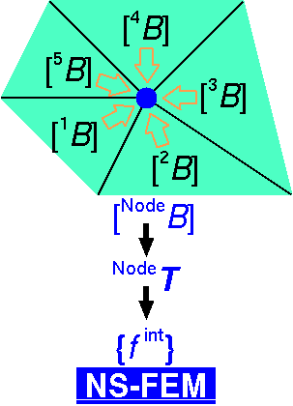

Review of Node-based S-FEM (NS-FEM)
Calculate $[B]$ at element as usual.
Distribute $[B]$ to the connecting nodes and make $[ ^{Node}B]$
F, T etc and {f ^{int}} are calculated on smoothed node domains.
Generally not accurate but volumetric locking free.
(due to zero-energy modes,
which are arisen in
reduced integration
finite elements as
hour-glass modes)
close to FVM with
vertex-based control volume

Slide 10
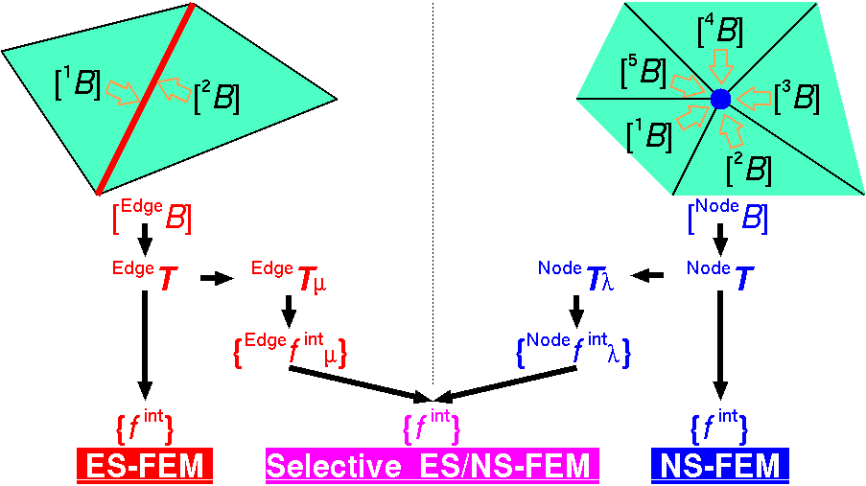

Review of Selective ES/NS-FEM
Separate stress into "$μ$ part" and "$λ$ part", where $μ$ and $λ$ are the Lame's parameters.
F, T etc and {f ^{int}} are calculated on both smoothed domains.
Only applicable to elastic constitutive models.
Substituting
"face"
for
"edge"
gives
FS/NS-FEM
for 3D

Slide 11


Our Modified Selective ES/NS-FEM
Separate stress into "deviatoric part" and "hydrostatic part"
instead of "$μ$ part" and "$λ$ part".
F, T etc and {f ^{int}} are calculated on both smoothed domains.
Applicable to any kind of material constitutive models.
Substituting
"face"
for
"edge"
gives
FS/NS-FEM
for 3D

Slide 12
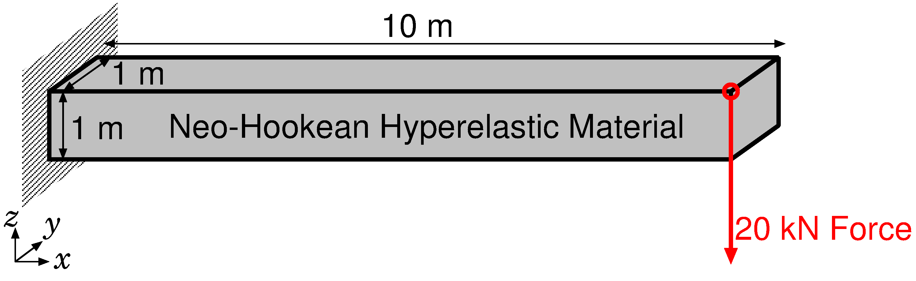
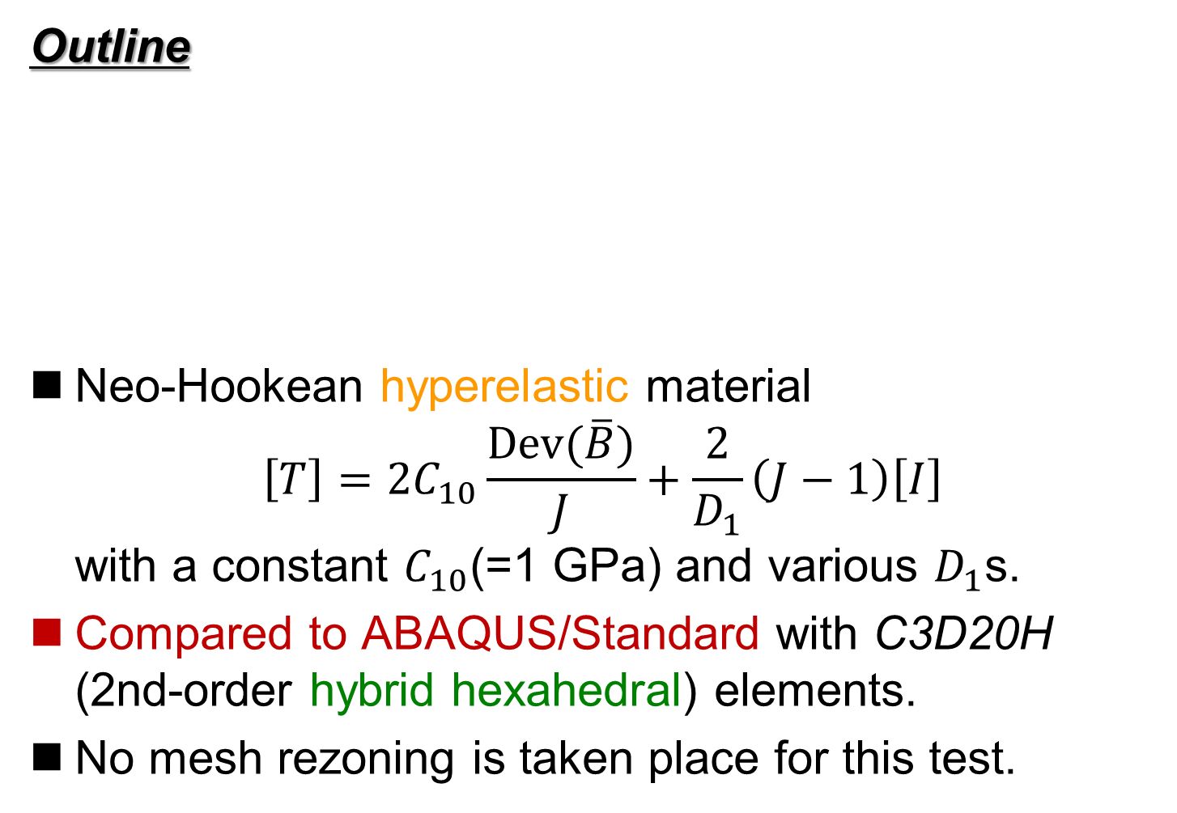
Bending of Cantilever
Outline
Neo-Hookean hyperelastic material
$\left[T\right]=2C_{10}\frac{Dev(\overline{B})}{J}+\frac{2}{D_{1}}\left(J−1\right)\left[I\right]$
with a constant $C_{10}$(=1 GPa) and various $D_{1}$s.
Compared to ABAQUS/Standard with C3D20H (2nd-order hybrid hexahedral) elements.
No mesh rezoning is taken place for this test.

Slide 13
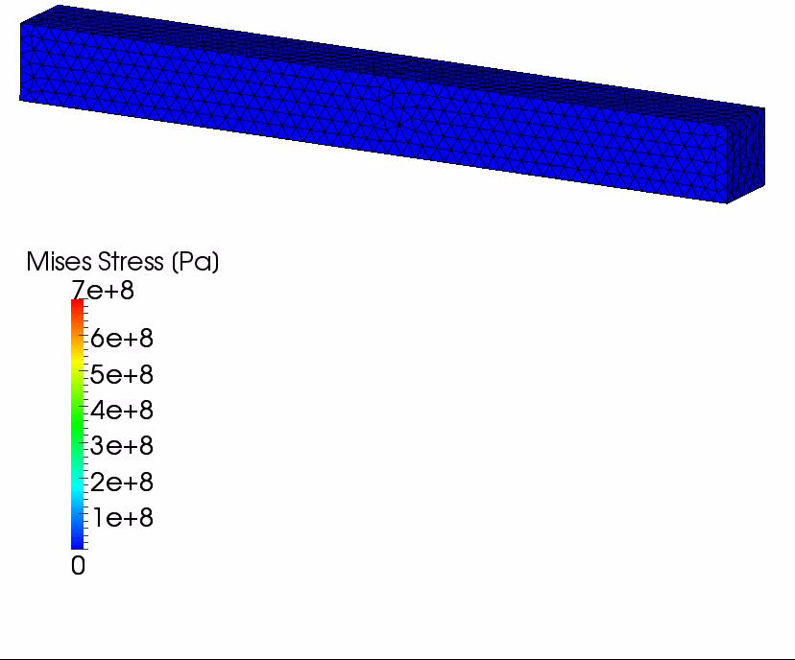

Verification of Our Selective S-FEM
Results with $D_{1}=2×10^{−15} [Pa^{−1}]$ ($ν_{ini}$=0.499999)
The amount of
vertical deflection
is about
6.5 m.
If we use
constant strain
tetrahedral,
the amount of
vertical deflection
is about only
0.1 m.

Slide 14
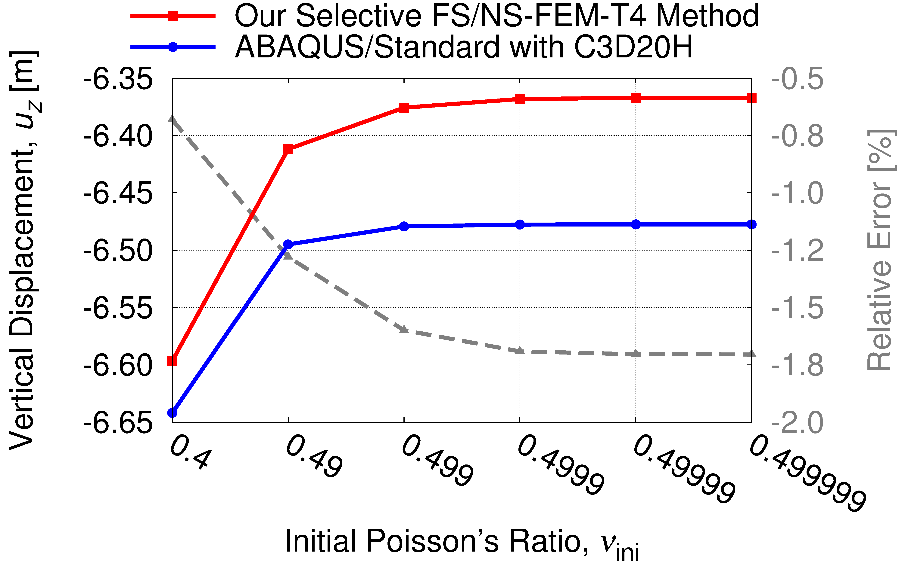
Verification of Our Selective S-FEM
Comparison to 2nd-order Hybrid Hex Element
Our selective S-FEM is free from shear locking!!

Slide 15
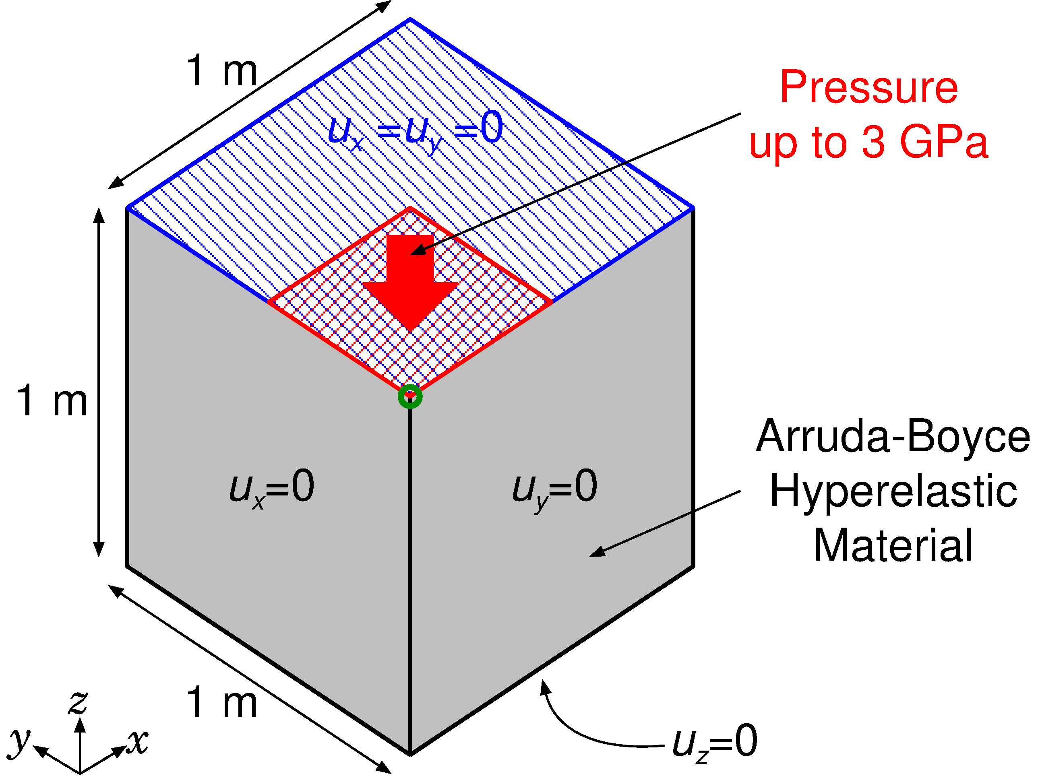

Partial Compression of Block
Outline
Arruda-Boyce Hyper elastic Material with $ν_{ini}=0.4999$
Applying pressure on ¼ of the top face

Slide 16
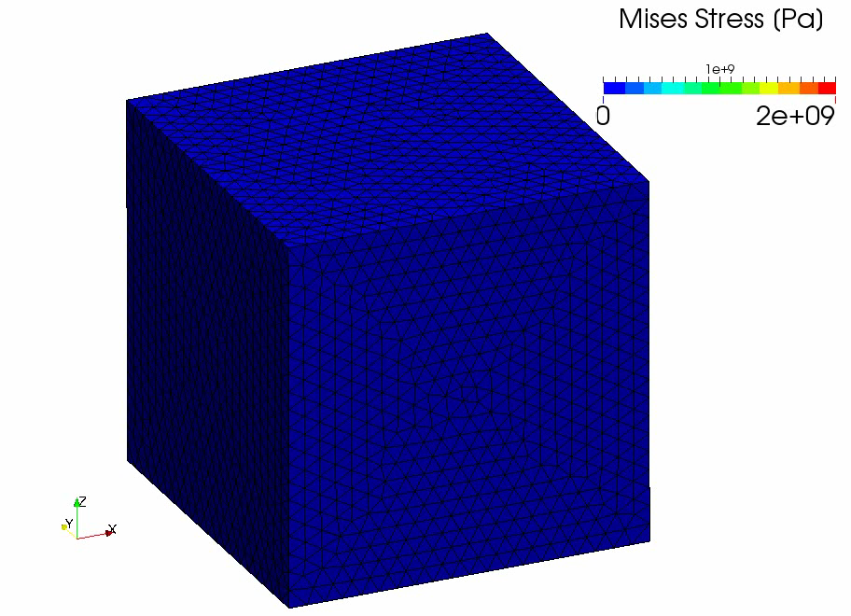
Partial Compression of Block
Result
of
our
method

Slide 17
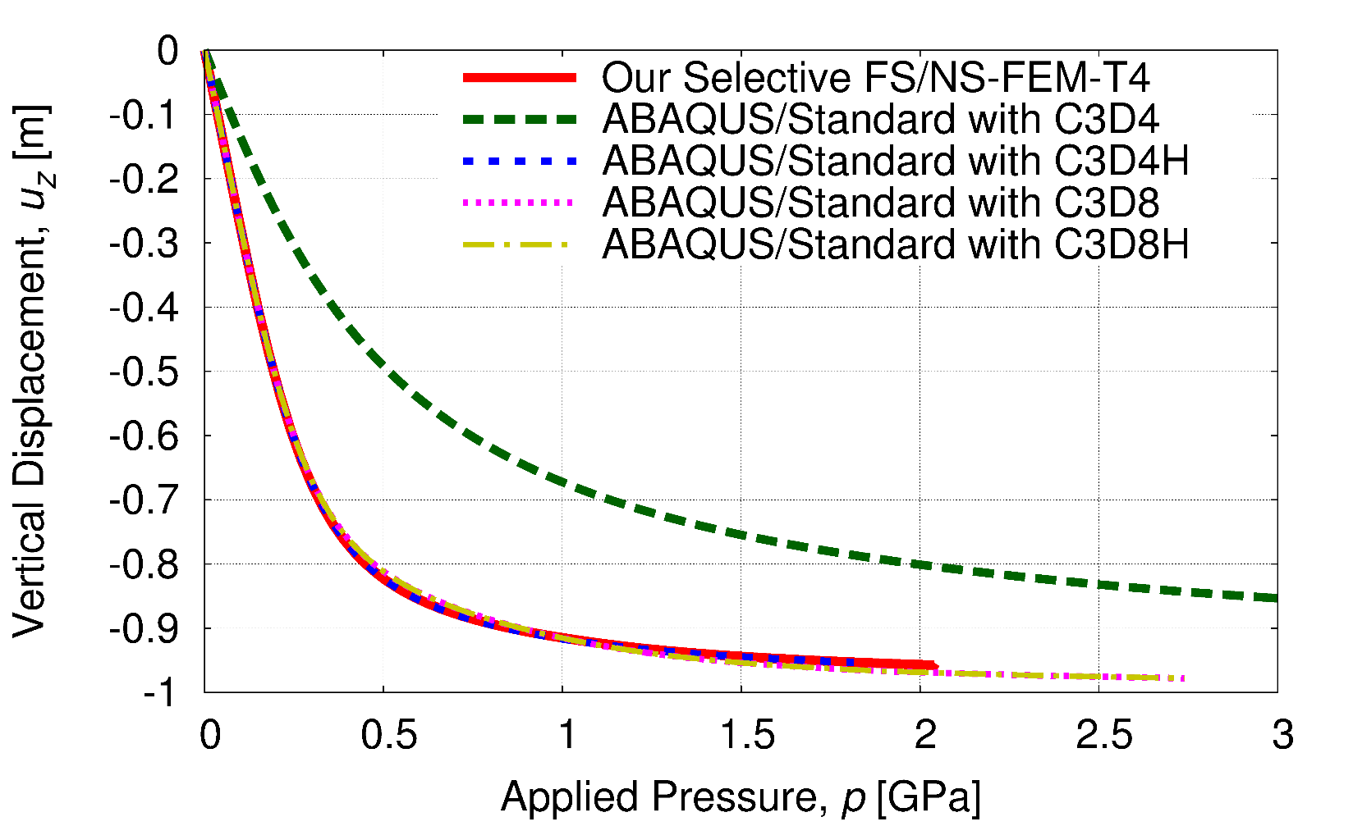
Partial Compression of Block
Vertical Displacements vs. Applied Pressure
Constant strain element (C3D4) locks quickly.
Other elements including our method do not lock.
Result of our method is almost identical to that of C3D4H.

Slide 18
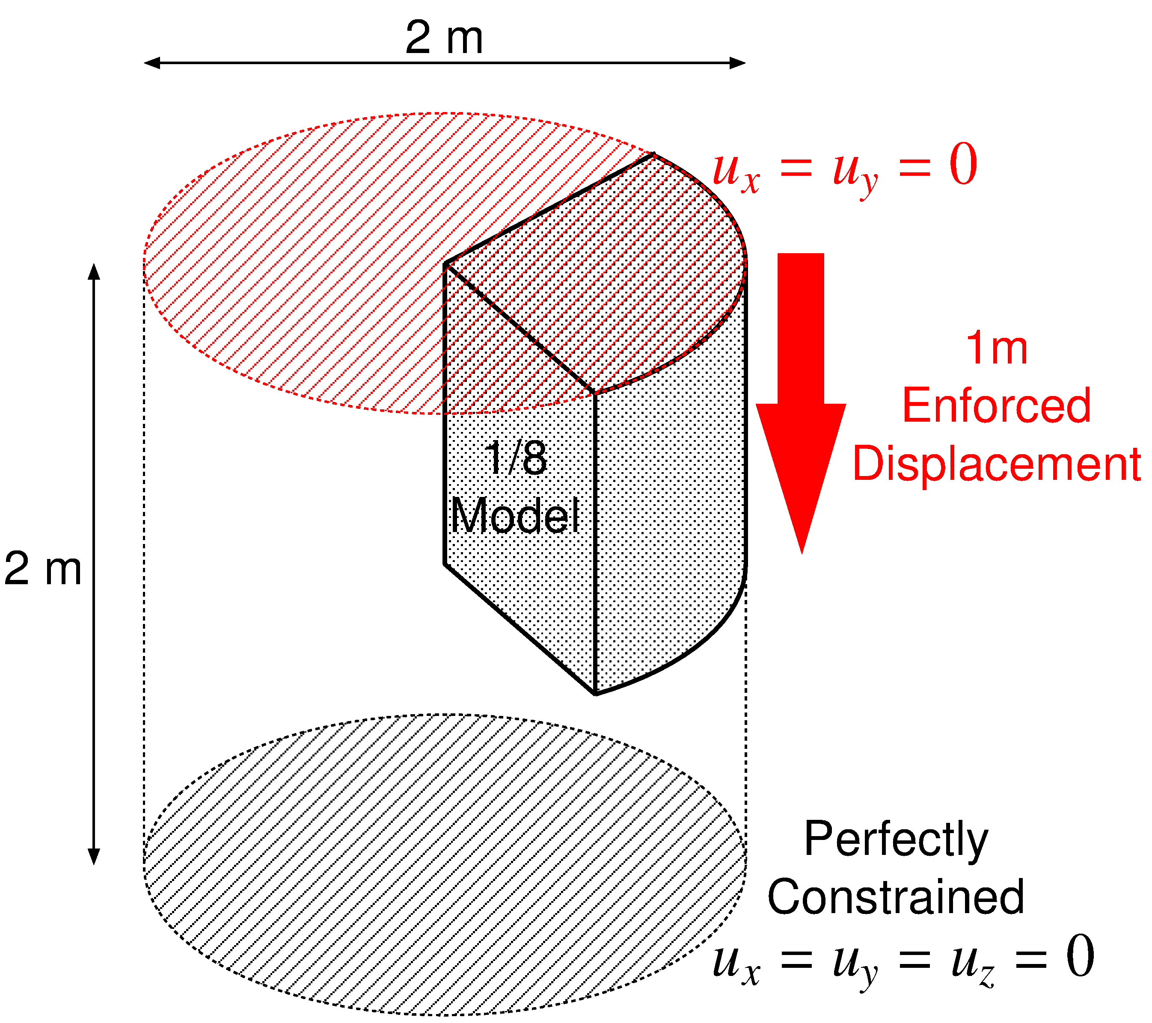

Compression of 1/8 Cylinder
Outline
50% axial compression.
Neo Hookean hyper elastic material of $C_{10}=40×{10}^{6} Pa, D=5×{10}^{−12} Pa^{−1}$ (i.e., $ν_{ini}=0.4999$).
Compared to C3D4H element of ABAQUS/Standard with exactly same mesh.

Slide 19
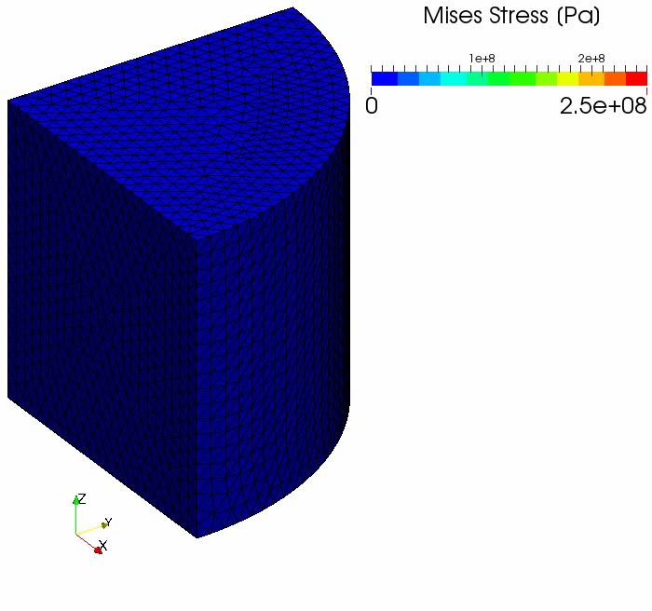
Compression of 1/8 Cylinder
Result
of
our
method

Slide 20
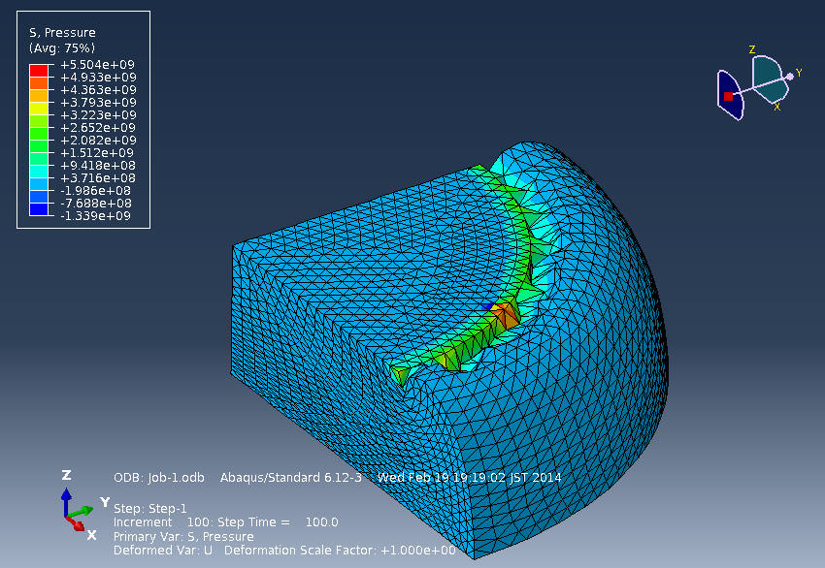
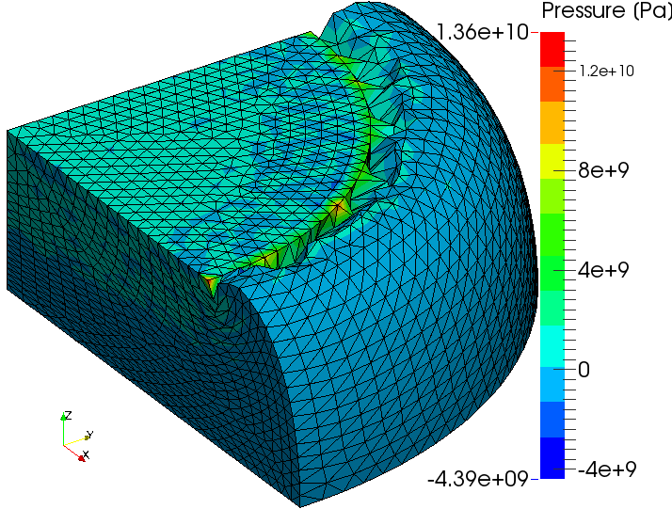
Compression of 1/8 Cylinder
Comparison to ABAQUS
Deformation is almost the same each other.
Pressure oscillation is about double in our result.
C3D4H
of ABAQUS/Standard
Our Selective
FS/NS-FEM-T4

Slide 21
Part 2:
Introduction of Our Modified selective S-FEM
with Mesh Rezoning

Slide 22
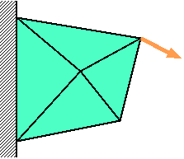
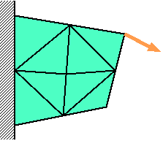
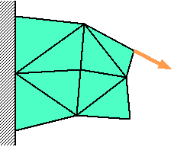



Procedure of Mesh Rezoning
Time:
t_{n-1}
Time:
t_{n}
Time:
t_{n+1}
Force
$$f^{\text{ext}}=f^{\text{int}}$$
$$f^{\text{ext}}≠f^{\text{int}}$$
$$f^{\text{ext}}=f^{\text{int}}$$
Solve
Equilibrium
Remesh
&
Map States
Resolve
Equilibrium
Solve
Equilibrium
The way of mapping varies with the material constitutive model.
(e.g. Elasto-plastic models necessitate some kind of correction.)

Slide 23
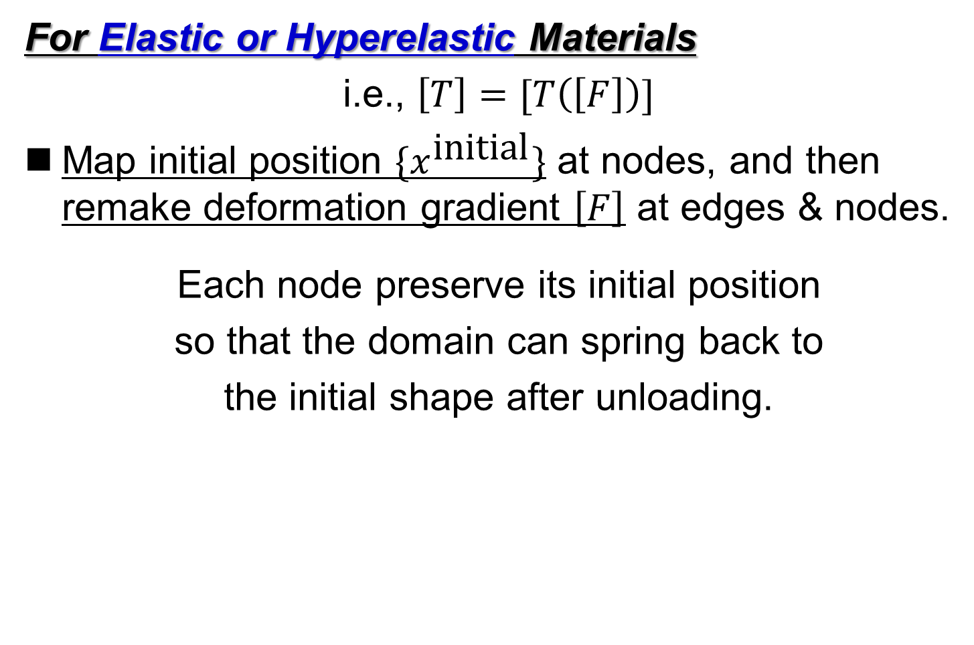
Mapping of Stress/Strain States
For Elastic or Hyperelastic Materials
i.e., $\left[T\right]=[T\left(\left[F\right]\right)]$
Map initial position $\{x^{\text{initial}}\}$ at nodes, and then remake deformation gradient $\left[F\right]$ at edges & nodes.
Each node preserve its initial position
so that the domain can spring back to
the initial shape after unloading.

Slide 24
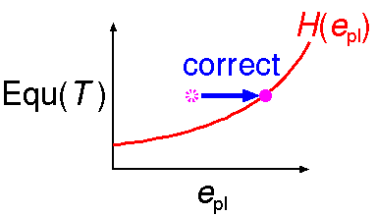
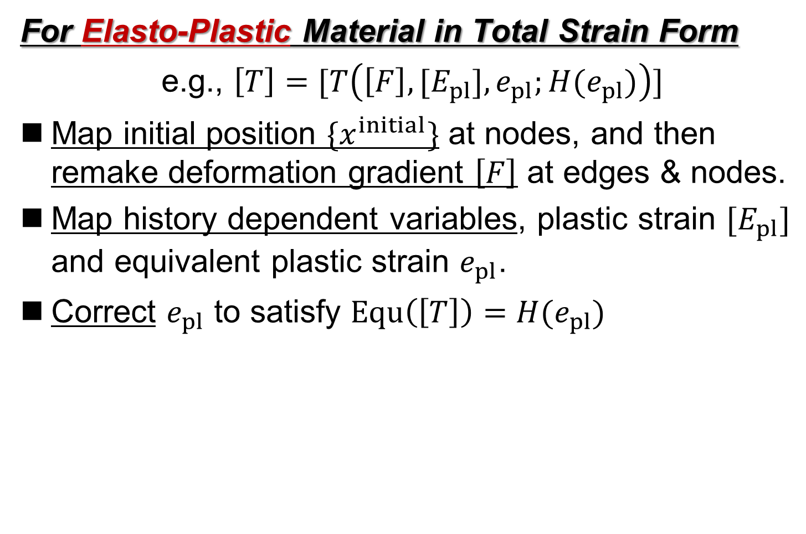
Mapping of Stress/Strain States
For Elasto-Plastic Material in Total Strain Form
e.g., $\left[T\right]=[T\left(\left[F\right],{[E}_{pl}], e_{pl};H(e_{pl})\right)]$
Map initial position $\{x^{initial}\}$ at nodes, and then
remake deformation gradient $\left[F\right]$ at edges & nodes.
Map history dependent variables, plastic strain $[E_{pl}]$ and equivalent plastic strain $e_{pl}$.
Correct $e_{pl}$ to satisfy $Equ\left(\left[T\right]\right)=H(e_{pl})$
= Mises Stress

Slide 25
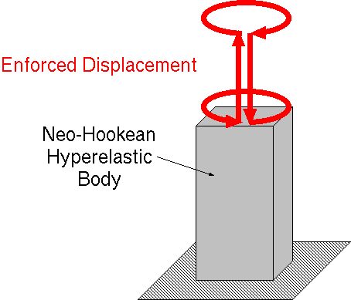
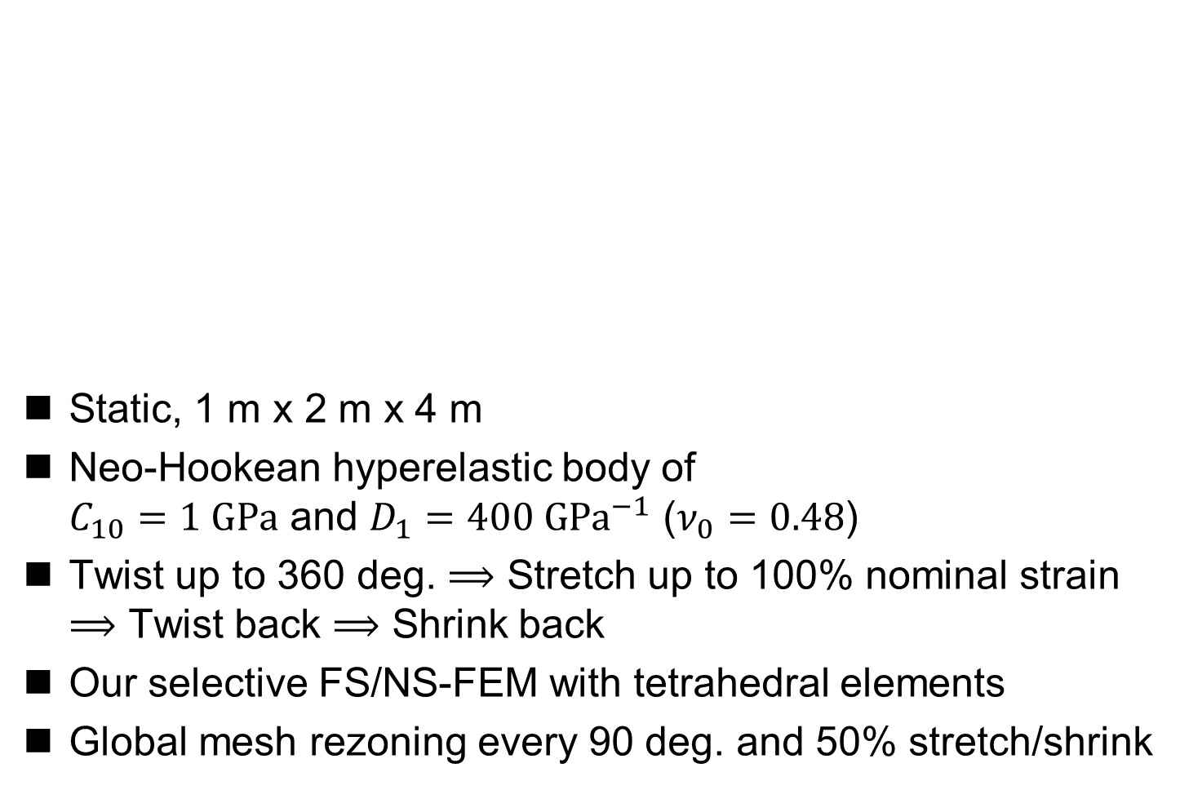
Twist and Stretch of Hyperelastic Body
Static, 1 m x 2 m x 4 m
Neo-Hookean hyperelastic body of
$C_{10}=1 GPa$ and $D_{1}=400 GPa^{−1}$ ($ν_{0}=0.48$)
Twist up to 360 deg. $⟹$ Stretch up to 100% nominal strain
$⟹$ Twist back $⟹$ Shrink back
Our selective FS/NS-FEM with tetrahedral elements
Global mesh rezoning every 90 deg. and 50% stretch/shrink

Slide 26
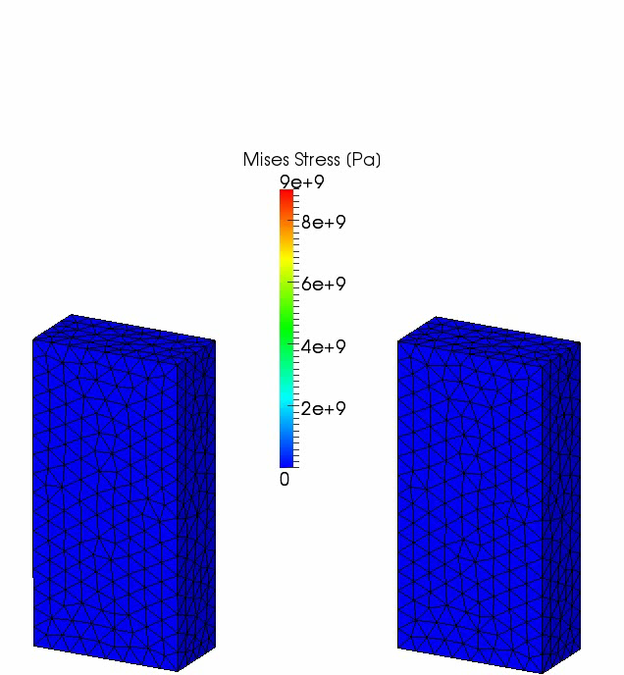
Twist and Stretch of Hyperelastic Body
Our selective
FS/NS-FEM
with
mesh rezoning
Our selective
FS/NS-FEM
without
mesh rezoning

Slide 27
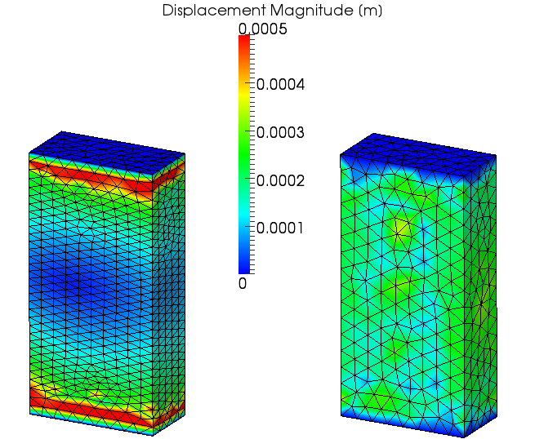
Twist and Stretch of Hyperelastic Body
Residual Displacement
It
spring
backed
almost
perfectly.

Slide 28
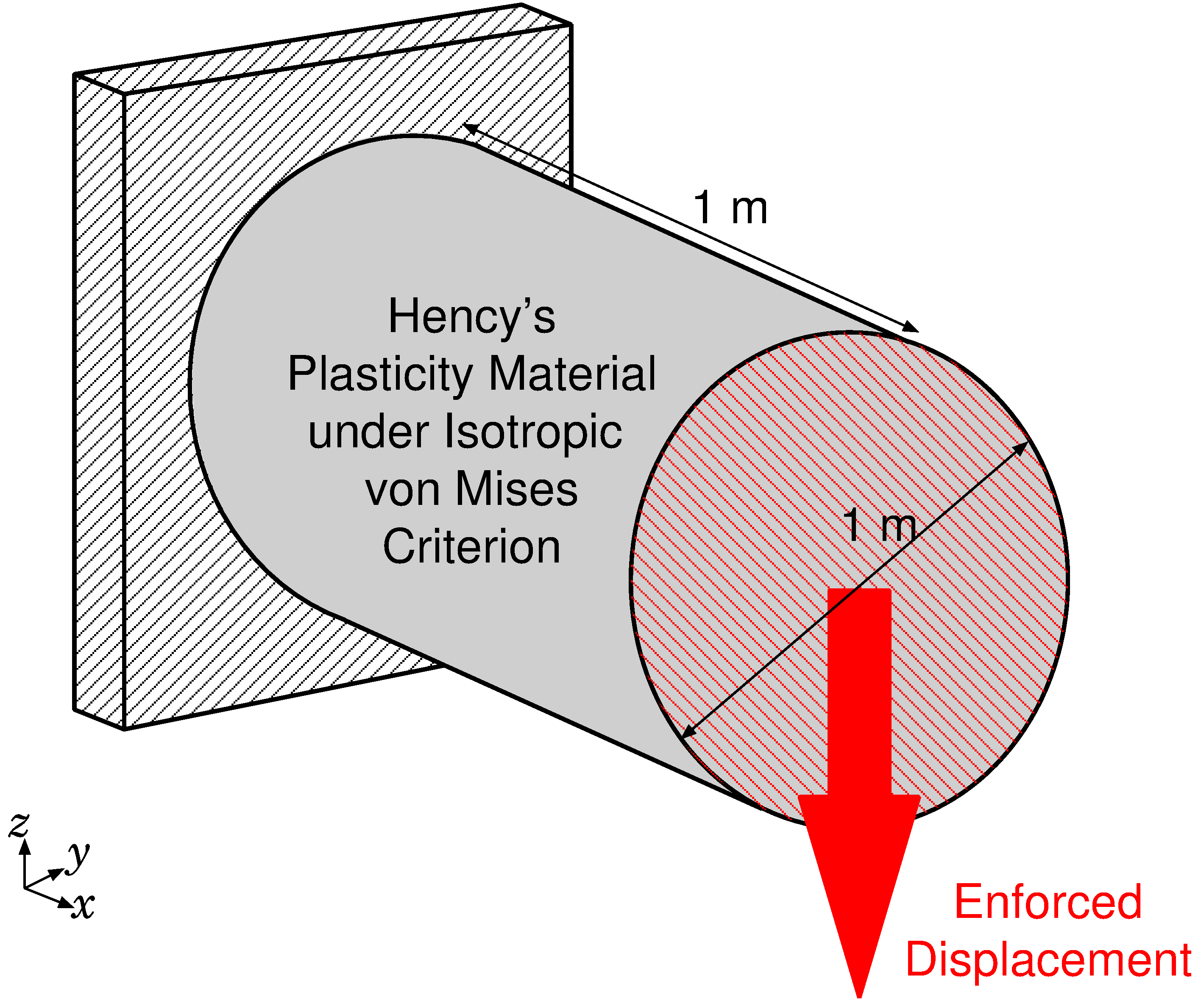
Shearing and Necking of 3D Plastic Rod
Outline
Static, 3D
Hencky’s Plasticity Material
with von Mises yield criterion and isotropic hardening.
(same as 2D case)

Slide 29
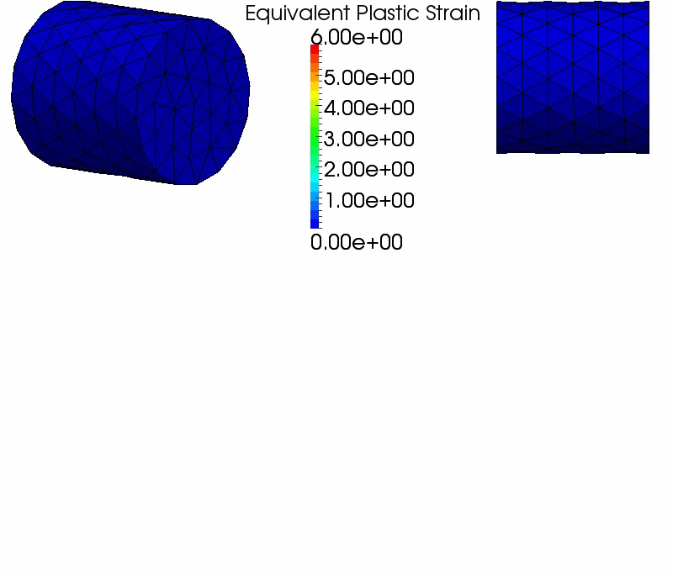
Shearing and Necking of 3D Plastic Rod
3D Result
The deformation
seems
to be valid.
After 2.8 m disp.,
mesh rezoning
error
occurred.

Slide 30
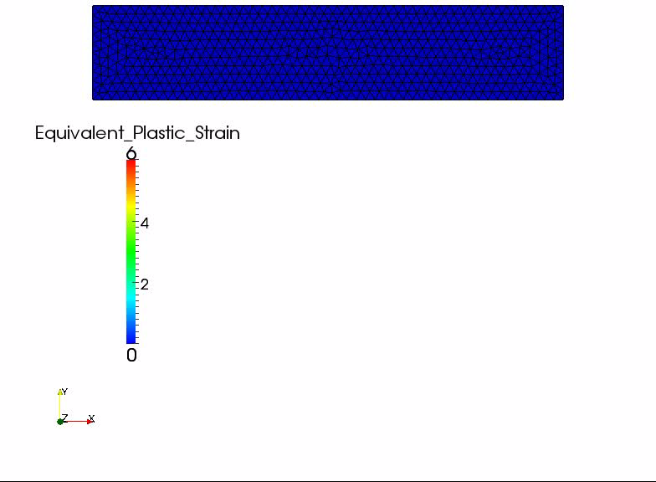
Shearing and Necking of 2D Plastic Bar
2D
Result

Slide 31
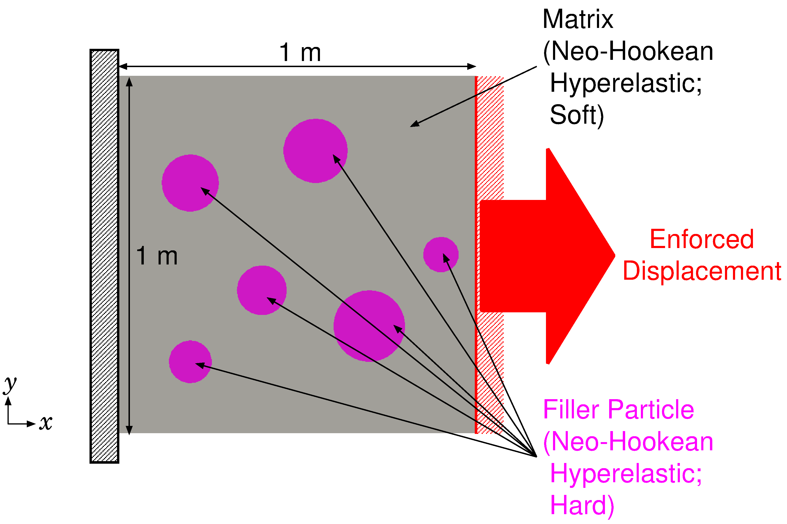

Tension of 2D Filler Particle Composite
Outline
Plane-strain static
Neo-Hookean Hyperelastic
  Filler: hard rubber（$E^{initial}=100 \text{GPa}, { ν}^{initial}=0.49$）
  Matrix: soft rubber（$E^{initial}=1 \text{GPa}, { ν}^{initial}=0.49$）

Slide 32
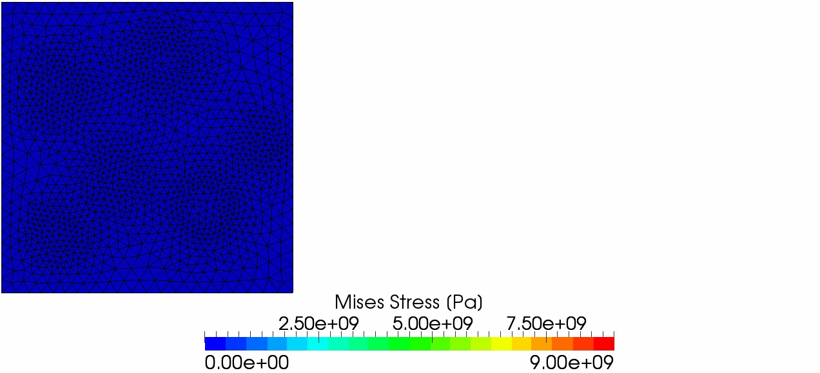
Tension of 2D Filler Particle Composite
2D Result
The deformation seems to be valid.
After 1.8 m disp.,
analysis is stopped due to mesh rezoning error.

Slide 33
Summary

Slide 34
Take-Home Messages
Our modified selective S-FEM with triangular or tetrahedral elements is locking free and very easy to implement.
The accuracy of our method is almost the same as C3D4H of ABAQUS, which is one of the current best hybrid elements.
Our S-FEM goes well together with mesh rezoning.

Slide 35
Summary and Future Work
Summary
  A new static-implicit mesh rezoning method for severely large deformation analysis is proposed.
  It adopts our modified selective S-FEM, which separates stress into deviatoric part and hydrostatic part.
  Its accuracy are verified with hyperelastic material and elasto-plastic material.
Future Work
  Explicit dynamic simulation for safety engineering
  (e.g., car crash simulation)
  Local mesh rezoning
  Apply to contact forming, crack propagation, etc.
Thank you for your kind attention.
I appreciate your question in slow and easy English!!

