Slide 1
Automotive Electrodeposition Coating Simulation using Edge-based Smoothed Finite Element Method
Yuki ONISHI (Institute of Science Tokyo)

Slide 2
Relatively Long Introduction to Electrodeposition Simulation

Slide 3
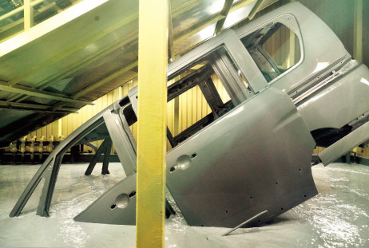
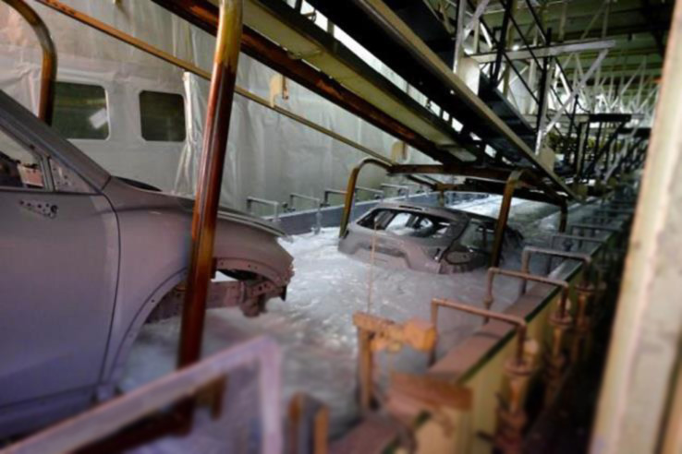


What is Electrodeposition (ED) ?
Most widely-used anti-rust base-coat methods for various metal products
including auto carbodies.
Depositing coating film by applying direct electric current in a paint pool.
In the actual car manufacturing line, the carbodies are moving in the paint pool.
Relatively good at depositing a uniform film on complex shapes such as carbody.
$$+$$
$$−$$
＋
＋
Paint
Anode
Cathode
http://n-link.nissan.co.jp/

Slide 4
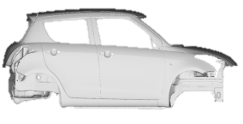
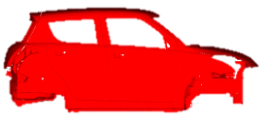
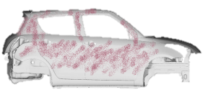
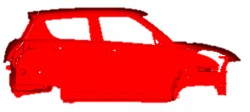

What is Electrodeposition (ED) ?
We focus on
this process.
Simplified Overview of the Entire Carbody Paint Shop
Degrease
Preparation
Electrodeposition (ED)
ED Oven
Base-coat
Intermediate
-coat
Top-coat
Intermediate Oven
Intermediate Coat
Sealing/Undercoat
Top Coat
Topcoat Oven
To Assembly Line

Slide 5

Importance of ED for safety
Quiz.)
Is this car safe
as when it was new?
No, because corrosion significantly reduces the strength and stiffness of a car.
As corrosion progresses, the initial strength and stiffness cannot be guaranteed.
Nevertheless, the safety inspections of cars (e.g., crash tests) are usually performed with new cars without corrosion……
https://wd40.pk/
$∴$ ED is quite important for ensuring the long-term safety of carbodies.

Slide 6
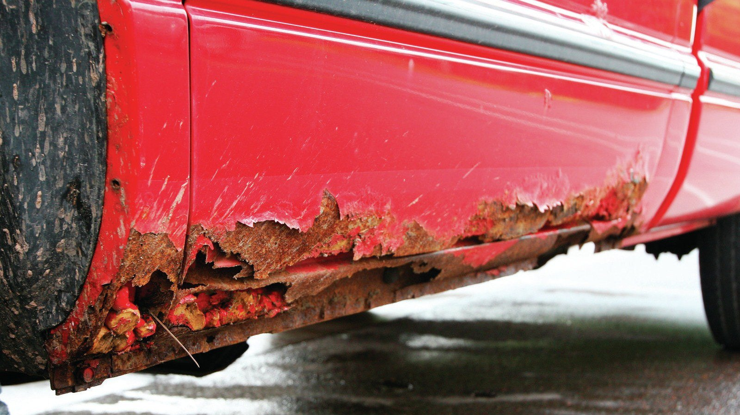
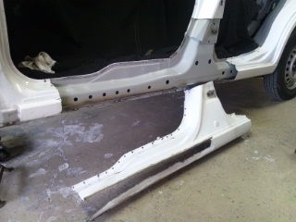
Impact of ED process on carbody design
Undercarriages are exposed to severe corrosive environments.
ED film thickness must be above minimum over the entire surface of the undercarriages.
Some undercarriage parts (e.g., side sills) have bag-like structures with multiple plates.
It is necessary to drill many ED holes to allow the electric current to pass through in the paint pool.
Side Sill
ED Hole
https://www.goauto.ca/
∴ Carbody designers should understand and consider the ED process,
including the location, size, and number of ED holes.

Slide 7
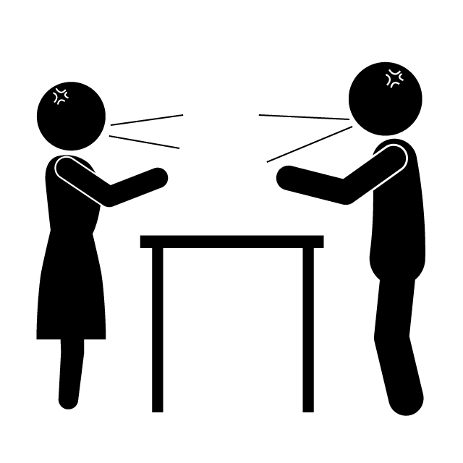
Need for ED Simulation
ED holes are essential for corrosion protection,
but they are NOT welcome for strength or stiffness.
Thus, the following conflict always occurs between carbody designers.
More
ED holes
for safety!
Fewer
ED holes
for safety!
Designer in Corrosion Section
Designer in Strength/Stiffness Section
In such a case, ED simulation can resolve the conflict
based on quantitative evidence data and lead to the optimal carbody design.

Slide 8
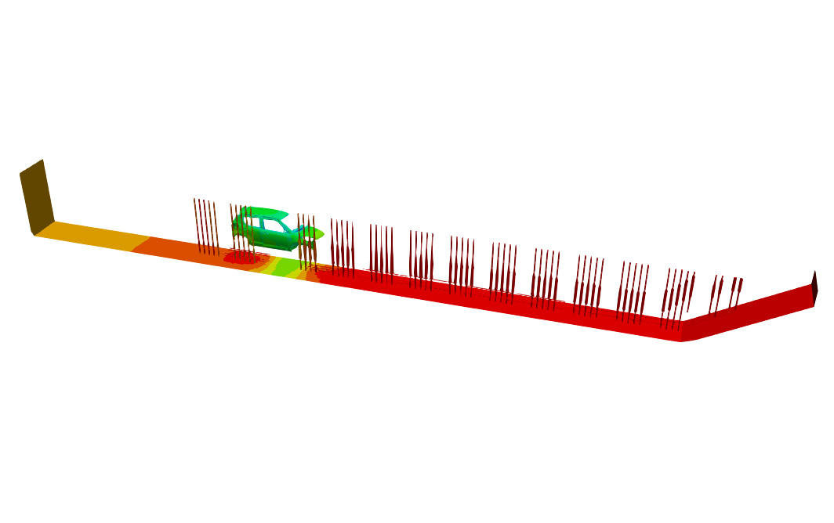
What is ED Simulation?
Actual ED Line
ED Simulation
Paint Pool
Carbodies with Motion
Electrodes (Anodes)
are reproduced in a computer.
Paint
Pool
Carbodies
w/ Motion
Electrodes
(Anodes)
Total length: about 30 m

Slide 9
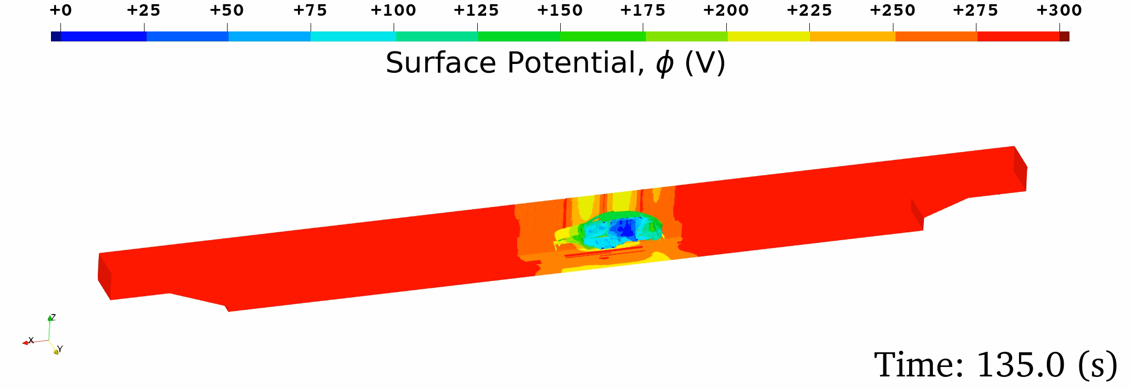
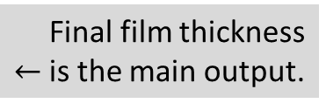


What is ED Simulation?
Governing equation:
Electrostatic Laplace equation ($∇^{2}φ=0$) in the paint pool domain.
Boundary conditions:
  Wall (insulation) BC，
  Anodic (electrode surface) BC,
  Cathodic (carbody surface) BC:
  Film initiation/growth/resistance constitutive models.
Motion: Overset mesh method
Outputs: Time-histories of
  Surface potential,
  Current density,
  Film thickness
Identified via
lab experiments.
$↓$
Final film thickness
$←$is the main output.

Slide 10
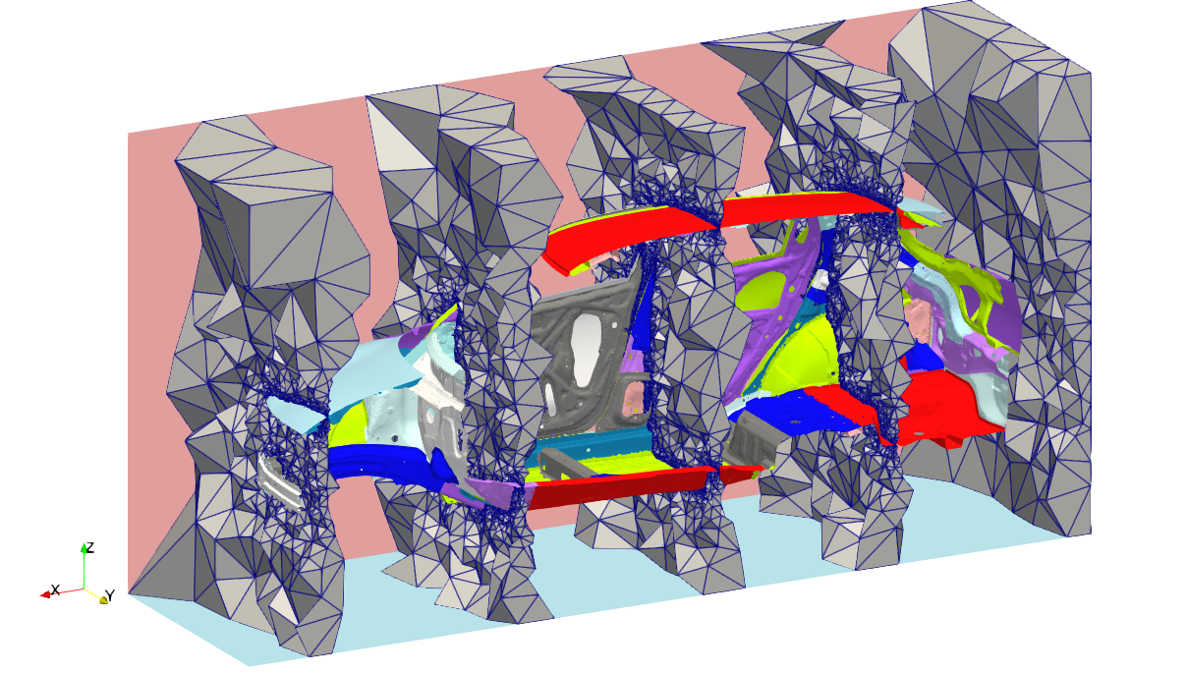
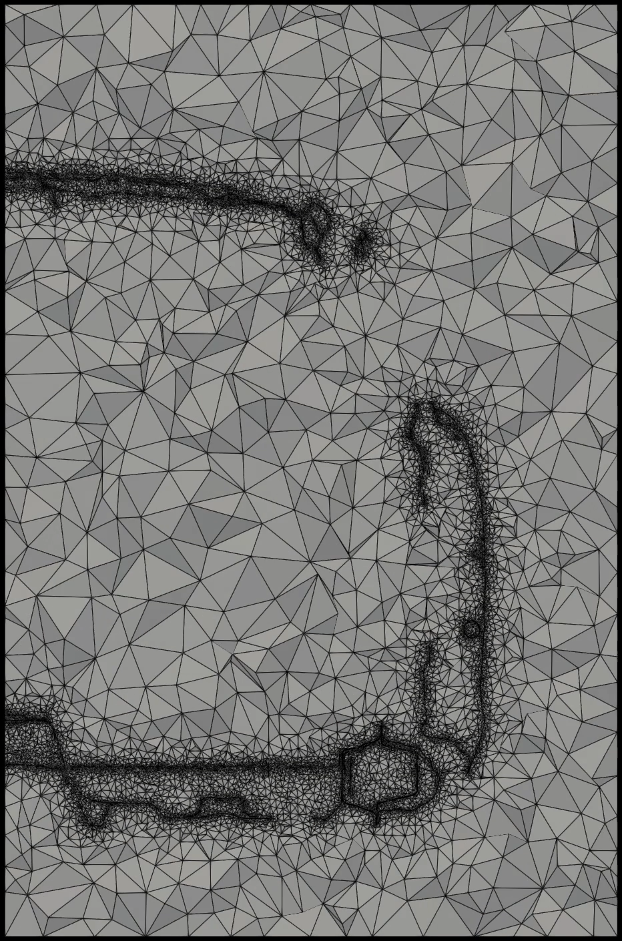
Two Issues in Meshing for ED Simulation
Issue #1: Impossible to make a good HEX mesh for carbodies.
An ED simulation requires a mesh for the space around the carbody like CFD.
In contrast to CFD, an ED mesh should include the room space and many narrow spaces among plates (such as inside of the side sill).
Animated slices
of a carbody mesh
from rear to front
5 slices of a carbody mesh

Slide 11
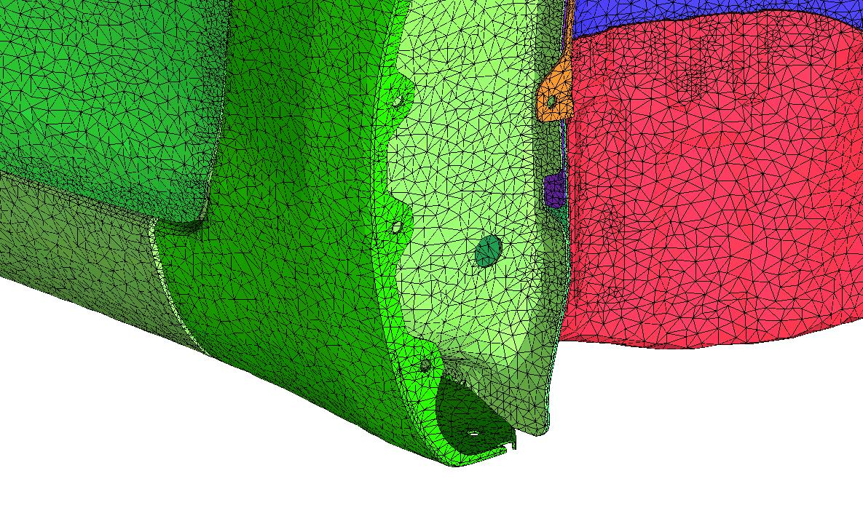
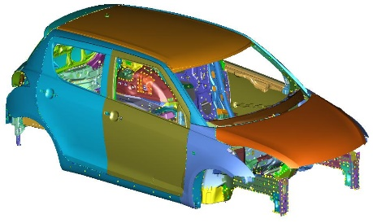
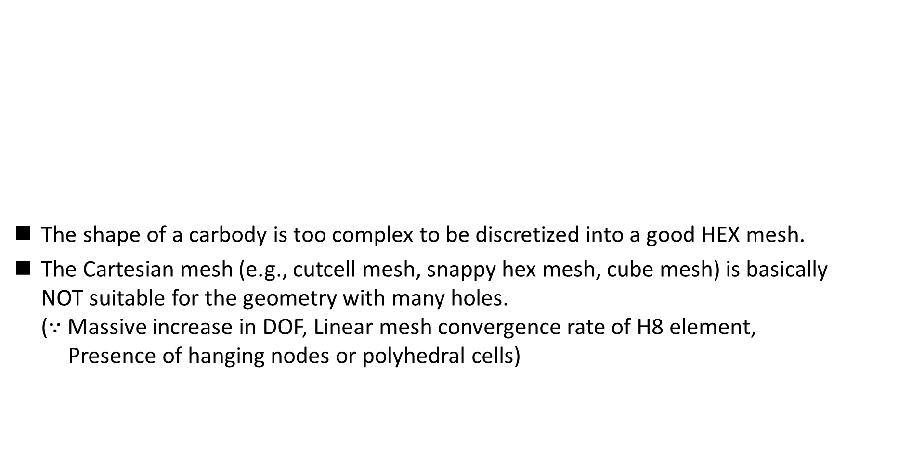
Two Issues in Meshing for ED Simulation
The shape of a carbody is too complex to be discretized into a good HEX mesh.
The Cartesian mesh (e.g., cutcell mesh, snappy hex mesh, cube mesh) is basically
NOT suitable for the geometry with many holes.
($∵$ Massive increase in DOF, Linear mesh convergence rate of H8 element,
Presence of hanging nodes or polyhedral cells)
✓
✗
Zoom-in view of a carbody surface mesh
TET meshes are preferable in ED simulation.

Slide 12
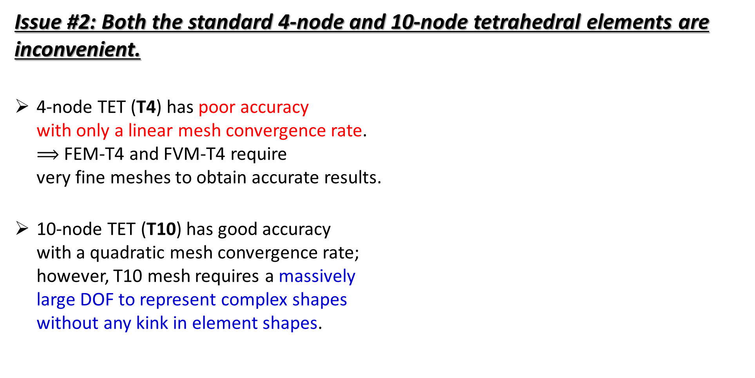
Two Issues in Meshing for ED Simulation
Issue #2: Both the standard 4-node and 10-node tetrahedral elements are inconvenient.
4-node TET (T4) has poor accuracy
with only a linear mesh convergence rate.
$⟹$ FEM-T4 and FVM-T4 require
very fine meshes to obtain accurate results.
10-node TET (T10) has good accuracy
with a quadratic mesh convergence rate;
however, T10 mesh requires a massively
large DOF to represent complex shapes
without any kink in element shapes.
T4
T10

Slide 13

Two Issues in Meshing for ED Simulation
$⟹$ If there is a small hole on a carbody plate,
the surface mesh around the hole looks like…
Plate
Plate
Plate
Hole
Hole
Hole
T4
T10
T4 mesh
T10 mesh w/o kink
T10 mesh w/ kink
✗ leads to poor mesh convergence rate
with FEM-T4.
✗ leads to a massive increase in DOF
with mid-nodes.
✗ leads to severe accuracy loss in shape function
with FEM-T10.
Both the standard T4 and T10 elements are inconvenient as a carbody mesh to achieve accurate simulation with minimal DOF.

Slide 14
Motivation
By the way, …
The smoothed finite element method (S-FEM) [detail later] has become popular in recent years as a next-generation high-performance FEM.
Especially, the edge-based S-FEM using T4 mesh (ES-FEM-T4) is known to achieve a superlinear mesh convergence rate even with T4 meshes.
Therefore, we expect that…
ES-FEM-T4 could be a solution for the meshing issues
to achieve fast and accurate ED simulation.

Slide 15
Objective
Development of ED simulator using ES-FEM-T4
for practical (fast & accurate) ED simulations.
Table of body contents:
Quick Introduction to S-FEM
Mesh Convergence Test
Validation Test
Summary

Slide 16
Quick Introduction to
Smoothed Finite Element Method (S-FEM)

Slide 17
What is S-FEM?
Smoothed finite element method (S-FEM) is a relatively new FE formulation proposed in 2006.
S-FEM is one of the gradient (strain) smoothing techniques.
Many types of S-FEMs have been developed with various smoothing schemes.
There are a few classical S-FEMs depending on the smoothing domain.
For example, in a 2D triangular mesh:
Edge-based S-FEM
(ES-FEM)
Node-based S-FEM
(NS-FEM)
Standard FEM
Each colored area shows the domain for gradient smoothing.

Slide 18





Brief of ES-FEM in Linear Elastic Analysis
Let me
explain in 2D
for simplicity
Let us consider a mesh with only two 3-node triangular cells.
Make $\left[B\right](=dN/dx)$ at each cell as usual.
At each edge, gather $[B]$s of the connecting cells and average them with area weights
to build $[ ^{Edge}B]$ .
Calculate strain $(ε)$, stress ($σ$) and nodal internal force $\{f^{int}\}$ in each edge smoothing domain with $[ ^{Edge}B]$.
$$[B_{1}]$$
As if putting
a Gauss point
at each edge center
No shear locking.
$$[B_{2}]$$
$$[^{Edge}B]$$
$↳{}^{Edge}ε,{}^{Edge}σ, \{^{Edge}f^{int}\}$ etc.

Slide 19
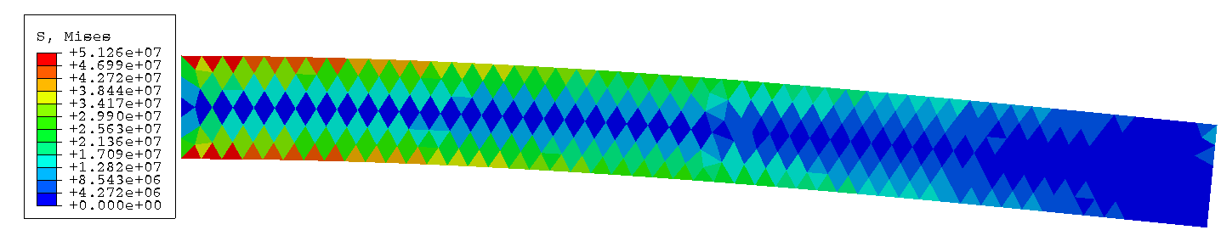
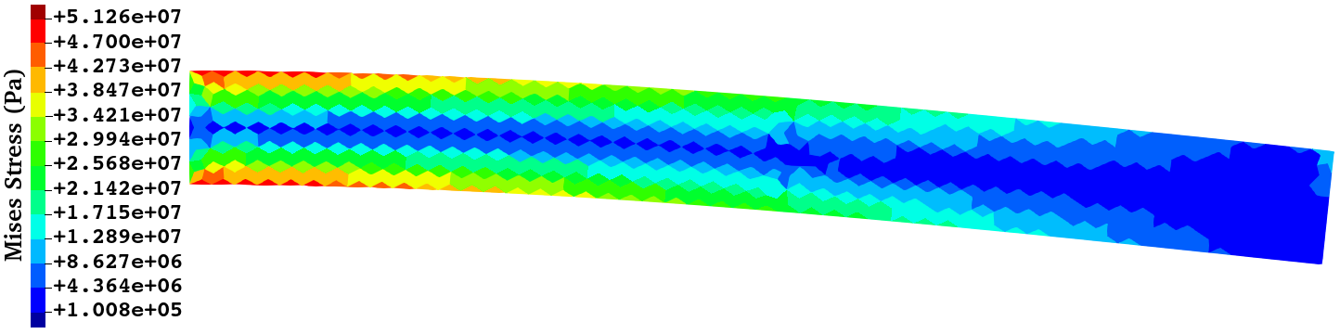
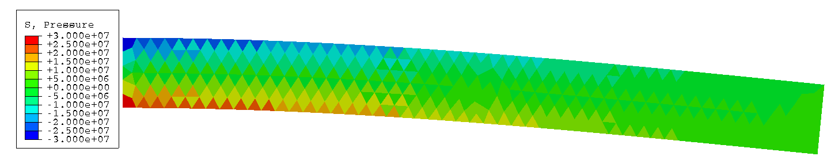
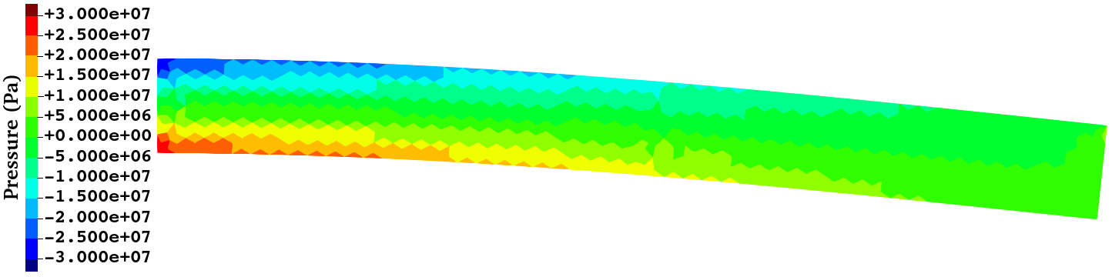

Performance of ES-FEM in Linear Elastic Analysis
Cantilever Bending Analysis with Dead Load at the Tip Size:10x1 m, $ν=0.3$
Mises stress
Pressure
ABAQUS CPE3
(Standard FEM-T3)
ES-FEM-T3
ES-FEM-T3 gives more accurate stress/strain distributions
than the standard FEM-T3 using the same mesh.

Slide 20
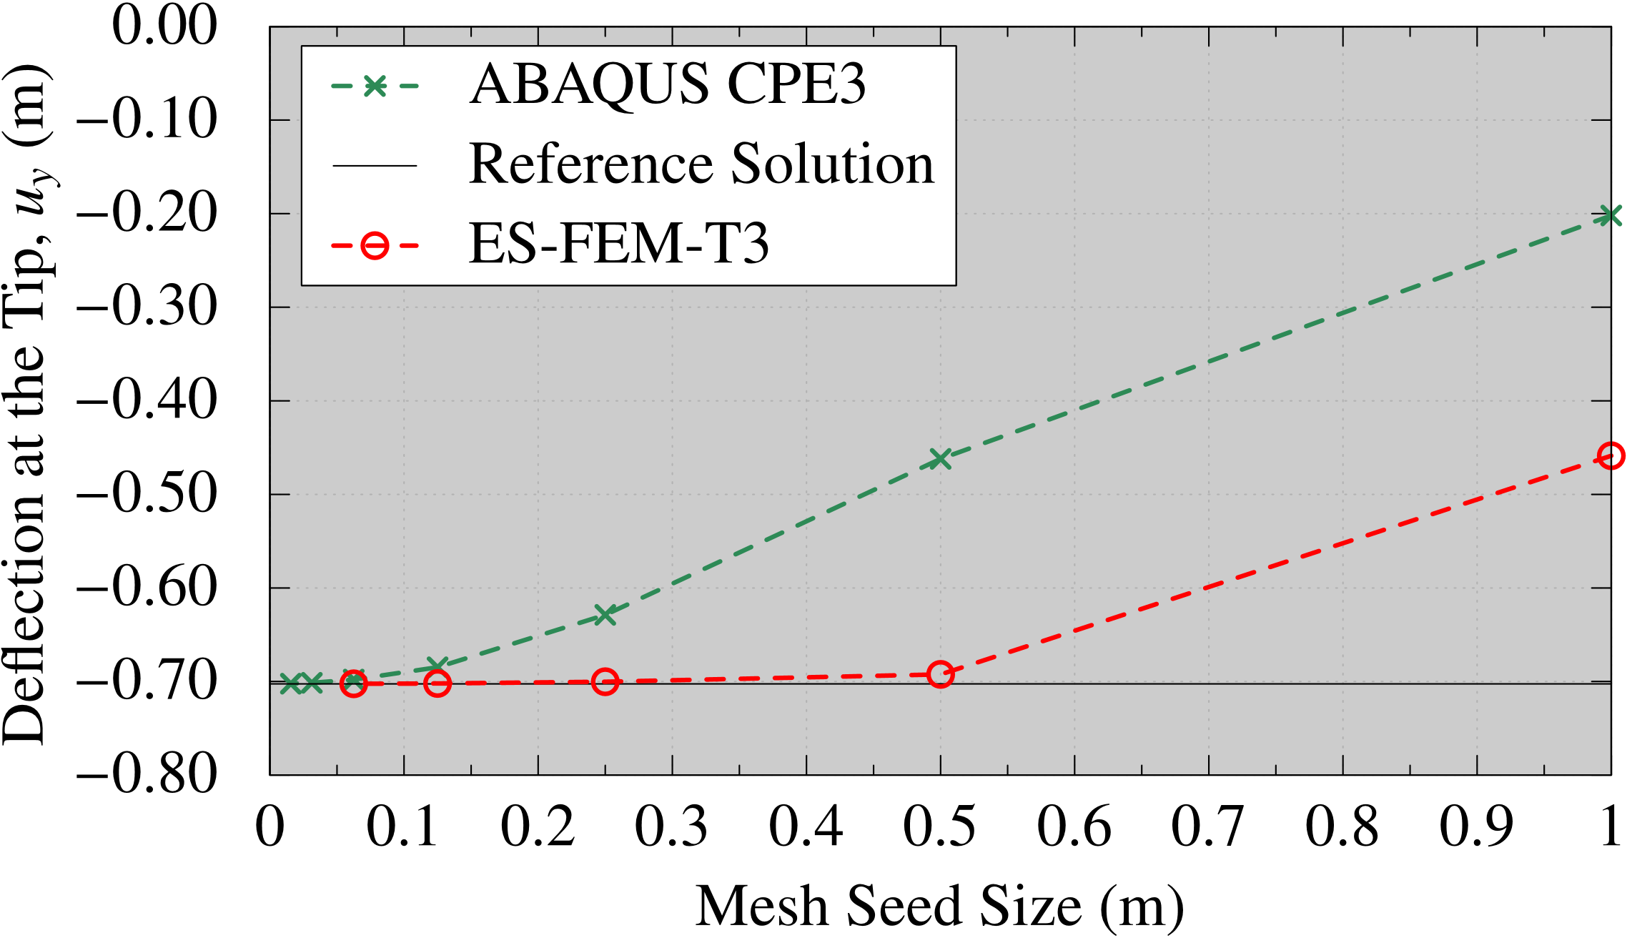
Performance of ES-FEM in Linear Elastic Analysis
Mesh Convergence in Displacement
Mesh Seed Size (m) | The Number of Triangles
1 | 22
1/2 | 84
1/4 | 342
1/8 | 1,442
1/16 | 5,766
1/32 | 23,034
1/64 | 92,146
Converged
Converged
ES-FEM-T4 should also be excellent in electrostatic (ED) simulations.
Finer
Coarser
ES-FEM-T3 is shear locking free and thus the mesh convergence rate of displacement/force is much faster than the Standard FEM-T3.

Slide 21
Mesh Convergence Test

Slide 22
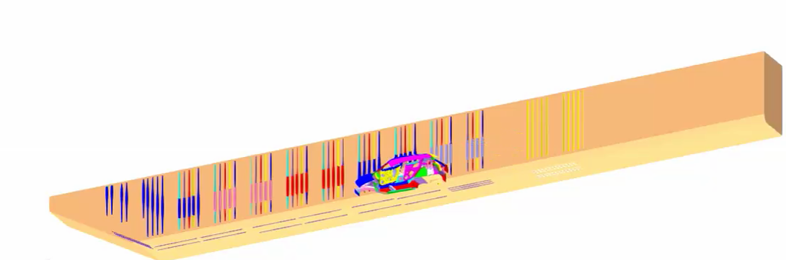

Mesh Convergence Test
Outline
Our ED simulator, which uses FEM-T3,
has been rewritten to use ES-FEM-T4.
Half-body analysis (only right-hand side).
The entire line shape, carbody motion, and electrode conditions are reproduced.
About 1000 timesteps for 300 s (i.e., average $Δt=0.3$ s).
The film thickness distribution is evaluated with 3 different density meshes
using FEM-T4 and ES-FEM-T4.

Slide 23
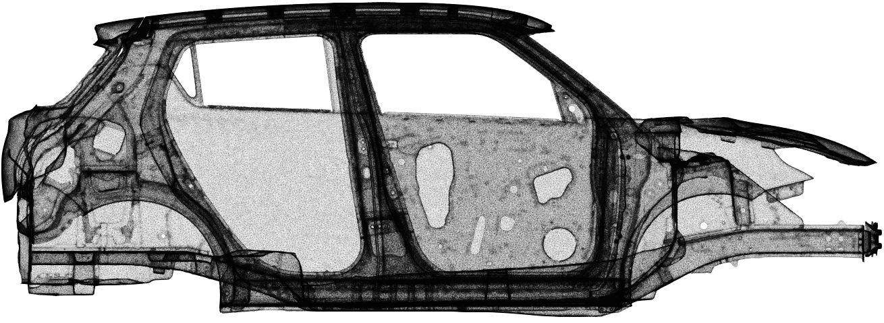
Mesh Convergence Test
Overview of Surface Mesh of 10M Element Mesh
There are many ED holes around narrow spaces among plates.
Only the surface
mesh is shown.

Slide 24
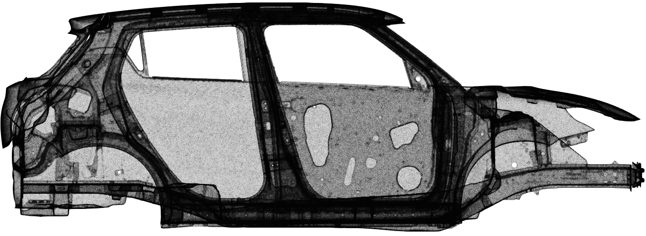
Mesh Convergence Test
Overview of Surface Mesh of 16M Element Mesh
There are many ED holes around narrow spaces among plates.
Only the surface
mesh is shown.

Slide 25
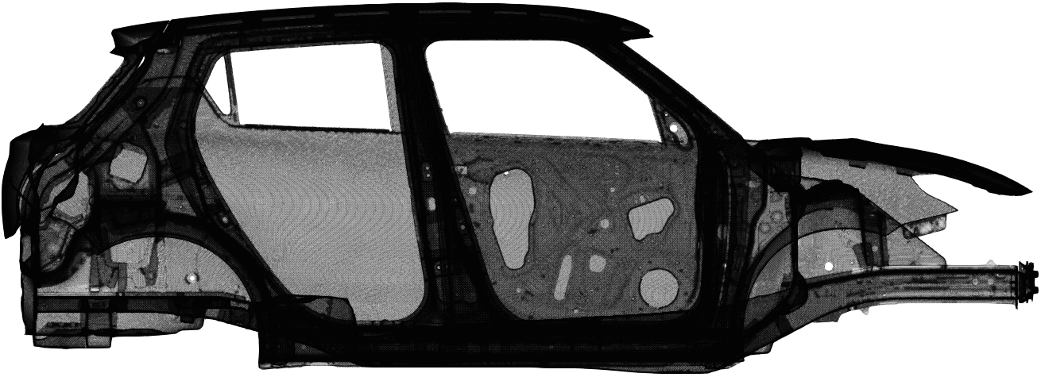
Mesh Convergence Test
Overview of Surface Mesh of 51M Element Mesh
There are many ED holes around narrow spaces among plates.
Only the surface
mesh is shown.

Slide 26
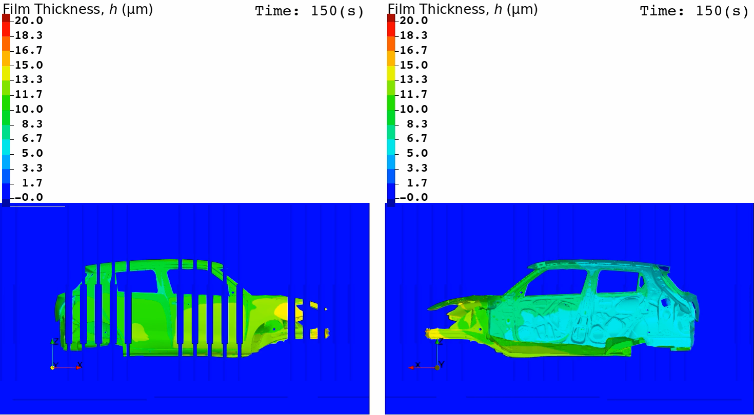
Mesh Convergence Test
Animation of Film Thickness (ES-FEM-T4 with 51M Element Mesh)
Outer View Inner View

Slide 27
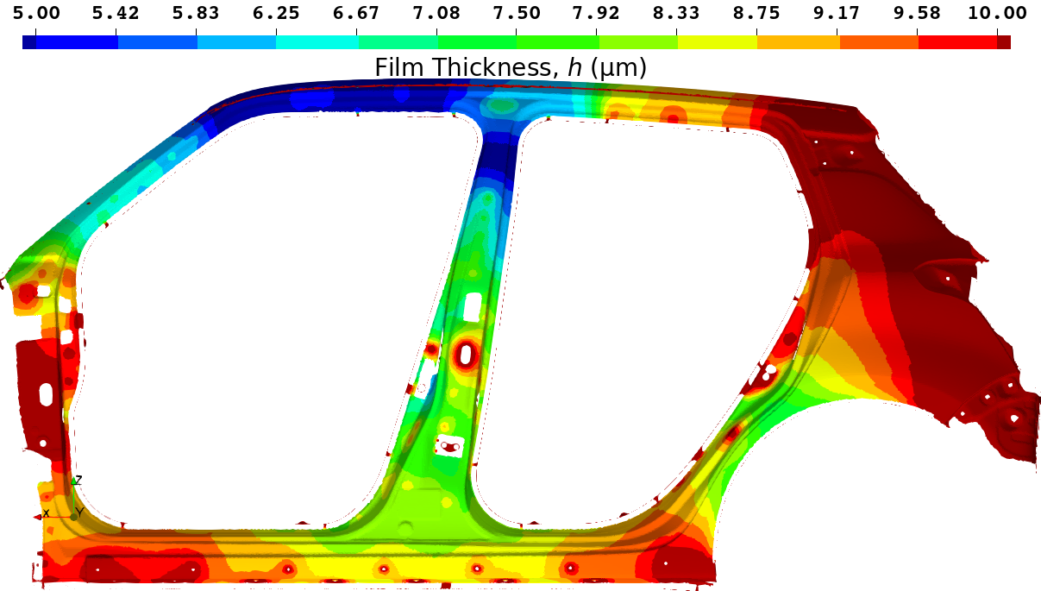
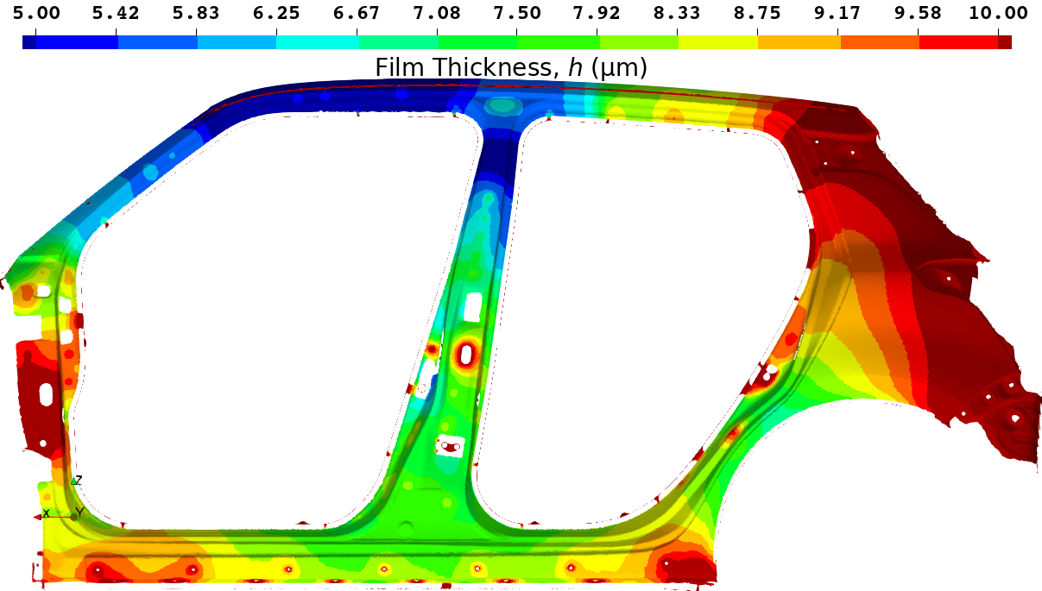
Mesh Convergence Test
Final Film Thickness Distribution on the side sill part with 51M Element Mesh
Standard FEM (FEM-T4)
Present Method (ES-FEM-T4)
Reference Solution
Standard FEM shows a little thicker result.
(The center of the side sill is Yellow.)
This result is regarded as the reference solution.
(The center of the side sill is Green)

Slide 28
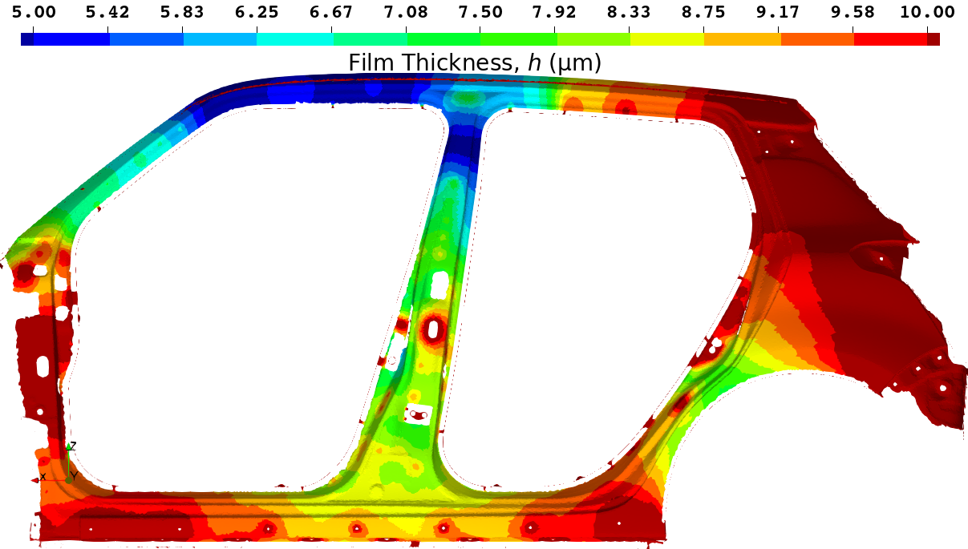
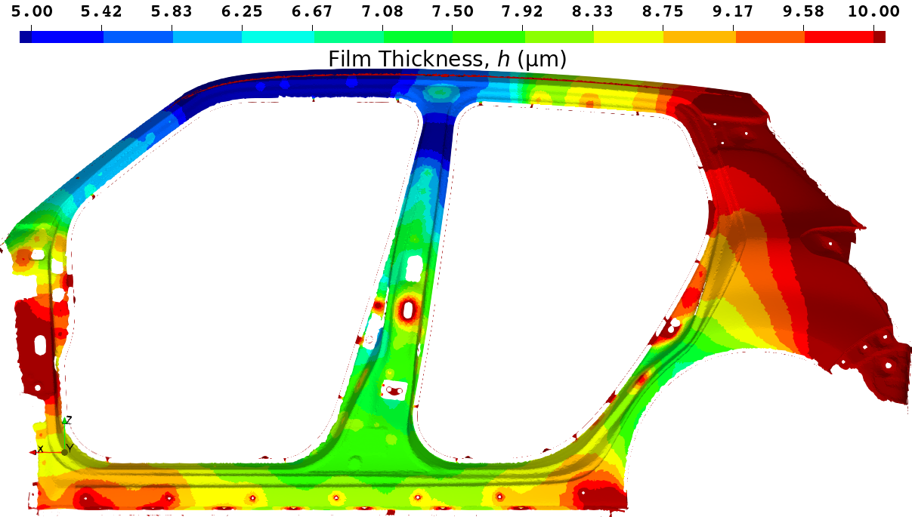
Mesh Convergence Test
Final Film Thickness Distribution on the side sill part with 16M Element Mesh
Standard FEM (FEM-T4)
Present Method (ES-FEM-T4)
参照解
Standard FEM shows a much thicker result.
(The center of the side sill is Orange.)
EDESFEM shows an accurate result.
(The center of the side sill is Green.)

Slide 29
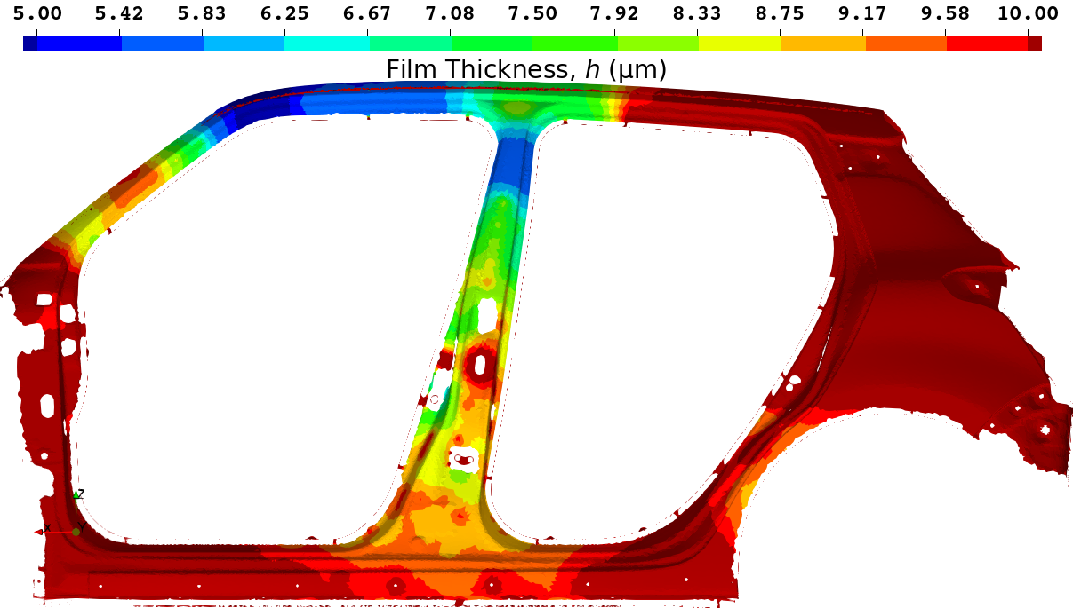
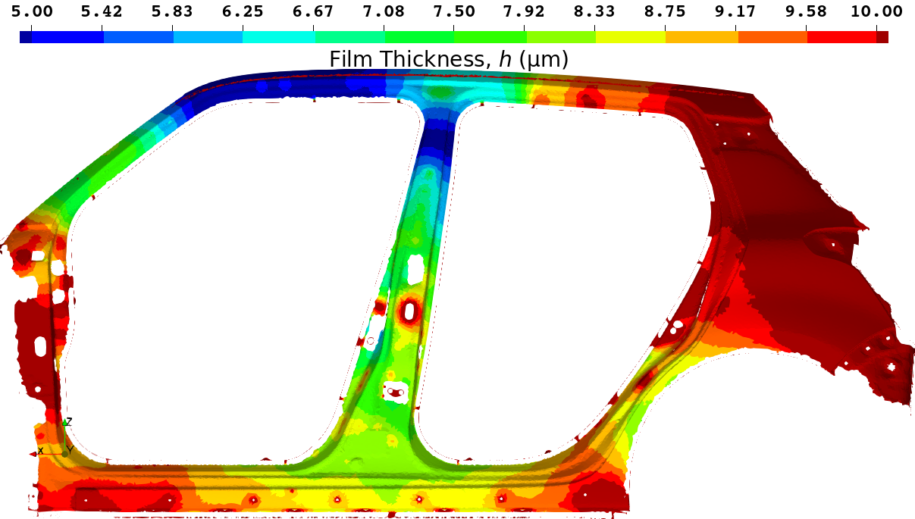
Mesh Convergence Test
Final Film Thickness Distribution on the side sill part with 10M Element Mesh
Standard FEM (FEM-T4)
Present Method (ES-FEM-T4)
A comparison of the time-history
of the film thickness at this point
is shown on the next page.
参照解
Standard FEM shows a massively thicker result.
(The center of the side sill is Red.)
EDESFEM shows a little thicker result.
(The center of the side sill is Yellow.)

Slide 30
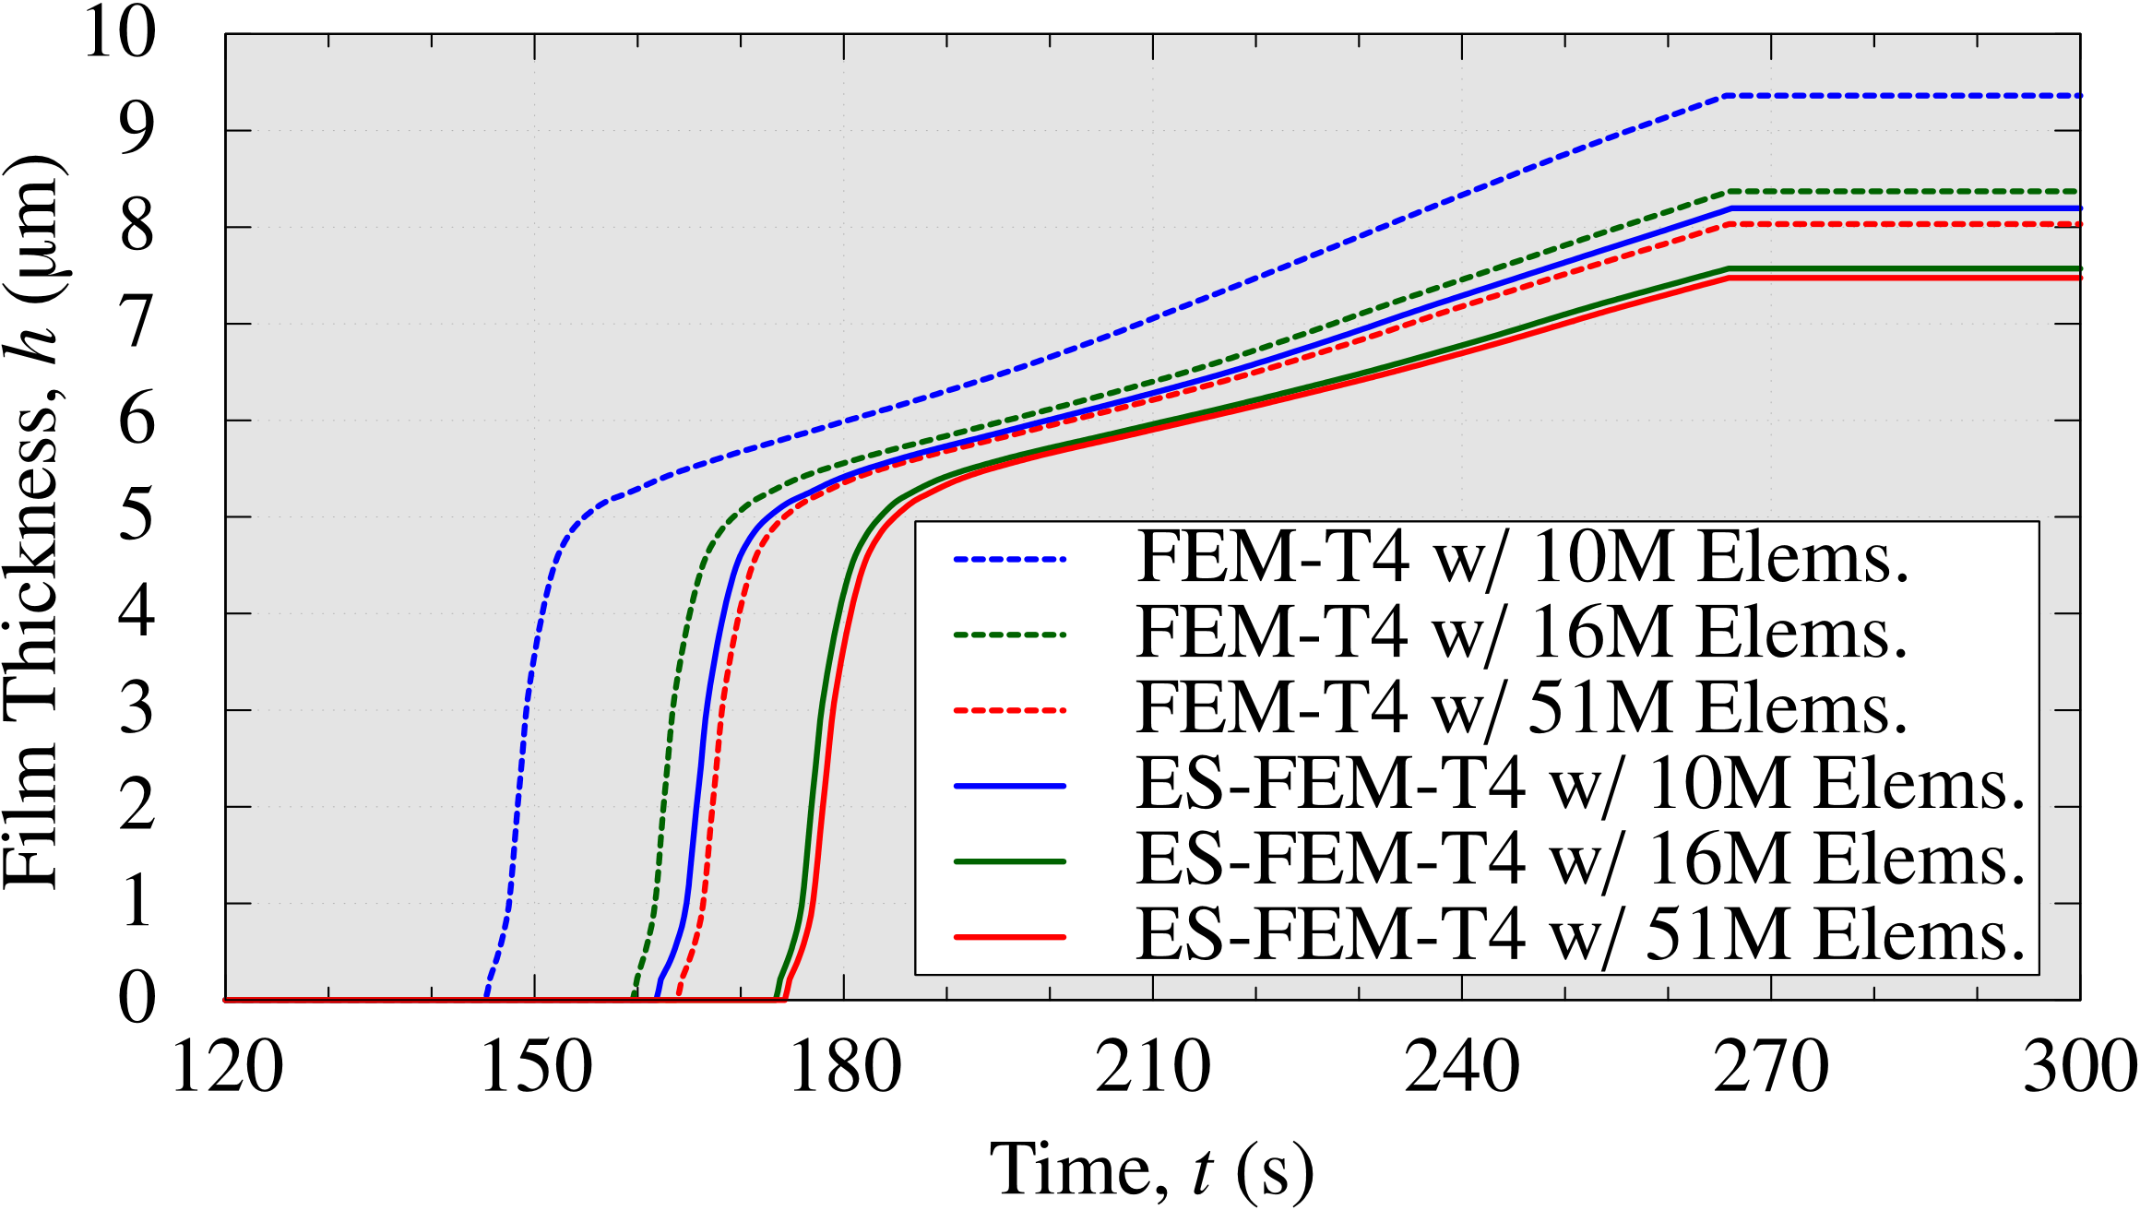
Mesh Convergence Test
Comparison of Time-histories of Film Thickness at a Sample Point on Side Sill
FEM-T4 with 51M elems. and ES-FEM-T4 with 10M elems.
has almost comparable accuracy.
ES-FEM-T4 with 16M elems. gives a practically converged result.

Slide 31
Mesh Convergence Test
Comparison of Calculation Time
On a cluster (64 CPUs: 896 cores of Intel Xeon E5-2680 v4 on TSUBAME3.0)
With the same mesh, ES-FEM-T4 is slower than FEM by x1.5.
For the same accuracy, ES-FEM-T4 is faster than FEM by x3.
# of Elements | Standard FEM (FEM-T4) | Present Method (ES-FEM-T4)
10M | 1.6 h | 1.9 h
16M | 2.3 h | 3.4 h
51M | 6.0 h | 8.5 h
Comparable
Accuracy
For the simulations of actual ED lines,
ES-FEM-T4 is 3 times efficient than FEM-T4.

Slide 32
Validation Test

Slide 33
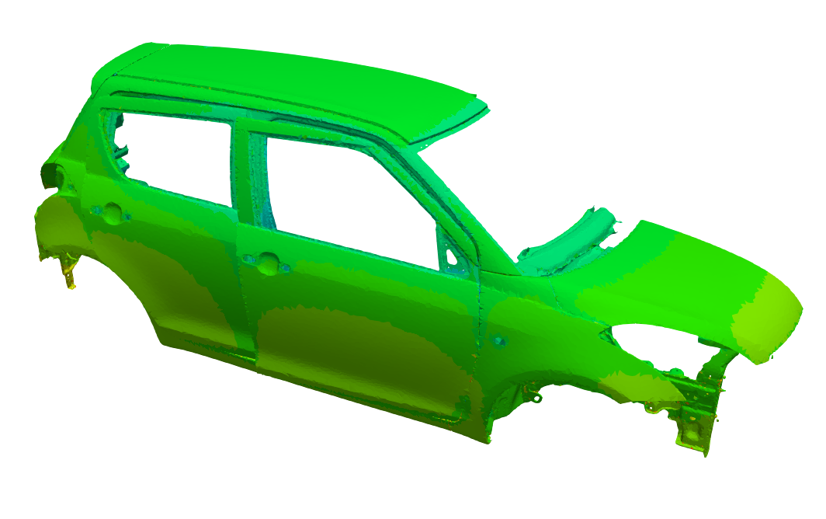
Validation Test
Measured 6 Points (Ch.2 - 7):
Outline
Measurement
A surface potential logging device with 6 probes was mounted
on a car running on an actual ED line.
After baking, the film thickness was measured at the probe points.
Simulation (Same as the mesh convergence test.)
Half-body analysis (only right-hand side).
The entire line shape, carbody motion, and standard electrode conditions are input.
Surface potential time history and final film thickness at the 6 points are compared.
Ch.7：Back Door
Ch.4：Roof
●
●
Ch.2：Hood
●
●
●
Ch.3：Side Door
Ch.5：Side Sill
Ch.6：Floor
(not visible on this Fig.)

Slide 34
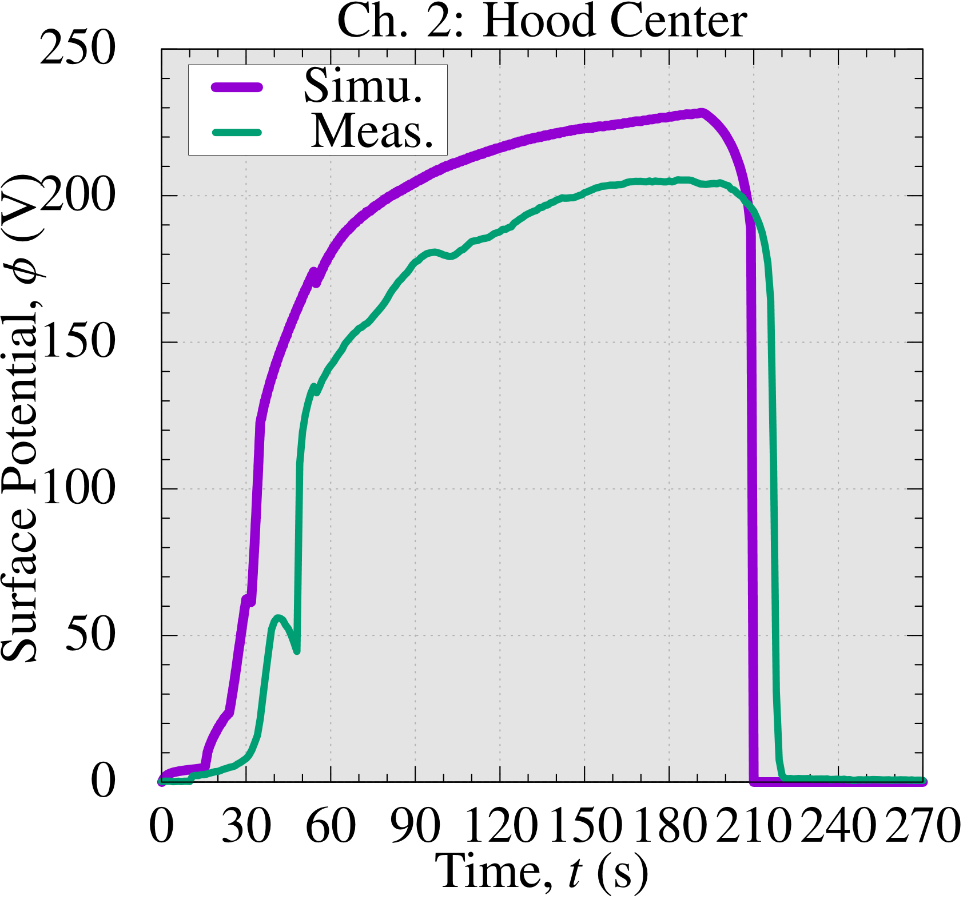
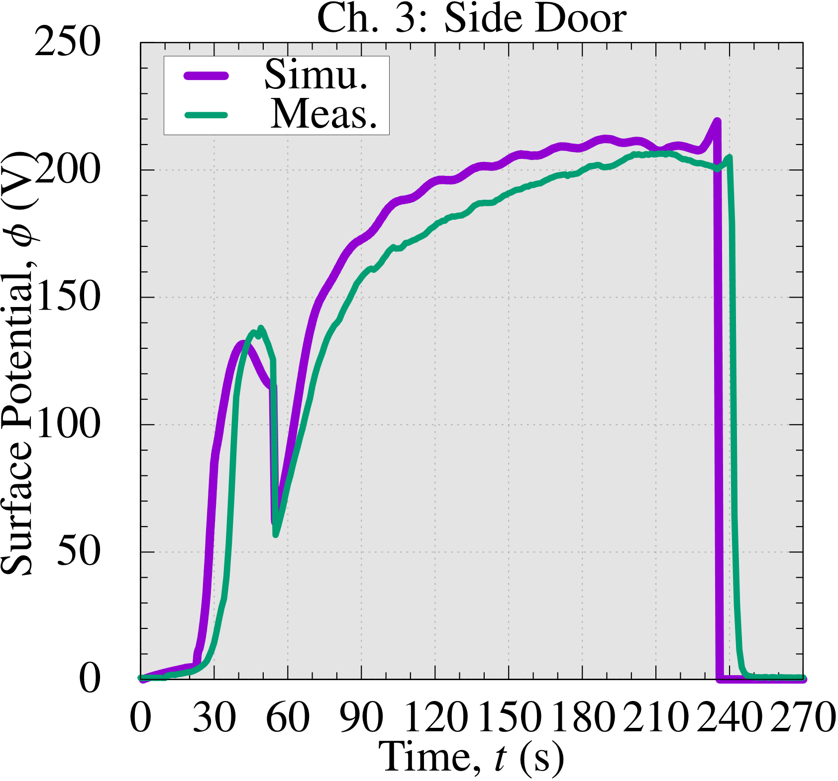
Validation Test
Validation of Surface Potential (Ch. 2 and 3)
The simulated surface potential is a little high
because the degradation of the membranes of electrodes was not precisely simulated;
yet, the results generally agree with practical accuracy.

Slide 35
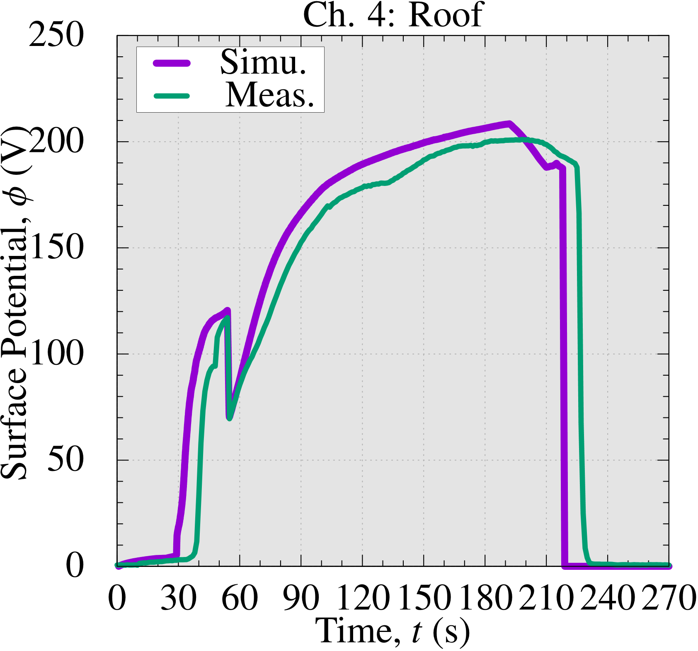
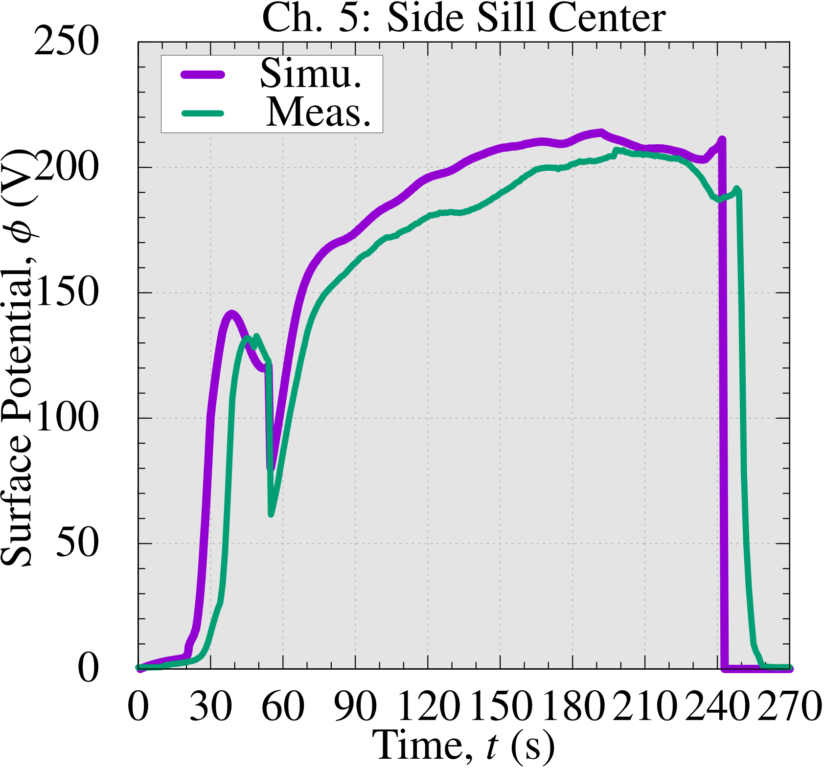
Validation Test
Validation of Surface Potential (Ch. 4 and 5)
The simulated surface potential is a little high
because the degradation of the membranes of electrodes was not precisely simulated;
yet, the results generally agree with practical accuracy.

Slide 36
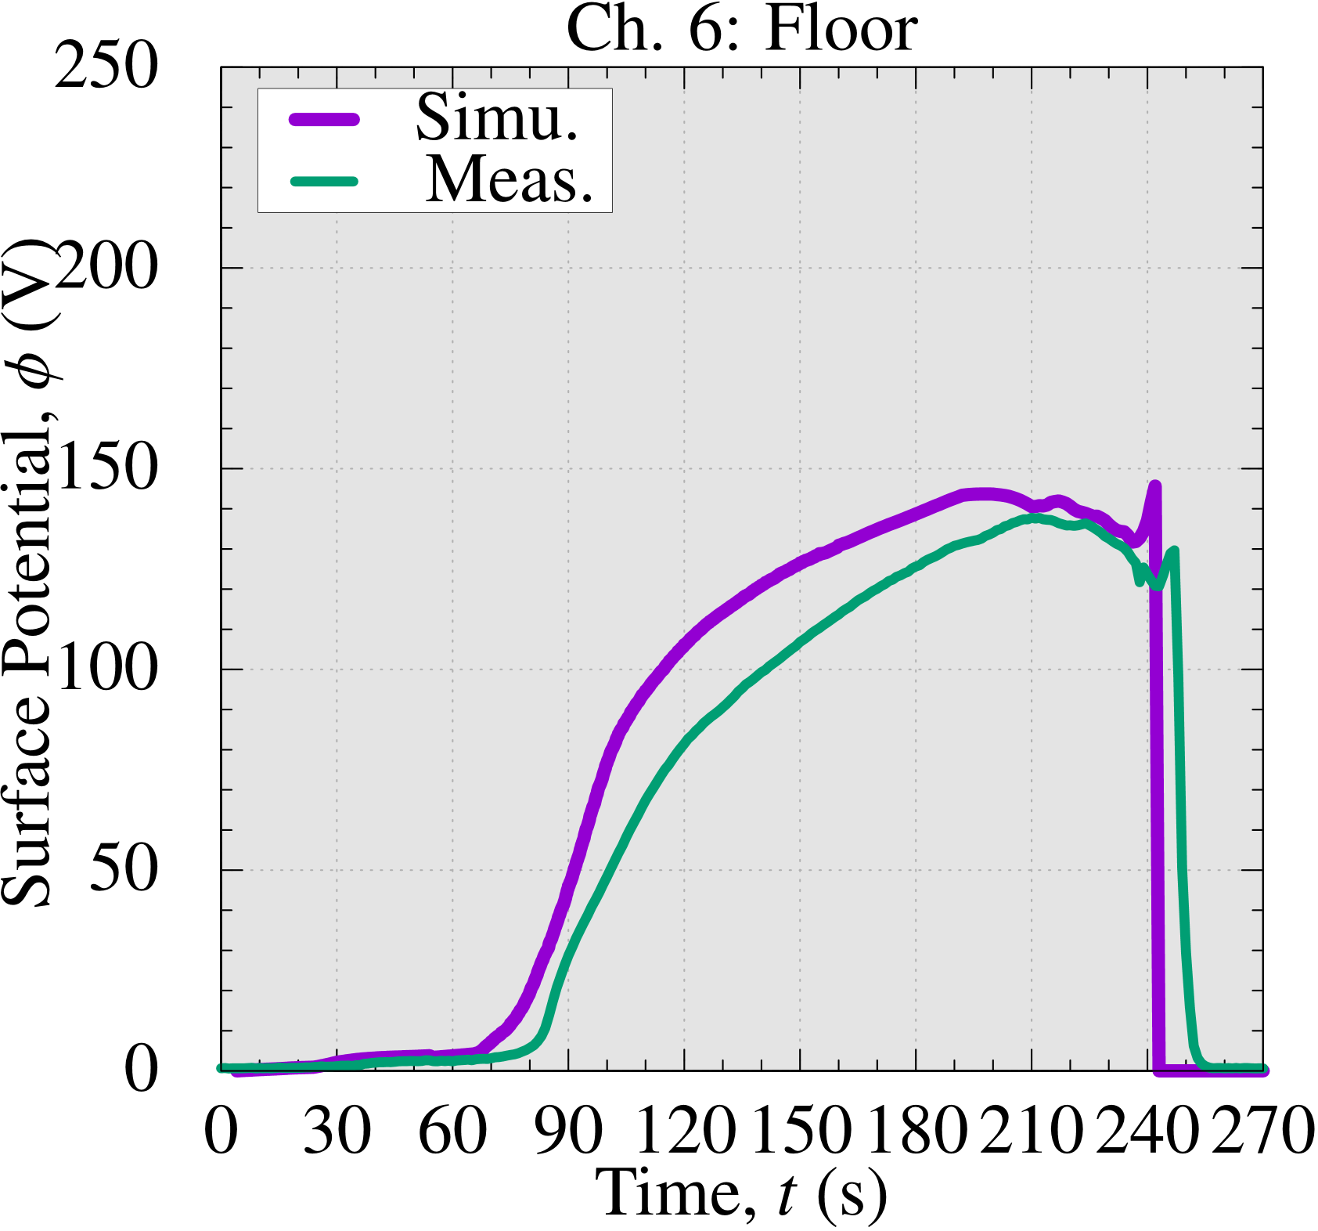
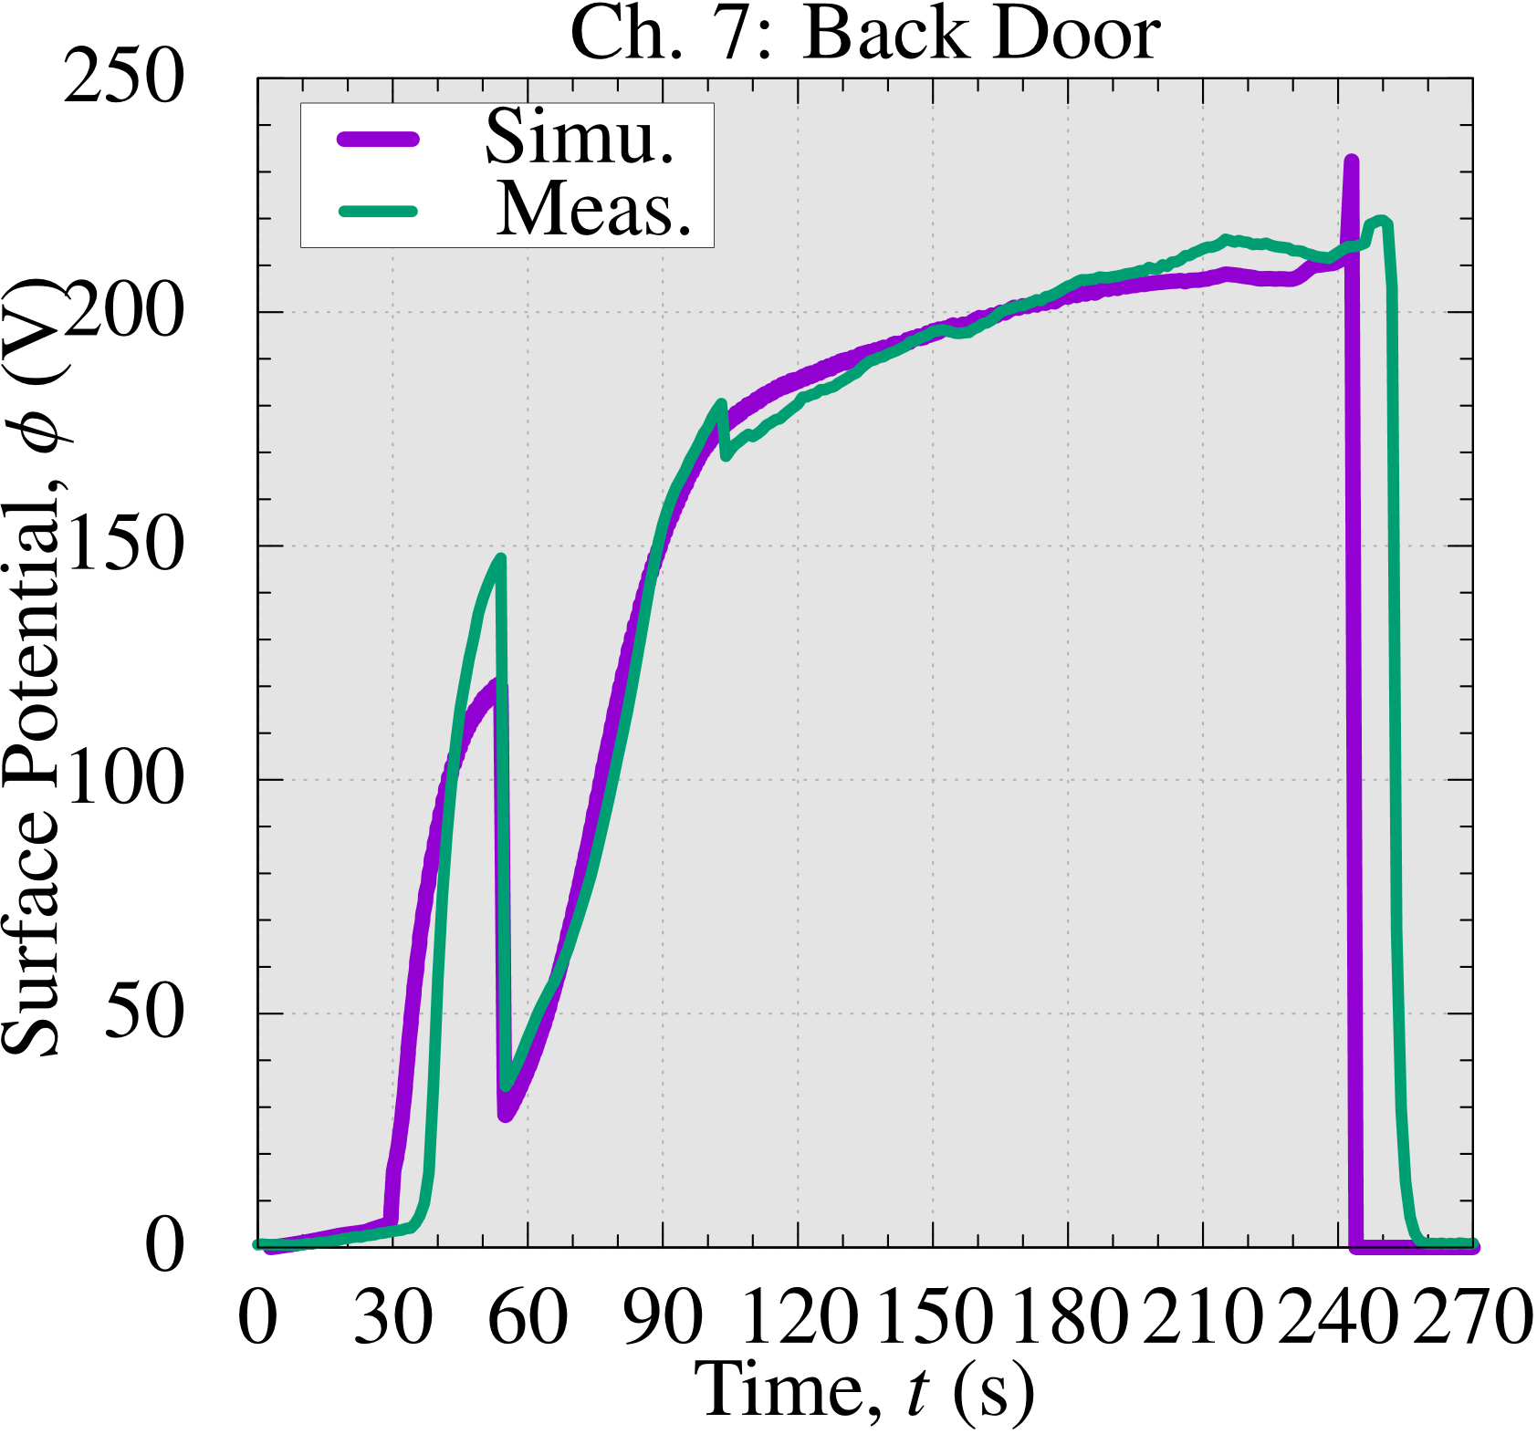
Validation Test
Validation of Surface Potential (Ch. 6 and 7)
The deposition delay at the
floor, an inner part, is reproduced successfully.
The simulated surface potential is a little high
because the degradation of the membranes of electrodes was not precisely simulated;
yet, the results generally agree with practical accuracy.

Slide 37
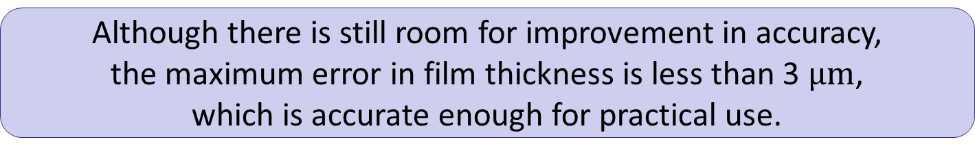
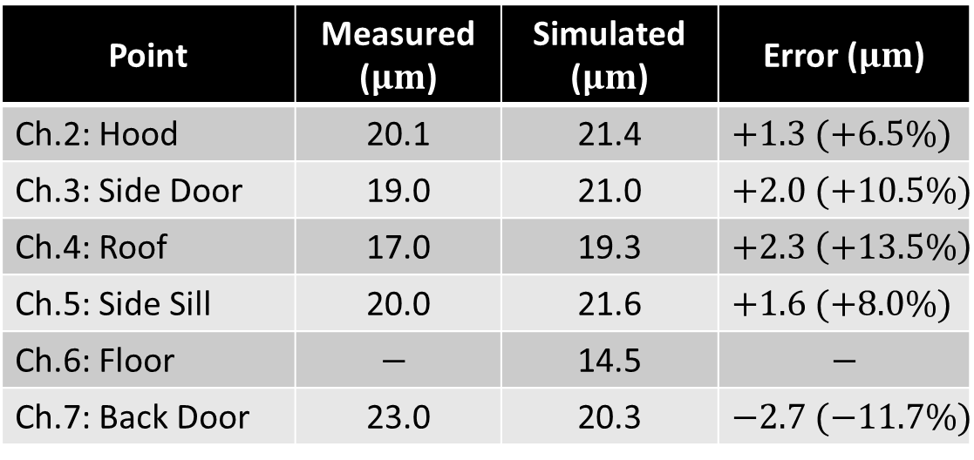
Validation Test
Validation of Final Film Thickness
Point | Measured ($μm$) | Simulated ($μm$) | Error ($μm$)
Ch.2: Hood | 20.1 | 21.4 | $+1.3 (+6.5\%)$
Ch.3: Side Door | 19.0 | 21.0 | $+2.0 (+10.5\%)$
Ch.4: Roof | 17.0 | 19.3 | $+2.3 \left(+13.5\%\right)$
Ch.5: Side Sill | 20.0 | 21.6 | $+1.6 (+8.0\%)$
Ch.6: Floor | $$−$$ | 14.5 | $$−$$
Ch.7: Back Door | 23.0 | 20.3 | $−2.7 (−11.7\%)$
Although there is still room for improvement in accuracy,
the maximum error in film thickness is less than 3 $μm$,
which is accurate enough for practical use.

Slide 38
Summary

Slide 39
Summary
Electrodeposition (ED) is important for automotive safety.
Tetrahedral meshes are preferable in ED Simulation.
ES-FEM-T4 has excellent accuracy for solving Laplace equation.
In the actual line ED simulations, ES-FEM-T4 is 3 times faster
than the standard FEM-T4 to obtain the same accuracy result.
The effectiveness of our ED simulator was validated by several car companies.
The application scope of ES-FEM-T4 and related FE formulations is now beginning to extend beyond Laplace simulations to solid, fluid, and acoustic simulations.
If you are interested in our ED simulator, please check the website.
Search
edesfem
Thank you for your kind attention!

