Slide 1
An Accurate and Stable Static-Implicit Finite Element Rezoning Method for Large Deformation Elasto-Plastic Analysis
yonishi@a.mei.titech.ac.jp
Yuki ONISHI, Kenji AMAYA Tokyo Institute of Technology (Japan)

Slide 2
Motivation and Background
Motivation
We want to solve severely large deformation problems accurately and stably! (Final target: thermal nanoimprinting)
Background
Finite elements are distorted in a short time, thereby resulting in convergence failure.
Mesh rezoning method (h-adaptive mesh-to-mesh solution mapping) is indispensable.

Slide 3
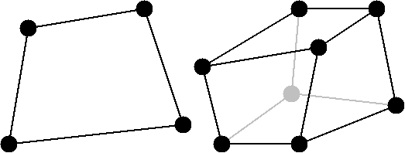
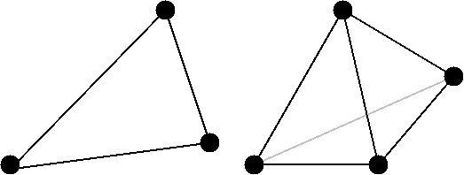
2 Major Problems in Mesh Rezoning
Problem 1: accuracy
It is impossible to remesh arbitrary deformed 2D or 3D domains with quadrilateral or hexhedral elements.
However, the standard (constant strain) triangular or tetrahedral elements induce shear and volumetric locking easily, which leads to inaccurate results.
We have to use triangular or tetrahedral elements...

Slide 4
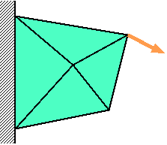
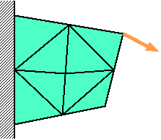
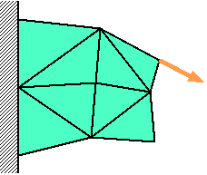
2 Major Problems in Mesh Rezoning
Problem 2: stability
The resolving process in mesh rezoning sometimes induces extremely large deformation.
Convergence
Failure
Time: t_{n-1}
Time:
t_{n}
Time:
t_{n+1}
Large
deformation
is induced.
Force
$$f^{\text{ext}}=f^{\text{int}}$$
$$f^{\text{ext}}≠f^{\text{int}}$$
$$f^{\text{ext}}=f^{\text{int}}$$
Solve
Equilibrium
Remesh
&
Map States
Resolve
Equilibrium
Solve
Equilibrium

Slide 5
Our Ideas
Idea for accuracy improvement We adopt smoothed finite element method (S-FEM) to avoid shear and volumetric locking even with use of triangular or tetrahedral elements.
Idea for stability improvement
We adopt the incremental implicit equilibrium equation (IIEE) as the equation to solve.
In this talk today,
I focus on Problem 1 and the idea of S-FEM.

Slide 6
Objective
Develop an accurate mesh rezoning method
for large deformation problems with our modified S-FEM formulation
Table of Body Contents
- Part 1: Introduction of our modified S-FEM formulation
- Part 2: Procedure of our mesh rezoning method
- Part 3: Examples analysis
- Summary

Slide 7
Part 1:
Introduction of Our Modified S-FEM Formulation

Slide 8
What is S-FEM?
One of strain smoothing techniques.
There are several types of S-FEM.
Edge-based (ES-FEM) for 2D
Face-based (FS-FEM) for 3D
Node-based (NS-FEM) for both 2D and 3D
Selective edge/node-based (ES/NS-FEM) for 2D
Selective face/node-based (FS/NS-FEM) for 3D
Selective S-FEMs are thought to be the best choice because they can avoid both shear and volumetric locking even with use of triangular or tetrahedral elements.
I will explain ES-FEM, NS-FEM, and selective ES/NS-FEM one by one.

Slide 9
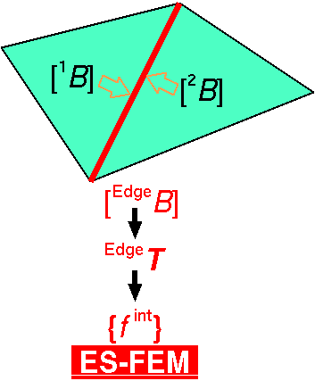
Edge-based S-FEM (ES-FEM)
Calculate $[B]$ at element.
Distribute $[B]$ to the connecting edges and make $[ ^{Edge}B]$
F, T, {f ^{int}} etc. are calculated at edges
Generally accurate but induces volumetric locking.
Substituting "face" for "edge"
gives FS-FEM for 3D

Slide 10
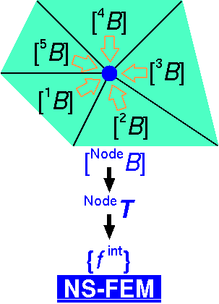
Node-based S-FEM (NS-FEM)
Calculate $[B]$ at element.
Distribute $[B]$ to the connecting nodes and make $[ ^{Node}B]$
F, T, {f ^{int}} etc. are calculated at nodes
Generally not accurate but volumetric locking free.
(due to zero-energy modes, which are arisen in
reduced integration
finite elements as hour-glass modes)

Slide 11
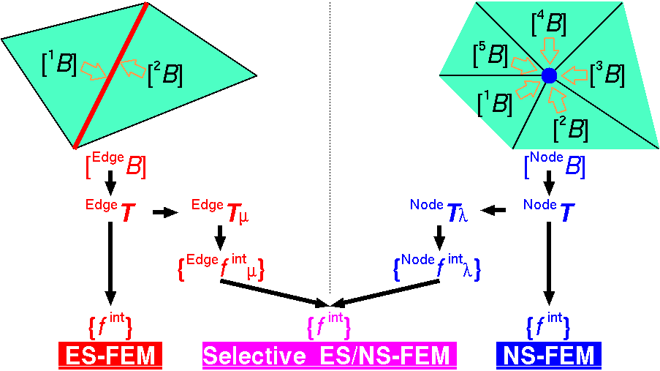
Original Selective ES/NS-FEM
Separate stress into "$μ$ part" and "$λ$ part", where $μ$ and $λ$ are the Lame's parameters.
F, T, {f ^{int}} etc. are calculated at both edges and nodes.
Only applicable to elastic constitutive models.
Substituting "face"
for
"edge"
gives
FS/NS-FEM
for 3D

Slide 12
Our Selective ES/NS-FEM
Separate stress into "deviatoric part" and "hydrostatic part" instead of "$μ$ part" and "$λ$ part".
Applicable to any kind of material constitutive models.
Substituting "face"
for
"edge"
gives
FS/NS-FEM
for 3D

Slide 13
Verification of Our Selective S-FEM
Cantilever Bending Test
10m x 1m x 1m cantilever with 20 kN dead load
Neo-Hookean hyperelastic material $\left[T\right]=2C_{10}\frac{Dev(\overline{B})}{J}+\frac{2}{D_{1}}\left(J−1\right)\left[I\right]$ with a constant $C_{10}$(=1 GPa) and various $D_{1}$s.
Our selective FS/NS-FEM with 9560 tetrahedral elements (and 2288 nodes) is performed.
ABAQUS/Standard with 1250 C3D20H (2nd-order hybrid hexahedral) elements (and 6696 nodes) is also performed.
No mesh rezoning is taken place for this test.

Slide 14
Verification of Our Selective S-FEM
Results with $D_{1}=2 PPa^{−1}$ ($ν_{0}$=0.499999)

Slide 15
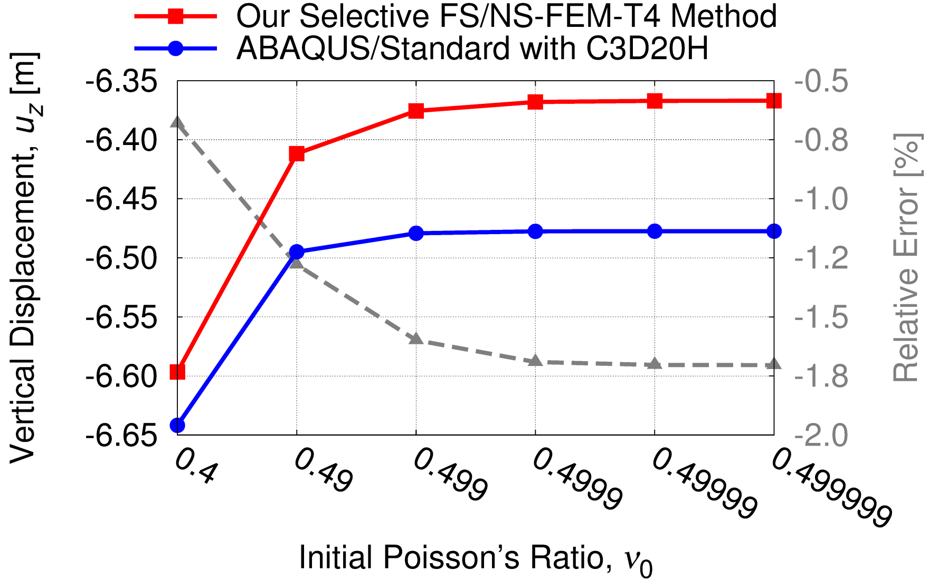
Verification of Our Selective S-FEM
Comparison to Standard Method
Our selective S-FEM can treat any material model
and is free from locking!!

Slide 16
Part 2:
Procedure of our mesh rezoning method

Slide 17
Procedure of Mesh Rezoning
Time: t_{n-1}
Time:
t_{n}
Time:
t_{n+1}
Force
$$f^{\text{ext}}=f^{\text{int}}$$
$$f^{\text{ext}}≠f^{\text{int}}$$
$$f^{\text{ext}}=f^{\text{int}}$$
Solve
Equilibrium
Remesh
&
Map States
Resolve
Equilibrium
Solve
Equilibrium
The way of mapping varies with the material constitutive model.
Elasto-plastic models necessitate some kind of correction.

Slide 18
Mapping of Stress/Strain States
For Elastic or Hyperelastic Materials
i.e., $\left[T\right]=[T\left(\left[F\right]\right)]$
Map initial position $\{x^{\text{initial}}\}$ at nodes, and then remake deformation gradient $\left[F\right]$ at edges & nodes.
Each node preserve its initial position
so that the domain can spring back to
the initial shape after unloading.

Slide 19
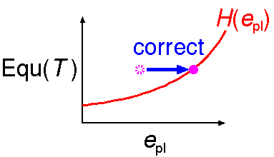
Mapping of Stress/Strain States
For Elasto-Plastic Material in Total Strain Form
e.g., $\left[T\right]=[T\left(\left[F\right],{[E}_{pl}], e_{pl};H(e_{pl})\right)]$
Map initial position $\{x^{initial}\}$ at nodes, and then remake deformation gradient $\left[F\right]$ at edges & nodes.
Map history dependent variables, plastic strain $[E_{pl}]$ and equivalent plastic strain $e_{pl}$
Correct $e_{pl}$ to satisfy $Equ\left(\left[T\right]\right)=H(e_{pl})$
= Mises Stress

Slide 20
Part 3:
Examples of Analysis

Slide 21
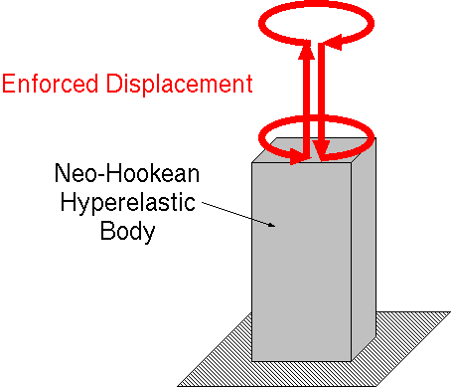
Twist and Stretch of Hyperelastic Body
Static, 1 m x 2 m x 4 m
Neo-Hookean hyperelastic body of $C_{10}=1 GPa$ and $D_{1}=400 GPa^{−1}$ ($ν_{0}=0.48$)
Twist up to 360 deg. $⟹$ Stretch up to 100% nominal strain $⟹$ Twist back $⟹$ Shrink back
Our selective FS/NS-FEM with tetrahedral elements
Global mesh rezoning every 90 deg. and 50% stretch/shrink

Slide 22
Twist and Stretch of Hyperelastic Body
Our selective FS/NS-FEM with mesh rezoning
Our selective FS/NS-FEM without mesh rezoning

Slide 23
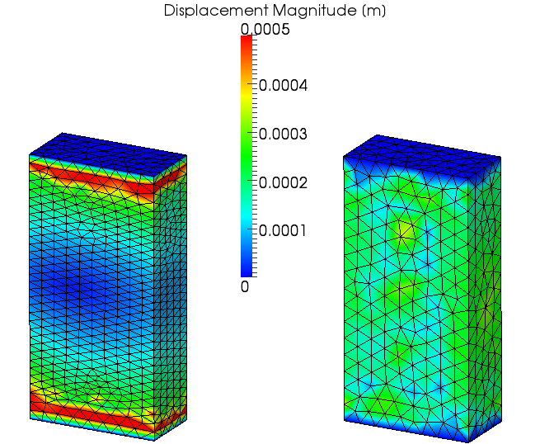
Twist and Stretch of Hyperelastic Body
Residual Displacement

Slide 24
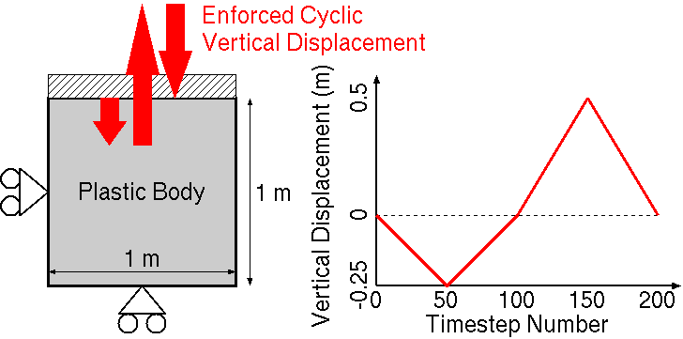
Cyclic Disp. of Elasto-Plastic Body
Static, Plane Strain, 1 m x 1 m
Hencky's elasto-plastic material
Horizontal constraint on left edge
Vertical constraint on bottom edge
Horizontal constraint and vertical enforced disp. on top edge
Our selective ES/NS-FEM with triangular elements

Slide 25
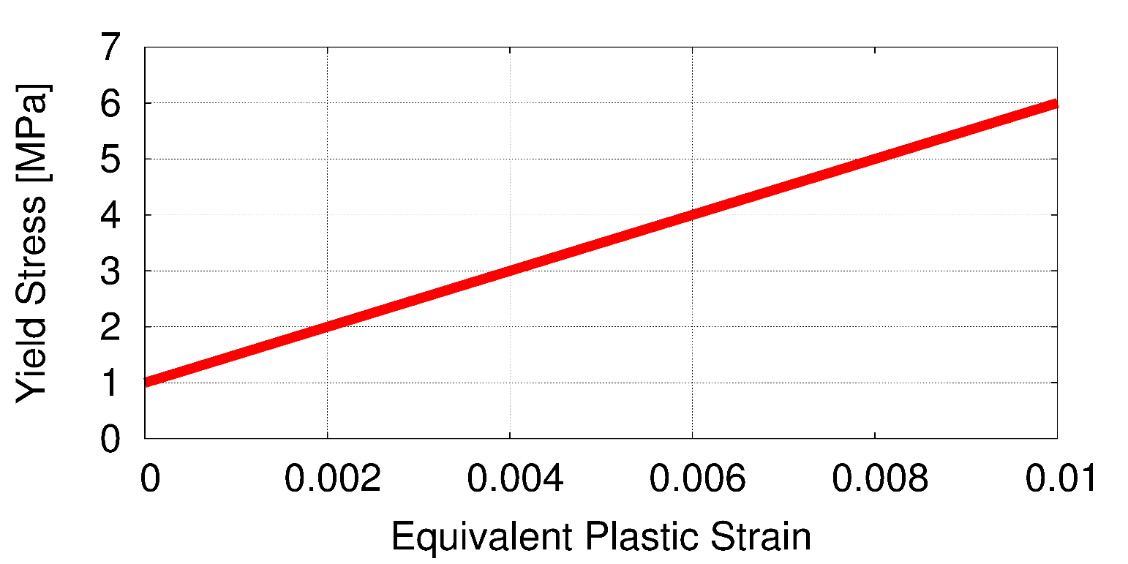
Cyclic Disp. of Elasto-Plastic Body
Material Constitutive Model
Hencky's elasto-plastic material, $T=C :h_{el}/J$, with von Mises yield criterion and isotropic hardening
Young's Modulus: 1 GPa, Poisson's Ratio: 0.3
Yield Stress: 1 MPa, Hardening Coeff.: 0.5 GPa

Slide 26
Cyclic Disp. of Elasto-Plastic Body
Deformation
is always
smooth.

Slide 27
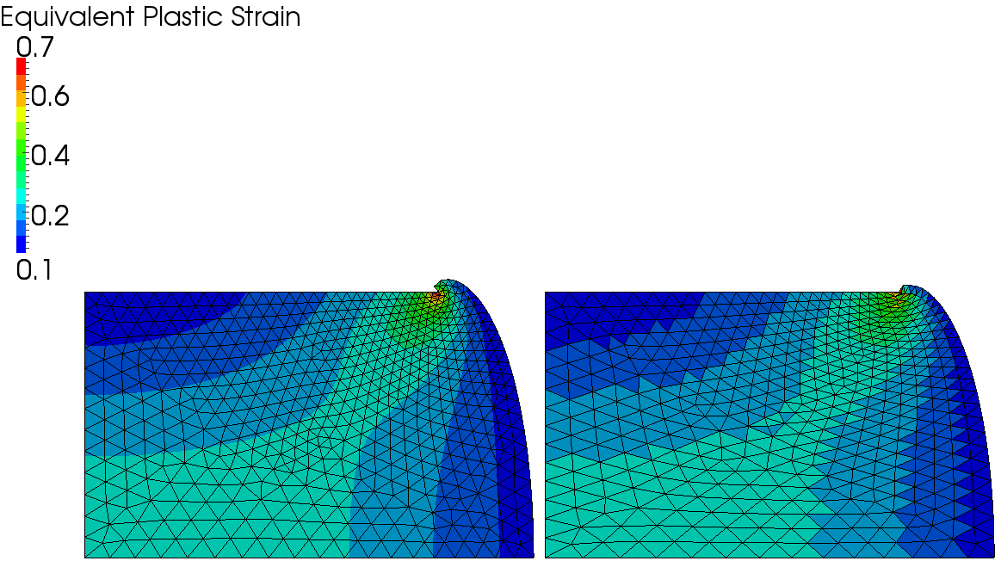
Cyclic Disp. of Elasto-Plastic Body
At the concave corner:
checkerboard pattern is observed.
stiffer than S-FEM.
$⟹$Locking is induced.
Our Selective ES/NS-FEM
with Mesh Rezoning
Standard FEM
without Mesh Rezoning
Timestep: 50

Slide 28
Cyclic Disp. of Elasto-Plastic Body
Our Selective ES/NS-FEM
with Mesh Rezoning
Standard FEM
without Mesh Rezoning
Timestep: 100

Slide 29
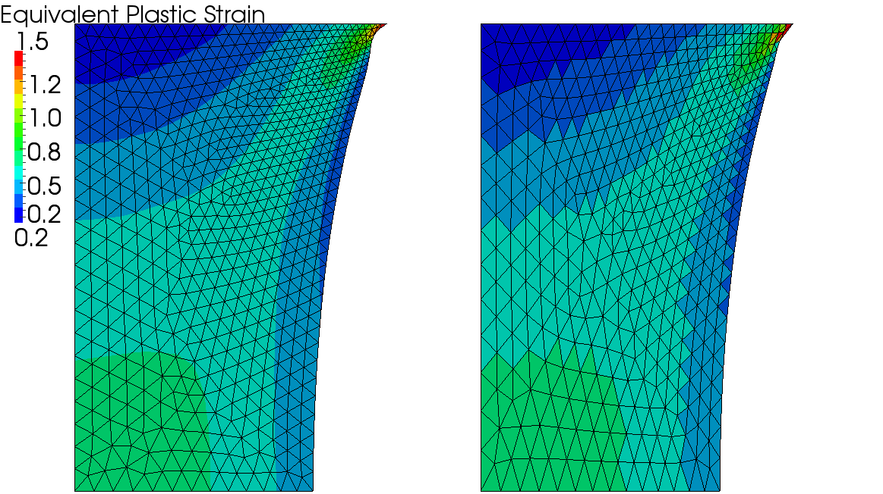
Cyclic Disp. of Elasto-Plastic Body
Our Selective ES/NS-FEM
with Mesh Rezoning
Standard FEM
without Mesh Rezoning
Timestep: 150

Slide 30
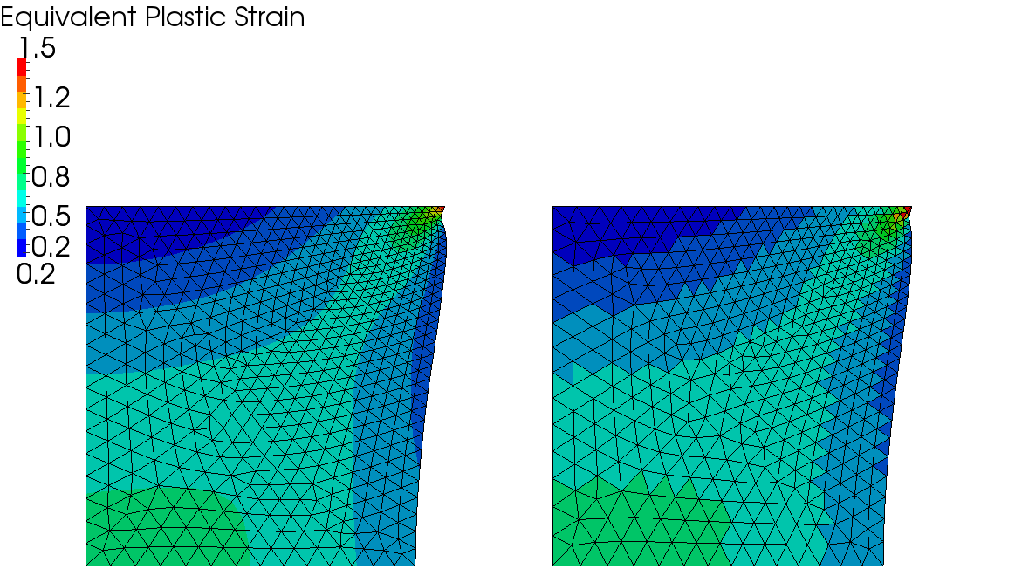
Cyclic Disp. of Elasto-Plastic Body
Our Selective ES/NS-FEM
with Mesh Rezoning
Standard FEM
without Mesh Rezoning
Timestep: 200

Slide 31
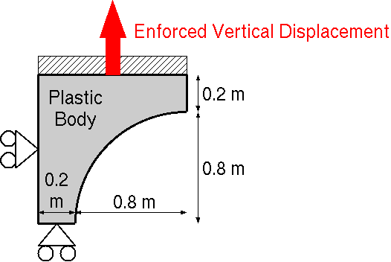
Necking of Elasto-Plastic Body
Outline
Static, Plane-strain
1/4 of test piece
horizontal constraint on left edge
vertical constraint on bottom edge
horizontal constraint and enforced displacement on top edge
Mesh rezoning every 0.05 m displacement
Our selective ES/NS-FEM with triangular elements

Slide 32
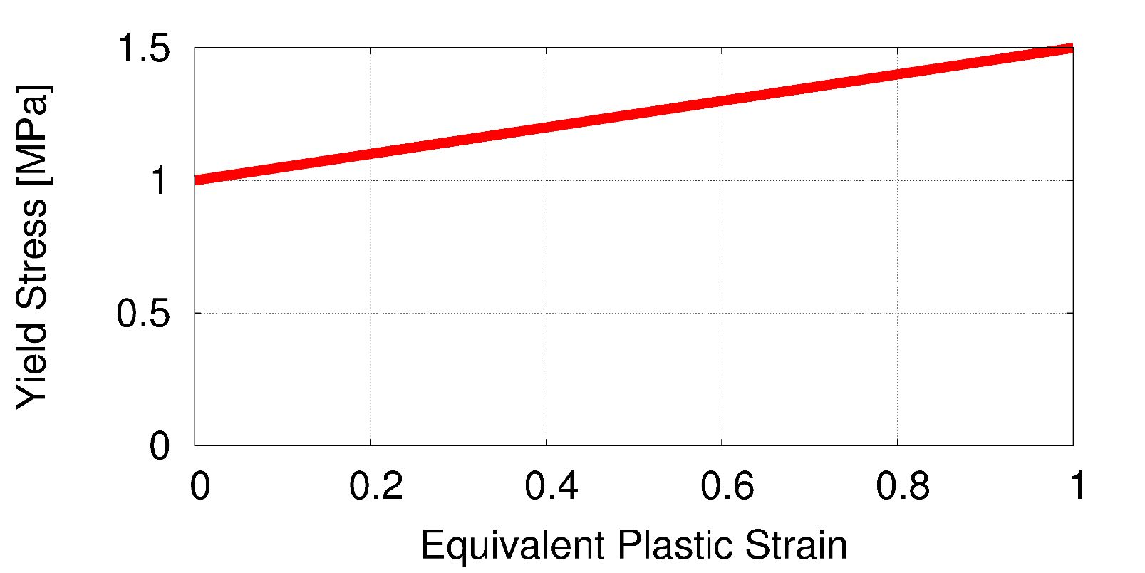
Necking of Elasto-Plastic Body
Material Constitutive Model
Hencky's elasto-plastic material, $T=C :h_{el}/J$, with von Mises yield criterion and isotropic hardening
Young's Modulus: 1 GPa, Poisson's Ratio: 0.3
Yield Stress: 1 MPa, Hardening Coeff.: 0.5 MPa
very close to
elastic-
perfect plastic
model

Slide 33
Necking of Elasto-Plastic Body
Typical deformation of necking test
is obtained.

Slide 34
Necking of Elasto-Plastic Body
Zoom-in view
around the center

Slide 35
Necking of Elasto-Plastic Body
ABAQUS /Standard
Strange deformation
is obtained
due to:
locking of triangular elements
absence of mesh rezoning

Slide 36
Twist of Elasto-Plastic Body
Static, 3D
1 m x 2 m x 4 m
Elasto-plastic body with 0.5 GPa
perfect constraint on bottom face
Horizontally twist top face up to 360 deg. and twist back
mesh rezoning every 90 deg. twist
Our selective FS/NS-FEM with tetrahedral elements

Slide 37
Summary

Slide 38
Take-Home Messages
Accurate (implicit) and stable mesh rezoning is almost a reality!!
Our modified selective S-FEM are worth using even without mesh rezoning!!

Slide 39
Summary and Future Work
Summary
A new static-implicit mesh rezoning method for severely large deformation analysis is proposed.
It adopts our modified selective S-FEM, which separates stress into deviatoric part and hydrostatic part.
Its accuracy are verified with hyperelastic material and elasto-plastic material.
Future Work
More V&V
Local mesh rezoning
Apply to contact forming, crack propagation, etc.
Thank you for your kind attention!!

