Slide 1
Multi-physics Galvanic Corrosion Analysis for Carbon-Aluminium Structures under Saltwater Film
Yuki ONISHI, Koichi MASUYA, Kenji AMAYA Tokyo Institute of Technology, Japan

Slide 2
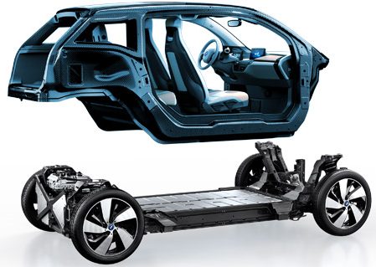
Background
The multi-material design of vehicles is recently in progress in order to reduce the weight.
Especially, carbon fiber reinforced plastics (CFRP) and aluminium alloys (Al) are coming into use.
As a result, galvanic corrosion occurs around the joint parts of different materials under saltwater film (e.g., seawater, solution of snow melting agents, etc.).
Fig. multi-material designed vehicle BMW Japan Corp.
http://www.bmw.co.jp/jp/ja/ insights/corporation/bmwi/ concept.html
Notes:
The background of my researching is that ……
CFRPとかAlを使っている車の絵か写真
http://www.bmw.co.jp/jp/ja/insights/corporation/bmwi/concept.htmlb

Slide 3
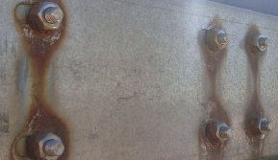
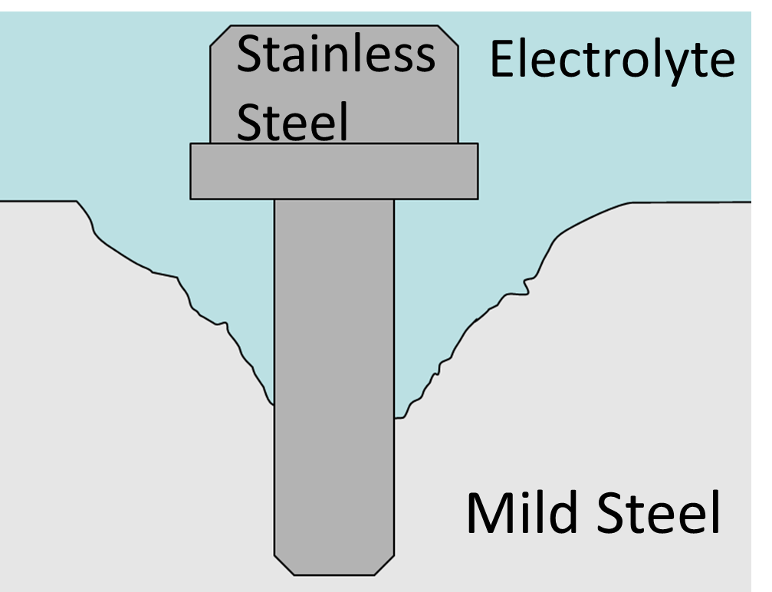
General Mechanism of Galvanic Corrosion
When multiple conductive materials with different ionization tendencies (or natural potentials) contact in electrolyte solution, an electric cell is formed.
The material with lower natural potential dissolves to the solution.
In addition, if the dissolved ions hydrolyze, pH of the solution becomes lower (acid).
Lower pH leads to further accelerated corrosion.
Fig. Galvanic corrosion
TRANECT LTD http://www.stainlesssteelbraid.co.uk/galvanic_corrosion.php
Evaluation of the corrosion rate in a variety of environments is important for safety engineering.
Notes:
Here, let me explain the general mechanism of galvanic corrosion quickly.
electrolyte solution that is salt water
The material that have higher electrode potential dissolves.

Slide 4
Issues in Corrosion Rate Evaluation
Issues in traditional Experimental Evaluation:
A large number of tests are required.
It costs high in terms of time and money.
Issues in recent Numerical Evaluation:
A complicated multi-physics formulation is required. (i.e., electrostatics, mass transport, and chemical reactions.)
A few constraints are difficult to be satisfied. (i.e., mass conservation and electroneutrarity)
Explicit time integration is easy to implement but slow due to the Courant (CFL) condition. (i.e., Speed of H⁺ ion is fast $⟹$ $Δt$ should be small.)
Notes:
The conventional method for corrosion rate evaluation is experimental evaluation.
It is difficult to estimate the corrosion rate by experiments because localized corrosion is a multiphysics problem.
Accordingly, numerical evaluation of localized corrosion is expected to be an effective approach to this issue.

Slide 5
Conventional Corrosion Simulations
 | K. L. Heppner et al.^{[1]} | S. Scheiner et al.^{[2]} | Y. Onishi et al.^{[3]}
Multi-physics | ✓ | ✗ | ✓
Mass conservation | ✗ | ✓ | ✓
Electroneutrarity | ✓ | ✗ | ✓
Implicit integration | ✗ | ✗ | ✗
No standard method that satisfies all of the above has been established yet…
[1] K. L. Heppner et al., Corrosion Eng Sci Tec, Vol. 41, No. 2, pp. 110--121, 2006.
[2] S. Scheiner et al., CMAME Vol. 198, No. 37-40, pp. 2898--2910, 2009. [3] Y. Onishi et al., Corrosion Science, Vol. 63, pp. 210--224, 2012.
Notes:
腐食シミュレーションは従来から研究されているのですが
腐食はマルチフィジックス問題であり，～のような複数の物理現象を含みます．
このように腐食を数値解析で再現したいのですが，腐食はイオンの電気泳動，拡散，反応といった物理現象を含み，また計算においては質量保存，電気的中性を満足し，腐食による金属の形状変化を表す移動境界を再現する必要があります．
腐食の数値解析に関してこれまでに
ヘプナー，シャイナー

Slide 6
Objective
Developing a fast and accurate numerical multi-physics simulator for localized galvanic corrosion especially for CFRP/Al composite under a seawater film
Table of Body Contents
Mechanism of galvanic corrosion on CFRP/Al composite under a seawater film
Our method to solve the corrosion problem
Validation of our method
Summary
Notes:
So, in this study, we aim at ……
Here is the contents of my talk.
First, I will explain the mechanism of localized corrosion under accumulated rust.
Second, I will explain the analysis method of localized corrosion.
Third, I will show the example of analysis of corrosion progress.
Finally, I will conclude my presentation.

Slide 7
Mechanism of Galvanic Corrosion on CFRP/Al Composite under a Seawater Film
Notes:
OK, Now, I would like to explain the ……
I explain the mechanism of localized corrosion under accumulated rust from this slide.

Slide 8
Mechanism of Galvanic Corrosion in Issue
In seawater, sodium ions $Na^{+}$ and chloride ions $Cl^{−}$ are dominated.
There are sufficient oxygen molecules ($O_{2}$) in the seawater film because the interface between air and the seawater film is relatively large.
Air
Seawater Film
$${Na}^{+}$$
$${Cl}^{−}$$
$$O_{2}$$
$$O_{2}$$
$$O_{2}$$
$$O_{2}$$
$$O_{2}$$
$$O_{2}$$
$${Cl}^{−}$$
$${Na}^{+}$$
$${Cl}^{−}$$
$${Na}^{+}$$
CFRP
Al
Notes:
Here is the outline of the typical initial state of the CFRP and Al composite under the Seawater Film surrounded by Air.
I explain the mechanism of galvanic corrosion between glassy carbon and aluminium under a salt water of sodium chloride solution.
GC stands for glassy carbon, and Al stands for aluminium.
GC and Al are electrically conductive.
specific area : 比表面積
O2 : Oxygen molecules
Na+ : Sodium ions (Natrium)
Cl- : chlorine ions

Slide 9
Mechanism of Galvanic Corrosion in Issue
As Al has lower natural potential than CFRP, Al is dissolved by the cell reaction.
Electric current flows from CFRP to Al in the solid part.
Chemical Reactions:
on Al: $Al→{Al}^{3+}+3e^{−}$ (anodic reaction)
on CFRP: $O_{2}+2H_{2}O+4e^{−}→4{OH}^{−}$ (cathodic reaction)
Air
Seawater Film
$${OH}^{−}$$
$$O_{2}$$
$${OH}^{−}$$
$$O_{2}$$
$${OH}^{−}$$
$$O_{2}$$
$${Al}^{3+}$$
CFRP
Al
Flow of Current
Higher Potential
Lower Potential
Notes:
Because Al has ……
oxidation of Al results in occurrence of Al3+
reduction of O2 results in occurrence of OH-

Slide 10
Mechanism of Galvanic Corrosion in Issue
The generated ions (hydroxide ions ${OH}^{−}$ and aluminium ions ${Al}^{3+}$) are electrically neutralized by the electrolyte ions, $Na^{+}$ and $Cl^{−}$.
Generation of ${OH}^{−}$ makes the solution on the CFRP alkaline.
Air
Seawater Film
$${Na}^{+}$$
$${Na}^{+}$$
$${Na}^{+}$$
$${Cl}^{−}$$
$${Cl}^{−}$$
$${OH}^{−}$$
$${OH}^{−}$$
$${OH}^{−}$$
$${Al}^{3+}$$
$${Cl}^{−}$$
CFRP
Al
Flow of Current
Higher Potential
Lower Potential
Notes:
The generated ions, I mean OH- and Al3+, are ……

Slide 11
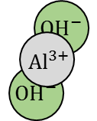
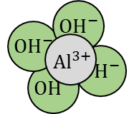
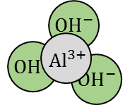
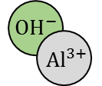
Mechanism of Galvanic Corrosion in Issue
Hydrolysis of ${Al}^{3+}$ makes the solution on the Al acid.
Chemical Reactions:
${{Al}^{3+}+H_{2}O⇄AlOH}^{2+}+H^{+}$, ${Al}^{3+}+2H_{2}O⇄Al{(OH)}_{2}^{+}+2H^{+}$,
${Al}^{3+}+3H_{2}O⇄Al{(OH)}_{3}↓+3H^{+}$, ${Al}^{3+}+4H_{2}O⇄Al{(OH)}_{4}^{−}+4H^{+}$.
Aluminium hydroxide $Al{\left(OH\right)}_{3}$ precipitates($↓$) on the Al surface as white sludge.
Air
Seawater Film
$${Na}^{+}$$
$${Na}^{+}$$
$${Na}^{+}$$
$$H^{+}$$
$${Cl}^{−}$$
$$H^{+}$$
$${OH}^{−}$$
$${OH}^{−}$$
$${OH}^{−}$$
$${Cl}^{−}$$
$$H^{+}$$
$${Cl}^{−}$$
CFRP
Al
Flow of Current
Higher Potential
Lower Potential
Notes:
On the other hand, hydrolysis of ……

Slide 12
Our Method to Solve the Corrosion Problem
Notes:
OK, from here, let me talk about our method to solve the corrosion problem briefly.

Slide 13
Governing Equations
1) Laplace equation in the electrostatic field
$$κ$$ | Electrical conductivity (S m⁻¹)
$$ϕ$$ | Electrostatic potential (V)
$$J$$ | Current density (A m⁻²)
$$C_{i}$$ | Molar concentration of ion $i$ (mol m⁻³)
$$z_{i}$$ | Charge number of ion $i$
$$u_{i}$$ | Mobility of ion $i$ (m² mol J⁻¹ s⁻¹)
$$F$$ | Faraday’s constant (F m⁻¹)
$$D_{i}$$ | Diffusion coefficient of ion $i$ (m² s⁻¹)
$$κ∇^{2}φ=∇J=0$$
2) Mass transport equation
$$\frac{∂C_{i}}{∂t}=−∇∙\left(−z_{i}u_{i}C_{i}F∇φ−D_{i}∇C_{i}\right)+E_{i}\left(C_{i}\right)$$
Electrophoresis
Mass diffusion
Chemical reaction
We solve these 2 eqs. of the multi-physics problem with a weak-coupling method.
Notes:
These two equations are the governing equations in the analysis.
Poisson equation of the electric field gives the distribution of the electrostatic potential.
Mass transport equation gives time-dependent change of the concentration of chemical species.
It consists of the electrophoresis term, the mass diffusion term, and the chemical reaction term.
In this study, we solve these two equations with the weak-coupling method.

Slide 14
Flowchart
Our method adopts the voxel-based finite volume method (Voxel FVM).
Start
Form metal surface and calculate surface area in cells
FVM
Solve electrostatic problem
Corrosion rates are calculated with considering the multi-physics problem.
Calculate mass transports
Voxel method
Consider chemical reactions
Metal shape and surface area are updated.
Update VOF of cells
End
Notes:
Here is the brief flowchart of our method.
Localized corrosion is calculated with voxel-based finite volume method also known as Voxel FVM.
In FVM, corrosion rates are calculated with considering multiphysics problem including electric field, electrophoresis, mass diffusion, and chemical reactions.
In voxel method, metal shape and surface area are updated.
This chart shows the flow of the analysis.

Slide 15
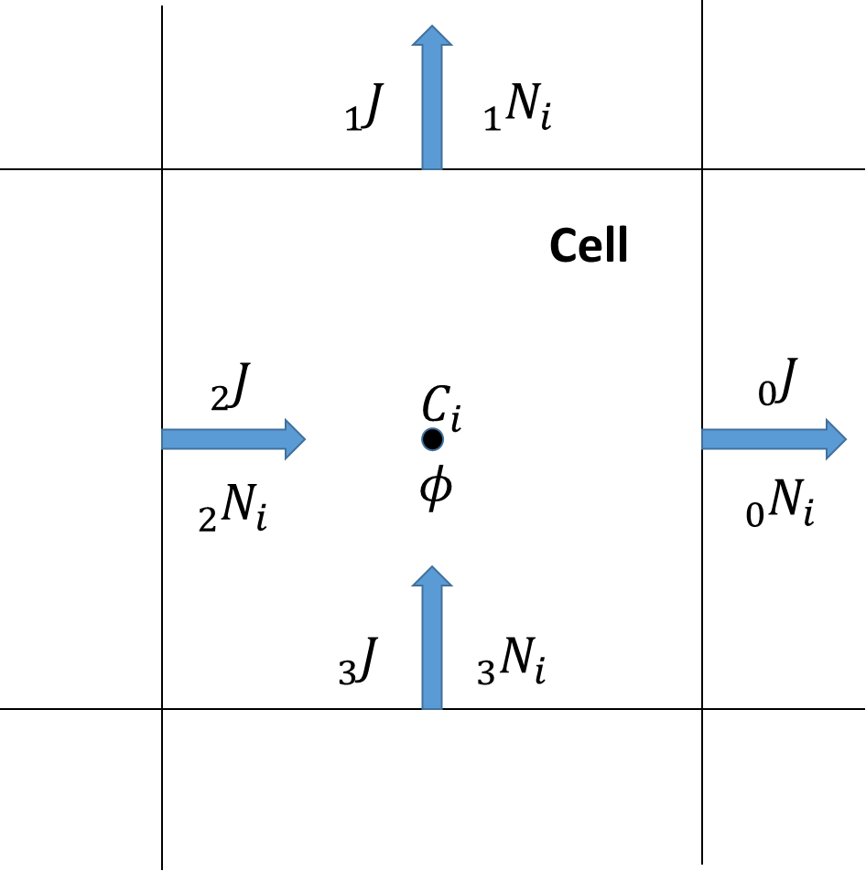
Point 1: Mass Conservation
Voxels are used as the control volumes of FVM.
Due to the adoption of FVM, mass conservation is perfectly satisfied.
[Note] We currently focus on 2D problems, this cell is not a voxel but a pixel in this study.
$$̂$$
$$̂$$
$$\hat{J}$$ | Normal current density (A m⁻²)
$$φ$$ | Electrostatic potential (V)
$${\hat{N}}_{i}$$ | Normal molar flux density of ion i (mol m⁻² s⁻¹)
$$C_{i}$$ | Molar concentration of ion i (mol m⁻³)
$$̂$$
$$̂$$
$$̂$$
$$̂$$
$$̂$$
$$̂$$
Notes:
This is the image of a voxel in our method.
Currently, we focus on 2D problems, this is not a voxel but a pixel in fact.

Slide 16
Point 2: Electroneutrality
The following equation should be considered as an additional constraint of the mass transport analysis.
$\hat{J}=F\sum_{i∈𝕀}{z_{i}{\hat{N}}_{i}}.$
In mass transport analysis, ${\hat{N}}_{i}$s are treated as unknowns and the solution is corrected with a projection method (similar to MAC method in CFD).
Due to this treatment, electroneutrality is perfectly satisfied.
$$\hat{J}$$ | Normal current density (A m⁻²)
$$F$$ | Faraday’s constant (C mol⁻¹)
$$z_{i}$$ | Charge number of ion $i$
$${\hat{N}}_{i}$$ | Normal molar flux density of ion $i$ (mol m⁻² s⁻¹)
Notes:
On the other hand, according to ……
物質移動解析において電気的中性を満たす
拘束条件を満たすΦをｐとして置き換える
これによって電気的中性が満たされる
MAC法

Slide 17
Point 3: Implicit Time Integration
In mass transport analysis with implicit scheme, ${\hat{N}}_{i}$s are treated as unknowns and the solution is given by solving a matrix equation for each time step.
The formulation becomes complicated,
The analysis requires a matrix solver. BUT,
CFL condition needs not to be satisfied and thus large $Δt$ is acceptable.
In total, implicit scheme is faster than explicit scheme.

Slide 18
Boundary Conditions
Polarization
curve
Electrostatic analysis
On CFRP: $\hat{J}=P_{cathode}\left(φ,\text{pH}\right)$,
On Al: $\hat{J}=P_{anode}\left(φ,\text{pH}\right)$,
On Air: $\hat{J}=0$.
Polarization curve represents relationship between $\left(φ, pH\right)$ and $\hat{J}$.
Mass transport analysis
On CFRP: ${\hat{N}}_{i}=\frac{λ_{i}^{CFRP}}{F \sum_{k∈I}{λ_{k}^{CFRP} z_{k}}} \hat{J}$, On Al: ${\hat{N}}_{i}=\frac{λ_{i}^{Al}}{F \sum_{k∈I}{λ_{k}^{Al} z_{k}}} \hat{J}$, On Air: ${\hat{N}}_{i}=0$ (except $O_{2}$), $C_{O_{2}}=const..$
Air
Solution
CFRP
Al
$$\hat{j}$$ | Normal current density (A m⁻²)
$$φ$$ | Electrostatic potential (V)
$${\hat{N}}_{i}$$ | Normal molar flux density of ion $i$ (mol m⁻²)
$$λ_{i}^{CFRP}$$ | Reaction ratio on CFRP of ion $i$
$$λ_{i}^{Al}$$ | Composition ratio of Al of ion $i$
$$z_{i}$$ | Charge number of ion $i$
$$F$$ | Faraday’s constant (C mol⁻¹)
Notes:
The boundary conditions are defined on CFRP, Al, and air.
In the electrostatic analysis, boundary conditions on metal are given by polarization curves.
Polarization curves represent relationship between electrostatic potential and current density for each pH.
others are defined as 0 current density.
In the mass transport analysis, boundary conditions are given by ionic molar flux density as a function of a polarization curve.

Slide 19
Validation of Our Method
Notes:
So let’s continue to the validation of our method.

Slide 20
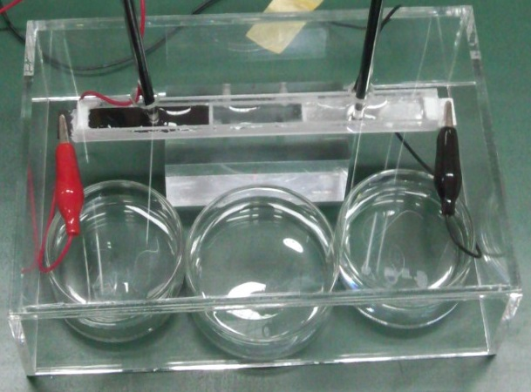
Experimental Setup
Top View Photo
Glassy carbon (GC) is used instead of CFRP for simplicity.
Plastic plate is inserted between GC and Al plates.
NaOH solution is put in an acrylic case with the test piece for CO₂ removal and humidification.
pH meters are set in the middle of each plate.
pH meter
GC
Plastic
Al
NaOH solution
Acrylic case
Notes:
こちらが試験片写真，こちらが側面図になります．
検証例題としてグラッシーカーボンとアルミニウム間に起こるガルバニック腐食について実験と解析を行い提案手法の検証を行いました．
CFRPには繊維があるため
グラッシーカーボン（GC）とアルミ（Al）間のガルバニック腐食実験を行った
簡単のためCFRPでなくGCを用いた
２ｃｍ平方のGCとAｌ板をボンドで貼り付けてテストピースとした．
GC plate instead
2cm*2cmのGCおよびAl板が使われる
板は絶縁性接着剤で接続される
その上に塩水膜を張って電流を測定，pHを測定

Slide 21
Experimental Setup
Side view sketch
Size of each electrode is 40 mm $×$ 10 mm.
Thickness of the NaCl solution film is 2 mm.
Strength of NaCl solution is 0.5 wt%.
Corrosion current is measured by ammeter.
The test time is 72 hours.
Two tests are conducted.
pH meter
pH meter
NaCl solution
2 mm
GC
Plastic
Al
40 mm
32mm
40 mm
A
Notes:
こちらが試験片写真，こちらが側面図になります．
検証例題としてグラッシーカーボンとアルミニウム間に起こるガルバニック腐食について実験と解析を行い提案手法の検証を行いました．
CFRPには繊維があるため
グラッシーカーボン（GC）とアルミ（Al）間のガルバニック腐食実験を行った
簡単のためCFRPでなくGCを用いた
２ｃｍ平方のGCとAｌ板をボンドで貼り付けてテストピースとした．
GC plate instead
2cm*2cmのGCおよびAl板が使われる
板は絶縁性接着剤で接続される
その上に塩水膜を張って電流を測定，pHを測定

Slide 22
Conditions of Numerical Analysis
Analysis domain
Cell size: 1mm $×$ 1 mm.
Chemical species: $H^{+}, {OH}^{−}, {Na}^{+}, {Cl}^{−}, O_{2},$ ${Al}^{3+}, Al{OH}^{2+}, {Al(OH)}_{2}^{+}, Al{\left(OH\right)}_{3}, {Al(OH)}_{4}^{−}$.
Initial conditions: concentrations of each ion.
Electro conductivity: constant $κ$ of 1.0 wt% NaCl solution ($≠0.5$ wt%).
air
solution
2 mm
GC
plastic
Al
40 mm
32mm
40 mm
A
Notes:
幾何形状は実験に合わせてこのように設定しました．
溶液の状態は奥行方向に均一であると仮定して二次元解析を行いました．
境界条件は表のように設定しました．
カソードもアノードも反応はこれら一種類のみが起こると仮定しました．

Slide 23
Conditions of Numerical Analysis
Analysis domain
Chemical Reactions:
${{Al}^{3+}+H_{2}O⇄AlOH}^{2+}+H^{+}$
${Al}^{3+}+2H_{2}O⇄Al{(OH)}_{2}^{+}+2H^{+}$
${Al}^{3+}+3H_{2}O⇄Al{(OH)}_{3}↓+3H^{+}$
${Al}^{3+}+4H_{2}O⇄Al{(OH)}_{4}^{−}+4H^{+}$
$H^{+}+{OH}^{−}⇄H_{2}O$
air
solution
2 mm
GC
plastic
Al
40 mm
32mm
40 mm
A
Simultaneous solutions are given by the bisection method.
Hydrolyses of Al ions
Ionization of H₂O
Notes:
幾何形状は実験に合わせてこのように設定しました．
溶液の状態は奥行方向に均一であると仮定して二次元解析を行いました．
境界条件は表のように設定しました．
カソードもアノードも反応はこれら一種類のみが起こると仮定しました．

Slide 24
Interval Photo Movie of Experiment

Slide 25
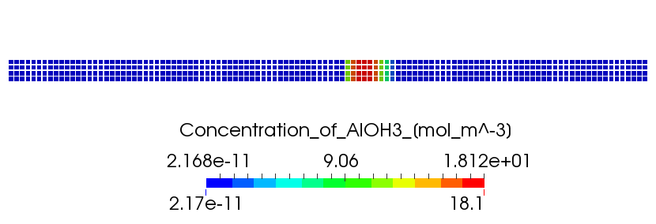
Results (Al(OH)₃ at finish time)
Experiment
White sludge
GC
Al
Numerical simulation
Al(OH)₃
pH 13
pH 3.7
GC
Al
The position of Al(OH)₃ white sludge is well agreed.
Notes:
数値解析結果は溶液内の物理量の分布を色で表します．

Slide 26
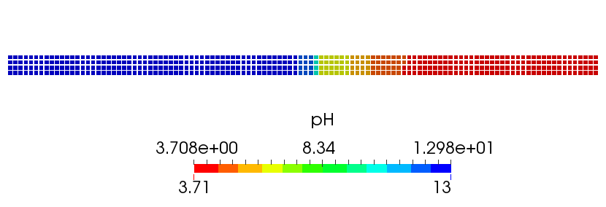
Results (pH at finish time)
Experiment
pH 11
pH 4
Numerical simulation
pH 13
pH 3.7
GC
Al
Probably due to unremoved CO₂.
The simulated pH on GC is a little high in comparison to the experimental result.
Notes:
数値解析結果は溶液内の物理量の分布を色で表します．

Slide 27
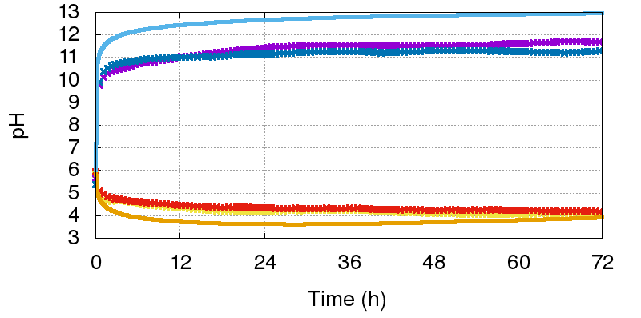
Results (pH time history)
Simulation
on GC
Two Experiments
at positions of pH meters
Two Experiments
on Al
Simulation
The tendencies of pH change are successfully simulated.
The quantitative agreement on GC is our future issue.
Notes:
横軸が時間，縦軸が電流値を表しています．
実験：pH4, pH11.7
実験か数値解析かは口で

Slide 28
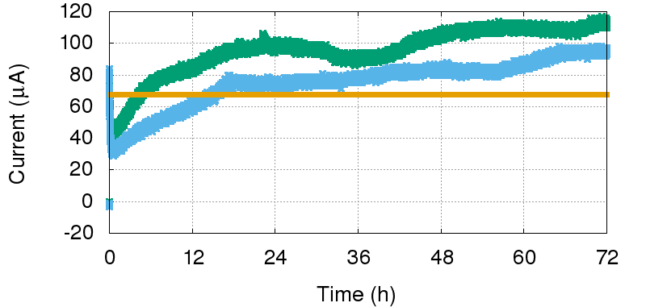
Results (corrosion current time history)
The magnitude of simulated current is approximately agreed with the average of the experimental results.
Yet, the increasing tendency of current could not be reproduced by our present model.
Two Experiments
Corrosion Current ($μA$)
Simulation
The increase in current is probably due to the increase of electro conductivity.
Notes:
横軸が時間，縦軸が電流値を表しています．
写真を見ると沈殿物の堤防が20時間で完成

Slide 29
CPU Time
CPU Time for the 72 h corrosion analysis
Scheme | CPU Time | Speed (vs. Exp.)
Explicit time integration (our previous) | 3 h 48 m 50 s | x 24
Implicit time integration (our new) | 0 h 09 m 08 s | x 470
Our implicit scheme for mass transport analysis enables large $Δt$ and thus is much faster than the conventional explicit scheme.

Slide 30
Summary
Notes:
Well, it’s time to summarize my talk.

Slide 31
Summary
A multi-physics simulator for localized galvanic corrosion was developed.
It takes the followings into account. > electrophoresis > mass diffusion > chemical reactions > moving boundaries > mass conservation > electroneutrality > implicit time integration
A validation test with GC/Al composite revealed that our method was able to reproduce the distributions of pH and white sludge, and corrosion current approximately.
A practical method for localized galvanic corrosion analysis is almost established.
Thank you for your kind attention.
Notes:
Well, it’s time to summarize my talk.

