Slide 1
Performance Evaluation of the
Selective Smoothed Finite Element Method with Deviatoric/Hydrostatic Split
Yuki ONISHI, Kenji AMAYA
Tokyo Institute of Technology (Japan)

Slide 2
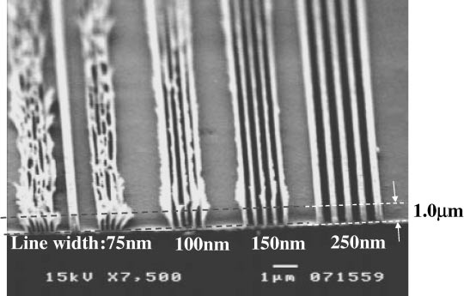
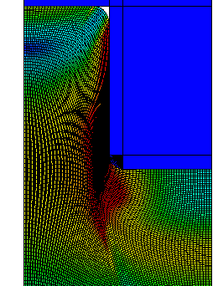
Motivation & Background
Motivation
  We want to analyze severely large
  deformation problems in solids
  accurately and stably!
  (Target: automobile tire, thermal nanoimprint, etc.)
Background
  Finite elements are distorted
  in a short time, thereby resulting
  in convergence failure.
Mesh rezoning method (h-adaptive
mesh-to-mesh solution mapping)
is indispensable.
Mold
Polymer

Slide 3
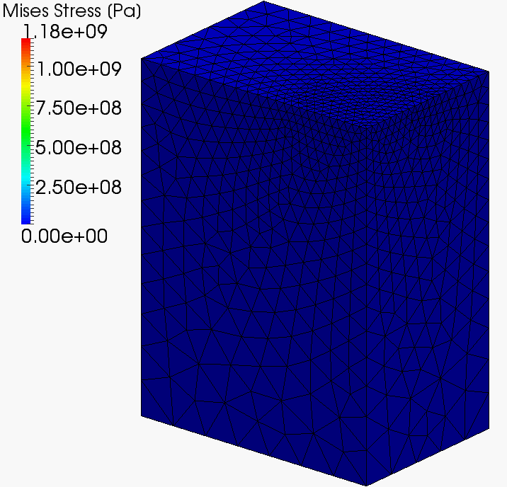
Our First Result in Advance
What we want to do:
Static
Implicit
Large deformation
Mesh rezoning

Slide 4


Issues
The biggest issue
in large deformation mesh rezoning
It is impossible to remesh arbitrary deformed 2D or 3D domains with quadrilateral or hexahedral elements.
However, the standard (constant strain) triangular or tetrahedral elements induce shear and volumetric locking easily, which leads to inaccurate results.
NO
YES
We have to use triangular or tetrahedral elements...

Slide 5
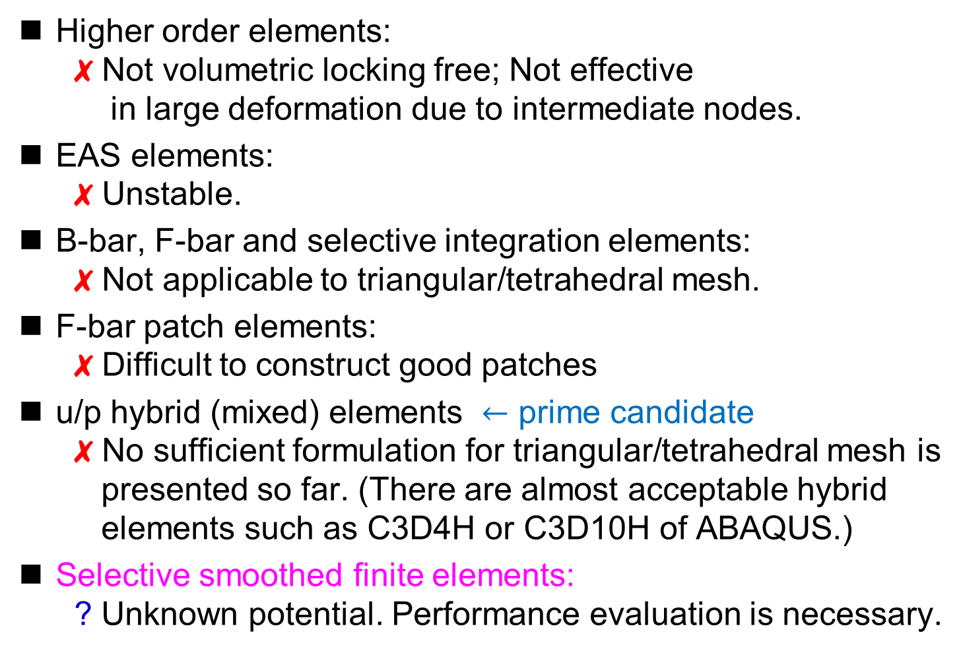
Conventional Methods
Higher order elements:
✗ Not volumetric locking free; Not effective
in large deformation due to intermediate nodes.
EAS elements:
✗ Unstable.
B-bar, F-bar and selective integration elements:
✗ Not applicable to triangular/tetrahedral mesh.
F-bar patch elements:
✗ Difficult to construct good patches
u/p hybrid (mixed) elements $←$ prime candidate
✗ No sufficient formulation for triangular/tetrahedral mesh is
presented so far. (There are almost acceptable hybrid
elements such as C3D4H or C3D10H of ABAQUS.)
Selective smoothed finite elements:
? Unknown potential. Performance evaluation is necessary.

Slide 6
Objective
Performance evaluation
of the selective S-FEMs
for large deformation problems
Table of Body Contents
Part 1: Brief Introduction to the Formulation of
the Selective S-FEMs with Dev/Hyd Split
Part 2: Results of Performance Evaluation
Part 3: Demonstration with Mesh Rezoning
Summary

Slide 7
Part 1:
Brief Introduction to the Formulation of
the Selective S-FEMs with Dev/Hyd Split

Slide 8
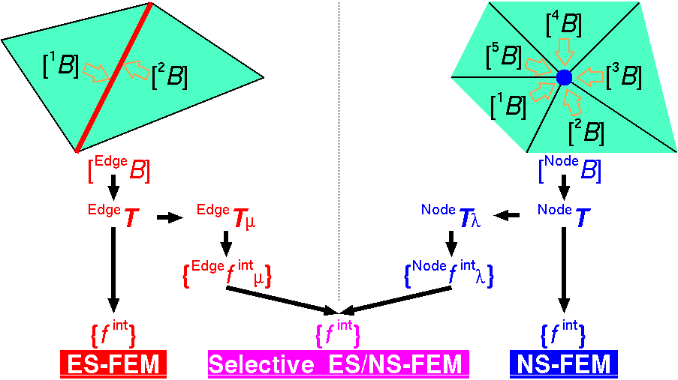

Review of Selective ES/NS-FEM
Separate stress into "$μ$ part" and "$λ$ part", where $μ$ and $λ$ are the Lame's parameters.
F, T etc and {f ^{int}} are calculated on both smoothed domains.
Only applicable to elastic constitutive models.
Substituting
"face"
for
"edge"
gives
FS/NS-FEM
for 3D

Slide 9


Modified Selective ES/NS-FEM
Separate stress into "deviatoric part" and "hydrostatic part"
instead of "$μ$ part" and "$λ$ part".
F, T etc and {f ^{int}} are calculated on both smoothed domains.
Applicable to any kind of material constitutive models.
Substituting
"face"
for
"edge"
gives
FS/NS-FEM
for 3D

Slide 10

3 Types of Selective S-FEMs
Method | Deviatoric Part | Hydrostatic Part
2D ES/NS-FEM-T3 | ES-FEM | NS-FEM
3D ES/NS-FEM-T4 | ES-FEM | NS-FEM
3D FS/NS-FEM-T4 | FS-FEM | NS-FEM
No increase in DOF!!
Displacement vector $\{u\}$ is only the unknown.

Slide 11
Part 2:
Results of Performance Evaluation
focused on the analysis
for hyperelastic materials
without mesh rezoning

Slide 12
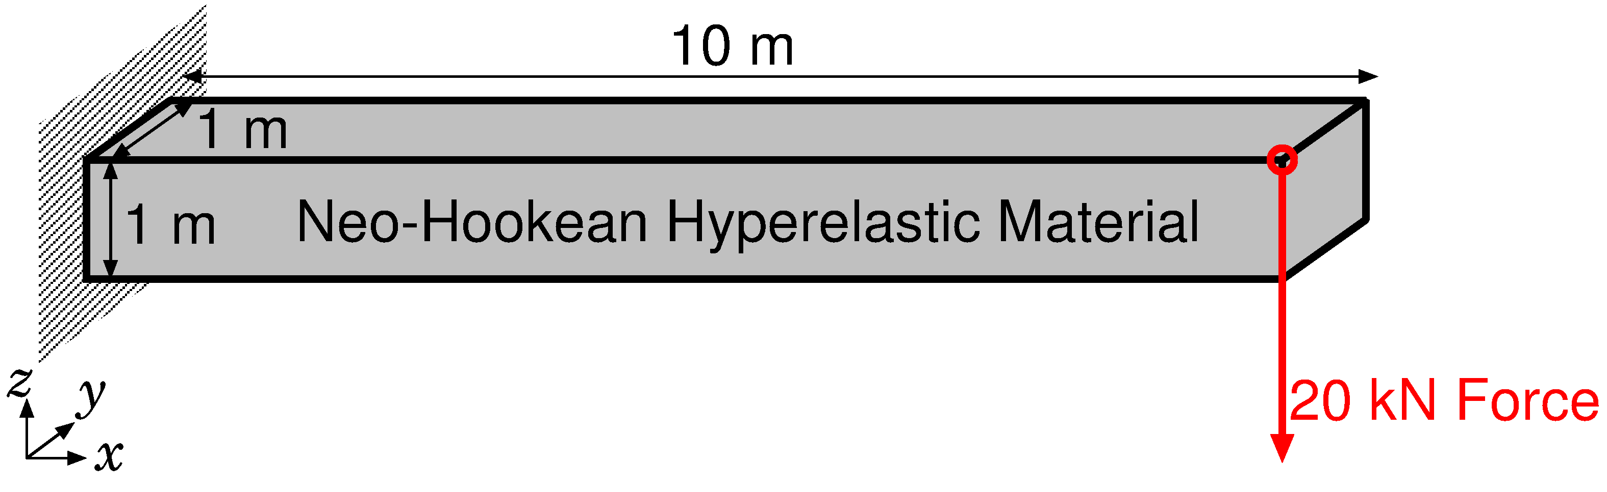
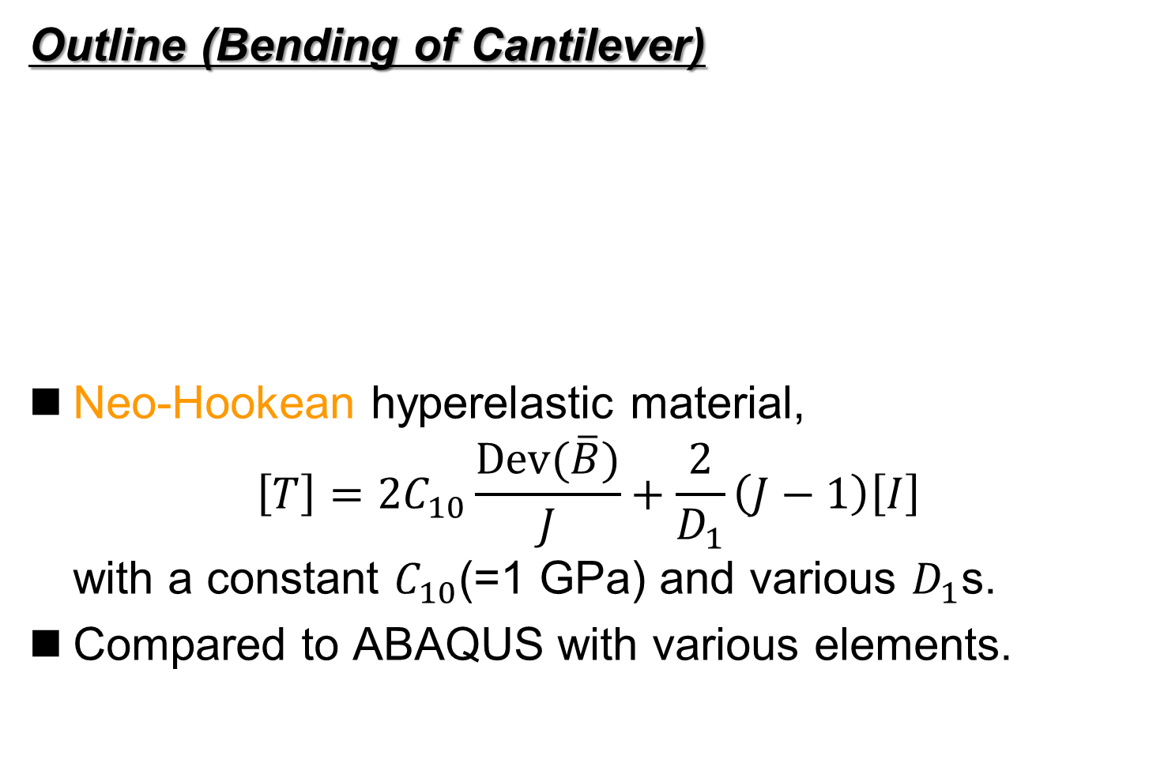
Verification ~ Bending of Cantilever ~
Outline (Bending of Cantilever)
Neo-Hookean hyperelastic material,
$\left[T\right]=2C_{10}\frac{Dev(\overline{B})}{J}+\frac{2}{D_{1}}\left(J−1\right)\left[I\right]$
with a constant $C_{10}$(=1 GPa) and various $D_{1}$s.
Compared to ABAQUS with various elements.

Slide 13
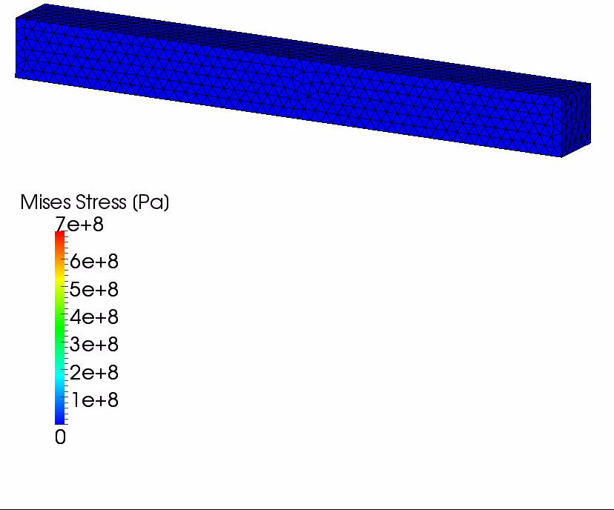

Verification ~ Bending of Cantilever ~
Results with $D_{1}=2×10^{−15} [Pa^{−1}]$ ($ν_{ini}$=0.499999)
The amount of
vertical deflection
is about
6.5 m.

Slide 14
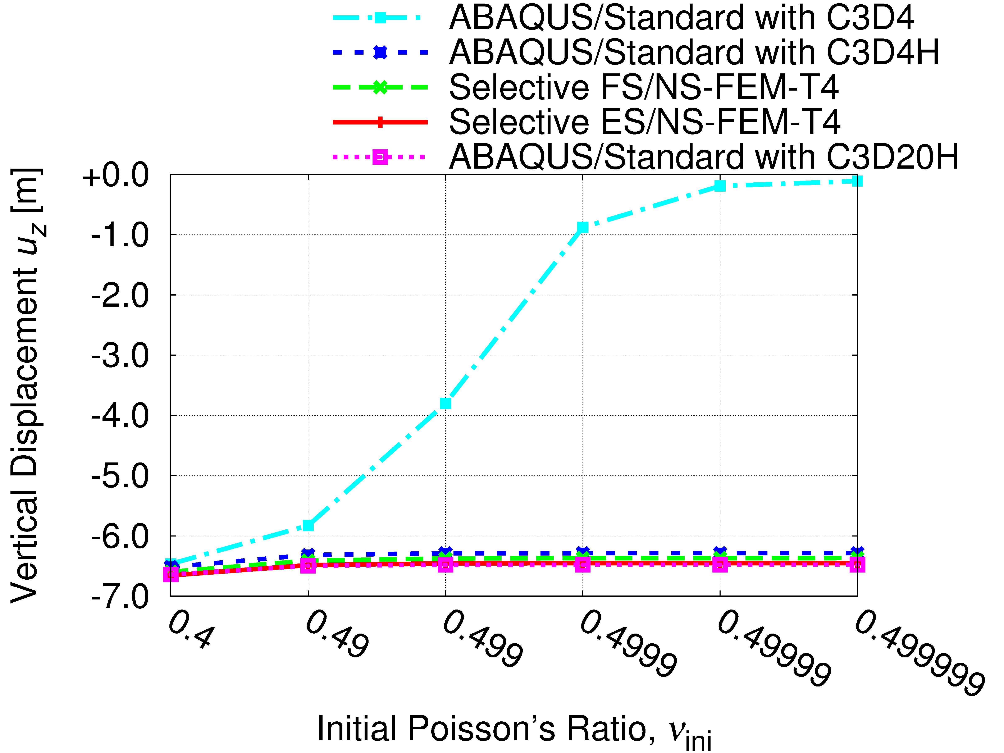
Verification ~ Bending of Cantilever ~
Comparison of Deflection Displacements

Slide 15
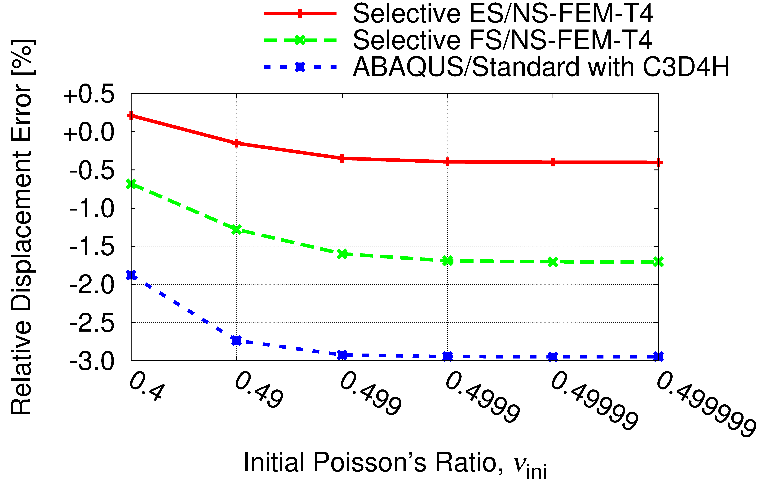
Verification ~ Bending of Cantilever ~
Comparison to 2nd-order Hybrid Hex Element (C3D20H)
Selective S-FEM is locking-free
in large deflection analysis!!

Slide 16
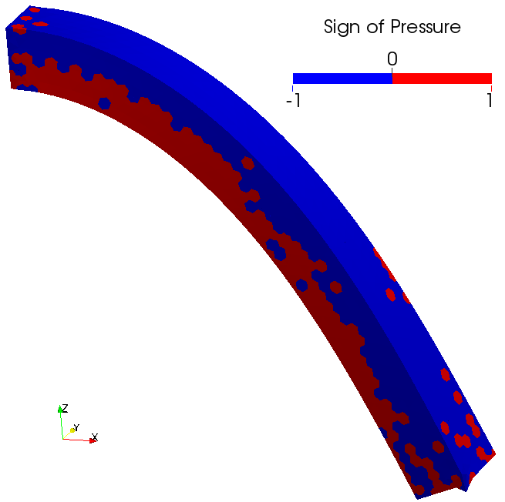
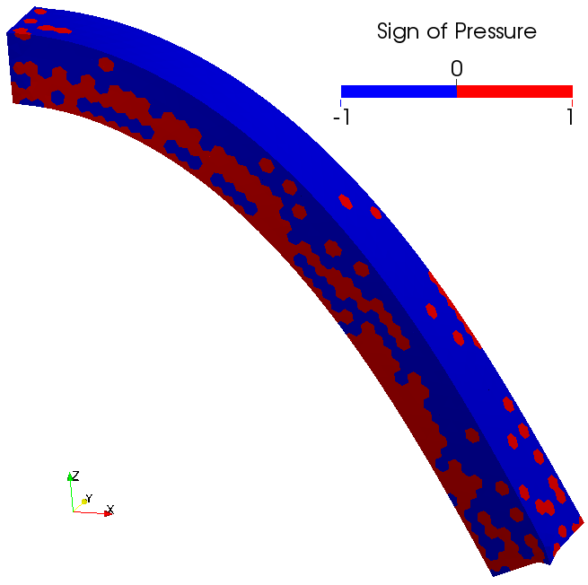

Verification ~ Bending of Cantilever ~
Sign of Pressure at Nodes ($ν_{ini}$=0.499999)
Selective ES/NS-FEM-T4
Selective FS/NS-FEM-T4
Selective S-FEMs suffer from pressure oscillation…

Slide 17
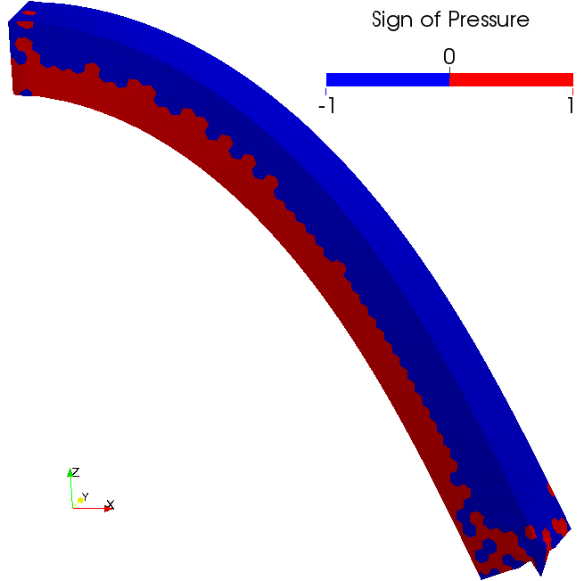

Verification ~ Bending of Cantilever ~
Sign of Pressure at Nodes ($ν_{ini}$=0.499999)
NS-FEM-T4
NS-FEM already suffers from minor pressure oscillation.
The oscillation is magnified a little in Selective S-FEMs.

Slide 18
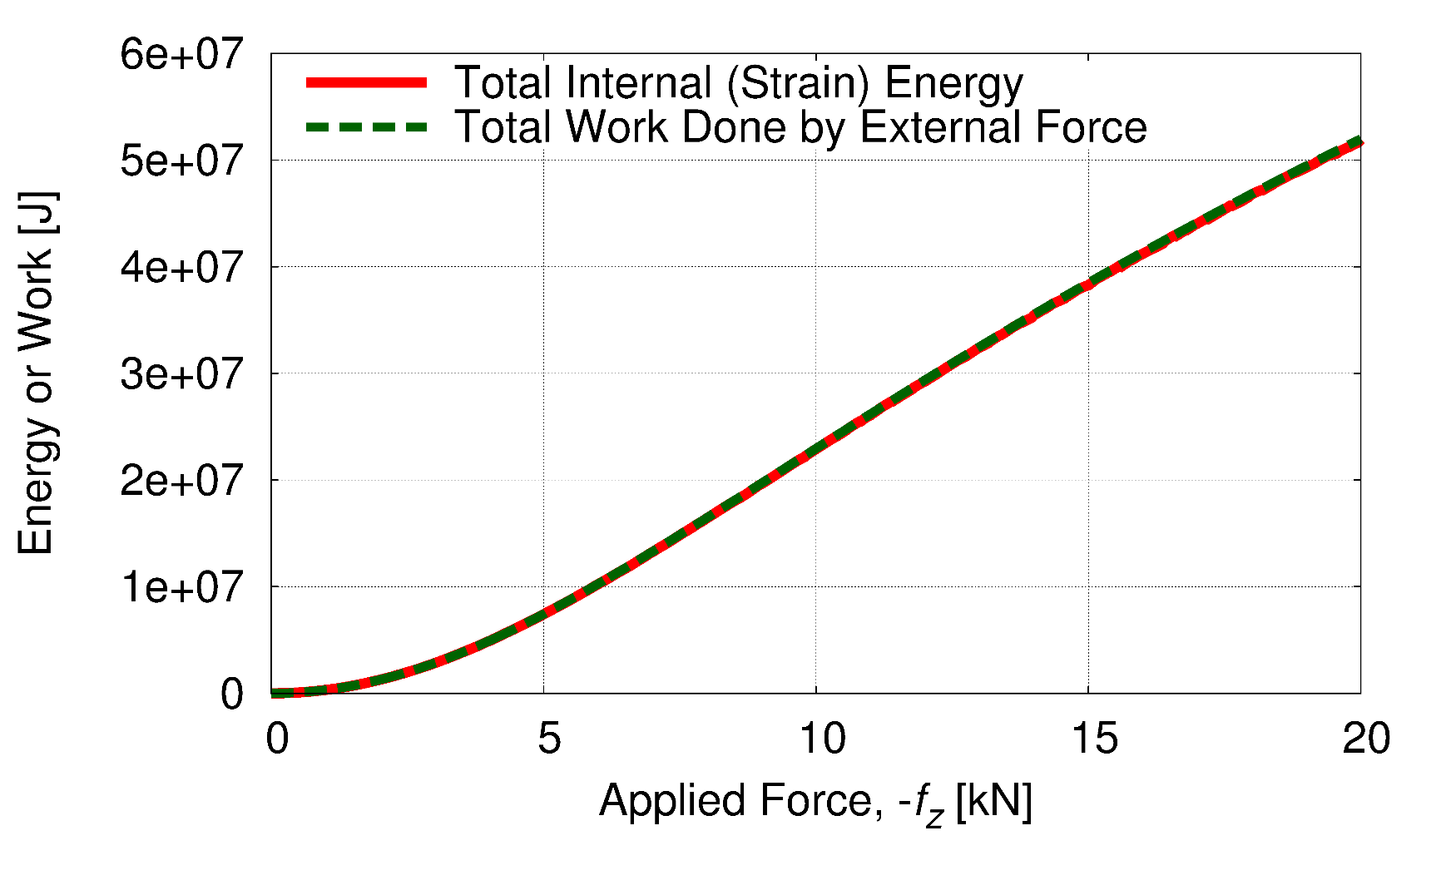

Verification ~ Bending of Cantilever ~
Internal Energy and External Work ($ν_{ini}$=0.499999)
Conservation of energy is exactly satisfied.
$$⟹$$
No energy divergence but pure pressure oscillation.

Slide 19
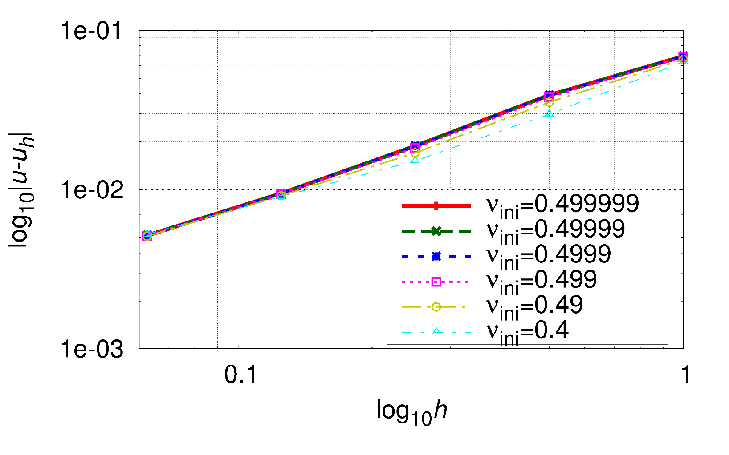
Verification ~ Bending of Cantilever ~
Mesh Size Convergence Rate
(Error of Displacement at the Tip)
Linear convergence as same as the standard 1st-order FEM.

Slide 20
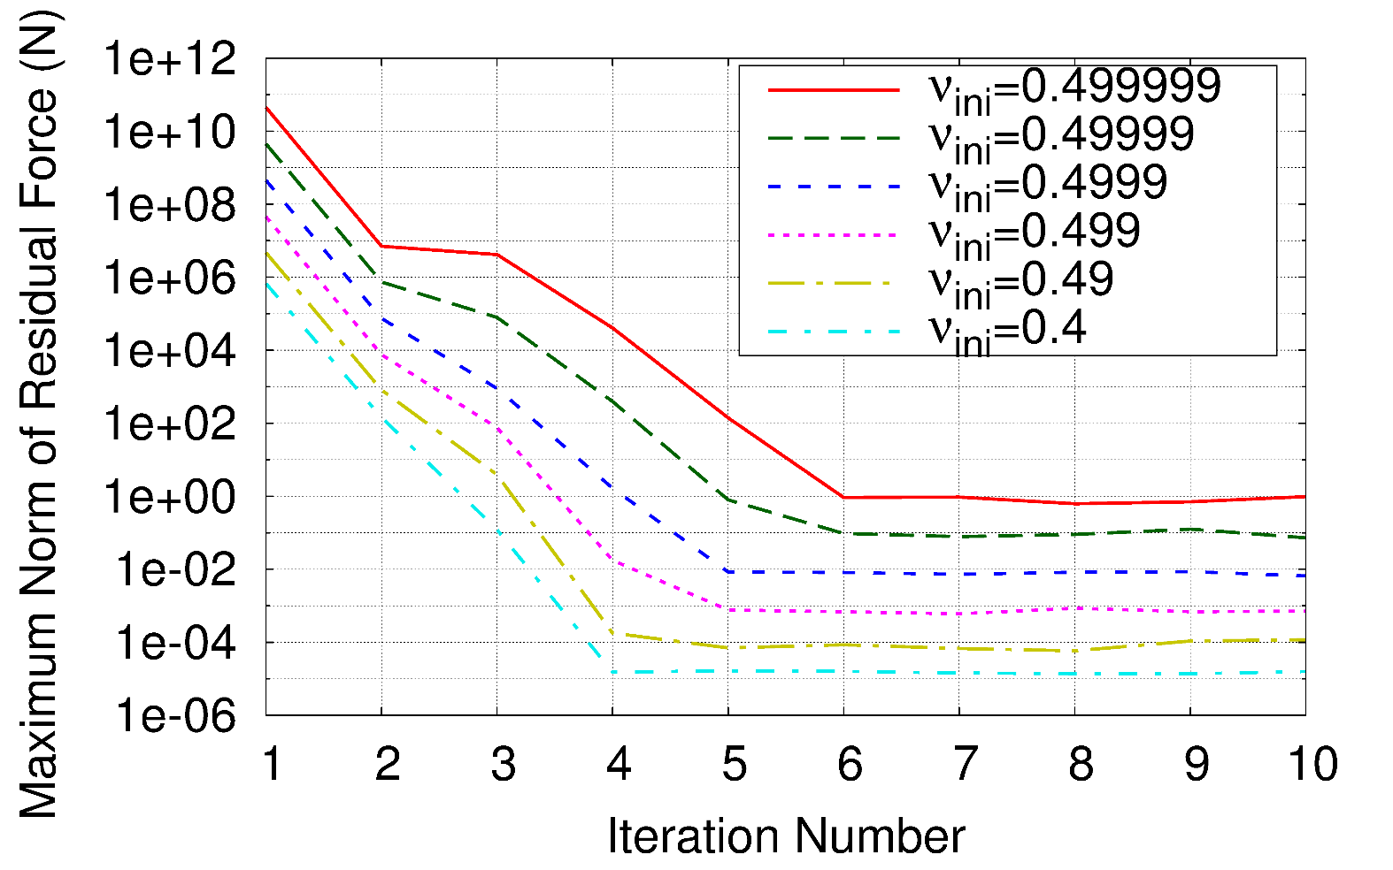
Verification ~ Bending of Cantilever ~
Convergence behavior in Newton-Raphson Loop
(In the 1st timestep)
Convergence rate slightly depends on Poisson’s ratio.
(Probably due to the loss/cancellation of digits in floating-point calculation.)

Slide 21
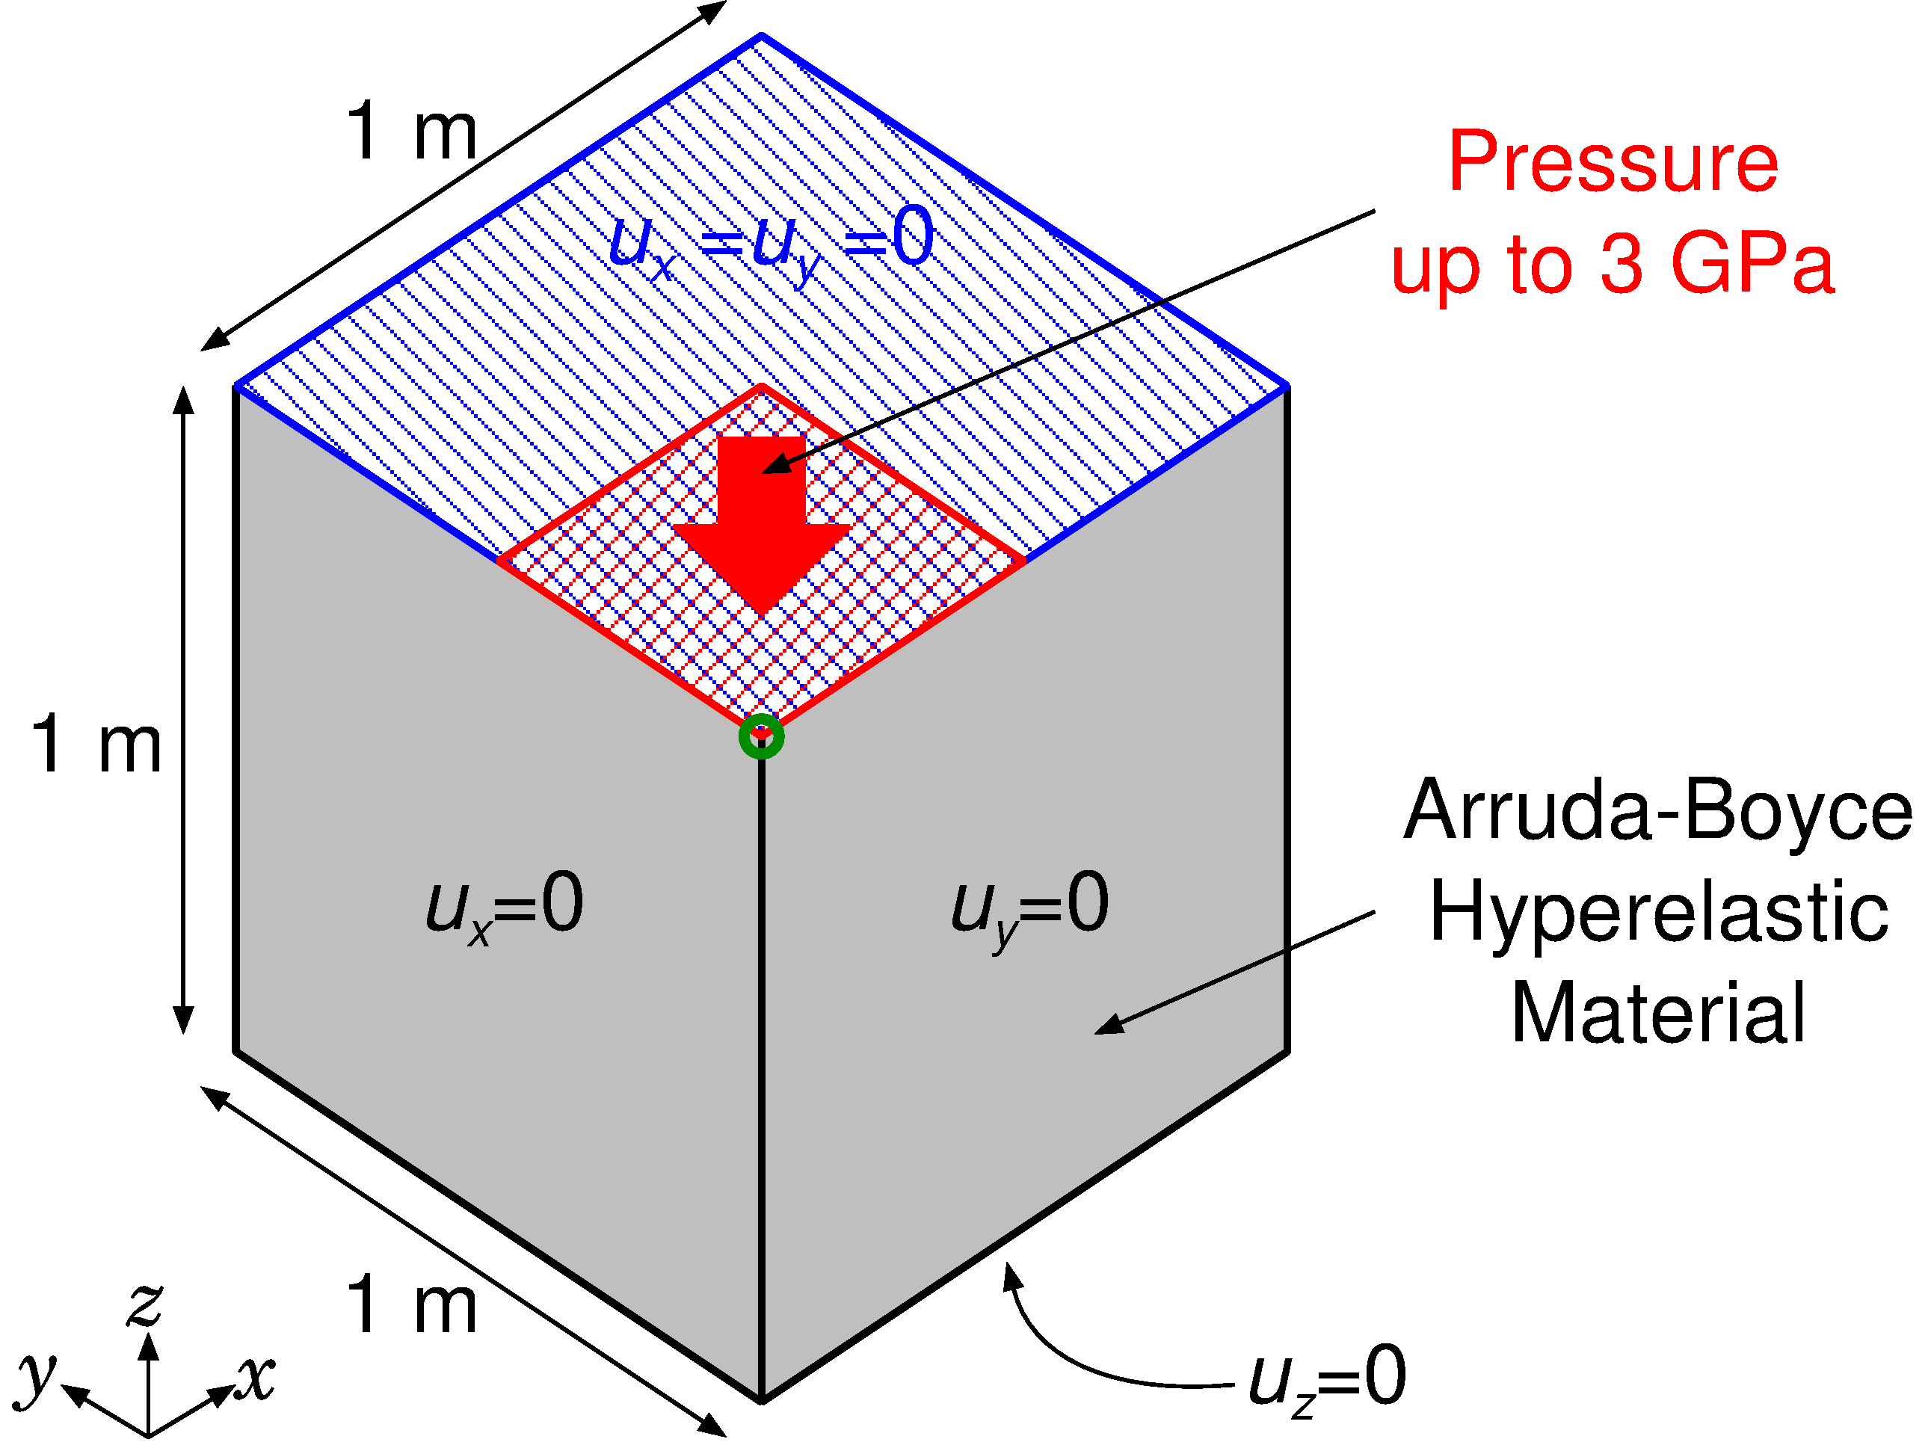

Verification ~Partial Compression of Block ~
Outline
Arruda-Boyce hyperelastic material
with $ν_{ini}=0.4999$.
Compared to ABAQUS with various elements.
on ¼ of top face

Slide 22
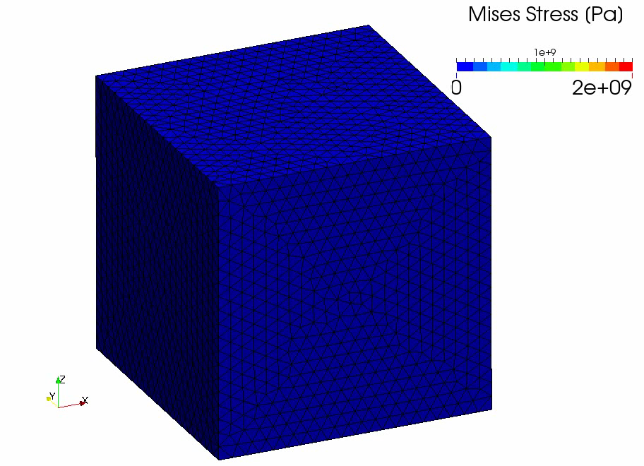
Verification ~Partial Compression of Block ~
Result of
Selective
FS/NS-
FEM-T4

Slide 23
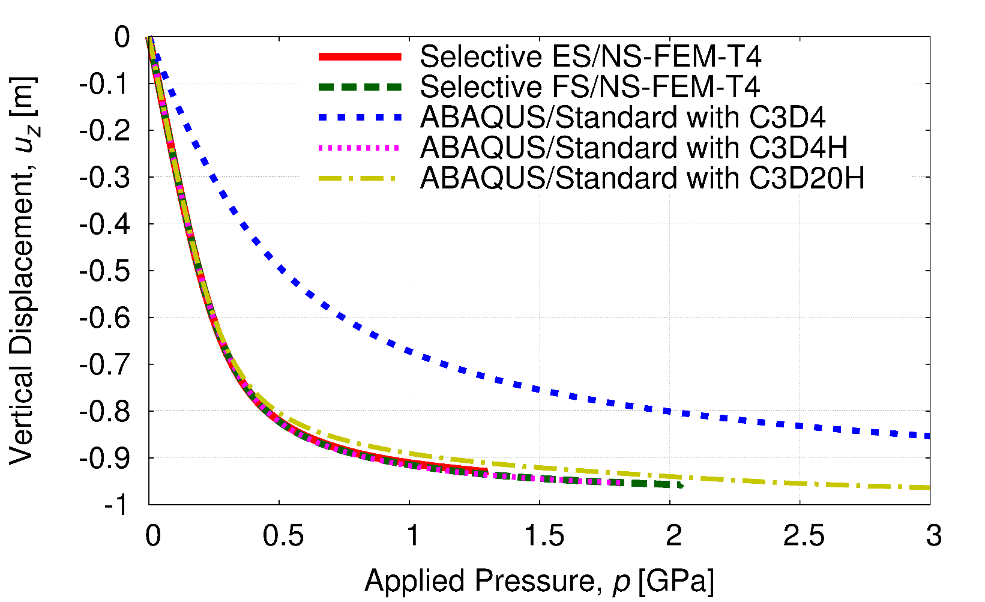
Verification ~Partial Compression of Block ~
Vertical Displacements vs. Applied Pressure
Constant strain element (C3D4) locks quickly.
Other elements including selective S-FEMs do not lock.
Selective S-FEMs are locking-free in large strain analysis!!

Slide 24
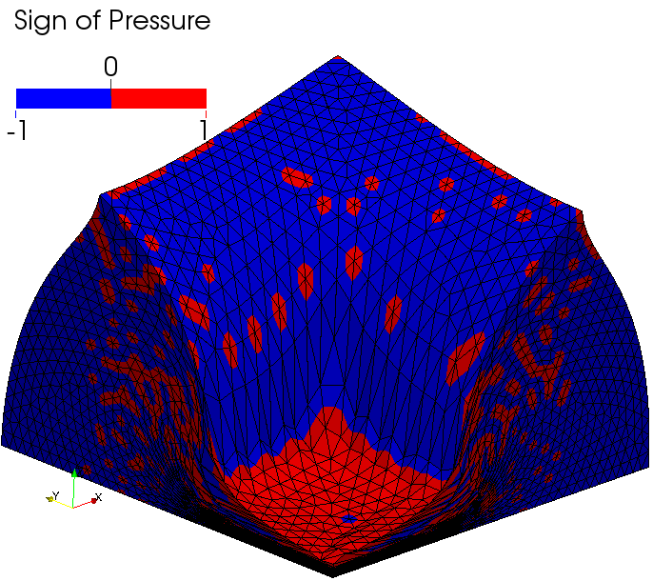
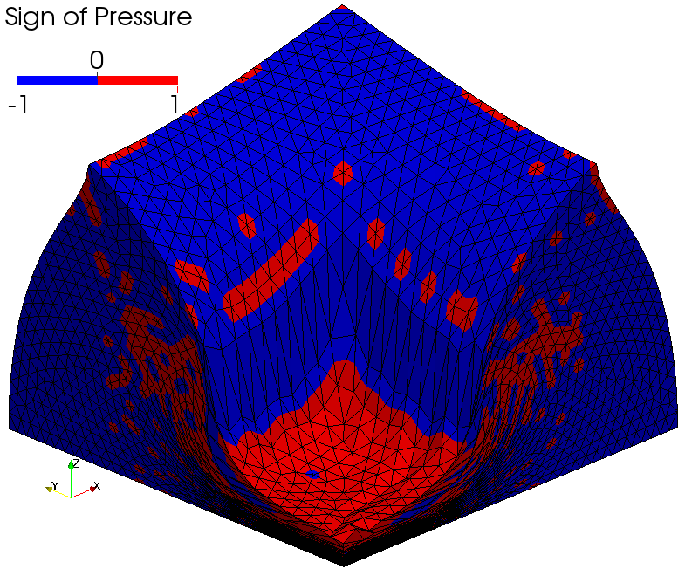
Verification ~Partial Compression of Block ~
Sign of Pressure
Selective ES/NS-FEM-T4
Selective FS/NS-FEM-T4
Pressure oscillation is present as well.

Slide 25
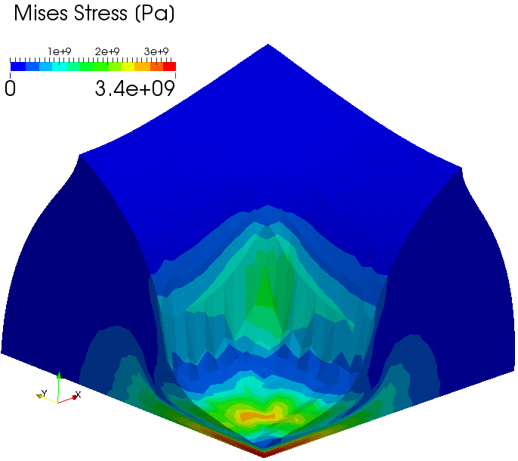
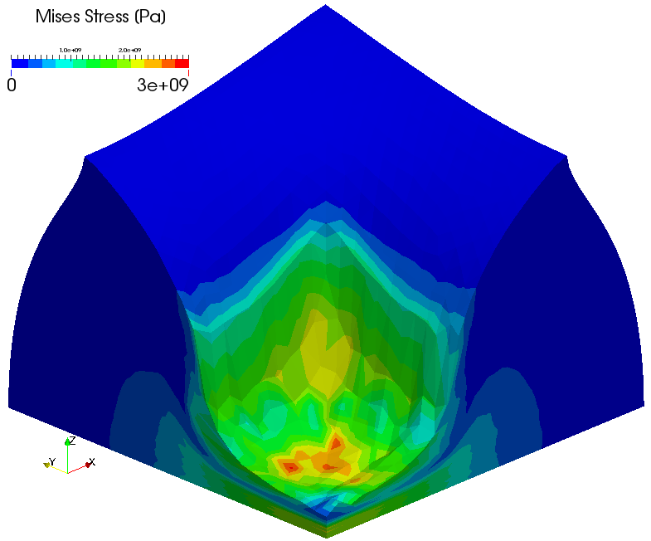
Verification ~Partial Compression of Block ~
Mises Stress
Selective ES/NS-FEM-T4
Selective FS/NS-FEM-T4
Selective S-FEMs cannot prevent locking of corner elements.

Slide 26
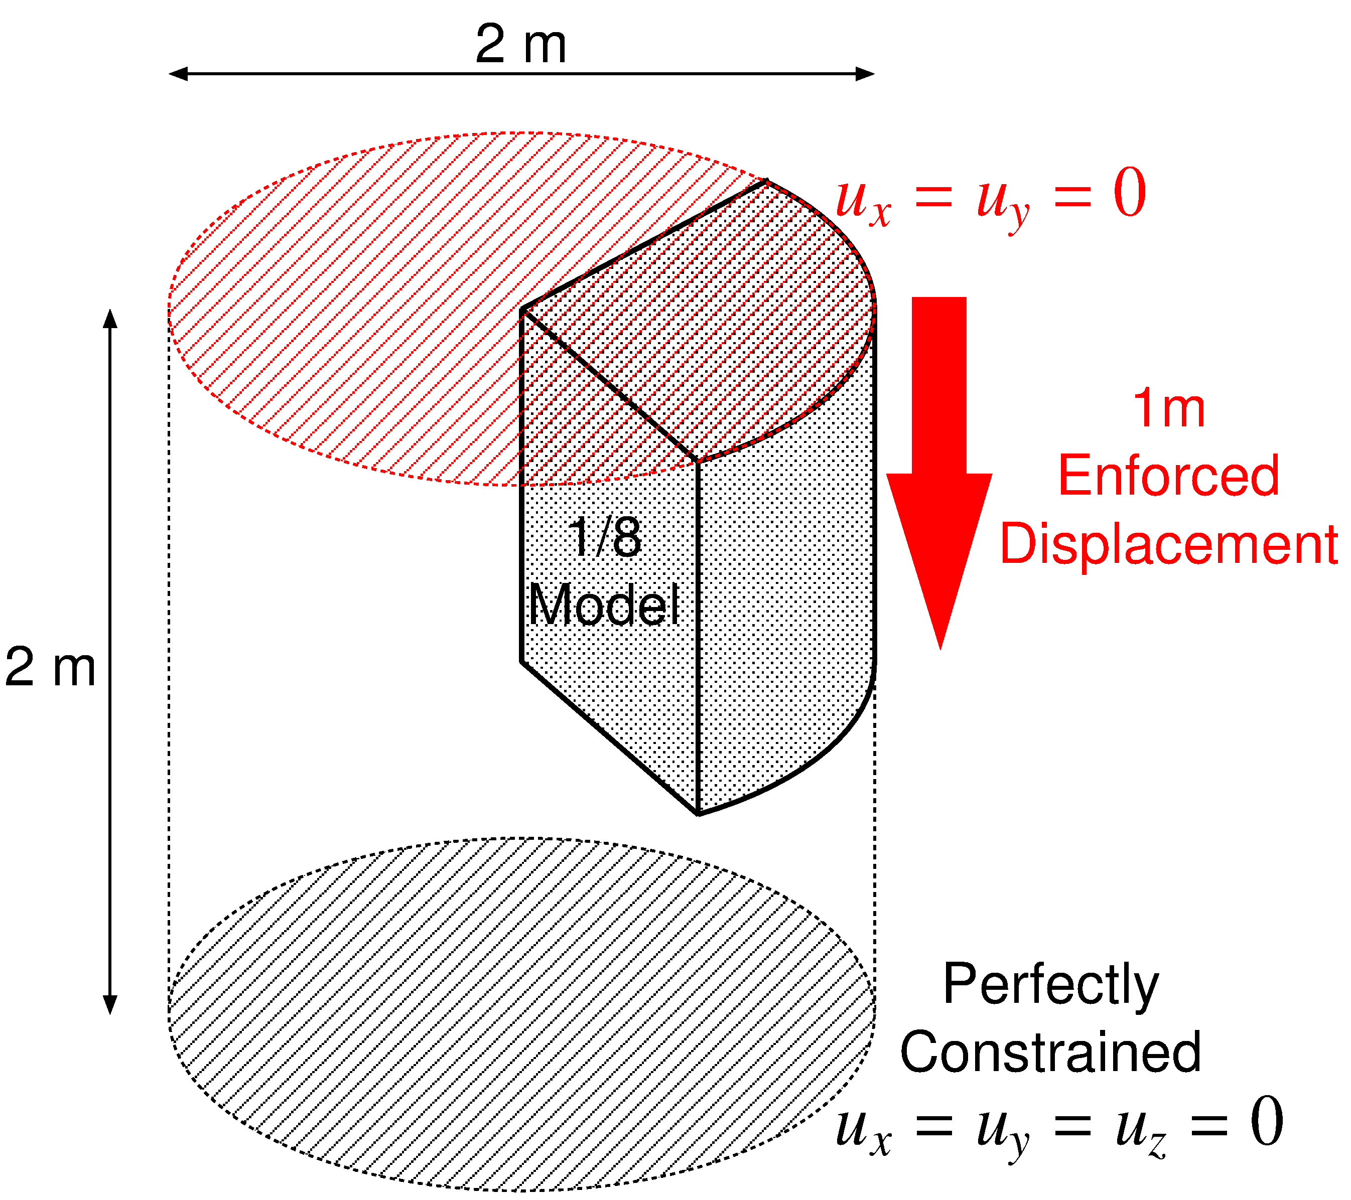

Verification ~ Compression of 1/8 Cylinder ~
Outline
Neo-Hookean hyper elastic material
with $ν_{ini}=0.4999$.
Compared to C3D4H of ABAQUS with exactly the same mesh.
(50% axial compression)

Slide 27
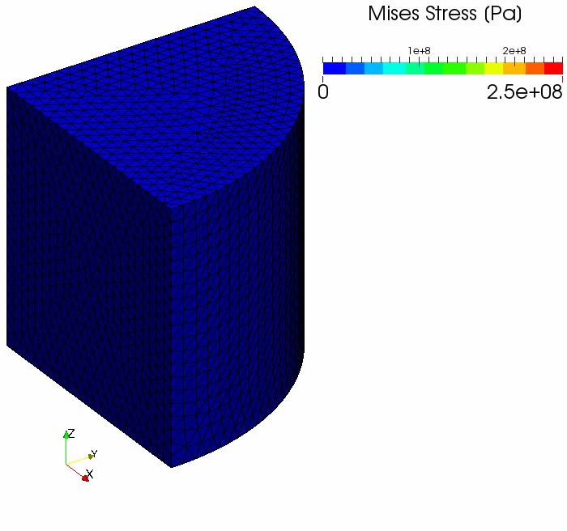
Verification ~ Compression of 1/8 Cylinder ~
Result of
Selective
FS/NS-
FEM-T4

Slide 28
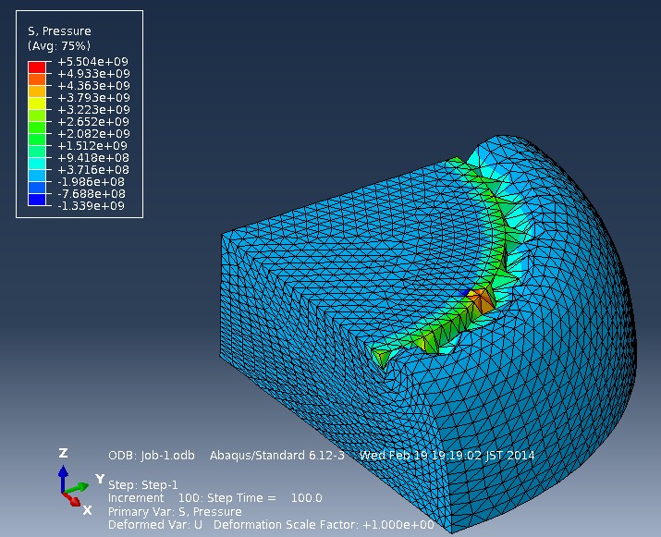
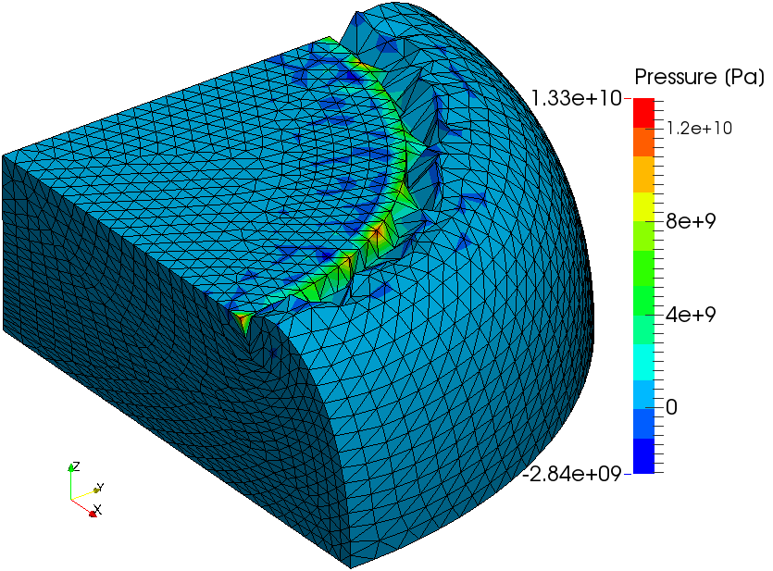
Verification ~ Compression of 1/8 Cylinder ~
Comparison to ABAQUS
Deformation is almost the same each other.
Pressure oscillation is about double in our result.
Locking of corner/edge elements is observed.
C3D4H
of ABAQUS/Standard
Selective
ES/NS-FEM-T4

Slide 29
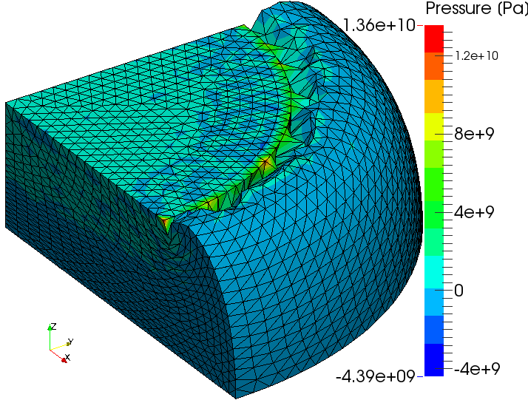
Verification ~ Compression of 1/8 Cylinder ~
Comparison to ABAQUS
Deformation is almost the same each other.
Pressure oscillation is about double in our result.
Locking of corner/edge elements is observed.
C3D4H
of ABAQUS/Standard
Selective
FS/NS-FEM-T4

Slide 30
3 Issues in Selective S-FEMs
Selective S-FEMs with dev/hyd split
cannot handle material constitutive models
with dev/vol coupling terms.
Selective S-FEMs cannot prevent
pressure oscillation in the analysis
with almost incompressible materials.
Selective S-FEMs cannot provide
sufficient smoothing effect
to elements at corners.

Slide 31
Part 3:
Demonstration with Mesh Rezoning

Slide 32
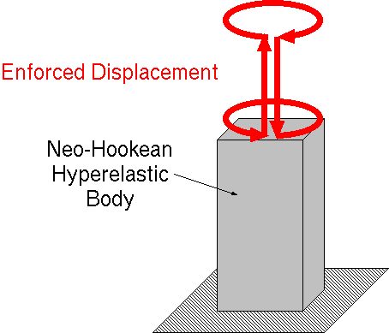
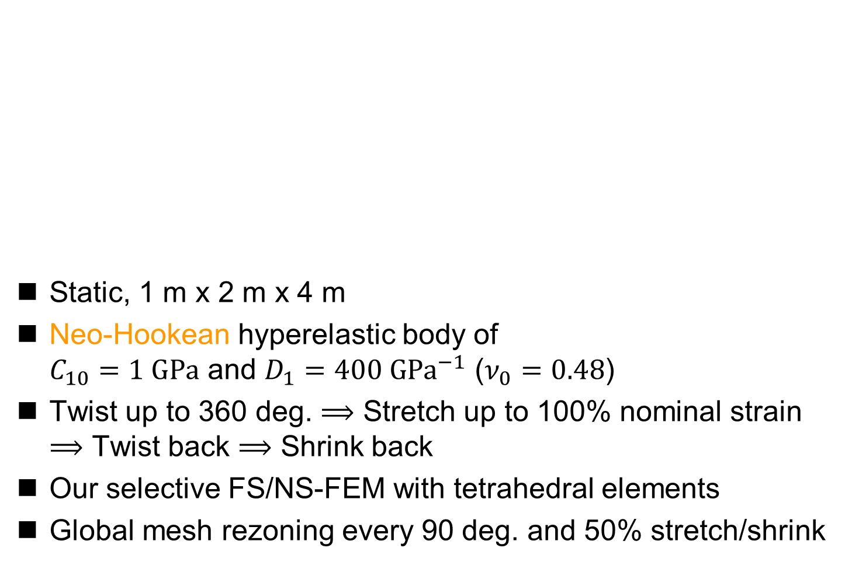
Demo ~ Twist & Stretch of Rubber Cuboid ~
Static, 1 m x 2 m x 4 m
Neo-Hookean hyperelastic body of
$C_{10}=1 GPa$ and $D_{1}=400 GPa^{−1}$ ($ν_{0}=0.48$)
Twist up to 360 deg. $⟹$ Stretch up to 100% nominal strain
$⟹$ Twist back $⟹$ Shrink back
Our selective FS/NS-FEM with tetrahedral elements
Global mesh rezoning every 90 deg. and 50% stretch/shrink

Slide 33
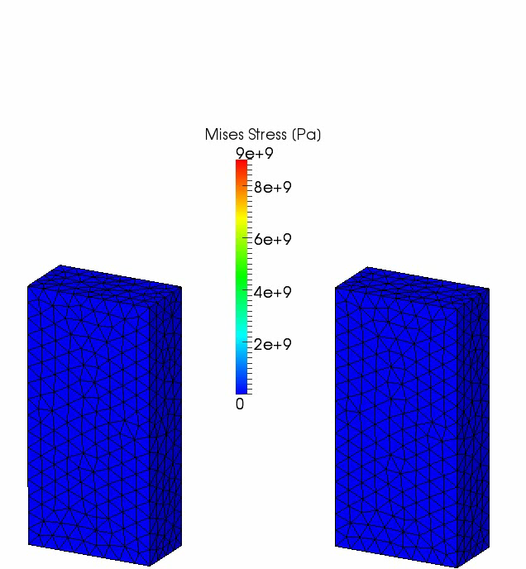
Demo ~ Twist & Stretch of Rubber Cuboid ~
Our selective
FS/NS-FEM
with
mesh rezoning
Our selective
FS/NS-FEM
without
mesh rezoning

Slide 34
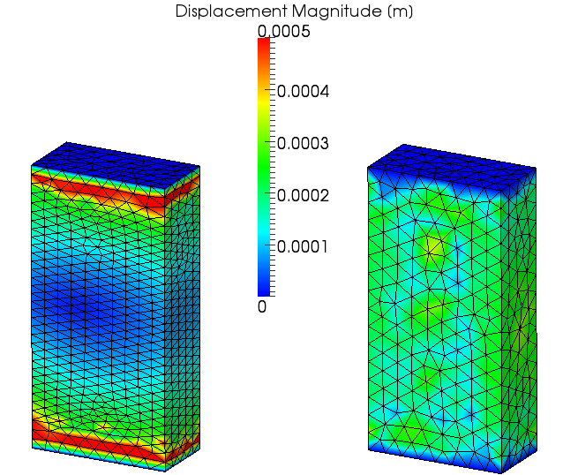
Demo ~ Twist & Stretch of Rubber Cuboid ~
Residual Displacement
It
spring
backed
almost
perfectly.

Slide 35
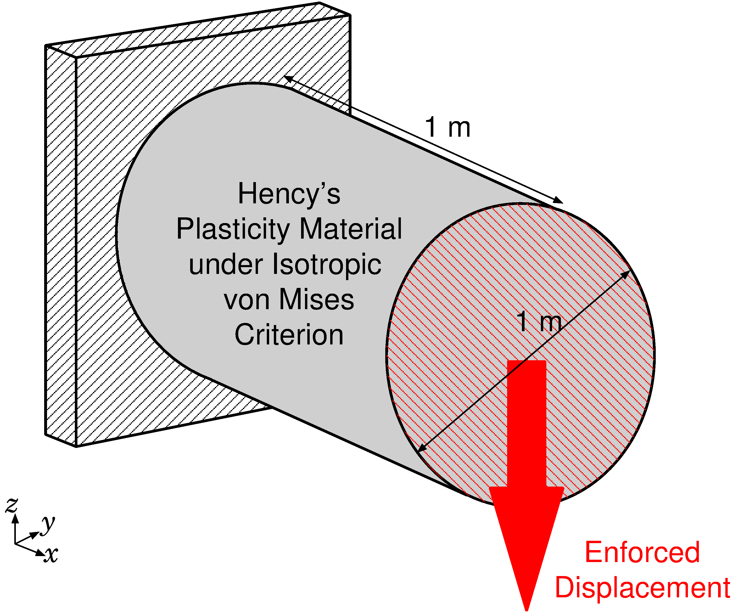

Demo ~ Shearing & Necking of Plastic Rod ~
Outline
Static, 3D
Hencky's elasto-plastic material, $T=C :h_{el}/J$,
with von Mises yield criterion and isotropic hardening.
Young's Modulus: 1 GPa, Poisson's Ratio: 0.3,
Yield Stress: 1 MPa, Hardening Coeff.: 0.5 MPa.

Slide 36
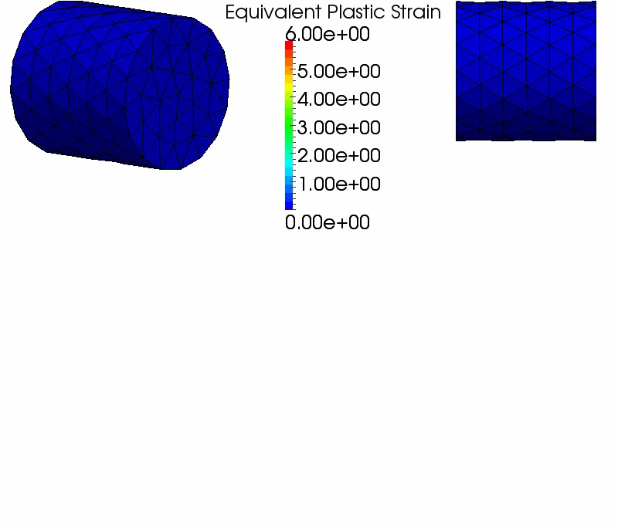
Demo ~ Shearing & Necking of Plastic Rod ~
Result
with
Selective
FS/NS-
FEM-T4
After 2.8 m disp.,
mesh rezoning error occurred.
The final nominal stretch is >7000% at the neck.

Slide 37
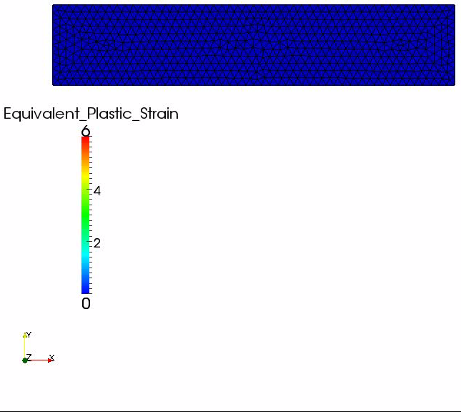
Demo ~ Shearing & Necking of Plastic Rod ~
Result of
Similar
Analysis
in 2D with
Selective
ES/NS-
FEM-T3

Slide 38
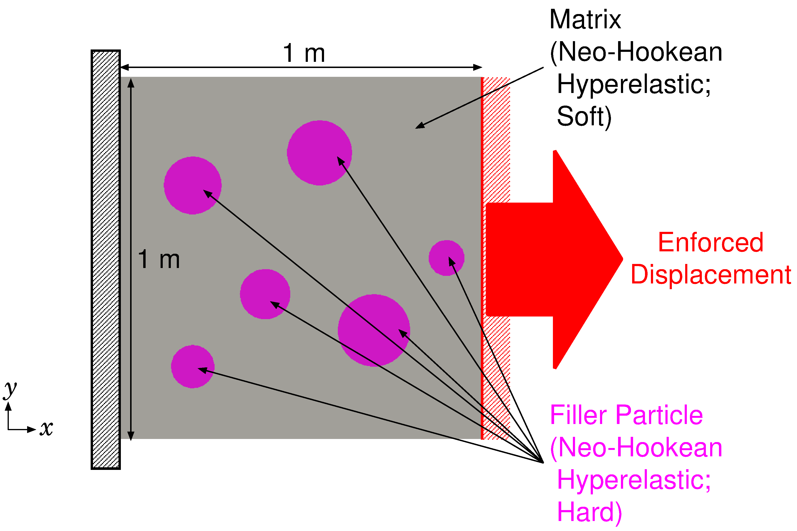

Demo ~Tension of Filler Particle Composite~
Outline
2D, plane-strain, static
Neo-Hookean Hyperelastic
  Filler: hard rubber（$E^{initial}=100 \text{GPa}, { ν}^{initial}=0.49$）
  Matrix: soft rubber（$E^{initial}=1 \text{GPa}, { ν}^{initial}=0.49$）

Slide 39
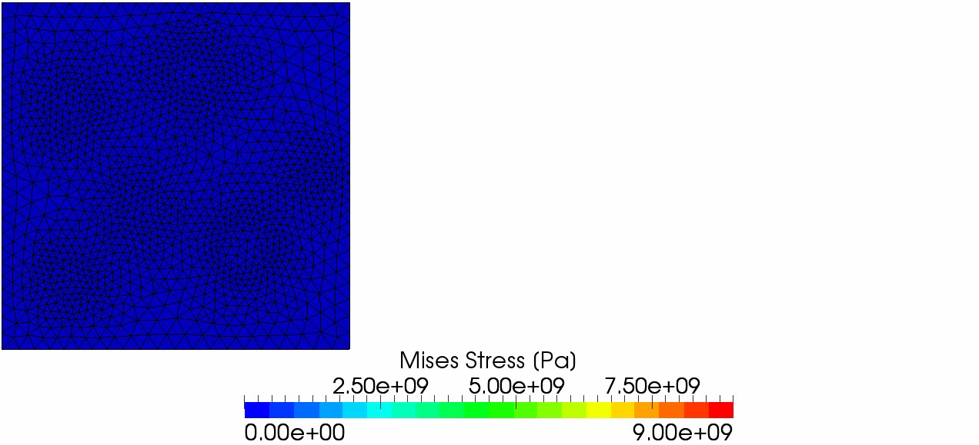
Demo ~Tension of Filler Particle Composite~
Result of Selective ES/NS-FEM-T4
The deformation seems to be valid.
After 180% stretch, analysis stopped due to mesh rezoning error.

Slide 40
Summary

Slide 41
Characteristics of S-FEMs & C3D4H
 | Shear Locking | Volumetric Locking | Zero Energy Mode | No Increase in DOF | Pressure Oscillation & Locking at Corner | Dev/Vol Coupled Material
Standard FEM-T4 | ✗ | ✗ | ✓ | - | ✗ | ✓
ES-FEM-T4 & FS-FEM-T4 | ✓ | ✗ | ✓ | ✓ | ✗ | ✗
NS-FEM-T4 | ✓ | ✓ | ✗ | ✓ | ✗ | ✗
Selective FS/NS-FEM-T4 & ES/NS-FEM-T4 | ✓ | ✓ | ✓ | ✓ | ✗ | ✗
ABAQUS C3D4H | ✓ | ✓ | ✓ | ✗ | ✗ | ✓
Benefit
Issues in Future

Slide 42
Summary and Future Work
Summary
  A new implicit static mesh rezoning method for severely large deformation analysis was proposed.
  It adopts our modified selective S-FEM, which separates stress into deviatoric part and hydrostatic part.
  Its performance was evaluated and then 3 issues were revealed.
Future Work
  Resolve the 3 issues
  Apply to contact forming, crack propagation, etc.
  Explicit dynamic formulation
  Local mesh rezoning
Thank you for your kind attention.
I appreciate your question in slow and easy English!!

