Slide 1
Performance Evaluation of Various Smoothed Finite Element Methods with Tetrahedral Elements in Large Deformation Dynamic Analysis
Ryoya IIDA, Yuki ONISHI, Kenji AMAYA
Tokyo Institute of Technology, Japan

Slide 2
Goal and Requirements
Goal
To analyze large deformation dynamic problems
for rubber-like materials
For such analysis, these 3 properties are required.
(1)Being applied to 4-noded Tet (T4) elements
(2)Stability even in Nearly incompressible materials
(3)Being directly applied to Explicit Dynamics

Slide 3
Requirements (1 of 3): T4 elements
Arbitrary shapes cannot be meshed
into good-quality Hex elements automatically.
✔
✗
Intermediate nodes cause bad-accuracy
in Large deformation problem.
First-order Tet elements (T4) are preferred for such analysis.

Slide 4
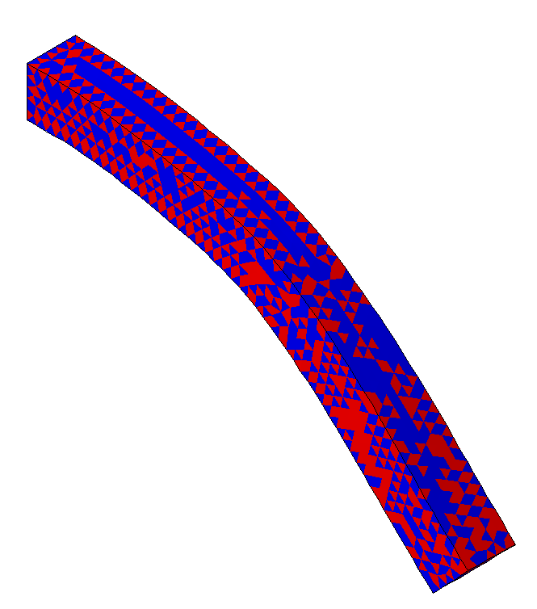
Requirements (2 of 3): Stability for rubber-like materials
Poisson’s ratio: 0.499
Reference solution
Standard T4 elements
✗pressure oscillation
✗shear & volumetric locking
In FE analysis for rubber-like materials,
Pressure oscillation & Locking easily arise.

Slide 5
Requirements (3 of 3): Explicit dynamics
2 types of time integration scheme
Implicit is suitable for long-term problems
Explicit is suitable for short-term problems
u/p hybrid formulations cannot be easily applied to explicit dynamics.
General methods of explicit dynamics
for rubber like materials have not been established !
The advantage of S-FEM is to be directly applied to explicit dynamics

Slide 6
Objective
Objective
To evaluate the performance of competitive S-FEMs
Selective ES/NS-FEM
F-barES-FEM
in explicit dynamics for nearly incompressible materials.
Table of Body Contents
Methods: Quick introduction of S-FEMs
Results & Discussion: A few verification analyses
Summary

Slide 7
Methods
Selective ES/NS-FEM F-barES-FEM

Slide 8
Quick review of S-FEM
Standard FEM
Nodal forces are calculated
by summing up of
each elements’
Integration area
Element
Node
Smoothed-FEM (S-FEM)
ES-FEM sums up each Edge values.
✔ High accuracy in isovolumetric part
without shear locking
NS-FEM sums up each Node values.
✔ High accuracy in volumetric part
with little pressure oscillation

Slide 9
Selective ES/NS-FEM (1 of 2)
Cauchy stress tensor $T$ is derived as
$$T=T^{dev }+T^{hyd}$$

Slide 10
Selective ES/NS-FEM (2 of 2)
This formulation is designed to have 3 advantages.
$$T=T^{dev }+T^{hyd}$$
Deviatoric part
Hydrostatic-pressure part
Like a ES-FEM
1. Shear locking free
Like a NS-FEM
2. Little pressure oscillation
3. Volumetric locking free

Slide 11
F-barES-FEM (1 of 3)
Deformation gradient of each edge, $\overline{F}$ is derived as
$$\overline{F}={\tilde{F}}^{iso}∙{\overline{F}}^{vol}$$
ES-FEM

Slide 12
F-barES-FEM (2 of 3)
Each part of $\overline{F}$ is calculated as
$$\overline{F}={\tilde{F}}^{iso}∙{\overline{F}}^{vol}$$
Isovolumetric part
Volumetric part
(1)
(2)
Smoothing the value of adjacent elements.
↓
The same manner as
ES-FEM
(1)Calculating node’s value by smoothing
the value of adjacent elements
(2)Calculating elements’ value by smoothing
the value of adjacent nodes
(3)Repeating (1) and (2) a few times

Slide 13
F-barES-FEM (3 of 3)
This formulation is designed to have 3 advantages.
$$\overline{F}={\tilde{F}}^{iso}∙{\overline{F}}^{vol}$$
Isovolumetric part
Volumetric part
Like a ES-FEM
1. Shear locking free
Like a NS-FEM
2. Little pressure oscillation
3. Volumetric locking free with the aid of F-bar method

Slide 14
Characteristics of S-FEMs
Selective ES/NS-FEM decomposes this part
✗ Constitutive models are restricted
Deformation
$ε, F$
Stress
$$T$$
Displacement
$$u$$
Internal force
$$f^{int}$$
F-barES-FEM decomposes this part.
✗ Stiffiness matrix becomes asymmetric
Both of S-FEMs have disadvantages…

Slide 15
Equation to solve
Equation of Motion
$\left[M\right]\left\{\ddot{u}\right\}=\left\{f^{ext}\right\}−\{f^{int}\}$,
Internal force vector is calculated as
Selective ES/NS-FEM
$$\left\{f^{int}\right\}=\sum_{Edge}{\left[{\tilde{B}}^{Edge}\right]\left\{{\tilde{T}}^{dev}\right\}V}+\sum_{Node}{\left[{\tilde{B}}^{Node}\right]\left\{{\tilde{T}}^{hyd}\right\}V}$$
F-barES-FEM $$\left\{f^{int}\right\}=\sum_{Edge}{\left[{\tilde{B}}^{Edge}\right]\left\{\overline{T}\right\}V}$$
Dev. parts are
derived from ES-FEM
Hyd. parts are
derived from NS-FEM
Defenition of $\left\{f^{int}\right\}$ in the same fashion as F-bar method
$B$-matrix of ES-FEM
Stress derived from $\overline{F}$

Slide 16
Result & Discussion

Slide 17
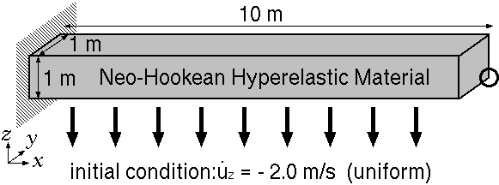
Bending of a cantilever
Dynamic explicit analysis.
Neo-Hookean material Initial Young’s modulus: 6.0 MPa, Initial Poisson’s ratio: 0.499, Density: 10000 kg/m³.
Compare the results of S-FEMs with Selective H8 (ABAQUS/Explicit C3D8) elements.

Slide 18
Result of Standard T4 elements
at $t=1.5$ s
ABAQUS/Explicit
C3D8
(Reference)
Standard T4 element
×pressure oscillation
×locking
The result of standard T4 elements is useless…

Slide 19
Time history of deformed shapes
ABAQUS/Explicit
C3D8
Reference
Selective ES/NS-FEM
F-barES-FEM
(2)
NS-FEM
All of S-FEMs are locking free.
F-barES-FEM shows good result in earlier stage
but gets worse in later stage.
Selective ES/NS-FEM and NS-FEM cannot suppress pressure oscillation…

Slide 20
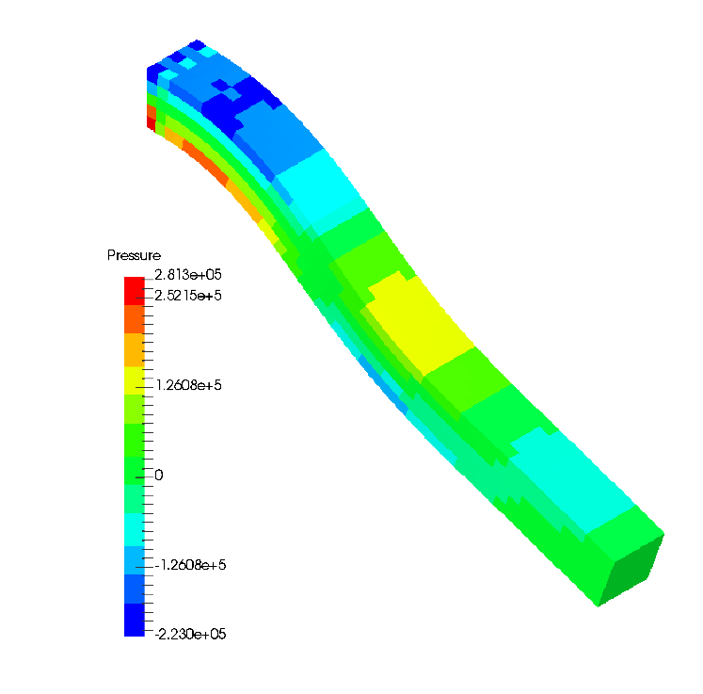
Deformed shapes and pressure distributions
at $t=1.5$ s
ABAQUS/Explicit C3D8
(Reference)
Selective
ES/NS-FEM
NS-FEM
Selective ES/NS-FEM and NS-FEM cannot suppress pressure oscillation due to the insufficient smoothing.

Slide 21
Deformed shapes and pressure distributions
at $t=1.5$ s
ABAQUS/Explicit C3D8
(Selective H8 element)
Reference
F-barES-FEM(2)
F-barES-FEM(2) is comparable to Selective H8 element!

Slide 22
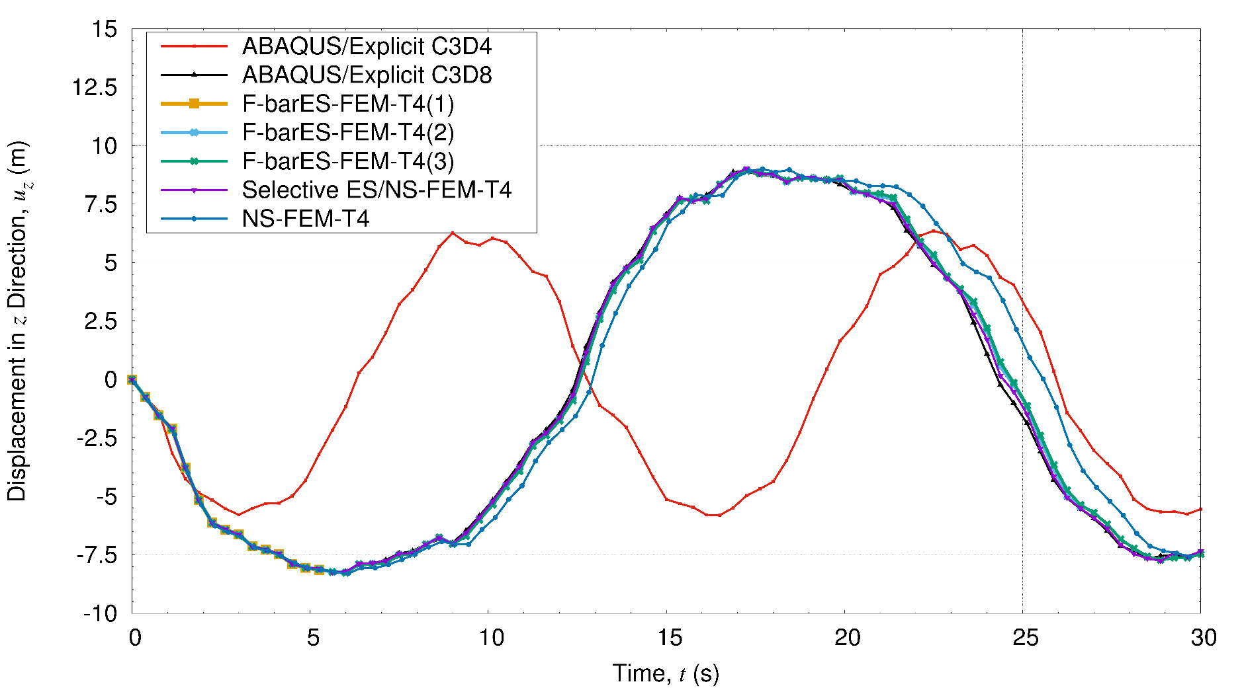
Time history of displacement
NS-FEM
Reference
Selective ES/NS-FEM
F-barES-FEM
NS-FEM shows slightly soft result.
Selective ES/NS-FEM and F-barES-FEM agree with the reference.

Slide 23
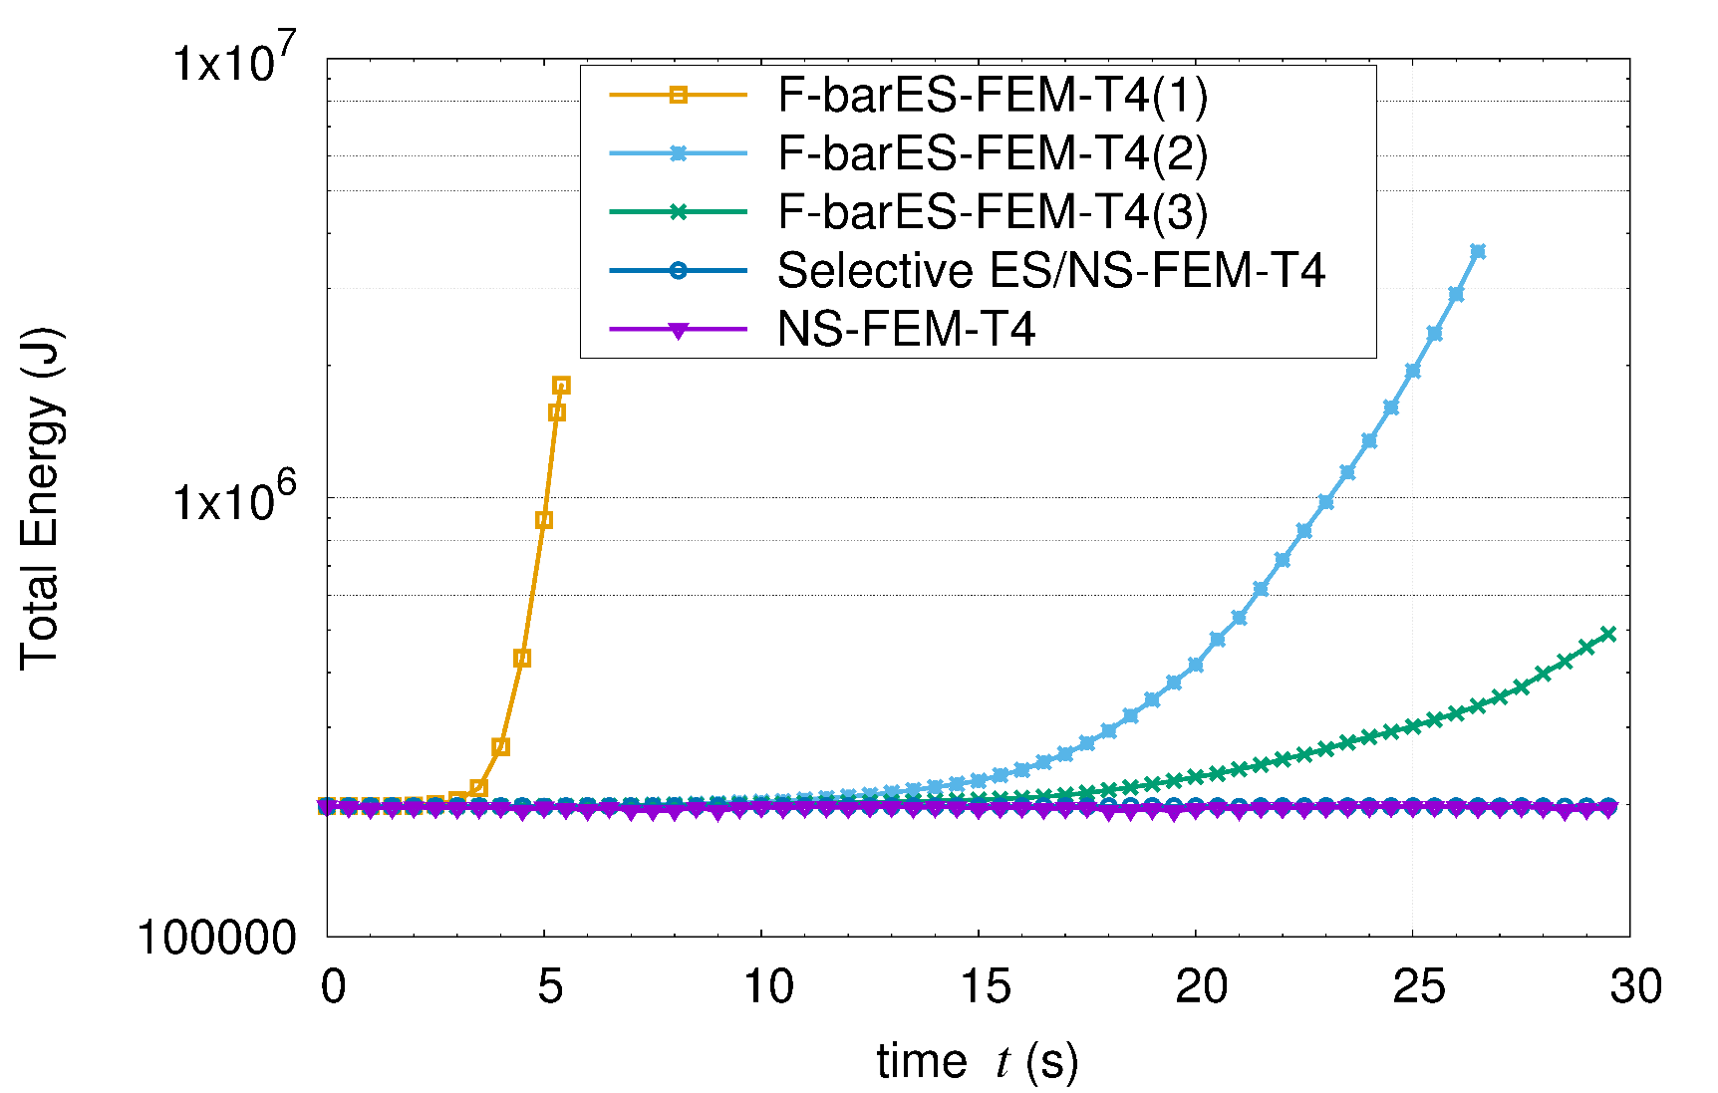
Time history of total energy
F-barES-FEM causes energy divergences in earlier stage…
Increasing the number of smoothings suppresses the speed of divergence.

Slide 24
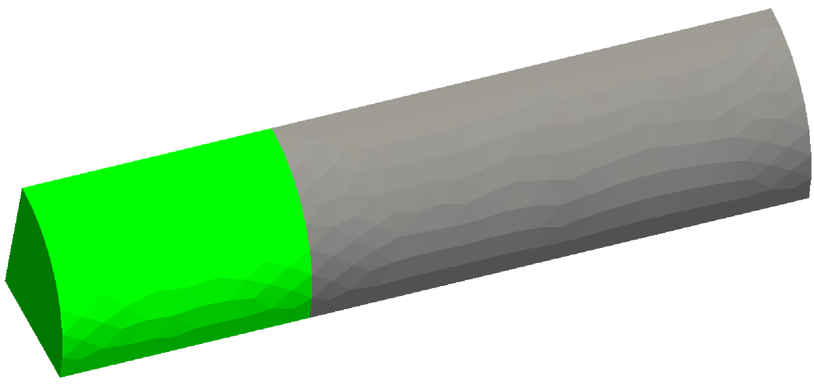
Natural Modes of ¼ Cylinder
Outline
Iron part: $E_{ini}=200 GPa, ν_{ini}=0.3, ρ=7800 kg/m^{3}$, Elastic, No cyclic smoothing.
Rubber part: $E_{ini}=6 MPa, ν_{ini}=0.499, ρ=920 kg/m^{3}$, Elastic, 1 or 2 cycles of smoothing.
Compare S-FEMs with ABAQUS C3D4 and C3D8.
In Plane Slide
Rubber Part
Fixed
In Plane Slide
Iron Part

Slide 25
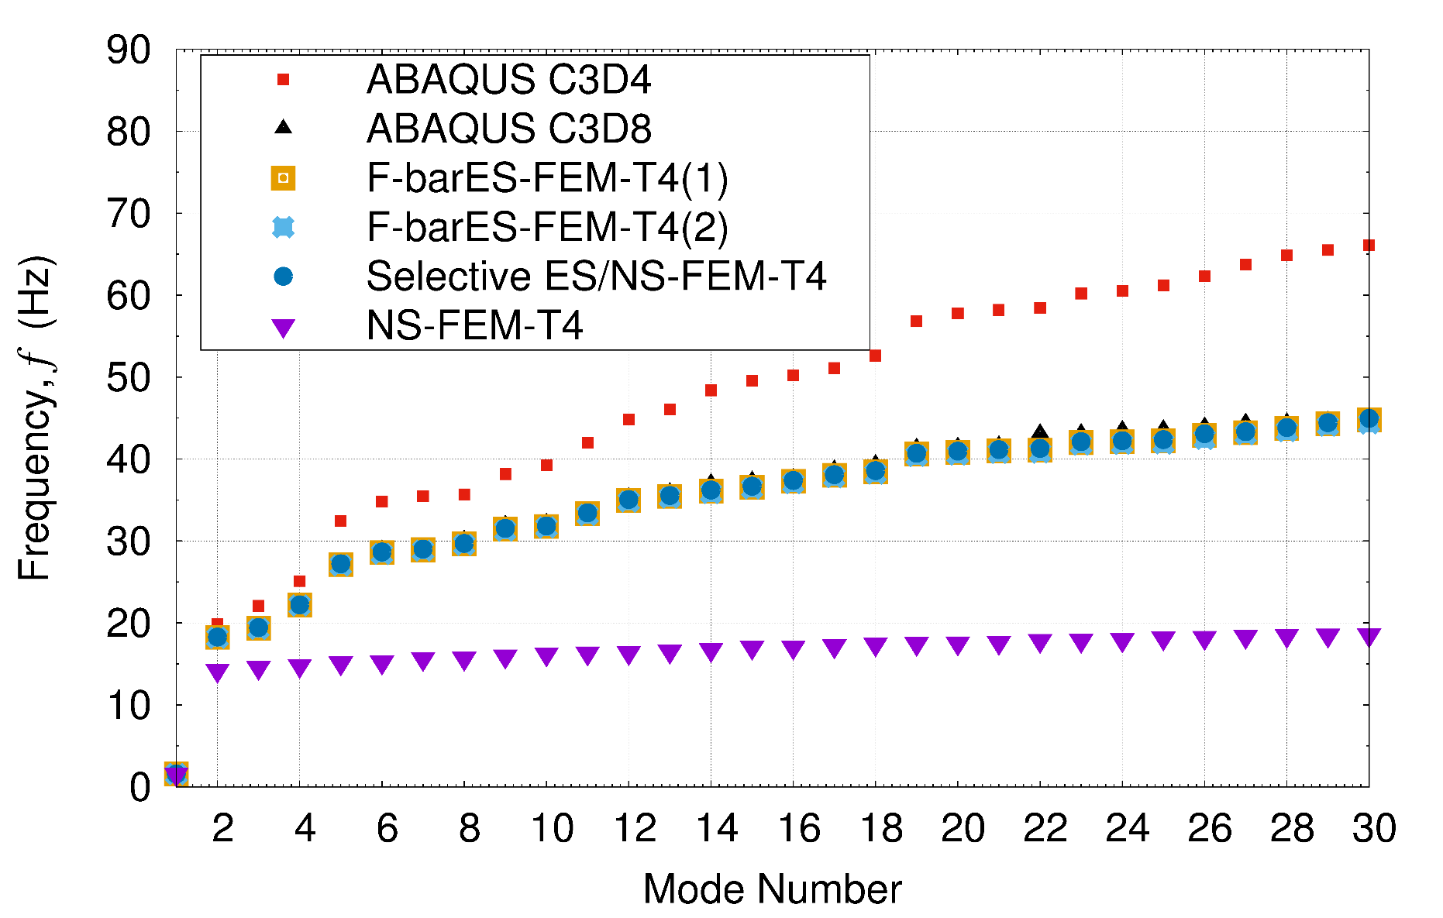
Natural frequencies of each mode
Reference
Selective ES/NS-FEM
F-barES-FEM
NS-FEM
1
NS-FEM shows bad results due to spurious low-energy modes.
Selective ES/NS-FEM and F-barES-FEM agree with the reference.
P. 25

Slide 26
1st mode shapes
ABAQUS C3D8
(Reference)
Selective ES/NS-FEM
F-barES-FEM(2)
NS-FEM
1st mode shapes also agree with the reference solutions.

Slide 27
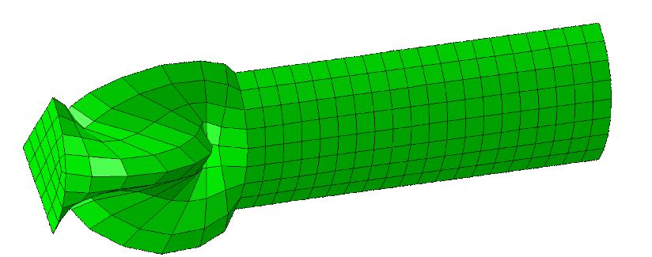
11th mode shapes
ABAQUS C3D8
(Reference)
Selective ES/NS-FEM
NS-FEM
spurious low-energy mode
F-barES-FEM(2)
NS-FEM shows spurious low-energy mode!

Slide 28
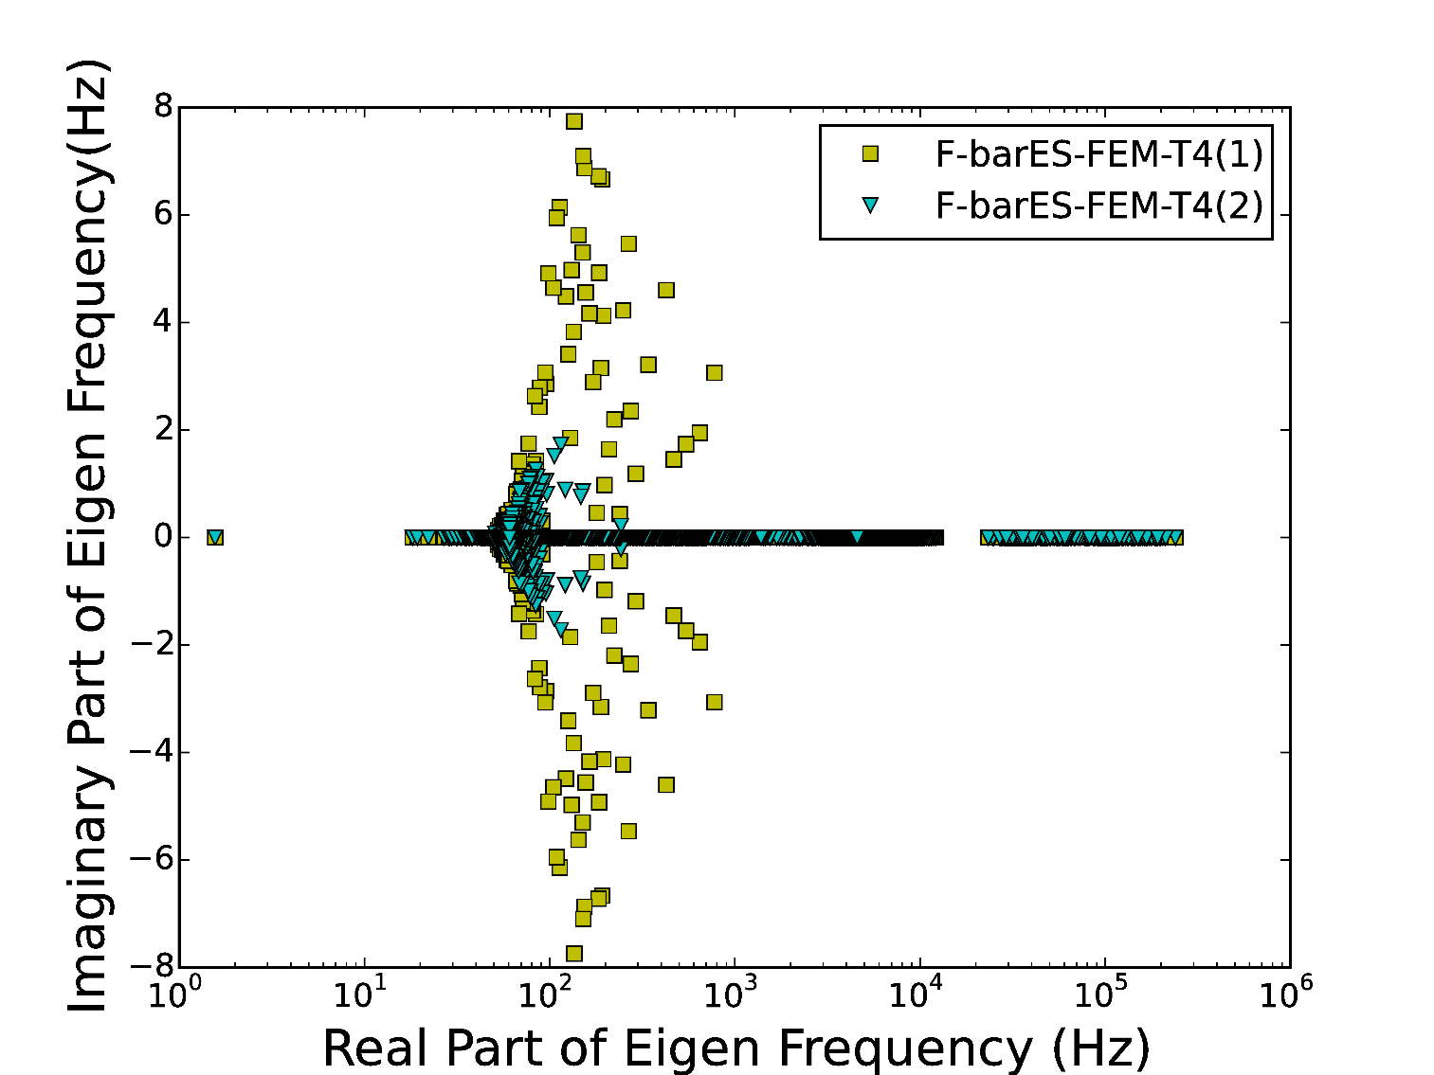
Distributions of natural frequencies of F-barES-FEM
Imag.
Part
Some natural frequencies have small imaginary part…
Increasing the number of smoothings makes
the frequencies close to real numbers.

Slide 29
Cause of energy divergence
Due to the adoption of F-bar method, the stiffness matrix $\left[K\right]$ becomes asymmetric.
Equation of Motion: $\left[M\right]\left\{\ddot{x}\right\}+\left[K\right]\left\{x\right\}=\{f^{ext}\}$
Asymmetric stiffness matrix gives rise to imaginary part of natural frequencies and instability in dynamic problem.
As shown before, increasing the number of smoothings suppress the energy divergence speed.
asymmetric
F-barES-FEM is restricted to short-term analysis (such as impact analysis) with a sufficient number of smoothings.

Slide 30
Swinging of Bunny Ears
Outline
Iron ears: $E_{ini}=200 GPa, ν_{ini}=0.3, ρ=7800 kg/m^{3}$, Neo-Hookean, No cyclic smoothing.
Rubber body: $E_{ini}=6 MPa, ν_{ini}=0.49, ρ=920 kg/m^{3}$, Neo-Hookean, 1 cycle of smoothing.
Compared to ABAQUS/Explicit C3D4. No Hex mesh available!
Iron Ears
Initial Velocity of Iron Ears
Rubber Body
Fixed

Slide 31
Time histories of deformed shapes
✔ Pressure waves
✗ Pressure oscillation
ABAQUS/Explicit C3D4
Selective ES/NS-FEM
✗Pressure oscillation
✗suspension in
an early stage
✗Pressure oscillation
F-barES-FEM
NS-FEM
Only F-barES-FEM seems to be representing not pressure oscillations but pressure waves.

Slide 32
Deformed shapes and sign of pressure
In an early stage
✗ Pressure oscillations
✔ Pressure waves
Selective ES/NS-FEM
F-barES-FEM
F-barES-FEM represents pressure waves correctly!

Slide 33
Deformed shapes and pressure distributions
✗strange shapes
NS-FEM
NS-FEM shows strange shapes in large deformed part

Slide 34
Summary

Slide 35
Summary
Characteristics of S-FEMs are summarized like them.
Selective ES/NS-FEM
Dynamic: with little pressure oscillation, temporary stable.
Modal : high accuracy
Constitutive equations are restricted.
F-barES-FEM
Dynamic: with no pressure oscillation, temporary unstable.
Modal : high accuracy, imaginary part of natural frequencies.
It is restricted to short-term analysis.
Thank you for your kind attention.

Slide 36
Appendix

Slide 37
B-barES-FEM
F-barES-FEM $$\left\{f^{int}\right\}=\sum_{Edge}{\left[{\tilde{B}}^{Edge}\right]\left\{\overline{T}\right\}V}$$
B-barES-FEM $$\left\{f^{int}\right\}=\sum_{Edge}{\left[{\overline{B}}^{Edge}\right]\left\{\overline{T}\right\}V}$$
derived from ES-FEM
derived from $\overline{F}$

Slide 38
Cantilever Bending Analysis
Small deformation static analysis
Compare B-barES-FEM with ABAQUS C3D20H

Slide 39
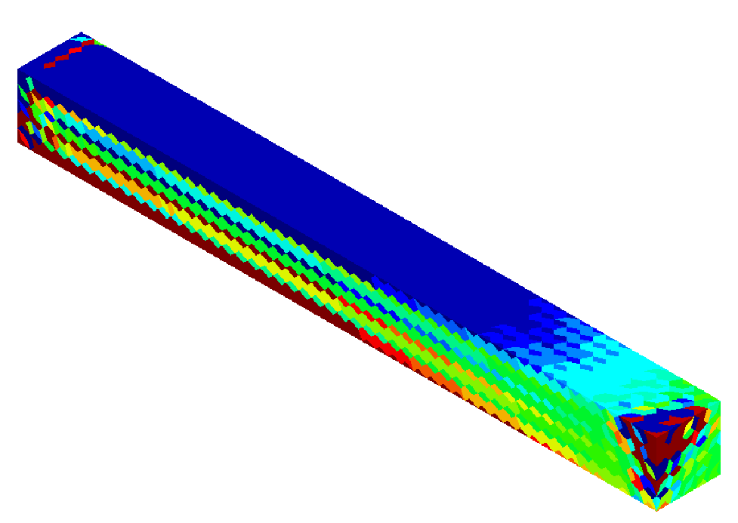
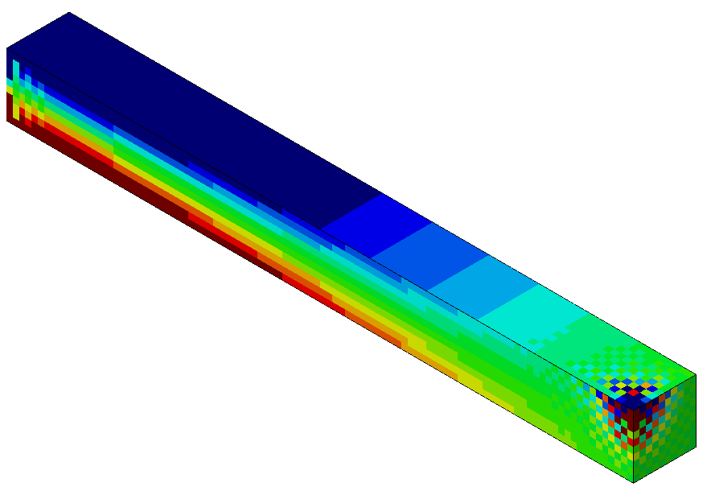
Pressure distributions
ABAQUS C3D20H
Reference
B-barES-FEM(1)
Reference

Slide 40
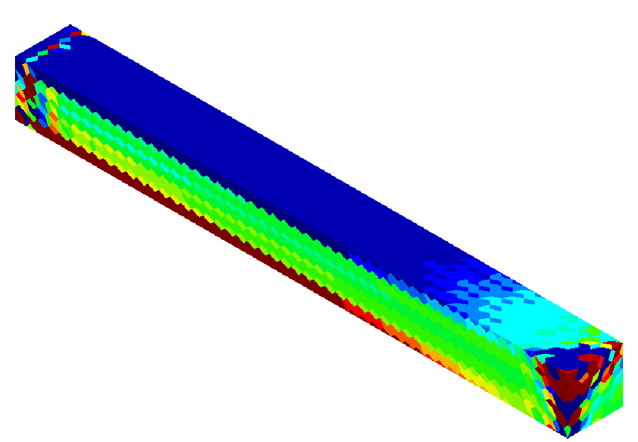
Pressure distributions
ABAQUS C3D20H
Reference
B-barES-FEM(2)
Reference

Slide 41
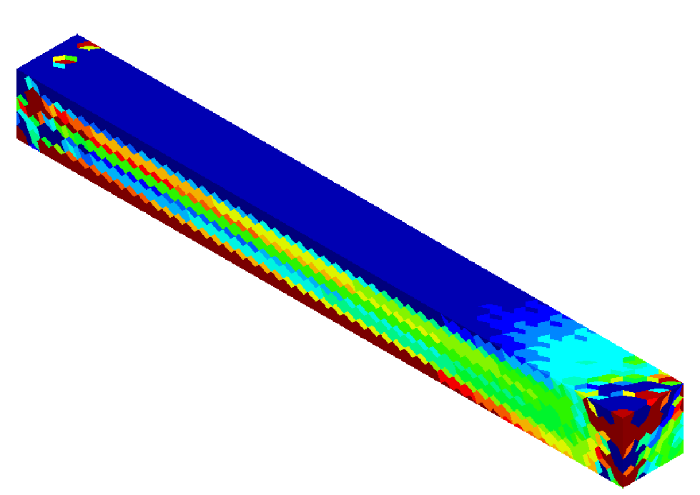
Pressure distributions
ABAQUS C3D20H
Reference
B-barES-FEM(3)
Reference

Slide 42
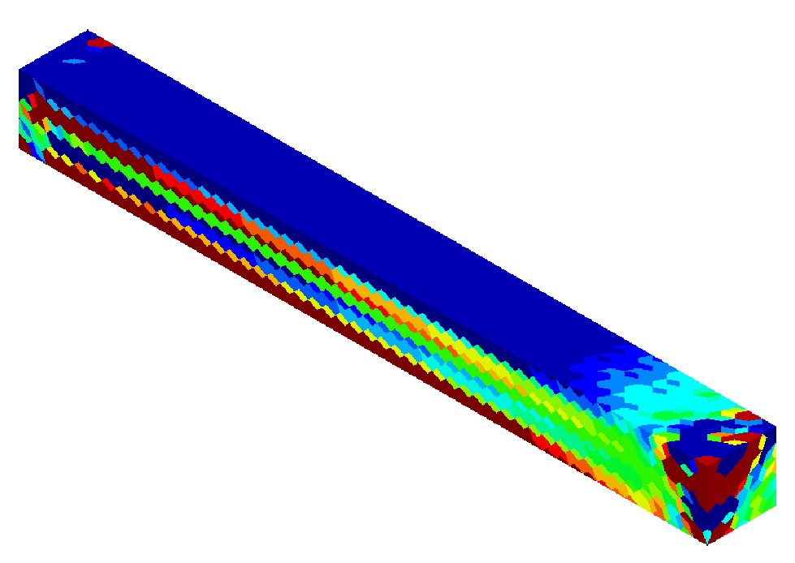
Pressure distributions
ABAQUS C3D20H
Reference
B-barES-FEM(4)
Reference

Slide 43
Propagation of 1D pressure wave
Outline
Small deformation analysis.
Linear elastic material, Young’s modulus: 200 GPa, Poisson’s ratio: 0.0, Density: 8000 kg/m³.
Results of F-barES-FEM(0), (1), (2), and (3) are compared to the analysical solution.

Slide 44
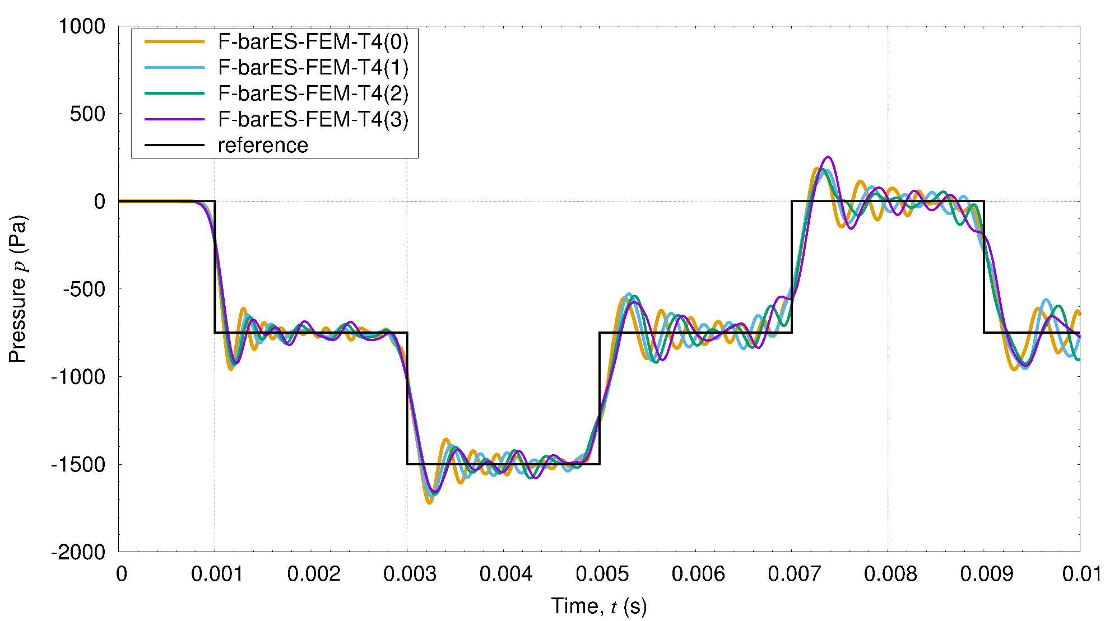
Propagation of 1D pressure wave
Results

Slide 45
Velocity Verlet Method
Algorithm
Calculate the next displacement $\left\{u_{n+1}\right\}$ as
$\left\{u_{n+1}\right\}=\left\{u_{n}\right\}+\left\{{\dot{u}}_{n}\right\}Δt+\frac{1}{2}\left\{{\ddot{u}}_{n}\right\}Δt^{2}$.
Calculate the next acceleration $\left\{{\ddot{u}}_{n+1}\right\}$ as
$\left\{{\ddot{u}}_{n+1}\right\}=\left[M^{−1}\right](\{f^{ext}\}−\{f^{int}(u_{n+1})\})$.
Calculate the next velocity $\left\{{\dot{u}}_{n+1}\right\}$ as
$$\left\{{\dot{u}}_{n+1}\right\} =\left\{{\dot{u}}_{n}\right\}+\left\{{\ddot{u}}_{n+1}\right\}Δt$$
Characteristics
2nd order symplectic scheme in time.
Less energy divergence.

Slide 46
Cause of energy divergence
Due to the adoption of F-bar method, the stiffness matrix $\left[K\right]$ becomes asymmetric and thus the dynamic system turns to unstable.
Equation of natural vibration, $\left[M\right]\left\{\ddot{u}\right\}+[K]\{u\}=\{0\}$, derives an eigen equation, ${(\left[M\right]}^{−1}[K])\left\{u\right\}=ω^{2}\{u\}$, which has asymmetric left-hand side matrix.
Some of eigen frequencies could be complex numbers.
When an angular frequency $ω_{k}=a+ib$（$b>0$）, the time variation of the $k$th mode is $\left\{u\left(t\right)\right\}=Re\left[\left\{u_{k}\right\}\exp\left(−iω_{k}t\right)\right]$ $=Re\left[\left\{u_{k}\right\}\exp\left(−iat\right)exp\left(bt\right)\right]$
Divergent term!

Slide 47
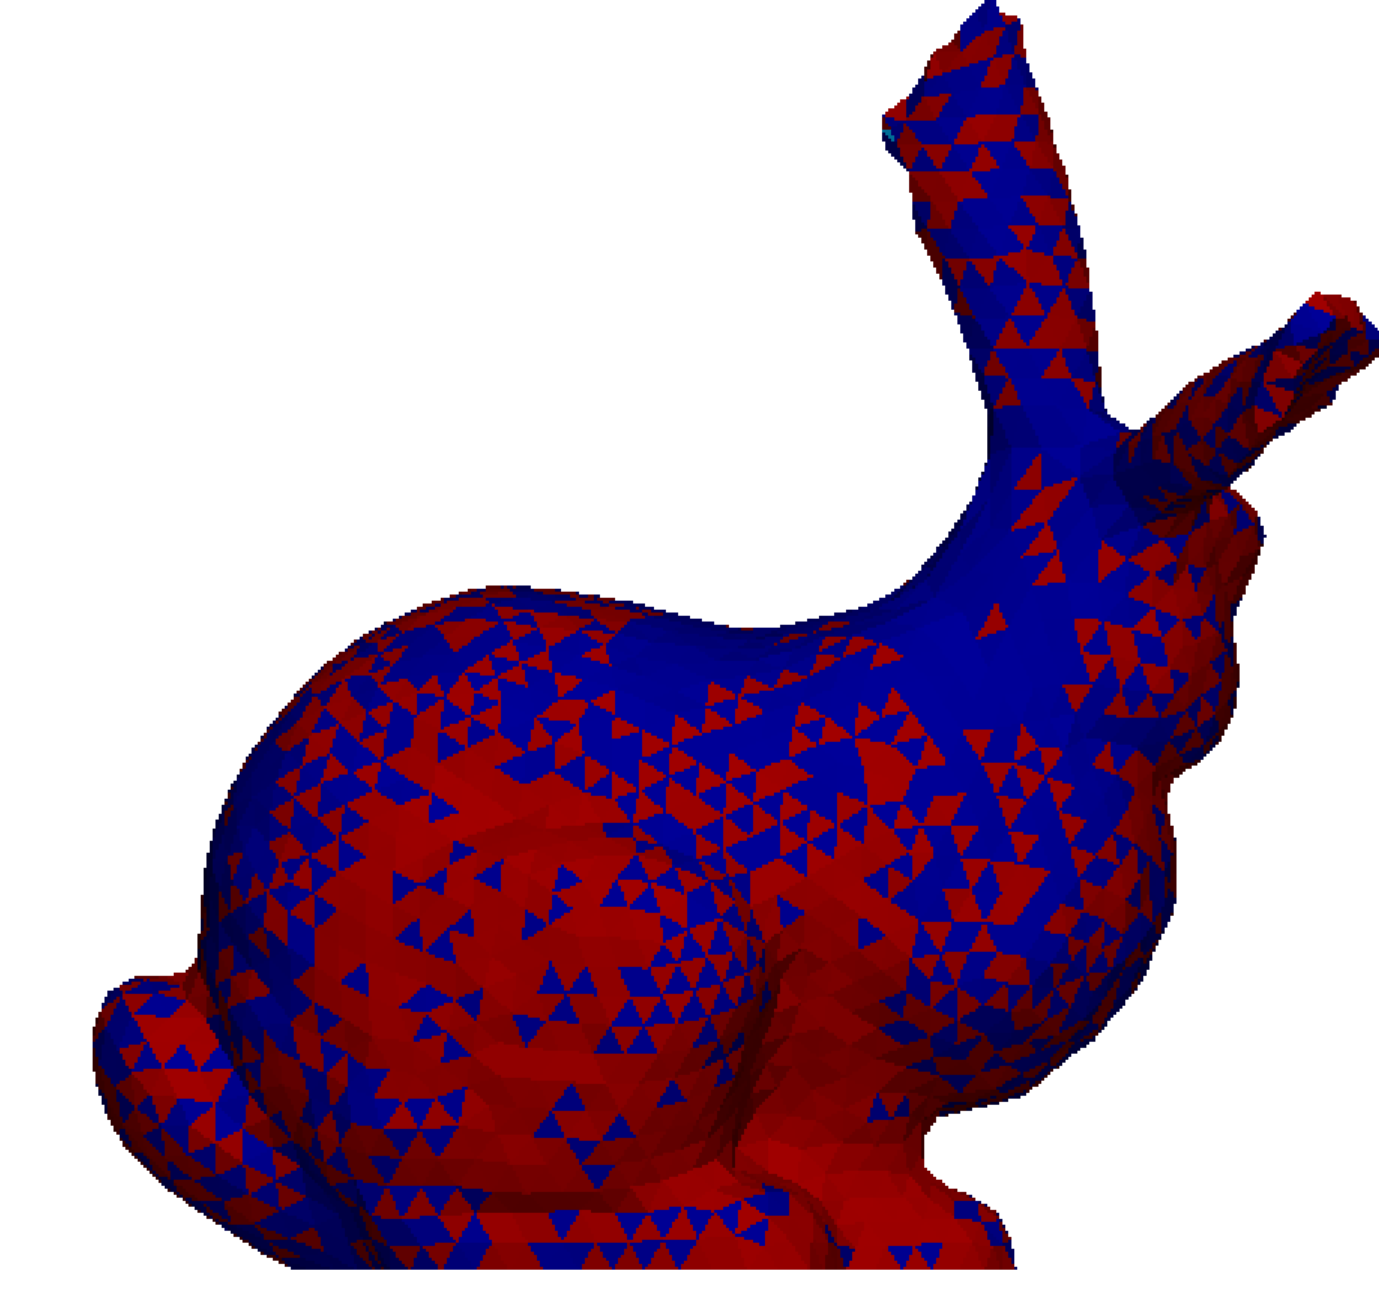
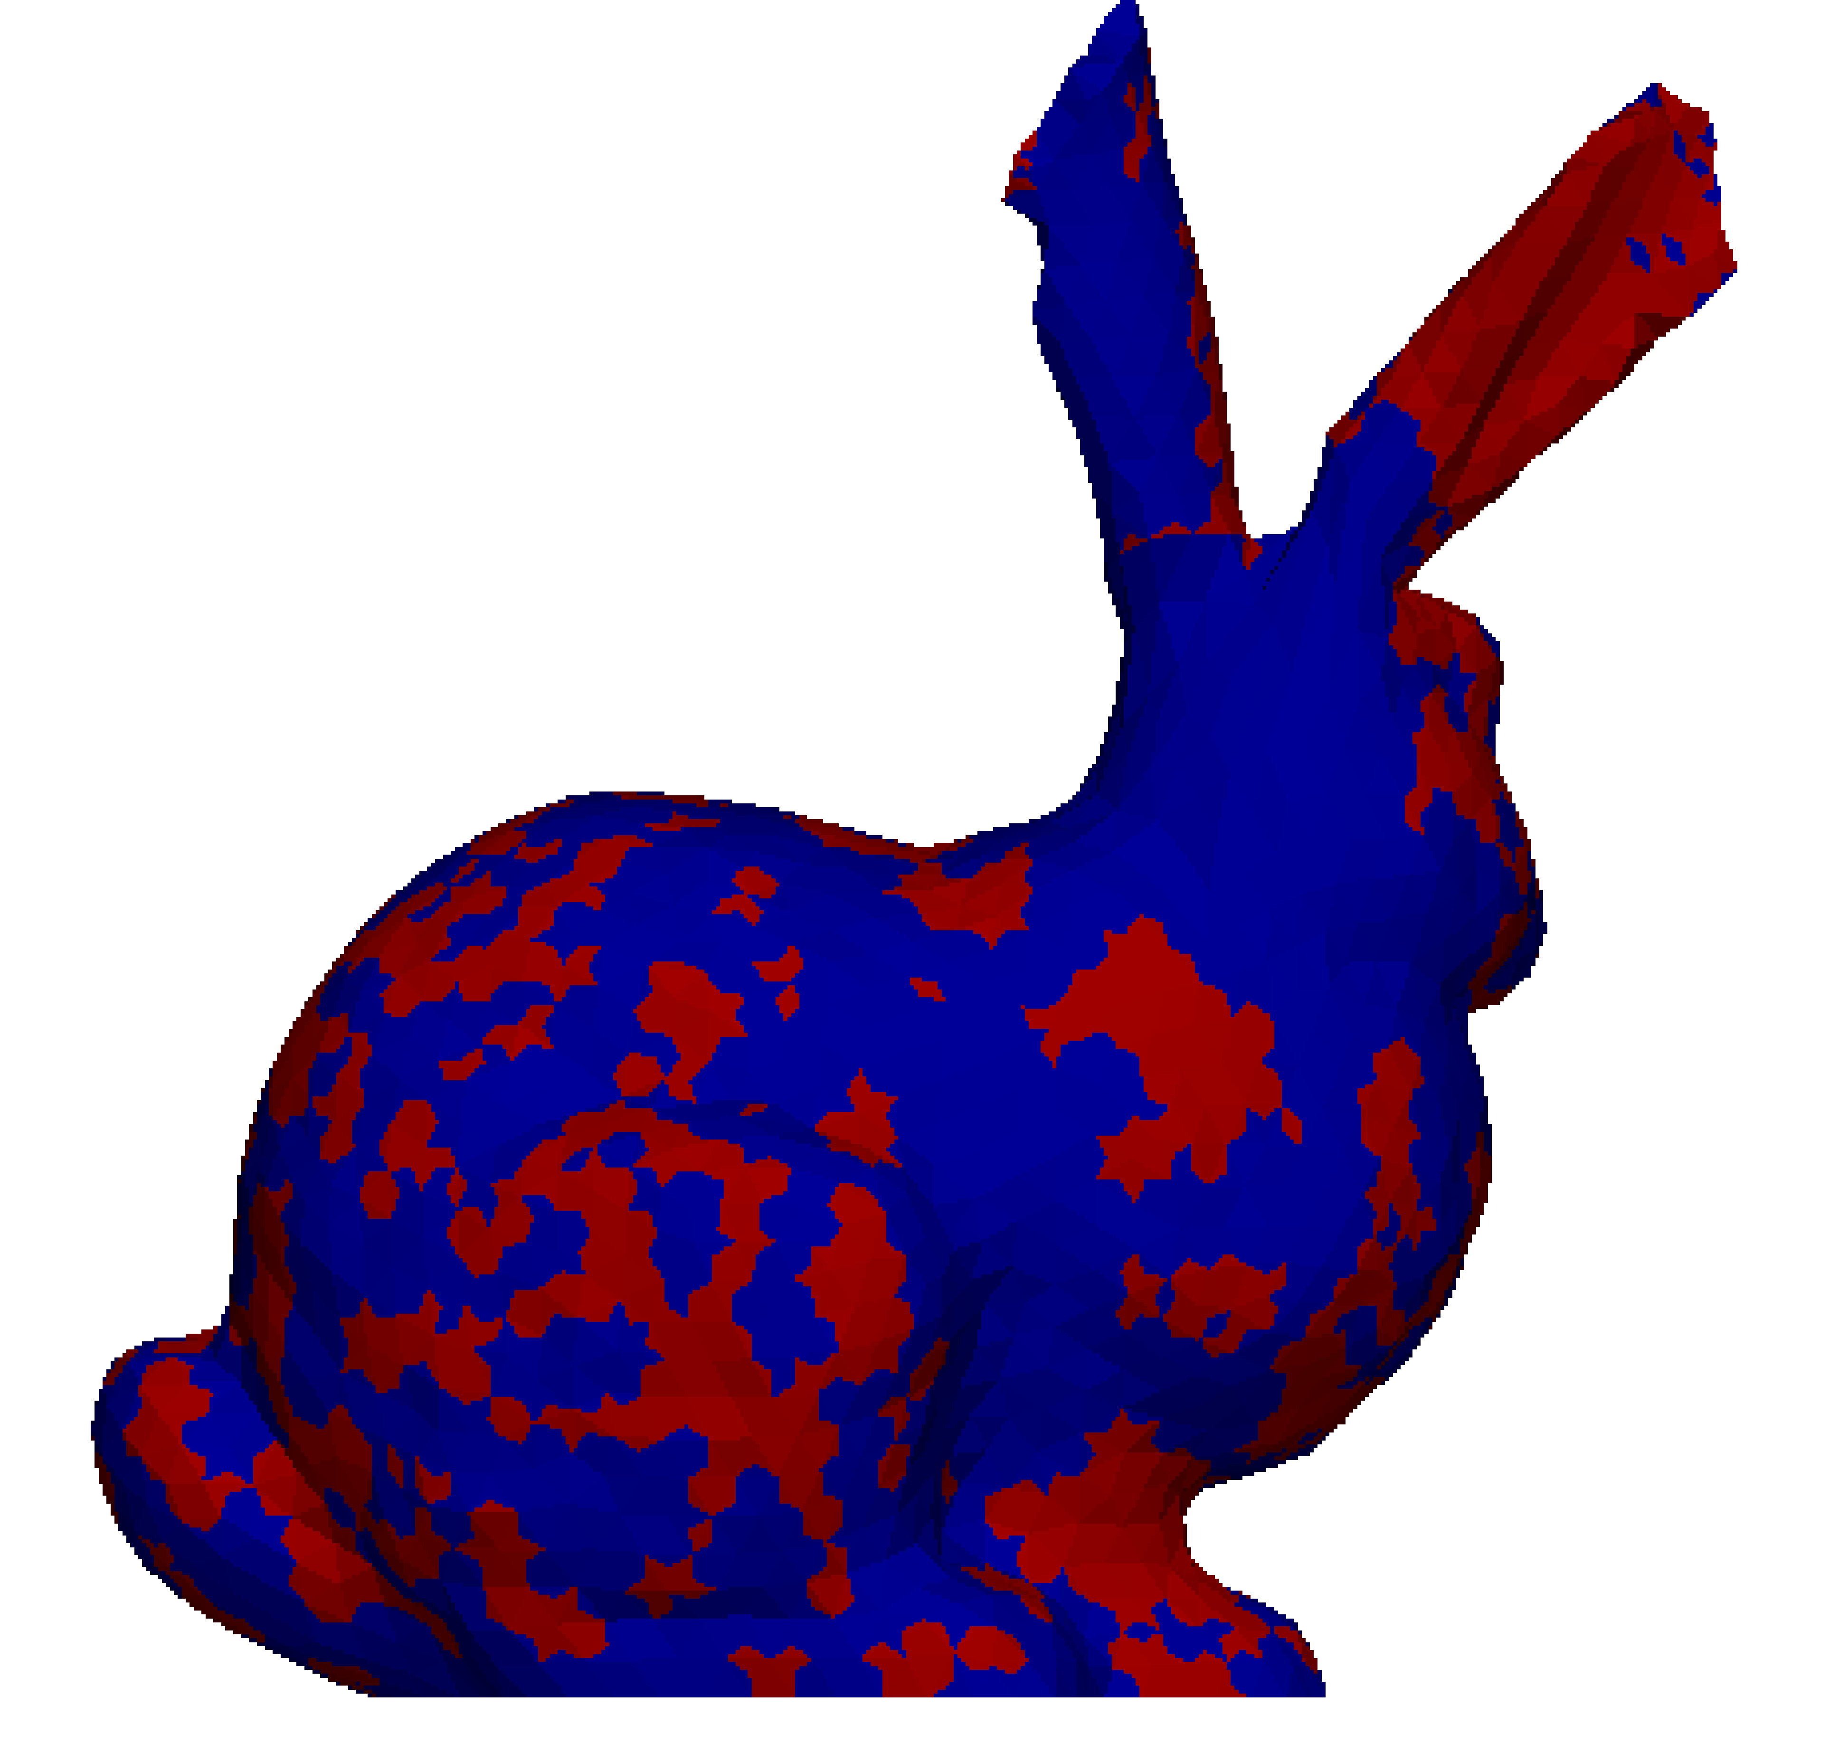
Deformed shapes and sign of pressure
In a later stage
✗ Pressure oscillation in iron ears
✔ No pressure oscillation in iron ears
ABAQUS/Explicit C3D4
(Standard T4 element)
F-barES-FEM
It should be noted that a presence of rubber spoils over all accuracy of the analysis with Standard T4 elements.
A rubber parts is a “bad apple” when Standard T4 elements are used.

