Slide 1
F-bar aided edge-based smoothed finite element methods with 4-node tetrahedral elements for static large deformation hyperelastic and elastoplastic problems
Yuki ONISHI, Ryoya IIDA, Kenji AMAYA Tokyo Institute of Technology, Japan

Slide 2
Motivation
Motivation
We want to accurately and stably analyze severe large deformation of solids in any shape with finite elements.
Issues
Only tetra mesh is available for arbitrary body shape.
The standard 1st / 2nd order tetrahedral element are poor especially when incompressibility is present. Also, all the other u/p hybrid tetrahedral elements (e.g., C3D4H, C3D10MH in ABAQUS) have some issues:
pressure oscillation,
early convergence failure, etc.
Researches on FE formulations for 1st order tetra (T4) are still active especially for rubber-like or elasto-plastic materials.

Slide 3
An Example for Rubber-like Material
Material: neo-Hookean hyperelastic, $ν_{ini}=0.49$
Pressure
Pressure
# of Nodes is almost the same.
1st order hybrid T4 (C3D4H)
✓ No shear/volumetric locking
✗ Pressure oscillation
✗ Corner locking
2nd order modified hybrid T10 (C3D10MH)
✓ No shear/volumetric locking
✗ Low interpolation accuracy ✗ Early convergence failure

Slide 4
An Example for Rubber-like Material
Material: neo-Hookean hyperelastic, $ν_{ini}=0.49$
# of Nodes is exactly the same as the C3D4H case.
Selective ES/NS-FEM-T4
✓ No shear/volumetric locking
✗ Pressure oscillation ✗ Corner locking
Selective ES/NS-FEM-T4 is not bad as ABAQUS C3D4H. Yet, it still has major issues…

Slide 5
Objective
Propose a new type of S-FEM, F-barES-FEM-T4, to resolve the pressure oscillation and the corner locking issues in hyperelastic and elastoplastic materials.
Table of Body Contents
Methods: Quick introduction of F-barES-FEM-T4
Results: A few example analyses
Summary

Slide 6
Methods
Quick introduction of F-barES-FEM-T4 (F-barES-FEM-T3 in 2D is explained for simplicity.)

Slide 7
Quick Review of Node-based S-FEM (NS-FEM)
Algorithm:
Calculate the deformation gradient at each element, $^{Elem}F$, as usual.
Distribute $^{Elem}F$ s to the connecting nodes with area weights to make $^{Node}\tilde{F}$ at each node.
Use $^{Node}\tilde{F}$ s to calculate the stress, nodal force and so on.
For triangular (T3) or tetrahedral (T4) elements.
NS-FEM avoids shear & volumetric locking in T3/T4 elements and also alleviates pressure oscillation. Yet, it suffers from spurious low-energy modes, corner locking and minor pressure oscillation….

Slide 8
Quick Review of Edge-based S-FEM (ES-FEM)
Algorithm:
Calculate the deformation gradient at each element, $^{Elem}F$, as usual.
Distribute $^{Elem}F$ s to the connecting edges with area weights to make $^{Edge}\tilde{F}$ at each edge.
Use $^{Edge}\tilde{F}$ s to calculate the stress, nodal force and so on.
For triangular (T3) or tetrahedral (T4) elements.
ES-FEM avoids shear locking in T3/T4 elements. Yet, it suffers from volumetric locking, corner locking, and major pressure oscillation…

Slide 9
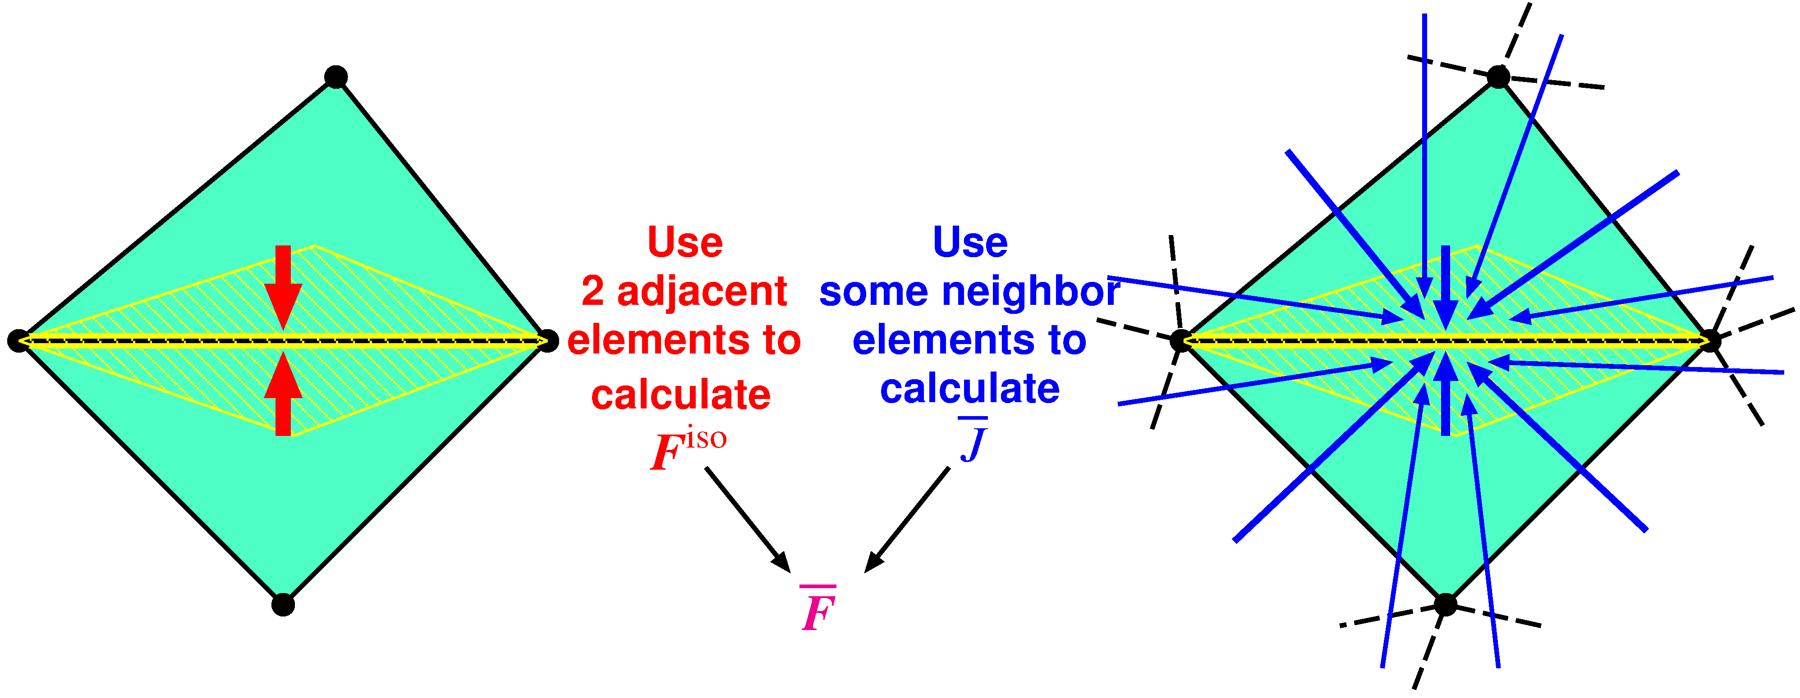
Quick Introduction of F-barES-FEM
Outlline
$^{Edge}{\tilde{F}}^{iso}$ is given by ES-FEM.
$^{Edge}\overline{ J }$ is given by cyclically applied NS-FEM.
$^{Edge}\overline{F }$ is calculated in the manner of F-bar method:
$^{Edge}\overline{F }=$ $^{Edge}{\overline{ J }}^{1/3}$ $^{Edge}{\tilde{F}}^{iso}$.
Concept: combine ES-FEM and NS-FEM using F-bar method

Slide 10
Outline of F-barES-FEM
Brief Formulation
Calculate$^{Elem}J$as usual.
Smooth$^{Elem}J$ at nodes and get$^{Node}\tilde{ J }$.
Smooth$^{Node}\tilde{ J }$ at elements and get$^{Elem}\tilde{ J }$.
Repeat 2. and 3. as necessary ($c$ times).
Smooth $^{Elem}\dot{\dot{\dot{\tilde{\tilde{ J }}}}}$ at edges to make $^{Edge}\overline{ J }$.
Combine $^{Edge}\overline{ J }$ and $^{Edge}F^{iso}$ of ES-FEM as
$^{Edge}\overline{F }= ^{Edge}{\overline{ J }}^{1/3} ^{Edge}F^{iso}$.
A kind of low-pass filter for $J$
Cyclic Smoothing of $J$
($c$ layers of ~)
Hereafter, F-barES-FEM-T4 with $c$ cycles of smoothing is called “F-barES-FEM-T4($c$)”.

Slide 11
Additional Point of F-barES-FEM
Typical Flow of FE Solver
Selective ES/NS-FEM splits $T$ into $T^{hyd}$ and $T^{dev}$ and merges $\{f_{hyd}^{int}\}$ and $\{f_{dev}^{int}\}$ into $\{f^{int}\}$.
F-barES-FEM builds $F^{vol}$ and $F^{iso}$ separately and combines $F^{vol}$ and $F^{iso}$ into $F$.
Displace-ment
$$u$$
Deformation Gradient $$F$$
Cauchy Stress $$T$$
Internal Force $$\{f^{int}\}$$
deformation evaluation
constitutive model
domain integration
F-barES-FEM can handle any kind of material constitutive model.

Slide 12
Results
A few example analyses

Slide 13
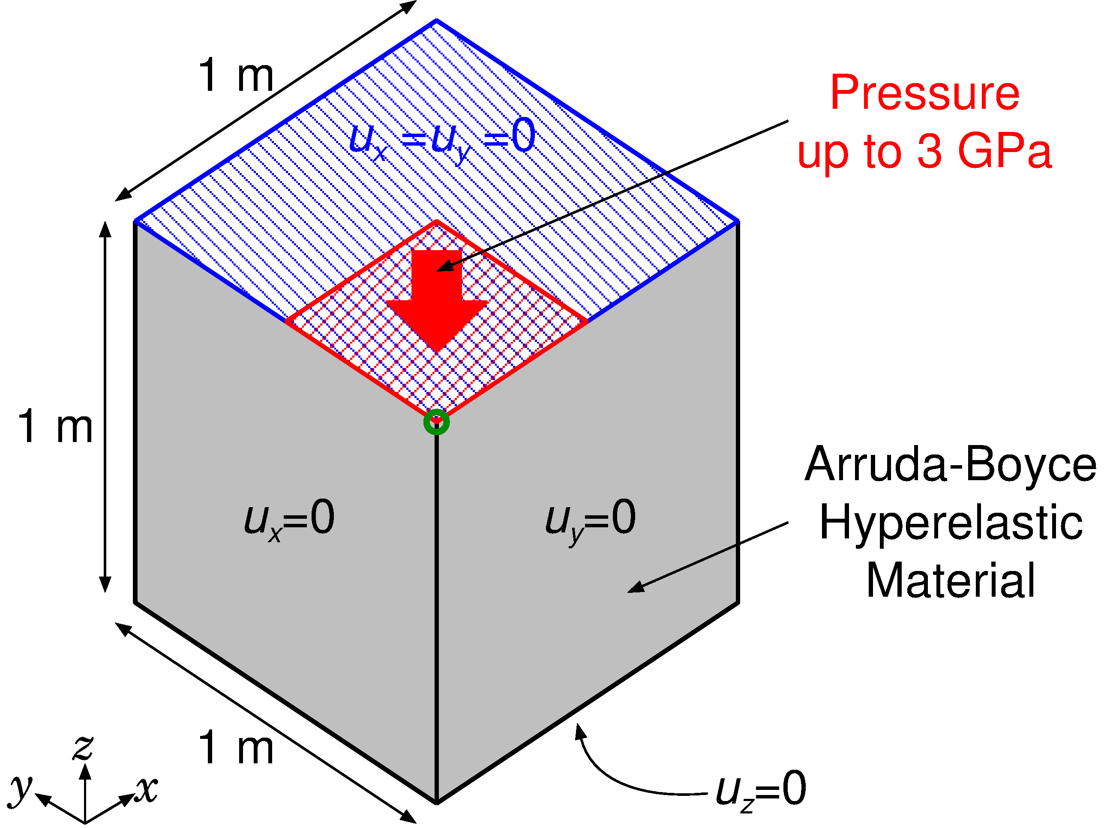
Compression of Rubber Block
Outline
Arruda-Boyce hyperelastic material ($ν_{ini}=0.499$).
Applying pressure on ¼ of the top face.
Compared to ABAQUS C3D4H with the same unstructured T4 mesh.
Load

Slide 14
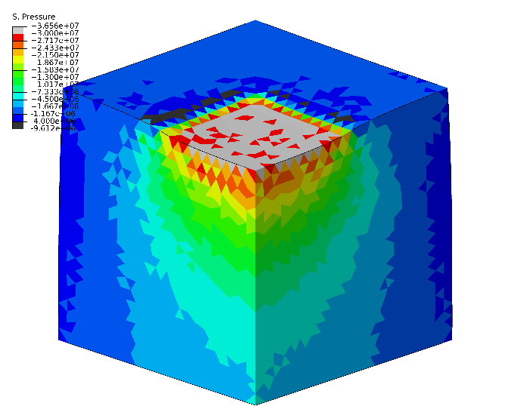
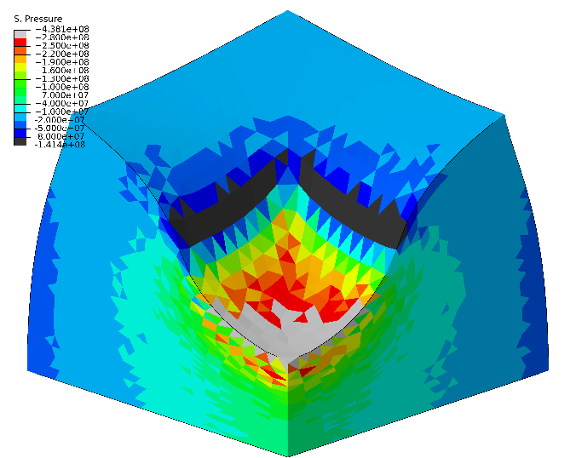
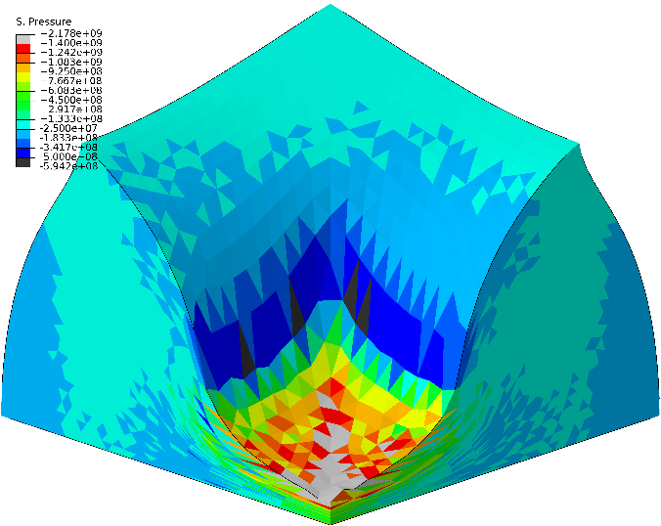
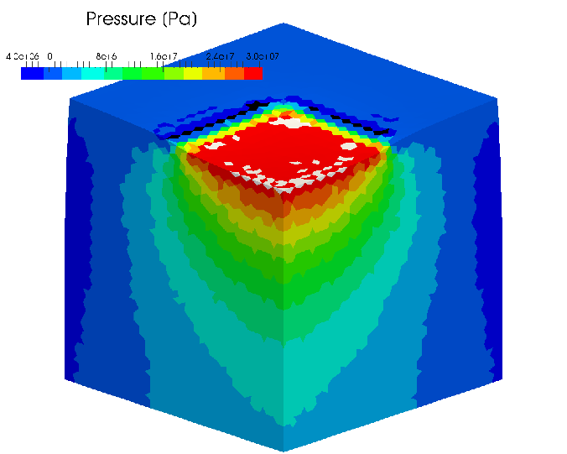
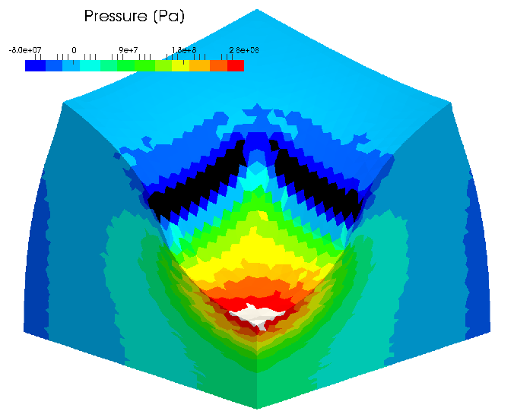
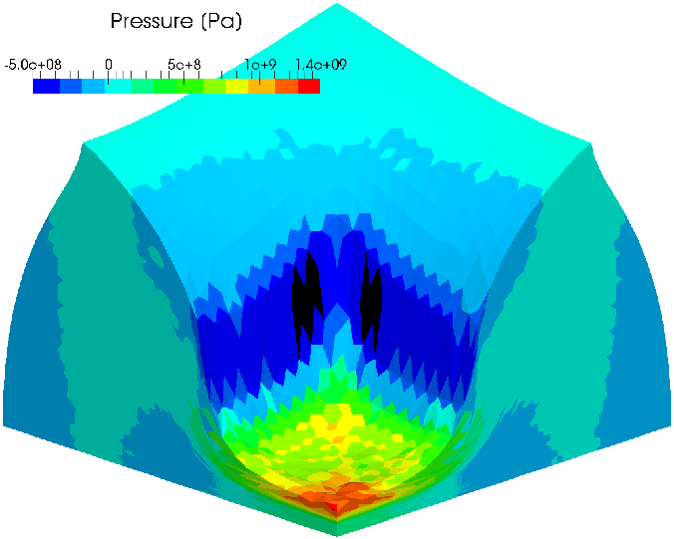
Compression of Rubber Block
Pressure Distribution
Early stage Middle stage Later stage
ABAQUS C3D4H
F-bar ES-FEM-
T4(2)

Slide 15
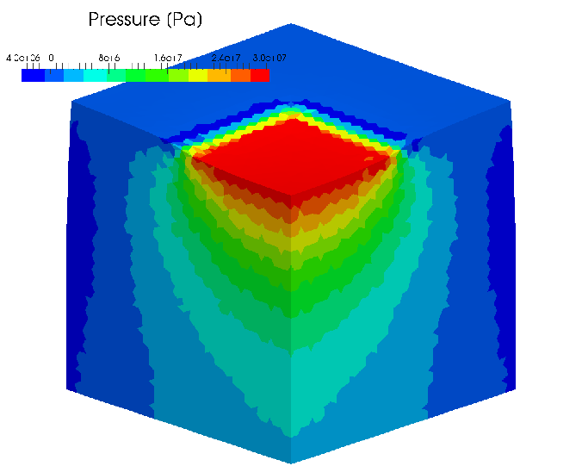
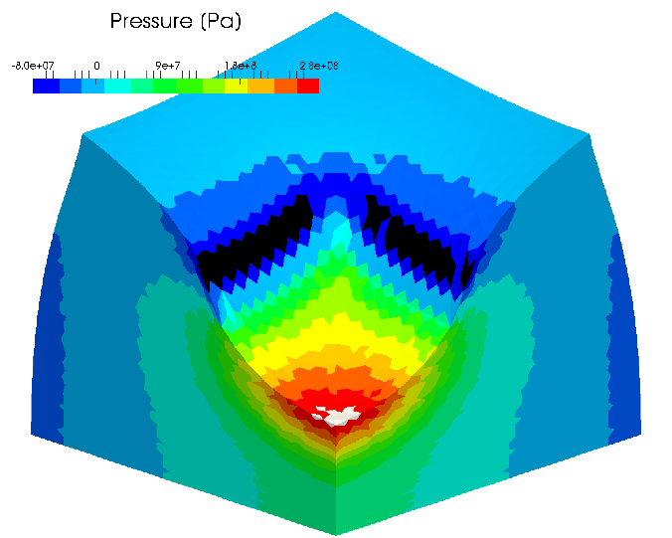
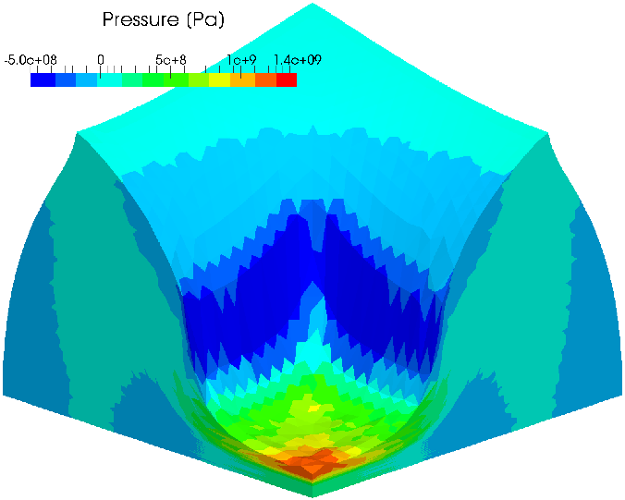
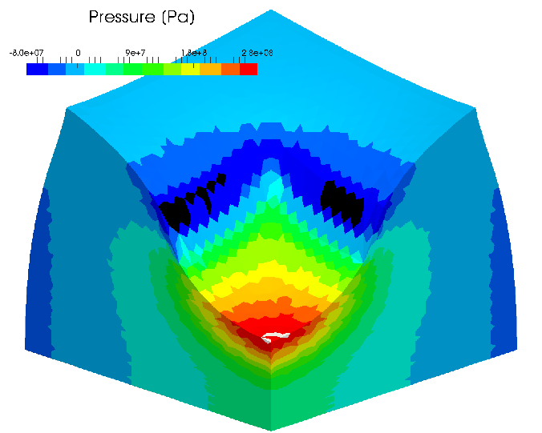
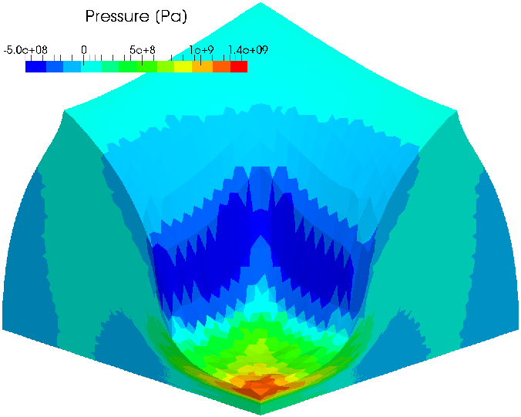
Compression of Rubber Block
Pressure Distribution
Early stage Middle stage Later stage
F-bar ES-FEM- T4(3)
F-barES-FEM-T4 resolves the pressure oscillation issue!
F-bar ES-FEM- T4(4)

Slide 16
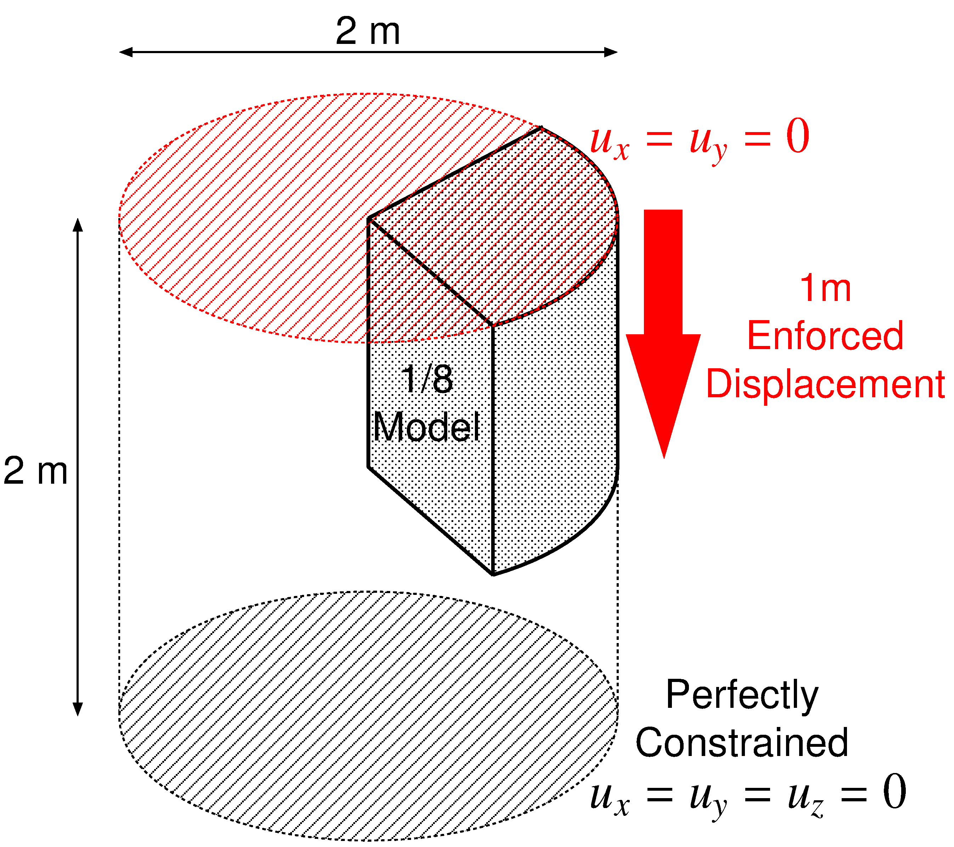
Barreling of 1/8 Rubber Cylinder
Outline
Neo-Hookean hyperelastic material ($ν_{ini}=0.499$).
Enforced displacement is applied to the top surface.
Compared to ABAQUS C3D4H with the same unstructured T4 mesh.

Slide 17
Barreling of 1/8 Rubber Cylinder
Result of F-bar ES-FEM(2) (Pressure)
50% nominal compression
Almost smooth
pressure
distribution is obtained
except just around the rim.

Slide 18
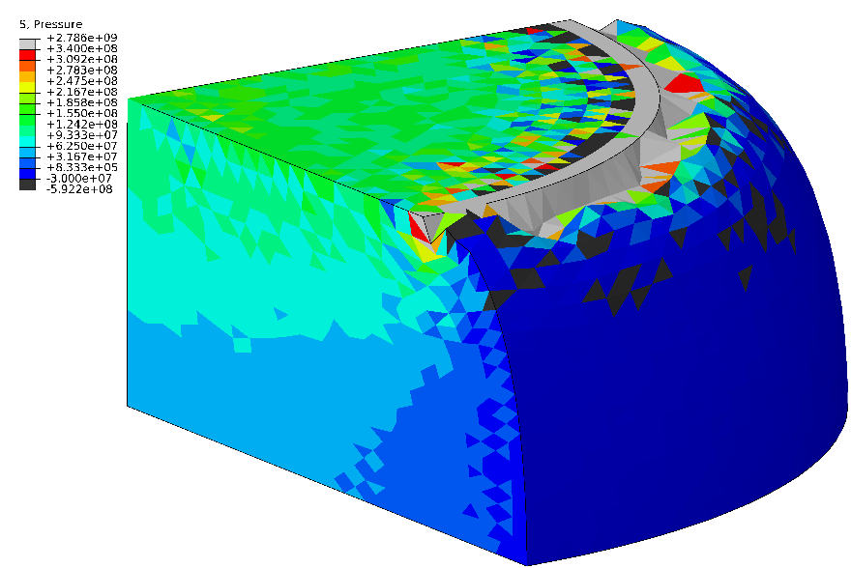
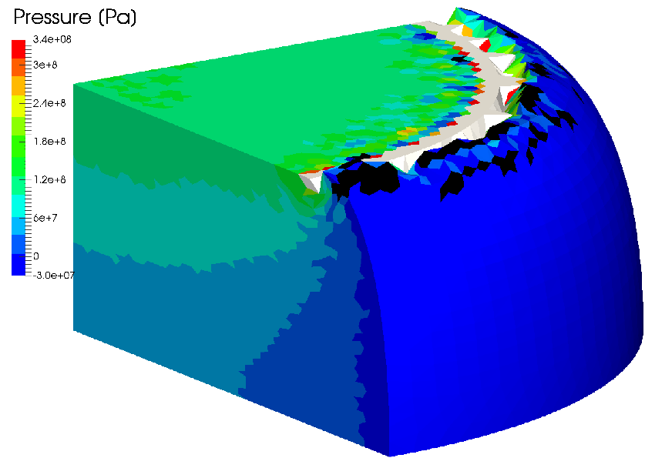
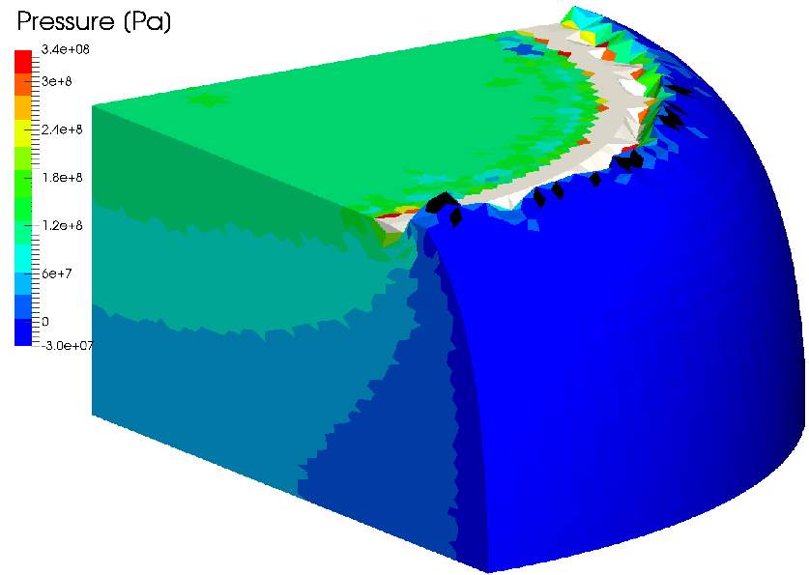
Barreling of 1/8 Rubber Cylinder
Pressure Distribution
Strange deformation (corner locking) around the rim
ABAQUS C3D4H
F-bar ES-FEM- T4(2)
F-barES-FEM-T4 with a sufficient cyclic smoothing resolves the corner locking issue!
F-bar ES-FEM-
T4(3)
F-bar ES-FEM-
T4(4)

Slide 19
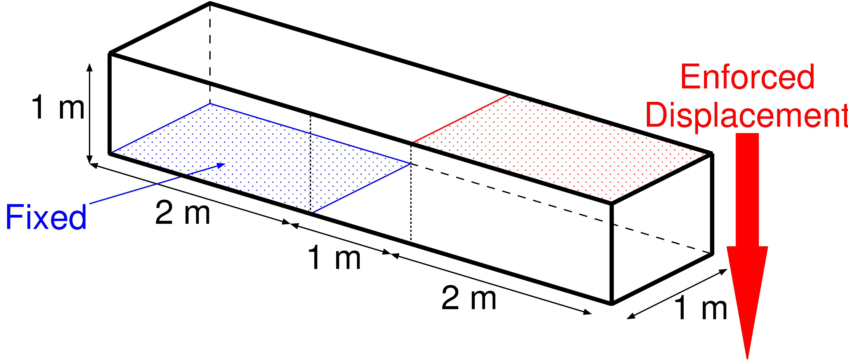
Shearing & Tensioning of Elasto-Plastic Bar
Outline
Blue face is perfectly constrained.
Red face is constrained in plane and pressed down.
Compared to ABAQUS C3D4H with the same unstructured T4 mesh.
1.2 k nodes & 4.8 k elems.
Elasto-plastic material:
Hencky elasticity with $E=1 GPa$ and $ν=0.3$.
Isotropic von Mises yield criterion with $σ_{Y}=1 MPa$and$H=0.1 GPa$ (constant).
P. 19

Slide 20
Shearing & Tensioning of Elasto-Plastic Bar
Result of F-bar ES-FEM (Equiv. Plastic Strain)

Slide 21
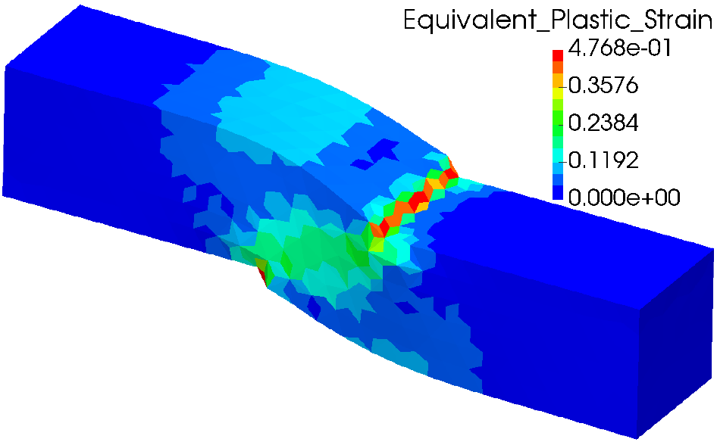
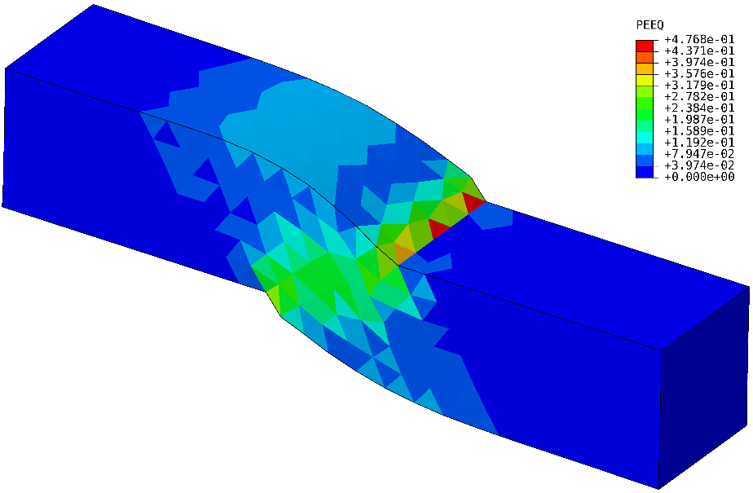
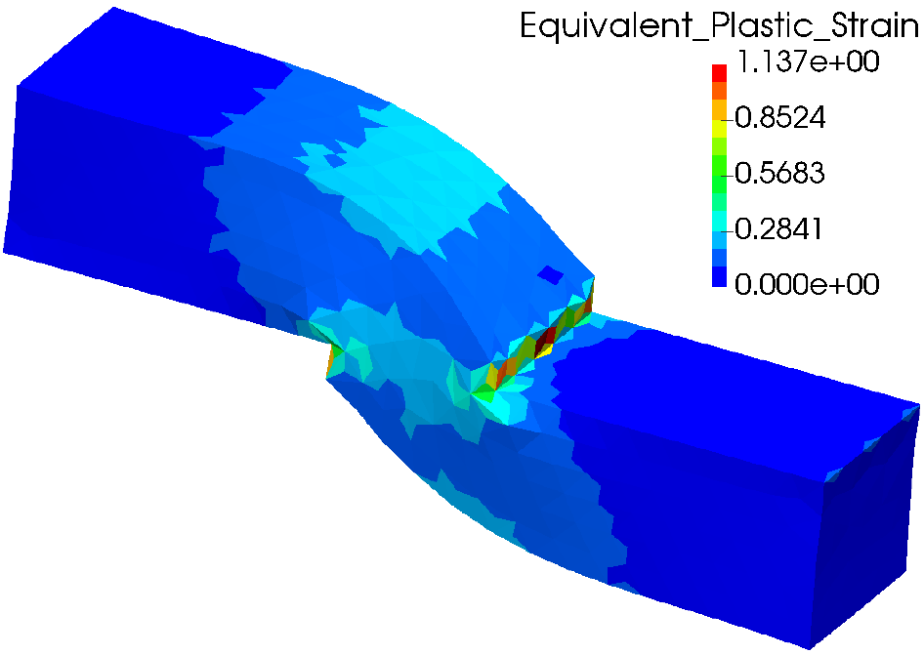
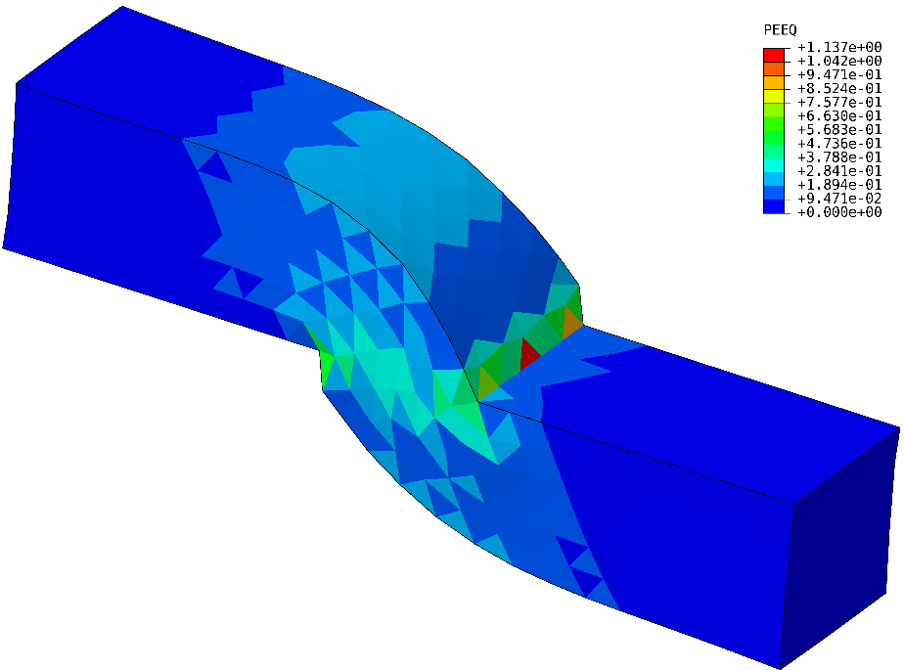
Shearing & Tensioning of Elasto-Plastic Bar
Equivalent Plastic Strain
$$u_{z}=0.5 m$$
Smooth distribution.
There is minor oscillation.
$$u_{z}=1.0 m$$
F-barES-FEM-T4
ABAQUS C3D4H
P. 21

Slide 22
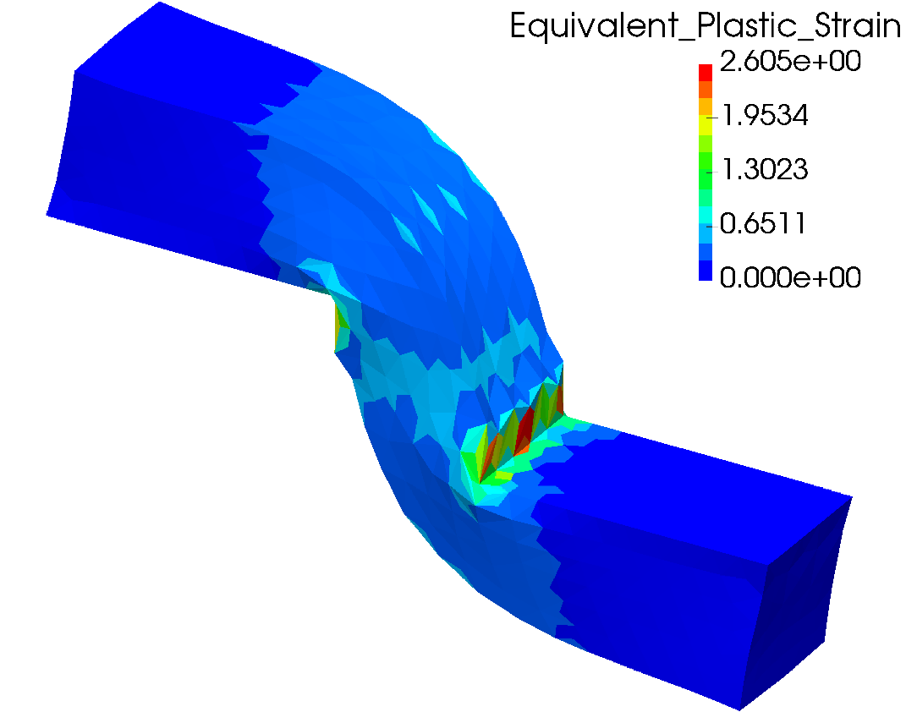
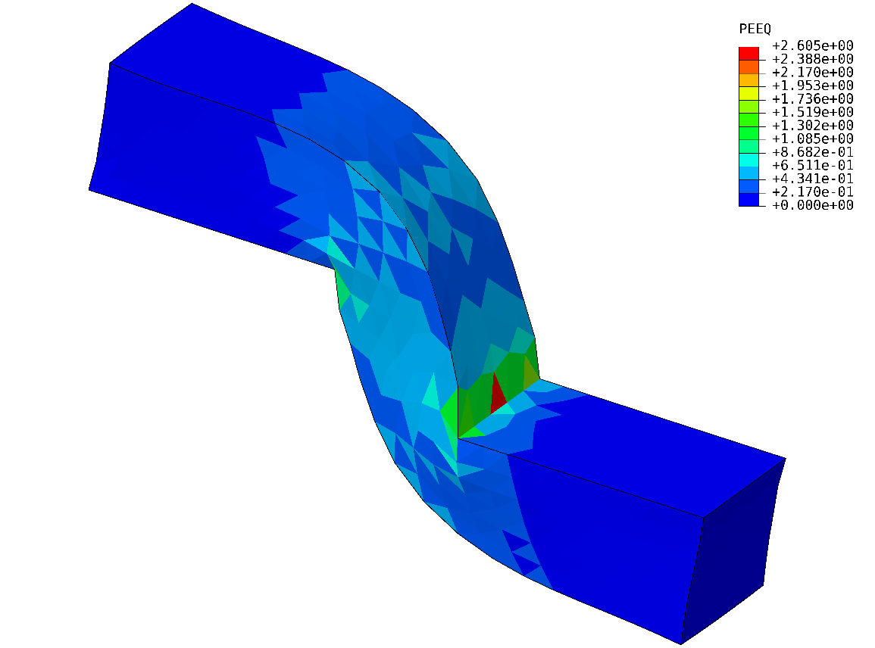
Shearing & Tensioning of Elasto-Plastic Bar
Equivalent Plastic Strain
$$u_{z}=2.0 m$$
F-barES-FEM-T4
ABAQUS C3D4H
Accuracy of equivalent plastic strain seems no much different.
P. 22

Slide 23
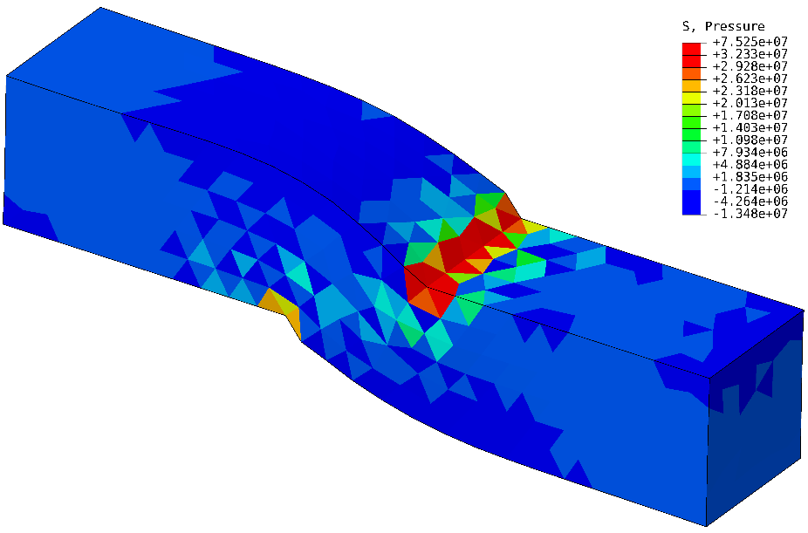
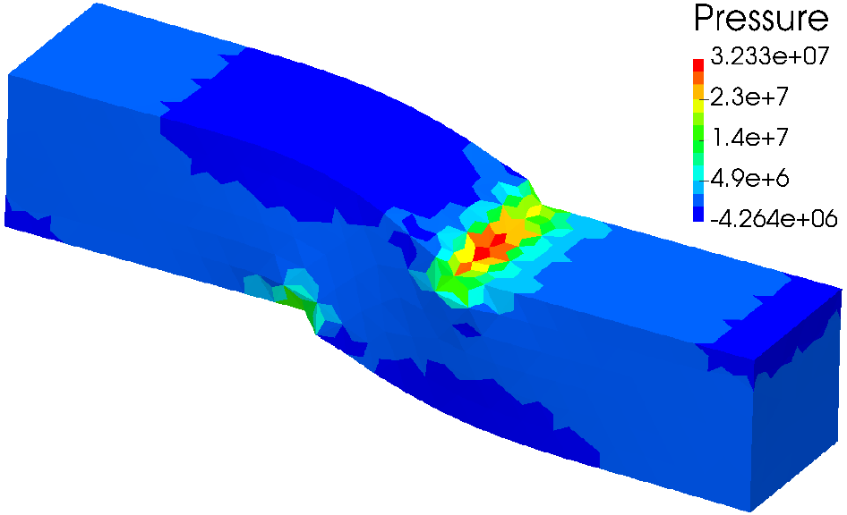
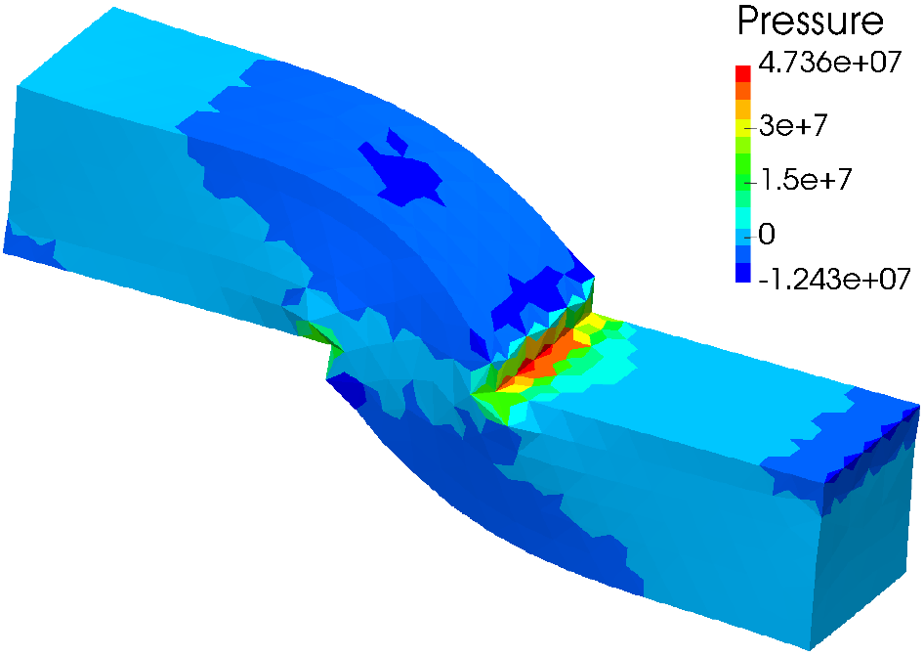
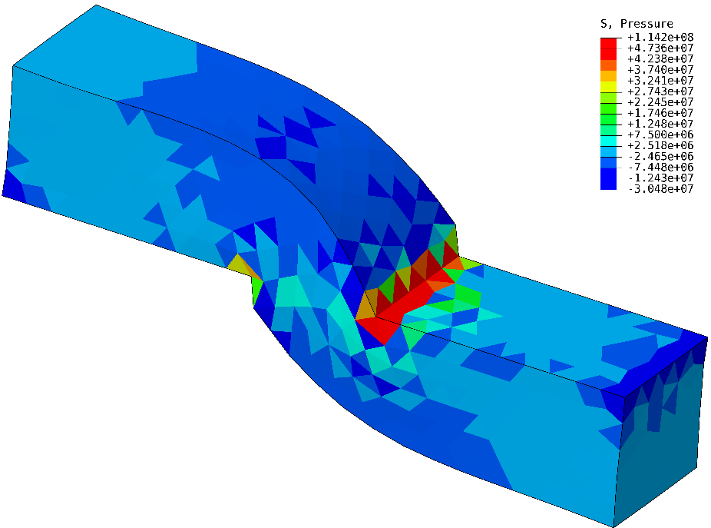
Shearing & Tensioning of Elasto-Plastic Bar
Pressure
$$u_{z}=0.5 m$$
Smooth distribution.
There is major oscillation.
$$u_{z}=1.0 m$$
F-barES-FEM-T4
ABAQUS C3D4H
P. 23

Slide 24
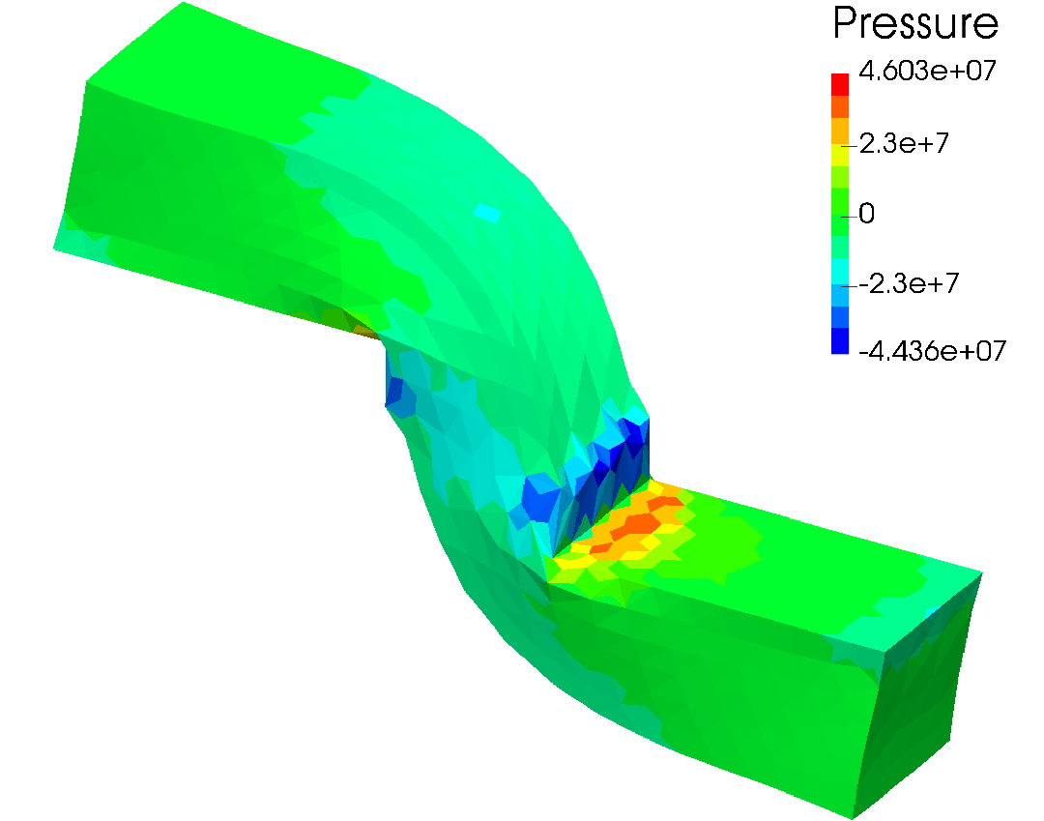
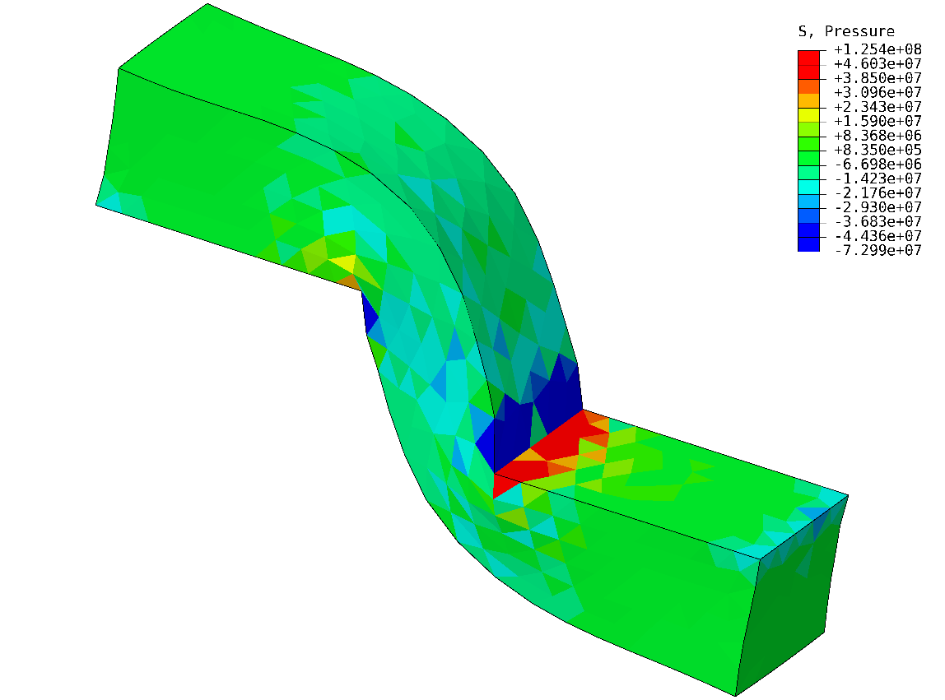
Shearing & Tensioning of Elasto-Plastic Bar
Pressure
$$u_{z}=2.0 m$$
F-barES-FEM-T4
ABAQUS C3D4H
F-barES-FEM-T4 is pressure oscillation free in elastoplastic analysis.
P. 24

Slide 25
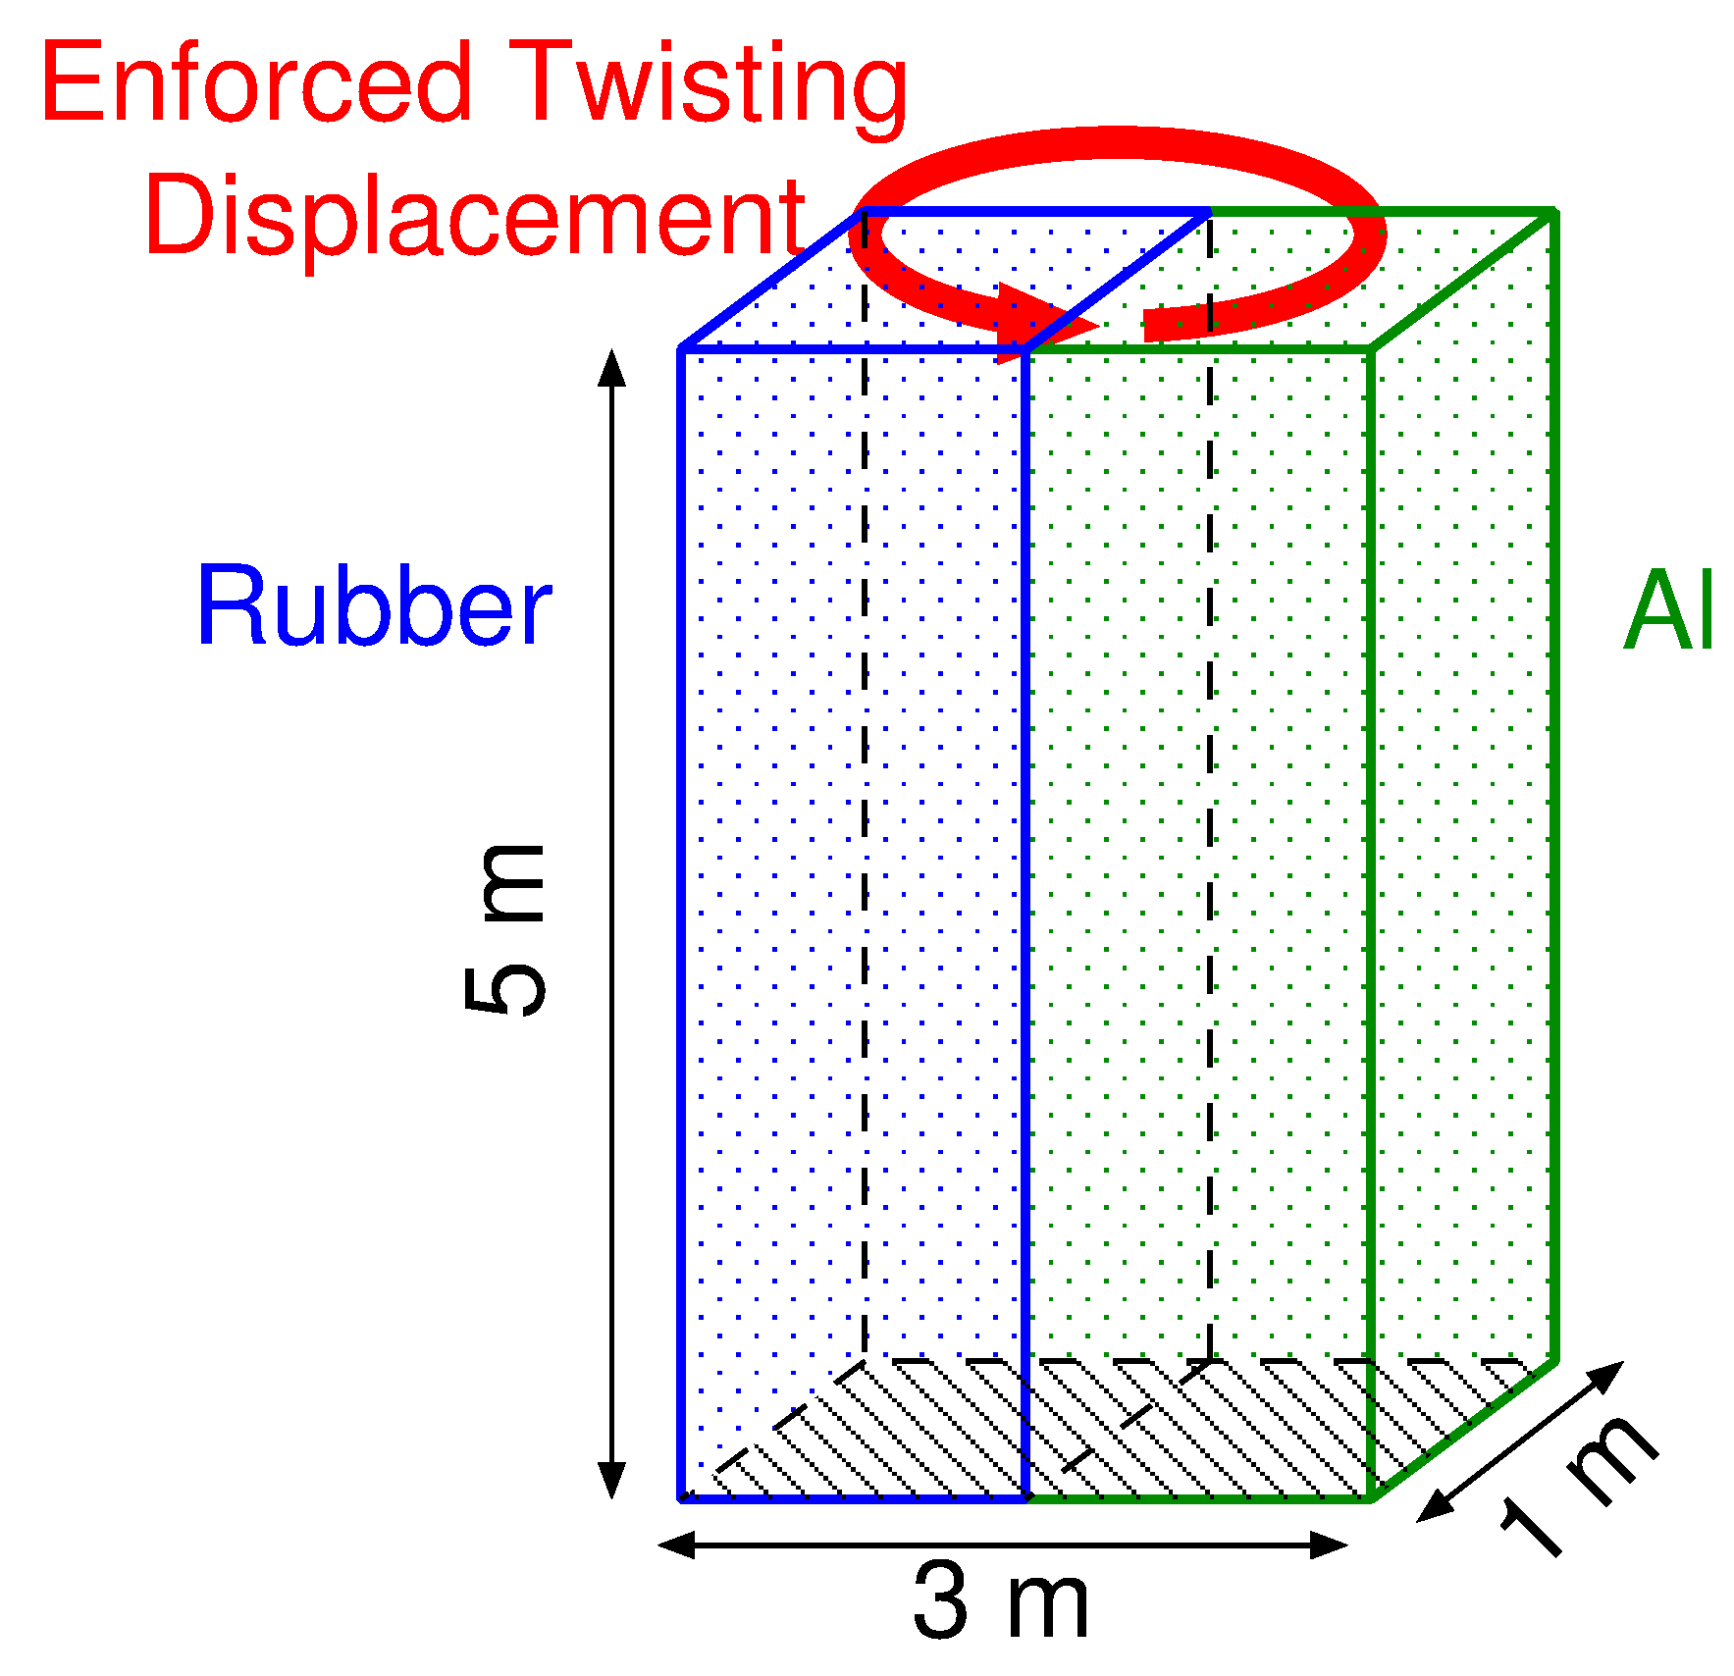
Twist of Rubber/Aluminium Composite Plate
Outline
Bottom face is perfectly constrained.
Top face is constrained in the plane and twisted 360 deg. around the vertical axis.
Calculated by F-barES-FEM-T4 only. (Just a demo.)
Multiple $F$s at edges on the material interface.
3 k nodes & 14 k elems.
[Aluminium]
Hencky elasticity: $E=70 GPa$， $ν=0.3$.
Isotropic von Mises plasticity: $σ_{Y}=100 MPa$， $H=0.7 GPa$ (const.), $(c=2)$
[Rubber]
Neo-Hook Hyperelasticity: $E^{ini}=5 MPa$, $$ν^{ini}=0.49, \\ (c=1)$$

Slide 26
Twist of Rubber/Aluminium Composite Plate
Result of F-bar ES-FEM-T4 Equivalent Plastic Strain
Seems valid.

Slide 27
Twist of Rubber/Aluminium Composite Plate
Result of F-bar ES-FEM-T4 Pressure
No pressure oscillation.

Slide 28
Twist of Rubber/Aluminium Composite Plate
Result of
F-bar ES-FEM-T4 Deformation Gradient $$F_{yz}$$
Discontinuous $F_{yz}$. $$⇑$$
No strain smoothing across material interfaces.

Slide 29
Summary

Slide 30
Benefits and Drawbacks of F-barES-FEM-T4
Benefits
Locking-free with 1st order tetra meshes.
No difficulty in severe strain or contact analysis.
No increase in DOF.
Purely displacement-based formulation.
No restriction of material constitutive model. Pressure dependent models are acceptable.
Less corner locking and pressure oscillation.
Drawbacks
✗ The more cyclic smoothing necessitates the more CPU time due to the wider bandwidth.
More accurate than Selective ES/NS-FEM!
Slower than Selective ES/NS-FEM…

Slide 31
FYI
If you are interested in F-barES-FEM-T4, please refer to the following paper:
“F-bar aided edge-based smoothed finite element method using tetrahedral elements for finite deformation analysis of nearly incompressible solids, International Journal for Numerical Methods in Engineering (IJNME), Jul. 2016.
Thank you for your kind attention!

