Slide 1
A stabilization method of F-barES-FEM-T4 for dynamic explicit analysis of nearly incompressible solids
Ryoya IIDA, Yuki ONISHI, Kenji AMAYA
Tokyo Institute of Technology, Japan

Slide 2
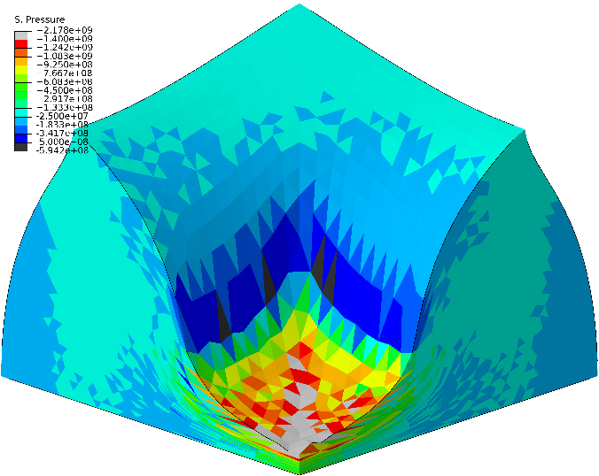
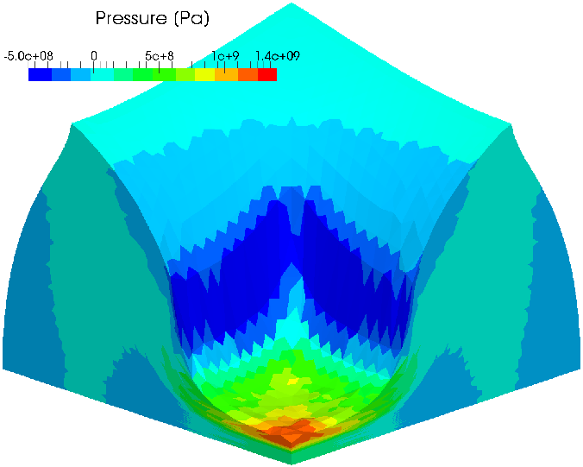
Background
Our group has proposed new FEM formulation named F-bar aided edge-based smoothed finite element method with tetrahedral elements (F-barES-FEM-T4).
ABAQUS C3D4H
✗ pressure oscillation
F-barES-FEM-T4(3)
# of cyclic smoothings
Our method shows excellent accuracy in static problems!

Slide 3
Drawbacks in explicit dynamics
Cantilever bending analysis
ABAQUS/Explicit
C3D8
Reference
time
F-barES-FEM
-T4(2)
Highly accurate results are restricted to short-term analysis.
F-barES-FEM-T4 causes energy divergence.

Slide 4
Cause of energy divergence
Due to the adoption of F-bar method, the stiffness matrix $\left[K\right]$ becomes asymmetric.
Equation of Motion: $\left[M\right]\left\{\ddot{x}\right\}+\left[K\right]\left\{x\right\}=\{f^{ext}\}$
Asymmetric stiffness matrix gives rise to imaginary part of natural frequencies and thus causes energy divergence (instability) in dynamic problem.
asymmetric
To realize long-term analysis,
stiffness matrix must be symmetrized.

Slide 5
Objective
Objective
To stabilize F-barES-FEM-T4 in explicit dynamics
for nearly incompressible materials.
Table of Body Contents
Methods: Quick introductions of F-barES-FEM-T4 and stabilized method
Results & Discussion: A few verification analyses
Summary

Slide 6
Methods
Notes:
Then we will explain our proposed method

Slide 7
Procedure of F-barES-FEM (1 of 2)
Deformation gradient of each edge, $\overline{F}$ is derived as
$$\overline{F}={\tilde{F}}^{iso}∙{\overline{F}}^{vol}$$
ES-FEM

Slide 8
Procedure of F-barES-FEM (2 of 2)
Each part of $\overline{F}$ is calculated as
$$\overline{F}={\tilde{F}}^{iso}∙{\overline{F}}^{vol}$$
Isovolumetric part
Volumetric part
(1)
(2)
Smoothing the value of adjacent elements.
↓
The same manner as
ES-FEM
(1)Calculating node’s value by smoothing
the value of adjacent elements
(2)Calculating elements’ value by smoothing
the value of adjacent nodes
(3)Repeating (1) and (2) a few times

Slide 9
Advantages of F-barES-FEM
This formulation is designed to have 3 advantages.
$$\overline{F}={\tilde{F}}^{iso}∙{\overline{F}}^{vol}$$
Isovolumetric part
Volumetric part
Like a ES-FEM
1. Shear locking free
Like a NS-FEM
2. Little pressure oscillation
3. Volumetric locking free with the aid of F-bar method

Slide 10
Construction of internal force vector
Internal force vector of F-barES-FEM-T4 is calculated as followings:
$$\left\{f^{int}\right\}=\sum{\left[\tilde{B}\right]\left\{\overline{T}\right\}\tilde{V} }$$
Combination of $\left[\tilde{B}\right]$, $\{\overline{T}\}$ and $\tilde{V}$ causes asymmetric stiffness matrix and thus causes energy divergence.
$V$ of ES-FEM
Defenition of $\left\{f^{int}\right\}$ in the same fashion as F-bar method
$B$-matrix of ES-FEM
Stress derived from $\overline{F}$

Slide 11
Proposed method: SymF-barES-FEM-T4
We modify the internal force vector in order to realize stabilization as followings:
$$\left\{f^{int}\right\}=\sum{\left[\tilde{B}\right]\left\{\overline{T}\right\}\tilde{V}}$$
F-barES-FEM-T4
volume
derived as
$$det\left(\overline{F}\right)V^{ini}$$
$$\left\{f^{int}\right\}=\sum{\left[\overline{B}\right]\left\{\overline{T}\right\}\overline{V} }$$
SymF-barES-FEM-T4
Proposed
$B$-matrix
Derived from $\overline{F}$
Stress
derived from $\overline{F}$
We named this formulation SymF-barES-FEM-T4.

Slide 12
Concept of SymF-barES-FEM-T4
volume
derived as
$$det\left(\overline{F}\right)V^{ini}$$
$$\left\{f^{int}\right\}=\sum{\left[\overline{B}\right]\left\{\overline{T}\right\}\overline{V} }$$
SymF-barES-FEM-T4
Proposed
$B$-matrix
Derived from $\overline{F}$
Stress
derived from $\overline{F}$
The replacement $\left[\tilde{B}\right]$ to$[\overline{B}]$ means to symmetrize stiffness matrix as standard FEM.
The replacement $\tilde{V}$ to$\overline{V}$ is natural extension of volume term and introduced empirically.

Slide 13
Result & Discussion

Slide 14
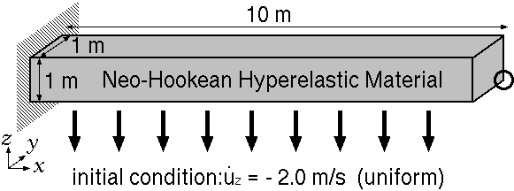
#1 Bending of a cantilever
Dynamic explicit analysis.
Neo-Hookean material Initial Young’s modulus: 6.0 MPa, Initial Poisson’s ratio: 0.49, Density: 920 kg/m³.
Compare the results of SymF-barES-FEM-T4, F-barES-FEM-T4 and Selective H8 (ABAQUS/Explicit C3D8) elements.

Slide 15
Inability of standard T4 element
at $t=0.75$ s (pressure distribution)
ABAQUS/Explicit C3D4
Standard T4 element
✗Pressure oscillation and locking
ABAQUS/Explicit C3D8
(Selective H8 element)
Reference
Standard T4 element is useless!

Slide 16
Time history of deformed shapes
ABAQUS/Explicit C3D8
(Selective H8 element)
Reference
F-barES-FEM-T4(2)
✔ No pressure oscillation
✔ No locking
✗ Energy divergence
SymF-barES-FEM-T4(2)
(Proposed method)
✔ Less pressure oscillation
✔ No locking
✔ No energy divergence

Slide 17
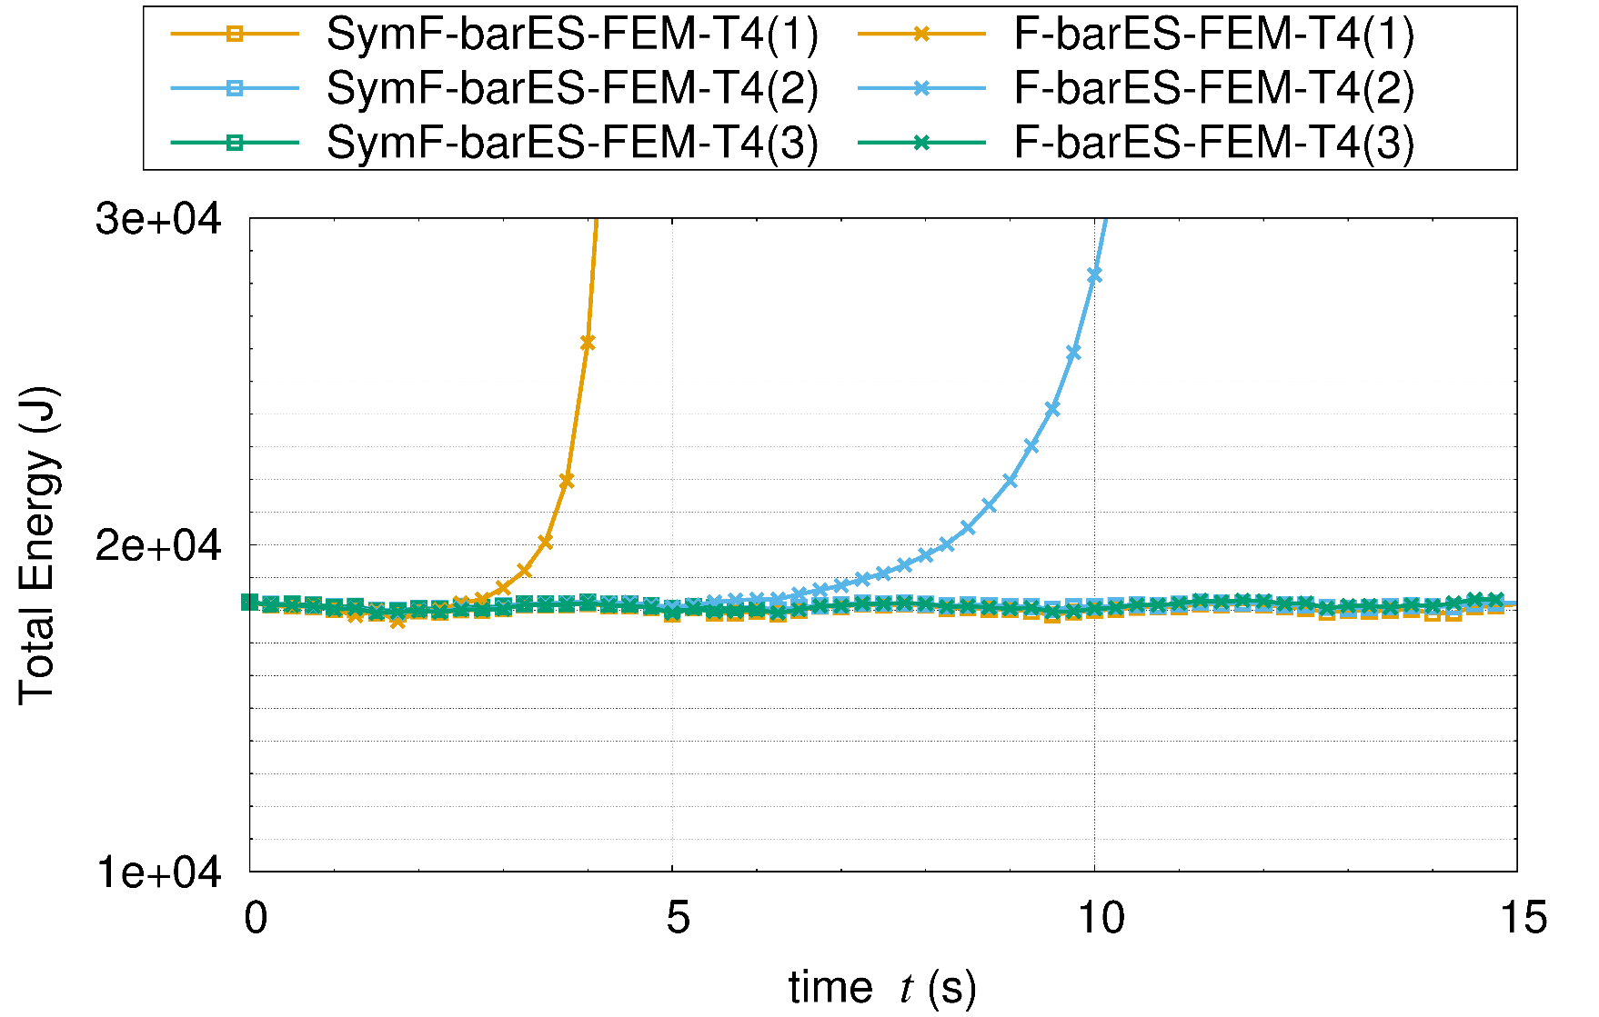
Time history of total energy
F-barES-FEM-T4
SymF-barES-FEM-T4
(Proposed)
150,000 time steps
SymF-barES-FEM-T4 can suppress energy divergence!

Slide 18
Deformed shapes and pressure distributions
at $t=0.75$ s
ABAQUS/Explicit C3D8
(Selective H8 element)
Reference
F-barES-FEM-T4(2)
✔ No pressure oscillation
✔ No locking
✗ Energy divergence
SymF-barES-FEM-T4(2)
(Proposed method)
✔ Less pressure oscillation
✔ No locking
✔ No energy divergence
Proposed method can give acceptable pressure distribution.

Slide 19
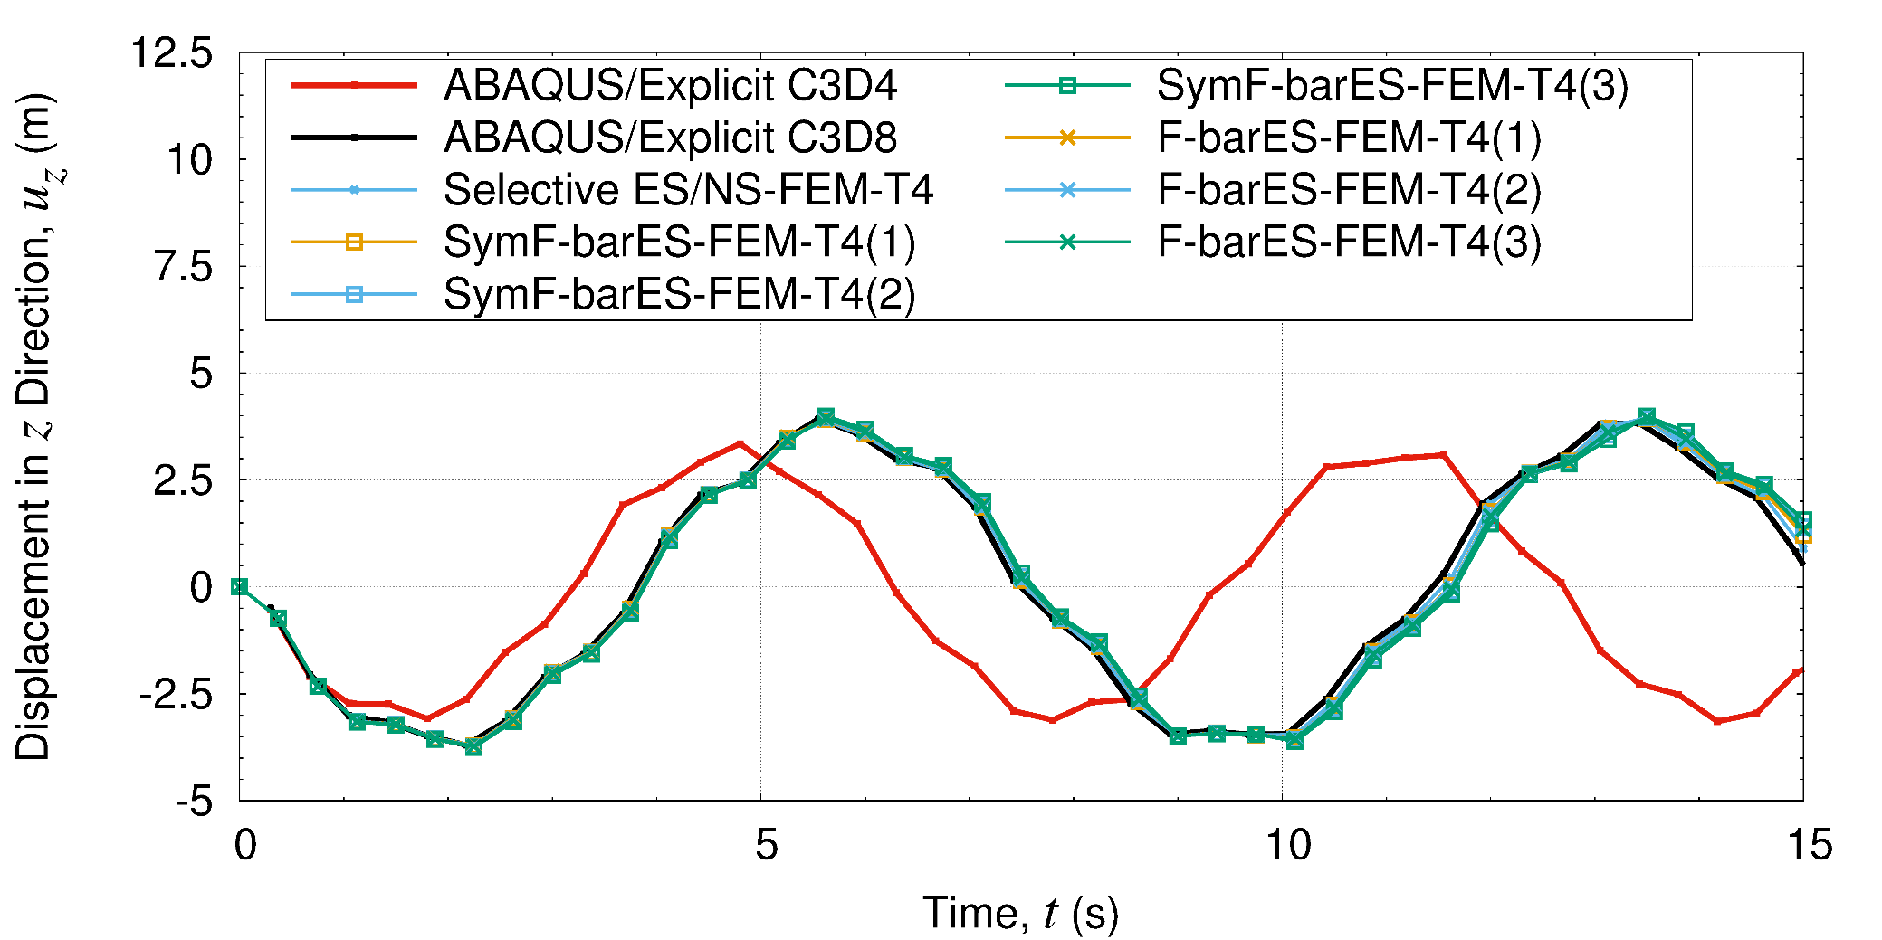
Time history of displacement
Proposed &
Reference
Standard T4
Proposed method shows good result without locking.
The accuracy of displacement does not depend on the number of cyclic smoothings as well as F-baES-FEM-T4.

Slide 20
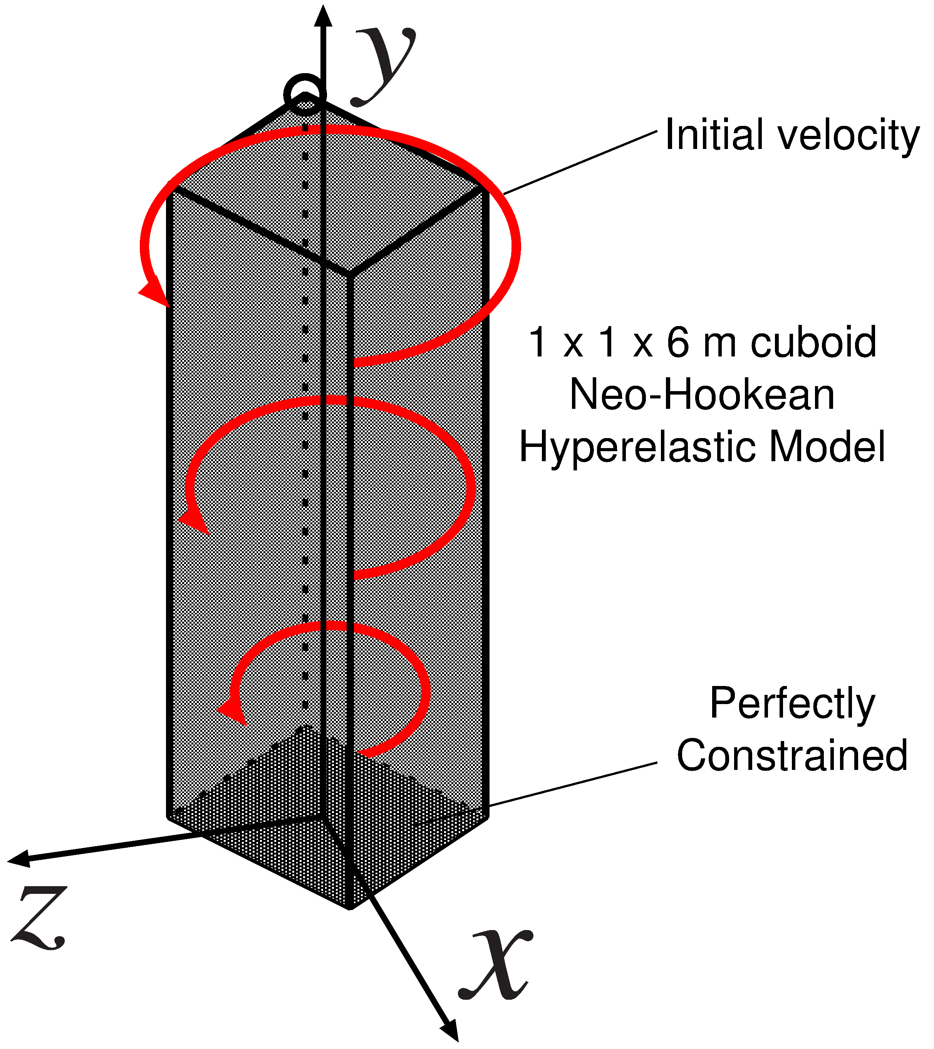
#2 Cantilever twisting analysis
Dynamic explicit analysis.
Twisting initial velocity fields:
$$v_{0}\left(x,y,z\right)=100\sin\left(\frac{yπ}{12}\right){\left\{z, 0, −x\right\}}^{T}.$$
Neo-Hookean material
Initial Young’s modulus: 17.0 MPa, Initial Poisson’s ratio: 0.49, Density: 1100 kg/m³.
Compare the results of
SymF-barES-FEM-T4, F-barES-FEM-T4,
and Selective H8

Slide 21
Time history of deformed shapes
ABAQUS/Explicit C3D8
(Selective H8 element)
Reference
F-barES-FEM-T4(2)
✔ No pressure oscillation
✔ No locking
✗ Energy divergence
SymF-barES-FEM-T4(2)
(Proposed method)
✔ Less pressure oscillation
✔ No locking
✔ No energy divergence

Slide 22
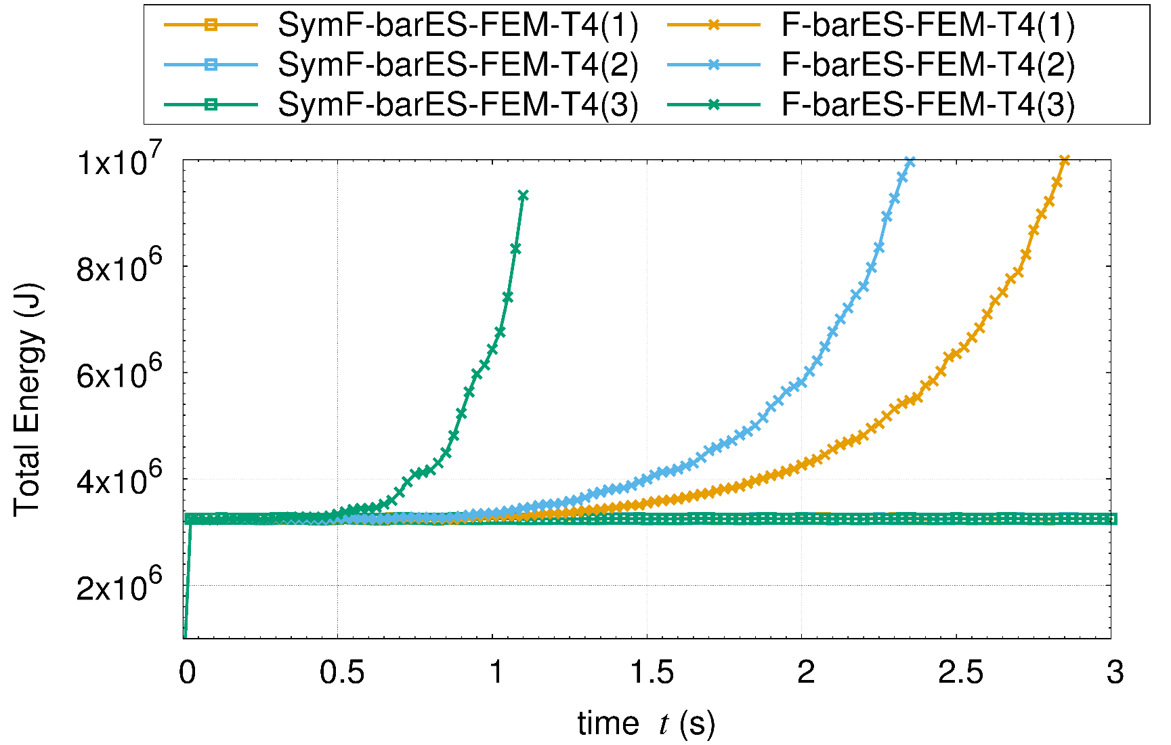
Time history of total energy
F-barES-FEM-T4
SymF-barES-FEM-T4
(Proposed)
60,000 time steps
SymF-barES-FEM-T4 can suppress energy divergence!

Slide 23
Effect of cyclic smoothings
#cyclic
smoothings
1
2
3
1
2
3
F-barES-FEM-T4
SymF-barES-FEM-T4
(Proposed method)
The increase in cyclic smoothings no longer improves distribution
unlike F-barES-FEM-T4

Slide 24
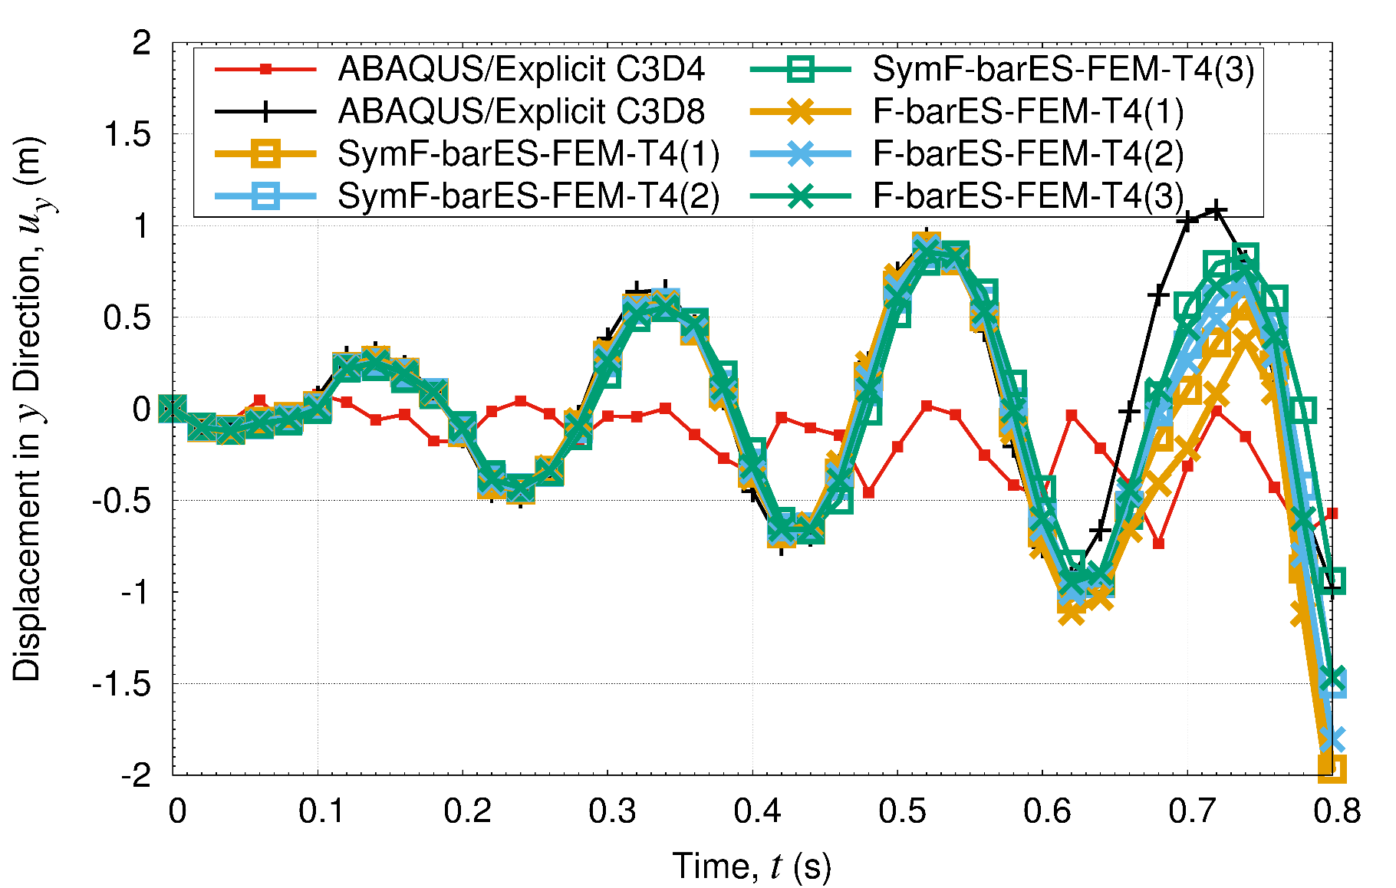
Time history of displacement
Standard T4
Proposed
Proposed methods can show as good result as F-barES-FEM-T4

Slide 25
#3 Swinging of Bunny Ears
Outline
Iron ears: $E_{ini}=200 GPa, ν_{ini}=0.3, ρ=7800 kg/m^{3}$, Neo-Hookean, No cyclic smoothing.
Rubber body: $E_{ini}=6 MPa, ν_{ini}=0.49, ρ=920 kg/m^{3}$, Neo-Hookean, 1 cycle of smoothing.
Compared to ABAQUS/Explicit C3D4. No Hex mesh available!
Iron Ears
Initial Velocity of Iron Ears
Rubber Body
Fixed

Slide 26
Time histories of deformed shapes
ABAQUS/Explicit C3D4
(Standard T4 element)
F-barES-FEM-T4(1)
SymF-barES-FEM-T4(1)
(Proposed method)
✔ No pressure oscillation
✔ No locking
✗ Energy divergence
✗ Pressure oscillation
✗ Locking
✔ No energy divergence
✔ Less pressure oscillation ✔ No locking
✔ No energy divergence

Slide 27
Deformed shapes and sign of pressure
In an early stage
✔ Pressure waves
✗ Pressure oscillations
ABAQUS/Explicit C3D4
(Standard T4 element)
F-barES-FEM-T4(1)
SymF-barES-FEM-T4(1)
(Proposed method)
Our method represents pressure waves appropriately!

Slide 28
Summary

Slide 29
Summary
SymF-barES-FEM-T4 was proposed in order to realize accurate and stable dynamic explicit analysis.
Proposed method realizes ✔ Less pressure oscillation ✔ No locking ✔ No energy divergence
Further improvement for perfect suppression of pressure oscillation is our future work.
Thank you for your kind attention.
Notes:
まとめです
今後は接触を考慮した問題への拡張を中心に、研究を進めていくつもりです。

