Slide 1
Electrodeposition Simulation with
Edge-based Smoothed Finite Element Method using 4-node Tetrahedral Elements for Complex Car Body Shapes
Kai KITAMURA, Yuki ONISHI, Kenji AMAYA
Tokyo Institute of Technology (Japan)

Slide 2
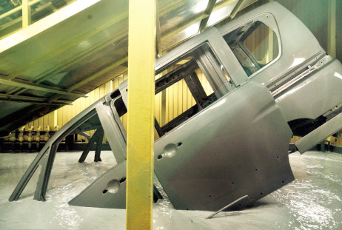
What is electrodeposition (ED) ?
Most widely-used basecoat methods for car bodies.
Making coated film by applying direct electric current
in a paint pool.
Relatively good at making uniform film thickness
but not satisfactory uniform in actual production lines.
ED simulator is necessary for optimizing carbody design
and line coating conditions.
+
-
Paint
＋
Anode
＋
Cathode
http://n-link.nissan.co.jp/NOM/PLANT/

Slide 3

Mechanism of Electrodeposition
Paint ions have positive (+) charge.
The vicinity of the cathode has negative (-) charge
because of $OH^{−}$ generated by electrolysis of water.
Some of the paint particles diffuse and dissolve.
Power on
Deposition
-
+
-
+
Coated
Film
-
-
+
When the particle gets big enough
Carbody
（Cathode)
Aggregated into paint particles
Paint Ions

Slide 4
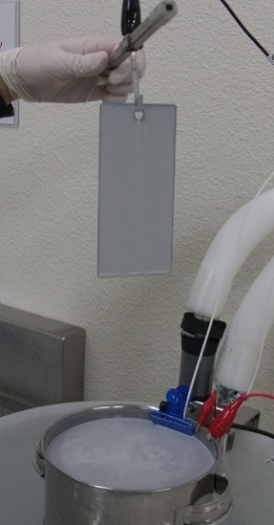
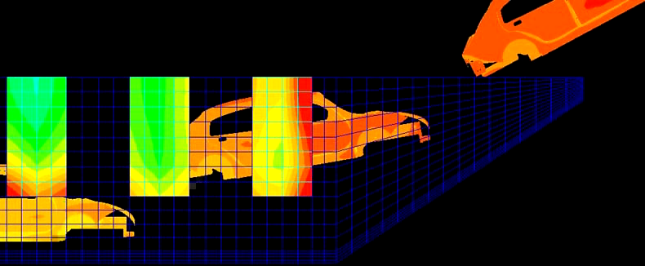
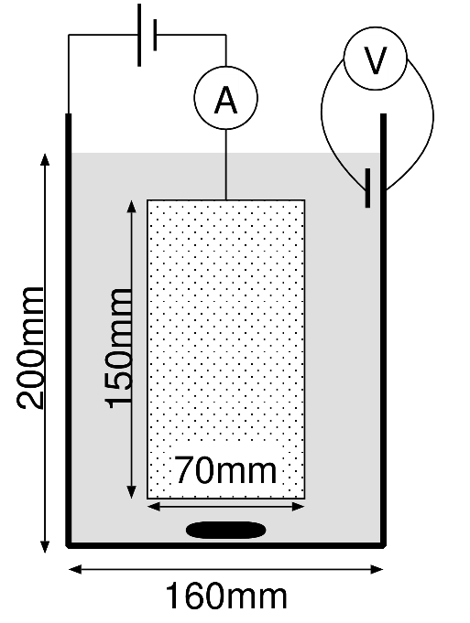
How to Develop an ED Simulator
Experiments at lab in various coating conditions.
Identification of ED boundary model
and its parameters.
Implementation to a FE code.
One-Plate Test
Plate
Paint
Anode
Plate
Stir bar
ED simulation for actual lines

Slide 5
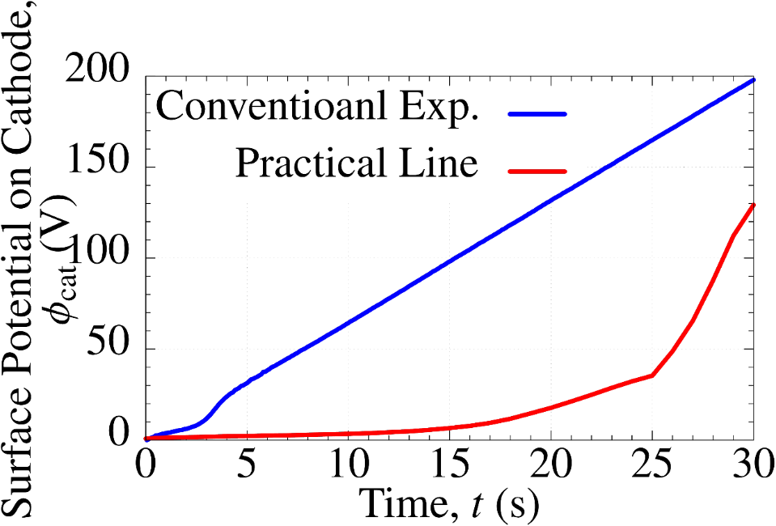

Two Issues in Previous Studies
Coating conditions in lab experiments are different from those in actual lines.
e.g.)
Accuracy is insufficient in low voltage cases.
$⟹$ Poor accuracy on inner surfaces of carbodies.
Lab Exp.
Actual Line
The conventional
lab experiments
did not reproduce
the actual line condition.
The conventional ED constitutive model was too simple
to reproduce the complex ED phenomena.

Slide 6
Objective
Propose a new lab experiment method
to reproduce coating conditions of actual ED lines.
Propose a new ED boundary model
to improve the accuracy of an ED simulation.
Table of body contents:
Our new Lab Experiment Method
Our new ED Boundary Model
Our S-FEM Code for ED Simulation
Validation & Demonstration Results

Slide 7
Our New
Lab Experiment Method

Slide 8
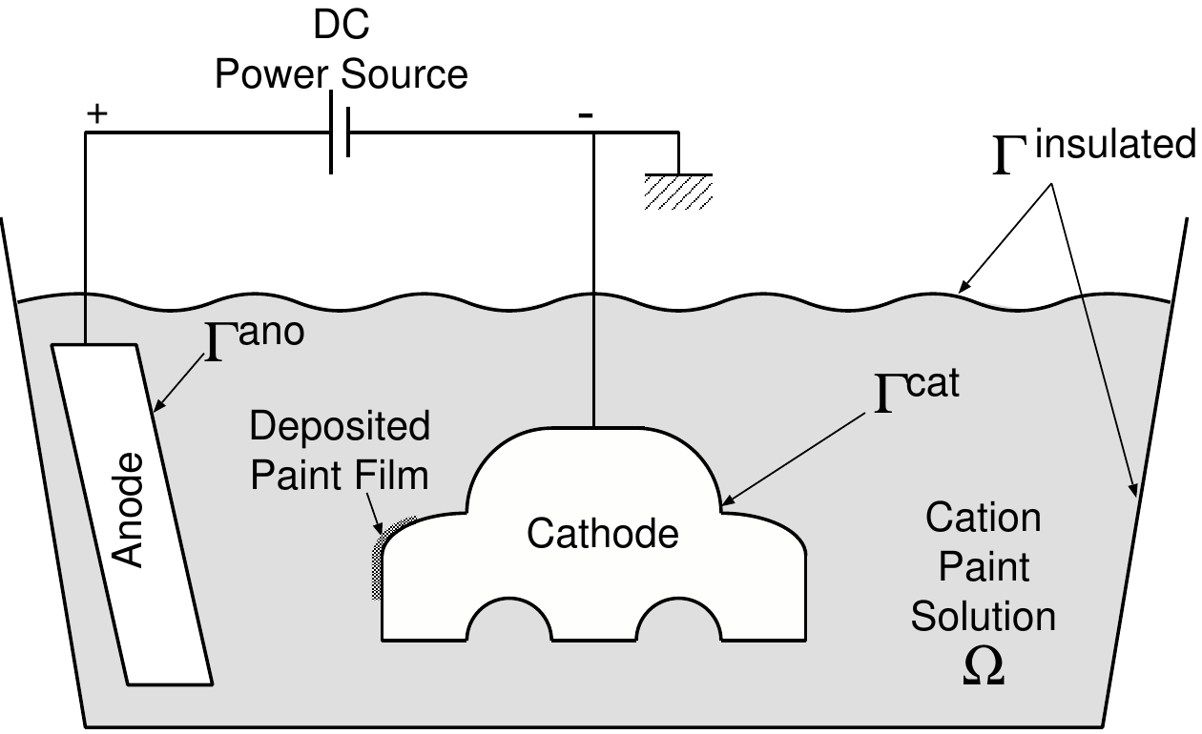
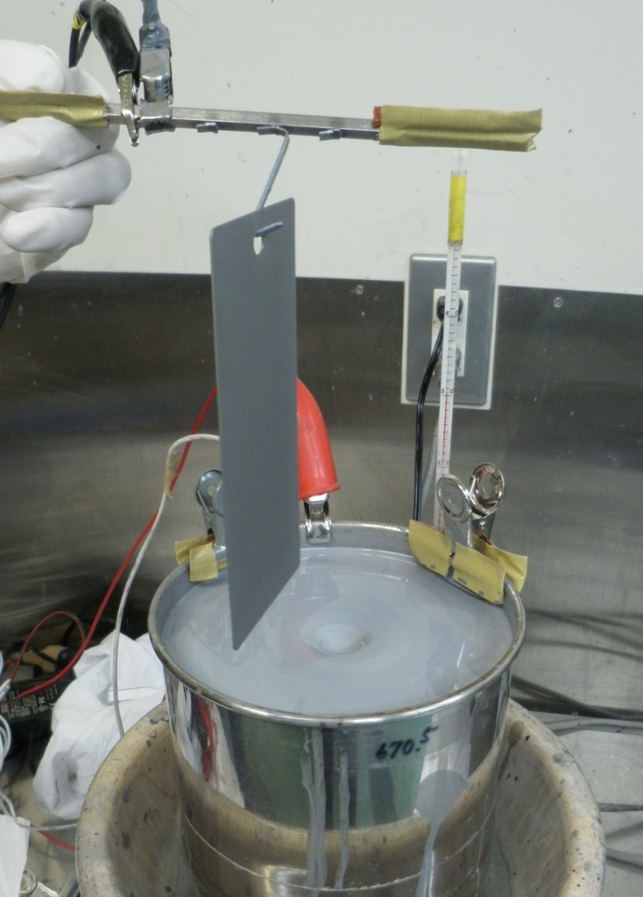
Outline of the One-Plate Test
Cathode
plate
Use a rectangular steel plate instead of a car body.
Use a SS pot instead of the paint pool and anode electrodes.
Paint
Anode
pot
Stirring
using a stirrer

Slide 9
Outline of the One-Plate Test
Cathode
plate
Dip a steel plate into the paint pot.
Apply voltage up to 270 V between the plate and pot.
Measure time-histories of
  applied voltage,
  current
  film thickness.
Paint
Anode
pot
Stirring
using a stirrer

Slide 10
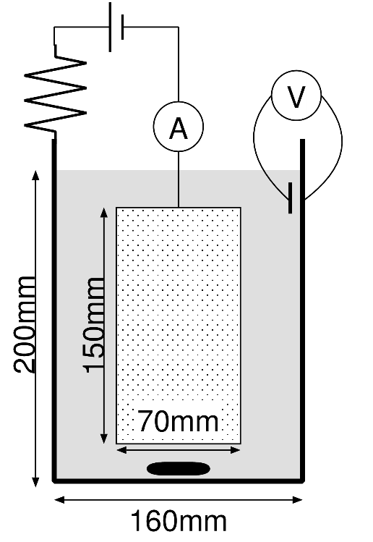
Our New Lab Experiment Method
Issue in the conventional lab experiment
IR drop in solution is too small.
In an actual line, IR drop in solution is about 100 V at most; however, in the conventional lab experiment, that is only 10 V.
Modification in the new lab experiment
An external resistor is introduced.
External
Resistor
Scale effect is canceled
by the external resistor.
Anode
Plate
Stir bar

Slide 11
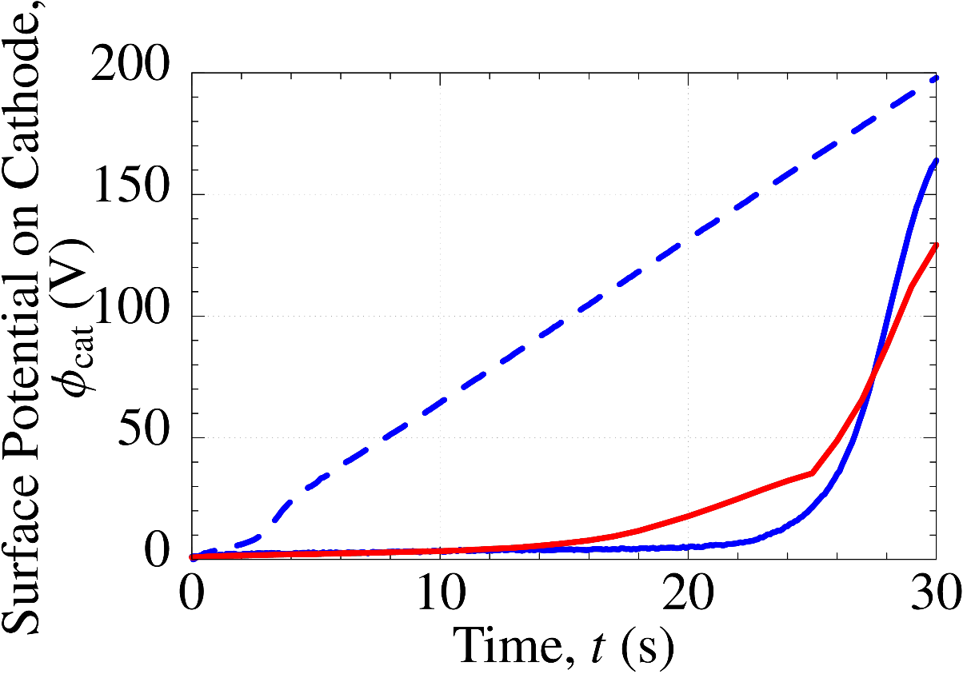

Our New Lab Experiment Method
Comparison of Surface Potential on Cathode
$⟹$ ED boundary models should be identified
with the new lab experiment data.
Our new meth.
An actual line
Conventional meth.
Our new lab experiment succeeded in
reproducing the actual line condition.

Slide 12
Our New
ED Boundary Model

Slide 13
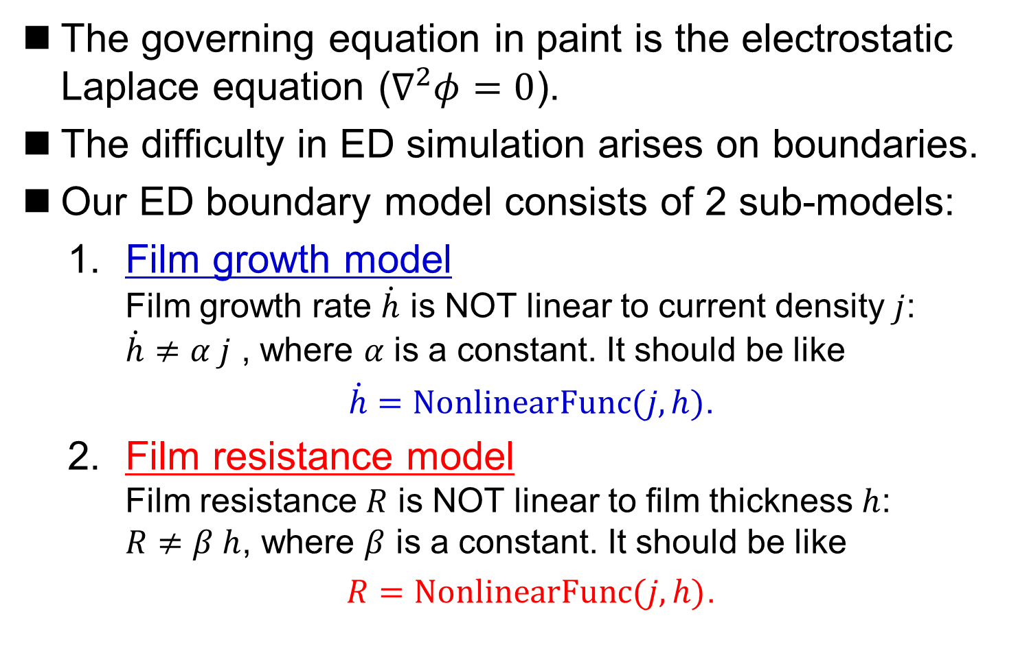
Our ED Boundary Model
The governing equation in paint is the electrostatic Laplace equation ($∇^{2}φ=0$).
The difficulty in ED simulation arises on boundaries.
Our ED boundary model consists of 2 sub-models:
  Film growth model
  Film growth rate $\dot{h}$ is NOT linear to current density $j$:
  $\dot{h}≠α j$ , where $α$ is a constant. It should be like
  $\dot{h}=NonlinearFunc(j,h)$.
  Film resistance model
  Film resistance $R$ is NOT linear to film thickness $h$:
  $R≠β h$, where $β$ is a constant. It should be like
  $R=NonlinearFunc(j,h)$.

Slide 14

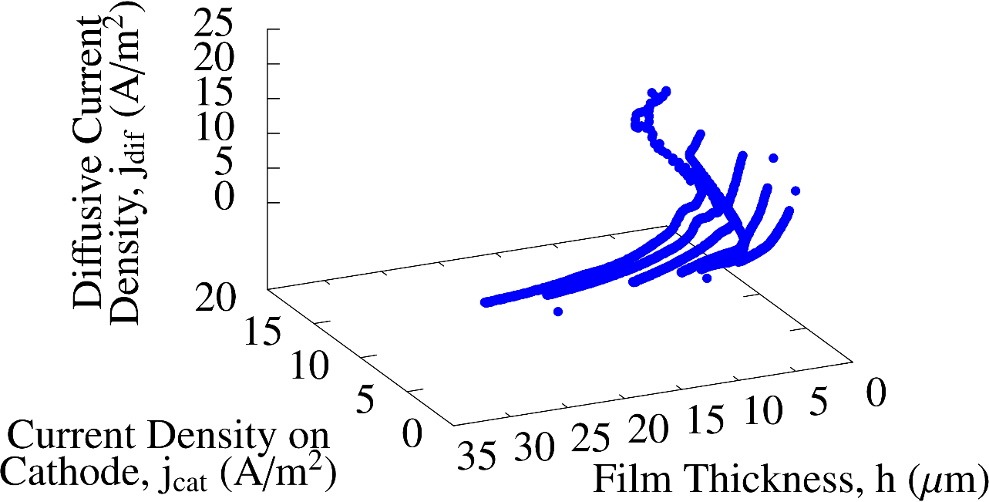
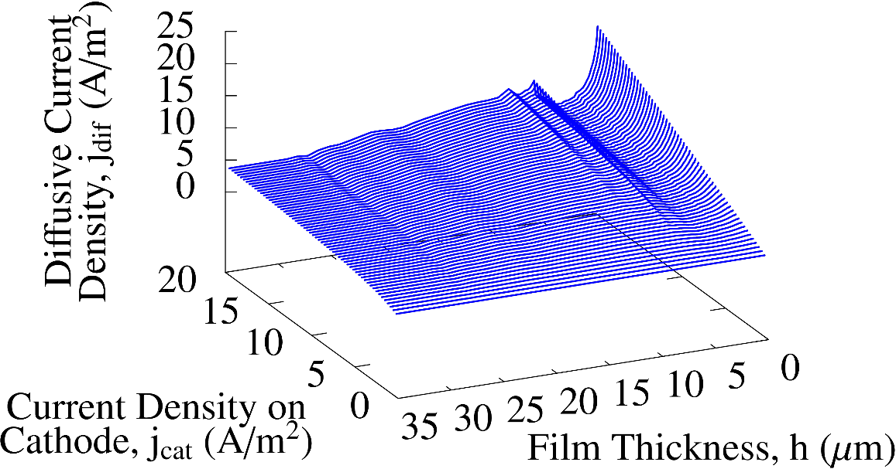

Procedure to Identify Film Growth Model
1. One-plate tests
2. Scatter diagram of $j_{cat}, h and \dot{h}$
Plot
3. Approximated surface
Data
fitting

Slide 15
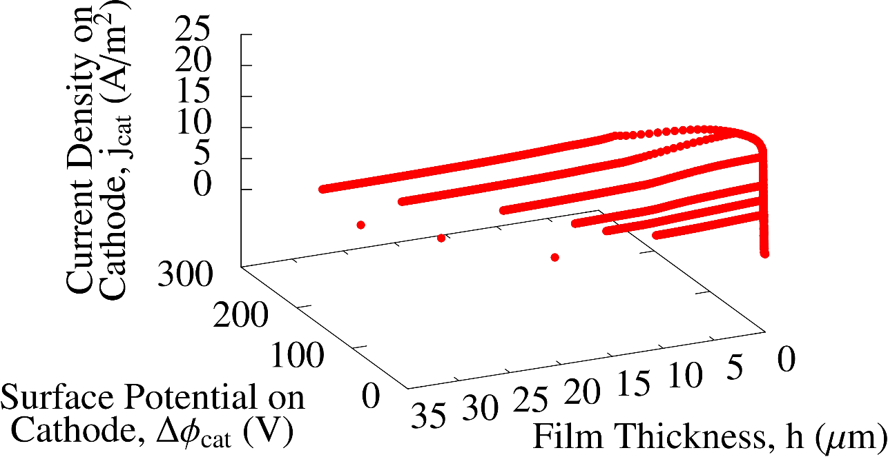
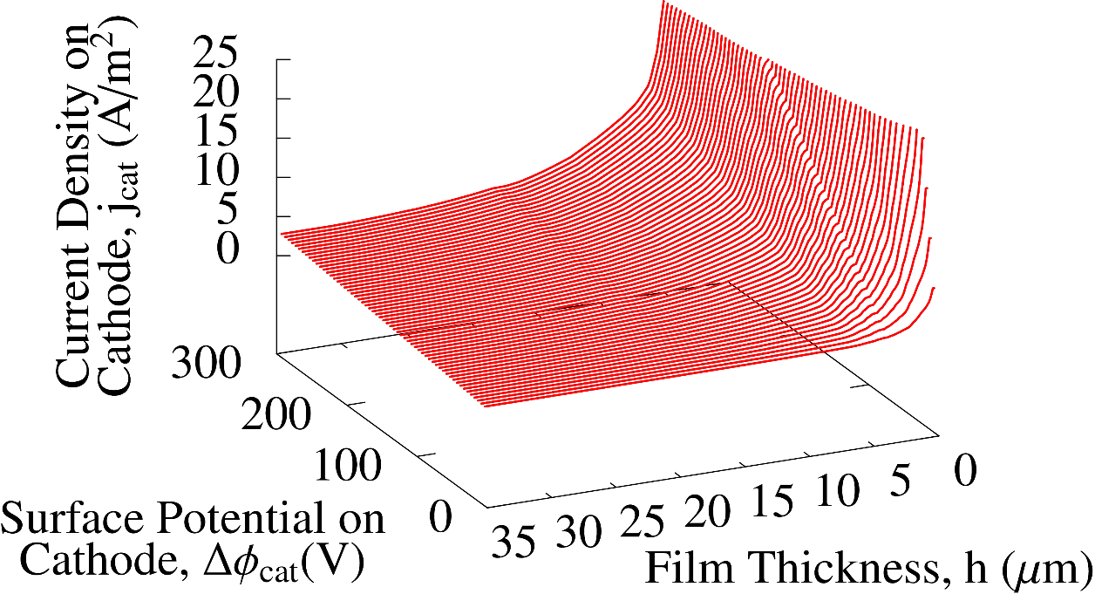

Procedure to Identify Film Resistance Model
1. One-plate tests
2. Scatter diagram of$φ_{cat}, h and j_{cat}$
Plot
3. Approximated surface
Data
fitting

Slide 16
Our S-FEM Code for ED Simulation

Slide 17
Our S-FEM Code for ED Simulation
What is ES-FEM-T4?
A kind of strain smoothing method.
Using element edges as Gauss points.
Robust against element skew.
Superlinear convergence rate with T4 mesh.
We adopt the edge-based S-FEM using
4-node Tetrahedral Elements（ES-FEM-T4）．
ES-FEM-T4 is always more efficient than FEM-T4.

Slide 18
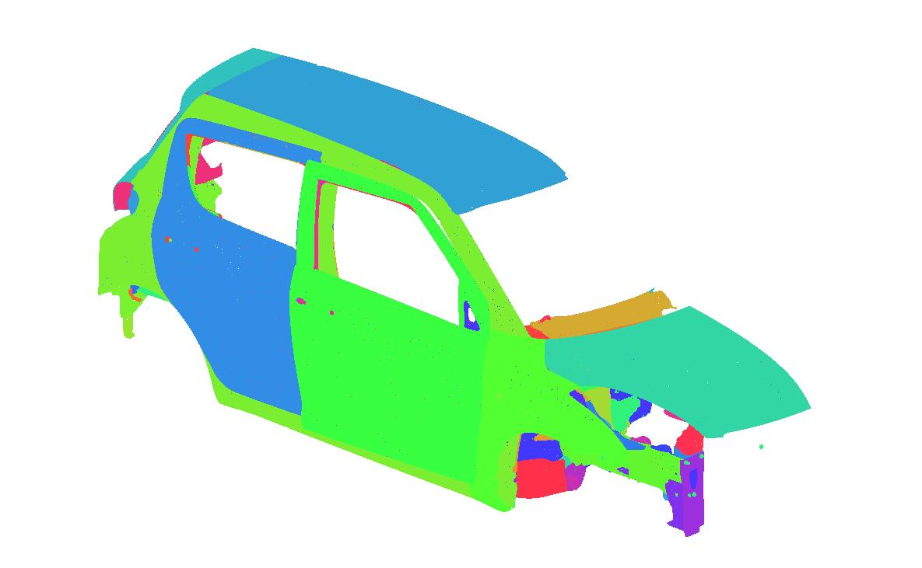
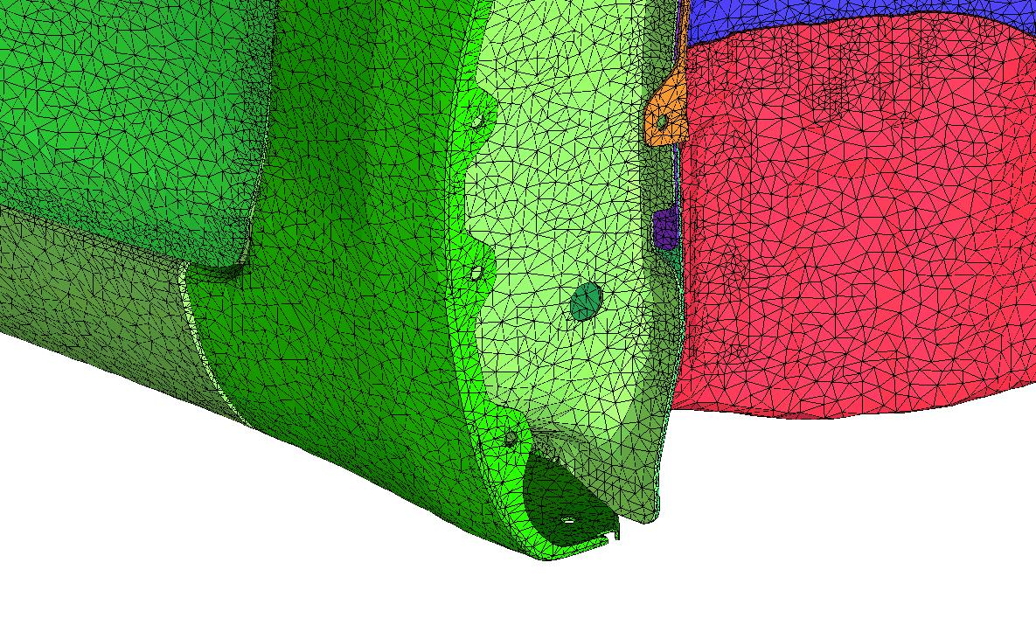
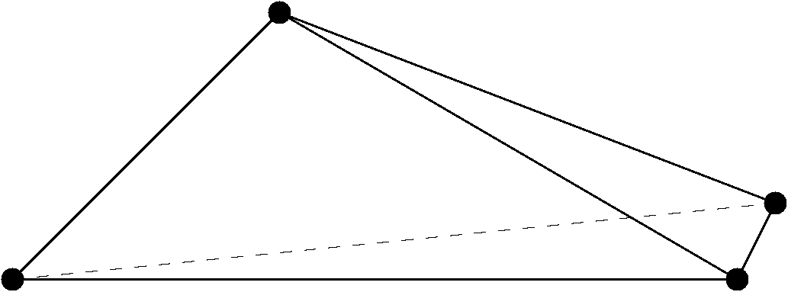
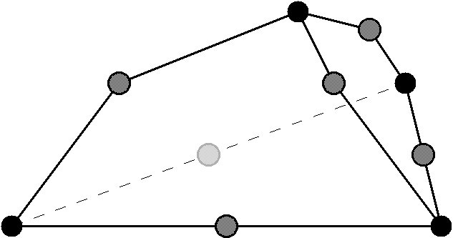
Our S-FEM Code for ED Simulation
Why not FEM-T10 but ES-FEM-T4?
T10 mesh generally requires more large number of nodes than T4 mesh to represent a complex shape.
Kinked T10 element causes severe accuracy loss.
Provided by
SUZUKI Motor Co.
Only surface
mesh is shown.
✓ Skewed T4
(acceptable)
✗Kinked T10
(unacceptable)
ES-FEM-T4 is always more practical than FEM-T10.

Slide 19
Validation & Demonstration Results

Slide 20
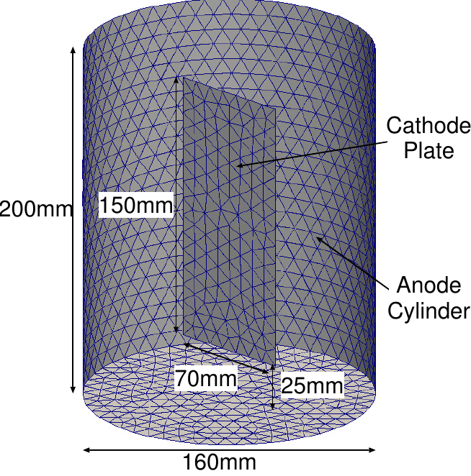

One-plate Test
Outline
The most basic lab experiment.
500 $Ω$ external resistor is considered.
Simulation results are compared to experiment data.

Slide 21
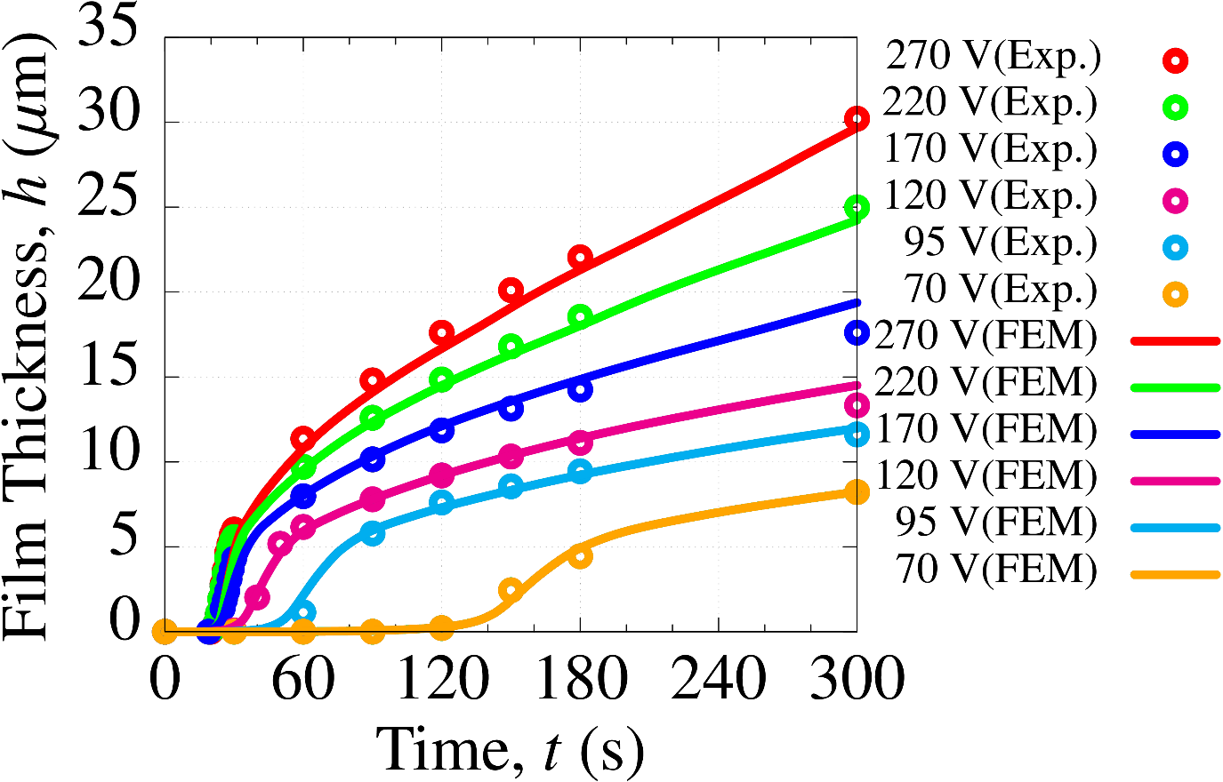
One-plate Test
Comparison of time history of film thickness
Our new ED simulator succeeded in
reproducing experimental results with high accuracy
from high voltage to low voltage.

Slide 22
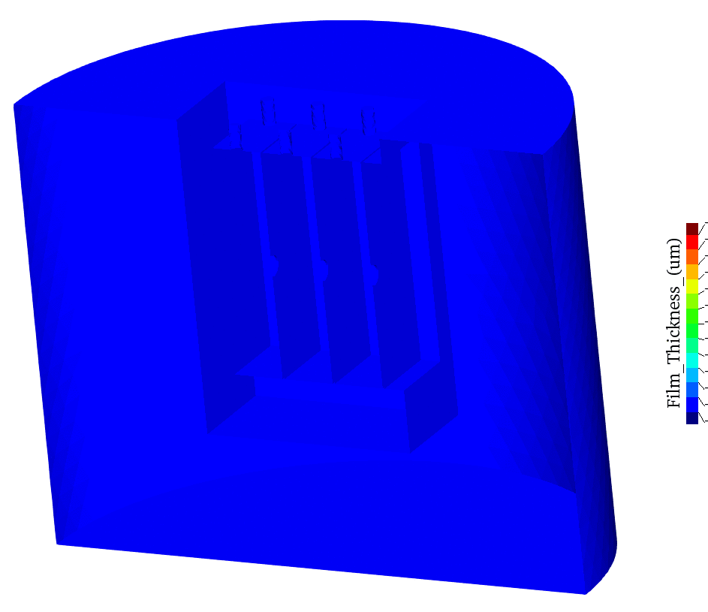
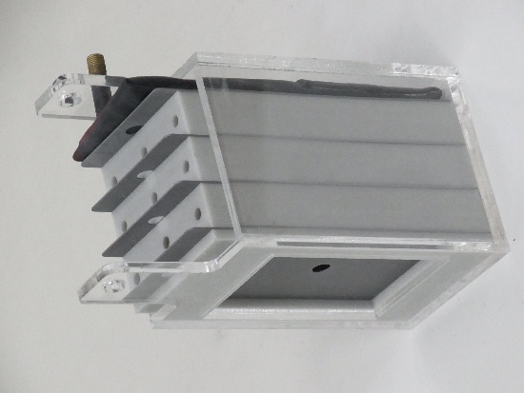
4-Plate BOX Test
Outline
Imitating a multiple bag-like structure.
Accuracy on the innermost surface (left side in Figs)
is the most important; i.e., “maximize the minimum”.
Objective is to confirm the validity of the ED boundary model identified with the one-plate data.

Slide 23
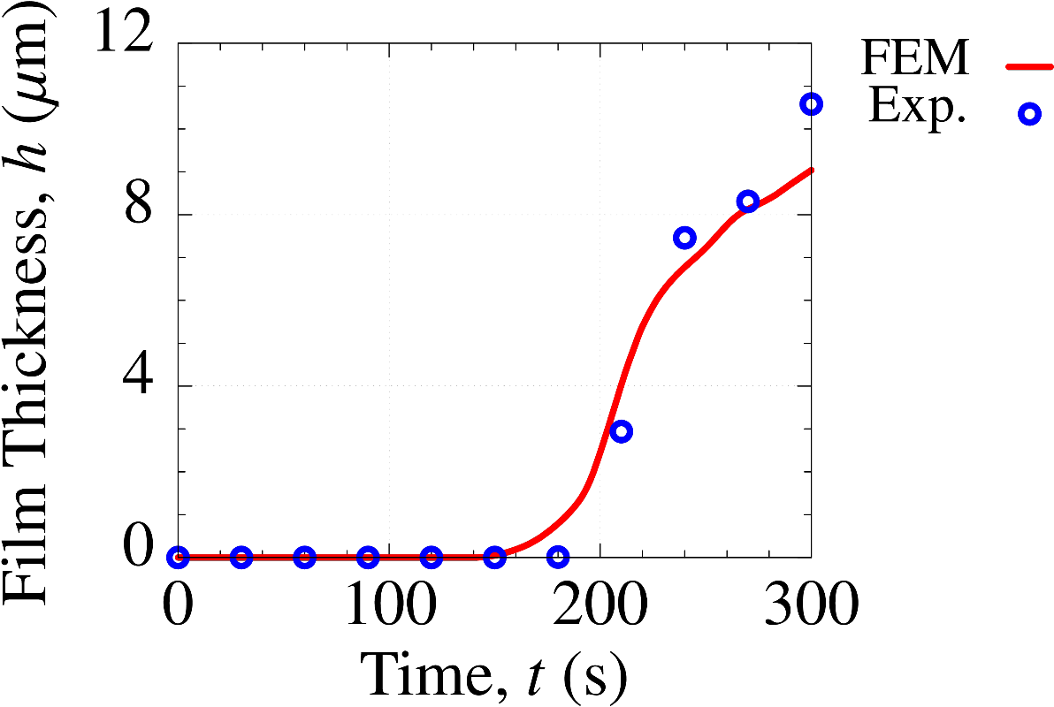
4-Plate BOX Test
Comparison of film thickness
on the innermost surface
Our new ED simulator has sufficient accuracy
to predict the film thickness on the innermost surface.

Slide 24
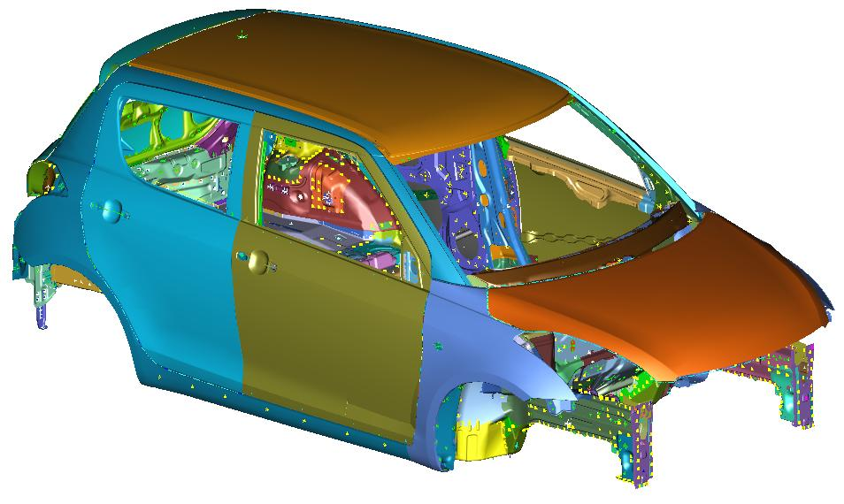
Carbody Analysis (Outline)
Demonstration analysis.
A half carbody in a box pool.
No motion.
3M nodes, 13M elements, and
18M edges for ES-FEM-T4.
1800 time-steps for 180 s.

Slide 25
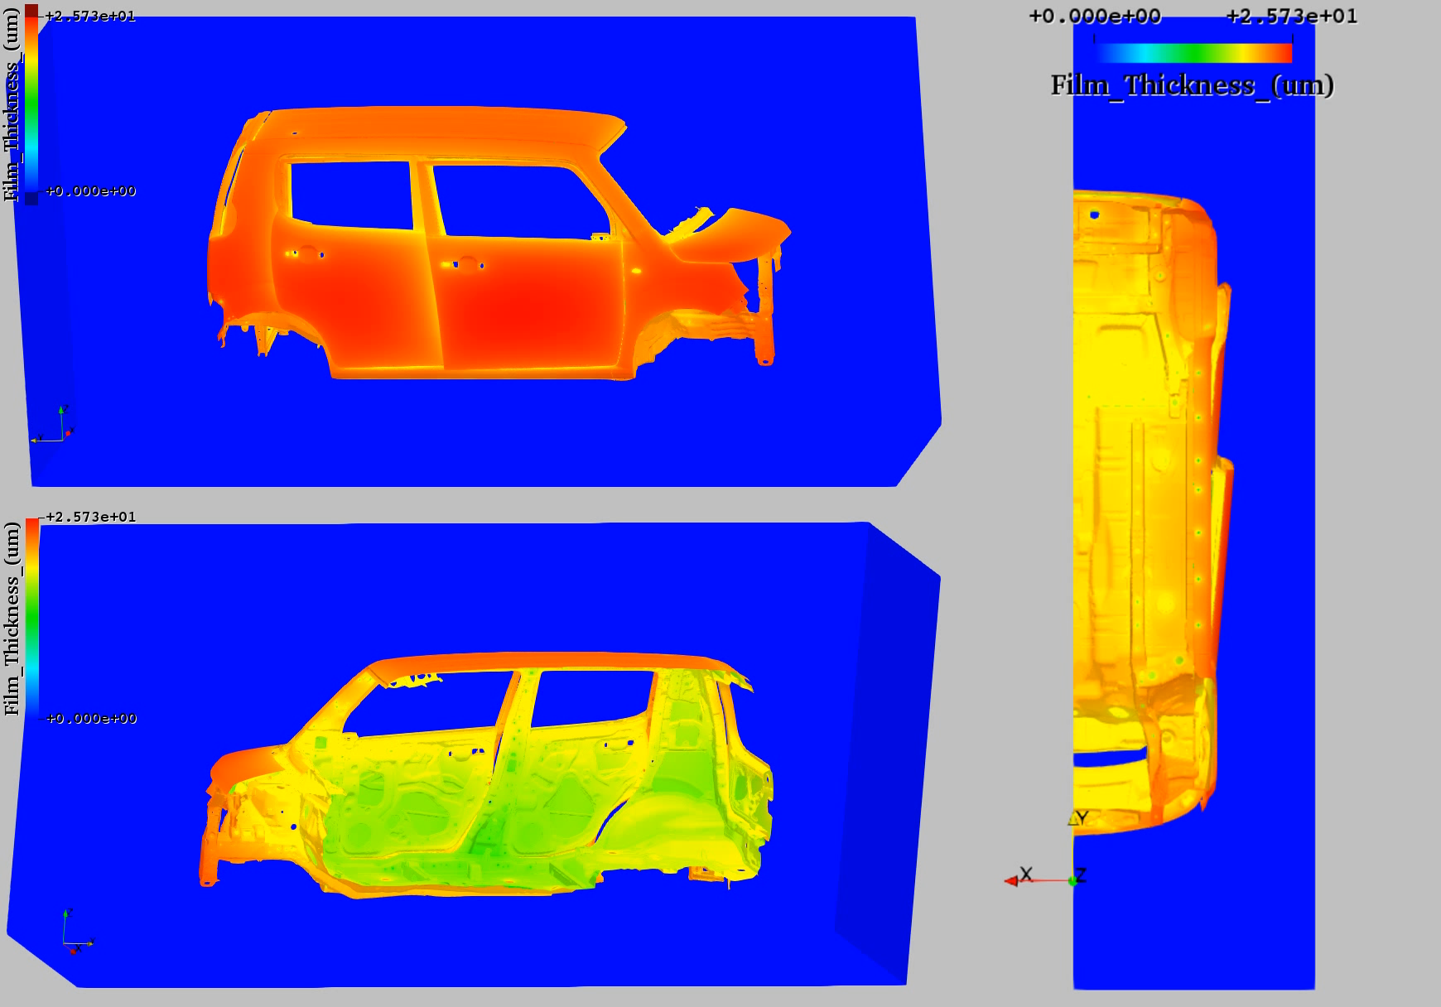
Carbody Analysis (Film Thickness)

Slide 26
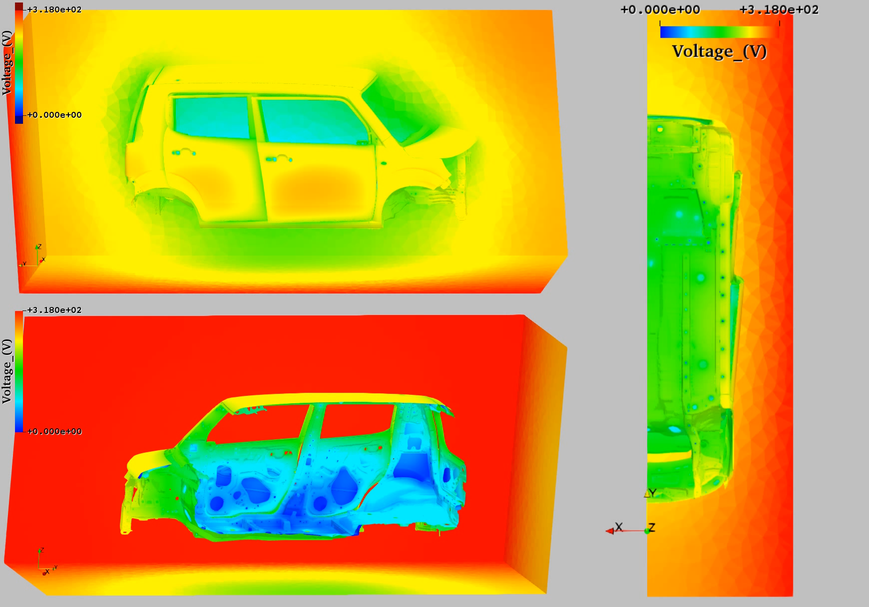
Carbody Analysis (Surface Potential)

Slide 27
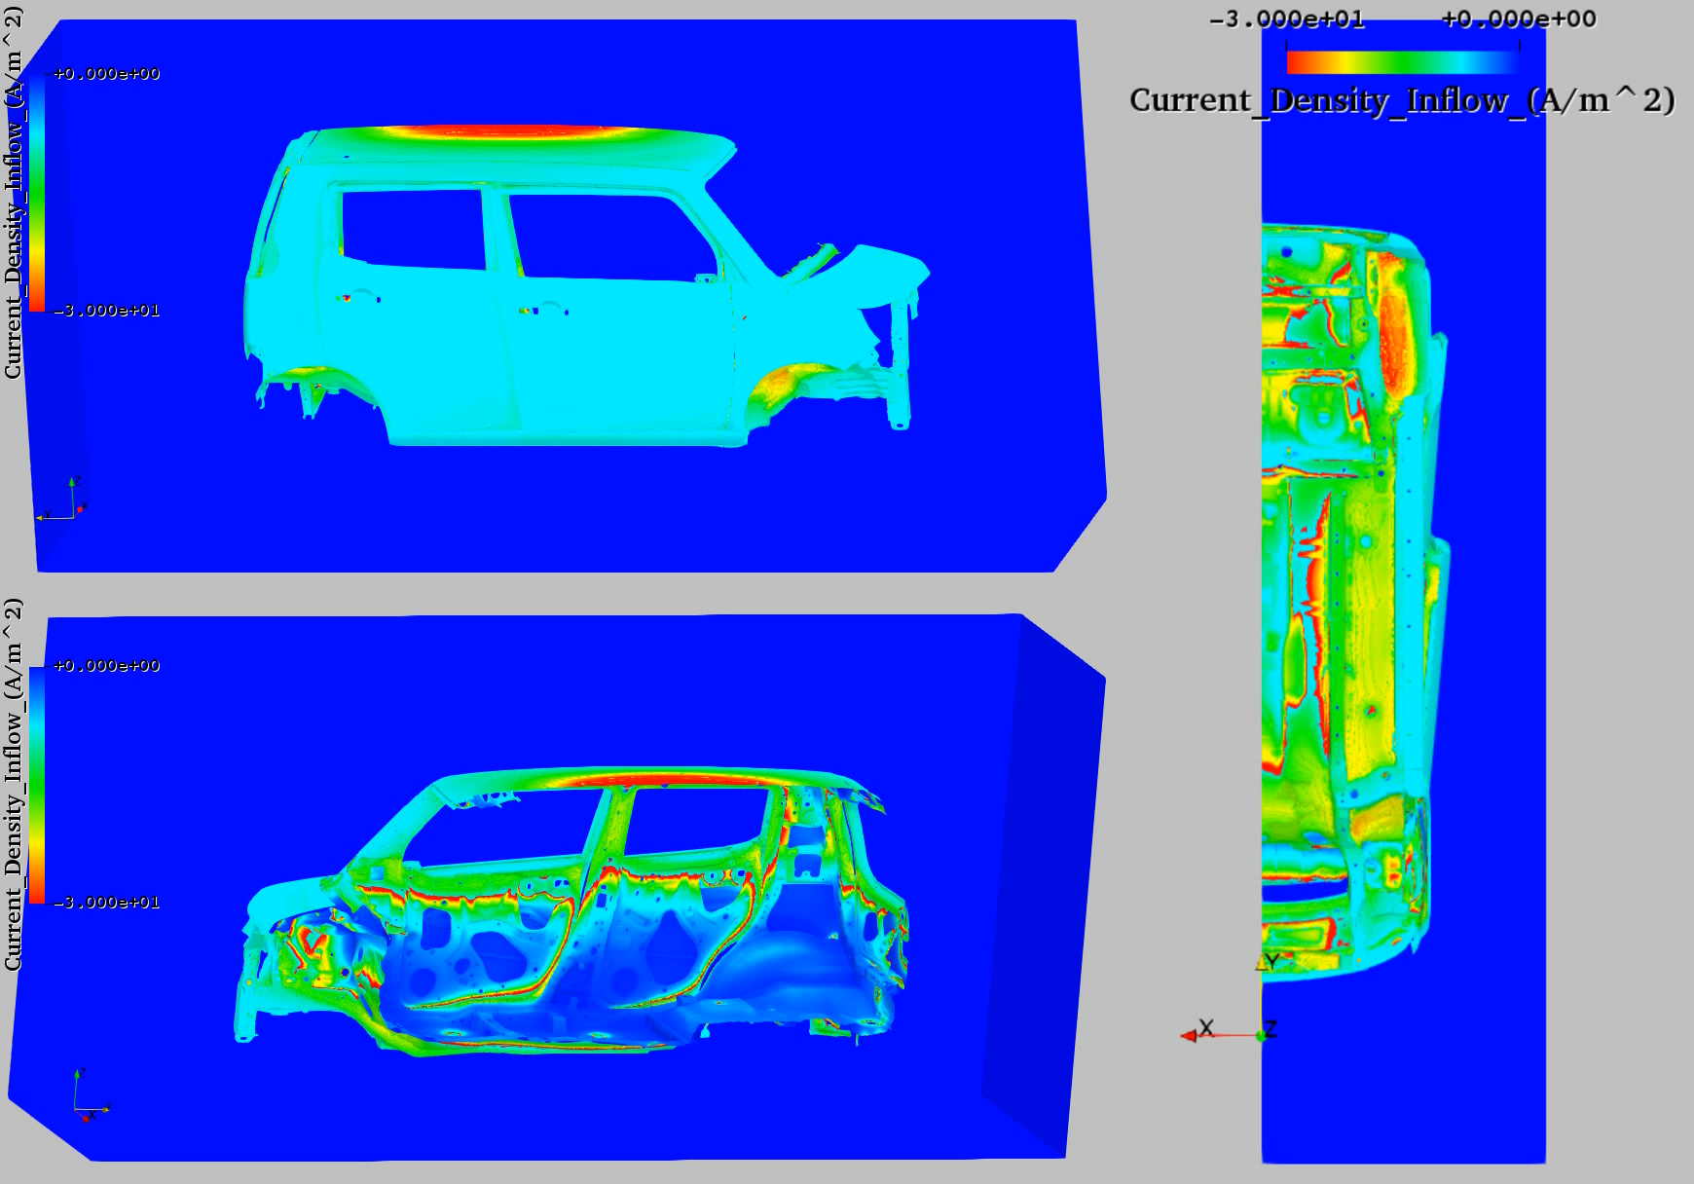
Carbody Analysis (Current Density)

Slide 28
Summary

Slide 29
Summary
A new ED lab experiment method with external resistor to reproduce the actual line conditions was proposed.
A new ED boundary model considering more complex nonlinear relations was proposed.
ES-FEM-T4 was introduced in order to improve the accuracy of our ED simulator using T4 mesh.
Our new ED simulator improved the accuracy in lab tests (one-plate test & 4-plate box test).
Validation on an actual line is our issue in the future.
Thank you for your kind attention.

Slide 30
Appendix

Slide 31
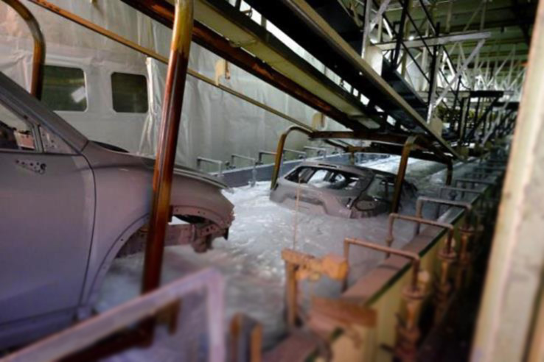
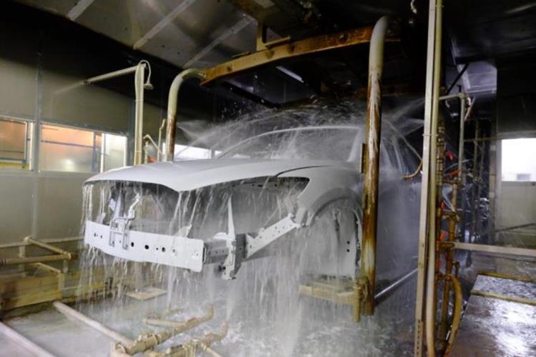
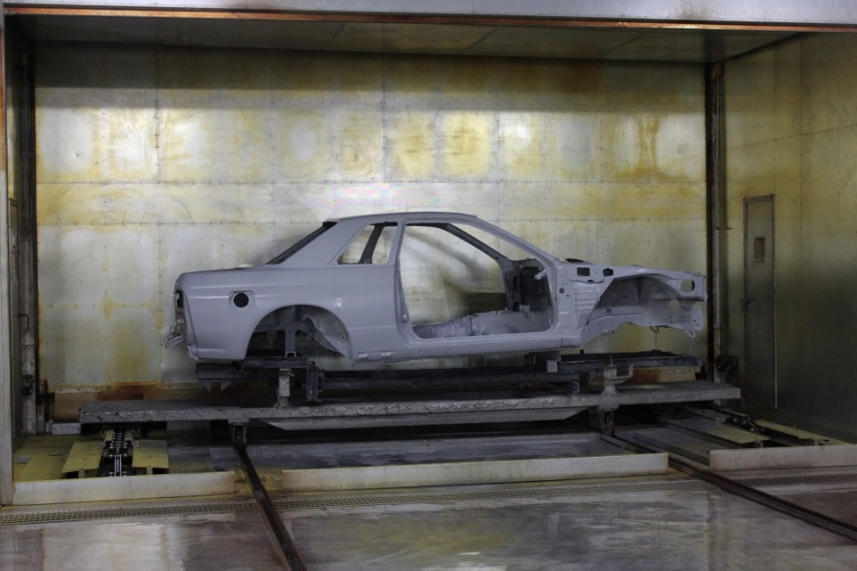
Photos of ED process line
1. dipping and deposition process
2. water rinse process
We focus on this.
3. baking process

Slide 32
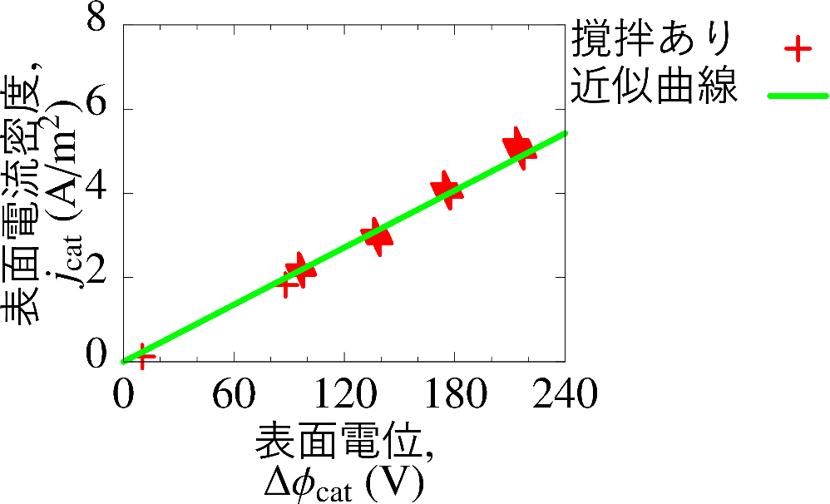
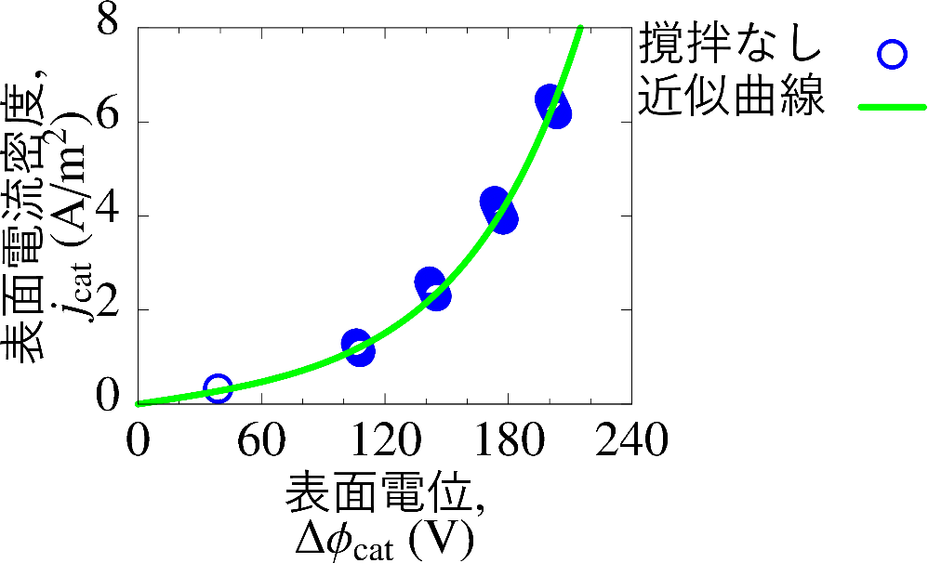
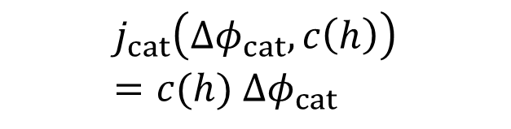
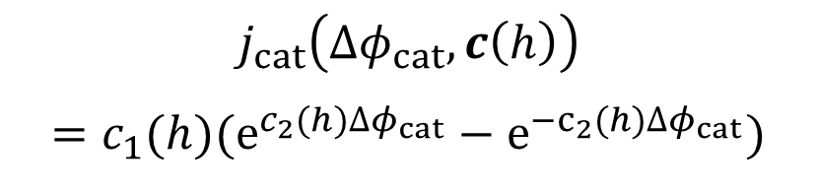
Film Resistance Model
Model Function for Film Resistance Model
$c\left(h\right)$ means model parameters．
(1)
With Stirring
(2)
Without Stirring
$$j_{cat}\left(∆φ_{cat}, c\left(h\right)\right)=c(h) {∆φ}_{cat}$$
$$j_{cat}\left({∆φ}_{cat}, c\left(h\right)\right)$$
$$=c_{1}(h)(e^{c_{2}(h)∆φ_{cat}}−e^{{−c}_{2}(h)∆φ_{cat}})$$
Exp.
Approx.
Exp.
Approx.

