Slide 1
Performance Evaluation of Edge-Based Smoothed Finite Element Method for 4-node Tetrahedral Meshes on Electrodeposition Simulation
Kai KITAMURA⁽¹⁾, Yuki ONISHI⁽¹⁾, Takeshi KASHIYAMA⁽²⁾,
Kenji AMAYA⁽¹⁾
(1) Tokyo Institute of Technology (Japan)
(2) SUZUKI MOTOR CORPORATION (Japan)

Slide 2
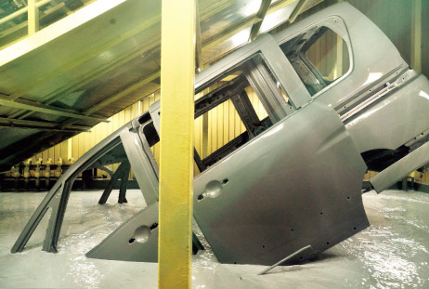
What is electrodeposition (ED) ?
Most widely-used basecoat methods for car bodies.
Making coated film by applying direct electric current
in a paint pool.
Relatively good at making uniform film thickness
but not satisfactory uniform in actual production lines.
ED simulator is necessary for the optimization of
carbody design and coating conditions in actual lines.
+
-
Paint
＋
Anode
＋
Cathode
http://n-link.nissan.co.jp/NOM/PLANT/

Slide 3
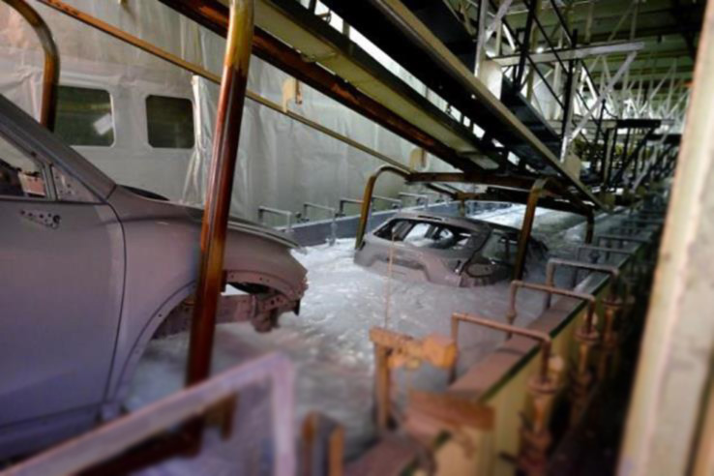
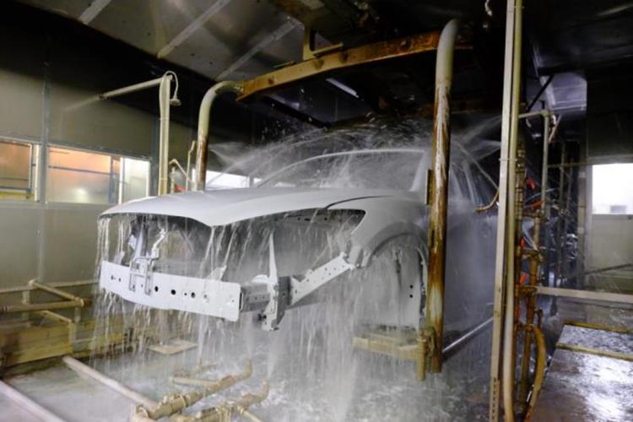
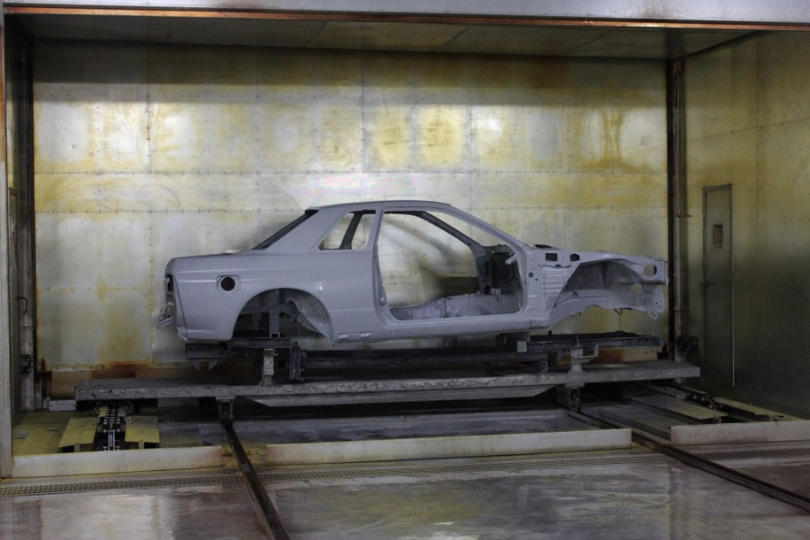
Photos of ED process line
1. dipping and deposition process
2. water rinse process
We focus on
this process.
3. baking process

Slide 4
Mechanism of Electrodeposition
Positively charged paint ions are attracted to the cathode.
Paint ions lose their electrical charge and are aggregated into paint particles.
Some of the paint particles diffuse and dissolve.
Voltage is applied
Deposition
Electrophoresis
-
+
-
+
Coated
Film
-
-
+
When the particle gets big enough
Carbody
（Cathode)
Aggregated into paint particles
Paint Ions

Slide 5
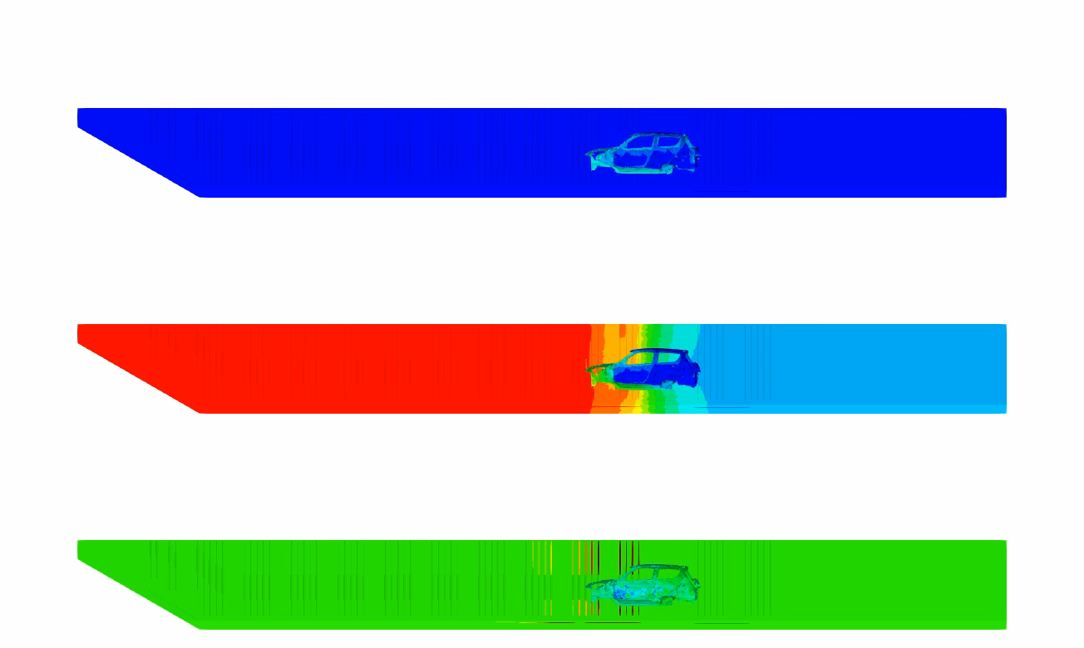
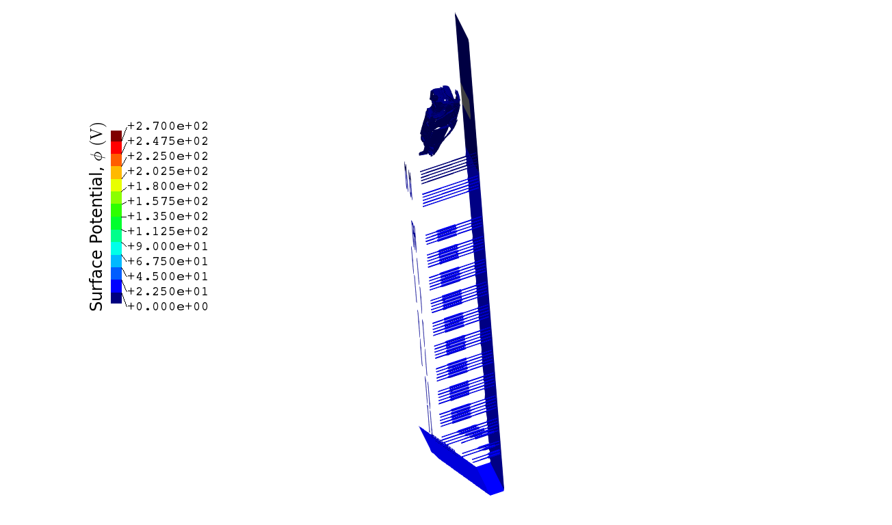






What is ED Simulation ?
ED simulation provides film thickness, surface potential,
surface current density and so on.
Film Thickness
$$30 μm$$
You can see that the paint film starts to be deposited
from the outside surface.
$$0 μm$$
Surface Potential
$$270 V$$
$$0 V$$
Surface Current Density
$$20 A/m^{2}$$
$$−20 A/m^{2}$$

Slide 6
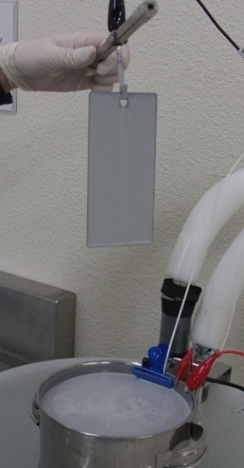
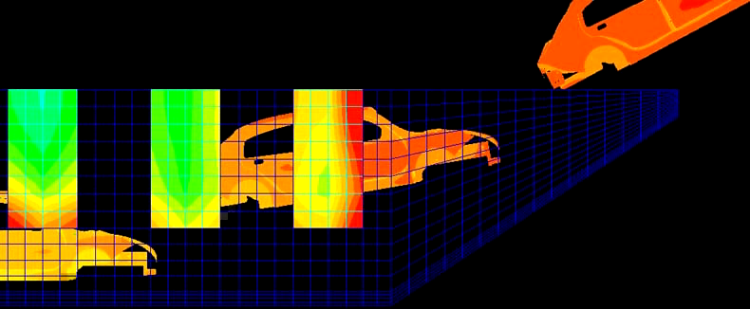
How to Develop an ED Simulator
Experiments at lab in various coating conditions.
Identification of ED boundary model
and its parameters.
Implementation to a FE code.
One-Plate Test
Plate
Paint
On the analogy of
solid mechanics,
Step 1: material tests
with MTS,
Step 2: identification of
elastoplastic model.
DELIGHT web page,
https://delightcfd.com
ED simulation for actual lines

Slide 7
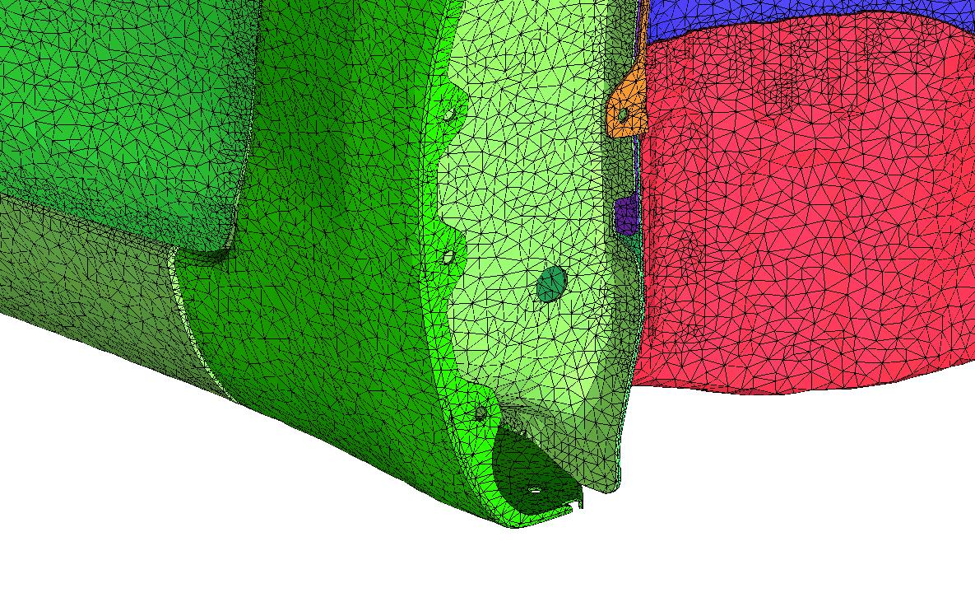
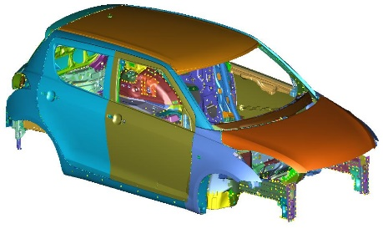
Issues in Meshing (1)
✗ It is difficult to discretize complex shapes
such as car bodies with hexahedral meshes.
→ We have to use tetrahedral meshes in ED simulation.
However…
✓
✗
Only surface
mesh is shown.
Accuracy of the standard FEM-T4 is insufficient
in complex shapes.

Slide 8
Issues in Meshing (2)
✗ 10-node tetrahedral (T10) mesh without kink generally
requires more large number of nodes than T4 mesh.
T4 T10 without kink
Carbody
Carbody
hole
hole
For the same shape representation, T10 mesh
without kink leads to massive increase in DOF.

Slide 9
Issues in Meshing (2 Cont.)
✗ 10-node tetrahedral (T10) mesh with kink causes
severe accuracy loss.
T4 T10 with kink
Carbody
Carbody
Kinked T10
hole
hole
T10 mesh with kink does not increase DOF
but induces severe accuracy loss.

Slide 10
Motivation
Hexahedral elements:
✗ It is difficult to discretize complex shapes.
T10 elements without kink:
✗ It leads to massive increase in DOF.
T10 elements with kink:
✗ It causes severe accuracy loss.
→ We want to realize high accuracy analysis with T4 mesh.
ES-FEM-T4 could be a solution to these issues.

Slide 11
Objective
Development of ED simulator using ES-FEM-T4
and its performance evaluation
by comparing with FEM-T4.
Table of body contents:
Outline of ED Simulation
Formulation of ES-FEM for ED Simulation
Analysis Results

Slide 12
Outline of ED Simulation

Slide 13

Fundamental Equations
+
-
Governing equation
The electrostatic Laplace equation
$∇^{2}φ=0$, in the paint pool domain.
Boundary conditions (BCs)
Insulation BC
Anodic (Electrode surface) BC
Cathodic (Carbody surface) BC
ED boundary models are identified with experimental data
at a laboratory.
＋
Paint
Anode
＋
Cathode
Solving the Laplace equation for potential, the current density distribution on a carbody is determined and then the film thickness distribution is time-evolutionally calculated.

Slide 14
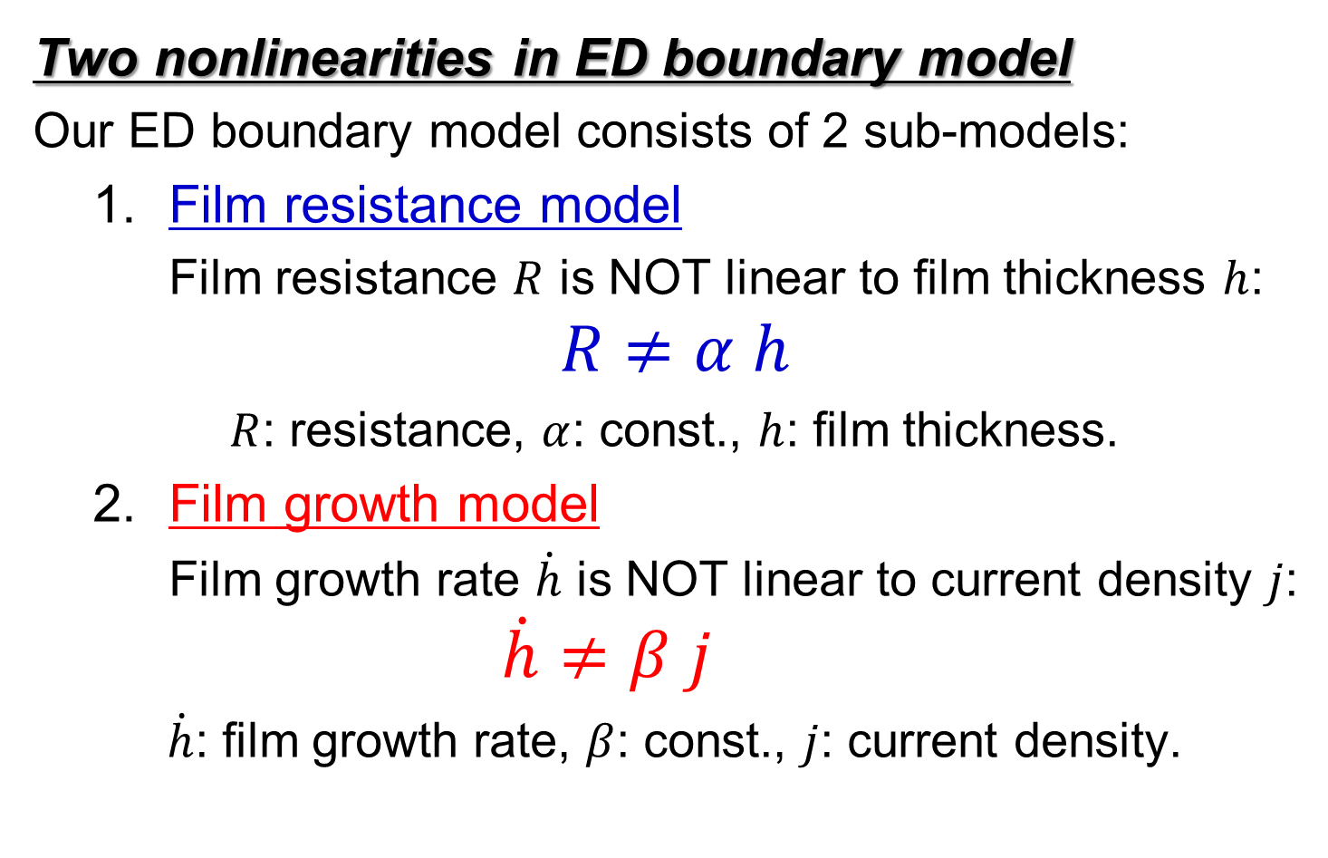
Two Complexities of ED Phenomena
Two nonlinearities in ED boundary model
Our ED boundary model consists of 2 sub-models:
  Film resistance model
  Film resistance $R$ is NOT linear to film thickness $h$:
$$R≠α h$$
$R$: resistance, $α$: const., $h$: film thickness.
  Film growth model
  Film growth rate $\dot{h}$ is NOT linear to current density $j$:
  $\dot{h}≠β j$
$\dot{h}$: film growth rate, $β$: const., $j$: current density.

Slide 15
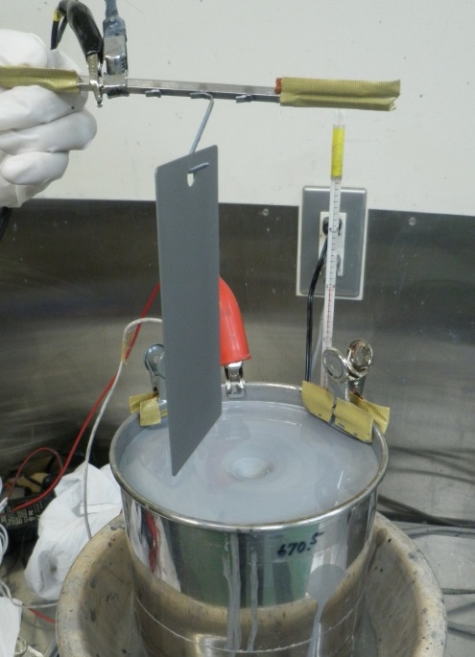
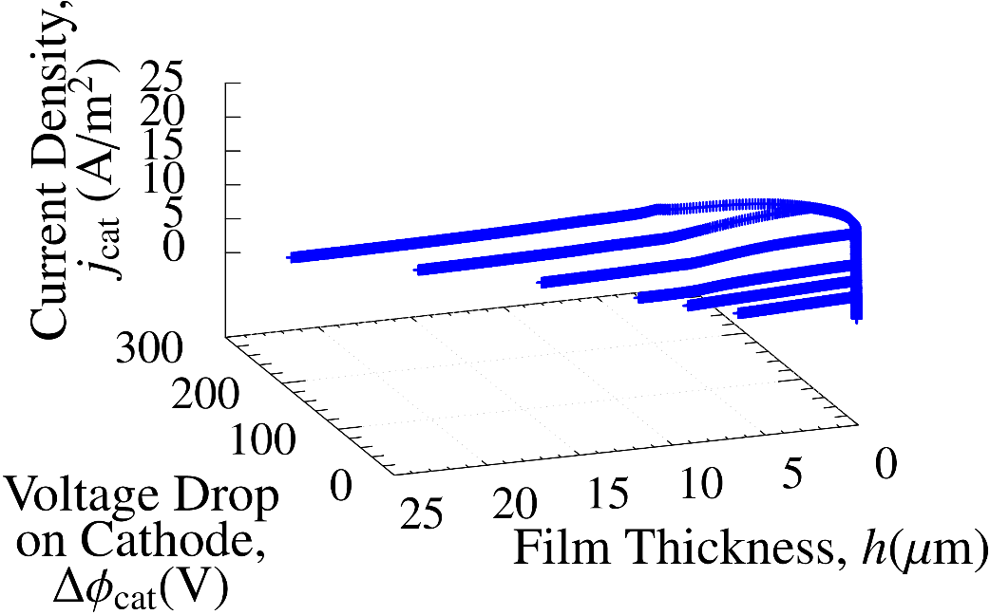
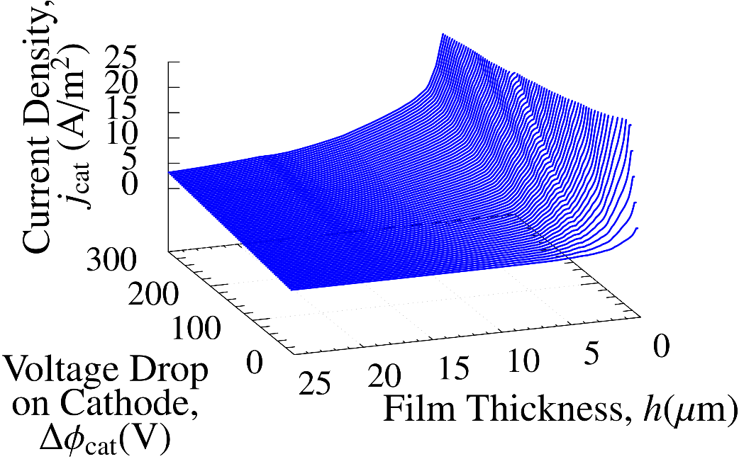

Procedure to Identify Film Resistance Model
1. One-plate tests
2. Scatter diagram of $Δφ_{cat}, j_{cat} and h$
Plot
3. Approximated surface
Data
fitting

Slide 16
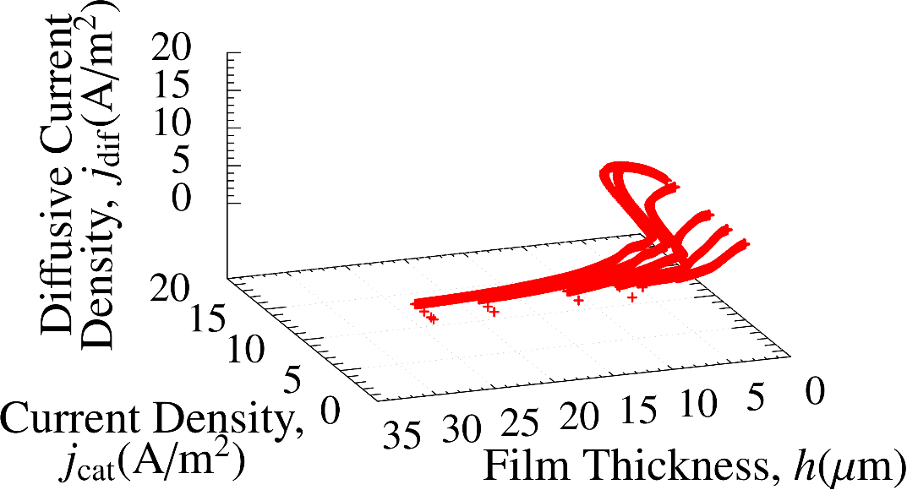
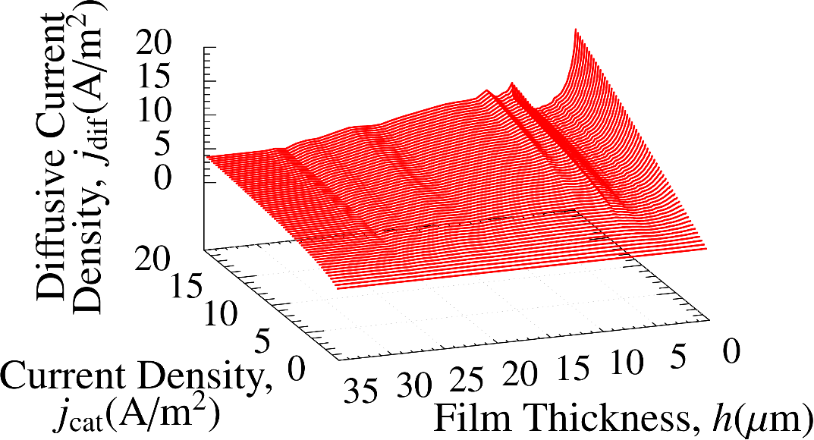

Procedure to Identify Film Growth Model
1. One-plate tests
2. Scatter diagram of $j_{dif}, j_{cat} and h$
Plot
Diffusive current density represents the amount of electricity consumed for the electrolysis of water, not used for the deposition of the coating film.
3. Approximated surface
Data
fitting

Slide 17
Formulation of ES-FEM for ED Simulation

Slide 18
Outline of ES-FEM
What is ES-FEM-T4?
A kind of strain smoothing method.
Using element edges as Gauss points.
Robust against element skew.
Super-linear mesh convergence rate with T4 mesh.
Standard FEM ES-FEM
FEM assembles
each element’s value.
ES-FEM assembles
each edge’s value.
Integration domain
Element
Integration
domain is
different !!
Node

Slide 19
Outline of ES-FEM
Short edges
When meshing complex shape, the generation of
short edges is inevitable.
Short edges lead to accuracy loss in standard FEM-T4.
Conventional FEM ES-FEM
ES-FEM can suppress the accuracy loss by smoothing.

Slide 20
Analysis Results

Slide 21
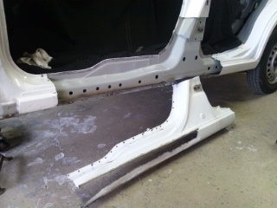
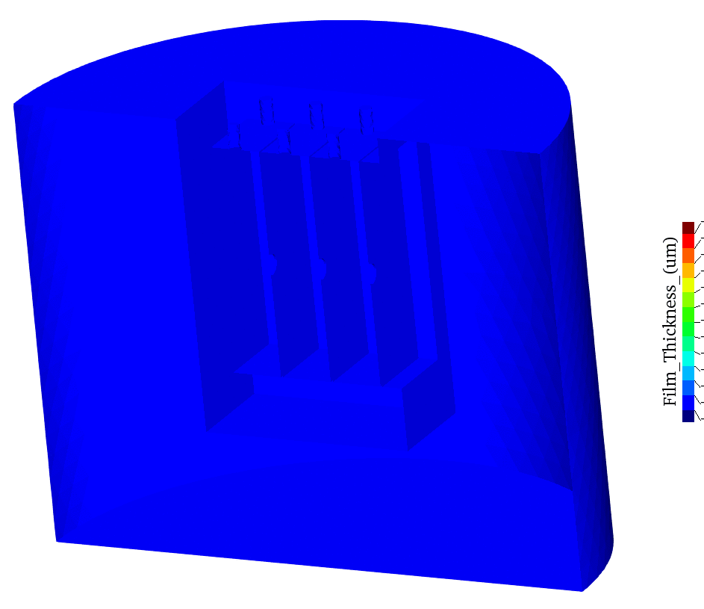
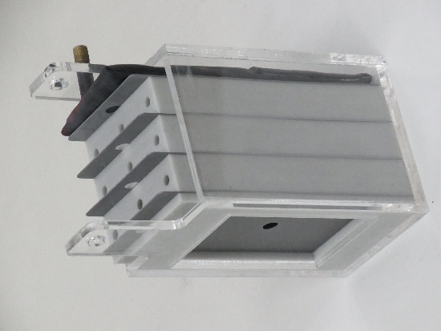
4-Plate BOX Simulation
Outline
Imitating a bag-like structure such as side sill in a carbody.
Accuracy on the innermost surface (leftmost plate surface) is the most important; i.e., “maximize the minimum”.
Film thickness is calculated with 4 different mesh seed sizes
and compared between FEM-T4 and ES-FEM-T4.
Film Thickness
Side Sill
(http://plaza.rakuten.co.jp/heroc)
4-P BOX

Slide 22
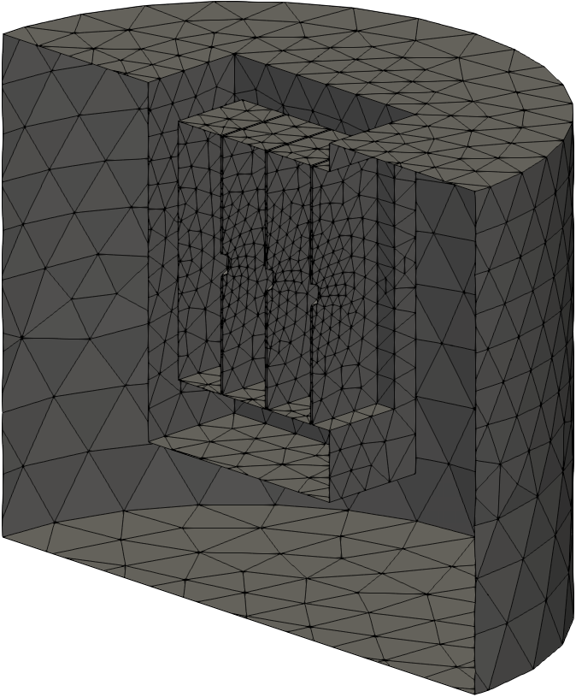
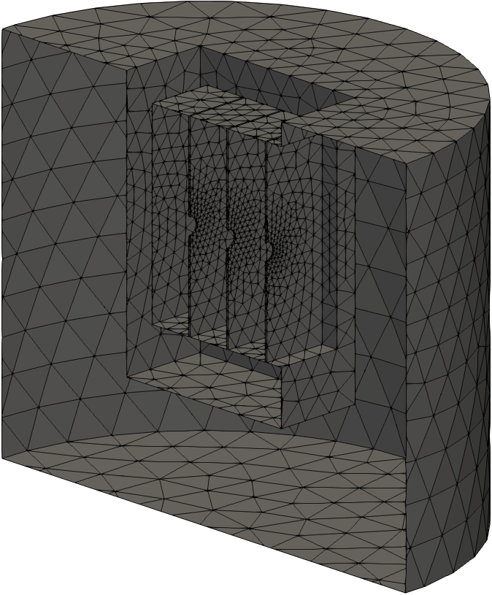
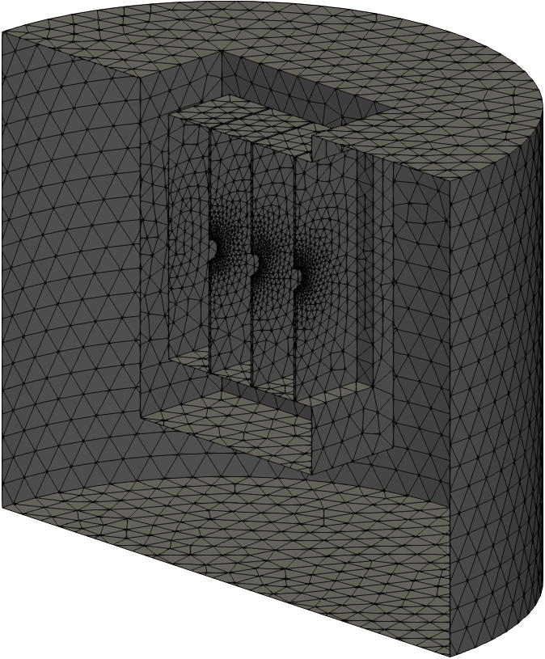
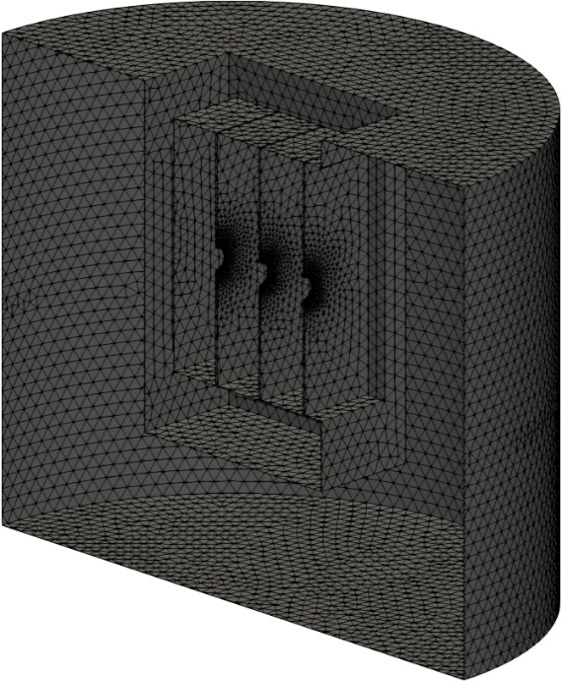
4-Plate BOX Simulation
Overview
of
Meshes
Only the
surface meshes
are shown.
3.2 mm Mesh
Seed Size
(31k T4 elem.)
1.6 mm Mesh
Seed Size
(65k T4 elem.)
0.8 mm Mesh
Seed Size
(169k T4 elem.)
0.4 mm Mesh
Seed Size
(716k T4 elem.)

Slide 23
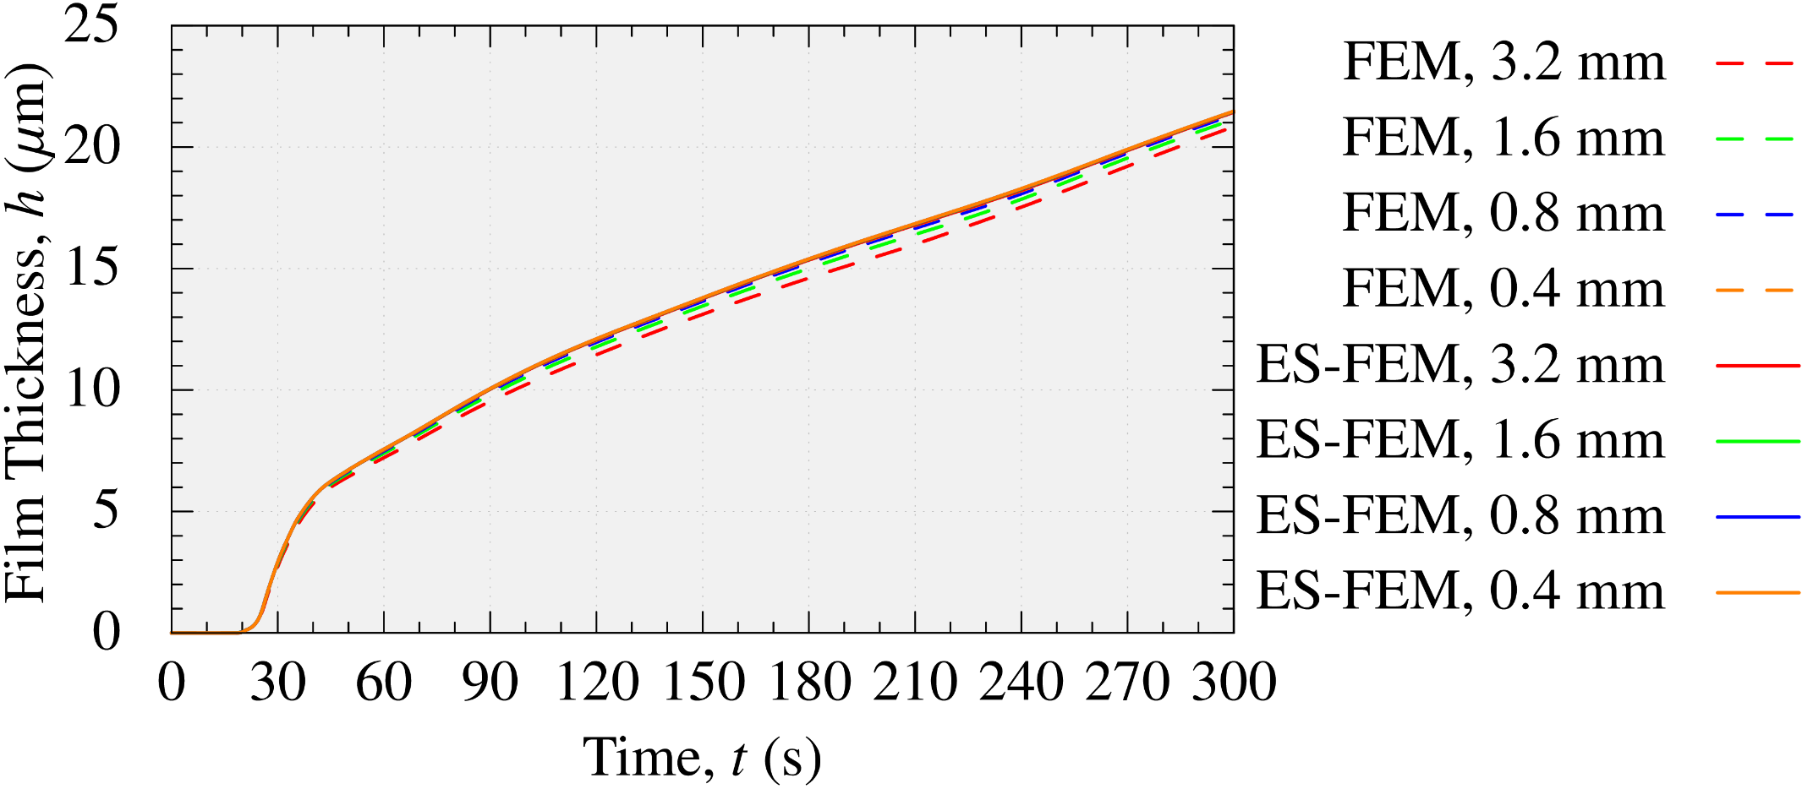
4-Plate BOX Simulation
Film Thickness of A-Plate (outermost surface)
Mesh seed size
FEM results (dashed lines) have tiny errors
due to mesh coarseness.
Meanwhile, ES-FEM (solid lines) results have no such errors.
Notes:
This graph shows the film thickness of A-Plate, which is the outermost surface.
The dashed lines show the FEM results, while the solid lines show the ES-FEM results.
As you can see, FEM results have tiny errors due to mesh coarseness.
Meanwhile, ES-FEM results have no such errors.

Slide 24
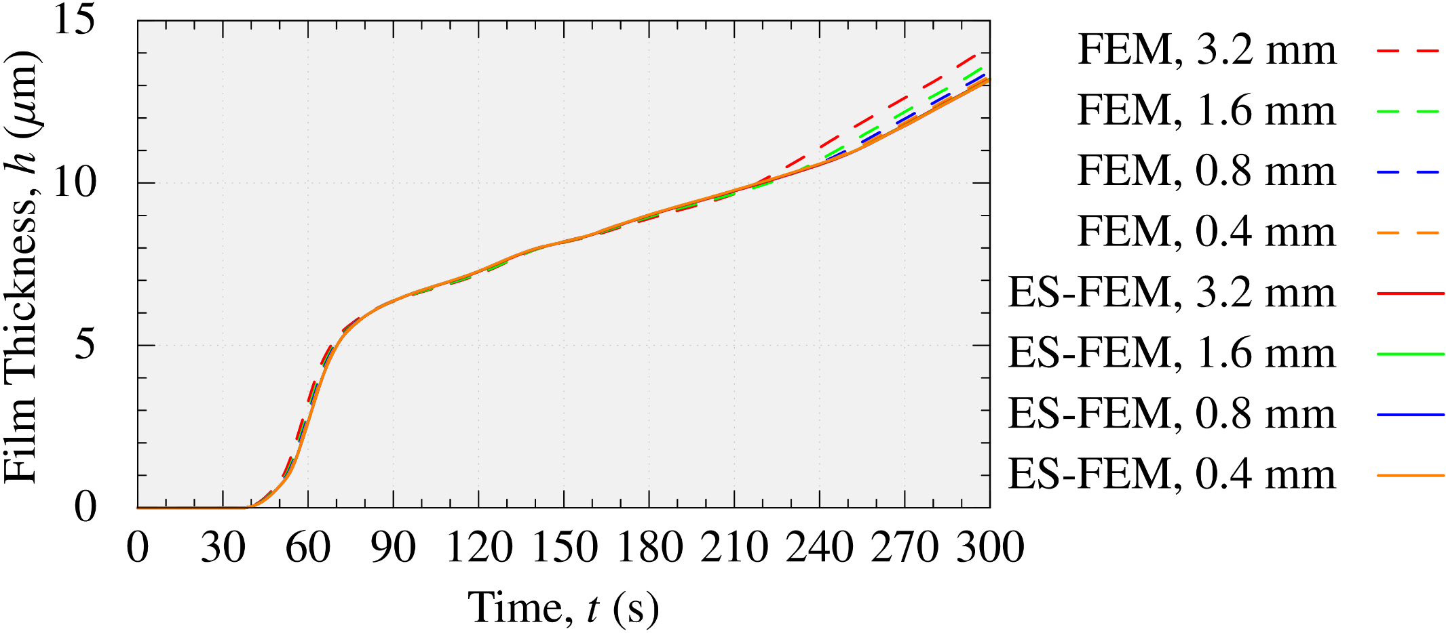
4-Plate BOX Simulation
Film Thickness of C-Plate (surface in the 1st bag)
Mesh seed size
FEM results (dashed lines) have small errors
due to mesh coarseness.
Meanwhile, ES-FEM (solid lines) results have no such errors.
Notes:
This graph shows the film thickness of C-Plate which is a surface in the 1st bag.
The error is bigger than A-Plate due to mesh coarseness.

Slide 25
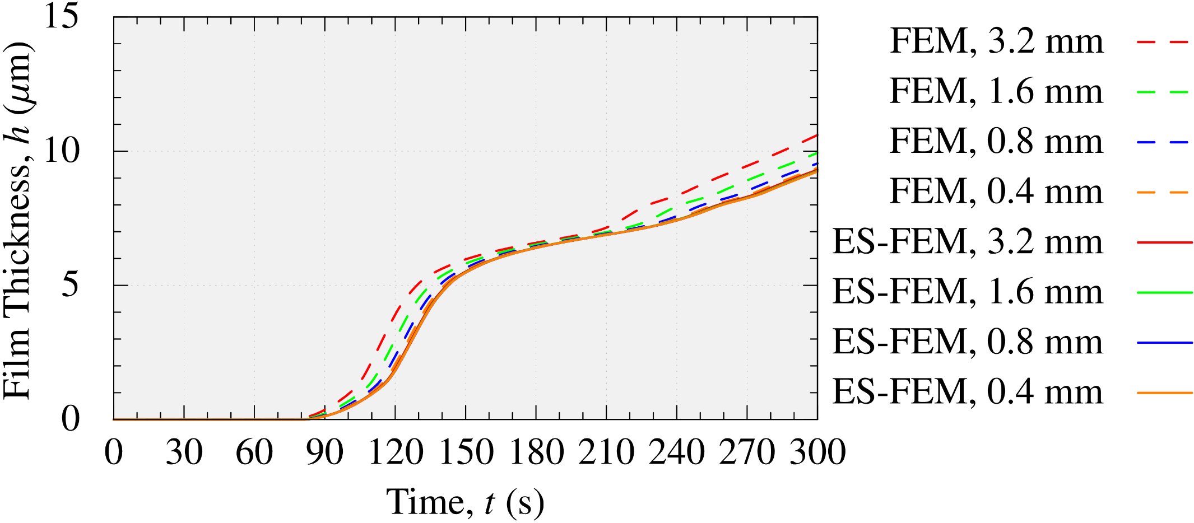
4-Plate BOX Simulation
Film Thickness of E-Plate (surface in the 2nd bag)
Mesh seed size
FEM results (dashed lines) have medium errors
due to mesh coarseness.
Meanwhile, ES-FEM (solid lines) results have no such errors.
Notes:
This graph shows the film thickness of E-Plate which is a surface in the 2nd bag.
The error is bigger than C-Plate due to mesh coarseness.

Slide 26
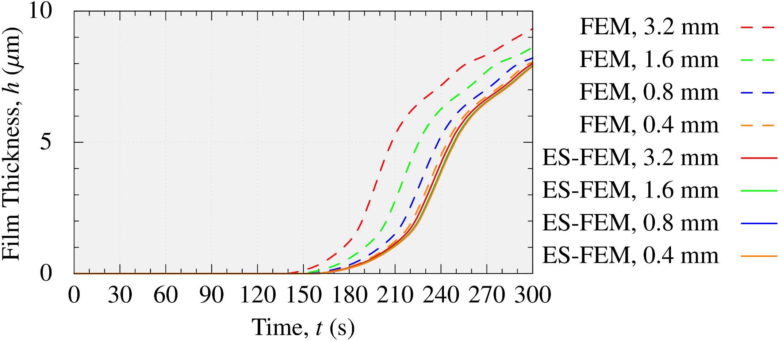
4-Plate BOX Simulation
Film Thickness of G-Plate (innermost surface)
Mesh seed size
FEM results (dashed lines) have large errors
due to mesh coarseness.
Meanwhile, ES-FEM (solid lines) results have no such errors.

Slide 27
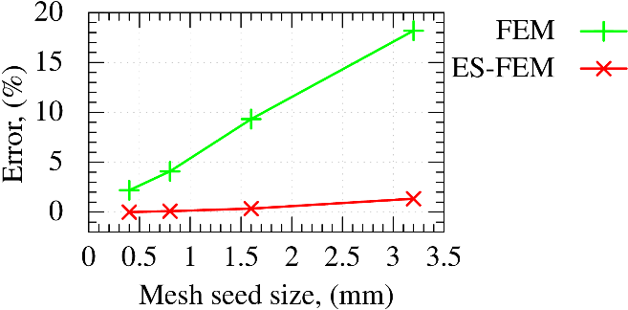
4-Plate BOX Simulation
Error of Final Film Thickness on G-Plate
The result of ES-FEM with the minimum mesh seed size (0.4 mm) is used as the reference.
ES-FEM-T4 has far better mesh convergence rate than FEM-T4 !!

Slide 28
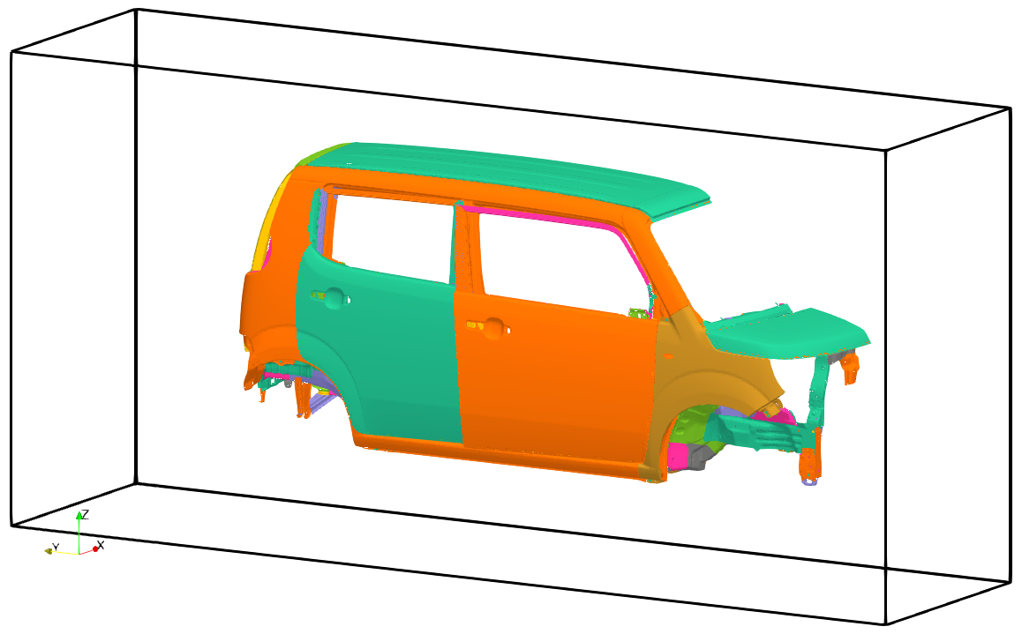
Carbody Simulation
Outline
A half carbody is fixed in a box pool.
The side wall is treated as an anode surface.
Compare the time-developed film thickness between FEM-T4 and ES-FEM-T4 with a same mesh.
270 V
0 30 180 (s)

Slide 29
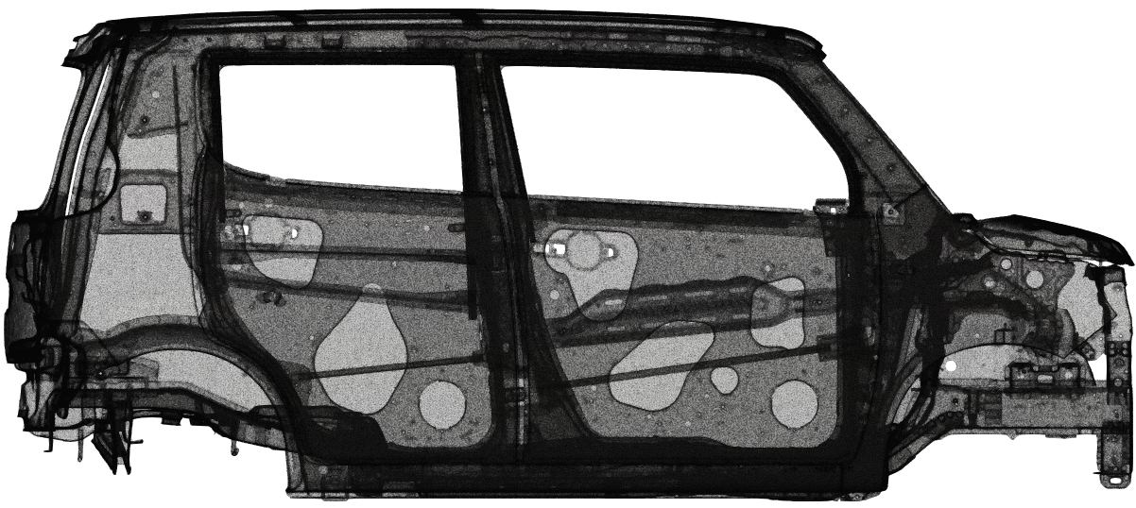
Carbody Simulation
Overview of Surface Mesh
13M T4 elements (3M nodes & 18M edges) in total
in the pool.
Provided by
SUZUKI MOTOR Co.

Slide 30
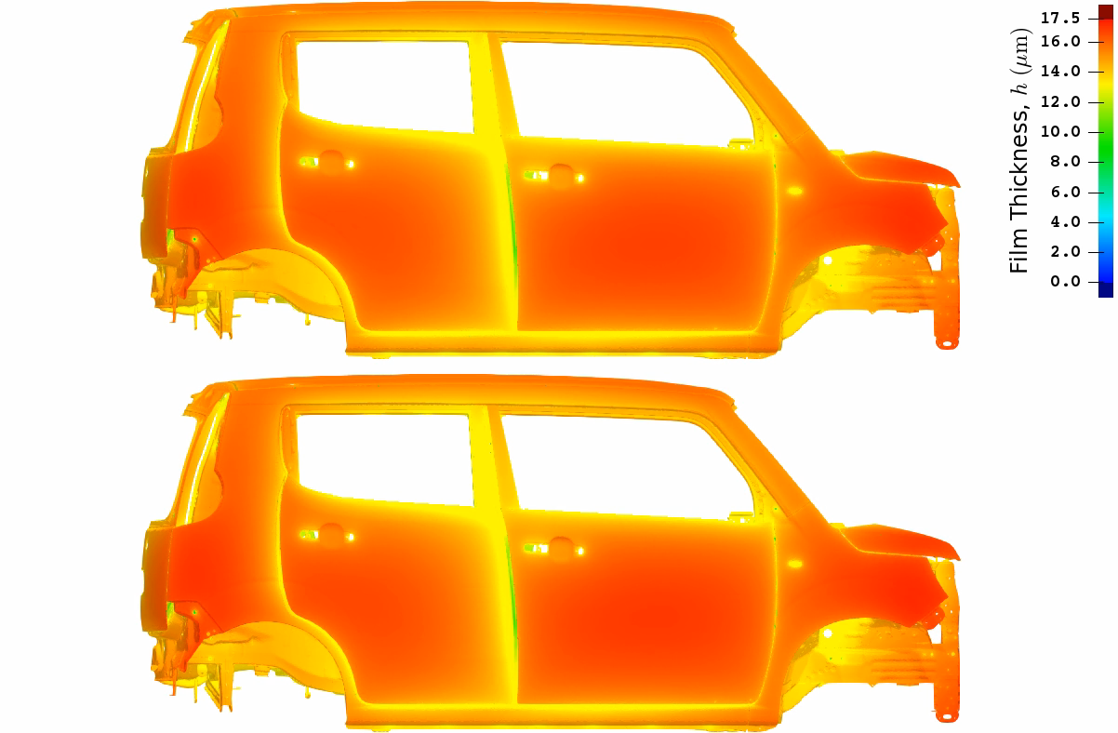
Carbody Simulation
Outer
View
FEM-T4
ES-FEM-T4
There is no mush difference on the outer surfaces.

Slide 31
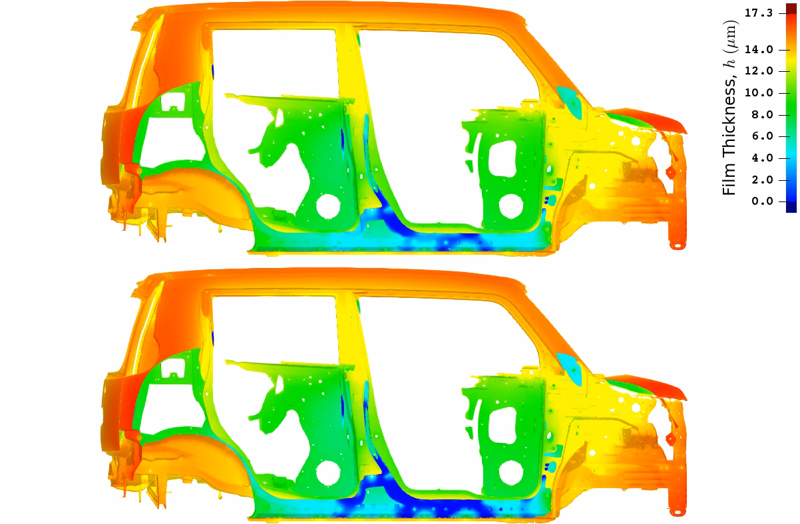
Carbody Simulation
Clipped
View
on
Side
Sill
FEM-T4
As the
4-P BOX
case,
ES-FEM-T4
presents
thinner dist.
on the
side sill.
ES-FEM-T4
Big difference appears on the inner surfaces.

Slide 32
Comparison of Computational Costs
Calculation Time
on a PC with Intel i9-9960X using 10 cores
 | FEM-T4 | ES-FEM-T4
4-P BOX with 3.2 mm mesh | 0.02 h | 0.02 h
4-P BOX with 1.6 mm mesh | 0.04 h | 0.05 h
4-P BOX with 0.8 mm mesh | 0.45 h | 0.45 h
4-P BOX with 0.4 mm mesh | 9.5 h | 9.0 h
Carbody | 67 h | 125 h
Same
Accuracy
There is no big difference in calculation time
although the accuracy of ES-FEM-T4 is much better.

Slide 33
Summary

Slide 34
Summary
Conclusion
ES-FEM-T4 was applied to ED simulations.
High accuracy of ES-FEM-T4 because of its super-linear mesh convergence rate was confirmed in comparison to the poor accuracy of FEM-T4.
Future Works
Validation of the ED models on the actual manufacturing lines.
Calculation speed-up with distributed memory parallelization.
Thank you for your kind attention.

Slide 35
Appendix

Slide 36

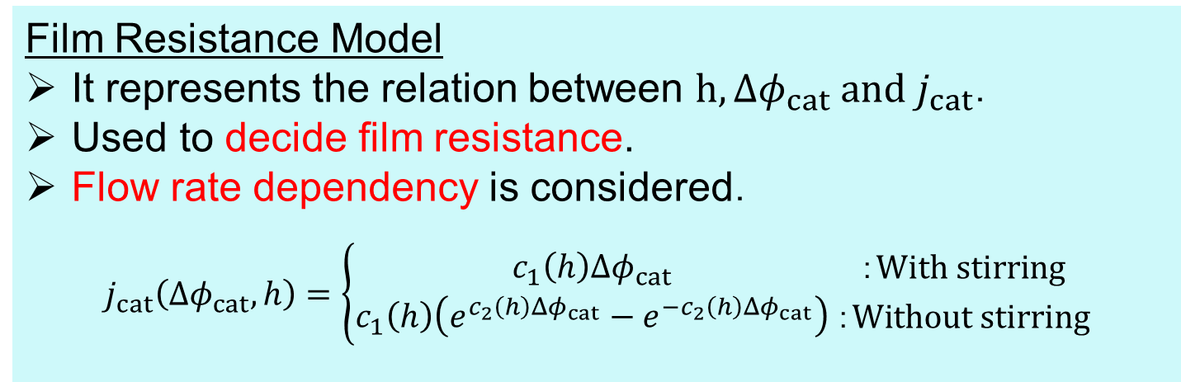
ED Boundary Models
Film Resistance Model
It represents the relation between $h,Δφ_{cat} and j_{cat}$．
Used to decide film resistance.
Flow rate dependency is considered．
$$j_{cat}\left(Δφ_{cat}, h\right)=\left\{\begin{aligned}c_{1}\left(h\right)Δφ_{cat} \\ c_{1}\left(h\right)\left(e^{c_{2}\left(h\right)Δφ_{cat}}−e^{−c_{2}\left(h\right)Δφ_{cat}}\right)\end{aligned}{：With stirring \atop ：Without stirring}\right.$$
Film Growth Model
It represents the relation between $h,j_{cat} and j_{dif}$．
Used to decide film growth rate.
After deposition ：$j_{difA}\left(j_{cat},h\right)=\frac{{\left(j_{cat}+d_{1}(h)\right)}^{d_{2}(h)}}{d_{1}^{d_{2}\left(h\right)−1}d_{2}(h)}−\frac{d_{1}(h)}{d_{2}(h)}$

Slide 37
Comparison of Computational Costs
This is because …
Most of the calculation time is consumed by the iterative matrix solver (MINRES with Jacobi preconditioner).
The matrix band width of ES-FEM-T4 is 3 times wider than that of FEM-T4; i.e., ES-FEM-T4 requires 3 times larger memory size.
However, the iteration count of MINRES in ES-FEM-T4 is about 1/3 or 2/3 of that in FEM-T4 thanks to the well-posedness of the matrix.

Slide 38
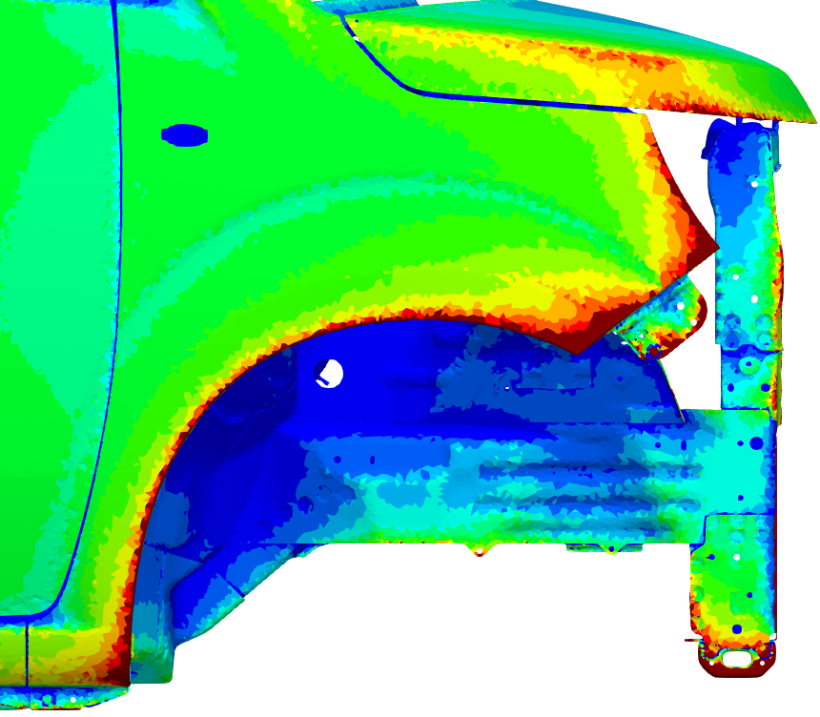



Carbody Simulation
Surface Current Density
FEM-T4 ES-FEM-T4
$$1 A/m^{2}$$
$$0 A/m^{2}$$
ES-FEM suppresses the spike error
of surface current density appearing in FEM.

Slide 39
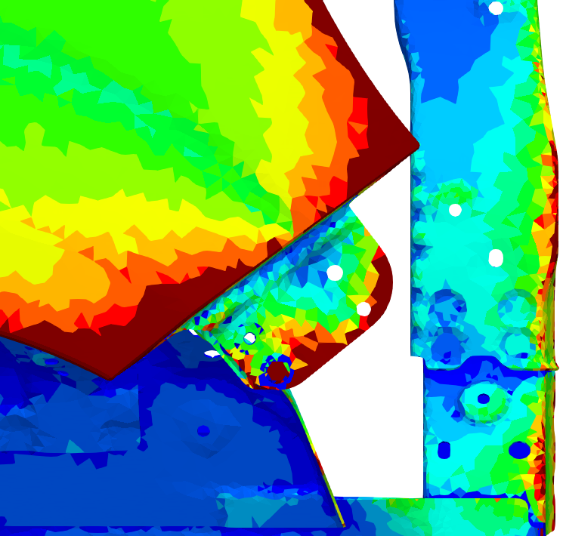
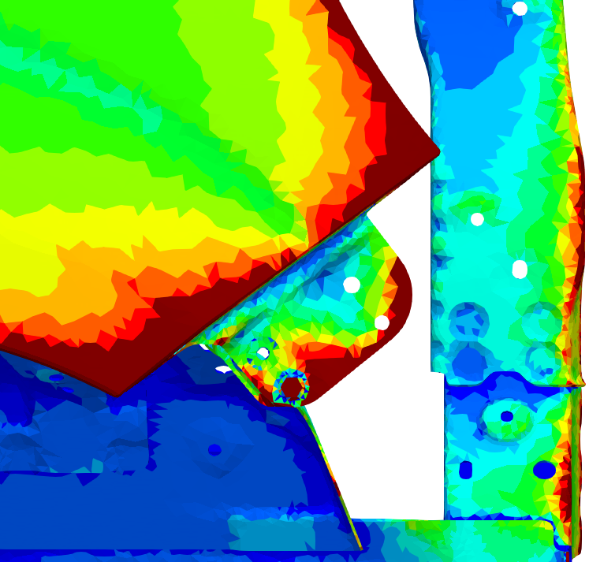
Carbody Simulation
Surface Current Density
FEM-T4 ES-FEM-T4
$$1 A/m^{2}$$
$$0 A/m^{2}$$
ES-FEM suppresses the spike error
of surface current density appearing in FEM.

Slide 40
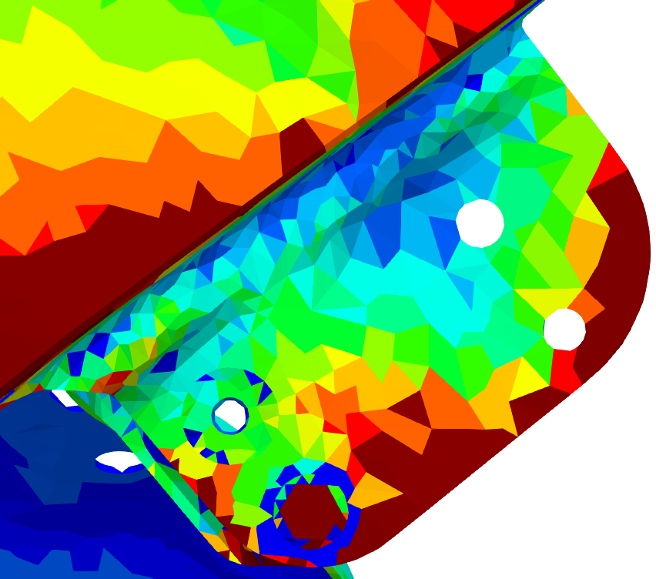
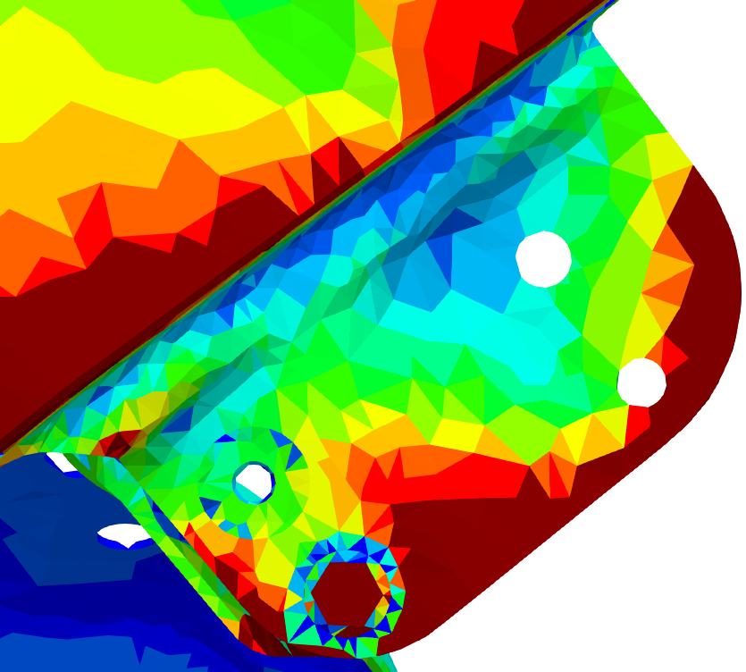


Carbody Simulation
Surface Current Density
FEM-T4 ES-FEM-T4
$$1 A/m^{2}$$
$$0 A/m^{2}$$
ES-FEM suppresses the spike error
of surface current density appearing in FEM.

