Slide 1
An Optimal Multiple Smoothing Scheme of Selective Cell-based
Smoothed Finite Element Methods with 10-node Tetrahedral Elements for Large Deformation of Nearly Incompressible Solids
Yuki ONISHI
Tokyo Institute of Technology, Japan

Slide 2
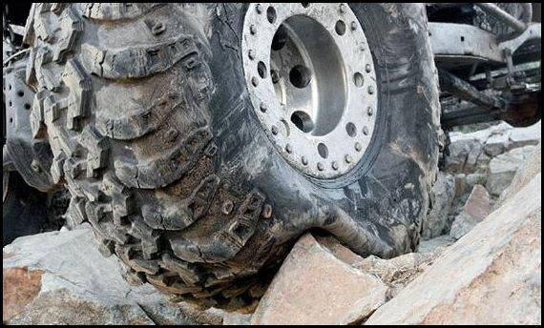
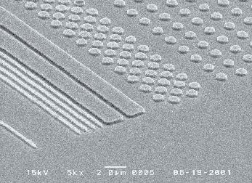


Motivation
What we want to do:
Solve hyper large deformation
analyses accurately and stably.
Treat complex geometries
with tetrahedral meshes.
Consider nearly incompressible materials $(ν≃0.5)$.
Support contact problems.
Handle auto re-meshing.
Rubber
Metal
Plastic/Glass

Slide 3
Issues
Conventional tetrahedral (T4/T10) FE formulations
still have issues in accuracy or stability
especially in nearly incompressible cases.
2nd or higher order elements:
✗ Volumetric locking.
Accuracy loss in large strain due to intermediate nodes.
B-bar method, F-bar method, Selective reduced integration:
✗ Not applicable to tetrahedral element directly.
F-bar-Patch method:
✗ Difficulty in building good-quality patches.
u/p mixed (hybrid) method:
(e.g., ABAQUS/Standard C3D4H and C3D10MH)
✗ Pressure checkerboarding, Early convergence failure etc..
F-bar type smoothed FEM (F-barES-FEM-T4):
✓ Accurate & stable ✗ Hard to implement in FEM codes.

Slide 4
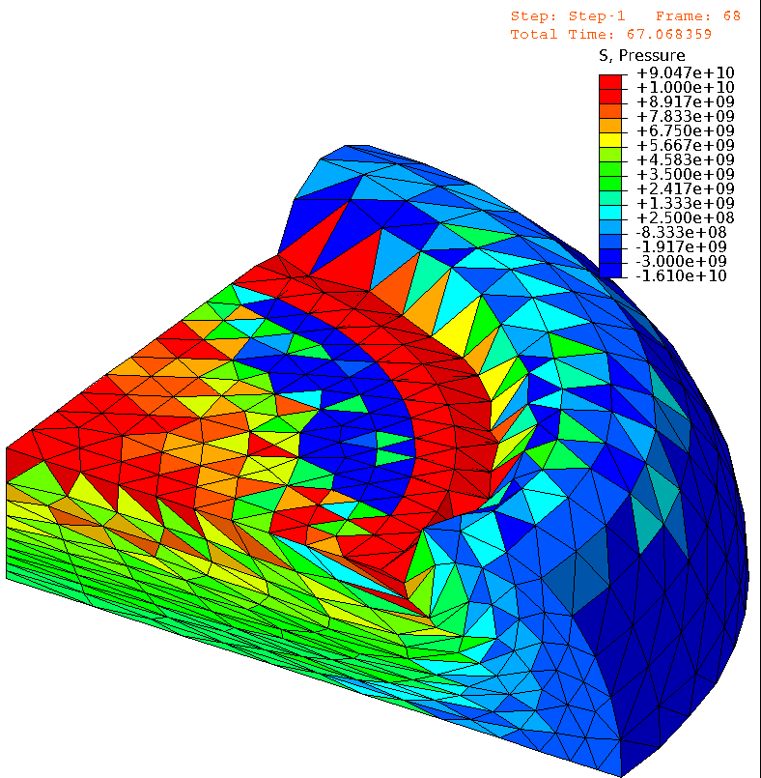
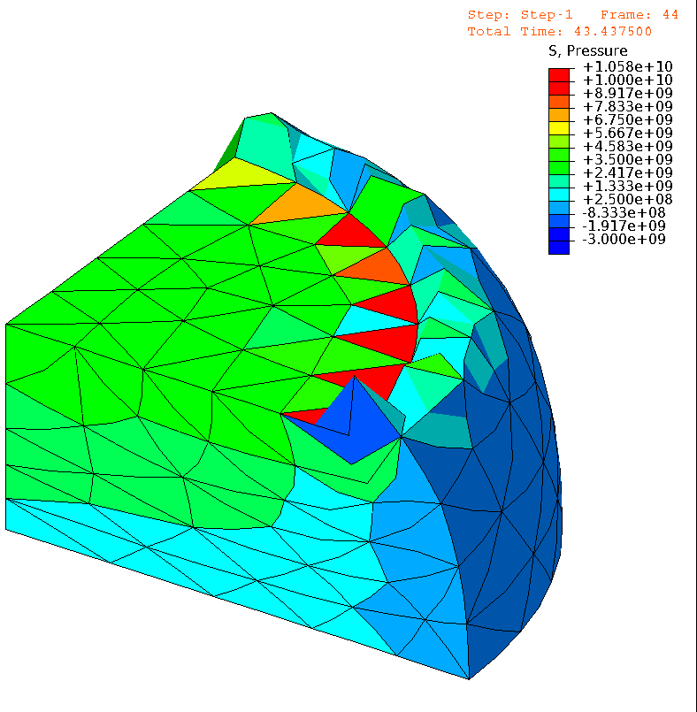

Issues (cont.)
E.g.) Compression of neo-Hookean hyperelastic body with $ν_{ini}=0.49$
Pressure
Pressure
# of Nodes is
almost the same.
1st order hybrid T4 (C3D4H)
✓ No volumetric locking
✗ Pressure checkerboarding
✗ Shear & corner locking
2nd order modified hybrid T10 (C3D10MH)
✓ No shear/volumetric locking
✗ Early convergence failure
✗ Low interpolation accuracy

Slide 5
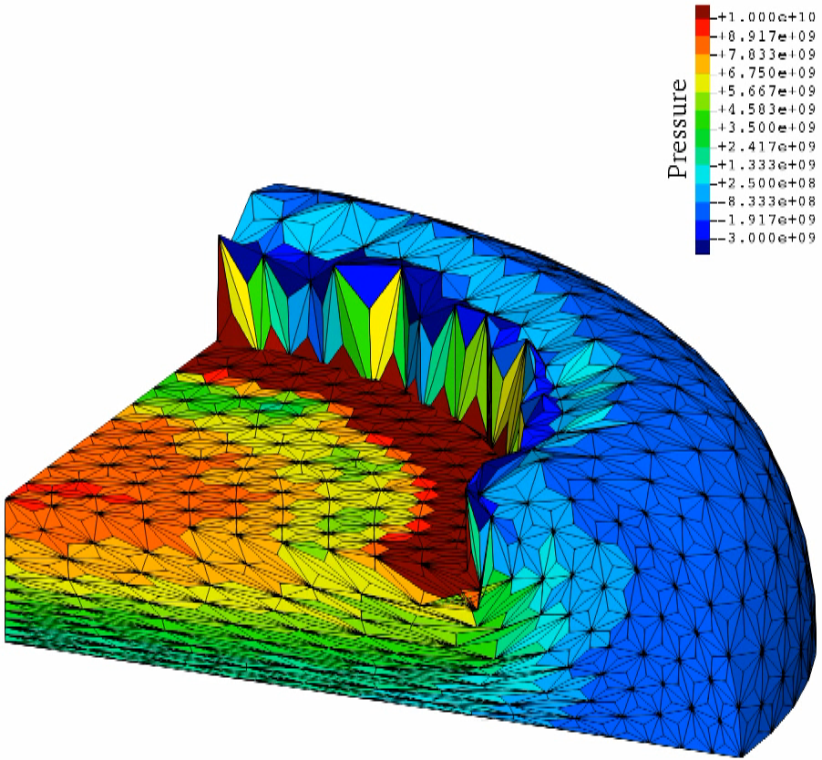

Issues (cont.)
E.g.) Compression of neo-Hookean hyperelastic body with $ν_{ini}=0.49$
Pressure
Although
F-barES-FEM-T4 is accurate and stable,
✗ it cannot be implemented in general-purpose
FE software
due to the adoption of ES-FEM.
Also, it cosumes
larger memory & CPU costs.
Same mesh
as C3D4H
case.
F-barES-FEM-T4
✓ No shear/volumetric locking
✓ No corner locking
✓ No pressure checkerboarding
✓ No increase in DOF
Another approach
adopting CS-FEM with T10 element would be effective.

Slide 6
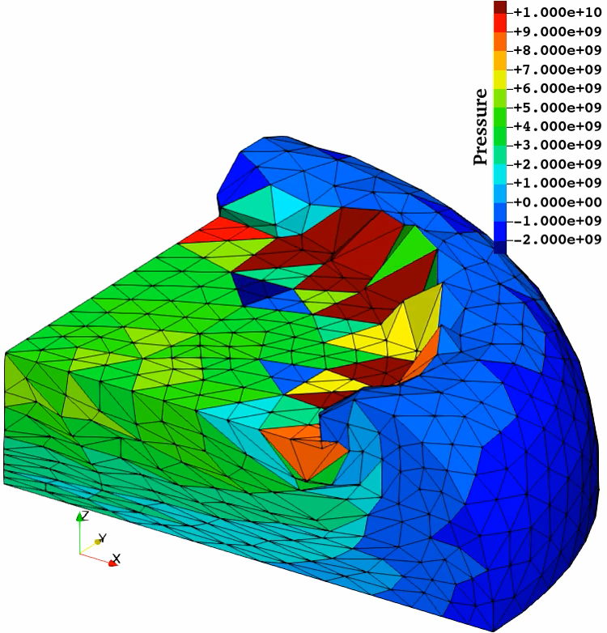
Issues (cont.)
E.g.) Compression of neo-Hookean hyperelastic body with $ν_{ini}=0.49$
As other S-FEMs,
SelectiveCS-FEM-T10
has many varieties
in the formulation.
The proposed method last year was
not an optimal formulation yet.
Same mesh
as C3D10MH
case.
SelectiveCS-FEM-T10 (Old Ver.)
✓ No shar/voluemetric locking
✓ Little corner locking
✓ Little pressure checkerboarding
✓ Same cost & userbility as T10 elements.

Slide 7
Objective
To find out an optimal formulation of SelectiveCS-FEM-T10
Table of Body Contents
Quick Introduction of ES-FEM, CS-FEM, and
Old SelectiveES-FEM-T10
Formulation of New SelectiveCS-FEM-T10
Demonstrations of New SelectiveCS-FEM-T10
Summary

Slide 8
Quick Introduction of
ES-FEM, CS-FEM, and
Old SelectiveCS-FEM-T10

Slide 9
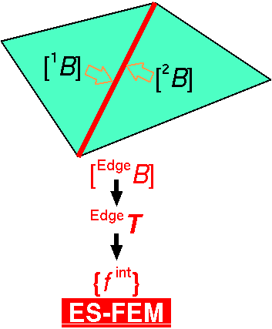

Brief Review of Edge-based S-FEM (ES-FEM)
Calculate $[B]$ at each element as usual.
Distribute $[B]$ to the connecting edges with area weight
and build $[ ^{Edge}B]$ .
Calculate $F, T, \left\{f^{int}\right\}$ etc. in each edge smoothing domain.
As if putting
an integration point
on each edge center
ES-FEM can avoid shear locking.
However,
it cannot be implemented in ordinary FE codes due to the strain smoothing across
multiple elements...

Slide 10
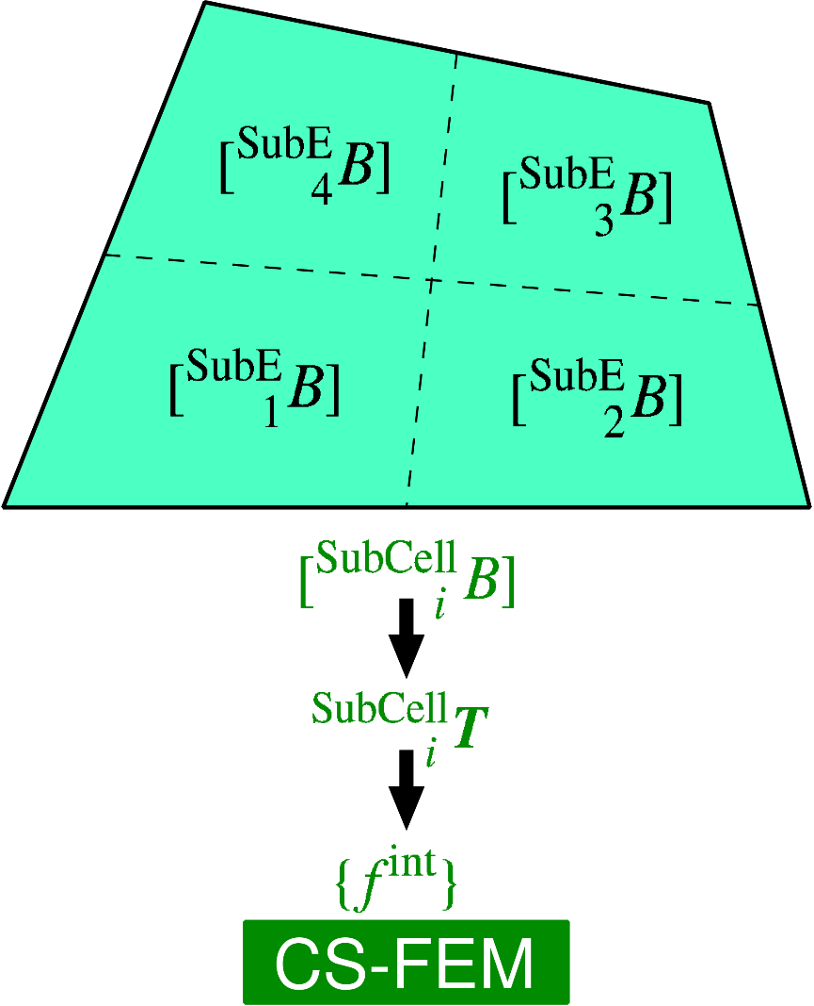
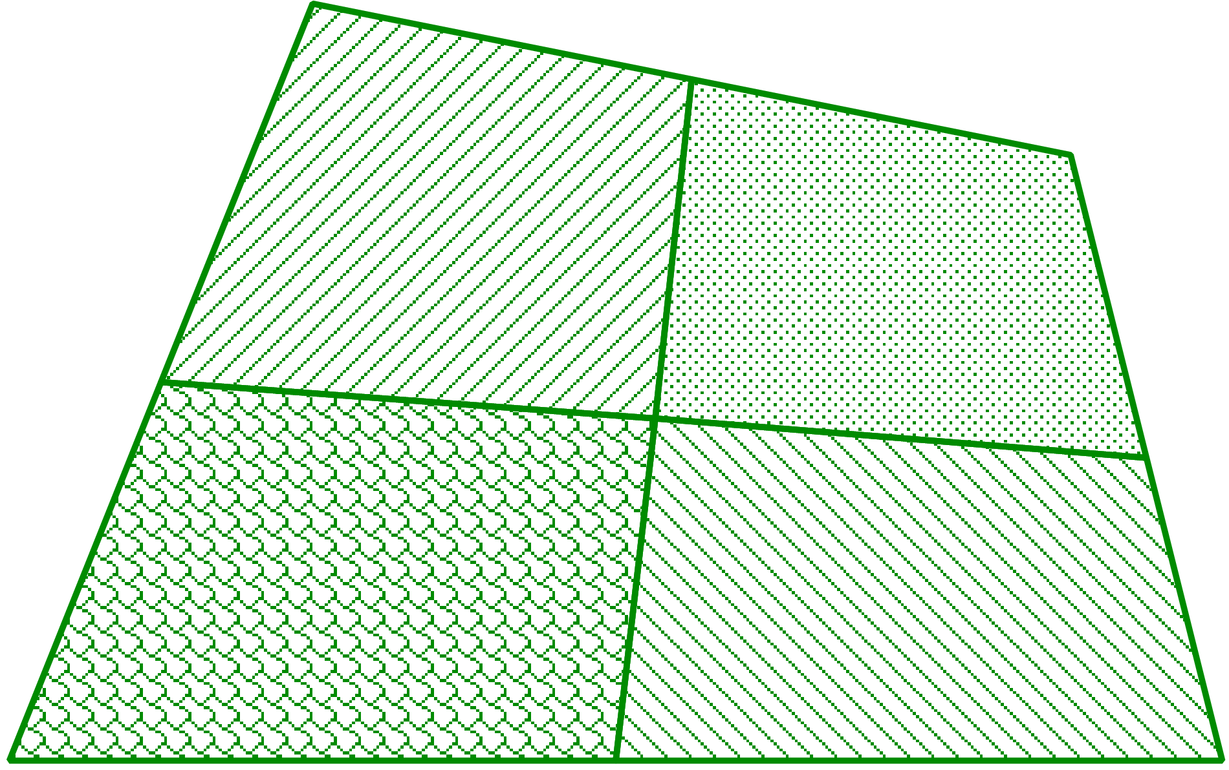

Brief Review of Cell-based S-FEM (CS-FEM)
Subdivide each element into some sub-element.
Calculate $[ ^{SubE}B]$ at each sub-element.
Calculate $F, T, \left\{f^{int}\right\}$ etc. in each sub-element.
As if putting
an integration point
on each sub-element
Implementable as an independent finite element.
Locking can be avoided with SRI etc..

Slide 11
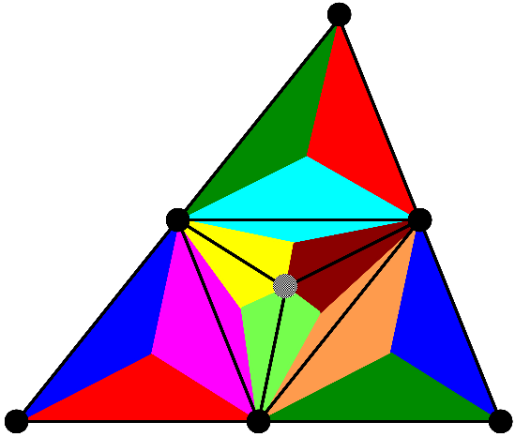
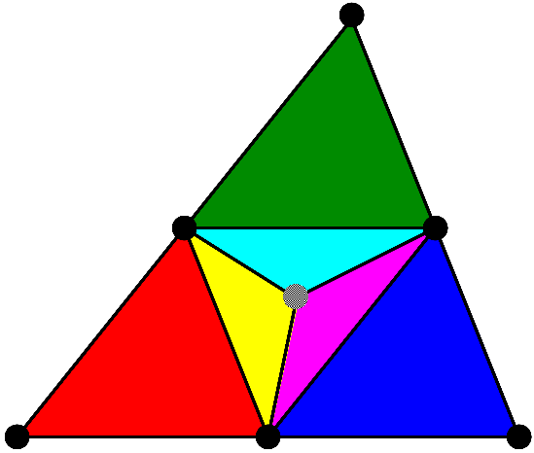
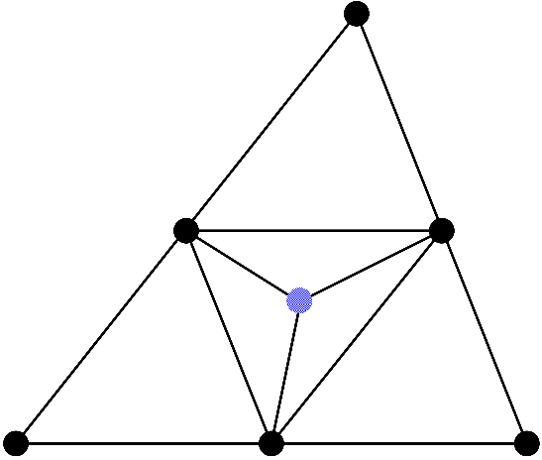
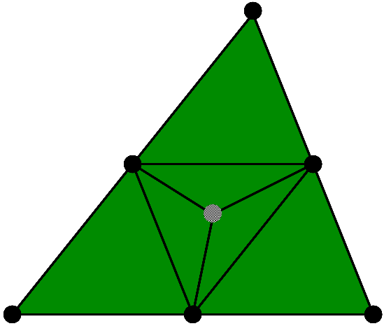

Flowchart of Old SelectiveCS-FEM-T10
Explanation in 2D (6-node triangular element) for simplicity
ES-FEM⁻¹
ES-FEM
(2) Dev. strain smoothing with edges and sub-elements
Overall
mean
SRI
(1) Subdivision with
a dummy node
(4) $\left\{f^{int}\right\} and [K]$
(3) Vol. strain smoothing with all sub-elements

Slide 12
Formulation of
New SelectiveCS-FEM-T10

Slide 13
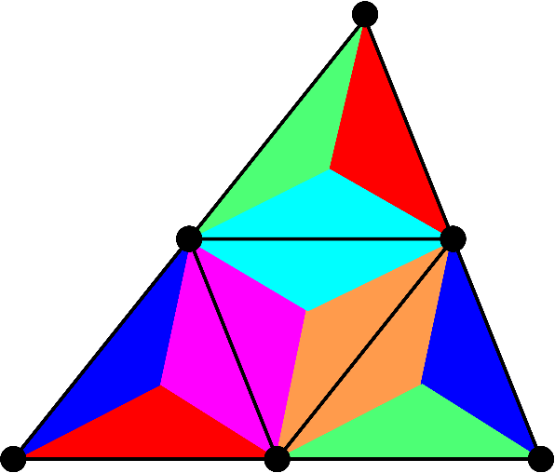
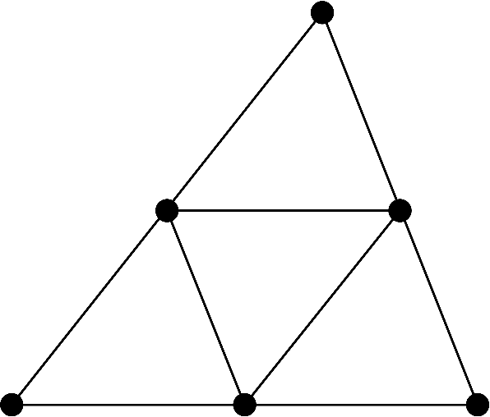
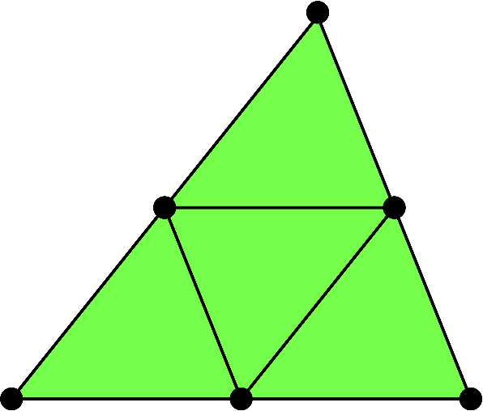

Flowchart of New SelectiveCS-FEM-T10
Explanation in 2D (6-node triangular element) for simplicity
ES-FEM
No ES-FEM⁻¹
(2) Dev. strain smoothing at edges
Overall
mean
SRI
(1) Subdivision without
dummy nodes
(4) $\left\{f^{int}\right\} and [K]$
(3) Vol. strain smoothing with all sub-elements

Slide 14
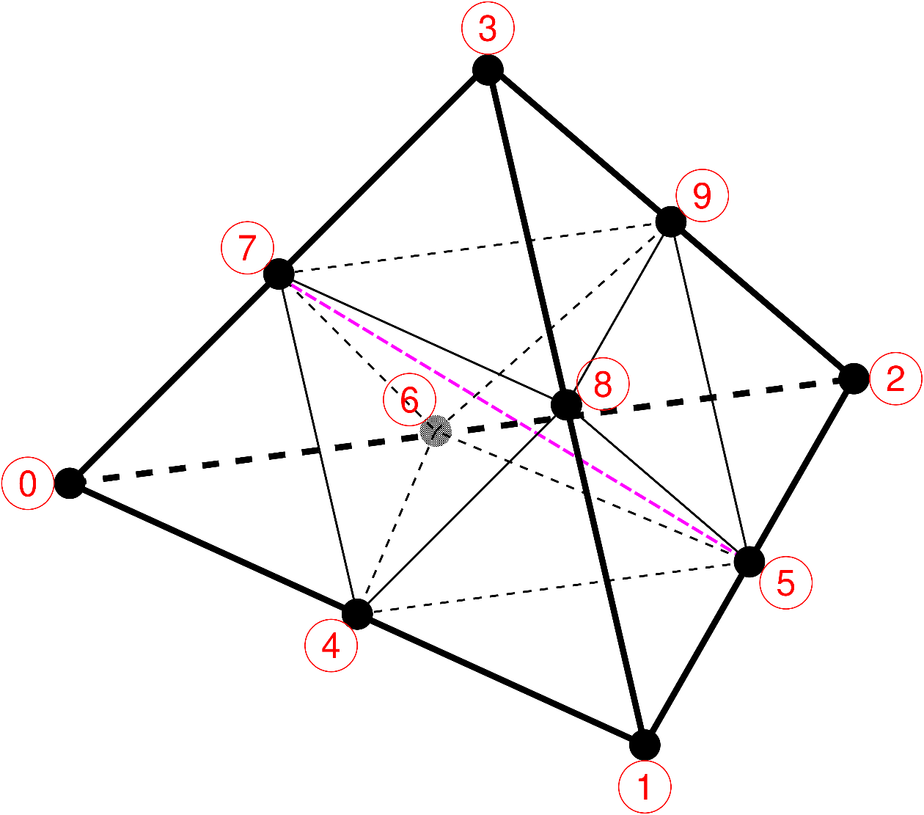
(1) Subdivision into T4 Sub-elements
Introduce no dummy node (i.e., asymmetric element).
Subdivide a T10 element into eight T4 sub-elements and calculate their B-matrices and strains.
The shape function
should not be quadratic
in large deformation analyses.

Slide 15
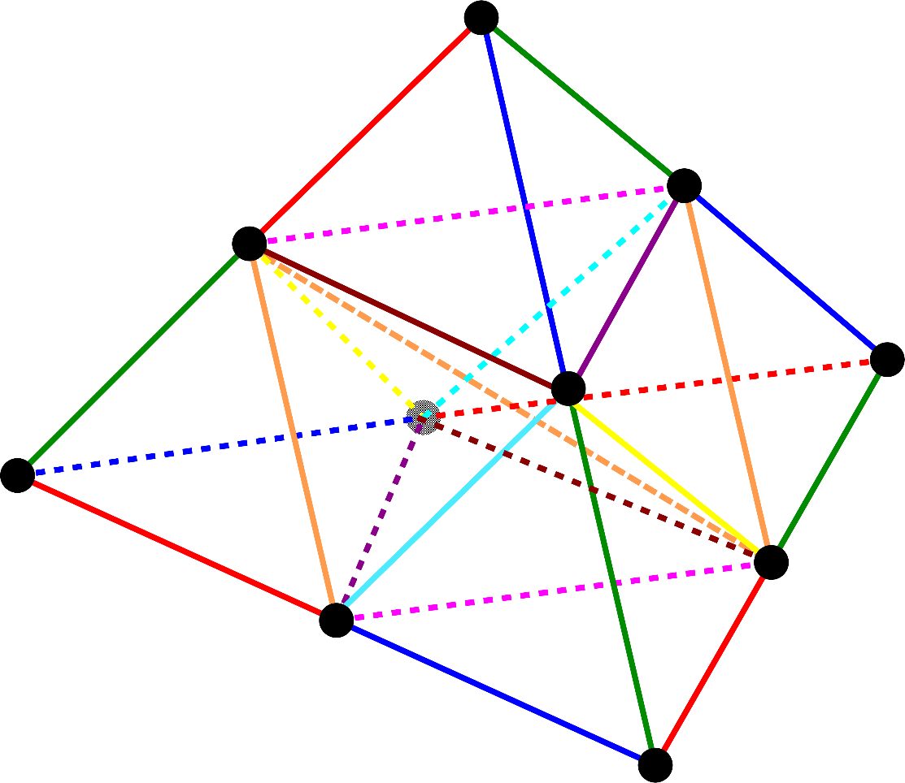
(2) Deviatoric Strain Smoothing
Perform strain smoothing in the manner of ES-FEM
(i.e., average dev. strains of sub-elements at edges).
Evaluate deviatoric strain and stress at edges.
T4 sub-elements cause
shear locking and thus
strain smoothing is
necessary.
From 8 sub-elements
to 25 edges

Slide 16
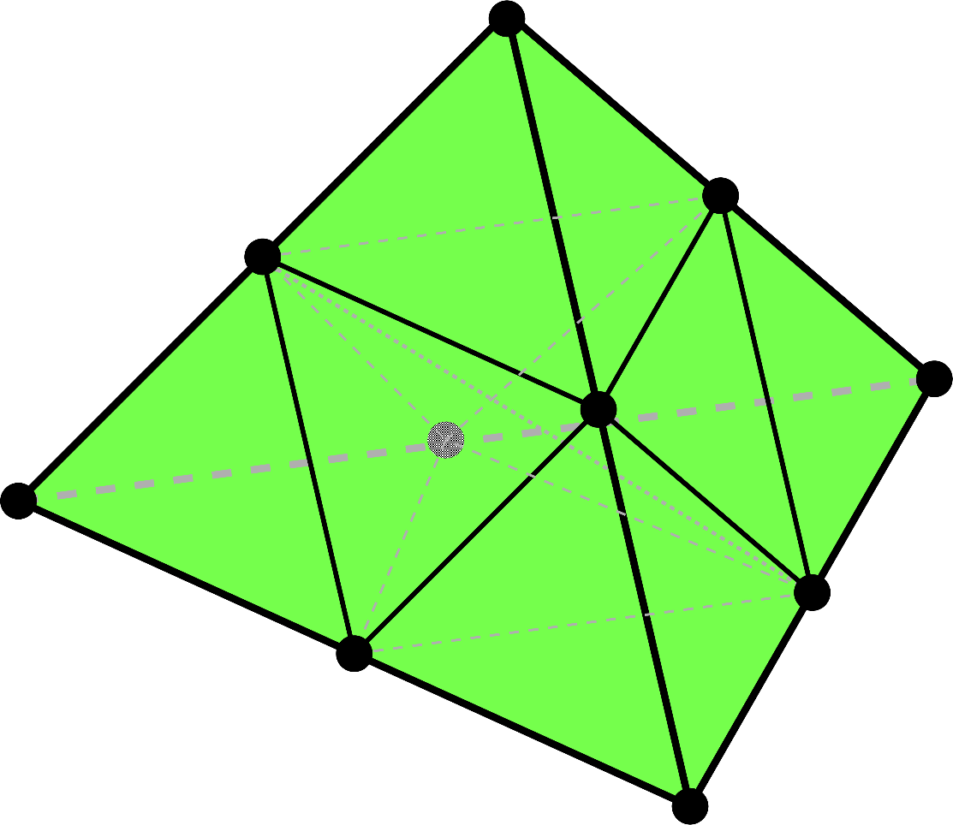
(3) Volumetric Strain Smoothing
Treat the overall mean vol. strain of all sub-elements
as the uniform element vol. strain (i.e., same approach as SRI elements).
The spatial order of
vol. strain should be
lower than that of
dev. strain to avoid
volumetric locking.

Slide 17



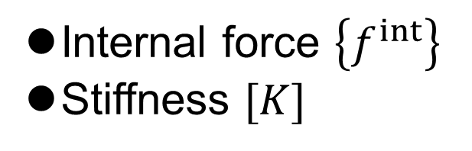
(4) Combining with SRI Method
Apply SRI method to combine the Dev. & Vol. parts
and obtain $\{f^{int}\}$ and $[K]$.
Deviatoric
Internal force $\left\{f^{int}\right\}$
Stiffness $[K]$
SRI
Volumetric

Slide 18
Differences between Old and New
The new formulation has NO dummy node at the center of an element.
  Fewer sub-elements and edges.
  Asymmetric element.
The new formulation has No ES-FEM⁻¹ after ES-FEM.
  Strain & stress evaluation at edges.
  No strain smoothing at frame edges.
Its reason has not revealed yet.
Intuitively, the lack of element symmetry and frame edge smoothing is not good for accuracy and stability; however, the new formulation is better in fact.

Slide 19
Demonstration of
New SelectiveCS-FEM-T10

Slide 20
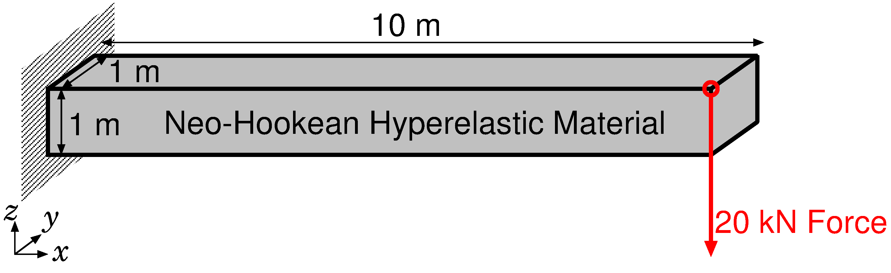
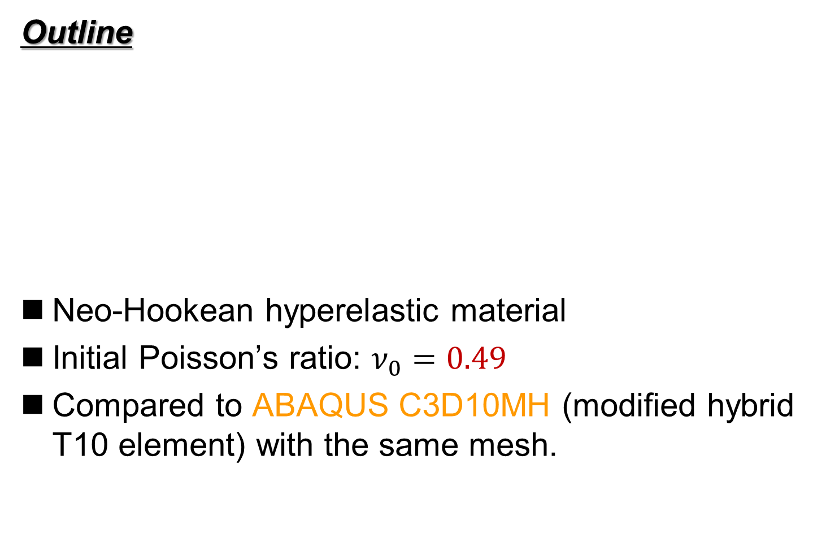
Bending of Hyperelastic Cantilever
Outline
Neo-Hookean hyperelastic material
Initial Poisson’s ratio: $ν_{0}=0.49$
Compared to ABAQUS C3D10MH (modified hybrid T10 element) with the same mesh.
Dead Load

Slide 21
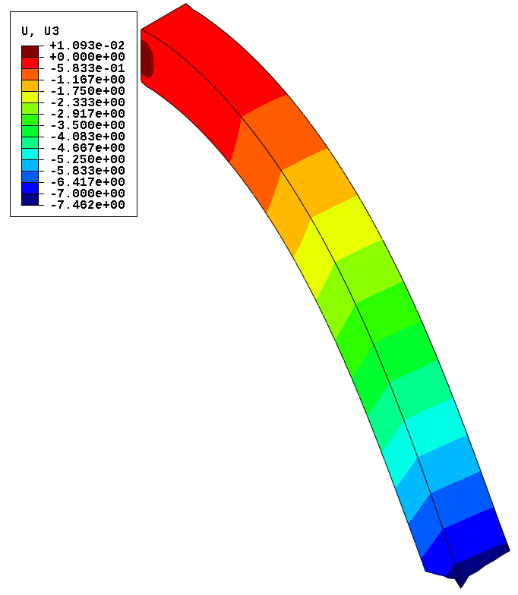
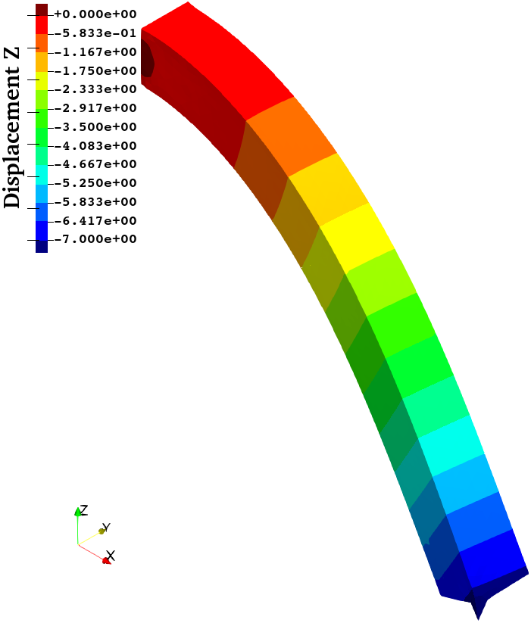
Bending of Hyperelastic Cantilever
Comparison of the deflection disp. at the final state
ABAQUS
C3D10MH
New Selective
CS-FEM-T10
No volumetric locking is observed.

Slide 22
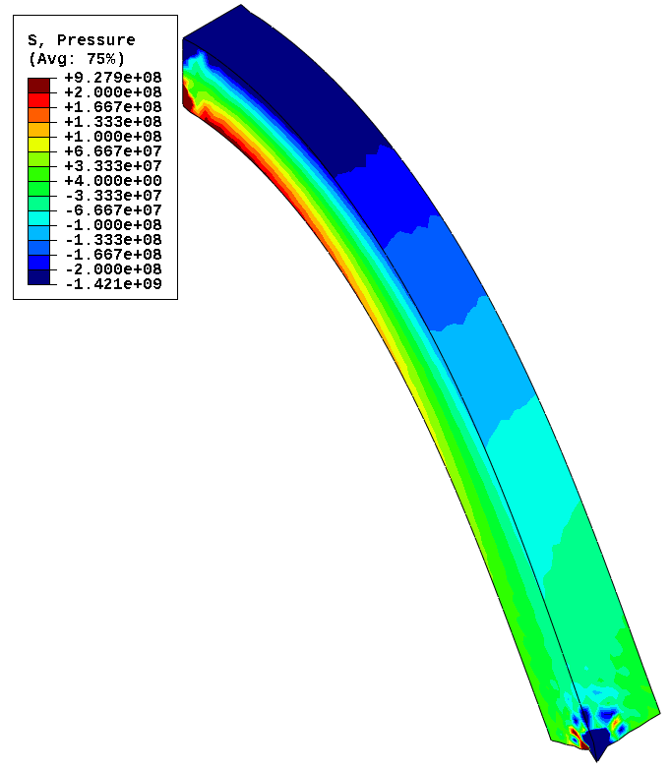
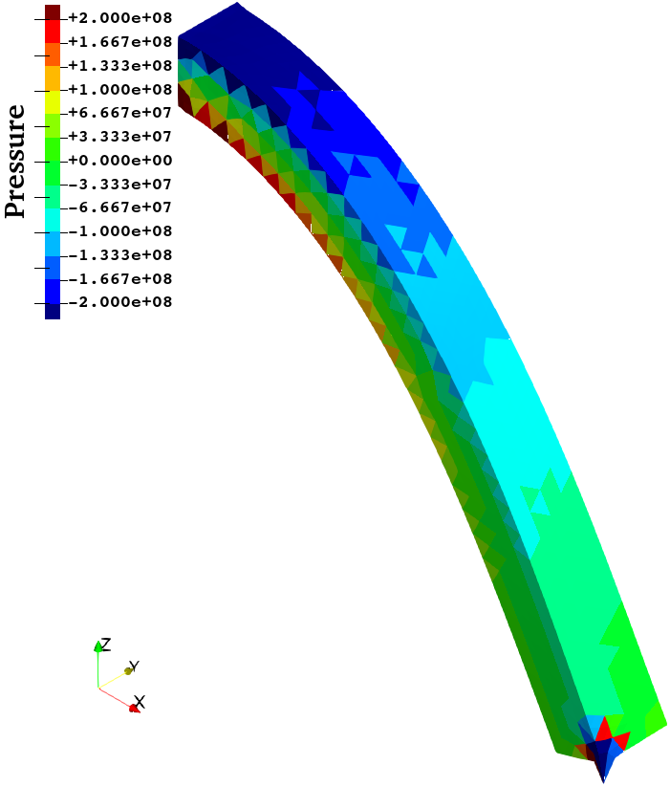
Bending of Hyperelastic Cantilever
Comparison of the pressure dist. at the final state
ABAQUS
C3D10MH
New Selective
CS-FEM-T10
Almost the same pressure distributions
with no checkerboarding.

Slide 23
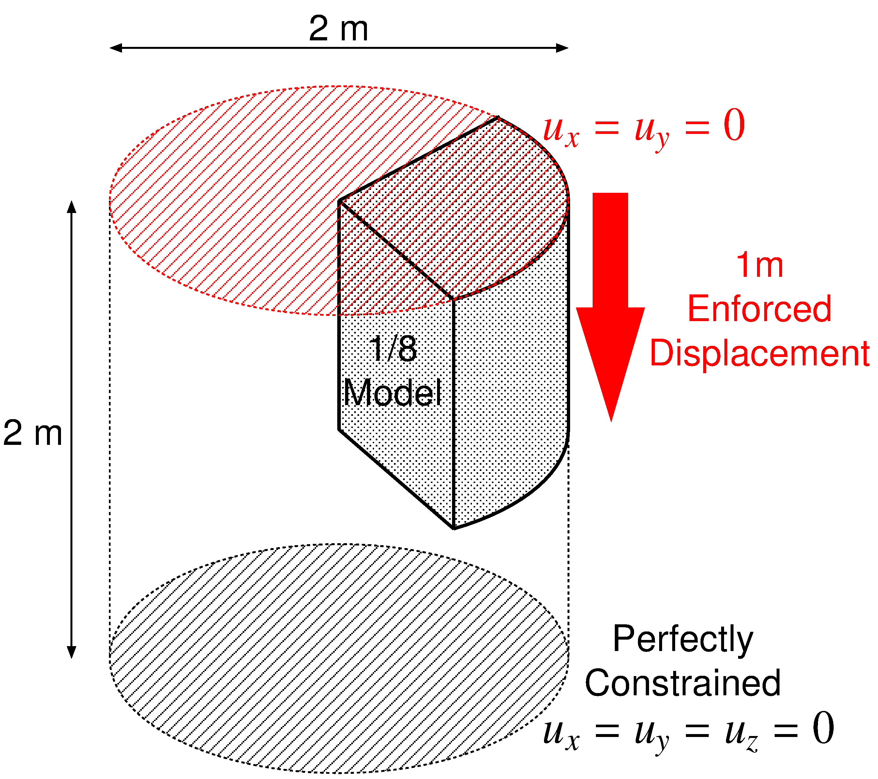
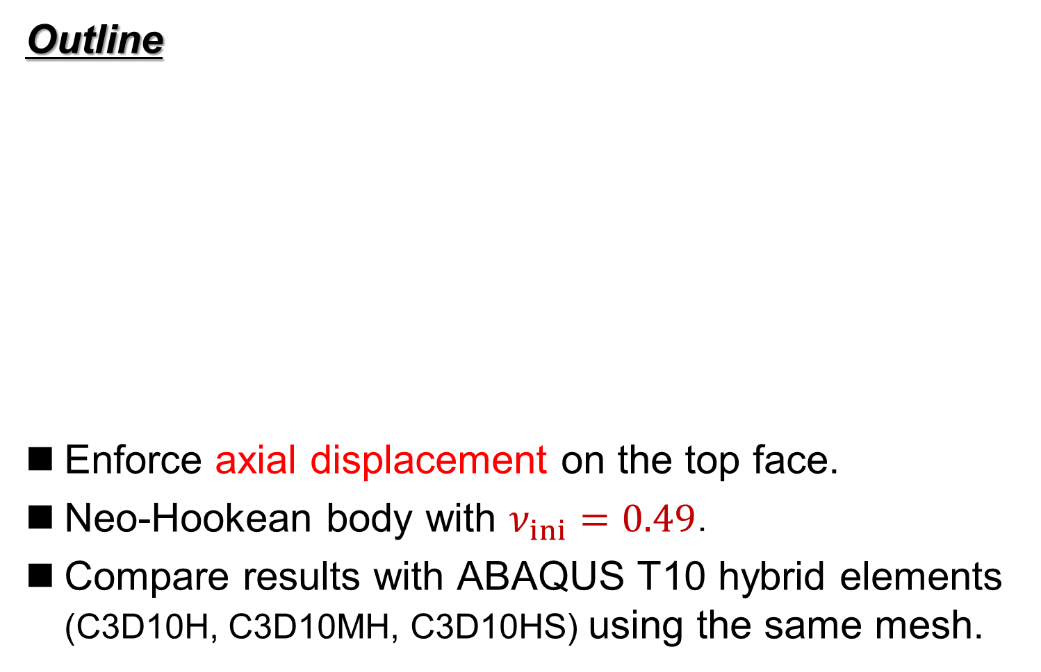
Barreling of Hyperelastic Cylinder
Outline
Enforce axial displacement on the top face.
Neo-Hookean body with $ν_{ini}=0.49$．
Compare results with ABAQUS T10 hybrid elements (C3D10H, C3D10MH, C3D10HS) using the same mesh.

Slide 24
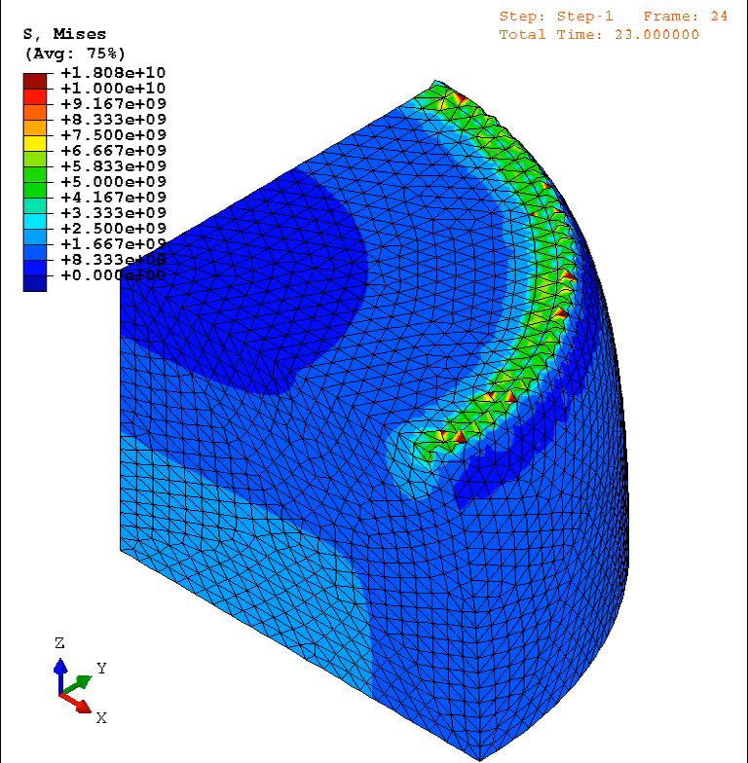
Barreling of Hyperelastic Cylinder
Animation
of
Mises
stress
(ABAQUS
C3D10MH)
Convergence
failure at 24%
compression
Unnaturally
oscillating
distributions
are obtained
around
the rim.

Slide 25
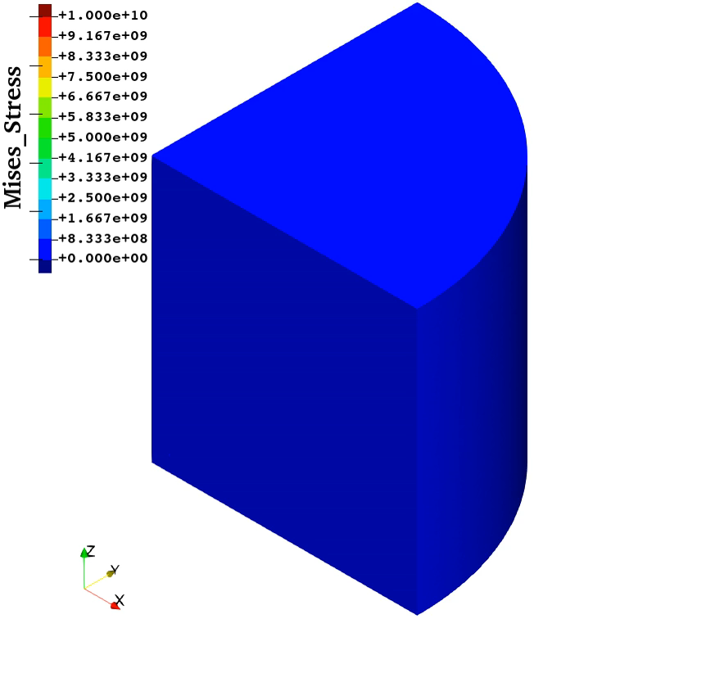
Barreling of Hyperelastic Cylinder
Animation
of
Mises
stress
(New Selective
CS-FEM-T10)
Smooth
distributions
are obtained
except around
the rim.
Convergence
failure at 43%
compression
The present
element
is more
robust than
ABAQUS
C3D10MH

Slide 26
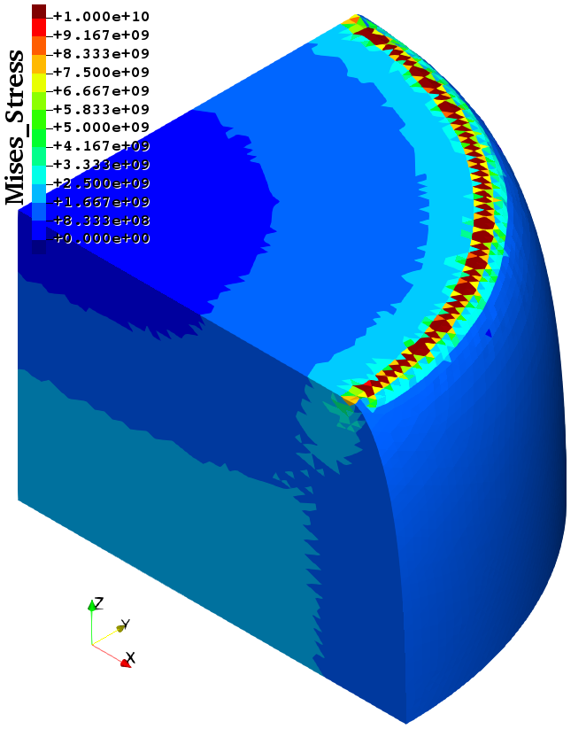
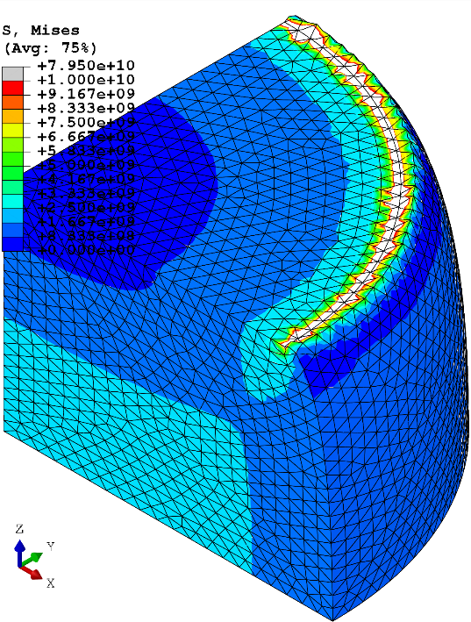
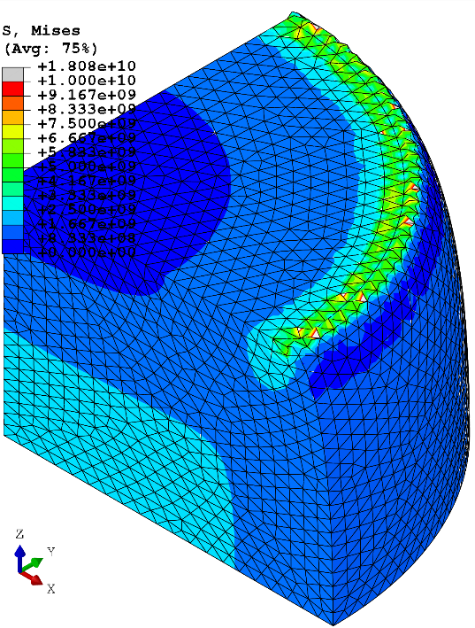
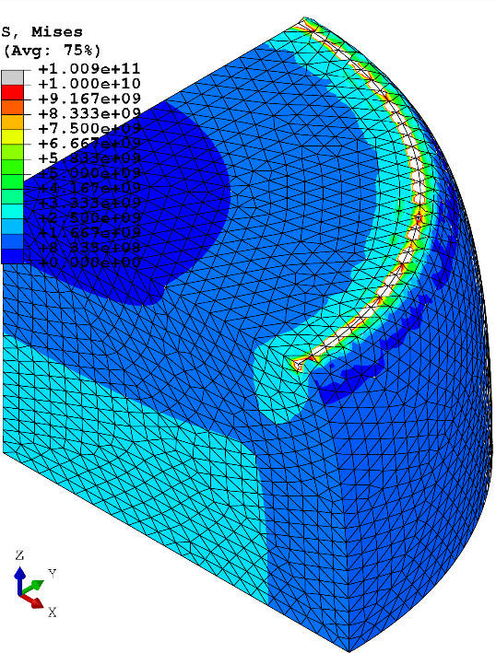
Barreling of Hyperelastic Cylinder
Comparison of Mises stress at 24% comp.
New Selective
CS-FEM-T10
ABAQUS
C3D10H
ABAQUS
C3D10MH
ABAQUS
C3D10HS
All results are similar to each other
except around the rim having stress singularity.

Slide 27
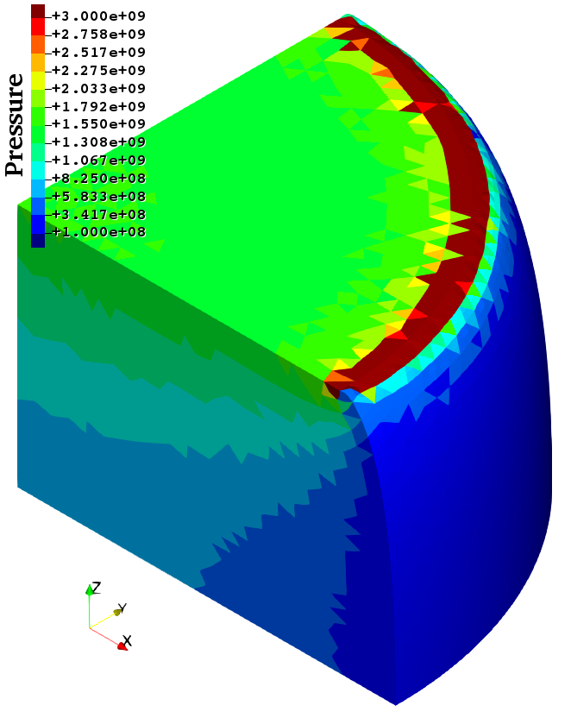
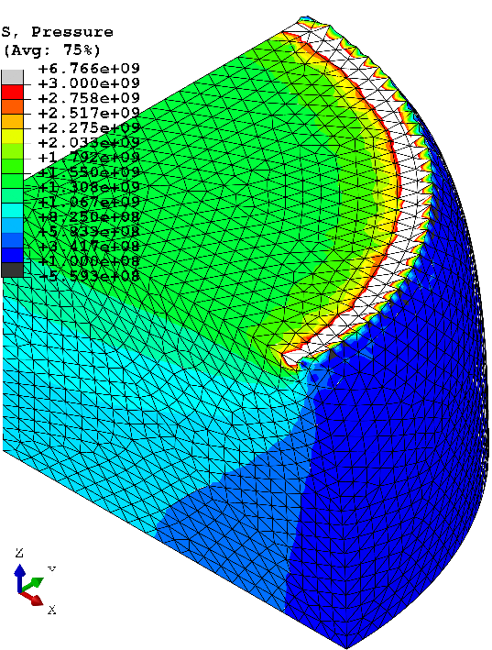

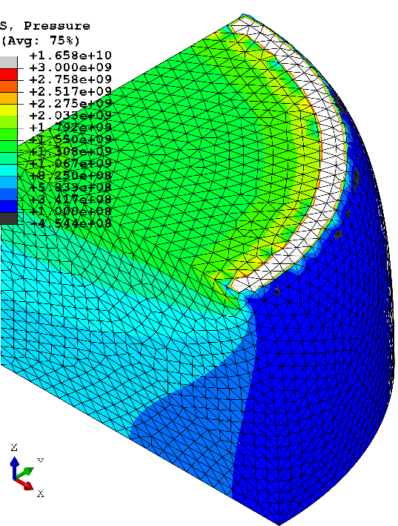
Barreling of Hyperelastic Cylinder
Comparison of pressure at 24% comp.
New Selective
CS-FEM-T10
ABAQUS
C3D10H
ABAQUS
C3D10MH
ABAQUS
C3D10HS
All results are similar to each other
except around the rim having stress singularity.

Slide 28
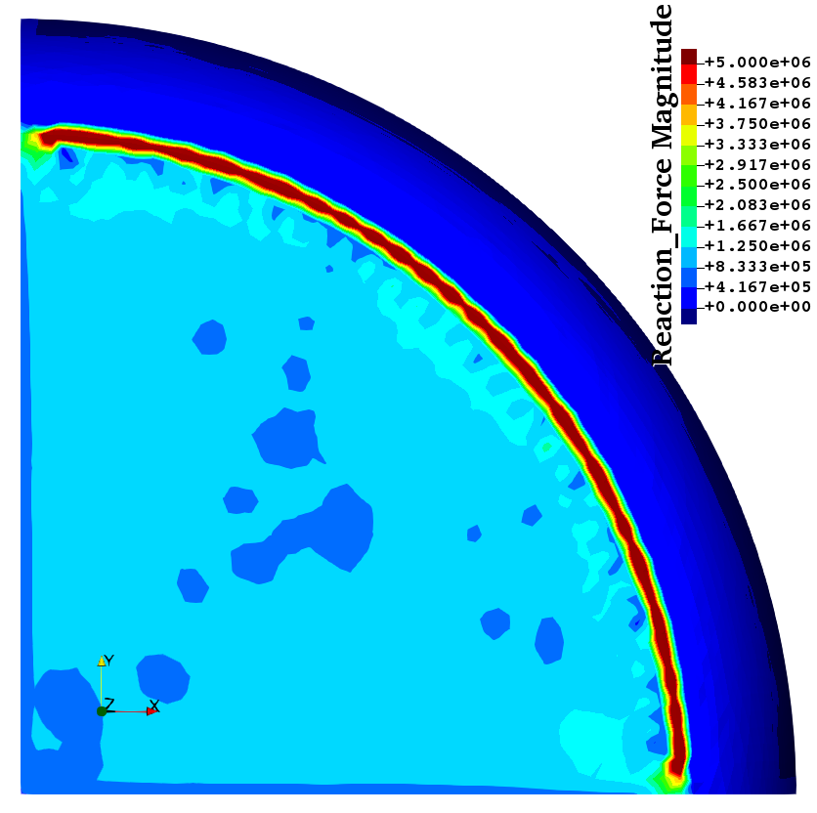
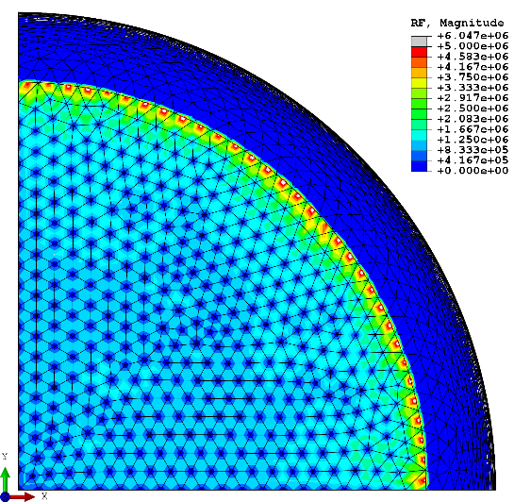
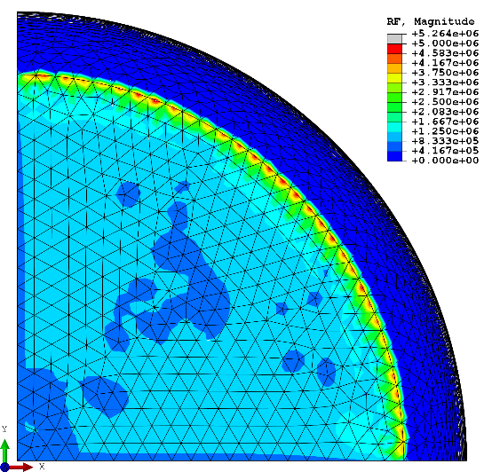

Barreling of Hyperelastic Cylinder
Comparison of nodal reaction force at 24% comp.
New Selective
CS-FEM-T10
ABAQUS
C3D10H
ABAQUS
C3D10MH
ABAQUS
C3D10HS
ABAQUS C3D10H and C3D10HS
suffer from nodal force oscillation.

Slide 29
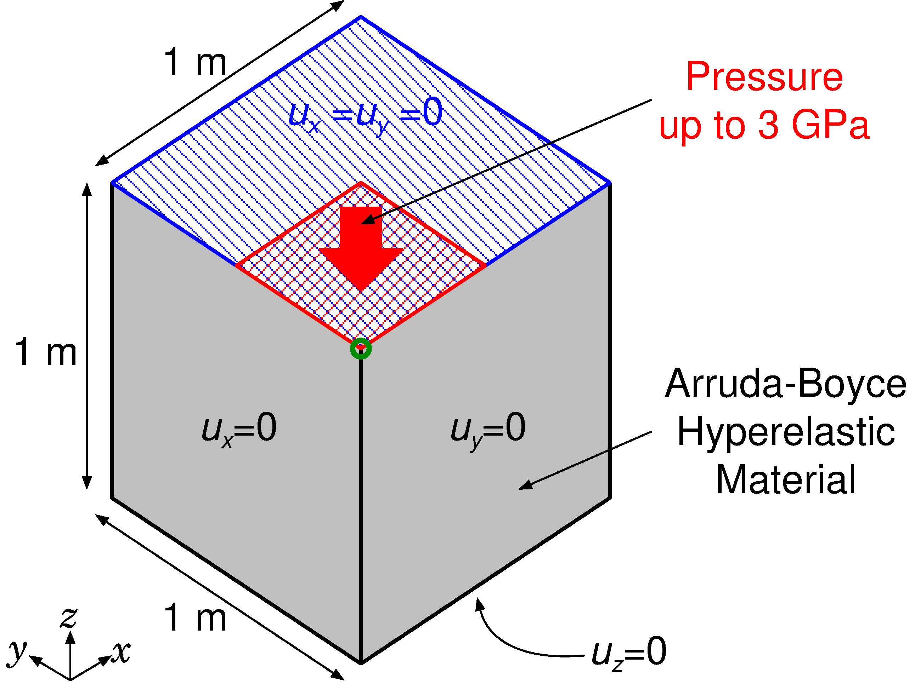
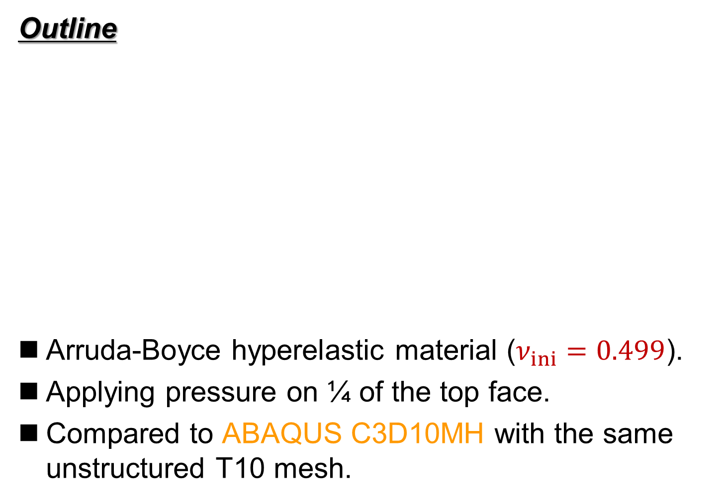
Compression of Hyperelastic Block
Outline
Arruda-Boyce hyperelastic material ($ν_{ini}=0.499$).
Applying pressure on ¼ of the top face.
Compared to ABAQUS C3D10MH with the same unstructured T10 mesh.
Load

Slide 30
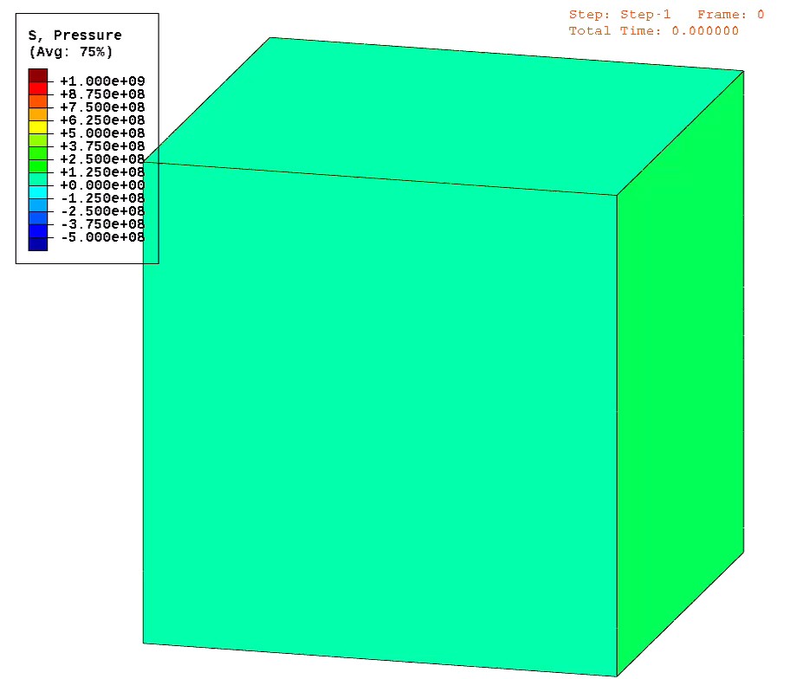
Compression of Hyperelastic Block
Animation
of
pressure
dist.
(ABAQUS
C3D10MH)
Convergence
failure at
0.71 GPa
pressure

Slide 31
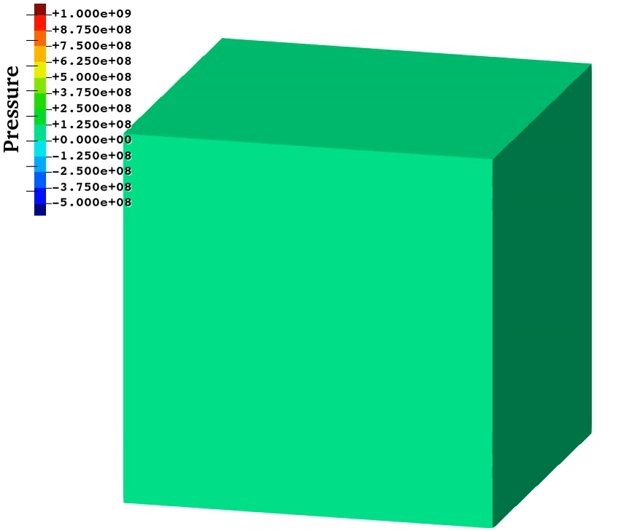
Compression of Hyperelastic Block
Animation
of
pressure
dist.
(New Selective
CS-FEM-T10)
Convergence
failure at
1.35 GPa
pressure
The present
element
is more
robust than
ABAQUS
C3D10MH

Slide 32
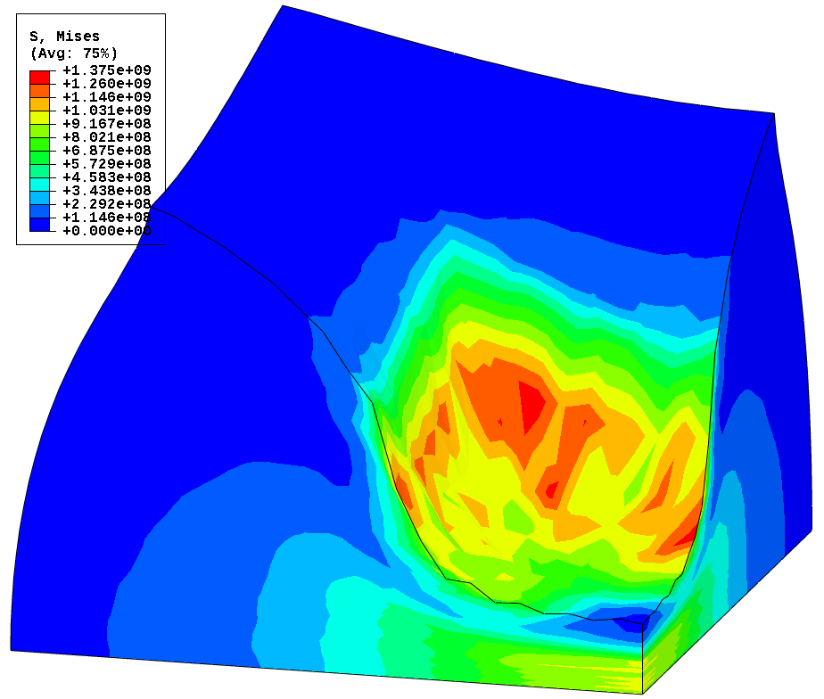

Compression of Hyperelastic Block
Misess stress dist. at 0.7 GPa pressre
ABAQUS C3D10MH New SelectiveCS-FEM-T10
Less smoothed Mises stress is observed in New SelectiveCS-FEM-T10.
Further improvement is still required.

Slide 33
Summary

Slide 34
Summary of SelectiveCS-FEM-T10
Benefits
  Accurate
  (no locking, no checkerboarding, no force oscillation).
  Robust (long-lasting in large deformation).
  No increase in DOF (No static condensation).
  Same memory & CPU costs as the other T10 elements.
  Implementable to commercial FE codes.
Drawbacks
✗ No longer a T4 formulation.
Take-home message
Please consider implementing SelectiveCS-FEM-T10 to your in-house code. It’s supremely useful & easy to code!!
Very close to practical use!!
Thank you for your kind attention!

