Slide 1
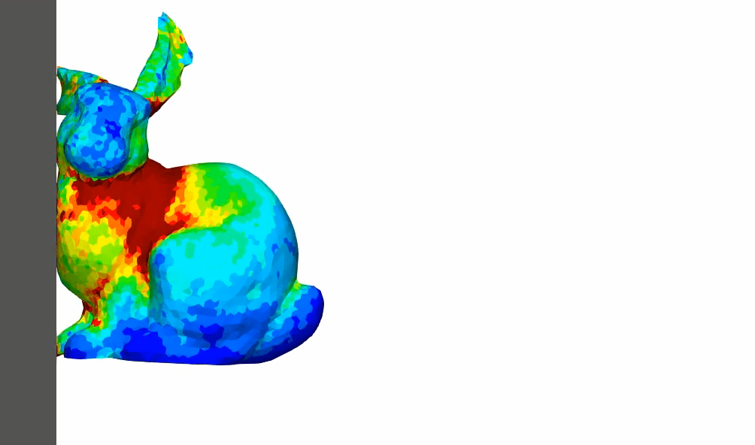
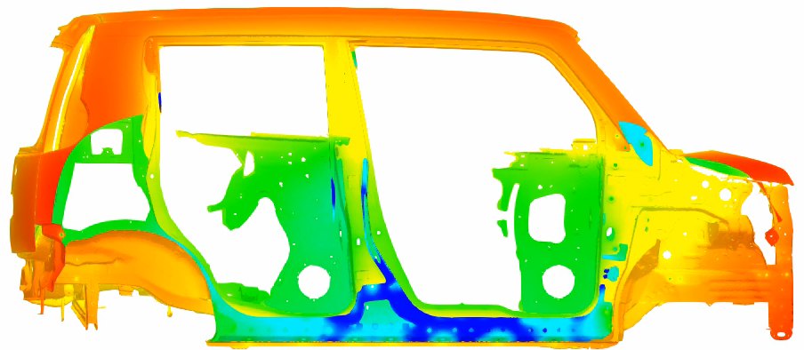
Smoothed Finite Element Methods:
Recent Academic/Practical Progress
Yuki ONISHI
Tokyo Institute of Technology, Japan

Slide 2
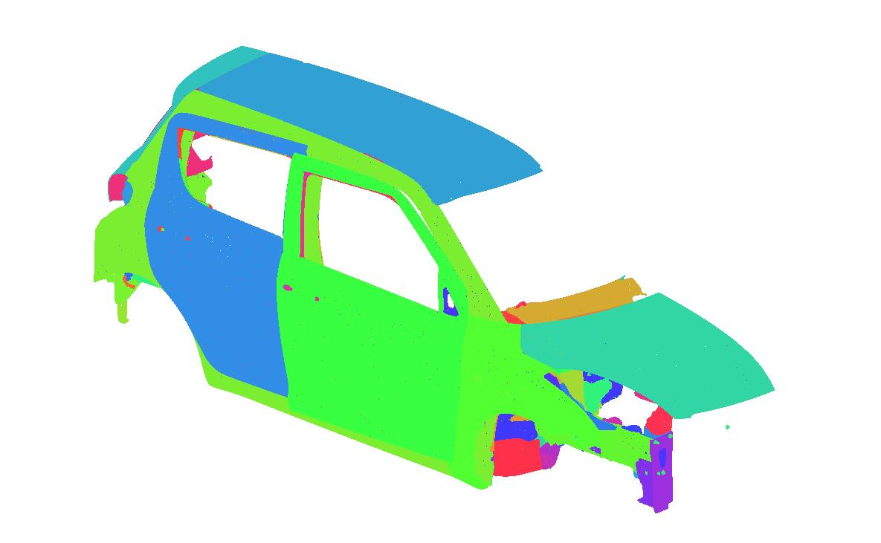
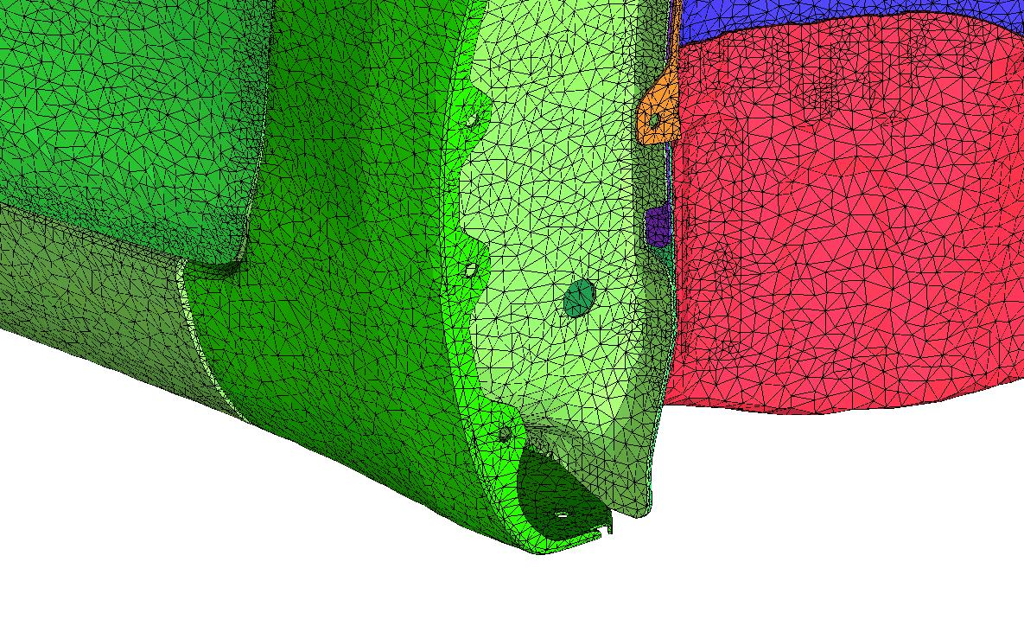
Motivation of My S-FEM Researches
Our group is mainly interested in practical research topics for industrial applications.
Manufactured products usually have complex body shapes, which are difficult to be discretized with Hex meshes in FEA.
Tet meshes are easy to generate, but the analyses with conventional Tet elements are inaccurate.
Provided by
SUZUKI Motor Co.
Only surface
mesh is shown.
We have started researching on
smoothed FEM (S-FEM) with Tet meshes.

Slide 3
What is S-FEM?
Smoothed finite element method (S-FEM) is a relatively new FE formulation proposed by Prof.
G. R. Liu in 2006.
S-FEM is one of the strain smoothing techniques.
There are several types of classical S-FEMs depending on the domains of strain smoothing.
For example in 2D triangular mesh:
Edge-based S-FEM
(ES-FEM)
Node-based S-FEM
(NS-FEM)
Standard FEM

Slide 4
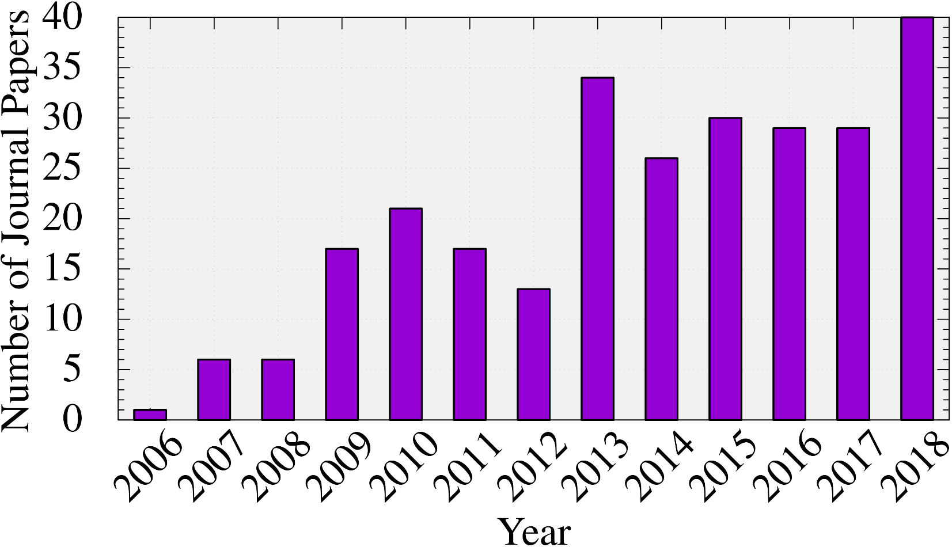
What is S-FEM?
Number of journal papers written in English
whose title contains “smoothed finite element”:
(inquired at Google Scholar)
The attraction of S-FEM is expanding continuously.

Slide 5
Today’s Agendas
Part 1: Academic Progress of S-FEM
in Large Deformation Analysis of Solids.
Part 2: Practical Progress of S-FEM
in Electrodeposition Process Simulation
of Auto Car Bodies.

Slide 6
Part 1:
Academic Progress of S-FEM
in Large Deformation Analysis
of Solids

Slide 7
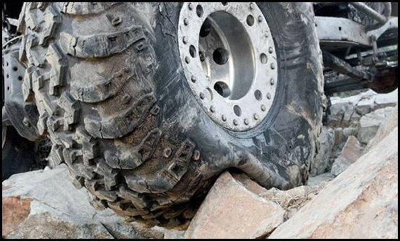
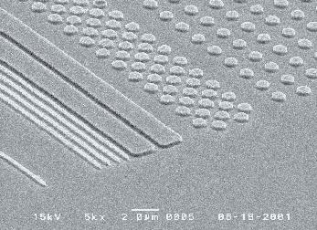


Motivation
What we want to do:
Solve hyper large deformation
analyses accurately and stably.
Treat complex geometries
with tetrahedral meshes.
Consider nearly incompressible materials $(ν≃0.5)$.
Support contact problems.
Handle auto re-meshing.
Rubber
Metal
Plastic

Slide 8
Issues
Conventional tetrahedral (T4/T10) FE formulations
still have issues in accuracy or stability
especially in nearly incompressible cases.
2nd or higher order elements:
✗ Volumetric locking.
Accuracy loss in large strain due to intermediate nodes.
Enhanced assumed strain method (EAS):
✗ Spurious low-energy modes.
B-bar method, F-bar method, Selective reduced integration:
✗ Not applicable to tetrahedral element directly.
F-bar-Patch method:
✗ Difficulty in building good-quality patches.
u/p mixed (hybrid) method:
(e.g., ABAQUS/Standard C3D4H and C3D10MH)
✗ Pressure checkerboarding etc..

Slide 9
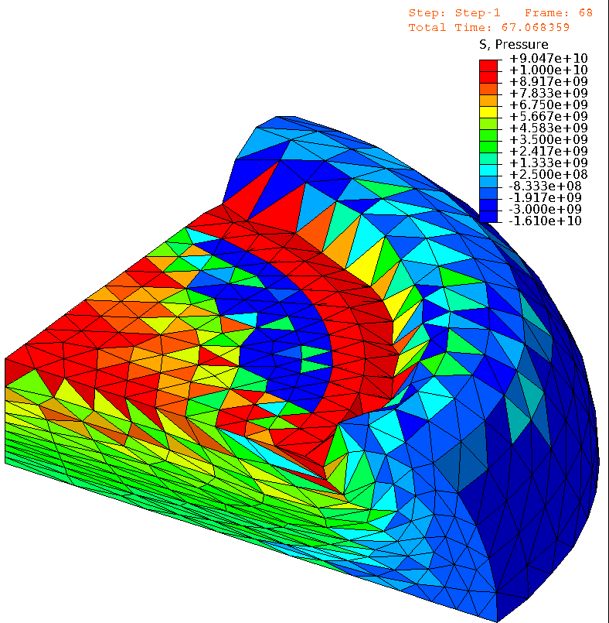
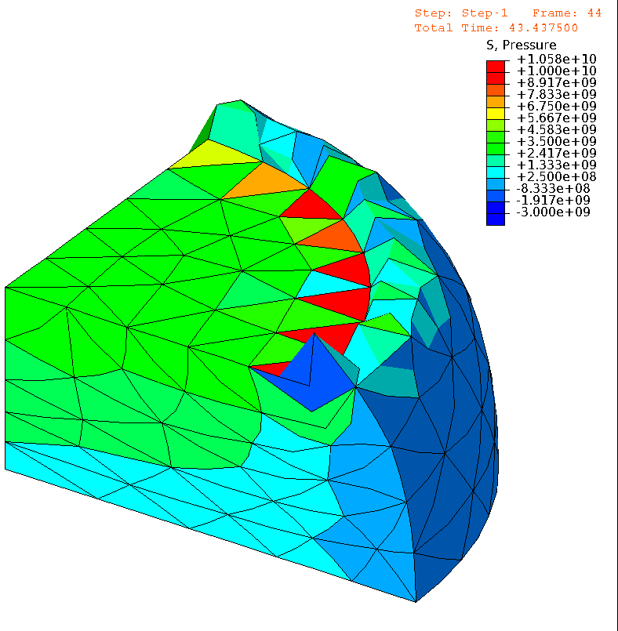

Issues (cont.)
E.g.) Compression of neo-Hookean hyperelastic body with $ν_{ini}=0.49$
Pressure
Pressure
# of Nodes is
almost the same.
1st order hybrid T4 (C3D4H)
✓ No shear/volumetric locking
✗ Pressure checkerboarding
✗ Corner locking
2nd order modified hybrid T10 (C3D10MH)
✓ No shear/volumetric locking
✗ Early convergence failure
✗ Low interpolation accuracy

Slide 10
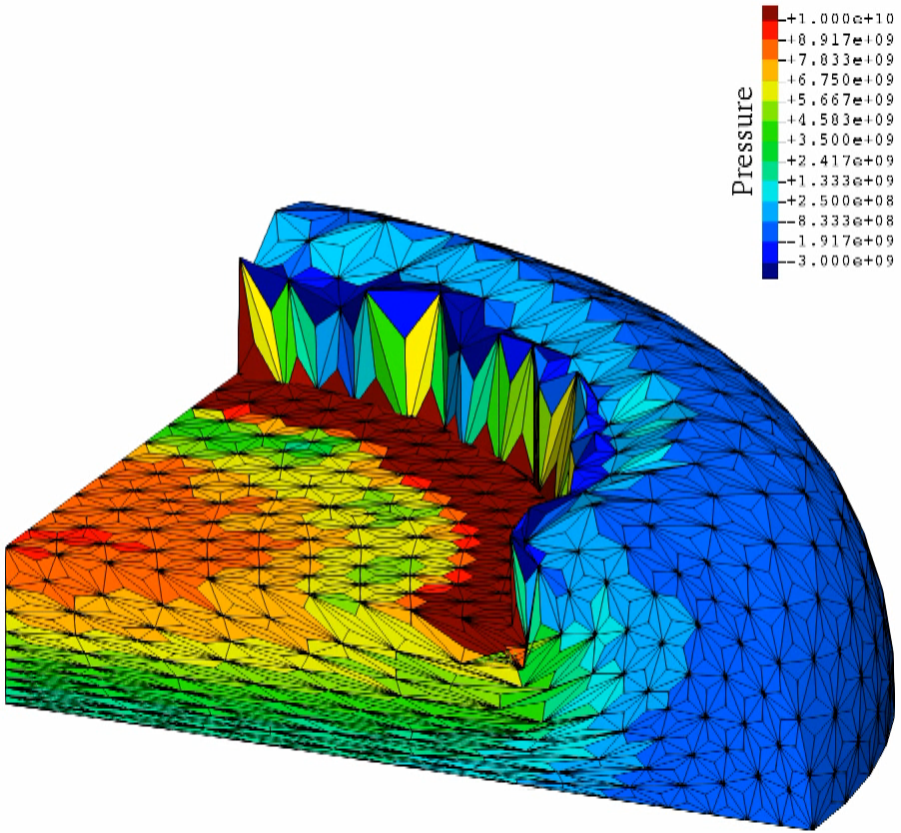

A Recent Solution: S-FEM
E.g.) Compression of neo-Hookean hyperelastic body with $ν_{ini}=0.49$
Pressure
Same mesh
as C3D4H
case.
F-barES-FEM-T4 (One of the latest S-FEM)
✓ No shear/volumetric locking
✓ No corner locking
✓ No pressure checkerboarding
✓ No increase in DOF (i.e., No static condensation)

Slide 11
Formulation of
F-barES-FEM-T4

Slide 12
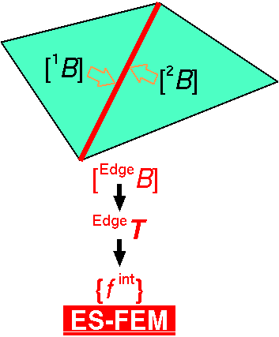

Quick Intro. of Edge-based S-FEM (ES-FEM)
Calculate $[B]$ at each element as usual.
Distribute $[B]$ to the connecting edges with area weight
and build $[ ^{Edge}B]$ .
Calculate $F, T, \left\{f^{int}\right\}$ etc. in each edge smoothing domain.
As if putting
an integration point
on each edge center
✗ Volumetric locking
✗ Pressure checkerboarding
No shear locking
No spurious modes

Slide 13
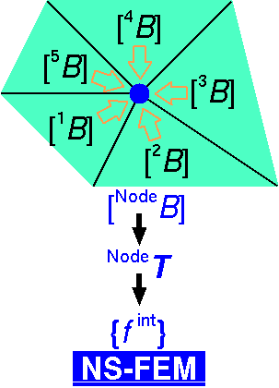

Quick Intro. of Node-based S-FEM (NS-FEM)
Calculate $[B]$ at each element as usual.
Distribute $[B]$ to the connecting nodes with area weight
and build $[ ^{Node}B]$.
Calculate $F, T, \left\{f^{int}\right\}$ etc. in each node smoothing domain.
As if putting
an integration point
on each node
✗ Spurious low-energy mode
(or hour-glass mode)
Less pressure
checkerboarding
No shear locking
No volumetric locking

Slide 14
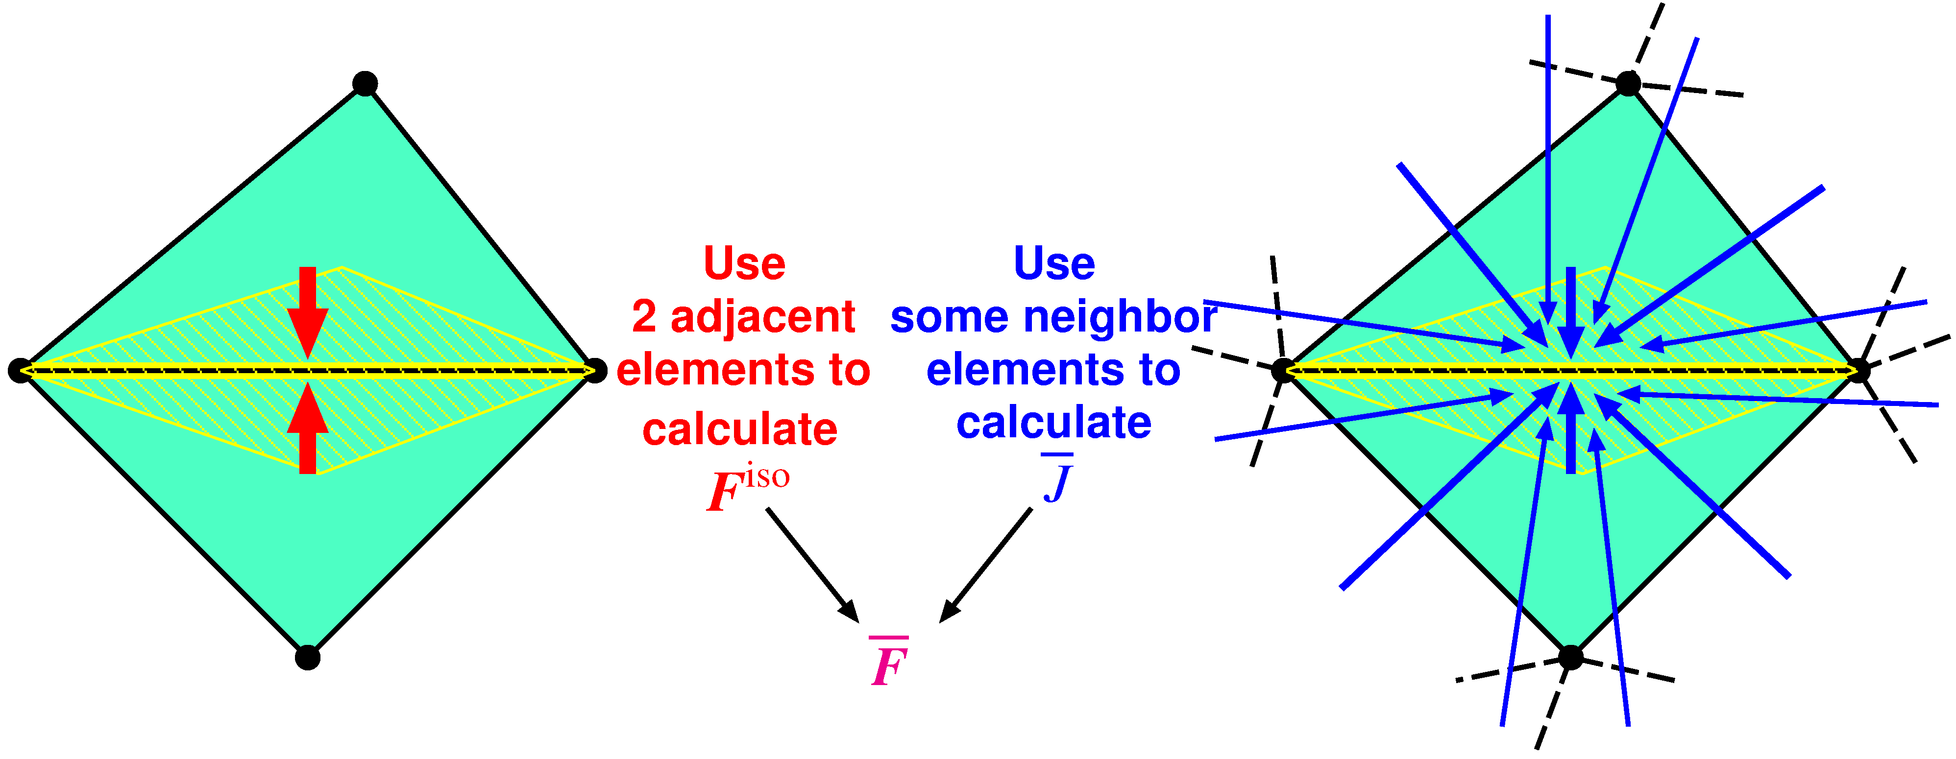

Concept of F-barES-FEM
Outlline
$^{Edge}{\tilde{F}}^{iso}$ is given by ES-FEM.
$^{Edge}\overline{ J }$ is given by cyclically applied NS-FEM.
$^{Edge}\overline{F }$ is calculated in the manner of F-bar method:
$^{Edge}\overline{F }=$ $^{Edge}{\overline{ J }}^{1/3}$ $^{Edge}{\tilde{F}}^{iso}$.
Concept: combining ES-FEM and NS-FEM using F-bar method

Slide 15
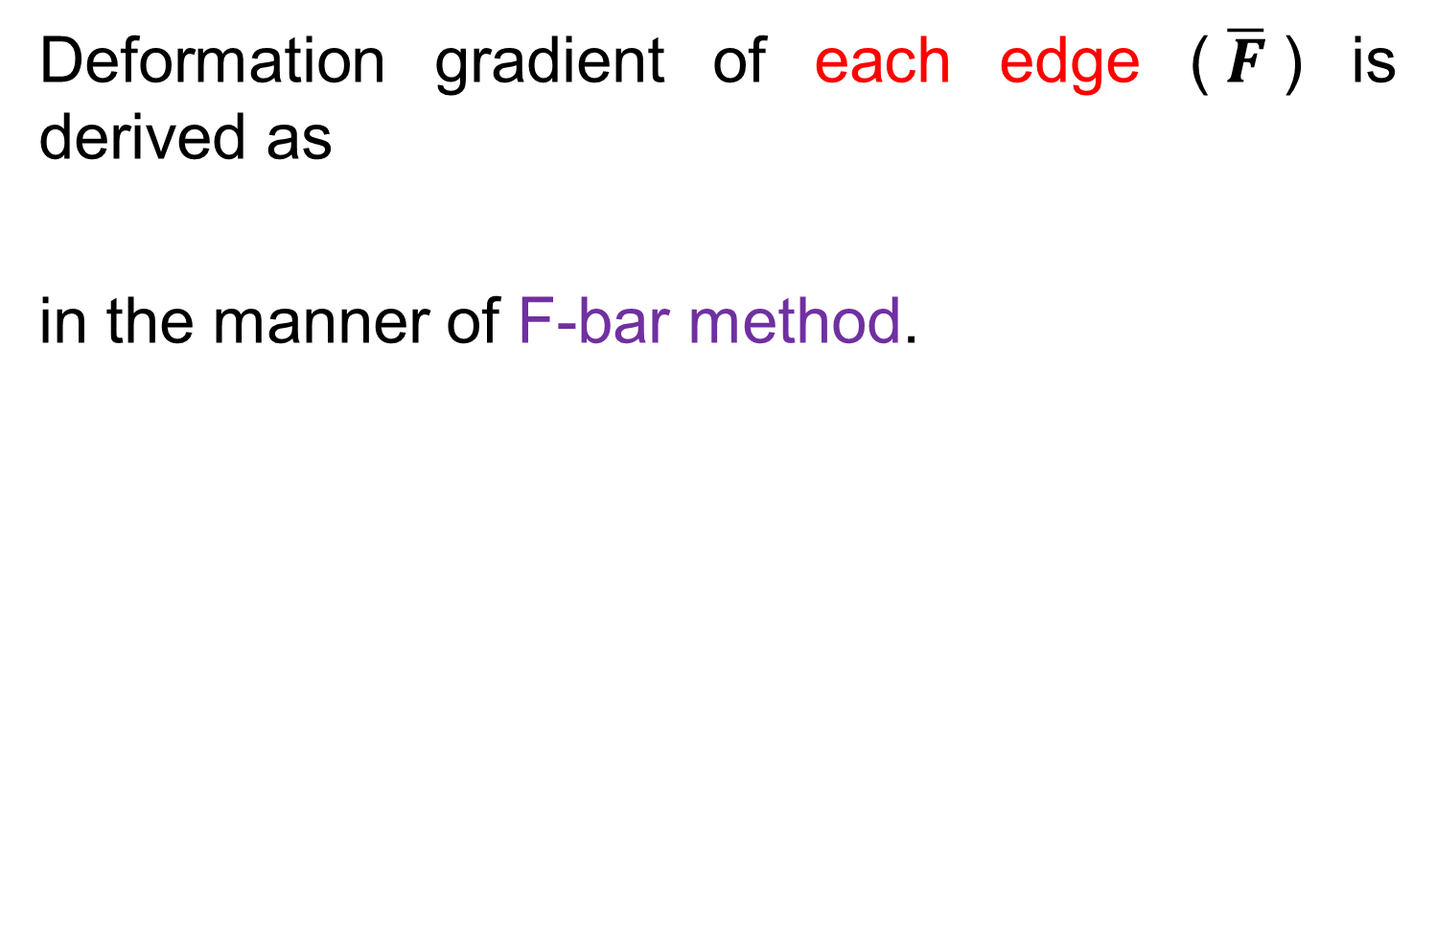
Formulation of F-barES-FEM (1 of 2)
Deformation gradient of each edge ($\overline{F}$) is derived as
in the manner of F-bar method.
$$\overline{F}={\tilde{F}}^{iso}∙{\overline{F}}^{vol}$$
ES-FEM

Slide 16

Formulation of F-barES-FEM (2 of 2)
Each part of $\overline{F}$ is calculated as
$$\overline{F}={\tilde{F}}^{iso}∙{\overline{F}}^{vol}$$
Isovolumetric part
Volumetric part
(1)
(2)
Smoothing the value of adjacent elements.
(same manner
as ES-FEM)
(1)Calculating node’s value by smoothing
the value of adjacent elements
(2)Calculating elements’ value by smoothing
the value of adjacent nodes
(3)Repeating (1) and (2) a few times

Slide 17
Advantages of F-barES-FEM
This formulation is designed to have 3 advantages.
$$\overline{F}={\tilde{F}}^{iso}∙{\overline{F}}^{vol}$$
Isovolumetric part
Volumetric part
Like a ES-FEM
1. Shear locking free
Like a NS-FEM
2. Little pressure oscillation
3. Volumetric locking free
with the aid of F-bar method

Slide 18
Demonstrations of
F-barES-FEM-T4

Slide 19
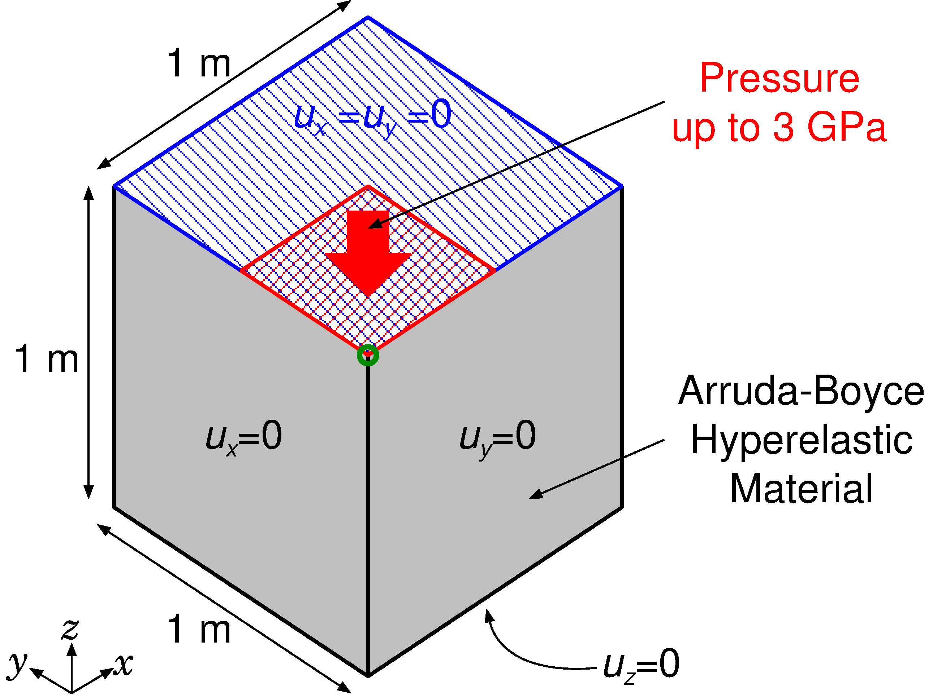
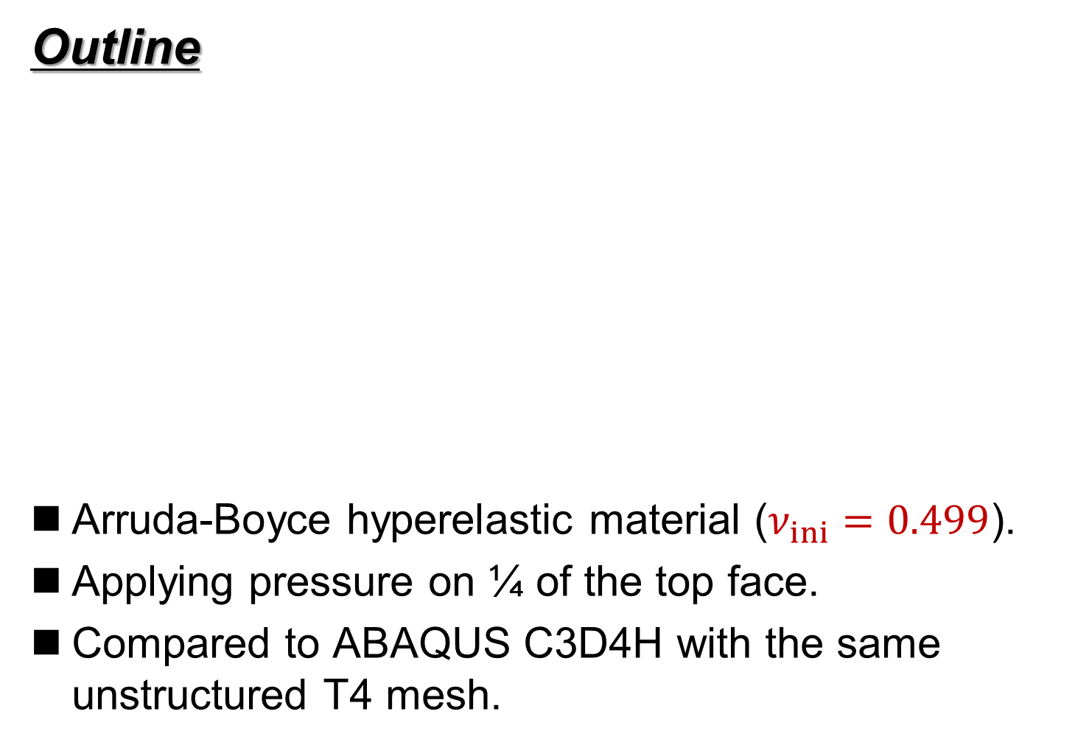
Compression of Rubber Block
Static
Implicit
Outline
Arruda-Boyce hyperelastic material ($ν_{ini}=0.499$).
Applying pressure on ¼ of the top face.
Compared to ABAQUS C3D4H with the same unstructured T4 mesh.
Load

Slide 20
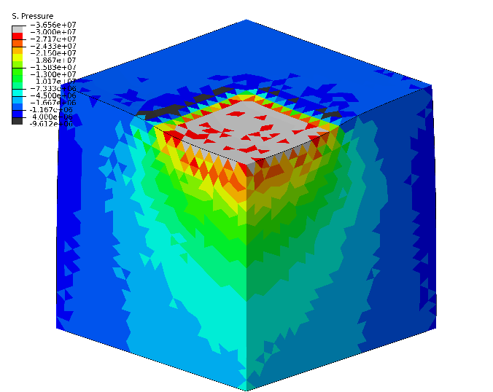
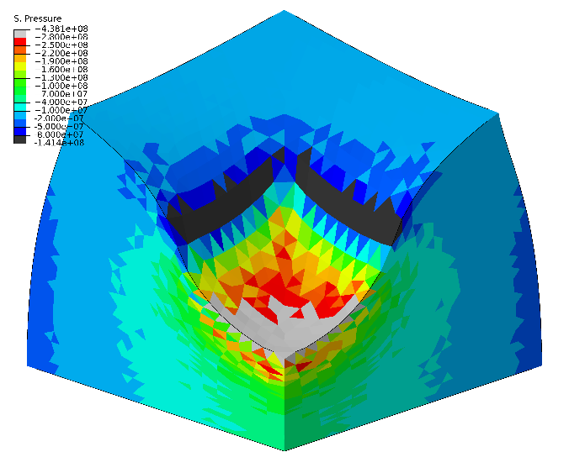
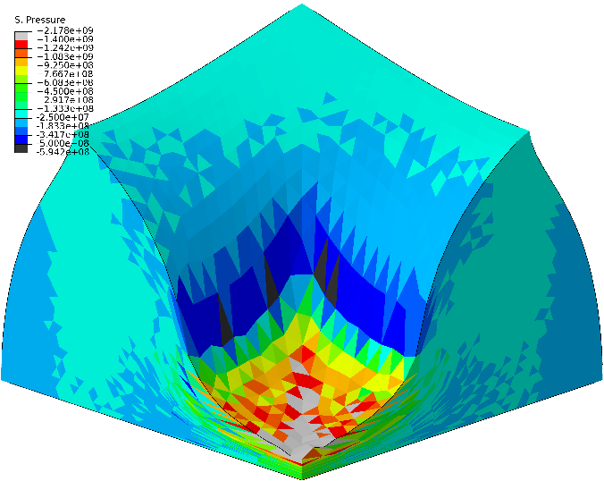
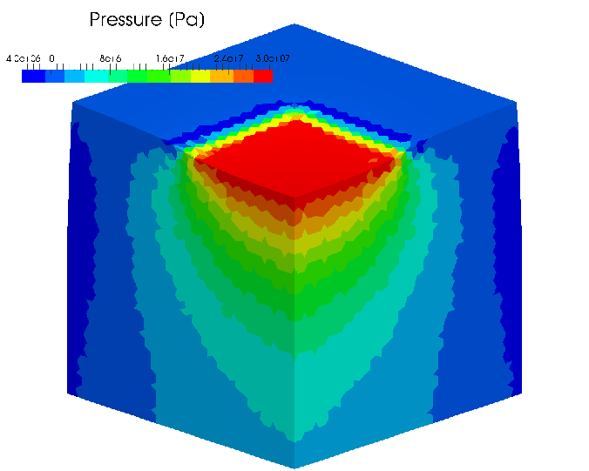
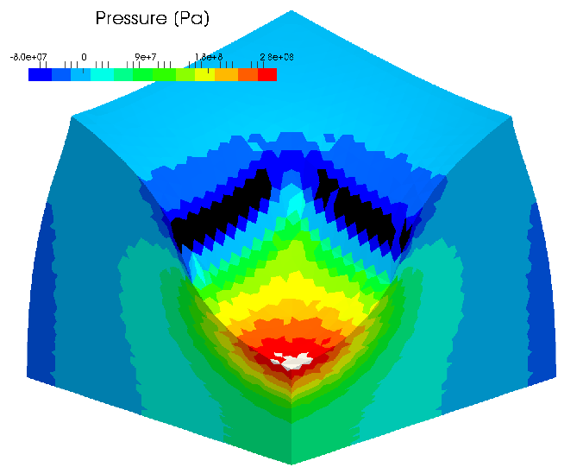
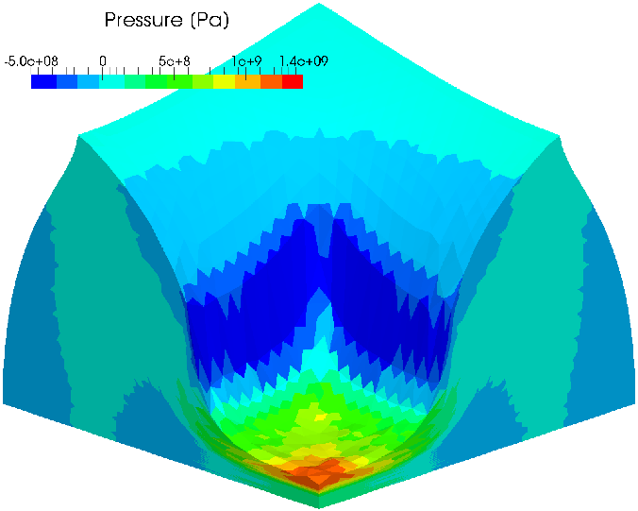
Compression of Rubber Block
Static
Implicit
Pressure dist.
Early stage Middle stage Later stage
ABAQUS
C3D4H
F-bar
ES-FEM-
T4(3)
Smooth pressure distributions are obtained.

Slide 21
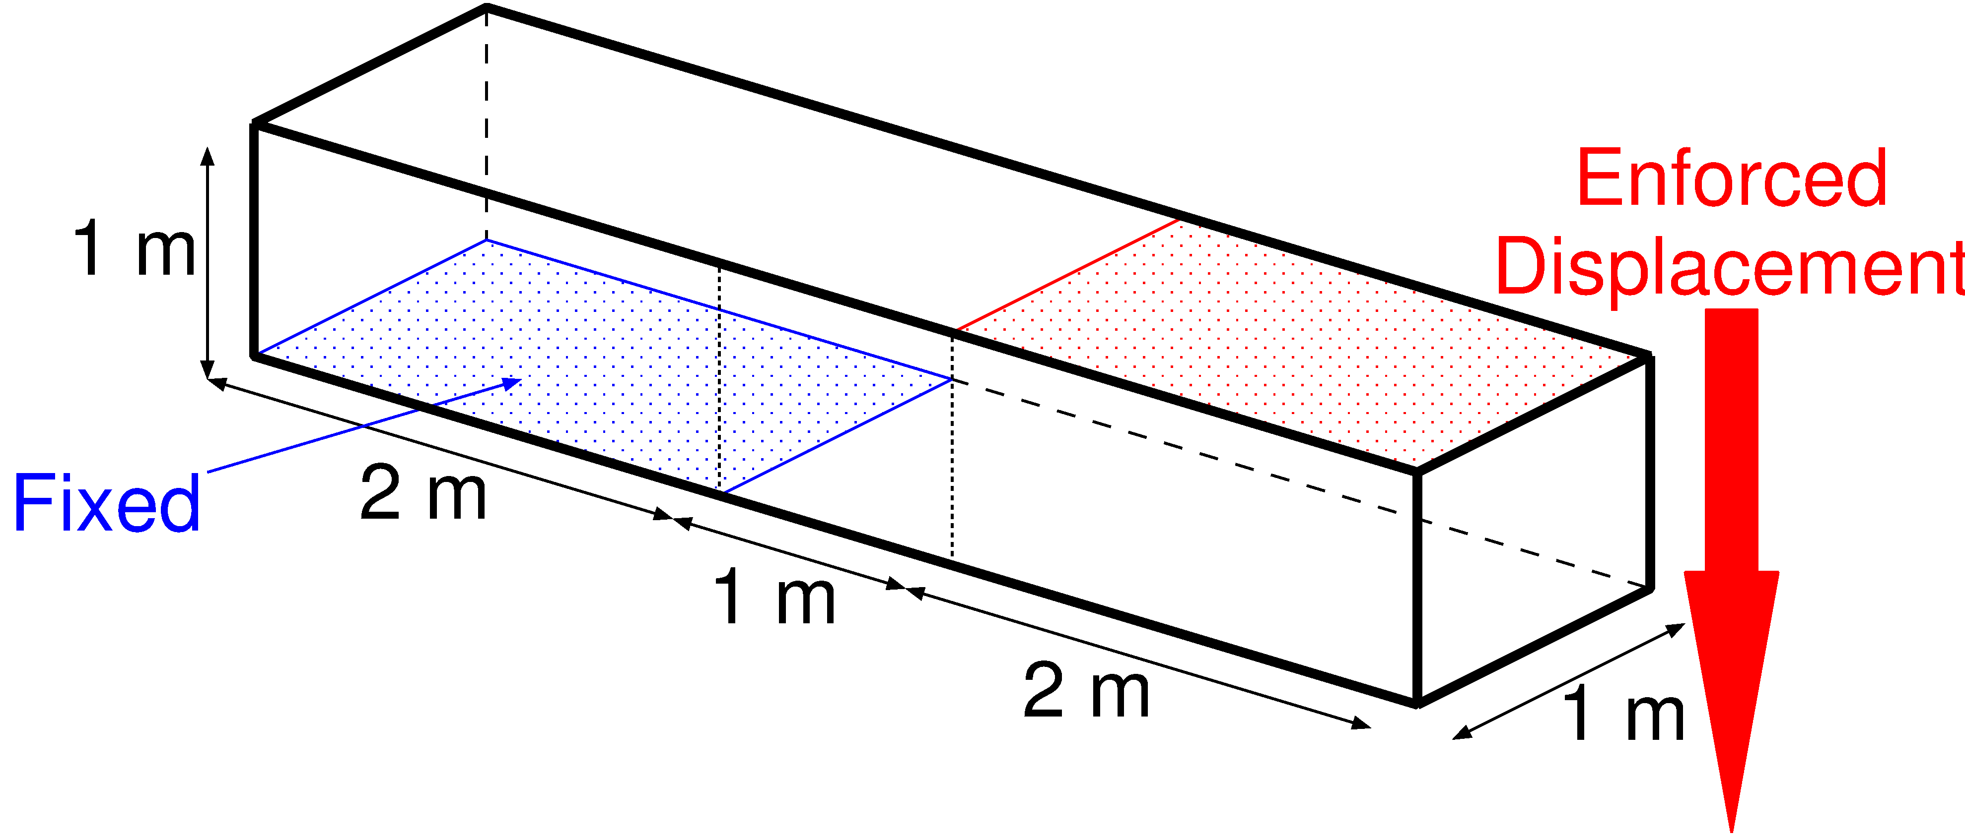
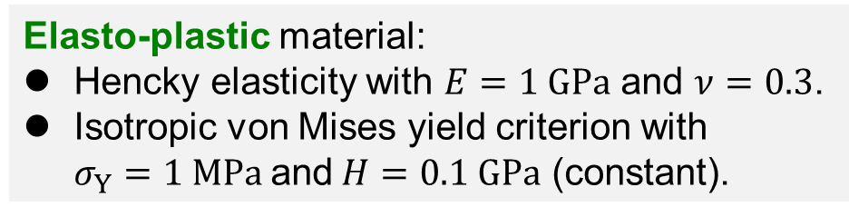
Shear-tensioning of Elasto-plastic Bar
Static
Implicit
Outline
Blue face is perfectly constrained.
Red face is constrained in plane and pressed down.
Compared to ABAQUS C3D4H with the same unstructured T4 mesh.
1.2 k nodes & 4.8 k elems.
Elasto-plastic material:
Hencky elasticity with $E=1 GPa$ and $ν=0.3$.
Isotropic von Mises yield criterion with
$σ_{Y}=1 MPa$and$H=0.1 GPa$ (constant).
P. 21

Slide 22
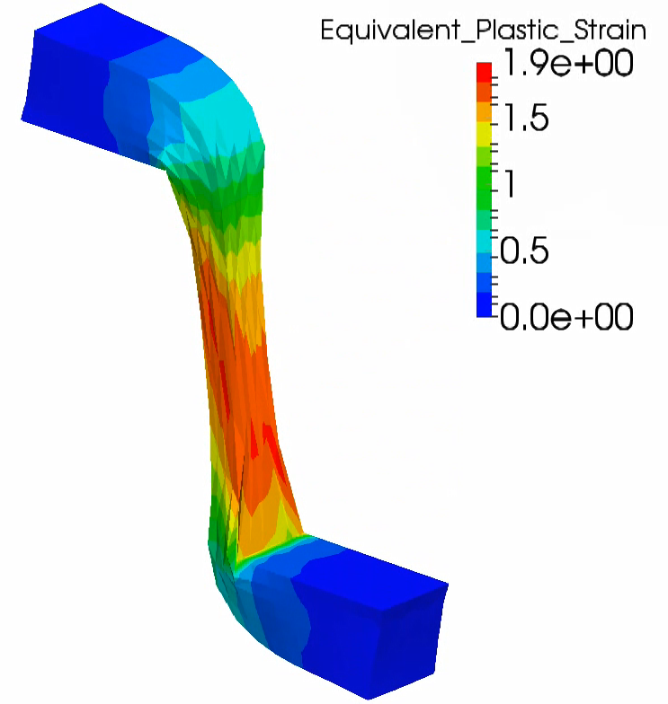
Shear-tensioning of Elasto-plastic Bar
Static
Implicit
Result of
F-bar
ES-FEM(2)
(Equiv.
plastic
strain)
Extreme large
deformation
with smooth
strain dist. is
successfully
achieved.

Slide 23
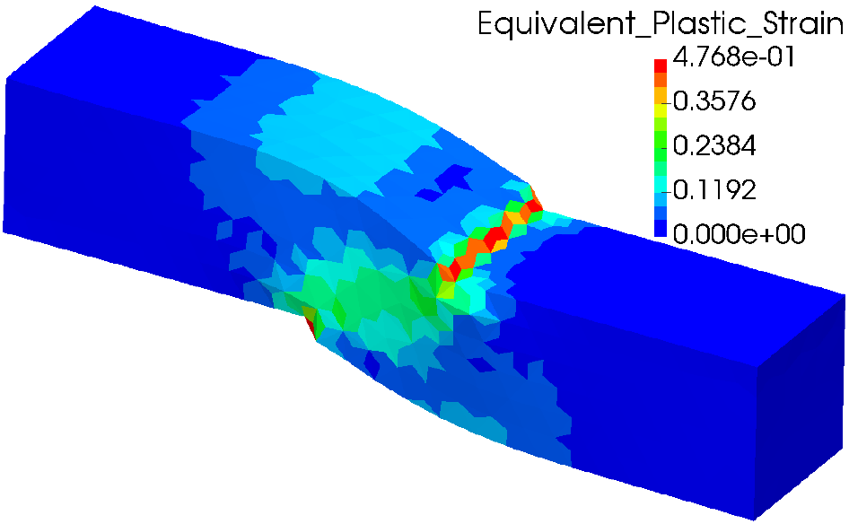
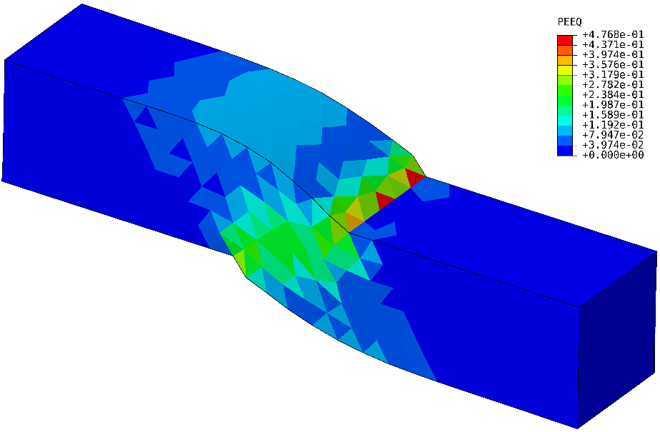
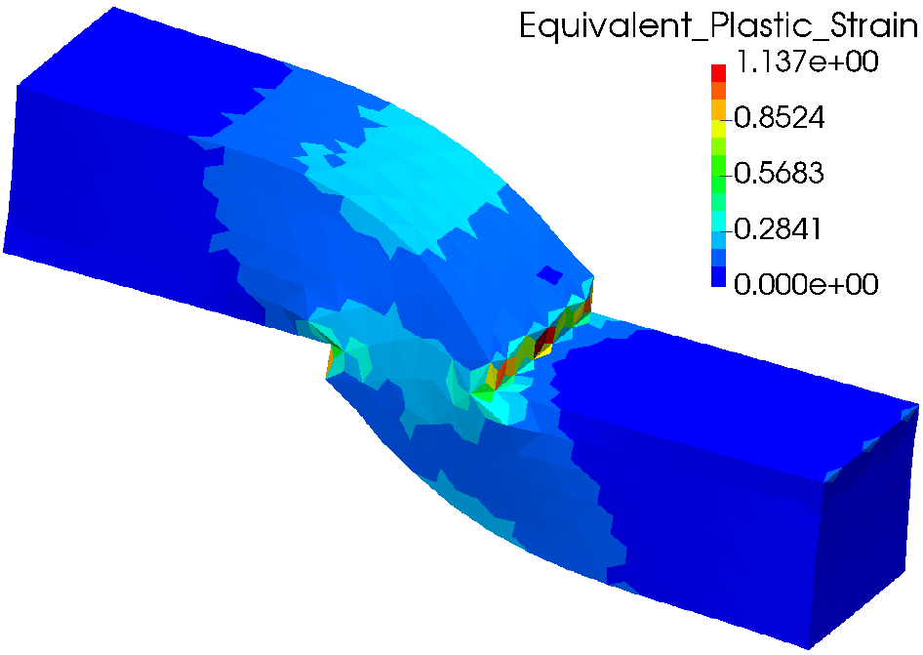
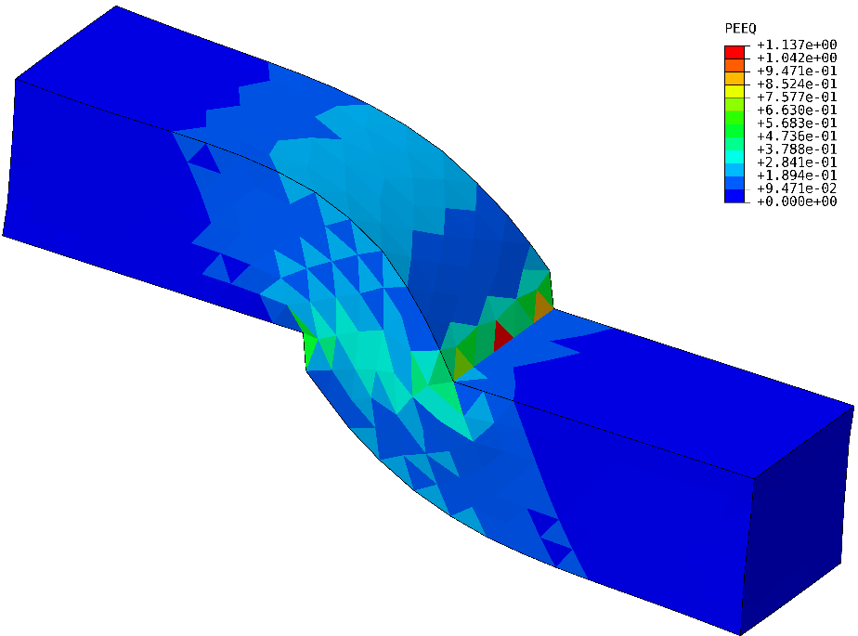


Shear-tensioning of Elasto-plastic Bar
Static
Implicit
Equivalent plastic strain dist. in middle states
$$u_{z}=0.5 m$$
Smooth distribution.
There is minor oscillation.
$$u_{z}=1.0 m$$
F-barES-FEM-T4(2)
ABAQUS C3D4H
P. 23

Slide 24
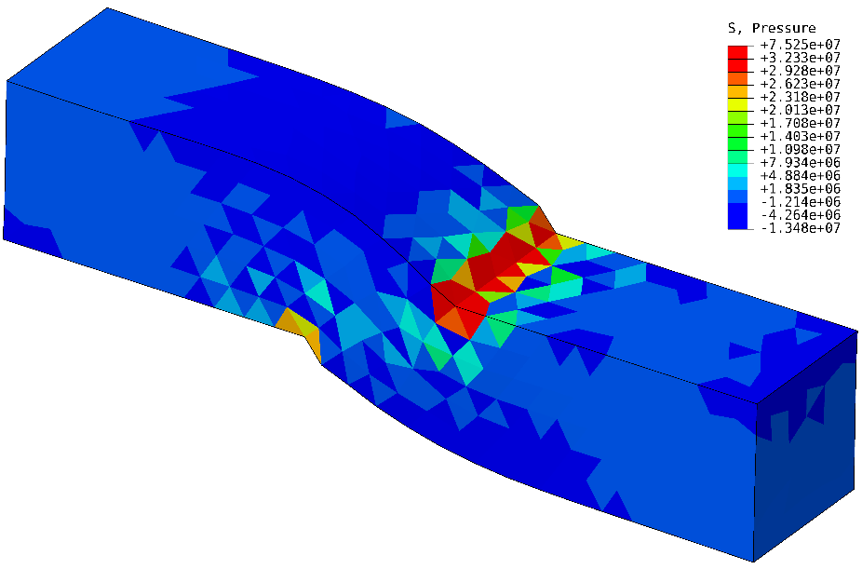
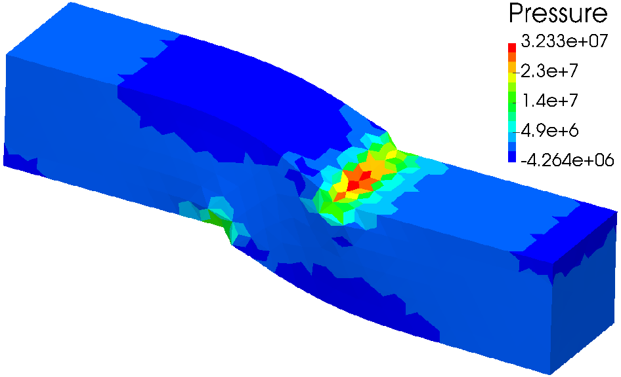
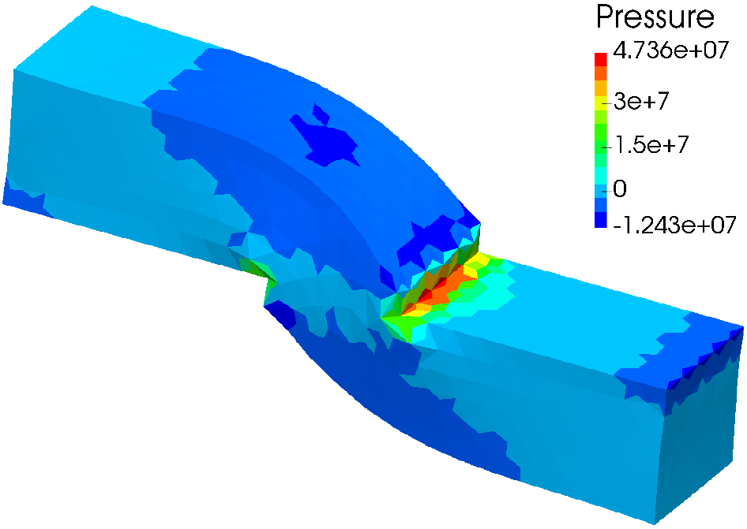
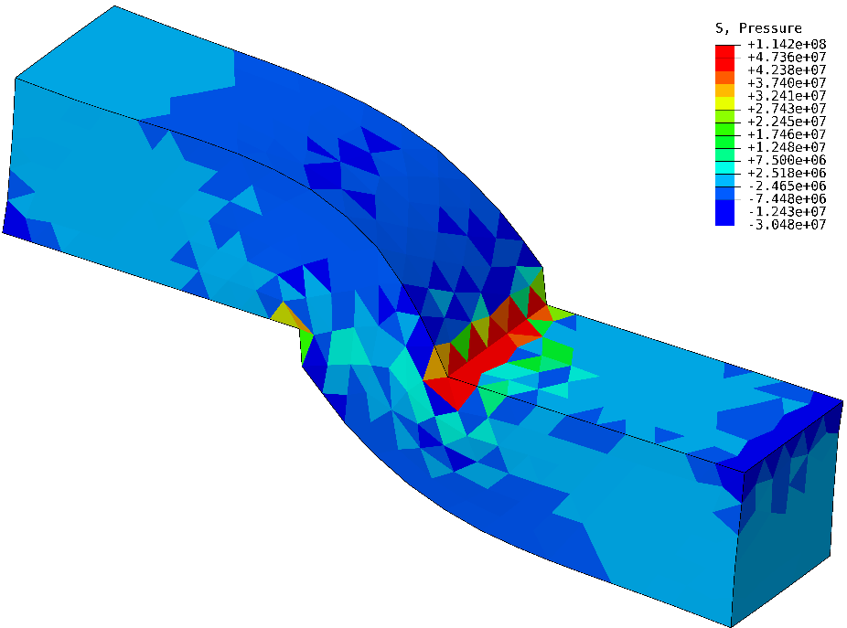


Shear-tensioning of Elasto-plastic Bar
Static
Implicit
Pressure dist. in middle states
$$u_{z}=0.5 m$$
Smooth distribution.
There is major oscillation.
$$u_{z}=1.0 m$$
F-barES-FEM-T4(2)
ABAQUS C3D4H
P. 24

Slide 25
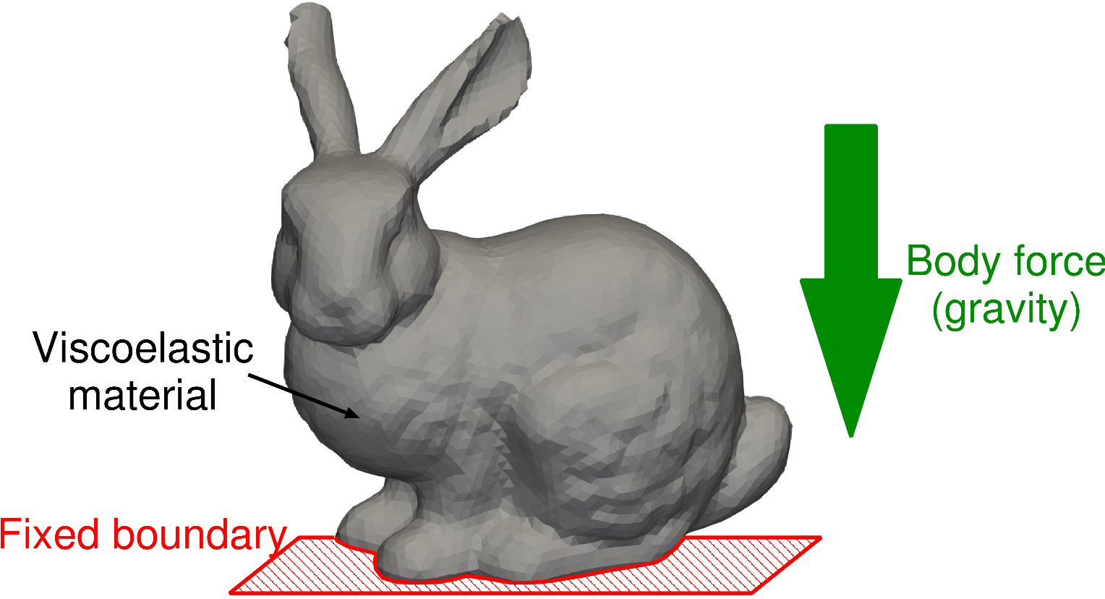

Collapse Analysis of Viscoelastic Bunny
Viscous
Implicit
Outline
Applying gravity to the Stanford Bunny and let it collapsed by its self-weight.
Soft viscoelastic material ${(ν}_{0}=0.3, ν_{∞}=0.49, τ=10 s)$.
Contact is NOT considered.
Comparing F-barES-FEM-T4(2) and ABAQUS C3D4H.
# of nodes: 24136
# of elems: 126231

Slide 26
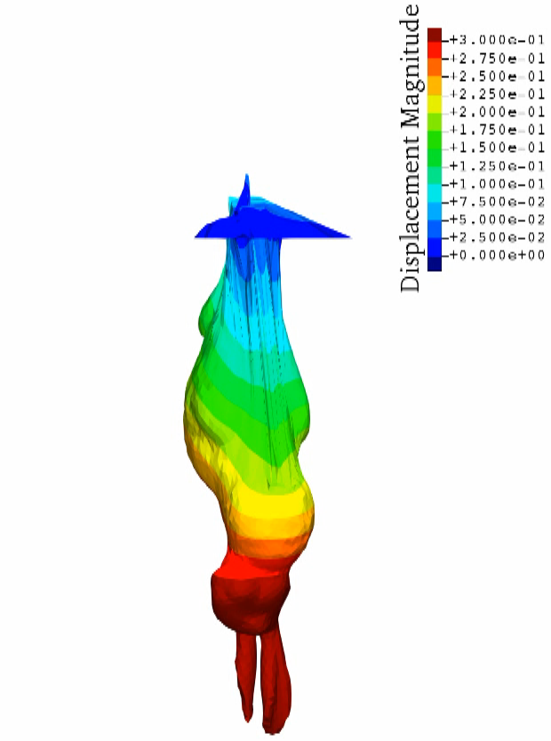
Viscous
Implicit
Animation
of
Deformation
Because contact
is not considered,
the body penetrates
the feet and
finally becomes
upside downside.
The analysis lasts
till the necking.

Slide 27
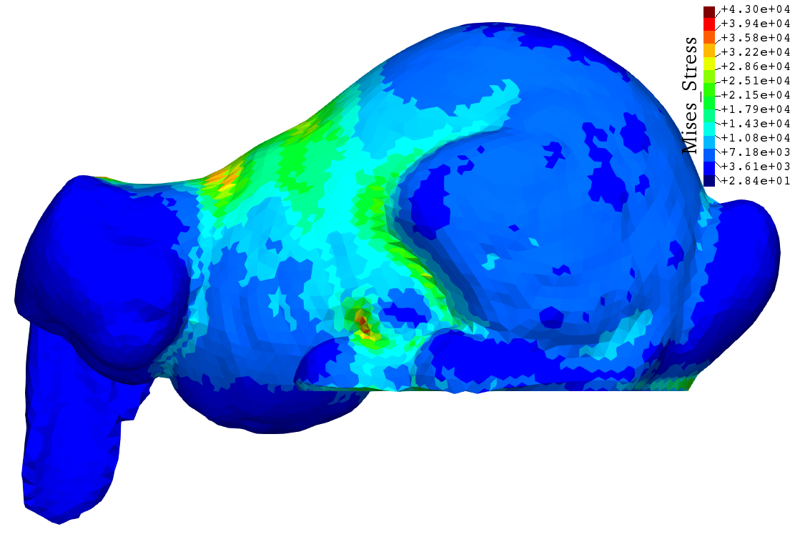
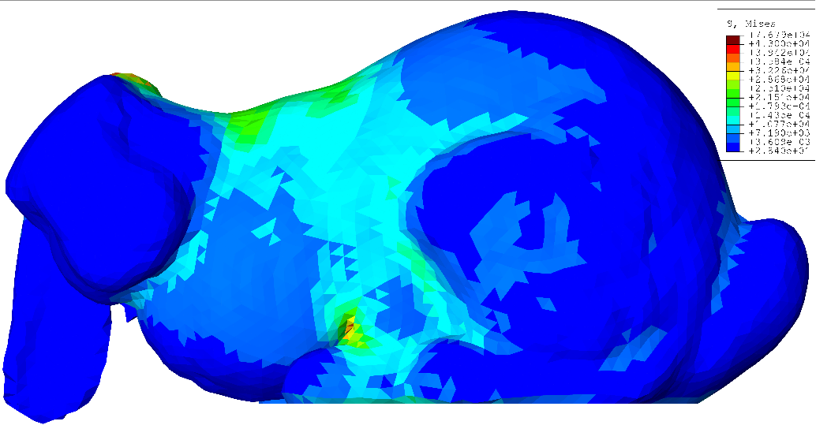
Collapse Analysis of Viscoelastic Bunny
Viscous
Implicit
Mises stress dist. when C3D4H get a convergence failure
ABAQUS C3D4H shows a stiffer result due to shear locking.
The result of F-barES-FEM-T4 would be better.
F-barES-FEM-T4(2)
ABAQUS C3D4H

Slide 28
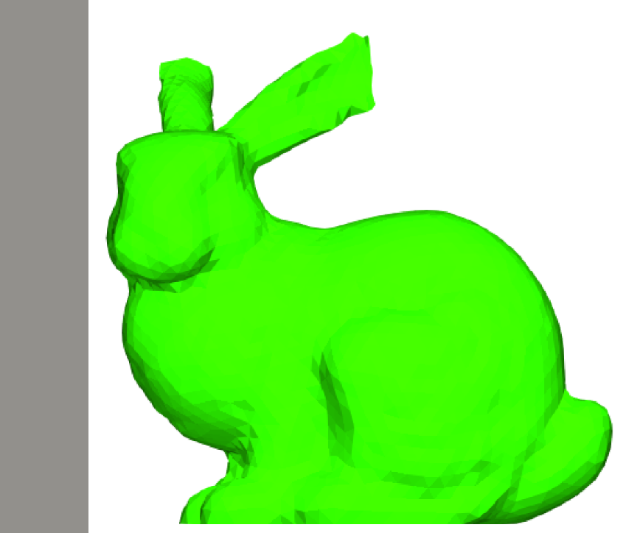
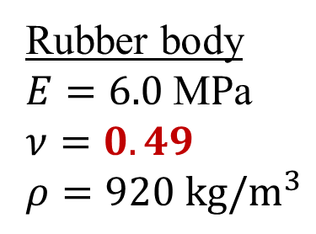
Impact of Rubber Bunny
Dynamic
Explicit
Outline
A bunny made of rubber (Neo-Hookean) is crushed to a rigid wall.
Compared with ABAQUS/Explicit C3D4 using a same T4 mesh.
Note that neither Hex mesh nor hybrid elements is not available in this problem.
Initial velocity
10 m/s
(uniform)
Rigid Wall
Contact condition
free-slip, free-separation
Rubber body
$E=6.0 \text{M}P\text{a}$
$ν=0.49$
$ρ=920 kg/m^{3}$

Slide 29
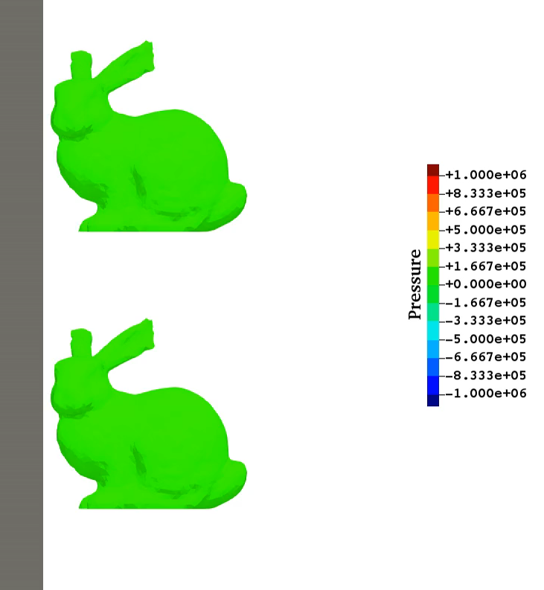
Impact of Rubber Bunny
Dynamic
Explicit
Animation of Pressure Dist.
ABAQUS/Explicit
C3D4
✗ Pressure
Checkerboarding
✗ Shear Locking
SymF-barES-
FEM-T4(1)
✓ Smooth pressure
✓ No Locking

Slide 30
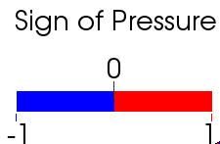
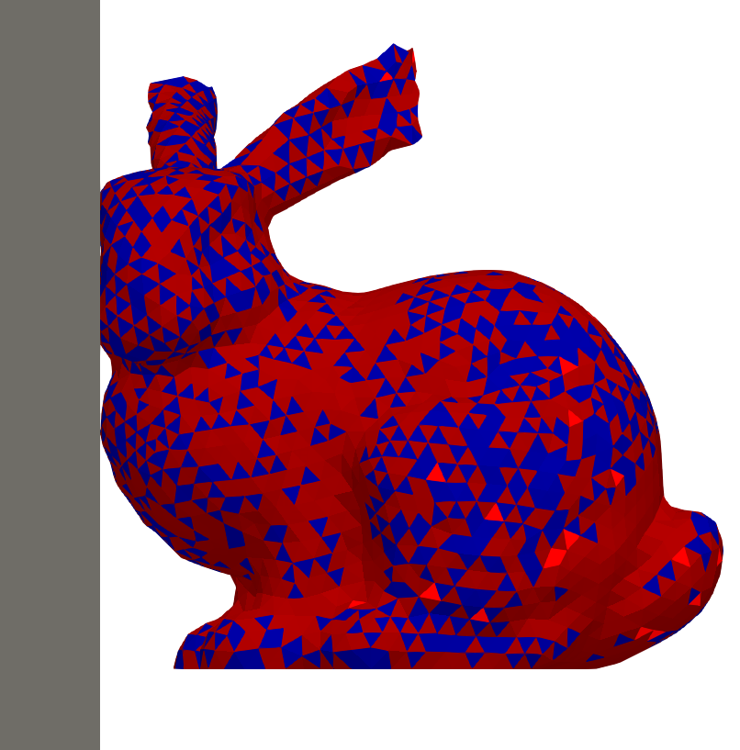

Impact of Rubber Bunny
Dynamic
Explicit
Sign of Pressure at Initial Phase
✗ Pressure
Checkerboarding
✔ Pressure Wave
ABAQUS/Explicit C3D4
(Standard T4 element)
SymF-barES-FEM-T4(1)
The proposed S-FEM captures the pressure wave
in a complex body successfully!!

Slide 31


Stretch of Filler-containing Rubber with Remesing
Static
Implicit
Several hard circular fillers are distributed in a square soft matrix rubber (neo-Hookean hyperelastic with $ν_{ini}=0.49$).
$E_{ini}$ of the filler is 100 times larger than $E_{ini}$ of the matrix.
Left side is constrained and right side is displaced.
Valid Mises stress dist. is obtained after many time remeshings.

Slide 32

Shear-tensioning of Elasto-plastic cylinder with Remeshing
Static
Implicit
Aluminium
cylinder subjected to
enforced disp..
Pure shear at
the initial stage, but stretch dominates at
the later stage.
Necking occurs in the end.
Final stretch at the
neck is more than
7000%.
Valid plastic strain dist. is obtained after many time remeshings.

Slide 33

Characteristics of F-barES-FEM-T4
No increase in DOF.
(No Lagrange multiplier. No static condensation.)
Locking- & checkerboarding-free with T4 mesh.
✗ Higher costs in memory and CPU time
due to wider bandwidth of $[K]$.
In case of standard unstructured T4 meshes:
Method | Approx. Bandwidth | Approx. Ratio
Standard FEM-T4 | 40 | 1
F-barES-FEM-T4(1) | 390 | x10
F-barES-FEM-T4(2) | 860 | x20
Another approach should be addressed
for full industrial applications.

Slide 34


Concept of SelectiveCS-FEM-T10
Our new another approach using T10 mesh.
Same memory & CPU costs as the T10 elements.
Details of SelectiveCS-FEM-T10 will be presented soon (10:40~) in the S-FEM MS at Room D today!!

Slide 35
Part 2:
Practical Progress of S-FEM
in Electrodeposition Process Simulation
of Auto Car Bodies

Slide 36

What is Electrodeposition (ED) ?
Most widely-used basecoat methods for car bodies.
Making coated film by applying direct electric current (up to 300 V) in a paint pool.
Relatively good at making uniform film thickness but not satisfactory uniform in actual production lines.
ED simulator is necessary for the optimization of carbody design and coating conditions in actual lines.
+
-
Paint
＋
Anode
＋
Cathode
http://n-link.nissan.co.jp/NOM/PLANT/
Notes:
What is electrodeposition.
Electrodeposition is the most widely-used ~~.
Coated film is made by applying direct electric current in a paint pool like this picture.
A carbody is cathode, while a paint pool is anode.
It is relatively good at making ~~.
So, ED simulator is necessary for ~~.

Slide 37



Photos of ED Process Line
1. dipping and deposition process
2. water rinse process
We focus on
this process.
3. baking process

Slide 38








What is ED Simulation ?
ED simulation calculates film thickness derived from surface
potential and current density with moving boundaries.
Film Thickness
$$30 μm$$
$$0 μm$$
Surface Potential
$$270 V$$
$$0 V$$
Surface Current Density
$$20 A/m^{2}$$
$$−20 A/m^{2}$$
Notes:
This is an example of ED simulation results.
ED simulation ~~.
You can see that the paint film starts to be deposited from the outside surface.

Slide 39

Issues in Meshing (1)
✗ It is difficult to discretize complex shapes
such as car bodies with hexahedral meshes.
→ We have to use tetrahedral meshes in ED simulation.
However…
✓
✗
Only surface mesh is shown.
Many holes exist on body plates
Accuracy of the standard FEM-T4 is insufficient
in complex shapes.
Notes:
There are some issues in meshing.
First of all, it is difficult to represent complex shape ~~.
So, we have to ~~.
However, the accuracy of ~~.

Slide 40
Issues in Meshing (2)
✗ 10-node tetrahedral (T10) mesh without kink generally
requires more large number of nodes than T4 mesh.
T4 T10 without kink
Carbody
Carbody
hole
hole
For the same shape representation, T10 mesh
without kink leads to massive increase in DOF.
Notes:
This slide explains the issues about T10 mesh without kink.
Let’s say this gray part represents the surface of a carbody,
and this white circle represents a hole on the carbody.
If we mesh this parts using T4 and T10 without kink respectively,
the meshes would be like this.
As you can see, for the same ~~.

Slide 41
Issues in Meshing (2 Cont.)
✗ 10-node tetrahedral (T10) mesh with kink causes
severe accuracy loss.
T4 T10 with kink
Carbody
Carbody
Kinked T10
hole
hole
T10 mesh with kink does not increase DOF
but induces severe accuracy loss.
Notes:
This slide explains the issues about T10 mesh with kink.
10-node tetrahedral ~~.
The meshes using T4 and T10 with kink respectively would be like this.
T10 mesh with kink ~~.

Slide 42
Motivation
Hexahedral elements:
✗ It is difficult to discretize complex shapes.
T10 elements without kink:
✗ It leads to massive increase in DOF.
T10 elements with kink:
✗ It causes severe accuracy loss.
→ We want to realize high accuracy analysis with T4 mesh.
ES-FEM-T4 could be a solution to these issues.
Notes:
We cannot use these elements in ED simulation as I explained.
So we want to realize high accuracy analysis with T4 mesh.
ES-FEM-T4 could be a solution to these issues.

Slide 43
Formulation of ES-FEM for ED Simulation
Notes:
Next, I would like to explain about the formulation of ES-FEM for ED Simulation.

Slide 44

Fundamental Equations
Governing equation
The electrostatic Laplace equation,
$∇^{2}φ=0$, in the paint pool domain.
Boundary conditions (BCs)
Insulation BC
Anodic (Electrode surface) BC
Cathodic (Carbody surface) BC
ED boundary models are identified with lab experiments.
+
-
＋
Paint
Anode
＋
Cathode
The role of ES-FEM is to solve the Laplace equation
for each timestep with the iterative solver (MINRES).
Notes:
This is the fundamental equations.
The governing equation is the electrostatic Laplace equation.
ES-FEM solves this equation.
There are three boundary conditions.
Insulation boundary condition, Anodic boundary condition and cathodic ~~.
Anode means the electrode surface and cathode means the carbody surface.
These are identified ~~.
In our ED Simulation, current density is determined using ~~.

Slide 45
Outline of ES-FEM
What is ES-FEM-T4?
A kind of strain smoothing method.
Using element edges as Gauss points.
Robust against element skew.
Super-linear mesh convergence rate with T4 mesh.
Standard FEM ES-FEM
assembles each element’s value.
assembles each edge’s value.
Integration domain
Element
Integration
domain is
different !!
Node
Notes:
This is the outline of ES-FEM.
ES-FEM is a kind of strain ~~.
It uses element ~~.
It is robust ~~.
And it has super-linear convergence rate with T4 mesh.
The difference between conventional fem and ES-FEM is the integration domain.
FEM sums up ~~, while ES-FEM ~~.

Slide 46
Analysis Results

Slide 47



4-Plate BOX Simulation
Outline
Imitating a bag-like structure such as side sill in a carbody.
Accuracy on the innermost surface (leftmost plate surface) is the most important; i.e., “maximize the minimum”.
Film thickness is calculated with 4 different mesh seed sizes
and compared between FEM-T4 and ES-FEM-T4.
Film Thickness
Side Sill
(http://plaza.rakuten.co.jp/heroc)
4-P BOX

Slide 48




4-Plate BOX Simulation
Overview
of
Meshes
Only the
surface meshes
are shown.
3.2 mm Mesh
Seed Size
(31k T4 elem.)
1.6 mm Mesh
Seed Size
(65k T4 elem.)
0.8 mm Mesh
Seed Size
(169k T4 elem.)
0.4 mm Mesh
Seed Size
(716k T4 elem.)

Slide 49

4-Plate BOX Simulation
Film Thickness of G-Plate (innermost surface)
Mesh seed size
FEM results (dashed lines) have large errors
due to mesh coarseness.
Meanwhile, ES-FEM (solid lines) results have no such errors.

Slide 50

4-Plate BOX Simulation
Error of Final Film Thickness on G-Plate
The result of ES-FEM with the minimum mesh seed size (0.4 mm) is used as the reference.
ES-FEM-T4 has far better mesh convergence rate than FEM-T4 !!

Slide 51

Carbody Simulation
Outline
A half carbody fixed in a box pool.
The side wall is treated as an anode surface.
Compare the time-developed film thickness between FEM-T4 and ES-FEM-T4 with a same mesh.
270 V
0 30 180 (s)

Slide 52

Carbody Simulation
Overview of Surface Mesh
13M T4 elements (3M nodes & 18M edges) in total in the pool.
Provided by
SUZUKI MOTOR Co.

Slide 53

Carbody Simulation
Animation
of
Film
Thickness
(Clipped
View on
Side Sill)
FEM-T4
As the
4-P BOX
case,
ES-FEM-T4
presents
thinner dist.
on the
side sill.
ES-FEM-T4
Big difference appears on the inner surfaces.

Slide 54
Comparison of Computational Costs
Calculation Time
on a PC with Intel i9-9960X using 10 cores
 | FEM-T4 | ES-FEM-T4
4-P BOX with 3.2 mm mesh | 0.02 h | 0.02 h
4-P BOX with 1.6 mm mesh | 0.04 h | 0.05 h
4-P BOX with 0.8 mm mesh | 0.45 h | 0.45 h
4-P BOX with 0.4 mm mesh | 9.5 h | 9.0 h
Carbody | 67 h | 125 h
Same
Accuracy
In case iterative solvers can be used,
there is no big difference in calculation time
although the accuracy of ES-FEM-T4 is much better.

Slide 55
Summary

Slide 56
Benefits and Drawbacks of S-FEMs
Benefits
  No increase in DOF.
  Purely displacement-based formulation.
  Locking- & checkerboarding-free with T4 mesh.
  No difficulty in severe strain or contact analysis.
  Super-linear mesh convergence rate.
  Suitable to for industrial problems with complex shape.
Drawbacks
✗ Larger memory consumption.
Wider matrix bandwidth as T10 element with T4 mesh.

Slide 57
Take-Home Messages
ES-FEM-T4 is already in practice as an accurate solver using T4 meshes to overcome the slow mesh convergence rate of the standard FEM-T4.
F-barES-FEM-T4 is the current best T4 FE formulation especially for the large deformation of rubber-like materials, viscoelastic materials, and elastoplastic materials.
Therefore, its practical use will be start shortly.
Details of SelectiveCS-FEM-T10 will be presented soon (10:40~) in the S-FEM MS at Room D today!!
Thank you for your kind attention!

Slide 58
Appendix

Slide 59


Natural Modes of ¼ Cylinder
Eigen
Mode
Outline
Iron part: $E_{ini}=200 GPa, ν_{ini}=0.3, ρ=7800 kg/m^{3}$,
Elastic, No cyclic smoothing.
Rubber part: $E_{ini}=6 MPa, ν_{ini}=0.499, ρ=920 kg/m^{3}$,
Elastic, 2 cycles of smoothing.
Compared to ABAQUS C3D4, C3D4H, and C3D8.
In Plane
Slide
Rubber Part
Fixed
In Plane
Slide
Iron Part

Slide 60

Natural Modes of ¼ Cylinder
Eigen
Mode
Eigen frequencies
C3D4 and C3D4H show higher frequencies (stiffer results).
F-barES-FEM-T4 and C3D8 are in good agreement.
1

Slide 61




Natural Modes of ¼ Cylinder
Eigen
Mode
1st eigen mode
ABAQUS C3D8
(reference)
Selective ES/NS-FEM-T4
F-barES-FEM-T4
NS-FEM-T4
The 1st modes are all the same as the reference solution.

Slide 62




Natural Modes of ¼ Cylinder
Eigen
Mode
11th eigen mode
ABAQUS C3D8
(reference)
Selective ES/NS-FEM-T4
F-barES-FEM-T4
NS-FEM-T4
NS-FEM-T4 shows strange results due to low-energy mode.
Selective ES/NS-FEM-T4 & F-barES-FEM-T4 are valid.

