Slide 1
SelectiveCS-FEM-T10 with Radial-type Mesh Subdivision
This is DAY2, Room B, Session 2B-2: “S-FEM”.
Yuki ONISHI Tokyo Institute of Technology, Japan
You can download this slide at http://nas.a.sc.e.titech.ac.jp/yonishi/slide/iccm2020-sfem-t10.pptx

Slide 2
What is S-FEM?
Smoothed finite element method (S-FEM) is a relatively new FE formulation proposed by Prof. G. R. Liu in 2006.
S-FEM is one of the strain smoothing techniques.
There are several types of classical S-FEMs depending on the domains of strain smoothing.
For example in a 2D triangular mesh:
Edge-based S-FEM (ES-FEM)
Node-based S-FEM (NS-FEM)
Standard FEM

Slide 3
What are the major pros of S-FEM?
Even when we use 4-node tetrahedral mesh:
Super-linear mesh convergence rate. (Almost same rate as the 2nd-order element.)
Shear locking free with ES-FEM. (Excellent with tetrahedral mesh.)
Little accuracy loss in skewed meshes. (No problem with complex geometry.)
S-FEM is a powerful method suitable for practical industrial applications.

Slide 4
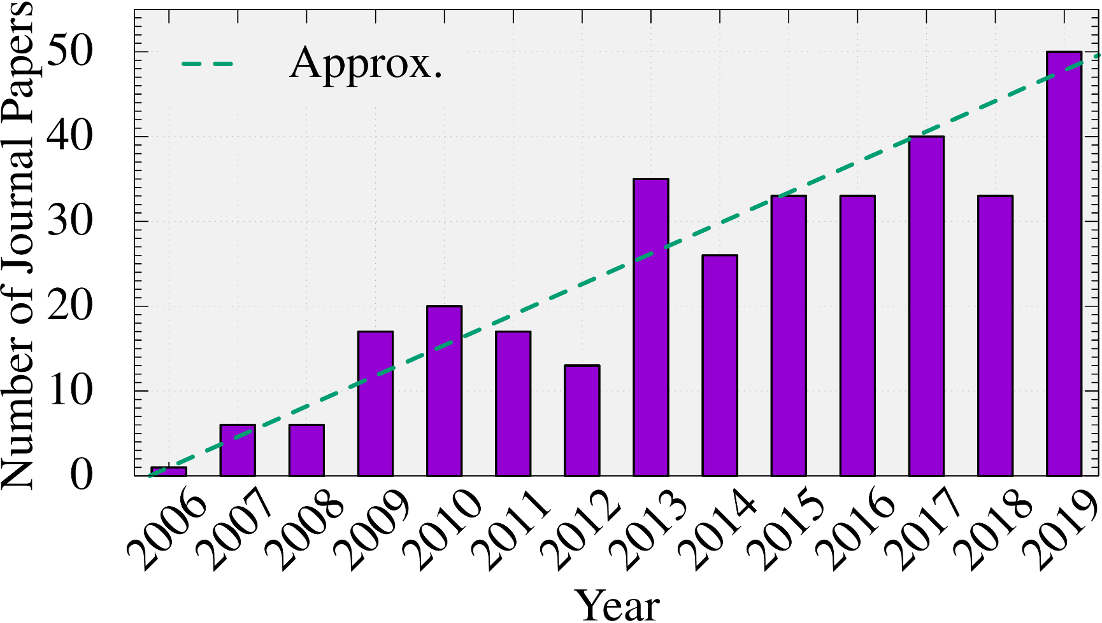
How popular is S-FEM?
Number of journal papers whose title contains “smoothed finite element”:
(inquired at Google Scholar)
The attraction of S-FEM is expanding continuously.

Slide 5
Applications of S-FEMs in Our Lab
Solid mechanics (still in lab stage)
Static Implicit Dynamic Explicit Viscous Implicit
Electrostatic
(already in practice)
Electro Deposition

Slide 6
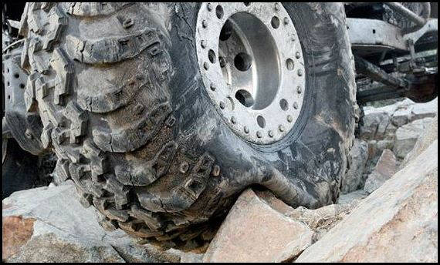
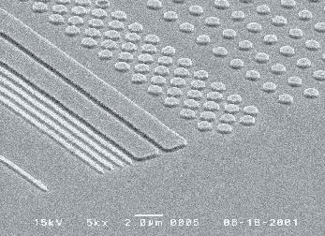
Motivation
What we want to do in actuality:
Solve hyper large deformation analyses accurately and robustly.
Treat complex geometries with tetrahedral meshes.
Consider nearly incompressible materials $(ν≃0.5)$.
Support contact problems.
Handle auto re-meshing.
Rubber
Metal
Plastic/Glass

Slide 7
Issues
2nd or higher order elements: ✗ Volumetric locking. Accuracy loss in large strain.
B-bar/F-bar method, Selective reduced integration (SRI): ✗ Not applicable to tetrahedral element directly.
F-bar-Patch method: ✗ Difficulty in building good-quality patches.
u/p mixed (hybrid) method (ABAQUS C3D10MH etc.): ✗ Early convergence failure. Accuracy loss in large strain.
F-bar aided ES-FEM-T4 [Y.Onishi, IJNME, 109 (2017)] : ✓ Accurate & robust ✗ Hard to implement in FEM codes.
SelectiveCS-FEM-T10 [Y.Onishi, IJCM, 17 (2020)] : ✓ Accurate, robust & easy to implement. ✗ Not yet optimal.
Conventional tetrahedral (T4/T10) FE formulations still have issues in accuracy and/or robustness especially in nearly incompressible cases.

Slide 8
Objective
To find an optimal formulation of SelectiveCS-FEM-T10 for severe large deformation analyses.
Table of Body Contents
Quick Review of Issues in Conventional Methods
Formulation of New SelectiveCS-FEM-T10
Demonstrations of New SelectiveCS-FEM-T10
Summary

Slide 9
Quick Review of Issues in Conventional Methods

Slide 10
Issues in Barreling Analysis of Rubber Cylinder
Neo-Hookean hyperelastic body with $ν_{ini}=0.49$
Pressure
Pressure
# of Nodes is almost the same.
1st order hybrid T4 (C3D4H)
✓ No volumetric locking
✗ Pressure checkerboarding
✗ Shear & corner locking
2nd order modified hybrid T10 (C3D10MH)
✓ No shear/volumetric locking ✗ Early convergence failure
✗ Low interpolation accuracy

Slide 11
Issues in Barreling Analysis of Rubber Cylinder
Neo-Hookean hyperelastic body with $ν_{ini}=0.49$
Pressure
Although F-barES-FEM-T4 is accurate and robust,
it cosumes larger memory & CPU costs.
it cannot be implemented in general-purpose FE software due to the adoption of ES-FEM.
Same mesh as C3D4H case.
F-barES-FEM-T4 ✓ No shear/volumetric locking
✓ No corner locking ✓ No pressure checkerboarding
✓ No increase in DOF
Another approach adopting CS-FEM with T10 element would be effective.
Y. Onishi, IJMNE, Vol. 109 (2017).

Slide 12
Issues in Barreling Analysis of Rubber Cylinder
Neo-Hookean hyperelastic body with $ν_{ini}=0.49$
As other S-FEMs, SelectiveCS-FEM-T10 has many varieties in the formulation.
The conventional method was not an optimal formulation yet.
Same mesh as C3D10MH case.
SelectiveCS-FEM-T10 (Conventional Ver.)
✓ No shar/voluemetric locking
✓ Little corner locking ✓ Little pressure checkerboarding ✓ Same cost & userbility as T10 elements.
This study proposes New Selective CS-FEM-T10.
Y. Onishi, IJCM, Vol. 17 (2020).

Slide 13
Formulation of New SelectiveCS-FEM-T10

Slide 14
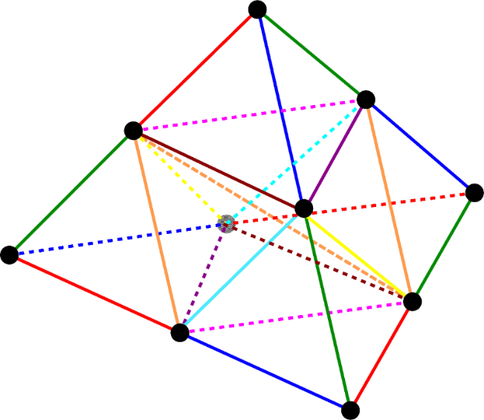
Concepts of SelectiveCS-FEM-T10
Using T10 element and subdivide it into T4 sub-elements. $⟹$ Overcomes the weak points of intermediate nodes.
Adopting CS-FEM having no strain smoothing across multiple elements. $⟹$ Becomes an independent element of existing FE codes.
Applying selective reduced integration (SRI). $⟹$ Overcomes volumetric locking.

Slide 15
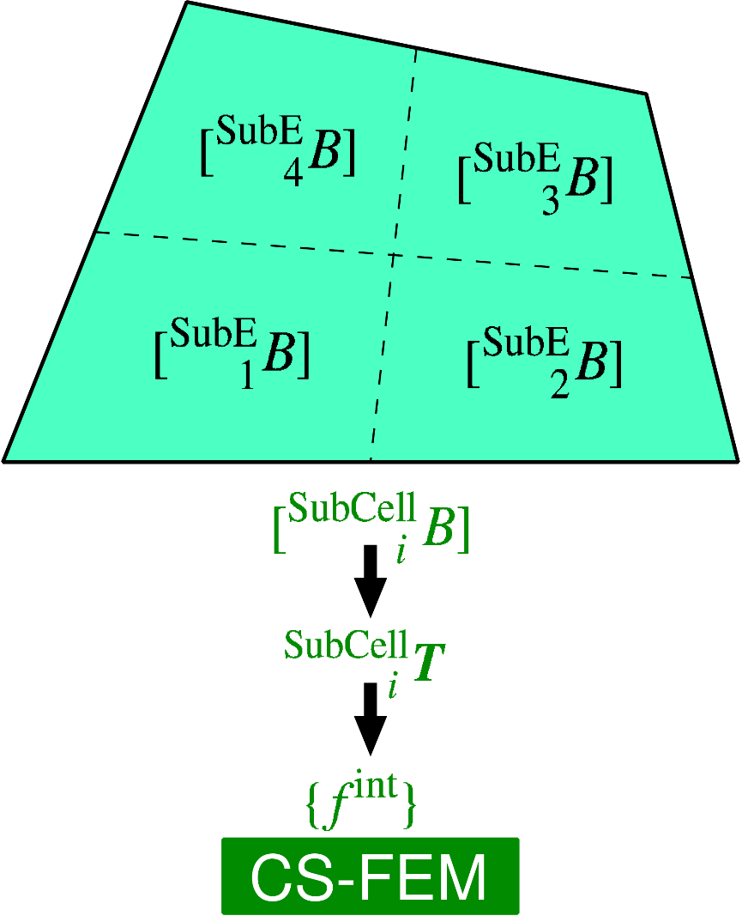
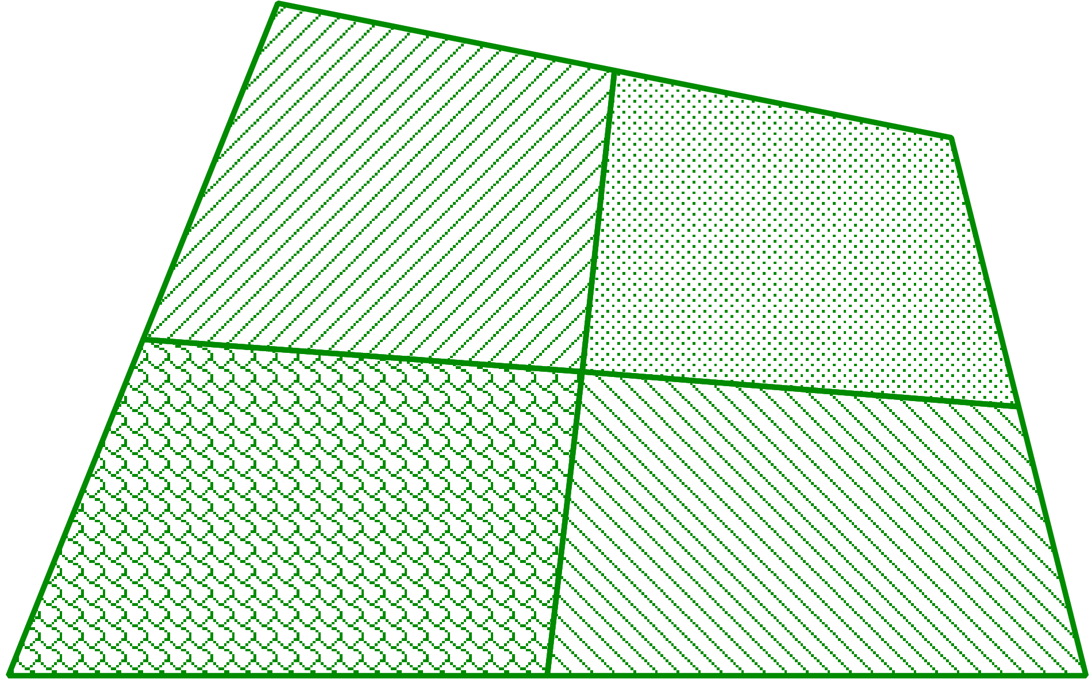
Brief of Cell-based S-FEM (CS-FEM)
Subdivide each element into some sub-element.
Calculate $[ ^{SubE}B]$ at each sub-element.
Calculate $F, T, \left\{f^{int}\right\}$ etc. in each sub-element.
As if putting an integration point on each sub-element
The biggest advantage of CS-FEM is its portability to existing FE codes.

Slide 16
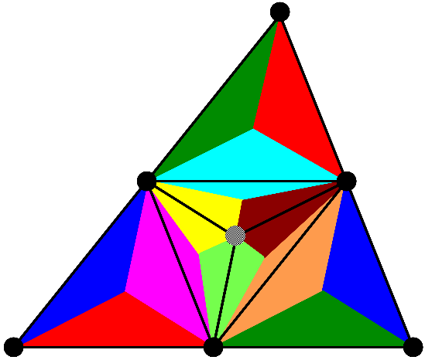
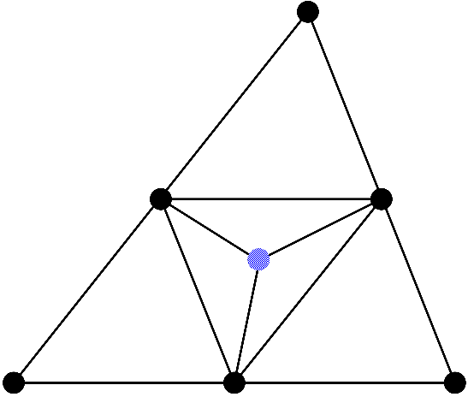
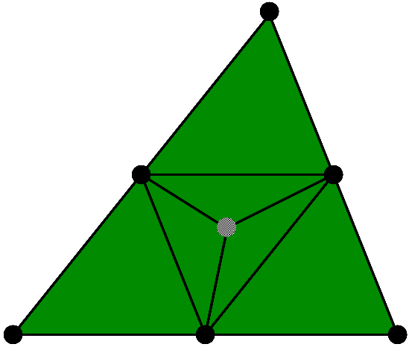
Flowchart of New SelectiveCS-FEM-T10
Explanation in 2D (6-node triangular element) for simplicity
(2) Dev. strain smoothing at edges
ES-FEM
SRI
(4) $\left\{f^{int}\right\} and [K]$
Overall mean
(1) Subdivision into sub-elements with a dummy node
In case of 3D, there are varieties in mesh subdivision.
(3) Vol. strain smoothing with all sub-elements

Slide 17
Mesh Subdivision Types in 3D
Conventional subdivision (30% shrunk mesh)
Each frame edge is owned by only one sub-element.
There are 12 sub-elements in total.
Strain on frame edges are NOT smoothed by ES-FEM.

Slide 18
Mesh Subdivision Types in 3D
New Radial-type subdivision (30% shrunk mesh)
Each frame edge is owned by two sub-elements.
There are 16 sub-elements in total.
Strain on all edges are smoothed by ES-FEM.
Sub-elements have a little larger skewness.

Slide 19
Mesh Subdivision Types in 3D
Future extension: Radial-type for polyhedral mesh
Each frame edge is owned by two sub-elements.
There are 60 sub-elements in total.
It should be useful for mixture meshing such as ANSYS Mosaic Meshing.

Slide 20
Demonstration of New SelectiveCS-FEM-T10

Slide 21
Bending of Hyperelastic Cantilever
Static Implicit
Outline
Neo-Hookean hyperelastic material
Initial Poisson’s ratio: $ν_{0}=0.49$
Compared to ABAQUS C3D10MH (modified hybrid T10 element) with the same mesh.
Dead Load

Slide 22
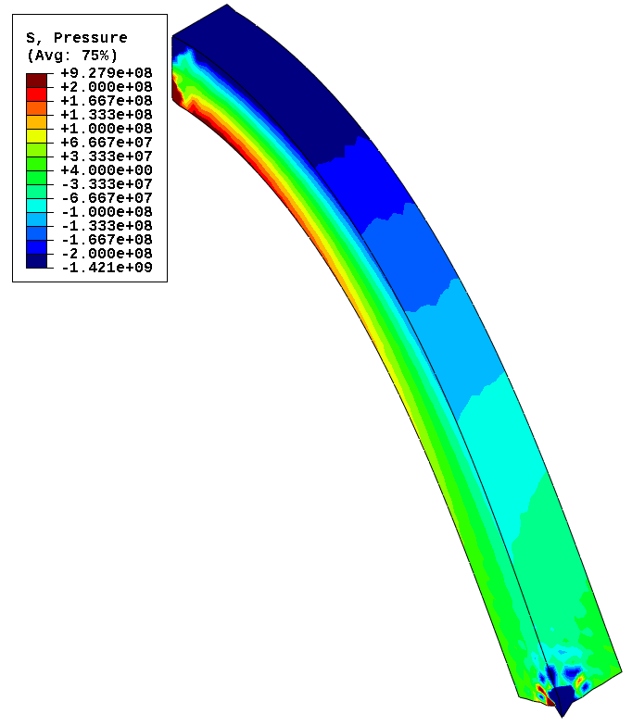
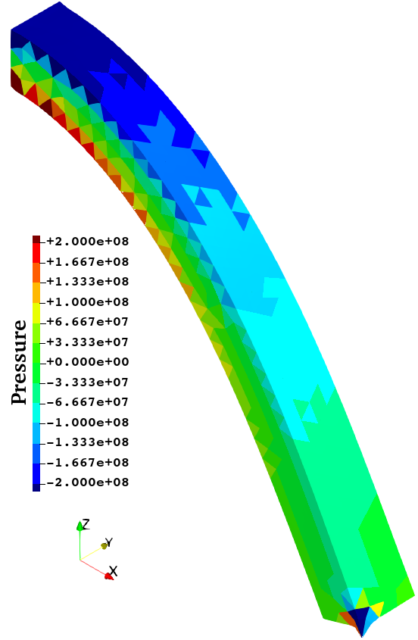
Bending of Hyperelastic Cantilever
Static Implicit
Comparison of the pressure dist. at the final state
ABAQUS C3D10MH
New Selective CS-FEM-T10
Almost the same pressure distributions with no checkerboarding. (No locking of course.)

Slide 23
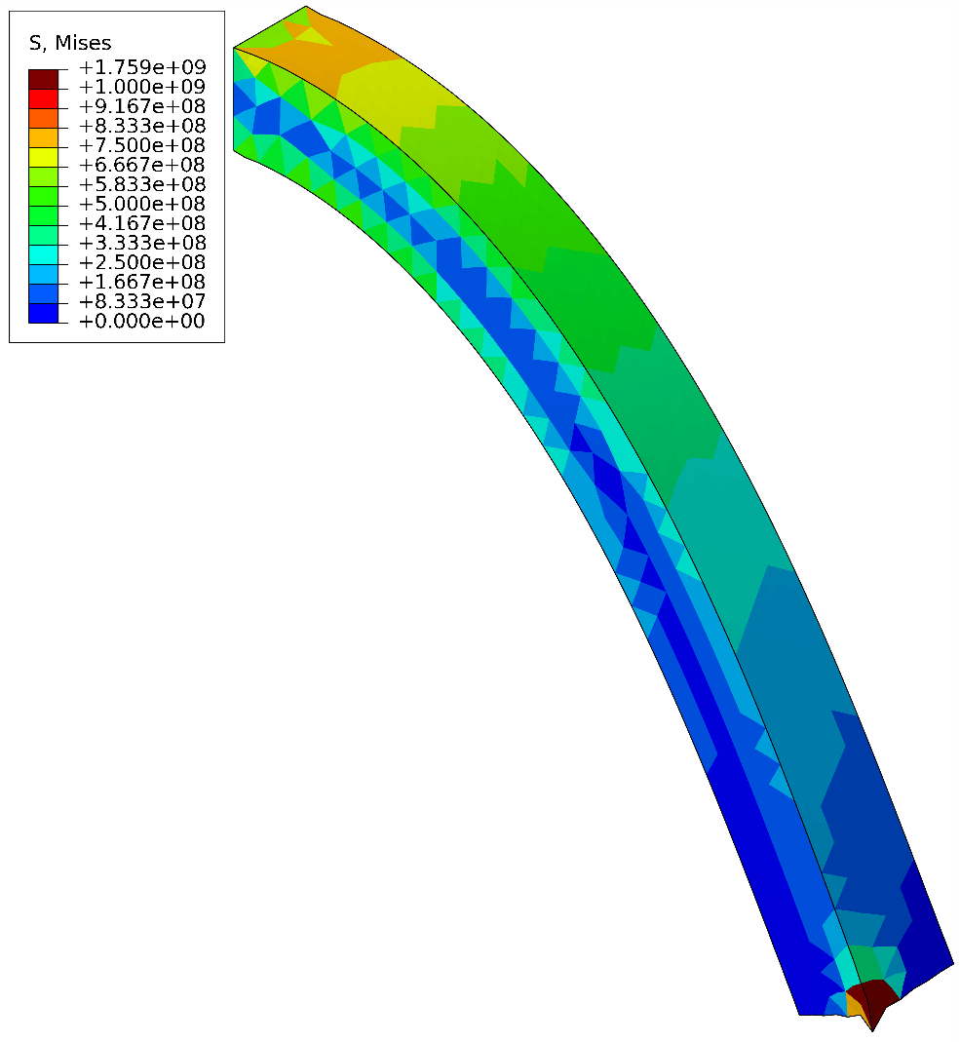
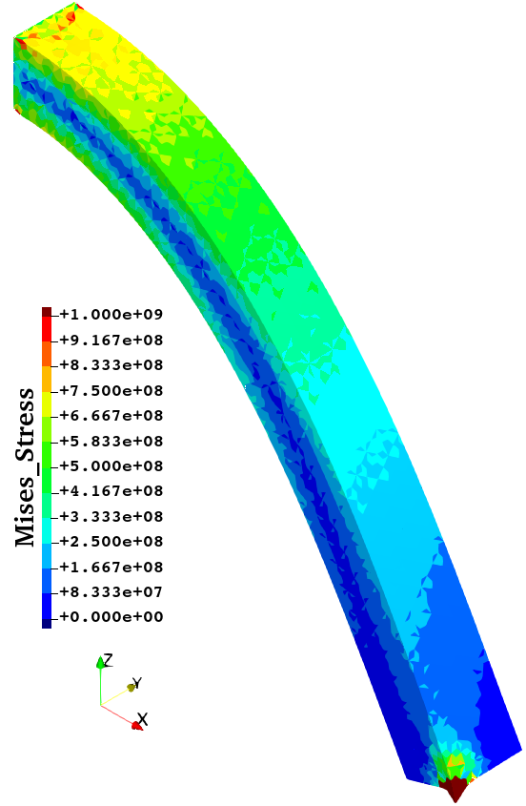
Bending of Hyperelastic Cantilever
Static Implicit
Comparison of the Mises stress dist. at the final state
ABAQUS C3D10MH
New Selective CS-FEM-T10
ABAQUS C3D10MH
Almost the same Mises stress distributions.

Slide 24
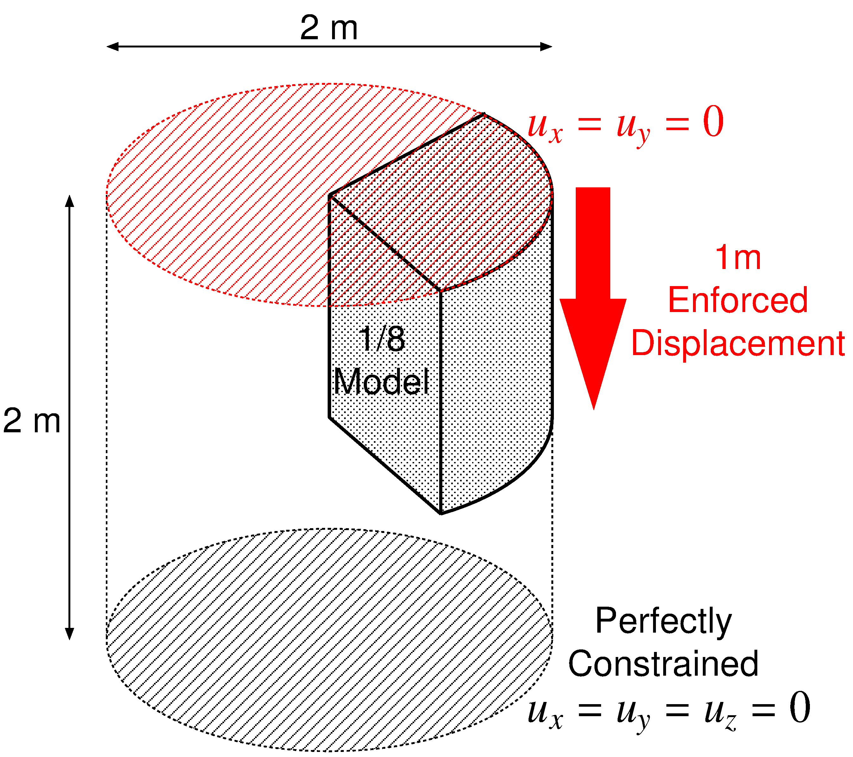
Barreling of Hyperelastic Cylinder
Static Implicit
Outline
Enforce axial displacement on the top face.
Neo-Hookean body with $ν_{ini}=0.49$．
Compare results with ABAQUS T10 hybrid elements (C3D10H, C3D10MH, C3D10HS) using the same mesh.

Slide 25
Barreling of Hyperelastic Cylinder
Static Implicit
Animation of Mises stress (ABAQUS C3D10MH)
Convergence failure at 24% compression
Unnaturally oscillating distributions are obtained around the rim.

Slide 26
Barreling of Hyperelastic Cylinder
Static Implicit
Animation of Mises stress (New Selective CS-FEM-T10)
Smooth distributions
are obtained except around the rim.
Convergence failure at 47% compression
The present element is more long-lasting (robust) than ABAQUS C3D10MH

Slide 27
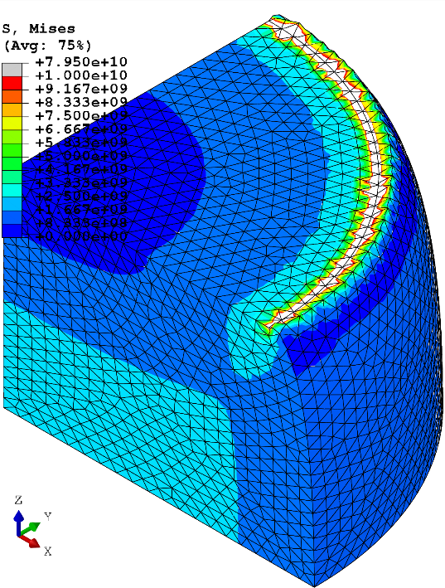
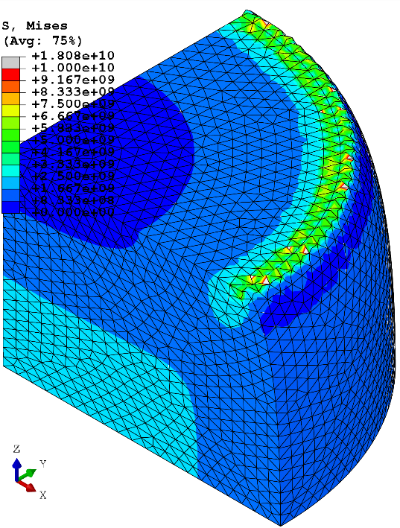
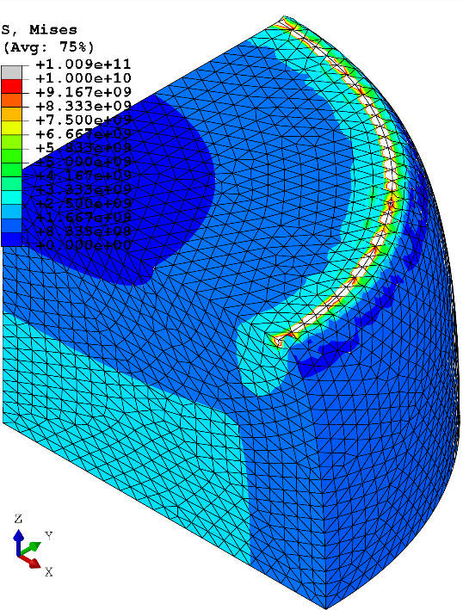
Barreling of Hyperelastic Cylinder
Static Implicit
Comparison of Mises stress at 24% comp.
New Selective CS-FEM-T10
ABAQUS C3D10H
ABAQUS C3D10MH
ABAQUS C3D10HS
All results are similar to each other except around the rim having stress singularity.

Slide 28
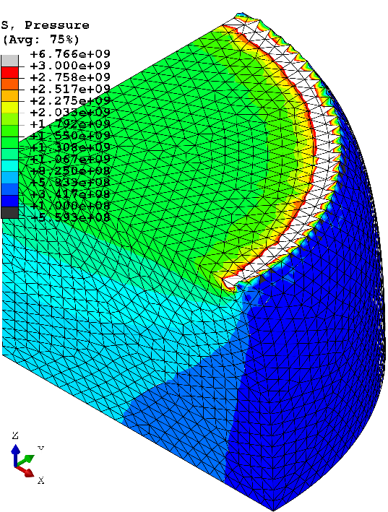
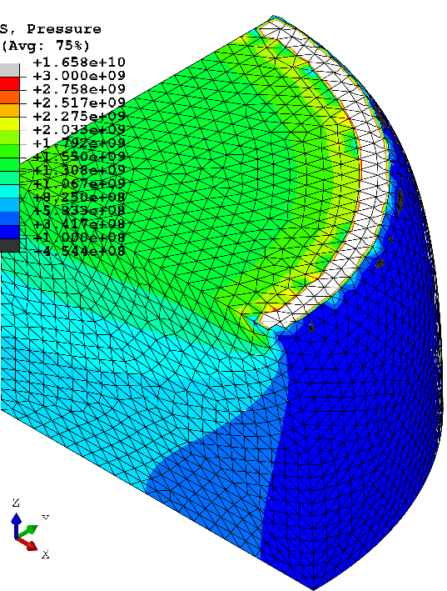
Barreling of Hyperelastic Cylinder
Static Implicit
Comparison of pressure at 24% comp.
New Selective CS-FEM-T10
ABAQUS C3D10H
ABAQUS C3D10MH
ABAQUS C3D10HS
All results are similar to each other except around the rim having stress singularity.

Slide 29
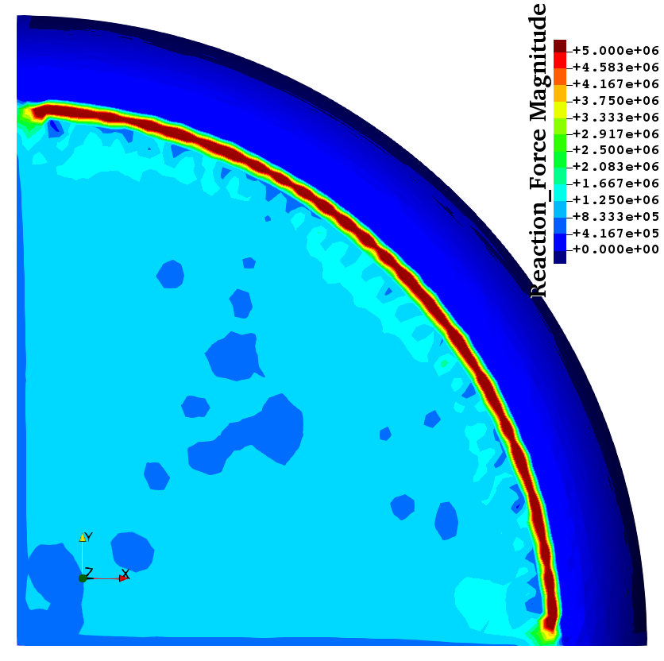
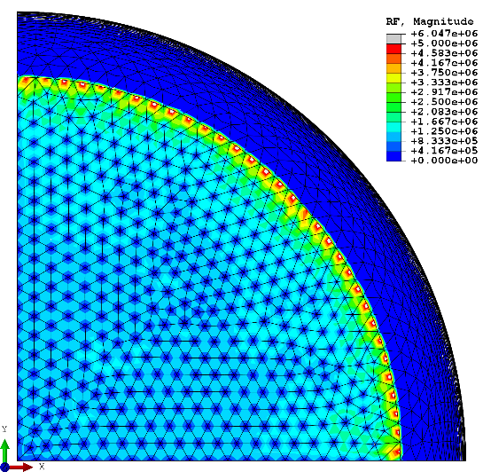
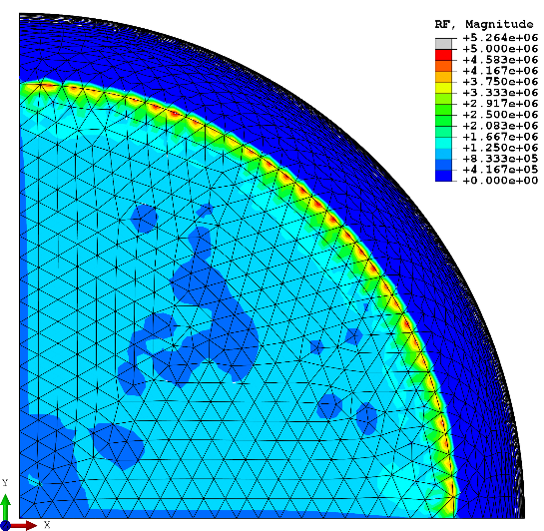
Barreling of Hyperelastic Cylinder
Static Implicit
Comparison of nodal reaction force at 24% comp.
New Selective CS-FEM-T10
ABAQUS C3D10H
ABAQUS C3D10MH
ABAQUS C3D10HS
ABAQUS C3D10H and C3D10HS suffer from nodal force oscillation.

Slide 30
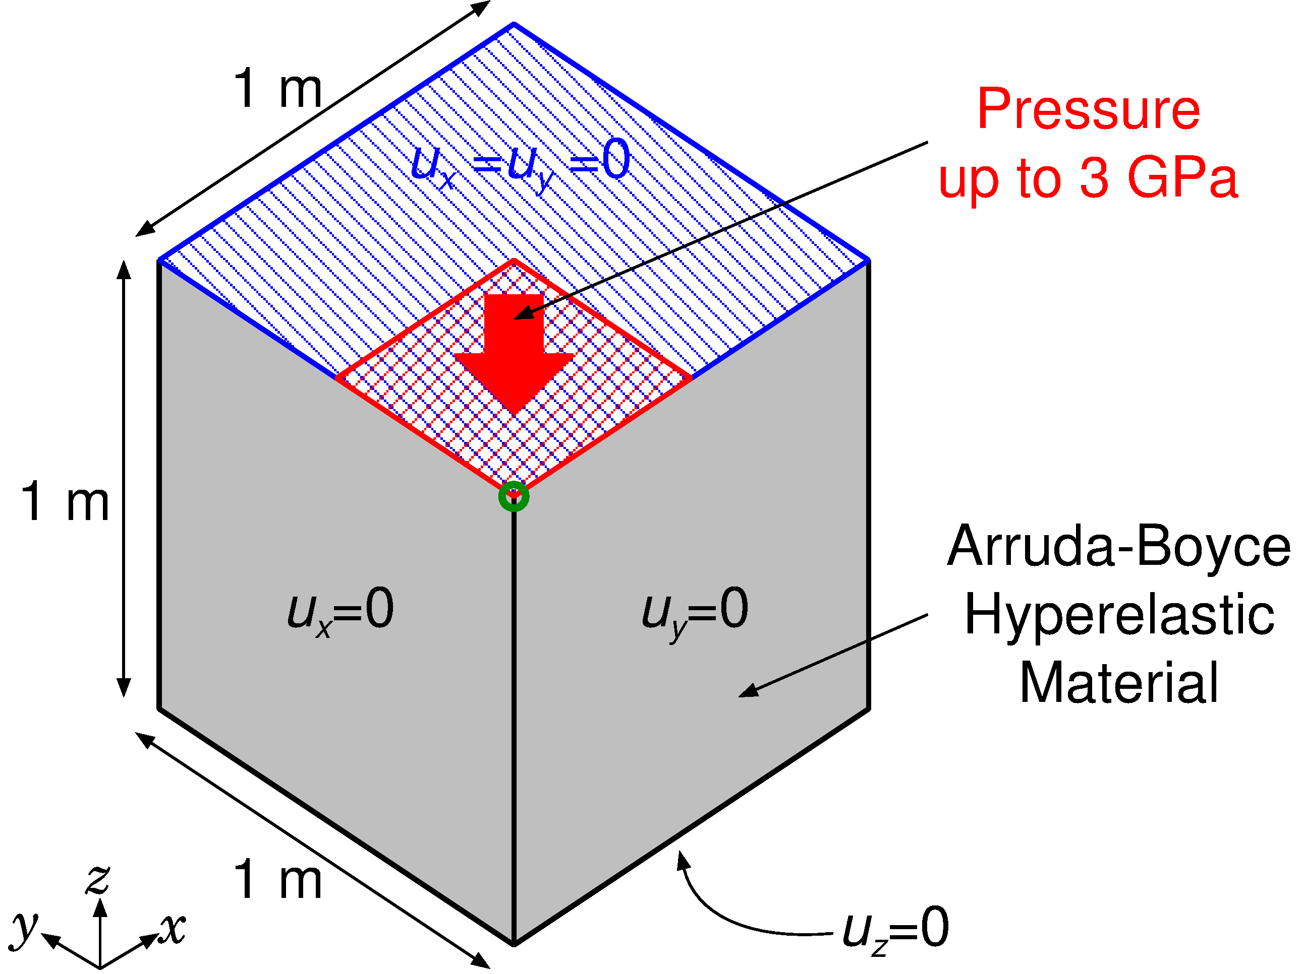
Compression of Hyperelastic Block
Static Implicit
Outline
Arruda-Boyce hyperelastic material ($ν_{ini}=0.499$).
Applying pressure on ¼ of the top face.
Compared to ABAQUS C3D10MH with the same unstructured T10 mesh.
Load

Slide 31
Compression of Hyperelastic Block
Static Implicit
Animation of pressure dist. (ABAQUS C3D10MH)
Convergence failure at 0.7 GPa pressure

Slide 32
Compression of Hyperelastic Block
Static Implicit
Animation of Mises stress dist. (ABAQUS C3D10MH)
Convergence failure at 0.7 GPa pressure

Slide 33
Compression of Hyperelastic Block
Static Implicit
Animation of pressure dist. (New Selective CS-FEM-T10)
Convergence failure at 3.3GPa pressure
The present element is more long-lasting (robust) than ABAQUS C3D10MH

Slide 34
Compression of Hyperelastic Block
Static Implicit
Animation of Mises stress dist. (New Selective CS-FEM-T10)
The present element presents Mises stress oscillation.

Slide 35
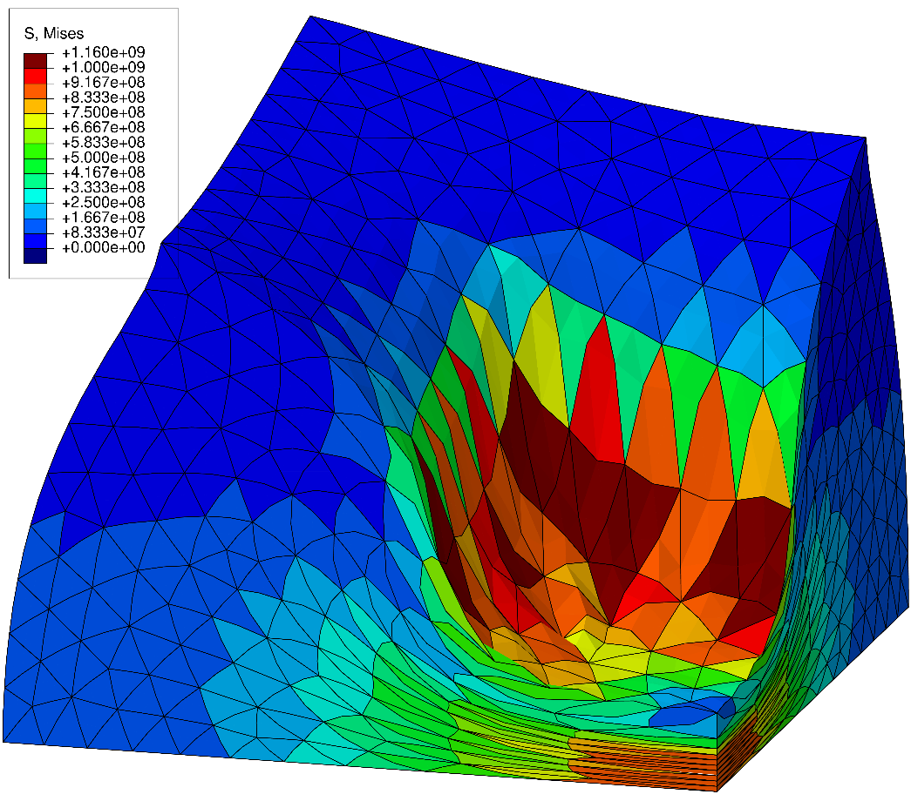
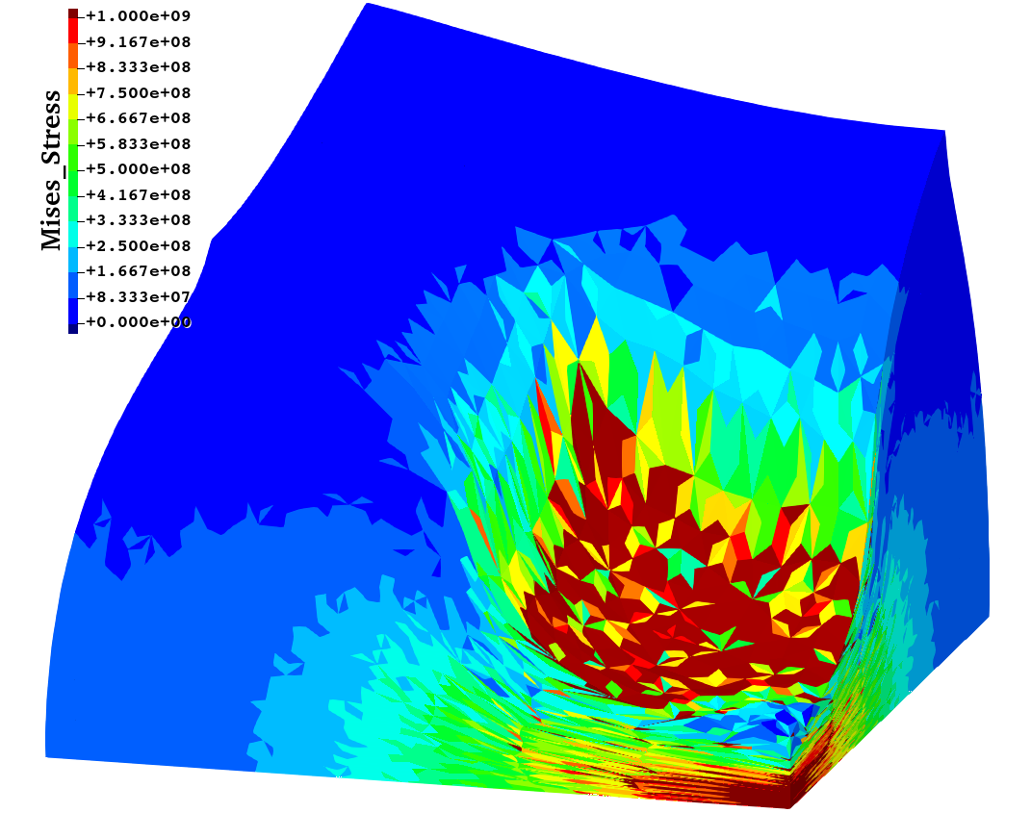
Compression of Hyperelastic Block
Static Implicit
Misess stress dist. at 0.7 GPa pressre
ABAQUS C3D10MH New SelectiveCS-FEM-T10
Less smooth Mises stress is observed in SelectiveCS-FEM-T10 compared to C3D10MH. Further improvement is still required.

Slide 36
Summary

Slide 37
Characteristics of SelectiveCS-FEM-T10
Benefits
Accurate (no locking, no checkerboarding, no force oscillation).
Robust (long-lasting in large deformation).
No increase in DOF (No static condensation).
Same memory & CPU costs as the other T10 elements.
Implementable to commercial FE codes (e.g., ABAQUS UEL).
Drawbacks
✗ Mises stress oscillation in some extreme analyses.
✗ No longer a T4 formulation.
SelectiveCS-FEM-T10 is competitive with the best ABAQUS T10 element, C3D10MH.

Slide 38
Summary
Summary
The present method (New SelectiveCS-FEM-T10) is more robust than the conventional one.
The present method is already very good enough for practical use as compared to ABAQUS Tet elements.
Take-home message
Please consider implementing New SelectiveCS-FEM-T10 to your in-house code. It’s supremely useful & easy to code!!
FYI
You can download my slides at http://www.a.sc.e.titech.ac.jp/~yonishi/
Please contact me on yonishi@a.sc.e.titech.ac.jp.
Thank you for your kind attention!

Slide 39
Appendix

Slide 40
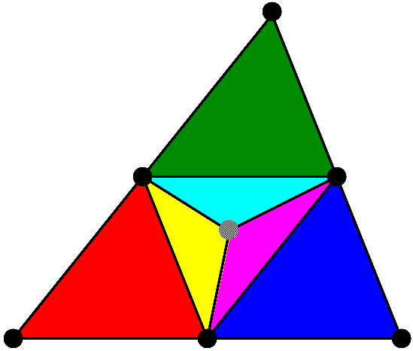
Flowchart of Old SelectiveCS-FEM-T10
Explanation in 2D (6-node triangular element) for simplicity
(ES-FEM)⁻¹
ES-FEM
(2) Dev. strain smoothing with edges and sub-elements
SRI
(1) Subdivision with a dummy node
Overall mean
(4) $\left\{f^{int}\right\} and [K]$
(3) Vol. strain smoothing with all sub-elements

Slide 41
Differences between Old and New
The new formulation adopts radial-type mesh subdivision.
Strain smoothing on all edges including frame edges.
Larger skewness of sub-elements .
The new formulation has No ES-FEM⁻¹ after ES-FEM.
Strain & stress evaluation at edges (NOT at sub-elements).
Discussions
The old formulation is shorter-lasting than the new one probably because of the low-energy modes induced by the multiple smoothing (too much smoothing).
The new formulation does not need multiple smoothing because any edge is owned by multiple sub-elements.

