Slide 1
A large deformation tetrahedral smoothed finite element formulation for nearly incompressible solids based on the strain smoothed element (SSE) technique
Yuki ONISHI
(Tokyo Institute of Technology)

Slide 2
What is S-FEM?
Smoothed finite element method (S-FEM) is a relatively new FE formulation proposed by Prof. G. R. Liu in 2006.
S-FEM is one of the strain smoothing techniques.
There are several types of classical S-FEMs depending on the domains of strain smoothing.
For example, in a 2D triangular mesh:
Edge-based S-FEM
(ES-FEM)
Node-based S-FEM
(NS-FEM)
Standard FEM

Slide 3
What are the major benefits of S-FEM?
Super-linear mesh convergence rate.
(Almost same rate as 2nd-order elements with T4 mesh.)
Shear locking free with ES-FEM.
(Excellent accuracy with T4 mesh.)
Little accuracy loss with skewed meshes.
(No problem with complex geometry or severe deformation.)
T4: 4-node Tetrahedra
S-FEM is a powerful method
suitable for practical industrial applications.

Slide 4
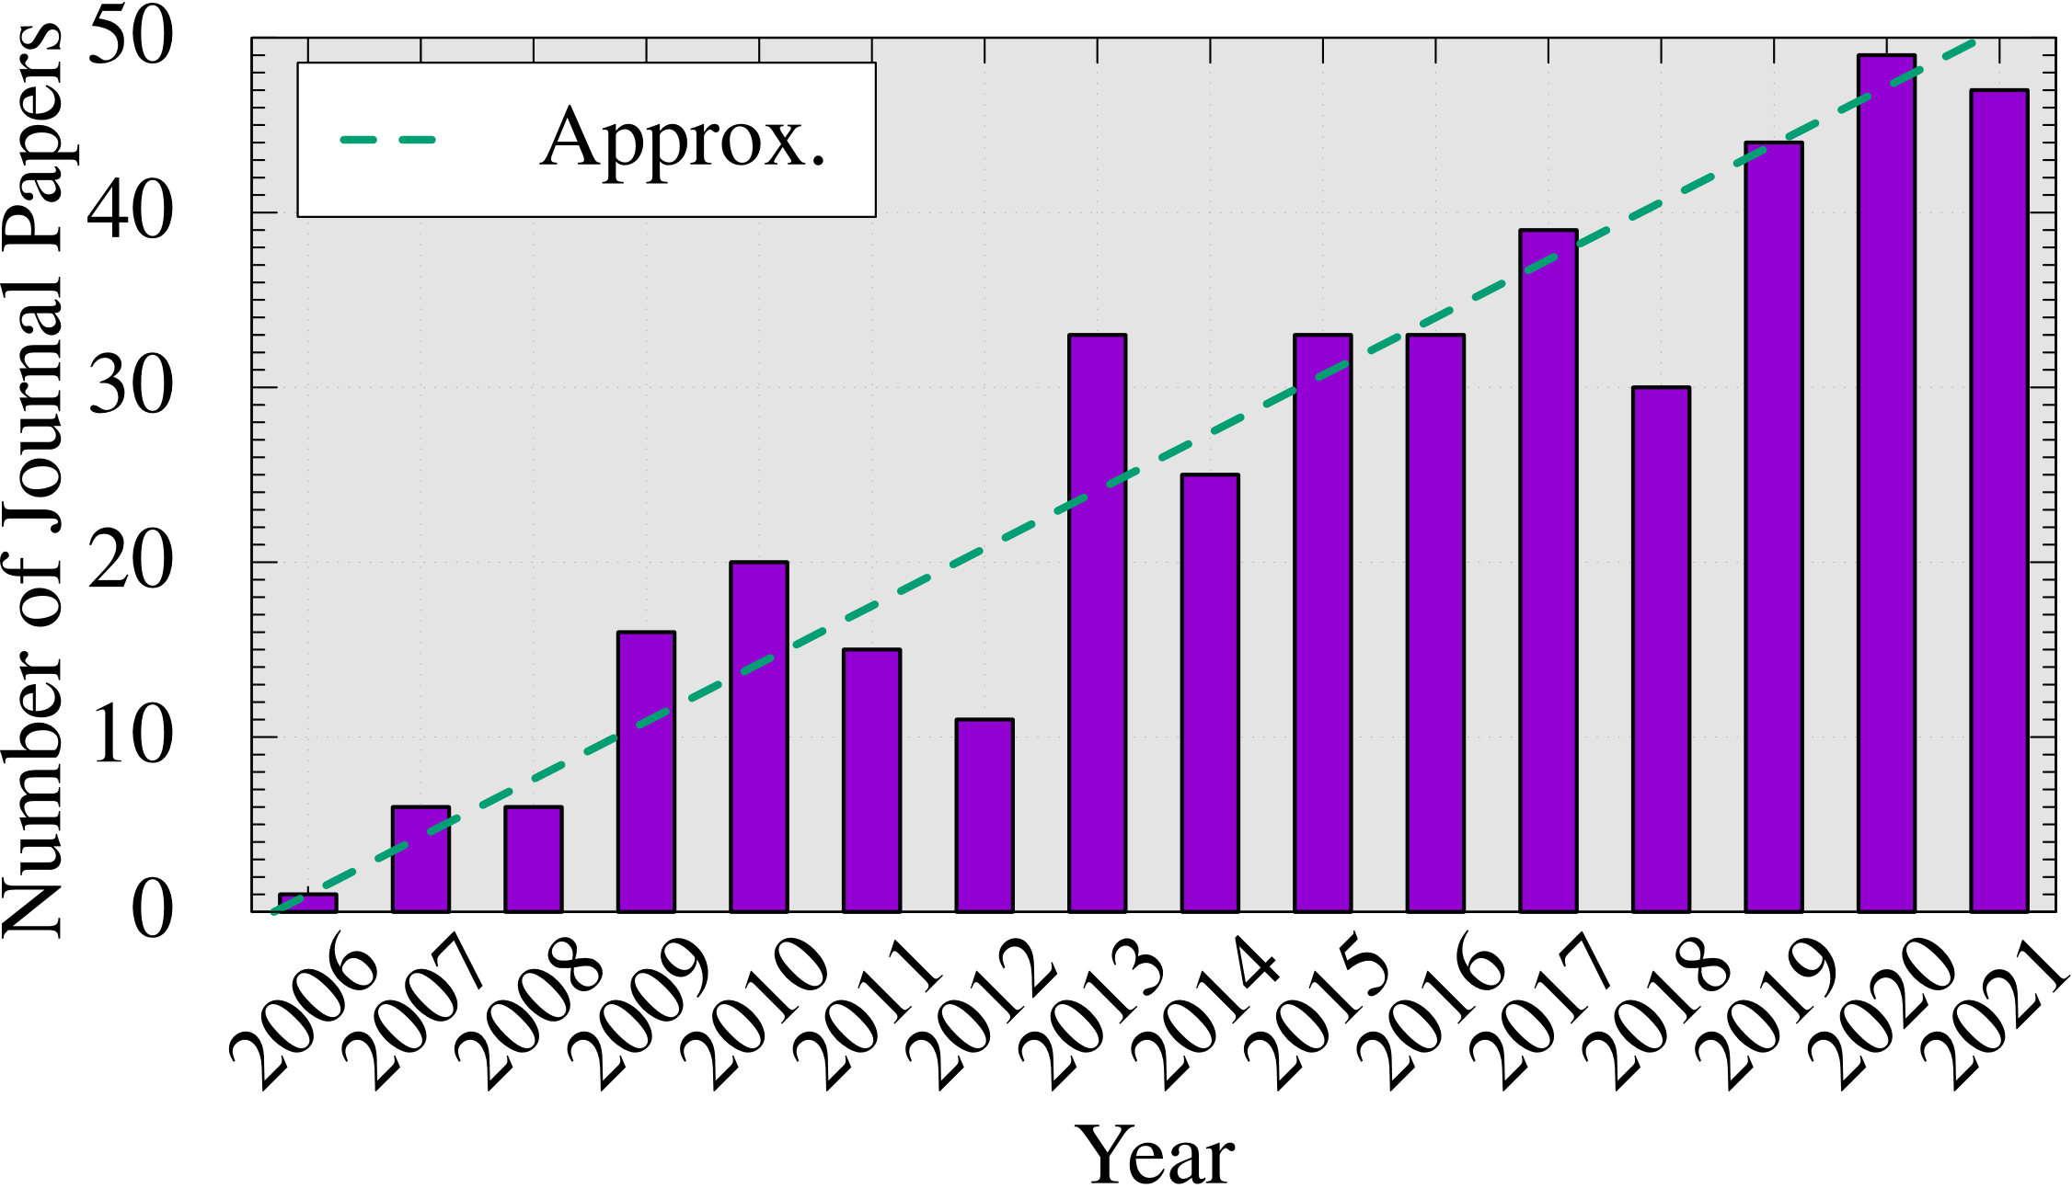
How popular is S-FEM?
Number of journal papers whose title contains
“smoothed finite element”:
(inquired at Google Scholar)
The attraction of S-FEM is expanding continuously.

Slide 5
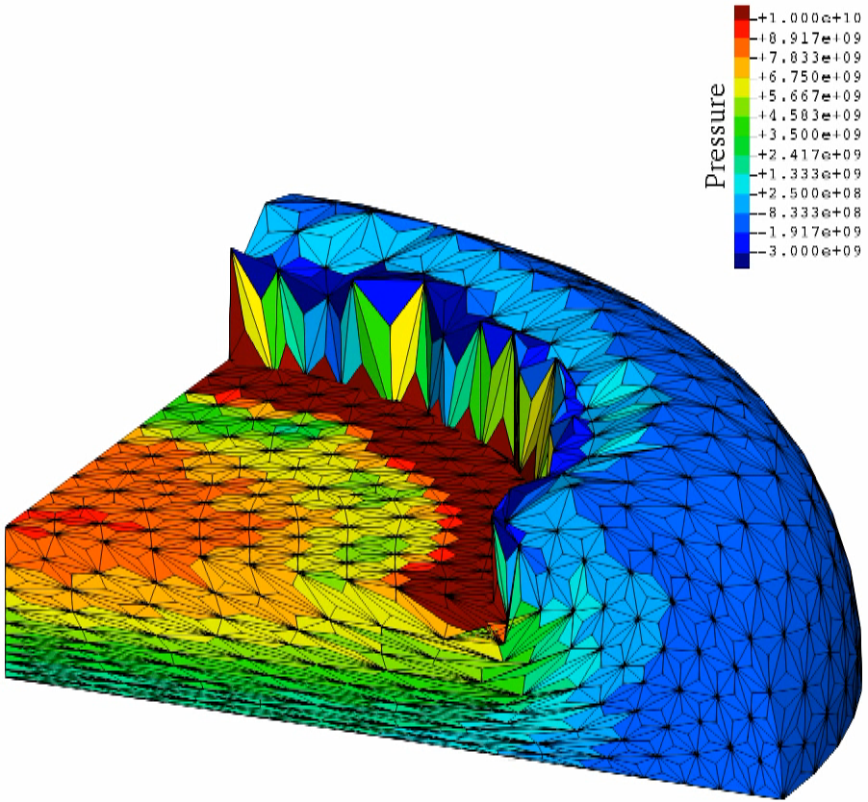
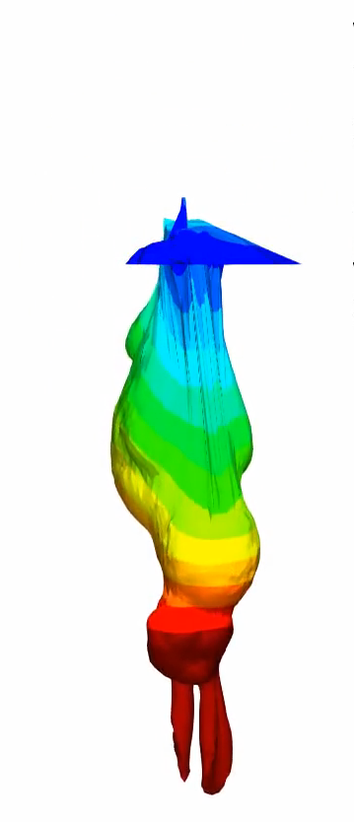
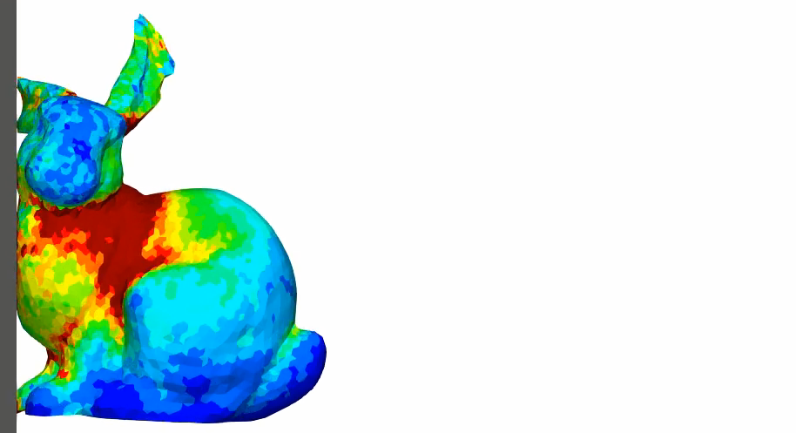
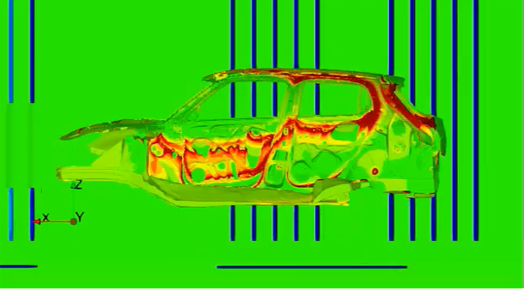
Applications of S-FEM in Our Lab
Large deformation solid mechanics (still in academic)
Static Implicit Dynamic Explicit Viscous Implicit
Electrostatic
(already in practice)
Carbody Electro-Deposition

Slide 6
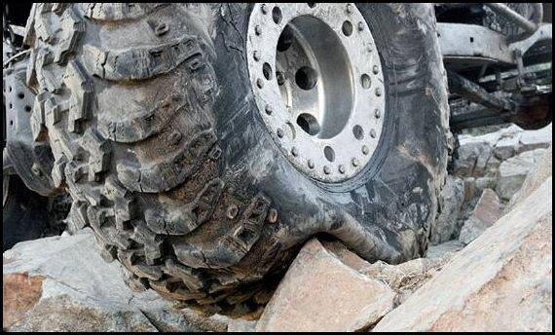
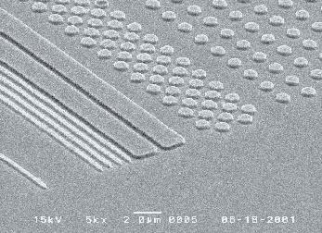


Motivation
What we want to do:
Solve severe large deformation
analyses accurately and robustly.
Treat complex geometries
with tetrahedral meshes.
Consider nearly incompressible materials $(ν≃0.5)$.
Support contact problems.
Handle auto re-meshing.
Rubber
Metal
Plastic/Glass

Slide 7
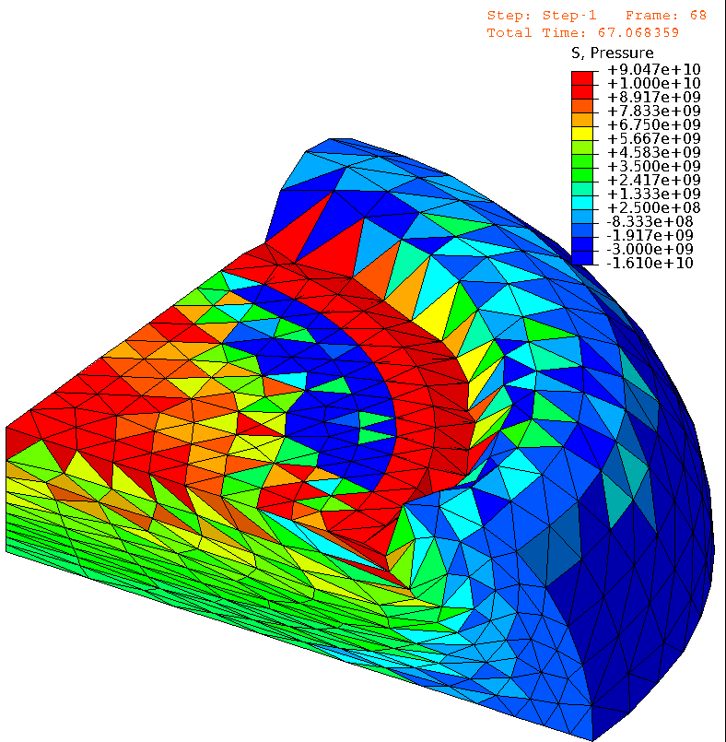
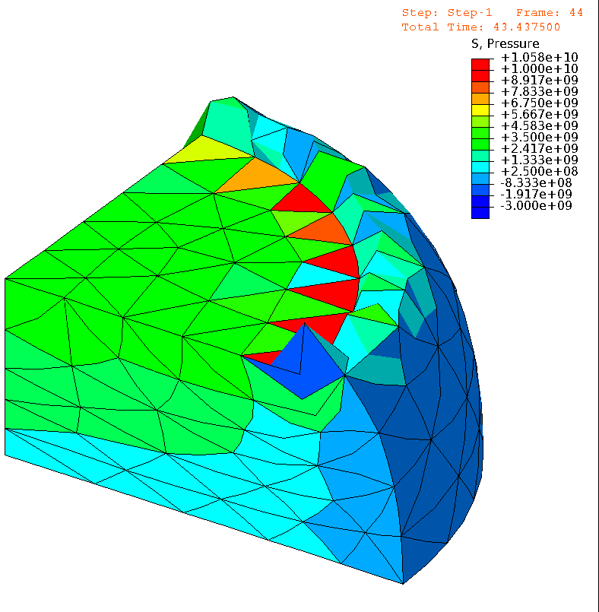

Issues in Conventional FE (ABAQUS）
Neo-Hookean hyperelastic body with $ν_{ini}=0.49$
4 node tet
(T4)
Pressure
10 node tet
(T10)
Pressure
Almost
the same
# of nodes.
ABQUS C3D4H
✓ No volumetric locking.
✗ Pressure checkerboarding.
✗ Shear locking & Corner locking.
ABAQUS C3D10MH
✓ No shear/volumetric locking.
✗ Short lasting (weak to severe deformation).
✗ Low interpolation accuracy.

Slide 8
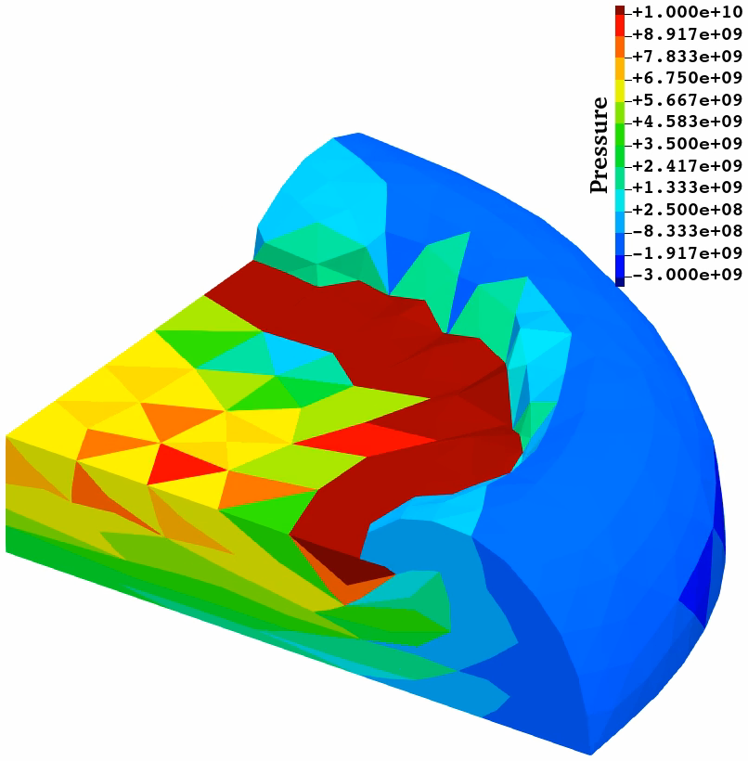
Our Approach using S-FEM
Neo-Hookean hyperelastic body with $ν_{ini}=0.49$
4 node tet
(T4)
10 node tet
(T10)
F-barES-FEM-T4 (2017)
✓ No shear/volumetric locking.
✓ Less pressure checkerboarding.
✓ Less corner locking. Long lasting.
✗ Long CPU time. Incompatible w/ FE.
SelectiveCS-FEM-T10 (2021)
✓ No shear/volumetric locking.
✓ Less pressure checkerboarding.
✓ Less corner locking. Long lasting.
✓ Same CPU time. Compatible w/ FE.

Slide 9
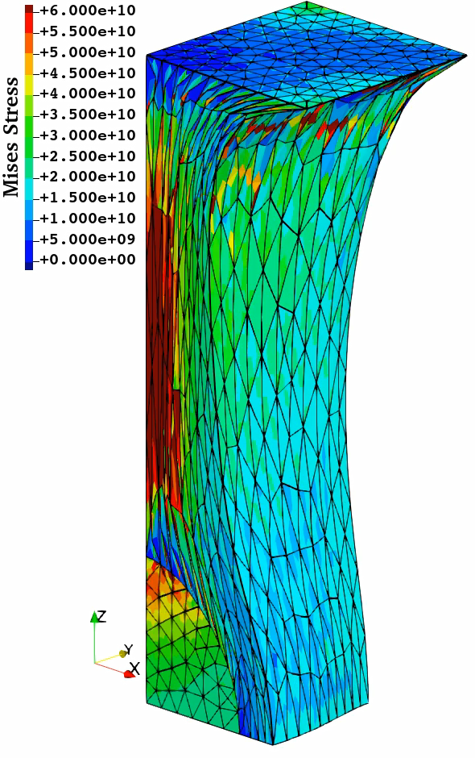
Issue in SelectiveCS-FEM-T10
Deviatoric stress oscillation
is observed in some cases…
e.g.) Tension of filler-rubber composite:
  A hard iron filler (1/8 sphere)
  Poisson’s ratio of rubber (soft) is 0.49.
✓ Excellent in robustness.
Up to 200% stretch!!
✓ Excellent in nodal displacement/
force and pressure accuracy.
✗ Poor in deviatoric stress accuracy.
Due to the lack of deviatoric strain smoothing?
Can we resolve this issue
by using the approach of
Strain Smoothed Element (SSE),
which adopts multi-smoothing?
SSE is
explained
later.

Slide 10
Objective
Development of a new T10 element formulation
“SelectiveCSSE-T10”
introducing the concept of SSE
to reduce the deviatoric stress oscillation.
Table of contents:
Method: brief of ES-FEM, SSE, SelectiveCS-FEM-T10,
and SelectiveCSSE-T10
Results: an example of analysis
Summary

Slide 11
Method

Slide 12






Brief of ES-FEM-T3
Let us consider two 3-node triangular elements in 2D, for simplicity.
Calculate $\left[B\right](=dN/dx)$ at each element as usual.
Distribute each $[B]$ to the connecting edge with an area weight
and build $[ ^{Edge}B]$ .
Calculate deformation gradient $(F)$, Cauchy stress ($σ$) and nodal internal force $\{f^{int}\}$ in each edge smoothing domain with $[ ^{Edge}B]$.
$$[B_{1}]$$
Constant stress/strain
in a smoothing domain.
As if putting
a Gauss point
on each edge center
No shear locking.
$$[B_{2}]$$
$$[^{Edge}B]$$
$↳{}^{Edge}F,{}^{Edge}σ, \{^{Edge}f^{int}\}$ etc.

Slide 13
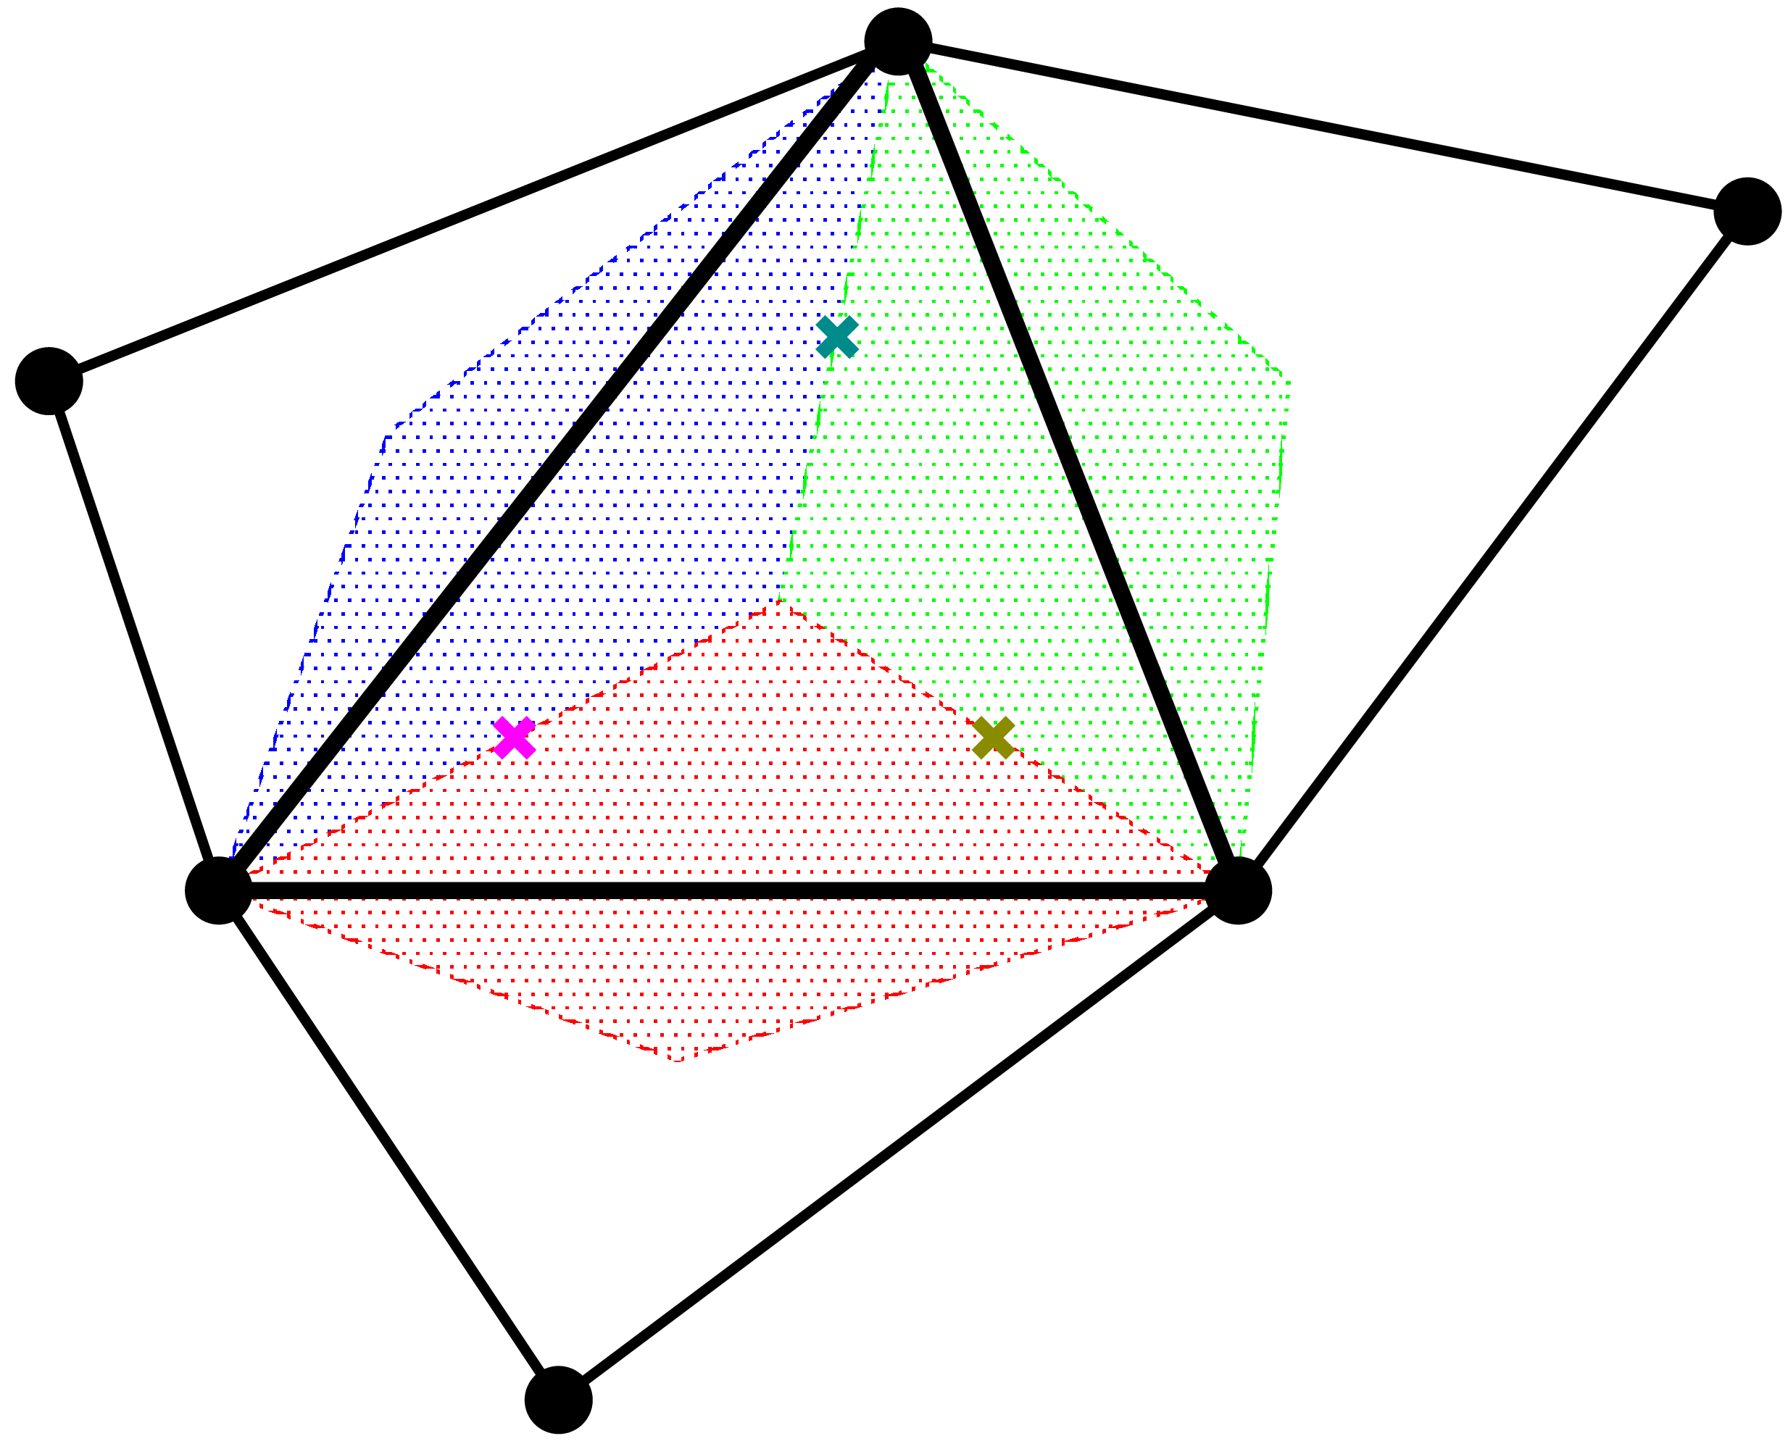
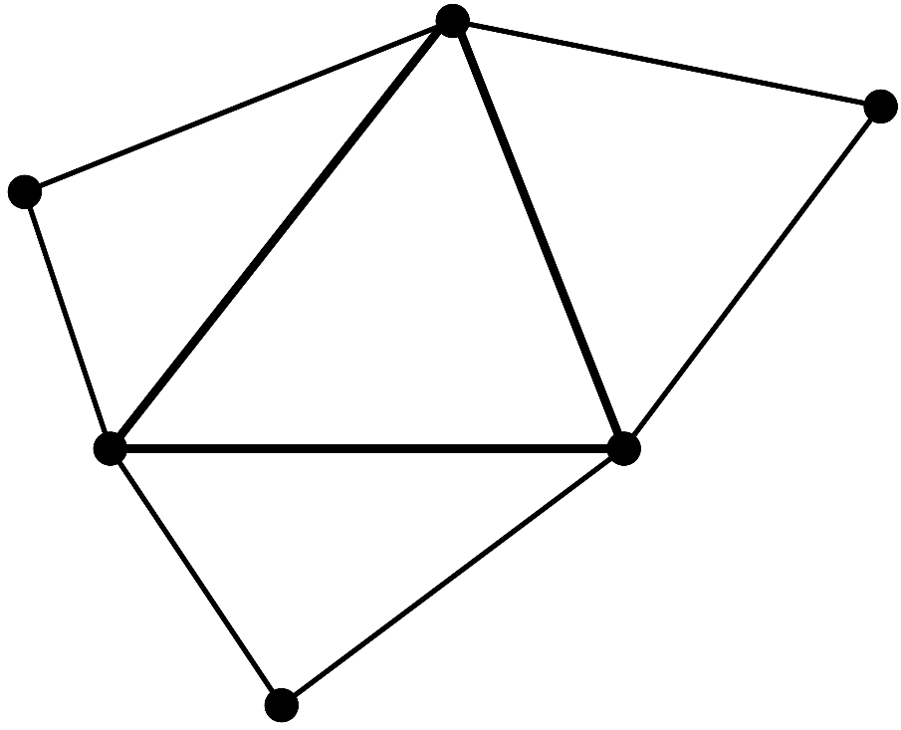
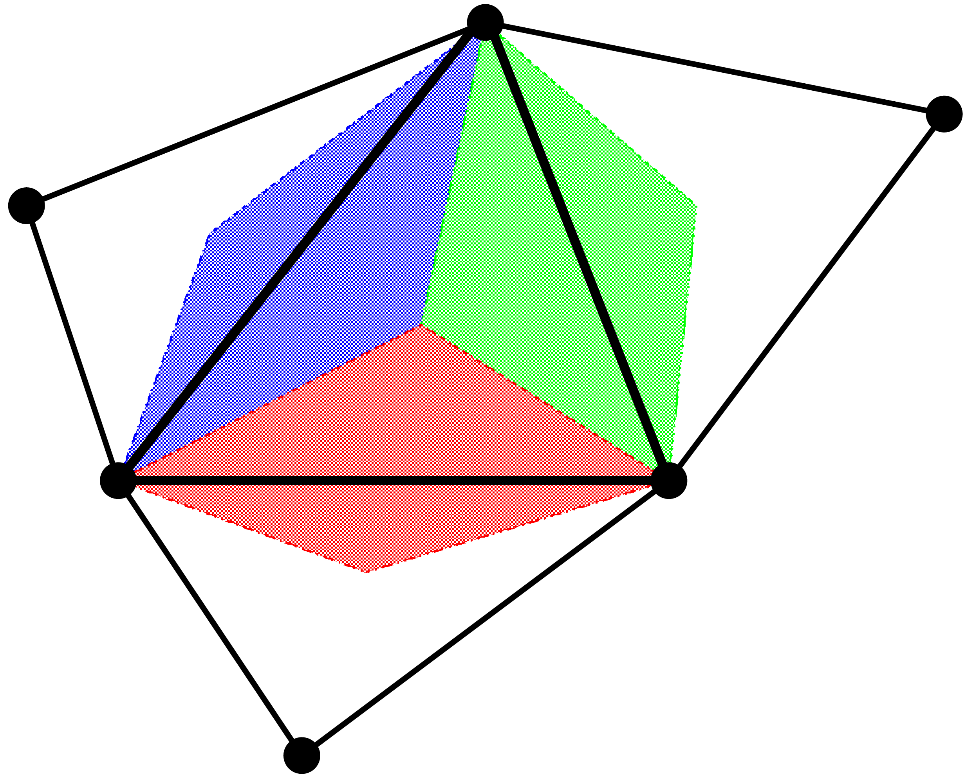

Brief of SSE-T3
Let us consider four 3-node triangular elements in 2D, for simplicity.
Calculate $\left[B\right](=dN/dx)$ at each element as usual.
Calculate $[ ^{Edge}B]$ at each edge in the same way as ES-FEM-T3.
Distribute each $[ ^{Edge}B]$ to the three Gauss points with an equal weight and build $[ ^{Gaus}B]$ .
Calculate $F$, $σ$, $\{f^{int}\}$ etc. with $[ ^{Gaus}B]$s in the same way as
FEM-T6.
Linear stress/strain
in an element.
Strain smoothing
is performed twice
before evaluating
the stress/strain.
No shear locking.
Faster rate
of mesh convergence.

Slide 14
Performance of SSE-T3
Comparison of Mises stress dist. in cantilever bending analysis
Step-like stress dist. (poor).
Shear locking.
Linear stress dist. (good).
No shear locking.
Linear stress dist. (fine).
No shear locking.
But,
SSE has volumetric locking.
SSE cannot be implemented as an element of standard FE codes.
T. Jinsong et al., Euro. J. Mech. /A, v95, 2022.

Slide 15
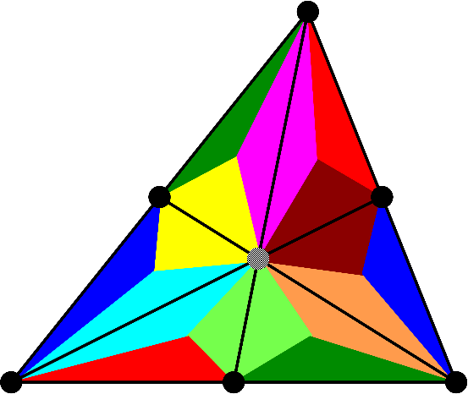
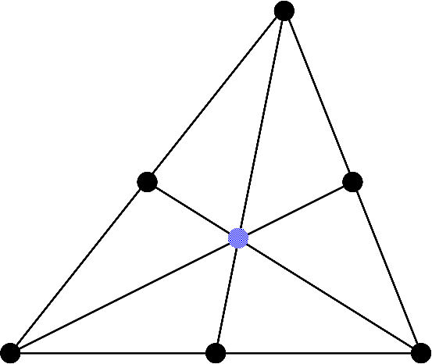
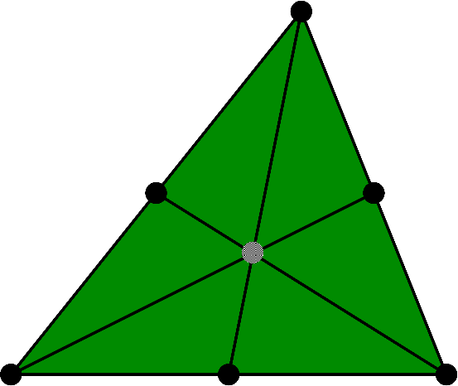

Brief of SelectiveCS-FEM-T10 (Old)
Explanation in 2D (6-node triangular element), for simplicity
(2) Iso-vol. strain smoothing at edges
Dev. stress
integration
at edges
Dummy
node
ES-FEM
SRI
(4) $\left\{f^{int}\right\} and [K]$
Overall
mean
(1) Radial type
element subdivision
into sub-elements
with a dummy node
(3) Vol. strain smoothing with all sub-elements

Slide 16
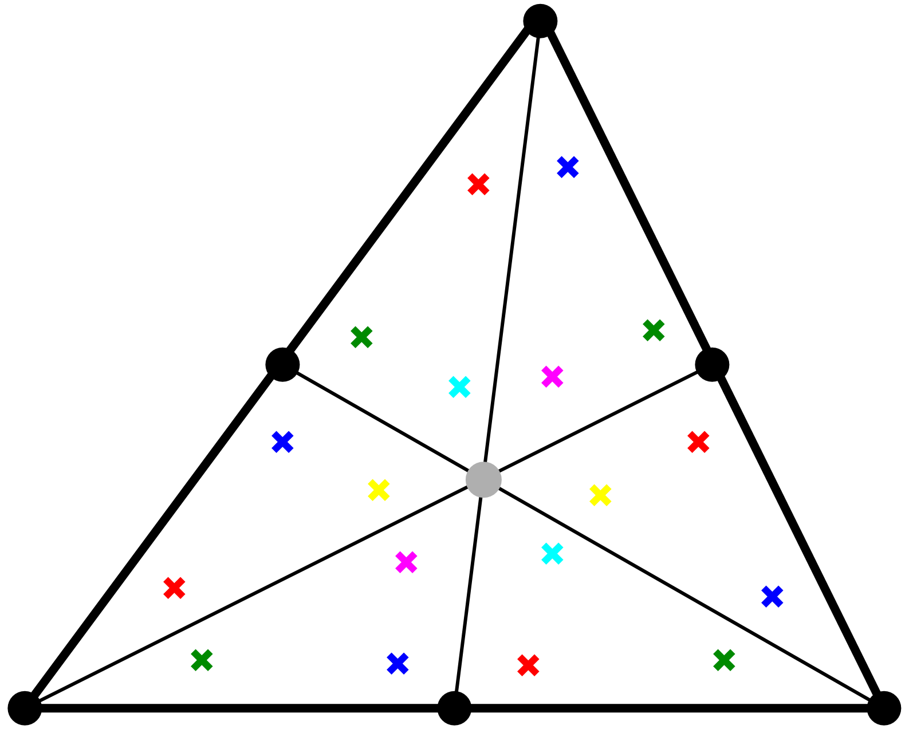

Brief of SelectiveCSSE-T10 (New)
Explanation in 2D (6-node triangular element), for simplicity
(2) Iso-vol. strain smoothing at Gauss points
Re-smoothing
at Gauss points
Dummy
node
ES-FEM
Dev. stress
integration
at Gauss
points.
Overall
mean
SRI
(1) Radial type
element subdivision
into sub-elements
with a dummy node
(4) $\left\{f^{int}\right\} and [K]$
(3) Vol. strain smoothing with all sub-elements

Slide 17
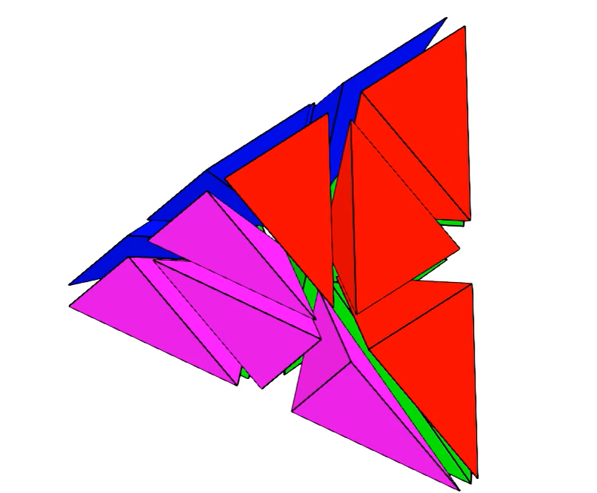
Brief of SelectiveCSSE-T10 in 3D
Radial subdivision of a T10 element (30% shrunk mesh)
There are 16
T4 sub-elements
in total.
2nd strain
smoothing
on 64 Gauss
points
(SSE).
1st strain
smoothing
on 34 edges
(ES-FEM).

Slide 18
Results

Slide 19
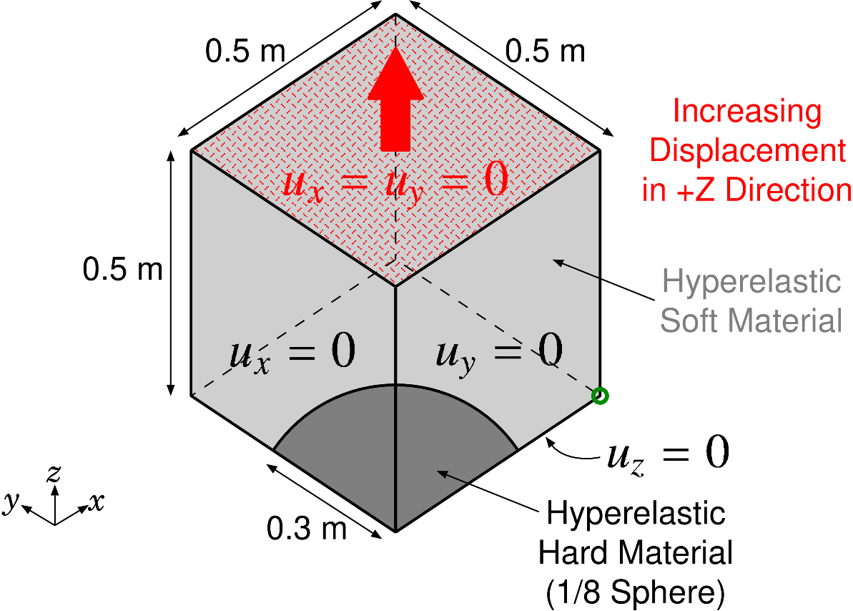

Tension of Filler-Rubber Composite
Static
Implicit
Outline
Filler: Neo-Hookean hyperelastic ($E_{ini}=260 GPa, ν_{ini}=0.3$)
Rubber: Neo-Hookean hyperelastic ($E_{ini}=6 GPa, ν_{ini}=0.49$)
T10 mesh (about 11,000 nodes & 7,000 elements)
Compared to ABAQUS C3D10MH (the best T10 element in ABAQUS) with the same mesh.

Slide 20
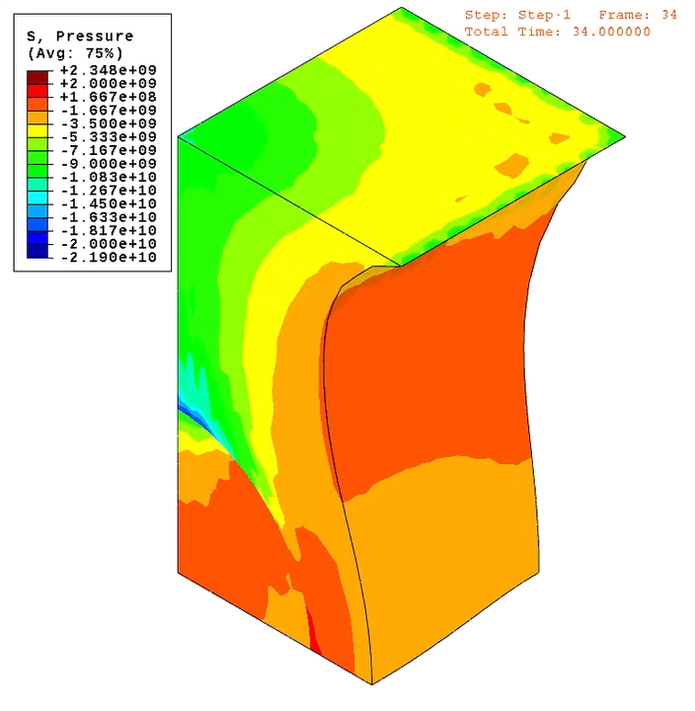
Tension of Filler-Rubber Composite
Static
Implicit
Result of
ABAQUS
C3D10MH
(Pressure
Dist.)
Convergence failure
at ~70%
stretch.

Slide 21
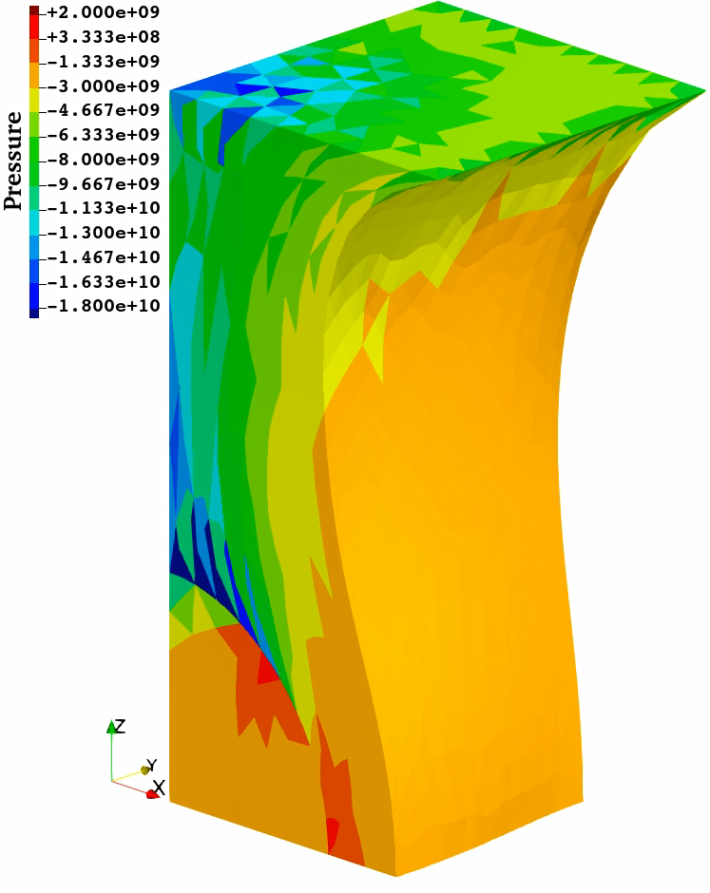

Tension of Filler-Rubber Composite
Static
Implicit
Result of
Selective
CSSE-T10
(Pressure
Dist.)
Convergence
failure
at ~100%
stretch.
$$⇓$$
Less robust
compared to
Selective
CS-FEM-T10
(up tp 200%
stretch.)

Slide 22
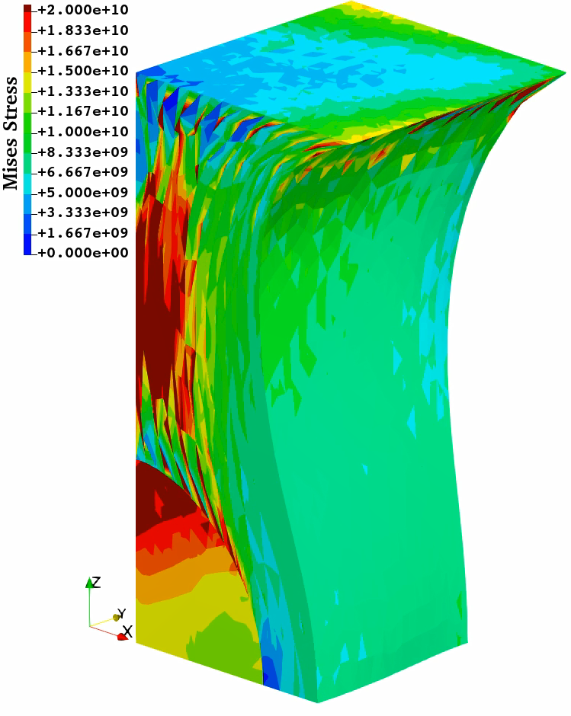
Tension of Filler-Rubber Composite
Static
Implicit
Result of
Selective
CSSE-T10
(Mises
Stress Dist.)
The issue of
deviatoric stress oscillation was hardly solved…

Slide 23
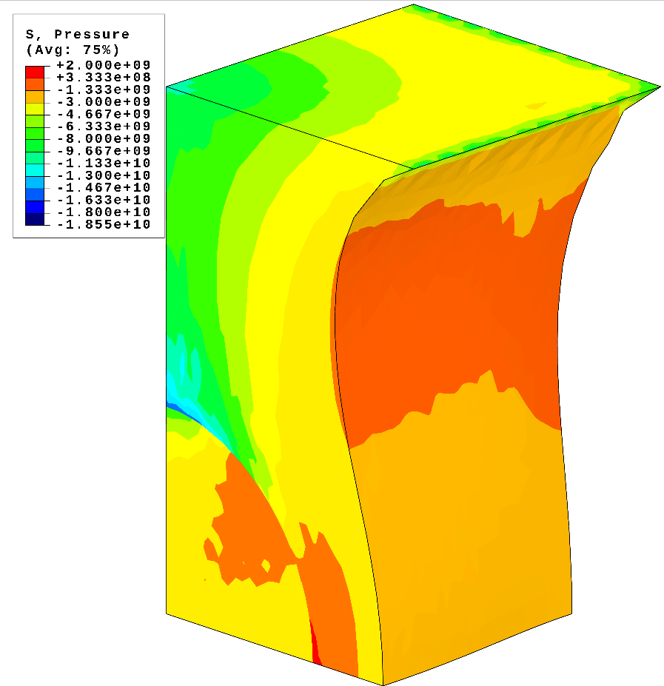
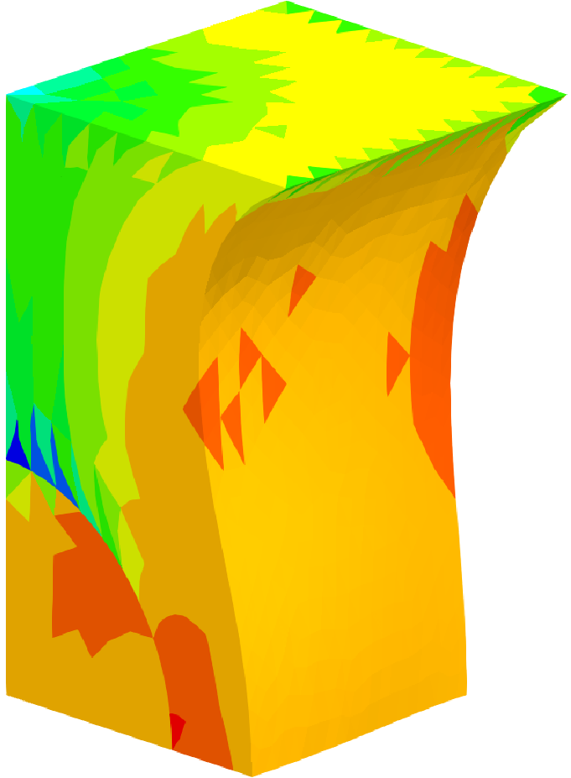
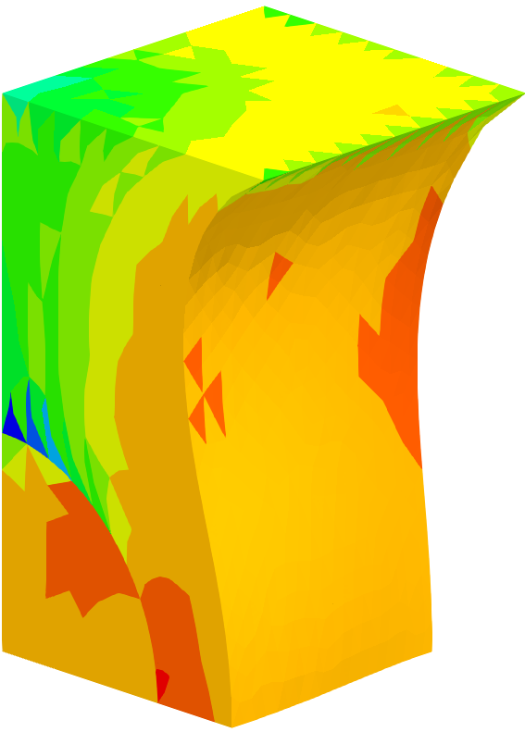
Tension of Filler-Rubber Composite
Static
Implicit
Comparison of pressure dist. at 60% stretch.
ABAQUS C3D10MH SelectiveCS-FEM-T10 SelectiveCSSE-T10
SelectiveCSSE-T10 has sufficient accuracy in
displacement/force and pressure.

Slide 24
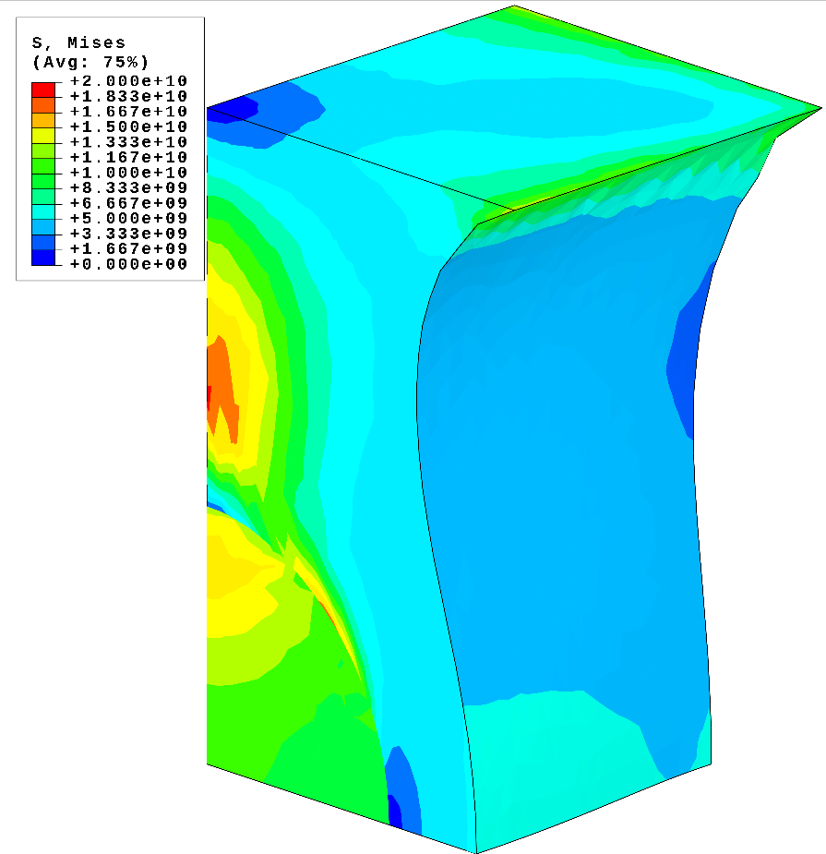
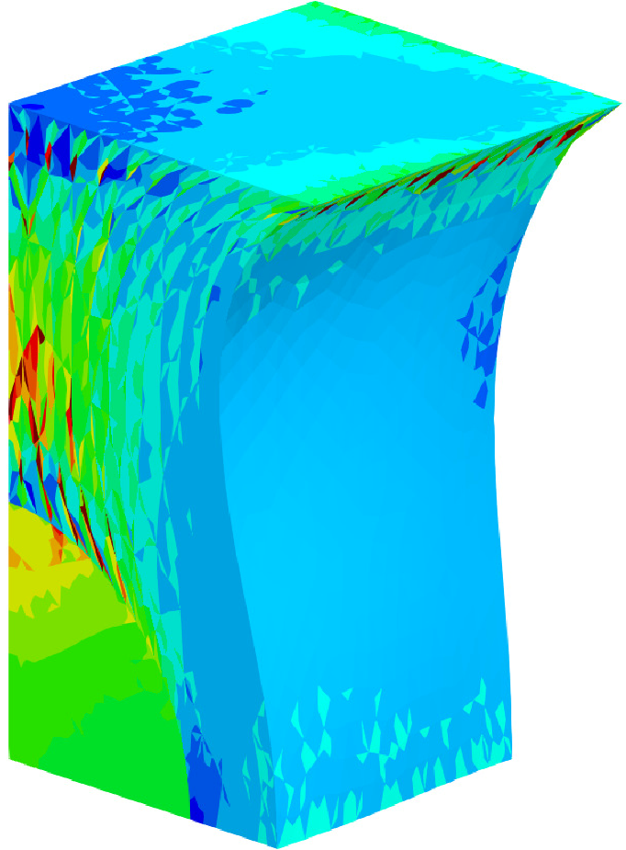
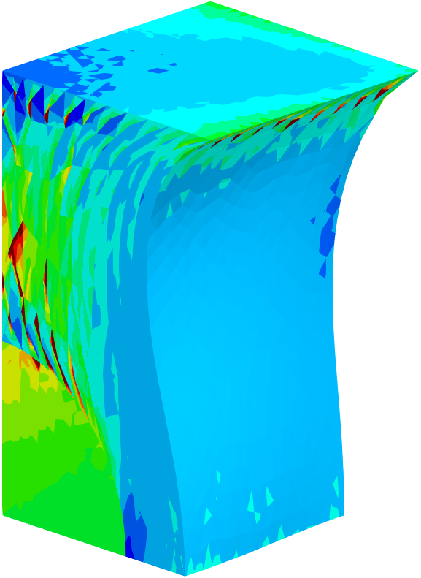
Tension of Filler-Rubber Composite
Static
Implicit
Comparison of Mises stress dist. at 60% stretch
ABAQUS C3D10MH SelectiveCS-FEM-T10 SelectiveCSSE-T10
SelectiveCSSE-T10 resolves the oscillation issue only a little bit.
Unfortunately, there is no fundamental improvement...

Slide 25
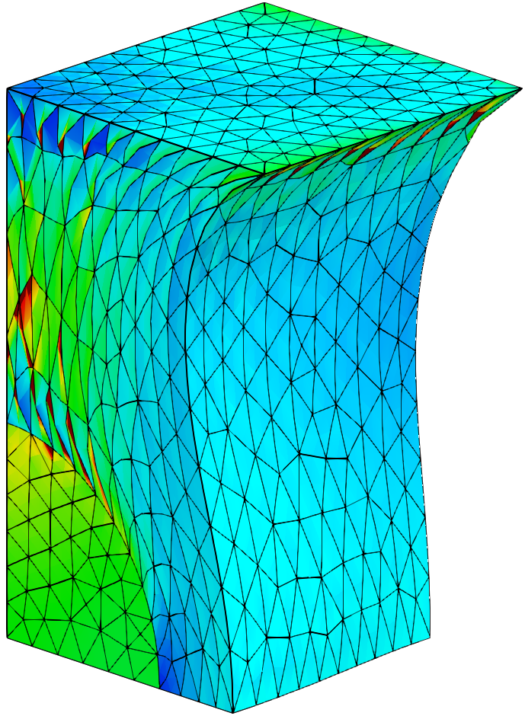

Tension of Filler-Rubber Composite
Static
Implicit
Mises stress
Dist. of
SelectiveCSSE-T10
at 60% stretch
Mises stress dist.
is severely discontinuous
at the element interfaces.
$$⇓$$
This issue may be
unavoidable as long as
CS-FEM is adopted...
(Strain smoothing
across elements
would be essential?)

Slide 26
Summary

Slide 27
Summary
A new CS-FEM formulation, SelectiveCSSE-T10, was developed.
SelectiveCSSE-T10 introduces the idea of the strain smoothing element (SSE) to our conventional method (SelectiveCS-FEM-T10) to resolve the issue of deviatoric stress oscillation.
Unfortunately, SelectiveCSSE-T10 cannot resolve the oscillation issue fundamentally...
Another approach should be taken to achieve a volumetric locking-free SSE formulation, which is our future work.
Thank you for your kind attention!

Slide 28
Appendix

Slide 29
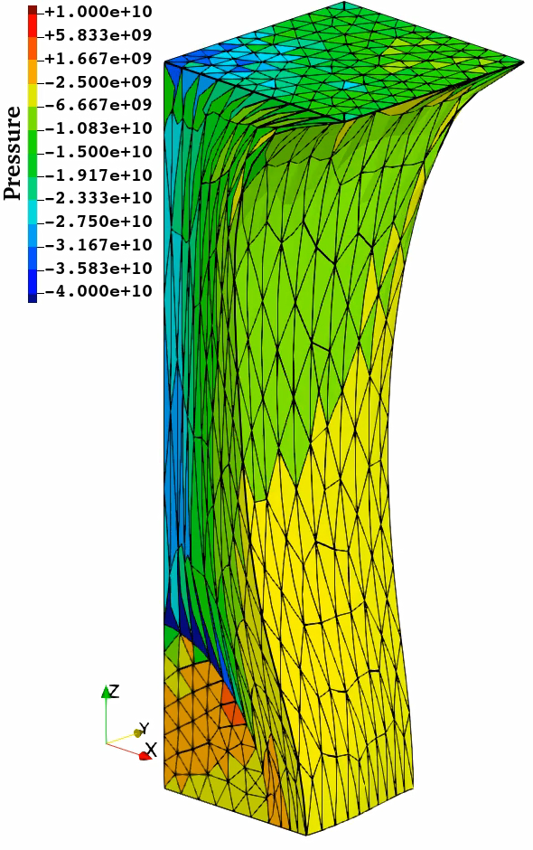
Tension of Filler-Rubber Composite
Static
Implicit
Result of
Selective
CS-FEM-T10
(Pressure
Dist.)
Convergence
failure
at ~200%
stretch.

