Slide 1
Application of Edge-based Smoothed Finite Element Method to Electrodeposition Simulation aiming for Super-linear Mesh Convergence in Film Thickness Accuracy
Yuki ONISHI (Tokyo Institute of Technology)

Slide 2
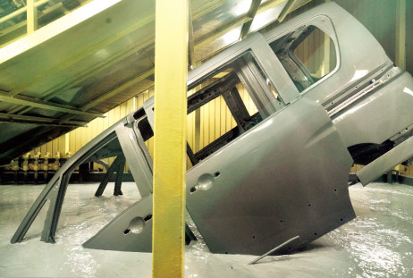


What is Electrodeposition (ED) ?
Most widely-used anti-rust basecoat methods for various metal products
including auto carbodies.
Depositing coating film by applying direct electric current in a paint pool.
Relatively good at depositing a uniform film on bodies in complex shapes.
$$+$$
$$−$$
＋
＋
Paint
Anode
Cathode
http://n-link.nissan.co.jp/

Slide 3
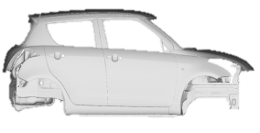
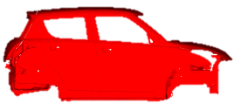
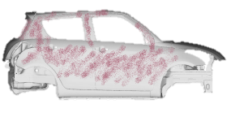
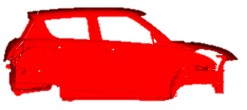

What is Electrodeposition (ED) ?
Overview of the Carbody Paint Shop
Degrease
Preparation
Electrodeposition (ED)
ED Oven
Intermediate Oven
Intermediate Coat
Sealing/Undercoat
Top Coat
Topcoat Oven
To Assembly Line
ED is responsible for the basecoat of a carbody.

Slide 4
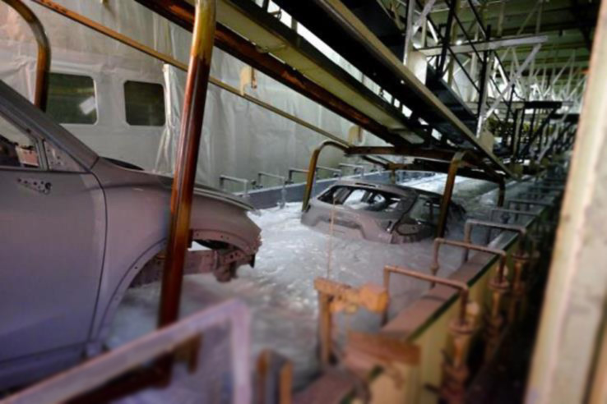
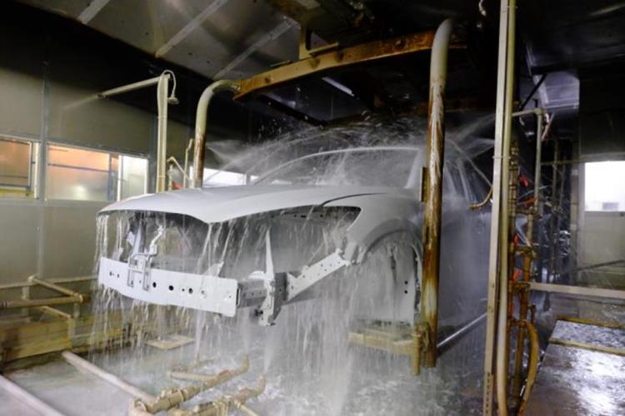
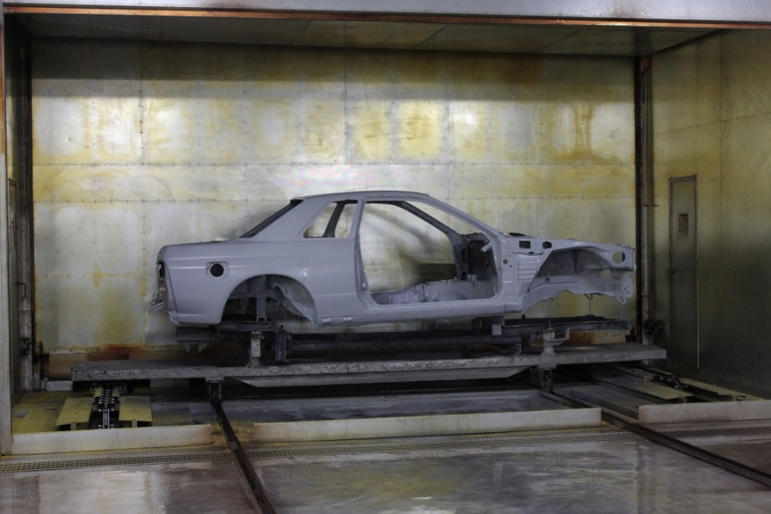
What is Electrodeposition (ED) ?
Photos of ED Process Line
1. Deposition process
2. Water rinse process
We focus on
this process.
3. Baking process
https://blog.mazda.com/archive/20160413_01.html

Slide 5
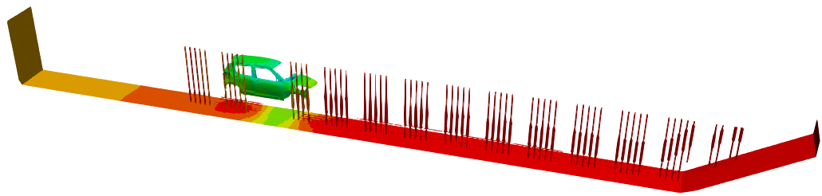
What is ED Simulation?
Actual ED Line
ED Simulation
Paint Pool
Carbody with Motion
Electrodes (Anodes)
are reproduced in a computer.
Paint Pool Mesh
Carbody Mesh
are separately prepared
and are connected with
the overset mesh method.
https://blog.mazda.com/
archive/20160413_01.html
Paint
Pool
Carbody
w/ Motion
Electrodes
(Anodes)
Total length: about 30 m

Slide 6
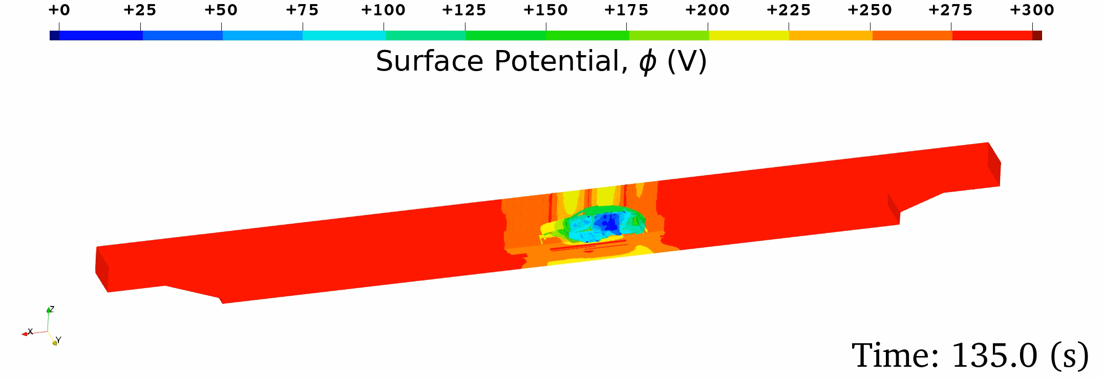
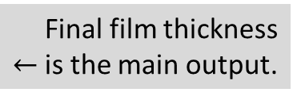


What is ED Simulation?
Governing equation:
Electrostatic Laplace equation ($∇^{2}φ=0$) in the paint pool domain.
A paint pool mesh and carbody meshes are connected with the overset mesh method.
Boundary conditions:
  Wall (insulation) BC，
  Anodic (electrode surface) BC,
  Cathodic (carbody surface) BC:
  Film resistance/growth constitutive model (Strongly non-linear).
Outputs: time-histories of
  Surface potential,
  Current density,
  Film thickness
Identified via
lab experiments.
$$↓$$
Final film thickness
$←$is the main output.

Slide 7
Motivation
The actual ED line simulations cost high due to the large number of meshes.
E.g., a typical actual ED line simulation for 3 carbodies sank in a paint pool at the same time requires about 100 million elements in total.
The standard FEM with 4-node tetrahedral elements (FEM-T4) is known as a
poor formulation due to the slow (linear) mesh convergence rate.
The edge-based smoothed FEM using T4 meshes (ES-FEM-T4) is known as a
next-generation high-performance formulation achieving a super-linear mesh convergence rate even with T4 meshes.
Therefore, we expect that…
Parallelized ES-FEM-T4 would be the best choice
for the actual ED line simulations for automakers.

Slide 8
Objective
Development of an ED simulator using the parallelized ES-FEM-T4
for large-scale practical ED simulations
to achieve super-linear mesh convergence.
Table of body contents:
Two Major Reasons for “Why did we choose ES-FEM-T4?”
Implementation of Parallelized ES-FEM-T4
Benchmark Tests
Summary

Slide 9
Two Major Reasons for
“Why did we choose ES-FEM-T4?”

Slide 10
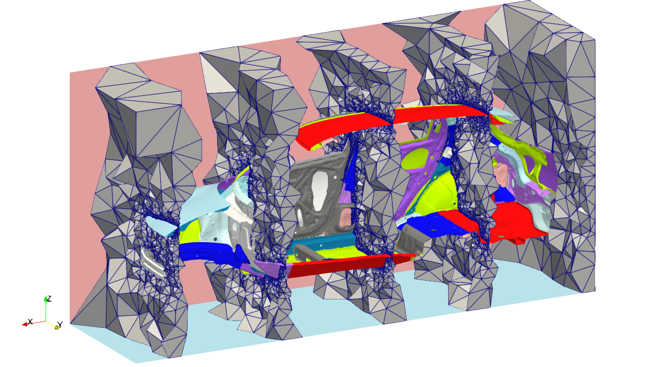
Why did we choose ES-FEM-T4?
Reason 1: It is impossible to make good HEX meshes for carbodies.
An ED simulation requires a mesh for the complex spaces around the carbody.
The Cartesian meshing generates unnecessarily fine meshes on curved surfaces.
Sliced view of a carbody mesh
A CutCell mesh of a carbody
TET meshes are preferable in ED simulation.

Slide 11
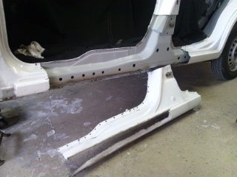
Why did we choose ES-FEM-T4?
Reason 2: There are many small holes on the carbody plates.
ED simulations need 3D meshes around many ED holes.
The 10-node TET meshing for the standard 2nd –order TET elements
leads to a massive increase in nodes and DOF around ED holes.
ES-FEM-T4 would be the best choice.
Carbody
Carbody
Side Sill
Hole
Hole
https://plaza.rakuten.co.jp/
heroc/diary/201212210000/
T4 mesh
T10 mesh
The 4-node TET (T4) meshing is preferable.

Slide 12
Implementation of
Parallelized ES-FEM-T4

Slide 13




Brief Formulation of ES-FEM
Let us consider two 3-node triangular (T3) elements in 2D for simplicity.
Calculate $\left[B\right](=dN/dx)$ at each element as usual.
Distribute $[B]$ to each connecting edge with an area weight and build $[ ^{Edge}B]$ .
Calculate current density $(J)$ and nodal internal current $\{i^{int}\}$
in each edge smoothing domain.
$$[B_{1}]$$
As if putting
a Gauss point
on each edge center
$$[B_{2}]$$
$$[^{Edge}B]$$
$↳{}^{Edge}J, \{^{Edge}i^{int}\}$ etc.

Slide 14


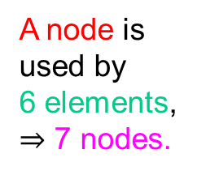
Characteristics of ES-FEM-T4
Advantages
Super-linear mesh convergence rate (as fast as 2nd-order elements).
No increase in DOF (Unknowns are nodal potentials only).
Same input file as FEM-T4.
Disadvantages
Longer assembling time of $[K]$ (~x2 of FEM-T4 w/ the same mesh) $∵$ES-FEM uses edges.
Wider bandwidth of $[K]$ (~x3 of FEM-T4 w/ the same mesh).
In 2D case:
No longer an independent T4 element (No good way to implement in standard FE codes).
All these disadvantages are cleared by developing parallelized in-house code.
A node is
used by
12 edges,
$⇒$ 12 elements,
$⇒$ 13 nodes.
A node is
used by
6 elements,
$⇒$ 7 nodes.
FEM-T3 (Bandwidth: 7)
ES-FEM-T3 (Bandwidth: 13)

Slide 15
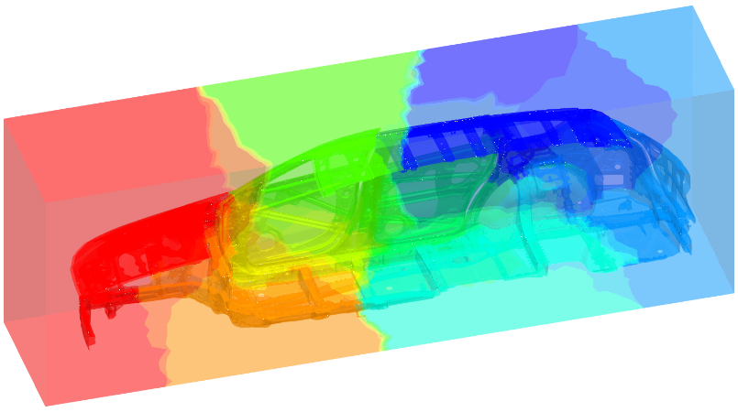
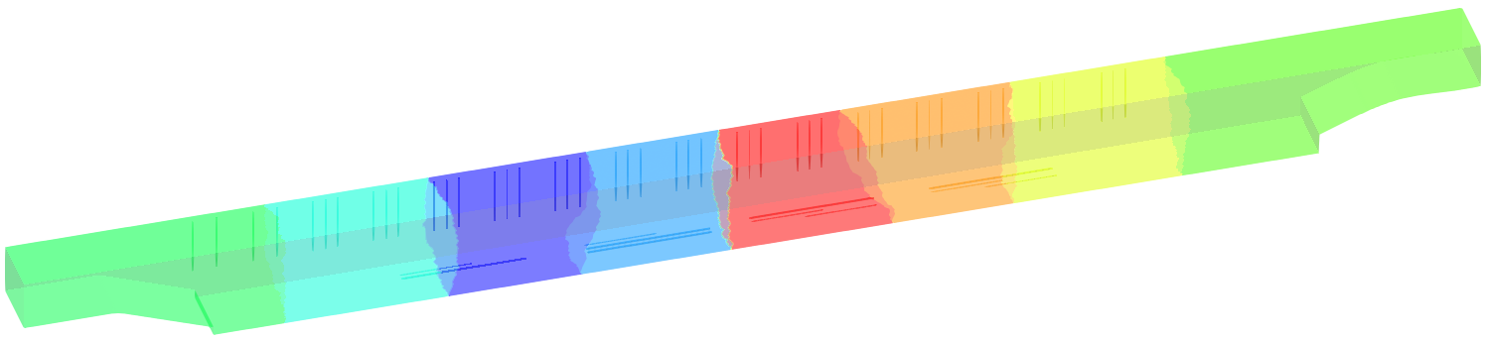
Parallelization of ES-FEM-T4
Our code adopts MPI/OpenMP hybrid parallelization for multi-core CPUs in multi-node HPC environments.
In the MPI/OpenMP coding, there is no particular difference from that of FEM-T4.
Execution steps:
  Generating T4 mesh for paint pool and carbody domains.
  Partitioning and reordering each mesh using METIS.
  Preparing an input file containing the mesh filenames,
  boundary conditions, motion path, etc..
  Executing the program. E.g., in the case of OpenMPI:
  orterun –np N -bind-to socket -npersocket 1
  -x OMP_NUM_THREADS=8 -x numactl -l edesfem.bin input_file_name
Paint pool mesh partitioning
Carbody mesh partitioning
There is no difficulty in parallelization of ES-FEM-T4.

Slide 16
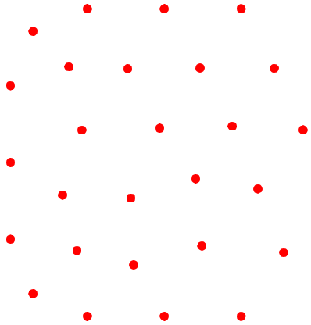

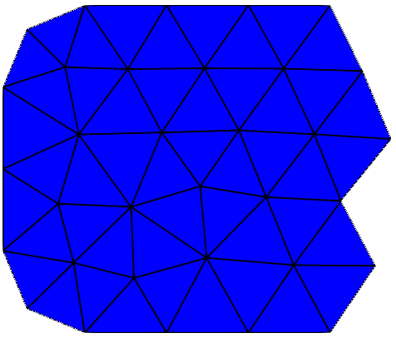
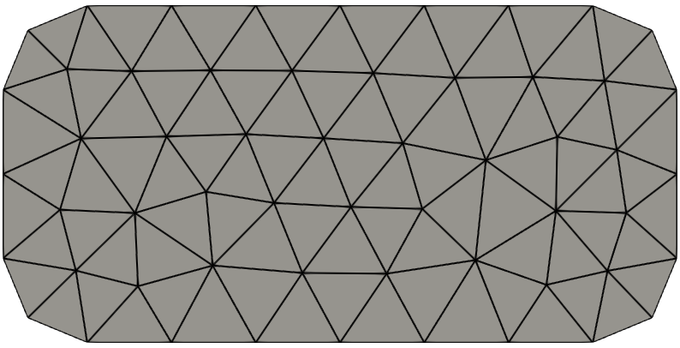

Parallelization of ES-FEM-T4
Review of a Typical Processing Flow in the Parallelized FEM-T3
  Partitioning assigns “nodes in charge” to each MPI process.
  Each MPI process extracts “related cells”, which use the nodes in charge.
  Each MPI process extracts “related nodes”, which are used by the related cells.
  Each OpenMP thread in an MPI process calculates the contributions of related cells and makes $\{i^{int}\}$ and $\left[K\right]$
  for the rows of nodes in charge.
2D explanation for simplicity
Nodes
in Charge
Related
Cells
Partitioned
Domain for
Process 0
Related
Nodes

Slide 17

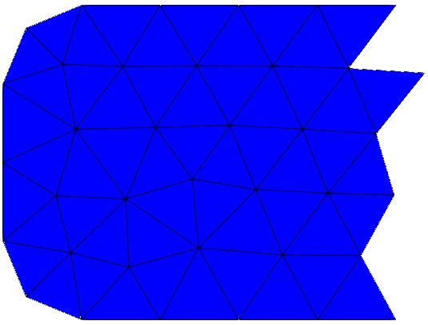
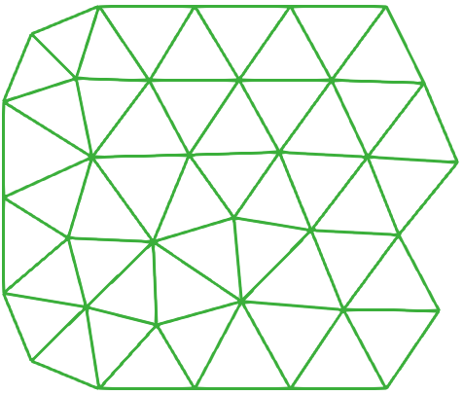

Parallelization of ES-FEM-T4
Brief of the Processing Flow in Our Parallelized ES-FEM-T3
  Partitioning assigns “nodes in charge” to each MPI process.
  Each MPI process extracts “related cells”, which use the nodes in charge.
  Each MPI process extracts “related edges”, which compose the related cells.
  Each MPI process updates “related cells”, which use the related edges.
  Each MPI process extracts “related nodes”, which are used by the related cells.
  Each OpenMP thread in an MPI process calculates the contributions of related edges and makes $\{i^{int}\}$ and $\left[K\right]$
  for the rows of nodes in charge.
2D explanation for simplicity
Nodes
in Charge
The number of
overlapping nodes
has increased
compared to FEM,
which leads to
a slight increase in calculation and communication costs.
Related
Cells
Partitioned
Domain for
Process 0
Related
Edges
Related
Nodes

Slide 18
Benchmark Tests

Slide 19
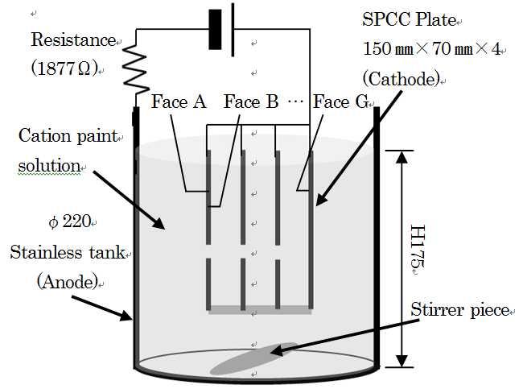
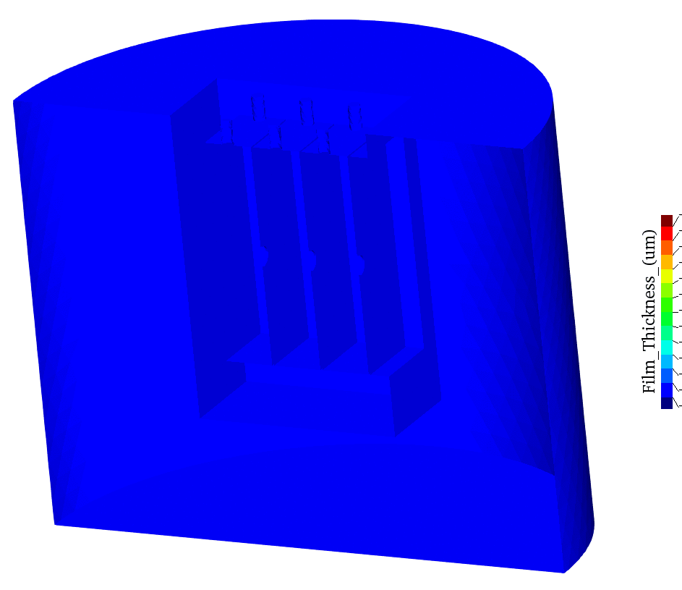
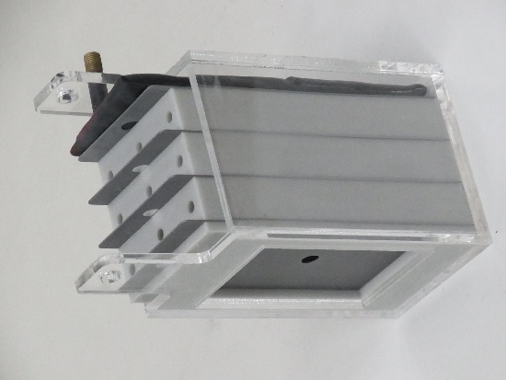
4-Plate BOX Analysis
Outline
Imitating a bag-like structure such as a side sill in a carbody.
Film thickness on the innermost face (Face G) is the most important so as to guarantee corrosion protection.
The film thickness is evaluated with 4 different meshes for using FEM-T4 and ES-FEM-T4
to compare the mesh convergence rate.
4 Plates forms 3 bags.
3rd bag is difficult to be deposited.
Film Thickness Anim.
Photo of a BOX

Slide 20
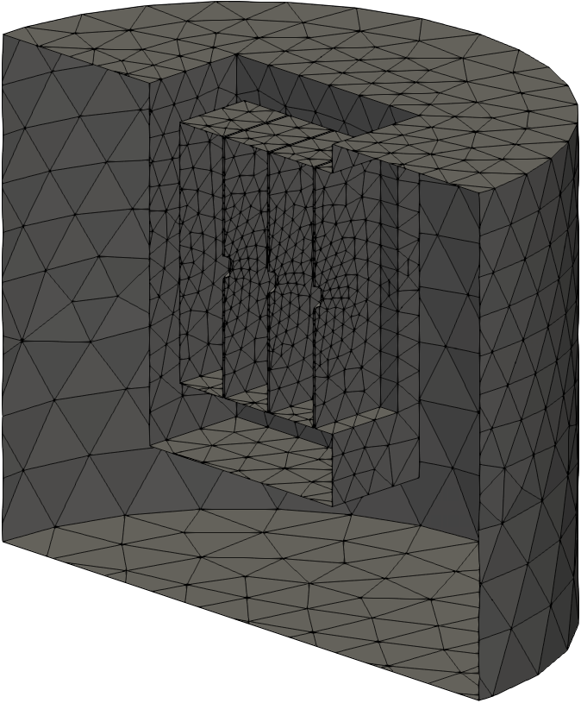
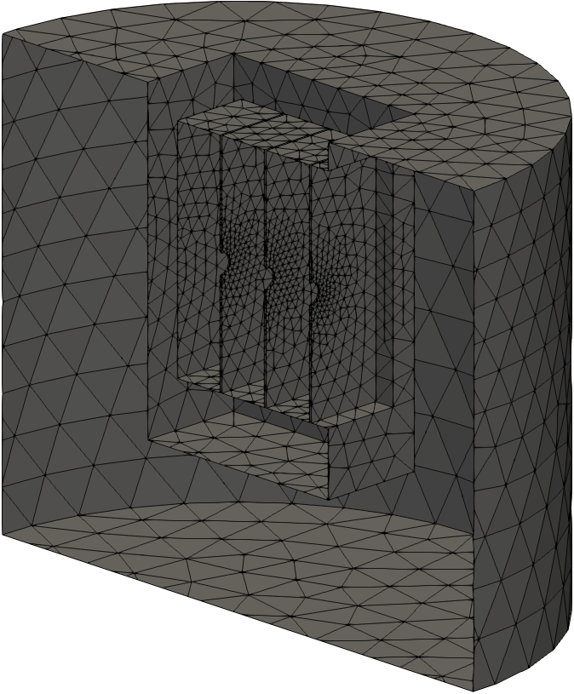
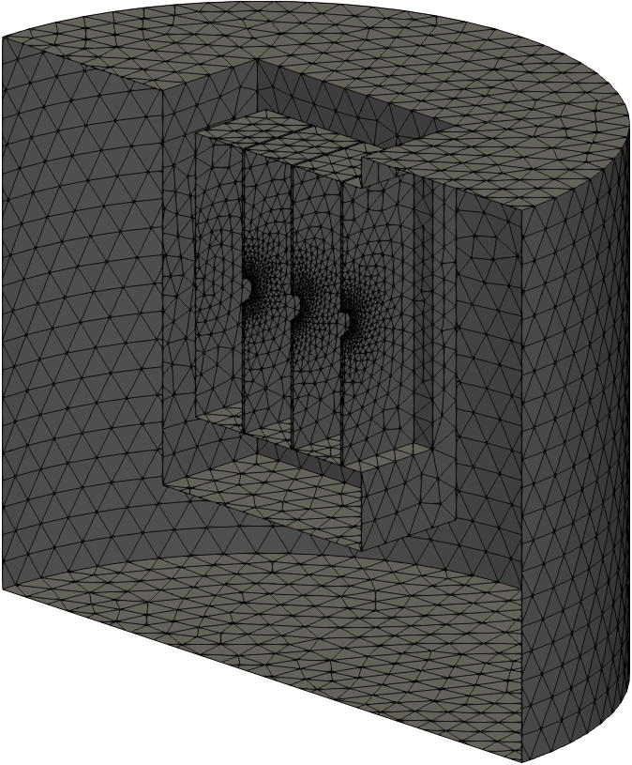
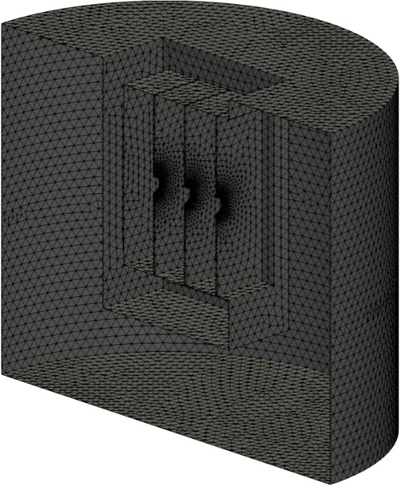
4-Plate BOX Analysis
Overview
of 4 Meshes
Only the
surface meshes
are shown.
3.2 mm Mesh
Seed Size
(31k T4 elem.)
1.6 mm Mesh
Seed Size
(65k T4 elem.)
0.8 mm Mesh
Seed Size
(169k T4 elem.)
0.4 mm Mesh
Seed Size
(716k T4 elem.)

Slide 21
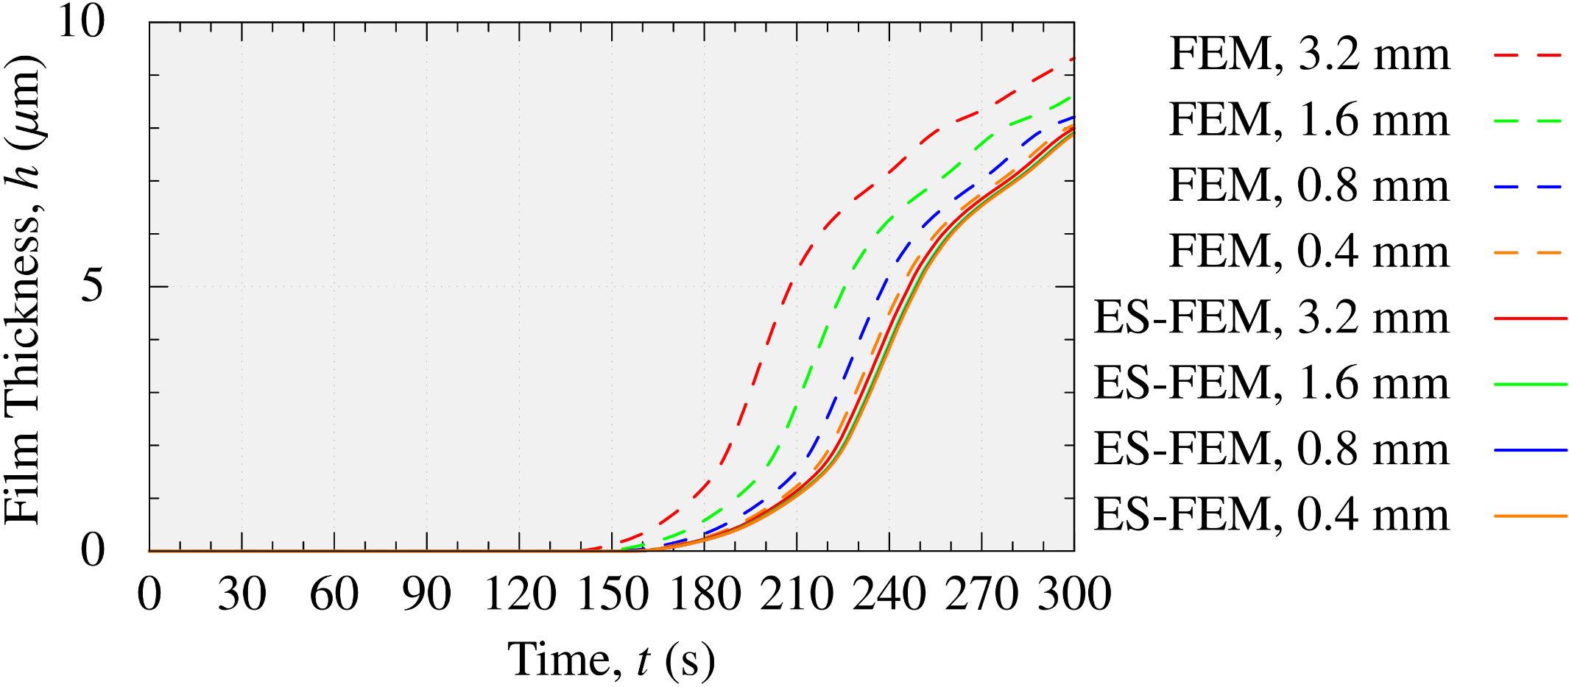
4-Plate BOX Analysis
Film Thickness on Face G (innermost face)
Mesh seed size
FEM results (dashed lines) have large errors.
Meanwhile, ES-FEM results (solid lines) have no such errors
due to the fast mesh convergence rate.

Slide 22
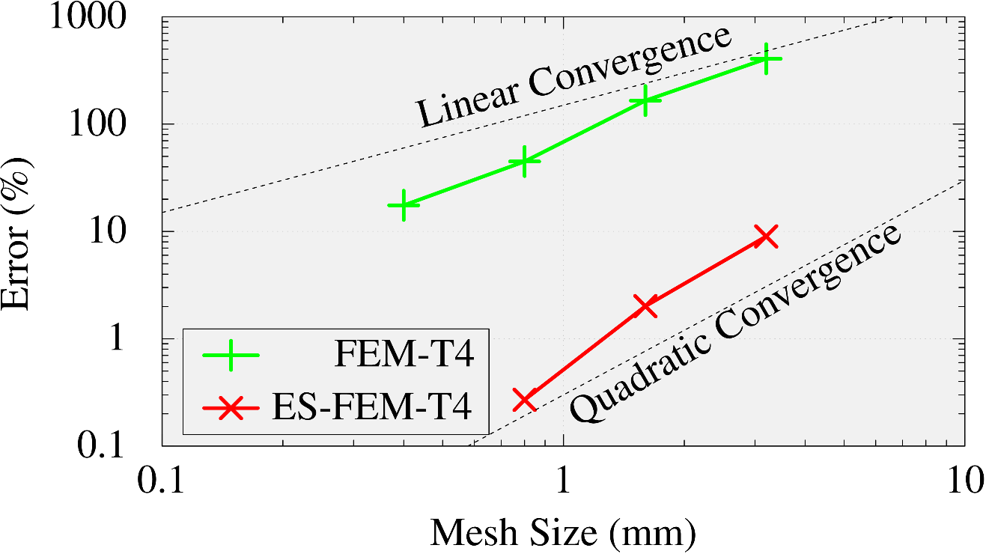
4-Plate BOX Analysis
Comparison of Mesh Convergence Rate on Face G (innermost face)
FEM-T4 shows a linear convergence.
ES-FEM-T4 shows a quadratic convergence.
In Final thickness
The result of ES-FEM with the finest mesh (0.4 mm) is used
as the reference.
ES-FEM-T4 has much better
mesh convergence rate than FEM-T4.

Slide 23
4-Plate BOX Analysis
Comparison of Calculation Time
on a PC (only 1 CPU: Intel i9-9960X)
With the same mesh, ES-FEM is slower than FEM by x2.
For the same accuracy, ES-FEM is faster than FEM by x4.
Mesh Size | FEM-T4 | ES-FEM-T4
3.2 mm | 7 s | 10 s
1.6 mm | 8 s | 14 s
0.8 mm | 12 s | 26 s
0.4 mm | 41 s | 125 s
Comparable
Accuracy
ES-FEM-T4 is supremely efficient
in comparison to FEM-T4.

Slide 24
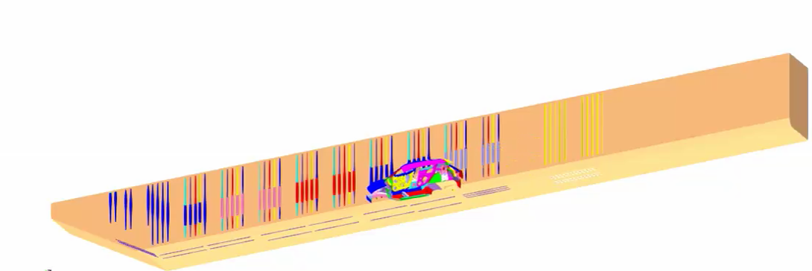

Actual Line Analysis
Outline
Half-body analysis (only right-hand side).
Entire line shape, carbody motion, and electrode conditions are faithfully reproduced.
About 1000 timesteps for 300 s (i.e., average $Δt=0.3$ s).
The film thickness distribution is evaluated with 3 different density meshes
using FEM-T4 and ES-FEM-T4.

Slide 25
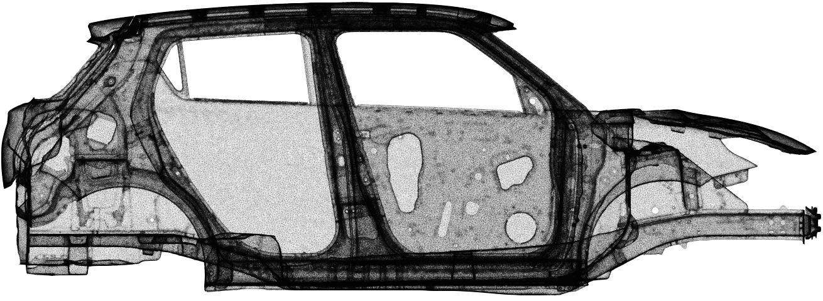
Actual Line Analysis
Overview of Surface Mesh of 10M Element Mesh
There are many ED holes around narrow spaces among plates.
Only the surface
mesh is shown.

Slide 26
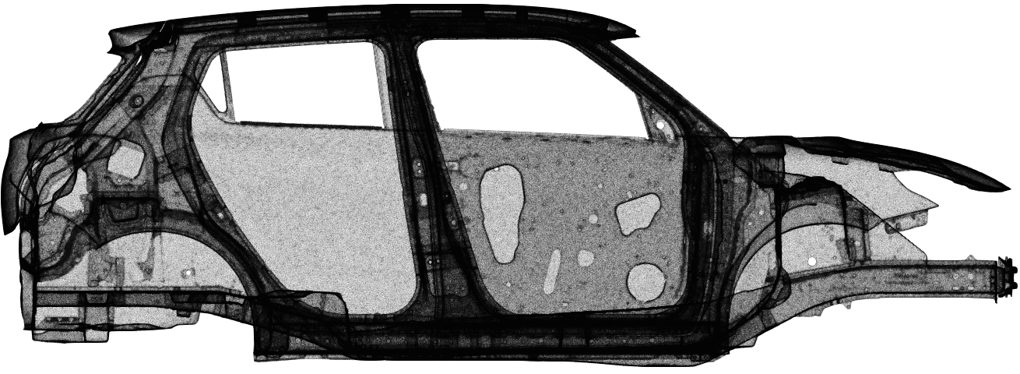
Actual Line Analysis
Overview of Surface Mesh of 16M Element Mesh
There are many ED holes around narrow spaces among plates.
Only the surface
mesh is shown.

Slide 27
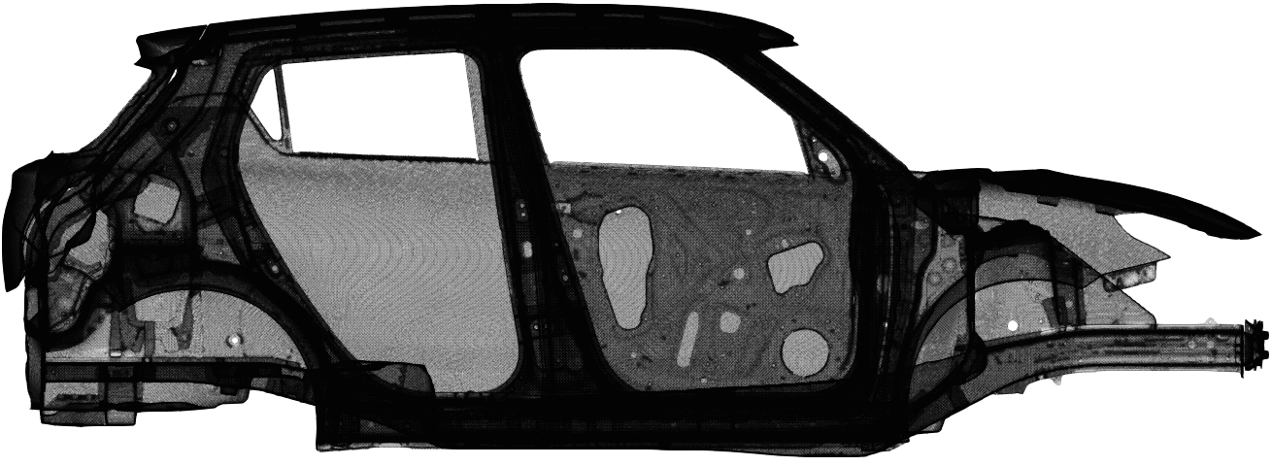
Actual Line Analysis
Overview of Surface Mesh of 51M Element Mesh
There are many ED holes around narrow spaces among plates.
The difference in the mesh can be seen clearly by zooming in around a hole.
Only the surface
mesh is shown.
Let’s zoom in here.

Slide 28
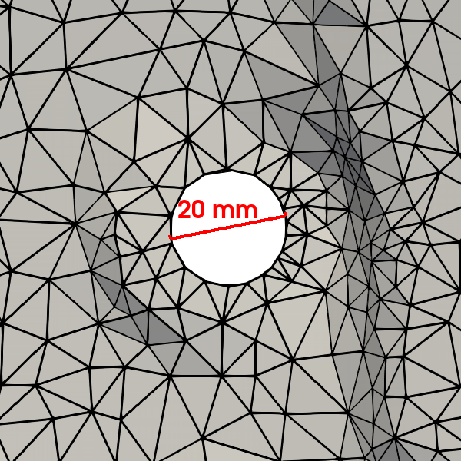
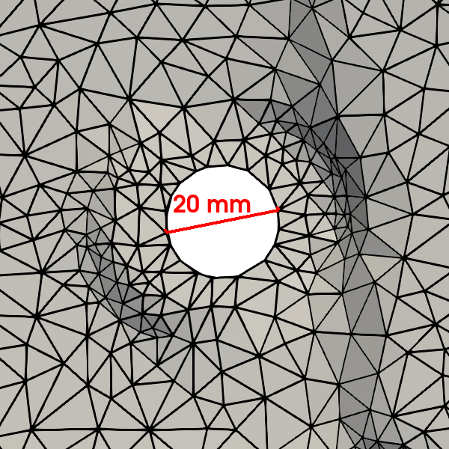
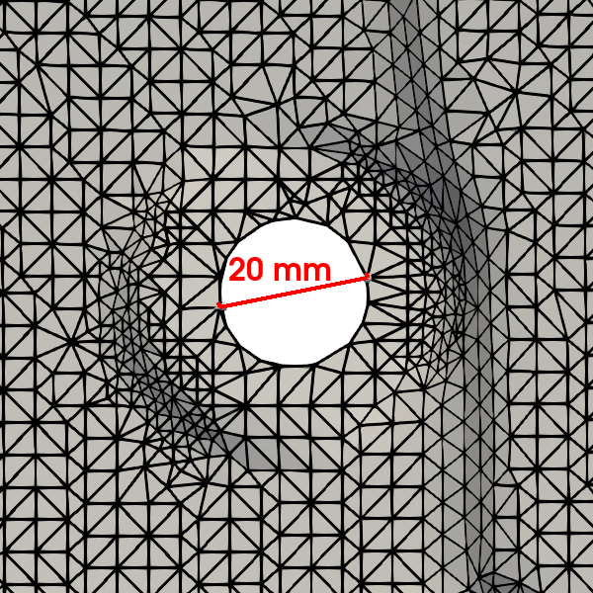
Actual Line Analysis
Zoom in View around the Hole on Carbody
There are many ED holes around narrow spaces among plates.
The difference in the mesh can be seen clearly by zooming in around a hole.
10M
16M
51M
Coarse Fine

Slide 29
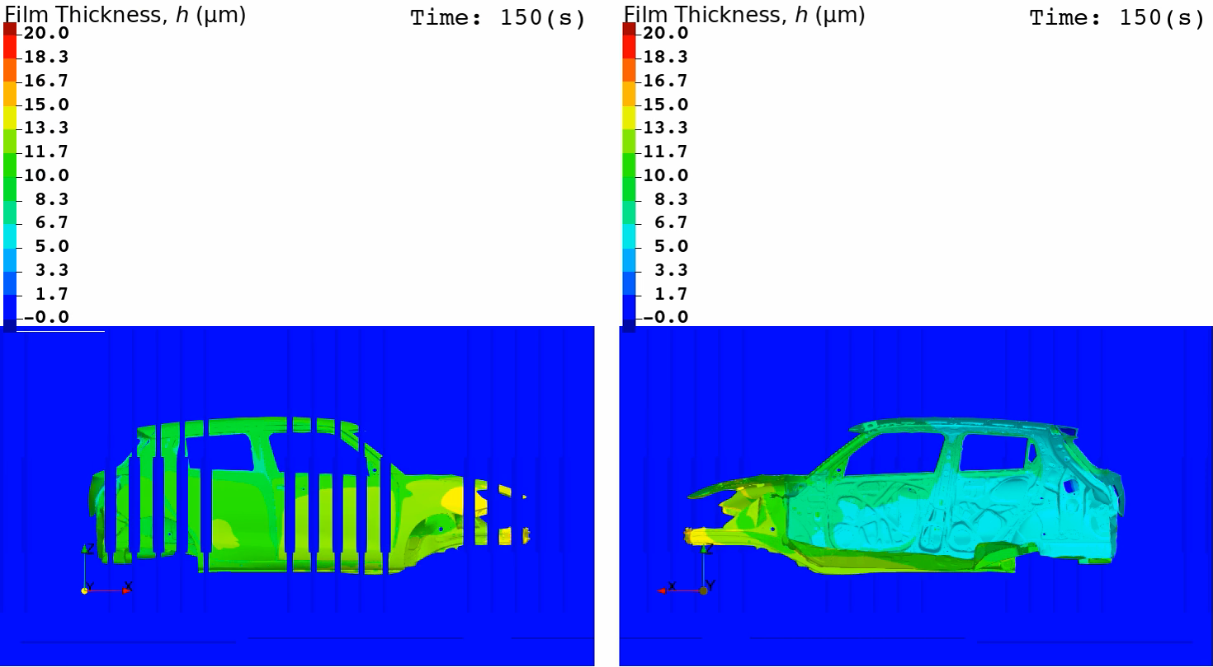
Actual Line Analysis
Animation of Film Thickness (ES-FEM-T4 with 51M Element Mesh)
Outer View Inner View

Slide 30
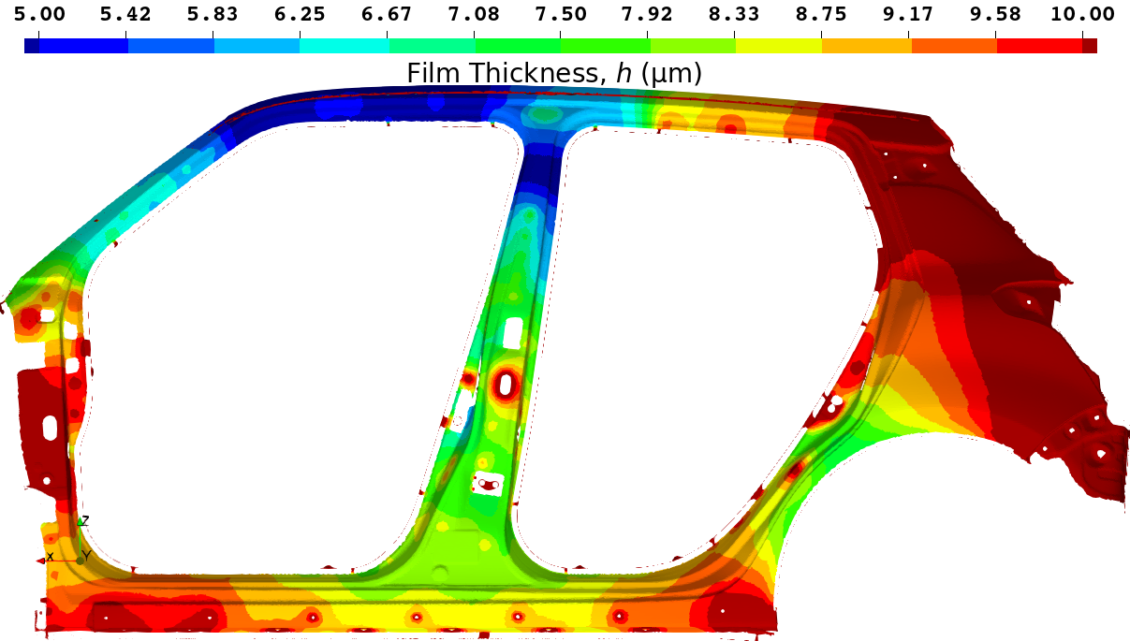
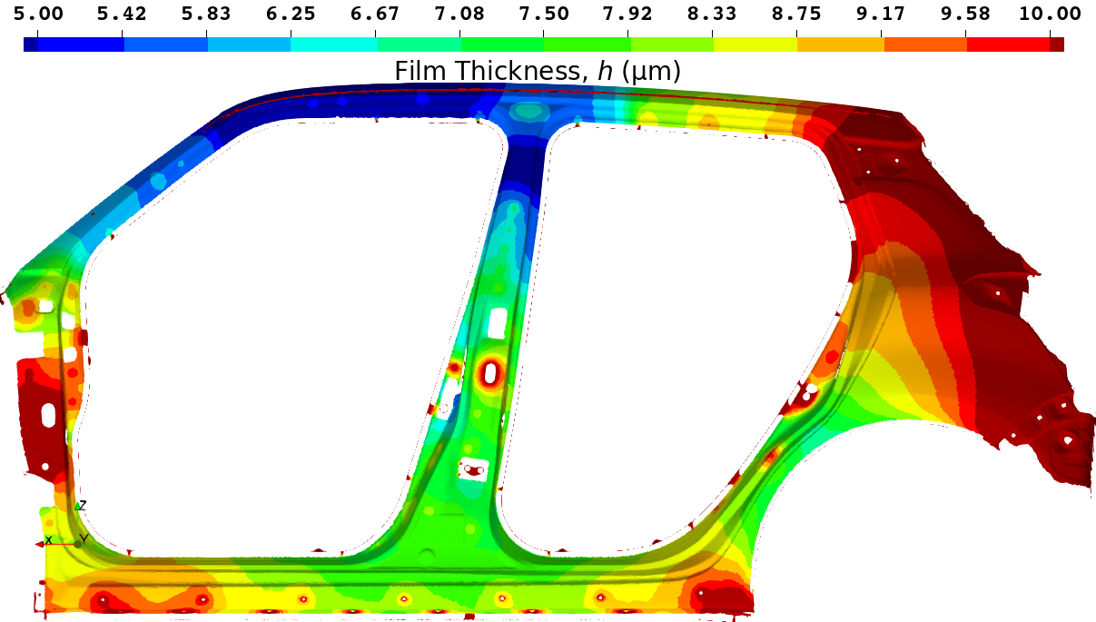
Actual Line Analysis
Final Film Thickness Distribution on the Side Sill Part with 51M Element Mesh
Standard FEM-T4
ES-FEM-T4
Reference Solution
Standard FEM-T4 shows a little thicker result.
(The center of the side sill is Yellow.)
This result is regarded as the reference solution.
(The center of the side sill is Green)

Slide 31
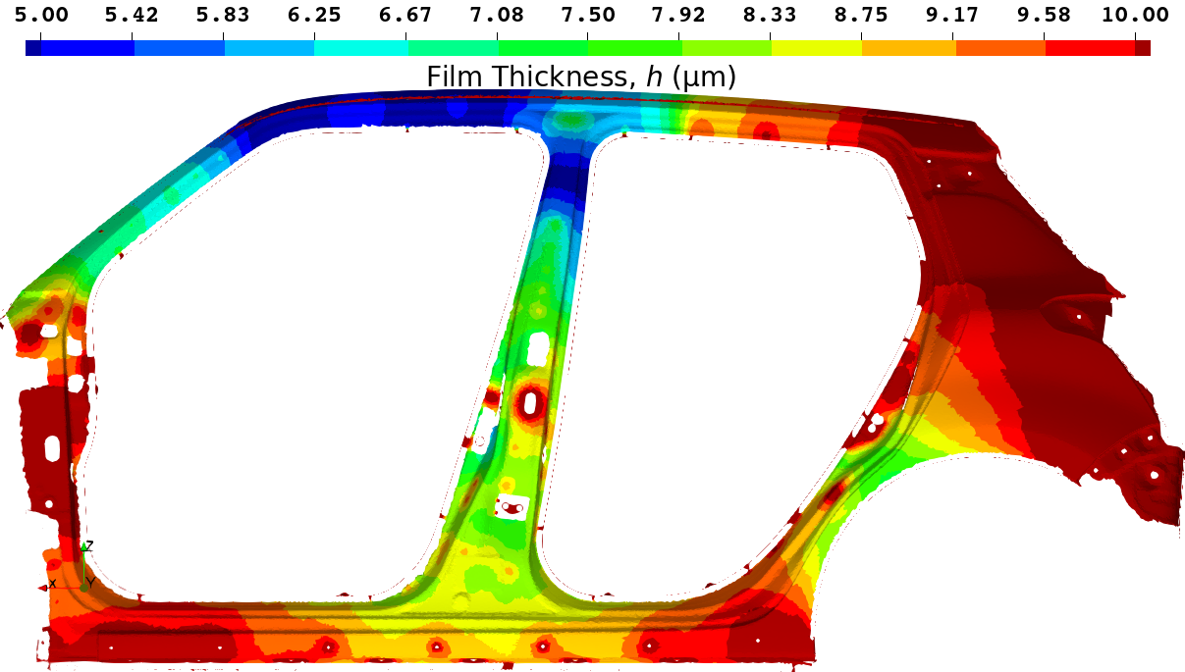
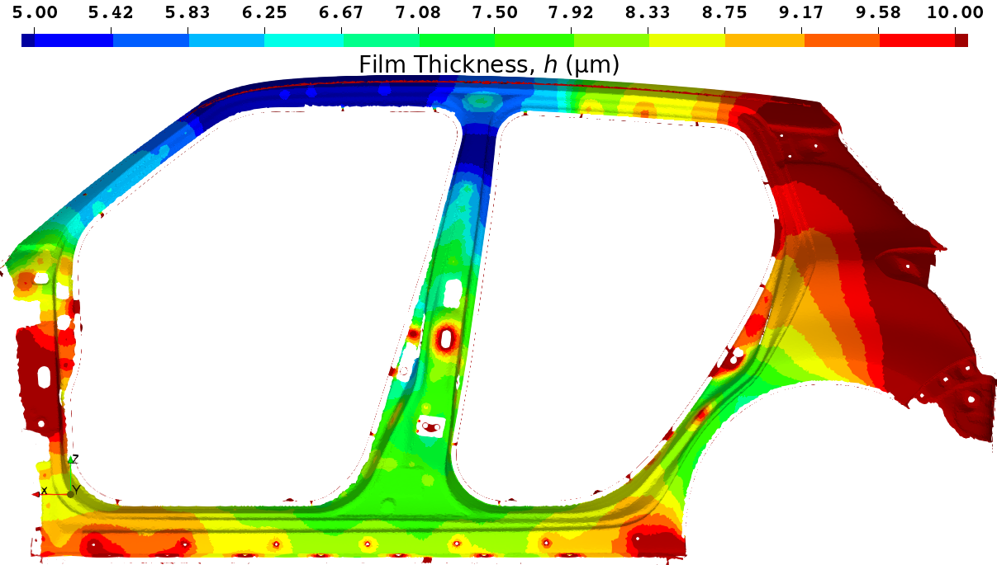
Actual Line Analysis
Final Film Thickness Distribution on the Side Sill part with 16M Element Mesh
Standard FEM-T4
ES-FEM-T4
参照解
Standard FEM-T4 shows a much thicker result.
(The center of the side sill is Orange.)
ES-FEM-T4 shows an accurate result.
(The center of the side sill is Green.)

Slide 32


Actual Line Analysis
Final Film Thickness Distribution on the Side Sill part with 10M Element Mesh
Standard FEM-T4
ES-FEM-T4
For more qualitative comparison,
the time-history of the film thickness
at this point is shown
on the next page.
参照解
Standard FEM-T4 shows a massively thicker result.
(The center of the side sill is Red.)
ES-FEM-T4 shows a little thicker result.
(The center of the side sill is Yellow.)

Slide 33

Actual Line Analysis
Comparison of Time-histories of Film Thickness at the Sample Point on the Side Sill
FEM-T4 with 51M elems. and ES-FEM-T4 with 10M elems.
has almost comparable accuracy.
ES-FEM-T4 with 16M elems. gives a practically converged result.

Slide 34
Actual Line Analysis
Comparison of Calculation Time
On a cluster (64 CPUs: 896 cores of Intel Xeon E5-2680 v4 on TSUBAME3.0)
With the same mesh, ES-FEM-T4 is slower than FEM-T4 by x1.5.
For the same accuracy, ES-FEM-T4 is faster than FEM-T4 by x3.
# of Elements | Standard FEM-T4 | ES-FEM-T4
10M | 1.6 h | 1.9 h
16M | 2.3 h | 3.4 h
51M | 6.0 h | 8.5 h
An actual line analysis
of a single-body entry
takes only a few hours.
Comparable
Accuracy
For the simulations of actual ED lines with parallel computing,
ES-FEM-T4 is much more efficient than FEM-T4.

Slide 35

Actual Line Analysis
Strong Scaling Test (with 10M Element Mesh)
On a cluster (up to 64 CPUs: 896 cores of Intel Xeon E5-2680 v4 on TSUBAME3.0)
Our ES-FEM-T4 code scales to some extent up to 64 CPUs at least.
  $∵$ Some tasks, including MPCs for the moving boundary, are not yet fully parallelized (our future work).

Slide 36
Summary

Slide 37
Summary
Conclusion
ES-FEM-T4 was applied to large-scale practical ED simulations.
The high accuracy of ES-FEM-T4, owing to its super-linear (almost quadratic) mesh convergence rate in ED simulation, was confirmed compared to the poor accuracy of the standard FEM-T4.
Our parallelized ES-FEM-T4 code enabled us to obtain mesh-converged accurate solutions of actual ED line simulations in reasonable time with relatively coarse meshes.
Our code is already in use by automakers.
Further improvement using the edge center-based strain smoothing element (EC-SSE-T4) is our work in the future.
For more information, please visit our commercial code “EDESFEM” official website.
Search
edesfem
Thank you for your kind attention.

Slide 38
Appendix

Slide 39

Actual Line Analysis
Animation of Surface Potential (ES-FEM-T4 with 51M Element Mesh)
Outer View Inner View

Slide 40

Actual Line Analysis
Animation of Current Density (ES-FEM-T4 with 51M Element Mesh)
Outer View Inner View

