Slide 1
Performance evaluation of the edge center-based strain smoothing element with selective reduced integration using 4-node tetrahedral meshes
(EC-SSE-SRI-T4) in nearly incompressible large deformation analyses
Yuki ONISHI (Tokyo Institute of Technology)

Slide 2
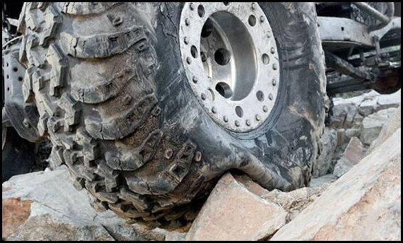

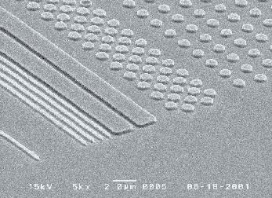

Motivation
What we want to do:
Solve severe large deformation analyses
accurately and robustly.
Treat complex geometries
with tetrahedral meshes.
Consider nearly incompressible materials $(ν≃0.5)$.
Support contact problems.
Handle auto re-meshing.
Rubber
Metal
Plastic/Glass

Slide 3
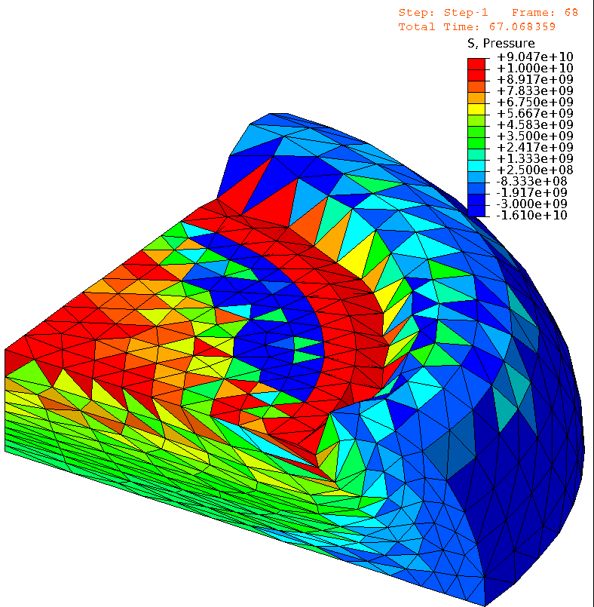
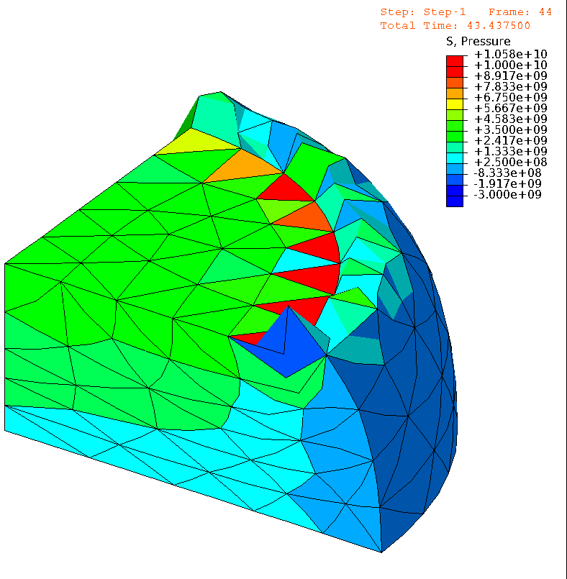

Issues in Conventional FE (ABAQUS）
e.g.) Barreling of Rubber Cylinder Neo-Hookean hyperelastic body with $ν_{ini}=0.49$
4 node tet
(T4)
Pressure
10 node tet
(T10)
Pressure
T4
T10
Almost
the same
# of nodes.
ABQUS C3D4H
✓ No volumetric locking.
✗ Pressure checkerboarding.
✗ Shear locking & Corner locking.
ABAQUS C3D10MH
✓ No shear/volumetric locking.
✗ Short lasting (weak to severe deformation).
✗ Low interpolation accuracy.

Slide 4
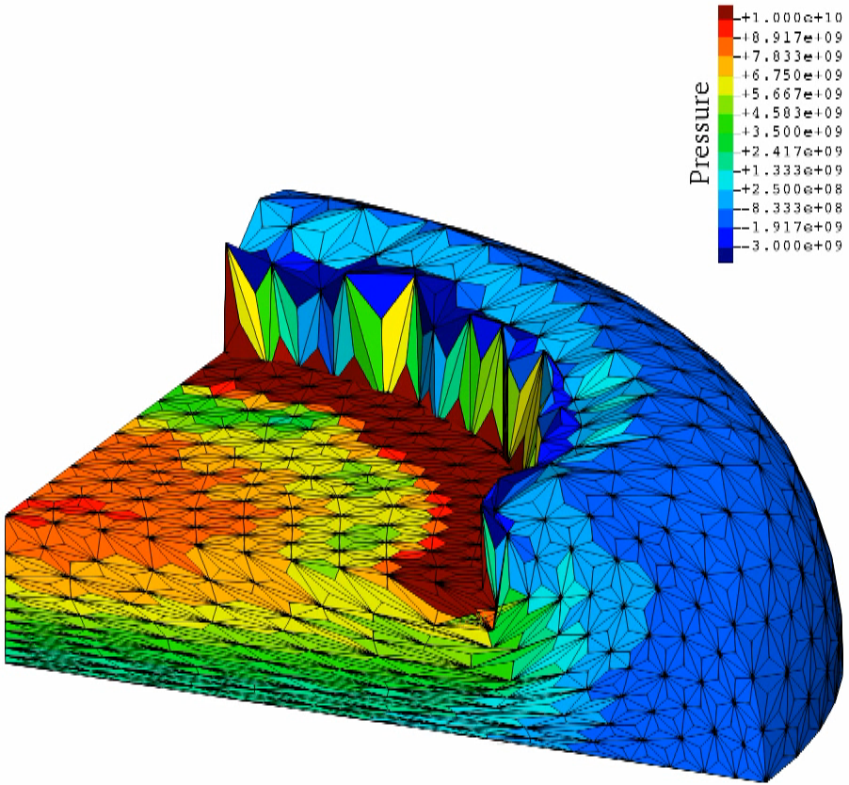
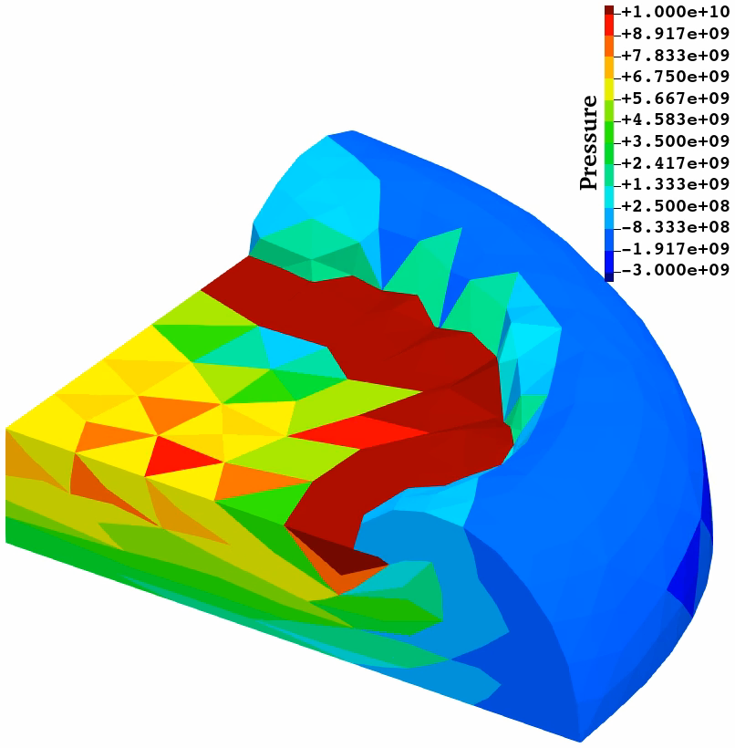
Our Approach using S-FEM
e.g.) Barreling of Rubber Cylinder Neo-Hookean hyperelastic body with $ν_{ini}=0.49$
4 node tet
(T4)
10 node tet
(T10)
Pressure
Pressure
T4
T10
F-barES-FEM-T4 (2017)
✓ No shear/volumetric locking.
✓ Less pressure checkerboarding.
✓ Less corner locking. Long lasting.
✓ No oscillation in deviatoric stress.
✗ Long CPU time. Incompatible w/ FE.
SelectiveCS-FEM-T10 (2021)
✓ No shear/volumetric locking.
✓ Less pressure checkerboarding.
✓ Less corner locking. Long lasting.
✗ Major oscillation in deviatoric stress.
✓ Same CPU time. Compatible w/ FE.
Cannot suppress
stress oscillation,
but no good idea
for accuracy improvement…
More than 10 times slower than FEM-T4, but no good idea for speed-up…

Slide 5
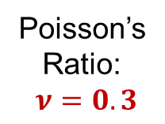
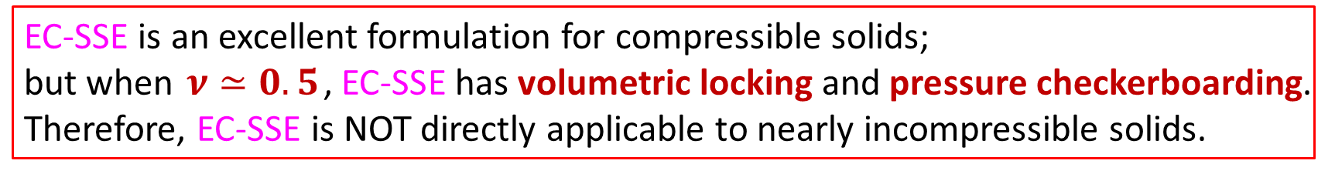
Birth of a Next-gen S-FEM, EC-SSE, in 2022
Comparison of Mises stress dist. in cantilever bending analyses in 2D
T. Jinsong et al., Euro. J. Mech. /A, v95, 2022.
Step-like stress dist. (poor).
Shear locking.
T3
Poisson’s
Ratio:
$ν=0.3$
Edge
Center-based
Strain
Smoothing
Element
Linear stress dist. (very good)
using the same T3 mesh.
Very close to analytical solution.
No shear locking.
Detailed Later
This breakthrough
should be called
“S-FEM 2.0”.
EC-SSE is an excellent formulation for compressible solids;
but when $ν≃0.5$, EC-SSE has volumetric locking and pressure checkerboarding.
Therefore, EC-SSE is NOT directly applicable to nearly incompressible solids.

Slide 6
Objective
Objective
Strategy
Use the selective reduced integration (SRI)
Use EC-SSE for the deviatoric part,
Use NS-FEM for the volumetric part, and
Combine them with SRI.
Develop a new S-FEM formulation to extend EC-SSE
to nearly incompressible large deformation analysis
EC-SSE-SRI

Slide 7
Method
Introduction to ES-FEM, NS-FEM，EC-SSE，and EC-SSE-SRI

Slide 8





Brief of ES-FEM
Let me
explain in 2D
for simplicity
Let us consider a mesh with only two 3-node triangular cells.
Make $\left[B\right](=dN/dx)$ at each cell as usual.
At each edge, gather $[B]$s of the connecting cells and average them with area weights
to build $[ ^{Edge}B]$ .
Calculate strain $(ε)$, stress ($σ$) and nodal internal force $\{f^{int}\}$ in each edge smoothing domain with $[ ^{Edge}B]$.
$$[B_{1}]$$
As if putting
a Gauss point
on each edge center
No shear locking.
Cannot avoid
volumetric locking &
pressure checkerboarding.
Strain distribution is
piecewise constant
in each smoothing domain.
$$[B_{2}]$$
$$[^{Edge}B]$$
$↳{}^{Edge}ε,{}^{Edge}σ, \{^{Edge}f^{int}\}$ etc.

Slide 9







Brief of NS-FEM
Let me
explain in 2D
for simplicity
Let us consider a mesh with only four 3-node triangular cells.
Make $\left[B\right](=dN/dx)$ at each cell as usual.
At each node, gather $[B]$s of the connecting cells and average them with area weights
to build $[ ^{Node}B]$ .
Calculate strain $(ε)$, stress ($σ$) and nodal internal force $\{f^{int}\}$ in each nodal smoothing domain with $[ ^{Node}B]$.
$$[B_{4}]$$
$$[B_{1}]$$
As if putting
a Gauss point
on each node center
No shar/volumetric locking.
Less pressure checkerboarding
$$[B_{3}]$$
$$[B_{2}]$$
Cannot avoid
spurious low-energy modes.
Strain distribution is
piecewise constant
in each smoothing domain.
$$[^{Node}B]$$
$↳{}^{Node}ε,{}^{Node}σ, \{^{Node}f^{int}\}$ etc.

Slide 10
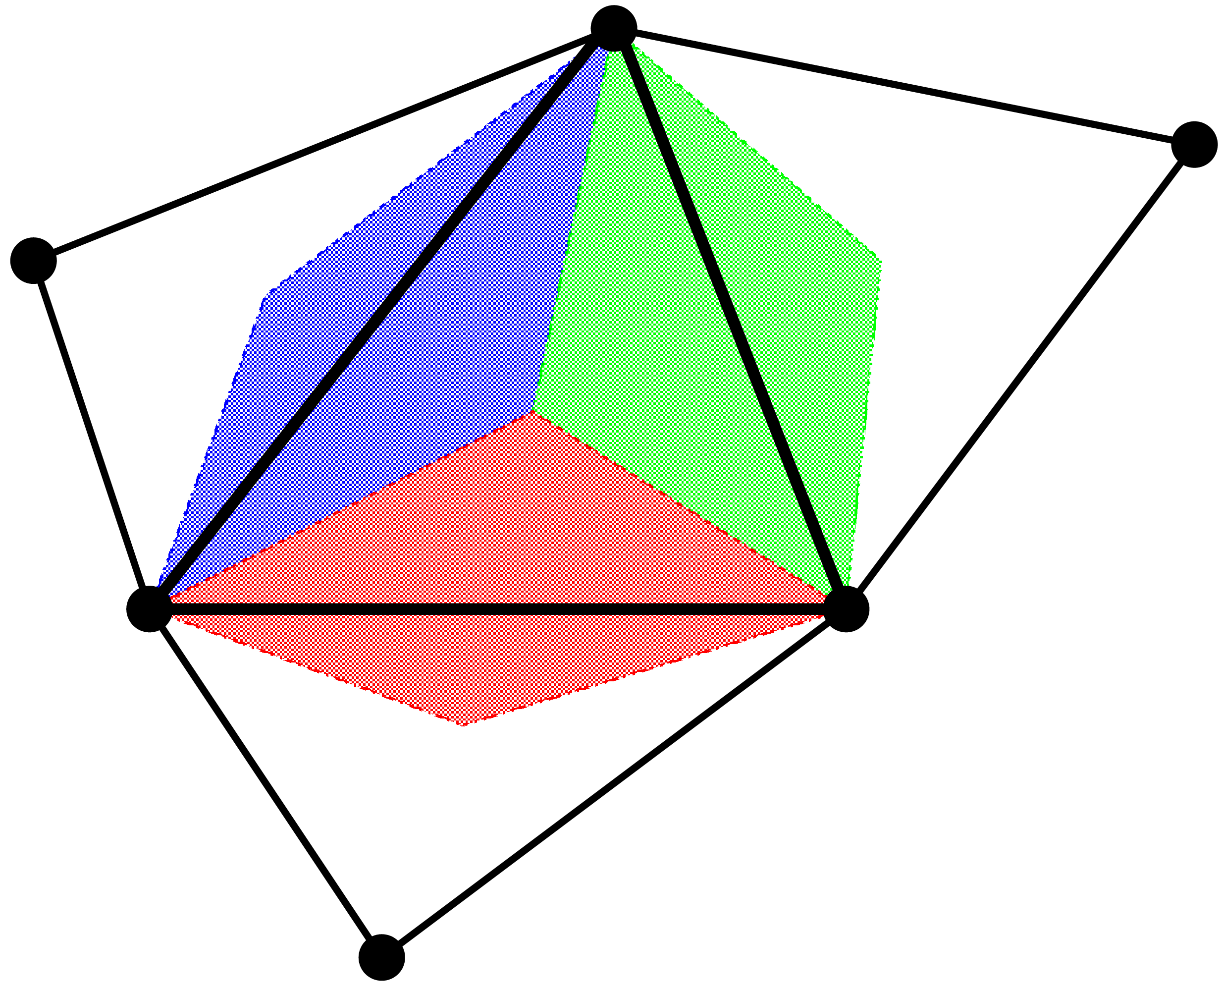
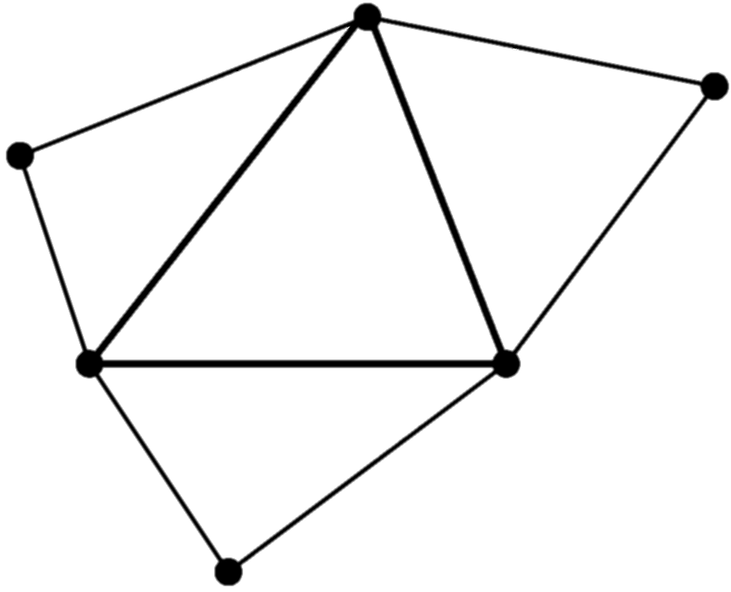
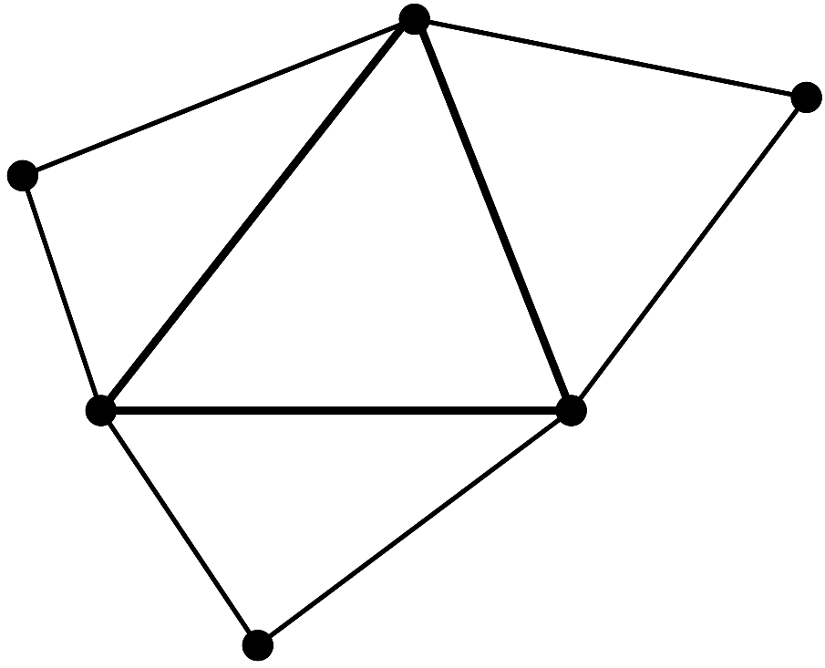








Brief of EC-SSE
Let me
explain in 2D
for simplicity
Make $\left[ ^{Edge}B\right]$s in the same procedure as ES-FEM.
Consider each $[ ^{Edge}B]$ is the value at the center of each edge,
and assume $[B]$ is linearly distributed in each cell.
Make three $[ ^{Gaus}B]$s in each cell as the extrapolation of the three $[ ^{Edge}B]$s.
Calculate $^{Gaus}ε$, $^{Gaus}σ$and $\{f^{int}\}$ using each $\left[ ^{Gaus}B\right]$ in the same manner
as the 2nd -order element.
Conducting strain smoothing twice,
the strain/stress are evaluated
at each Gauss point.
No shear locking
with T3/T4 mesh.
Fast mesh convergence rate
in strain/stress
as an 2nd –order element.
$[ ^{Edge}B_{3}]$
$[ ^{Edge}B_{2}]$
$[ ^{Gaus}B_{3}]$
$[ ^{Gaus}B_{1}]$
$[ ^{Gaus}B_{2}]$
Strain distribution is
piecewise-linear in each cell
and is
continuing at every edge center.
$[ ^{Edge}B_{1}]$
Cannot avoid
volumetric locking and
pressure checkerboarding

Slide 11

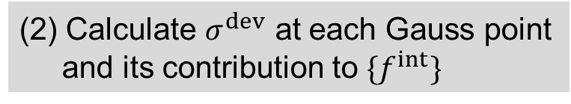

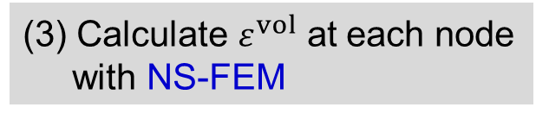
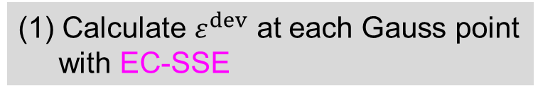
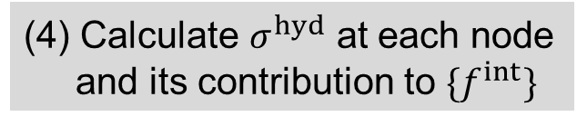
Brief of EC-SSE-SRI (Our Latest Method)
Let me
explain in 2D
for simplicity
Apply the selective reduced integration (SRI) to EC-SSE to handle rubber-like solids
(1) Calculate $ε^{dev}$ at each Gauss point
with EC-SSE
(3) Calculate $ε^{vol}$ at each node
with NS-FEM
Deviatoric
Part
Volumetric
Part
(2) Calculate $σ^{dev}$ at each Gauss point
and its contribution to $\{f^{int}\}$
(4) Calculate $σ^{hyd}$ at each node
and its contribution to $\{f^{int}\}$
Selective Reduced
Integration (SRI)
Deviatoric strain distribution is
piecewise-linear in each cell
and is
continuing at each edge center.
No shear/volumetric locking.
Less pressure checkerboarding.
(5) Assemble $\{f^{int}\}$

Slide 12
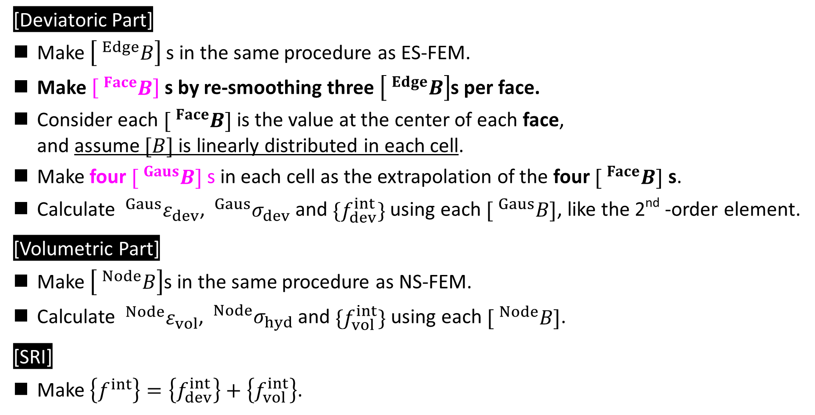
Brief of EC-SSE-SRI-T4 (in 3D)
Let me
explain with
text only
[Deviatoric Part]
Make $\left[ ^{Edge}B\right]$s in the same procedure as ES-FEM.
Make $\left[ ^{Face}B\right]$s by re-smoothing three $\left[ ^{Edge}B\right]$s per face.
Consider each $[ ^{Face}B]$ is the value at the center of each face,
and assume $[B]$ is linearly distributed in each cell.
Make four $[ ^{Gaus}B]$ s in each cell as the extrapolation of the four $[ ^{Face}B]$ s.
Calculate $^{Gaus}ε_{dev}$, $^{Gaus}σ_{dev}$and $\{f_{dev}^{int}\}$ using each $[ ^{Gaus}B]$, like the 2nd -order element.
[Volumetric Part]
Make $\left[ ^{Node}B\right]$s in the same procedure as NS-FEM.
Calculate $^{Node}ε_{vol}$, $^{Node}σ_{hyd}$and $\{f_{vol}^{int}\}$ using each $[ ^{Node}B]$.
[SRI]
Make $\left\{f^{int}\right\}=\left\{f_{dev}^{int}\right\}+\left\{f_{vol}^{int}\right\}$.

Slide 13
Result & Discussion
Performance evaluation of EC-SSE-SRI-T4 in 3D and Discussion of CPU Cost

Slide 14
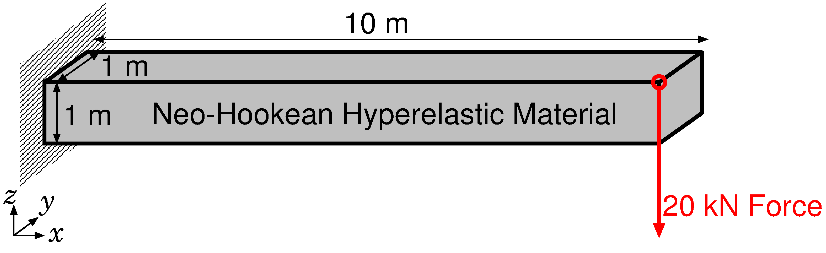
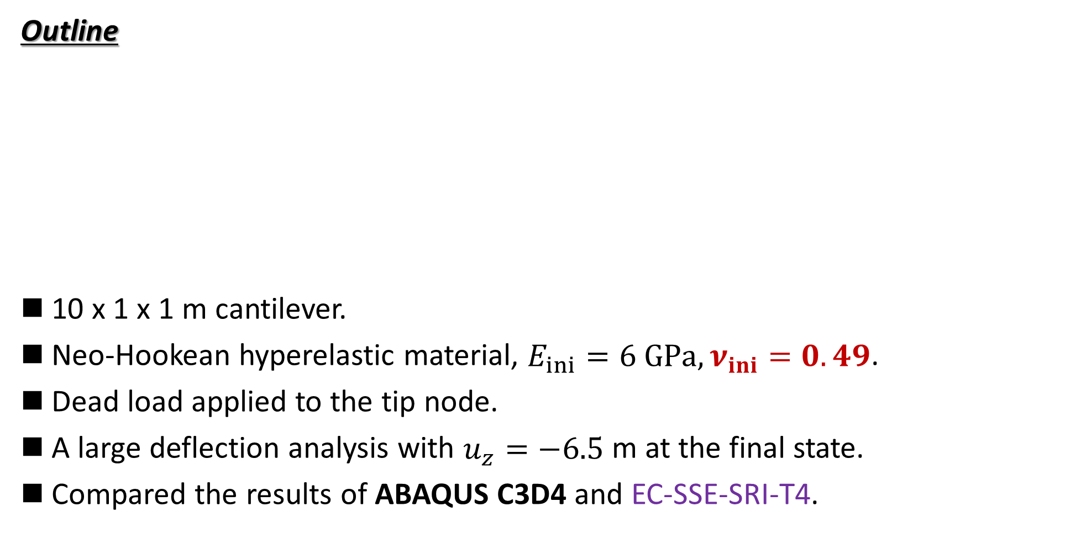
Bending of Rubber Cantilever
Static
Implicit
Outline
10 x 1 x 1 m cantilever.
Neo-Hookean hyperelastic material, $E_{ini}=6 GPa, ν_{ini}=0.49$.
Dead load applied to the tip node.
A large deflection analysis with $u_{z}=−6.5$ m at the final state.
Compared the results of ABAQUS C3D4 and EC-SSE-SRI-T4.
Dead Load

Slide 15
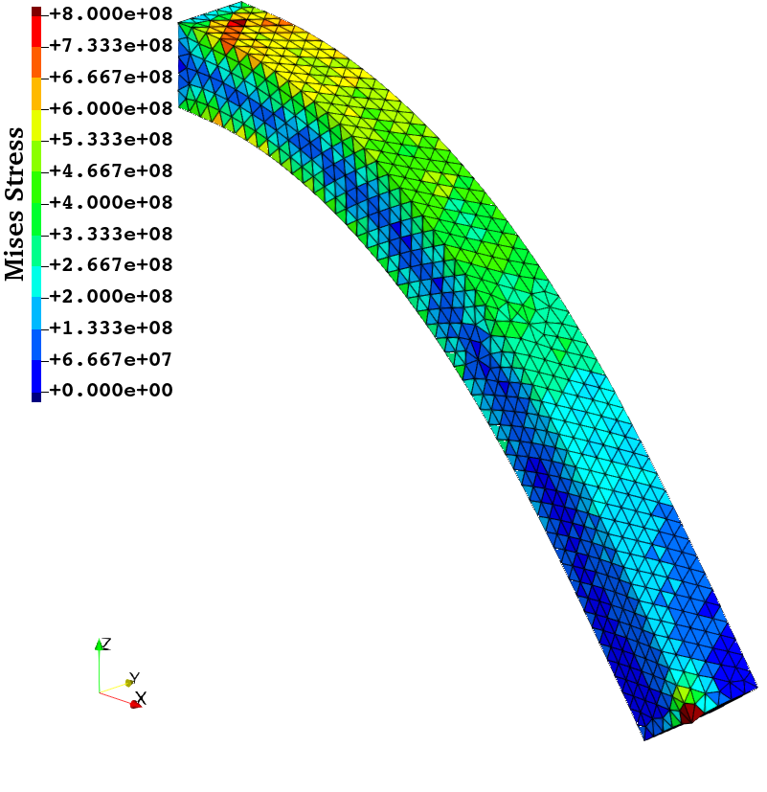
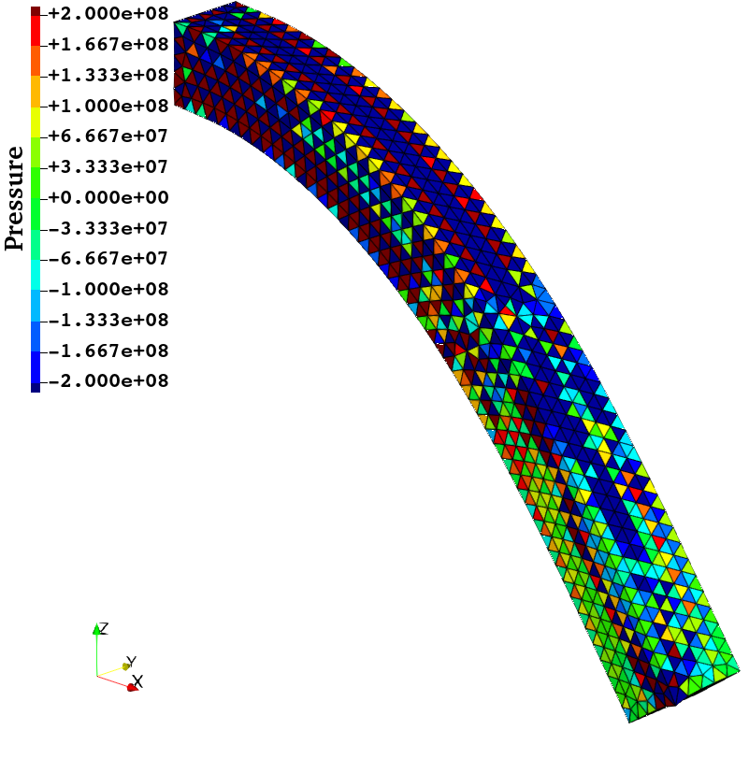
Bending of Rubber Cantilever
Static
Implicit
Results of
ABAQUS
C3D4
(Final State)
Discontinuous distribution.
Volumetric locking.
(-15% error in deflection)
Severe pressure
checkerboarding.
ABAQUS dat file:
***WARNING: THE INITIAL BULK MODULUS OF 9.93333E+10 EXCEEDS 25 TIMES THE
INITIAL SHEAR MODULUS OF 2.00000E+09 (SO THE INITIAL POISSONS
RATIO 0.49000 EXCEEDS 0.48) FOR THE HYPERELASTIC MATERIAL NAMED
MATERIAL-1. HOWEVER, A HYBRID TYPE ELEMENT IS NOT USED. THIS MAY
CAUSE CONVERGENCE PROBLEMS.

Slide 16
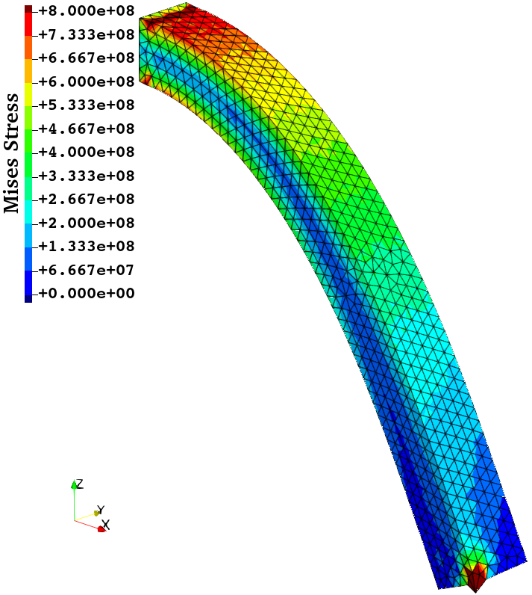
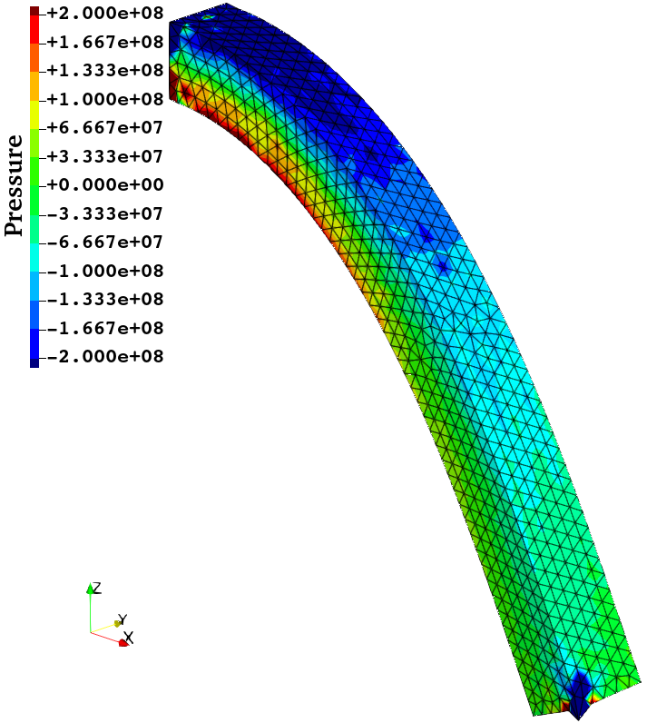
Bending of Rubber Cantilever
Static
Implicit
Results of
EC-SSE
-SRI-T4
(Final State)
Smooth distribution.
No locking.
Little oscillation, but no checkerboarding.

Slide 17
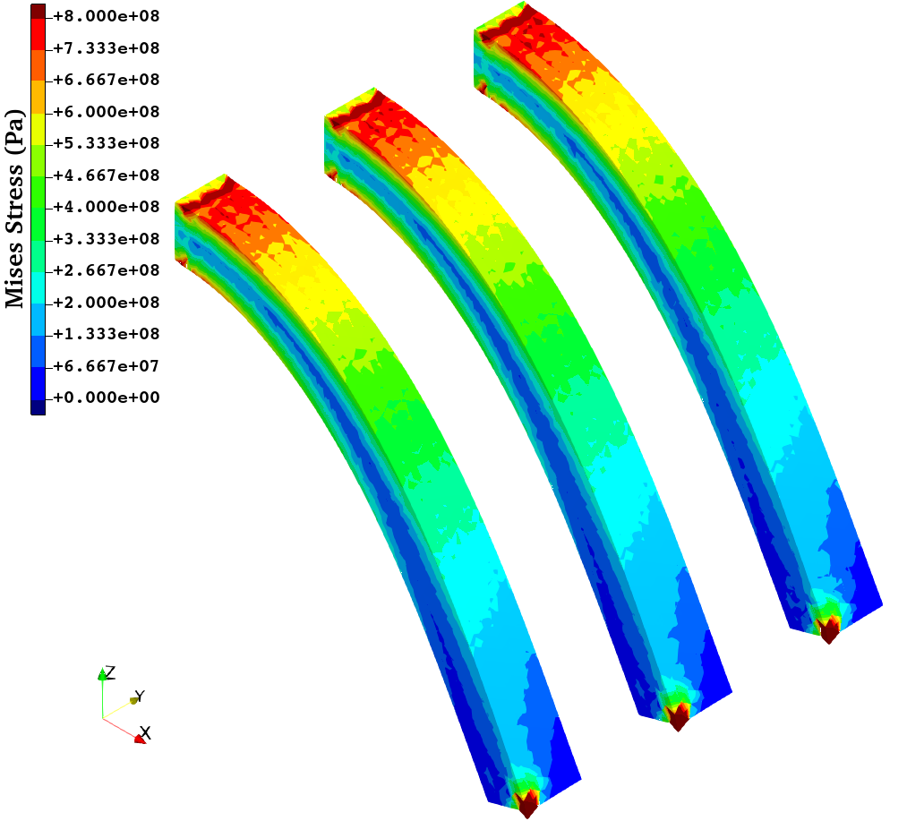
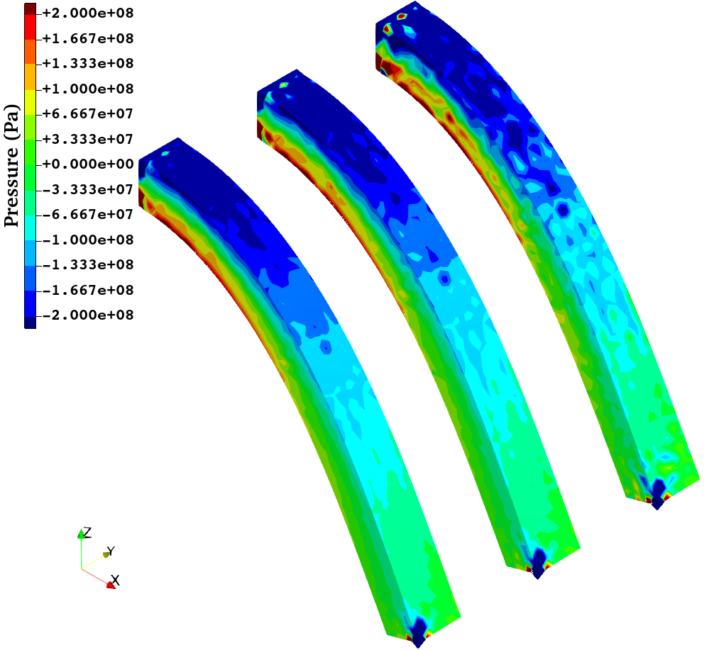
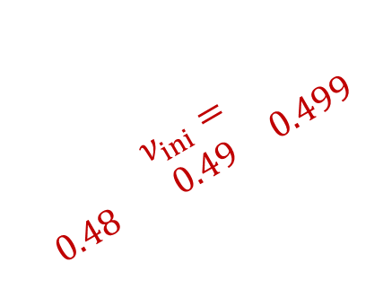


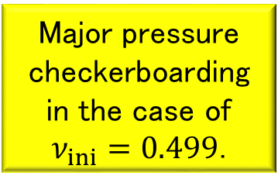
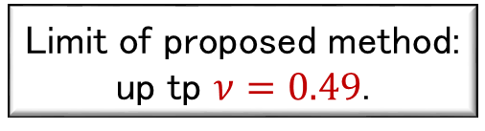
Bending of Rubber Cantilever
Static
Implicit
Results of EC-SSE-SRI-T4 with Different $ν_{ini}$s (Final State)
$$ν_{ini}= \\ 0.48 0.49 0.499$$
$$ν_{ini}= \\ 0.48 0.49 0.499$$
Major pressure checkerboarding
in the case of $ν_{ini}=0.499$.
No major difference in the Mises stress distributions.
Limit of proposed method:
up tp $ν=0.49$.

Slide 18
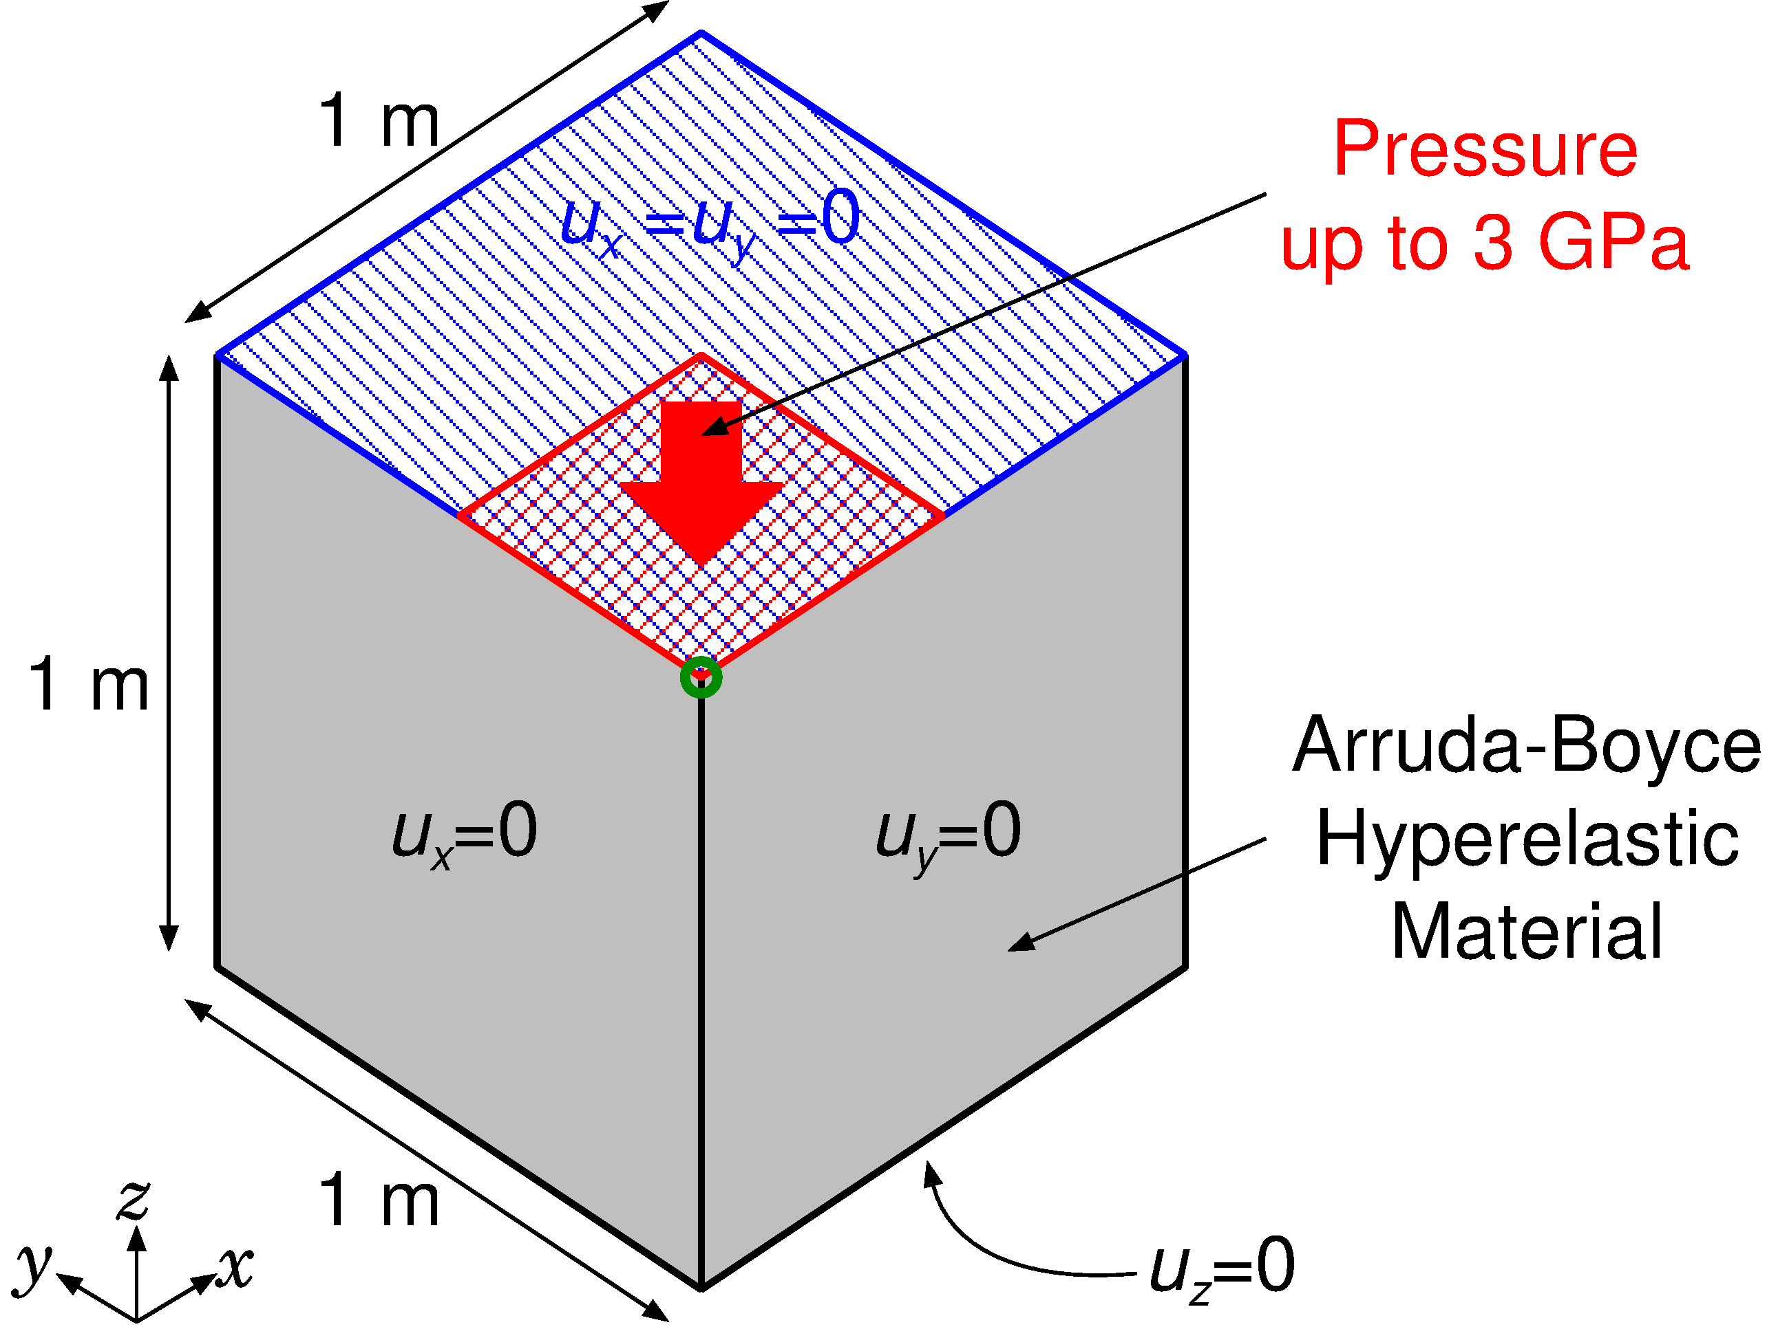

Pressuring of Rubber Block
Static
Implicit
Outline
1 x 1 x 1 m block.
Arruda-Boyce hyperelastic material, $E_{ini}=24$ GPa, $ν_{ini}=0.49$.
Applying pressure on ¼ of the top face with lateral confinement.
Evaluated the result of EC-SSE-SRI-T4.
Load

Slide 19
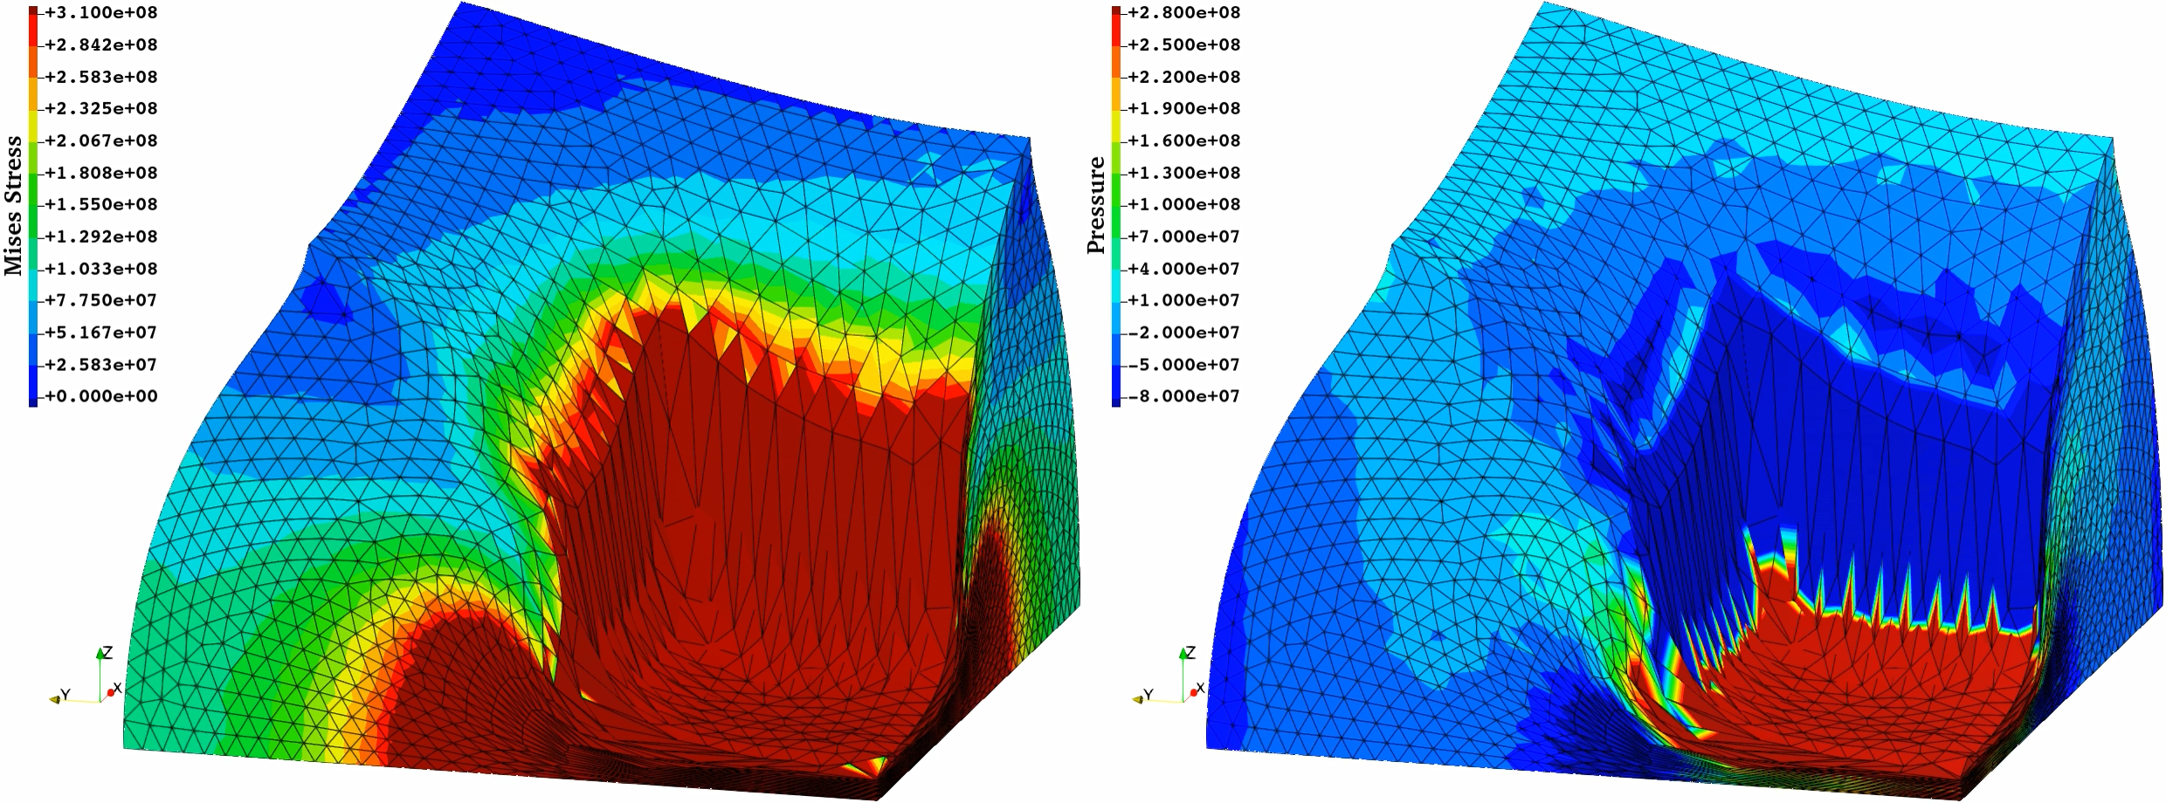
Pressuring of Rubber Block
Static
Implicit
Results of EC-SSE-SRI-T4
No big issue in stress distributions
Sufficient large deformation robustness

Slide 20
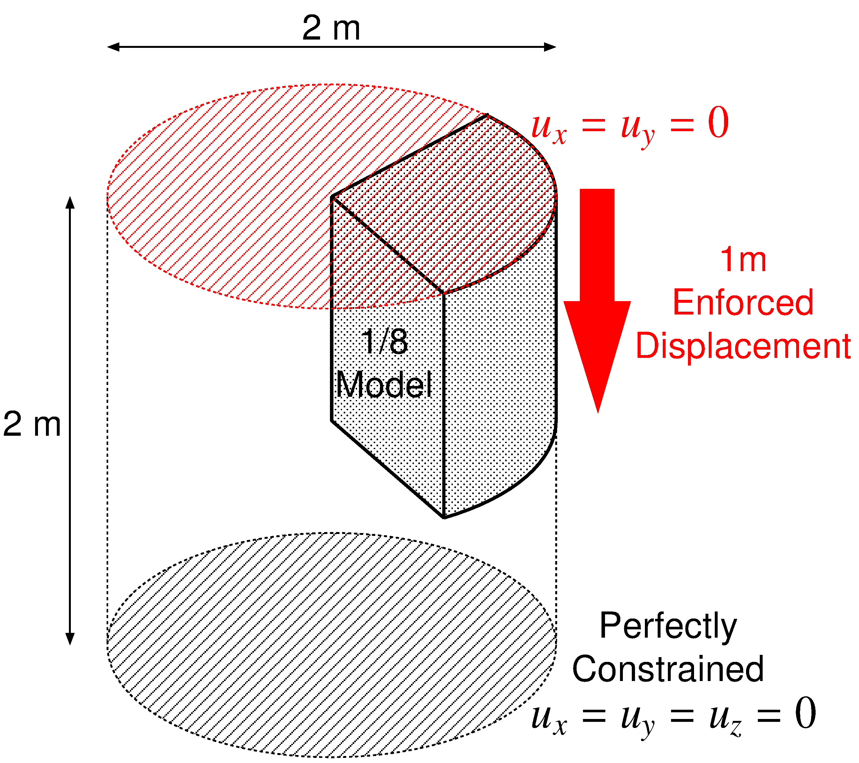

Barreling of Rubber Cylinder
Static
Implicit
Outline
1 m cylinder in radius and height.
Neo-Hookean hyperelastic material, $E_{ini}=6 GPa, ν_{ini}=0.49$.
Applying enforced compression displacement on the top face with lateral confinement.
Evaluated the result of EC-SSE-SRI-T4.

Slide 21
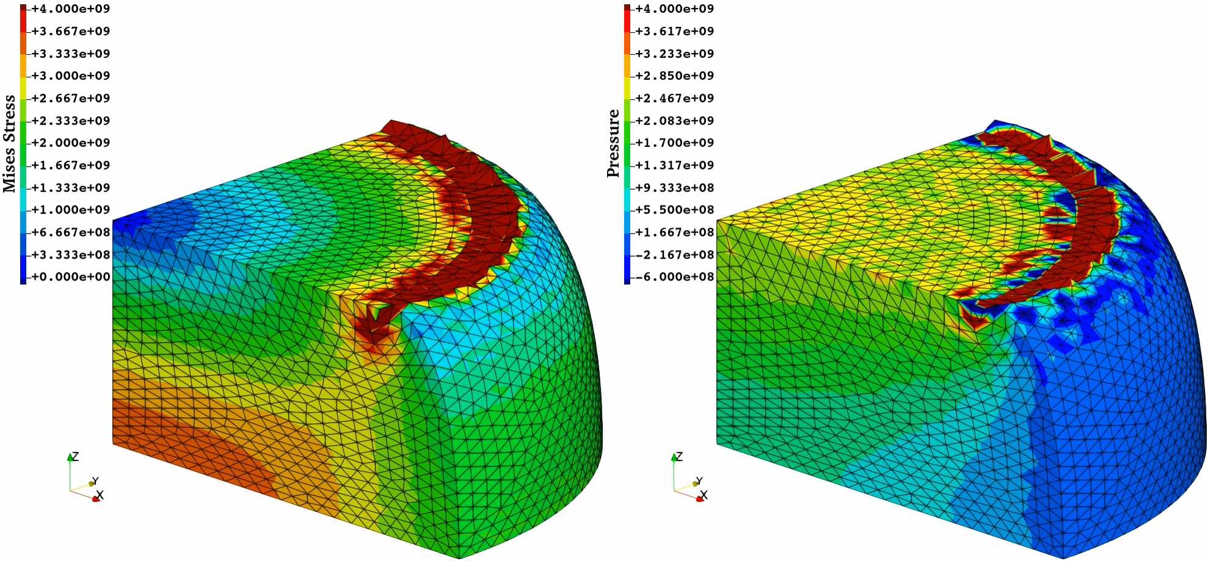

Barreling of Rubber Cylinder
Static
Implicit
Convergence failure
at 37% compression.
$∴$ acceptably robust in large deformation
Within acceptable
range, I think.
Results of EC-SSE-SRI-T4
No problem in Mises stress.
Minor oscillation in pressure.

Slide 22
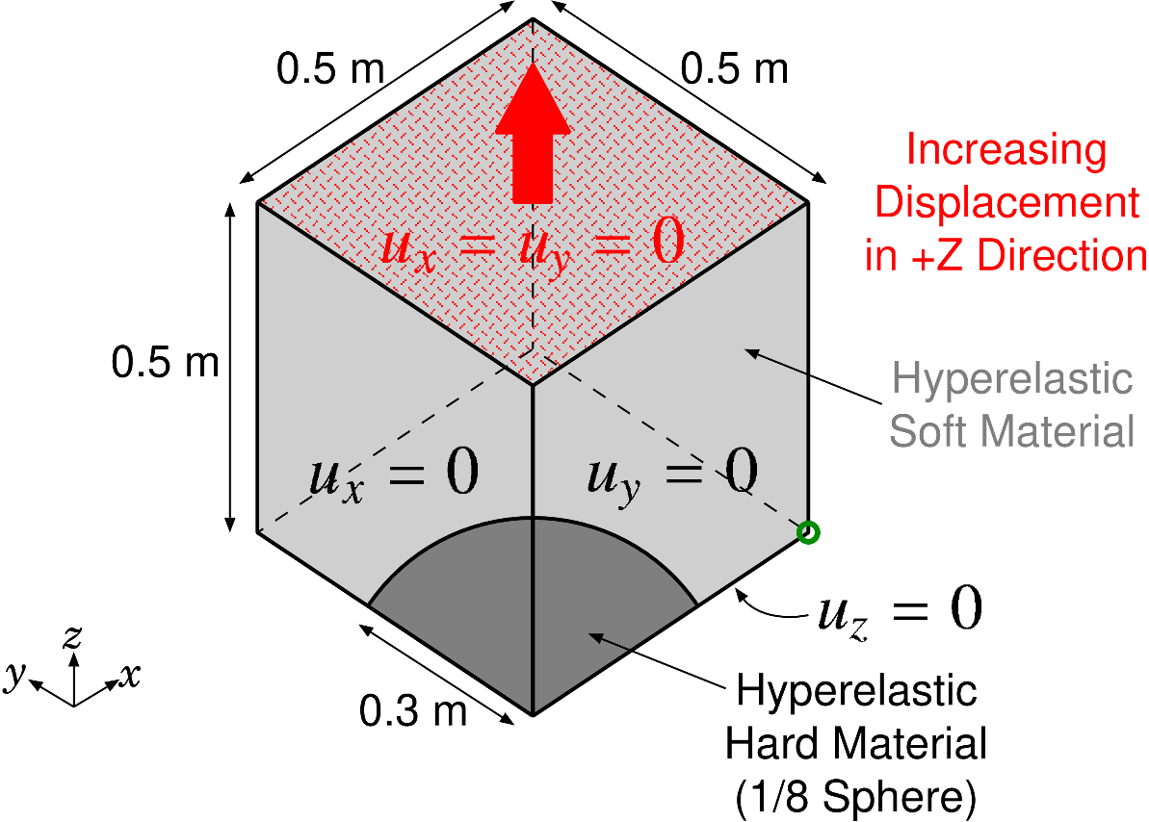

Tensioning of Rubber-Filler Composite
Static
Implicit
Outline
0.5 x 0.5 x 0.5 m cube (1/8 model)
Rubber: Neo-Hookean hyperelastic material $(E_{ini}=6 GPa, ν_{ini}=0.49)$
Iron Filler: Neo-Hookean hyperelastic material $(E_{ini}=260 GPa, ν_{ini}=0.3)$
Applying enforced tensioning displacement on the top face with lateral confinement.
Evaluated the result of EC-SSE-SRI-T4.

Slide 23
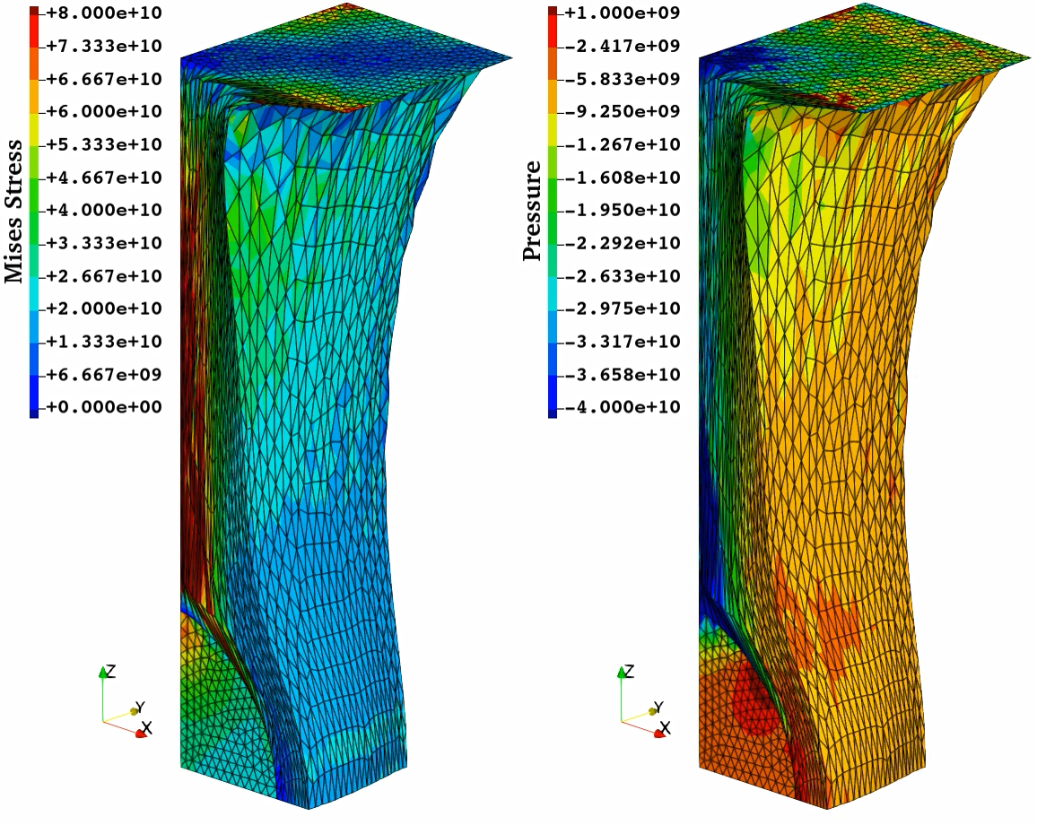
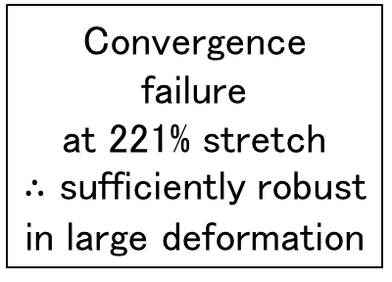
Tensioning of Rubber-Filler Composite
Static
Implicit
Results of
EC-SSE
-SRI-T4
Convergence
failure
at 221% stretch
$∴$ sufficiently robust
in large deformation
No issue in Mises stress.
Minor pressure oscillation only
in rubber part.
Within acceptable
range, I think.

Slide 24

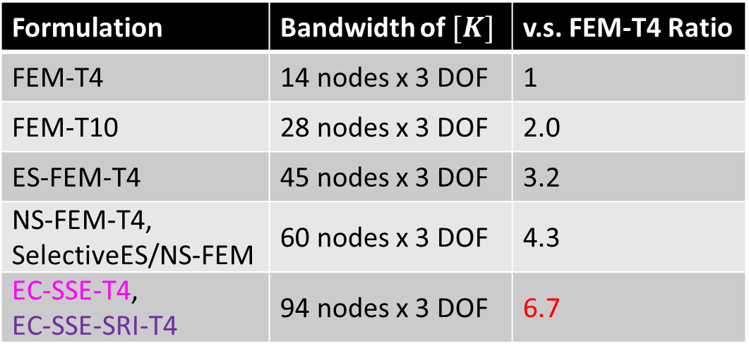
Discussion on CPU Time of EC-SSE-SRI-T4
Since the most of CPU time for implicit analyses is spent solving the stiffness equation
(i.e., $\left[K\right]\left\{u\right\}=\{f\}$), the size of $[K]$ matrix ($N$) directly affects the CPU time.
EC-SSE-SRI-T4 is a purely displacement-based FE formulation; thus,
the matrix size ($N$) is exactly identical to that of FEM-T4.
EC-SSE-SRI-T4 conducts strain smoothing across FE cells; thus,
the matrix bandwidth of $[K]$ is x6.7 wider than that of FEM-T4.
Therefore, as for calculation speed, EC-SSE-SRI-T4 is about x6.7 slower than FEM-T4.
Formulation | Bandwidth of $[K]$ | v.s. FEM-T4 Ratio
FEM-T4 | 14 nodes x 3 DOF | 1
FEM-T10 | 28 nodes x 3 DOF | 2.0
ES-FEM-T4 | 45 nodes x 3 DOF | 3.2
NS-FEM-T4, SelectiveES/NS-FEM | 60 nodes x 3 DOF | 4.3
EC-SSE-T4, EC-SSE-SRI-T4 | 94 nodes x 3 DOF | 6.7

Slide 25
Discussion on CPU Time of EC-SSE-SRI-T4
Meanwhile, we should remind that
  FEM-T4 cannot avoid volumetric locking and pressure checkerboarding,
  FEM-T10 cannot have large deformation robustness (short-lasting),
  no matter how fine the mesh is.
Therefore, I believe, EC-SSE-SRI-T4 is practically acceptable and worth using,
even though the CPU time is 7 times longer than FEM-T4.
What do you think?

Slide 26
Summary

Slide 27
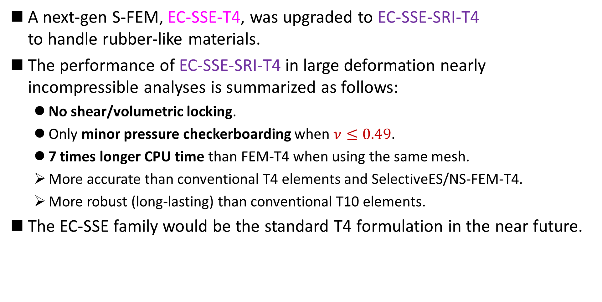
Summary
A next-gen S-FEM, EC-SSE-T4, was upgraded to EC-SSE-SRI-T4
to handle rubber-like materials.
The performance of EC-SSE-SRI-T4 in large deformation nearly incompressible analyses is summarized as follows:
  No shear/volumetric locking.
  Only minor pressure checkerboarding when $ν≤0.49$.
  7 times longer CPU time than FEM-T4 when using the same mesh.
  More accurate than conventional T4 elements and SelectiveES/NS-FEM-T4.
  More robust (long-lasting) than conventional T10 elements.
The EC-SSE family would be the standard T4 formulation in the near future.
Thank you for your kind attention!

Slide 28
Appendix

Slide 29

Difference in Formulation
Let me
explain in 2D
for simplicity
Strain Distribution in each Formulation
FEM and ES-FEM:
Piece-wise constant, Different pieces.
SSE and EC-SSE:
Piece-wise linear, Different continuity.
SSE
FEM
ES-FEM
If calculation time is disregarded,
EC-SSE is expected to provide highly accurate strain/stress with a T3/T4 mesh.
EC-SSE

Slide 30
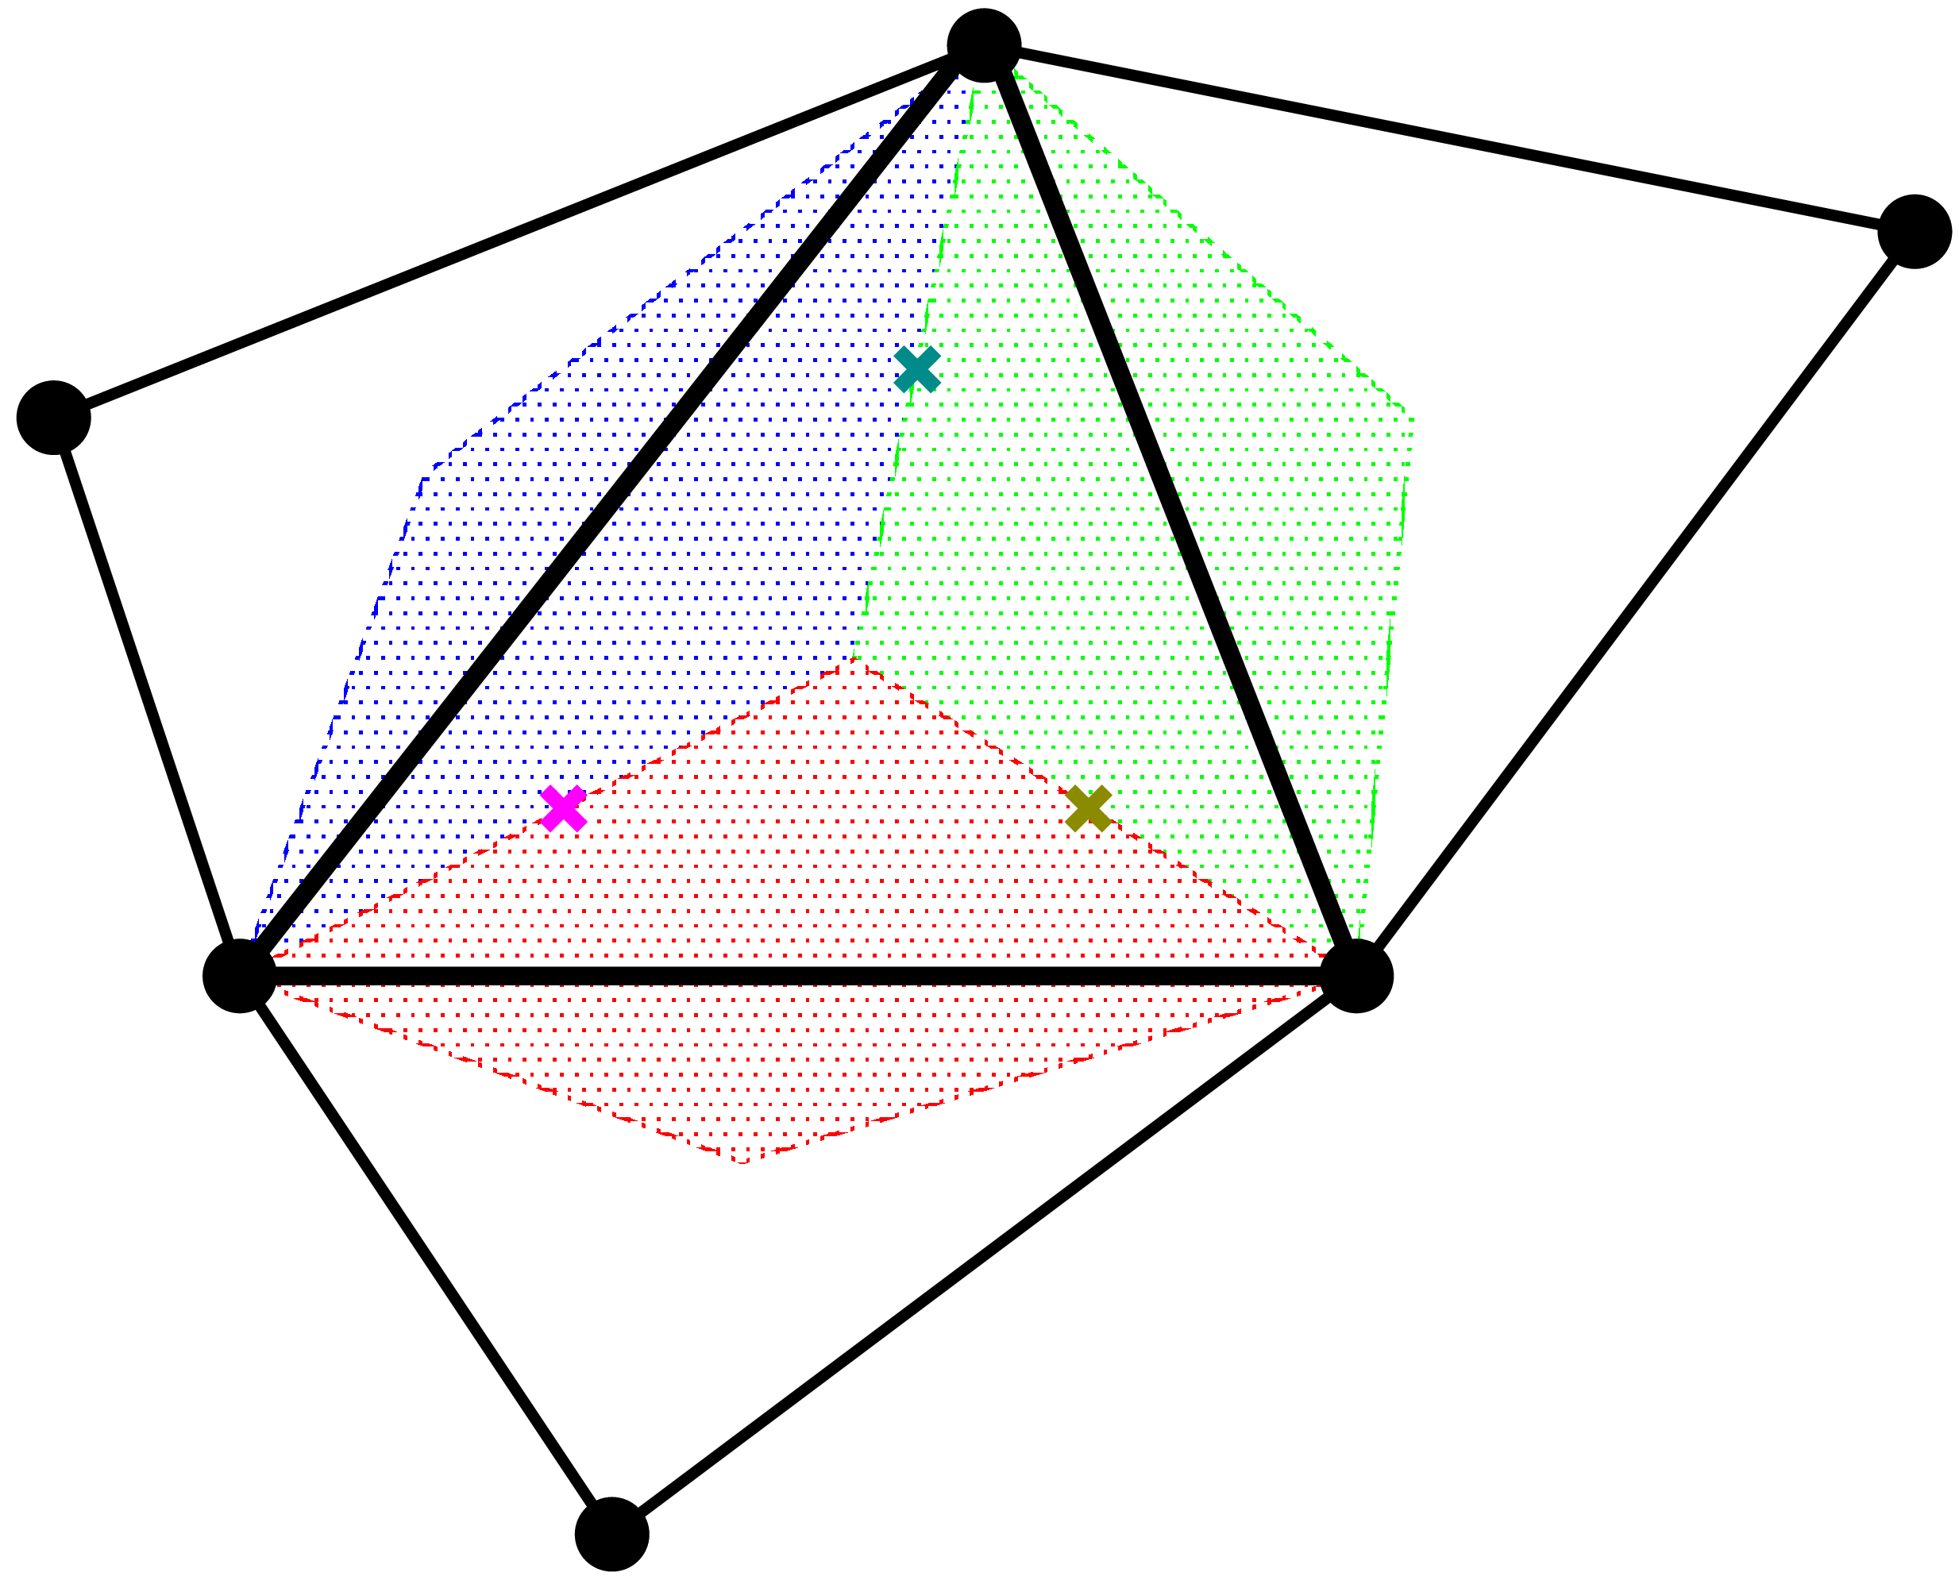

Brief of SSE
Let me
explain in 2D
for simplicity
Make $[ ^{Edge}B]$s in the same procedure as ES-FEM.
Consider each $[ ^{Edge}B]$ represents $[B]$ in its edge smoothing domain,
and assume $[B]$ is linearly distributing in each cell.
Make three $[ ^{Gaus}B]$s in each cell as the average of neighbor two $[ ^{Edge}B]$s .
Calculate $^{Gaus}ε$, $^{Gaus}σ$and $\{f^{int}\}$ using each $\left[ ^{Gaus}B\right]$ in the same manner
as the 2nd -order element.
Conducting strain smoothing twice,
the strain/stress are evaluated
at each Gauss point.
No shear locking
with T3/T4 mesh.
Fast mesh convergence rate
in strain/stress.
Cannot avoid
volumetric locking and
pressure checkerboarding
Strain distribution is
piecewise-linear in each cell

Slide 31
Why not T10 but T4?
It is because T10 mesh is NOT good for the representation of complex geometries.
For example, surface mesh around a small hole looks like…
Also, the presence of mid-nodes leads to early convergence failure in large deformation.
Then, T4 is preferable.
solid
solid
solid
T10
T4
Hole
Hole
Hole
T10 mesh w/o kink
T10 mesh w/ kink
T4 mesh
✗ leads to a massive
increase in DOF.
✗ leads to severe
accuracy loss.
is excellent with ES-FEM
using minimal # of meshes.

