Slide 1
Pressure checkerboarding suppression in the next-gen smoothed finite element method: EC-SSE-SRI-T4
Yuki ONISHI (Institute of Science Tokyo)

Slide 2
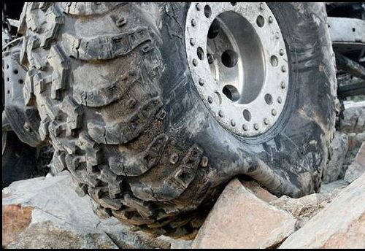

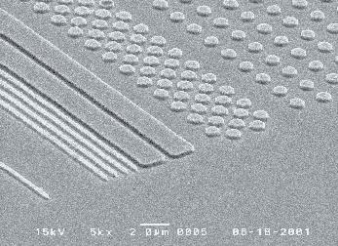

Motivation
What we want to do:
Solve severe large deformation analyses with finite elements.
Treat complex geometries with tetrahedral (tet) meshes.
Consider nearly incompressible materials $(ν≃0.5)$.
Support contact problems.
Handle auto re-meshing.
Current situation:
There is no tet FE formulation that satisfies the 3 points: i) Accuracy, ii) Robustness in large deformation, and iii) Compute time.
Ductile Metal
Rubber
Hot Plastic/Glass

Slide 3
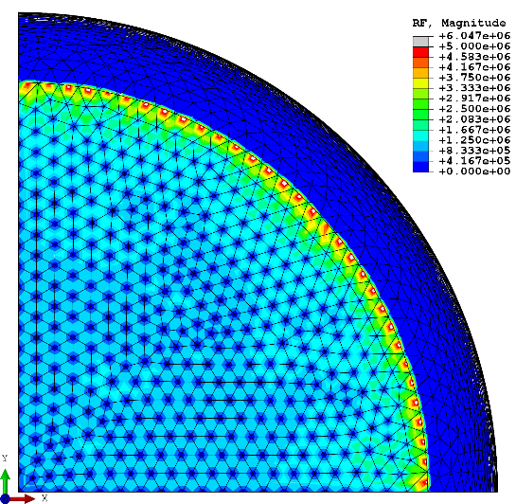
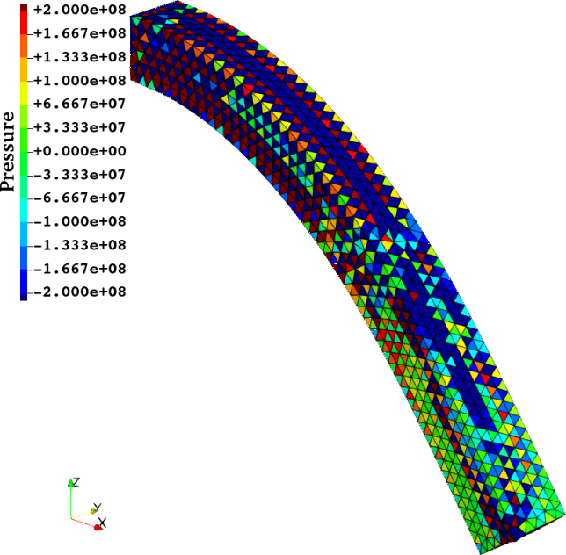
Issues in Accuracy and Their Solutions
Issues in Accuracy | Solutions
Shear Locking | 2nd-order, ES-FEM, NS-FEM, etc.
Volumetric Locking | SRI, B-bar, F-bar, NS-FEM, etc.
Reaction Force Oscillation | 1st-order, Modified 2nd-order, etc.
Pressure Checkerboarding | None! (No absolute solution)
Related to Nodal Force/Disp.
Related to Stress/Strain
Pressure checkerboarding is quite difficult to resolve.
Typical reaction force oscillation (ABAQUS C3D10)
Typical pressure checkerboarding (ABAQUS C3D4)

Slide 4
Birth of a Next-gen S-FEM, EC-SSE, in 2022
Comparison of Mises stress dist. in cantilever bending analyses in 2D
T. Jinsong et al., Euro. J. Mech. /A, v95, 2022.
Step-like stress dist. (poor).
Shear locking.
T3
Poisson’s Ratio: $ν=0.3$
Edge Center-based Strain Smoothing Element
Linear stress dist. (very good) using the same T3 mesh. Very close to analytical solution.
No shear locking.
Detailed Later
This breakthrough should be called
“S-FEM 2.0”.
EC-SSE is an excellent formulation for compressible solids; but when $ν≃0.5$, EC-SSE has volumetric locking and pressure checkerboarding. Therefore, EC-SSE is NOT directly applicable to nearly incompressible solids.

Slide 5
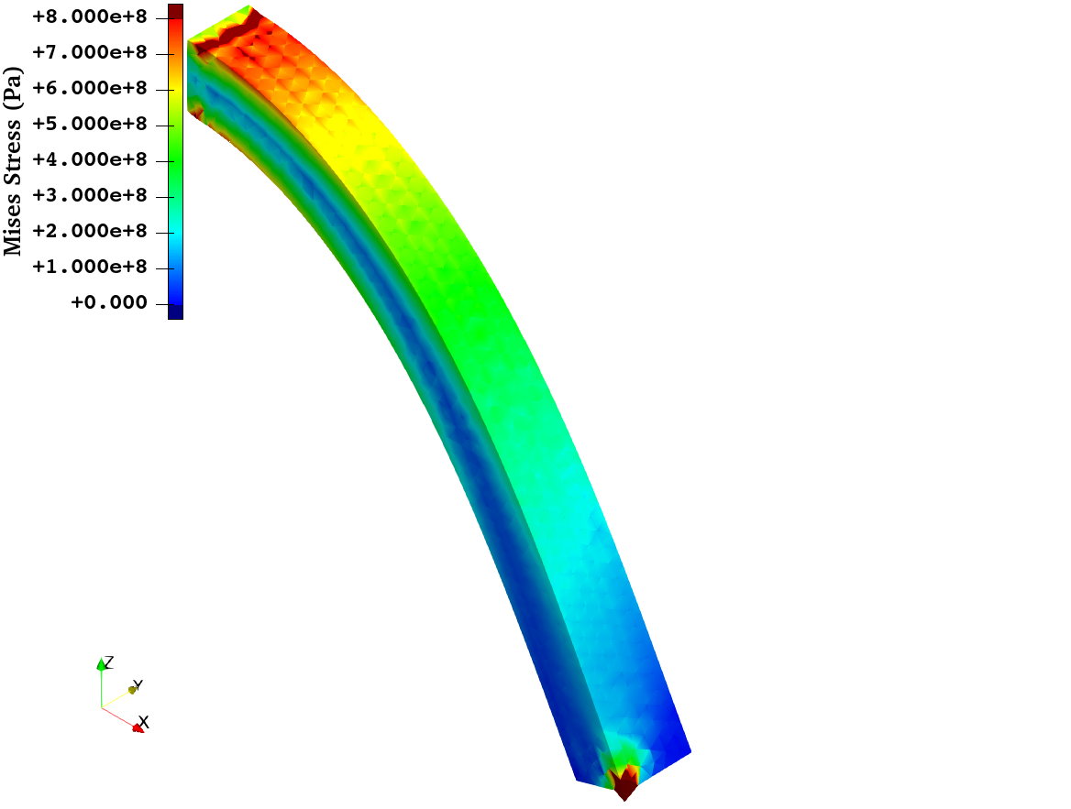
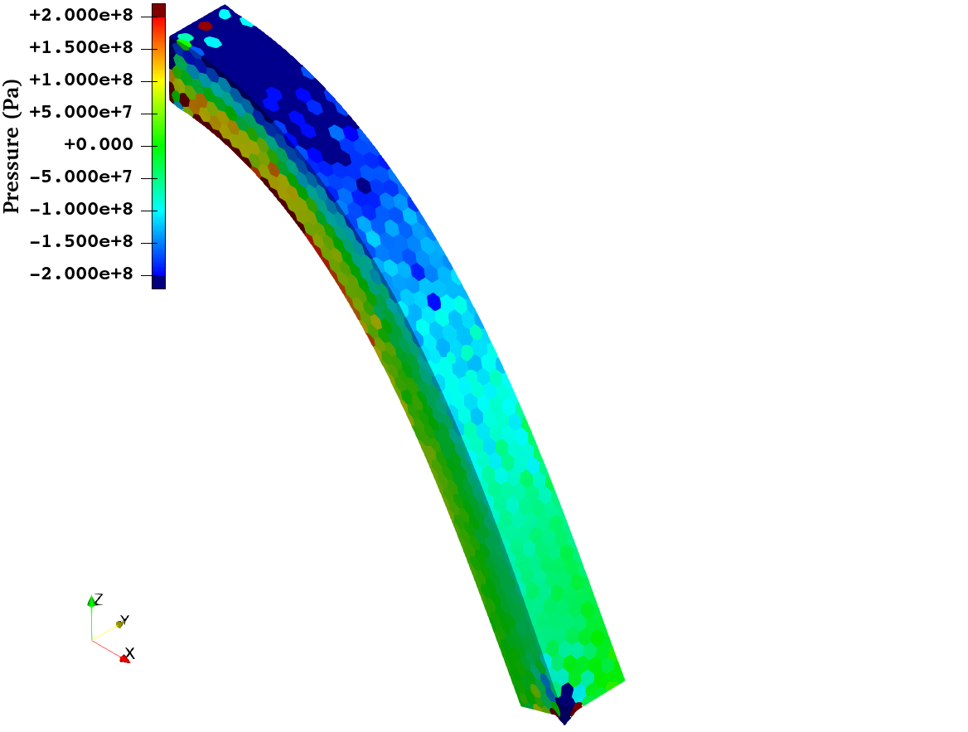
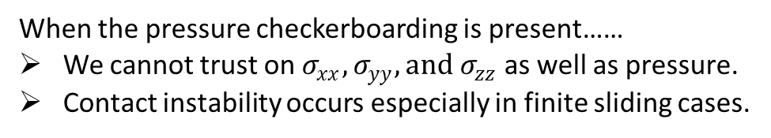

Development of EC-SSE-SRI-T4 in 2024
3D Rubber Cantilever Bending Analysis
Points | Results
Accuracy | Excellent in Mises stress. No shear/volumetric locking. Pressure checkerboarding still remains.
Robustness in Large Deformation | No problem.
Compute Time | Same as EC-SSE-T4.
$$ν_{ini}=0.49$$
T4
When the pressure checkerboarding is present……
We cannot trust on $σ_{xx}, σ_{yy}, {and σ}_{zz}$ as well as pressure.
Contact instability occurs especially in finite sliding cases.
Hence, EC-SSE-SRI-T4(2024) is not bad, but it is not an ultimate formulation, yet.

Slide 6
Objective and Strategy
Objective
Strategy Adopting the following two techniques (detailed later):
Double strain smoothing in the volumetric part,
Inconsistent hydrostatic stress integration.
Develop a new low-cost improvement method of EC-SSE-SRI to suppress the pressure checkerboarding in nearly incompressible large deformation analysis.
New EC-SSE-SRI

Slide 7
Method Introduction to ES-FEM, NS-FEM, EC-SSE, and Old/New EC-SSE-SRI

Slide 8

Brief of ES-FEM
Let me explain in 2D for simplicity
Let us consider a mesh with only two 3-node triangular cells.
Make $\left[B\right](=dN/dx)$ at each cell as usual.
At each edge, gather $[B]$s of the connecting cells and average them with area weights to build $[ ^{Edge}B]$ .
Calculate strain $(ε)$, stress ($σ$) and nodal internal force $\{f^{int}\}$ in each edge smoothing domain with $[ ^{Edge}B]$.
$$[B_{1}]$$
As if putting a Gauss point on each edge center
No shear locking.
Cannot avoid volumetric locking & pressure checkerboarding.
Strain distribution is piecewise constant in each smoothing domain.
$$[B_{2}]$$
$$[^{Edge}B]$$
$↳{}^{Edge}ε,{}^{Edge}σ, \{^{Edge}f^{int}\}$ etc.

Slide 9
Brief of NS-FEM
Let me explain in 2D for simplicity
Let us consider a mesh with only four 3-node triangular cells.
Make $\left[B\right](=dN/dx)$ at each cell as usual.
At each node, gather $[B]$s of the connecting cells and average them with area weights to build $[ ^{Node}B]$ .
Calculate strain $(ε)$, stress ($σ$) and nodal internal force $\{f^{int}\}$ in each nodal smoothing domain with $[ ^{Node}B]$.
$$[B_{4}]$$
$$[B_{1}]$$
As if putting a Gauss point on each node center
No shear/volumetric locking. Less pressure checkerboarding.
$$[B_{3}]$$
$$[B_{2}]$$
Cannot avoid spurious low-energy modes.
Strain distribution is piecewise constant in each smoothing domain.
$$[^{Node}B]$$
$↳{}^{Node}ε,{}^{Node}σ, \{^{Node}f^{int}\}$ etc.

Slide 10
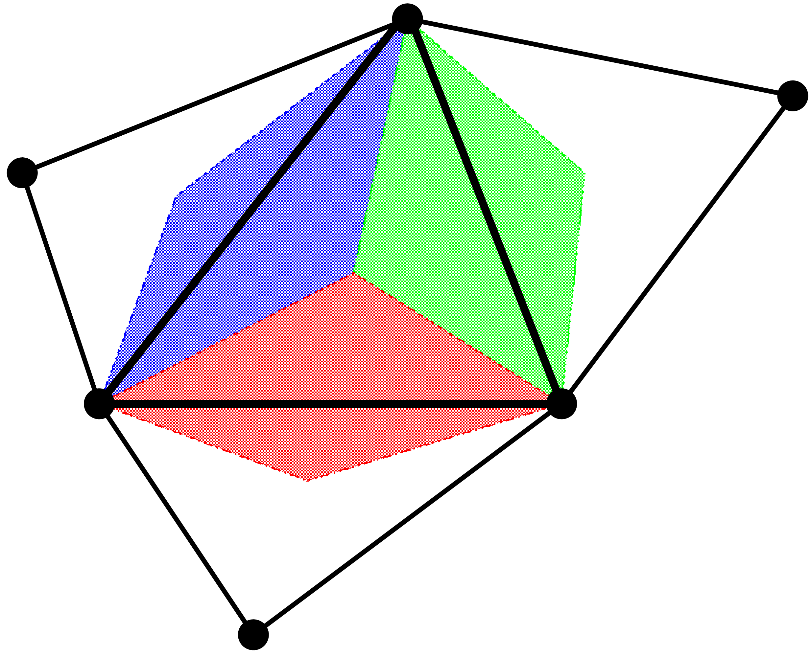
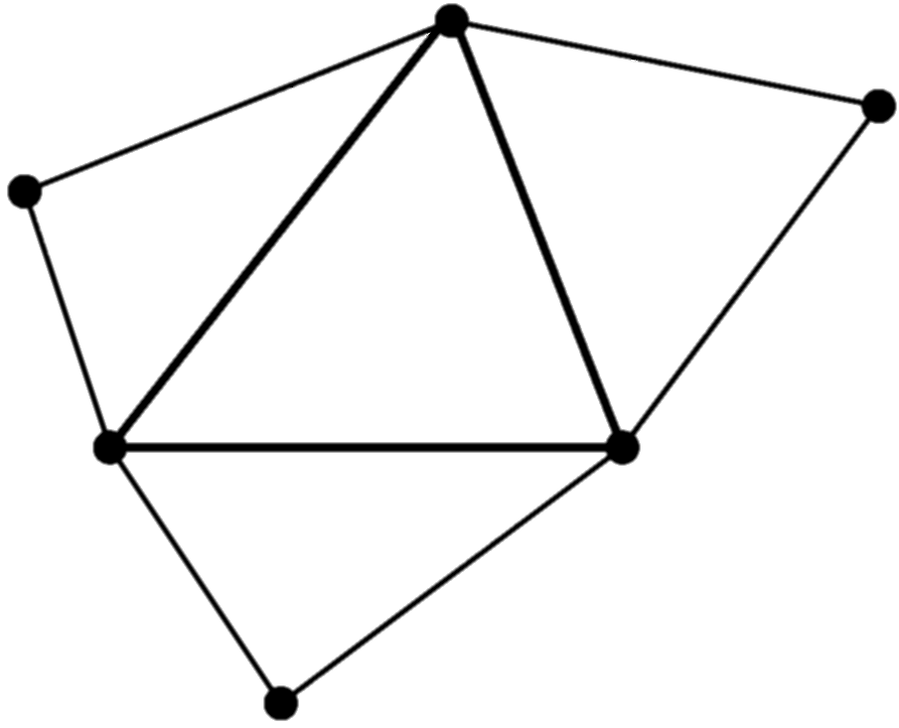
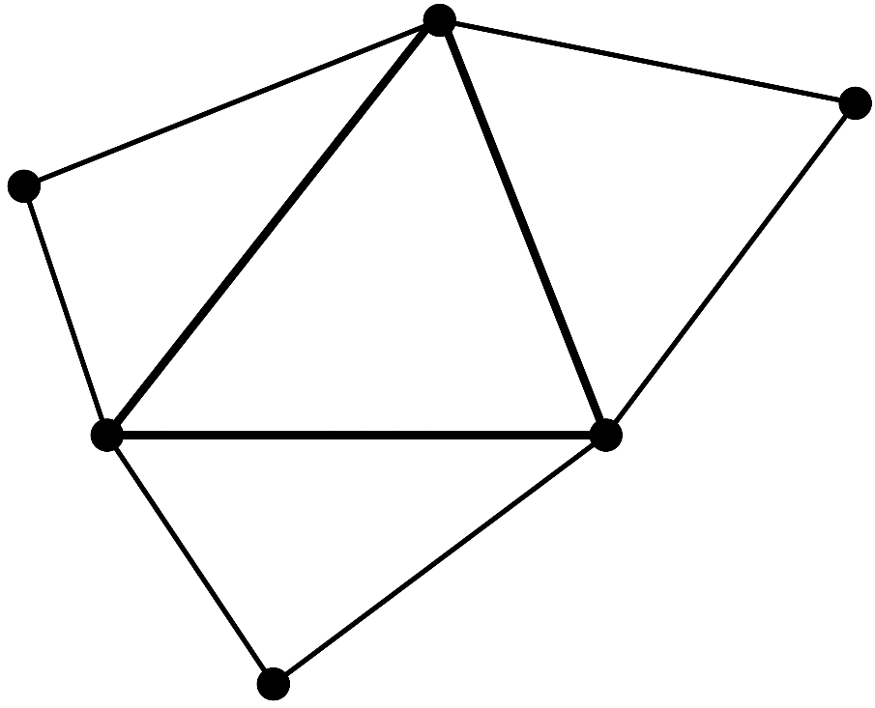


Brief of EC-SSE
Let me explain in 2D for simplicity
Make $\left[ ^{Edge}B\right]$s in the same procedure as ES-FEM.
Consider each $[ ^{Edge}B]$ is the value at the center point of each edge, and assume $[B]$ is linearly distributed in each cell.
Make three $[ ^{Gaus}B]$s in each cell as the extrapolation of the three $[ ^{Edge}B]$s.
Calculate $^{Gaus}ε$, $^{Gaus}σ$and $\{f^{int}\}$ using each $\left[ ^{Gaus}B\right]$ in the same manner as the 2nd -order element.
No shear locking with T3/T4 mesh.
Fast mesh convergence rate in strain/stress as an 2nd –order element.
Strain/stress are evaluated at the Gauss points in each cell.
$[ ^{Edge}B_{3}]$
$[ ^{Gaus}B_{3}]$
$[ ^{Edge}B_{2}]$
Strain distribution is piecewise-linear in each cell and is continuing at every edge center.
$[ ^{Gaus}B_{1}]$
$[ ^{Gaus}B_{2}]$
$[ ^{Edge}B_{1}]$
Cannot avoid volumetric locking and pressure checkerboarding

Slide 11

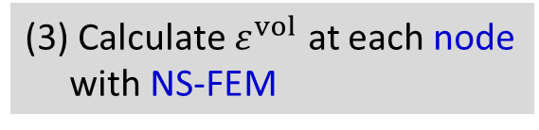
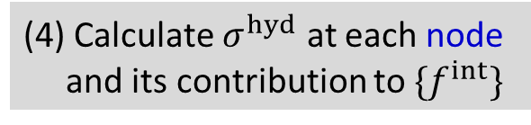
Brief of Old EC-SSE-SRI (2024)
Let me explain in 2D for simplicity
Apply the selective reduced integration (SRI) to EC-SSE to handle rubber-like solids
(1) Calculate $ε^{dev}$ at each Gauss point with EC-SSE
(3) Calculate $ε^{vol}$ at each node with NS-FEM
Deviatoric Part
Volumetric Part
Similar idea as Selective ES/NS-FEM
(2) Calculate $σ^{dev}$ at each Gauss point and its contribution to $\{f^{int}\}$
(4) Calculate $σ^{hyd}$ at each node and its contribution to $\{f^{int}\}$
Selective Reduced Integration (SRI)
No shear locking.
Excellent accuracy in deviatoric stress.
No volumetric locking.
Pressure checkerboarding remains.
(5) Assemble $\{f^{int}\}$

Slide 12
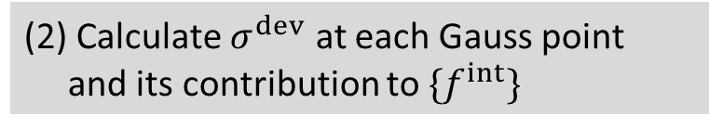

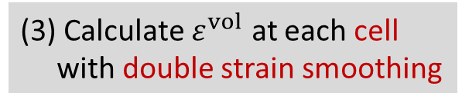
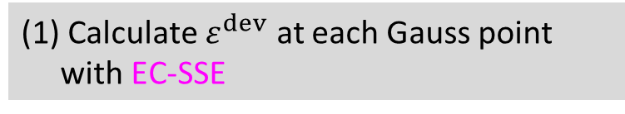
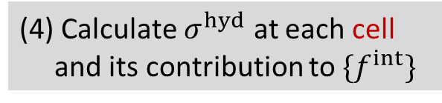
Brief of New EC-SSE-SRI (2025)
Let me explain in 2D for simplicity
Apply the selective reduced integration (SRI) to EC-SSE to handle rubber-like solids
(1) Calculate $ε^{dev}$ at each Gauss point with EC-SSE
(3) Calculate $ε^{vol}$ at each cell with double strain smoothing
Deviatoric Part
Volumetric Part
Double strain smoothing: Strain smoothing at nodes (NS-FEM) followed by strain smoothing at cells (NS-FEM⁻¹)
(2) Calculate $σ^{dev}$ at each Gauss point and its contribution to $\{f^{int}\}$
(4) Calculate $σ^{hyd}$ at each cell and its contribution to $\{f^{int}\}$
Selective Reduced Integration (SRI)
No shear locking.
Excellent accuracy in deviatoric stress.
No volumetric locking.
Less pressure checkerboarding.
(5) Assemble $\{f^{int}\}$

Slide 13
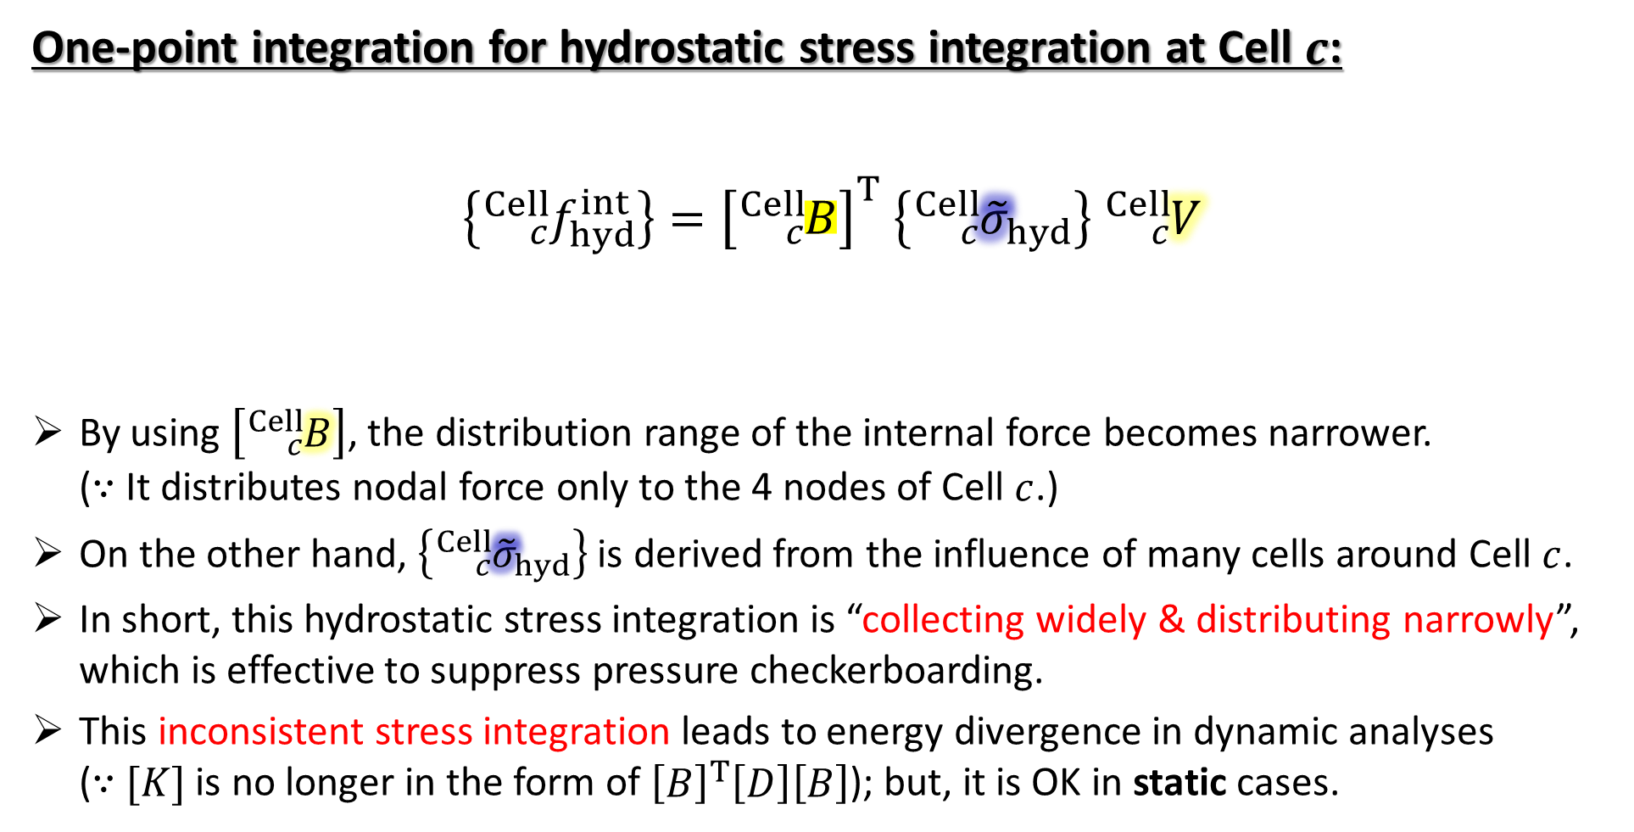
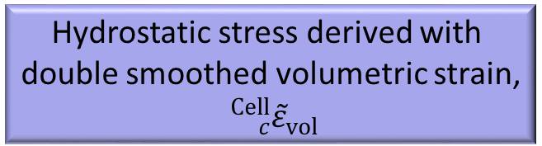
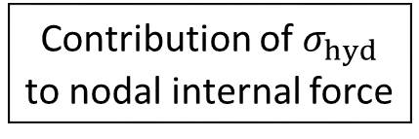
Inconsistent Hydrostatic Stress Integration in New EC-SSE-SRI
One-point integration for hydrostatic stress integration at Cell $c$:
$$\left\{{}_{c}^{Cell}{f_{hyd}^{int}}\right\}={\left[{}_{c}^{Cell}B\right]}^{T} \left\{{}_{c}^{Cell}{{\tilde{σ}}_{hyd}}\right\} {}_{c}^{Cell}V$$
By using $\left[{}_{c}^{Cell}B\right]$, the distribution range of the internal force becomes narrower. ($∵$ It distributes nodal force only to the 4 nodes of Cell $c$.)
On the other hand, $\left\{{}_{c}^{Cell}{{\tilde{σ}}_{hyd}}\right\}$ is derived from the influence of many cells around Cell $c$.
In short, this hydrostatic stress integration is “collecting widely & distributing narrowly”, which is effective to suppress pressure checkerboarding.
This inconsistent stress integration leads to energy divergence in dynamic analyses ($∵$ $[K]$ is no longer in the form of ${\left[B\right]}^{T}\left[D\right]\left[B\right]$); but, it is OK in static cases.
B-matrix of the standard FEM-T4
Cell volume of the standard FEM-T4
Contribution of $σ_{hyd}$ to nodal internal force
Hydrostatic stress derived with double smoothed volumetric strain, ${}_{c}^{Cell}{{\tilde{ε}}_{vol}}$

Slide 14
Result & Discussion Performance evaluation of New EC-SSE-SRI-T4 and Discussion on CPU Cost

Slide 15
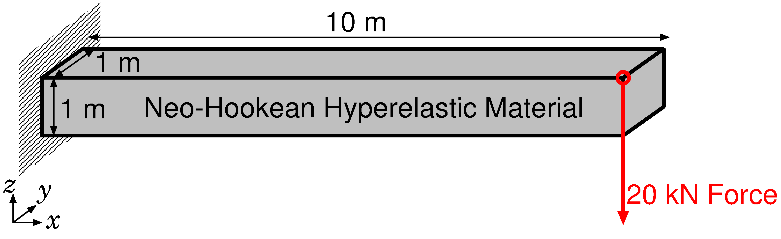
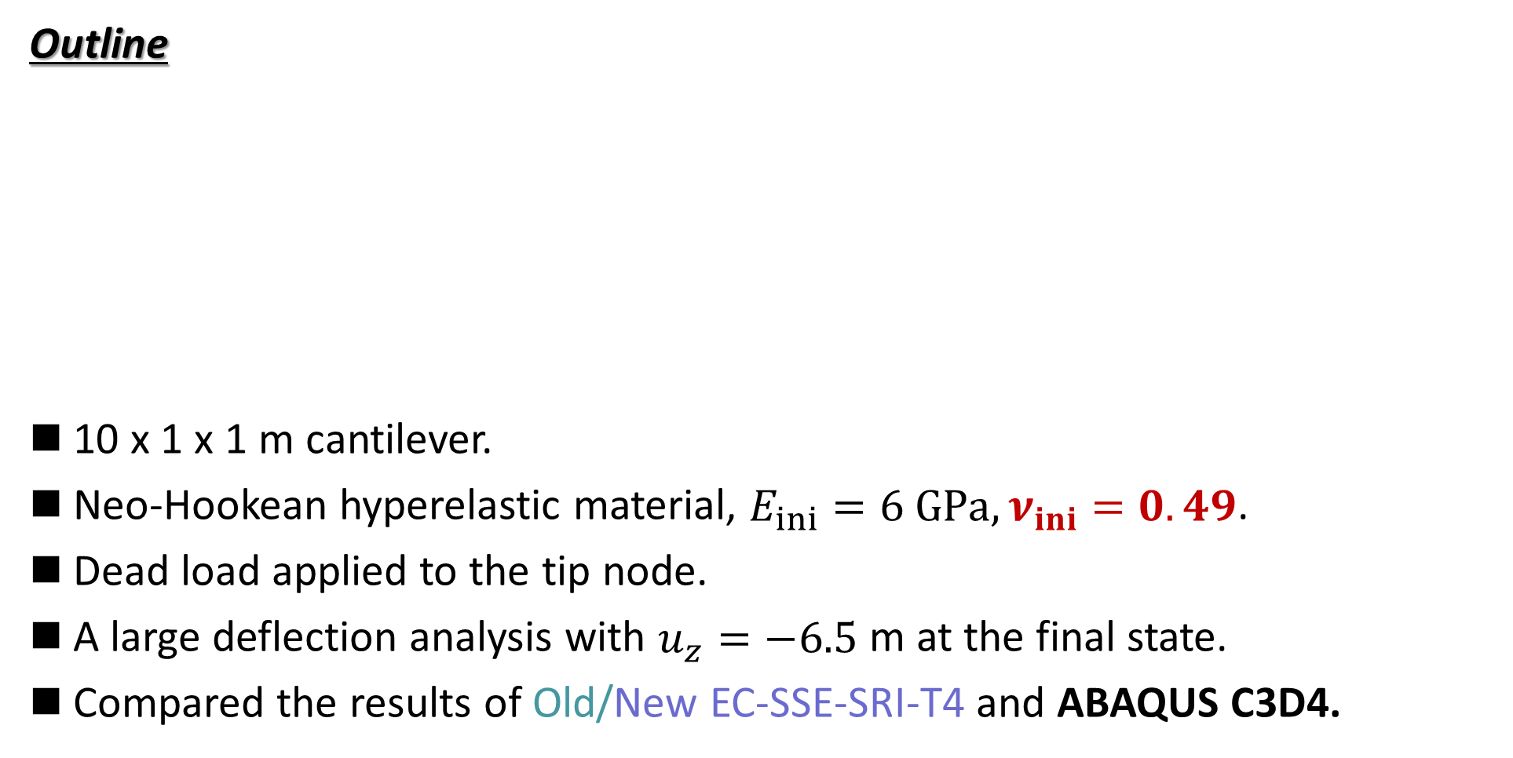
Bending of Rubber Cantilever
Static Implicit
Outline
10 x 1 x 1 m cantilever.
Neo-Hookean hyperelastic material, $E_{ini}=6 GPa, ν_{ini}=0.49$.
Dead load applied to the tip node.
A large deflection analysis with $u_{z}=−6.5$ m at the final state.
Compared the results of Old/New EC-SSE-SRI-T4 and ABAQUS C3D4.
Dead Load

Slide 16
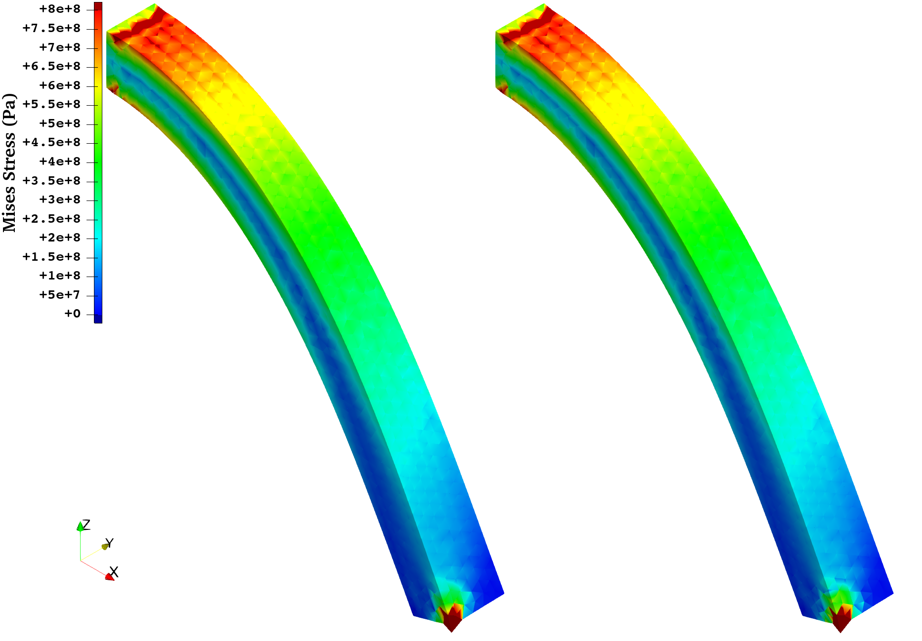
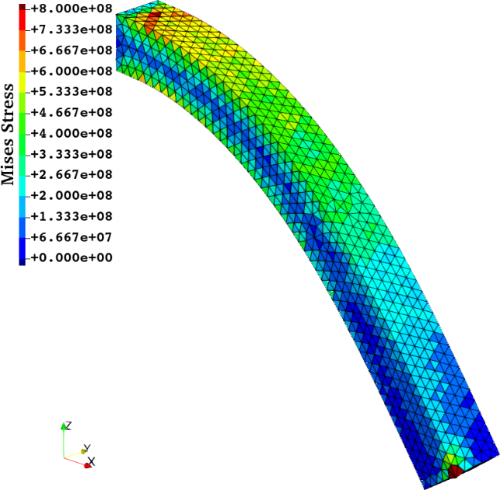
Bending of Rubber Cantilever
Static Implicit
Mises Stress Distribution at the Finial State
(Ref.) ABAQUS C3D4: Standard FEM-T4
Both results are excellent and have no much difference.
No issues in nodal displacement & force (details omitted).
Old EC-SSE-SRI-T4
New EC-SSE-SRI-T4

Slide 17
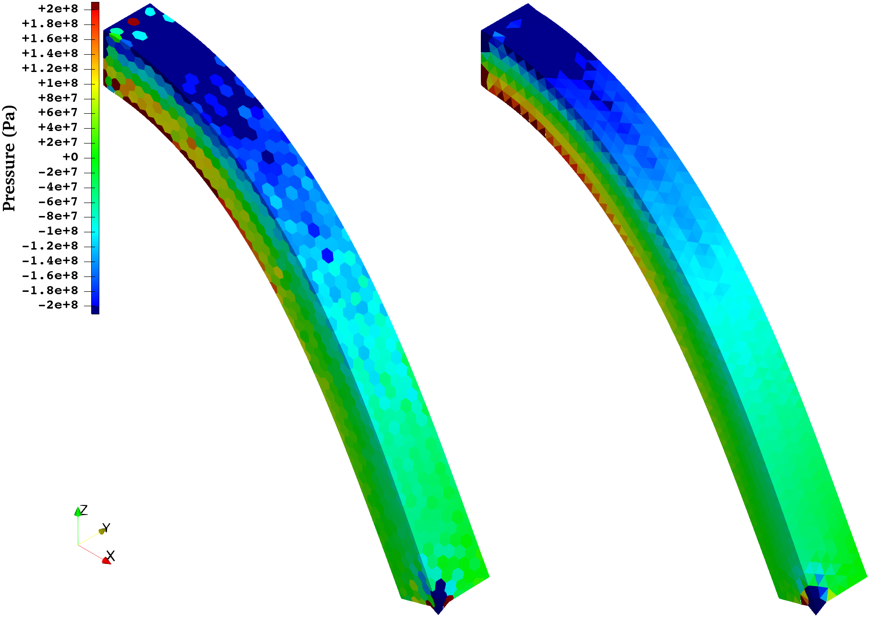
Bending of Rubber Cantilever
Static Implicit
Pressure Distribution at the Finial State
(Ref.) ABAQUS C3D4: Standard FEM-T4
In the old formulation, checkerboarding remains.
In the new formulation, checkerboarding is almost suppressed!!
Old EC-SSE-SRI-T4
New EC-SSE-SRI-T4

Slide 18
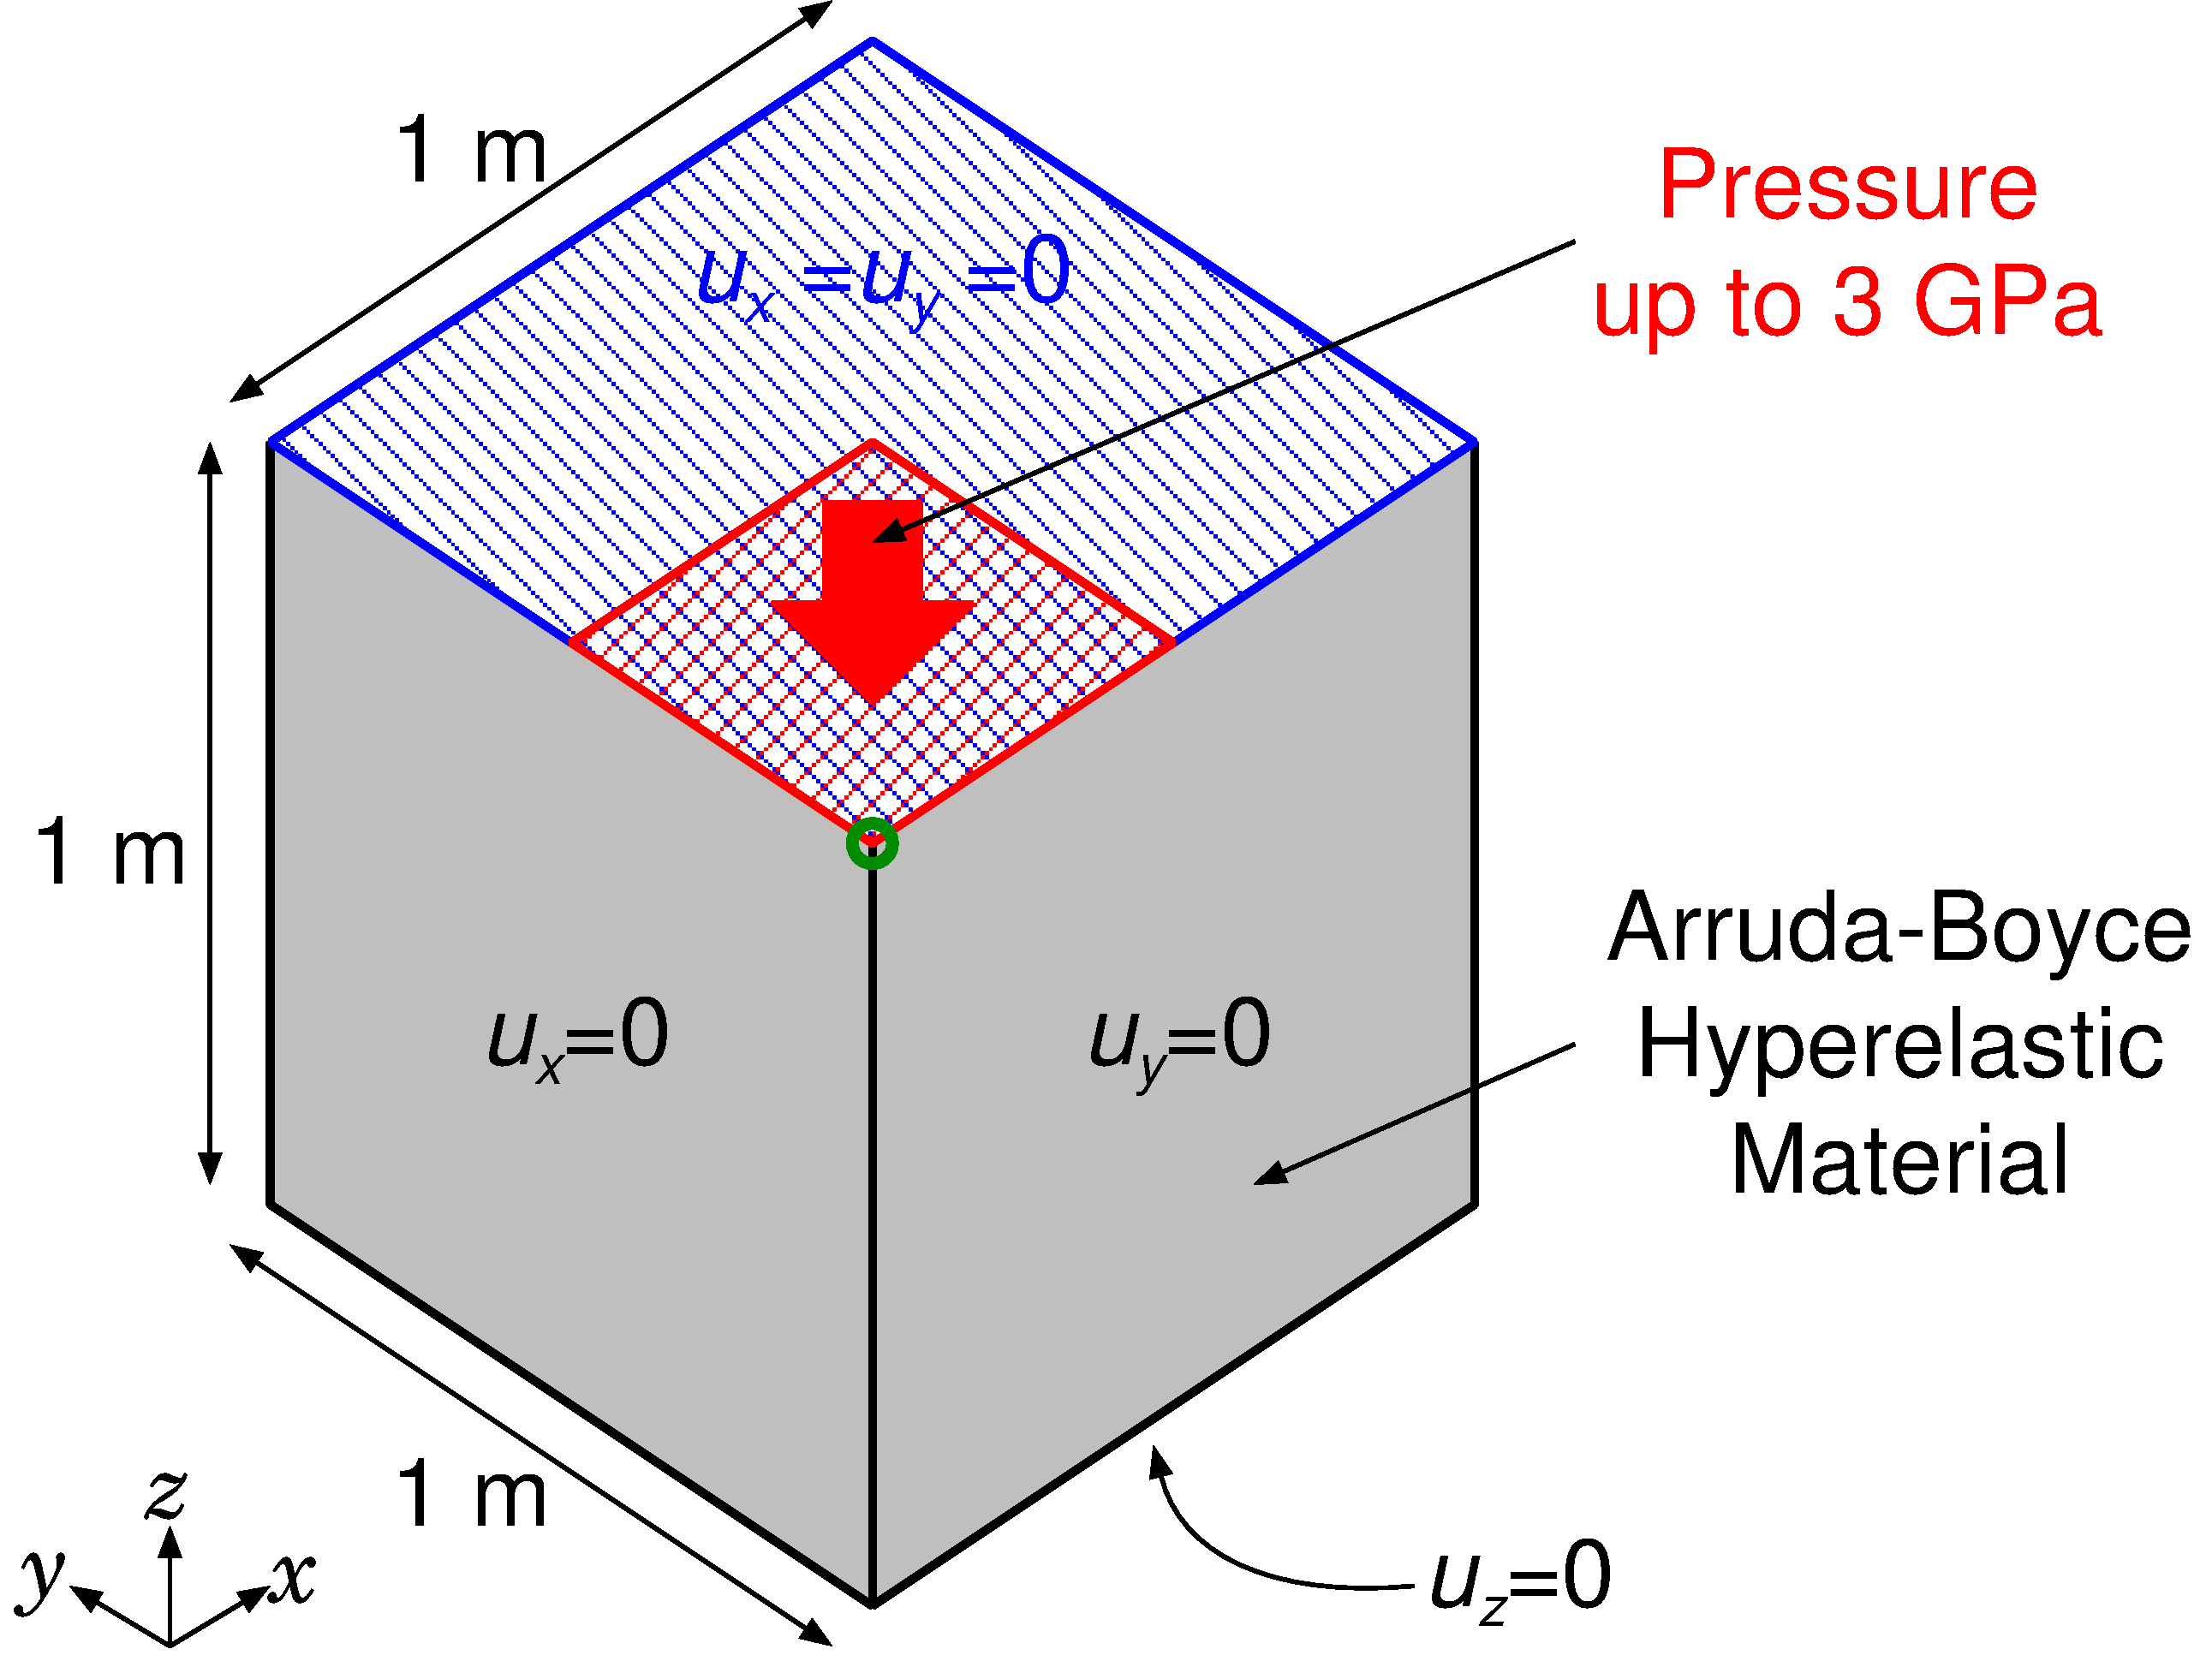

Pressuring of Rubber Block
Static Implicit
Outline
1 x 1 x 1 m block.
Arruda-Boyce hyperelastic material, $E_{ini}=24$ GPa, $ν_{ini}=0.49$.
Applying pressure on ¼ of the top face with lateral confinement.
Evaluated the result of New EC-SSE-SRI-T4.
Load

Slide 19
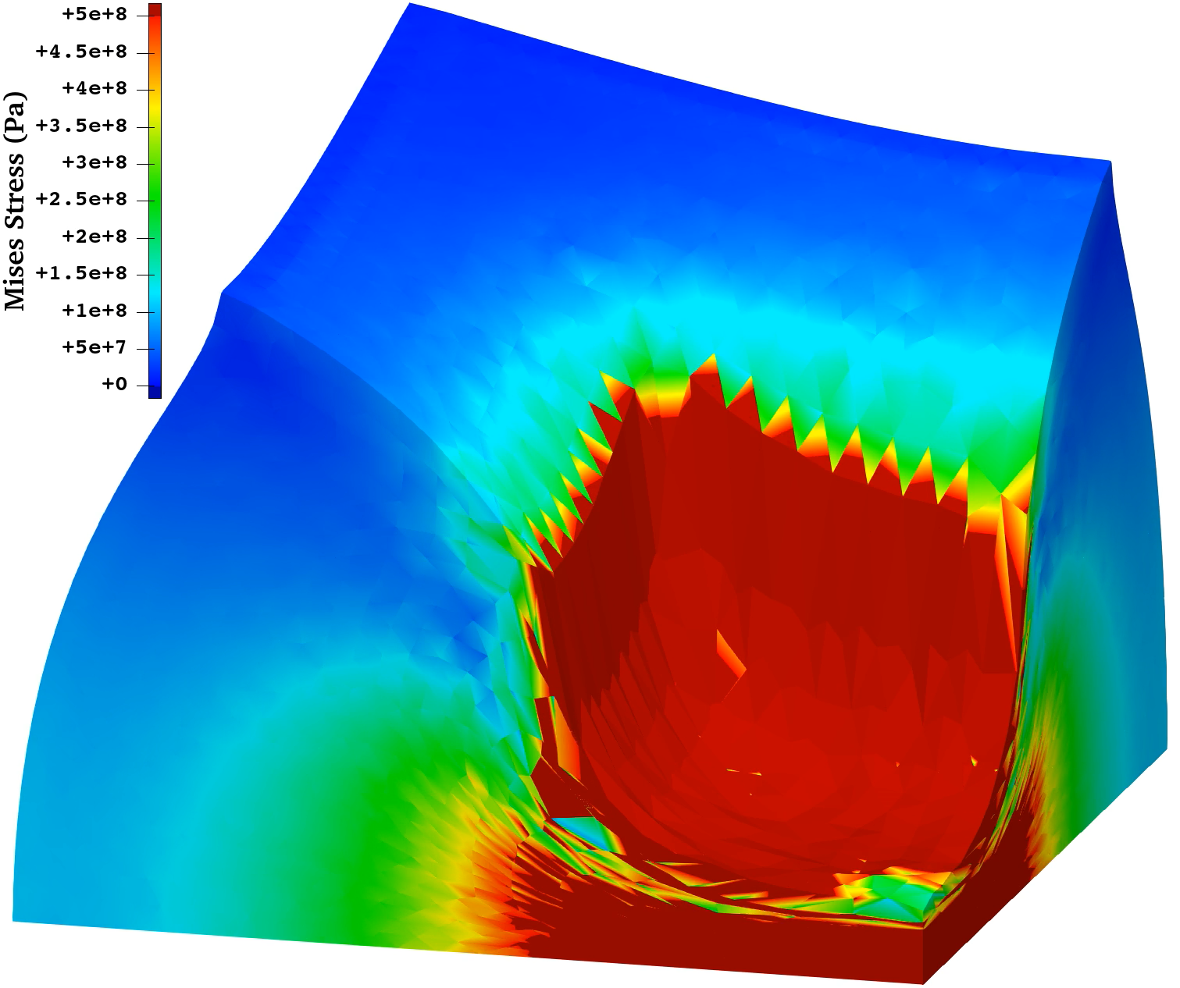
Pressuring of Rubber Block
Static Implicit
Mises Stress Animation of New EC-SSE-SRI-T4
No major issue found:
Smooth distribution of Mises stress.
Sufficient robustness in large deformation

Slide 20
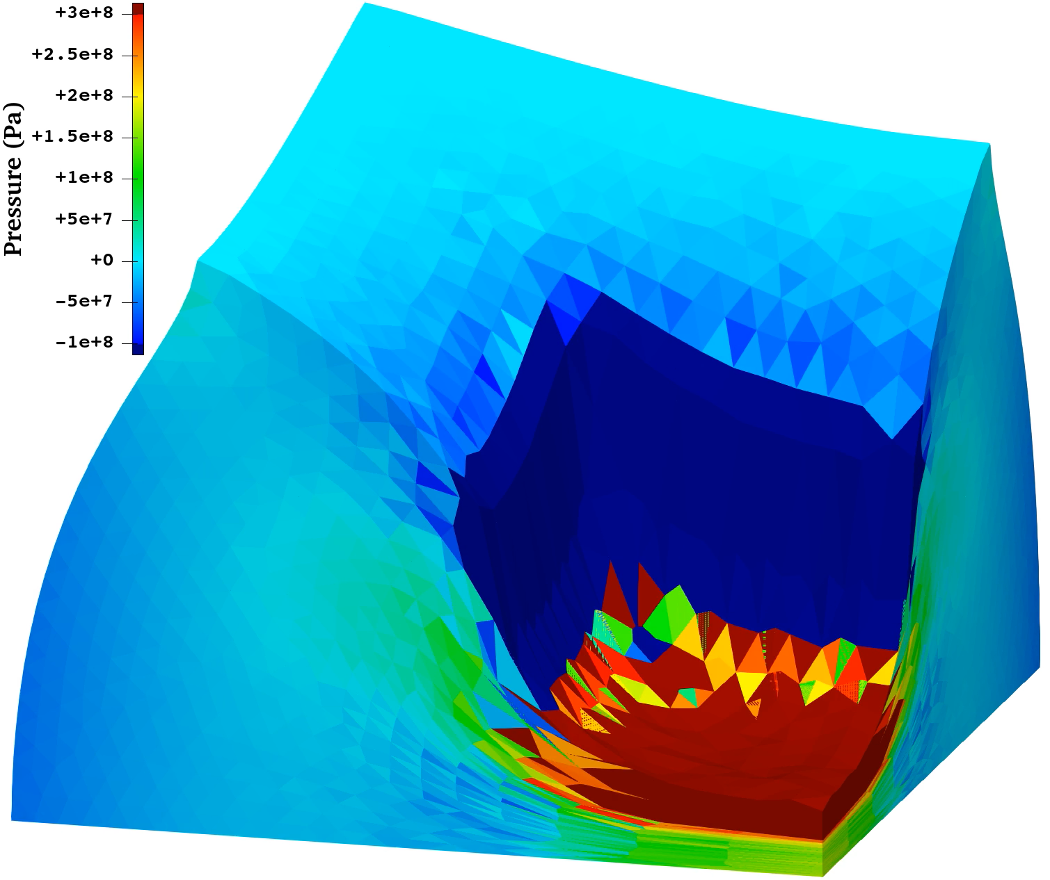
Pressuring of Rubber Block
Static Implicit
Pressure Animation of New EC-SSE-SRI-T4
Noticeable checkerboarding at the final state.
But, in the middle stage, checkerboarding is limited and sufficiently practical.

Slide 21
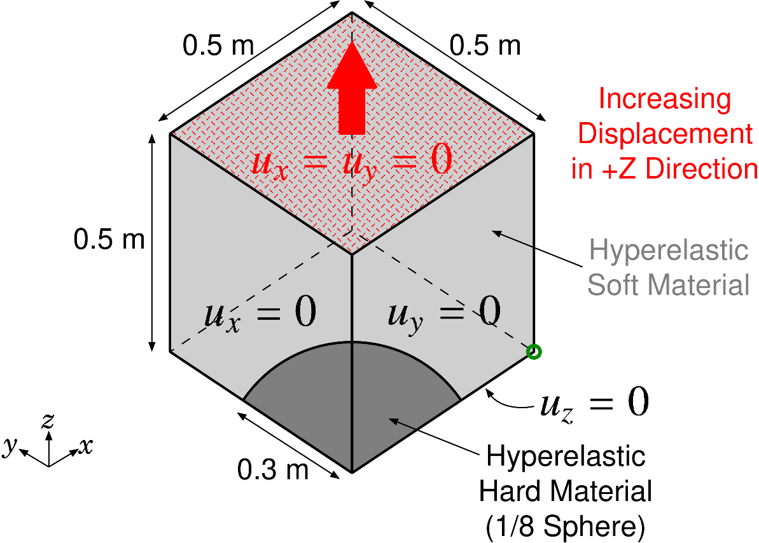

Tensioning of Rubber-Filler Composite
Static Implicit
Outline
0.5 x 0.5 x 0.5 m cube (1/8 model)
Rubber: Neo-Hookean hyperelastic material $(E_{ini}=6 GPa, ν_{ini}=0.49)$
Iron Filler: Neo-Hookean hyperelastic material $(E_{ini}=260 GPa, ν_{ini}=0.3)$
Applying enforced tensioning displacement on the top face with lateral confinement.
Evaluated the result of New EC-SSE-SRI-T4.

Slide 22
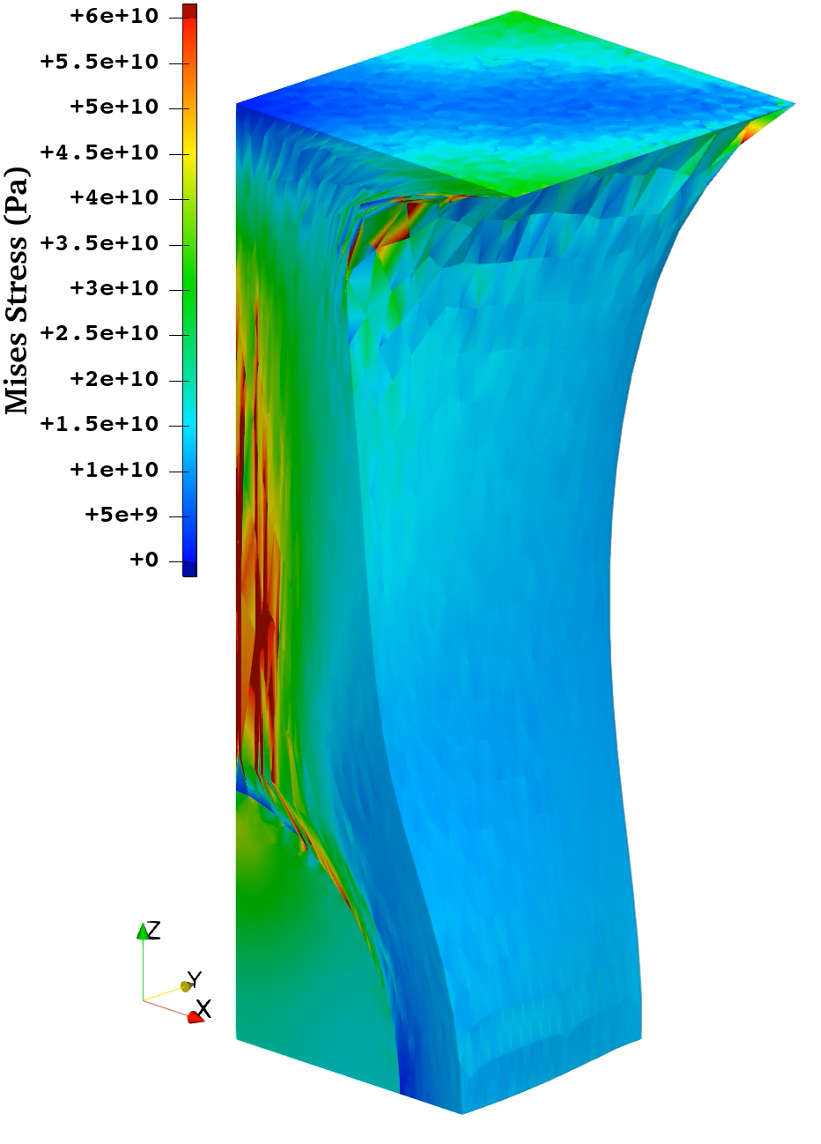
Tensioning of Rubber-Filler Composite
Static Implicit
Mises Stress Animation of New EC-SSE-SRI-T4
No major issue is found:
Smooth distribution of Mises stress.
Sufficient robustness in large deformation.
Convergence failure at 188% nominal streatch

Slide 23
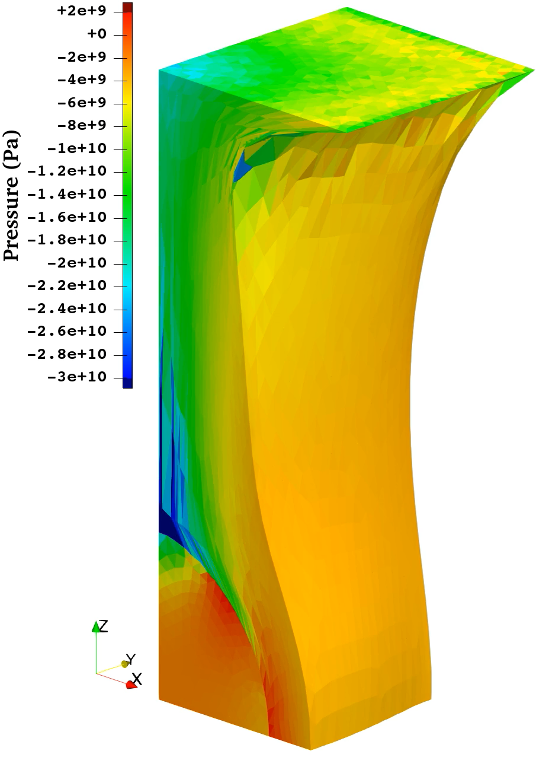
Tensioning of Rubber-Filler Composite
Static Implicit
Pressure Animation of New EC-SSE-SRI-T4
Practical result is obtained:
No checkerboarding in the steel part.
Only little checkerboarding in the rubber part.

Slide 24

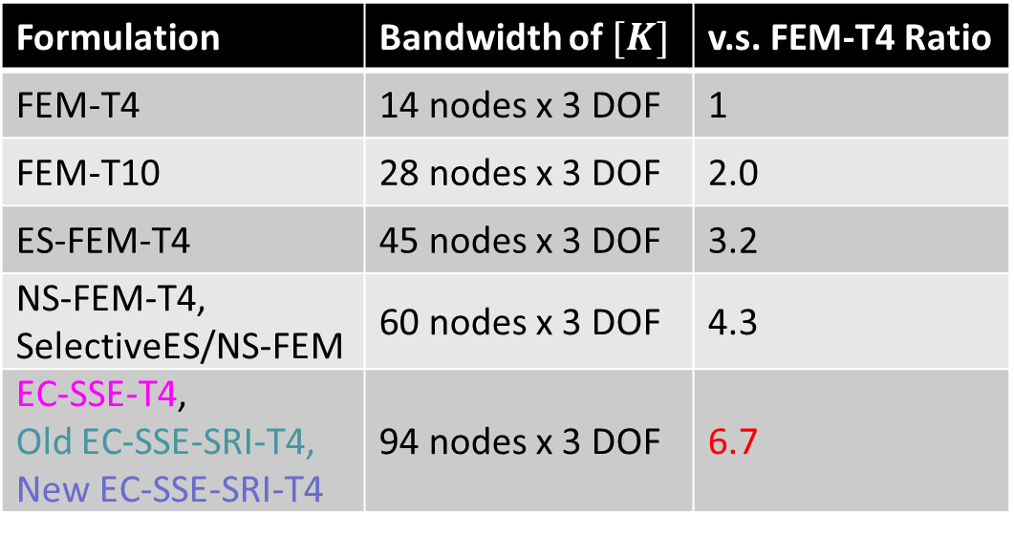
Discussion on CPU Time of New EC-SSE-SRI-T4
Since the most of CPU time for implicit analyses is spent solving the stiffness equation (i.e., $\left[K\right]\left\{u\right\}=\{f\}$), the size of $[K]$ matrix ($N$) directly affects the CPU time.
S-FEMs including the EC-SSE-T4 family are purely displacement-based FE formulations; thus, the matrix size ($N$) is exactly identical to that of FEM-T4.
The EC-SSE-T4 family has all the same bandwidth of $[K]$, which is x6.7 wider than that of FEM-T4.
Formulation | Bandwidth of $[K]$ | v.s. FEM-T4 Ratio
FEM-T4 | 14 nodes x 3 DOF | 1
FEM-T10 | 28 nodes x 3 DOF | 2.0
ES-FEM-T4 | 45 nodes x 3 DOF | 3.2
NS-FEM-T4, SelectiveES/NS-FEM | 60 nodes x 3 DOF | 4.3
EC-SSE-T4, Old EC-SSE-SRI-T4, New EC-SSE-SRI-T4 | 94 nodes x 3 DOF | 6.7
No increase in CPU time compared to EC-SSE-T4 or Old EC-SSE-SRI-T4.

Slide 25
Summary

Slide 26
Summary
New EC-SSE-SRI-T4 introduces double smoothing and inconsistent stress integration in the volumetric/hydrostatic part.
Its specs in nearly incompressible large deformation analyses are:
New EC-SSE-SRI-T4 is a method very close to our goal.
Points | Results
Accuracy | Excellent in Mises stress. No shear/volumetric locking. Sufficiently small pressure checkerboarding.
Robustness in Large Deformation | No problem.
Compute Time | Same as EC-SSE-T4.
Thank you for your kind attention!

Slide 27
Appendix

Slide 28
Brief of Old EC-SSE-SRI-T4 (in 3D)
Let me explain with text only
[Deviatoric Part]
Make $\left[ ^{Edge}B\right]$s in the same procedure as ES-FEM.
Make $\left[ ^{Face}B\right]$s by re-smoothing three $\left[ ^{Edge}B\right]$s per face.
Consider each $[ ^{Face}B]$ is the value at the center of each face, and assume $[B]$ is linearly distributed in each cell.
Make four $[ ^{Gaus}B]$ s in each cell as the extrapolation of the four $[ ^{Face}B]$ s.
Calculate $^{Gaus}ε_{dev}$, $^{Gaus}σ_{dev}$and $\{f_{dev}^{int}\}$ using each $[ ^{Gaus}B]$, like the 2nd -order element.
[Volumetric Part]
Make $\left[ ^{Node}B\right]$s in the same procedure as NS-FEM.
Calculate $^{Node}ε_{vol}$, $^{Node}σ_{hyd}$and $\{f_{vol}^{int}\}$ using each $[ ^{Node}B]$.
[SRI]
Make $\left\{f^{int}\right\}=\left\{f_{dev}^{int}\right\}+\left\{f_{vol}^{int}\right\}$.
T4

