Slide 1
A Low-cost and Pressure-checker-free
Smoothed Finite Element Formulation using 4-node Tetrahedral Meshes for Nearly Incompressible Large Deformation Analyses
Yuki ONISHI
(Institute of Science Tokyo, Japan)

Slide 2
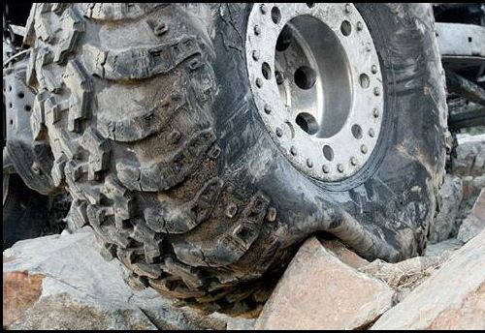

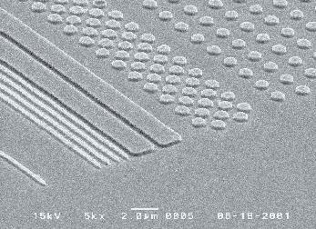
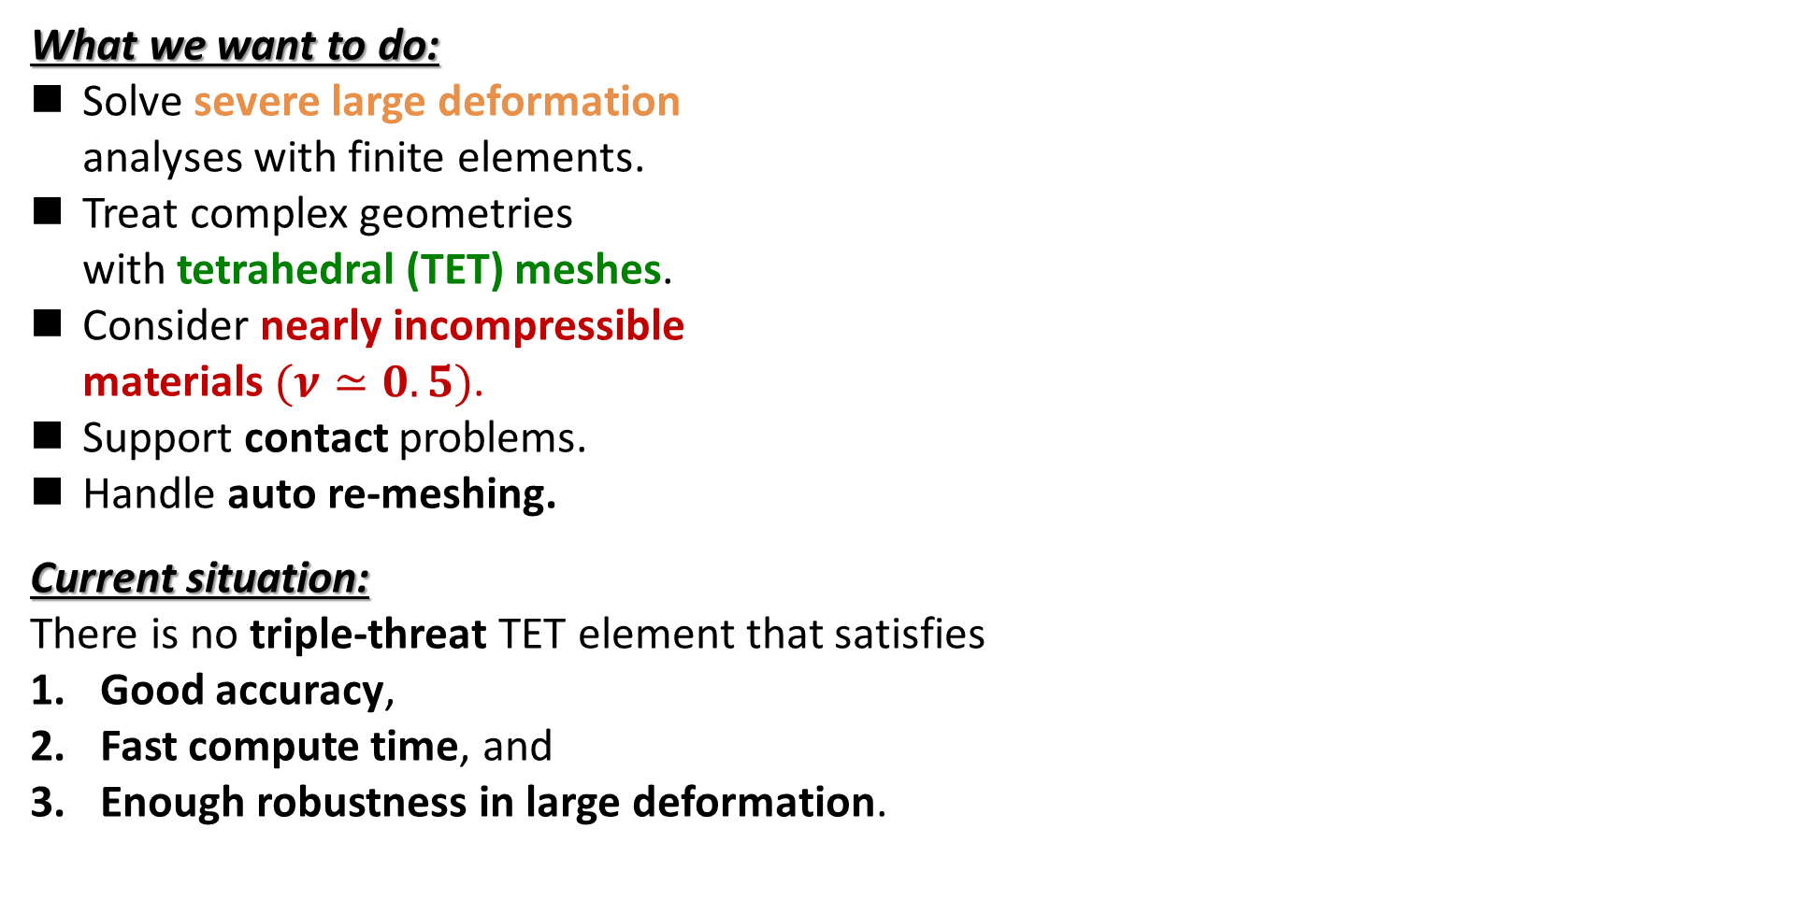
Motivation
What we want to do:
Solve severe large deformation
analyses with finite elements.
Treat complex geometries
with tetrahedral (TET) meshes.
Consider nearly incompressible
materials $(ν≃0.5)$.
Support contact problems.
Handle auto re-meshing.
Current situation:
There is no triple-threat TET element that satisfies
Good accuracy,
Fast compute time, and
Enough robustness in large deformation.
Ductile
Metal
Rubber
Hot Plastic/Glass

Slide 3
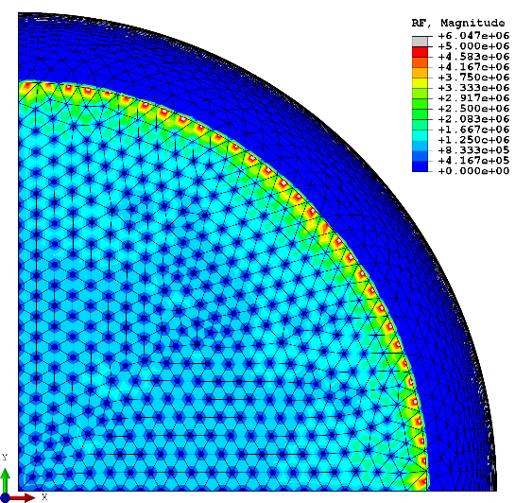
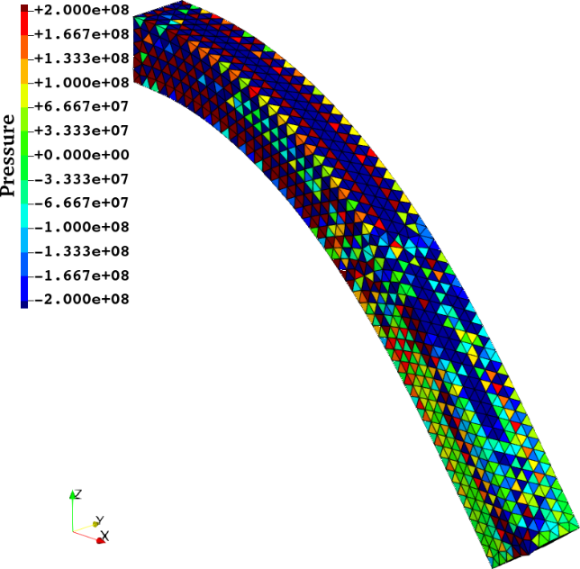
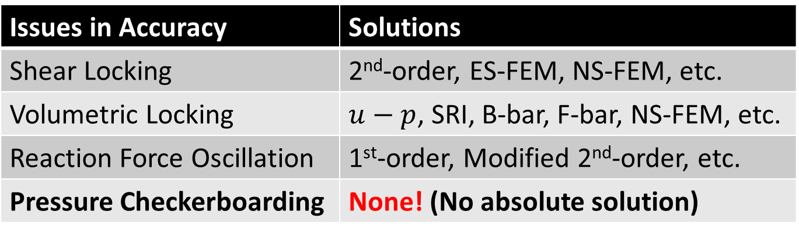
Issues of TET Elems in Accuracy and Their Solutions
Issues in Accuracy | Solutions
Shear Locking | 2nd-order, ES-FEM, NS-FEM, etc.
Volumetric Locking | $u−p$, SRI, B-bar, F-bar, NS-FEM, etc.
Reaction Force Oscillation | 1st-order, Modified 2nd-order, etc.
Pressure Checkerboarding | None! (No absolute solution)
S-FEMs will be
detailed later.
Related to
Nodal Force/Disp.
Related to Stress/Strain
Pressure checkerboarding is quite difficult to resolve.
Typical reaction force oscillation (ABAQUS C3D10)
Typical pressure checkerboarding (ABAQUS C3D4)

Slide 4
Objective
Develop a new smoothed finite element method
with 4-node tetrahedral meshes (ES-FEM-SRI-T4)
to suppress pressure checkerboarding
in nearly incompressible large deformation analysis.
Table of Contents
Quick Introduction to S-FEM
Method: Brief of ES-FEM-SRI-T4
Result & Discussion 1: Performance of ES-FEM-SRI-T4
Result & Discussion 2: Performance of Conventional S-FEM
with Post-Smoothing in Pressure
Summary

Slide 5
Quick Introduction to S-FEM

Slide 6
What is S-FEM?
Smoothed finite element method is an FE formulation proposed by Prof. G.R. Liu in 2006.
After 20 years of active research, practical applications are now underway in various fields.
S-FEM is one of the gradient (strain) smoothing techniques.
There are many kinds of S-FEMs depending on the scheme of smoothing.
There are a few classical S-FEMs depending on the smoothing domain.
For example, in a 2D triangular mesh:
Edge-based S-FEM
(ES-FEM)
Node-based S-FEM
(NS-FEM)
Standard FEM
Each colored area shows the domain for gradient smoothing.

Slide 7
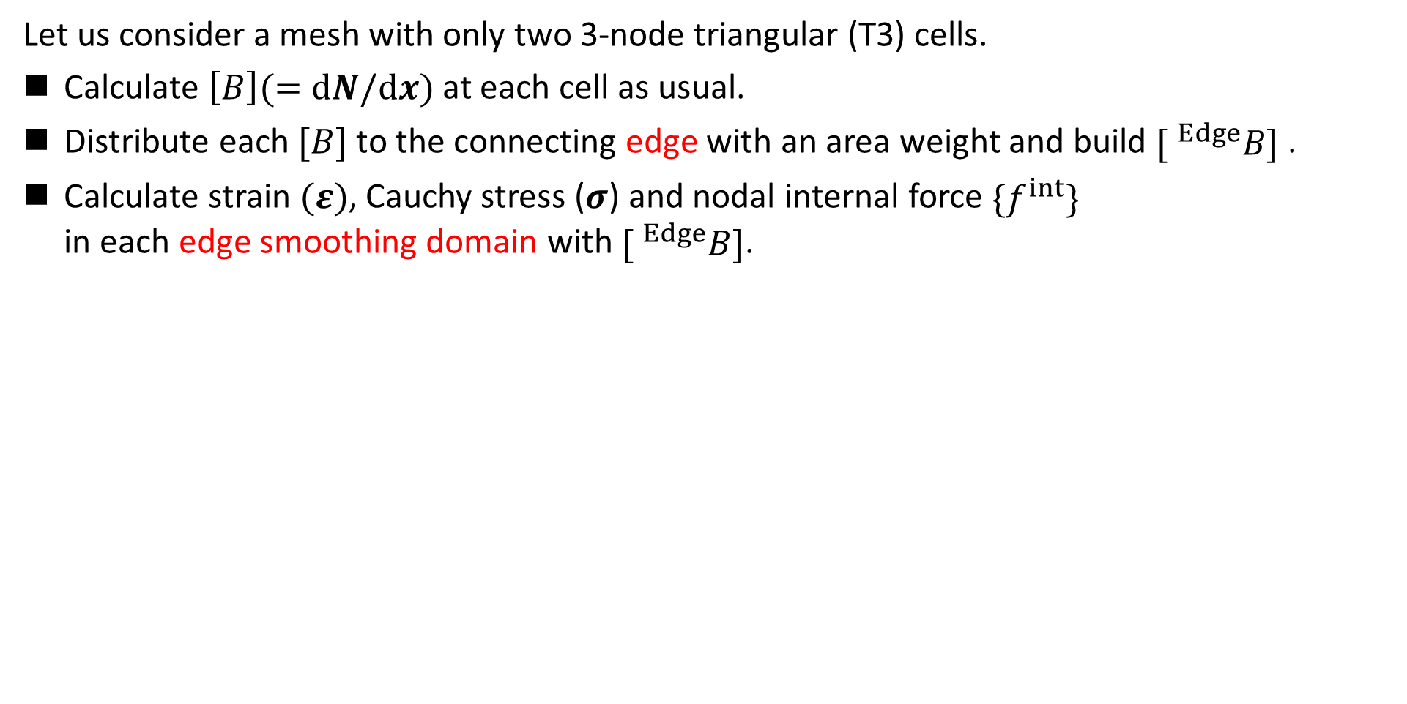
Brief of ES-FEM
Let me
explain in 2D
for simplicity
Let us consider a mesh with only two 3-node triangular (T3) cells.
Calculate $\left[B\right](=dN/dx)$ at each cell as usual.
Distribute each $[B]$ to the connecting edge with an area weight and build $[ ^{Edge}B]$ .
Calculate strain $(ε)$, Cauchy stress ($σ$) and nodal internal force $\{f^{int}\}$
in each edge smoothing domain with $[ ^{Edge}B]$.
$$[B_{1}]$$
As if putting
a Gauss point
on each edge center
$$[B_{2}]$$
$$[^{Edge}B]$$
$↳{}^{Edge}ε,{}^{Edge}σ, \{^{Edge}f^{int}\}$ etc.

Slide 8
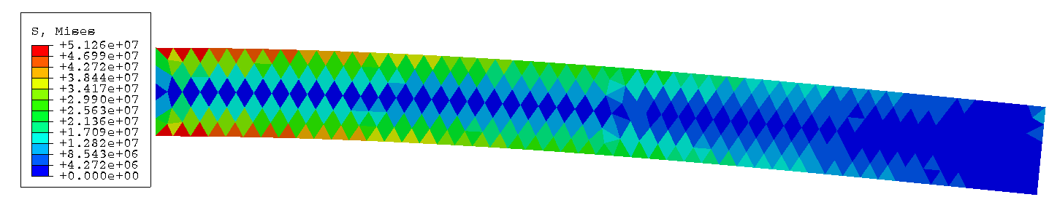
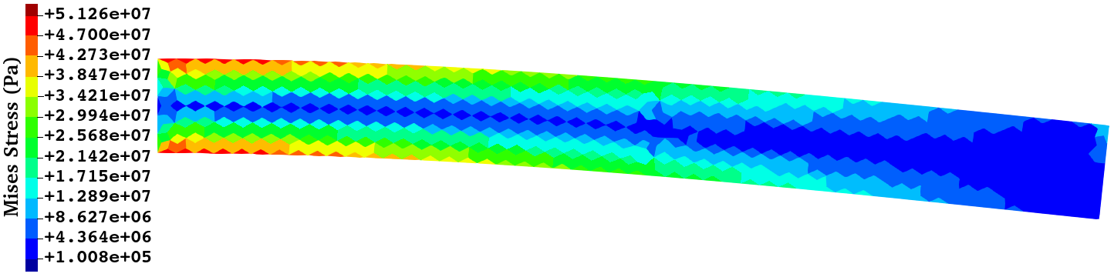
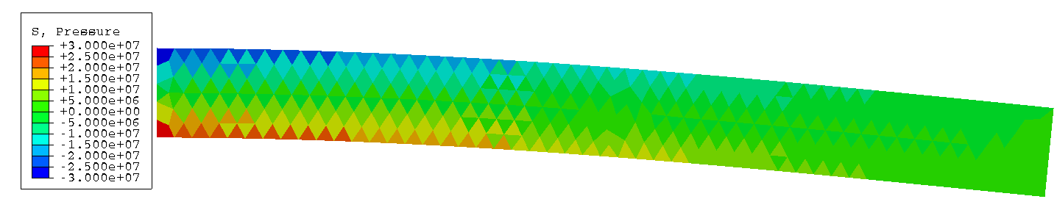
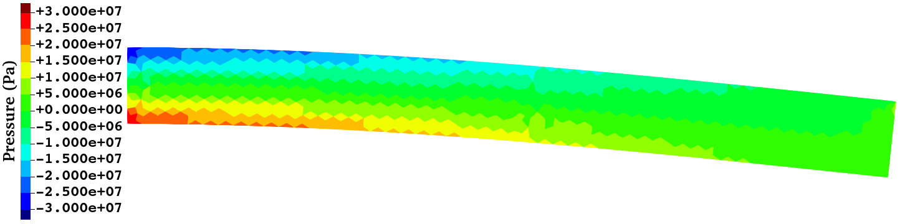
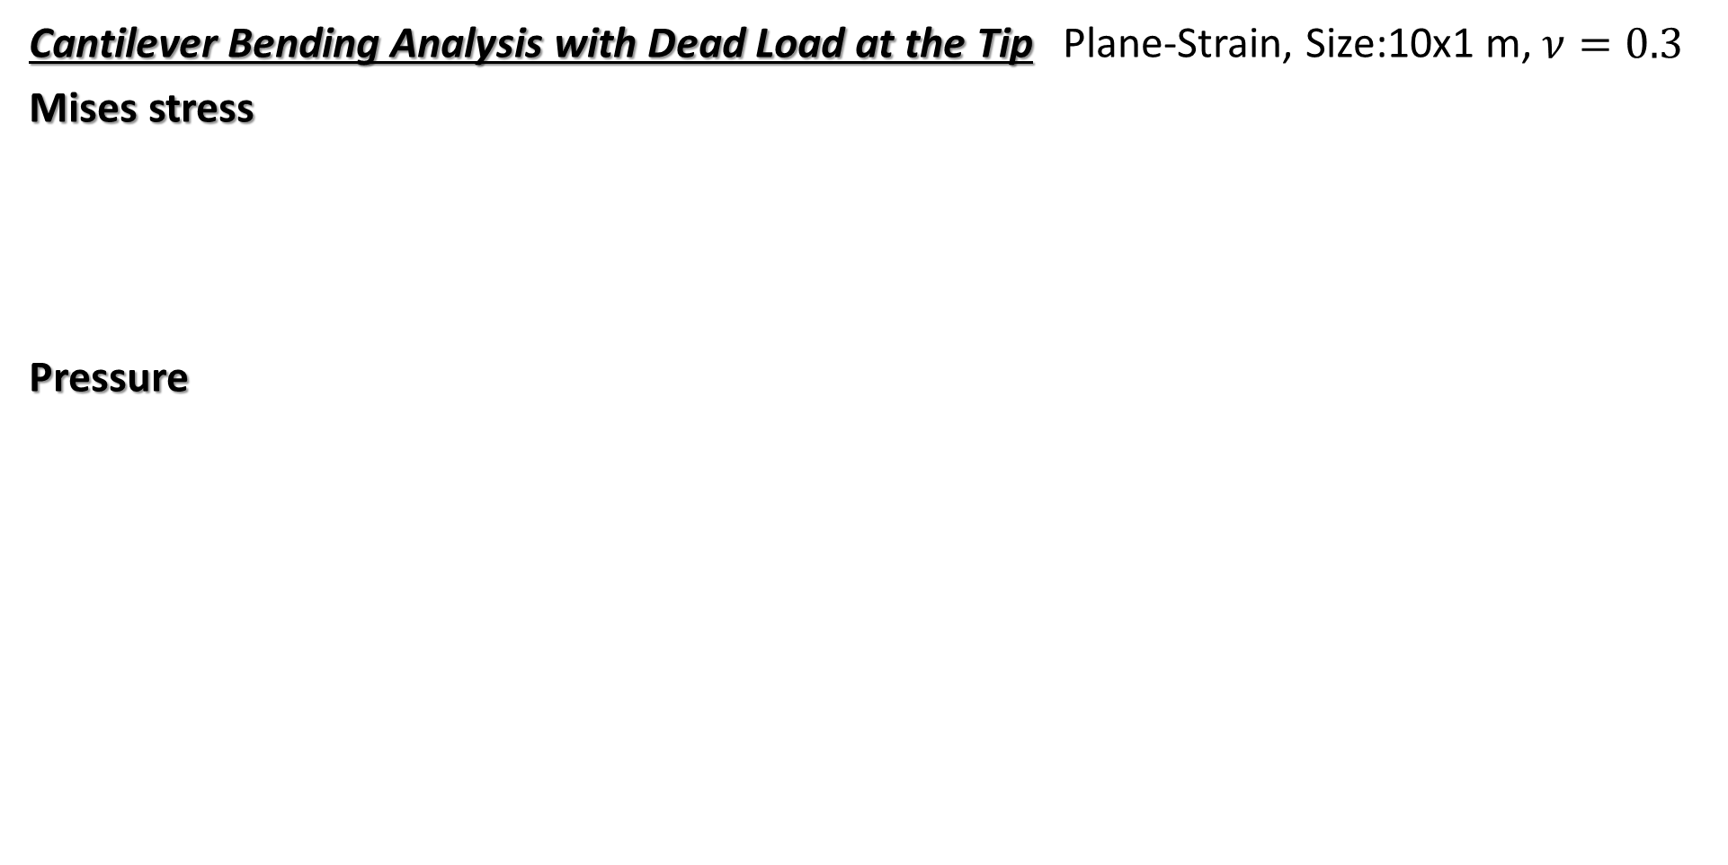
Performance of ES-FEM
Cantilever Bending Analysis with Dead Load at the Tip Plane-Strain, Size:10x1 m, $ν=0.3$
Mises stress
Pressure
ABAQUS CPE3
(Standard FEM-T3)
ES-FEM-T3
ES-FEM-T3 gives more accurate stress/strain distributions
than the standard FEM-T3 using the same mesh.

Slide 9
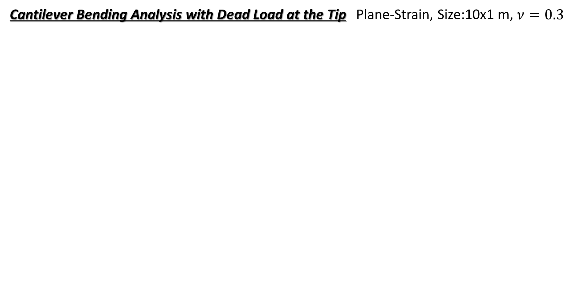
Performance of ES-FEM
Cantilever Bending Analysis with Dead Load at the Tip Plane-Strain, Size:10x1 m, $ν=0.3$
Mesh Seed Size (m) | The Number of Cells
1 | 22
1/2 | 84
1/4 | 342
1/8 | 1,442
1/16 | 5,766
1/32 | 23,034
1/64 | 92,146
Converged
Converged
ES-FEM-T3 is shear locking free and thus the mesh convergence rate of displacement/force is much faster than the Standard FEM-T3.

Slide 10
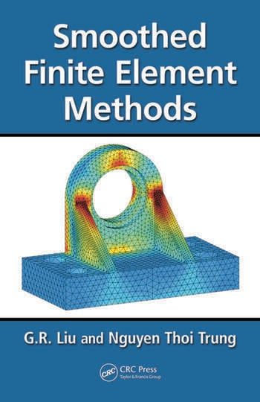
What are the benefits of S-FEM?
T4: 4-node Tetrahedra
Super-linear mesh convergence rate with T4 mesh.
(Almost same rate as 2nd-order T10 elements.)
Shear locking free with ES-FEM-T4.
(Good accuracy with T4 mesh in solid mechanics.)
Volumetric locking free with NS-FEM-T4.
(Key technique for rubber-like nearly incompressible solid.)
Little accuracy loss with skewed meshes.
(No problem with complex geometry or severe deformation.)
No increase in DOF.
(Purely displacement-based formulation. )
Easy to code.
(keeping away from mixed variational formulations.)
T4
G.R. Liu
et al.,
CRC Press
Search
S-FEM wiki
S-FEM is a powerful method suitable for practical industrial applications.

Slide 11
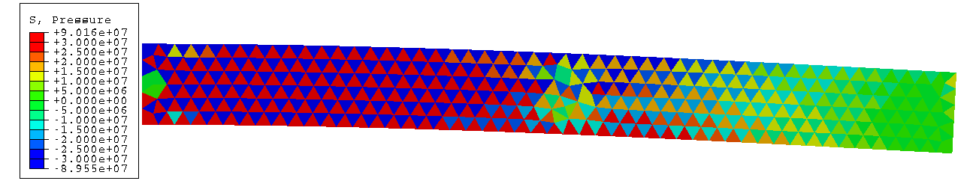
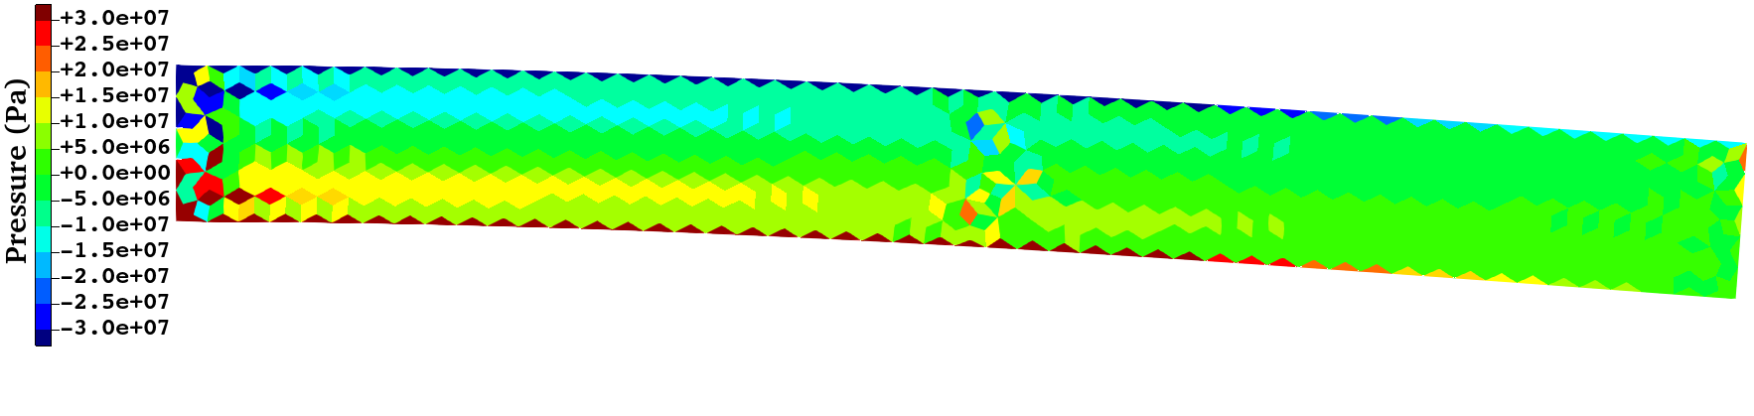
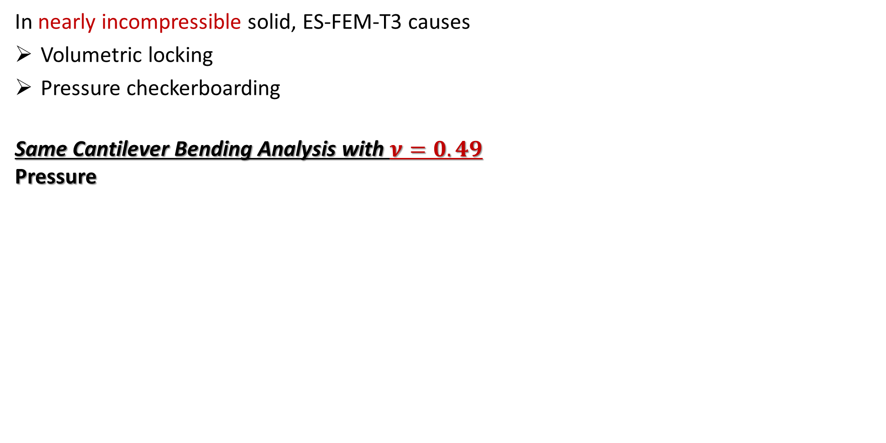
Two Major Issues in ES-FEM
In nearly incompressible solid, ES-FEM-T3 causes
Volumetric locking
Pressure checkerboarding
Same Cantilever Bending Analysis with $ν=0.49$
Pressure
ABAQUS CPE3
(Standard FEM-T3)
ES-FEM-T3
A brand-new code with a novel S-FEM formulation
for nearly incompressible solids is still awaited.

Slide 12
Method
Brief of ES-FEM-SRI-T4

Slide 13
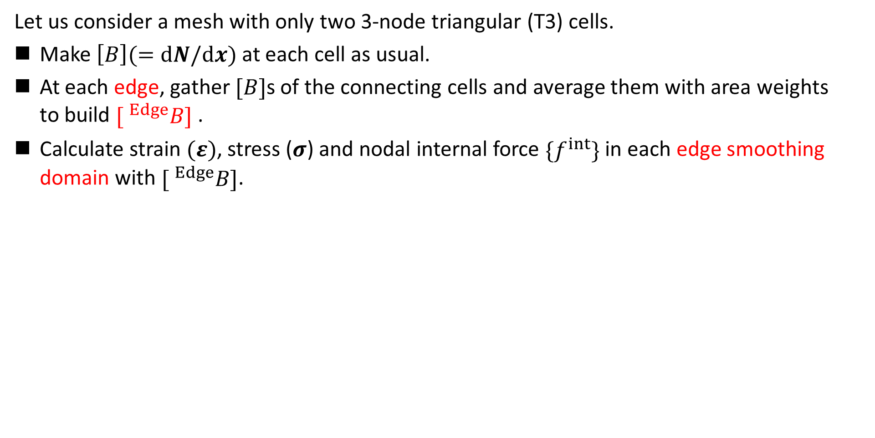
Brief of ES-FEM
Let me
explain in 2D
for simplicity
Let us consider a mesh with only two 3-node triangular (T3) cells.
Make $\left[B\right](=dN/dx)$ at each cell as usual.
At each edge, gather $[B]$s of the connecting cells and average them with area weights
to build $[ ^{Edge}B]$ .
Calculate strain $(ε)$, stress ($σ$) and nodal internal force $\{f^{int}\}$ in each edge smoothing domain with $[ ^{Edge}B]$.
$$[B_{1}]$$
As if putting
a Gauss point
on each edge center
No shear locking.
Cannot avoid
volumetric locking &
pressure checkerboarding.
Strain distribution is
piecewise constant
in each smoothing domain.
$$[B_{2}]$$
$$[^{Edge}B]$$
$↳{}^{Edge}ε,{}^{Edge}σ, \{^{Edge}f^{int}\}$ etc.

Slide 14
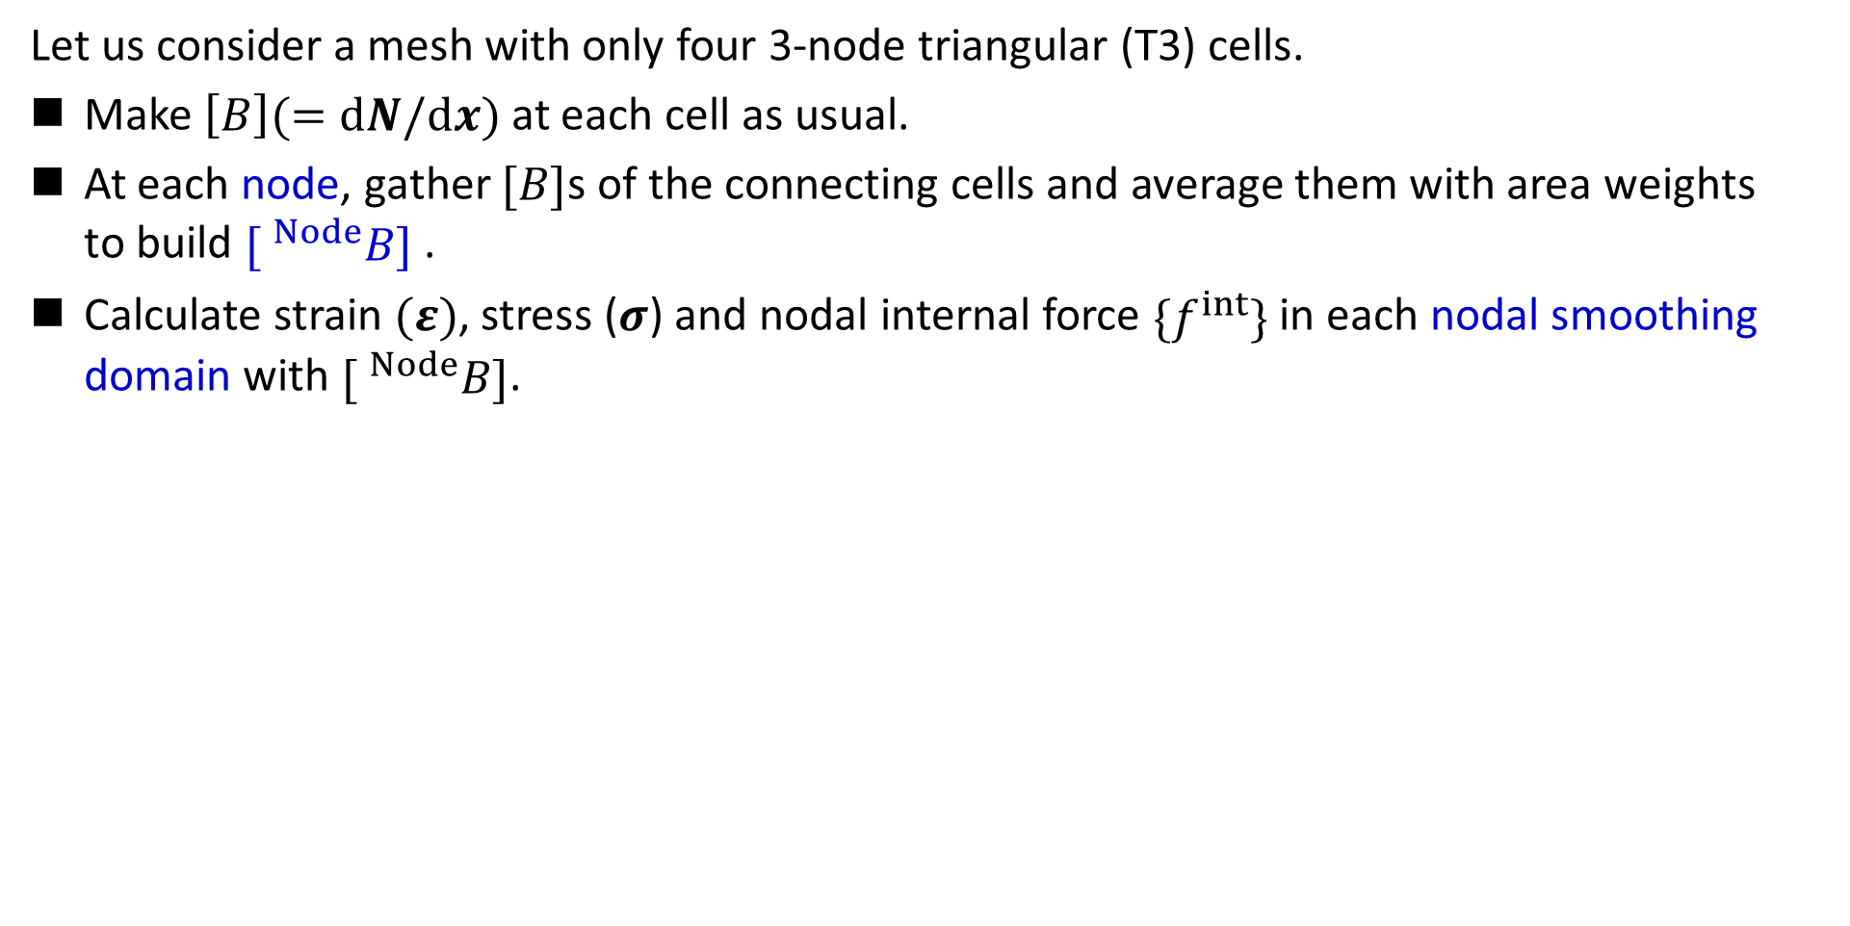
Brief of NS-FEM
Let me
explain in 2D
for simplicity
Let us consider a mesh with only four 3-node triangular (T3) cells.
Make $\left[B\right](=dN/dx)$ at each cell as usual.
At each node, gather $[B]$s of the connecting cells and average them with area weights
to build $[ ^{Node}B]$ .
Calculate strain $(ε)$, stress ($σ$) and nodal internal force $\{f^{int}\}$ in each nodal smoothing domain with $[ ^{Node}B]$.
$$[B_{4}]$$
$$[B_{1}]$$
As if putting
a Gauss point
on each node center
No shear/volumetric locking.
Minor pressure checkerboarding.
$$[B_{3}]$$
$$[B_{2}]$$
Cannot avoid
spurious low-energy modes.
Strain distribution is
piecewise constant
in each smoothing domain.
$$[^{Node}B]$$
$↳{}^{Node}ε,{}^{Node}σ, \{^{Node}f^{int}\}$ etc.

Slide 15
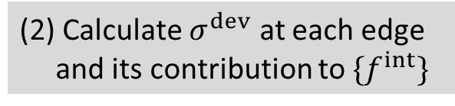
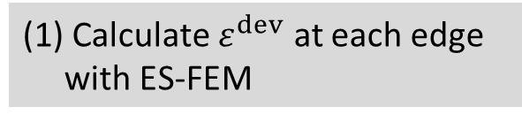

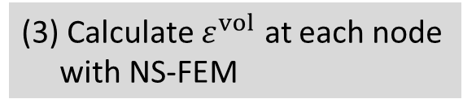
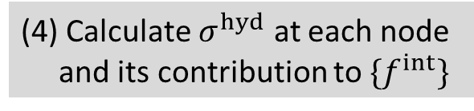
Brief of SelectiveES/NS-FEM (Conventional Method)
Apply the selective reduced integration (SRI) to ES-FEM to handle rubber-like solids
Let me
explain in 2D
for simplicity
(1) Calculate $ε^{dev}$ at each edge
with ES-FEM
(3) Calculate $ε^{vol}$ at each node
with NS-FEM
Deviatoric
Part
Volumetric
Part
(2) Calculate $σ^{dev}$ at each edge
and its contribution to $\{f^{int}\}$
(4) Calculate $σ^{hyd}$ at each node
and its contribution to $\{f^{int}\}$
Selective Reduced
Integration (SRI)
No shear locking.
Good accuracy in deviatoric stress.
No volumetric locking.
Unacceptable pressure checkerboarding.
(5) Assemble $\{f^{int}\}$

Slide 16
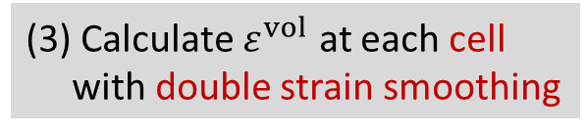
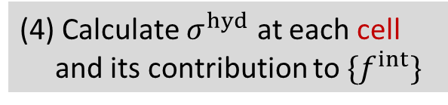
Brief of ES-FEM-SRI (New Method)
Apply the selective reduced integration (SRI) to ES-FEM to handle rubber-like solids
Let me
explain in 2D
for simplicity
(1) Calculate $ε^{dev}$ at each edge
with ES-FEM
(3) Calculate $ε^{vol}$ at each cell
with double strain smoothing
Deviatoric
Part
Volumetric
Part
Double strain smoothing:
Strain smoothing at nodes (NS-FEM) followed by another smoothing at cells (NS-FEM⁻¹)
(2) Calculate $σ^{dev}$ at each edge
and its contribution to $\{f^{int}\}$
(4) Calculate $σ^{hyd}$ at each cell
and its contribution to $\{f^{int}\}$
Selective Reduced
Integration (SRI)
No shear locking.
Good accuracy in deviatoric stress.
No volumetric locking.
Less pressure checkerboarding.
(5) Assemble $\{f^{int}\}$

Slide 17
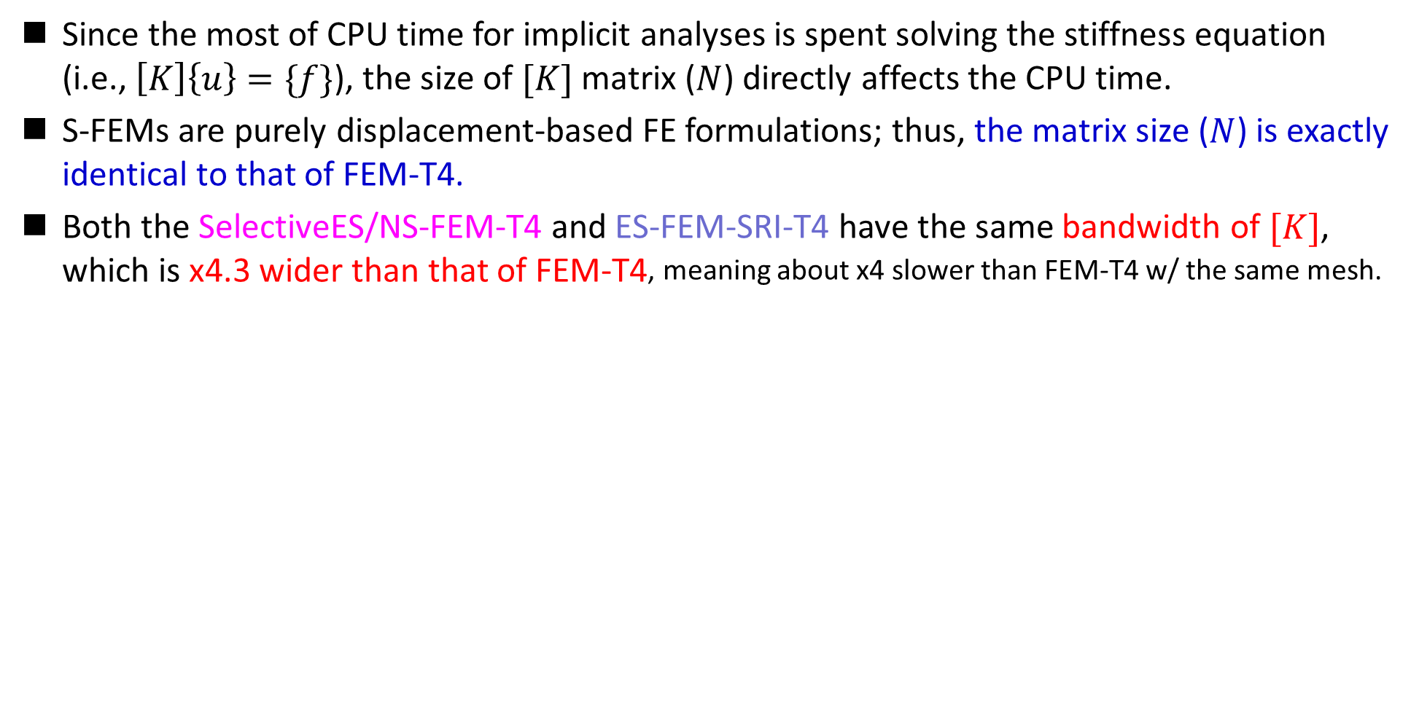
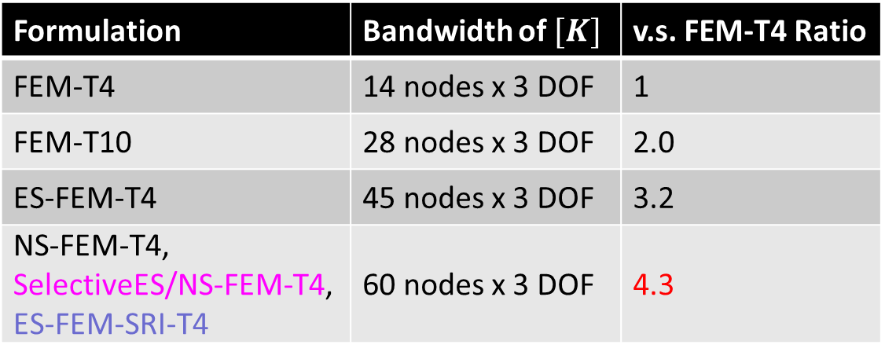
CPU Time of S-FEM-T4s
Since the most of CPU time for implicit analyses is spent solving the stiffness equation
(i.e., $\left[K\right]\left\{u\right\}=\{f\}$), the size of $[K]$ matrix ($N$) directly affects the CPU time.
S-FEMs are purely displacement-based FE formulations; thus, the matrix size ($N$) is exactly identical to that of FEM-T4.
Both the SelectiveES/NS-FEM-T4 and ES-FEM-SRI-T4 have the same bandwidth of $[K]$,
which is x4.3 wider than that of FEM-T4, meaning about x4 slower than FEM-T4 w/ the same mesh.
Formulation | Bandwidth of $[K]$ | v.s. FEM-T4 Ratio
FEM-T4 | 14 nodes x 3 DOF | 1
FEM-T10 | 28 nodes x 3 DOF | 2.0
ES-FEM-T4 | 45 nodes x 3 DOF | 3.2
NS-FEM-T4, SelectiveES/NS-FEM-T4, ES-FEM-SRI-T4 | 60 nodes x 3 DOF | 4.3
Remind that S-FEM-T4s have much faster mesh convergence rate than
FEM-T4.
Therefore, S-FEM-T4s are faster than FEM-T4 to obtain a solution with a certain level of accuracy.
ES-FEM-SRI-T4 costs the same as SelectiveES/NS-FEM-T4 and is relatively low-cost.

Slide 18
Result & Discussion 1
Performance of ES-FEM-SRI-T4

Slide 19
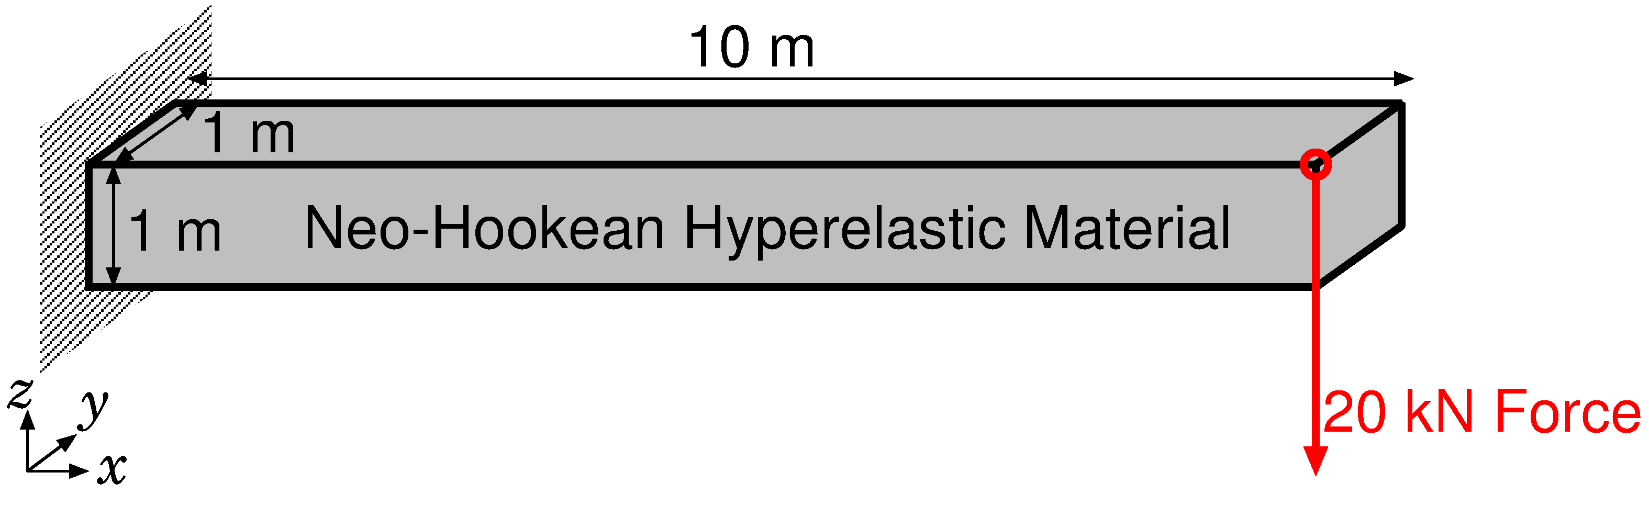
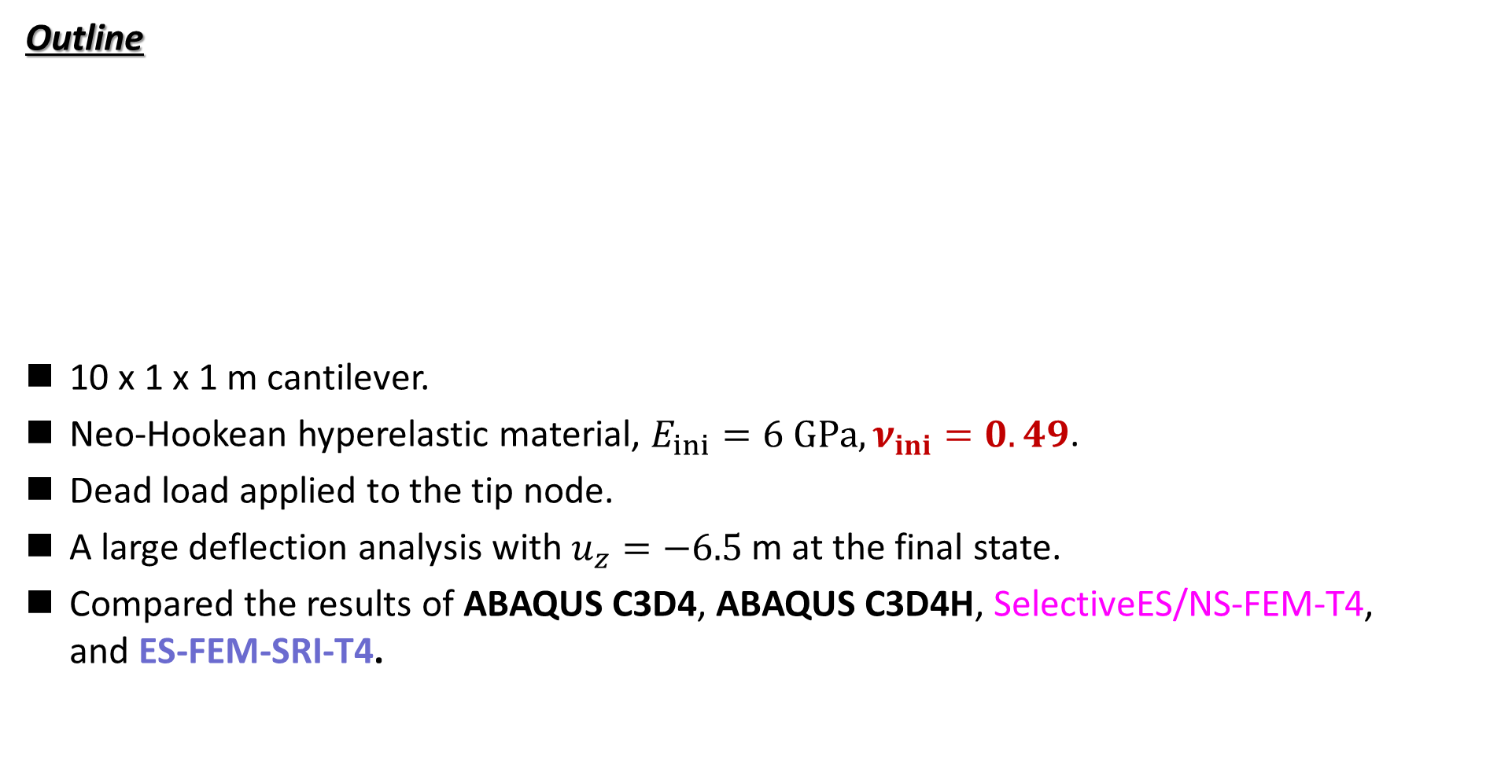
Bending of Rubber Cantilever
Static
Implicit
Outline
10 x 1 x 1 m cantilever.
Neo-Hookean hyperelastic material, $E_{ini}=6 GPa, ν_{ini}=0.49$.
Dead load applied to the tip node.
A large deflection analysis with $u_{z}=−6.5$ m at the final state.
Compared the results of ABAQUS C3D4, ABAQUS C3D4H, SelectiveES/NS-FEM-T4,
and ES-FEM-SRI-T4.
Dead Load

Slide 20
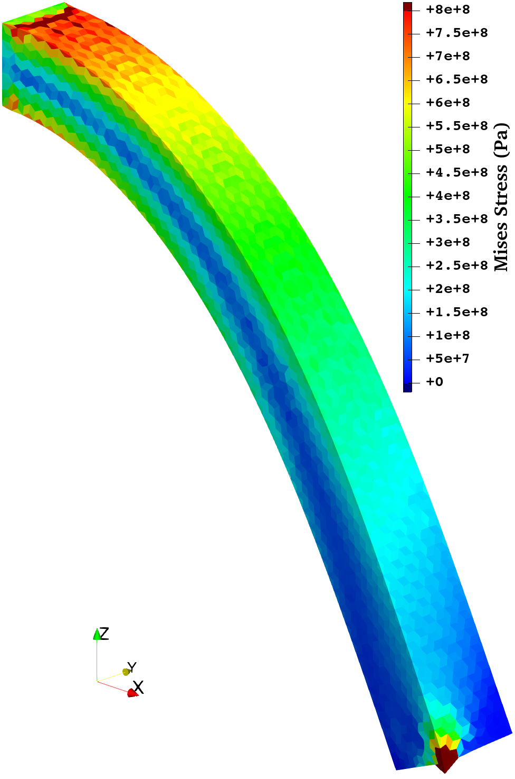

Bending of Rubber Cantilever
Static
Implicit
Mises Stress Distribution at the Finial State
ABAQUS C3D4
(Standard FEM-T4)
ABAQUS C3D4H
(Hybrid)
Selective
ES/NS-FEM-T4
ES-FEM-SRI-T4
C3D4 suffers from severe volumetric locking, whereas C3D4H has slight shear locking.
SelectiveES/NS-FEM-T4 and ES-FEM-SRI-T4 are locking-free and present smoother stress distributions.

Slide 21
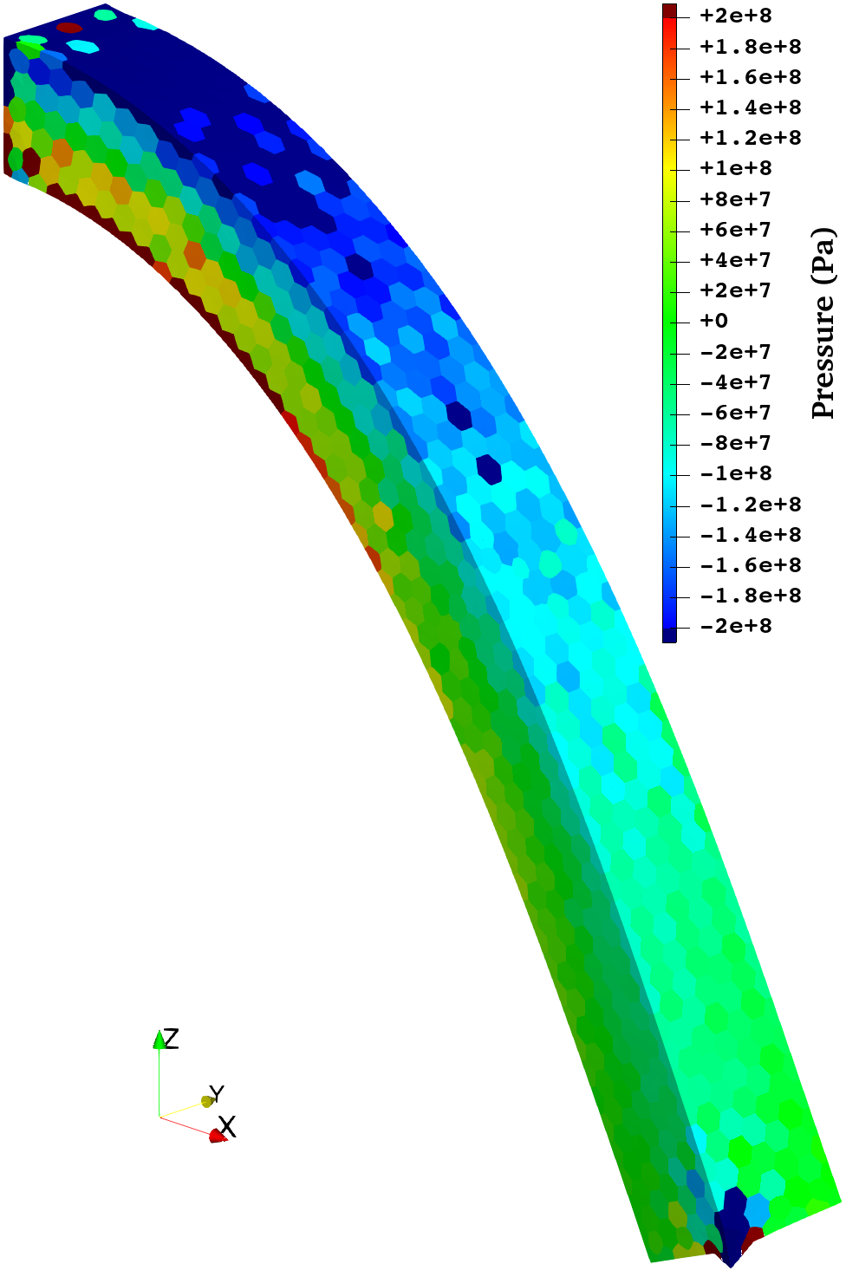
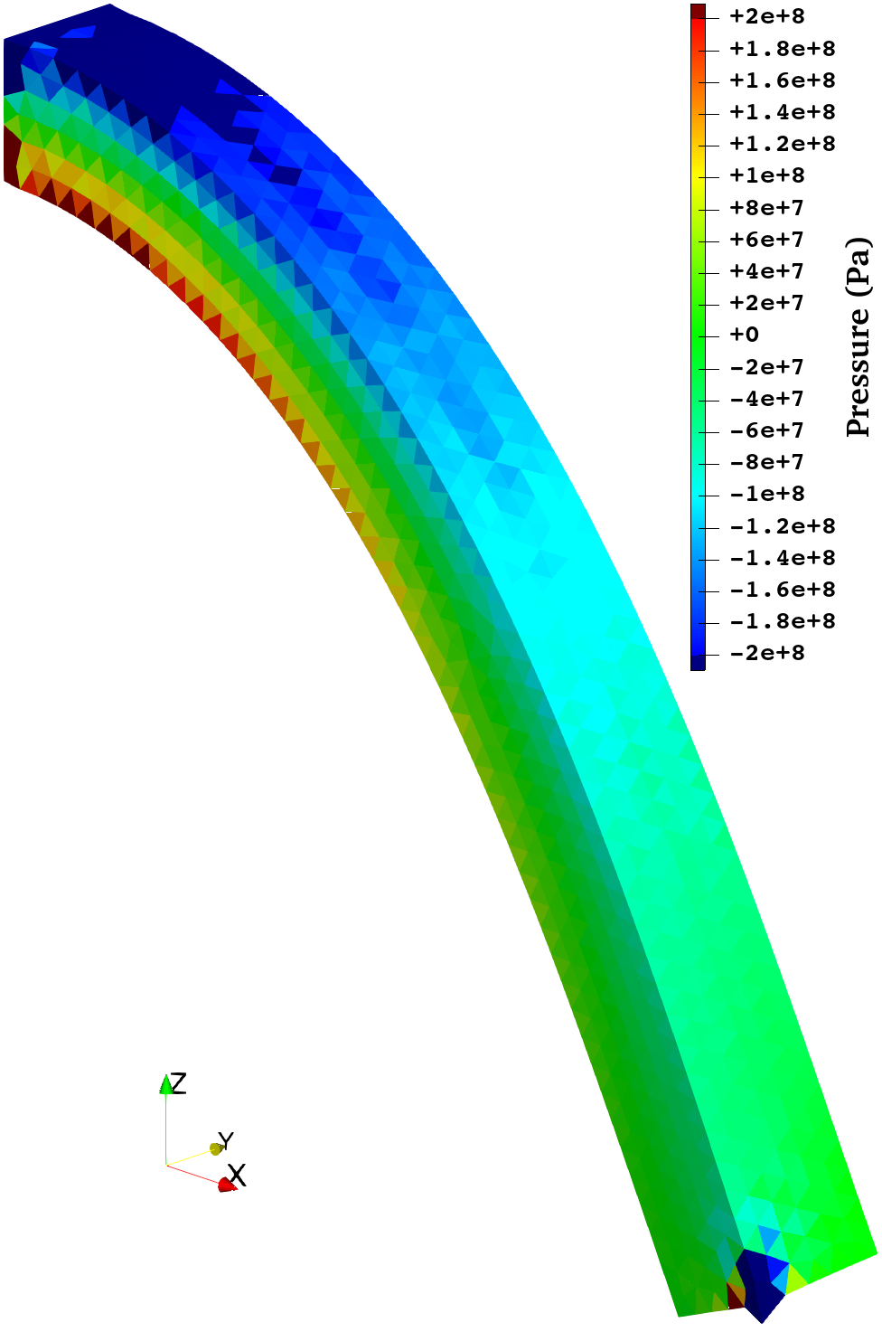
Bending of Rubber Cantilever
Static
Implicit
Pressure Distribution at the Finial State
ABAQUS C3D4
(Standard FEM-T4)
ABAQUS C3D4H
(Hybrid)
SelectiveES/NS
-FEM-T4
ES-FEM-SRI-T4
Only ES-FEM-SRI-T4 shows an acceptable pressure-checker-free result.
Inaccurate pressure leads to accuracy loss in $σ_{ii}$, direction and magnitude of principal stresses, etc..

Slide 22
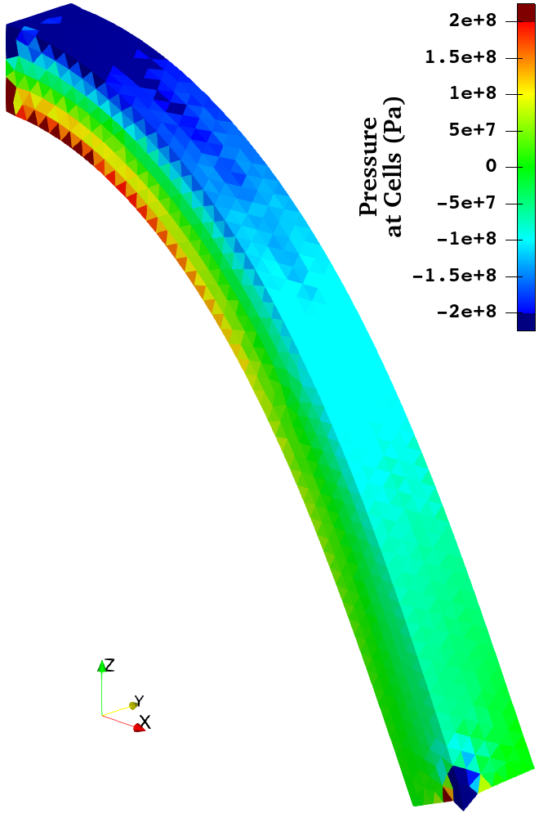

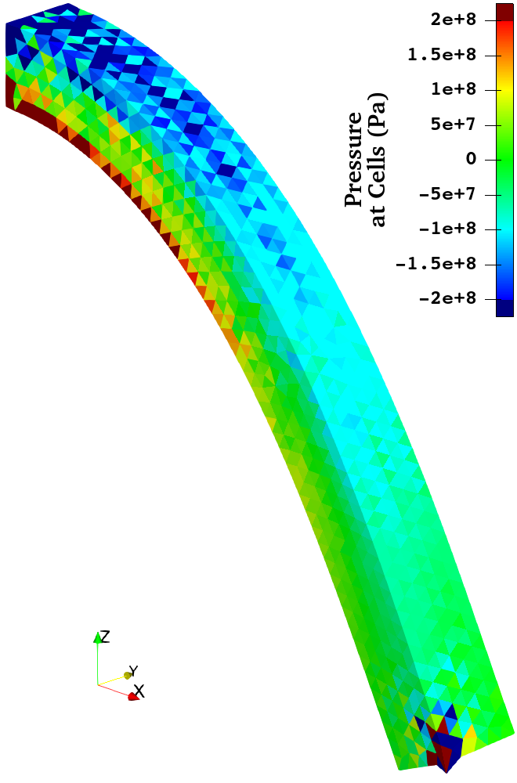
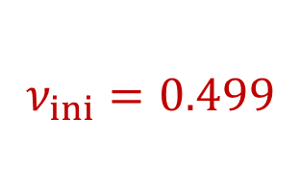
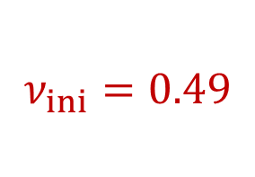
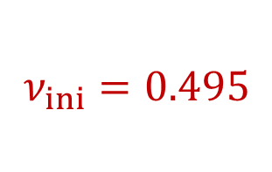
Bending of Rubber Cantilever
Static
Implicit
Pressure Distribution at the Finial State of ES-FEM-SRI-T4 with Various Poisson’s Ratios
$$ν_{ini}=0.49$$
$$ν_{ini}=0.495$$
$$ν_{ini}=0.499$$
ES-FEM-SRI-T4 is pressure-checker-free up to $ν=0.49$, but not beyond that.

Slide 23
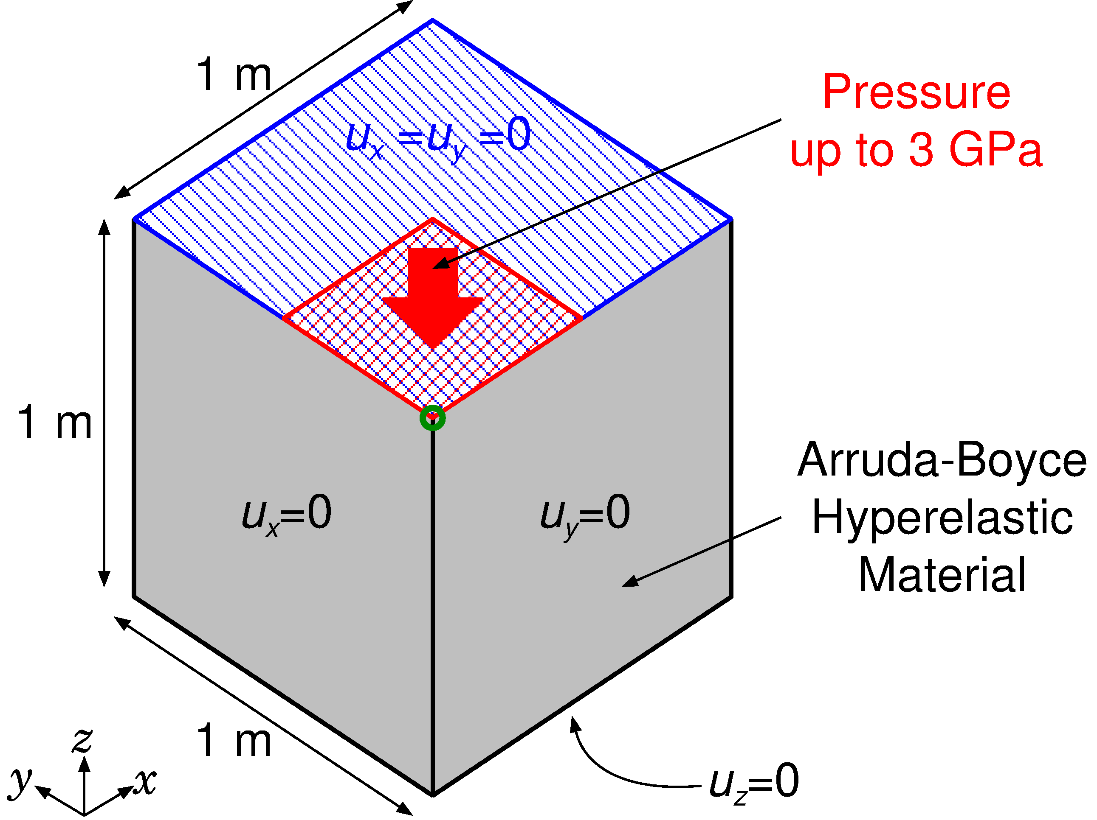
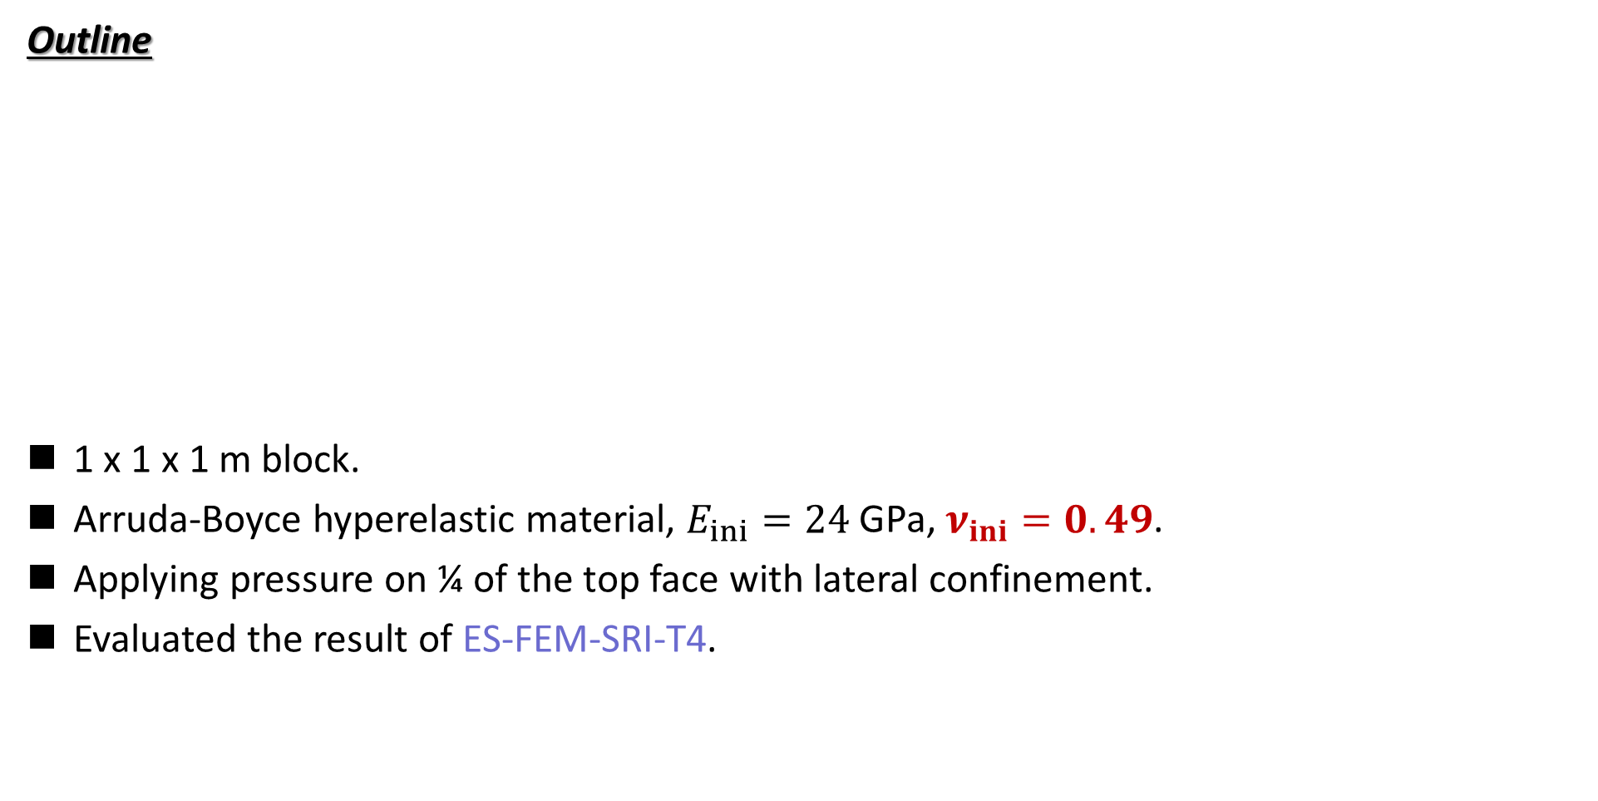
Pressuring of Rubber Block
Static
Implicit
Outline
1 x 1 x 1 m block.
Arruda-Boyce hyperelastic material, $E_{ini}=24$ GPa, $ν_{ini}=0.49$.
Applying pressure on ¼ of the top face with lateral confinement.
Evaluated the result of ES-FEM-SRI-T4.
Load

Slide 24
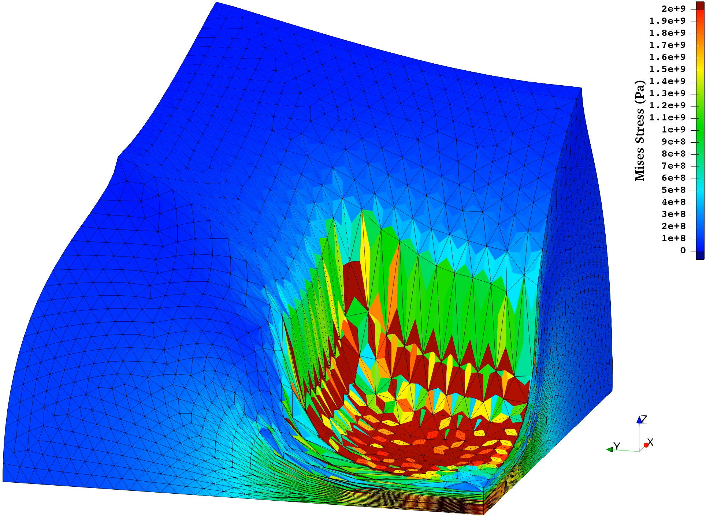
Pressuring of Rubber Block
Static
Implicit
Mises Stress
Animation of
ES-FEM-SRI-T4
Smooth distribution
of Mises stress.
Sufficient robustness
in large deformation
No major issue is found.

Slide 25
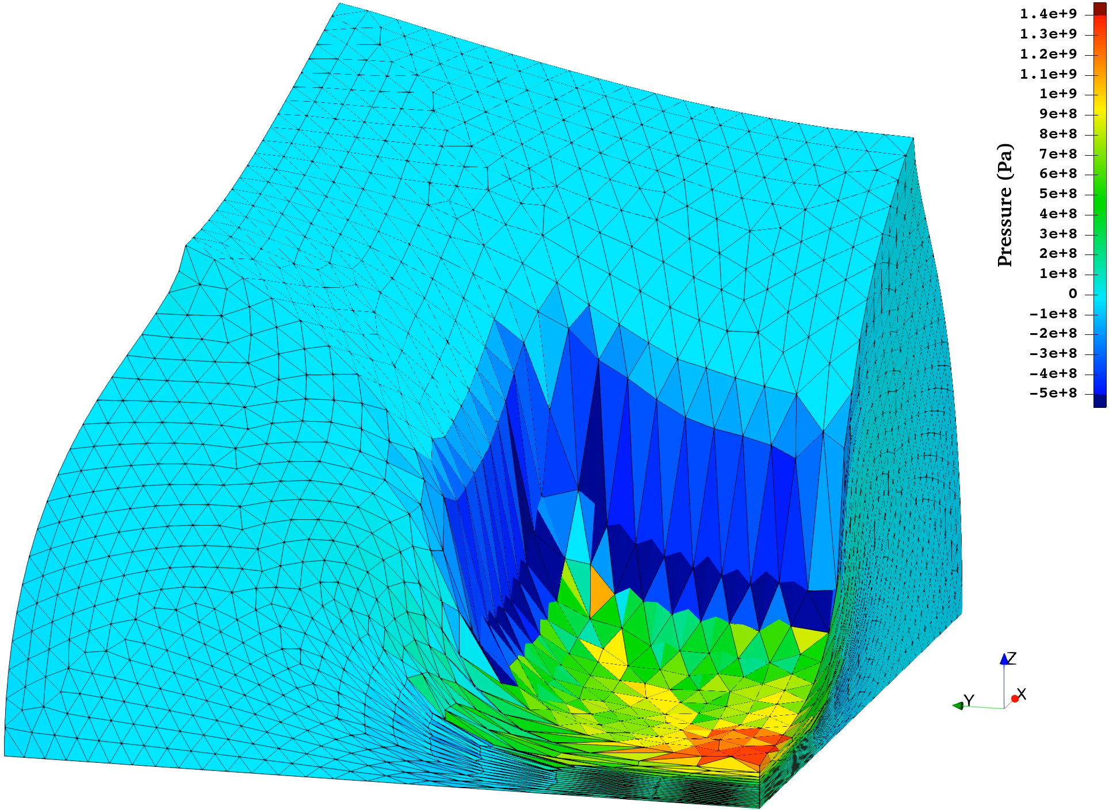
Pressuring of Rubber Block
Static
Implicit
Pressure
Animation of
ES-FEM-SRI-T4
No major checkerboarding.
Practical result is obtained.

Slide 26
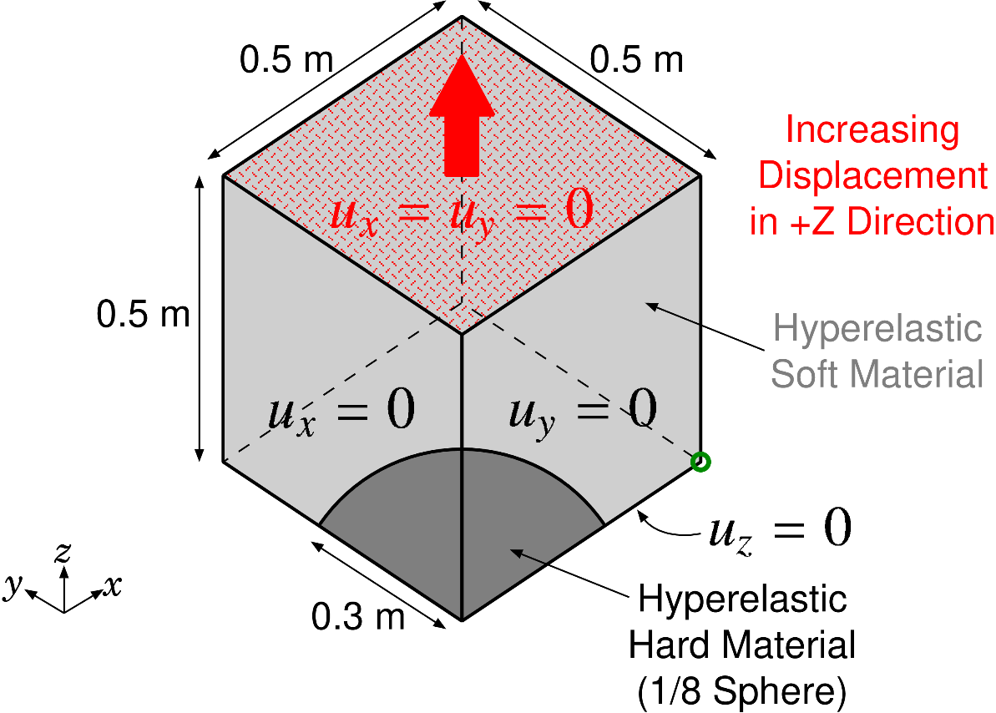
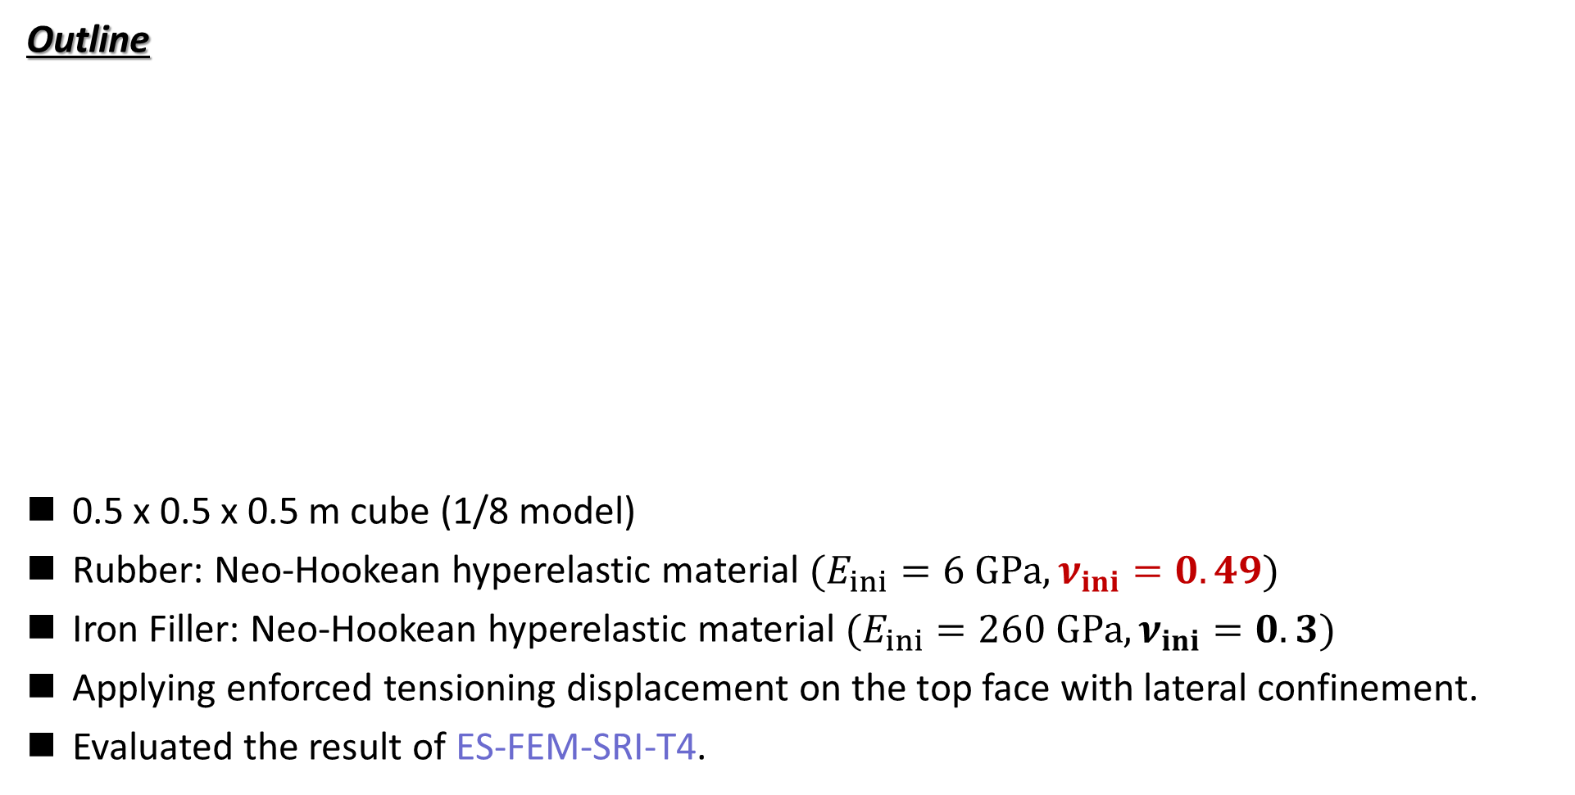
Tensioning of Rubber-Filler Composite
Static
Implicit
Outline
0.5 x 0.5 x 0.5 m cube (1/8 model)
Rubber: Neo-Hookean hyperelastic material $(E_{ini}=6 GPa, ν_{ini}=0.49)$
Iron Filler: Neo-Hookean hyperelastic material $(E_{ini}=260 GPa, ν_{ini}=0.3)$
Applying enforced tensioning displacement on the top face with lateral confinement.
Evaluated the result of ES-FEM-SRI-T4.

Slide 27
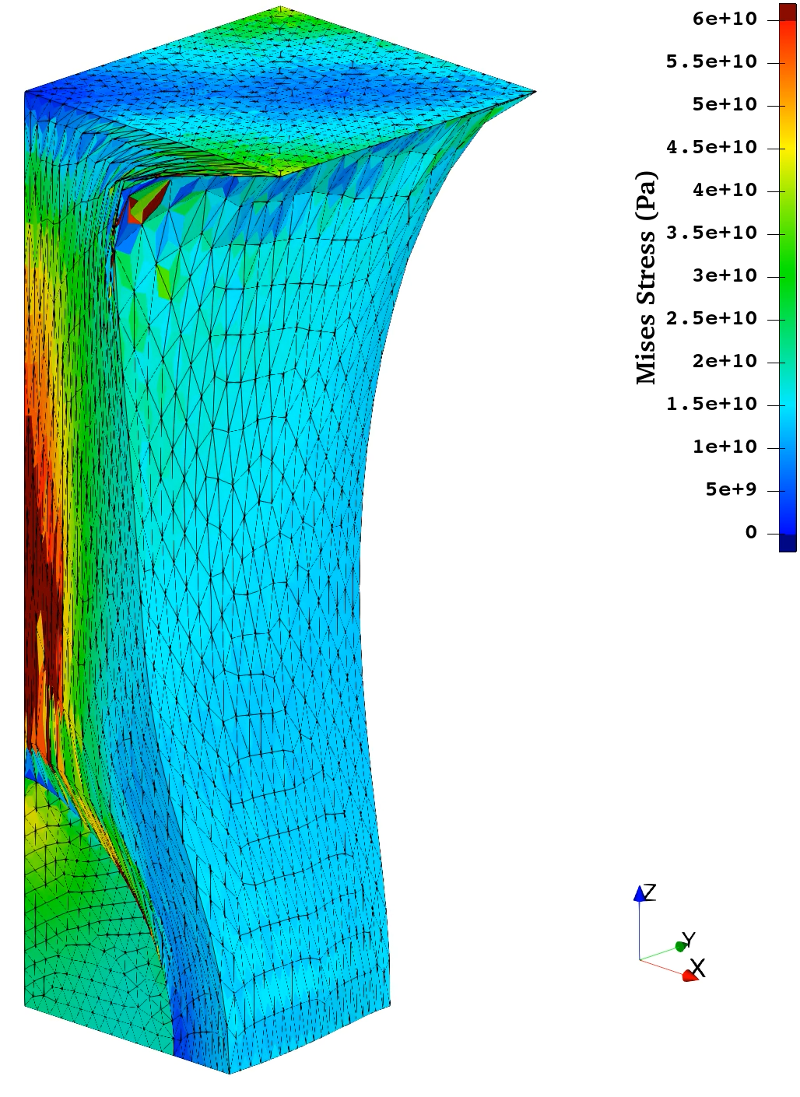
Tensioning of Rubber-Filler Composite
Static
Implicit
Mises Stress
Animation of
ES-FEM-SRI-T4
Smooth distribution
of Mises stress.
Sufficient robustness
in large deformation
No major issue is found.

Slide 28
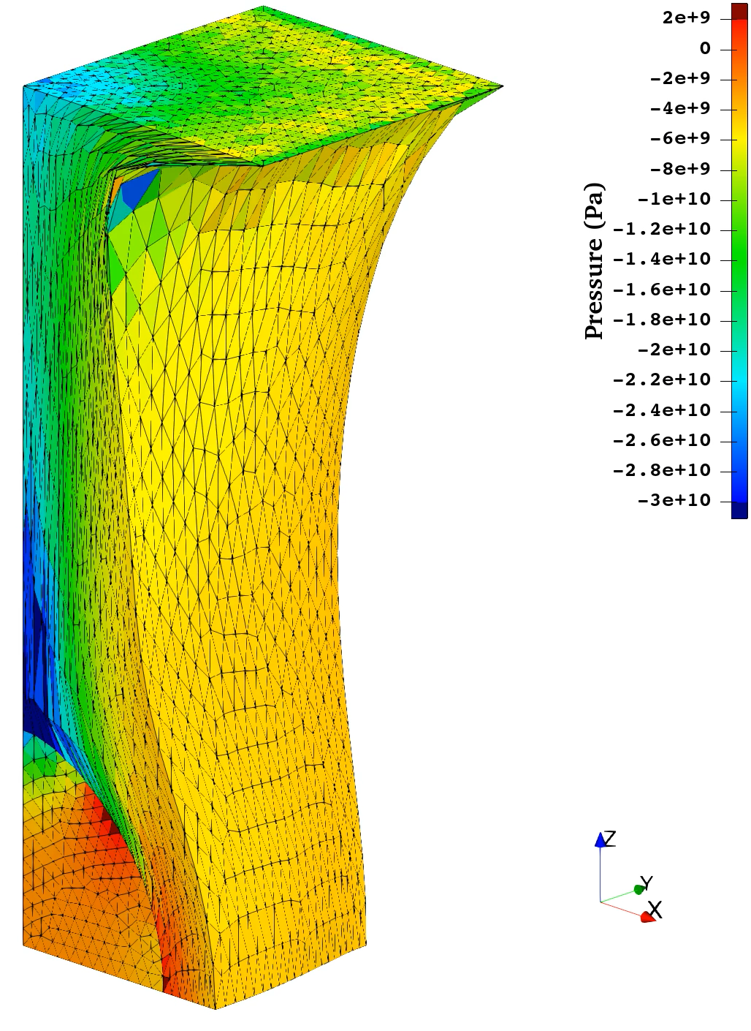
Tensioning of Rubber-Filler Composite
Static
Implicit
Pressure
Animation of
ES-FEM-SRI-T4
No checkerboarding
in the steel part.
No major checkerboarding
in the rubber part.
Practical result is obtained.

Slide 29
Result & Discussion 2
Performance of SelectiveES/NS-FEM-T4 with Post-Smoothing in Pressure

Slide 30
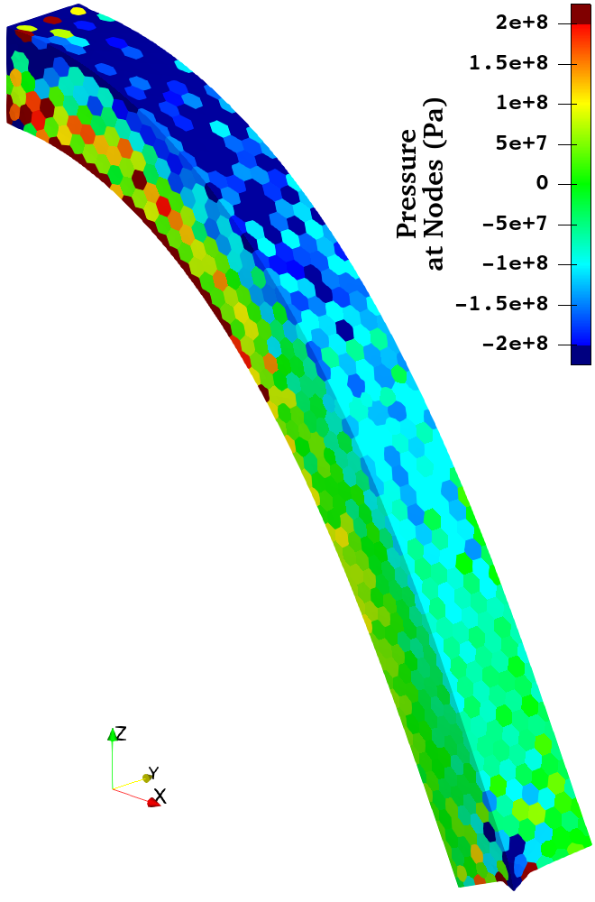

Quick Introduction to Post-Smoothing in Pressure
The conventional S-FEM (SelectiveES/NS-FEM-T4) has the pressure checkerboarding issue
in nearly incompressible analyses.
But, in most practical analyses, we can accept results smoothed in post-processing.
?
Post-Smoothing
in Pressure
SelectiveES/NS-FEM-T4
$$ν_{ini}=0.499$$
Can we accept it, or not?

Slide 31


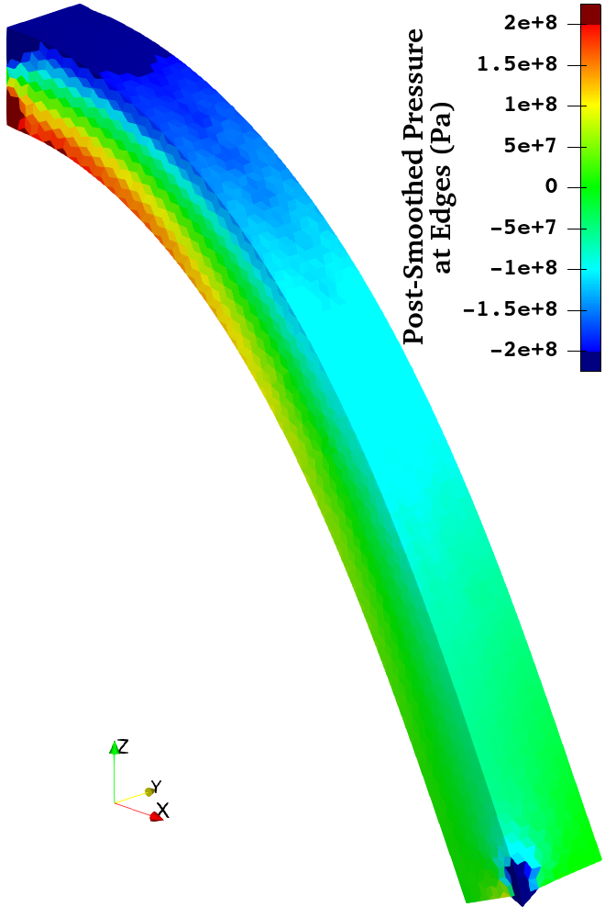
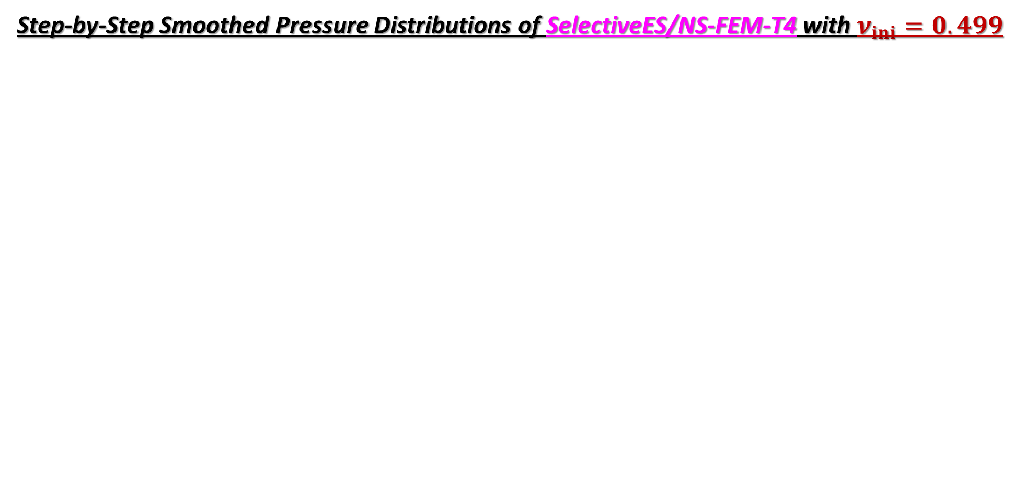
Bending of Rubber Cantilever
Static
Implicit
Step-by-Step Smoothed Pressure Distributions of SelectiveES/NS-FEM-T4 with $ν_{ini}=0.499$
Original
Result
Node-to-Cell
Post-Smoothing
Cell-to-Node
Post-Smoothing
Node-to-Edge
Post-Smoothing
SelectiveES/NS-FEM-T4 with post-smoothing in pressure works so well
to obtain a smooth pressure distribution.

Slide 32
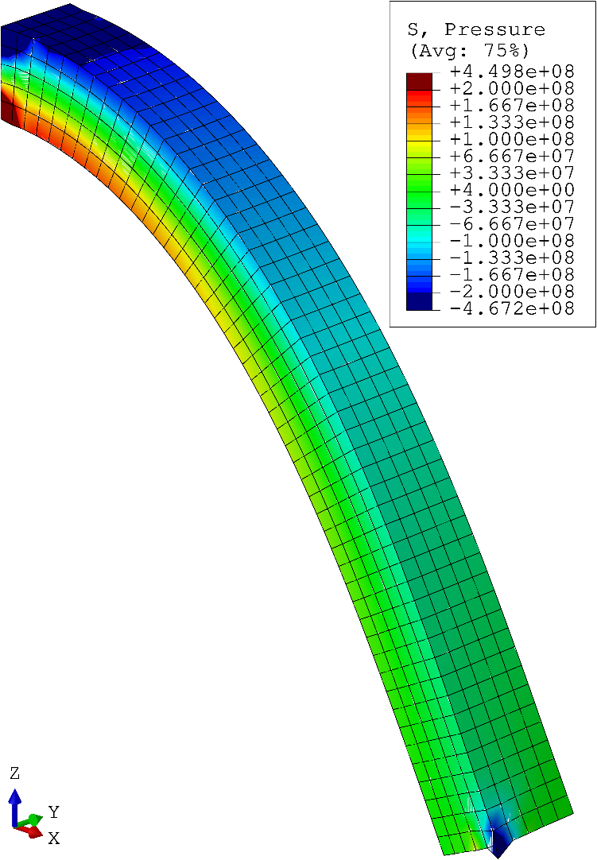
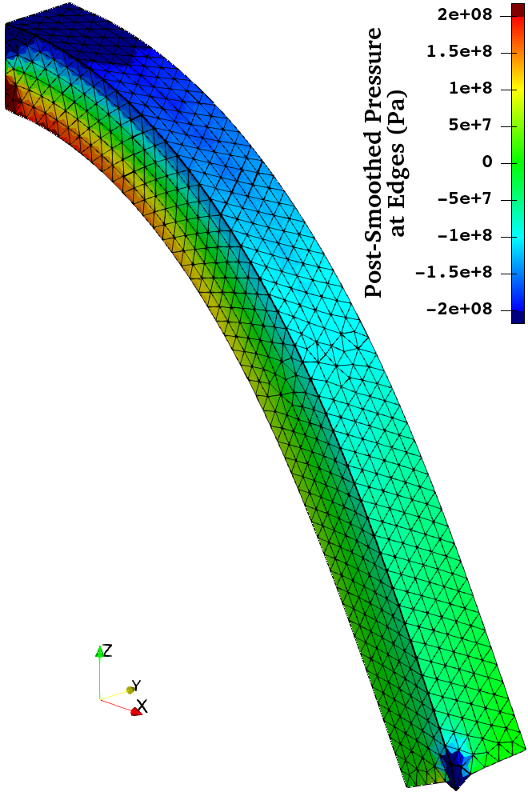



Bending of Rubber Cantilever
Static
Implicit
Comparison to the Reference Solution (ABAQUS C3D8) with $ν_{ini}=0.499$
Mises
Stress
Pressre
ABAQUS
C3D8
Selective
ES/NS-FEM-T4
ABAQUS
C3D8
Selective
ES/NS-FEM-T4
SelectiveES/NS-FEM-T4 with post-smoothing in pressure gives acceptable solutions
for all stress components.

Slide 33







Bending of Rubber Cantilever
Static
Implicit
Post-Smoothed Pressure Distribution of SelectiveES/NS-FEM-T4 with Various $ν_{ini}$s
3-Step
Post-Smoothing
3-Step
Post-Smoothing
Original
Result
$$ν_{ini}=0.4999$$
Original
Result
$$ν_{ini}=0.49999$$
SelectiveES/NS-FEM-T4 with post-smoothing in pressure works so well
even for the almost incompressible cases.

Slide 34

Overview of the Differences Between the Two Methods
ES-FEM-SRI-T4:
Pre-smoothing of volumetric strain ($ε_{vol}$) before stress calculation.
  Pressure-dependent constitutive models (e.g., Gurson, Drucker-Prager, Cam-Clay, etc.) can be treated appropriately.
Selective-ES/NS-FEM-T4 with Post-Smoothing in Pressure:
Post-smoothing of pressure ($p$, $σ_{hyd}$) after stress calculation.
  Pressure-dependent constitutive models cannot be treated appropriately.
However, since handling pressure-dependent materials is relatively rare in practice,
the post-smoothing method is sufficient in most cases.

Slide 35


Pressuring of Rubber Block
Static
Implicit
Pressure
Animation of
Selective
ES/NS-FEM-T4
with Post-Smoothing
No checkerboarding
although $ν_{ini}=0.49$.
An excellent result is obtained.

Slide 36


Pressuring of Rubber Block
Static
Implicit
Comparison of Pressure Distributions at 1.8 GPa Loading State
Selective
ES/NS-FEM-T4
with
Post-Smoothing
ABAQUS
C3D8
SelectiveES/NS-FEM-T4 with post-smoothing in pressure works so well
in nearly incompressible severe large deformation analyses.

Slide 37


Tensioning of Rubber-Filler Composite
Static
Implicit
Pressure
Animation of
Selective
ES/NS-FEM-T4
with Post-Smoothing
No checkerboarding in both the rubber part ($ν_{ini}=0.49$) and the steel part ($ν_{ini}=0.3$).
An excellent result is obtained.

Slide 38
Summary

Slide 39
Summary
A new smoothed finite element method (ES-FEM-SRI-T4) was proposed.
Despite using 4-node tetrahedral (T4) meshes, ES-FEM-SRI-T4 is not only locking-free but also pressure-checker-free for solids with Poisson’s ratio up to 0.49.
The pressure-checker-free property is especially important in the implicit analyses with pressure-dependent constitutive models (e.g., Gurson, Drucker-Prager, Cam-Clay, etc.), in which cosmetic post-smoothing in pressure does not work.
For the analyses only with pressure-independent constitutive models, the conventional SelectiveES/NS-FEM-T4 with post-smoothing in pressure works well.
Take Home Message:
By using SelectiveES/NS-FEM-T4 with post-smoothing or ES-FEM-SRI-T4 appropriately,
most practical problems, including nearly incompressible large deformation analyses with complex geometries, are accurately solved.

Slide 40





Applications of S-FEM-T4s in Our Lab
Large deformation solid mechanics (still in academic research)
Dynamic Explicit Static Implicit Viscous Implicit
Electrostatic
(already in
commercial use)
$$\overline{ε^{pl}}$$
Carbody
Electro
Deposition
Thank you for your
kind attention!

Slide 41
Appendix

Slide 42
Proper Usage of S-FEM-T4s
Post-smoothing is a technique for cosmetic improvement and is not welcomed;
however, it is an extremely useful technique for materials without pressure dependency
in engineering applications.
Material Properties | Recommended Method
A) Compressible | ES-FEM-T4 or SelectiveES/NS-FEM-T4
B) Incompressible & Pressure-independent | SelectiveES/NS-FEM-T4 with Post-Smoothing
C) Incompressible & Pressure-dependent | ES-FEM-SRI-T4 with Poisson’s Ratio up to 0.49 or SelectiveES/NS-FEM-T4 with Post-Smoothing and Explicit parameterization for Pressure

