Slide 1
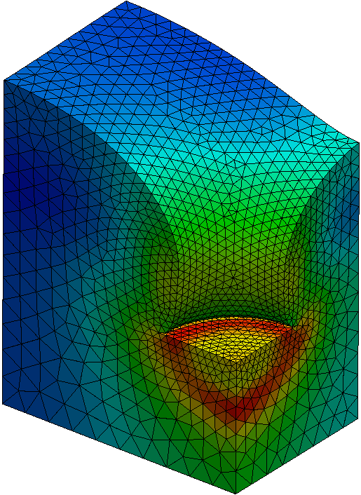
A Stable Rezoning Method for Large Deformation Finite Element Analysis using Incremental Equilibrium Equation
yonishi@a.mei.titech.ac.jp
This talk indirectly relates to Particle/Meshfree methods.
I beg your patience till the end.
Yuki ONISHI, Kenji AMAYA
Tokyo Institute of Technology (Japan)

Slide 2
Motivation and Background
Motivation
We want to solve severely large deformation problems accurately and stably! (Final target: thermal nanoimprinting)
Background
Finite elements are distorted in a short time, thereby resulting in convergence failure.
FE rezoning method (h-adaptive mesh-to-mesh solution mapping) is indispensable.

Slide 3
Methods for Forming Simulation
 | Software | Accuracy | Stability
One Step Method | HyperForm FASTFORM | * | *****
Dynamic-Explicit FE Rezoning | LS-DYNA PAM-STAMP | ** | ***
Static-Explicit FE Rezoning | ASU/P-form | *** | **
Static-Implicit FE Rezoning | ABAQUS MARC | ***** | *
Most of the
rezoning researches
try to improve this.
Our approach
tries to improve
this with
a new idea.

Slide 4
Objective
Develop an accurate and stable implicit FE rezoning method
for large deformation problems with a new idea.
New Idea: adopting implicit FE formulation based on
the incremental equilibrium equation (IEE)
Table of Body Contents
Derivation of the IEE for static-implicit analysis
Formulation of our implicit FE rezoning method based on the IEE
Verification analysis in 2D
Demonstration analysis in 3D

Slide 5
Derivation of the incremental equilibrium equation (IEE)
for static-implicit analysis

Slide 6
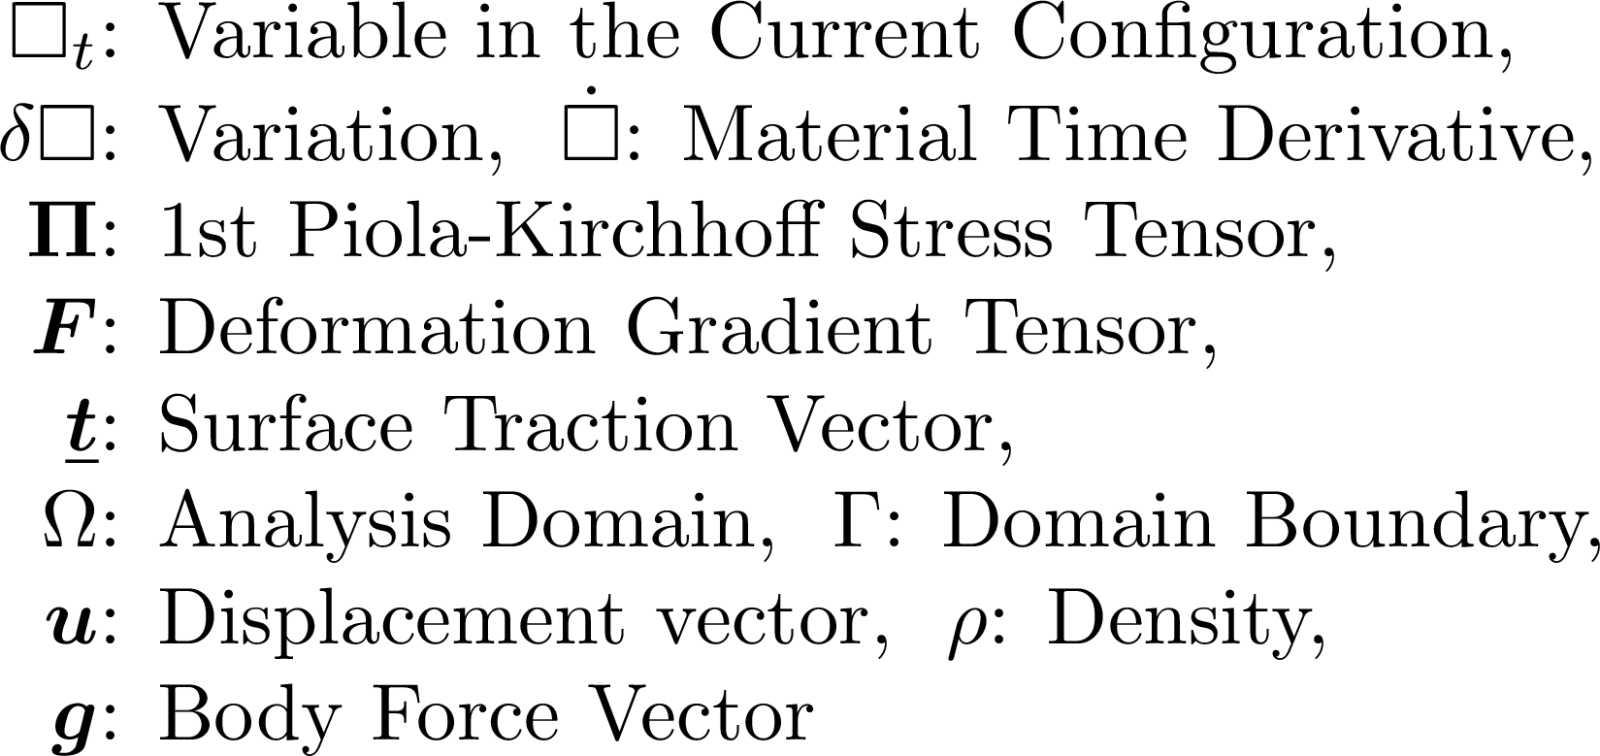
Virtual Work Equation in Rate Form
The static-explicit FE formulation uses
the same Eq.
Work Conjugate

Slide 7
Linearization and Discretization
Work Conjugate
Linearization
in Time
Galerkin
Discretization
Fully Implicit Time Advancing
$□^{+}$:Trial Variable,
E : Set of Elements,
S : Set of Element Faces

Slide 8
Incremental Equilibrium Equation (IEE)
$□^{+}$:Trial Variable,
E : Set of Elements,
S : Set of Element Faces
Let the left-hand side be $\{∆f^{\text{int}}\}$, the right-hand side be $\{∆f^{\text{ext}}\}$.
The implicit IEE:
Avoid error accumulation through timesteps.
The implicit IEE (secondary form):
We use the secondary form in the actual implementation.

Slide 9
Comparison of IEE to Standard EE
[Standard
Static-Implicit EE]
Cauchy Stress
[Implicit
IEE]
1st P-K Stress
increment

Slide 10
Formulation of
our implicit FE rezoning method based on the IEE

Slide 11
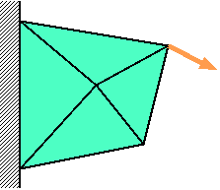
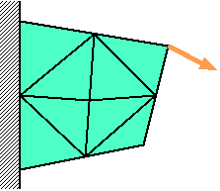
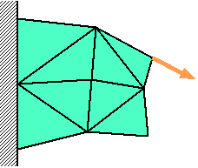
Conventional Implicit FE Rezoning
Time: t_{n-1}
Time:
t_{n}
Time:
t_{n+1}
Force
$$f^{\text{ext}}=f^{\text{int}}$$
$$f^{\text{ext}}≠f^{\text{int}}$$
$$f^{\text{ext}}=f^{\text{int}}$$
Solve
Standard EE
Remesh
&
Map States
Resolve
Standard EE
Solve
Standard EE
Induce
Large Deformation
and
Convergence Failure

Slide 12
Proposed Implicit FE Rezoning
Time: t_{n-1}
Time:
t_{n}
Time:
t_{n+1}
Force
$$f^{\text{ext}}=f^{\text{int}}$$
$$f^{\text{ext}}≠f^{\text{int}}$$
$$f^{\text{ext}}=f^{\text{int}}$$
Solve
IEE
Remesh
&
Map $f^{\text{ext}}$
and States
Assign
$f^{\text{ext}}$ to $f^{\text{int}}$
Solve
IEE
Never Induce
Any Deformation
nor
Convergence Failure
Unique Operations

Slide 13
Flowchart of the Proposed Method
Start of timestep loop
Assume initial $\{Δu\}$
Start of (implicit) Newton-Raphson loop
Calculate trial states
Calculate $\left\{Δf^{ext}\right\} ,\left\{Δf^{int}\right\} , \text{and} [K]$
Convergence check
Solve $\left[K\right]\left\{δu\right\}=\left(\left\{f^{ext}\right\}+\left\{Δf^{ext}\right\}\right) −(\left\{f^{int}\right\}+\left\{Δf^{int}\right\})$
Substitute $\left\{Δu\right\}+\{δu\}$ for $\{Δu\}$
Substitute $\left\{f^{ext}\right\}+\{Δf^{ext}\}$ for $\{f^{ext}\}$
Substitute $\left\{f^{int}\right\}+\left\{Δf^{int}\right\}$ for $\{f^{int}\}$
Update States
Rezone if necessary
Almost the same as the
conventional implicit method
except the green parts

Slide 14
Proposed vs. Conventional
 | Proposed Implicit FE Rezoning | Conventional Implicit FE Rezoning
Equation to be Solved | IEE | Standard EE
Mapping of $f^{ext}$ | Required... | Unnecessary!
Equilibrium after Mapping | YES! | NO...
Unique Deformed Shape at a Time | YES! | NO...
Convergence Failure in Rezoning Process | NO! | YES...

Slide 15
Verification Analysis
in 2D

Slide 16
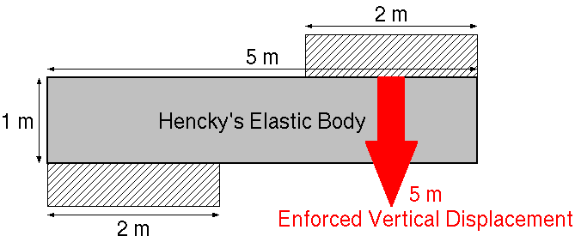
Shearing of 2D Bar
Static, 2D Plane-strain condition
All 1st order triangular elements
Global rezoning every 10 timesteps (much more frequent than necessary)
remeshing with ANSYS GAMBIT

Slide 17
Shearing of 2D Bar
Material: Hencky's elastic body
constitutive equation in total strain form:
Cauchy Stress $∝$ Hencky Strain
constitutive equation in rate form:
Jaumann Rate of Cauchy Stress $∝$ Stretching
Young's modulus: 1 GPa; Poisson's Ratio: 0.3

Slide 18
Shearing of 2D Bar

Slide 19
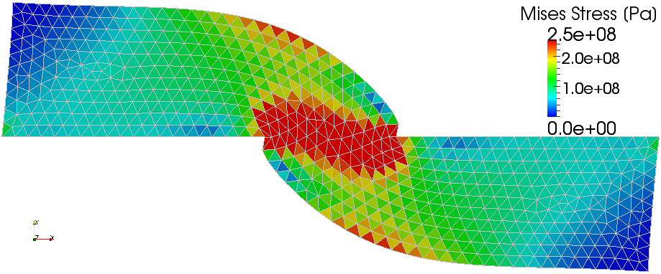
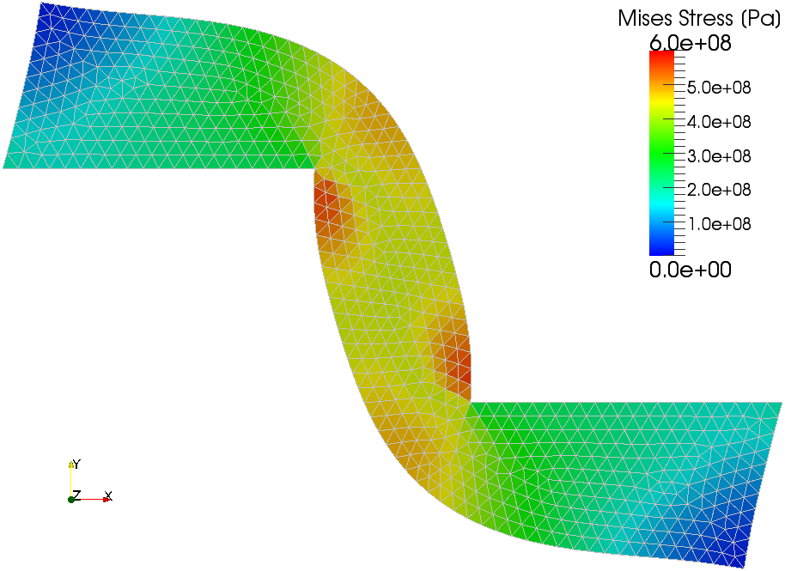
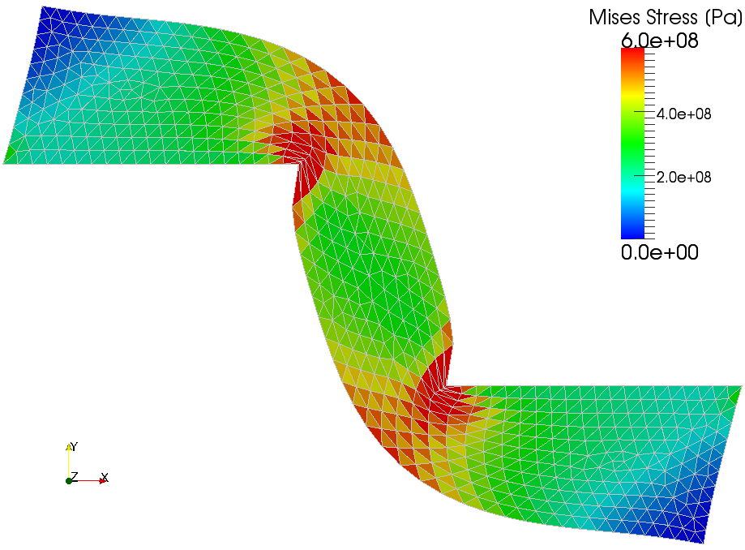
Shearing of 2D Bar
1 m Disp.
9 Times Rezoning
1 m Disp.
2.5 m Disp.
24 Times Rezoning
2.5 m Disp.
Shear
Locking
Proposed Method
Standard Implicit FEM without Rezoning

Slide 20
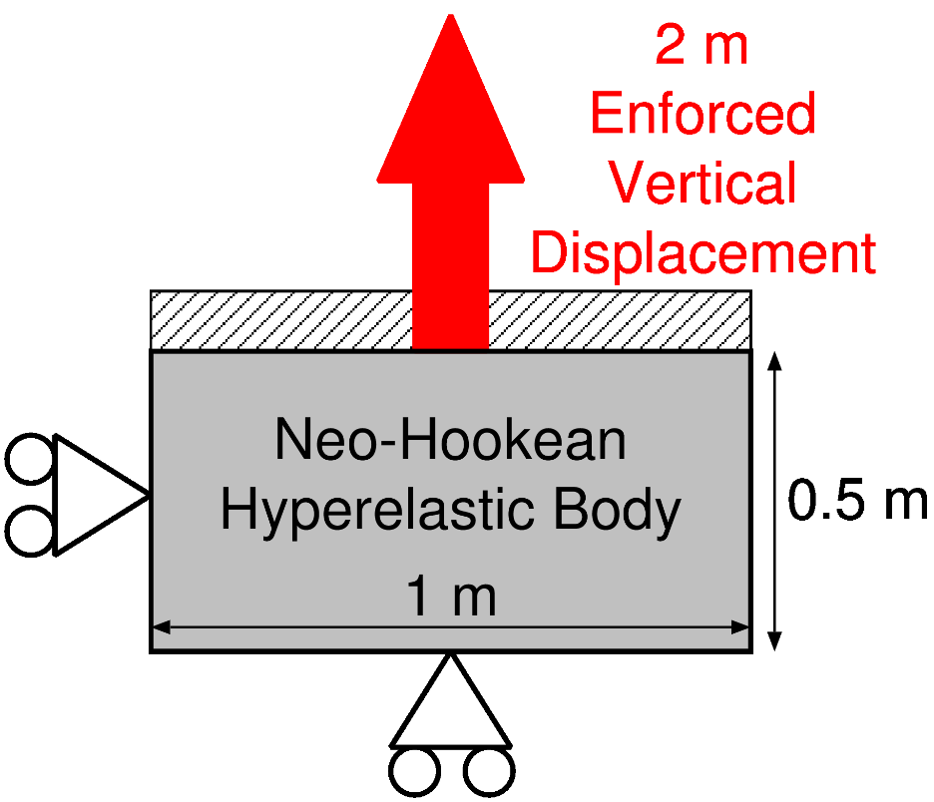
Tension of 2D Brick
Up to 400%
Nominal Strain
Static, 2D Plane-strain condition
All 1st order triangular elements
Global rezoning every 5 timesteps

Slide 21
Tension of 2D Brick
Material: Neo-Hookean hyperelastic body
Strain energy density function:
Constitutive equation in total strain form:
Constitutive equation in strain rate form:
where CL(F) is obtained through a long hand calculation.
C₁₀=0.172 GPa; D₁=0.6 GPa⁻¹

Slide 22
Tension of 2D Brick

Slide 23
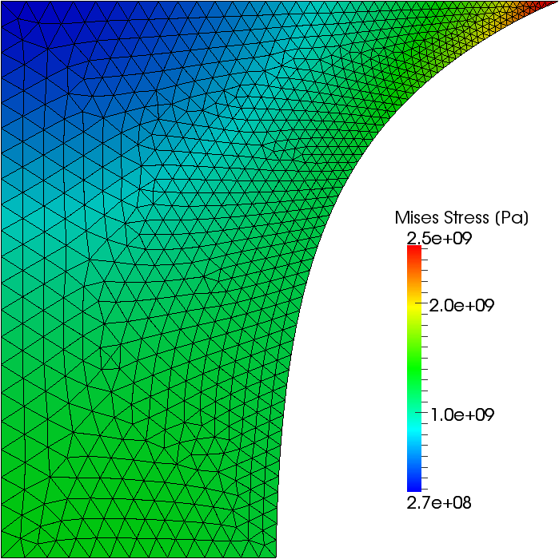
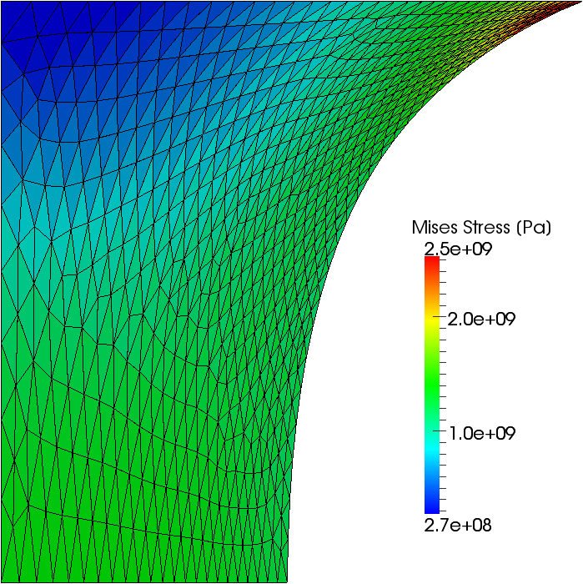
Tension of 2D Brick
Proposed Method (19 Times Rezoning)
Standard Implicit FEM without Rezoning
0.5 m Disp.
(100% Nominal
Strain)

Slide 24
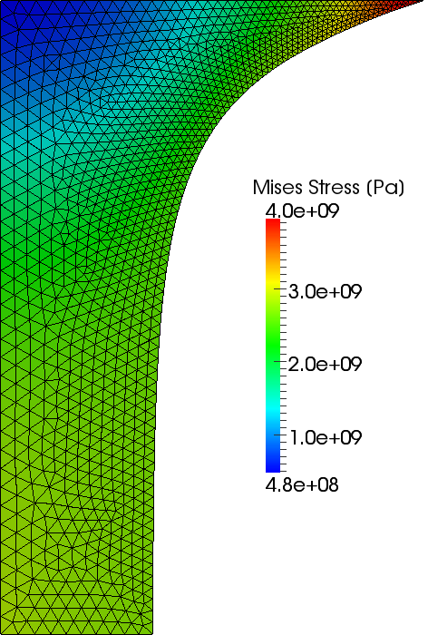
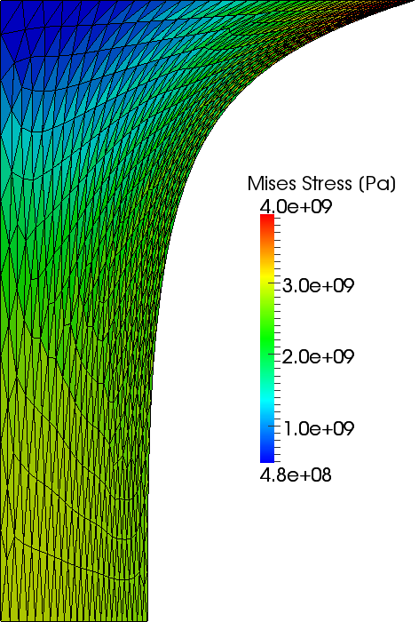
Tension of 2D Brick
Proposed Method (39 Times Rezoning)
Standard Implicit FEM without Rezoning
1.0 m Disp.
(200% Nominal
Strain)

Slide 25
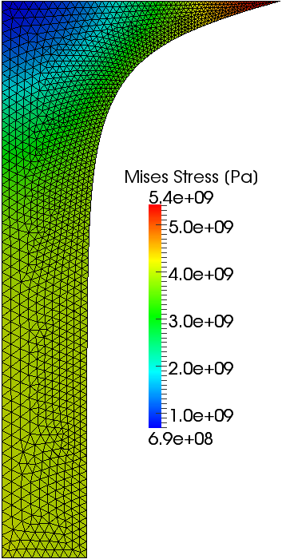
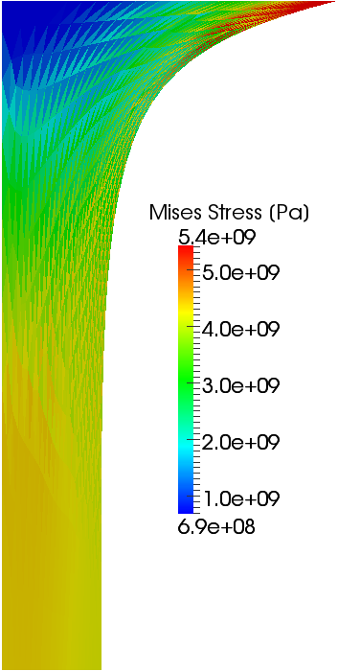
Tension of 2D Brick
Proposed Method (59 Times Rezoning)
Standard Implicit FEM without Rezoning
1.5 m Disp.
(300% Nominal
Strain)

Slide 26
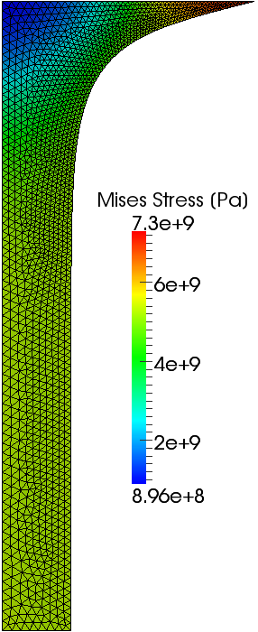
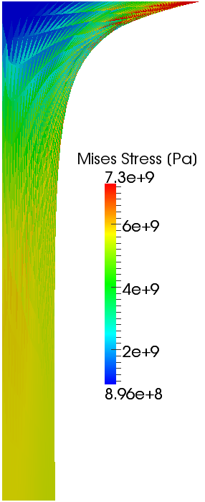
Tension of 2D Brick
Proposed Method (79 Times Rezoning)
Standard Implicit FEM without Rezoning
2.0 m Disp.
(400% Nominal
Strain)

Slide 27
Demonstration Analysis
in 3D

Slide 28
Tension of 3D Cube
Static, 3D
1/8 model of a cube
Neo-Hookean hyperelastic body
All 1st order tetrahedral elements
Global rezoning every 10 timesteps
Up to 300% nominal strain

Slide 29
Twist of 3D Cuboid
Static, 3D
1 x 2 x 4 m size
Henkey's elastic body of $ν=0.45$
All 1st order tetrahedral elements
Global rezoning every 30 degree
Up to 360 degree rotation

Slide 30
Punching of 3D Cuboid
Static, 3D
1/4 model
2 x 3 x 4 m size
Henkey's elastic body of $ν=0.2$
All 1st order tetrahedral elements
Global rezoning every 10 timesteps
radius of punch $R=1$ m
punch up to 1/3 height

Slide 31
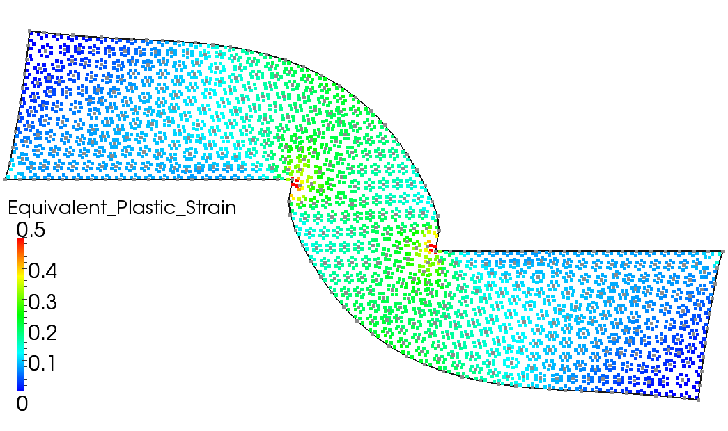
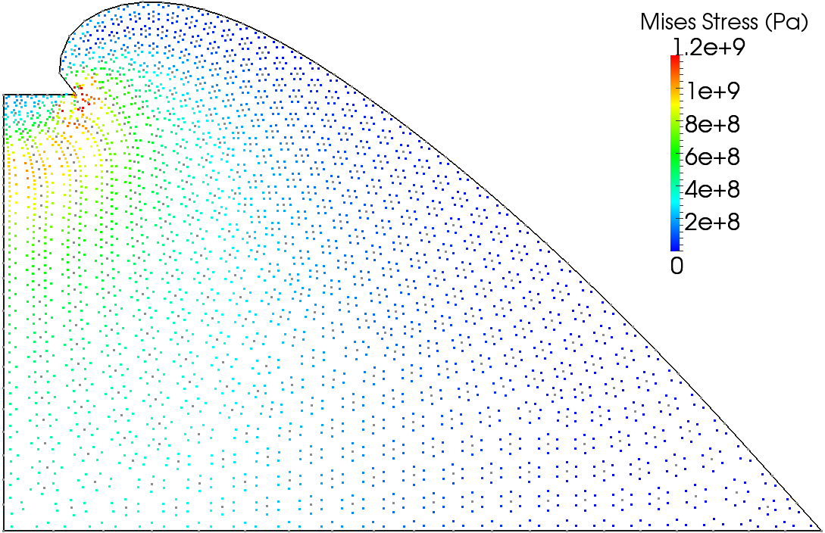
Take-Home Messages
Our method is as stable as the explicit method and as accurate as the implicit method.
The Implicit IEE is useful not only for FE rezoning
but also Meshfree/Particle methods.
See the e-book of PARTICLES2011 or our full-paper in Int. J. Numer. Meth. Engng (2012) in detail.

Slide 32
Summary and Future Work
Summary
A new implicit FE rezoning method for severely large deformation analysis is proposed.
It solves the IEE instead of the standard EE.
It maps $f^{ext}$ in addition to the other states.
Its accuracy and stability are verified.
Future Work
More V&V
SFEM implementation
Apply to contact forming, crack propagation, etc.
Thank you for your kind attention!

Slide 33
Appendix

Slide 34
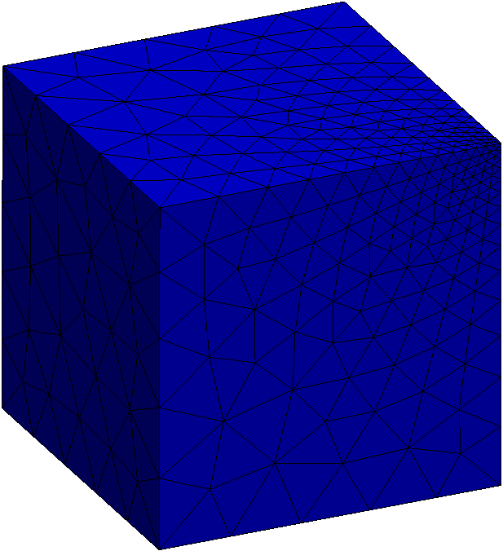
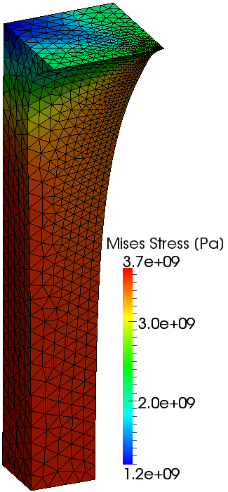
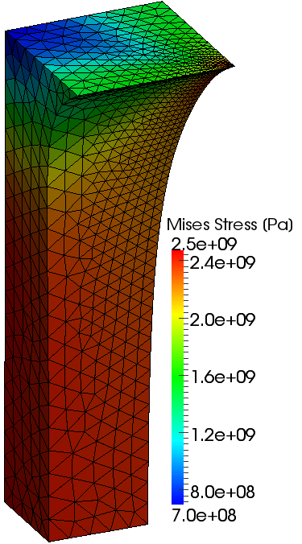
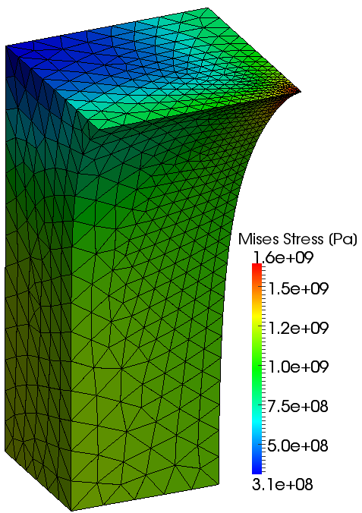
Tension of 3D Cube
0% Nominal Strain
(Initial State)
300%
Strain
200%
Strain
100%
Strain

Slide 35
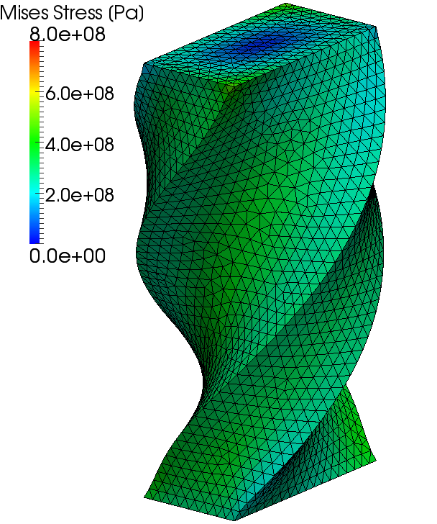
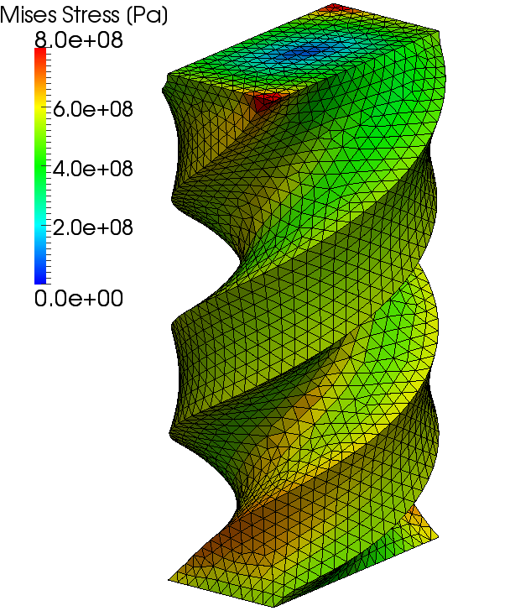
Twist of 3D Cuboid

Slide 36
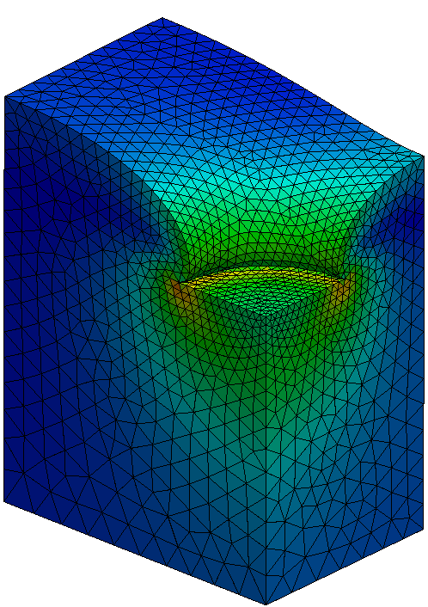
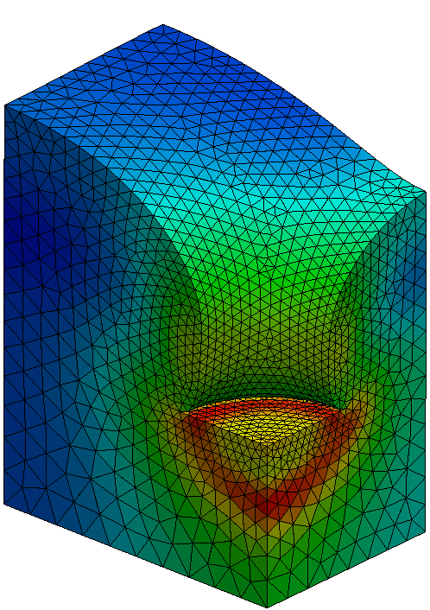
Punching of 3D Cuboid

Slide 37
Mapping of $f^{ext}$
Boil down to the following minimization problem:
Unknown
nodal $f^{ext}$ on the new mesh surface
Cost Function
$∑$ || {surface traction on the new mesh face}
$−$ {surface traction on the old mesh face} ||²
Constraints
$∑$ {new nodal $f^{ext}$} $=$ $∑$ {old nodal $f^{ext}$}
$∑$ {new nodal ${x×f}^{ext}$} $=$ $∑$ {old nodal ${x×f}^{ext}$}
Solve it with Lagrange multiplier method

Slide 38
Derivation of Stiffness Matrix (1/2)
Relation between ${\dot{Π}}_{t}$ and $\dot{T}$:
Relation between $\dot{□}$ and Jaumann rate:
Erasing $\dot{T}$:
Constitutive equation (e.g. Hencky's):
Erasing :

Slide 39
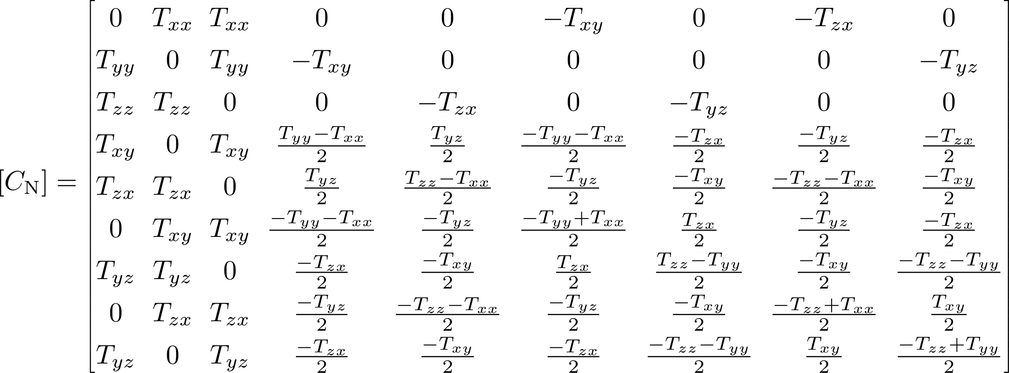
Derivation of Stiffness Matrix (2/2)
Rewrite in matrix form:
where
Stiffness Matrix

Slide 40
Characteristics of Meshfree Method
Advantage
Locking free
Easy to add/remove nodes
Disadvantage
High cost to construct a stable shape function
High cost to correct [B] to satisfy the divergence-free condition
High cost to treat multiple materials, concave boundaries, contact, etc.

Slide 41
Characteristics of Static-Explicit Method
Advantage
No convergence calculation
Solution can stably be obtained (even if there exist no static solution)
Disadvantage
Equilibrium is not guaranteed due to error accumulation
Necessitates small $Δt$ with r-min method in plasticity

Slide 42
Comparison of IEE to Stiffness Eq.
[Standard
Static-Explicit EE]
NOT equilibrium equation
BUT stiffness equation
without trial values
[Implicit
IEE]

