Slide 1
Resin Deformation Analysis in UV Imprint Considering UV Shrinkage, Thermal Deformation, and Thermochemical Kinetics
Yuki ONISHI, Ryunosuke YAMASHITA, Kenji AMAYA (Tokyo Institute of Technology)
Yoshihiko HIRAI
(Osaka Prefecture University)

Slide 2
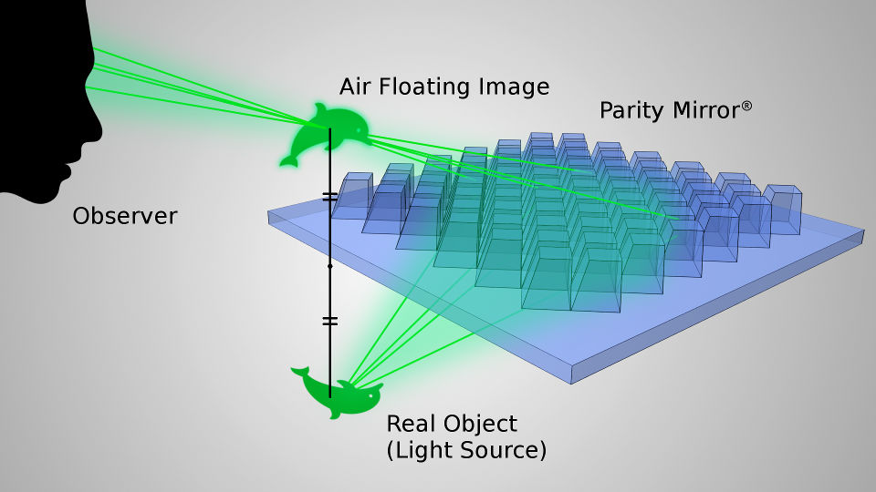
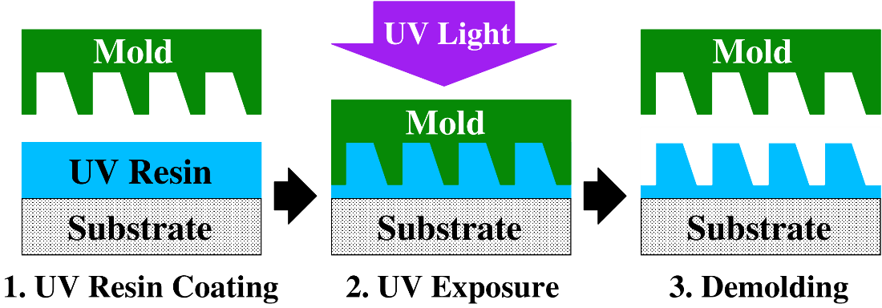
Background
UV imprint is known as a low-cost and high-throughput nano/micro fabrication method.
In recent years, it has been adopted as a fabrication method for micro-optical devices such as micromirror array that requires high-precision surface profiles.
Basic steps in UV imprint.
Optical device produced by thermal imprint.
Parity Innovations Co., Ltd.
https://www.piq.co.jp/about_e.html

Slide 3
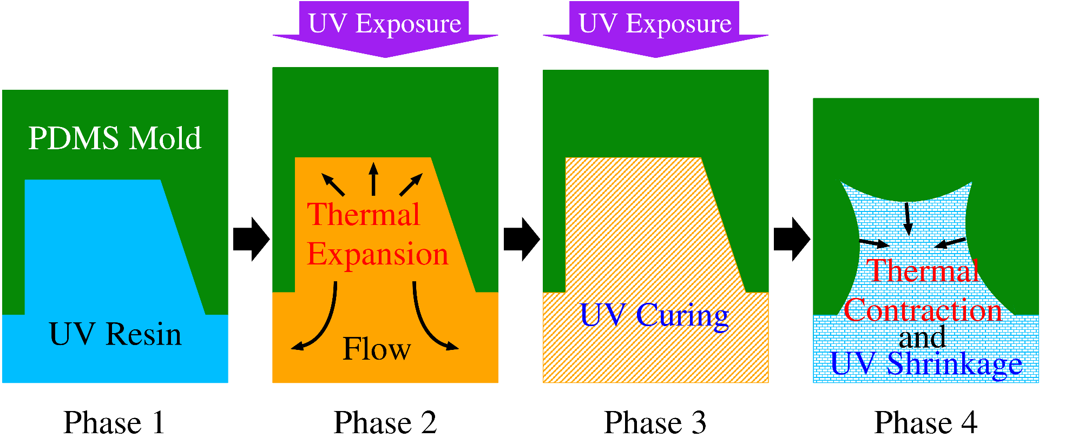
Issue
UV resin undergoes several percent thermal deformation and UV shrinkage during imprint, resulting in unexpected surface curvature when a soft mold is used.
We need to predict this by numerical simulation, but no numerical modeling method has been proposed yet.
Mechanism of surface curvature generation

Slide 4
Related research
A numerical modeling method for thermal imprint has already been proposed.
Thermo-viscoelastic constitutive model for thermoplastic resin:
Thermal deformation: heat expansion coeff.
Shear behavior: viscoelastic (generalized Maxwell model)
Temperature dependency: time-temperature superposition (WLF law）
Finite element method
Example of thermal imprint analysis
Idea: It may be possible to achieve UV imprint modeling with a similar approach.

Slide 5
Our approach
Focusing on the analogy with thermo-viscoelastic model in thermal imprinting:
UV reaction progress $⟹$ Cooling
UV curing $⟹$ Cooling solidification
UV shrinkage $⟹$ Cooling contraction
i.e., giving a virtual cooling of UV resin.
To give virtual cooling, we introduce the idea of “virtual temperature”.

Slide 6
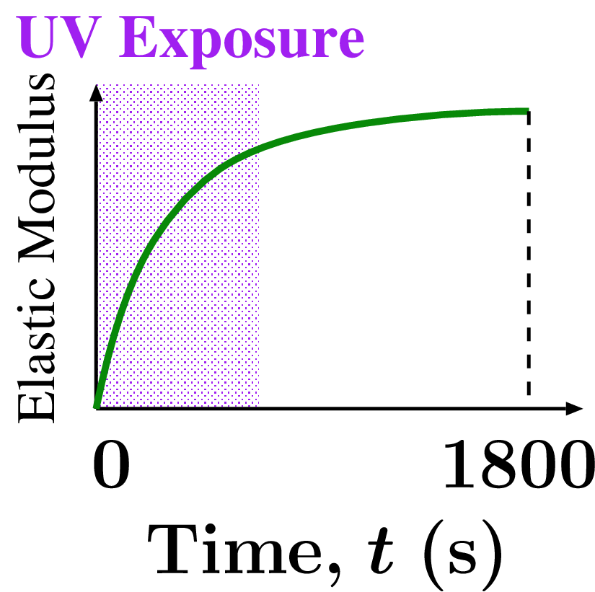
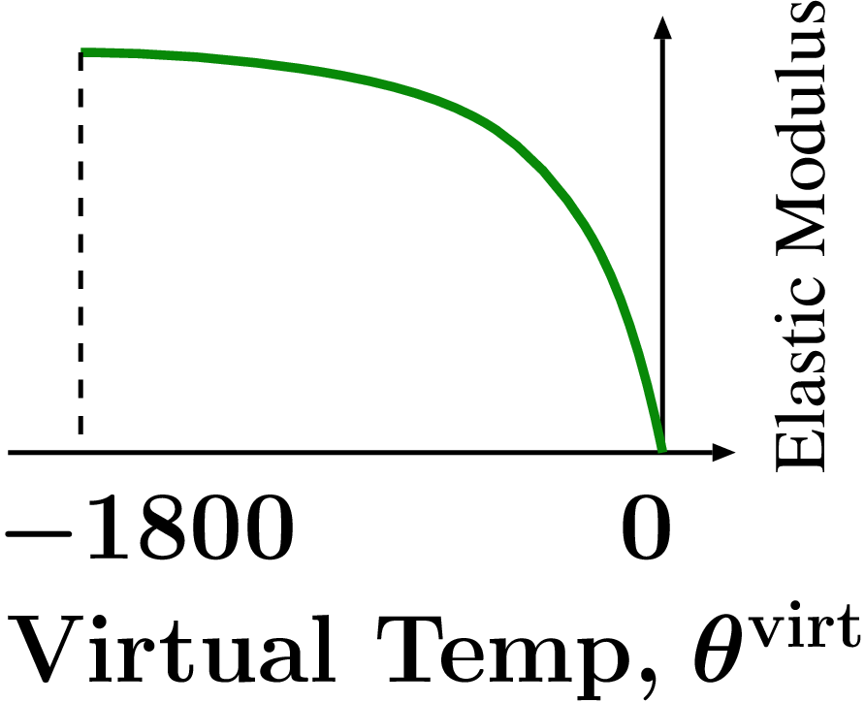
Idea of “virtual temperature”
Virtual temperature ($θ^{virt}$) is introduced as a measure of UV reaction progress to cool the UV resin virtually.
e.g., UV curing $⟹$ Cooling solidification
Hard
Hard
Soft
Soft
Virtual Temperature
$$θ^{virt}$$
UV Reaction
Virtual Cooling
UV Curing
Cooling Solidification

Slide 7
Objective
Establishment of numerical modeling method for resin deformation analysis in UV imprints considering
UV curing,
UV shrinkage,
thermal deformation, and
temperature-dependent reaction rate.
Validation of the modeling method with a micromirror array example for aerial display.
Table of body contents:
Experiments
Methods
Results and discussion
Summary

Slide 8
Experiments

Slide 9
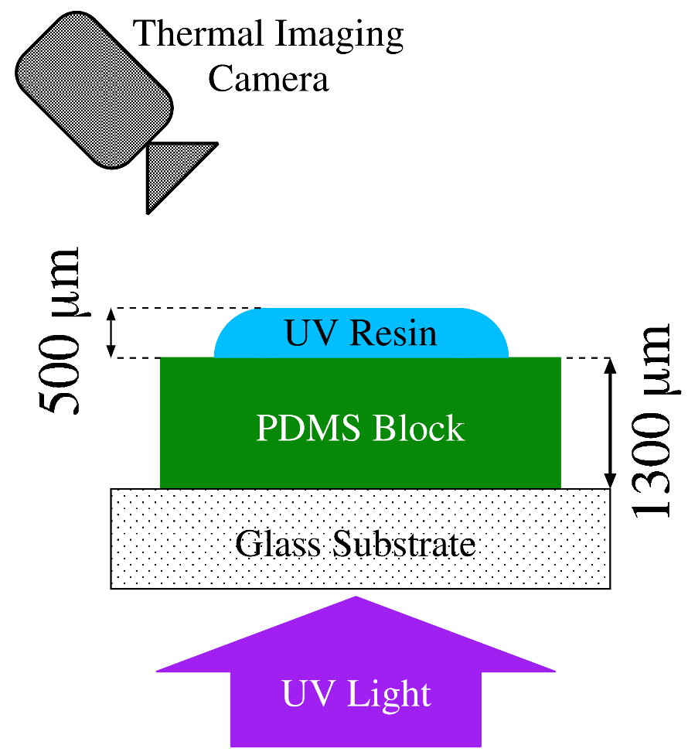
Resin temperature measurement test
Outline
UV resin is dropped on a PDMS block placed on a glass substrate.
UV light is exposed from below.
A thermal imaging camera measures resin temp. from above.
The test specifications are identical to those of the actual micromirror array imprint.
Cation polymerization-type resin
Hard PDMS with Young's modulus of 5 MPa
UV-LED flat light of 365 nm
30 s exposure with 50 mW/cm²

Slide 10
Resin temperature measurement test
An example result (300 mW/cm² case)
150 $°C$
~ 20 mm
25 $°C$
The temp. reaches the maximum in several seconds after the start of exposure and gradually returns to room temp..

Slide 11
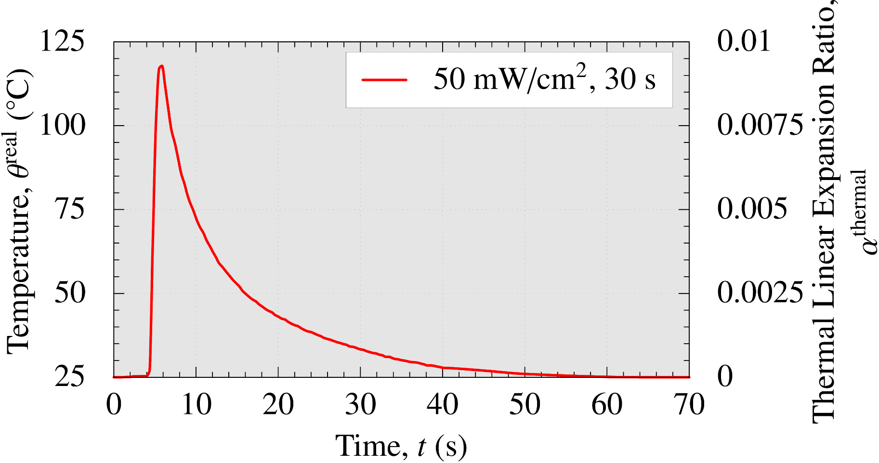
Resin temperature measurement test
Time histories of temp. and expansion（50 mW/cm², 30s)
$⋇$ From another experiment, the coef. of linear thermal expansion is obtained as $1.0×10^{−4}$ [1/K].
A temperature increase about 100 K causes about 1% thermal linear expansion (3% expansion in volume) in 6 s after exposure.

Slide 12
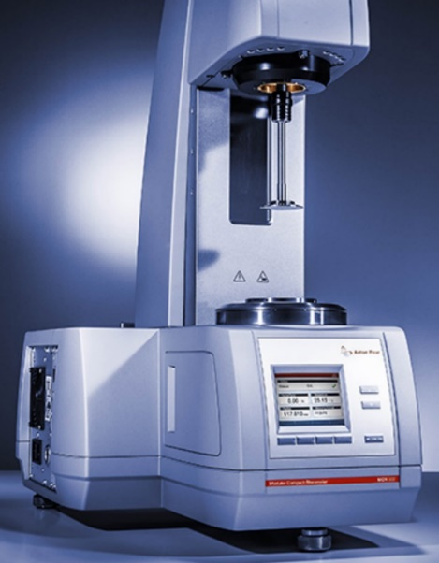
UV shrinkage & complex shear modulus meas. tests
Outline
Rotational oscillatory rheometer.
Small rotational oscillation is given to the UV resin under UV curing.
Time history of UV shrinkage (gap length) is measured.
Time history of Complex shear modulus at various temps. and freqs. is also measured.
Resin temp. is kept constant by the aluminum rod with temp. control.
Same UV exposure condition as the micromirror array imprint.
Small Rotational Oscillation
Cylinder
Rod
Follow
Gap
Change
UV Resin
Gap
Glass Plate
Anton Paar MCR series
https://www.anton-paar.com/corp-en/products/details/rheometer-mcr-102-302-502/
UV Light
Intensity
0 30 time (s)

Slide 13
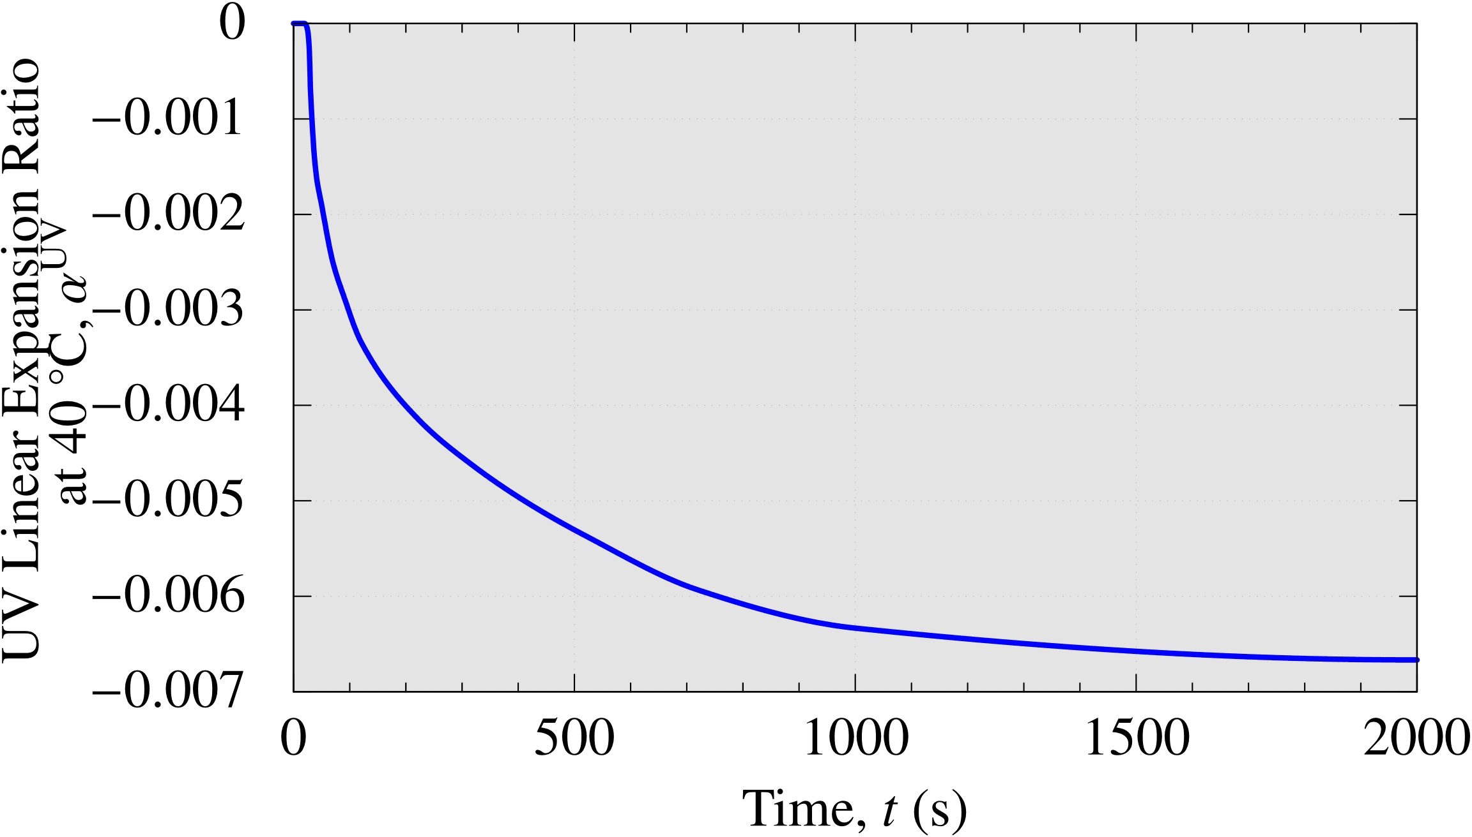
UV shrinkage & complex shear modulus meas. tests
Time history of UV shrinkage (at 40 ${}_{ }^{∘}C$, independent of freq.)
UV shrinkage continues after the UV exposure due to dark curing.
UV curing finally causes about 0.7% linear shrinkage (2% shrinkage in volume) $⟹$ It seems possible to treat this as virtual “thermal” contraction by combining this with the real thermal expansion.

Slide 14
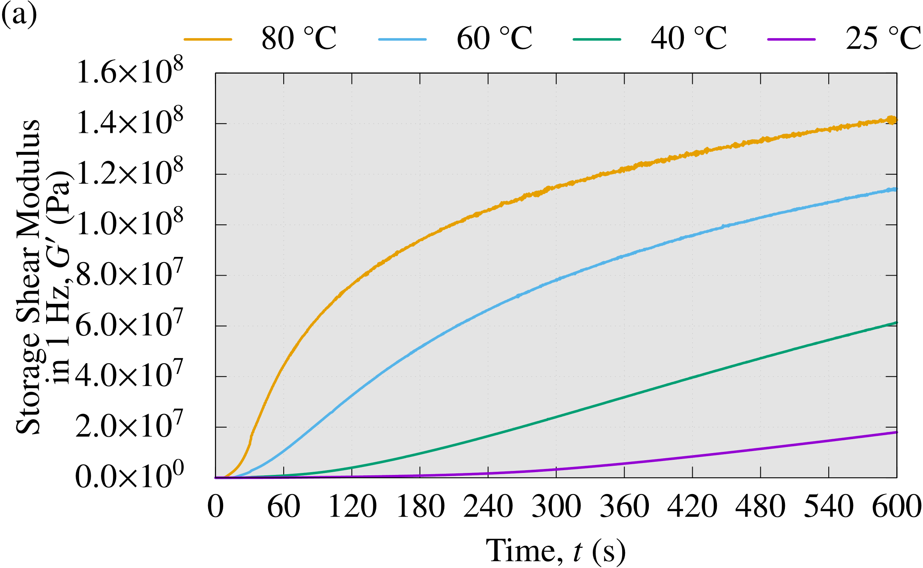
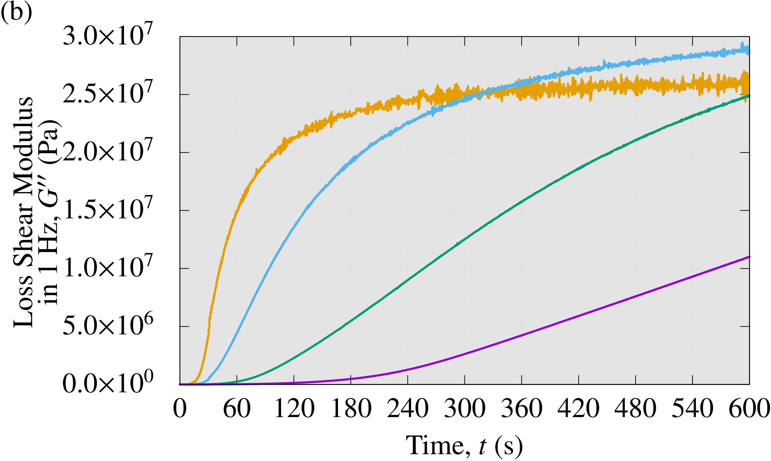
UV shrinkage & complex shear modulus meas. tests
Time history of complex shear modulus at various temps. (1 Hz in freq.)
Left: Storage shear modulus, Right: Loss shear modulus
UV curing progresses faster as the temp. increases.
$⟹$ It seems possible to identity the temp.-dependent reaction rate constants.

Slide 15
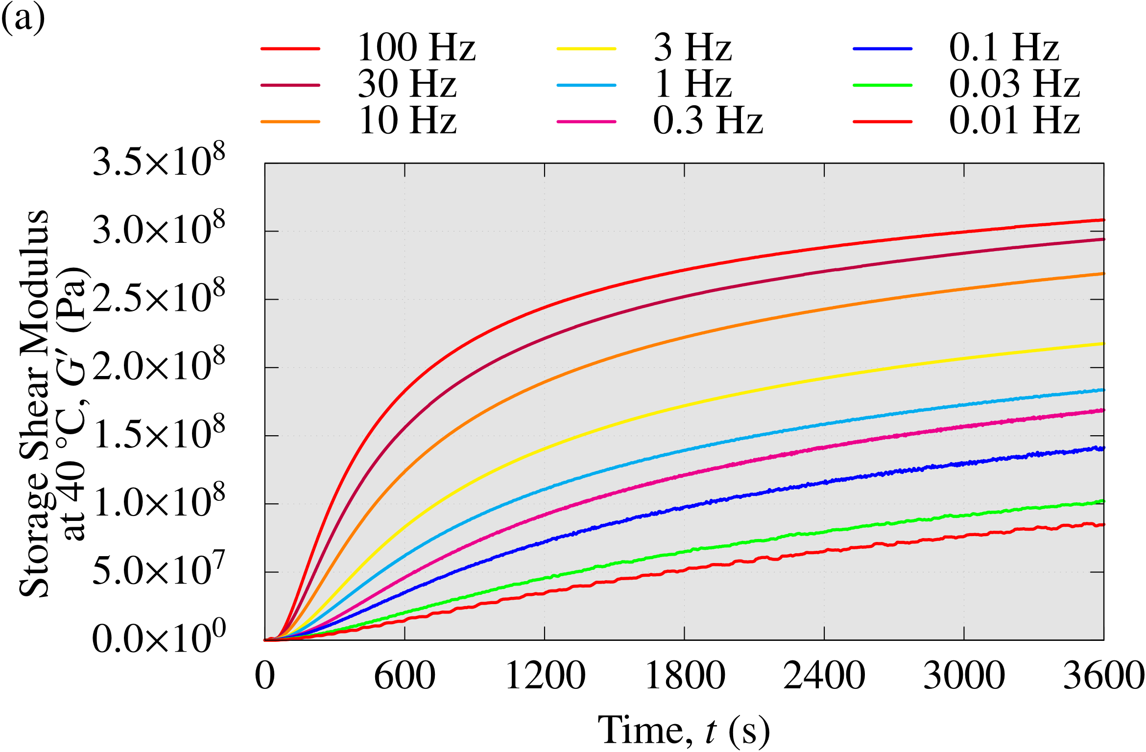
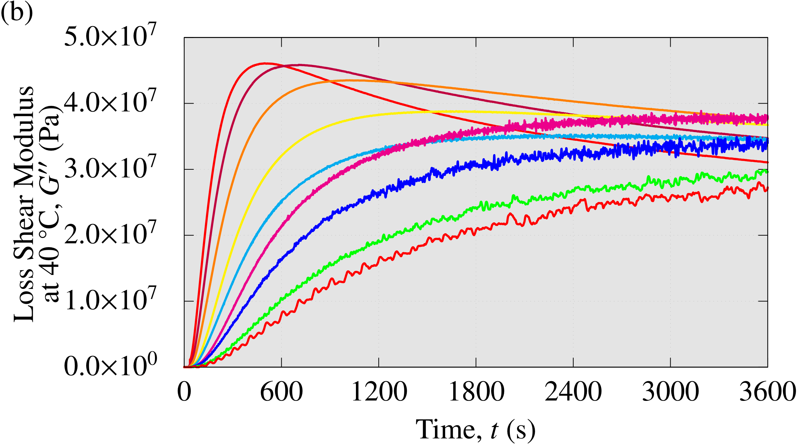
UV shrinkage & complex shear modulus meas. tests
Time history of complex shear modulus at various freqs. (40 ${}_{ }^{∘}C$ in temp.)
Left: Storage shear modulus, Right: Loss shear modulus
The storage modulus becomes larger as the freq. increases. $⟹$ It seems possible to identify the Prony series of the generalized Maxwell model and the time-(virtual)temperature superposition law.

Slide 16
Methods

Slide 17
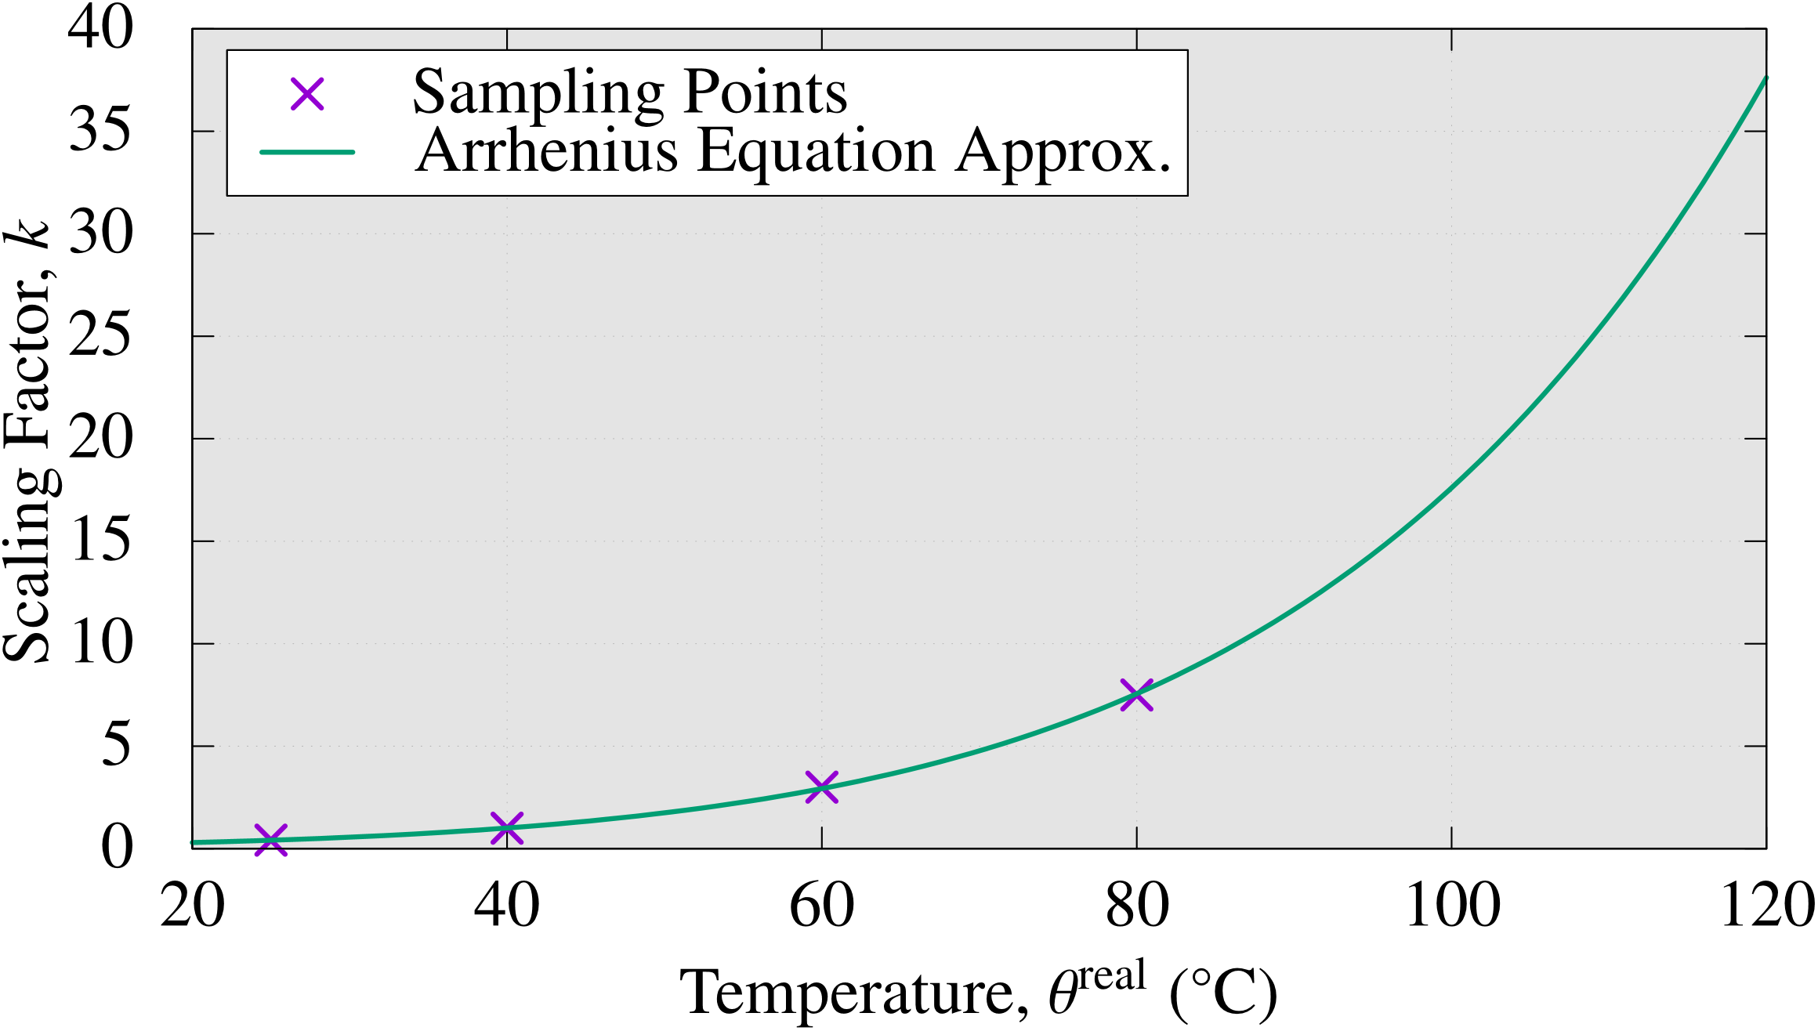
Identification of Arrhenius Constants
The reaction rate scaling factor $k\left(θ^{real}\right)$ can be identified from the time history of the complex shear modulus at various temps. (right fig.).
Based on thermochemical kinetics, the Arrhenius equation is used for curve fitting. $k\left(θ^{real}\right)=C_{1} exp\left(−C_{2}/(θ^{real}+273.15)\right)$
Ref. temp. is 40 ${}_{ }^{∘}C$ (i.e., $k=1$ at 40 ${}_{ }^{∘}C$)

Slide 18
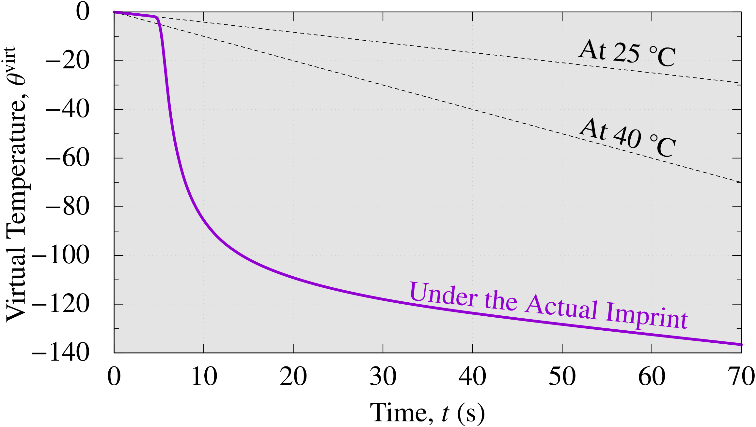
Definition of virtual temp. time history
$θ^{virt}=0$ before UV exposure $(t≤0$).
After UV exposure, $θ^{virt}$ is monotonically decreased according to the reaction rate factor $k$ at each moment. $θ^{virt}\left(t\right)≡\int_{0}^{t}{−k\left(θ^{real}\left(t\right)\right) dt}$
$θ^{virt}\left(t\right)$ represents the measure UV reaction progress.
Bef.
The Curve of $θ^{virt}(t)$ is defined as a table data.
Aft.

Slide 19
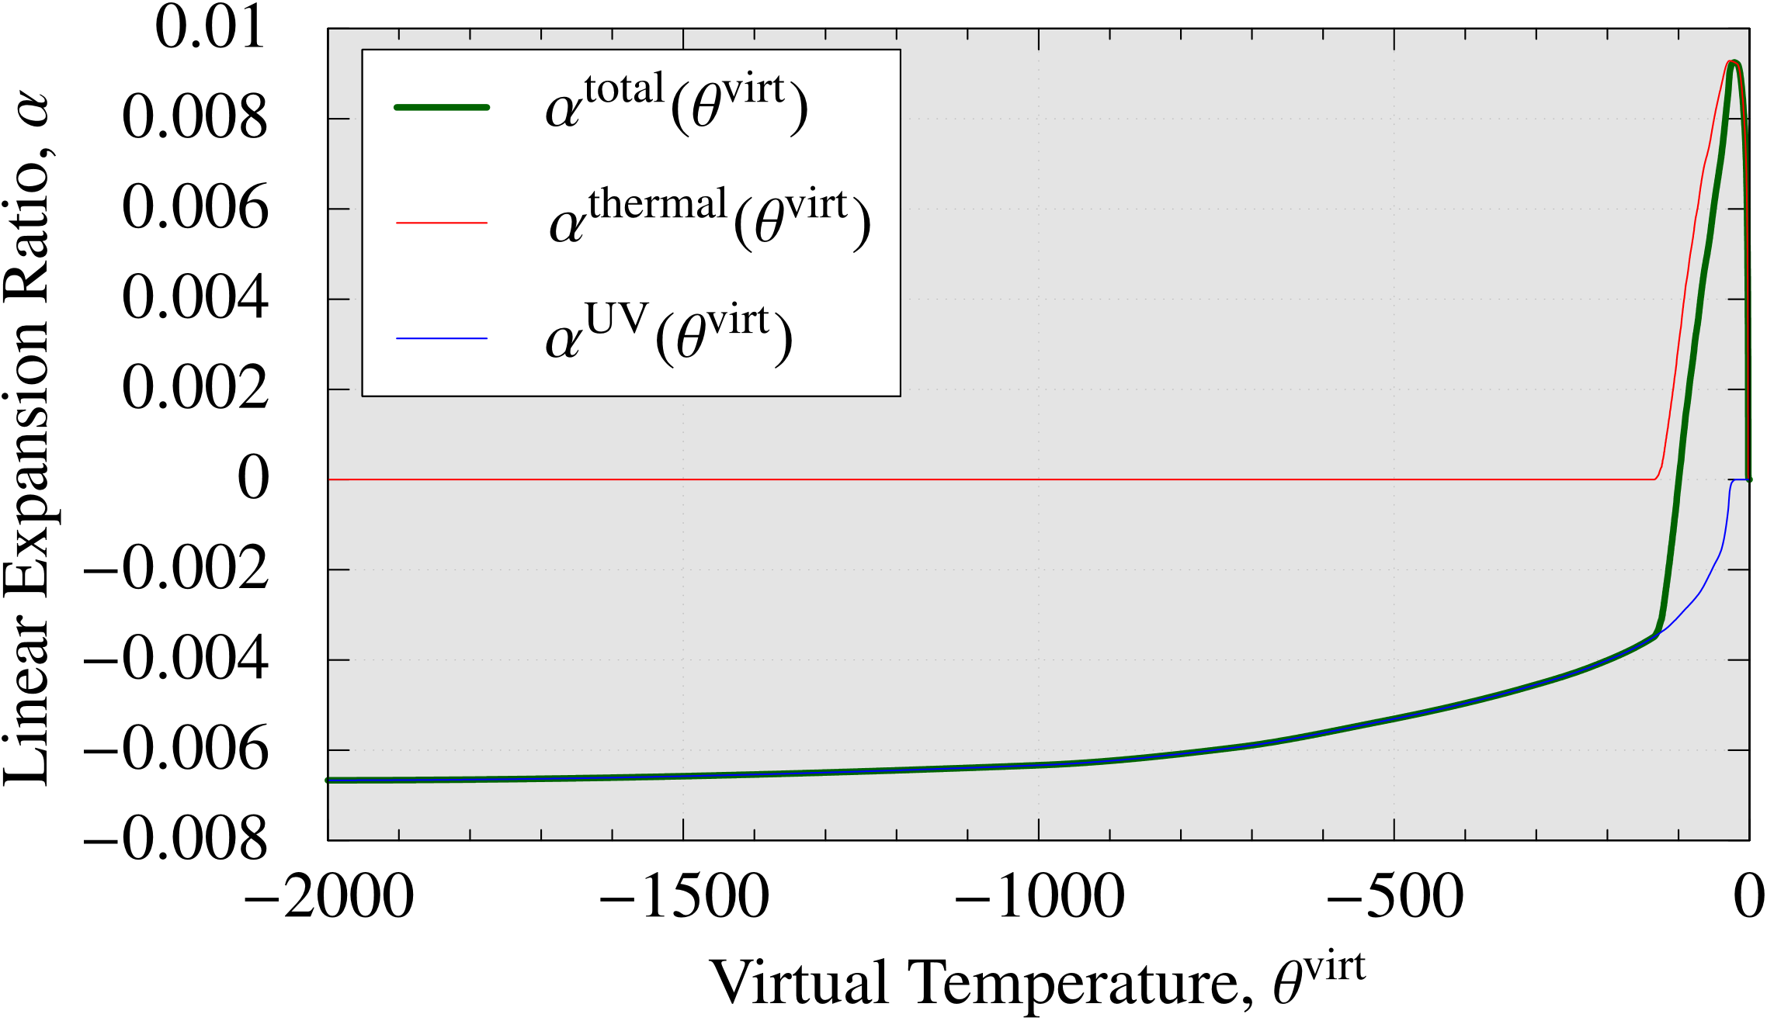
Identification of virtual temp.-dependent expansion
The previous plots of time-dependent thermal deformation and UV shrinkage are converted into virtual temp.-dependent plots.
The sum of the two is the virtual temp.-dependent expansion coefficient.
Thermal deformation and UV shrinkage can be considered simultaneously.
$$α^{total}≡α^{thermal}+α^{UV}$$
The Curve of $α^{total}(θ^{virt})$ is defined as a table data.
Aft.
Bef.

Slide 20
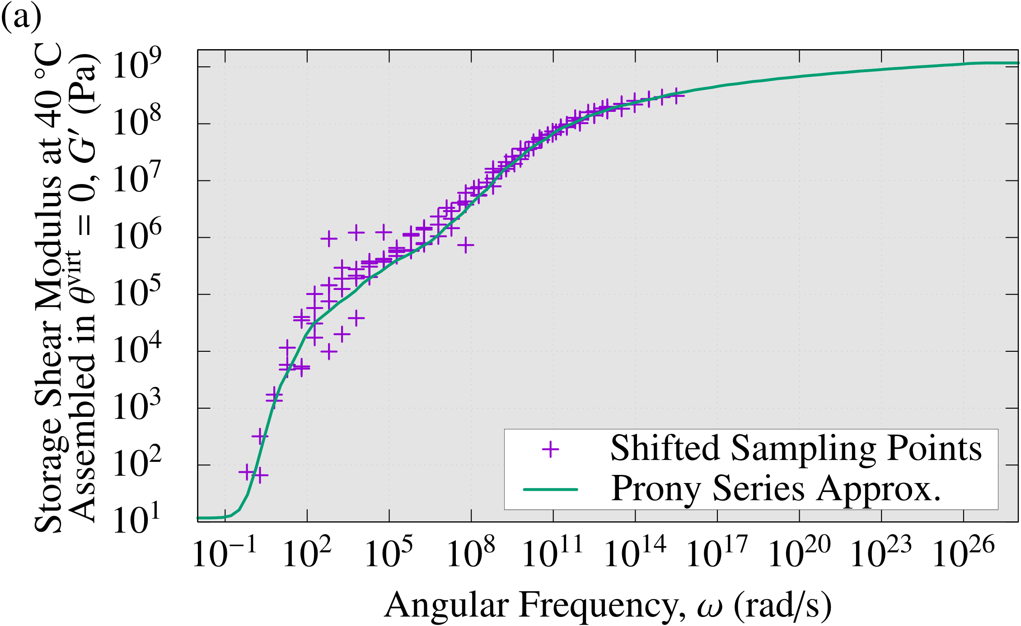
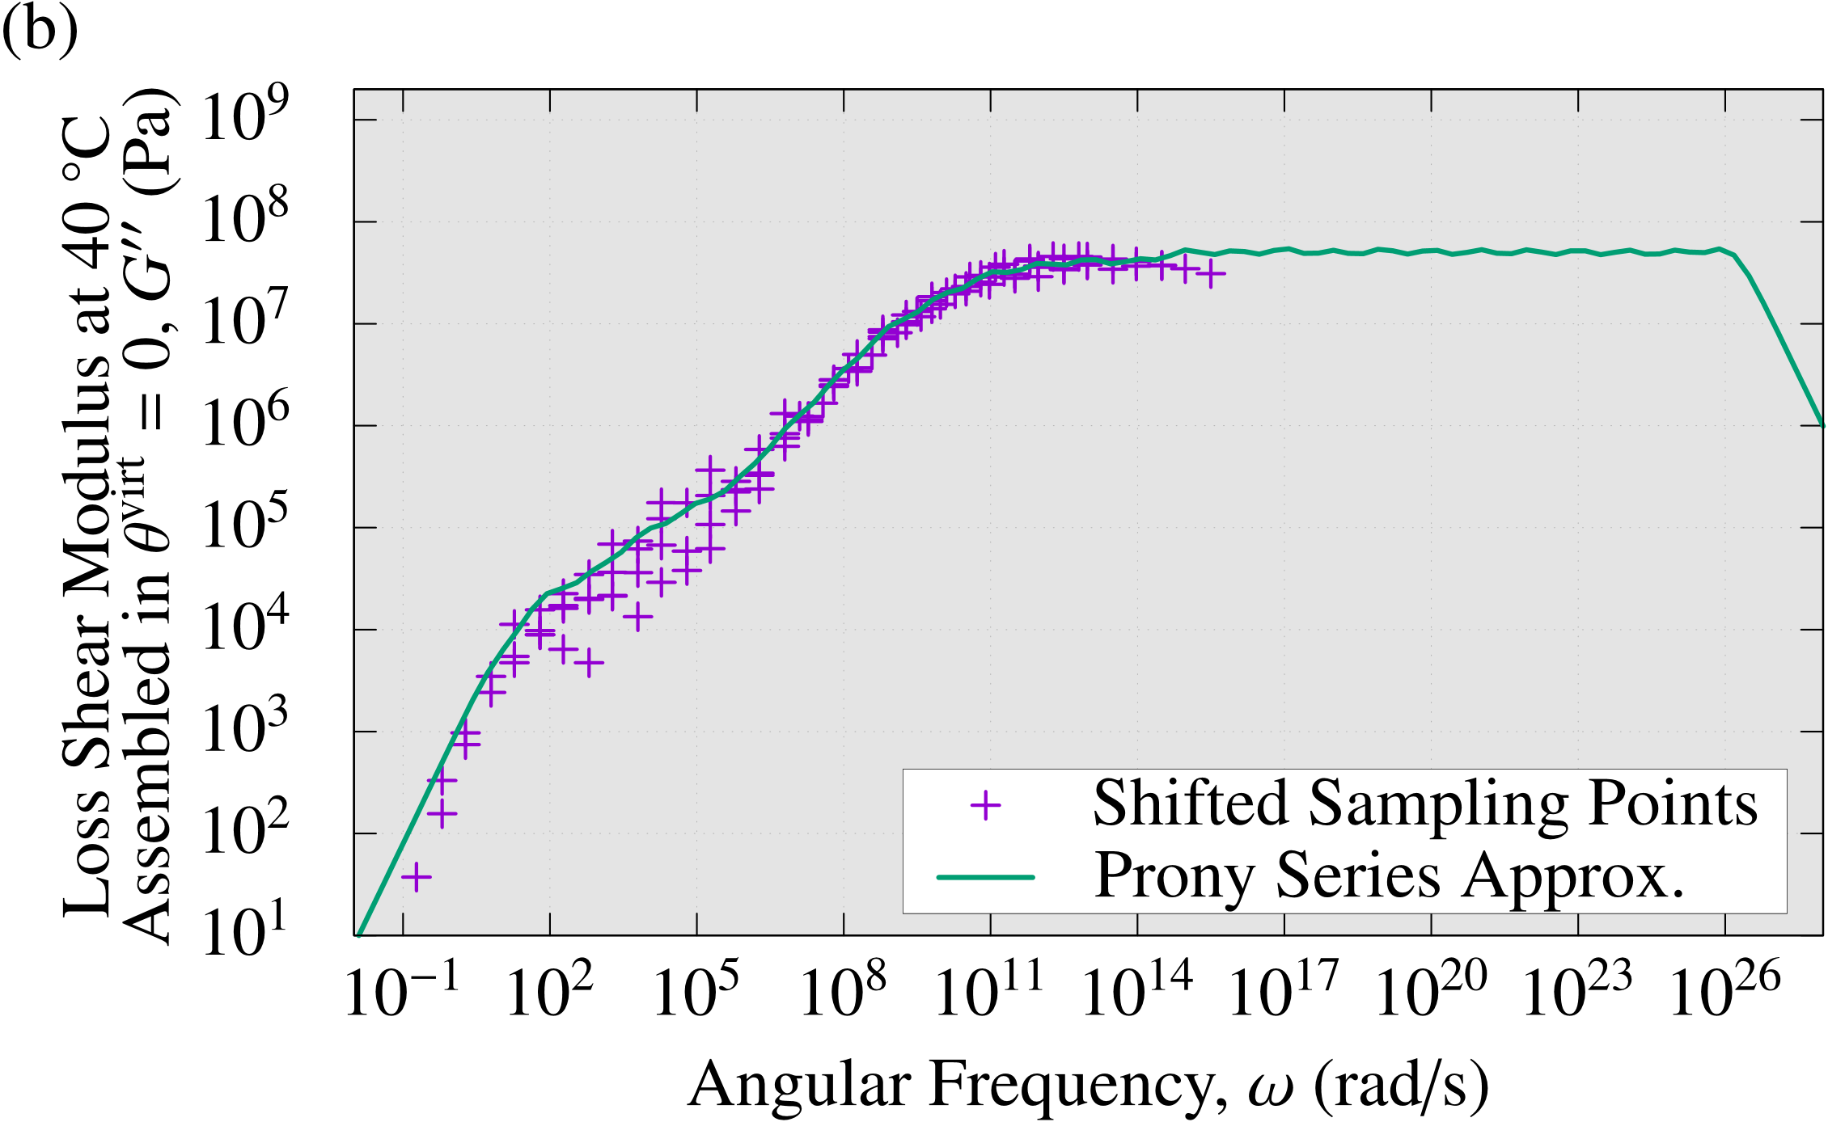
Identification of thermo-viscoelastic properties
Prony series coefs.
The Prony series coefs. ($g_{i}$, $τ_{i}$)s are identified by the curve fitting for the master curves of storage/loss shear modulus.
$$G^{′}\left(ω\right)=G_{∞}+G_{0}\sum_{i}{\left(g_{i}\frac{ω^{2}τ_{i}^{2}}{1+ω^{2}τ_{i}^{2}}\right)}$$
$$G^{′′}\left(ω\right)=G_{0}\sum_{i}{\left(g_{i}\frac{ωτ_{i}}{1+ω^{2}τ_{i}^{2}}\right)}$$
Storage shear modulus $G′$
Loss shear modulus $G′′$
($g_{i}, τ_{i}$)s are described as a table data.

Slide 21
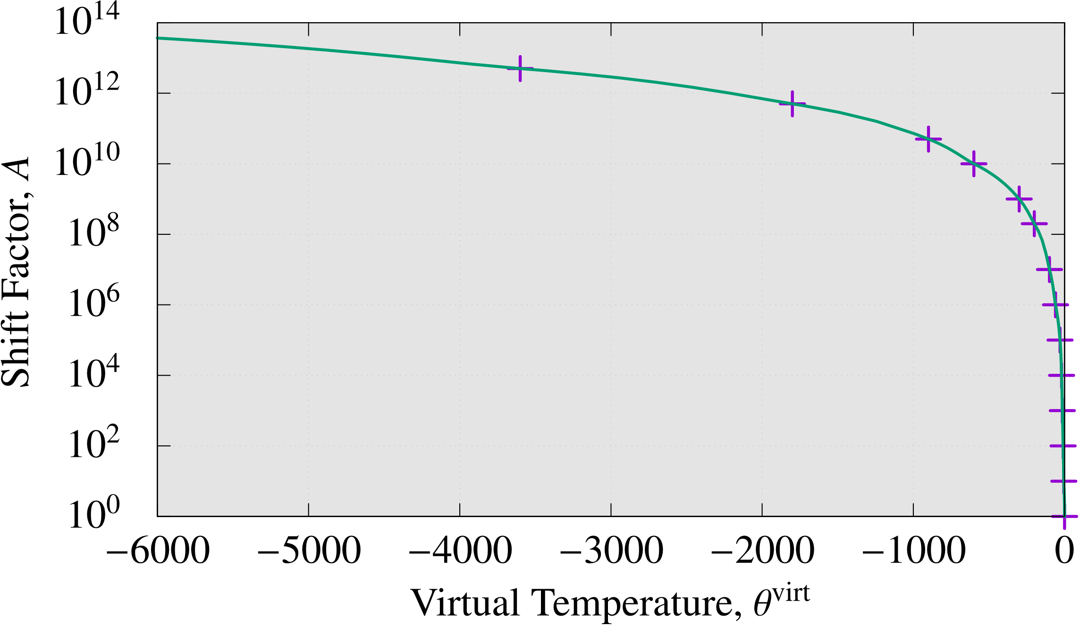
Identification of thermo-viscoelastic properties
Time-virtul temp. superposition
The shift factor $A(θ^{virt})$ for the time-virtual temp. superposition is identified by curve fitting using time shift data for the master curves.
$A(θ^{virt})$ is defined as a table data.
Aft.
Bef.
Now, a set of model parameters for UV resin deformation was all identified.

Slide 22
Results and Discussion

Slide 23
Micromirror array imprint analysis
Outline
Target pattern is a micromirror array for aerial display.
Since the mold has repetitive structure, only one pattern is taken into account with periodic boundary conditions.
The initial state is when the pattern is filled with UV resin.
Commercial finite element code, ABAQUS, is used for simulation.
8-node hexahedral SRI element (C3D8) is adopted.
Schematic view of
micromirror array
Optical device produced by thermal imprint.
Parity Innovations Co., Ltd.
https://www.piq.co.jp/about_e.html

Slide 24
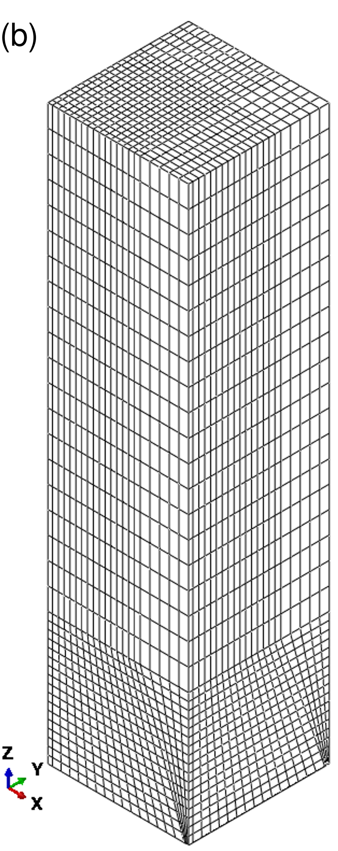
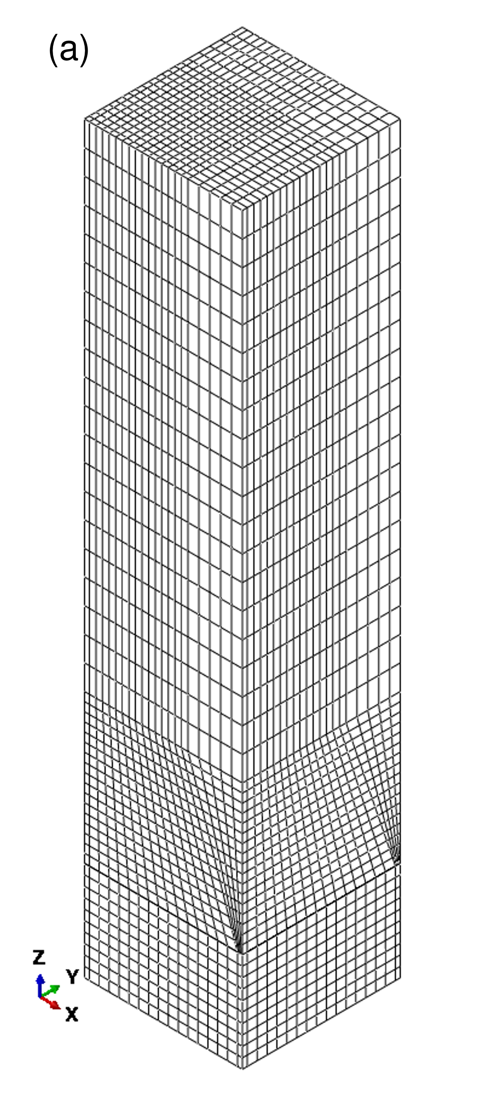
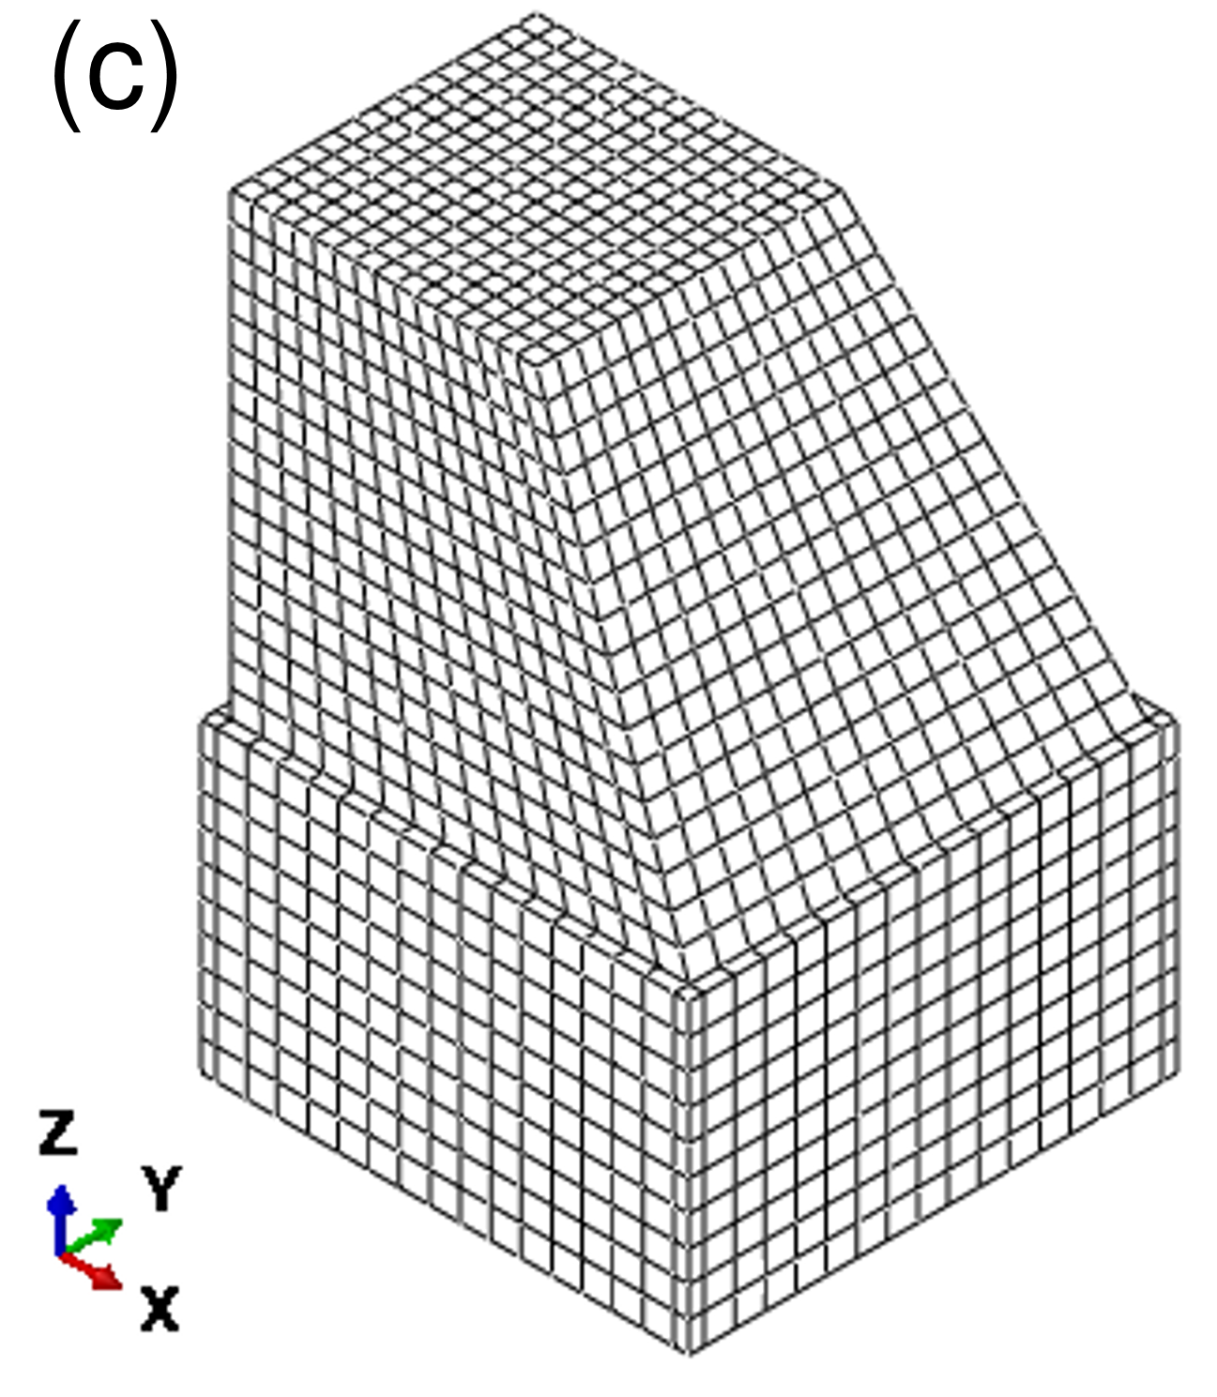
Micromirror array imprint analysis
Finite element mesh
Outline
Target pattern is a micromirror array for aerial display.
Since the mold has repetitive structure, only one pattern is taken into account with periodic boundary conditions.
The initial state is when the pattern is filled with UV resin.
Commercial finite element code, ABAQUS, is used for simulation.
8-node hexahedral SRI element (C3D8) is adopted.
Mold part
Resin part
Entire model

Slide 25
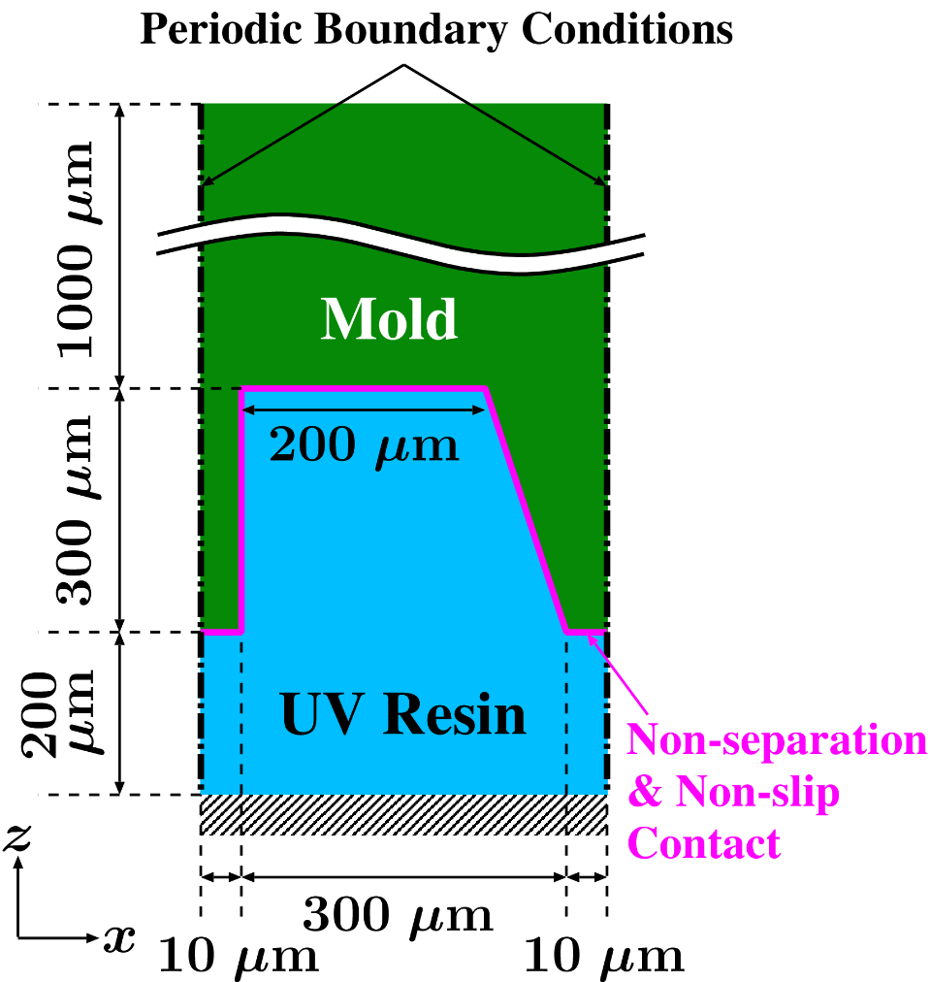
Steps for imprint simulation
Step 1: Initial state ($0$ s)
Static analysis considering gravity
Apply non-separation & non-slip contact
Step 2: UV exposure and dark curing (500 s)
Quasi-static analysis (till the end)
Decrease $θ^{virt}$ ($0→−312$)
Step 3: Demolding and dark curing (10 s)
Remove the contact definition
Lift up the mold
Decrease $θ^{virt}$ ($−312→−316$)
Step 4: Dark curing (100000 s)
Decrease $θ^{virt}$ ($−316→−41164$)
2D
cut view
Part | Material model
UV resin | Thermo viscoelastic body with the identified params.
Mold | Neo-Hookean hyperelastic body

Slide 26
Simulation result
Animation of Z displ. dist. on a central Y cross-section
The periodic boundary conditions are given correctly.
Major expansion of UV resin soon after UV exposure.
Gradual contraction of UV resin during dark curing.
Surface curve on the PDMS mold is reproduced.
Deformation magnification: x 10

Slide 27
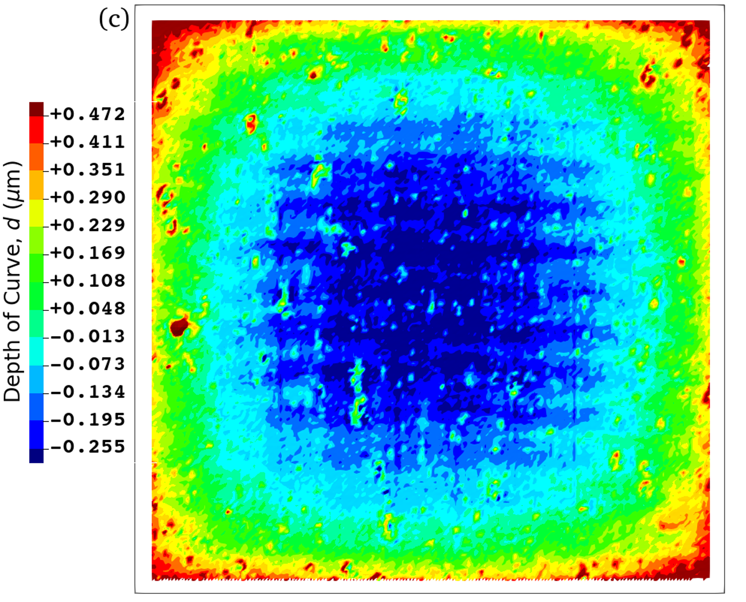
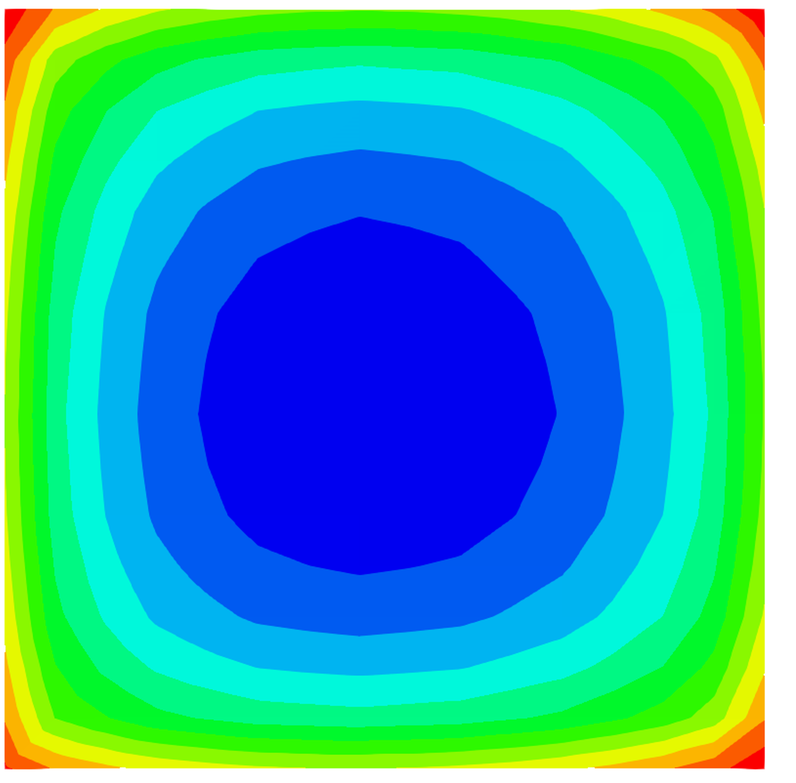
Comparison of results
Distribution of depth of curve on the top face
200 μm
Actual Imprint (measured by laser microscope)
Simulation Result
The curvatures are in good agreement.

Slide 28
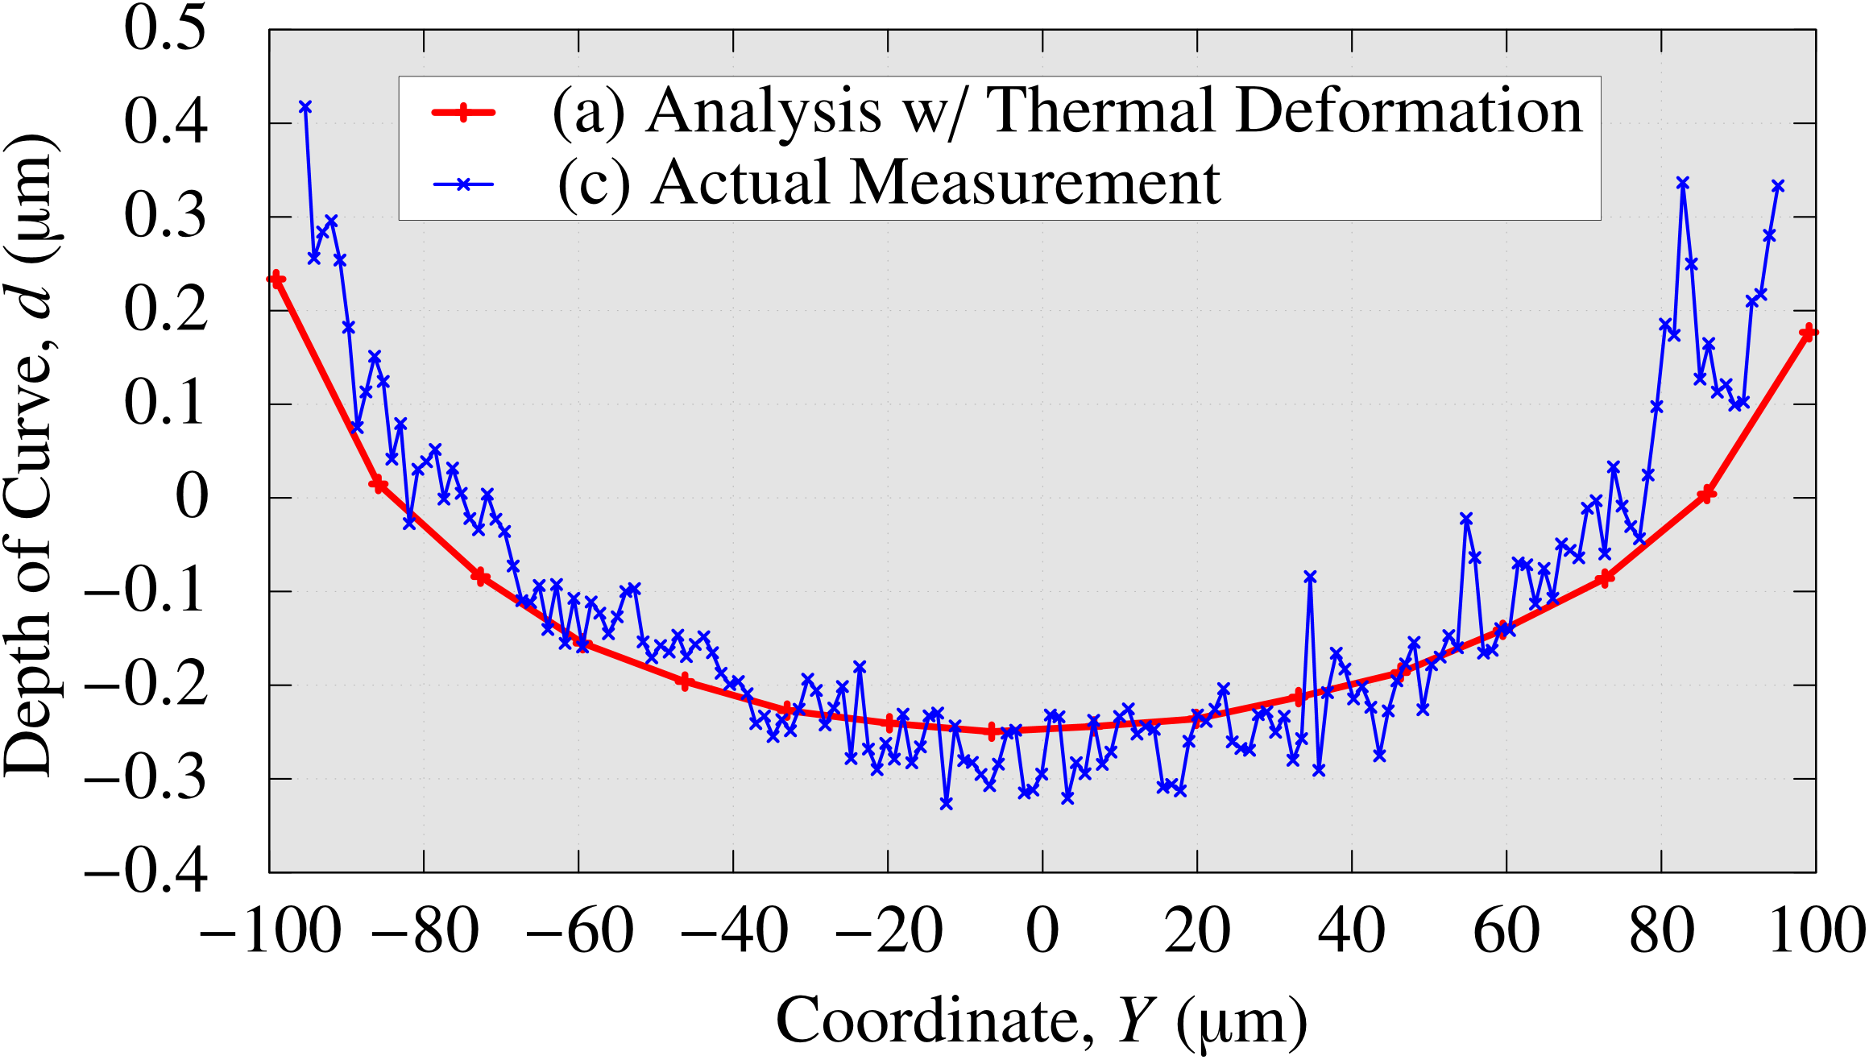
Comparison of results
Profiles of depth of curve on the vertical center line of the top face
The profiles are in good agreement, but the simulation result is about 10% shallower than the actual measurement. It may be necessary to consider the thermal softening effect of the PDMS mold due to temperature rise in the PDMS mold.

Slide 29
Summary

Slide 30
Summary
A novel numerical modeling method for shape deformation analysis in UV imprint was proposed.
UV curing, UV shrinkage, thermal deformation, and temperature-dependent reaction rate were all considered simultaneously by introducing the virtual temperature, reaction kinetics, and thermo-viscoelastic constitutive law.
A set of model parameters for UV resin was identified through the thermal camera tests and rheometer tests.
A micromirror array imprint analysis was conducted to validate that the simulated surface curve agreed with the actual measurement with 10% error approximately.
The temperature rise and thermal softening of the mold due to heat transfer are to be considered in the future.
Thank you for your kind attention!

