Slide 1
Modal and dynamic explicit analyses with the latest tetrahedral smoothed finite element method
Yuki ONISHI (Tokyo Institute of Technology)

Slide 2
What is S-FEM?
Smoothed finite element method (S-FEM) is a relatively new FE formulation proposed by Prof. G. R. Liu in 2006.
S-FEM is one of the strain smoothing techniques.
There are several types of classical S-FEMs depending on the domains of strain smoothing.
For example in a 2D triangular mesh:
Edge-based S-FEM (ES-FEM)
Node-based S-FEM (NS-FEM)
Standard FEM

Slide 3
What are the major benefits of S-FEM?
Super-linear mesh convergence rate. (Almost same rate as 2nd-order elements with T4 mesh.)
Shear locking free with ES-FEM. (Excellent accuracy with T4 mesh.)
Little accuracy loss with skewed meshes. (No problem with complex geometry.)
T4: 4-node Tetrahedra
S-FEM is a powerful method suitable for practical industrial applications.

Slide 4
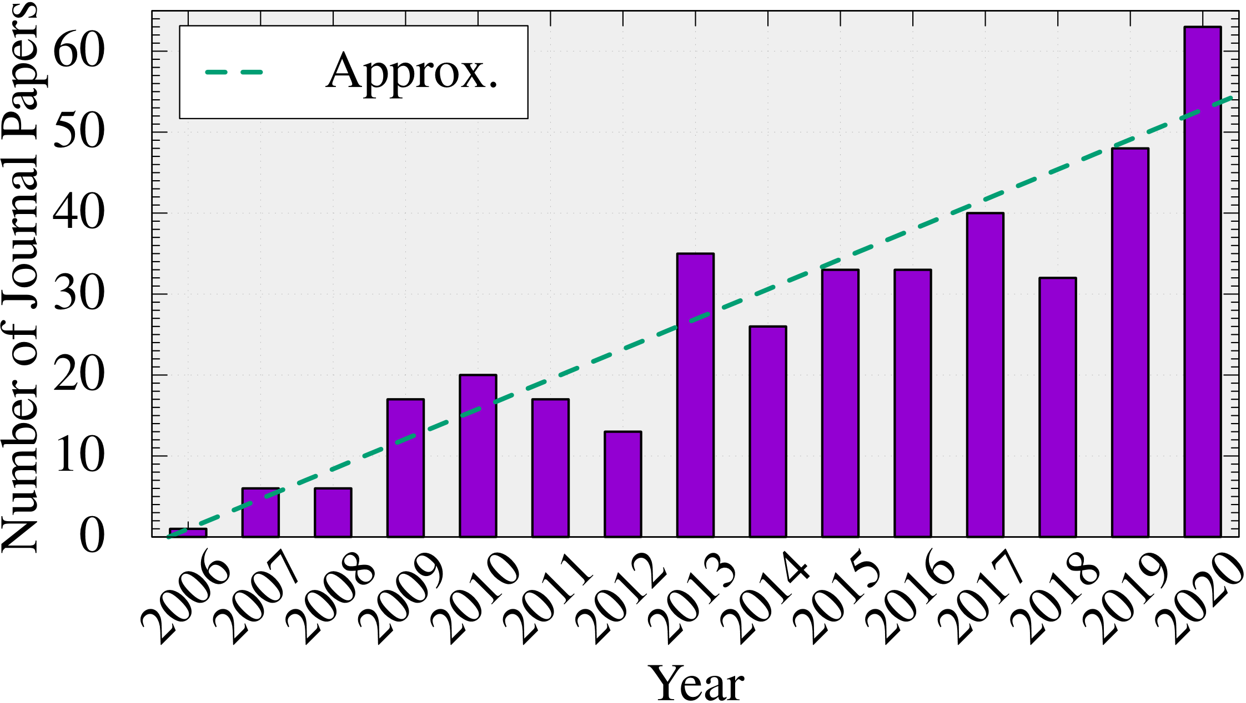
How popular is S-FEM?
Number of journal papers whose title contains “smoothed finite element”:
(inquired at Google Scholar)
The attraction of S-FEM is expanding continuously.

Slide 5
Applications of S-FEMs in Our Lab
Solid mechanics (still in academic)
Static Implicit Dynamic Explicit Viscous Implicit
Electrostatic (already in practice)
Carbody Electro Deposition

Slide 6
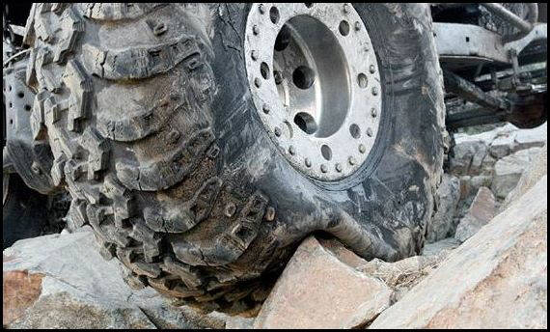
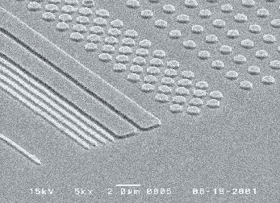
Motivation
What we want to do:
Solve severe large deformation analyses accurately and robustly.
Treat complex geometries with tetrahedral meshes.
Consider nearly incompressible materials $(ν≃0.5)$.
Support contact problems.
Handle auto re-meshing.
Rubber
Metal
Plastic/Glass

Slide 7
Issues (e.g., barreling analysis of rubber cylinder)
Neo-Hookean hyperelastic body with $ν_{ini}=0.49$
Pressure
With the best tetrahedral element in ABAQUS
T10: 10-node Tetrahedra
2nd order modified hybrid T10 (ABAQUS C3D10MH)
✓ No shear/volumetric locking ✗ Short lasting (weak to severe deformation)
✗ Low interpolation accuracy

Slide 8
Our Approach (e.g., barreling analysis of rubber cylinder)
Neo-Hookean hyperelastic body with $ν_{ini}=0.49$
Selective CS-FEM-T10 is much better than conventional tetrahedral elements in static analyses.
With the latest S-FEM tetrahedral element
Same mesh & contour range as C3D10MH case.
Y. Onishi, IJCM, (2021).
Latest S-FEM T10 (SelectiveCS-FEM-T10)
✓ No shear/volumetric locking ✓ Less pressure checkerboarding ✓ Long lasting (robust to severe deformation) ✓ Same CPU time as T10 elements.
Further evaluation is necessary in dynamic analyses.

Slide 9
Objective
Development of a dynamic version of SelectiveCS-FEM-T10
Evaluation of its accuracy and robustness in severe large deformation dynamic analyses.
Table of Body Contents
Methods: Formulation of SelectiveCS-FEM-T10
Results: Demonstrations of SelectiveCS-FEM-T10
Summary

Slide 10
Methods: Formulation of SelectiveCS-FEM-T10

Slide 11
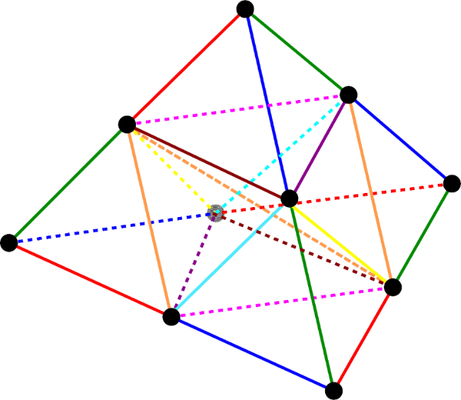
Concepts of SelectiveCS-FEM-T10
Using T10 element and subdivide it into T4 sub-elements. $⟹$ Overcomes the drawbacks of intermediate nodes.
Adopting intra-element ES-FEM (a kind of CS-FEM) having no strain smoothing across multiple elements. $⟹$ Becomes an independent element of existing FE codes.
Applying selective reduced integration (SRI). $⟹$ Overcomes volumetric locking.

Slide 12
Brief Formulation of ES-FEM
Let us consider two 3-node triangular elements in 2D for simplicity.
Calculate $\left[B\right](=dN/dx)$ at each element as usual.
Distribute each $[B]$ to the connecting edge with an area weight and build $[ ^{Edge}B]$ .
Calculate deformation gradient $(F)$, Cauchy stress ($σ$) and nodal internal force $\{f^{int}\}$ in each edge smoothing domain.
$$[B_{1}]$$
As if putting a Gauss point on each edge center
$$[B_{2}]$$
$$[^{Edge}B]$$
$↳{}^{Edge}F,{}^{Edge}σ, \{^{Edge}f^{int}\}$ etc.

Slide 13
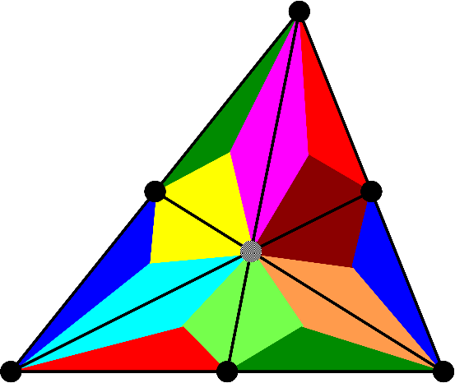
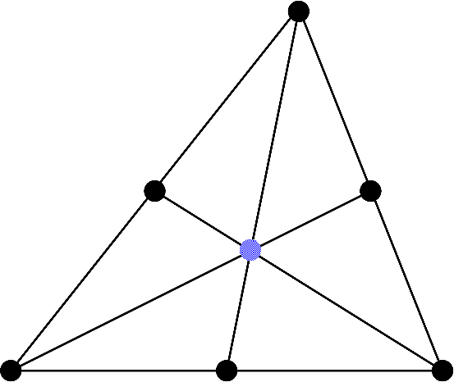
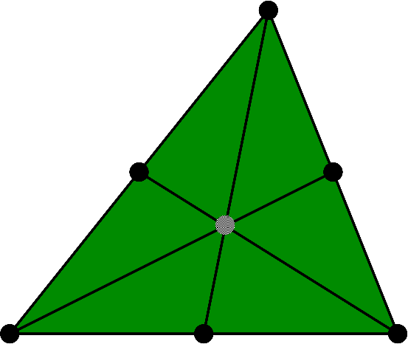
Flowchart of SelectiveCS-FEM-T10
Explanation in 2D (6-node triangular element) for simplicity
(2) Iso-vol. strain smoothing at edges
ES-FEM
SRI
(4) $\left\{f^{int}\right\} and [K]$
Overall mean
(1) Radial type element subdivision into sub-elements with a dummy node
(3) Vol. strain smoothing with all sub-elements

Slide 14
T10 Element Subdivision in 3D
Radial subdivision (30% shrunk mesh)
There are 16 T4 sub-elements in total.
Sub-elements have a little larger skewness.
Strain on all 34 edges are smoothed by ES-FEM.
but skewness is not a big issue for ES-FEM.

Slide 15
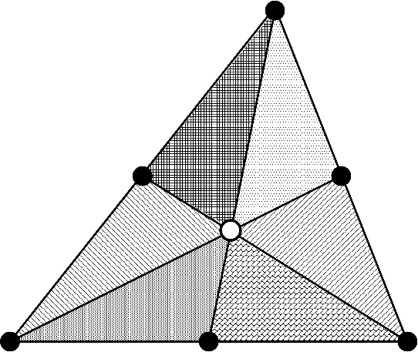
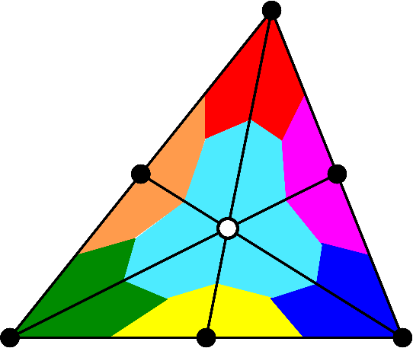
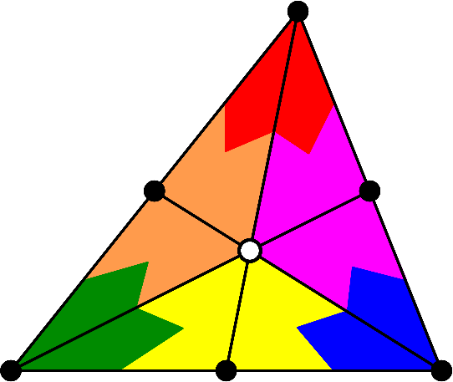
Building Lumped Mass Matrix
Calculate the mass of each sub-element.
Distribute it to composing 4 nodes. (3 nodes in 2D.)
The mass of the dummy node is distributed to the connecting 6 mid-nodes. (3 mid-nodes in 2D.)
Schematics in 2D
Each color denotes the corresponding area for mass.

Slide 16
Results: Demonstration of SelectiveCS-FEM-T10

Slide 17
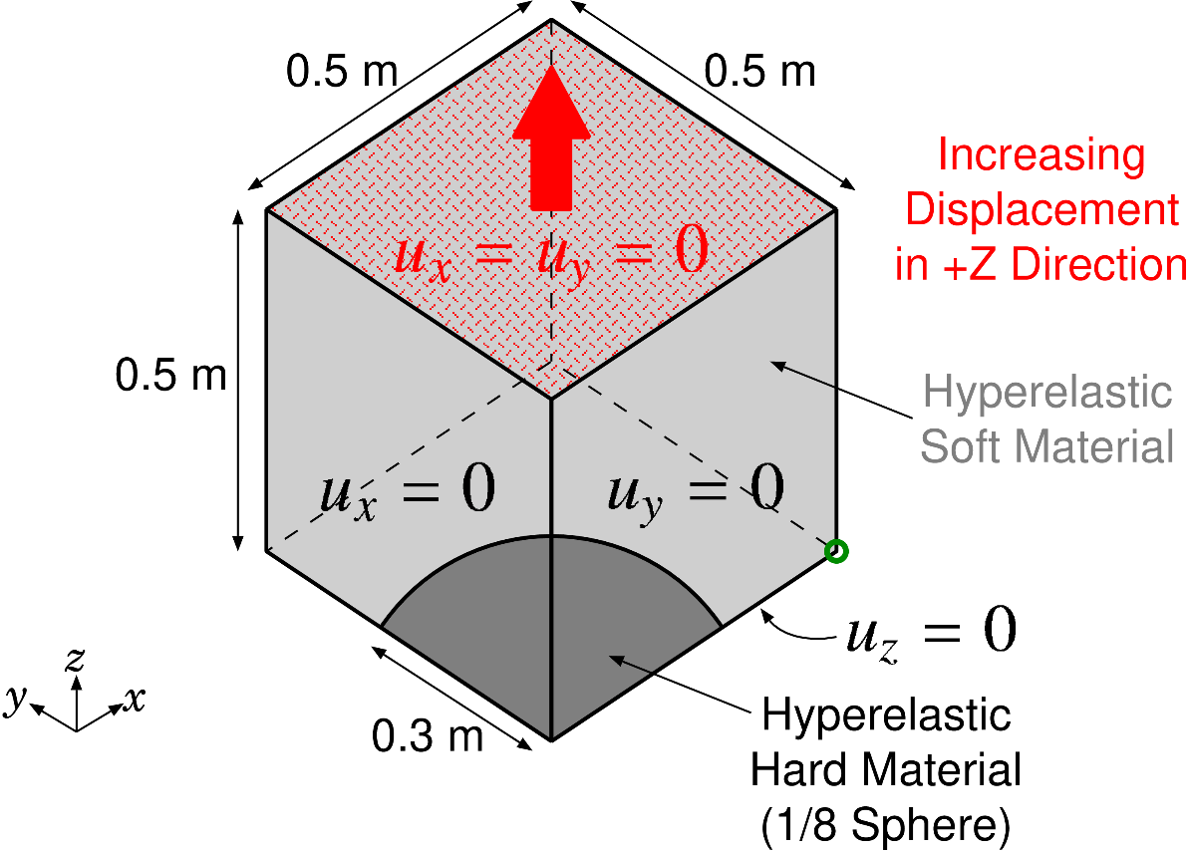
Tensioning of Rubber-Filler Composite
Static Implicit
Outline
Soft material: Neo-hookean, $E_{ini}=6 GPa, ν_{ini}=0.49.$
Hard material: Neo-hookean, $E_{ini}=260 GPa, ν_{ini}=0.3.$
Discretized into T10 mesh. (about 11,000 nodes and 7,000 elements)
Compared to ABAQUS C3D10MH, the best T10 element of ABAQUS, with the same mesh.

Slide 18
Tensioning of Rubber-Filler Composite
Static Implicit
Result of ABAQUS C3D10MH with pressure contour
Convergence failure at 69% nominal stretch (short lasting)

Slide 19
Tensioning of Rubber-Filler Composite
Static Implicit
Result of Selective CS-FEM-T10 with pressure contour
Convergence failure at 166% nominal stretch (long lasting)

Slide 20
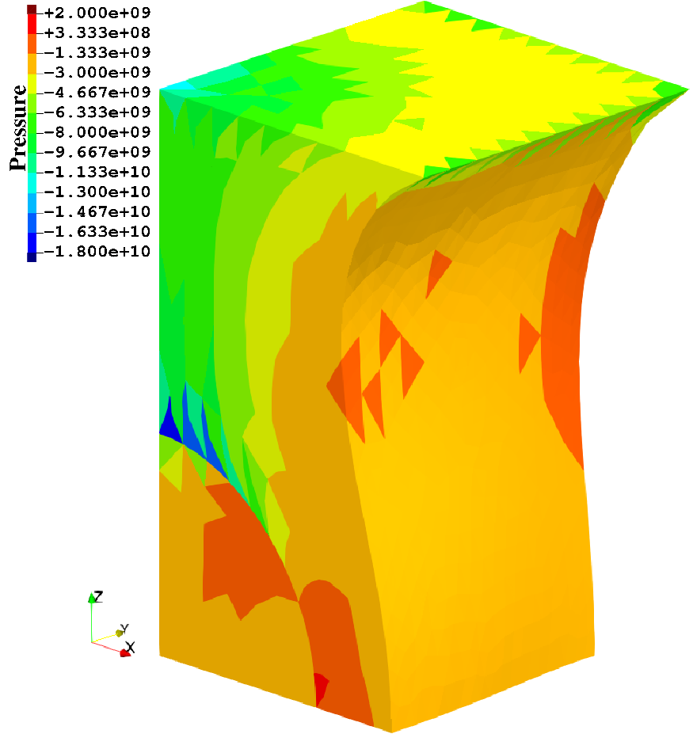
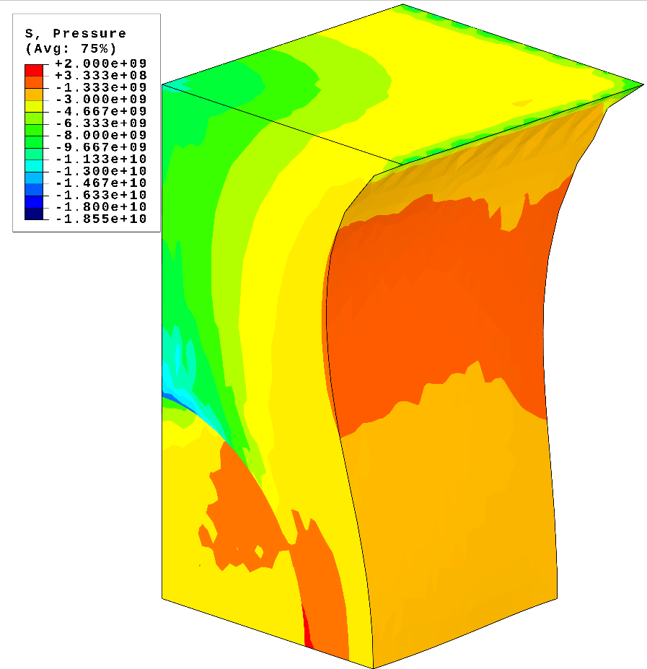
Tensioning of Rubber-Filler Composite
Static Implicit
Comparison of pressure dist. at 60% nominal stretch
SelectiveCS-FEM-T10 ABAQUS C3D10MH
SelectiveCS-FEM-T10 has good pressure accuracy.

Slide 21
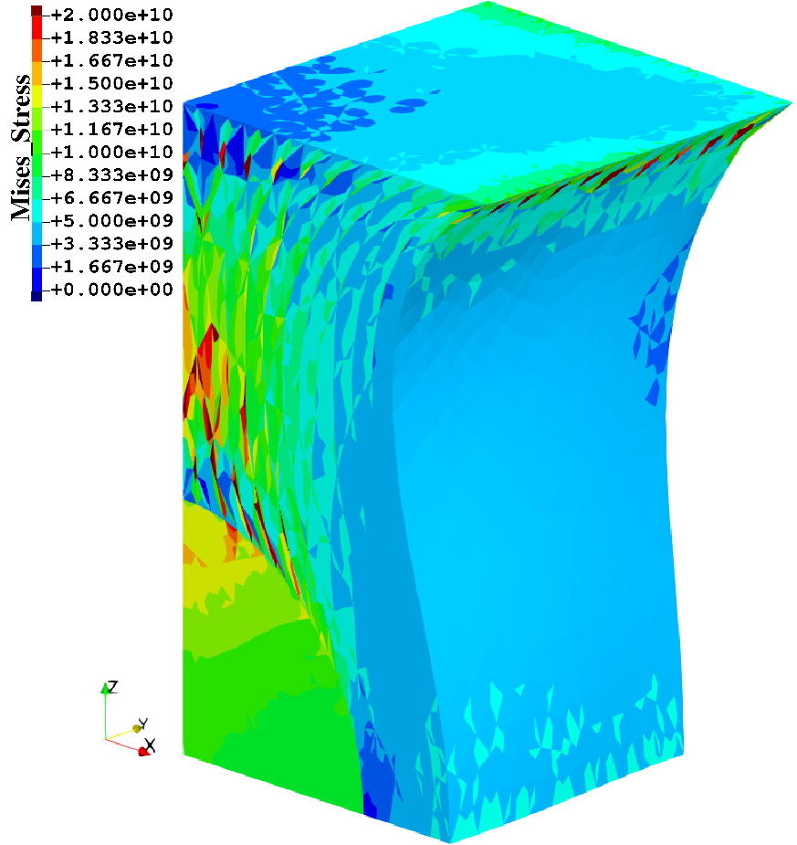
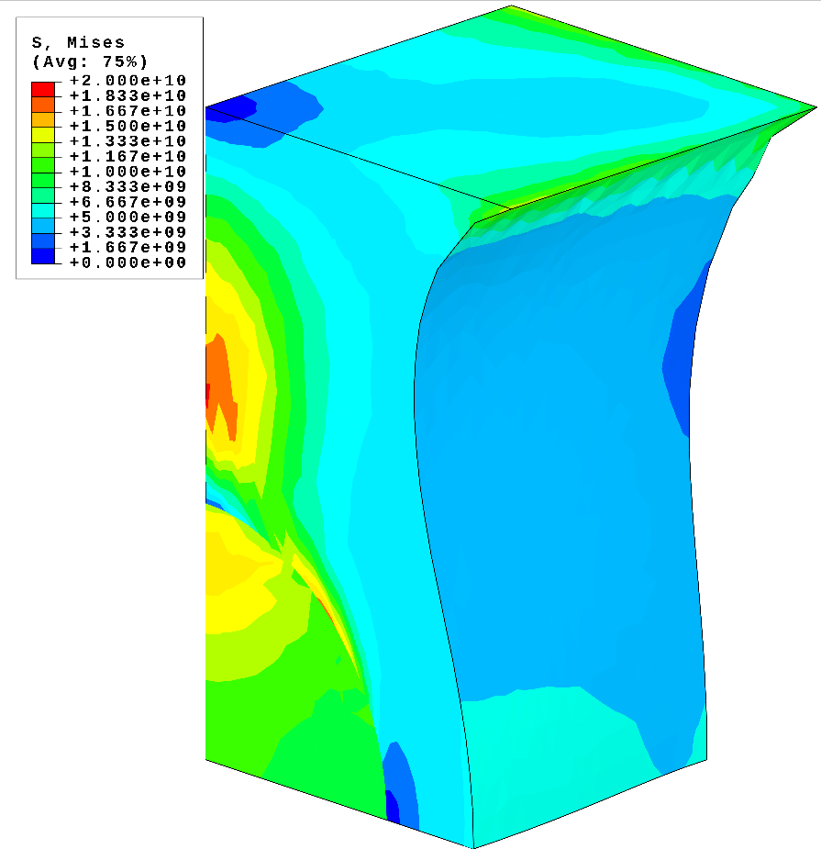
Tensioning of Rubber-Filler Composite
Static Implicit
Comparison of Mises stress dist. at 60% nominal stretch
SelectiveCS-FEM-T10 ABAQUS C3D10MH
SelectiveCS-FEM-T10 has an issue of Mises stress oscillation, which should be resolved in the future.

Slide 22
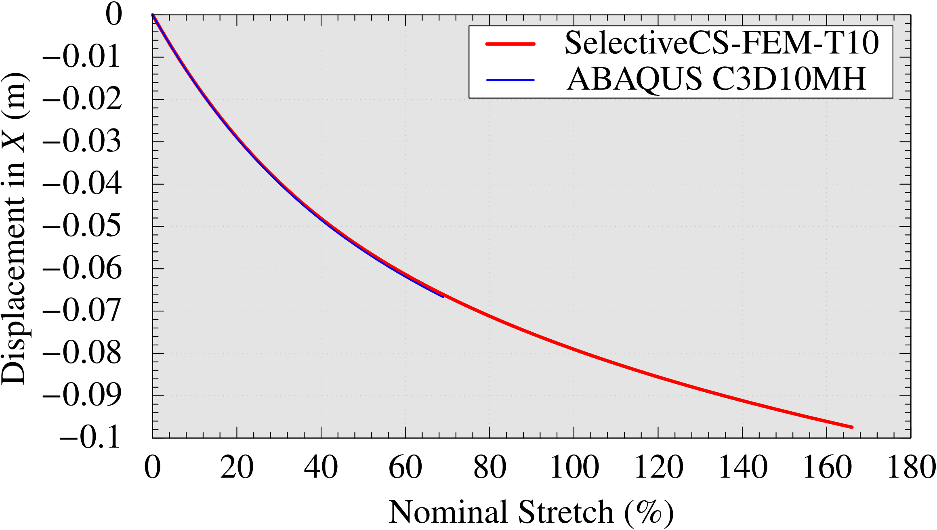
Tensioning of Rubber-Filler Composite
Static Implicit
Comparison of history of $u_{x}$ at the bottom corner
ABAQUS C3D10MH died here.
$$x$$
Selective CS-FEM-T10 died here.
SelectiveCS-FEM-T10 has enough accuracy in displacement (and force, also) in addition to large deformation robustness.

Slide 23
Deformation Modes of Armadillo
Eigen Mode
Outline
Rubber body. (Young’s modulus: 5MPa, Poisson’s ratio: 0.49)
Discretized in T10 mesh. (about 80,000 nodes and 52,000 elements)
Both soles of the feet are perfectly constrained.
Modal analysis up to 40 eigen modes. (This is not a large deformation analysis.)
Compared to ABAQUS C3D10MH with the same mesh.

Slide 24
Deformation Modes of Armadillo
Eigen Mode
Eigen modes up to Mode 40 with SelectiveCS-FEM-T10
There are no unnatural modes.
SelectiveCS-FEM-T10 has no spurious low-energy modes like hour-glass modes.

Slide 25
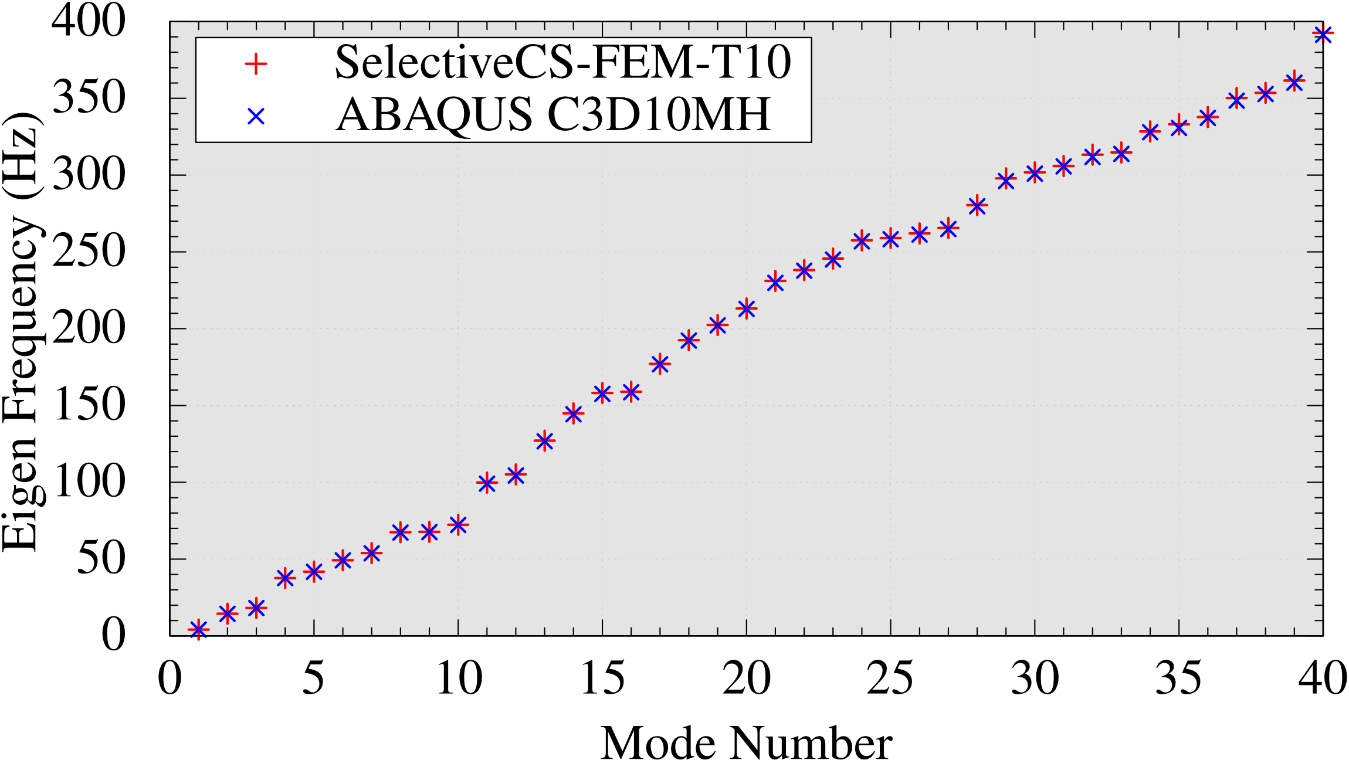
Deformation Modes of Armadillo
Eigen Mode
Comparison of eigen frequencies
SelectiveCS-FEM-T10 has practical accuracy in modal analyses as ABAQUS C3D10MH; therefore, SelectiveCS-FEM-T10 would be stable in dynamic analyses.

Slide 26
Swing of Bunny Ears
Dynamic Explicit
Iron Ears
Outline
Iron ears: Neo-Hookean, $E_{ini}=200 GPa, ν_{ini}=0.3, ρ=7800 kg/m^{3}$.
Rubber body: Neo-Hookean, $E_{ini}=6 MPa, ν_{ini}=0.49, ρ=920 kg/m^{3}$.
Discretized into T10 mesh. (about 61,000 nodes and 41,000 elements)
Compared to ABAQUS/Explicit C3D10M (NOT C3D10MH) with the same mesh and $Δt$.
Contact is not considered.
25 m/s Initial Velocity of Iron Ears
Rubber Body
Fixed Soles
$Δt=0.05 μs$, which is recommended $Δt$ for C3D10M

Slide 27
Swing of Bunny Ears
Dynamic Explicit
Comparison of Mises stress animation
SelectiveCS-FEM-T10 ABAQUS C3D10M
SelectiveCS-FEM-T10 has similar accuracy in displacement and Mises stress to ABAQUS C3D10M.

Slide 28
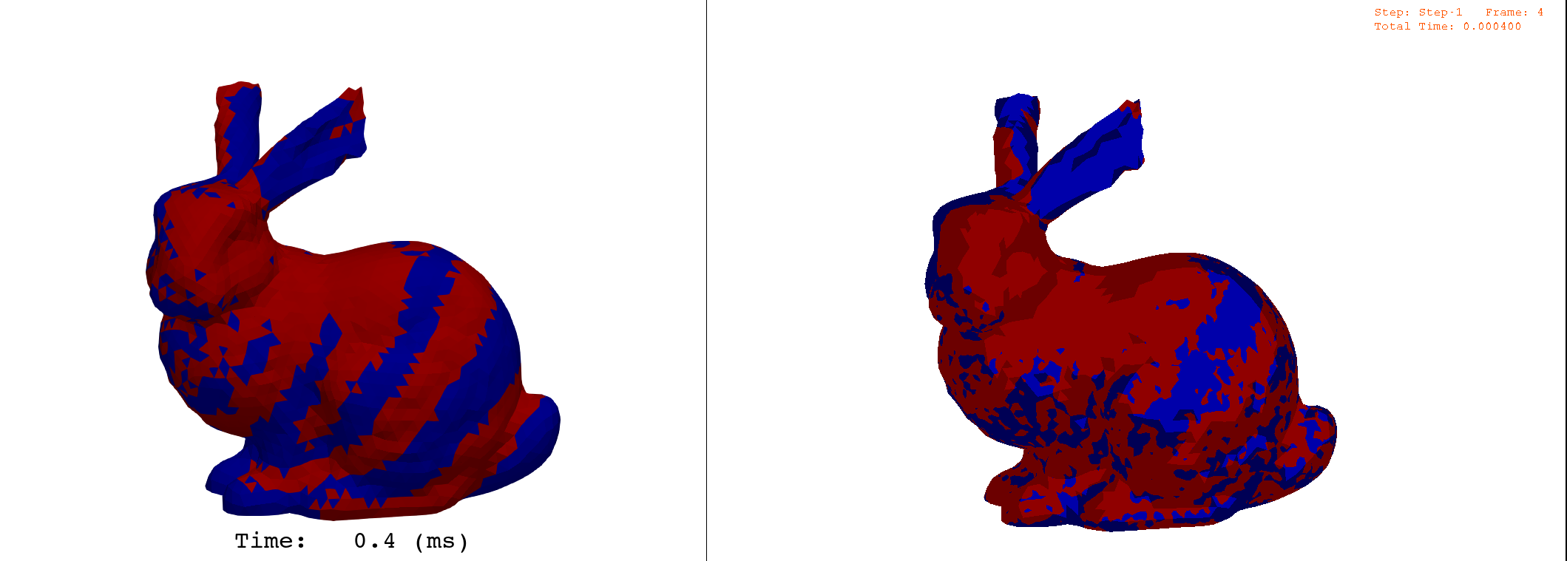
Swing of Bunny Ears
Dynamic Explicit
Comparison of pressure sign at $t=$0.4 ms (right after the stat)
Red: positive pressure Blue: negative pressure
Clear stripe pattern
Unclear stripe pattern
SelectiveCS-FEM-T10 ABAQUS C3D10M
SelectiveCS-FEM-T10 seems to calculate the initial pressure wave propagation more correctly than ABAQUS C3D10M.

Slide 29
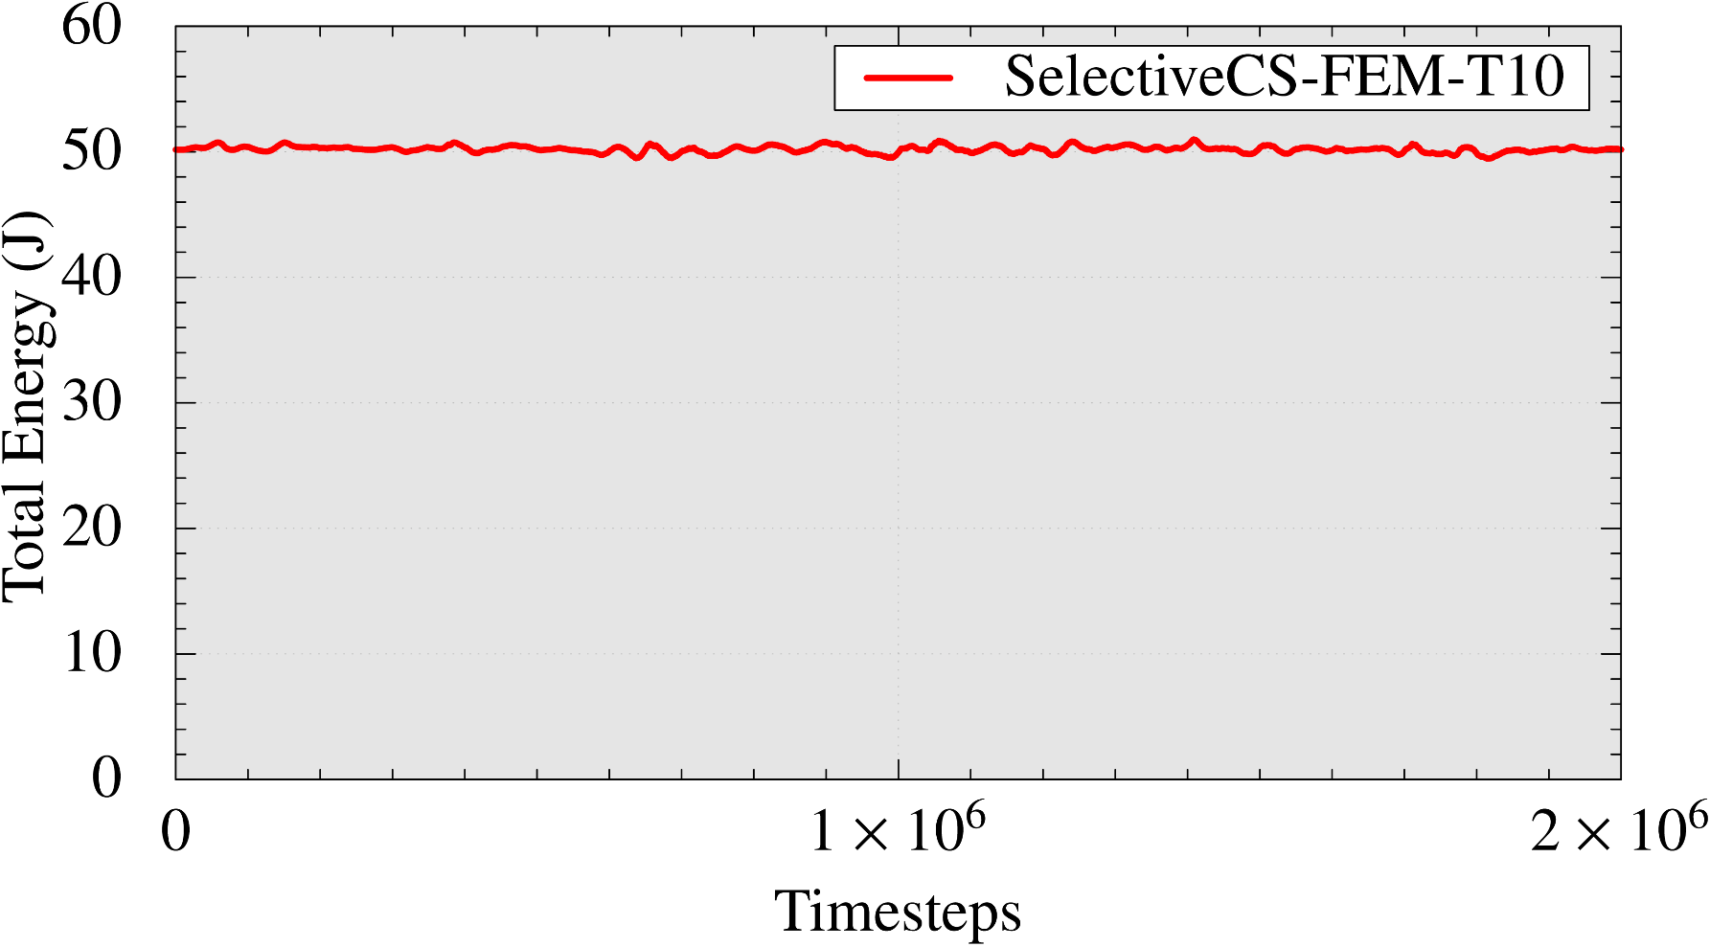
Swing of Bunny Ears
Dynamic Explicit
Timestep-history of total energy (= kinetic + strain)
($=$ 0.1 s)
SelectiveCS-FEM-T10 has enough energetic stability in dynamic analysis.

Slide 30
Summary

Slide 31
Summary
Summary
A new S-FEM was proposed, which is called SelectiveCS-FEM-T10:
More robust to severe large deformation than the conventional T10s.
Enough accuracy for practical use as compared to ABAQUS’s best T10.
Slower than conventional T10s only in dynamic explicit analysis.
More severe large deformation dynamic analyses should be performed for evaluation.
Take-home message
If you are interested in large deformation analysis,
please consider implementing SelectiveCS-FEM-T10 to your FE code. It’s supremely useful & easy to code!!
Thank you for your kind attention!

Slide 32
Appendix

Slide 33
Computational Cost
In static, modal, dynamic implicit analyses:
CPU time: almost the same as the standard T10. $∵$ Time to solve the matrix equation (i.e., $\left[K\right]\left\{u\right\}=\{f\}$) dominates the CPU time.
Memory size: several times larger than the standard T10. $∵$ Memory to store $F$ and $σ$ at Gauss points occupies a main part of the memory size. SelectiveCS-FEM-T10 has 34 edges. Standard T10 has 4 Gauss Points.
In dynamic explicit analysis:
CPU time: several times longer than the standard T10. $∵$ Time to build internal force vector $\{f^{int}\}$ occupies a main part of the CPU time.
Memory size: several times larger than the standard T10. $∵$ Same reason above.
Trade-off between robustness and costs

Slide 34
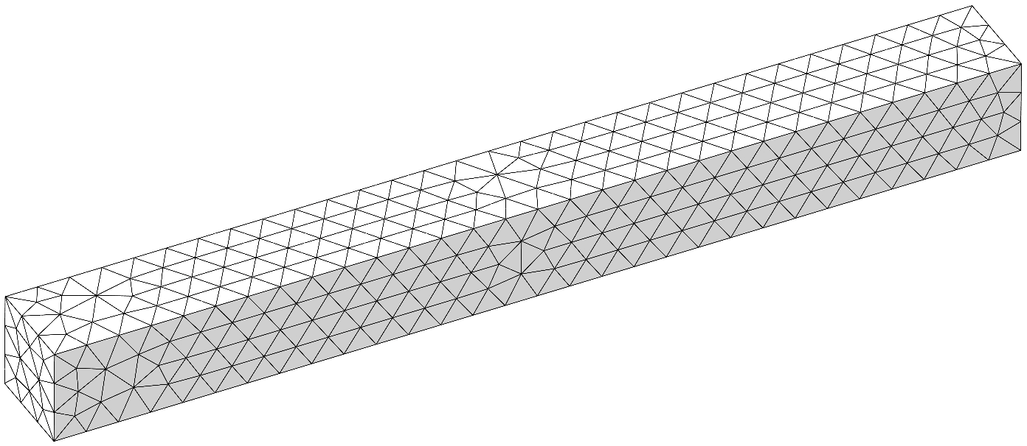
Wave Propagation in a Long Bar
Dynamic Explicit
10 m $×$ 1 m $×$ 1 m.
Neo-Hookean, $E_{ini}=1 MPa, ν_{ini}=0.49, ρ=920 kg/m^{3}$.
Lateral confinement on the sidewalls.
Discretized into T10 mesh. (about 4,000 nodes and 2,000 elements)
Compared to analytical solution.
$$x$$
1 m/s constant velocity in $x$
Sidewalls slid only in $x$
$Δt=0.1$ ms (constant)

Slide 35
Wave Propagation in a Long Bar
Dynamic Explicit
Animation of pressure
SelectiveCS-FEM-T10 seem to has good pressure accuracy.

Slide 36
Wave Propagation in a Long Bar
Dynamic Explicit
Animation of Mises stress
We need more careful investigation.

Slide 37
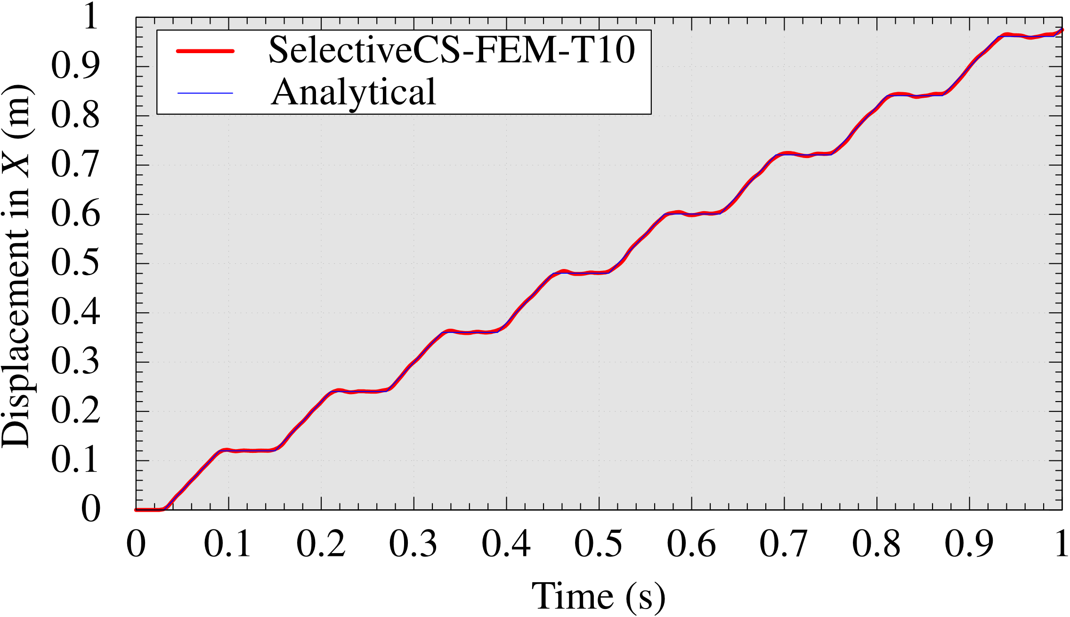
Wave Propagation in a Long Bar
Dynamic Explicit
Time-history of displacement at the right end
Analytical pressure wave speed: $$c=\sqrt{\frac{λ+2μ}{ρ}}$$
SelectiveCS-FEM-T10 has enough accuracy in 1D pressure wave propagation analysis.

Slide 38
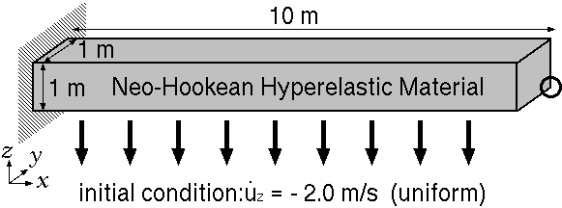
Dynamic Bending of Cantilever
Dynamic Explicit
Neo-Hookean, $E_{ini}=6.0 MPa$, $ν_{ini}=0.49$, $ρ=920 kg/m^{3}$
Initial velocity: $v_{z}=−5 m/s$ for all nodes of cantilever
Discretized into T10 mesh. (about 4,000 nodes and 2,000 elements)
Compared to ABAQUS/Explicit C3D10M (NOT C3D10MH) with the same mesh and $Δt (=0.1 ms)$.
Initial Condition: $v_{z}=−5 m/s$ (uniform)

Slide 39
Dynamic Bending of Cantilever
Dynamic Explicit
Comparison of animation of Mises stress
SelectiveCS-FEM-T10/Explicit ABAQUS/Explicit C3D10M
SelectiveCS-FEM-T10 has similar accuracy in displacement and Mises stress to ABAQUS C3D10M.

Slide 40
Dynamic Bending of Cantilever
Dynamic Explicit
Comparison of animation of pressure
SelectiveCS-FEM-T10/Explicit ABAQUS/Explicit C3D10M
SelectiveCS-FEM-T10 has similar accuracy in displacement and pressure to ABAQUS C3D10M.

Slide 41
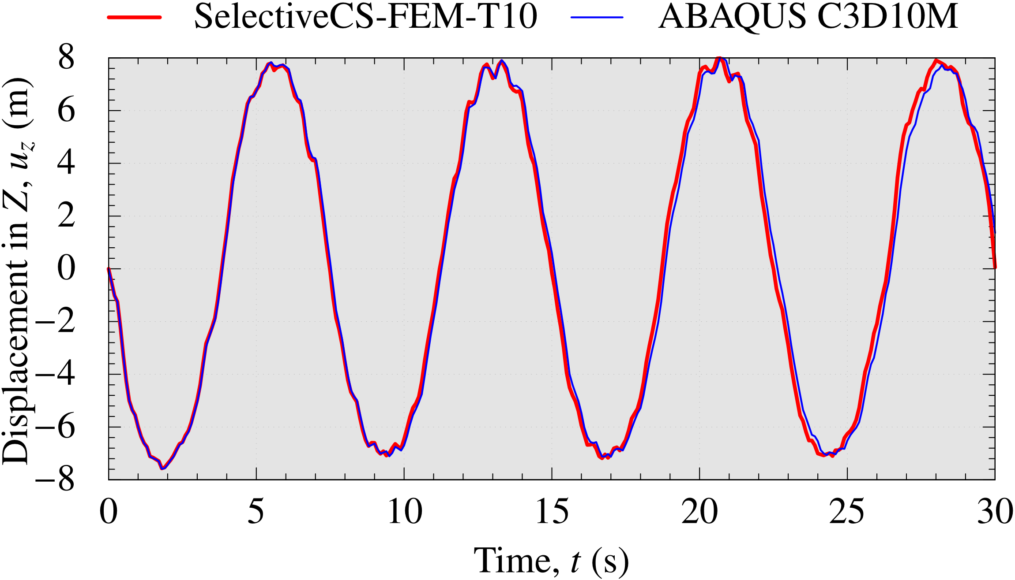
Dynamic Bending of Cantilever
Dynamic Explicit
Comparison of time-history of $u_{z}$ at the tip node
SelectiveCS-FEM-T10 has similar accuracy in displacement to ABAQUS C3D10M.

