Slide 1
F-barES-FEM-T4: a new finite element formulation of nearly incompressible solids with tetrahedral elements
Yuki ONISHI, Ryoya IIDA Tokyo Institute of Technology, Japan
In this presentation, there are no structural elements and no collapse...
But there are a few dynamic analyses of continuum elements. I hope they interest you.

Slide 2
Motivation & Background
Motivation
We want to analyze severe large deformation of nearly incompressible solids accurately and stably! (Target: automobile tire, thermal nanoimprint, etc.)
Background
Finite elements are distorted in a short time, thereby resulting in convergence failure.
Mesh rezoning (aka., remeshing) is indispensable.
1$μ$m
Mold
Polymer

Slide 3
Our First Result in Advance
What we want to do:
Large deformation
Mesh rezoning
Various kinds of analyses:
Static implicit
Dynamic explicit
Eigen Mode

Slide 4
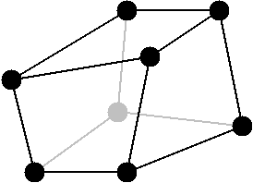
Issues
The biggest issue in large deformation mesh rezoning
It is impossible to remesh arbitrary deformed 3D shapes with hexahedral 8-node (H8) elements.
However, the standard (constant strain) T4 elements easily induce shear and volumetric locking, which leads to inaccurate results.
✗
✓
We have to use tetrahedral 4-node (T4) elements...

Slide 5
Conventional Methods
Higher order elements: ✗ Not volumetric locking free; Unstable in contact analysis; No good in large deformation due to intermediate nodes.
EAS method: ✗ Unstable due to spurious zero-energy modes.
B-bar, F-bar and selective integration method: ✗ Not applicable to T4 mesh directly.
F-bar patch method: ✗ Difficult to construct good patches. Not shear locking free.
u/p hybrid elements based on the mixed variational principle: ✗ No sufficient formulation for T4 mesh so far. (There are almost acceptable hybrid elements such as C3D4H of ABAQUS.)
Smoothed finite element method (S-FEM): ? Unknown potential (since 2007~). It’s worth trying!!

Slide 6
Various Types of S-FEMs
Basic type
Node-based S-FEM (NS-FEM)
Face-based S-FEM (FS-FEM)
Edge-based S-FEM (ES-FEM)
Selective type
Selective FS/NS-FEM
Selective ES/NS-FEM
Bubble-enhanced or Hat-enhanced type
bFS-FEM, hFS-FEM
bES-FEM, hES-FEM
F-bar type
F-barES-FEM
✗ Spurious zero-energy
✗ Volumetric Locking
✗ Restriction of constitutive model, Pressure oscillation, Corner locking (detailed later)
✗ Pressure oscillation, Short-lasting
NEW
? Unknown potential

Slide 7
Objective
Develop a new S-FEM, F-barES-FEM-T4, by combining F-bar method and ES-FEM-T4 for large deformation problems of rubber-like materials
Table of Body Contents
Methods: Formulation of F-barES-FEM-T4
Results: Some verification analyses
Summary

Slide 8
Methods
Formulations of F-barES-FEM-T4 (F-barES-FEM-T3 in 2D is explained for simplicity.)

Slide 9
Quick Review of F-bar Method
Algorithm
Calculate deformation gradient $F$ at the element center, and then make the relative volume change $\overline{ J }$ $(=det\left(F\right))$.
Calculate deformation gradient $F$ at each gauss point as usual, and then make $F^{iso}$ $(=F / J^{1/3}$) .
Modify $F$ at each gauss point to obtain $\overline{F }$ as
$\overline{F }=$ ${\overline{ J }}^{1/3}$ $F^{iso}$.
Use $\overline{F }$ to calculate the stress, nodal force and so on.
For quadrilateral (Q4) or hexahedral (H8) elements
A kind of low-pass filter for $J$
F-bar method is used to avoid volumetric locking in Q4 or H8 elements. Yet, it cannot avoid shear locking.

Slide 10
Quick Review of ES-FEM
Algorithm:
Calculate the deformation gradient $F$ at each element as usual.
Distribute the deformation gradient $F$ to the connecting edges with area weights to make $^{Edge}F$ at each edge.
Use $^{Edge}F$ to calculate the stress, nodal force and so on.
For triangular (T3) or tetrahedral (T4) elements.
ES-FEM is used to avoid shear locking in T3 or T4 elements. Yet, it cannot avoid volumetric locking.

Slide 11
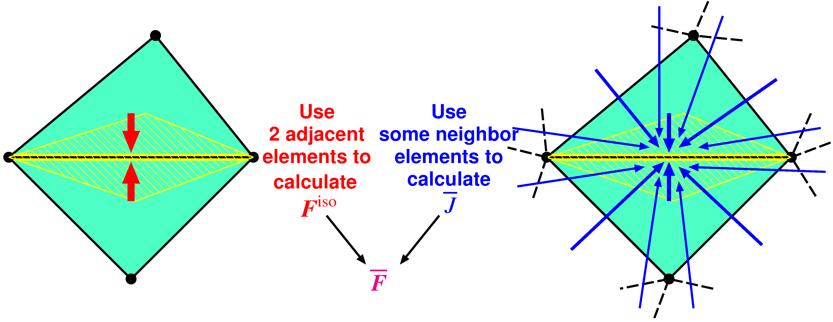
Outline of F-barES-FEM
Concept
$^{Edge}F^{iso}$ is given by ES-FEM.
$^{Edge}\overline{ J }$ is given by Cyclic Smoothing (detailed later).
$^{Edge}\overline{F }$ is calculated in the manner of F-bar method:
$^{Edge}\overline{F }=$ $^{Edge}{\overline{ J }}^{1/3}$ $^{Edge}F^{iso}$.
Combination of F-bar method and ES-FEM

Slide 12
Outline of F-barES-FEM
Brief Formulation
Calculate$^{Elem}J$as usual.
Smooth$^{Elem}J$ at nodes and get$^{Node}\tilde{ J }$.
Smooth$^{Node}\tilde{ J }$ at elements and get$^{Elem}\tilde{ J }$.
Repeat 2. and 3. as necessary ($c$ times).
Smooth $^{Elem}\dot{\dot{\dot{\tilde{\tilde{ J }}}}}$ at edges to make $^{Edge}\overline{ J }$.
Combine $^{Edge}\overline{ J }$ and $^{Edge}F^{iso}$ of ES-FEM as
$^{Edge}\overline{F }= ^{Edge}{\overline{ J }}^{1/3} ^{Edge}F^{iso}$.
A kind of low-pass filter for $J$
Cyclic Smoothing of $J$
($c$ layers of ~)
Hereafter, F-barES-FEM-T4 with $c$ cycles of smoothing is called “F-barES-FEM-T4($c$)”.

Slide 13
Equations to Satisfy
Implicit static
Balance equation: $\left\{f^{ext}\right\}−\{f^{int}\}=\left\{0\right\}$.
In Newton-Raphson loop, there is a need for solving the matrix equation:
$\left[K\right]\left\{δu\right\}=\left\{f^{ext}\right\}−\{f^{int}\}$.
Dynamic explicit
Motion equation: $\left[M\right]\left\{\ddot{u}\right\}=\{f^{ext}\}−\{f^{int}\}$.
Using the lumped mass matrix for $[M]$, there is no need for solving any matrix equations.
Velocity Verlet method is applied for time integration.

Slide 14
Results
Some verification analyses (Analyses for hyperelastic materials without mesh rezoning are presented for pure verification.)

Slide 15
Bending of a Cantilever
Static Implicit
Outline
Neo-Hookean hyperelastic material
Initial Poisson’s ratio: 0.49 or 0.499.
Two types of T4 meshes: a structured mesh and an unstructured mesh.
Compared to ABAQUS C3D4H (1st-order hybrid tetrahedral element).
Dead Load

Slide 16
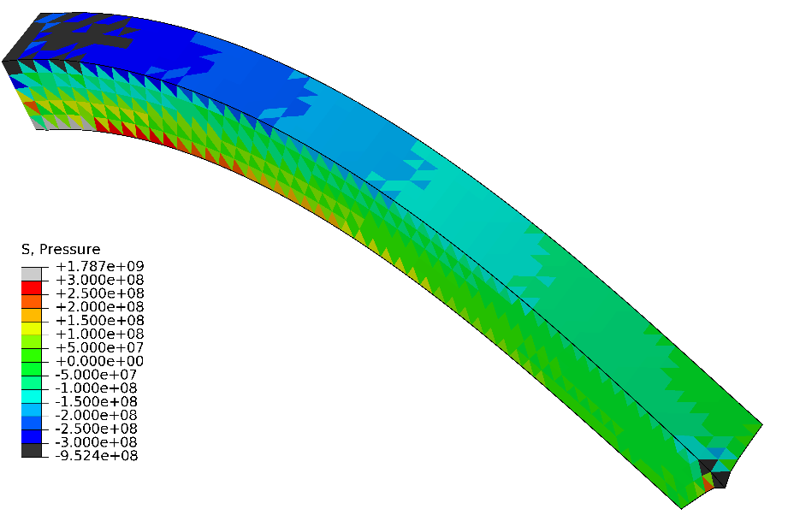
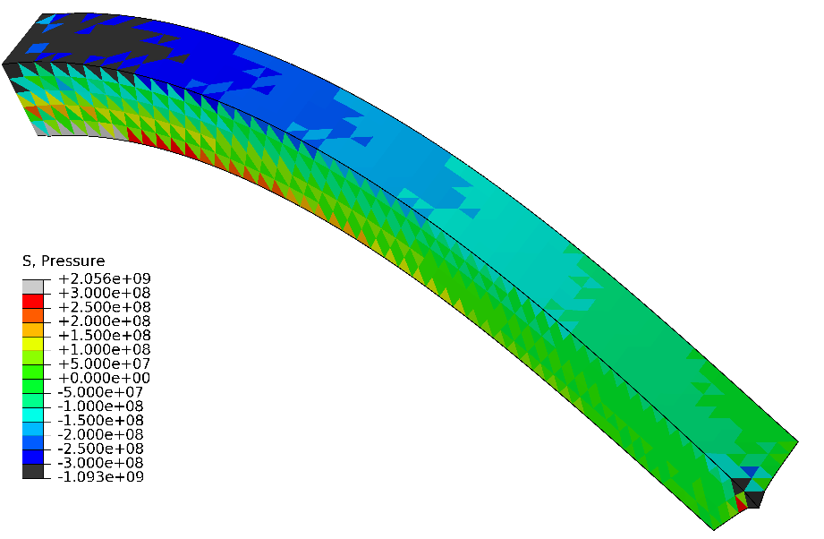
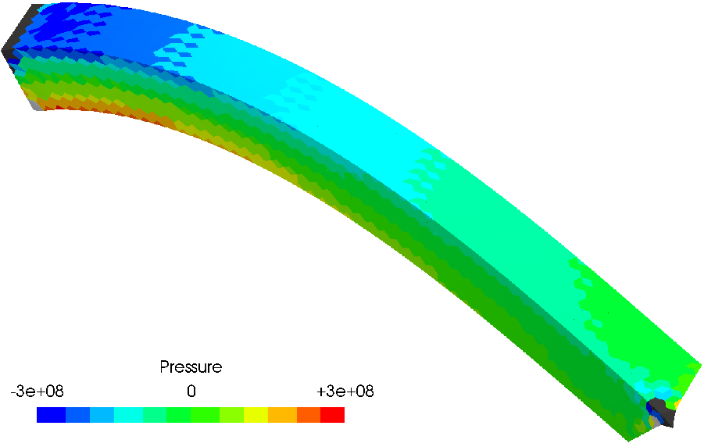
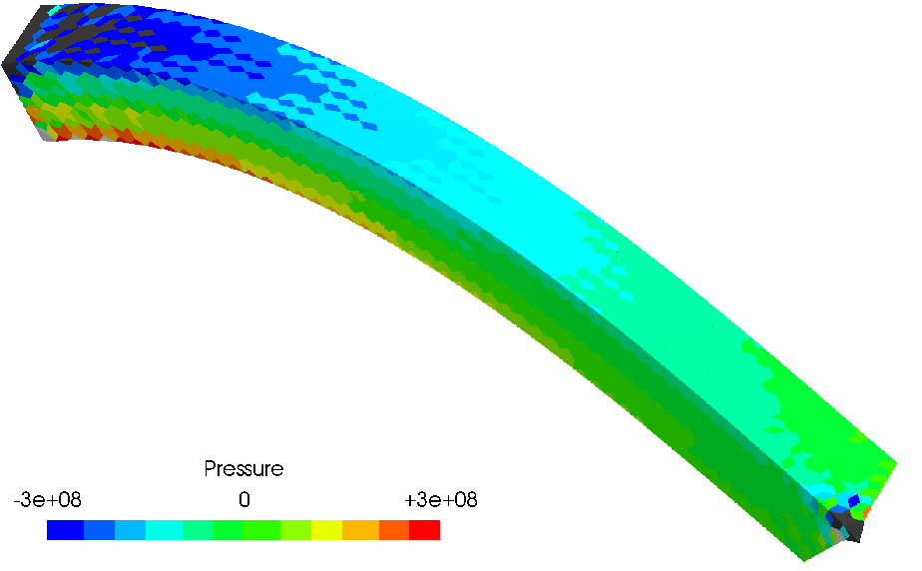
Bending of a Cantilever
Static Implicit
Pressure Distributions
$$ν^{ini}=0.49$$
Structured Mesh
$$ν^{ini}=0.499$$
ABAQUS C3D4H
F-bar ES-FEM- T4(1)

Slide 17
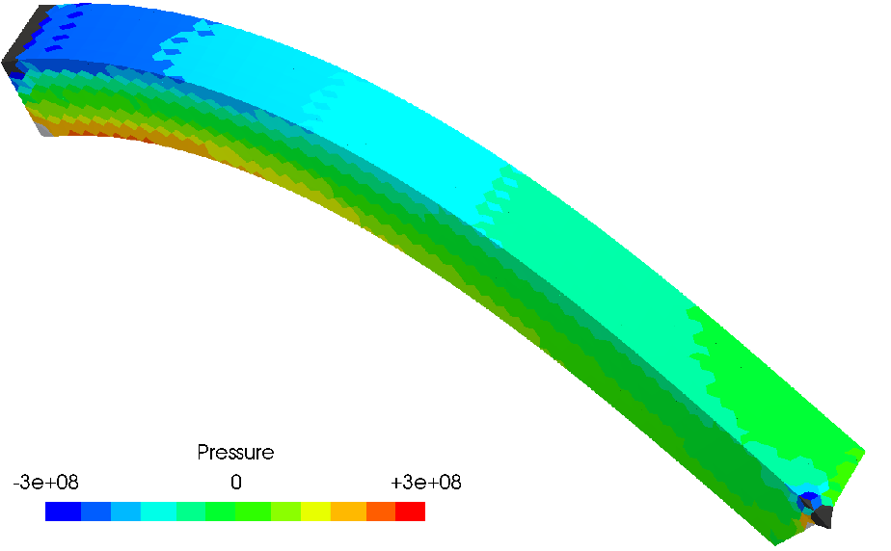
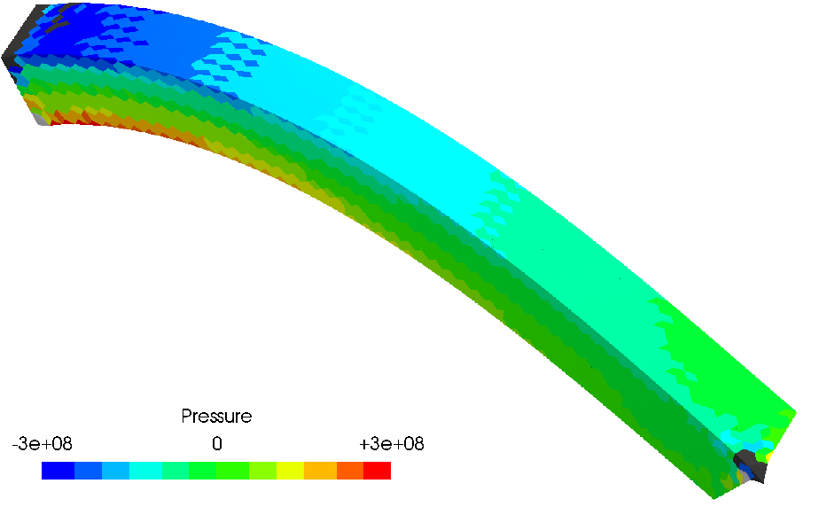
Bending of a Cantilever
Static Implicit
Pressure Distributions
$$ν^{ini}=0.49$$
Structured Mesh
$$ν^{ini}=0.499$$
F-bar ES-FEM-
T4(2)
Increase in the number of cyclic smoothing ($c$) makes stronger suppression of pressure oscillation.
F-bar ES-FEM- T4(3)

Slide 18
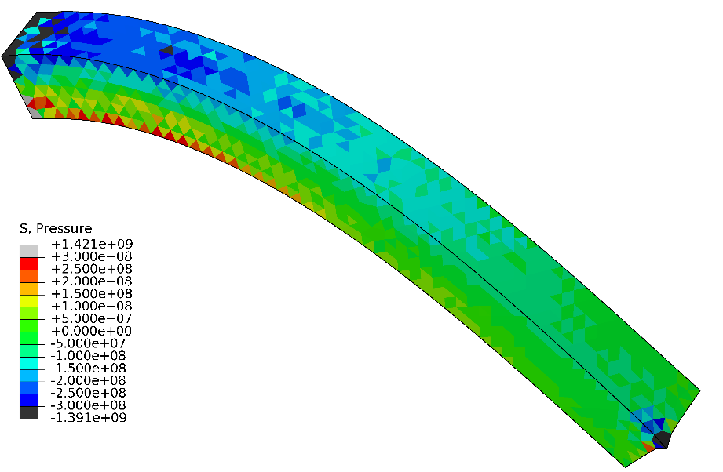
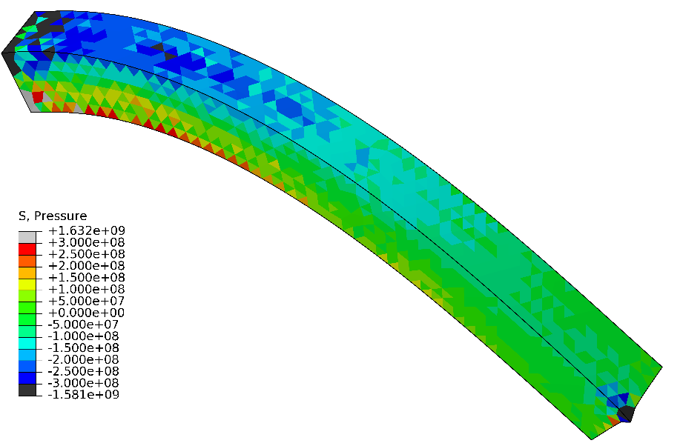
Bending of a Cantilever
Static Implicit
Pressure Distributions
$$ν^{ini}=0.49$$
Unstructured Mesh
$$ν^{ini}=0.499$$
ABAQUS C3D4H
F-bar ES-FEM- T4(1)

Slide 19
Bending of a Cantilever
Static Implicit
Pressure Distributions
$$ν^{ini}=0.49$$
Unstructured Mesh
$$ν^{ini}=0.499$$
F-bar ES-FEM-
T4(2)
F-bar ES-FEM-
T4(3)
No mesh dependency is observed.

Slide 20
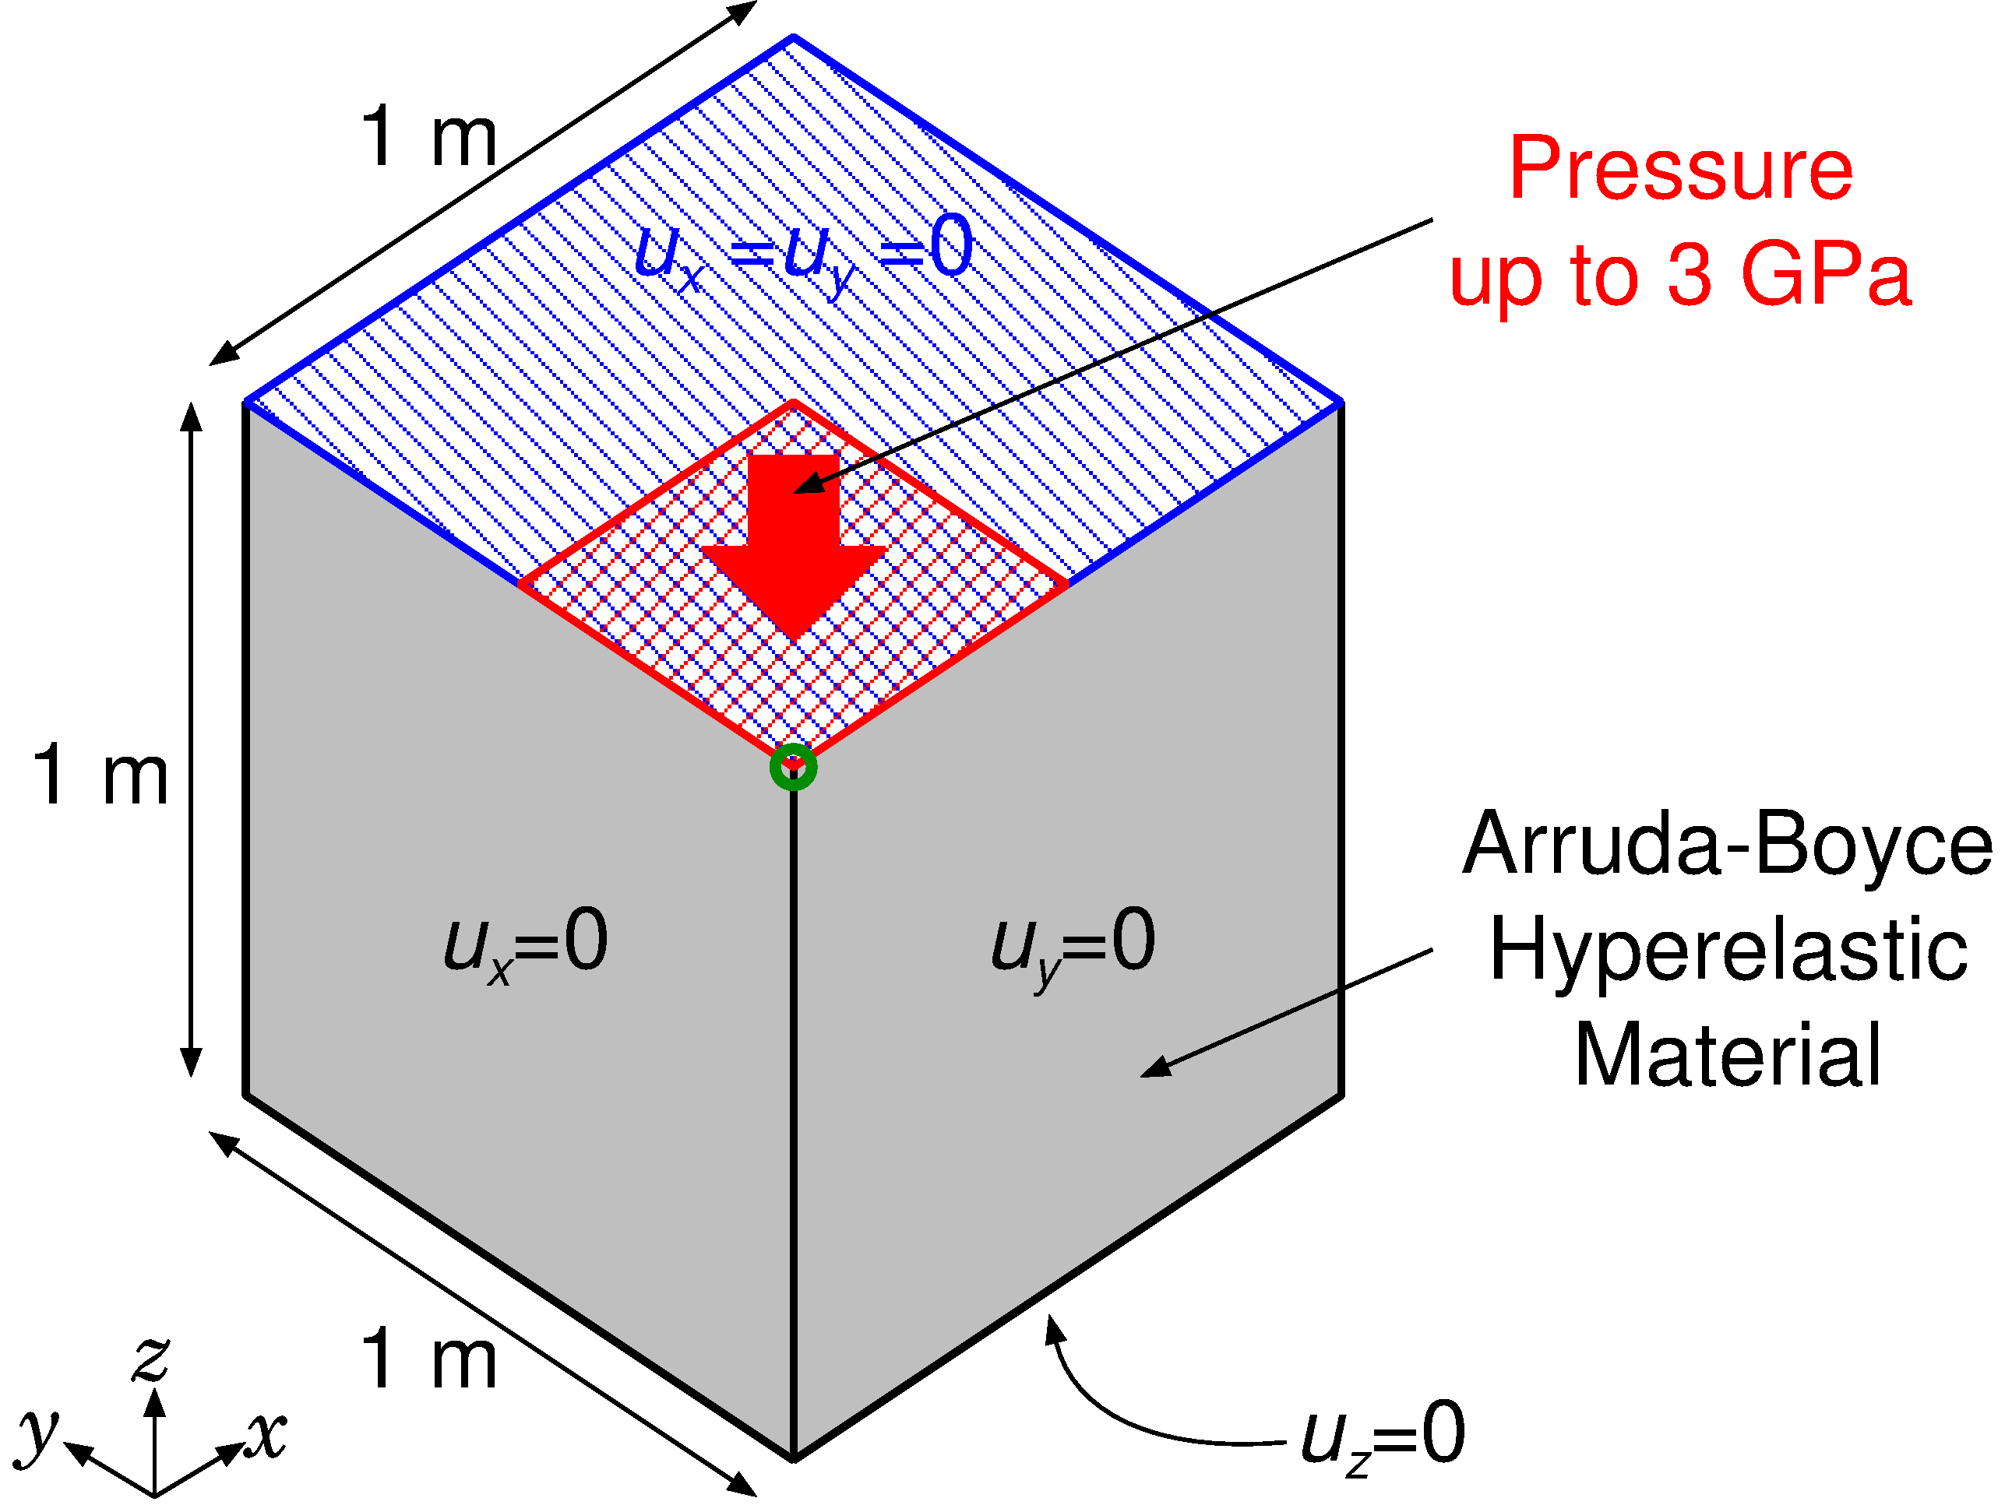
Compression of a Block
Static Implicit
Outline
Arruda-Boyce hyperelastic material ($ν_{ini}=0.499$).
Applying pressure on ¼ of the top face.
Compared to ABAQUS C3D4H with the same unstructured T4 mesh.
Load

Slide 21
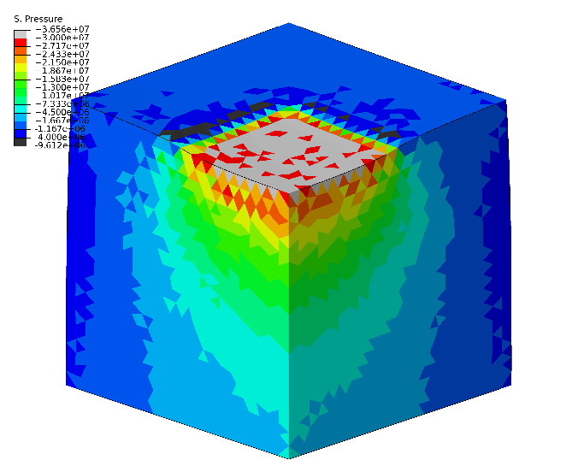
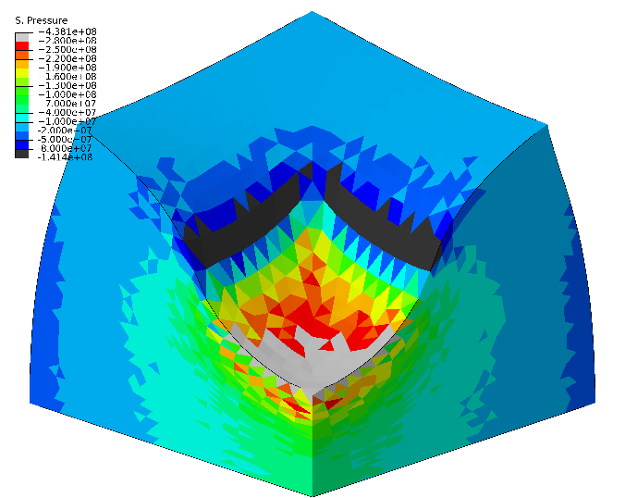
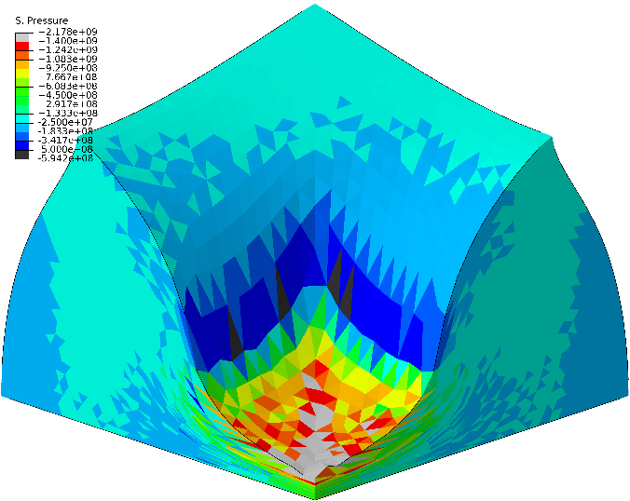
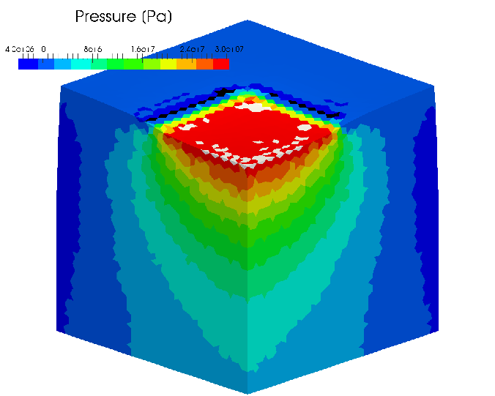
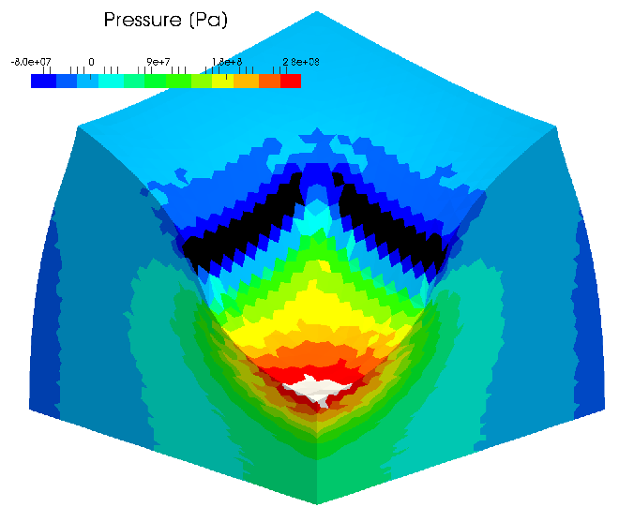
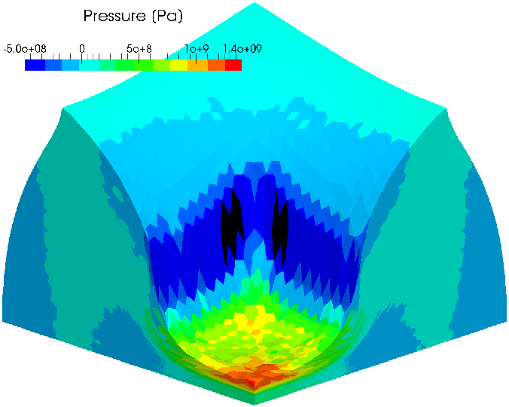
Compression of a Block
Static Implicit
Pressure Distribution
Early stage Middle stage Later stage
ABAQUS C3D4H
F-bar ES-FEM-
T4(2)

Slide 22
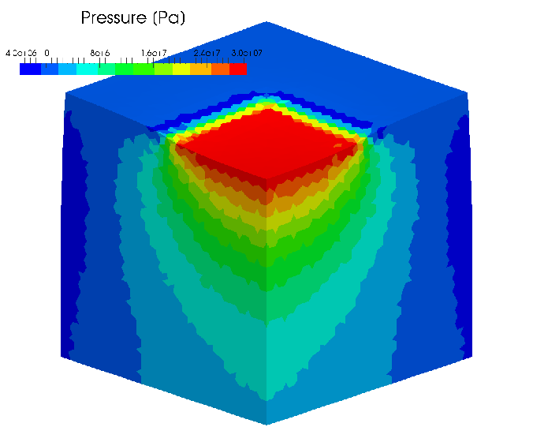
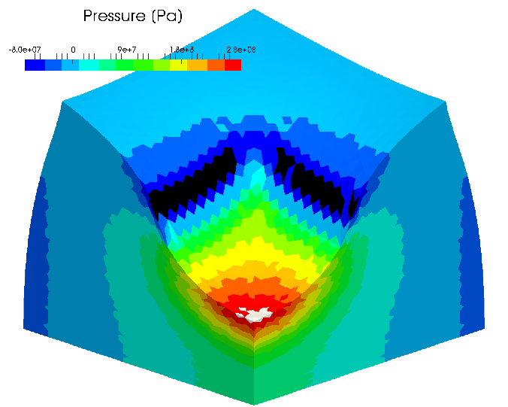
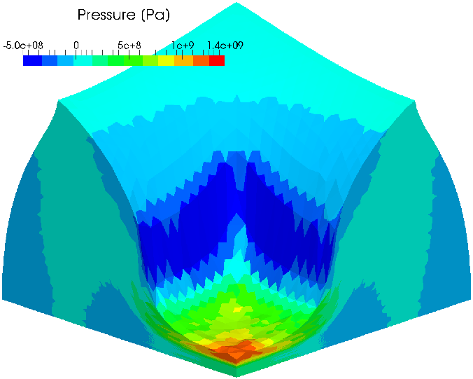
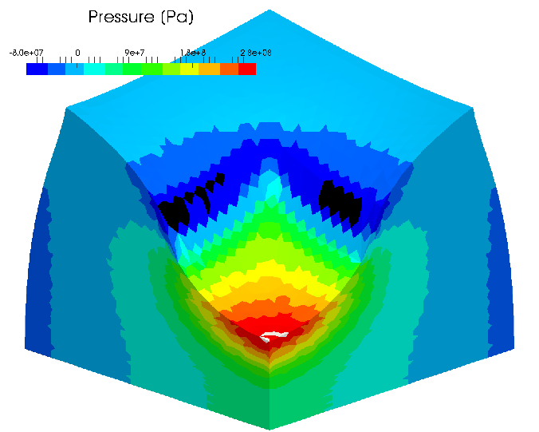
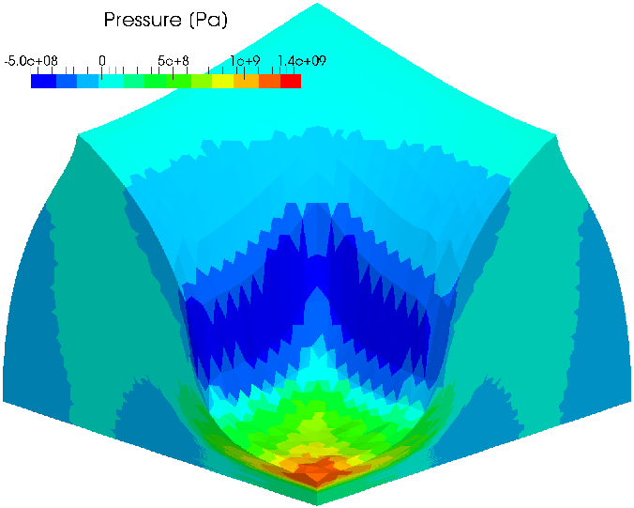
Compression of a Block
Static Implicit
Pressure Distribution
Early stage Middle stage Later stage
F-bar ES-FEM- T4(3)
In case the Poisson’s ratio is 0.499, F-barES-FEM-T4(2) or later resolves the pressure oscillation issue.
F-bar ES-FEM- T4(4)

Slide 23
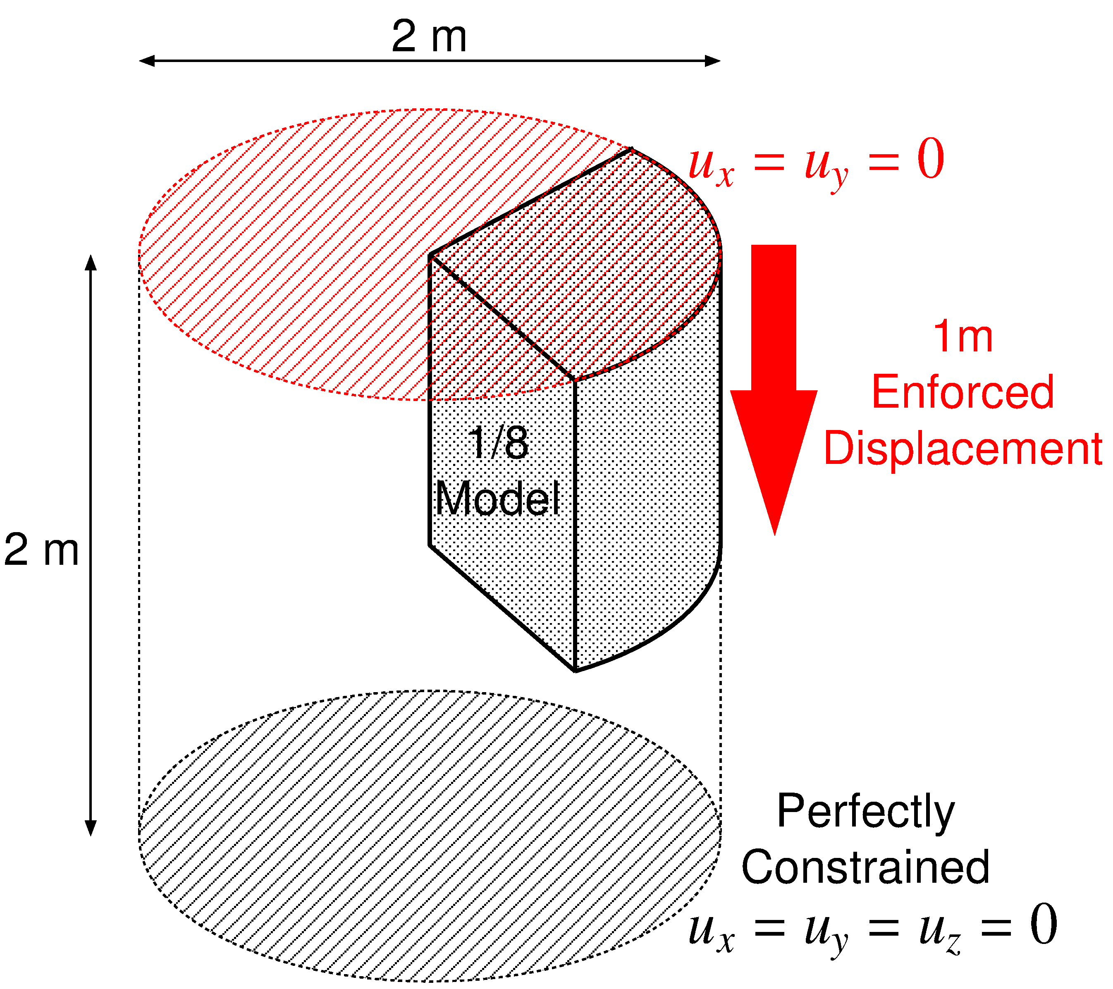
Barreling of 1/8 Cylinder
Static Implicit
Outline
Neo-Hookean hyperelastic material ($ν_{ini}=0.499$).
Enforced displacement is applied to the top surface.
Compared to ABAQUS C3D4H with the same unstructured T4 mesh.

Slide 24
Barreling of 1/8 Cylinder
Static Implicit
Result of F-bar ES-FEM(2) (Pressure)
50% nominal compression
Almost smooth
pressure
distribution is obtained
except just around the rim.

Slide 25
Barreling of 1/8 Cylinder
Static Implicit
Result of F-bar ES-FEM(2) (Mises Stress)
50% nominal compression
Smooth
Mises stress
distribution is obtained
except just around the rim.

Slide 26
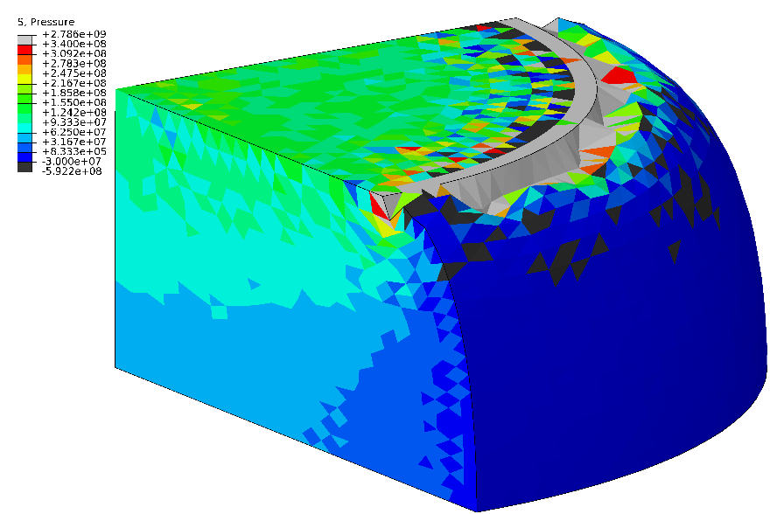
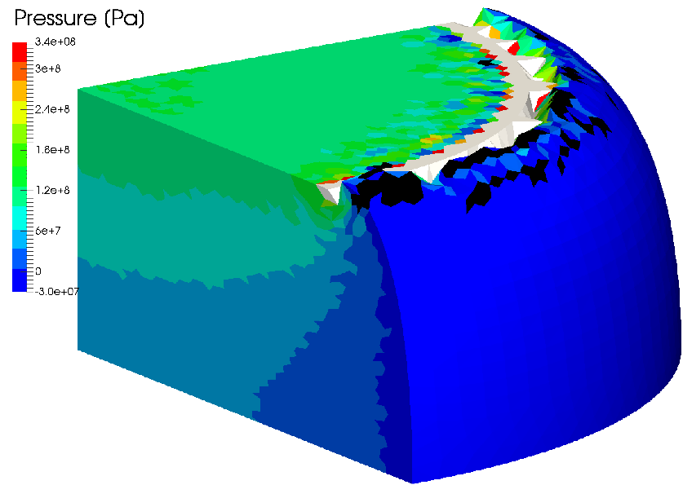
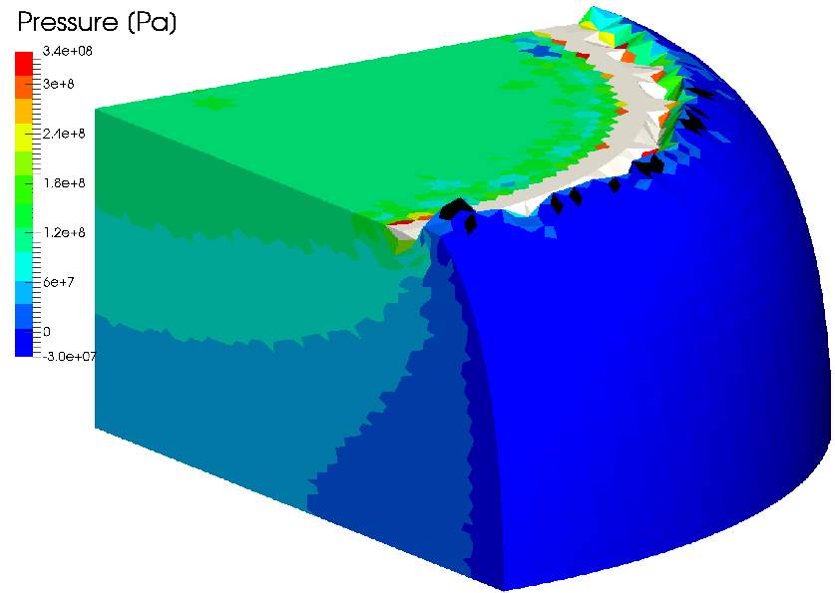
Barreling of 1/8 Cylinder
Static Implicit
Pressure Distribution
Strange deformation (corner locking) around the rim
ABAQUS C3D4H
F-bar ES-FEM- T4(2)
F-barES-FEM-T4 with a sufficient cyclic smoothing can resolve the corner locking issue.
F-bar ES-FEM-
T4(3)
F-bar ES-FEM-
T4(4)

Slide 27
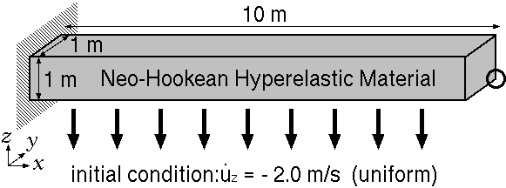
Bending of a Cantilever
Dynamic Explicit
Outline
Neo-Hookean hyperelastic material: $E_{ini}=6 MPa, ν_{ini}=0.499, ρ=1000 kg/m^{3}$.
Uniform initial velocity: ${\dot{u}}_{z}=−2 m/s$.
Compared to ABAQUS/Explicit C3D4 (NOT C3D4H) & C3D8 (hexahedral selective reduced integration).

Slide 28
Bending of a Cantilever
Dynamic Explicit
Pressure sign distributions
ABAQUS/Explicit C3D4 (✗Locking & Pressure oscillation)
ABAQUS/Explicit C3D8
F-barES-FEM-T4(2)
F-barES-FEM has no locking & less pressure oscillation in dynamic explicit analysis.

Slide 29
Bending of a Cantilever
Dynamic Explicit
Pressure at $t=1.5 s$
ABAQUS/Explicit C3D4
ABAQUS/Explicit C3D8
F-barES-FEM-T4(2)
F-barES-FEM-T4 has good accuracy in pressure.

Slide 30
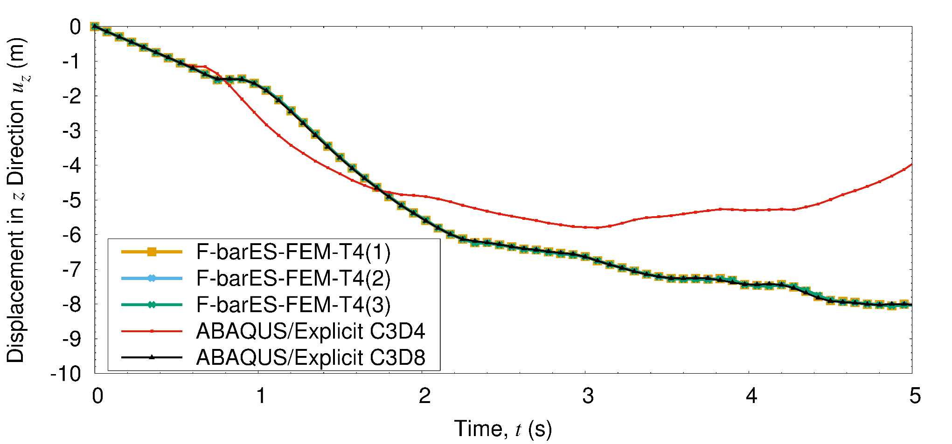
Bending of a Cantilever
Dynamic Explicit
Deflection
Displacement accuracy of F-barES-FEM is independent of the number of cyclic smoothing.

Slide 31
Swinging of Bunny Ears
Dynamic Explicit
Outline
Iron ears: $E_{ini}=200 GPa, ν_{ini}=0.3, ρ=7800 kg/m^{3}$, Neo-Hookean, No cyclic smoothing.
Rubber body: $E_{ini}=6 MPa, ν_{ini}=0.49, ρ=920 kg/m^{3}$, Neo-Hookean, 1 cycle of smoothing.
Compared to ABAQUS/Explicit C3D4.
Iron Ears
Initial Velocity of Iron Ears
Rubber Body
Fixed

Slide 32
Swinging of Bunny Ears
Dynamic Explicit
Pressure sign distributions
F-barES-FEM is apparently softer than C3D4.
F-barES-FEM shows patchy pressure patterns due to complex reflections of pressure waves.
C3D4 shows typical checkerboard patterns.
ABAQUS/
Explicit C3D4
F-barES- FEM-T4

Slide 33
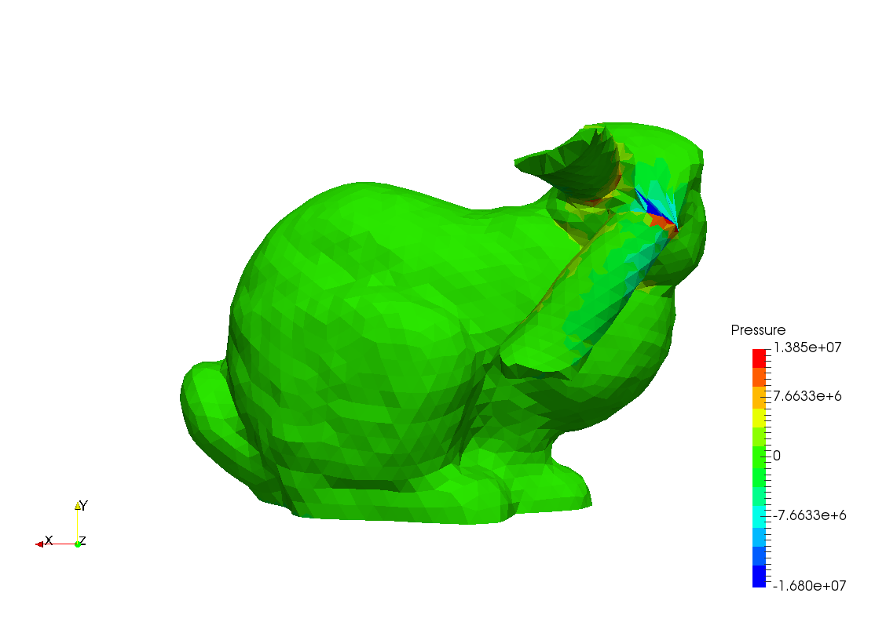
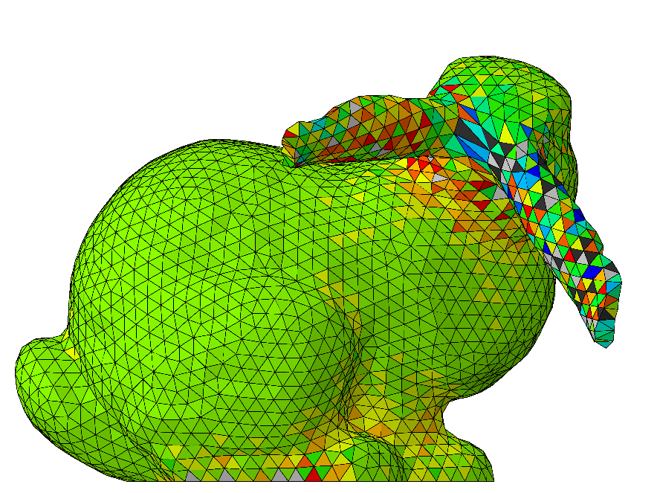
Swinging of Bunny Ears
Dynamic Explicit
Pressure distributions (back shot)
C3D4 shows checkerboard patterns even on the iron ears. (Because of the negative influence from rubber body???)
F-barES-FEM-T4 shows smooth pressure distribution except the connection interfaces (corners).
ABAQUS/Explicit C3D4
F-barES-FEM-T4

Slide 34
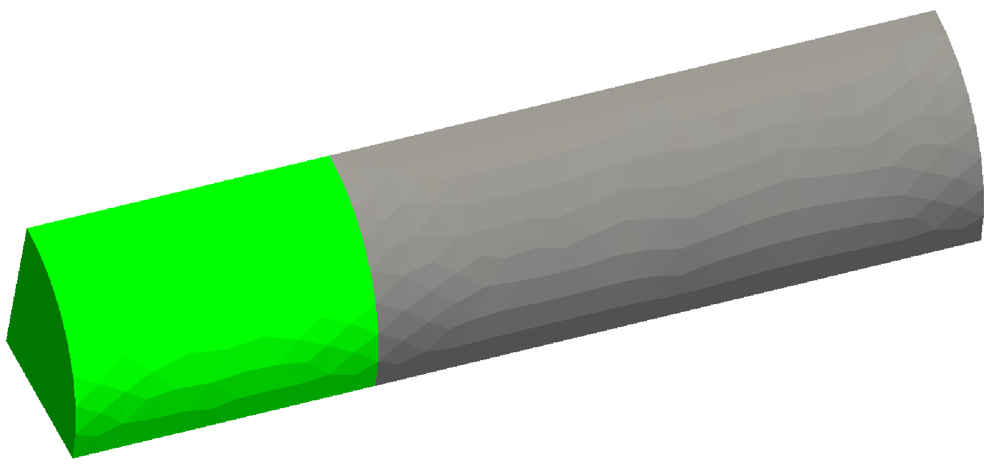
Natural Modes of ¼ Cylinder
Eigen Mode
Outline
Iron part: $E_{ini}=200 GPa, ν_{ini}=0.3, ρ=7800 kg/m^{3}$, Elastic, No cyclic smoothing.
Rubber part: $E_{ini}=6 MPa, ν_{ini}=0.499, ρ=920 kg/m^{3}$, Elastic, 2 cycles of smoothing.
Compared to ABAQUS C3D4, C3D4H, and C3D8.
In Plane Slide
Rubber Part
Fixed
In Plane Slide
Iron Part

Slide 35
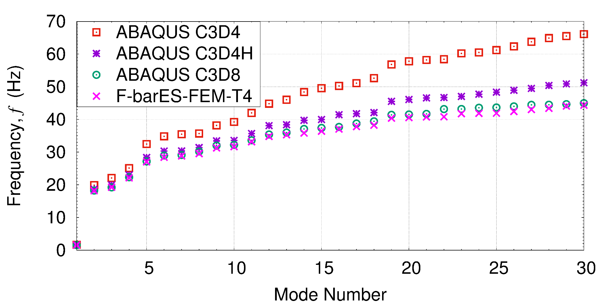
Natural Modes of ¼ Cylinder
Eigen Mode
Eigen frequencies
C3D4 and C3D4H show higher frequencies (stiffer results).
F-barES-FEM-T4 and C3D8 are in good agreement.
1

Slide 36
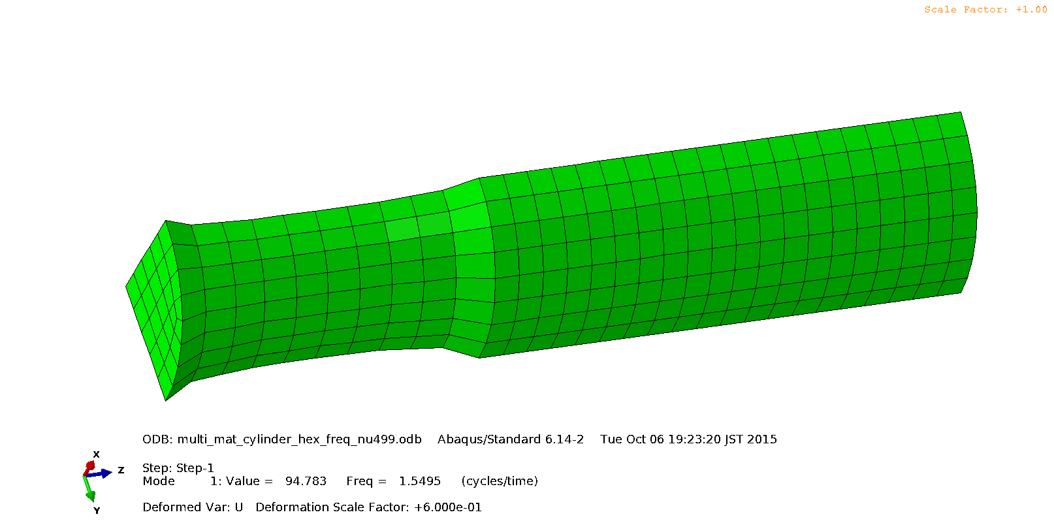
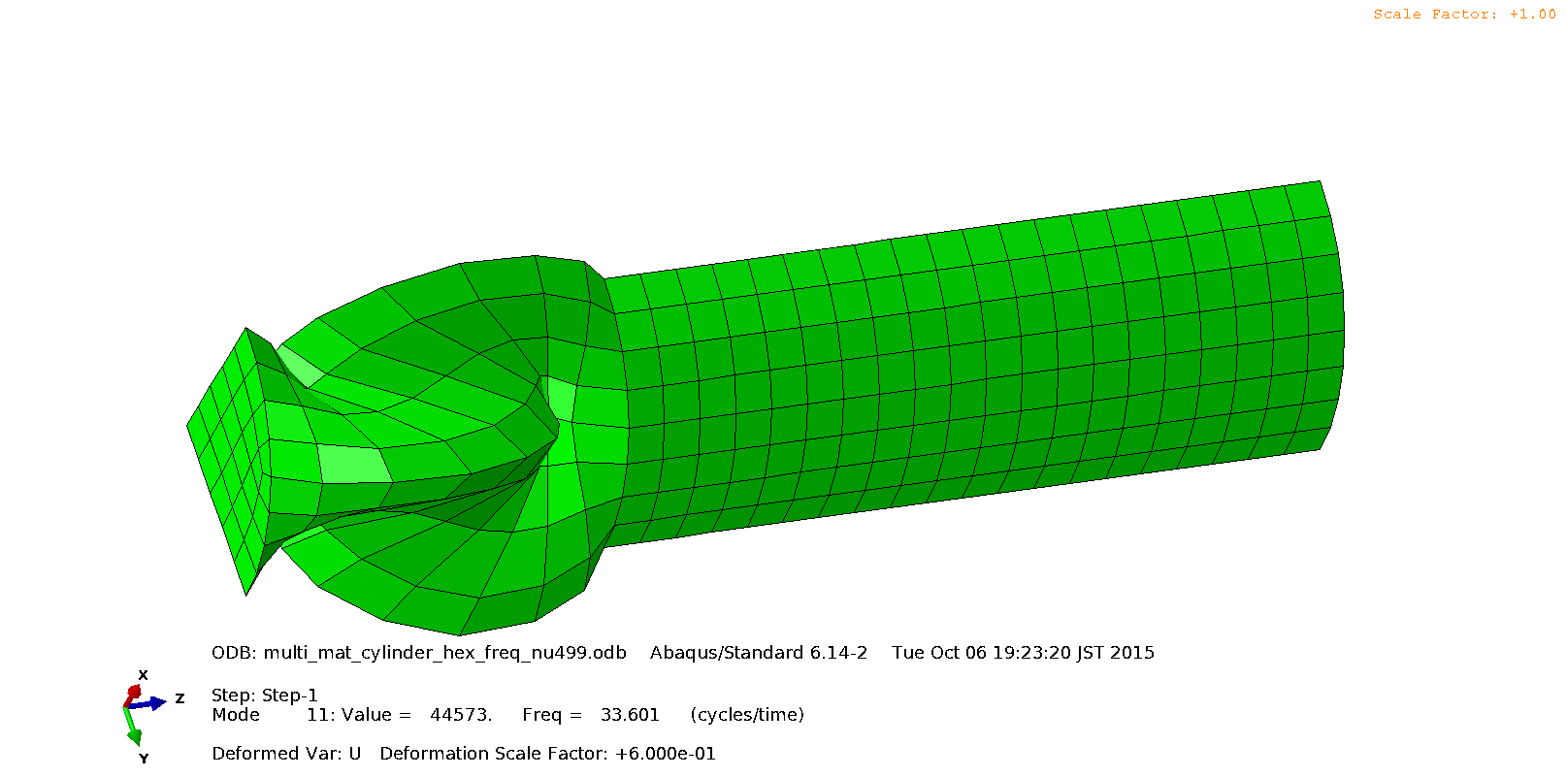
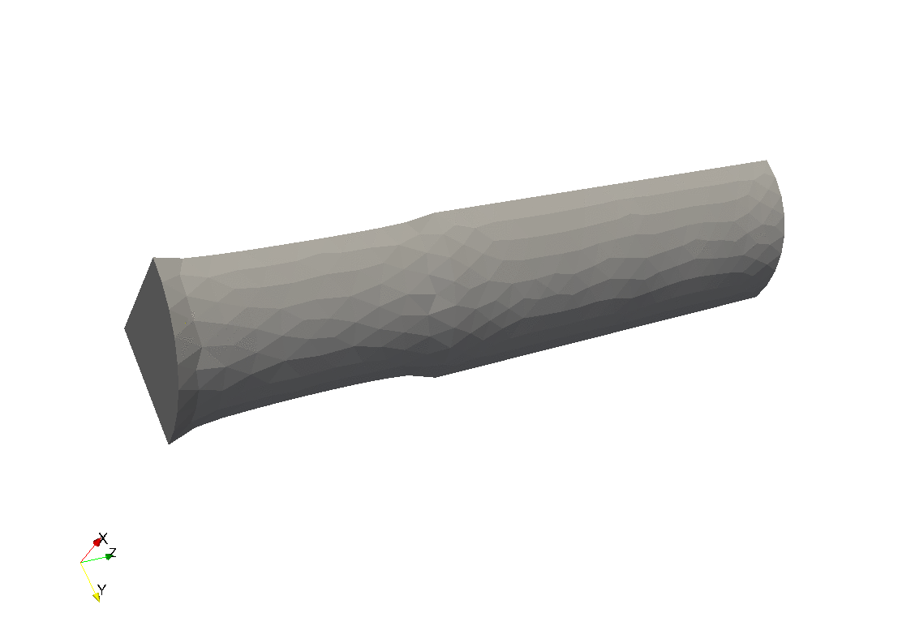
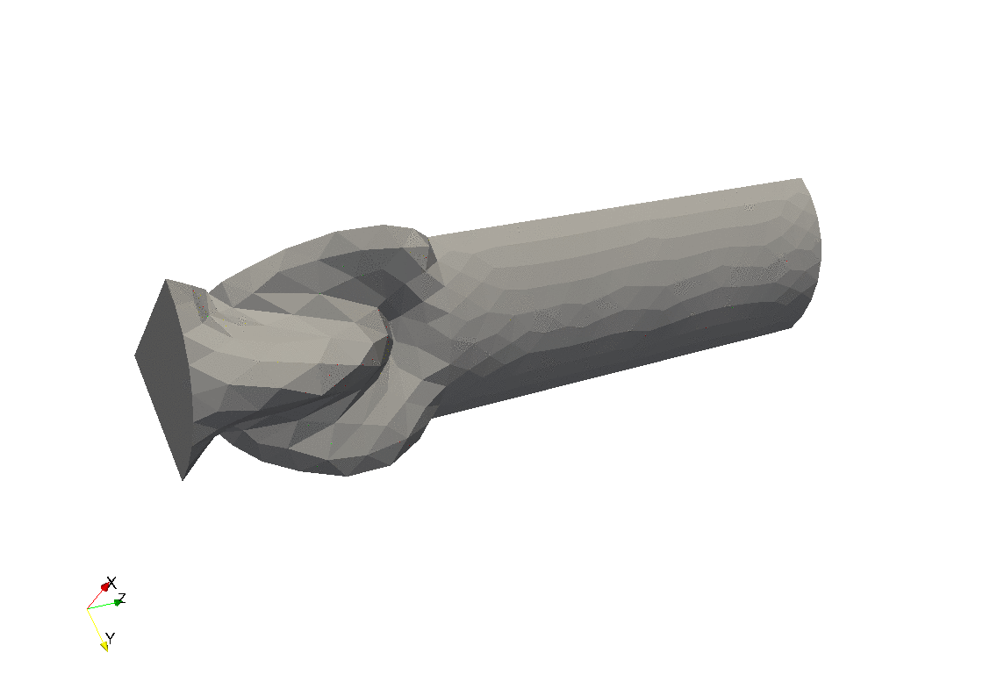
Natural Modes of ¼ Cylinder
Eigen Mode
Eigen modes
 | 1st Mode | 11th Mode
ABAQUS C3D8
F-barES-FEM-T4
F-barES-FEM-T4 has good accuracy in eigen mode analysis.

Slide 37
Summary

Slide 38
Benefits and Drawbacks of F-barES-FEM-T4
Benefits
Locking-free with 1st -order tetra meshes. No difficulty in severe strain or contact analysis.
No increase in DOF. No need of static condensation.
No restriction of material constitutive model.
Less pressure oscillation in rubber-like materials.
Less corner locking.
Applicable to static/dynamic, implicit/explicit, and modal analyses.

Slide 39
Benefits and Drawbacks of F-barES-FEM-T4
Drawbacks
✗ Slow speed of calculation.
In implicit analyses, CPU Time is roughly linear with respect to the band width of [K].
(x39.5)
(x21.5)
(x9.8)
(x1)

Slide 40
Benefits and Drawbacks of F-barES-FEM-T4
Drawbacks
✗ Slow speed of calculation.
In explicit analyses, [K] is unnecessary; yet, CPU Time increases gradually with the # of cyclic smoothings.
(x13.1)
(x6.3)
(x2.7)
(x1)

Slide 41
Conclusion
F-barES-FEM-T4 has excellent accuracy, but needs some effort for speed-up.
Thank you for your kind attention!

