Slide 1
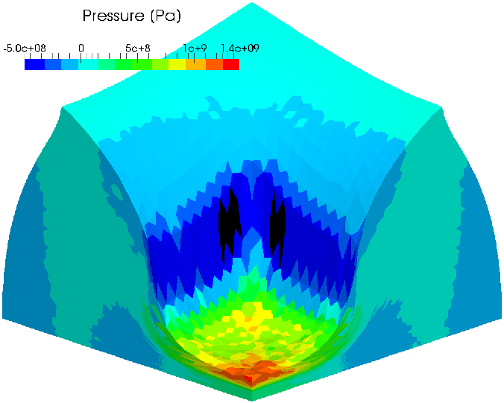
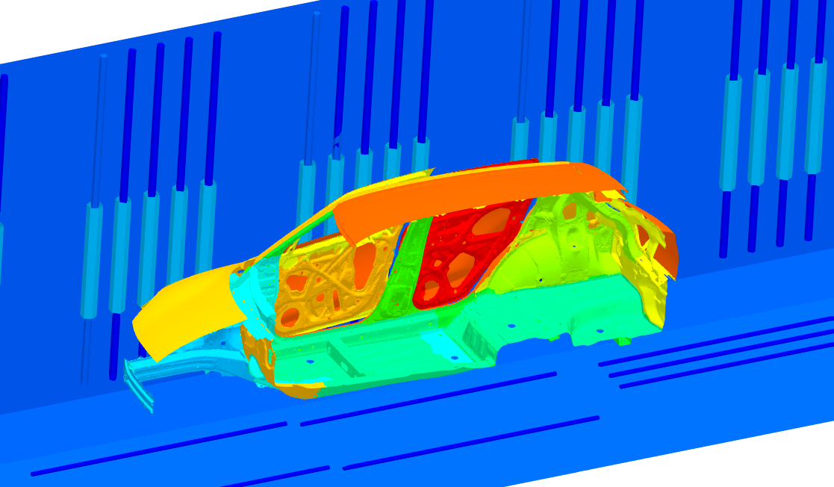
EC-SSE-SRI-T4: a next-gen smoothed finite element method for nearly incompressible large deformation analysis
Yuki ONISHI (Tokyo Institute of Technology)

Slide 2
Quick Review of
Smoothed Finite Element Method (S-FEM)

Slide 3
What is S-FEM?
Smoothed finite element method (S-FEM) is a relatively new FE formulation proposed in 2006.
S-FEM is one of the gradient (strain) smoothing techniques.
There are many kinds of S-FEMs depending on the scheme of smoothing.
There are a few classical S-FEMs depending on the smoothing domain.
For example, in a 2D triangular mesh:
Edge-based S-FEM
(ES-FEM)
Node-based S-FEM
(NS-FEM)
Standard FEM
Each colored area shows the domain for gradient smoothing.

Slide 4





e.g.) Brief of ES-FEM
Let me
explain in 2D
for simplicity
Let us consider a mesh with only two 3-node triangular cells.
Calculate $\left[B\right](=dN/dx)$ at each cell as usual.
Distribute each $[B]$ to the connecting edge with an area weight and build $[ ^{Edge}B]$ .
Calculate strain $(ε)$, Cauchy stress ($σ$) and nodal internal force $\{f^{int}\}$
in each edge smoothing domain with $[ ^{Edge}B]$.
$$[B_{1}]$$
As if putting
a Gauss point
on each edge center
$$[B_{2}]$$
$$[^{Edge}B]$$
$↳{}^{Edge}ε,{}^{Edge}σ, \{^{Edge}f^{int}\}$ etc.

Slide 5
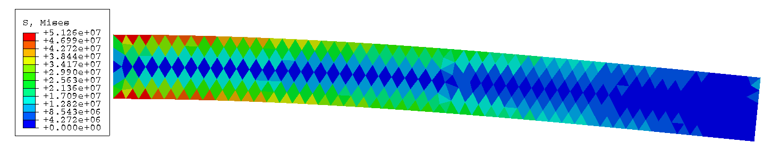
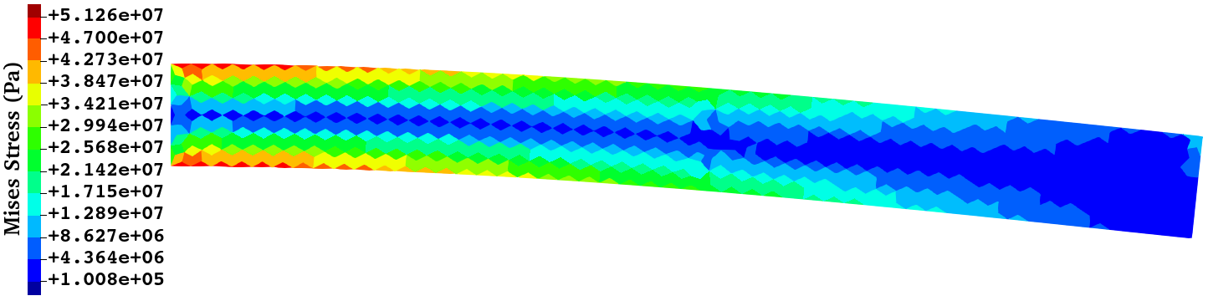
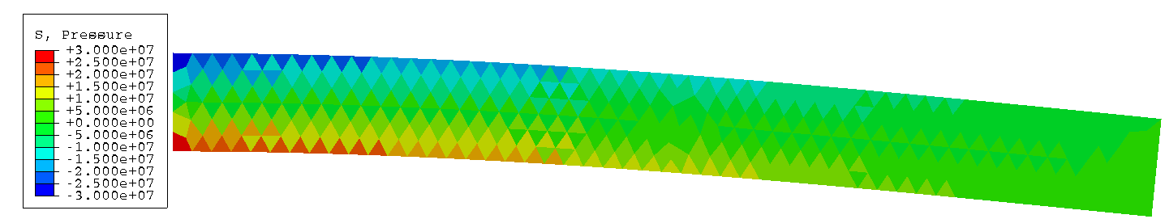
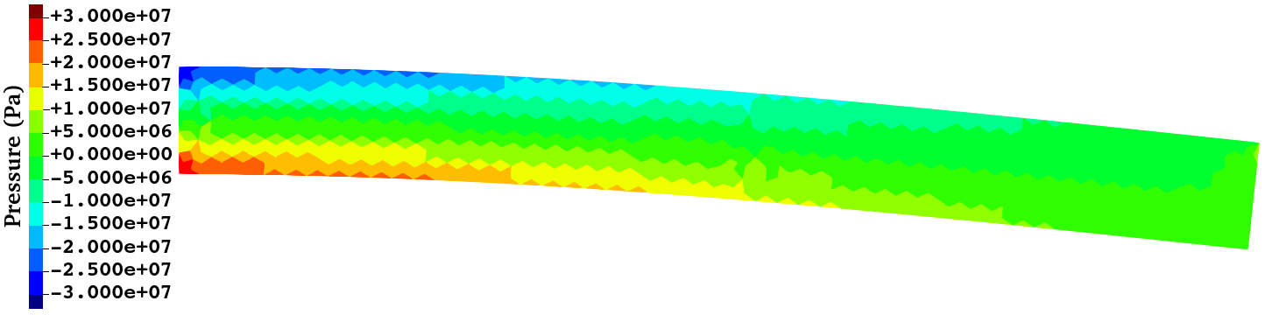

Performance of ES-FEM
Cantilever Bending Analysis with Dead Load at the Tip Size:10x1 m, $ν=0.3$
Mises stress
Pressure
ABAQUS CPE3
(Standard FEM-T3)
ES-FEM-T3
ES-FEM-T3 gives more accurate stress/strain distributions
than the standard FEM-T3 using the same mesh.

Slide 6
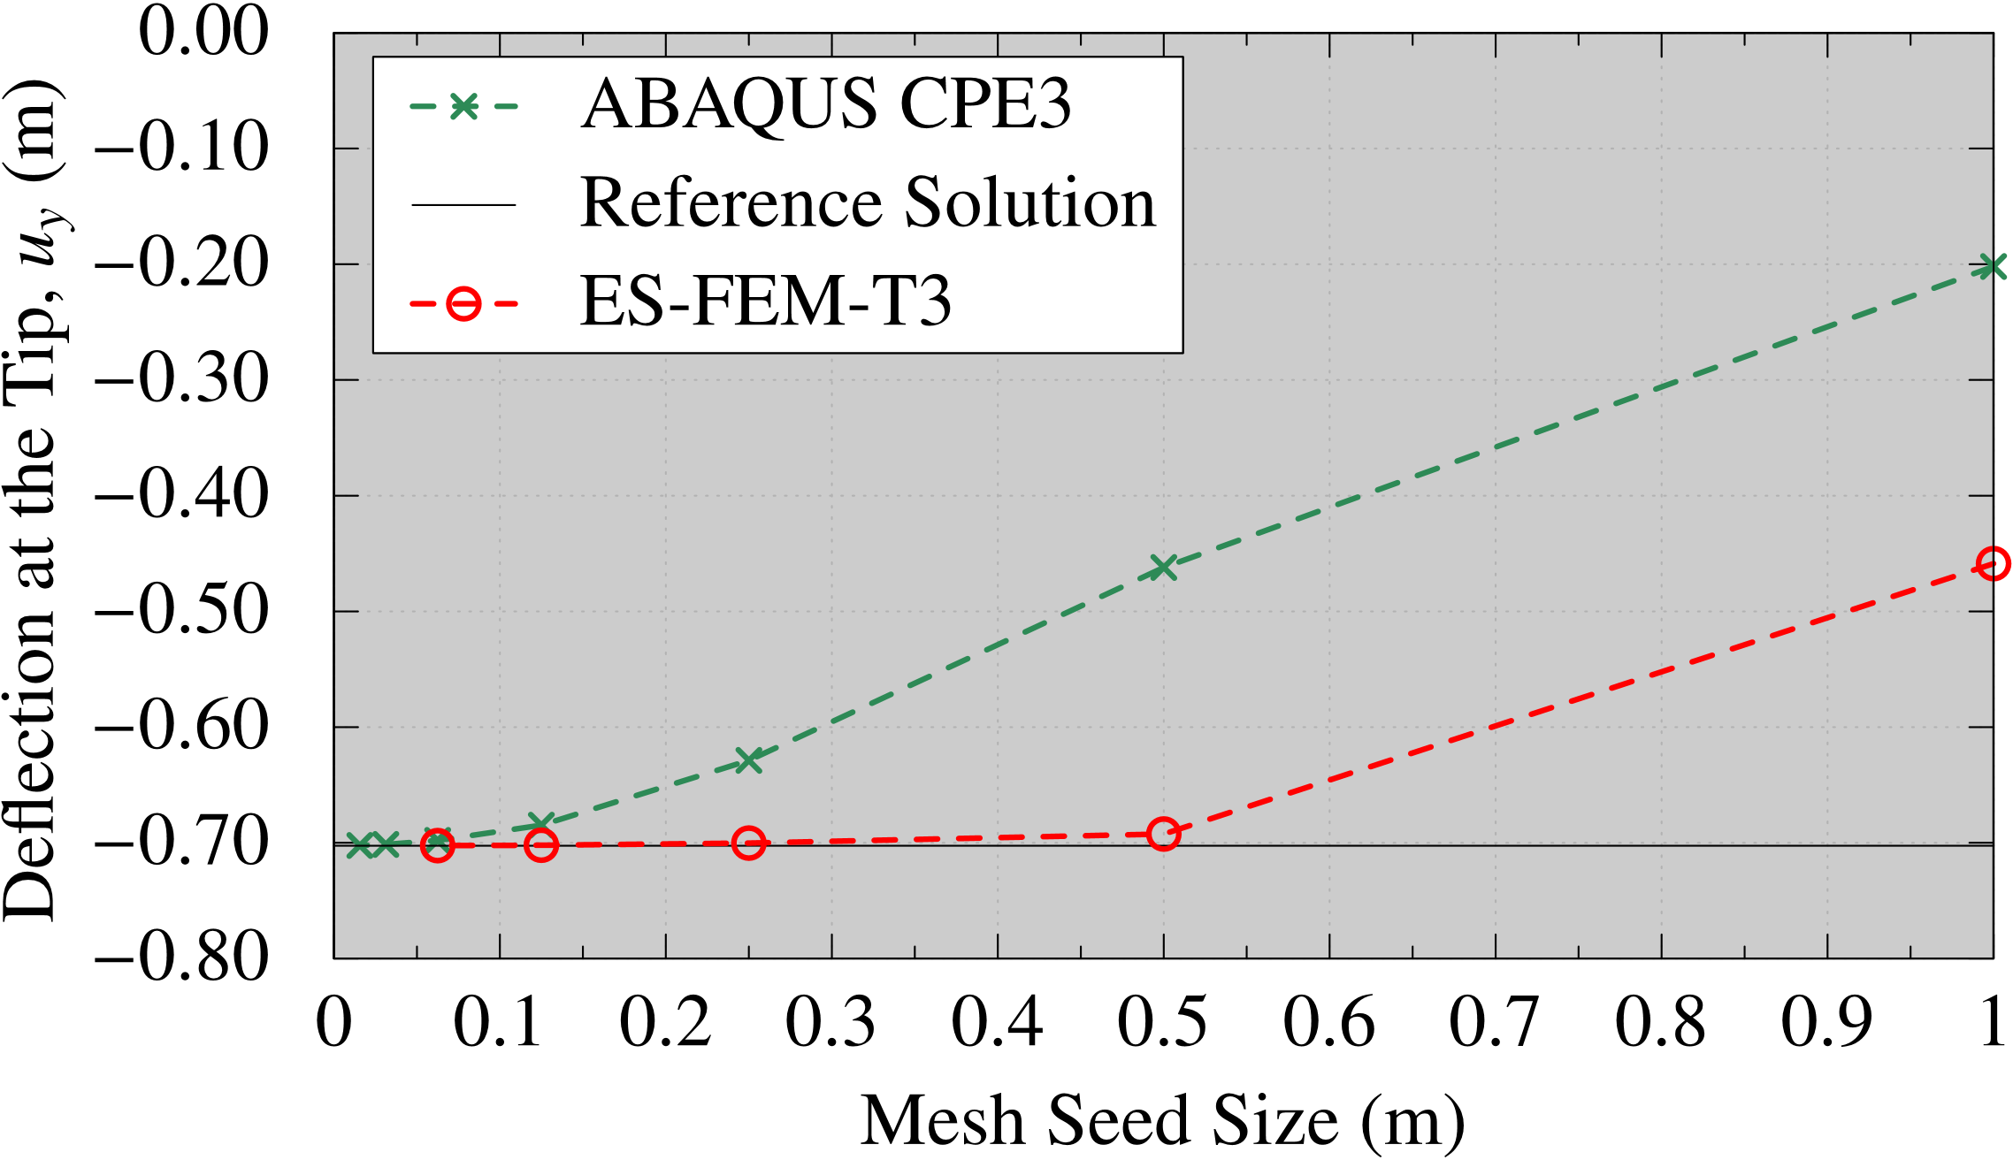

Performance of ES-FEM
Cantilever Bending Analysis with Dead Load at the Tip Size:10x1 m, $ν=0.3$
Mesh Seed Size (m) | The Number of Cells
1 | 22
1/2 | 84
1/4 | 342
1/8 | 1,442
1/16 | 5,766
1/32 | 23,034
1/64 | 92,146
Converged
Converged
ES-FEM-T3 is shear locking free and thus the mesh convergence rate of displacement/force is much faster than the Standard FEM-T3.

Slide 7
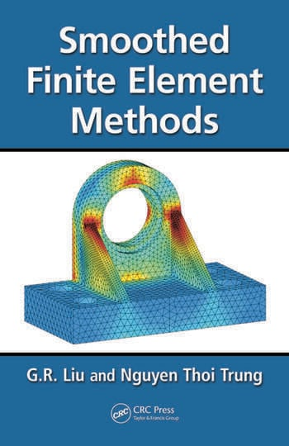
What are the benefits of S-FEM?
T4: 4-node Tetrahedra
Super-linear mesh convergence rate with T4 mesh.
(Almost same rate as 2nd-order elements with T4 mesh.)
Shear locking free with ES-FEM-T4.
(Good accuracy with T4 mesh in solid mechanics.)
Volumetric locking free with NS-FEM-T4.
(Key technique for rubber-like nearly incompressible solid.)
Little accuracy loss with skewed meshes.
(No problem with complex geometry or severe deformation.)
No increase in DOF.
(Purely displacement-based formulation. )
Easy to code.
(keeping away from mixed variational formulations.)
T4
G.R. Liu
et al.,
CRC Press
Search
S-FEM wiki
S-FEM is a powerful method suitable for practical industrial applications.

Slide 8


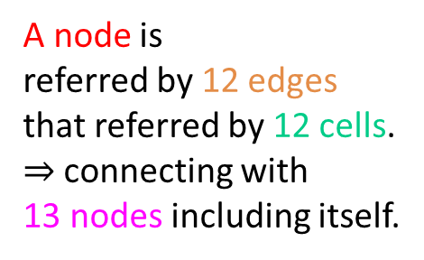

What are the drawbacks of S-FEM?
Wider bandwidth of stiffness matrix $[K]$.
e.g., in case of T3 mesh in 2D,
(In case of T4 mesh in 3D, the bandwidth of $[K]$ is about x3 wider.)
However, this drawback is NOT a major issue
because ES-FEM has much faster mesh convergence rate than FEM-T4.
A node is
referred by 12 edges
that referred by 12 cells.
$⇒$ connecting with
13 nodes including itself.
A node is
referred by 6 calls.
$⇒$ connecting with
7 nodes including itself.
FEM-T3 (Bandwidth: 7)
ES-FEM-T3 (Bandwidth: 13)
$∴$ about x2 bandwidth.

Slide 9
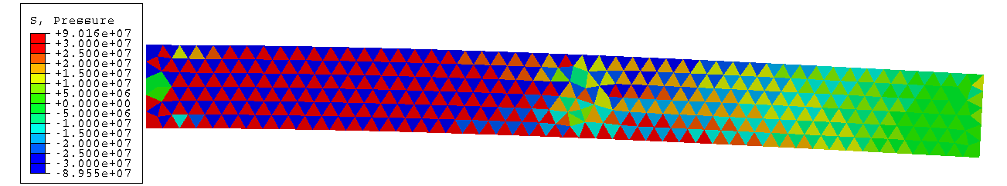
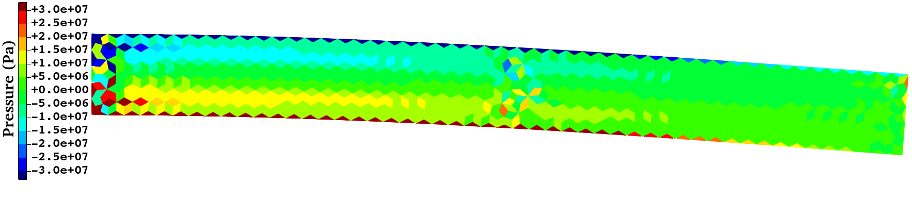
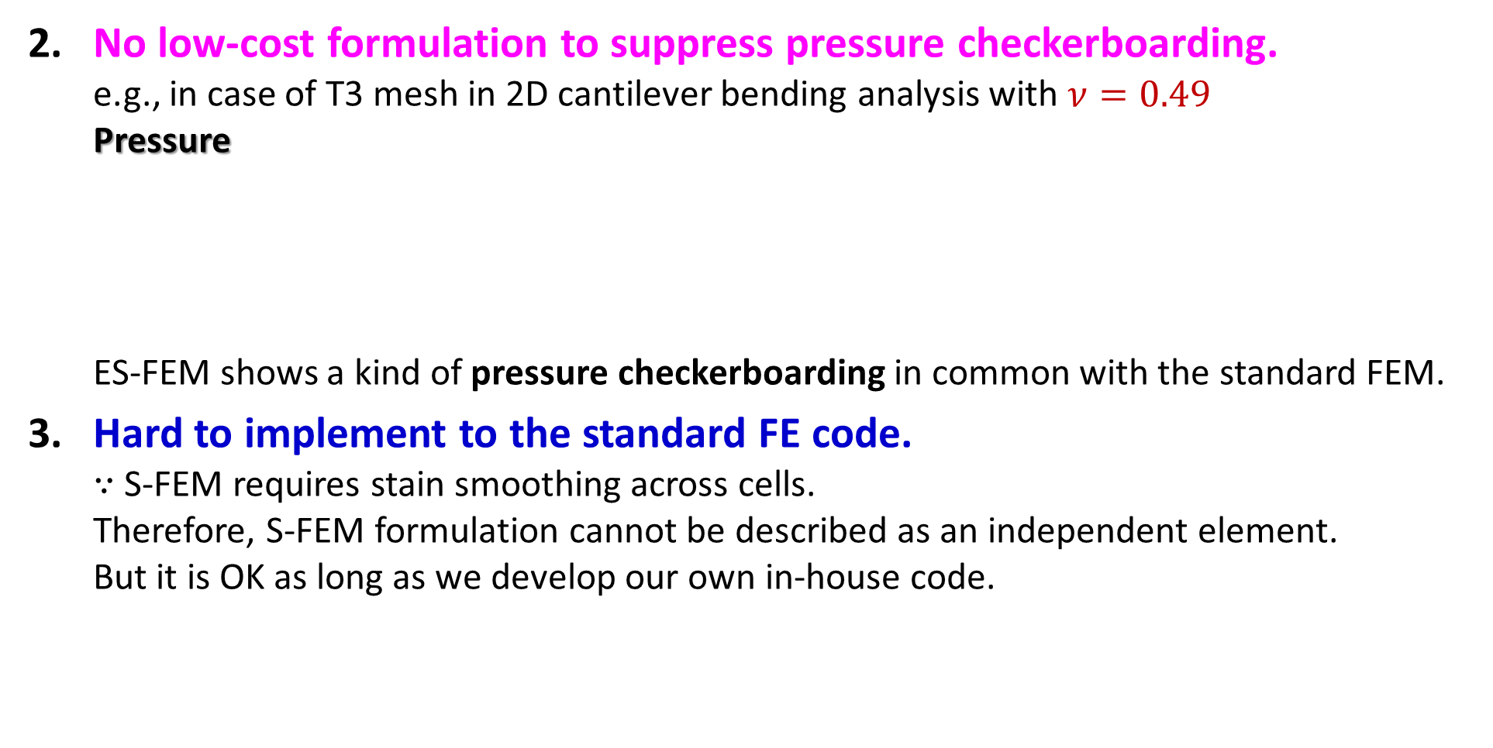
What are the drawbacks of S-FEM?
No low-cost formulation to suppress pressure checkerboarding.
e.g., in case of T3 mesh in 2D cantilever bending analysis with $ν=0.49$
Pressure
ES-FEM shows a kind of pressure checkerboarding in common with the standard FEM.
Hard to implement to the standard FE code.
$∵$ S-FEM requires stain smoothing across cells.
Therefore, S-FEM formulation cannot be described as an independent element.
But it is OK as long as we develop our own in-house code.
ABAQUS CPE3
(Standard FEM-T3)
ES-FEM-T3
A brand-new code with a novel S-FEM formulation
for nearly incompressible solids is still awaited.

Slide 10
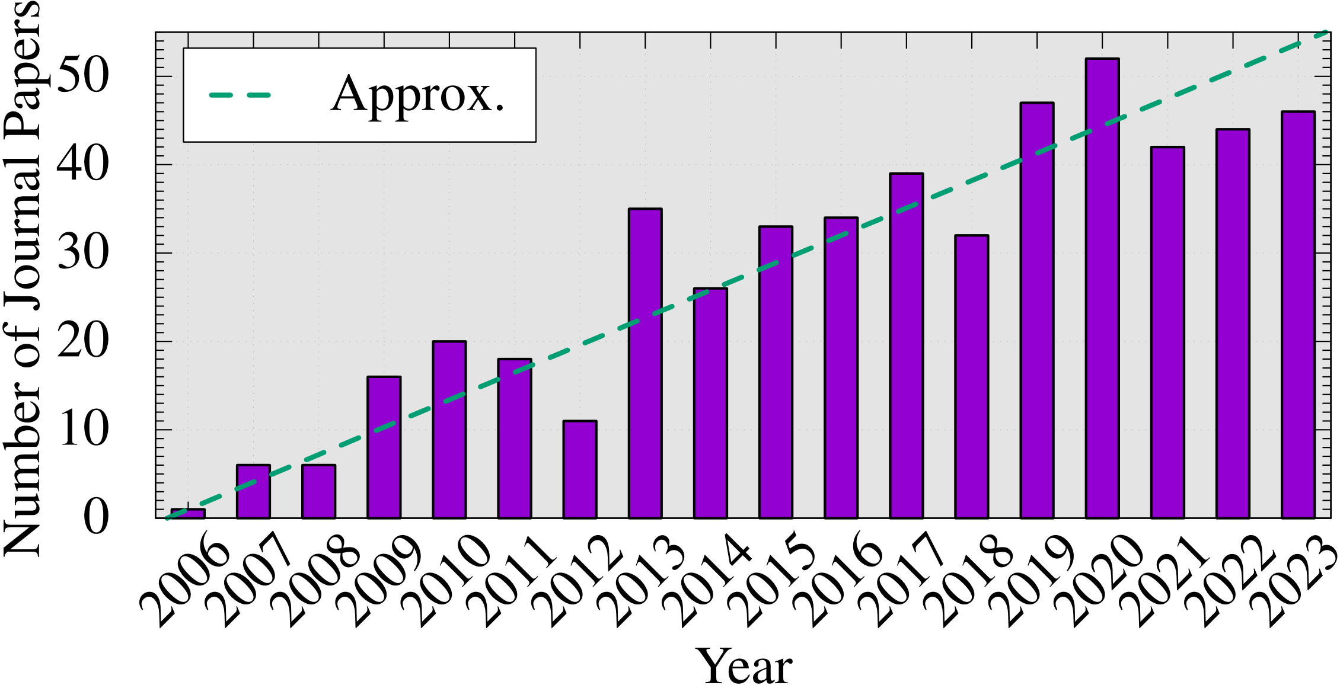
How popular is S-FEM?
Number of journal papers whose title contains
“smoothed finite element”:
inquired at
Google Scholar
The attraction to S-FEM is expanding continuously.

Slide 11
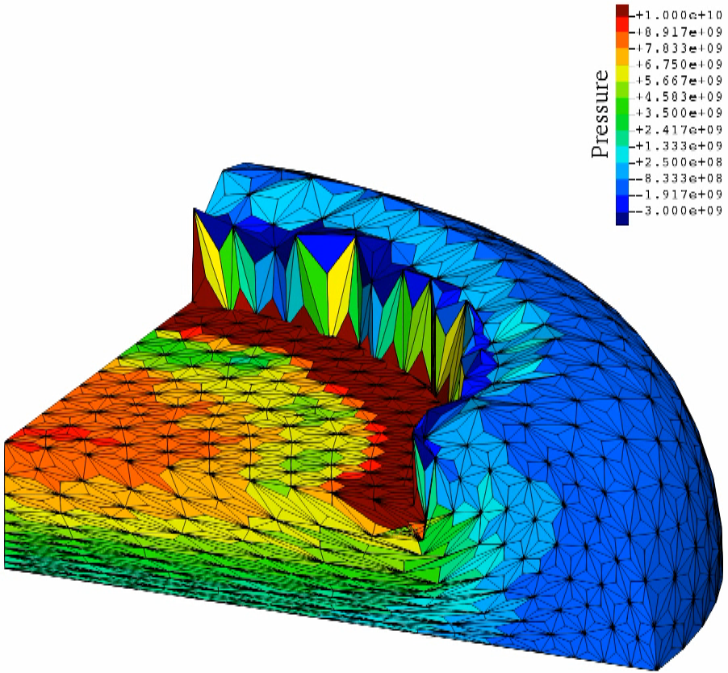
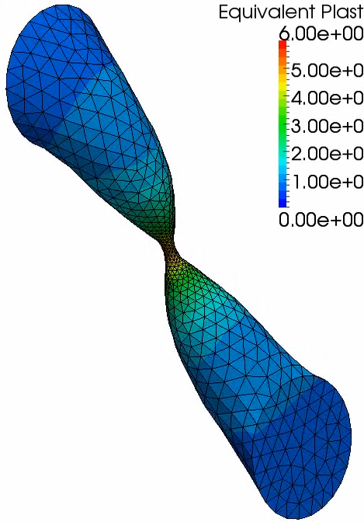
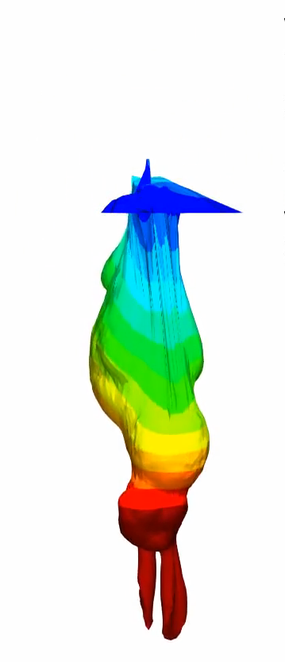
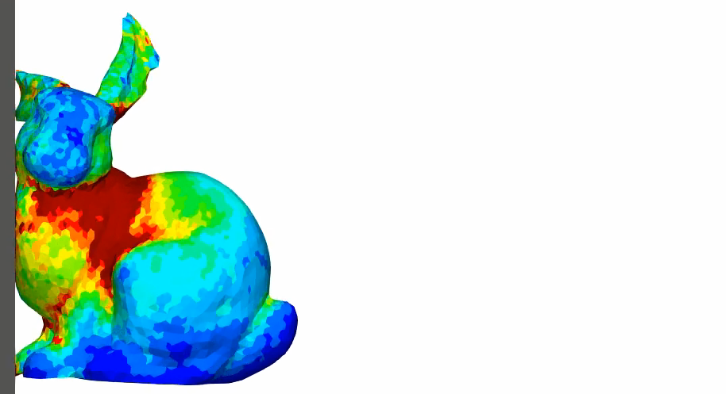
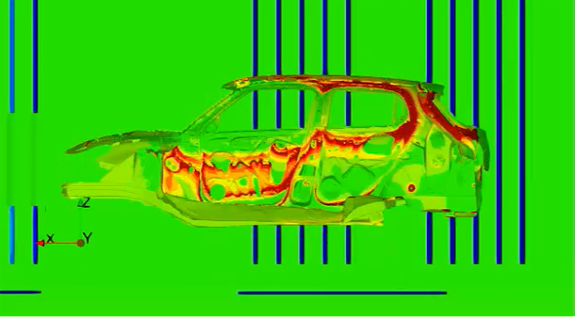

Applications of S-FEM-T4 in Our Lab
Large deformation solid mechanics (still in academic research)
Dynamic Explicit Static Implicit Viscous Implicit
Electrostatic
(already in
commercial use)
$$\overline{ε^{pl}}$$
Carbody
Electro
Deposition
Today, I’ll focus on static implicit
analyses and introduce the latest
studies on S-FEM-T4 briefly.

Slide 12
Motivation & Objective of Our Latest Study

Slide 13
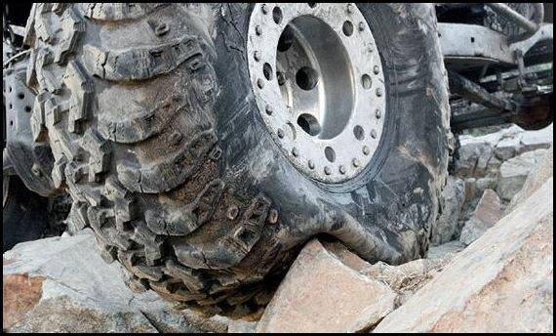

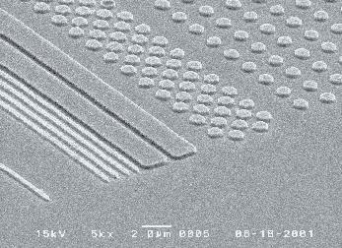

Motivation
What we want to do:
Solve severe large deformation analyses
accurately and robustly.
Treat complex geometries
with tetrahedral meshes.
Consider nearly incompressible materials $(ν≃0.5)$.
Support contact problems.
Handle auto re-meshing.
Rubber
Metal
Plastic/Glass

Slide 14
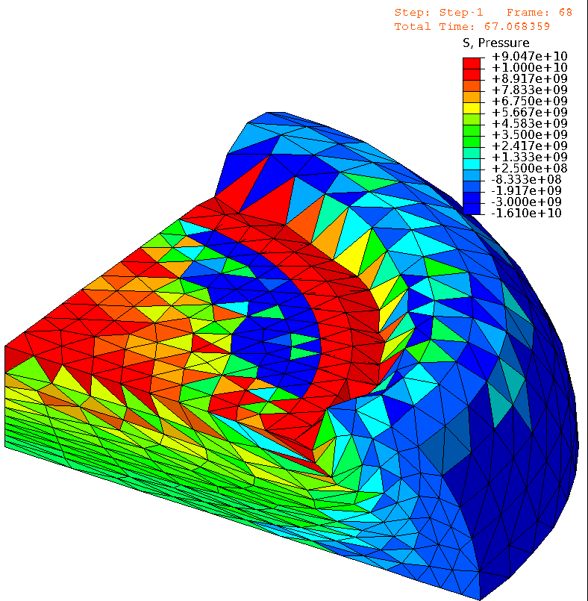
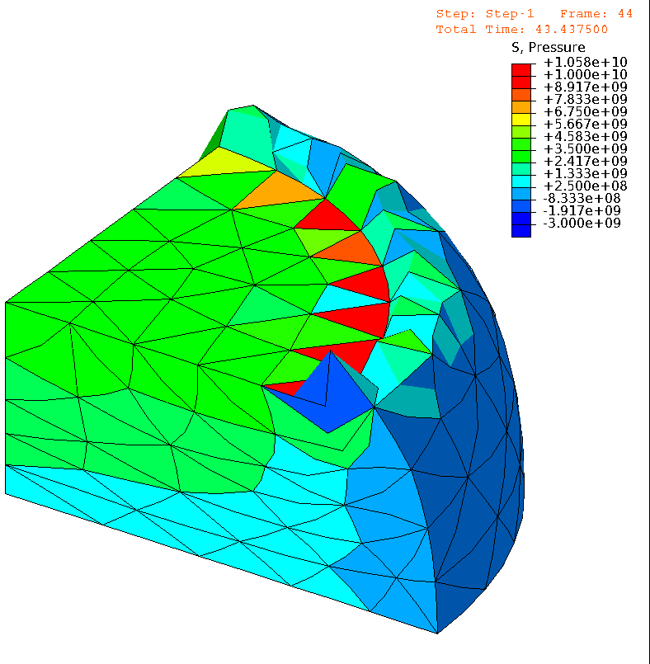

Issues in Conventional FE (ABAQUS）
e.g.) Barreling of Rubber Cylinder Neo-Hookean hyperelastic body with $ν_{ini}=0.49$
4 node tet
(T4)
Pressure
10 node tet
(T10)
Pressure
T4
T10
Almost
the same
# of nodes.
ABQUS C3D4H
✓ No volumetric locking.
✗ Pressure checkerboarding.
✗ Shear locking & Corner locking.
ABAQUS C3D10MH
✓ No shear/volumetric locking.
✗ Short lasting (weak to severe deformation).
✗ Low interpolation accuracy.

Slide 15
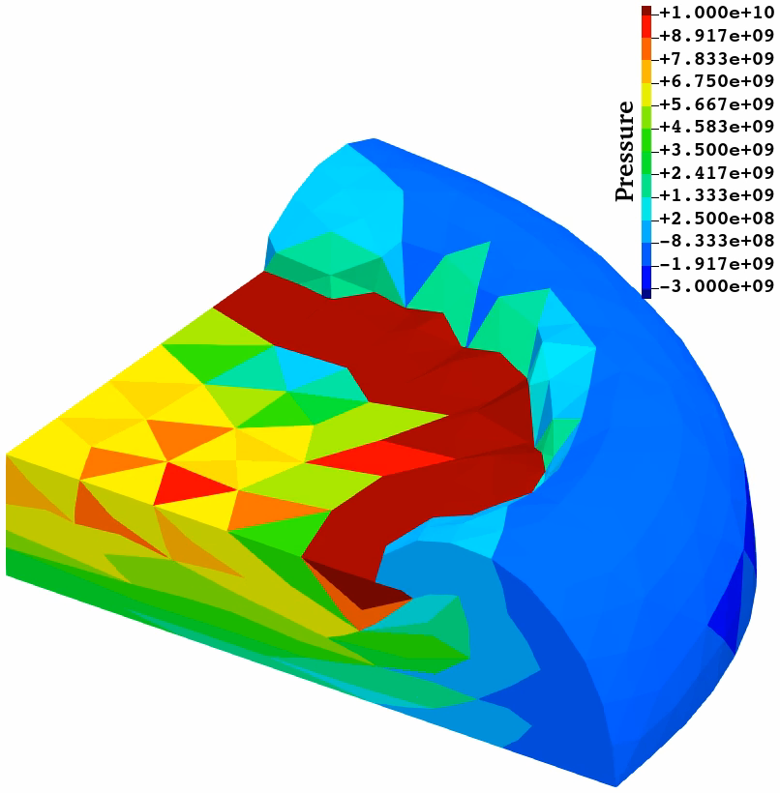
Our Approach using S-FEM
e.g.) Barreling of Rubber Cylinder Neo-Hookean hyperelastic body with $ν_{ini}=0.49$
4 node tet
(T4)
10 node tet
(T10)
Pressure
Pressure
T4
T10
F-barES-FEM-T4 (2017)
✓ No shear/volumetric locking.
✓ Less pressure checkerboarding.
✓ Less corner locking. Long lasting.
✓ No oscillation in deviatoric stress.
✗ Long CPU time. Incompatible w/ FE.
SelectiveCS-FEM-T10 (2021)
✓ No shear/volumetric locking.
✓ Less pressure checkerboarding.
✓ Less corner locking. Long lasting.
✗ Major oscillation in deviatoric stress.
✓ Same CPU time. Compatible w/ FE.
Cannot suppress
stress oscillation,
but no good idea
for accuracy improvement…
More than 10 times slower than FEM-T4, but no good idea for speed-up…

Slide 16
Why not T10 but T4?
It is because T10 mesh is NOT good for the representation of complex geometries.
For example, surface mesh around a small hole looks like…
Also, the presence of mid-nodes leads to early convergence failure in large deformation.
solid
solid
solid
Hole
Hole
Hole
T4
T10
T4 mesh
T10 mesh w/o kink
T10 mesh w/ kink
is excellent with ES-FEM
using minimal # of meshes.
✗ leads to a massive
increase in DOF.
✗ leads to severe
accuracy loss.
Then, T4 is preferable for practical analyses with complex geometry.

Slide 17
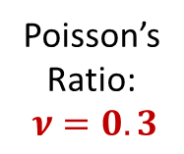
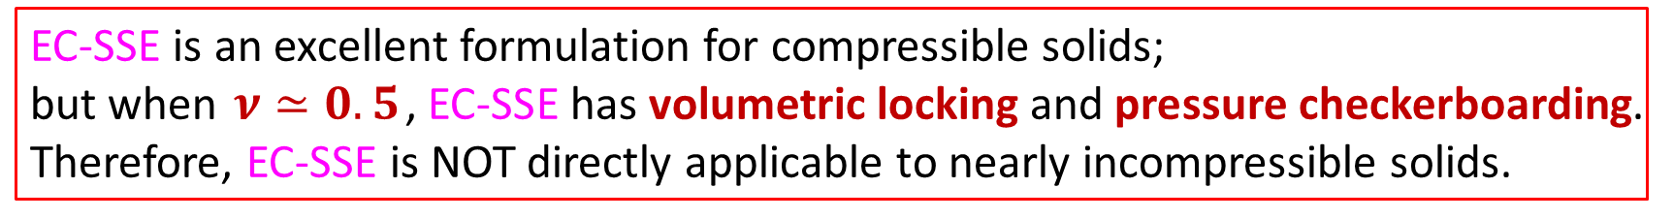
Birth of a Next-gen S-FEM, EC-SSE, in 2022
Comparison of Mises stress dist. in cantilever bending analyses in 2D
T. Jinsong et al., Euro. J. Mech. /A, v95, 2022.
Step-like stress dist. (poor).
Shear locking.
T3
Poisson’s
Ratio:
$ν=0.3$
Edge
Center-based
Strain
Smoothing
Element
Linear stress dist. (very good)
using the same T3 mesh.
Very close to analytical solution.
No shear locking.
Detailed Later
This breakthrough
should be called
“S-FEM 2.0”.
EC-SSE is an excellent formulation for compressible solids;
but when $ν≃0.5$, EC-SSE has volumetric locking and pressure checkerboarding.
Therefore, EC-SSE is NOT directly applicable to nearly incompressible solids.

Slide 18
Objective
Objective
Strategy
Use the selective reduced integration (SRI)
Use EC-SSE for the deviatoric part,
Use NS-FEM for the volumetric part, and
Combine them with SRI.
Develop a new S-FEM formulation to extend EC-SSE
to nearly incompressible large deformation analysis
EC-SSE-SRI

Slide 19
Method
Introduction to ES-FEM, NS-FEM，EC-SSE，and EC-SSE-SRI

Slide 20

Brief of ES-FEM
Let me
explain in 2D
for simplicity
Let us consider a mesh with only two 3-node triangular cells.
Make $\left[B\right](=dN/dx)$ at each cell as usual.
At each edge, gather $[B]$s of the connecting cells and average them with area weights
to build $[ ^{Edge}B]$ .
Calculate strain $(ε)$, stress ($σ$) and nodal internal force $\{f^{int}\}$ in each edge smoothing domain with $[ ^{Edge}B]$.
$$[B_{1}]$$
As if putting
a Gauss point
on each edge center
No shear locking.
Cannot avoid
volumetric locking &
pressure checkerboarding.
Strain distribution is
piecewise constant
in each smoothing domain.
$$[B_{2}]$$
$$[^{Edge}B]$$
$↳{}^{Edge}ε,{}^{Edge}σ, \{^{Edge}f^{int}\}$ etc.

Slide 21







Brief of NS-FEM
Let me
explain in 2D
for simplicity
Let us consider a mesh with only four 3-node triangular cells.
Make $\left[B\right](=dN/dx)$ at each cell as usual.
At each node, gather $[B]$s of the connecting cells and average them with area weights
to build $[ ^{Node}B]$ .
Calculate strain $(ε)$, stress ($σ$) and nodal internal force $\{f^{int}\}$ in each nodal smoothing domain with $[ ^{Node}B]$.
$$[B_{4}]$$
$$[B_{1}]$$
As if putting
a Gauss point
on each node center
No shar/volumetric locking.
Less pressure checkerboarding
$$[B_{3}]$$
$$[B_{2}]$$
Cannot avoid
spurious low-energy modes.
Strain distribution is
piecewise constant
in each smoothing domain.
$$[^{Node}B]$$
$↳{}^{Node}ε,{}^{Node}σ, \{^{Node}f^{int}\}$ etc.

Slide 22
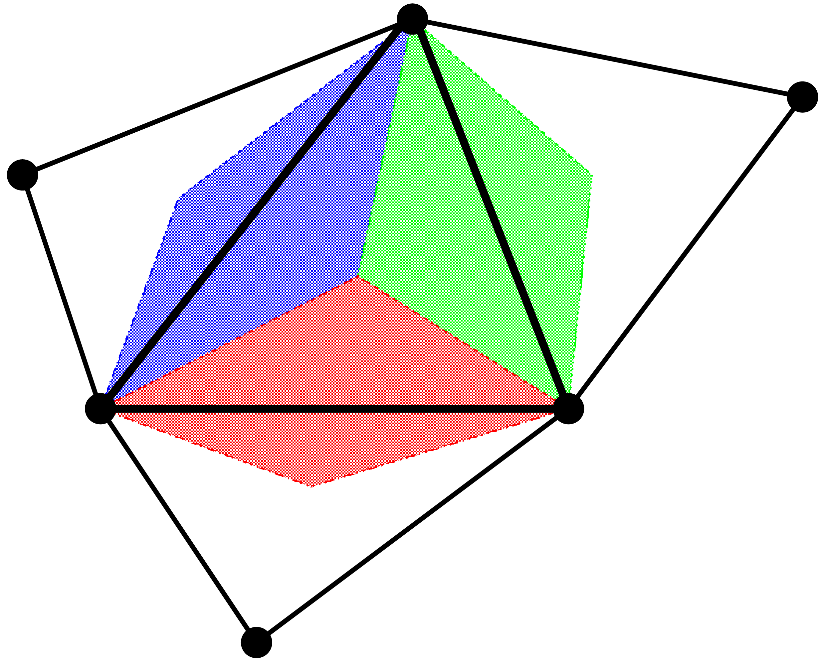
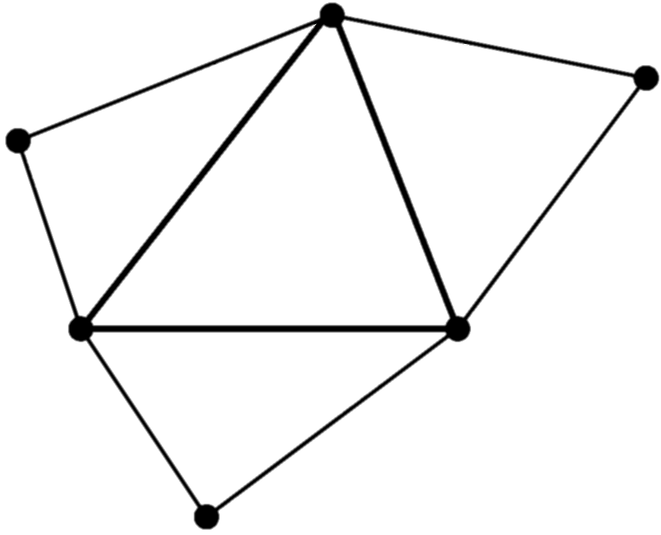
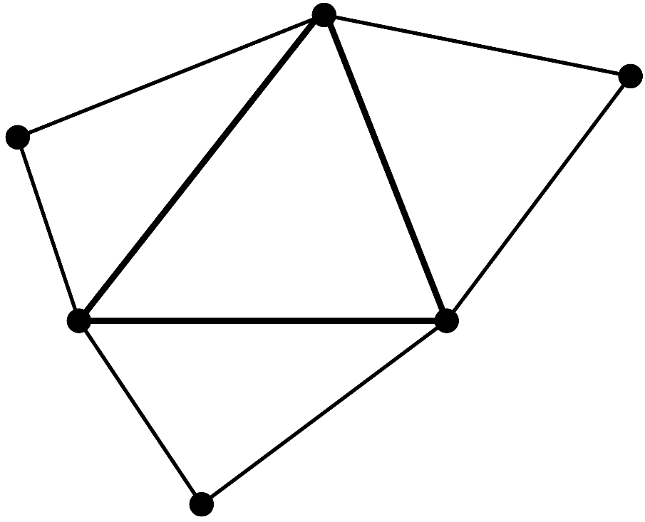








Brief of EC-SSE
Let me
explain in 2D
for simplicity
Make $\left[ ^{Edge}B\right]$s in the same procedure as ES-FEM.
Consider each $[ ^{Edge}B]$ is the value at the center of each edge,
and assume $[B]$ is linearly distributed in each cell.
Make three $[ ^{Gaus}B]$s in each cell as the extrapolation of the three $[ ^{Edge}B]$s.
Calculate $^{Gaus}ε$, $^{Gaus}σ$and $\{f^{int}\}$ using each $\left[ ^{Gaus}B\right]$ in the same manner
as the 2nd -order element.
Conducting strain smoothing twice,
the strain/stress are evaluated
at each Gauss point.
No shear locking
with T3/T4 mesh.
Fast mesh convergence rate
in strain/stress
as an 2nd –order element.
$[ ^{Edge}B_{3}]$
$[ ^{Edge}B_{2}]$
$[ ^{Gaus}B_{3}]$
$[ ^{Gaus}B_{1}]$
$[ ^{Gaus}B_{2}]$
Strain distribution is
piecewise-linear in each cell
and is
continuing at every edge center.
$[ ^{Edge}B_{1}]$
Cannot avoid
volumetric locking and
pressure checkerboarding

Slide 23

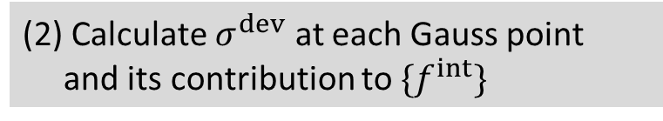

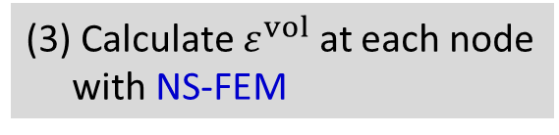
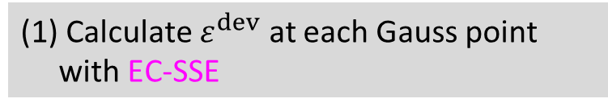
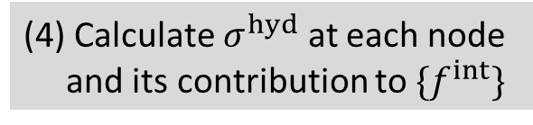
Brief of EC-SSE-SRI (Our Latest Method)
Let me
explain in 2D
for simplicity
Apply the selective reduced integration (SRI) to EC-SSE to handle rubber-like solids
(1) Calculate $ε^{dev}$ at each Gauss point
with EC-SSE
(3) Calculate $ε^{vol}$ at each node
with NS-FEM
Deviatoric
Part
Volumetric
Part
(2) Calculate $σ^{dev}$ at each Gauss point
and its contribution to $\{f^{int}\}$
(4) Calculate $σ^{hyd}$ at each node
and its contribution to $\{f^{int}\}$
Selective Reduced
Integration (SRI)
Deviatoric strain distribution is
piecewise-linear in each cell
and is
continuing at each edge center.
No shear/volumetric locking.
Less pressure checkerboarding.
(5) Assemble $\{f^{int}\}$

Slide 24
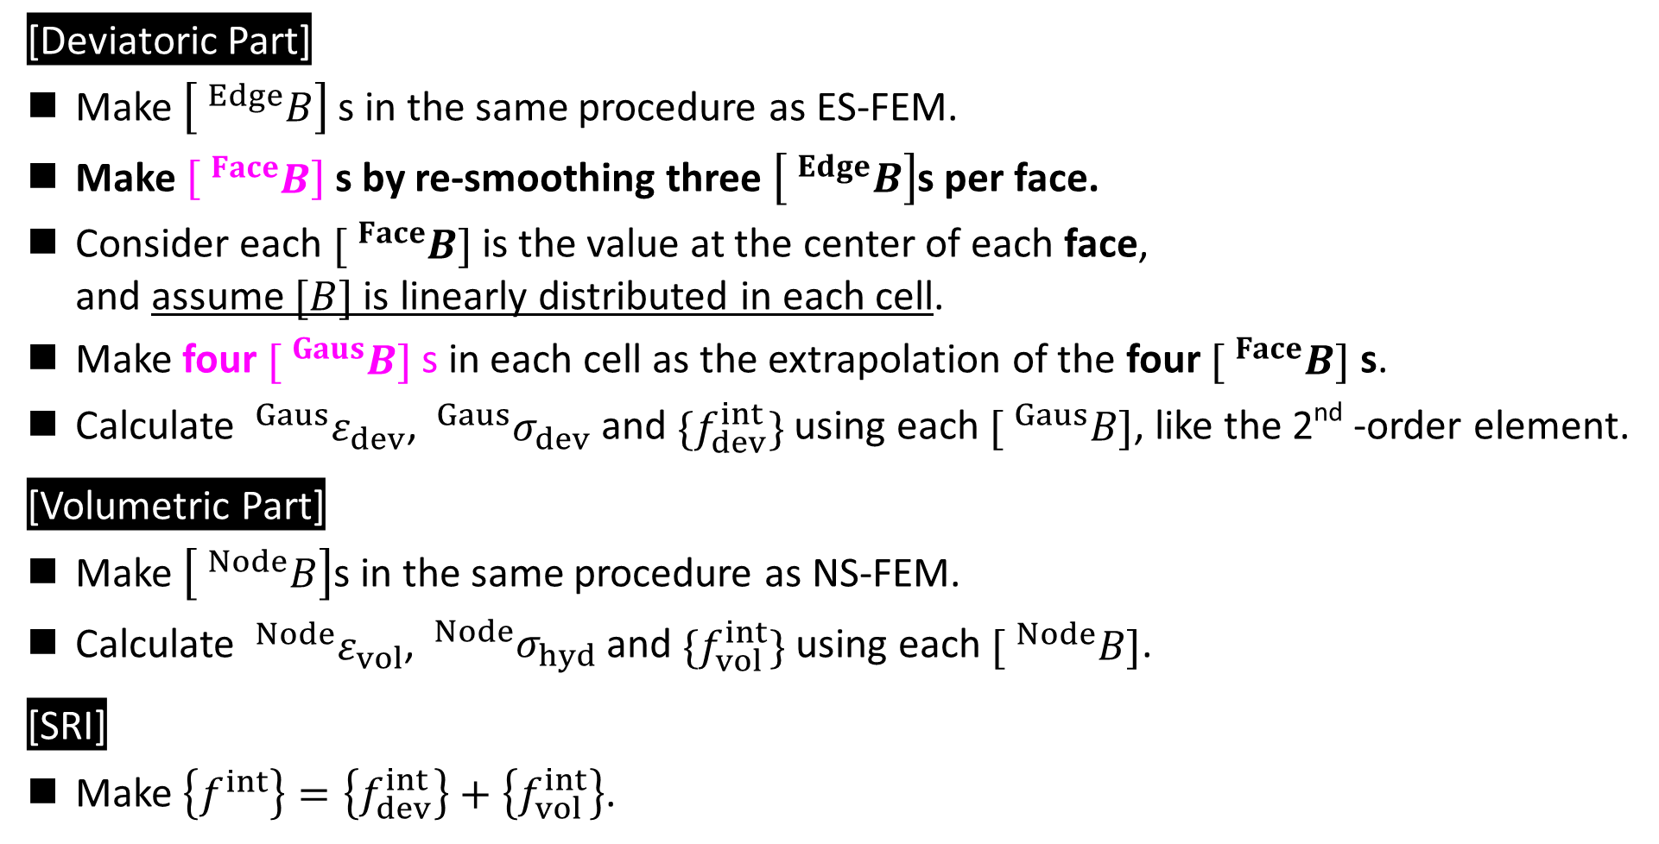
Brief of EC-SSE-SRI-T4 (in 3D)
Let me
explain with
text only
[Deviatoric Part]
Make $\left[ ^{Edge}B\right]$s in the same procedure as ES-FEM.
Make $\left[ ^{Face}B\right]$s by re-smoothing three $\left[ ^{Edge}B\right]$s per face.
Consider each $[ ^{Face}B]$ is the value at the center of each face,
and assume $[B]$ is linearly distributed in each cell.
Make four $[ ^{Gaus}B]$ s in each cell as the extrapolation of the four $[ ^{Face}B]$ s.
Calculate $^{Gaus}ε_{dev}$, $^{Gaus}σ_{dev}$and $\{f_{dev}^{int}\}$ using each $[ ^{Gaus}B]$, like the 2nd -order element.
[Volumetric Part]
Make $\left[ ^{Node}B\right]$s in the same procedure as NS-FEM.
Calculate $^{Node}ε_{vol}$, $^{Node}σ_{hyd}$and $\{f_{vol}^{int}\}$ using each $[ ^{Node}B]$.
[SRI]
Make $\left\{f^{int}\right\}=\left\{f_{dev}^{int}\right\}+\left\{f_{vol}^{int}\right\}$.

Slide 25
Result & Discussion
Performance evaluation of EC-SSE-SRI-T4 in 3D and Discussion of CPU Cost

Slide 26
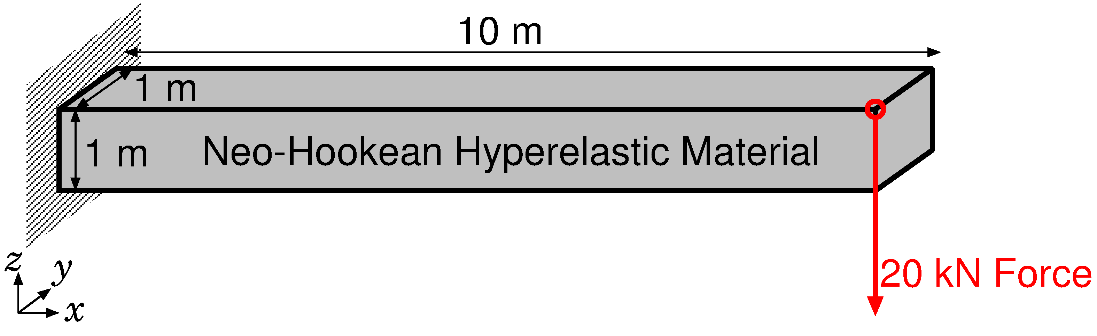
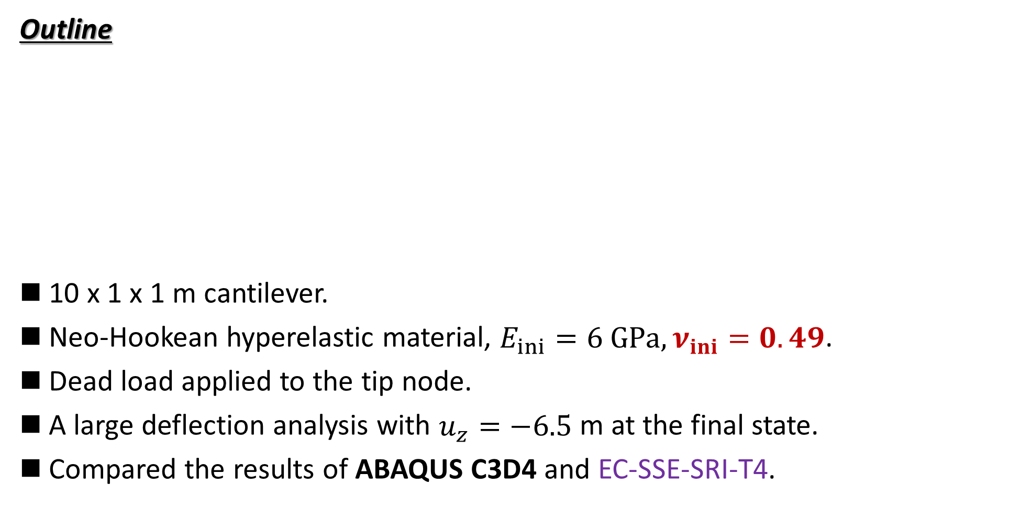
Bending of Rubber Cantilever
Static
Implicit
Outline
10 x 1 x 1 m cantilever.
Neo-Hookean hyperelastic material, $E_{ini}=6 GPa, ν_{ini}=0.49$.
Dead load applied to the tip node.
A large deflection analysis with $u_{z}=−6.5$ m at the final state.
Compared the results of ABAQUS C3D4 and EC-SSE-SRI-T4.
Dead Load

Slide 27
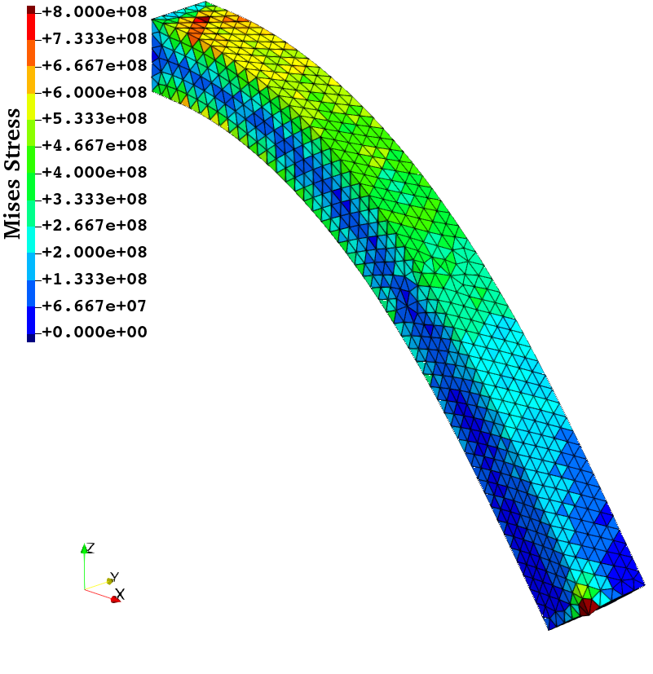
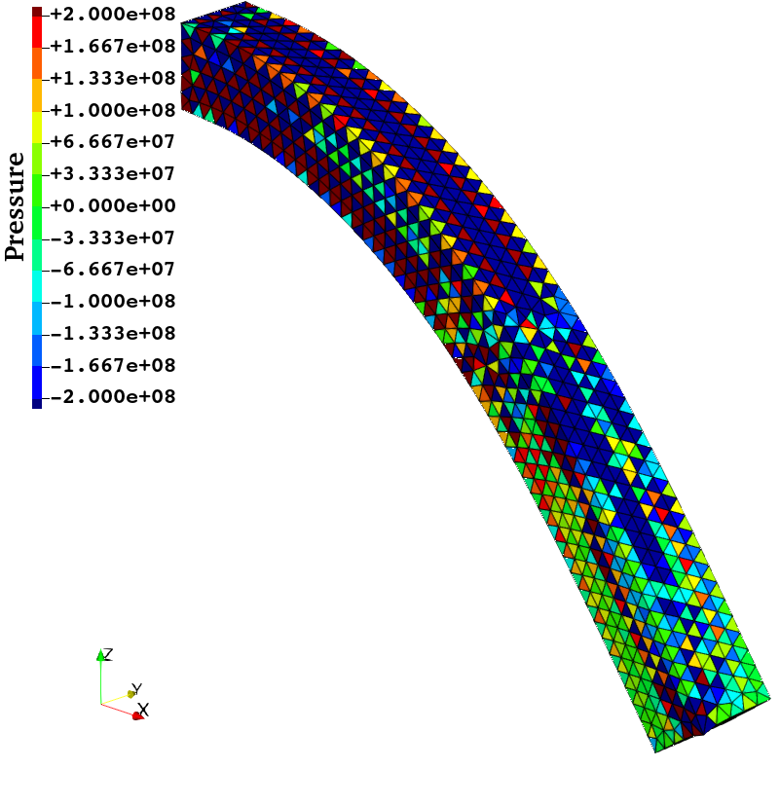
Bending of Rubber Cantilever
Static
Implicit
Results of
ABAQUS
C3D4
(Final State)
Discontinuous distribution.
Volumetric locking.
(-15% error in deflection)
Severe pressure
checkerboarding.
ABAQUS dat file:
***WARNING: THE INITIAL BULK MODULUS OF 9.93333E+10 EXCEEDS 25 TIMES THE
INITIAL SHEAR MODULUS OF 2.00000E+09 (SO THE INITIAL POISSONS
RATIO 0.49000 EXCEEDS 0.48) FOR THE HYPERELASTIC MATERIAL NAMED
MATERIAL-1. HOWEVER, A HYBRID TYPE ELEMENT IS NOT USED. THIS MAY
CAUSE CONVERGENCE PROBLEMS.

Slide 28
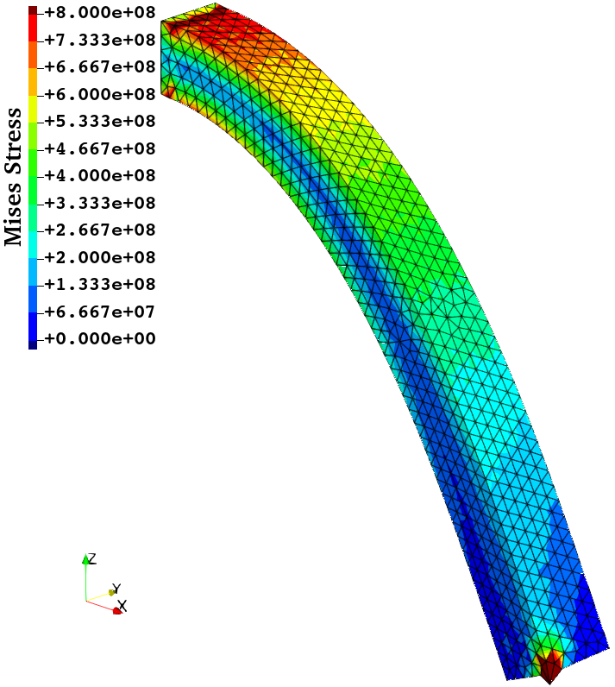
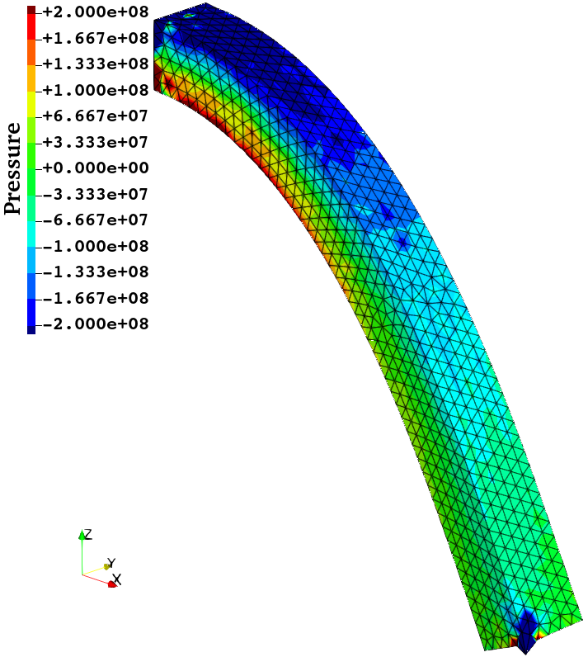
Bending of Rubber Cantilever
Static
Implicit
Results of
EC-SSE
-SRI-T4
(Final State)
Smooth distribution.
No locking.
Little oscillation, but no checkerboarding.

Slide 29
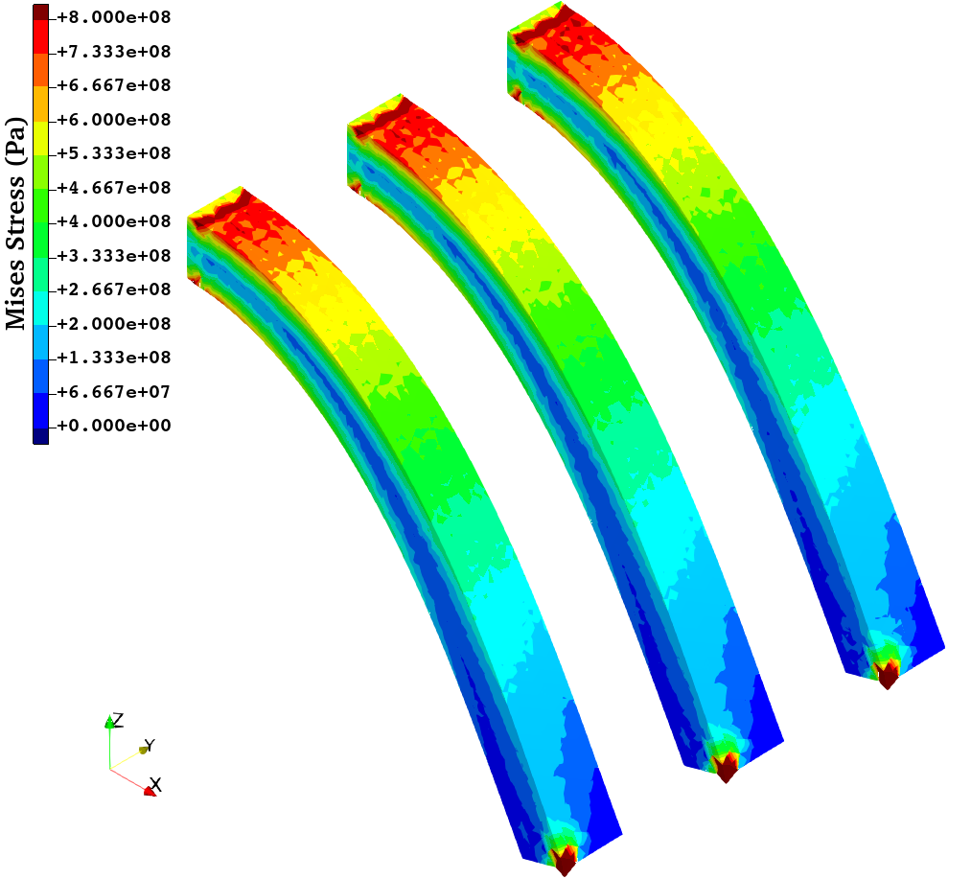






Bending of Rubber Cantilever
Static
Implicit
Results of EC-SSE-SRI-T4 with Different $ν_{ini}$s (Final State)
$$ν_{ini}= \\ 0.48 0.49 0.499$$
$$ν_{ini}= \\ 0.48 0.49 0.499$$
Major pressure checkerboarding
in the case of $ν_{ini}=0.499$.
No major difference in the Mises stress distributions.
Limit of proposed method:
up tp $ν=0.49$.

Slide 30


Pressuring of Rubber Block
Static
Implicit
Outline
1 x 1 x 1 m block.
Arruda-Boyce hyperelastic material, $E_{ini}=24$ GPa, $ν_{ini}=0.49$.
Applying pressure on ¼ of the top face with lateral confinement.
Evaluated the result of EC-SSE-SRI-T4.
Load

Slide 31

Pressuring of Rubber Block
Static
Implicit
Results of EC-SSE-SRI-T4
No big issue in stress distributions
Sufficient large deformation robustness

Slide 32


Barreling of Rubber Cylinder
Static
Implicit
Outline
1 m cylinder in radius and height.
Neo-Hookean hyperelastic material, $E_{ini}=6 GPa, ν_{ini}=0.49$.
Applying enforced compression displacement on the top face with lateral confinement.
Evaluated the result of EC-SSE-SRI-T4.

Slide 33


Barreling of Rubber Cylinder
Static
Implicit
Convergence failure
at 37% compression.
$∴$ acceptably robust in large deformation
Within acceptable
range, I think.
Results of EC-SSE-SRI-T4
No problem in Mises stress.
Minor oscillation in pressure.

Slide 34


Tensioning of Rubber-Filler Composite
Static
Implicit
Outline
0.5 x 0.5 x 0.5 m cube (1/8 model)
Rubber: Neo-Hookean hyperelastic material $(E_{ini}=6 GPa, ν_{ini}=0.49)$
Iron Filler: Neo-Hookean hyperelastic material $(E_{ini}=260 GPa, ν_{ini}=0.3)$
Applying enforced tensioning displacement on the top face with lateral confinement.
Evaluated the result of EC-SSE-SRI-T4.

Slide 35


Tensioning of Rubber-Filler Composite
Static
Implicit
Results of
EC-SSE
-SRI-T4
Convergence
failure
at 221% stretch
$∴$ sufficiently robust
in large deformation
No issue in Mises stress.
Minor pressure oscillation only
in rubber part.
Within acceptable
range, I think.

Slide 36


Discussion on CPU Time of EC-SSE-SRI-T4
Since the most of CPU time for implicit analyses is spent solving the stiffness equation
(i.e., $\left[K\right]\left\{u\right\}=\{f\}$), the size of $[K]$ matrix ($N$) directly affects the CPU time.
EC-SSE-SRI-T4 is a purely displacement-based FE formulation; thus,
the matrix size ($N$) is exactly identical to that of FEM-T4.
EC-SSE-SRI-T4 conducts strain smoothing across FE cells; thus,
the matrix bandwidth of $[K]$ is x6.7 wider than that of FEM-T4.
Therefore, as for calculation speed, EC-SSE-SRI-T4 is about x6.7 slower than FEM-T4.
Formulation | Bandwidth of $[K]$ | v.s. FEM-T4 Ratio
FEM-T4 | 14 nodes x 3 DOF | 1
FEM-T10 | 28 nodes x 3 DOF | 2.0
ES-FEM-T4 | 45 nodes x 3 DOF | 3.2
NS-FEM-T4, SelectiveES/NS-FEM | 60 nodes x 3 DOF | 4.3
EC-SSE-T4, EC-SSE-SRI-T4 | 94 nodes x 3 DOF | 6.7

Slide 37
Discussion on CPU Time of EC-SSE-SRI-T4
Meanwhile, we should remind that
  FEM-T4 cannot avoid volumetric locking and pressure checkerboarding,
  FEM-T10 cannot have large deformation robustness (short-lasting),
  no matter how fine the mesh is.
Therefore, I believe, EC-SSE-SRI-T4 is practically acceptable and worth using,
even though the CPU time is 7 times longer than FEM-T4.
What do you think?

Slide 38
Summary

Slide 39

Summary
A next-gen S-FEM, EC-SSE-SRI-T4, was proposed to handle large deformation of rubber-like solids.
The performance of EC-SSE-SRI-T4 is summarized as follows:
  No shear/volumetric locking.
  Minor pressure checkerboarding when $ν≤0.49$.
  7 times longer CPU time than FEM-T4 when using the same mesh.
  More accurate than conventional T4 elements and SelectiveES/NS-FEM-T4.
  More robust (long-lasting) than conventional T10 elements.
The EC-SSE family would be the standard T4 formulation in the near future.
Thank you for your kind attention!

Slide 40
Appendix

Slide 41

Difference in Formulation
Let me
explain in 2D
for simplicity
Strain Distribution in each Formulation
FEM and ES-FEM:
Piece-wise constant, Different pieces.
SSE and EC-SSE:
Piece-wise linear, Different continuity.
SSE
FEM
ES-FEM
If calculation time is disregarded,
EC-SSE is expected to provide highly accurate strain/stress with a T3/T4 mesh.
EC-SSE

Slide 42


Brief of SSE
Let me
explain in 2D
for simplicity
Make $[ ^{Edge}B]$s in the same procedure as ES-FEM.
Consider each $[ ^{Edge}B]$ represents $[B]$ in its edge smoothing domain,
and assume $[B]$ is linearly distributing in each cell.
Make three $[ ^{Gaus}B]$s in each cell as the average of neighbor two $[ ^{Edge}B]$s .
Calculate $^{Gaus}ε$, $^{Gaus}σ$and $\{f^{int}\}$ using each $\left[ ^{Gaus}B\right]$ in the same manner
as the 2nd -order element.
Conducting strain smoothing twice,
the strain/stress are evaluated
at each Gauss point.
No shear locking
with T3/T4 mesh.
Fast mesh convergence rate
in strain/stress.
Cannot avoid
volumetric locking and
pressure checkerboarding
Strain distribution is
piecewise-linear in each cell

