Slide 1
Recent Advancement in Smoothed Finite Element Methods for Locking-free Analysis with Tetrahedral Elements
Yuki ONISHI
Tokyo Institute of Technology (Japan)

Slide 2
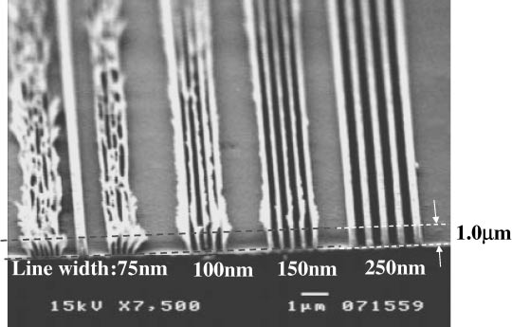
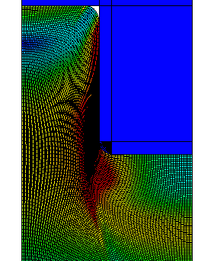
Motivation & Background
Motivation
  We want to analyze severely large
  deformation problems in solids
  accurately and stably!
  (Target: automobile tire, thermal nanoimprint, etc.)
Background
  Finite elements are distorted
  in a short time, thereby resulting
  in convergence failure.
Mesh rezoning method (h-adaptive
mesh-to-mesh solution mapping)
is indispensable.
Mold
Polymer

Slide 3
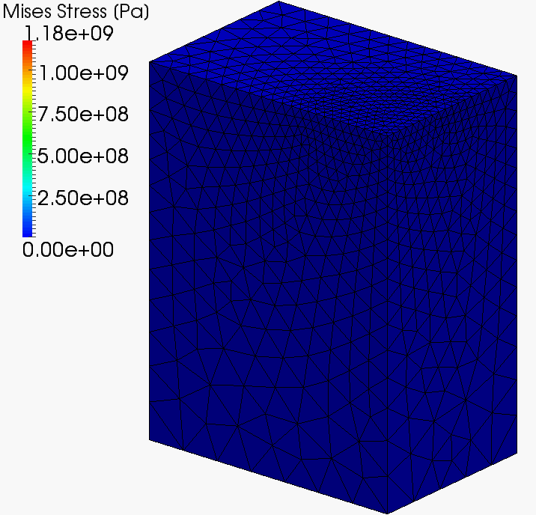
Our First Result in Advance
What we want to do:
Static
Implicit
Large deformation
Mesh rezoning

Slide 4
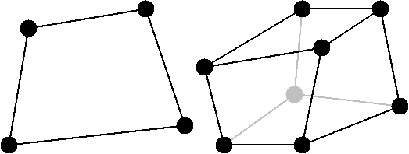
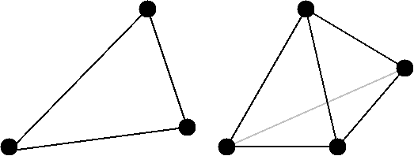
Issues
The biggest issue
in large deformation mesh rezoning
It is impossible to remesh arbitrary deformed 2D or 3D domains with quadrilateral or hexahedral elements.
However, the standard (constant strain) triangular or tetrahedral elements induce shear and volumetric locking easily, which leads to inaccurate results.
NO
YES
We have to use triangular or tetrahedral elements...

Slide 5
Conventional Methods
Higher order elements:
✗ Not volumetric locking free; Not effective
in large deformation due to intermediate nodes.
EAS elements:
✗ Unstable.
B-bar, F-bar and selective integration elements:
✗ Not applicable to triangular/tetrahedral mesh.
F-bar patch elements:
✗ Difficult to construct good patches
u/p hybrid (mixed) elements
✗ No sufficient formulation for triangular/tetrahedral mesh is
presented so far. (There are almost acceptable hybrid
elements such as C3D4H or C3D10H of ABAQUS.)
Smoothed finite elements:
? Unknown potential (since 2009~). Let’s try!

Slide 6
Objective
Develop a locking-free, accurate and stable
smoothed finite element method (S-FEM)
with 4-node tetrahedral elements (T4)
for large deformation problems
Table of Body Contents
Quick survey of 3 classical S-FEMs
Introduction to a recent S-FEM: hES-FEM
Introduction to our new S-FEM: F-barES-FEM
Summary

Slide 7
Quick survey of
3 Classical S-FEMs

Slide 8
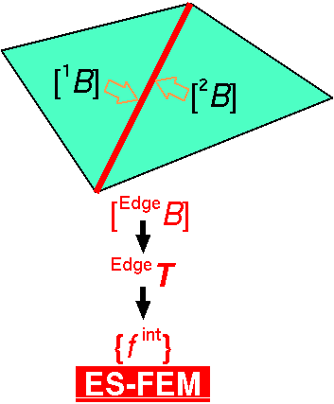

(i) Edge-based S-FEM (ES-FEM)
Calculate $[B]$ at element as usual.
Distribute $[B]$ to the connecting edges and make $[ ^{Edge}B]$.
F, T etc and {f ^{int}} are calculated on smoothed edge domains.
Generally accurate but induces volumetric locking.
Substituting "face" for "edge"
gives FS-FEM for 3D

Slide 9
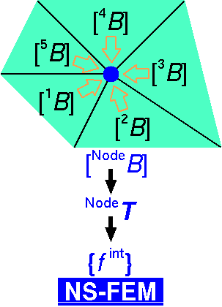

(ii) Node-based S-FEM (NS-FEM)
Calculate $[B]$ at element as usual.
Distribute $[B]$ to the connecting nodes and make $[ ^{Node}B]$
F, T etc and {f ^{int}} are calculated on smoothed node domains.
Generally not accurate but volumetric locking free.
(due to zero-energy modes,
which are arisen in
reduced integration
finite elements as
hour-glass modes)
close to FVM with
vertex-based control volume

Slide 10
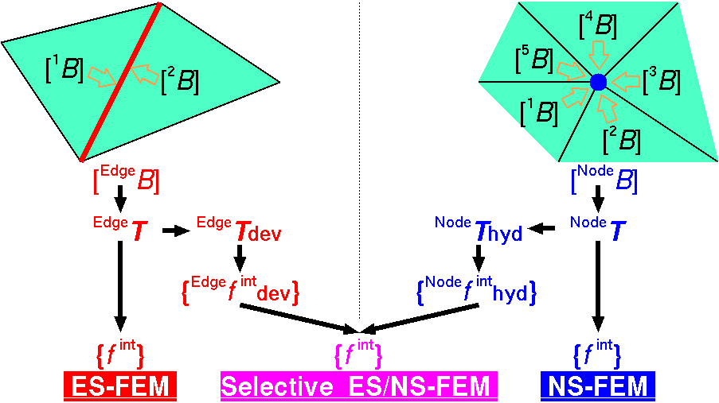
(iii) Selective ES/NS-FEM
Separate stress into "deviatoric part" and "hydrostatic part“
and combine them .
F, T etc and {f ^{int}} are calculated on both smoothed domains.
No locking & No zero-energy modes!!
thus, the best choice.
Substituting
"face"
for
"edge"
gives
FS/NS-FEM
for 3D

Slide 11
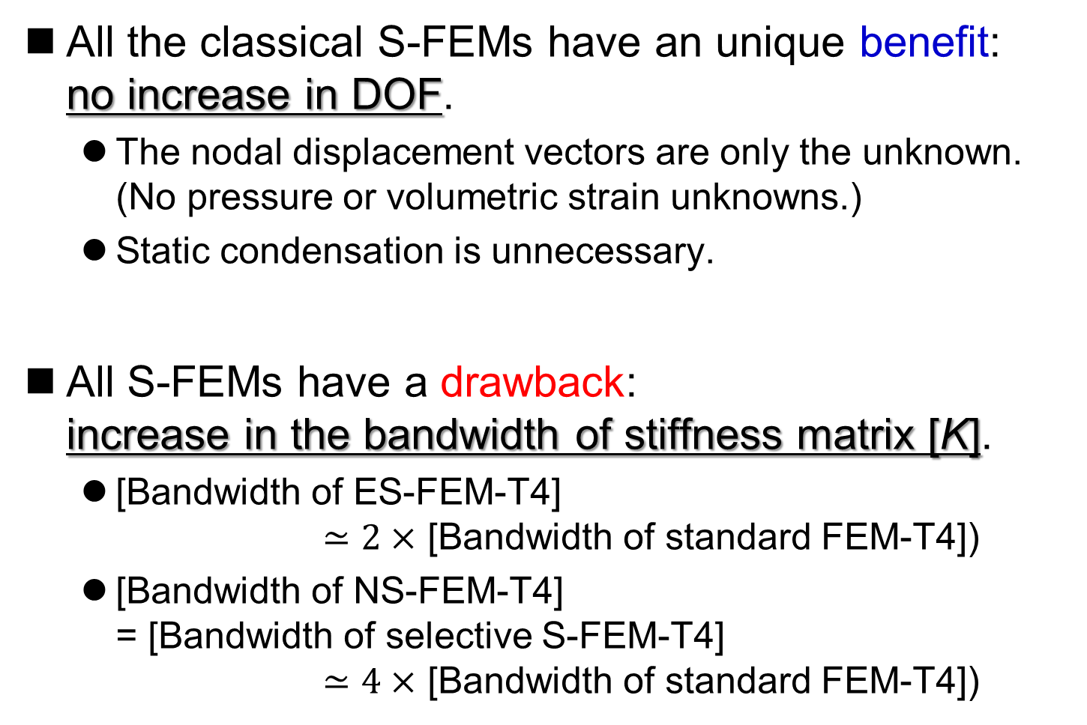
Characters of 3 Classical S-FEMs
All the classical S-FEMs have an unique benefit:
no increase in DOF.
  The nodal displacement vectors are only the unknown.
  (No pressure or volumetric strain unknowns.)
  Static condensation is unnecessary.
All S-FEMs have a drawback:
increase in the bandwidth of stiffness matrix [K].
  [Bandwidth of ES-FEM-T4]
  $≃2×$ [Bandwidth of standard FEM-T4])
  [Bandwidth of NS-FEM-T4]
  = [Bandwidth of selective S-FEM-T4]
  $≃4×$ [Bandwidth of standard FEM-T4])

Slide 12
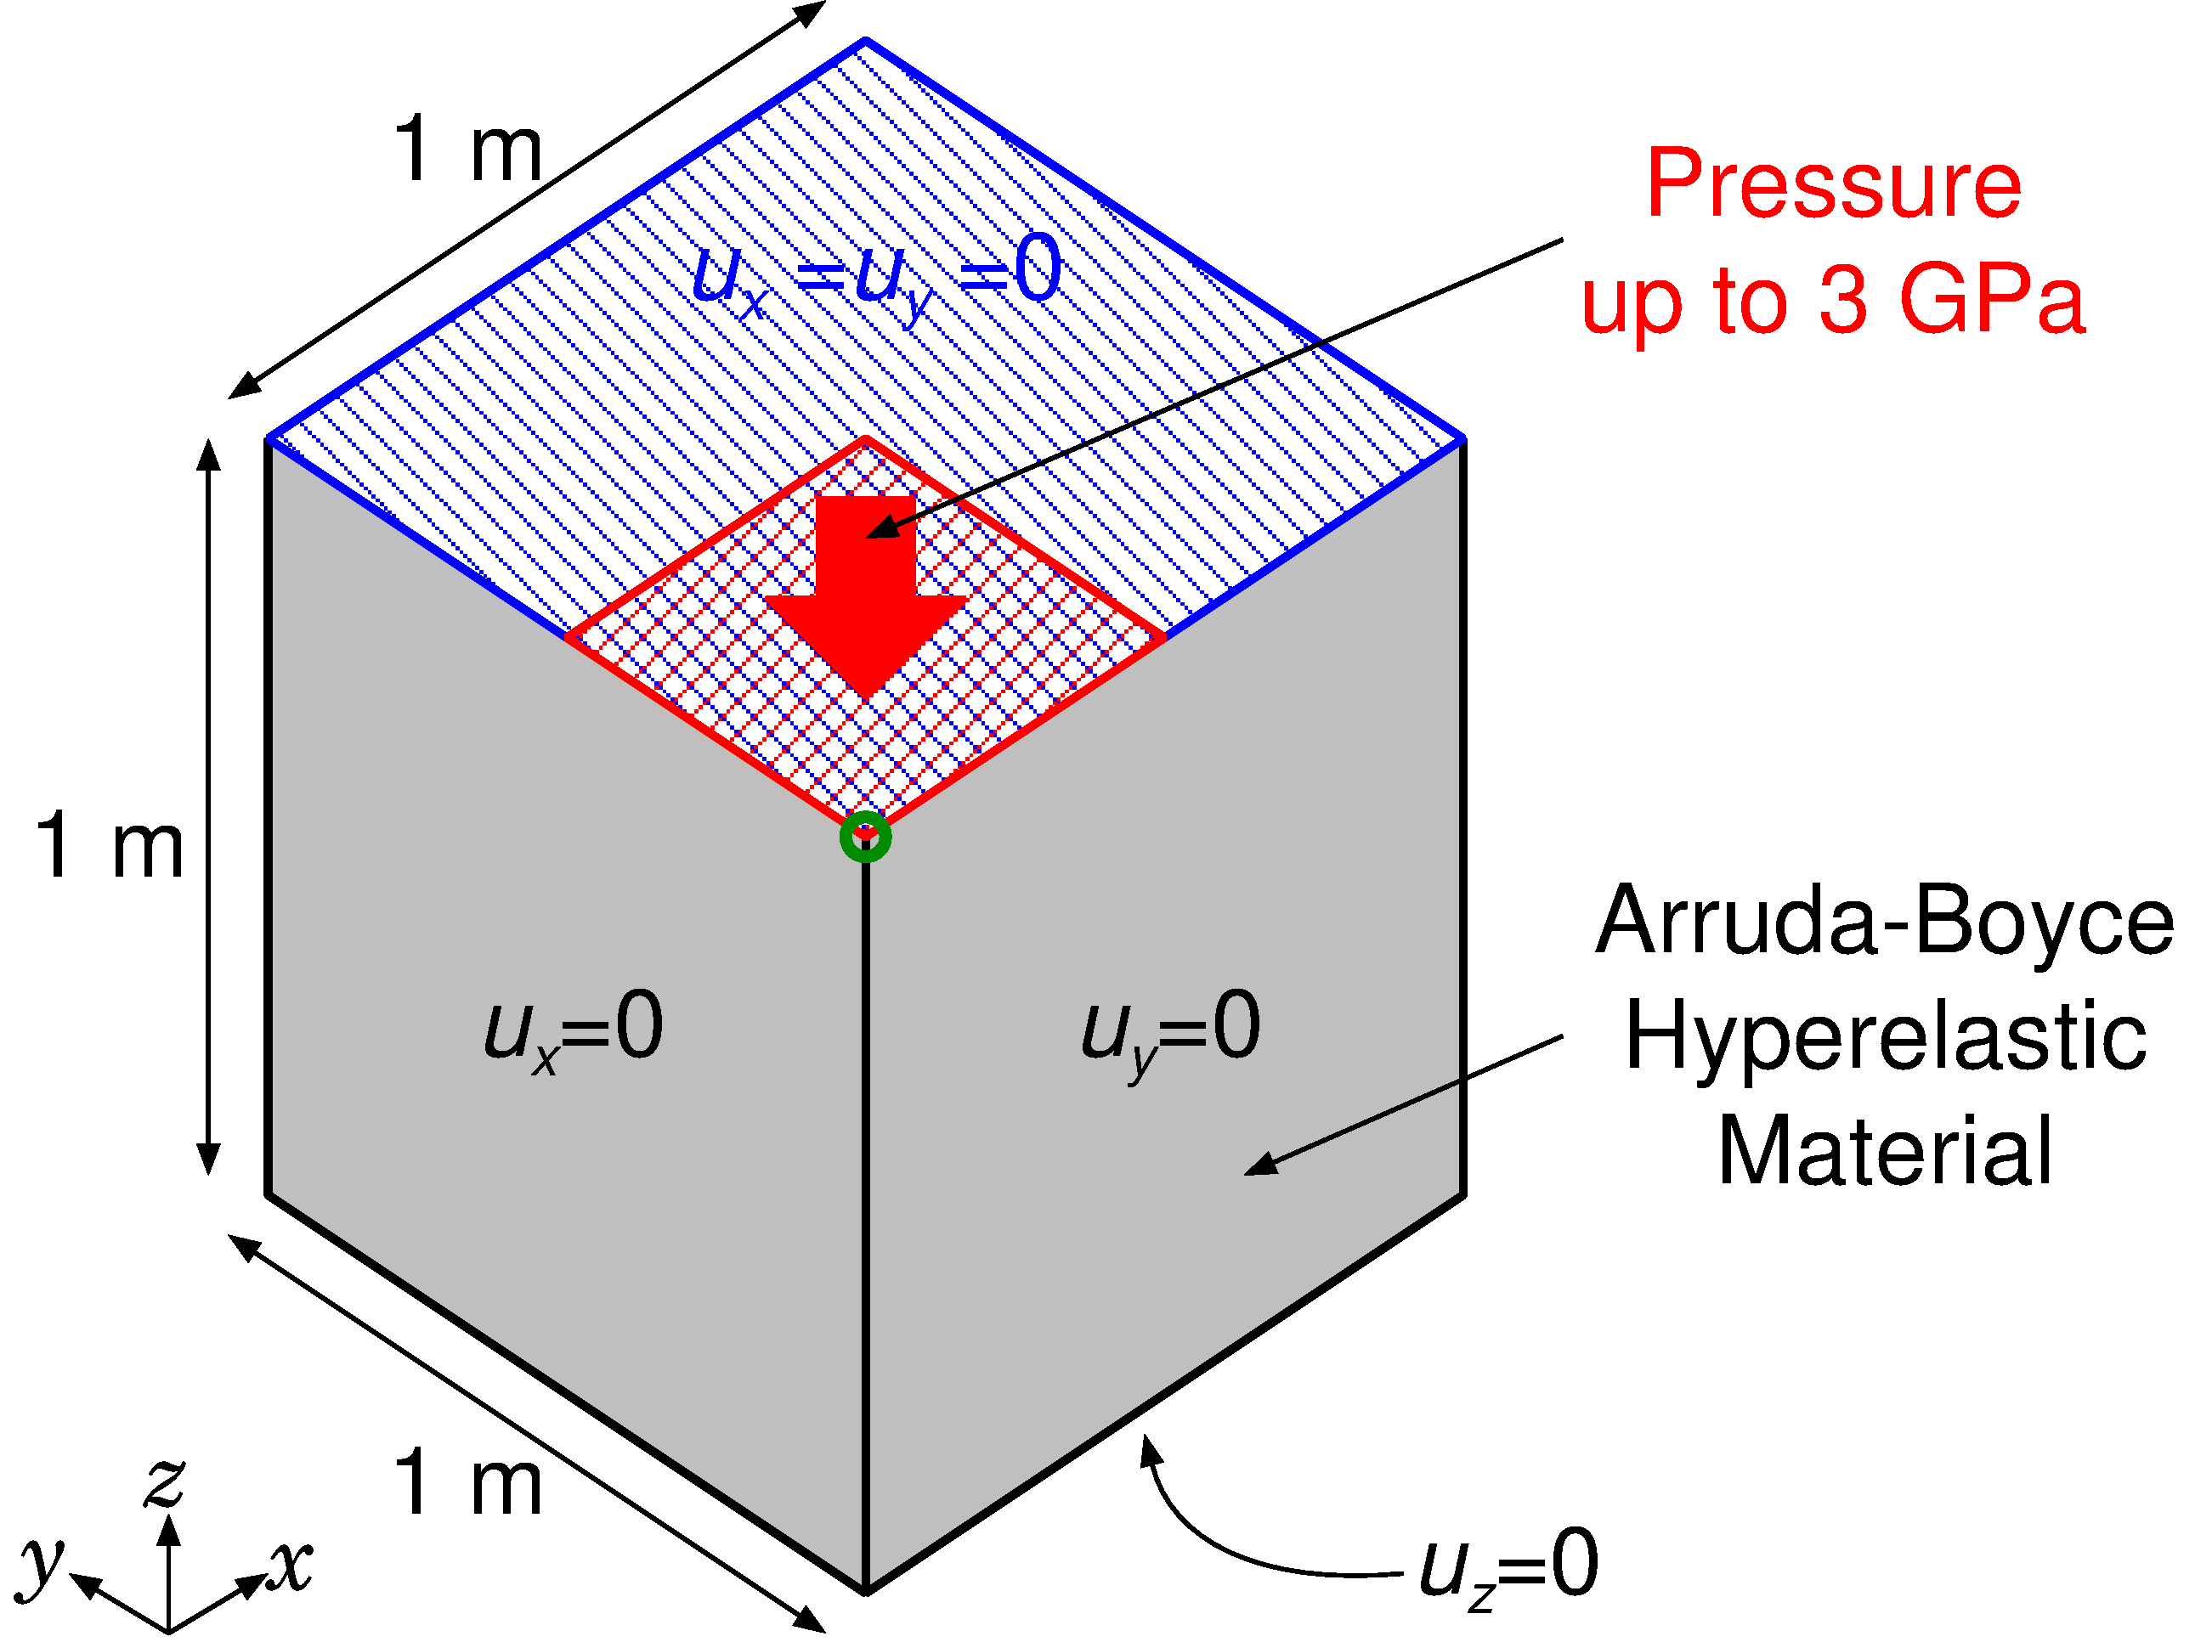

Example: Compression of Hyperelastic Block
Outline
Arruda-Boyce hyperelastic material ($ν_{ini}=0.499$)
Applying pressure on ¼ of the top face

Slide 13
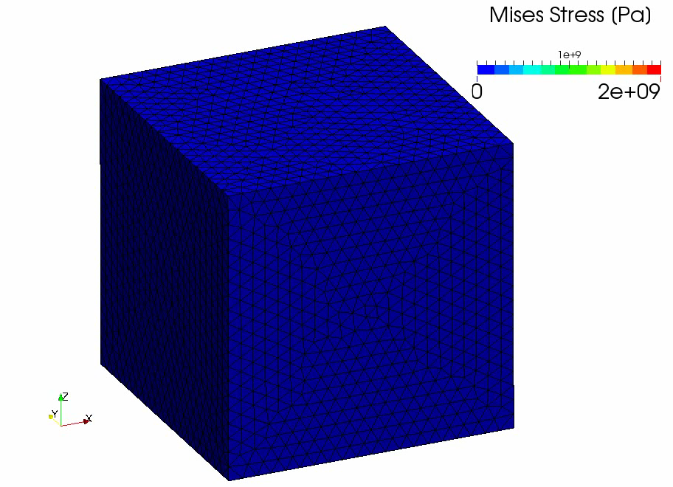
Example: Compression of Hyperelastic Block
Result of
Selective
ES/NS-
FEM-T4

Slide 14
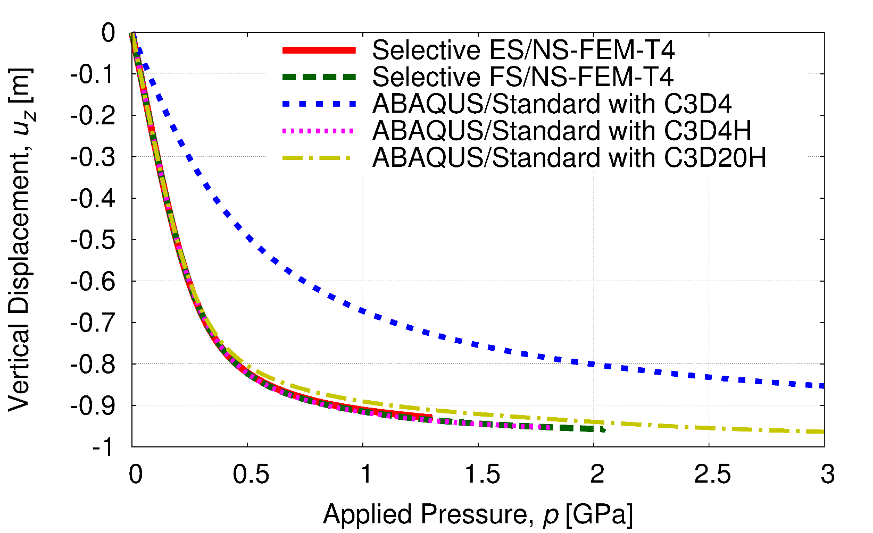
Example: Compression of Hyperelastic Block
Vertical Displacements vs. Applied Pressure
Constant strain element (C3D4) locks quickly.
Other elements including selective S-FEMs do not lock.
Selective S-FEMs are locking-free in large strain analysis!!

Slide 15
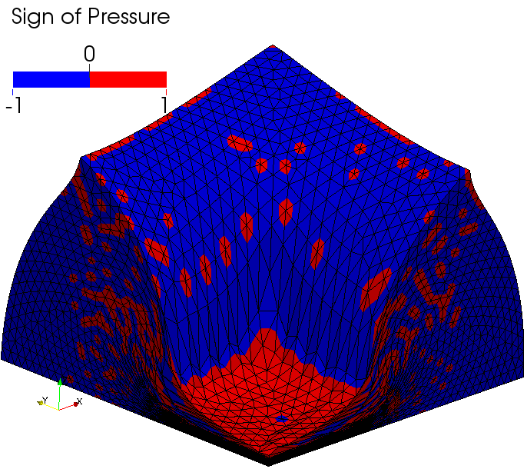
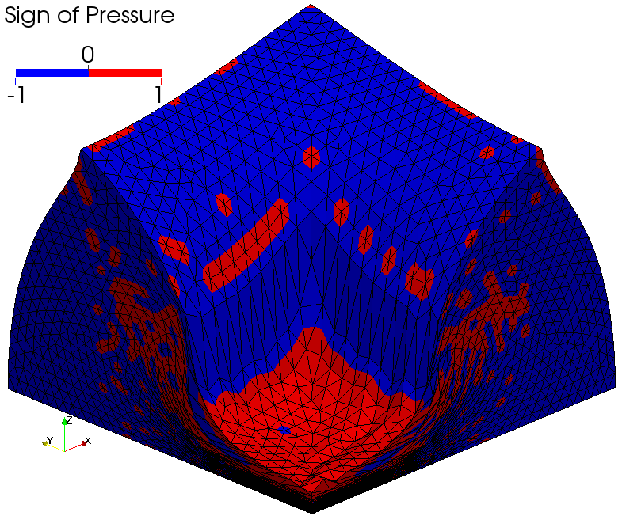
Example: Compression of Hyperelastic Block
Sign of Pressure
Checkerboard
patterns
are observed.
Selective ES/NS-FEM-T4
Selective FS/NS-FEM-T4
Pressure oscillation is present…

Slide 16
Characteristics of Classical S-FEMs
 | Shear Locking | Volumetric Locking | Zero- Energy Mode | Pressure Oscillation
Standard FEM-T4 | ✗ | ✗ | ✓ | ✗
NS-FEM-T4 | ✓ | ✓ | ✗ | ✗
ES-FEM-T4 & FS-FEM-T4 | ✓ | ✗ | ✓ | ✗
Selective S-FEM-T4 | ✓ | ✓ | ✓ | ✗
There still remain
issues to be resolved.

Slide 17
Introduction to a Recent S-FEM:
hES-FEM

Slide 18
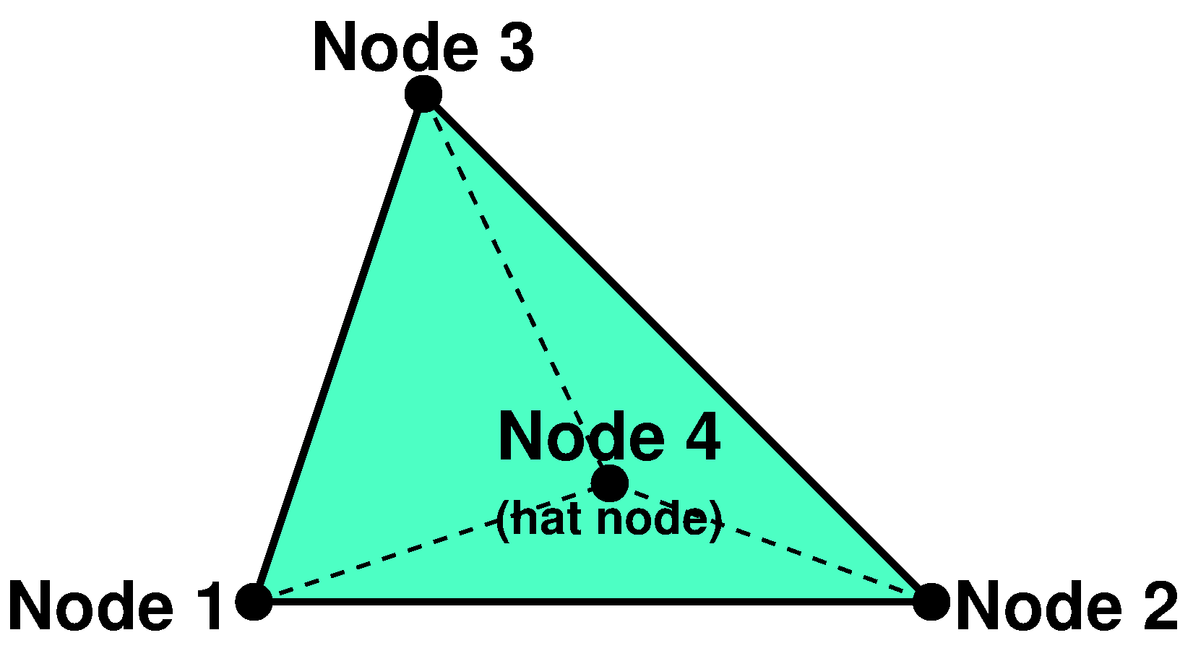
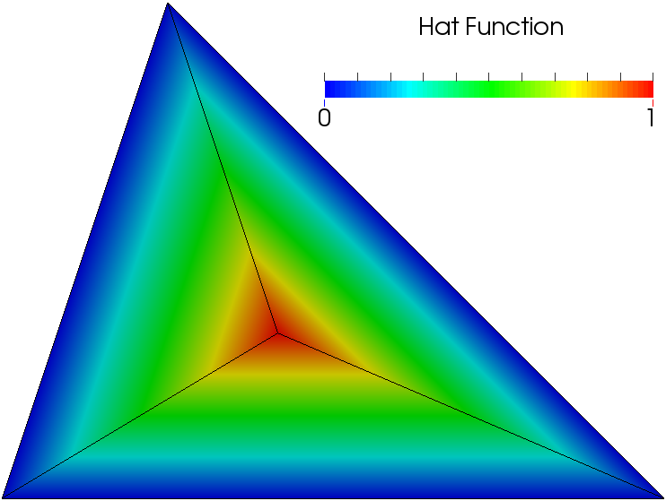

Hat-enhanced ES-FEM (hES-FEM)
Concept
An additional internal node (hat node or bubble node) is put at each standard triangular element.
Each hat node has its own displacement DOFs.
The shape function of hat nodes is the hat function.
Namely in hES-FEM, 3 sub-elements ($Δ124$, $Δ234$, $Δ314$) have the same shape functions as the standard triangular elements.
3 sub-elements
In an element
Hat Function
0
0
1
0

Slide 19
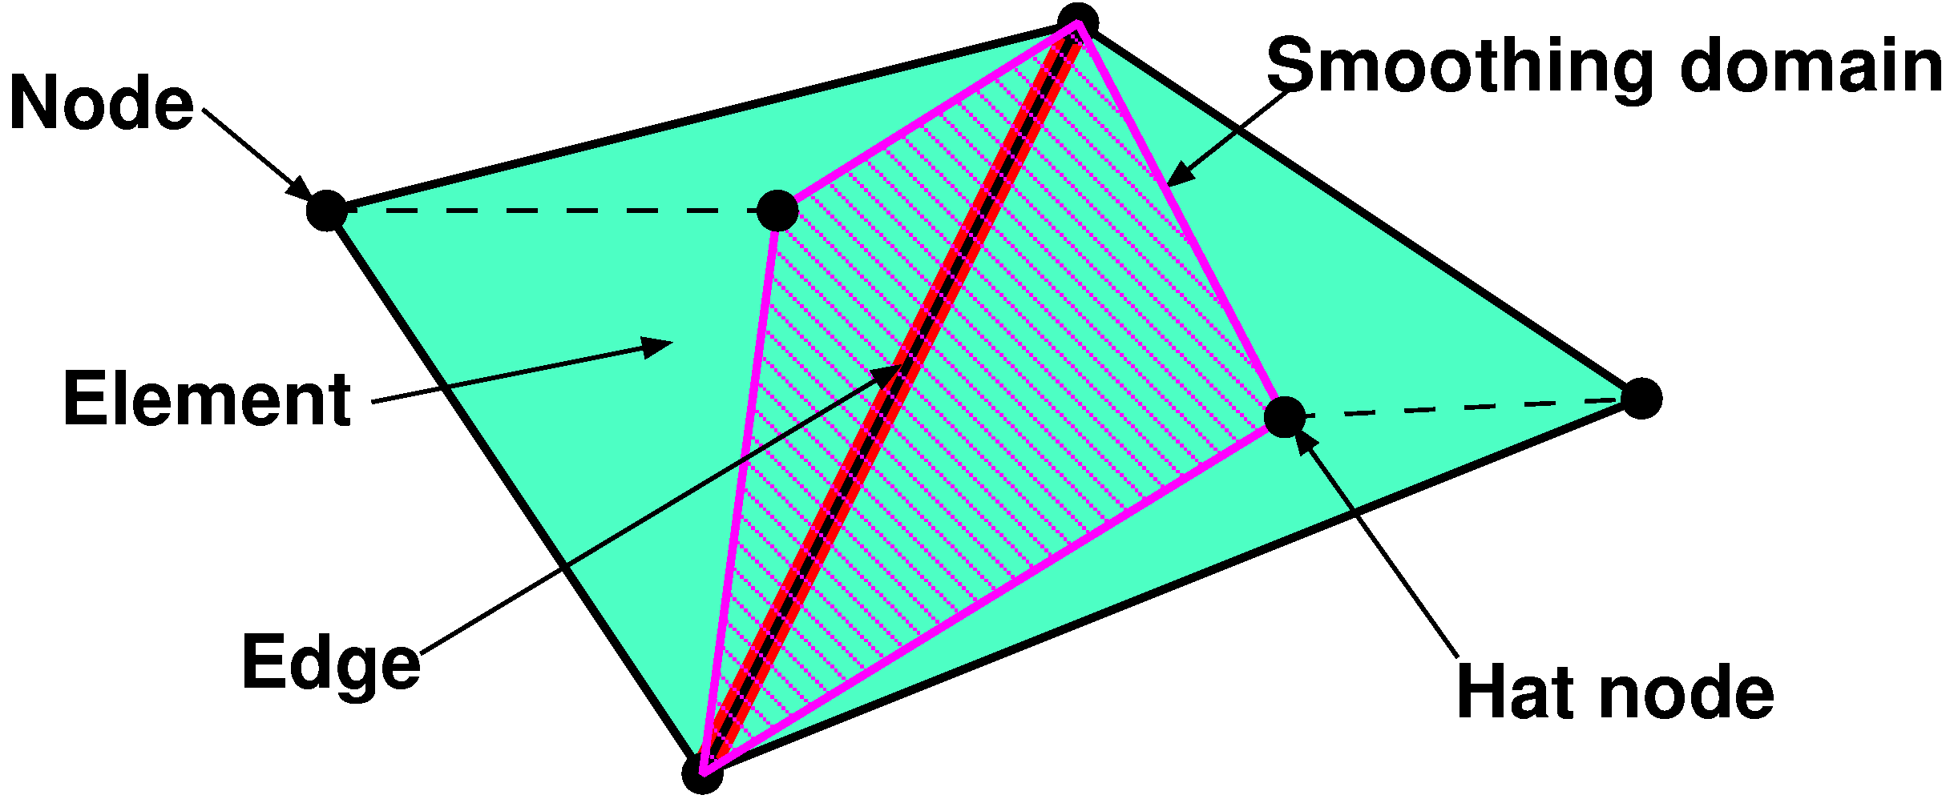

Hat-enhanced ES-FEM (hES-FEM)
Brief formulation
Calculate $[B]$ at sub-element as usual.
Distribute $[B]$ to the connecting edges and make $[ ^{Edge}B]$.
F, T etc and {f ^{int}} are calculated on smoothed edge domains.
Segments
between
nodes and
hat nodes
are not
regarded
as edges.
$[^{Edge}B] ⟶ ^{Edge}F ⟶$ $^{Edge}T⟶\{^{Edge}f^{int}\}$
hES-FEM

Slide 20
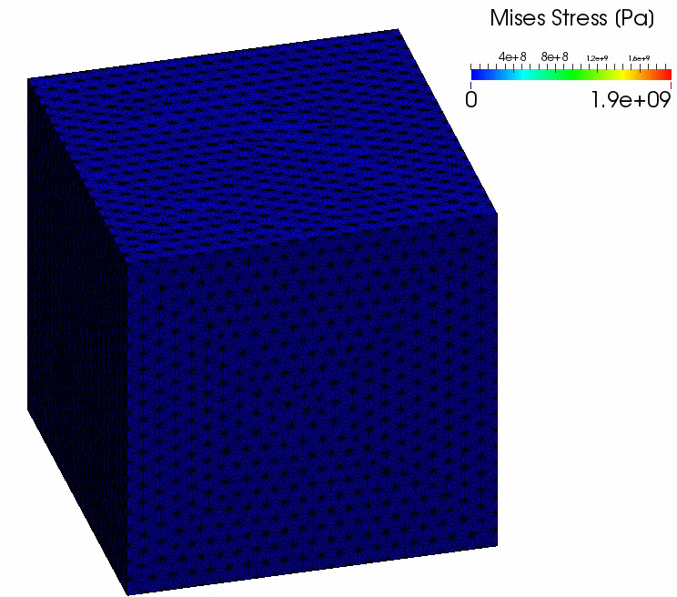
Example: Compression of Hyperelastic Block
Result
of
hES-FEM
Mises stress
distribution is
smooth.
But, it got
convergence failure
at a relatively
earlier stage
due to pop out
of hat nodes…

Slide 21
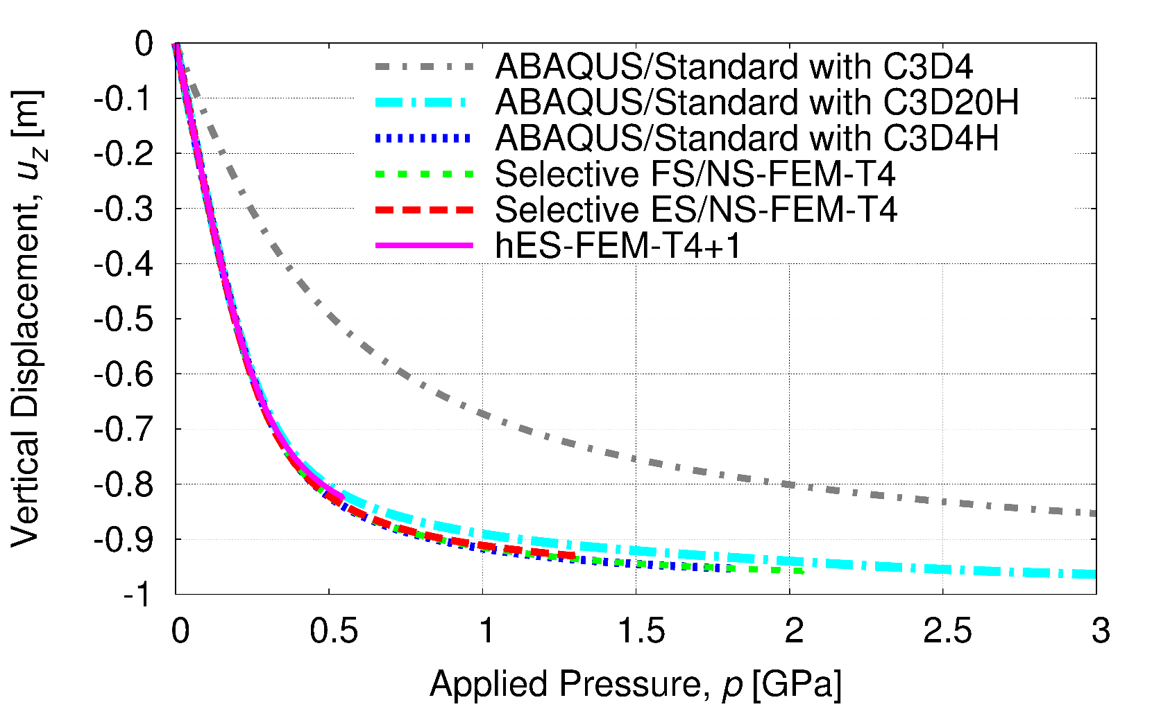
Example: Compression of Hyperelastic Block
Vertical Displacements vs. Applied Pressure
Locking-free and accurate.
hES-FEM stopped at 82% nominal compression, where as other locking-free methods stopped around 95% of that.
Standard (constant strain) T4
hES-FEM
is loking-free
but cannot
bear with
severe strain.

Slide 22
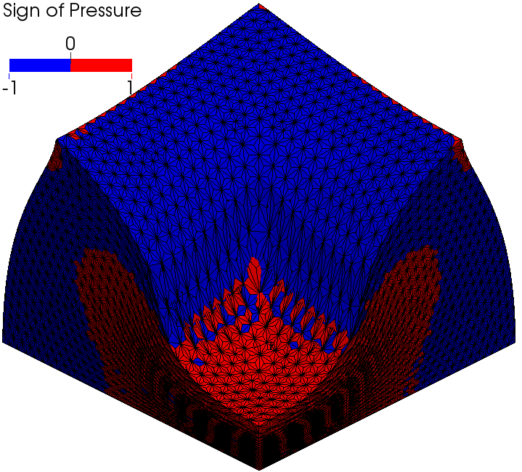
Example: Compression of Hyperelastic Block
Pressure distribution
Pressure oscillation is almost suppressed.

Slide 23
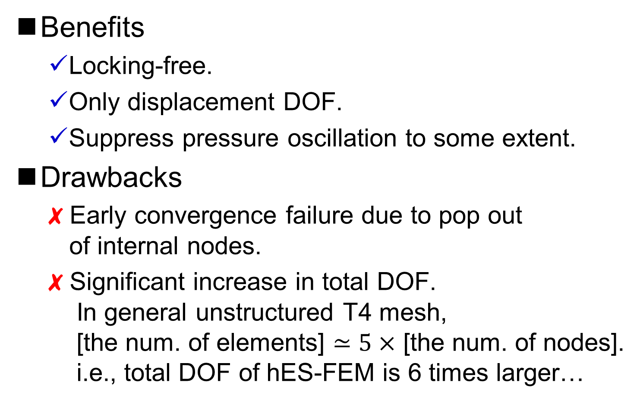
Characteristics of hES-FEM
Benefits
  Locking-free.
  Only displacement DOF.
  Suppress pressure oscillation to some extent.
Drawbacks
  ✗ Early convergence failure due to pop out
  of internal nodes.
  ✗ Significant increase in total DOF.
  In general unstructured T4 mesh,
  [the num. of elements] $≃5×$ [the num. of nodes].
  i.e., total DOF of hES-FEM is 6 times larger…

Slide 24
Introduction to our new S-FEM:
F-barES-FEM

Slide 25
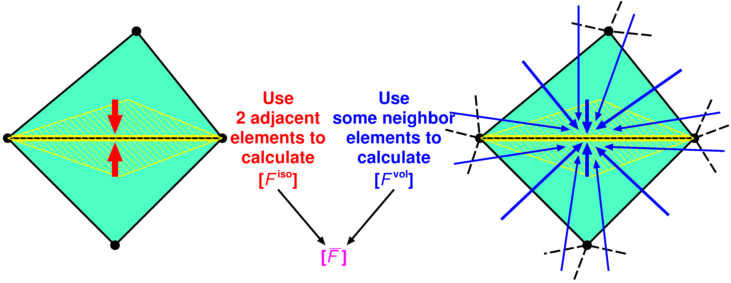

F-bar aided ES-FEM (F-barES-FEM)
Concept
Use classical ES-FEM to calculate $[F^{iso}]$.
Use “cyclic smoothing” to calculate $[F^{vol}]$.
Apply F-bar method to obtain $[\overline{F}]$.
Combination of
F-bar method and ES-FEM

Slide 26
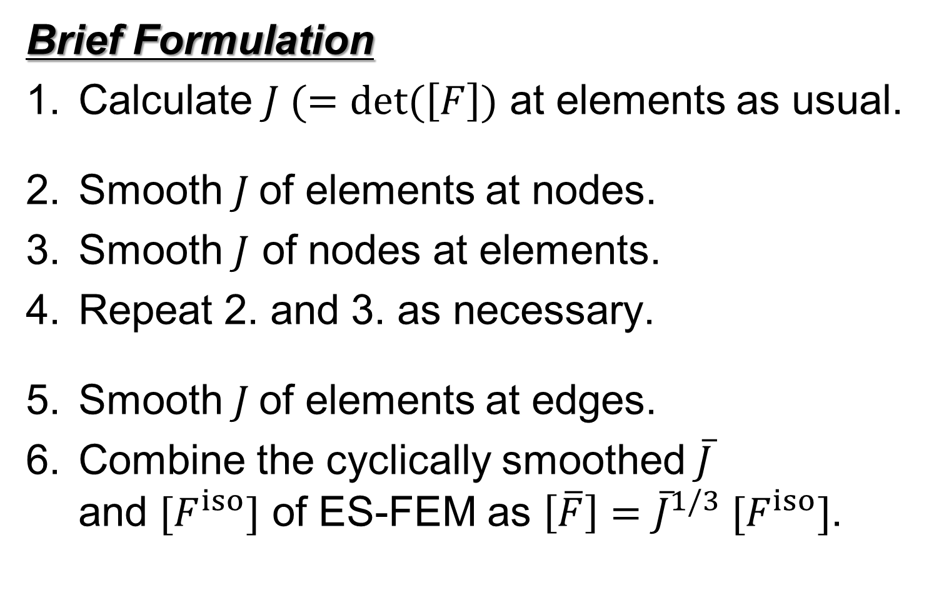
F-bar aided ES-FEM (F-barES-FEM)
Brief Formulation
Calculate $J (=det⁡(\left[F\right])$ at elements as usual.
Smooth $J$of elements at nodes.
Smooth $J$ of nodes at elements.
Repeat 2. and 3. as necessary.
Smooth $J$of elements at edges.
Combine the cyclically smoothed $\overline{J}$
and $[F^{iso}]$ of ES-FEM as $\left[\overline{F}\right]={\overline{J}}^{1/3} [F^{iso}]$.
Cyclic
Smoothing
of J
(Currently
we employ
2 cycles.)

Slide 27
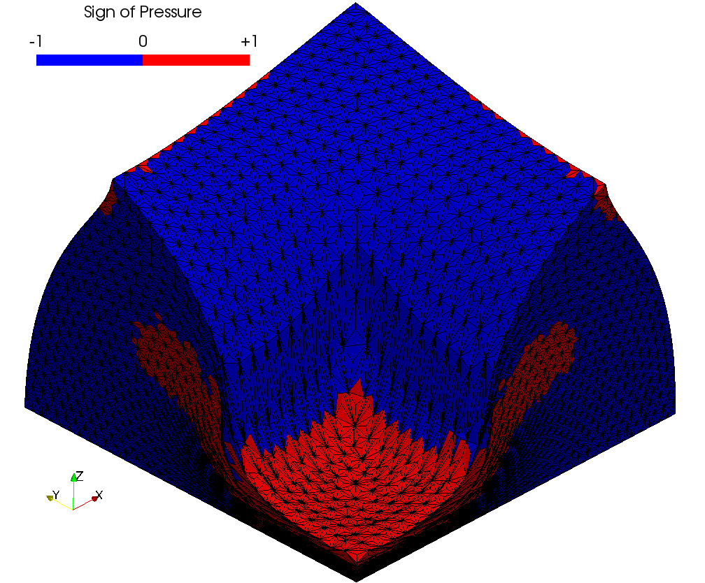
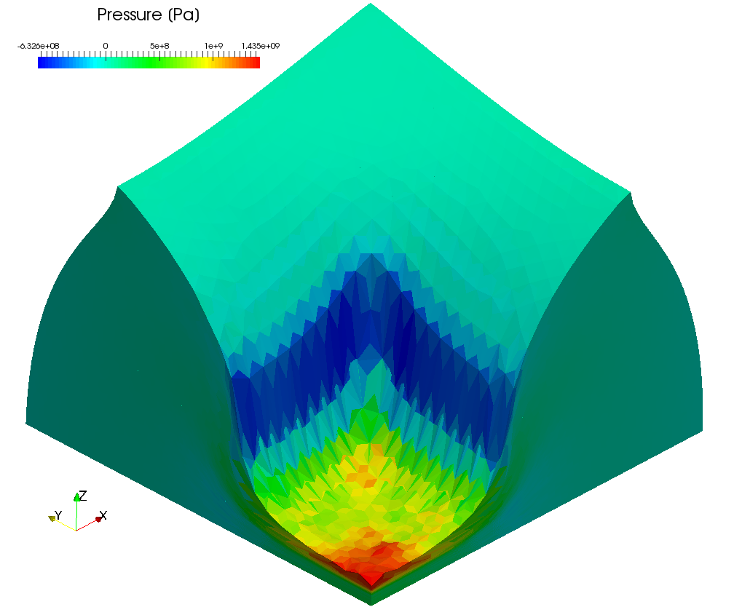
Example: Compression of Hyperelastic Block
Pressure distribution
No checkerboard patterns are observed.
F-barES-FEM(2) suppresses pressure oscillation!!

Slide 28
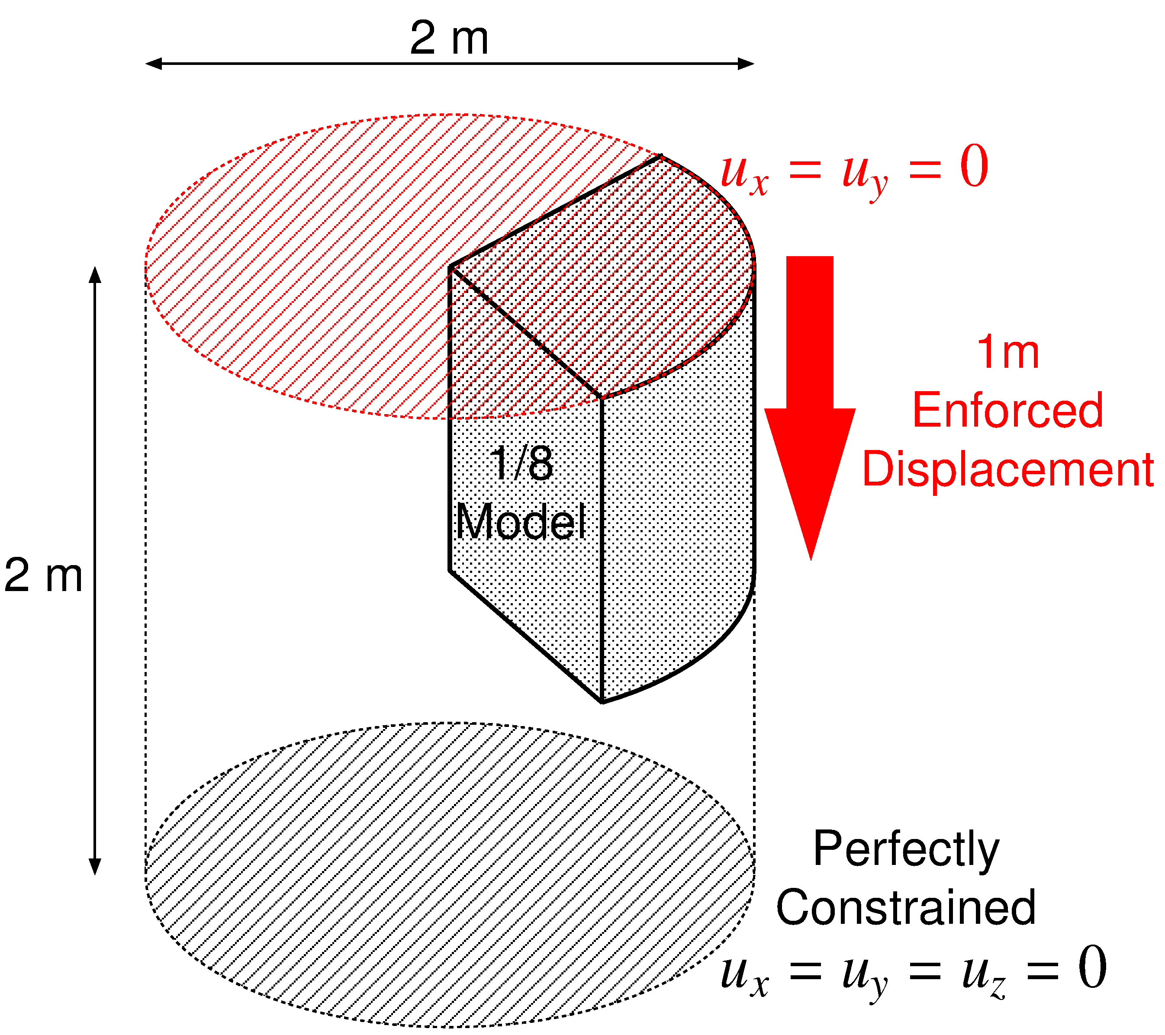

Example: Compression of 1/8 Cylinder
Outline
Neo-Hookean hyperelastic material ($ν_{ini}=0.499$).
Enforced displacement is applied to the top surface.
Stress singularity is present around the rim.

Slide 29
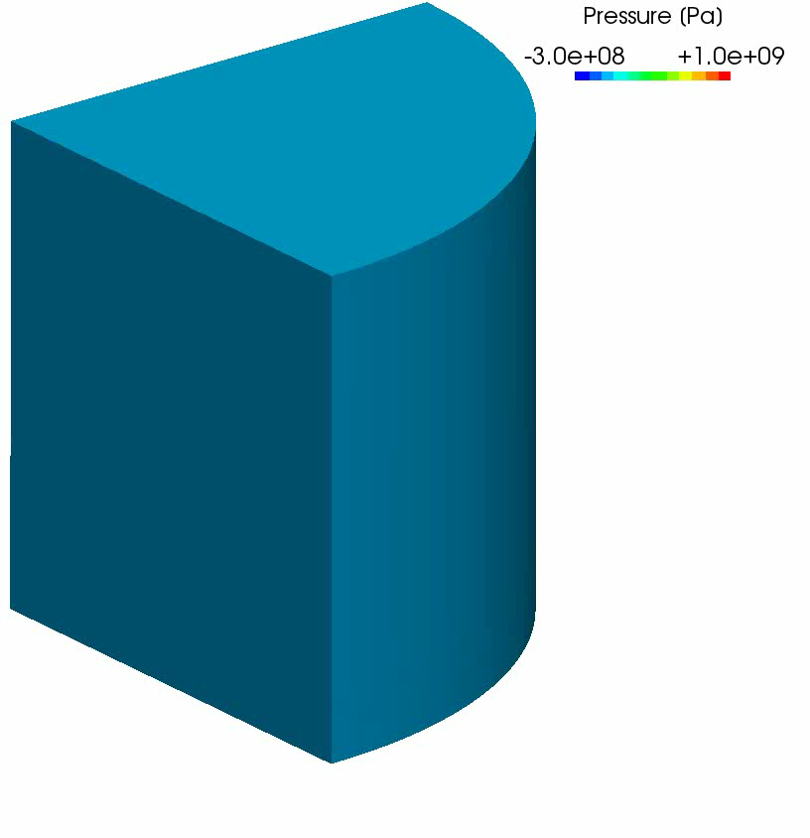
Example: Compression of 1/8 Cylinder
Result
of F-bar
ES-FEM(2)
50% nominal
compression
Almost smooth
pressure
distribution
is obtained
except just
around the rim.

Slide 30
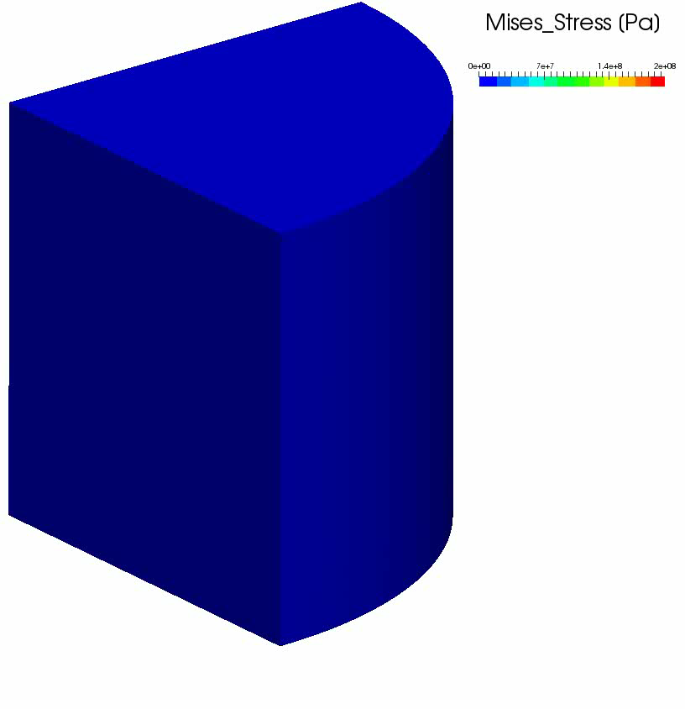
Example: Compression of 1/8 Cylinder
Result
of F-bar
ES-FEM(2)
50% nominal
compression
Smooth
Mises stress
distribution
is obtained
except just
around the rim.

Slide 31
Characteristics of F-barES-FEM
Benefits
  Locking-free.
  No increase in DOF.
  Suppress pressure oscillation as increasing the number of cyclic smoothing.
Drawbacks
  ✗ Increase in bandwidth of stiffness matrix [K].
  In general unstructured T4 mesh,
  F-barES-FEM(1): 10 times wider than FEM-T4,
  F-barES-FEM(2): 20 times wider than FEM-T4.
  But, exactly consistent [K] is not necessary
  and thus speed up can be expected.

Slide 32
Summary

Slide 33
Characteristics of S-FEMs
 | Shear & Volumetric Locking | Zero- Energy Mode | Dev/Vol Coupled Material | Pressure Oscillation | Severe Strain
Standard FEM-T4 | ✗ | ✓ | ✓ | ✗ | ✓
Selective S-FEM-T4 | ✓ | ✓ | ✗ | ✗ | ✓
hES-FEM-T4 | ✓ | ✓ | ✓ | ✓ | ✗
F-bar ES-FEM-T4 | ✓ | ✓ | ✓ | ✓ | ✓
This is ✓ when the num. of
cyclic smoothing is large enough;
but, speed-up is necessary.

Slide 34
Take-Home Messages
Recent S-FEMs are about to realize locking-free, accurate and stable large deformation analysis of nearly incompressible solids with T4 elements.
Recent S-FEMs have no increase in DOF
(or no increase in non-displacement DOF);
thus, they have potential to be applied to various types of analysis such as eigen mode, harmonic response, explicit dynamic, etc..
Thank you for your kind attention!

