Slide 1
A Novel Meshfree Method for Large Deformation Analysis of Elastic and Viscoelastic Bodies without using Background Cells
Yuki ONISHI and Kenji AMAYA
Tokyo Institute of Technology

Slide 2
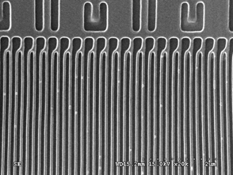
Background
After the advent of nanoimprinting, micro hot embossing and thermal nanoimprinting have been in area of active research.
  Pressing patterned mold onto
  polymer or glass to transcribe
  the pattern.
  Better precision than photo
  lithography
  A mechanical process
  Experiments cost high!
J.W.Lee et al., EIPBN (2007)‏
Goal
Establishment of numerical technique
for thermal nanoimprint process optimization.

Slide 3
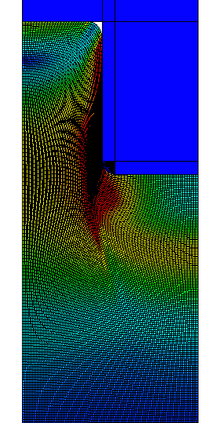
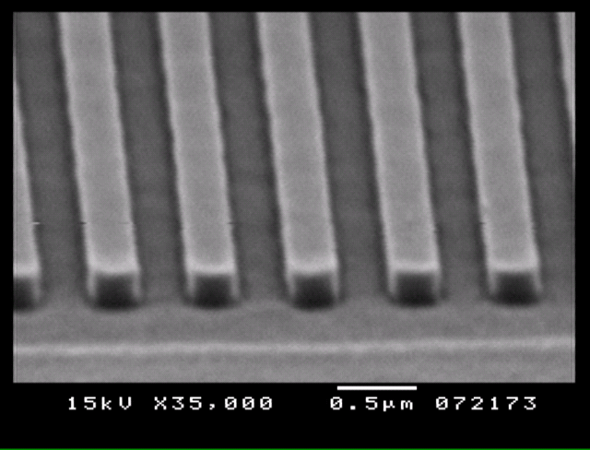
Our Previous Work
Finite element Analysis
  Geometric nonlinear
  (Large deformation)
  Material nonlinear
  （rigid mold and viscoelastic polymer)
  Contact nonlinear
  Quasi-static analysis
Mold
（rigid）
Polymer
(viscoelastic)
FE analyses agreed
with experiments
in case of
line-and-space
up to AR=1
Onishi et al.,
JVST B (2008) etc.‏

Slide 4
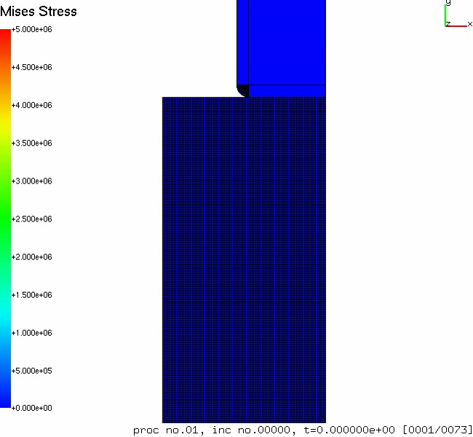
Our Previous Work

Slide 5
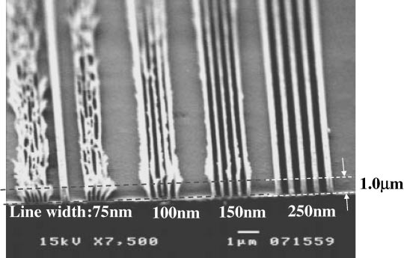
Objective
Our previous work was incomplete…
In practical applications,
AR over 1 is not uncommon.
(even AR>3 is usual.)
FEM cannot treat the extremely large deformation without adaptive meshing. (Adaptive meshing is difficult to implement.)
Objective
Development of a meshfree method
for viscoelastic large deformation analysis
(utilize it for thermal nanoimprint process optimization in the future)

Slide 6
Proposing Meshfree Formulation
[4 Points]
1. Quasi-static analysis for viscoelastic body
2. Modified stress-point integration
3. Robust moving least squares (Robust MLS)
with integration correction
4. Quasi-implicit time advancing

Slide 7
1. Viscoelastic Model
Standard solid model in shear
(the simplest generalized Maxwell model)
●Schematic diagram
G∞：long-term shear modulus
G₀：instantaneous shear modulus
g：dimensionless shear modulus
τ：relaxation time
On the other hand, bulk modulus, K, is a constant.
●Constitutive equation
T:Cauchy stress, E^{vol}：logarithmic volumetric strain，
E’：logarithmic deviatoric strain, E^{v}’：logarithmic viscous strain

Slide 8
1. Viscoelastic Model
material constants used in example analysis
instantaneous Young’s modulus（E₀）： 9 GPa
instantaneous Poisson’s ratio（ν₀）： 0.333・・・
instantaneous shear modulus（G₀）： 3.375 GPa
bulk modulus（K）： 9 GPa
dimensionless shear modulus（g）： 0.9
relaxation time（τ）： 5 s
long-term Young’s modulus（E∞）： 1 GPa
long-term Poission’s ratio（ν∞）： 0.481
long-term shear modulus(G∞): 0.3375 GPa

Slide 9
2. Modified SP Integration
Meshfree domain integration with BG cells is not suitable for large deformation.
There are 2 ways of domain integration without BG cells.
[1] Nodal integration (J. S. Chen)
merit) very simple.
generation of stress-points is not necessary.
demerit) zero-energy mode arise without artificial stabilization. (similar to hour-glass modes in FEM)
[2] Stress-point (SP) integration (T. Belytschko)
merit) artificial stabilization is not essential.
demerit) generation and translation of stress-points are
required.
No practical SP integration scheme
for large deformation analysis
was developed so far.
We introduce a SP integration
modified for large deformation
analysis.

Slide 10
2. Modified SP Integration (initialization)
(currently) SPs are generated from FE meshes
[Note] meshes are only for initialization!!!
Locate every SP in the middle edges
(Belytschko’s SP integration has master and slave SPs.)
Corresponding SP volume is calculated with meshes
：node
(has only x and u)
：stress point (SP)
(has x, T, E, E ^{v}, etc.)

Slide 11

2. Modified SP Integration (updates)
Location
x: current location, S: set of nodes in the support,
φ: shape function
Volume
V^{initial}：initial volume，F：deformation gradient

Slide 12
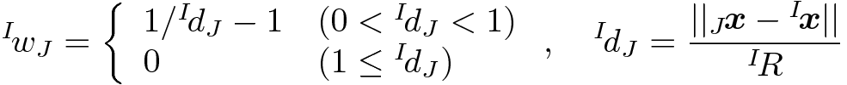
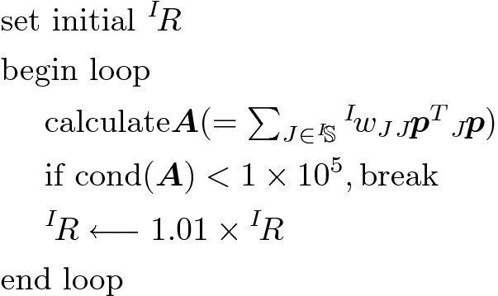

3. Robust MLS (approximation)
Weight function
not bell shape
but mountain shape
Support radius
(small)
^{I}R
^{I}R
^{I}R

Slide 13
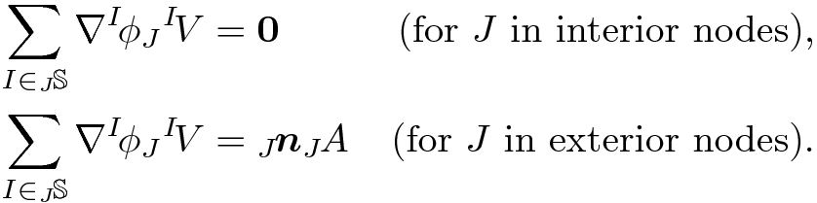

3. Robust MLS (integration correction)
Integration constraint
n: outward normal unit vector, A: correspoiding nodal area
_{J}S: set of SPs that include node J in the support
Integration correction (IC)
determine γ s so that modified ψ s satisfy reproducing constraints
including integration constraint

Slide 14
4. Quasi-implicit Time Advancing
Start of time increment loop
  Start of Newton-Raphson loop
    update support, w, φ, etc.
    calc f ^{int.} and K
    calc r = f ^{int.} -f ^{ext.}
    solve K δu = r
    update node locations
    update SP locations
  End of Newton-Raphson loop
End of time increment loop
Typical fully-implicit time advancing

Slide 15
4. Quasi-implicit Time Advancing
Start of time increment loop
  update support, w, φ, etc.
  renew f ^{virtual}
  Start of Newton-Raphson loop
    update support, w, φ, etc.
    calc f ^{int.} and K
    calc r = f ^{int.} -f ^{ext.} -f ^{virtual}
    solve K δu = r
    update node locations
    update SP locations
  End of Newton-Raphson loop
End of time increment loop
Constant shape function
in each
Newton-Raphson loop
Enforcement of
temporal continuity of the
mechanical equilibrium

Slide 16
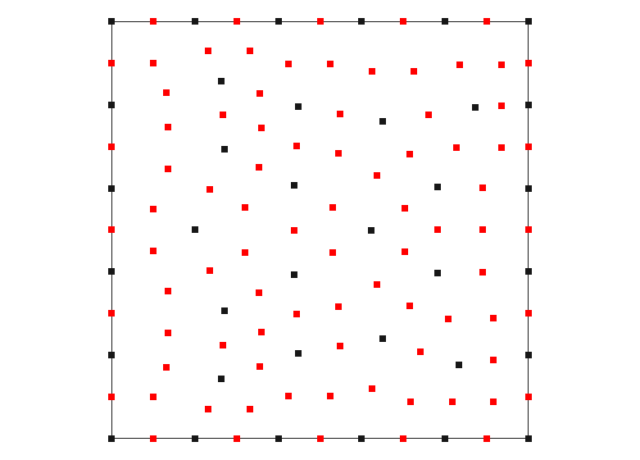

Patch Test
：node
：stress point
(SP)
Elastic body, Static, Plane-strain
Irregularly-arranged nodes and SPs
Displacement BC for every external nodes

Slide 17
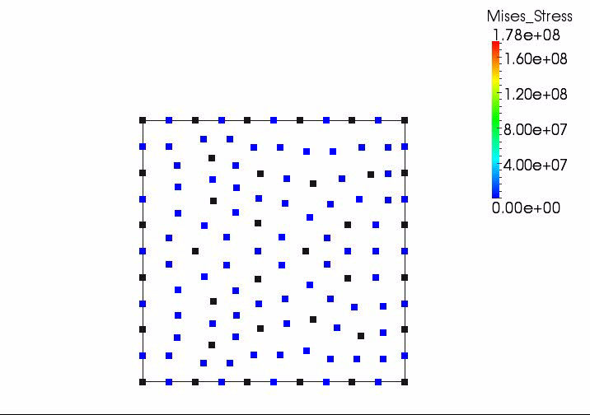
Patch Test (animation)

Slide 18
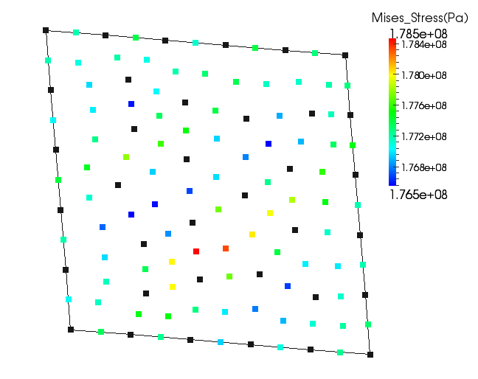
Patch Test (result)
within 1% error of Mises stress
Proposed method passes the patch test

Slide 19
Bending of Cantilever
Force
200 kN
Time
1s
100s
Elastic/Viscoelastic body
0.1m
1m
Static/Quasi-static, Plane strain
50x5 structured grid nodes
Concentrated force at right-top node
Compared to FEM(ABAQUS/Standard) with same node arrangements and selective reduced integration quadrangle elements

Slide 20
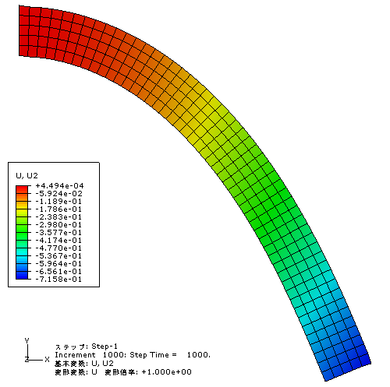
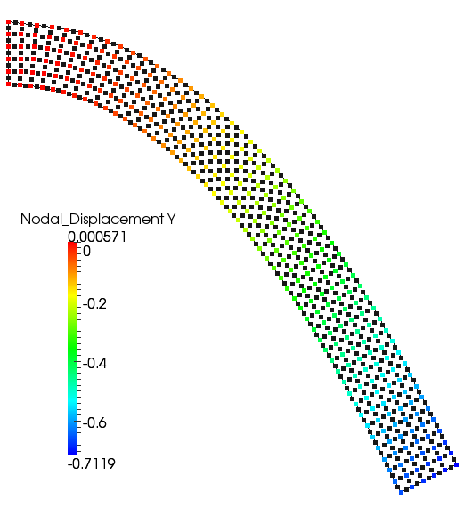
Bending of Cantilever (elastic)
E=1GPa, ν=0.481
ABAQUS/Standard Proposed Method
Less than 1% error of displacement
No problem in elastic large deflection analysis

Slide 21
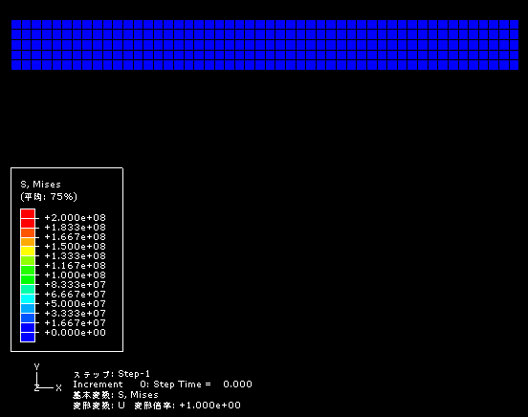
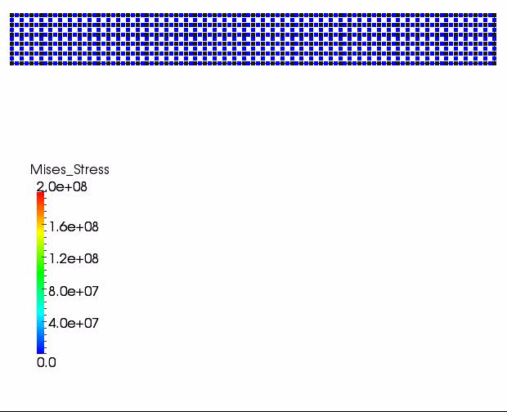
Bending of Cantilever (viscoelastic)
ABAQUS/Standard Proposed Method

Slide 22
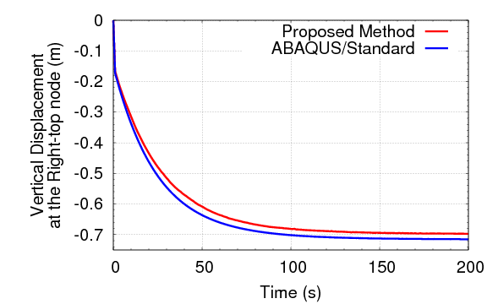
Bending of Cantilever (viscoelastic)
2.5% error of displacement
Error decreases as dt decreases
Further improvement of time-advancing scheme is necessary

Slide 23
Imprinting-like Analysis
Quasi-static, plane strain
Horizontal bounding for left and right side
Vertical bounding for bottom side
Enforced displacement for right half of top side toward downward with horizontal bounding
Unstructured grid with fineness and coarseness
0.5m disp.
in 100s
1m
1m

Slide 24
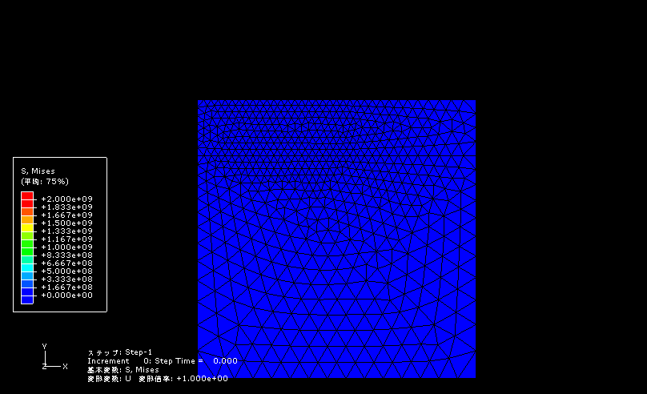
Imprinting-like Analysis (FEM)
Inappropriate deformation because of the locking under the corner

Slide 25
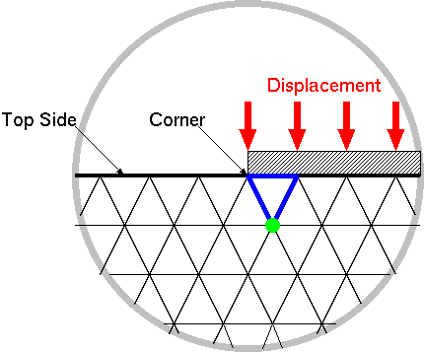
Imprinting-like Analysis (FEM)

Slide 26
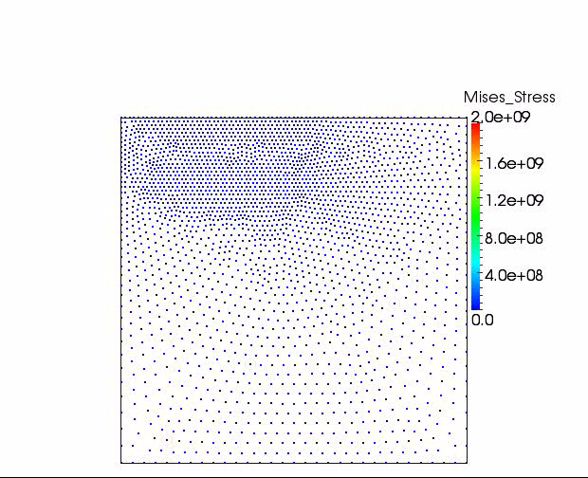
Imprinting-like Analysis (animation)
An appropriate result was obtained.

Slide 27
Summary & Future Work
Summary
  A Meshfree formulation of large deformation of viscoelastic body without BG cells was proposed.
  It passes the patch test.
  It has fair accuracy in large deflation analysis.
  Appropriate result is obtained in imprinting-like analysis.
  Further modification is required to apply it to thermal nanoimprint simulation.
Future work
  Improvement of time advancing scheme
  Verification with experiments or FEM with adaptive meshing
  Insertion of additional nodes and SPs during analysis
  Contact analysis

