Slide 1
Numerical modeling method to reproduce UV imprint process using thermo-viscoelastic constitutive law
R. YAMASHITA ª, Y. ONISHI ª, K. AMAYA ª, Y. HIRAI ^{b}
ª Tokyo Institute of Technology, Japan
^{b} Osaka Prefecture University, Japan

Slide 2
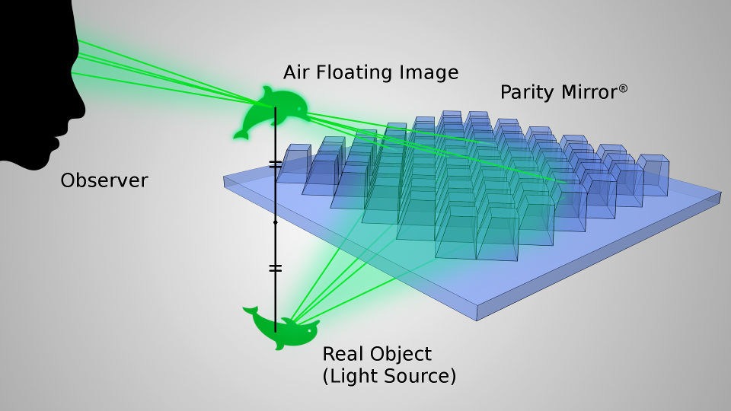
Background
UV imprinting is a low cost and high throughput production method.
It has been adopted to the production of various optical devices
requiring high surface accuracy such as micromirror array.
Mold
PDMS Mold
UV Resin
UV Exposure
& Demolding
UV Resin
Example of optical product produced by micro imprint.
Parity Innovations Co., Ltd.
https://www.piq.co.jp/about_e.html

Slide 3
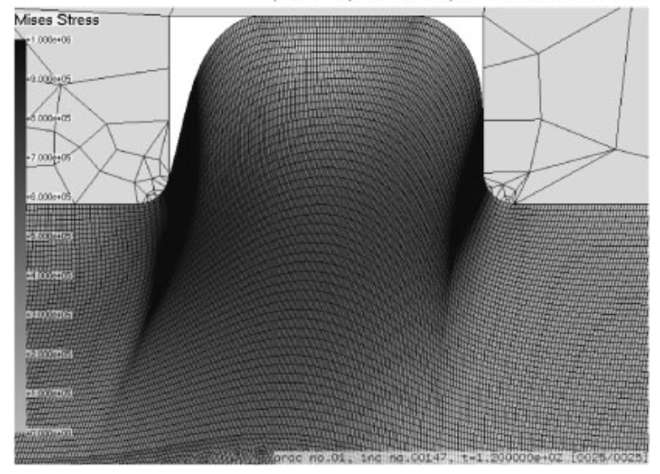
Issues
In the curing process, volume shrinkage of UV resin arises and
may cause unintended surface curvature when a soft mold such as PDMS is used.
There is no numerical modeling method to reproduce this type of error in UV imprint, although there are a few conventional methods for thermal imprint.
Unintended
Surface
Curvature
✘
Soft Mold
Soft Mold
UV
Exposure
Shrink
Demolding
UV Resin
UV Resin
UV Resin
Y. Onishi et al. Jpn. J. Appl. Phys. 47 5145 (2008)

Slide 4
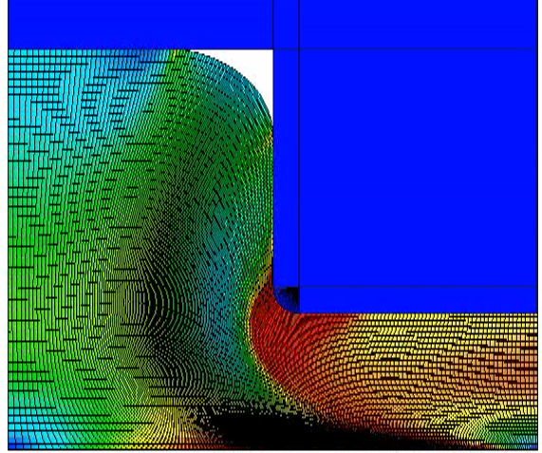
Brief of Conventional Method for Thermal Imprint Simulation
Thermo-viscoelastic constitutive model
  Thermal contraction is described with thermal
  expansion coefficient.
  Shear behavior is described with the time-
  temperature superposition principle and
  Prony series for the generalized Maxwell model.
  Volumetric behavior is assumed to be independent
  of strain rate and temperature.
Numerical simulation with the finite element
method (FEM)
τ₁
τ_{n}
G_{inf}
G₁
G_{n}
Our idea：
Similar numerical approach could be used for UV imprint simulation.

Slide 5
Objective
Propose a numerical method for UV curing process simulation.
Perform a numerical analysis for validation of the proposed numerical method.

Slide 6
Methods

Slide 7
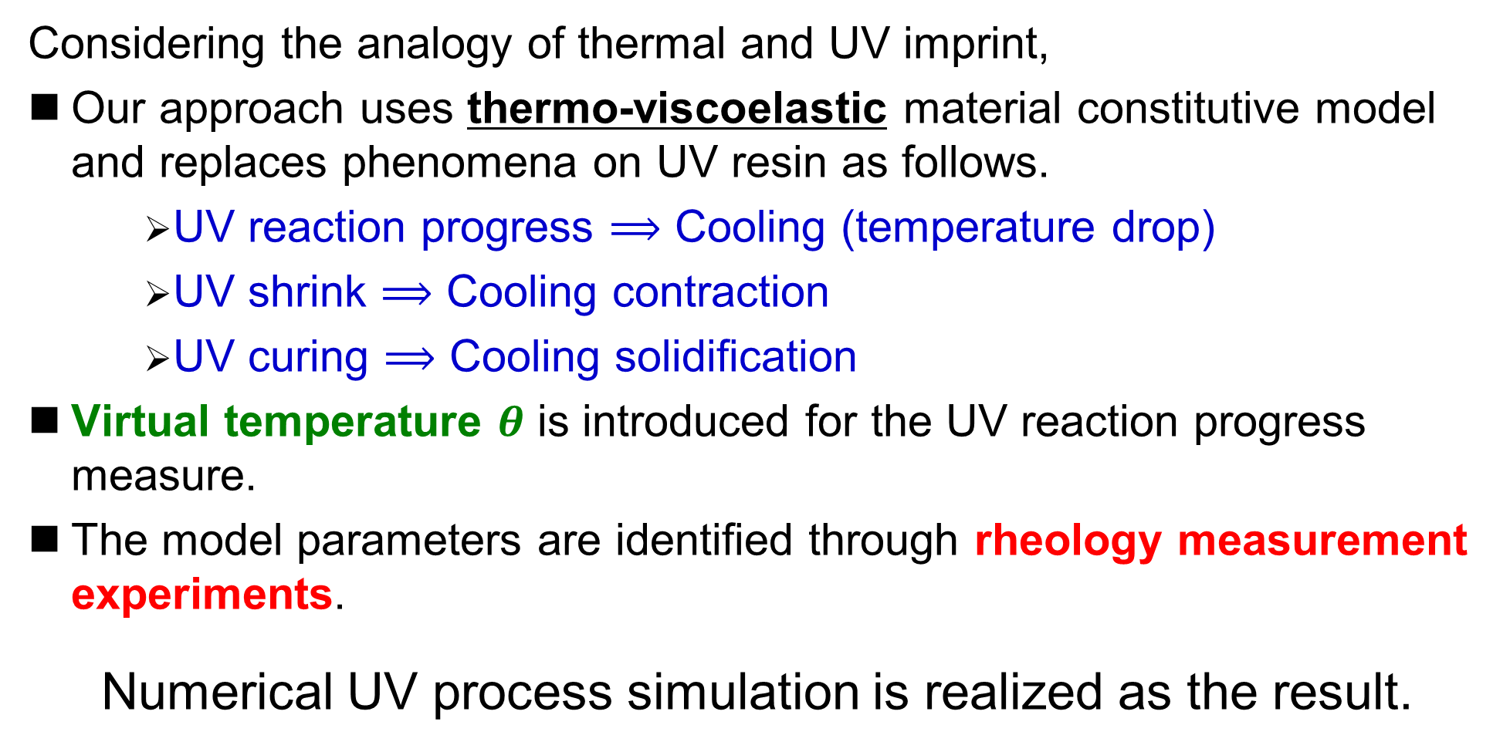
Overview of Our Method
Considering the analogy of thermal and UV imprint,
Our approach uses thermo-viscoelastic material constitutive model
and replaces phenomena on UV resin as follows.
    UV reaction progress $⟹$ Cooling (temperature drop)
    UV shrink $⟹$ Cooling contraction
    UV curing $⟹$ Cooling solidification
Virtual temperature $θ$ is introduced for the UV reaction progress measure.
The model parameters are identified through rheology measurement experiments.
Numerical UV process simulation is realized as the result.
Becomes similar to
thermal imprint simulation

Slide 8
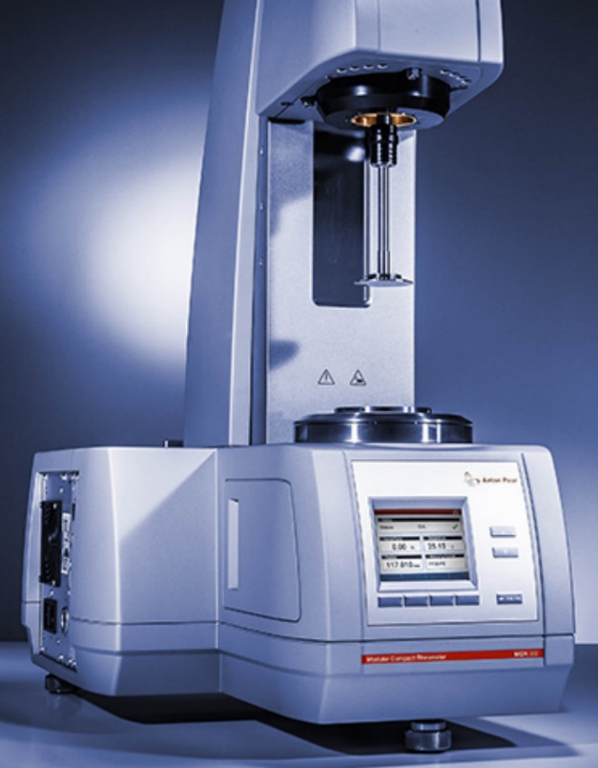
Experimental Conditions
Rotational oscillatory rheometer (Anton Paar MCR301) is used.
The measurement object is
a cationic polymerization-type UV resin
from Daicel Co..
Room temperature is 25℃ (const.).
UV exposure condition is constant
(30 s exposure in a constant intensity).
The oscillation frequency is varied
from 0.1 to 10 Hz.
The gap between the cylinder rod
and the glass plate changes over time
due to UV shrink.
Long time measurement is conducted
to consider the dark curing.
Small
Rotational Oscillation
Cylinder
Rod
Follow
Gap
Change
UV Resin
Gap
Glass Plate
Anton Paar MCR series
https://www.anton-paar.com/corp-en/products/details/rheometer-mcr-102-302-502/
UV Light
Intensity
0 30 time (s)

Slide 9
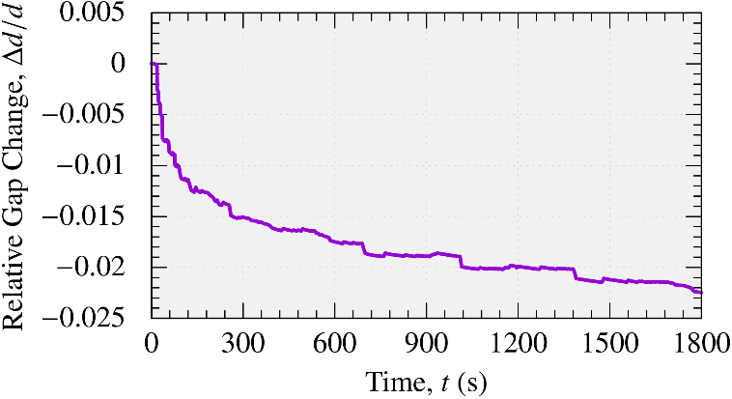
Relative Gap Change (Experimental Result)
Time History of Relative Gap Change
Note: the time history of the relative gap change is always the same in all cases
(∵ UV exposure condition is constant).
UV shrink progresses with time, and the shrink speed gradually decreases.

Slide 10
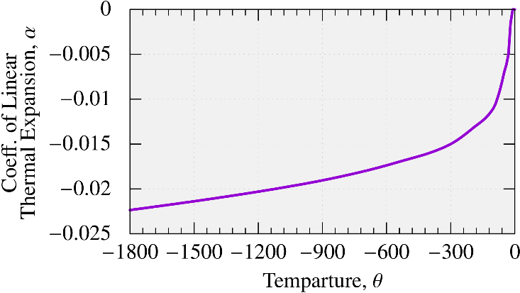

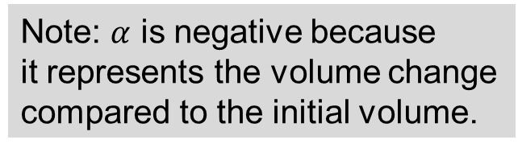
Relative Gap Change (Model Parameter Identification)
UV shrink is modeled as thermal (cooling) contraction.
The time history of virtual temperature is given as $θ\left(t\right)=−t$.
(Note that $θ$ is not a real physical quantity but just a virtual value.)
The time history of relative gap change is converted into the virtual temperature-dependent coefficient of thermal expansion.
Virtual Temperature-
Dependent Coefficient of
Thermal Expansion
Note: $α$ is negative because
it represents the volume change
compared to the initial volume.
Virtual

Slide 11
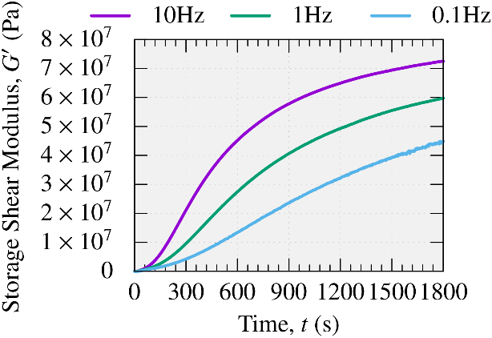
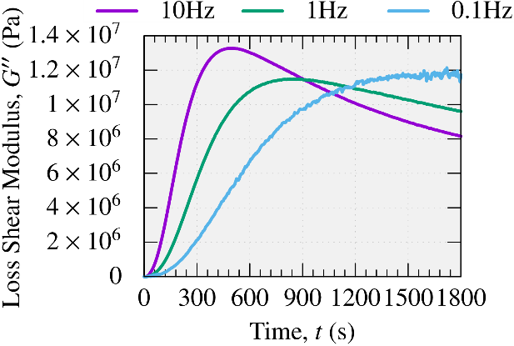

Viscoelasticity (Experimental Result)
Time History of Storage / Loss Shear Modulus ($G^{′}/G′′$)
Depending on the frequency, the time histories of $G′$ and $G′′$ are different
(harder at higher frequencies).
At any frequency, UV resin monotonically hardens with time.

Slide 12
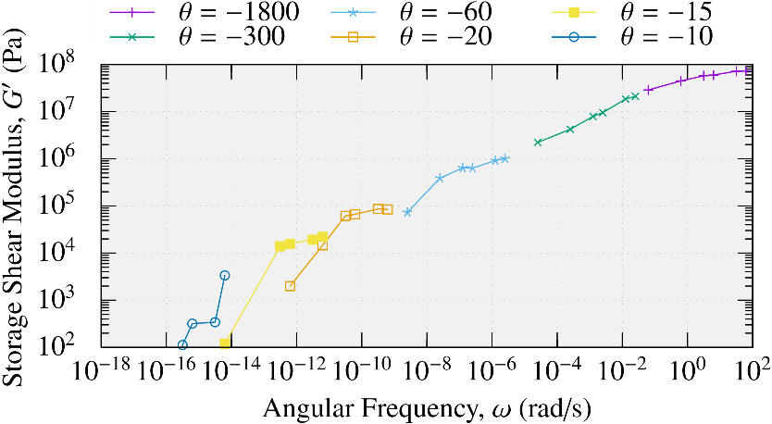

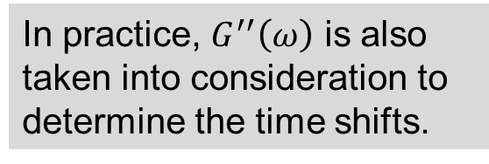






Viscoelasticity (Model Parameter Identification 1/2)
UV resin is modeled as viscoelastic material based on the time-temperature superposition principle and Prony series for the generalized Maxwell model.
The reference virtual temperature is set as $θ^{ref}=−1800$.
Pick $G′$s and $G′′$s at various $θ$s and identify each time shift.
Time-Shifted
Storage Shear Modulus
$G^{′}\left(ω\right)$ at $θ^{ref}$
(Master Curve)
Measurement at $θ=θ^{ref}$
Shift for $θ=−300$
Shift for $θ=−60$
Shift for $θ=−20$
In practice, $G^{′′}\left(ω\right)$ is also taken into consideration to determine the time shifts.
Shift for $θ=−15$
Shift for $θ=−10$
P. 12

Slide 13
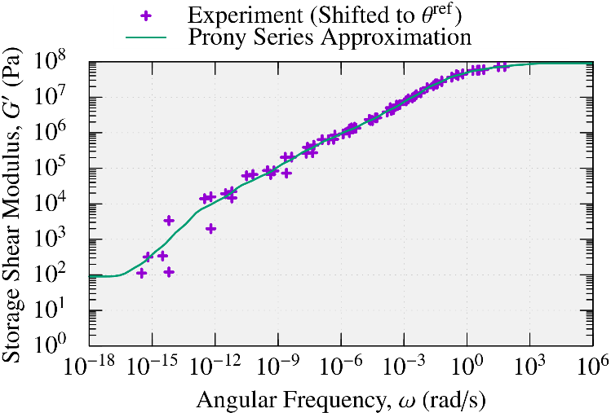
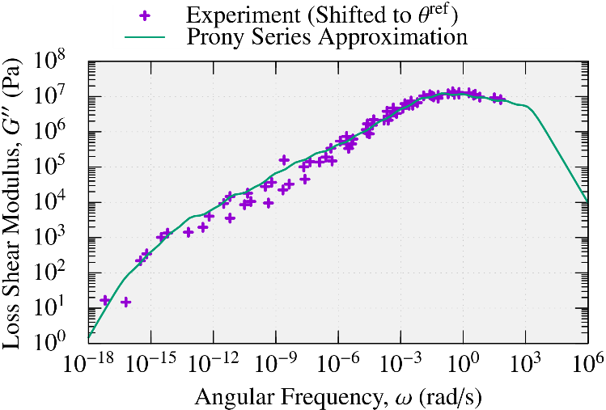
Viscoelasticity (Model Parameter Identification 2/2)
Find the Prony series coeffs by fitting the master curve at the reference temp.
Storage / Loss Shear Modulus at Reference Temp. Expressed by Prony Series
From the above, the constitutive model of thermo-viscoelasticity
to simulate UV shrink and curing were identified.

Slide 14
Result & Discussion

Slide 15
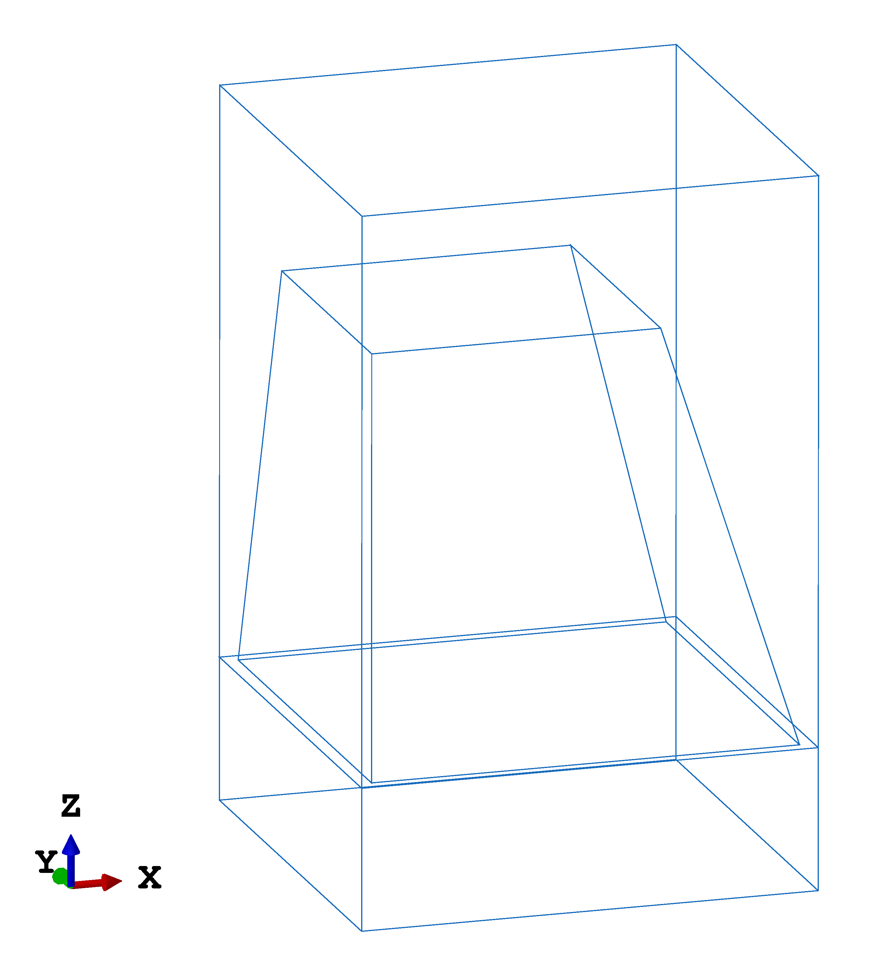




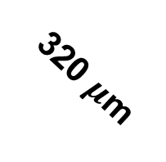

UV Curing Process Simulation (Outline)
Commercial finite element code, ABAQUS, is adopted.
Target pattern is a micromirror array.
The mold pattern is periodic and thus
only one pattern is taken into account
with periodic boundary conditions.
Mold cavity is filled with UV resin at the initial state.
Virtual temperature is given as $θ\left(t\right)=−t$.
UV exposure condition is exactly the same as
that of the rheology measurement experiments.
(30 s exposure in a constant intensity).
Demolding is conducted 100 s after the end of
UV exposure.
Curvature on top surface of UV resin is evaluated
enough after the demolding (6000 s).
3D View
PDMS Mold
1000 $μ$m
300 $μ$m
Top Surface
of UV Resin
200 $μ$m
UV Resin
320 $μ$m
320 $μ$m

Slide 16
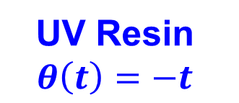
UV Curing Process Simulation (Outline)
Commercial finite element code, ABAQUS, is adopted.
Target pattern is a micromirror array.
The mold pattern is periodic and thus
only one pattern is taken into account
with periodic boundary conditions.
Mold cavity is filled with UV resin at the initial state.
Virtual temperature is given as $θ\left(t\right)=−t$.
UV exposure condition is exactly the same as
that of the rheology measurement experiments.
(30 s exposure in a constant intensity).
Demolding is conducted 100 s after the end of
UV exposure.
Curvature on top surface of UV resin is evaluated
enough after the demolding (6000 s).
Demolding
2D Cut View
Non-slip &
Non-separation
Contact
PDMS Mold
Top Surface
of UV Resin
UV Resin
$$θ\left(t\right)=−t$$
Periodic Boundary Condition

Slide 17
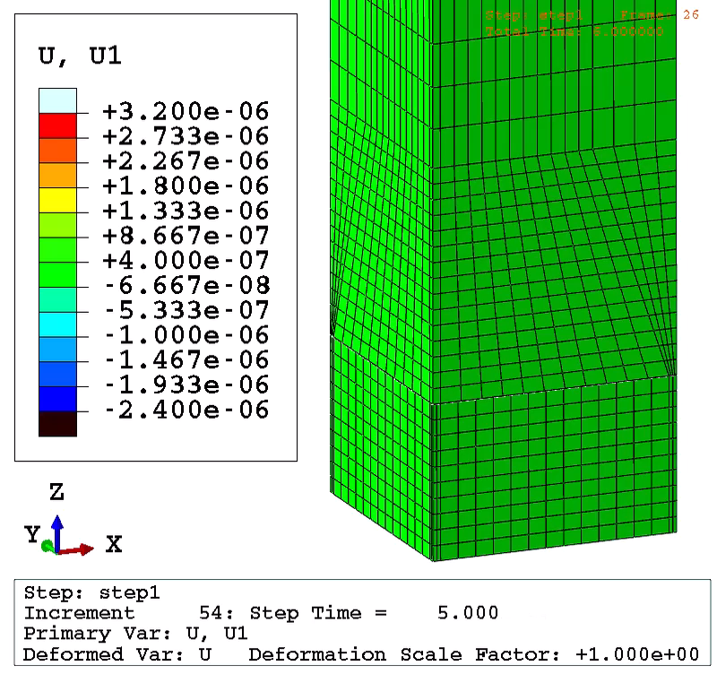
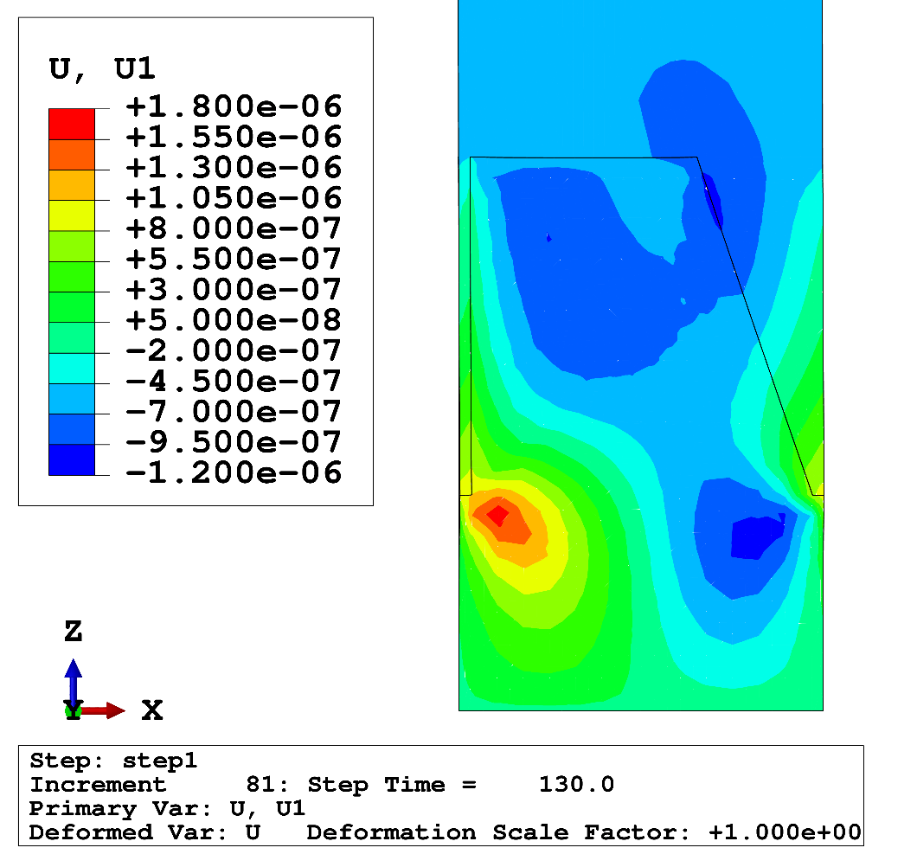
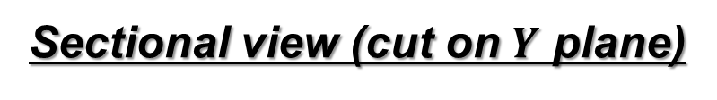
UV Curing Process Simulation (Simulation Result)
Displacement Dist. in X Direction
Right before
Demolding
3D view
Sectional view (cut on $Y$ plane)
Surface curvature due to the UV shrink of resin and the mold deformation is observed.
Flow of UV resin due to the
UV shrink is observed.

Slide 18
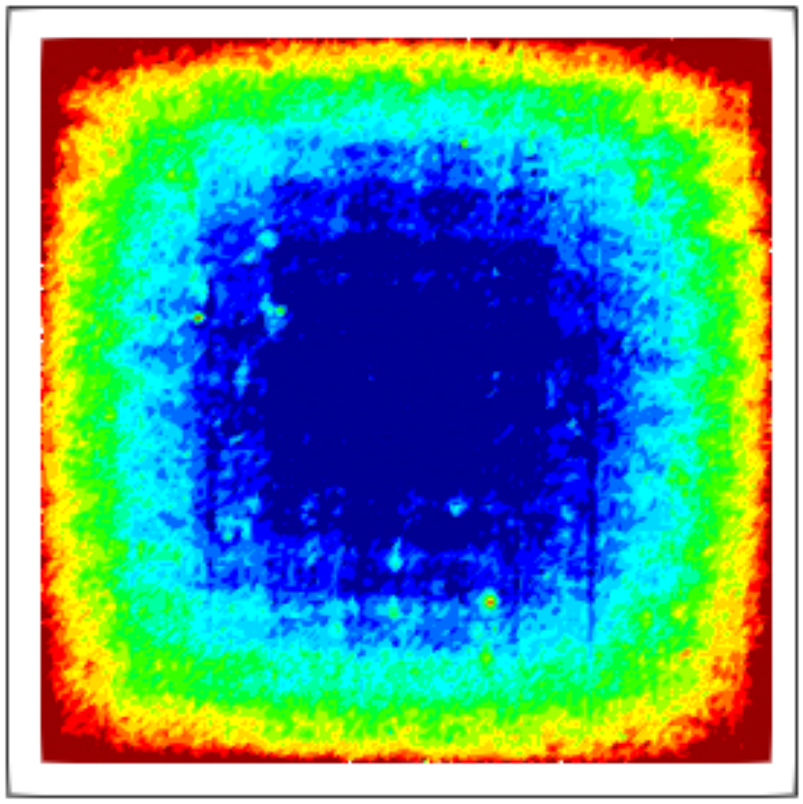
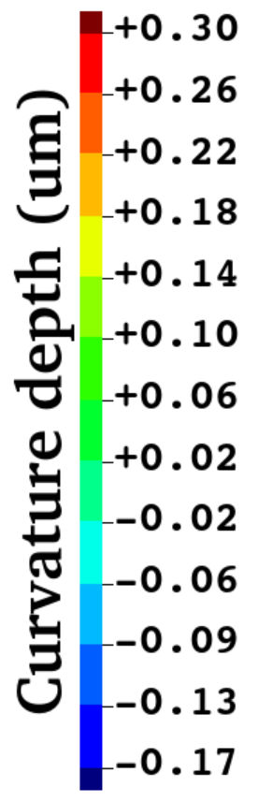
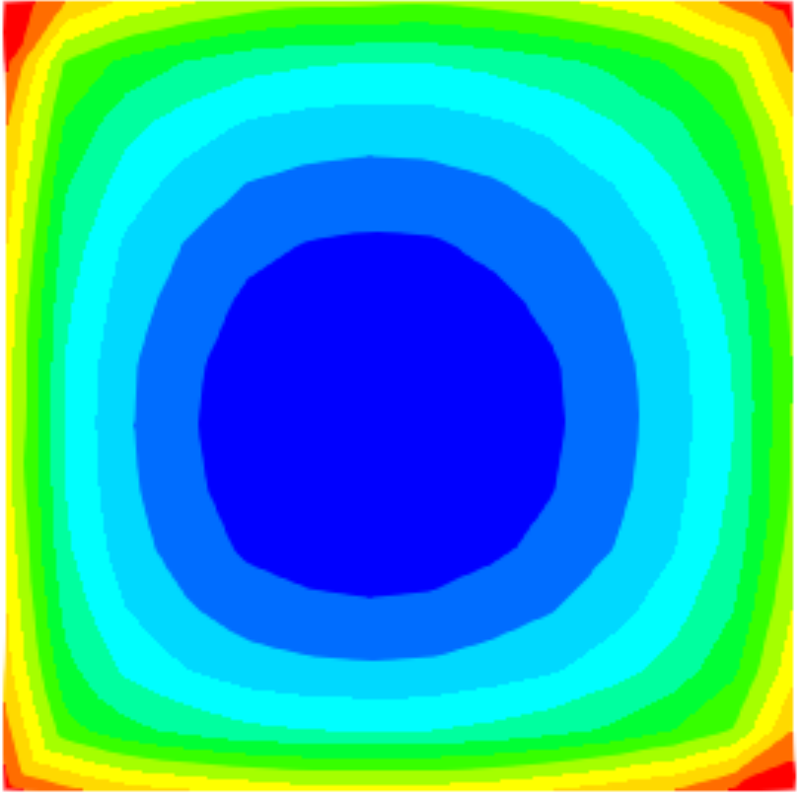





UV Curing Process Simulation (Validation)
Curvature Depth Dist. on Top Surface
200 $μ$m
200 $μ$m
Actual
micromirror array
Experimental Result
(Measured with laser microscope
VK-X100, KEYENCE Co.)
200 $μ$m
Simulation Result
Max. depth: about 0.75 $μm$
Max. depth: about 0.47 $μm$
✔ Simulation result agreed with the experimental measurement data qualitatively.
✘ However, maximum curvature depth of simulation is smaller than experimental one.

Slide 19
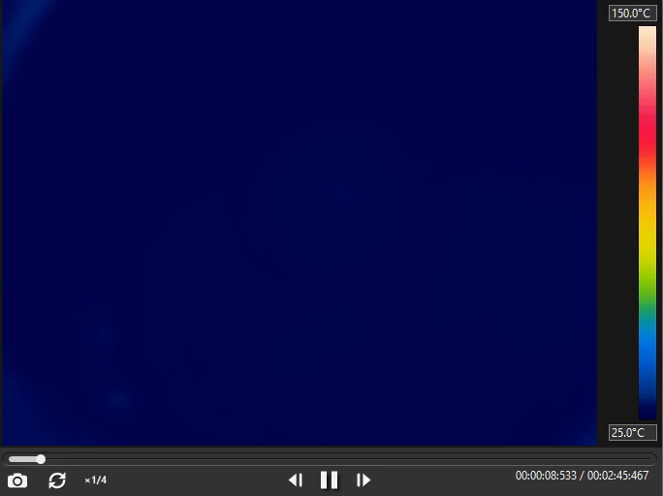
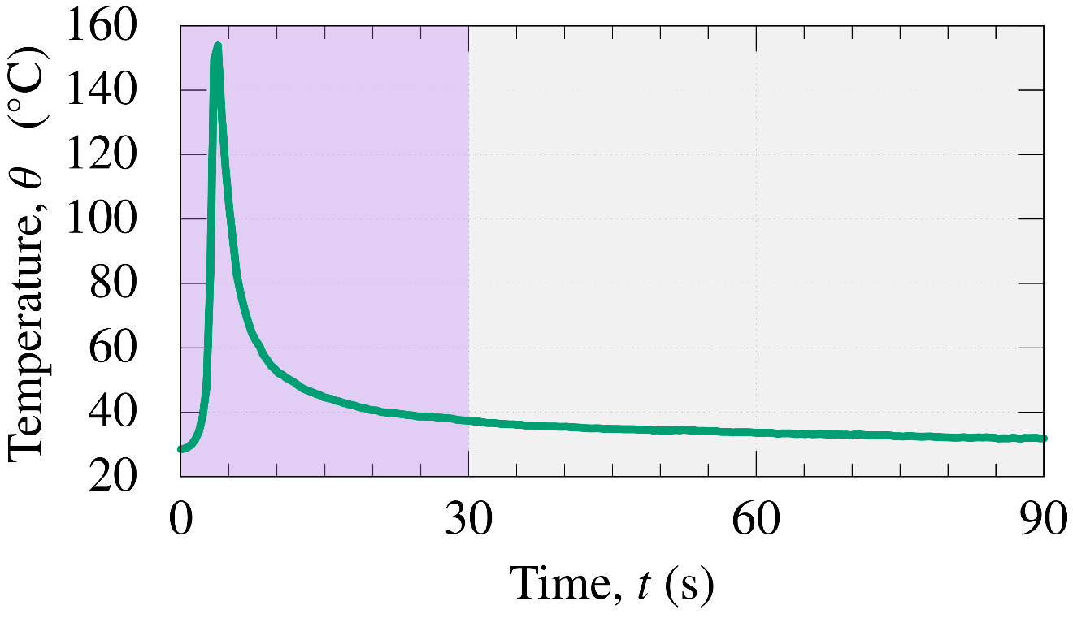


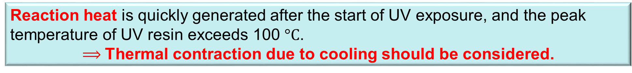
Why curvature depth of simulation is small?
Temperature time history of UV resin during UV reaction
(Stage temp. $25 °C$，UV intensity $300 mW/cm^{2}$, 500 $μ$m thick )
Temperature time history of resin center
Recorded by thermography (FLIR C2)
Peak temp. at 4 s
$$150 °C$$
UV exposure
for 30 s
~ 20 mm
Temp. drop can cause thermal contraction!
$$25 °C$$
Reaction heat is quickly generated after the start of UV exposure, and the peak temperature of UV resin exceeds 100 $°C$.
$⟹$Thermal contraction due to cooling should be considered.

Slide 20
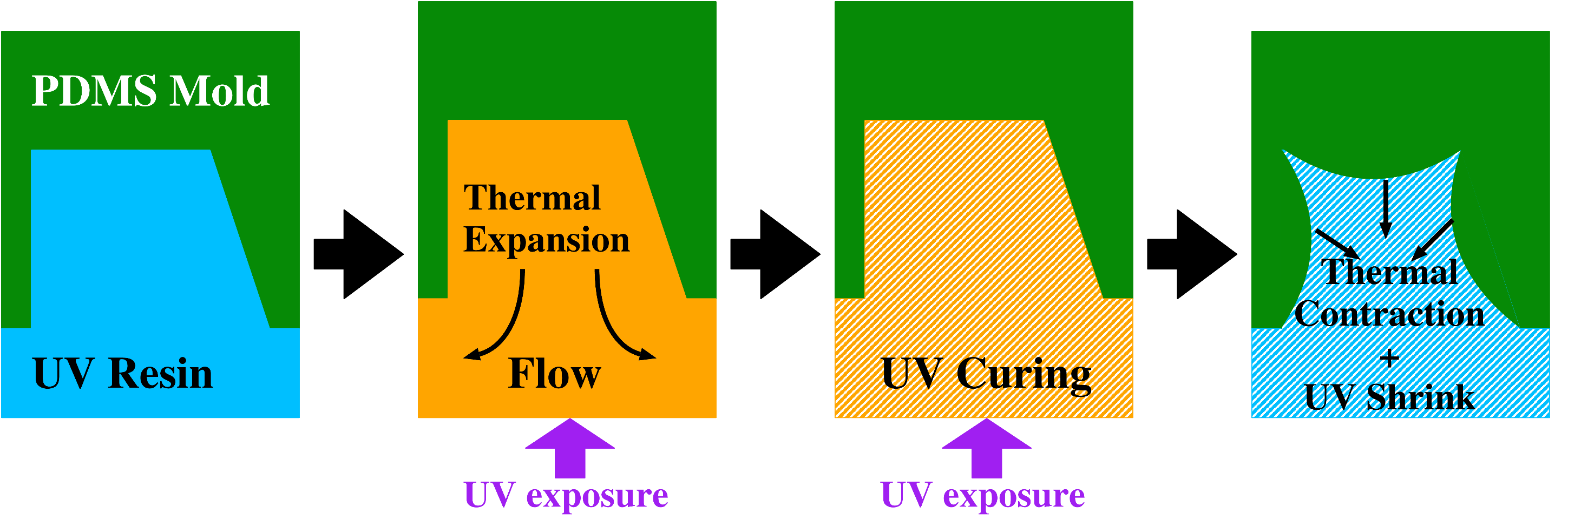
Why curvature depth of simulation is small?
Mechanism of surface curvature of UV resin formed by thermal contraction (Hypothesis)
Reaction heat generated
Double Effect!?
Temp: low
Viscosity: low
UV shrink: yet
Temp: high
Viscosity: low
UV shrink: yet
Temp: high
Viscosity: high
UV shrink: yet
Temp: low
Viscosity: high
UV shrink: done

Slide 21
Summary

Slide 22
Summary
A numerical modeling method for UV shrink & curing simulation
using thermo-viscoelastic model was proposed.
The model parameters were identified through the rheology measurement experiments.
A process simulation for micromirror array using PDMS mold
validated the qualitative accuracy on mirror surface curvature.
Our recent future works are below:
  Investigate the hypothesis to achieve the quantitative validation of our method.
  Improve our modeling method and simulation accuracy to aim for practical application.
Thank you for your kind attention.

Slide 23
Appendix

Slide 24
Limitation of Our Method
UV exposure condition to simulate must be exactly the same as that on the rheology measurement experiments.
The pattern size must be large enough to apply continuum approximation.

Slide 25
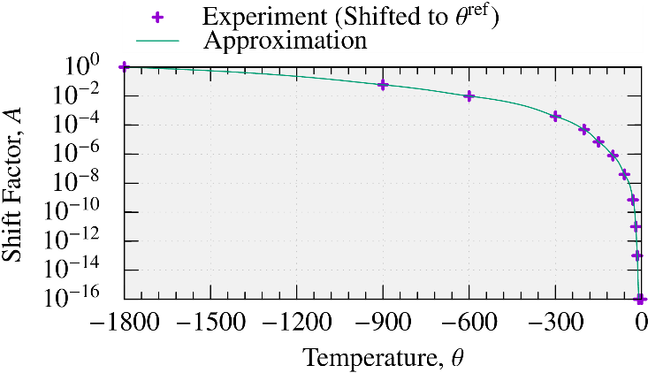

Viscoelasticity (Model Parameter Identification 2/3)
A virtual temperature-dependent shift factor (i.e., time-temperature superposition) is obtained by fitting the time-shifts at various temperatures.
Virtual Temperature-
Dependent
Shift Factor $A(θ)$

Slide 26

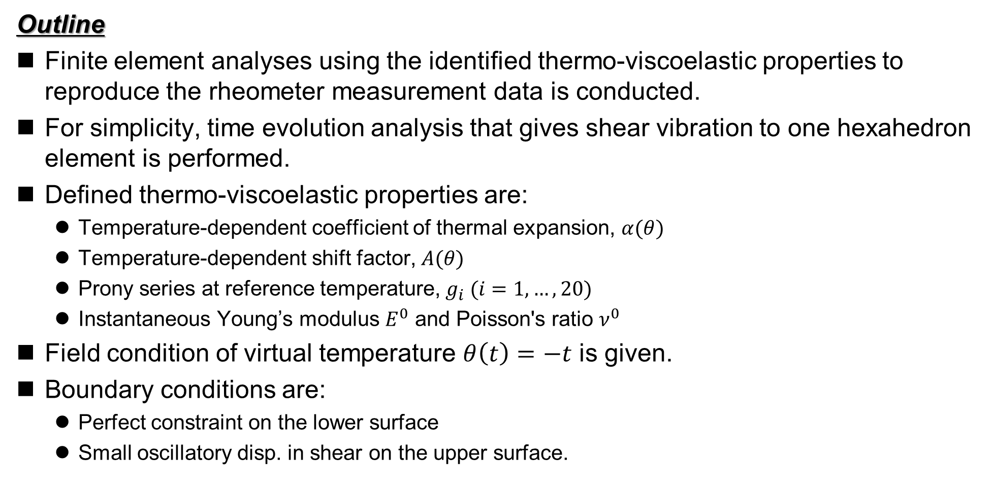
Validation of Material Constitutive Model
Outline
Finite element analyses using the identified thermo-viscoelastic properties to reproduce the rheometer measurement data is conducted.
For simplicity, time evolution analysis that gives shear vibration to one hexahedron element is performed.
Defined thermo-viscoelastic properties are:
  Temperature-dependent coefficient of thermal expansion, $α(θ)$
  Temperature-dependent shift factor, $A(θ)$
  Prony series at reference temperature, $g_{i} (i=1,…,20)$
  Instantaneous Young’s modulus $E^{0}$ and Poisson's ratio $ν^{0}$
Field condition of virtual temperature $θ\left(t\right)=−t$ is given.
Boundary conditions are:
  Perfect constraint on the lower surface
  Small oscillatory disp. in shear on the upper surface.
Small shear oscillation
$$θ\left(t\right)=−t$$

Slide 27
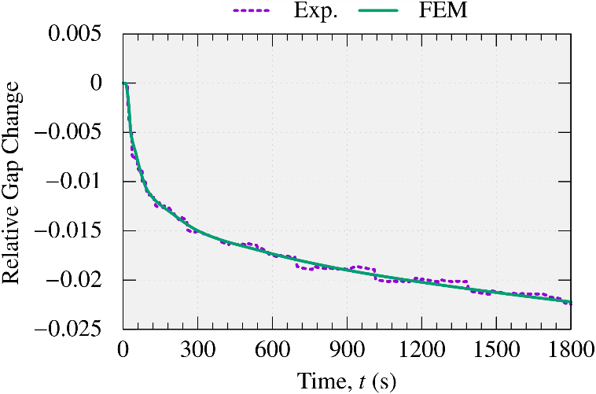
Validation of Material Constitutive Model
Time History of Relative Gap Change
The relative gap change is accurately simulated.

Slide 28
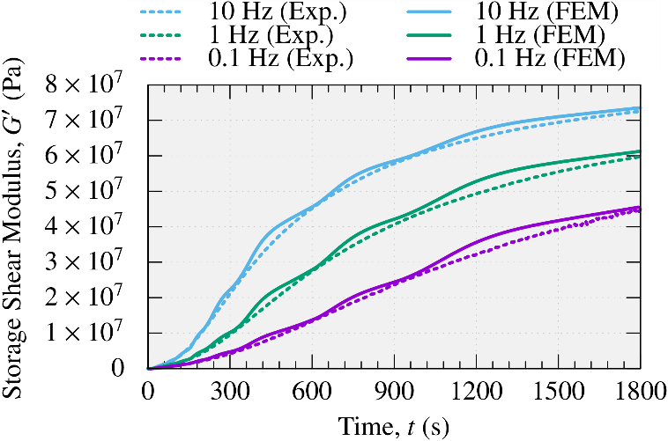
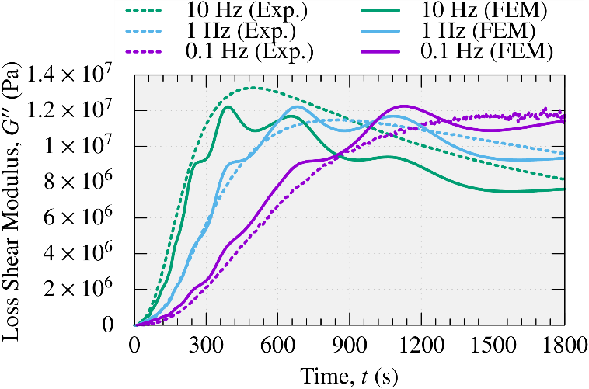

Validation of Material Constitutive Model
Time History of Storage / Loss Shear Modulus
The storage shear modulus $G′$ is accurately simulated.
On the other hand, minor problem remains in the accuracy of
the loss shear modulus $G′′$ because $G^{′}≫G^{′′}$.

Slide 29

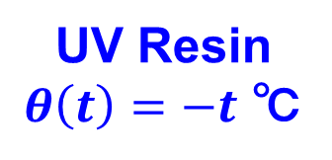
Steps of UV Process Simulation
Step 1: Stationary (1 sec.)
  Static analysis
  Start no-slip & no-separation contact
Step 2: UV exposure & Dark curing (130 sec.)
  Quasi-static analysis
  Lower UV resin virtual temperature: $θ\left(t\right)=−t$
Step 3: Demolding w/ Dark curing (10 sec.)
  Quasi-static analysis
  Remove no-slip & no-separation contact
  Lift mold upward
  Lower UV resin virtual temperature: $θ\left(t\right)=−t$
Step 4: Dark curing (6000 sec.)
  Quasi-static analysis
  Lower UV resin virtual temperature: $θ\left(t\right)=−t$
Displacement 400µm
Non-slip &
Non-separation
contact
PDMS Mold
UV Resin
$θ\left(t\right)=−t$ ℃
Periodic boundary condition
ABAQUS/Standard C3D8 is used for FE analysis.

Slide 30
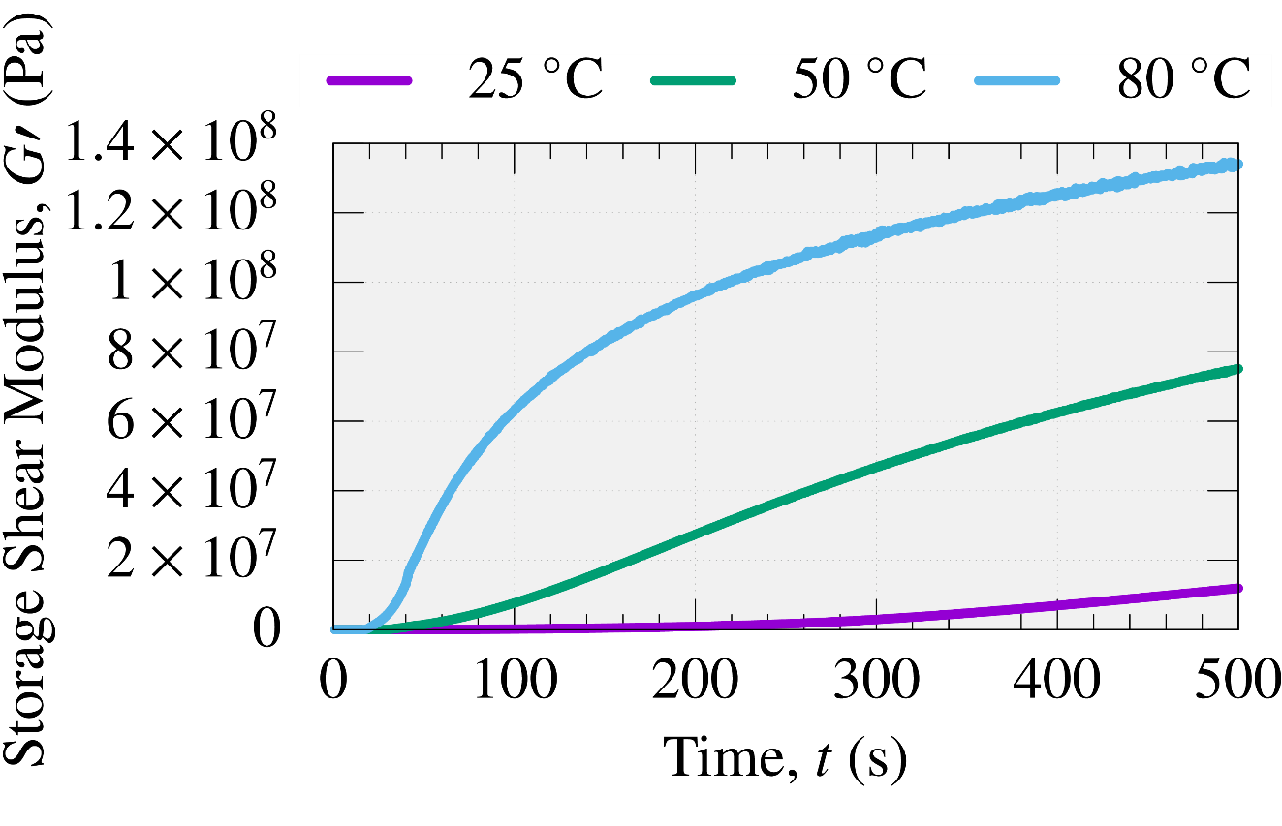
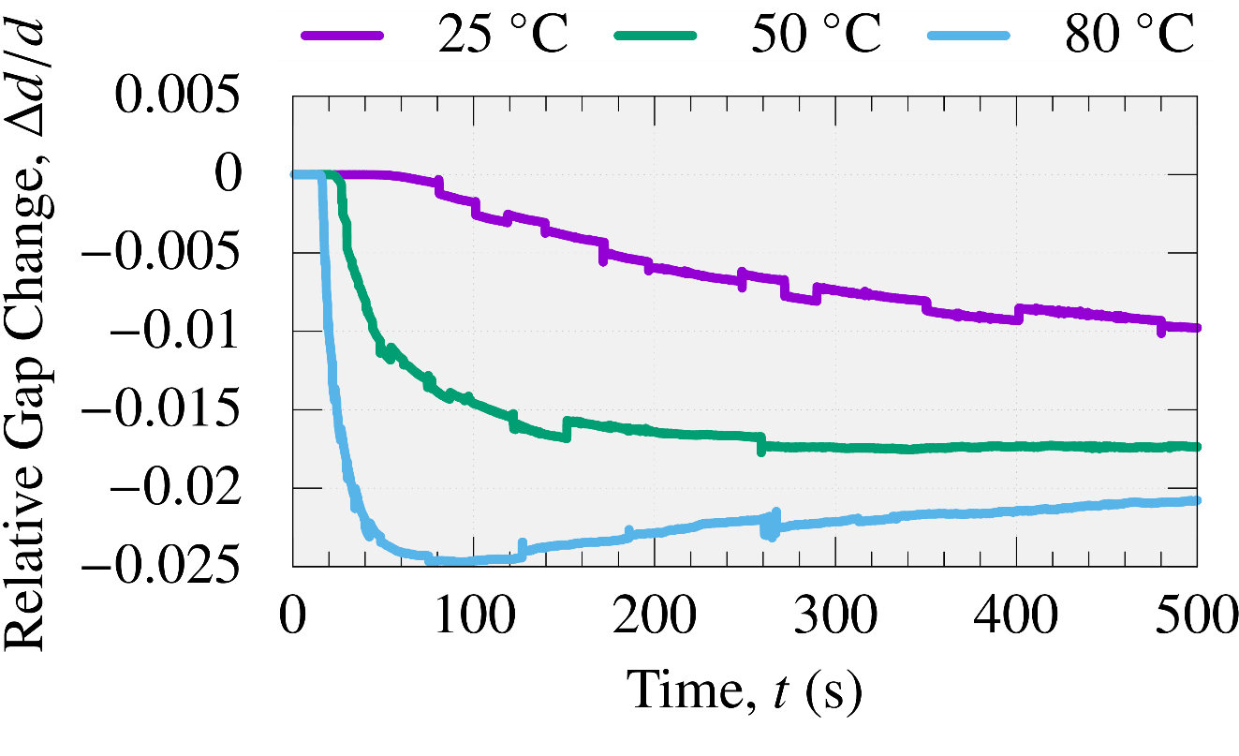


Acceleration of UV reaction by reaction heat
Rheology measurement results at various stage temperature (Frequency: $1 Hz,$ UV intensity: $25 mW/cm^{2}$)
Storage Shear Modulus $G^{′}$
Relative Gap Change
The higher temperature, the faster the UV reaction.
$⟹$ In the actual process, UV shrink can be accelerated by the reaction heat.

Slide 31
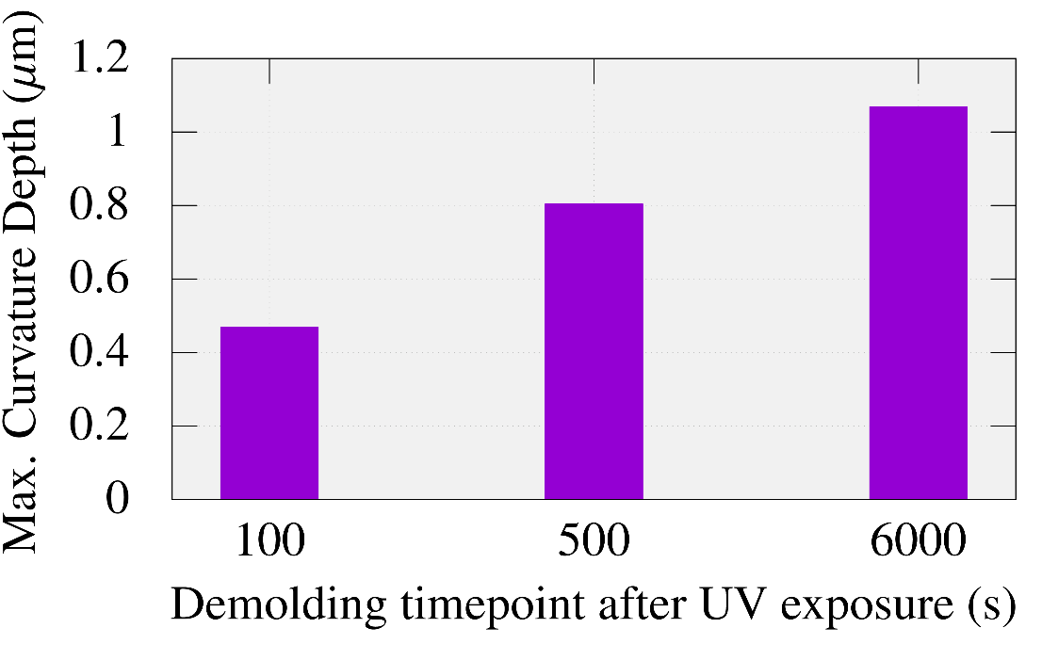
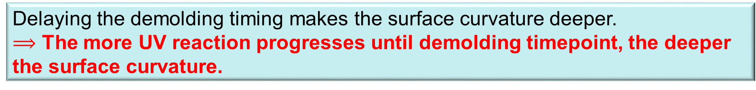
Effect of demolding timepoint on curvature depth
Relation between demolding timepoint and max. curvature depth
Delaying the demolding timing makes the surface curvature deeper.
$⟹$ The more UV reaction progresses until demolding timepoint, the deeper the surface curvature.

Slide 32
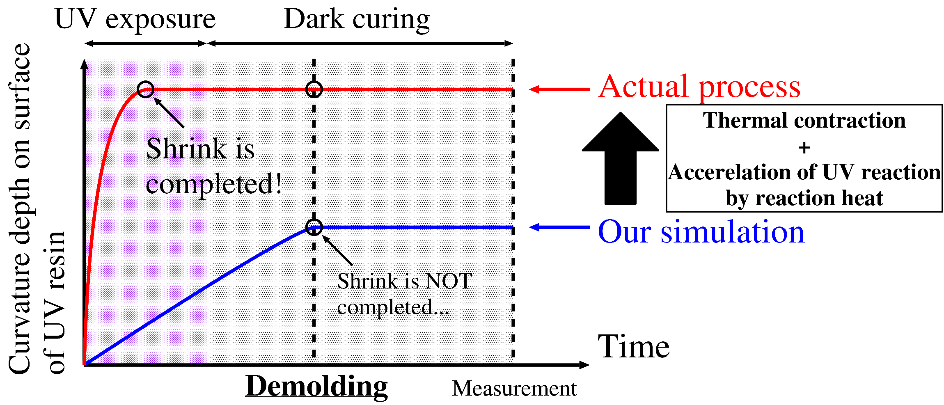
Why curvature depth of simulation is small?
In the simulation, UV shrink is not completed at the time of demolding, and the curvature depth at that time is observed.
In the actual process, UV shrink with thermal contraction has been completed before demolding, therefore the curvature depth becomes deeper than our simulation’s one.

Slide 33
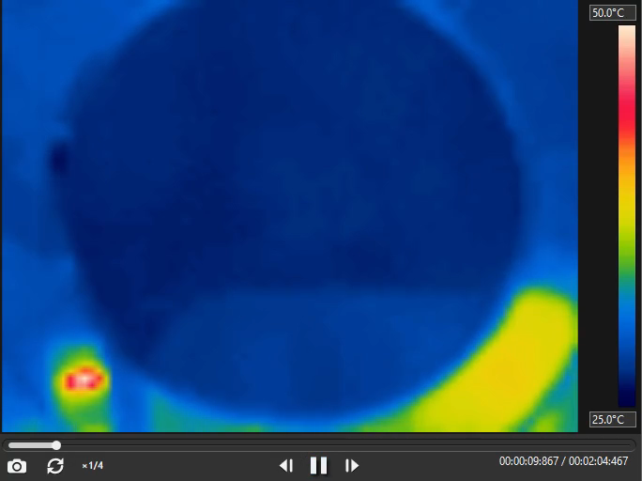
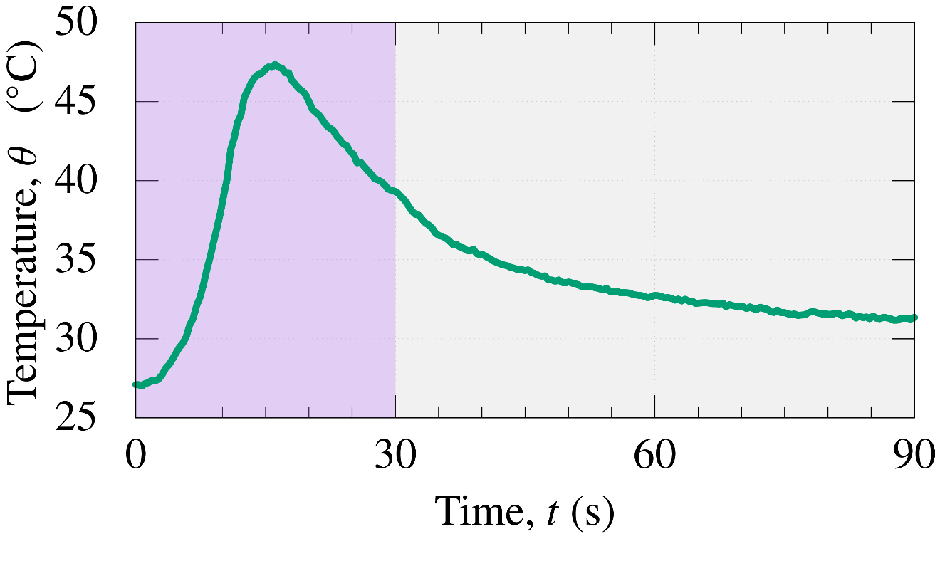

Why curvature depth of simulation is small?
Temperature time history of UV resin during UV reaction
(Stage temp. $25 °C$，UV intensity $50 mW/cm^{2}$, 500 $μ$m thick )
Recorded by thermography (FLIR C2)
Temperature time history of resin center
$$50 °C$$
Peak temp. at 15 s
~ 20 mm
UV exposure
for 30 s
$$25 °C$$

