Slide 1
Accurate Determination of
Inlet/Outlet Boundary Conditions in Vascular CFD Analysis using 4D-Flow Velocimetry
Tokyo Institute of Technology |  | Y. Onishi, K. Aoki, K. Amaya,
R'Tech Co. Ltd. |  | T. Shimizu, T. Kosugi,
Nagoya Univ. |  | H. Isoda,
Hamamatsu Univ. Hosp. |  | Y. Takehara,
Stanford Univ. |  | M. Alley
GEHC Japan |  | T. Wakayama

Slide 2
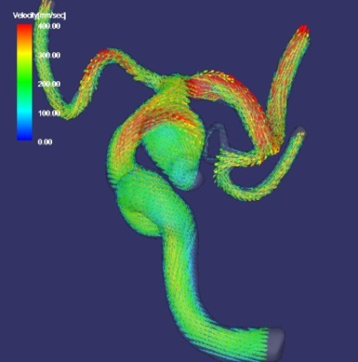
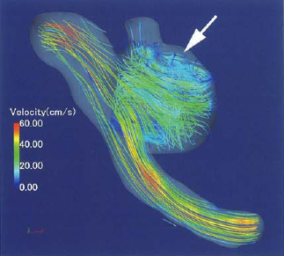
Introduction
Target of our research
Patient-specific vascular computational fluid dynamics (CFD) for intracranial aneurysms
Goal of our research
Accurate calculation of WSS, pressure, etc.
in aneurysms with CFD
Tool for clinical quantitative hemodynamic evaluation

Slide 3
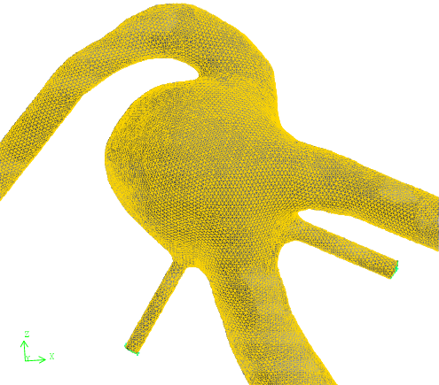

Introduction (cont.)
Three requirements for vascular CFD
  Accurate Extraction of Vascular Shape
  Accurate Setting of Blood Viscosity Model
  Accurate Determination of Inlet/Outlet BC
All of them are
essential for
the practical
vascular CFD.
Density
and
Viscosity?
Newtonian
or
Non-Newtonian?
Flow Rate,
Velocity
or
Pressure?
Accurate
Vasclular
CFD
+
+
$$⟹$$
In this study, we focus on
"3. Accurate Determination of Inlet/Outlet BC".

Slide 4
Conventional Methods
Conventional methods of BC determination
  Giving the standard (well-used) volume flow rate (VFR)
  Giving a VFR so that representative WSS is the standard
  Giving a Womersly velocity profile of the standard VFR
  Physical basis is too weak.
  Giving a velocity profile measured by
  2D/3D cine PC-MR.
  Measurement error (artifact) is too large.
The method to determine the inlet/outlet BC accurately have not been established yet.

Slide 5
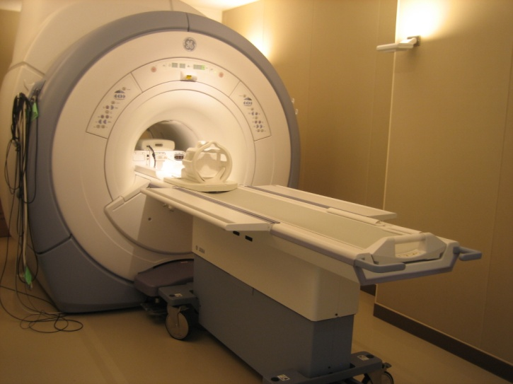
Objective
Objective
Propose a new method
to determine accurate inlet/outlet BC
for vascular CFD
using 4D-Flow
Table of contents
Part 1: Experiments for error evaluation of 4D-Flow
Part 2: Procedure of our BC determination method
Part 3: Validation experiments
Part 4: Summary

Slide 6
Part 1:
Experiments for error evaluation
of 4D-Flow

Slide 7
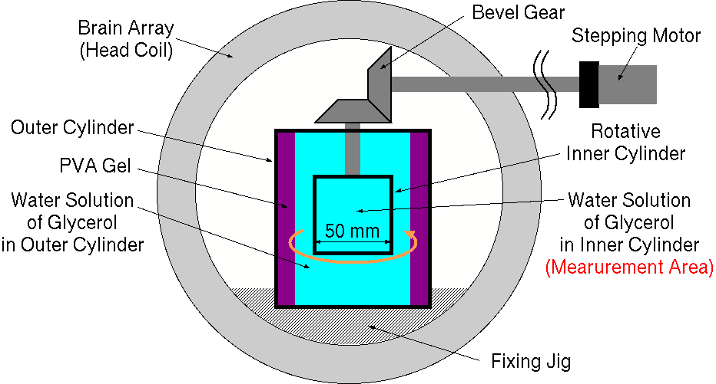
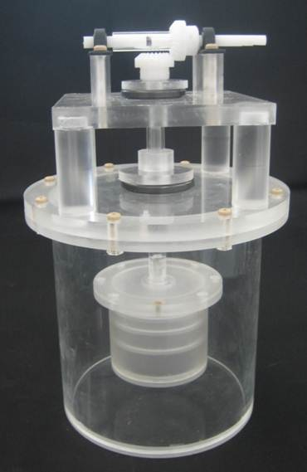

Error Eval. of 4D-Flow (Device)
Rotative phantom (nested two cylinders)
Water solution of glycerol of 40wt% (no contrast agents)
GEHC Signa HDxt 3.0T with 8ch brain array
Rotate the inner cylinder at a constant speed
$⇒$ inner fluid rotates rigidly

Slide 8
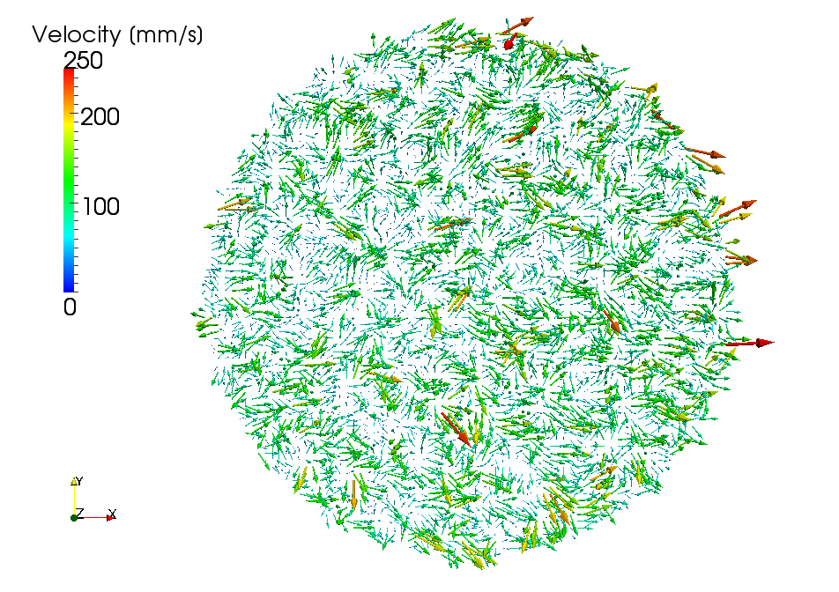
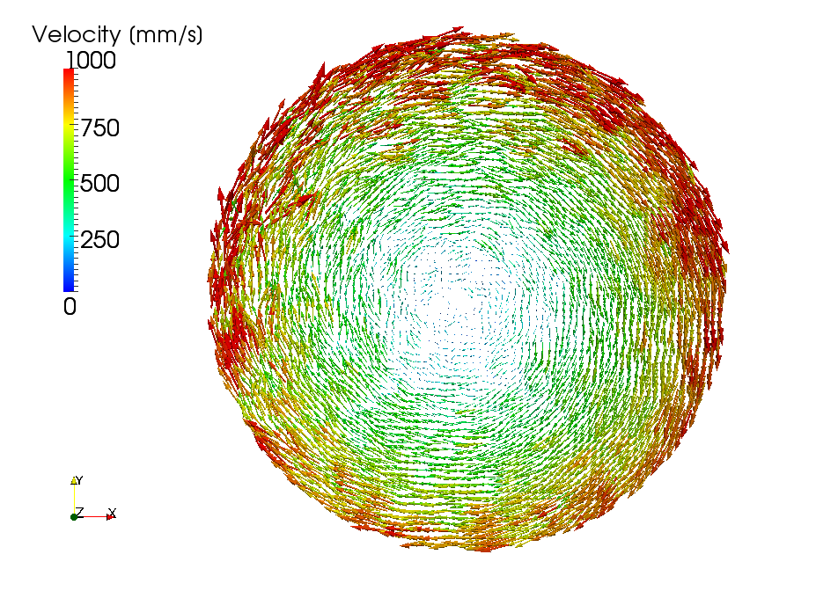
Error Eval. of 4D-Flow (Results)
Velocity distribution on a horizontal plane
Roughly agreed with actual velocity
Many pixel have apparently incorrect velocity
Seems to contain the random error
Rotating speed: 0 rpm
Rotating speed: 360 rpm

Slide 9
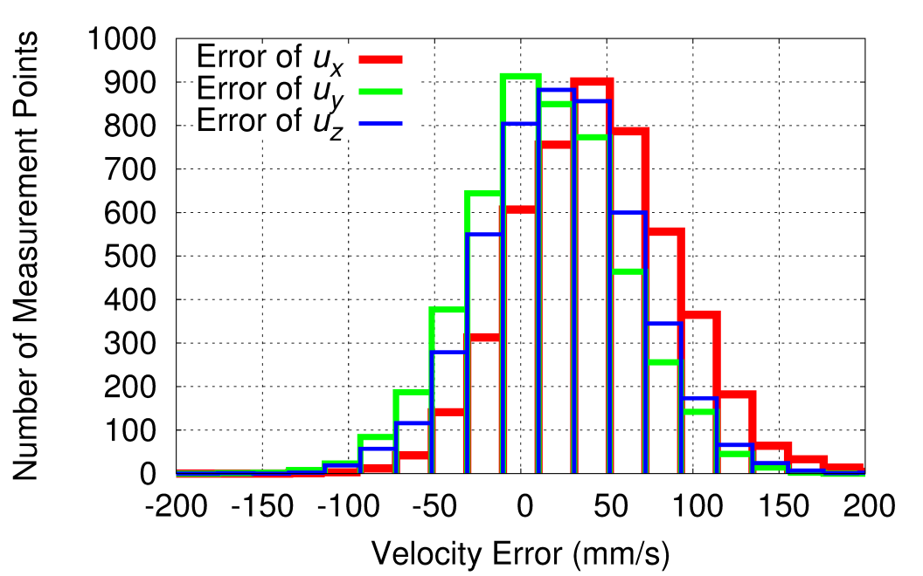
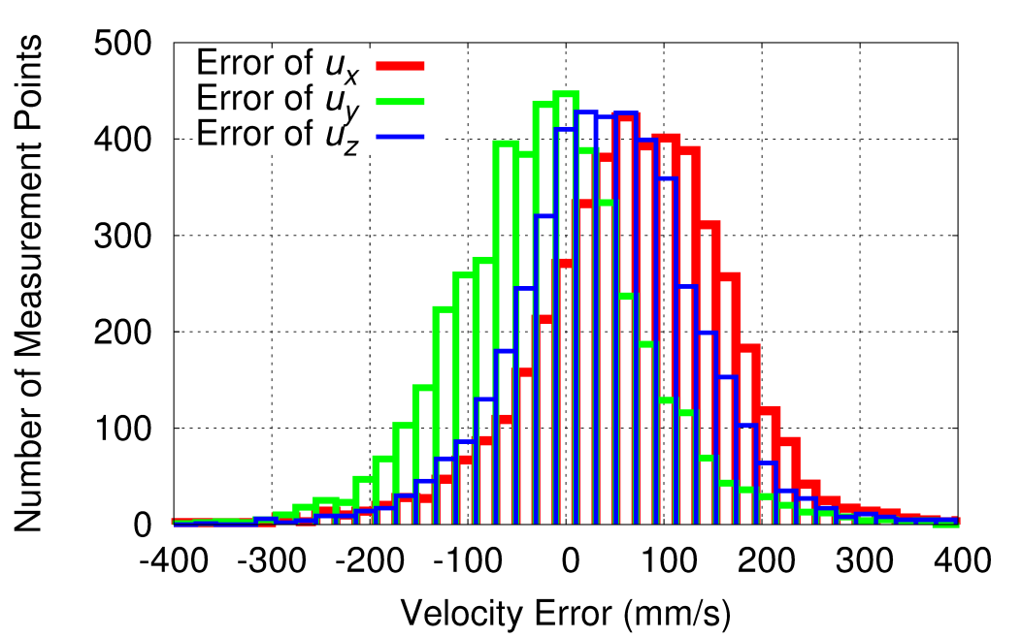

Error Eval. of 4D-Flow (Results)
Histogram of velocity component error
Calculate ${u_{i}^{\text{error}}=u}_{i}^{\text{measured}}−u_{i}^{\text{exact}} (i=x,y,z)$
Distributed normally with average $μ≃0$
Standard deviation is relatively large
(0 rpm: $σ=$34.5 mm/s, 360 rpm: $σ=$98.3 mm/s)
Rotating speed: 0 rpm
Rotating speed: 360 rpm

Slide 10
Error Eval. of 4D-Flow (Findings)
Findings through the experiment
The raw 4D-Flow velocity data at each pixel
is inaccurate, and thus unsuitable to be
directly assigned as the BCs
in vascular CFD analyses;
The averaged or lumped data calculated
from the raw 4D-Flow velocity data
(e.g. volume flow rate) can be accurate
according to the law of large numbers.

Slide 11
Part 2:
Procedure of our
BC determination method

Slide 12
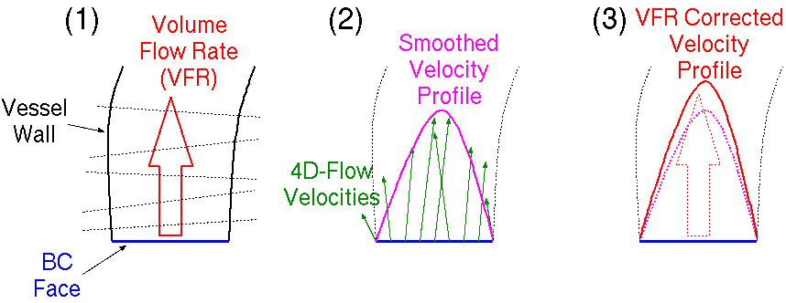
BC Determination Method
Procedure of our method
Estimation of
Volume Flow Rate
(VFR)
Smoothing of
Velocity Profile
Correction of
Velocity Profile
with VFR

Slide 13
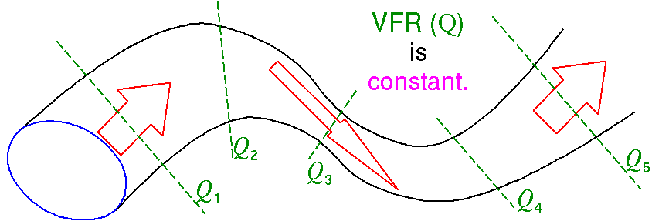
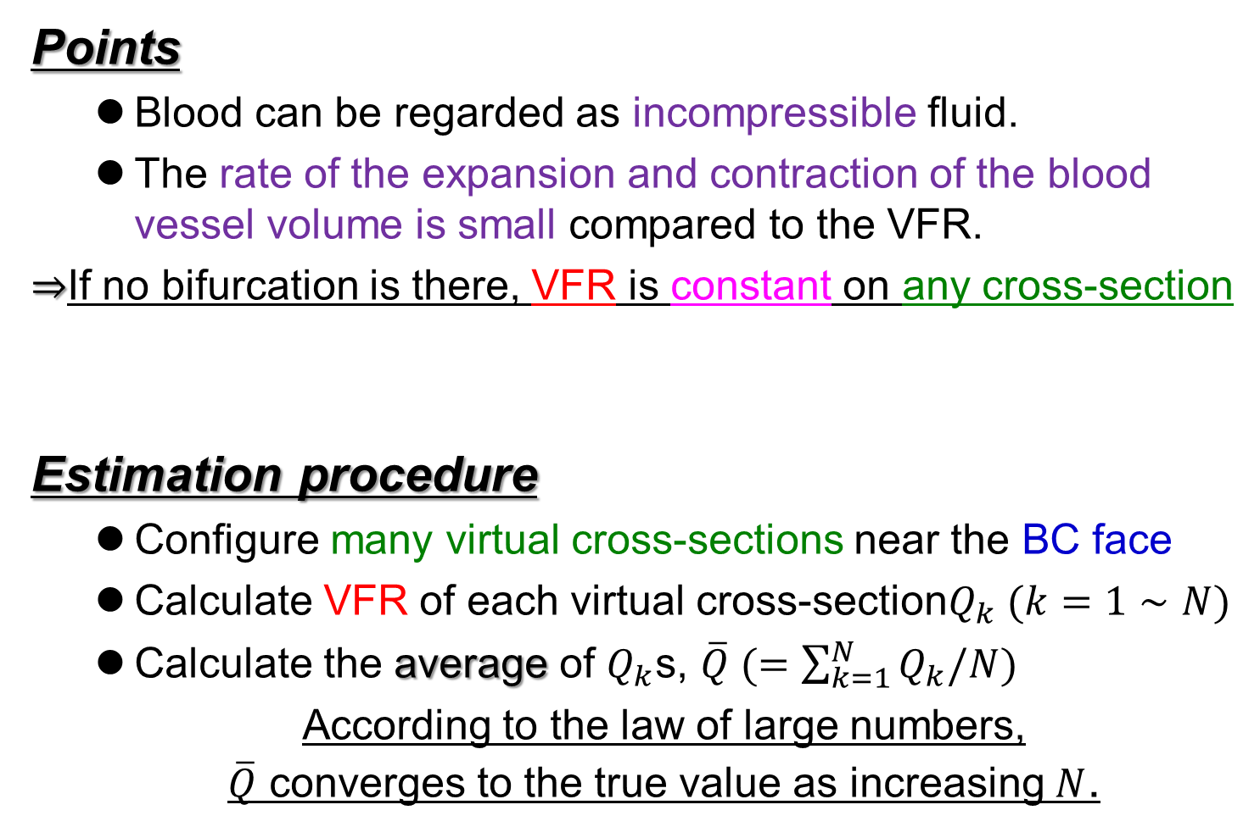
Procedure (1): Estimation of VFR
Points
  Blood can be regarded as incompressible fluid.
  The rate of the expansion and contraction of the blood vessel volume is small compared to the VFR.
$⇒$If no bifurcation is there, VFR is constant on any cross-section
Estimation procedure
  Configure many virtual cross-sections near the BC face
  Calculate VFR of each virtual cross-section$Q_{k} (k=1∼N)$
  Calculate the average of $Q_{k}$s, $\overline{Q} (=\sum_{k=1}^{N}{Q_{k}/N})$
  According to the law of large numbers,
  $\overline{Q}$ converges to the true value as increasing $N$.

Slide 14
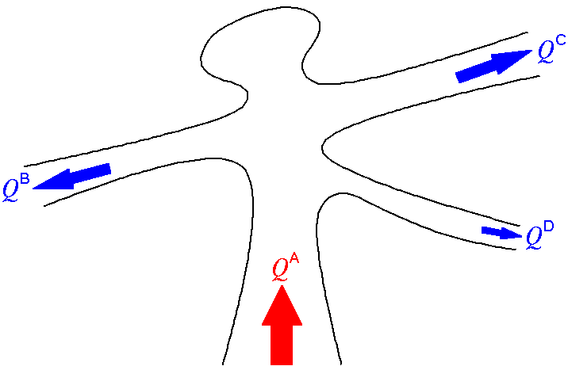
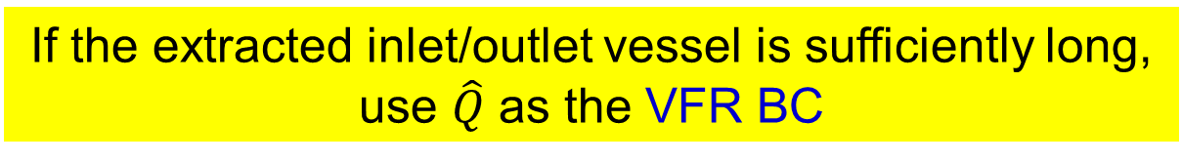


Procedure (1): Estimation of VFR
Estimation procedure (cont.)
  Correct $\overline{Q}$s of all inlets/outlets so that the sum of VFRs is exactly zero.
  e.g.)
  Set the corrected VFR ($\hat{Q}$) as the estimated VFR.
Constraint
$$\hat{Q^{A}} −\hat{Q^{B}}−\hat{Q^{C}}−\hat{Q^{D}}=0$$
Cost Function
$\sum_{i=A,B,C,D}{{\left(\hat{Q^{i}}−\overline{Q^{i}}\right)}^{2}}→\text{min}$
  If the extracted inlet/outlet vessel is sufficiently long,
  use $\hat{Q}$ as the VFR BC

Slide 15
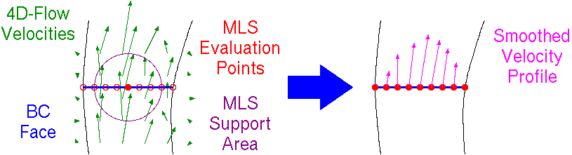

Procedure (2): Smoothing of Profile
Point
  Velocity profiles on BC faces obtained from the raw 4D-Flow data are jagged. $⇒$ Need smoothing with a low-pass filter.
Smoothing procedure
  Generate meshes over the BC face
  Interpolate the velocity at the center of each mesh
  using moving least square (MLS) method.

Slide 16
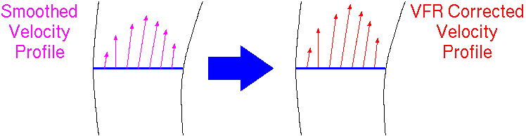

Procedure (3): Correction of Profile
Point
  Procedure (1) gives the accurate VFR ($\hat{Q}$).
  Procedure (2) gives a smooth velocity profile.
  $⇒$ modify the profile so that its VFR agrees with $\hat{Q}$
Correction procedure
  Magnify the velocities
  by a constant factor
  If the extracted inlet/outlet vessel is short,
use the VFR corrected velocity profile
as the velocity BC.

Slide 17
Part 3:
Validation experiments

Slide 18
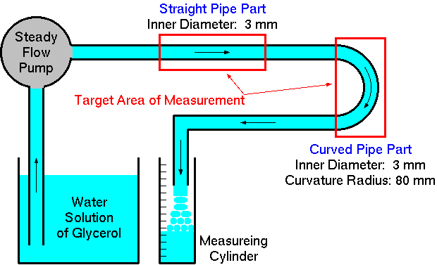
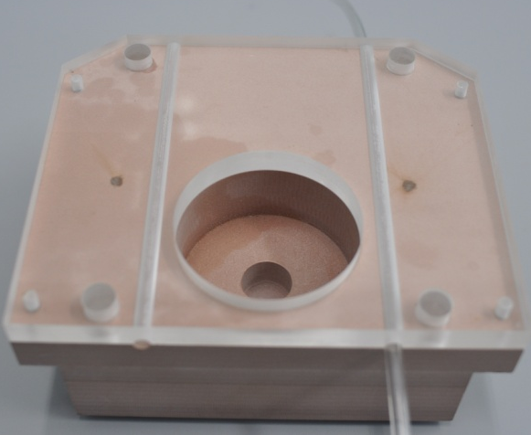
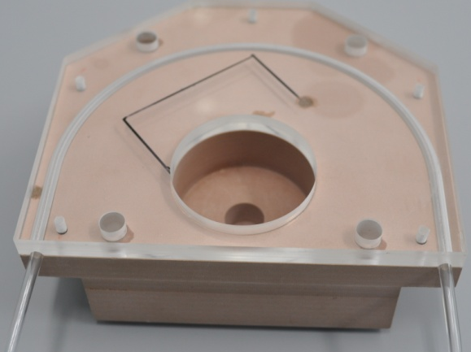

Validation Experiments (Device)
Straight and curved pipes of $φ$=3 mm
Water solution of glycerol of 40wt% (no contrast agents)
Steady laminar flow made by steady flow pump
Measuring cylinder measures the actual VFR

Slide 19
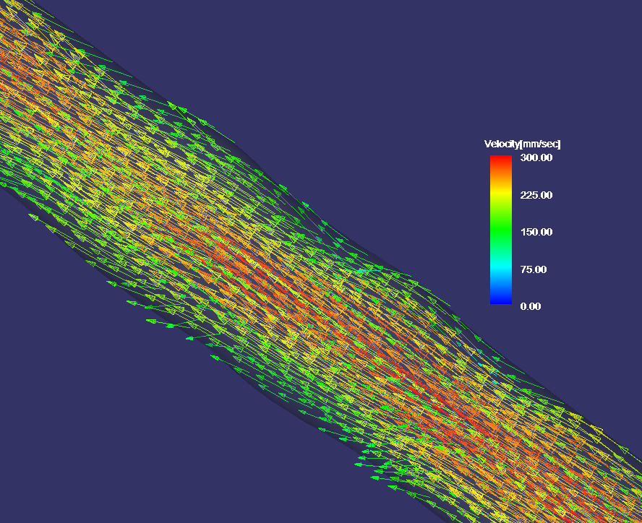
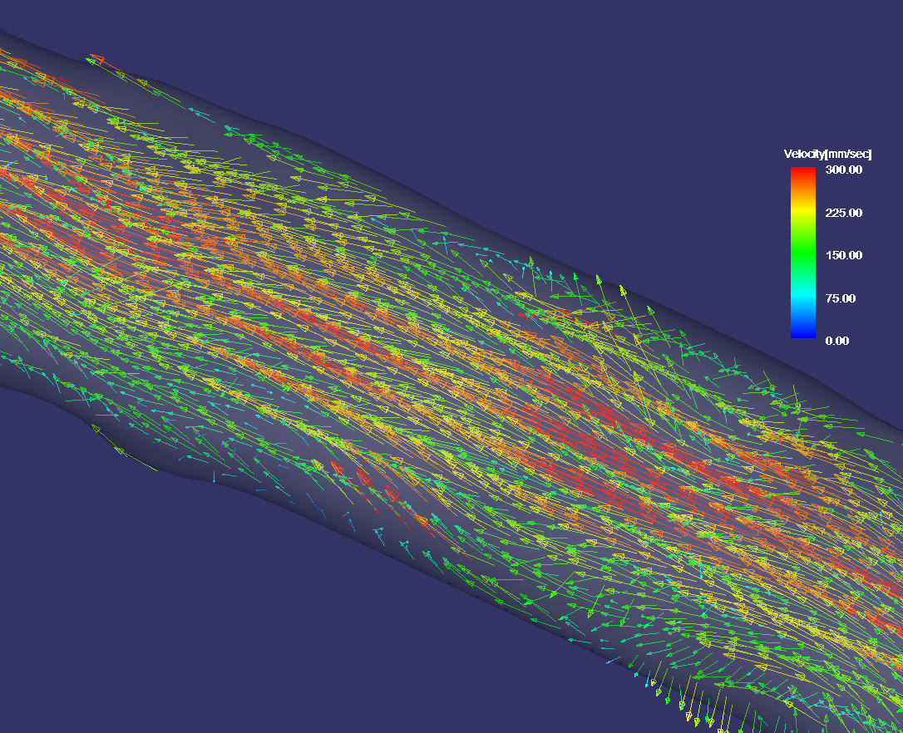
Validation Experiments (Results)
Raw 4D-Flow velocity data
The actual flow is a laminar flow
but it appears as if a turbulent flow
because of the large error of 4D-Flow.
Straight Pipe
Curved Pipe

Slide 20
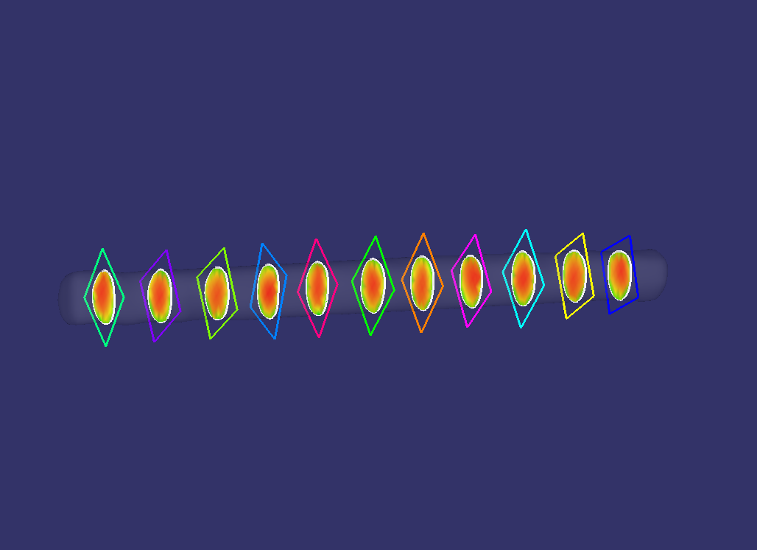
Comparison of VFR
VFR estimated by our method
with 11 virtual cross-sections
VFR is successfully estimated within 2% error.
Straight Pipe
Curved Pipe
 | Actual VFR [mm³/s] | Estimated VFR [mm³/s] | Error
Straight | 1150.1 | 1130.3 | 1.7%
Curved | 1860.2 | 1882.9 | 1.2%

Slide 21
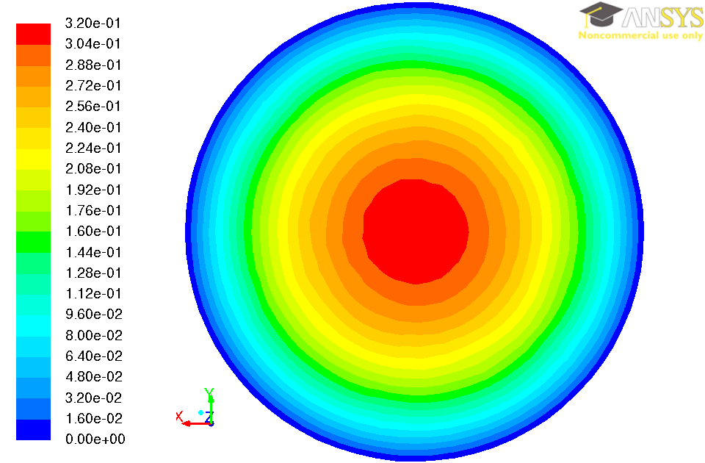
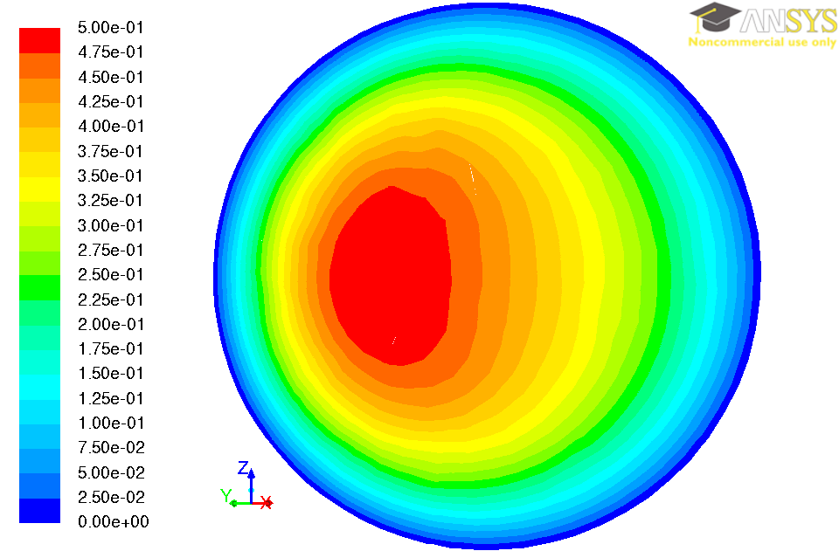
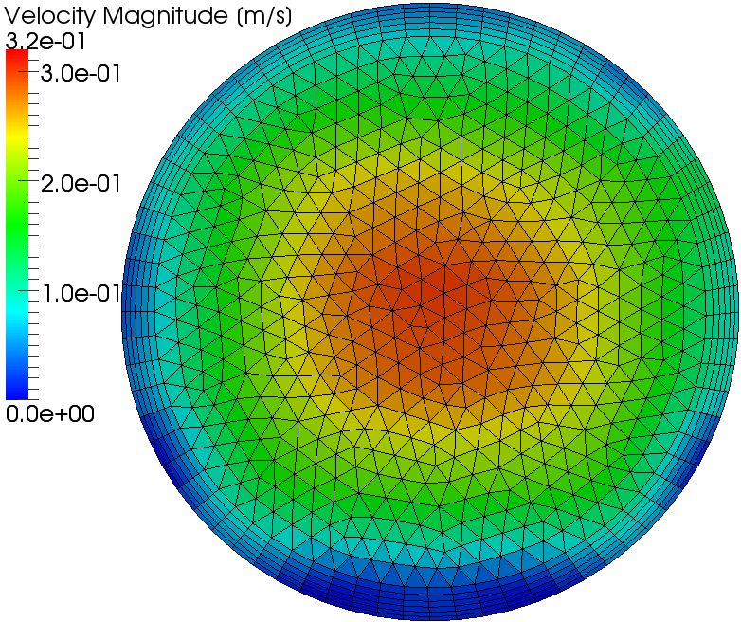
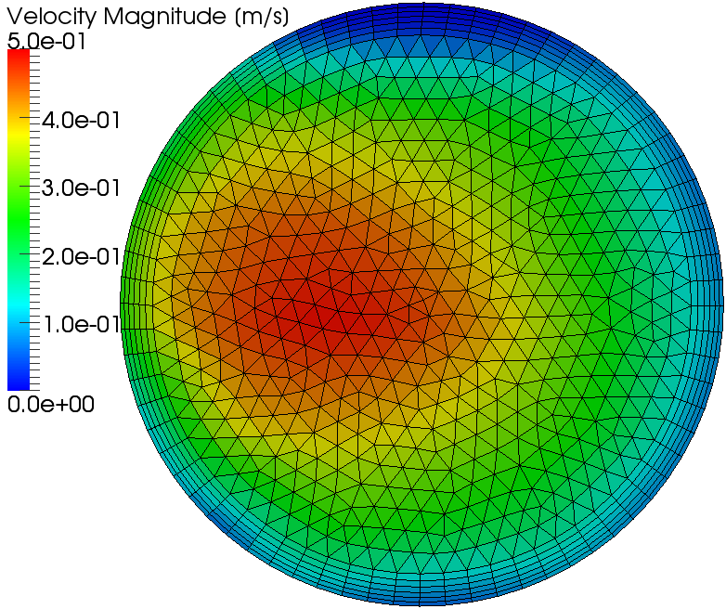
Comparison of Velocity Profile
Straight Pipe
Curved Pipe
Estimated velocity profiles are in good agreement
with actual velocity profile
Actual Profile
Estimated Profile

Slide 22
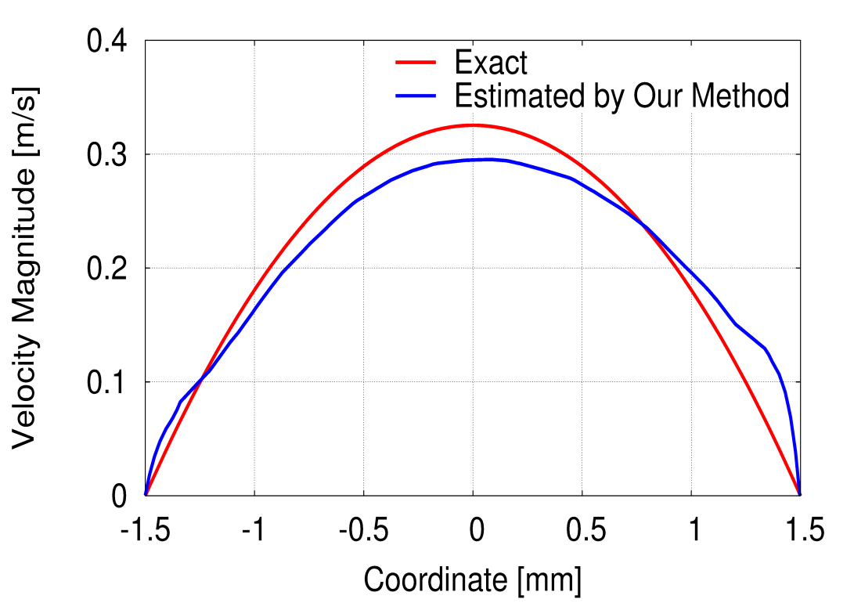
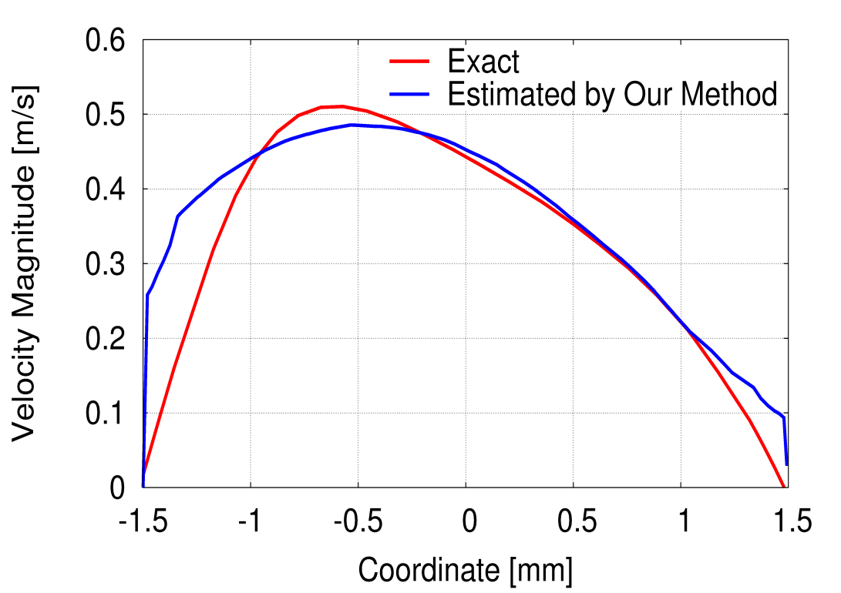
Comparison of Velocity Profile
Straight Pipe
Curved Pipe
VFR is accurate + Velocity profile is similar
A short inlet/outlet length makes the profile accurate.
Our method can determine the velocity BC
with practically sufficient accuracy.

Slide 23
Part 4:
Summary

Slide 24
Summary
  A new method to determine the accurate inlet/outlet BC for vascular CFD analysis using 4D-Flow is proposed.
  Its practically sufficient accuracy is validated through the experiments with straight and curved pipe phantoms.
  Our method can satisfy one of the three requirements for vascular CFD analysis.
Thank you for your attention.
And give me questions
in slow English without medical terms!!

Slide 25
Appendix

Slide 26
Measurement Parameters
TR [ms] | 39.28
TE [ms] | 05.26
Acquisition Time | 16:49
FOV [mm] | 160×160
Matrix | 320×320
Slice Thickness [mm] | 0.8
FA [deg] | 15
Band Width [Hz/pixel] | 488
VENC [m/sec] | 1.2
This is just an example.

Slide 27
An Example of Breakdown of VFR
Cross-section # | VFR [mm³/s]
CS-01 | 1090
CS-02 | 1141
CS-03 | 1155
CS-04 | 1107
CS-05 | 1117
CS-06 | 1163
CS-07 | 1226
CS-08 | 1150
CS-09 | 1221
CS-10 | 1310
CS-11 | 1324
Ave.: 1182.2 mm³/s, Stand. Dev.: 75.1 mm³/s
Exact: 1150.3 mm³/s, Error: 2.8 %

Slide 28
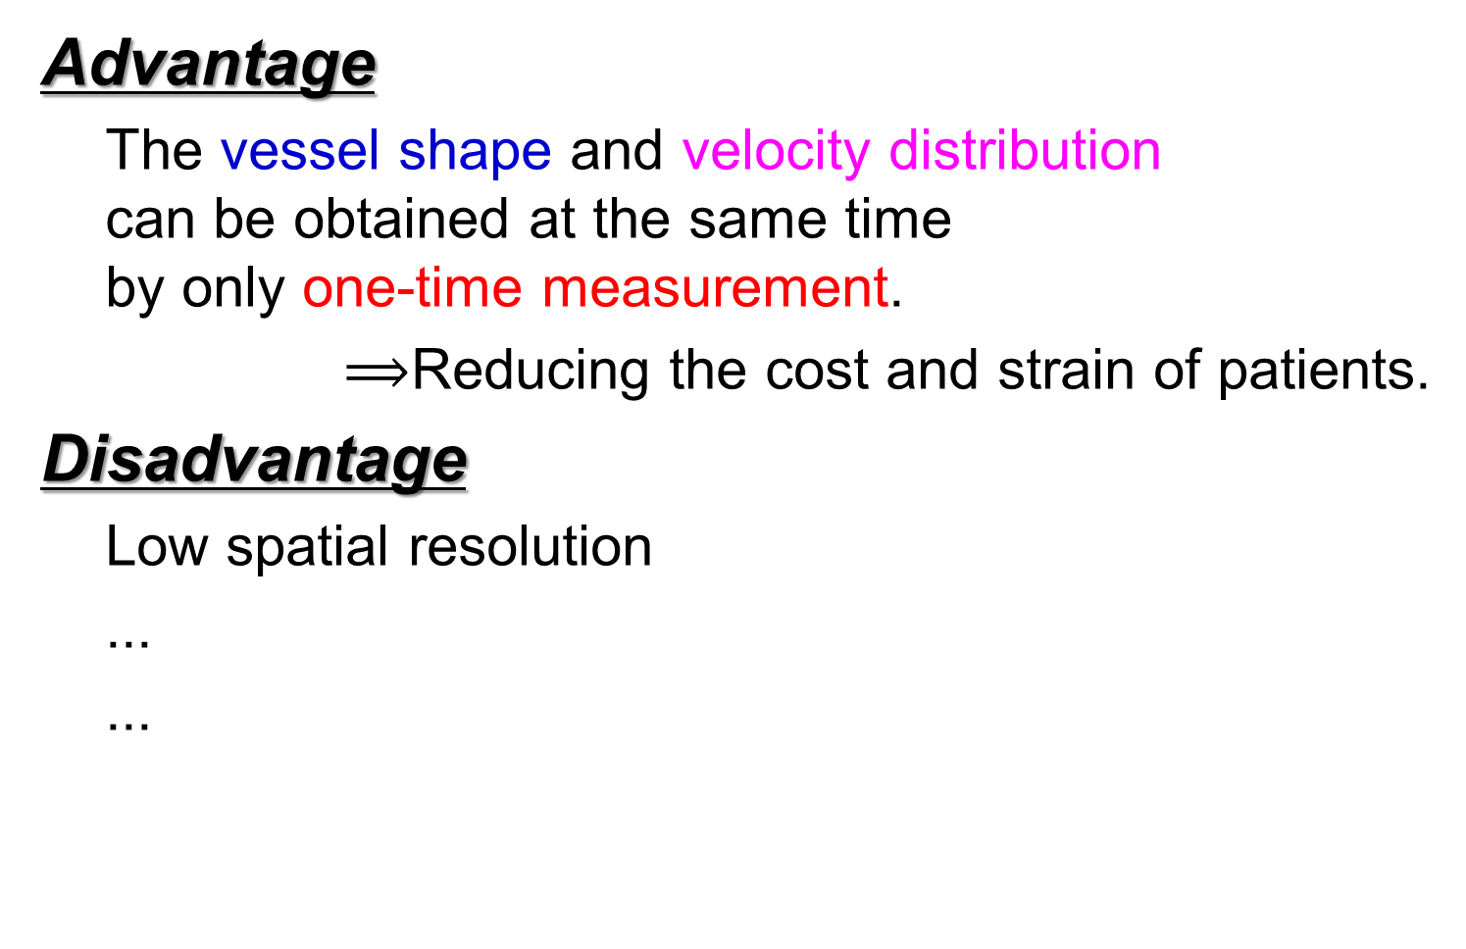
Advantage/Disadvantage of 4D-Flow
Advantage
  The vessel shape and velocity distribution
  can be obtained at the same time
  by only one-time measurement.
$⟹$Reducing the cost and strain of patients.
Disadvantage
  Low spatial resolution
  ...
  ...

Slide 29
Why is CFD necessary?

