Slide 1
Meshfree Large Deformation Analysis with Modified Formulation of Floating Stress-point Integration (FSPI)
Yuki ONISHI, Kenji AMAYA,
Tokyo Institute of Technology, JAPAN
Ryuta IMAI
Mizuho Information & Research Institute, Inc., JAPAN

Slide 2
Table of Contents
Introduction and Objective
Formulation of Floating Stress-Point Integration (FSPI) Meshfree Method
Examples of Analysis
Conclusion

Slide 3
Table of Contents
Introduction and Objective
Formulation of Floating Stress-Point Integration (FSPI) Meshfree Method
Examples of Analysis
Conclusion

Slide 4
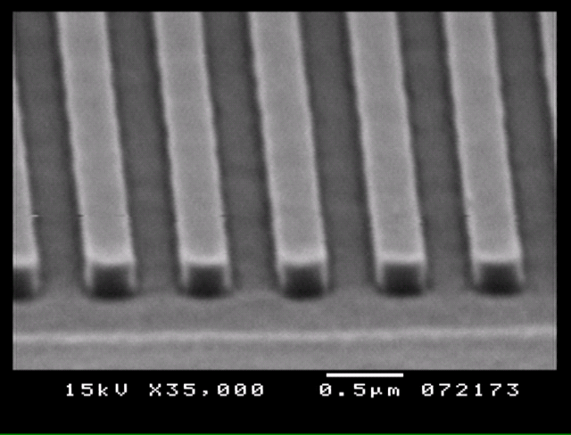
Backuground and Motivation
We want to solve extremely large deformation problems easily!! Final target: thermal imprinting
Using FEM, finite elements are easily distorted and bring analysis failure.
Adaptive FEM is not convenient so far.
Challenge meshfree!!

Slide 5
3 Types of Domain Integration
Background Cell Integration (EFGM)
Numerical diffusion arises through physical state interpolation.
Nodal Integration (SCNI)
Doesn't get along with updated Lagrangian.
Zero-energy mode arises without artificial stabilization.
Stress-Point Integration
Move of SPs is required with deformation goes on.
We adopted this, and
developed a new one named FSPI.
There are only few researches especially for large deformation. (There is no standard formulation.)

Slide 6
Objective
In this presentation,
effectiveness of FSPI in cases of
elastic and elastoplastic materials
are presented.
Develop a new type of
stress-point integration meshfree method,
floating stress-point integration (FSPI),
for large deformation problems

Slide 7
Table of Contents
Introduction and Objective
Formulation of Floating Stress Point Integration (FSPI) Meshfree Method
Examples of Analysis
Conclusion

Slide 8
Outline of FSPI
Concept of FSPI
Fully meshfree method for large deformation
Use stress-points for domain integration
Use updated Lagrangian procedure
Use implicit time advancing sheme
Introduced Unique Techniques
Shape function construction with Robust MLS
Incremental equilibrium equation for quasi-implicit time advancing scheme
Combination of these two is difficult to be realized
in meshfree.

Slide 9
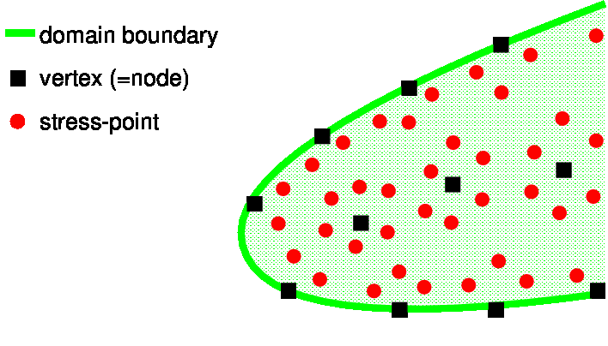
Spacial Discretization & Initialization
Generate nodes and stress-points in the initial analysis domain
Any generation methods will do.

Slide 10
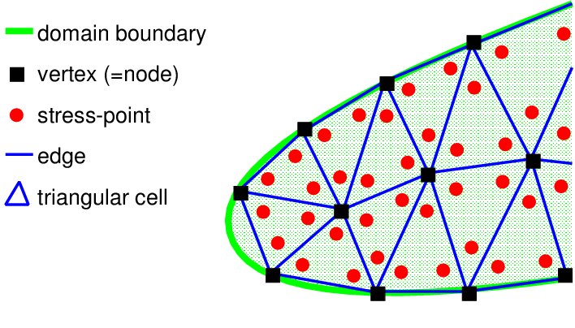
Spacial Discretization & Initialization
Currently, nodes and stress-points are generated with unstructured triangular meshes.
Assign initial corresponding volume of stress-points, , as .

Slide 11
Spacial Discretization & Initialization
After the generation and the assignment, meshes are never referred any more.
This way of node and stress-point generation is not an optimal one.

Slide 12
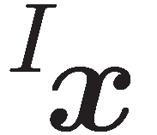
Mathematical Notation Rules
: variable of a stress-point I superscript I to the left of a variable e.g.) : location of stress-point I
: variable of a node J subscript J to the left of a variable e.g.) : location of node J
: trial variable in time increments superscript + to the right of a variable e.g.) : trial internal force vector

Slide 13
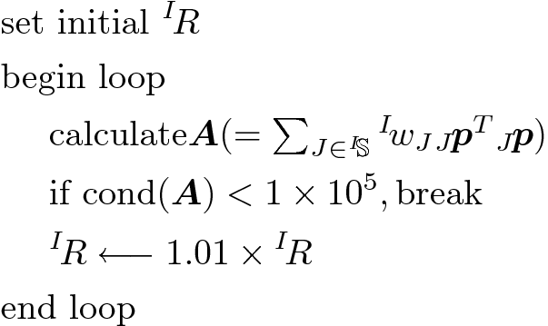
Shape Function
Robust Moving Least Squares (Robust MLS)
Support radius for each stress-point I, ^{I}R, is set dynamically and varies over time.
<Algorithm to set ^{I}R >
(small)
^{I}R
^{I}R
^{I}R

Slide 14
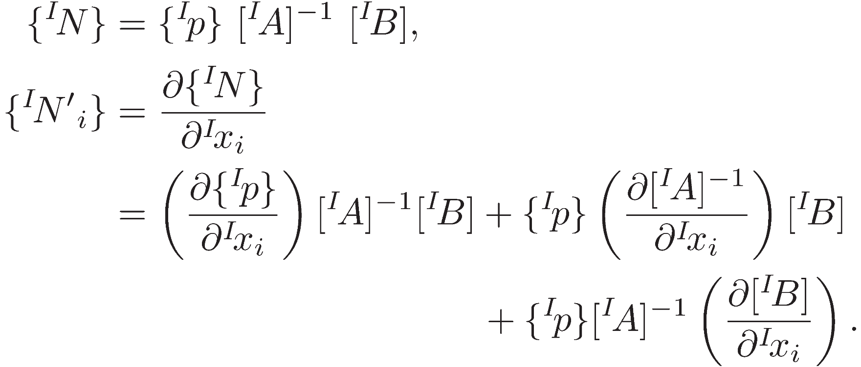
Shape Function
Weight function w (at a stress-point I to a node J )
Shape function N and its derivatives N '
(at a stress-point I )
same as the original MLS except ^{I}R

Slide 15
Integration Correction
Integration constraint (Divergence-free cond.)
Necessary and sufficient condition to pass patch tests.
Unfortunately, s don't satisfy this condition.
Making corrected ( ) is necessary.
n : outward normal unit vector
_{J}A : correspoiding nodal area
_{J}I : set of SPs that include node J in the support

Slide 16
Integration Correction
Scaling type integration correction
^{I}g : correction coefficient
Currently, we simply took minimum norm solution as {γ} to minimize the magnitude of the correction.
Assigning this into the equations of integration constraint,
a matrix equation is obtained.
This is an
Under-determined
system
The num. of SPs > The num. of nodes

Slide 17
Time Advancing Scheme
Fully-implicit Time Advancing
Start of a time increment
Start of the Newton-Raphson loop
Update support, w, N, and N' of SPs
Calculate strain, stress, etc. of SPs
Calculate {f ^{int.}}, {f ^{ext.}}, and [K ]
If || {f ^{ext.}} - {f ^{int.}}|| is small, break
Solve [K ] {δu } = {f ^{ext.}} - {f ^{int.}}
Update {Δu } ={Δu } + {δu }
Update disp. of Nodes and SPs
Update all physical variables
Support, shape function, etc. are changed every time in Newton-Raphson loop.
A node can get in-and-out of the support repetitively
Unstable

Slide 18
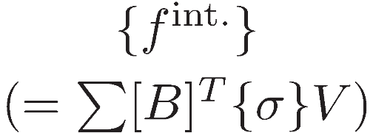
Time Advancing Scheme
Quasi-implicit Time Advancing
Start of a time increment
Update support, w, N, and N' of SPs
Start of the Newton-Raphson loop
Update support, w, N, and N' of SPs
Calculate strain, stress, etc. of SPs
Calculate {f ^{int.}}, {f ^{ext.}}, and [K ]
If || {f ^{ext.}} - {f ^{int.}}|| is small, break
Solve [K ] {δu } = {f ^{ext.}} - {f ^{int.}}
Update {Δu } ={Δu } + {δu }
Update disp. of Nodes and SPs
Update all physical variables
B matrix changed suddenly.
also changed suddenly.
Unstable

Slide 19
Time Advancing Scheme
Quasi-implicit Time Advancing + Incremental
Start of a time increment
Update support, w, N, and N' of SPs
Start of the Newton-Raphson loop
Update support, w, N, and N' of SPs
Calculate strain, stress, etc. of SPs
Calculate {Δf ^{int.}}, {Δf ^{ext.}}, and [K ]
If || {Δf ^{ext.}} - {Δf ^{int.}}|| is small, break
Solve [K ] {δu } = {Δf ^{ext.}} - {Δf ^{int.}}
Update {Δu } ={Δu } + {δu }
Update disp. of Nodes and SPs
Update all physical variables
Equalibrium
Equation
Stable!!

Slide 20
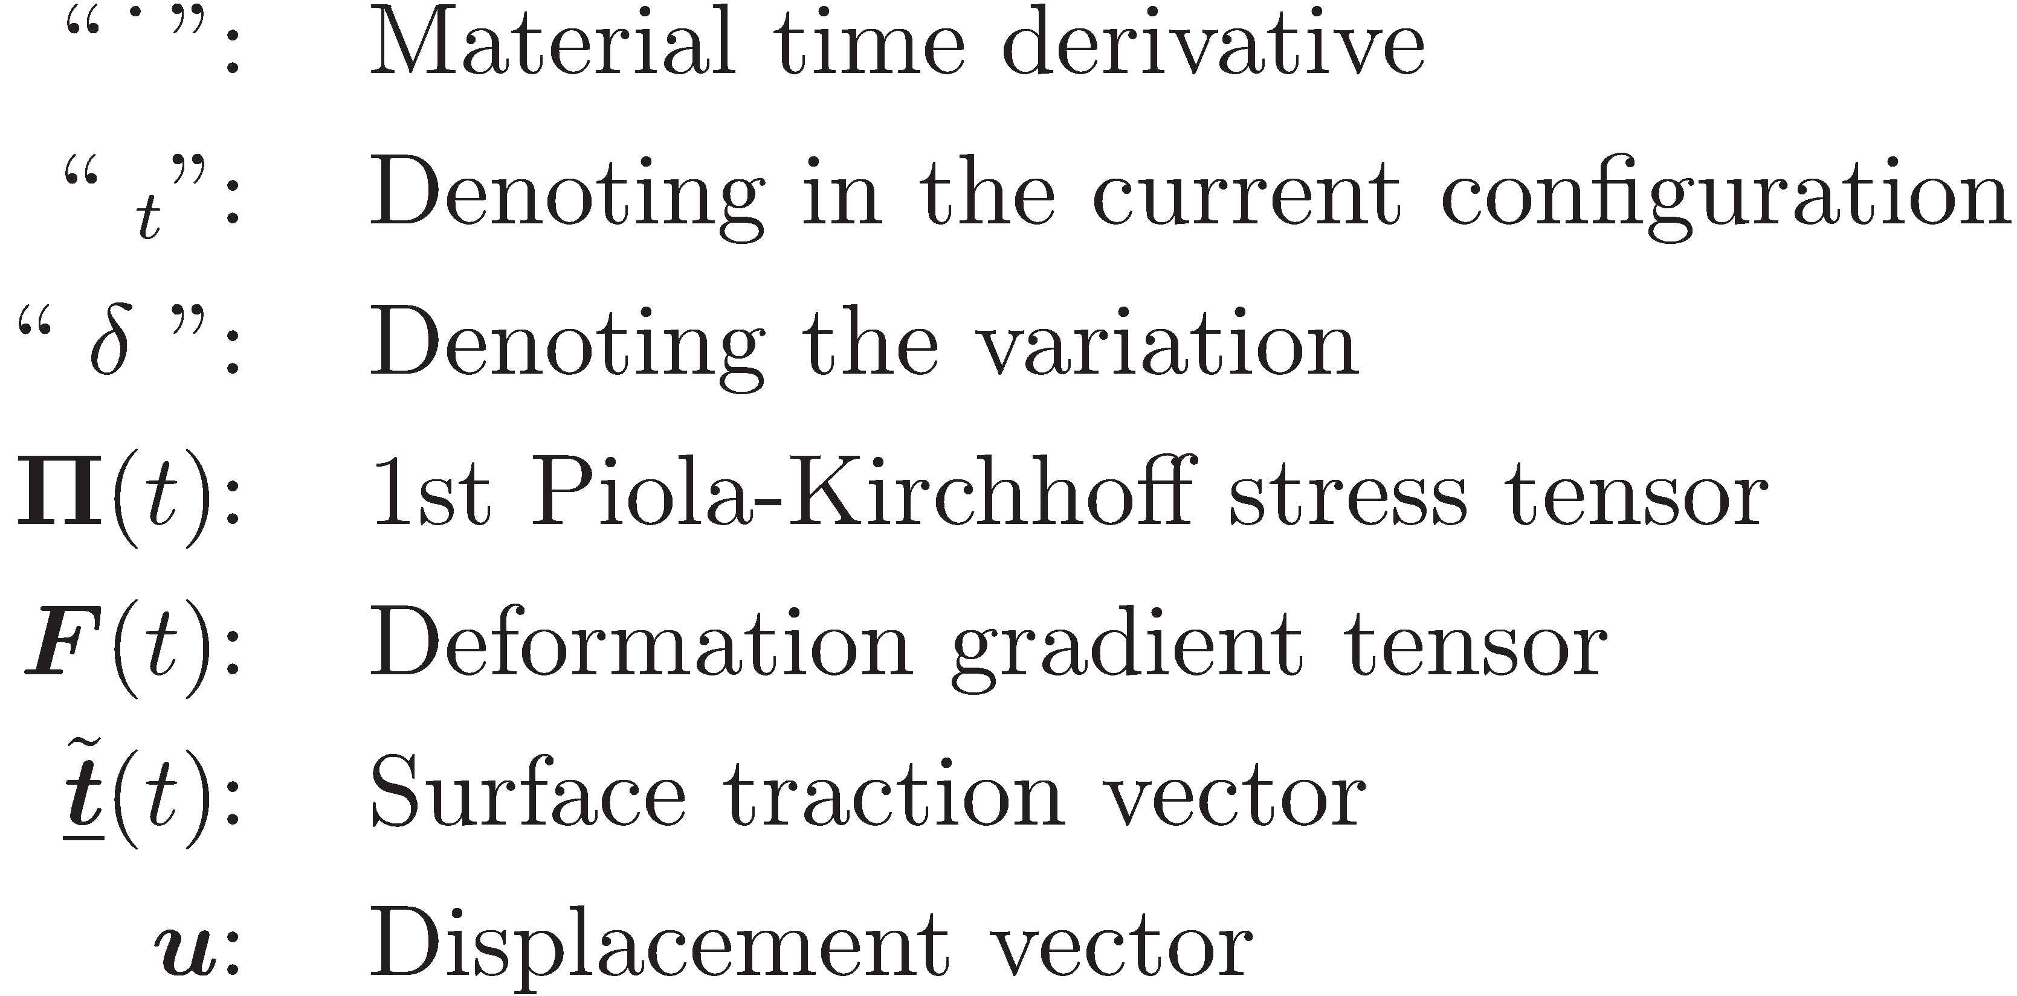
Incremental Equilibrium Equation
Virtual Work Equation in Rate Form without body force term

Slide 21
Incremental Equilibrium Equation
Linearize
time derivative
Galerkin
discretization

Slide 22
Table of Contents
Introduction and Objective
Formulation of Floating Stress-Point Integration (FSPI) Meshfree Method
Examples of Analysis
Conclusion

Slide 23
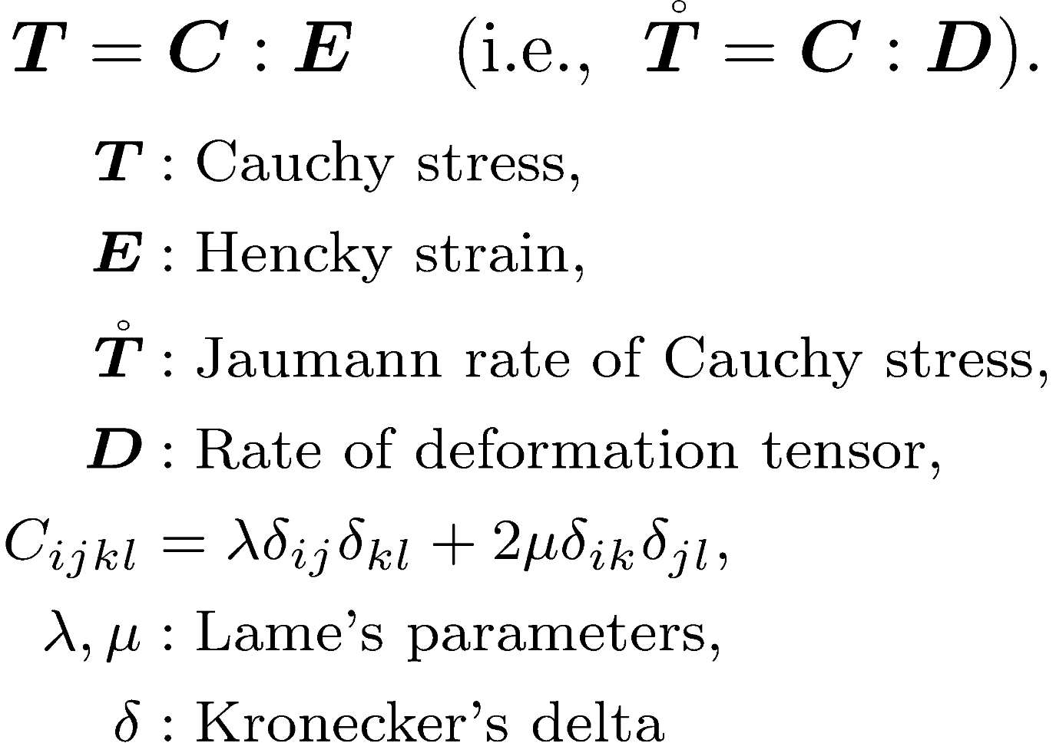
Elastic Constitutive Equation
Common isotropic elastic model
Exactly the same as the default elastic model of ABAQUS/Standard.

Slide 24
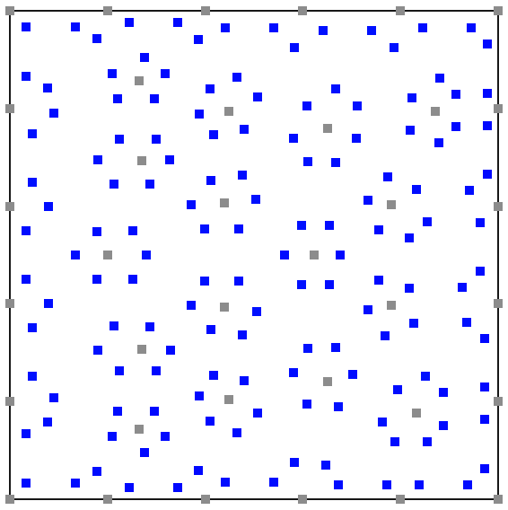
Patch Test
：node
：stress point (SP)
Irregularly
-arranged
Quasi-static, Plane strain
Young's modulus: 1GPa, Poisson's ratio: 0.3
Displacement BC for every external nodes

Slide 25
Patch Test
Distribution of Misess Stress

Slide 26
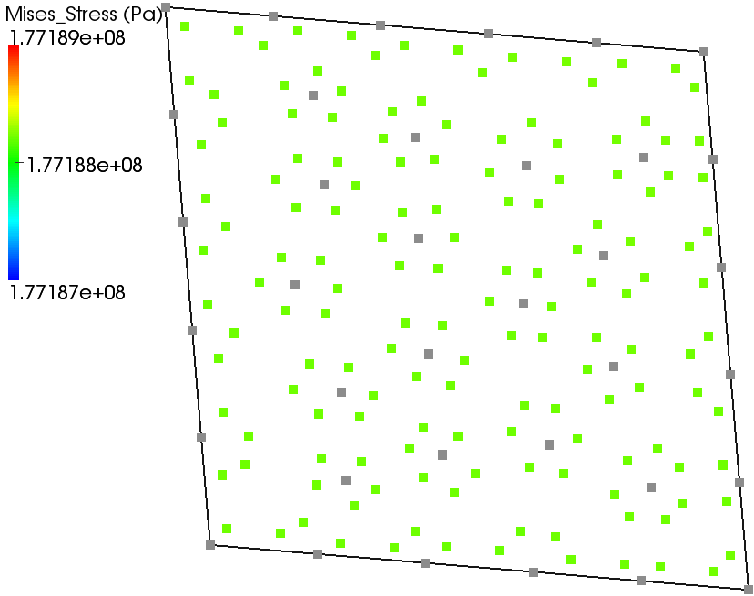
Patch Test
Mises stress at the final state is between 177.187 and 177.189 MPa.
Error of Mises stress is less than 0.2%.

Slide 27
Elastic Cantilever Bending
Quasi-static, Plane strain
Young's modulus: 1GPa, Poisson's ratio: 0.3
The num. of nodes: 335, The num of SPs: 1450
400kN concentrated force to downward dir.
Compared to ABAQUS/Standard with 8-node 2nd-order quadrilateral elements (CPE8)

Slide 28
Elastic Cantilever Bending
Distributions of Mises Stress
FSPI Meshfree ABAQUS/Standard

Slide 29
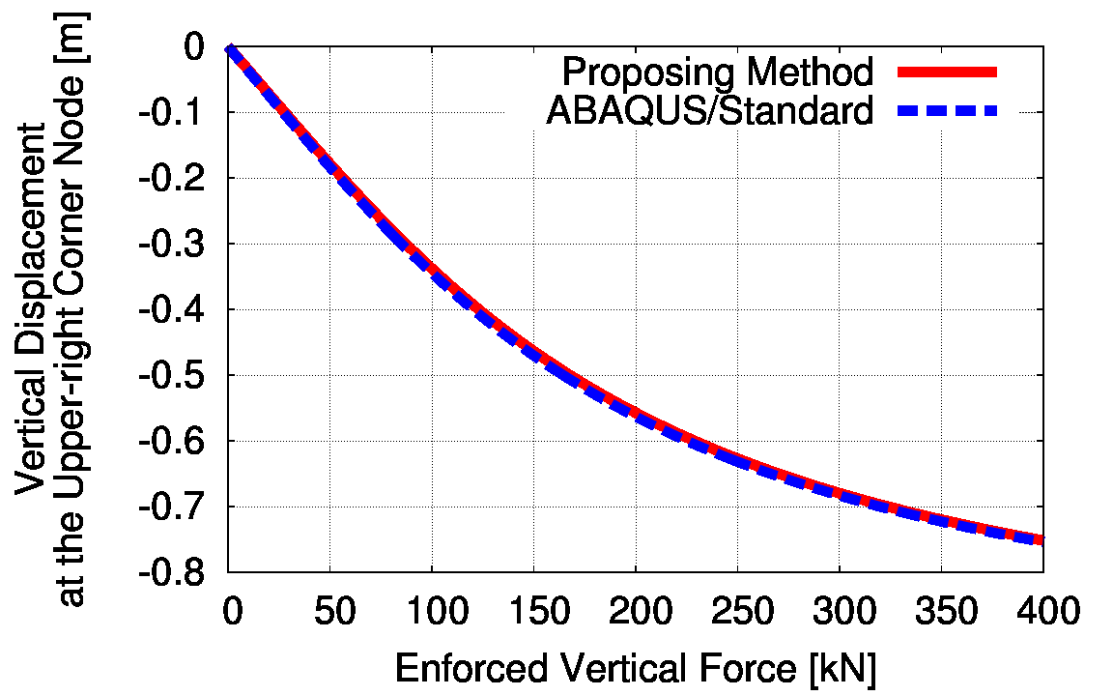
Elastic Cantilever Bending
Displacement error is less than 0.3%.
Proposing method is shear locking free.

Slide 30
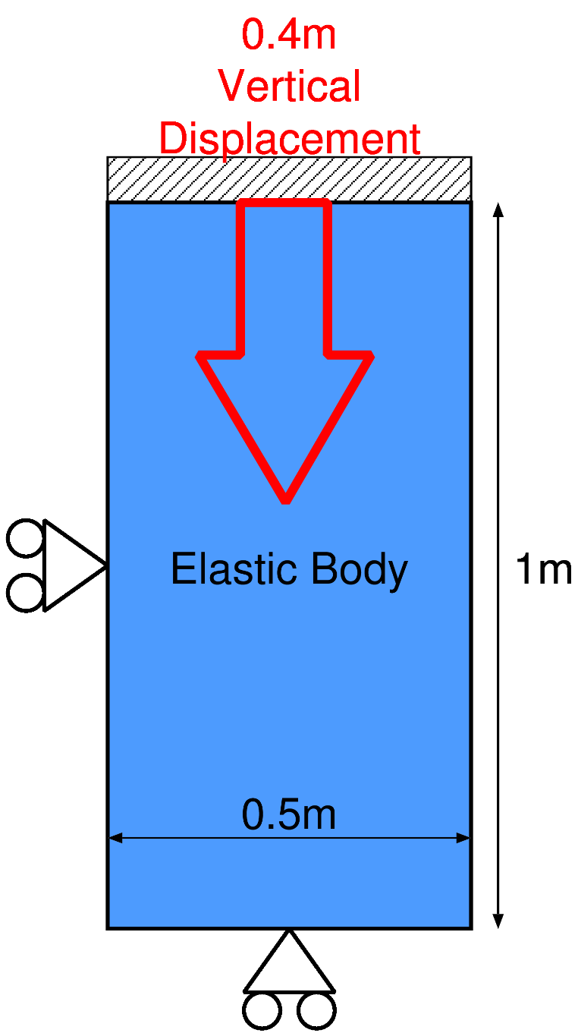
Elastic Uniaxial Compression
Quasi-static, Plane strain
Young's modulus: 1GPa, Poisson's ratio: 0.45
The num. of nodes: 528, The num. of SPs: 2455
0.4m displacement to downward dir.
Compared to ABAQUS/ Standard with 3-node 1st-order triangular elements (CPE3)

Slide 31
Elastic Uniaxial Compression
FSPI Meshfree ABAQUS/Standard
ABAQUS stopped at 0.28m displacement.

Slide 32
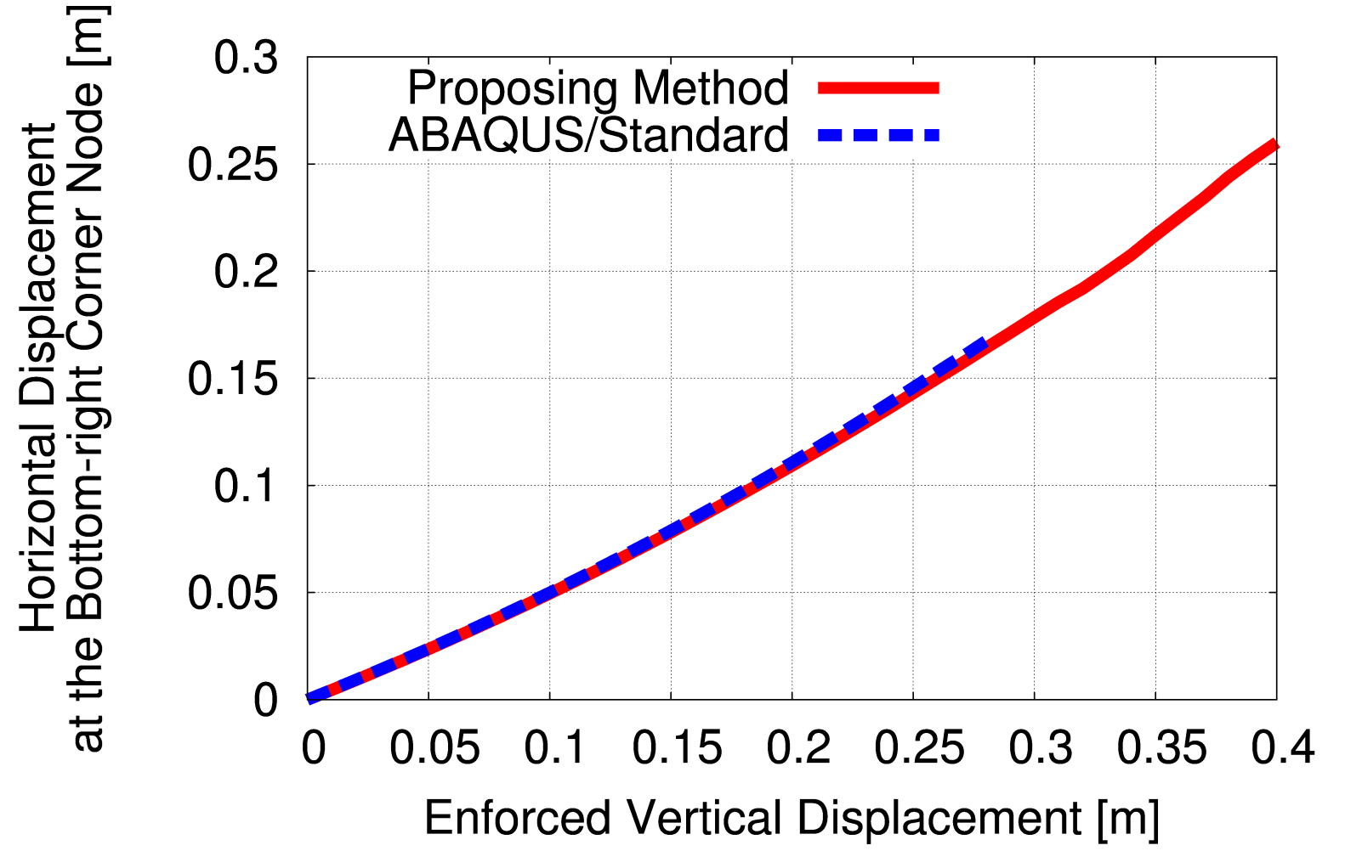
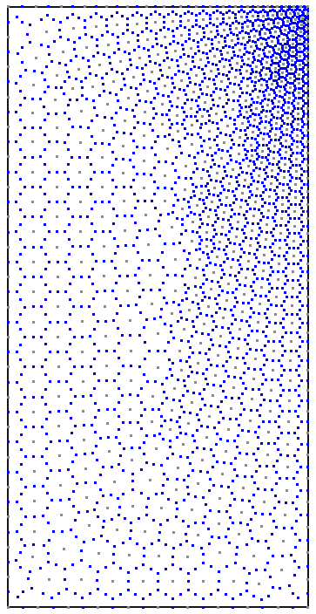
Elastic Uniaxial Compression
3% displacement difference at 0.28m disp.
Treatments at the concave corner is necessary.

Slide 33
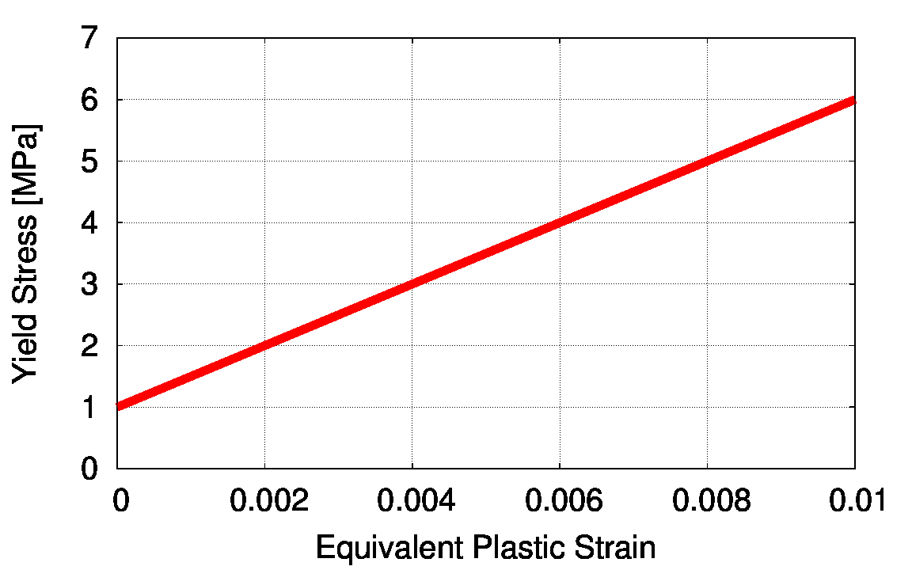
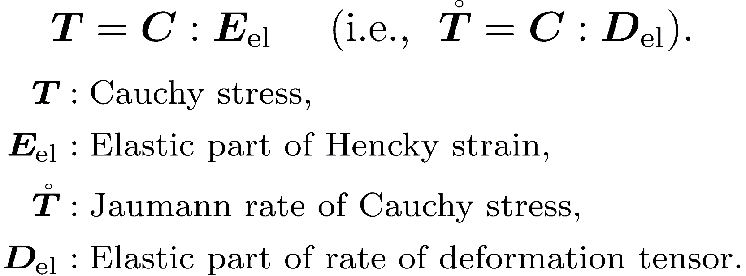
Elasto-plastic Constitutive Equation
Classical elasto-plastic model with
von Mises yield criterion
associated flow rule
isotropic hardening rule
Exactly the same as the default elasto-plastic model of ABAQUS/Standard.
Young's Modulus: 1GPa
Poisson's Ratio: 0.3

Slide 34
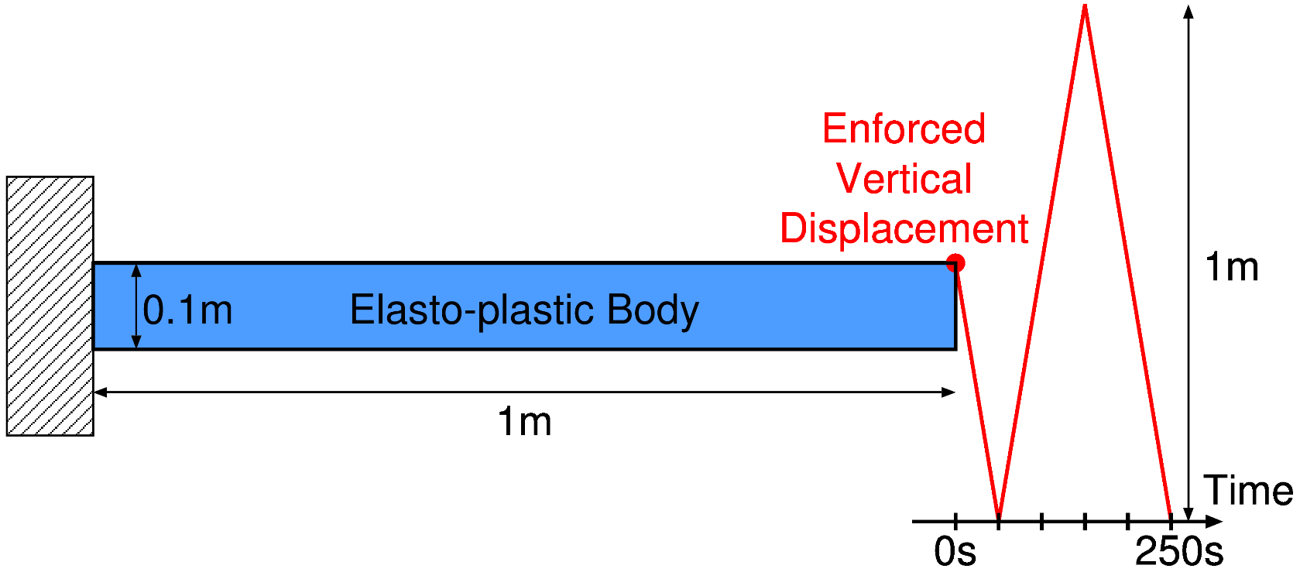
Elasto-plastic Cantilever Bending
Quasi-static, Plane strain
Num. of Nodes: 335, Num of SPs: 1450
Oscillating vertical disp. enforced
Compared to ABAQUS/Standard with 8-node 2nd-order quadrilateral elements (CPE8)

Slide 35
Elasto-plastic Cantilever Bending
Distributions of Equivalent Plastic Strain
FSPI Meshfree ABAQUS/Standard

Slide 36
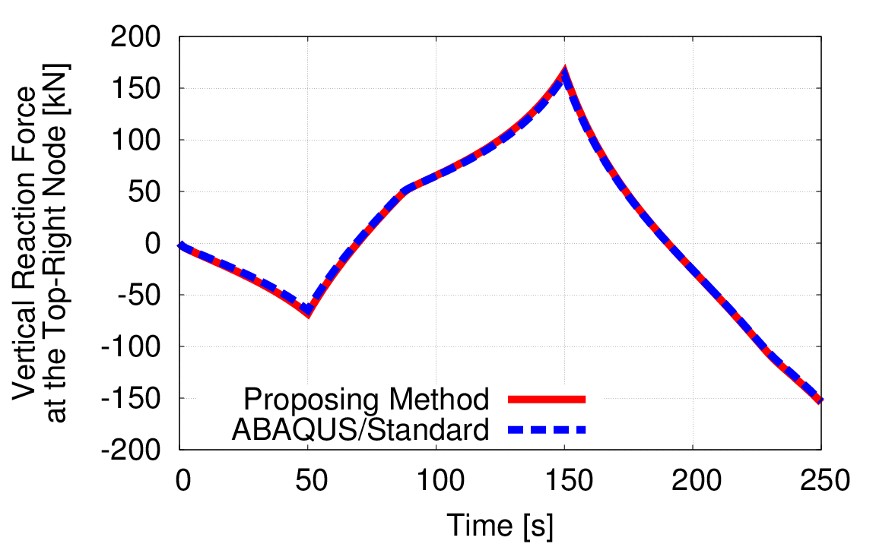
Elasto-plastic Cantilever Bending
Time-history of Vertical Reaction Force at the Bounding Node
Error of reaction force is less than 0.3%
No shear locking in elasto-plastic case too

Slide 37
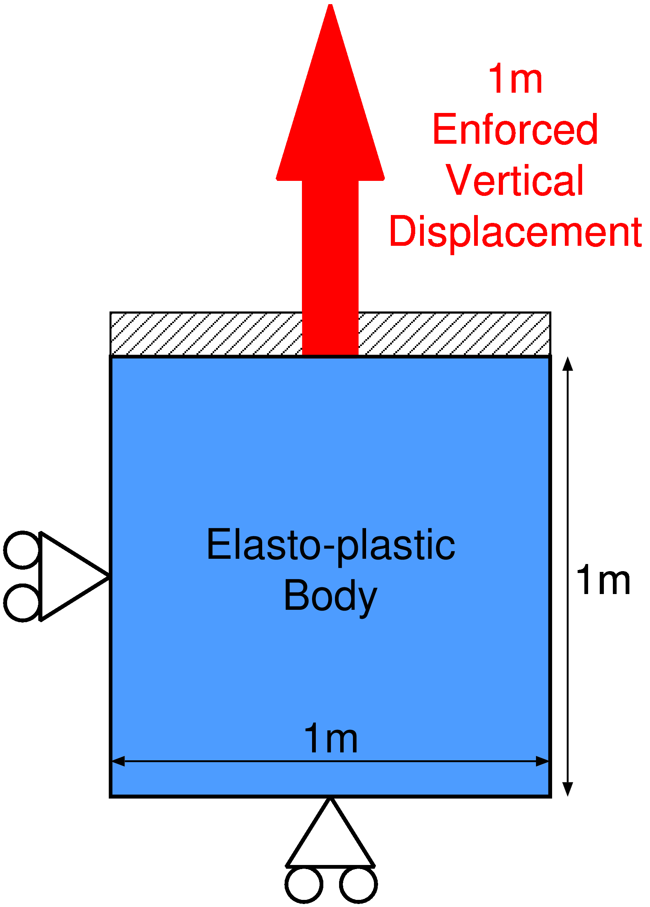
Elasto-plastic Uniaxial Tensioning
Quasi-static, Plane strain
1m disp. of upper side
The num. of nodes: 1800, The num of SPs: 5400
Compared to ABAQUS /Standard with 3-node 1st-order triangular elements (CPE3)

Slide 38
Elasto-plastic Uniaxial Tensioning
Distributions of
Equivalent Plastic Stain
FSPI Meshfree ABAQUS/Standard

Slide 39
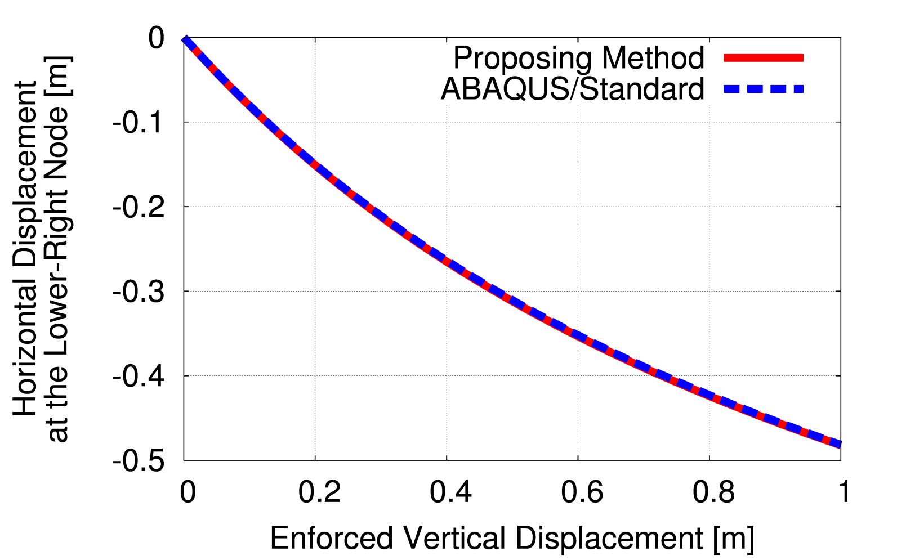
Elasto-plastic Uniaxial Tensioning
Progress of Horizontal Displacement at the Lower-right Node
Error of displacement is less than 0.2%.
Enough accuracy in plastic large deformation

Slide 40
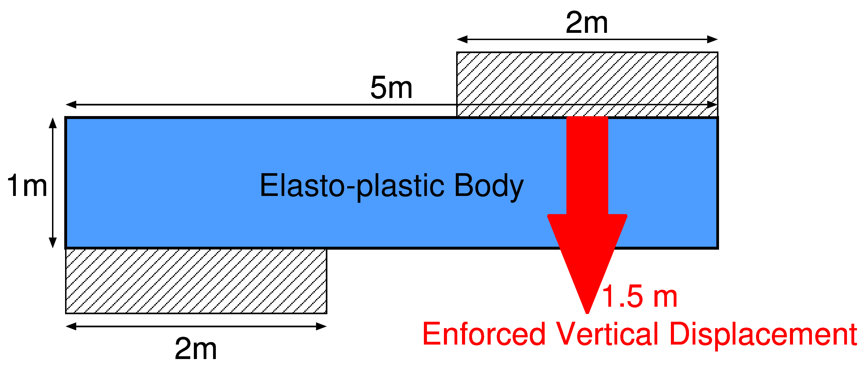
Elasto-plastic Bar Shearing
Quasi-static, Plane strain
Shearing with 1.5m vertical displacement
The num. of nodes: 1052, The num. of SPs: 3156
Compared to ABAQUS/Standard with 3-node 1st-order triangular elements (CPE3)

Slide 41
Elasto-plastic Bar Shearing
FSPI
Meshfree
ABAQUS /Standard
Distributions of
Equivalent Plastic Strain

Slide 42
Table of Contents
Introduction and Objective
Formulation of Floating Stress-Point Integration (FSPI) Meshfree Method
Examples of Analysis
Conclusion

Slide 43
Summary and Future Work
Summary
A new meshfree method for large deformation analysis, FSPI meshfree method, was proposed.
Its formulation based on robust MLS and incremental equilibrium equation was presented.
A patch test and a few examples of elasto-plastic large deformation analysis were performed to verify that the method had enough accuracy.
Future Work
solve contact problems
feature of adding node and stress-point
adaptive FEM based on the incremental equilibrium equation

Slide 44
Appendix

Slide 45
List of Specifications
 | Standard FEM | FSPI Meshfree
Node | Yes | Yes
Element | Yes | No (only for initialization)
Evaluation Point | Integration Point | Stress-Point
Shape Func. | in Element | with MLS
Integration Correction | Unnecessary | Scaling Type Correction
Time-advancing | Fully implicit | Quasi-implicit (shape func. etc. are explicit)
Reference Configuration | Updated/Total Lagrange | Updated Lagrange
Equilibrium Eq. | Standard Form | Incremental Form

Slide 46
Update Equations for SP variables
Location ^{I}x
x: Current Posiotion, S: Set of Nodes in Support, φ: Shape Function
Corresponding volume ^{I}V
V^{initial}: Initial Corresponding Volume F: Deformation Gradient

Slide 47
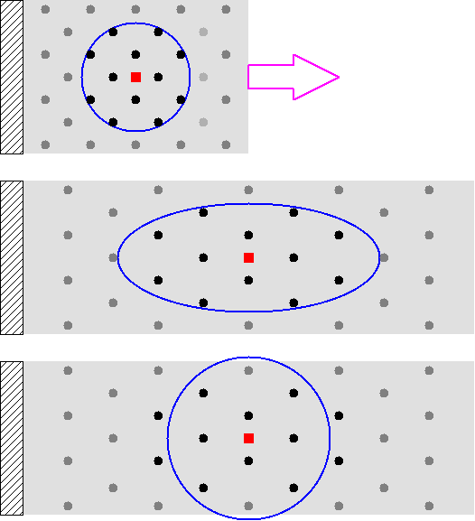
MLS with Total/Updated Lagrange
In case of wide horizontal stretch:
Before
After (Total- Lagrange)
After (Updated-
Lagrange)
Support is widened
↓
Unsuitable for very large deformation and rezoning
Support is dynamic circles
↓
Having nodes to start/stop relation
(Same as adaptive FEM)

