Slide 1
Application of Preconditioned Iterative Methods in Selective Smoothed Finite Element Methods with Tetrahedral Elements for Nearly Incompressible Materials
----------------------------------------------------------- ----------------------------------------------------------- F-bar
Yuki ONISHI Tokyo Institute of Technology, Japan

Slide 2
Motivation & Background
Motivation
We want to analyze severe large deformation of nearly incompressible solids accurately and stably! (Target: automobile tire, thermal nanoimprint, etc.)
Background
Finite elements are distorted in a short time, thereby resulting in convergence failure.
Mesh rezoning method is indispensable.
1$μ$m
Mold
Polymer

Slide 3
Our First Result in Advance
What we want to do:
Static
Implicit
Large deformation
Mesh rezoning with locking-free T4 elements

Slide 4
Conventional Methods
Higher order elements: ✗ Not volumetric locking free; Unstable in contact analysis; No good in large deformation due to intermediate nodes.
EAS method: ✗ Unstable due to spurious zero-energy modes.
B-bar, F-bar and selective integration method: ✗ Not applicable to T4 mesh directly.
F-bar patch method: ✗ Difficult to construct good patches. Not shear locking free.
u/p hybrid (mixed) elements: ✗ No sufficient formulation for T4 mesh so far. (There are almost acceptable hybrid elements such as C3D4H of ABAQUS.)
Smoothed finite element method (S-FEM): ? Unknown potential (since 2009~). It’s worth trying!!

Slide 5
Various Types of S-FEMs
Basic type
Node-based S-FEM (NS-FEM)
Face-based S-FEM (FS-FEM)
Edge-based S-FEM (ES-FEM)
Selective type
Selective FS/NS-FEM
Selective ES/NS-FEM
Bubble-enhanced or Hat-enhanced type
bFS-FEM, hFS-FEM
bES-FEM, hES-FEM
F-bar type
F-barES-FEM
✗ Spurious zero-energy
✗ Volumetric Locking
✗ Limitation of constitutive model, Pressure oscillation, Corner locking
✗ Pressure oscillation, Short-lasting
NEW
? Unknown potential

Slide 6
Objective
Develop a new S-FEM, F-barES-FEM-T4, by combining F-bar method and ES-FEM-T4 for large deformation problems of nearly incompressible solids
Table of Body Contents
Method: Formulation of F-barES-FEM-T4 & Introduction of AMG-GMRES
Result: Verification of F-barES-FEM-T4
Discussion: Application of AMG-GMRES to F-barES-FEM-T4
Summary

Slide 7
Method
Formulation of F-barES-FEM-T4 & Introduction of AMG-GMRES
(F-barES-FEM-T3 in 2D is explained for simplicity.)

Slide 8
Quick Review of F-bar Method
Algorithm
Calculate deformation gradient $F$ at the element center, and then make the relative volume change $\overline{ J }$ $(=det\left(F\right))$.
Calculate deformation gradient $F$ at each gauss point as usual, and then make $F^{iso}$ $(=F / J^{1/3}$) .
Modify $F$ at each gauss point as
$\overline{F }=$ ${\overline{ J }}^{1/3}$ $F^{iso}$.
Use $\overline{F }$ to calculate the stress, nodal force and so on.
For quadrilateral (Q4) or hexahedral (H8) elements
F-bar method is used to avoid volumetric locking in Q4 or H8 elements. Yet, it cannot avoid shear locking.

Slide 9
Quick Review of ES-FEM
Algorithm:
Calculate the deformation gradient $F$ at each element as usual.
Distribute the deformation gradient $F$ to the connecting edges with area weights to make $^{Edge}F$ at each edge.
Use $^{Edge}F$ to calculate the stress, nodal force and so on.
For triangular (T3) or tetrahedral (T4) elements.
ES-FEM is used to avoid shear locking in T3 or T4 elements. Yet, it cannot avoid volumetric locking.

Slide 10
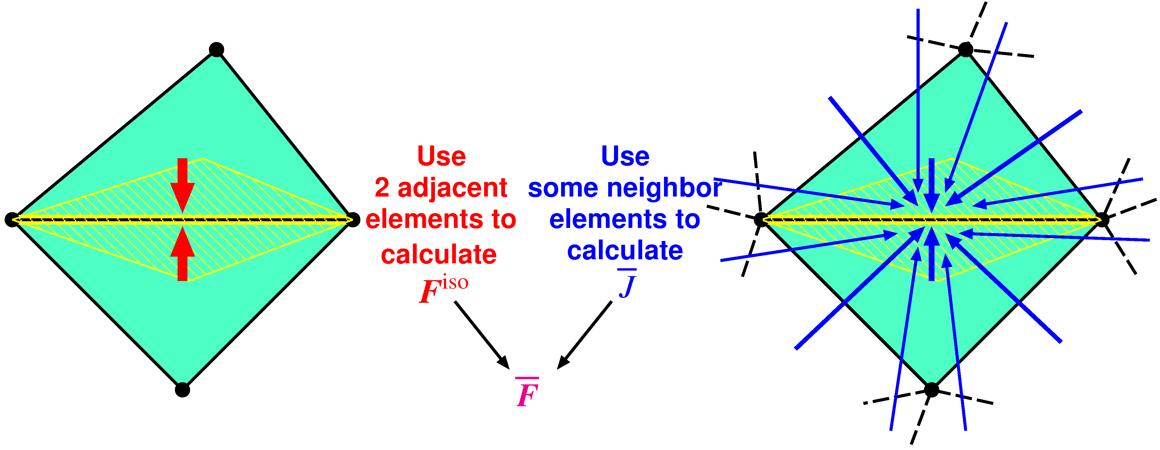
Outline of F-barES-FEM
Concept
$^{Edge}F^{iso}$ is given by ES-FEM.
$^{Edge}\overline{ J }$ is given by Cyclic Smoothing (detailed later).
$^{Edge}\overline{F }$ is calculated in the manner of F-bar method:
$^{Edge}\overline{F }=$ $^{Edge}{\overline{ J }}^{1/3}$ $^{Edge}F^{iso}$.
Combination of F-bar method and ES-FEM

Slide 11
Outline of F-barES-FEM
Brief Formulation
Calculate$^{Elem}J$as usual.
Smooth$^{Elem}J$ at nodes and get$^{Node}\tilde{ J }$.
Smooth$^{Node}\tilde{ J }$ at elements and get$^{Elem}\tilde{ J }$.
Repeat 2. and 3. as necessary ($c$ times).
Smooth $^{Elem}\dot{\dot{\dot{\tilde{\tilde{ J }}}}}$ at edges to make $^{Edge}\overline{ J }$.
Combine $^{Edge}\overline{ J }$ and $^{Edge}F^{iso}$ of ES-FEM as
$^{Edge}\overline{F }= ^{Edge}{\overline{ J }}^{1/3} ^{Edge}F^{iso}$.
Cyclic Smoothing of $J$
($c$ layers of ~)
Hereafter, F-barES-FEM-T4 with $c$-time cyclic smoothing is called “F-barES-FEM-T4($c$)”.

Slide 12
Quick Introduction of AMG-GMRES
Preconditioner: AMG
Algebraic Multi-Grid.
A framework of stationary iterative methods.
Mainly comprised of 3 parts: Smoothing, Restriction, and Prolongation.
Can be used as a preconditioner.
Solver: GMRES
Generalized Minimal RESidual.
One of the non-stationary iterative methods.
Usually used with a restart parameter r as GMRES(r).

Slide 13
Result
Verification of F-barES-FEM-T4
(Analyses without mesh rezoning are presented for pure verification.)

Slide 14
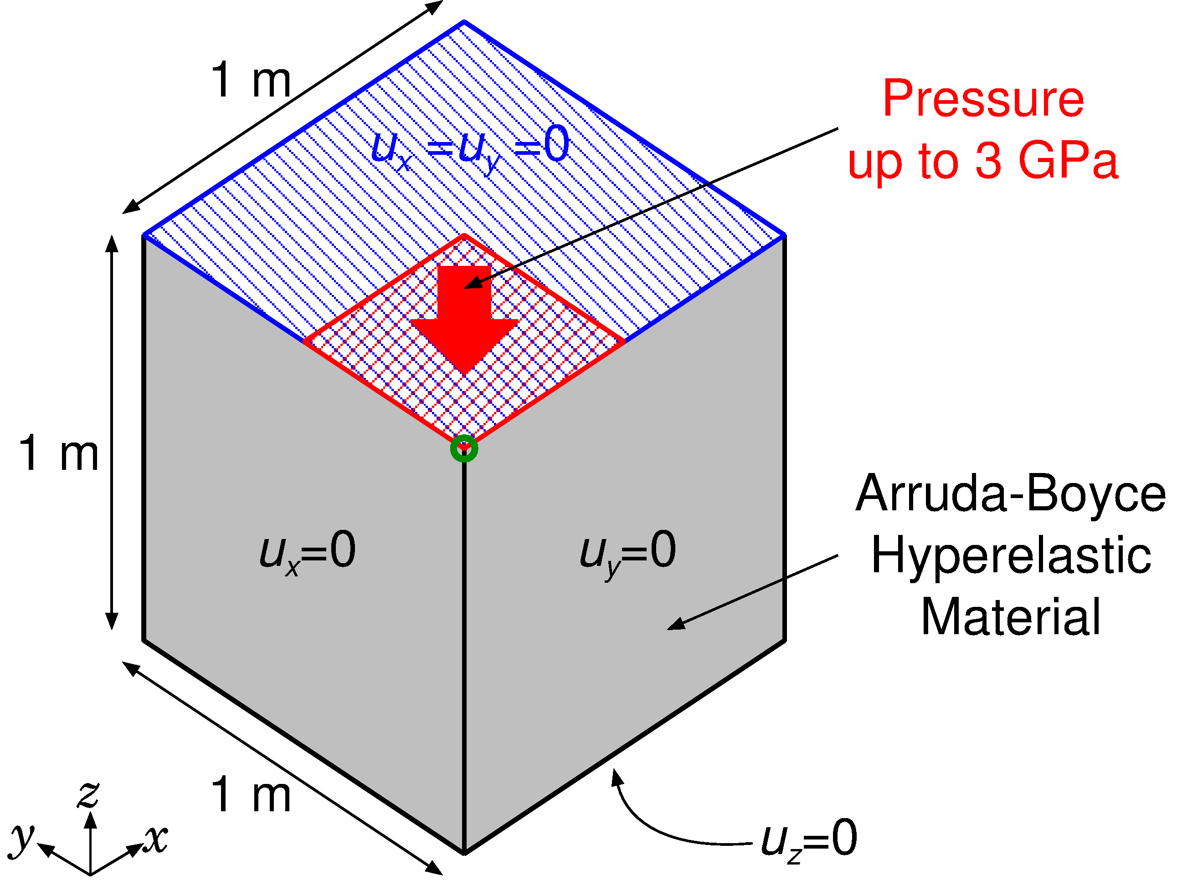
#1: Compression of a Block
Outline
Arruda-Boyce hyperelastic material ($ν_{ini}=0.499$).
Applying pressure on ¼ of the top face.
Compared to ABAQUS C3D4H with the same unstructured tetra mesh.
Load

Slide 15
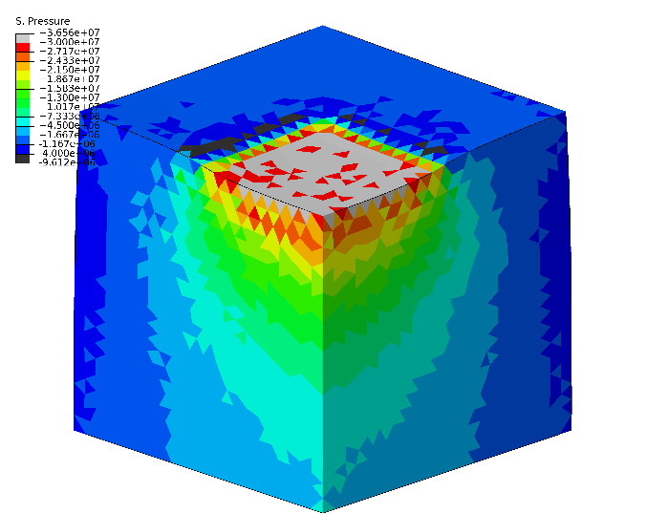
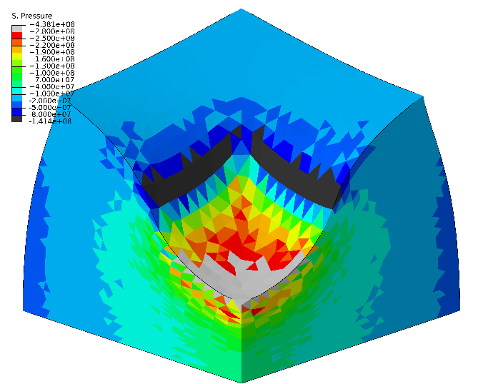
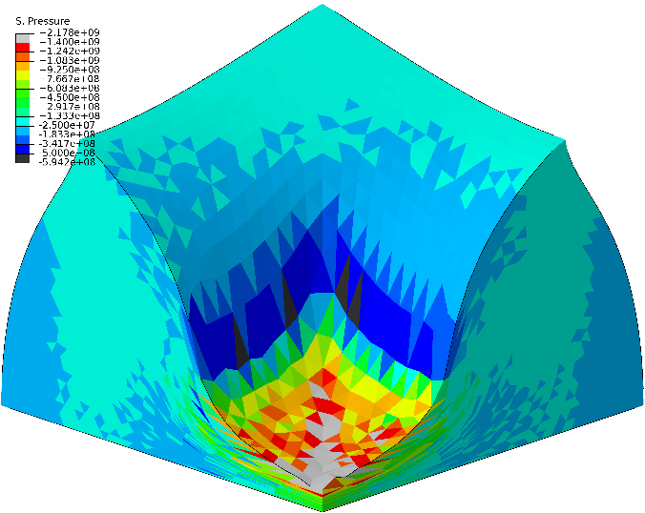
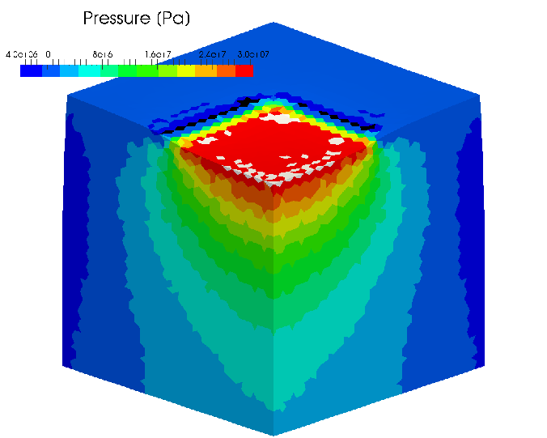
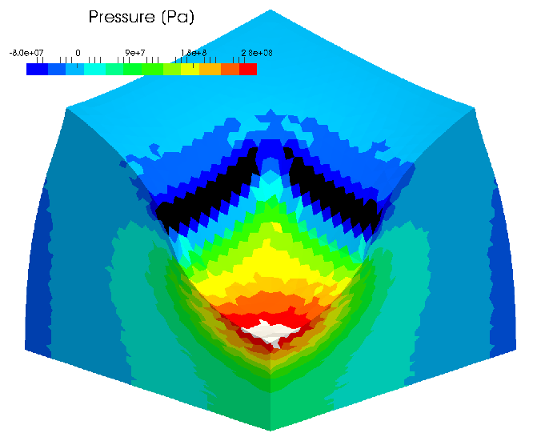
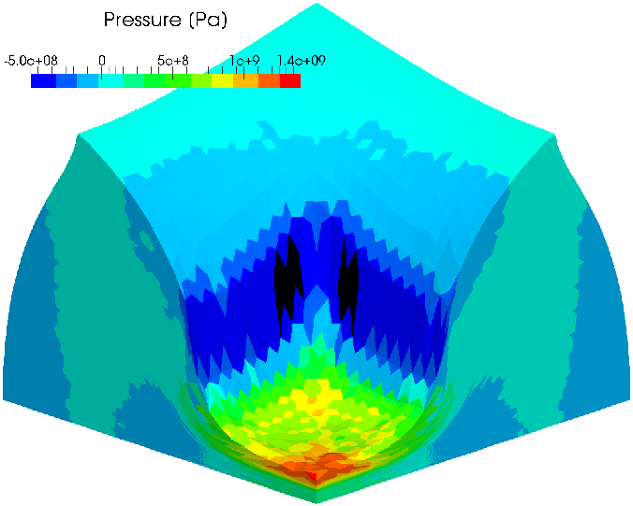
#1: Compression of a Block
Pressure Distribution
Early stage Middle stage Later stage
ABAQUS C3D4H
F-bar ES-FEM-
T4(2)

Slide 16
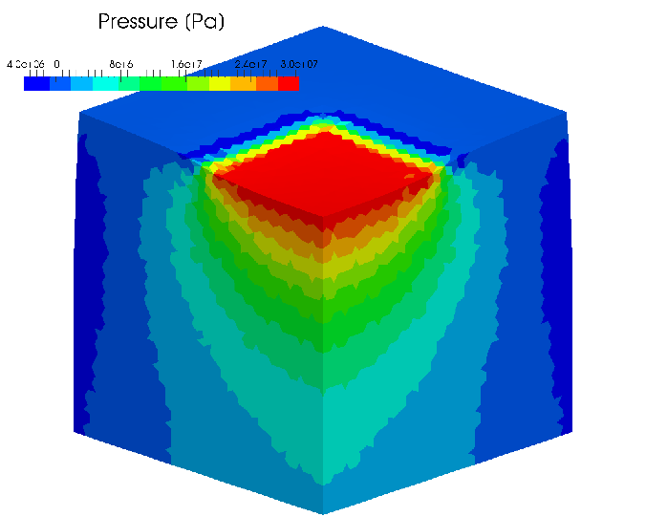
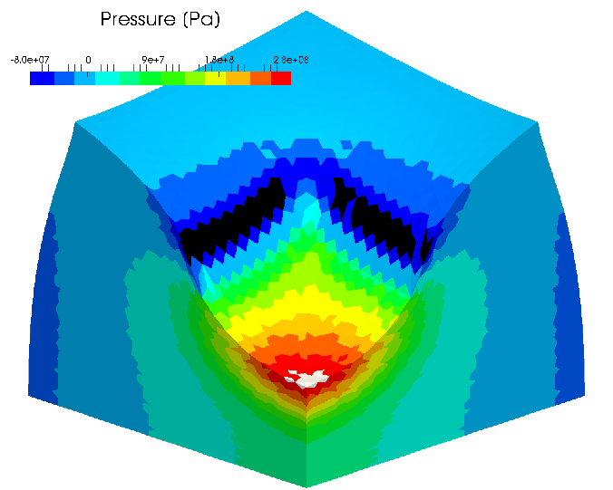
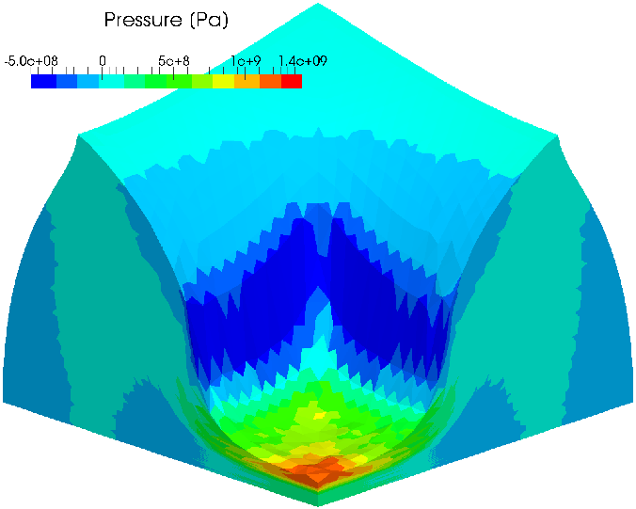
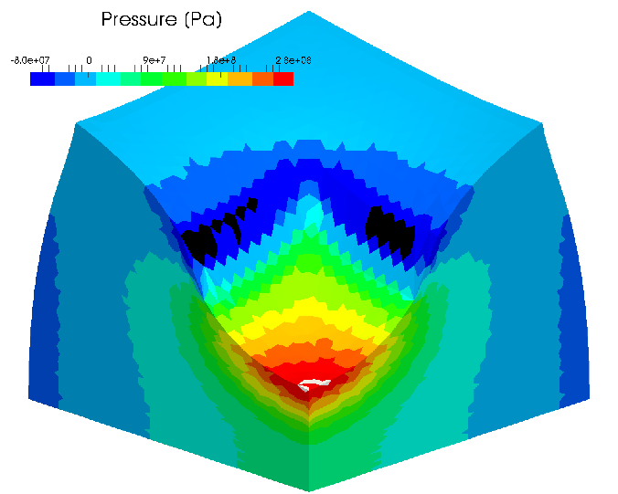
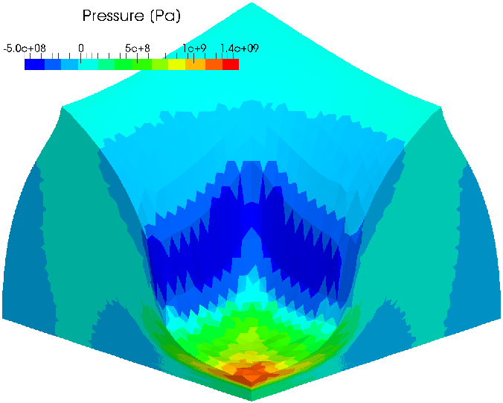
#1: Compression of a Block
Pressure Distribution
Early stage Middle stage Later stage
F-bar ES-FEM- T4(3)
In case the Poisson’s ratio is 0.499, F-barES-FEM-T4(2) or later resolves the pressure oscillation issue.
F-bar ES-FEM- T4(4)

Slide 17
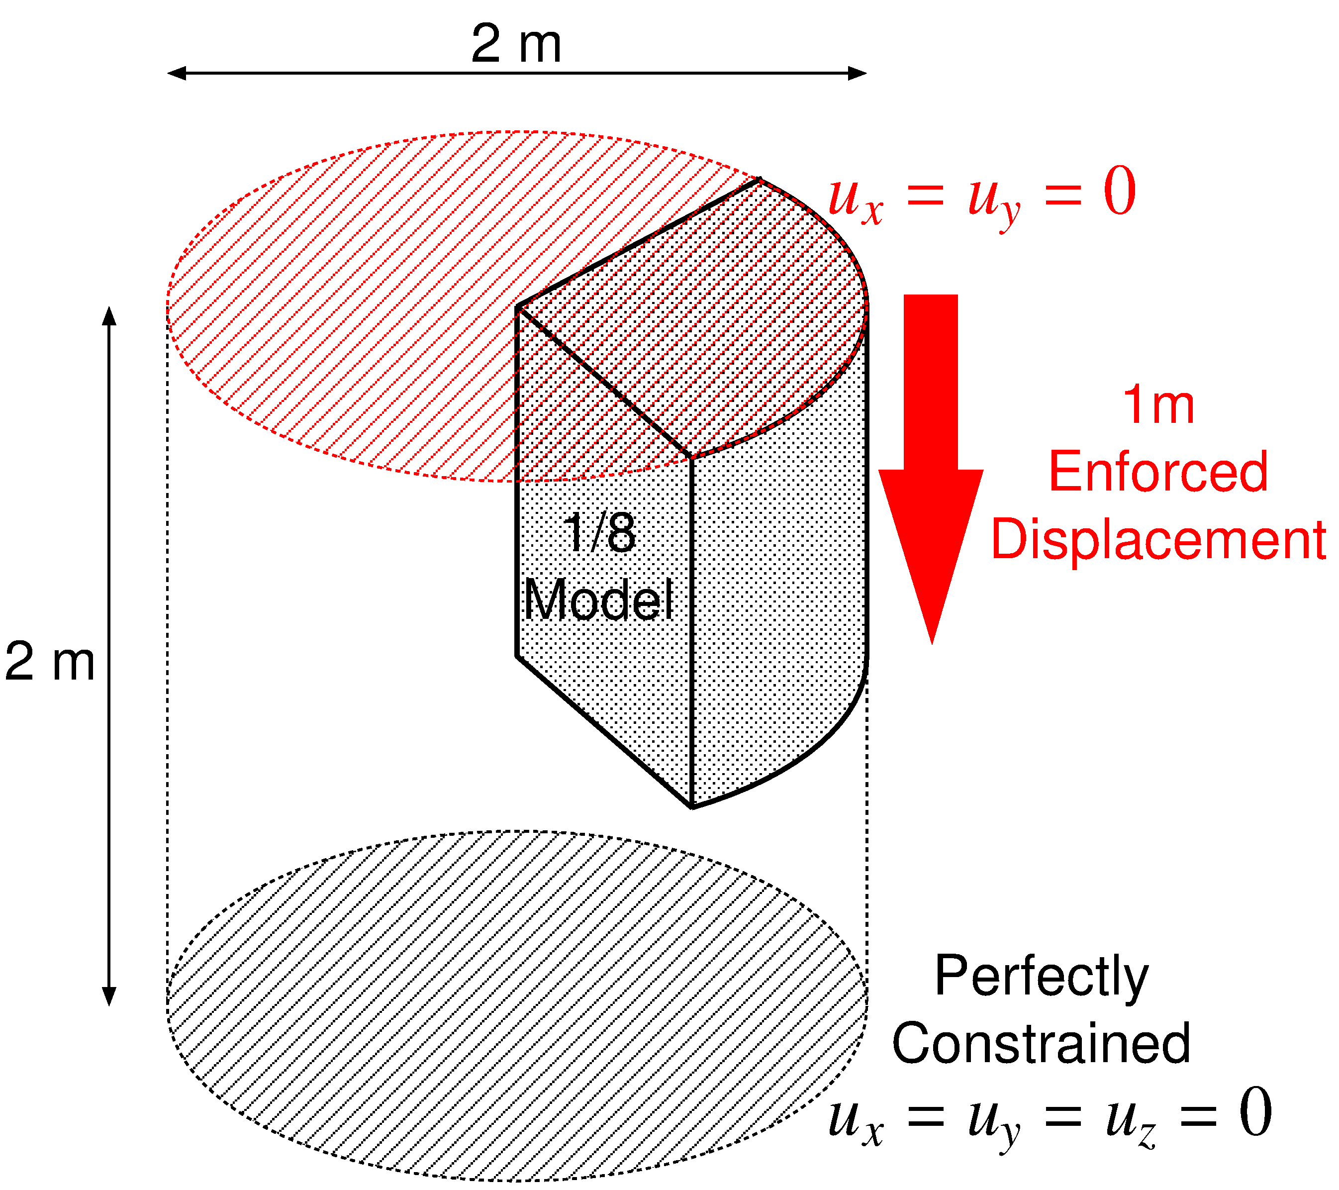
#2: Compression of 1/8 Cylinder
Outline
Neo-Hookean hyperelastic material ($ν_{ini}=0.499$).
Enforced displacement is applied to the top surface.
Compared to ABAQUS C3D4H with the same unstructured tetra mesh.

Slide 18
#2: Compression of 1/8 Cylinder
Result of F-bar ES-FEM(2)
50% nominal compression
Almost smooth
pressure
distribution is obtained
except just around the rim.

Slide 19
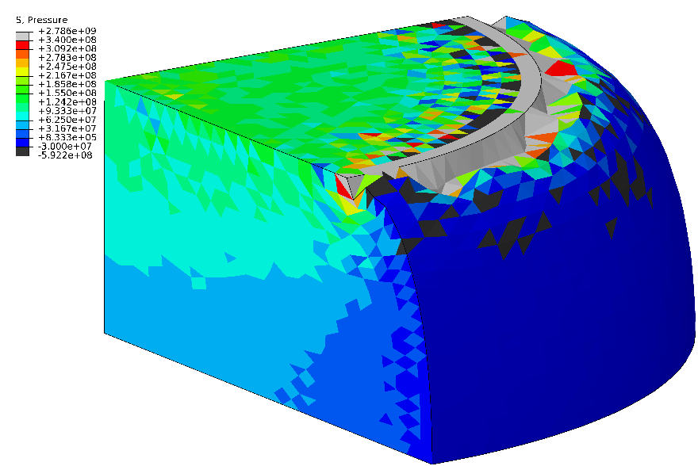
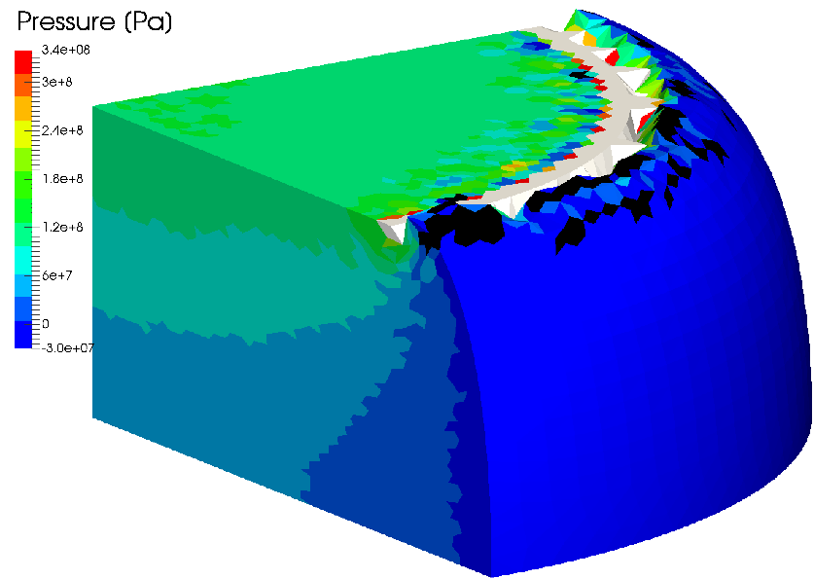
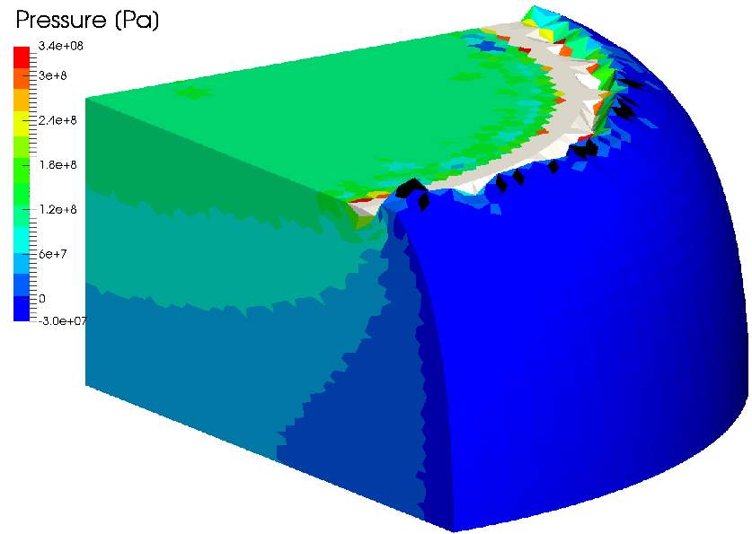
#2: Compression of 1/8 Cylinder
Pressure Distribution
F-bar ES-FEM- T4(2)
ABAQUS C3D4H
F-barES-FEM-T4 with a sufficient cyclic smoothing also resolves the corner locking issue.
F-bar ES-FEM-
T4(3)
F-bar ES-FEM-
T4(4)

Slide 20
Discussion
Application of AMG-GMRES to F-barES-FEM-T4

Slide 21
Characteristics of [K] in F-barES-FEM-T4
✓ No increase in DOF. (No Lagrange multiplier. No static condensation.)
✓ Positive definite.
✗ Wide in bandwidth… In case of standard unstructured T4 meshes, ✗ Ill-posed… (Relatively large condition number.)
Method | Approx. Bandwidth | Approx. Ratio
Standard FEM-T4 | 40 | 1
F-barES-FEM(1) | 390 | x10
F-barES-FEM(2) | 860 | x20
F-barES-FEM(3) | 1580 | x40
F-barES-FEM(4) | 2600 | x65

Slide 22
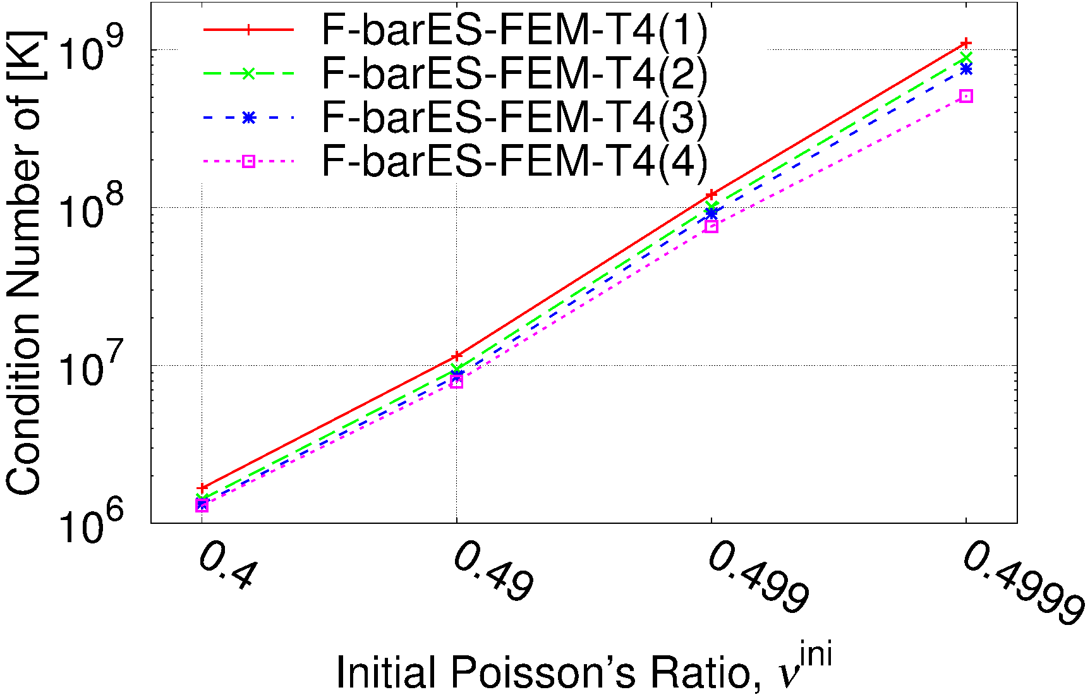
Condition Number of [K]
Condition number vs. Initial Poisson’s ratio
In one case of cantilever bending with neo Hookean model
Increase in c does not improve the ill-posedness of [K] much… $⟹$ Application of iterative solver for [K] is difficult.

Slide 23
Capability of AMG-GMRES
AMG-GMRES with
5th order Chebyshev polynomial smoother
Jacobi smoothed aggregation
Restart number is fixed at $r=150$
# of V-cycle is varied between 10 and 30.
 | $$ν=0.49$$ | $$ν=0.499$$ | $$ν=0.4999$$
# of V-cycle = 10 | ✓ | ✗ | ✗
# of V-cycle = 20 | ✓ | ✓ | ✗
# of V-cycle = 30 | ✓ | ✓ | ✓
Increase in the # of V-cycles improves the condition number of [K] for GMRES and helps the convergence of AMG-GMRES.

Slide 24
CPU Time of AMG-GMRES
CPU time is compared between
Direct solver: MKL PARDISO of Intel
Iterative solver: AMG-GMRES(150) (Note that it is not tuned yet...)
Currently,
AMG-GMRES is faster only when $ν≤0.49$.
MKL PARDISO is faster when $ν>0.49$.
This is due to the increase of cost for many V-cycles and also the lack of tuning of AMG-GMRES.
In point of speed, F-barES-FEM-T4 needs some improvements. e.g.) finding a good sparse approximation of $[K]$, generalization of $[K]$, and so on.

Slide 25
Summary

Slide 26
Benefits and Drawbacks of F-barES-FEM-T4
Benefits
Locking-free with 1st -order tetra meshes. No difficulty in severe strain or contact analysis.
No increase in DOF. No need of static condensation; Easy extension to dynamic explicit analysis.
Suppression of pressure oscillation in nearly incompressible materials.
Suppression of corner locking.
Drawbacks
✗ Increase in bandwidth of the exact tangent stiffness $[K]$. ✗ Relatively large condition number of $[K]$.
F-barES-FEM-T4 has excellent accuracy but needs some effort for speed-up.

Slide 27
Conclusion
A new FE formulation named “F-barES-FEM-T4” is proposed.
F-barES-FEM-T4 combines the F-bar method and ES-FEM-T4.
Owing to the cyclic smoothing, F-barES-FEM-T4 is locking-free and also pressure oscillation-free with no increase in DOF.
Only one drawback of F-barES-FEM-T4 is the decrease of calculation speed due to the increase in bandwidth of $[K]$, which is our future work to solve.
Thank you for your kind attention! I appreciate your questions and comments in easy and slow English!

Slide 28
Appendix

Slide 29
Characteristics of FEM-T4s
 | Shear & Volumetric Locking | Zero- Energy Mode | Dev/Vol Coupled Material | Pressure Oscillation | Corner Locking | Severe Strain
Standard FEM-T4 | ✗ | ✓ | ✓ | ✗ | ✗ | ✓
ABAQUS C3D4H | ✓ | ✓ | ✓ | ✗ | ✗ | ✓
Selective S-FEM-T4 | ✓ | ✓ | ✗ | ✗ | ✗ | ✓
bES-FEM-T4 hES-FEM-T4 | ✓ | ✓ | ✓ | ✗ | ✗ | ✗
F-bar ES-FEM-T4 | ✓ | ✓ | ✓ | ✓* | ✓* | ✓
*
) when the num. of cyclic smoothings is sufficiently large.

Slide 30
#2: Compression of 1/8 Cylinder
Result of F-bar ES-FEM(2)
50% nominal compression
Smooth
Mises stress
distribution is obtained
except just around the rim.

Slide 31
#0: Bending of a Cantilever
Outline
Neo-Hookean hyperelastic material $\left[T\right]=2C_{10}\frac{Dev(\overline{B})}{J}+\frac{2}{D_{1}}\left(J−1\right)\left[I\right]$ with a constant $C_{10}$(=1 GPa) and various $D_{1}$s so that the initial Poisson’s ratios are 0.49 and 0.499.
Two types of tetra meshes: structured and unstructured.
Compared to ABAQUS C3D4H (1st-order hybrid tetrahedral element).
Dead Load

Slide 32
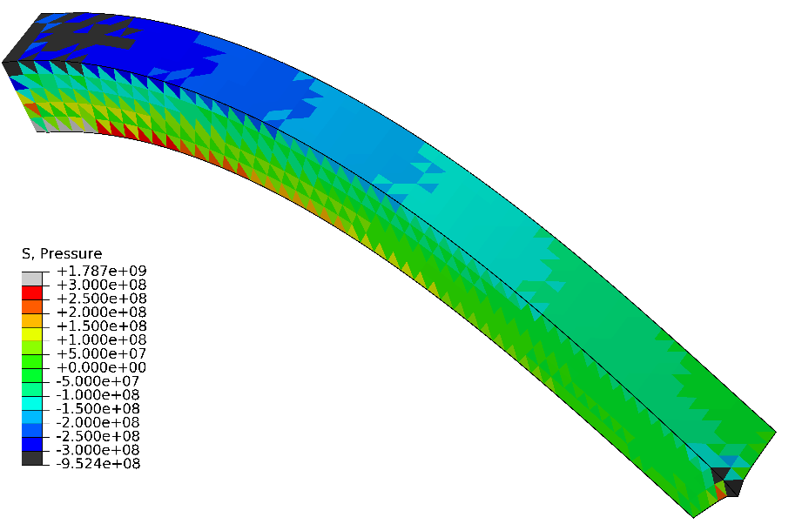
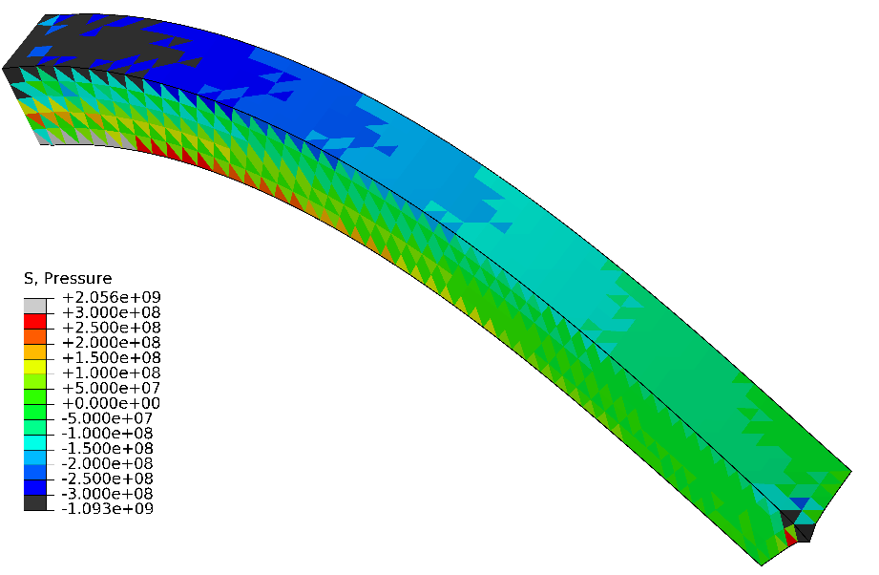
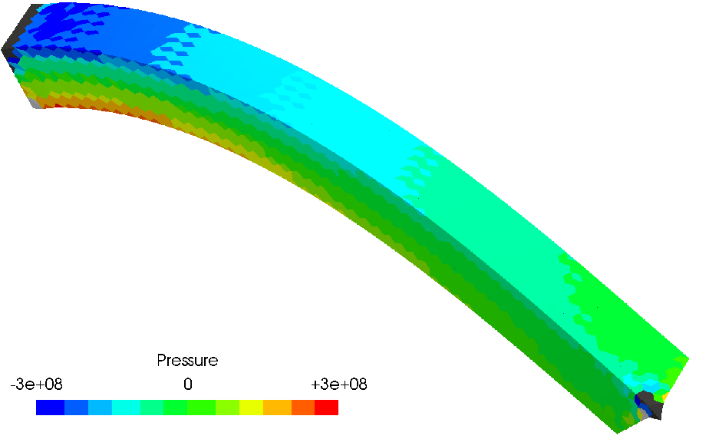
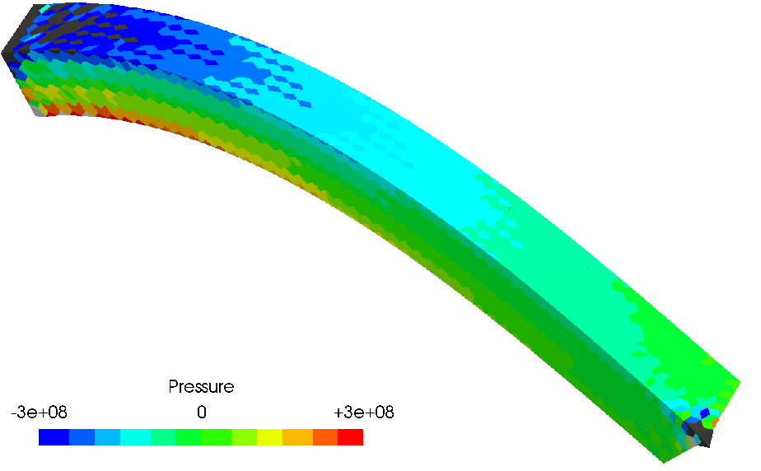
#0: Bending of a Cantilever
Pressure Distributions
$$ν^{ini}=0.49$$
Structured Mesh
$$ν^{ini}=0.499$$
ABAQUS C3D4H
F-bar ES-FEM- T4(1)

Slide 33
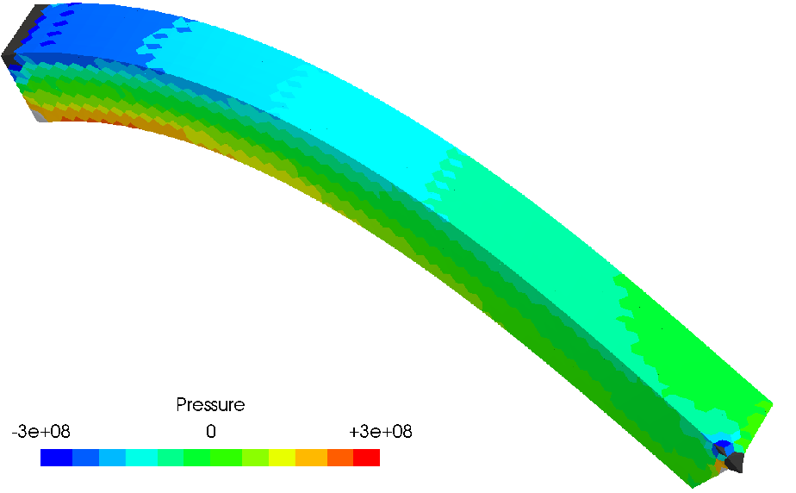
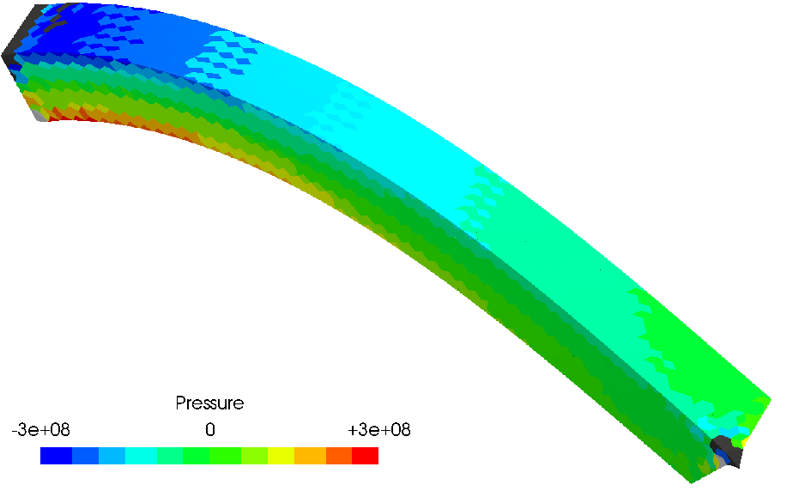
#0: Bending of a Cantilever
Pressure Distributions
$$ν^{ini}=0.49$$
Structured Mesh
$$ν^{ini}=0.499$$
F-bar ES-FEM-
T4(2)
Increase in the number of cyclic smoothing ($c$) makes stronger suppression of pressure oscillation.
F-bar ES-FEM- T4(3)

Slide 34
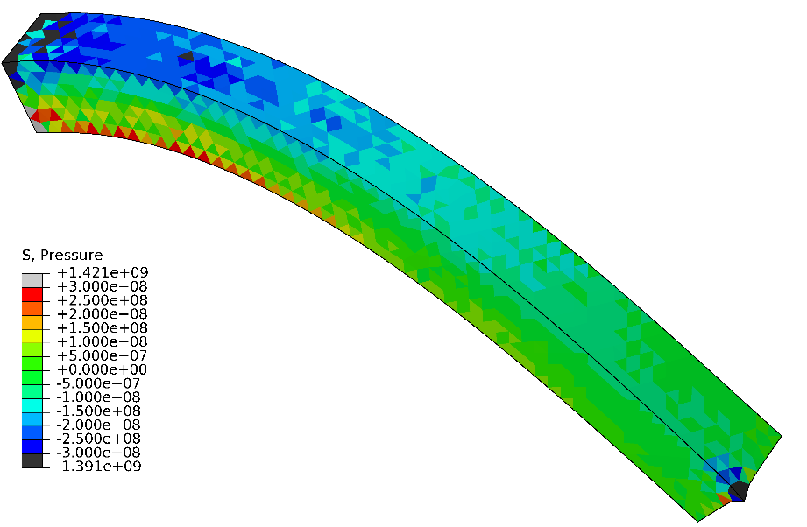
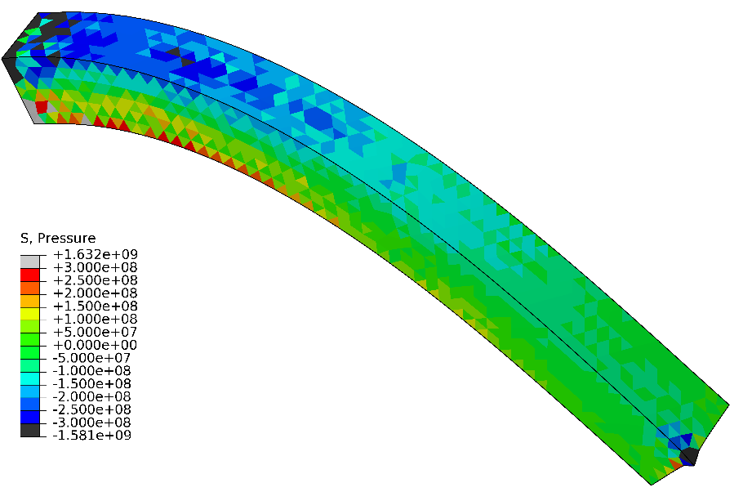
#0: Bending of a Cantilever
Pressure Distributions
$$ν^{ini}=0.49$$
Unstructured Mesh
$$ν^{ini}=0.499$$
ABAQUS C3D4H
F-bar ES-FEM- T4(1)

Slide 35
#0: Bending of a Cantilever
Pressure Distributions
$$ν^{ini}=0.49$$
Unstructured Mesh
$$ν^{ini}=0.499$$
F-bar ES-FEM-
T4(2)
F-bar ES-FEM-
T4(3)
No mesh dependency is observed.

