Slide 1
F-bar aided edge-based smoothed finite element method with 4-node tetrahedral elements
(F-barES-FEM-T4) for viscoelastic large deformation problems
Yuki ONISHI
Tokyo Institute of Technology, Japan

Slide 2
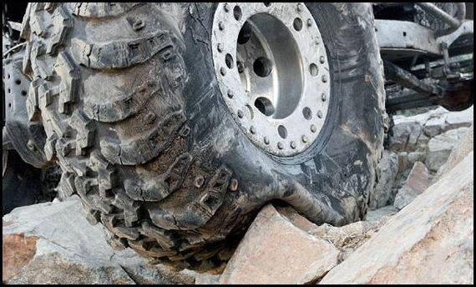
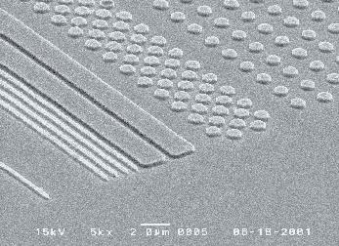


Motivation
What we want to do:
Solve hyper large deformation
analyses accurately and stably.
Treat complex geometries
with tetrahedral meshes.
Consider nearly incompressible materials $(ν≃0.5)$.
Support contact problems.
Handle auto re-meshing.
Rubber
Metal
Plastic/Glass

Slide 3
Issues
Conventional tetrahedral (T4/T10) FE formulations
still have issues in accuracy or stability
especially in nearly incompressible cases.
2nd or higher order elements:
✗ Volumetric locking.
Accuracy loss in large strain due to intermediate nodes.
Enhanced assumed strain method (EAS):
✗ Spurious low-energy modes.
B-bar method, F-bar method, Selective reduced integration:
✗ Not applicable to tetrahedral element directly.
F-bar-Patch method:
✗ Difficulty in building good-quality patches.
u/p mixed (hybrid) method:
(e.g., ABAQUS/Standard C3D4H and C3D10MH)
✗ Pressure checkerboarding, Early convergence failure etc..

Slide 4
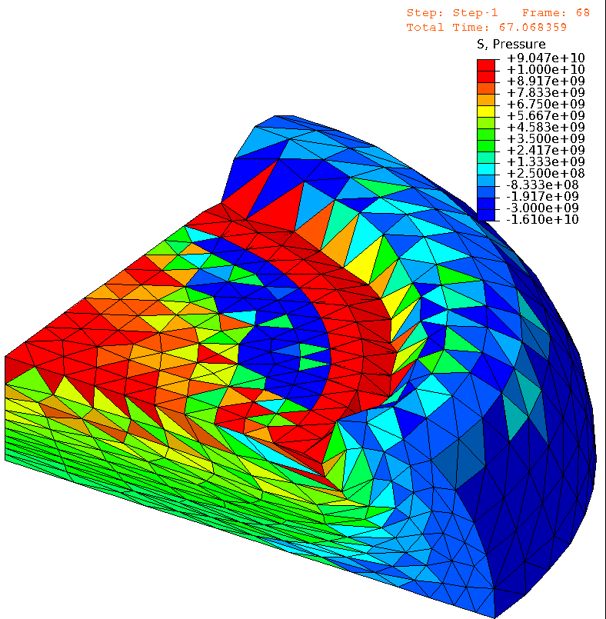
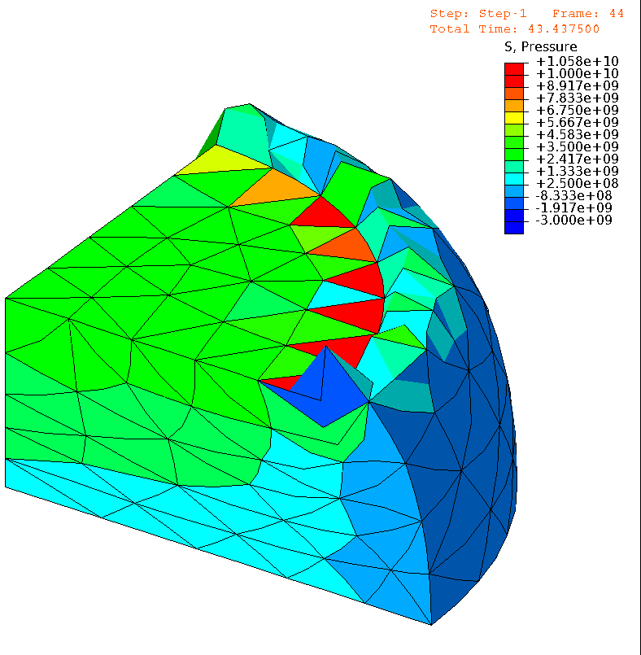

Issues (cont.)
E.g.) Compression of neo-Hookean hyperelastic body with $ν_{ini}=0.49$
Pressure
Pressure
# of Nodes is
almost the same.
1st order hybrid T4 (C3D4H)
✓ No volumetric locking
✗ Pressure checkerboarding
✗ Shear & corner locking
2nd order modified hybrid T10 (C3D10MH)
✓ No shear/volumetric locking
✗ Early convergence failure
✗ Low interpolation accuracy

Slide 5
A Recent Solution
A new idea of FE formulation called “Smoothed Finite Element Method (S-FEM)” was recently proposed and is in researching today widely.
Our group has proposed a latest S-FEM named
“F-barES-FEM-T4” (detailed later):
  No intermediate node & No additional DOF,
  (i.e., Purely displacement-based
  4-node tetrahedral (T4) element),
  Free from shear, volumetric and corner locking,
  No pressure checkerboarding,
  Long lasting in large deformation.

Slide 6
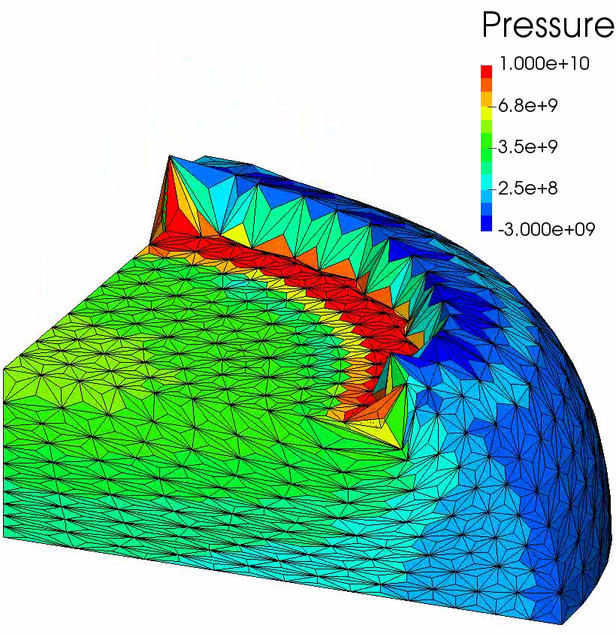

A Recent Solution (cont.)
E.g.1) Compression of hyperelastic body with $ν_{ini}=0.49$
Pressure
Same mesh
as C3D4H
case.
F-barES-FEM-T4 (One of the latest S-FEM)
✓ No shear/volumetric locking
✓ No corner locking
✓ No pressure checkerboarding

Slide 7
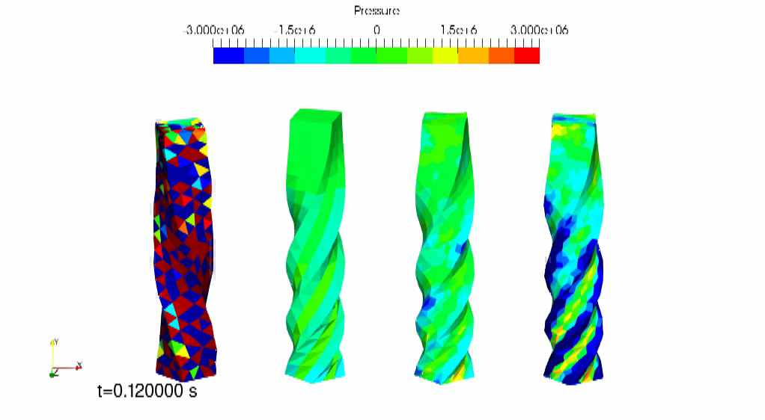

A Recent Solution (cont.)
E.g.2) Explicit dynamic twist of hyperelastic body with $ν_{ini}=0.49$
C3D4
C3D8
F-barES-FEM-T4
SymF-barES-FEM-T4

Slide 8
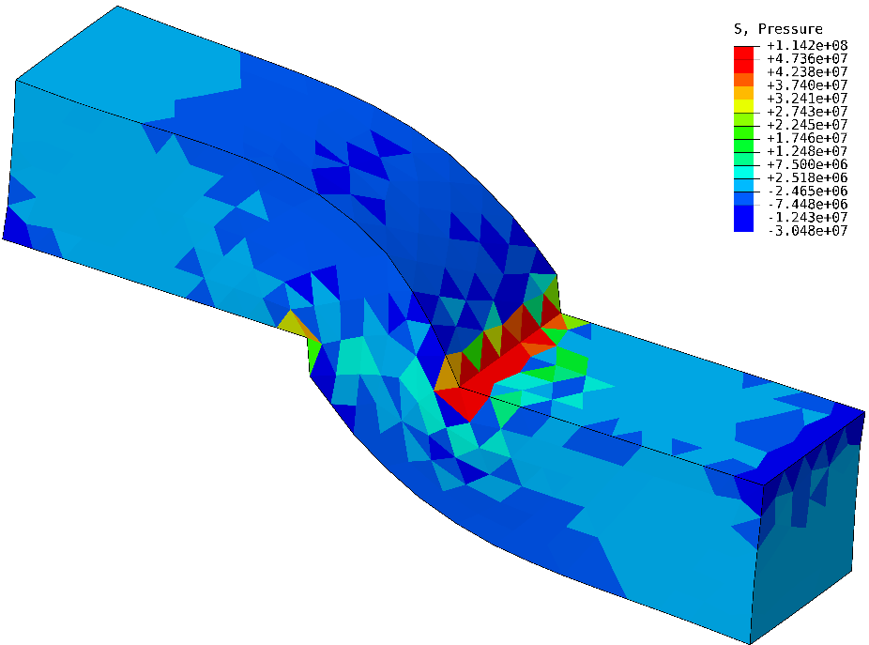
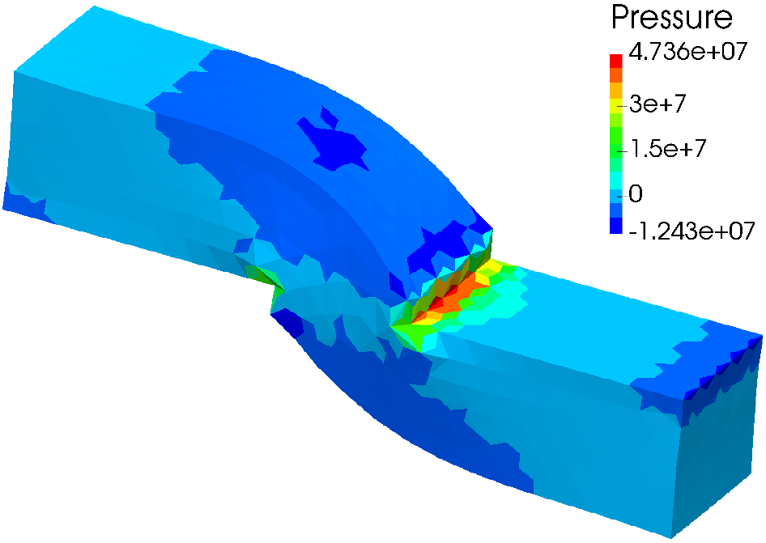
A Recent Solution (cont.)
E.g.3) Shear of elastoplastic body with soft hardening coeff.
Pressure
1st order hybrid T4 (C3D4H)
✓ No volumetric locking
✗ Shear locking
✗ Pressure checkerboarding
F-barES-FEM-T4
✓ No volumetric locking
✓ No shear locking
✓ No pressure checkerboarding
We have evaluated F-barES-FEM-T4 in elastic and elastoplastic cases but NOT in viscoelastic cases yet.

Slide 9
Objective
To applying and demonstrate
the latest S-FEM called F-barES-FEM-T4
to viscoelastic large deformation problems.
Table of Body Contents
Introduction of F-barES-FEM-T4’s formulation
Demonstration of F-barES-FEM-T4
in viscoelastic problems
Summary

Slide 10
Introduction of
F-barES-FEM-T4’s
formulation

Slide 11
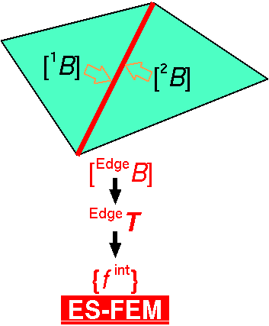

1. Brief of Edge-based S-FEM (ES-FEM)
Calculate $[B]$ at each element as usual.
Distribute $[B]$ to the connecting edges with area weight
and build $[ ^{Edge}B]$ .
Calculate $F, T, \left\{f^{int}\right\}$ etc. in each edge smoothing domain.
As if putting
an integration point
on each edge center
✗ Volumetric locking
✗ Pressure checkerboarding
No shear locking
No spurious modes

Slide 12
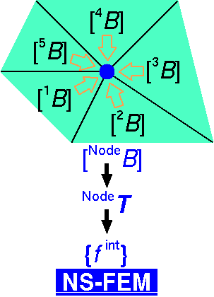

2. Brief of Node-based S-FEM (NS-FEM)
Calculate $[B]$ at each element as usual.
Distribute $[B]$ to the connecting nodes with area weight
and build $[ ^{Node}B]$.
Calculate $F, T, \left\{f^{int}\right\}$ etc. in each node smoothing domain.
As if putting
an integration point
on each node
✗ Spurious low-energy mode
Less pressure
checkerboarding
No shear locking
No volumetric locking

Slide 13
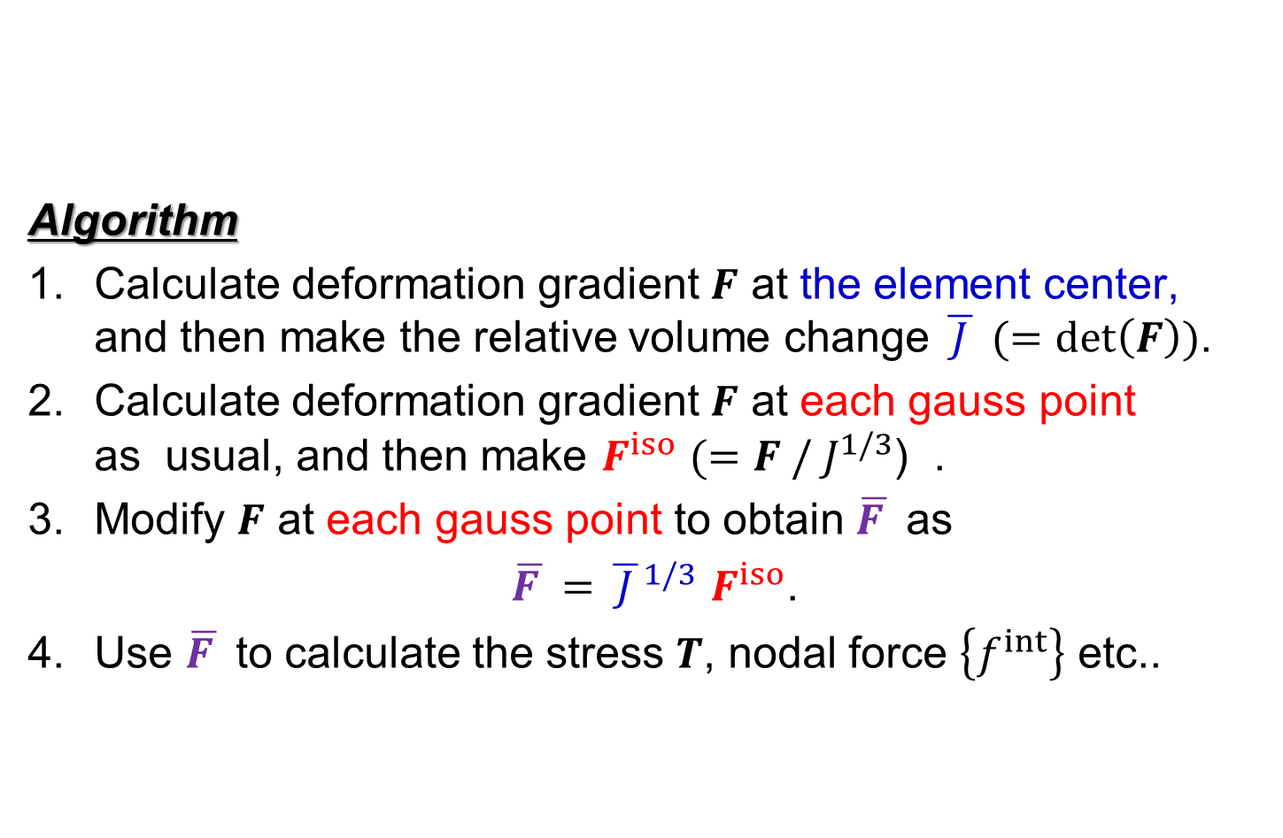
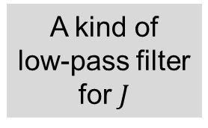
3. Brief of F-bar Method
Algorithm
Calculate deformation gradient $F$ at the element center,
and then make the relative volume change $\overline{ J }$ $(=det\left(F\right))$.
Calculate deformation gradient $F$ at each gauss point
as usual, and then make $F^{iso}$ $(=F / J^{1/3}$) .
Modify $F$ at each gauss point to obtain $\overline{F }$ as
$\overline{F }=$ ${\overline{ J }}^{1/3}$ $F^{iso}$.
Use $\overline{F }$ to calculate the stress $T$, nodal force $\left\{f^{int}\right\}$ etc..
For quadrilateral (Q4)
or hexahedral (H8)
elements
A kind of
low-pass filter
for $J$
F-bar method is used to avoid volumetric locking in Q4 or H8
elements. Yet, it cannot avoid shear locking.

Slide 14
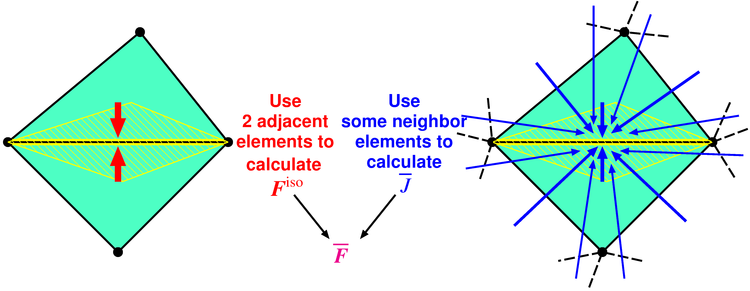

Outline of F-barES-FEM
Outlline
$^{Edge}{\tilde{F}}^{iso}$ is given by ES-FEM.
$^{Edge}\overline{ J }$ is given by cyclically applied NS-FEM.
$^{Edge}\overline{F }$ is calculated in the manner of F-bar method:
$^{Edge}\overline{F }=$ $^{Edge}{\overline{ J }}^{1/3}$ $^{Edge}{\tilde{F}}^{iso}$.
Concept: combine ES-FEM and NS-FEM using F-bar method

Slide 15
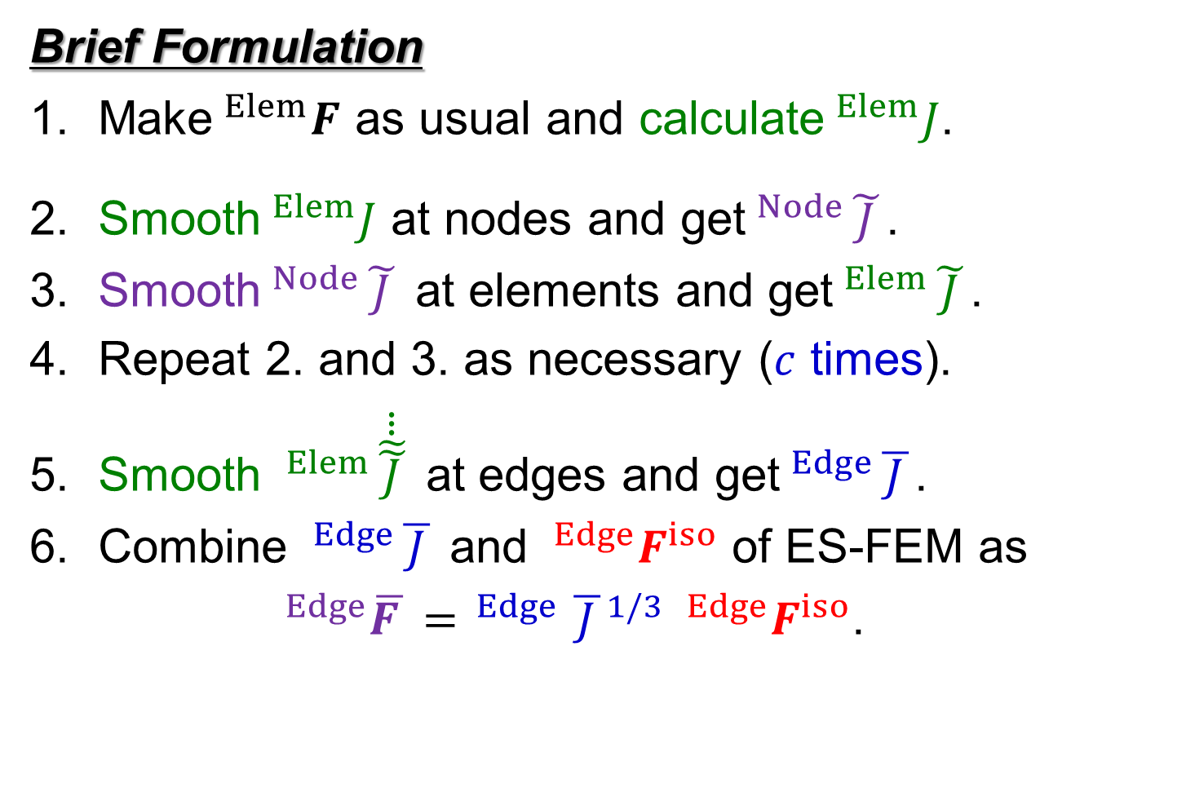

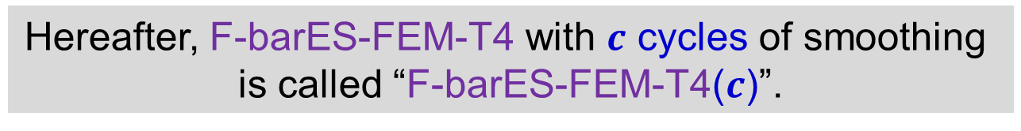
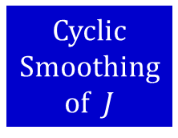
Outline of F-barES-FEM (cont.)
Brief Formulation
Make$^{Elem}F$ as usual and calculate$^{Elem}J$.
Smooth$^{Elem}J$ at nodes and get$^{Node}\tilde{ J }$.
Smooth$^{Node}\tilde{ J }$ at elements and get$^{Elem}\tilde{ J }$.
Repeat 2. and 3. as necessary ($c$ times).
Smooth $^{Elem}\dot{\dot{\dot{\tilde{\tilde{ J }}}}}$ at edges and get$^{Edge}\overline{ J }$.
Combine $^{Edge}\overline{ J }$ and $^{Edge}F^{iso}$ of ES-FEM as
$^{Edge}\overline{F }= ^{Edge}{\overline{ J }}^{1/3} ^{Edge}F^{iso}$.
Cyclic
Smoothing
of $J$
A kind of
low-pass
filter
($c$ layers of ~)
Hereafter, F-barES-FEM-T4 with $c$ cycles of smoothing
is called “F-barES-FEM-T4($c$)”.

Slide 16

How to Treat Viscoelastic Model
Stress
$\left\{\begin{aligned}T^{hyd}=K tr\left(H\right) I, \\ T^{dev}=2G_{0}\left(H^{dev}−{∑g}_{i}H_{i}^{v}\right).\end{aligned}\right.$
Time advance of viscous strain
$$H_{i}^{v+}=R⋅H_{i}^{v}⋅R^{T}+ΔH_{i}^{v}.$$
Equation to solve
$$[K]\left\{u\right\}=\{f\}$$
The target constitutive model to treat is
the Hencky’s viscoelastic model based on
the generalized Maxwell model.
The most
standard one.
Bulk modulus
Hencky (Logarithmic) strain
Viscosity only in
deviatoric stress.
Instantaneous shear modulus
Prony coeff
Viscous strain
Rigid rotation in an increment
Viscous strain increment
Same as static problems
due to the absence of inertia

Slide 17
Demonstration of
F-barES-FEM-T4
in viscoelastic problems

Slide 18
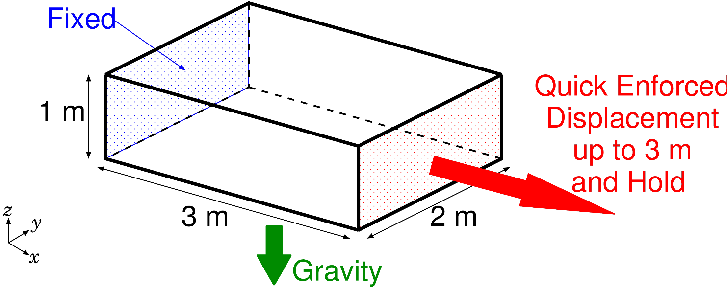
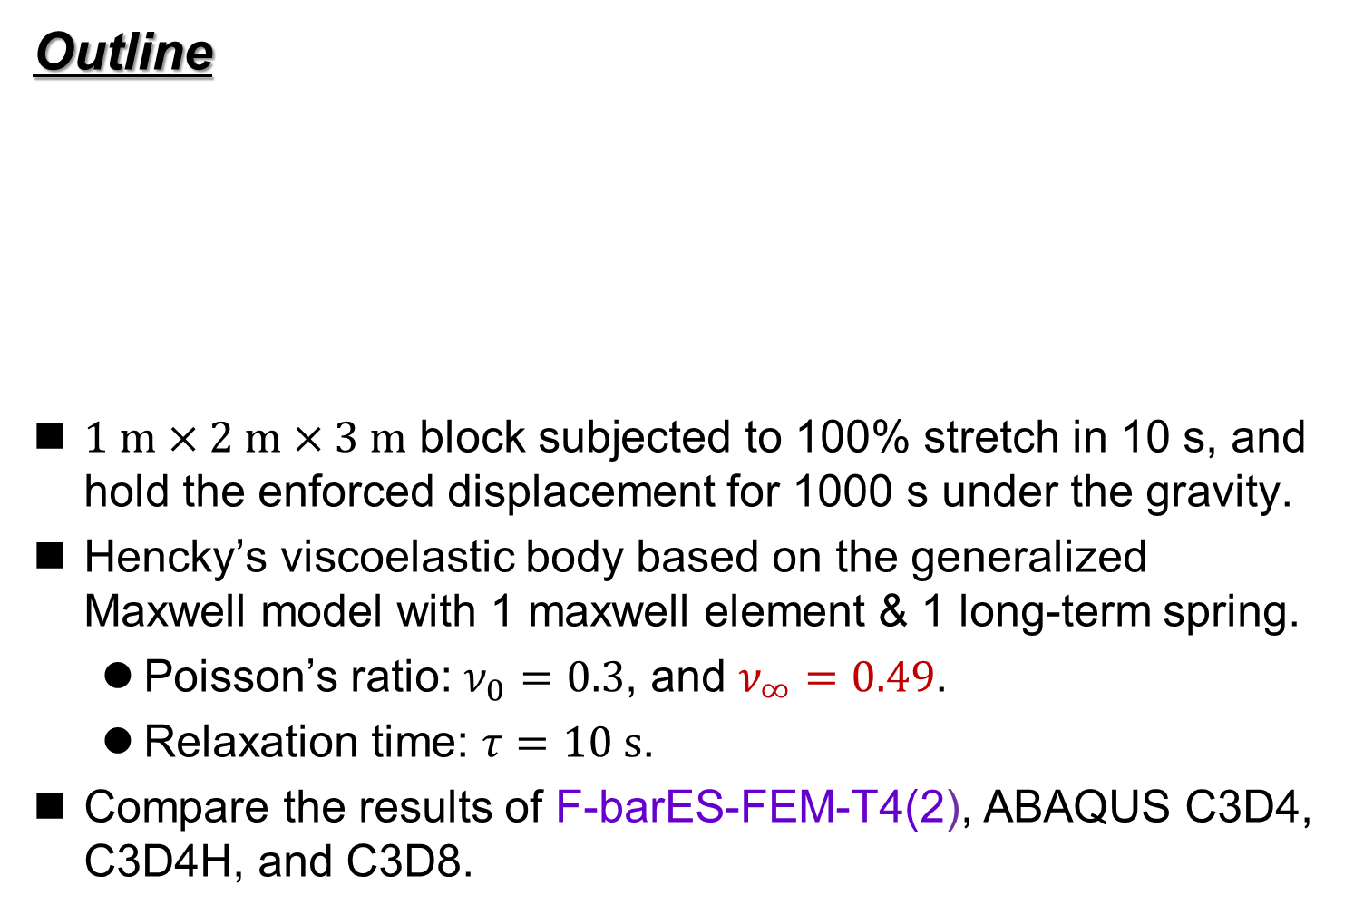
Tensile Suspension of Viscoelastic Block
Outline
$1 m×2 m×3 m$ block subjected to 100% stretch in 10 s, and hold the enforced displacement for 1000 s under the gravity.
Hencky’s viscoelastic body based on the generalized Maxwell model with 1 maxwell element & 1 long-term spring.
  Poisson’s ratio: $ν_{0}=0.3$, and $ν_{∞}=0.49$.
  Relaxation time: $τ=10 s$.
Compare the results of F-barES-FEM-T4(2), ABAQUS C3D4, C3D4H, and C3D8.

Slide 19
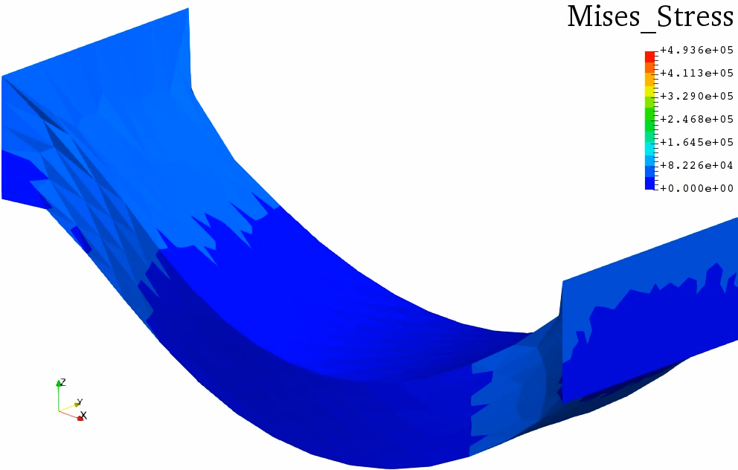
Tensile Suspension of Viscoelastic Block
Animation of Mises Stress (F-barES-FEM-T4(2))
Stress relaxation
progresses
after stretch.

Slide 20
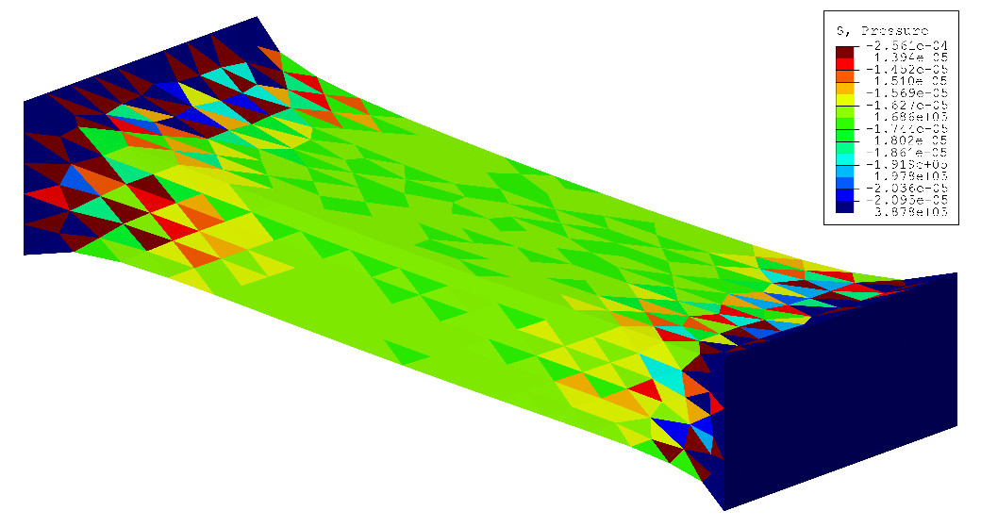
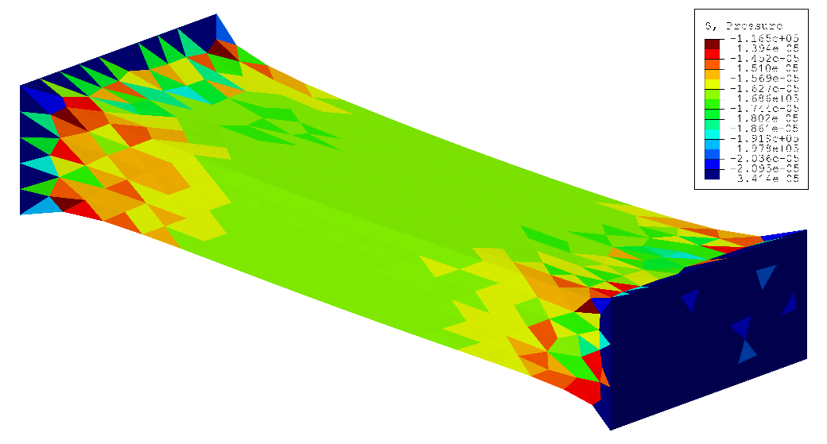
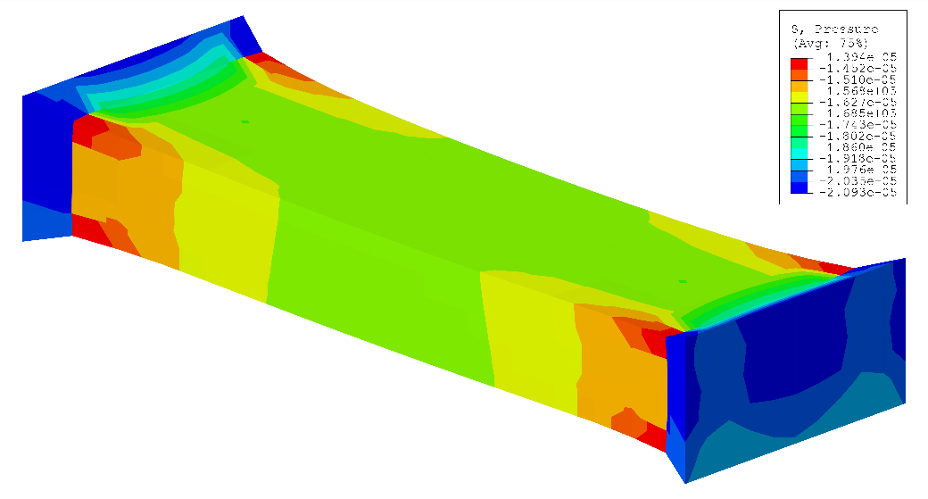
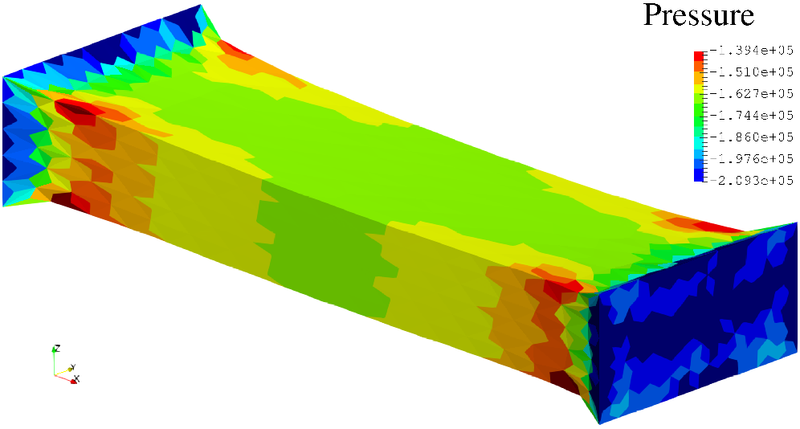
Tensile Suspension of Viscoelastic Block
Pressure at the end of stretch (common contour range)
ABAQUS C3D4
ABAQUS C3D4H
Checkerboarding
ABAQUS C3D8
F-barES-FEM-T4(2)
No Checkerboarding!!

Slide 21
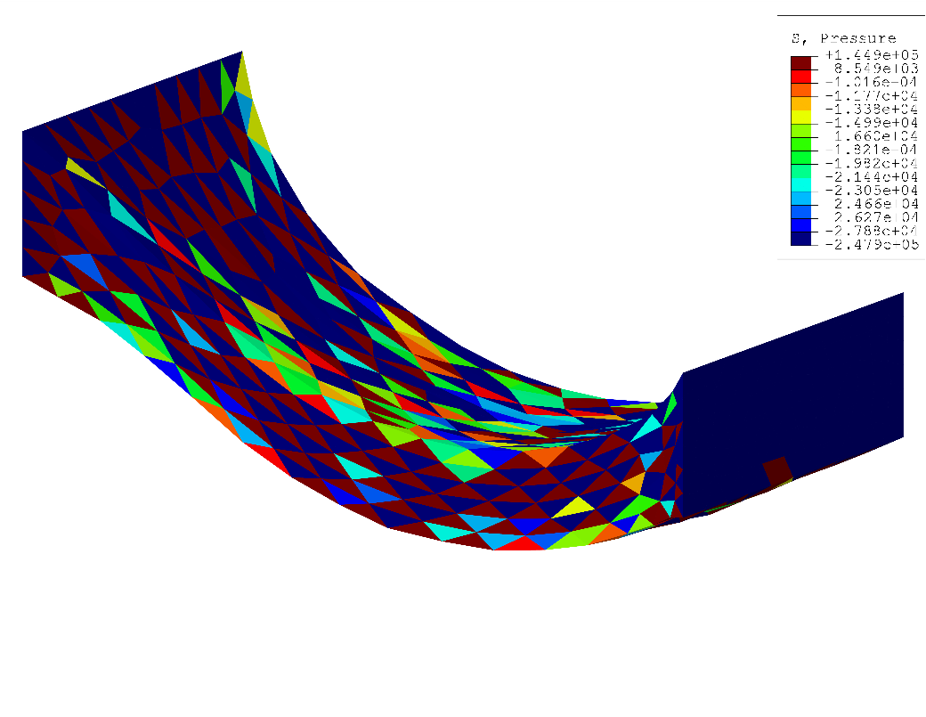
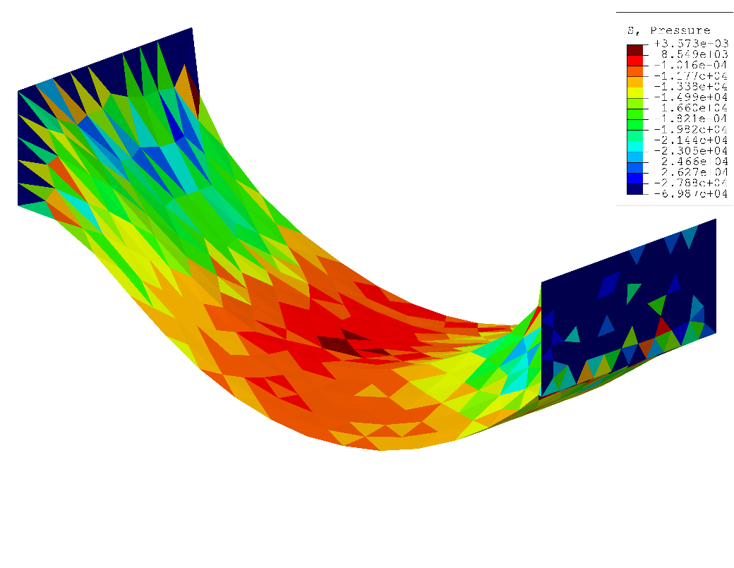
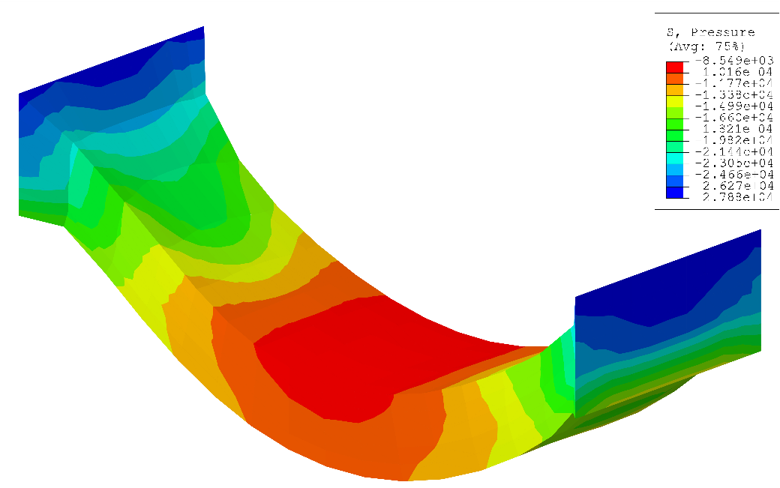
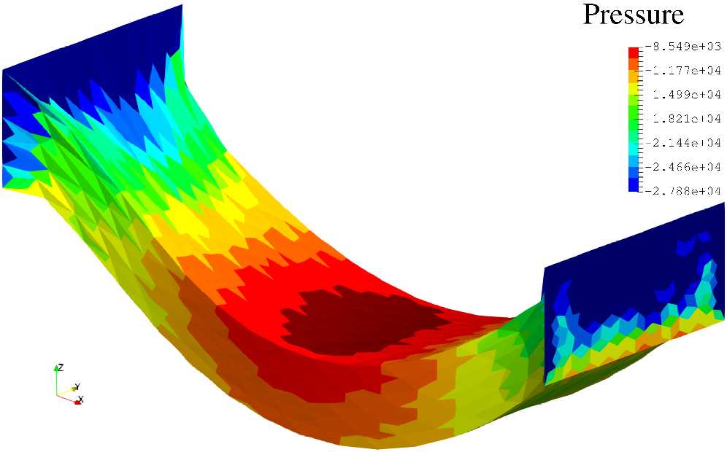
Tensile Suspension of Viscoelastic Block
Pressure at the final state (common contour range)
ABAQUS C3D4
ABAQUS C3D4H
Small
Deflection
Severe
Checkerboarding
ABAQUS C3D8
F-barES-FEM-T4(2)
No Checkerboarding!!

Slide 22
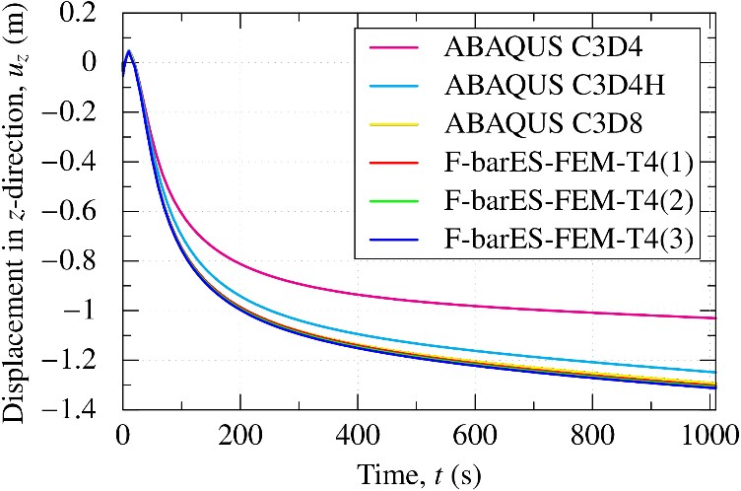

Tensile Suspension of Viscoelastic Block
Time histories of $u_{z}$ at the center of bottom face
ABAQUS
C3D4
and
C3D4H
have
shear
locking.
ABAQUS’s T4 elements cannot avoid shear locking, whereas
F-barES-FEM-T4 has good accuracy as H8-SRI element.

Slide 23
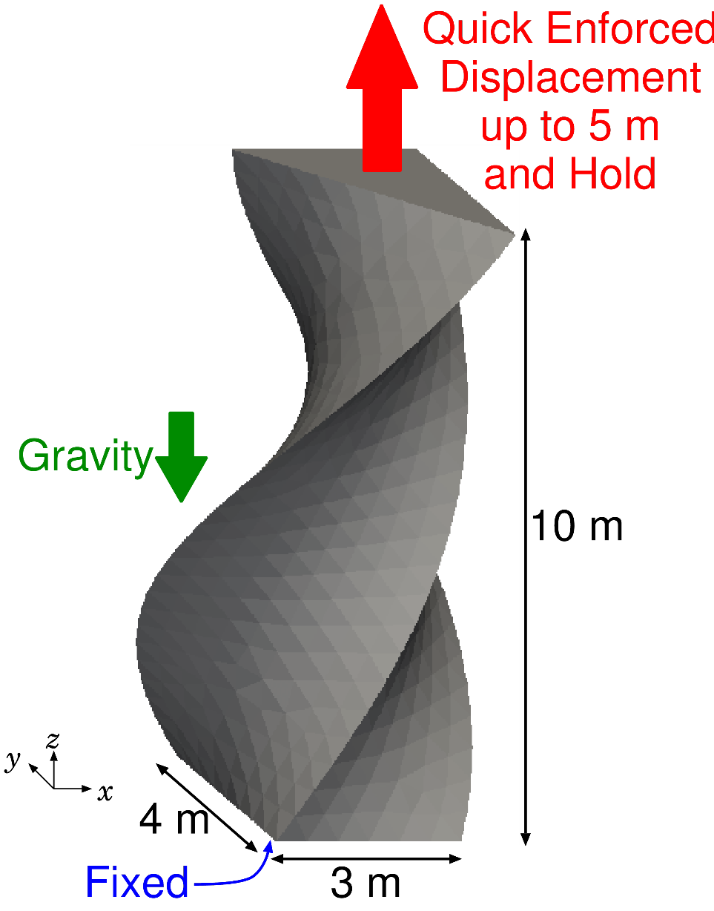
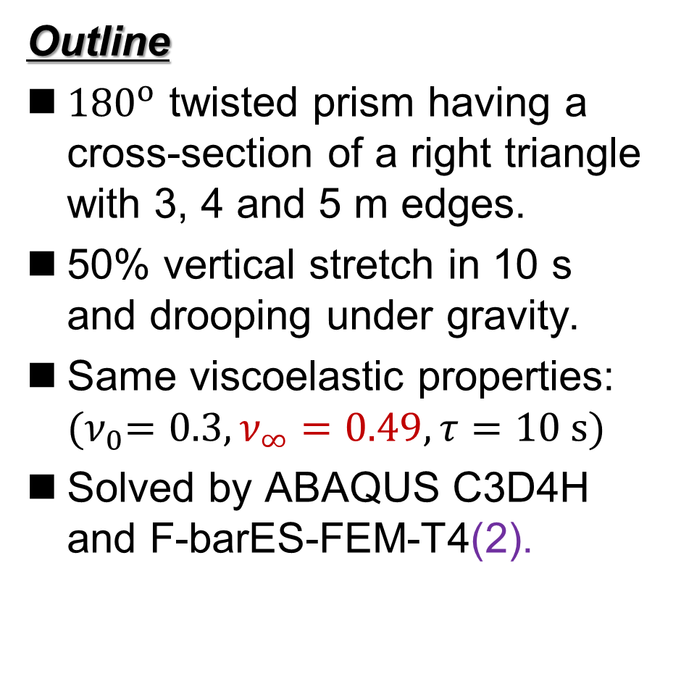
Tensile Drooping of Viscoelastic Twisted Prism
Outline
${180}^{o}$ twisted prism having a cross-section of a right triangle with 3, 4 and 5 m edges.
50% vertical stretch in 10 s
and drooping under gravity.
Same viscoelastic properties:
${(ν}_{0}=0.3, ν_{∞}=0.49, τ=10 s)$
Solved by ABAQUS C3D4H and F-barES-FEM-T4(2).

Slide 24
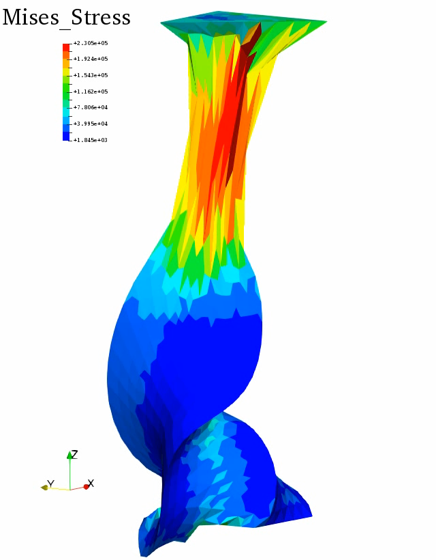
Tensile Drooping of Viscoelastic Twisted Prism
Mises
Stress
Dist.
(F-barES-
FEM-T4(2))
Continuous stretch
in the upper part
after the enforced stretch.
Stress relaxation
in the lower part.

Slide 25
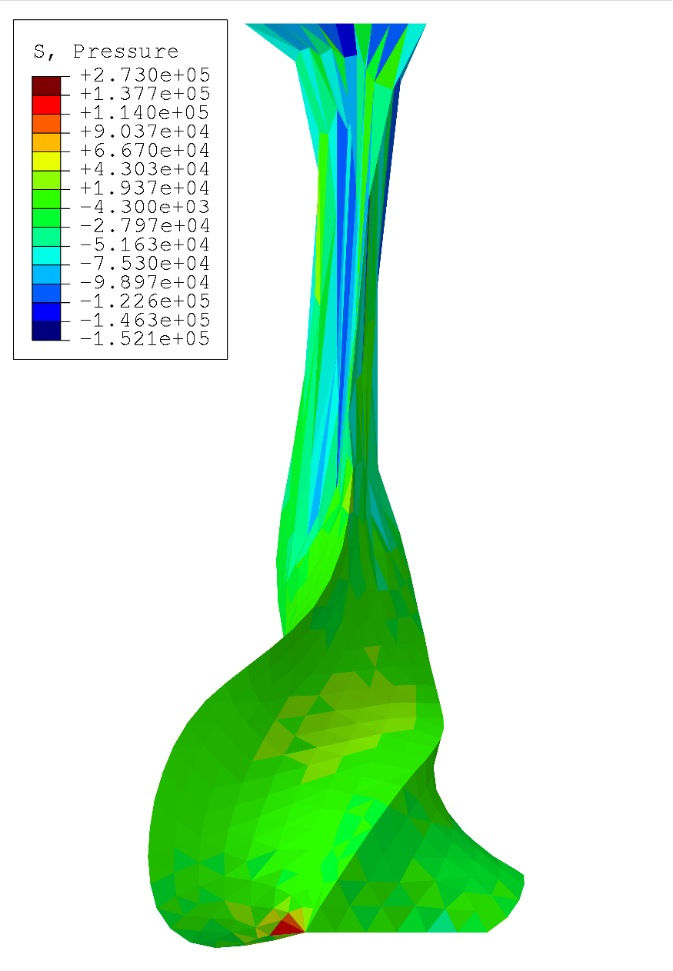
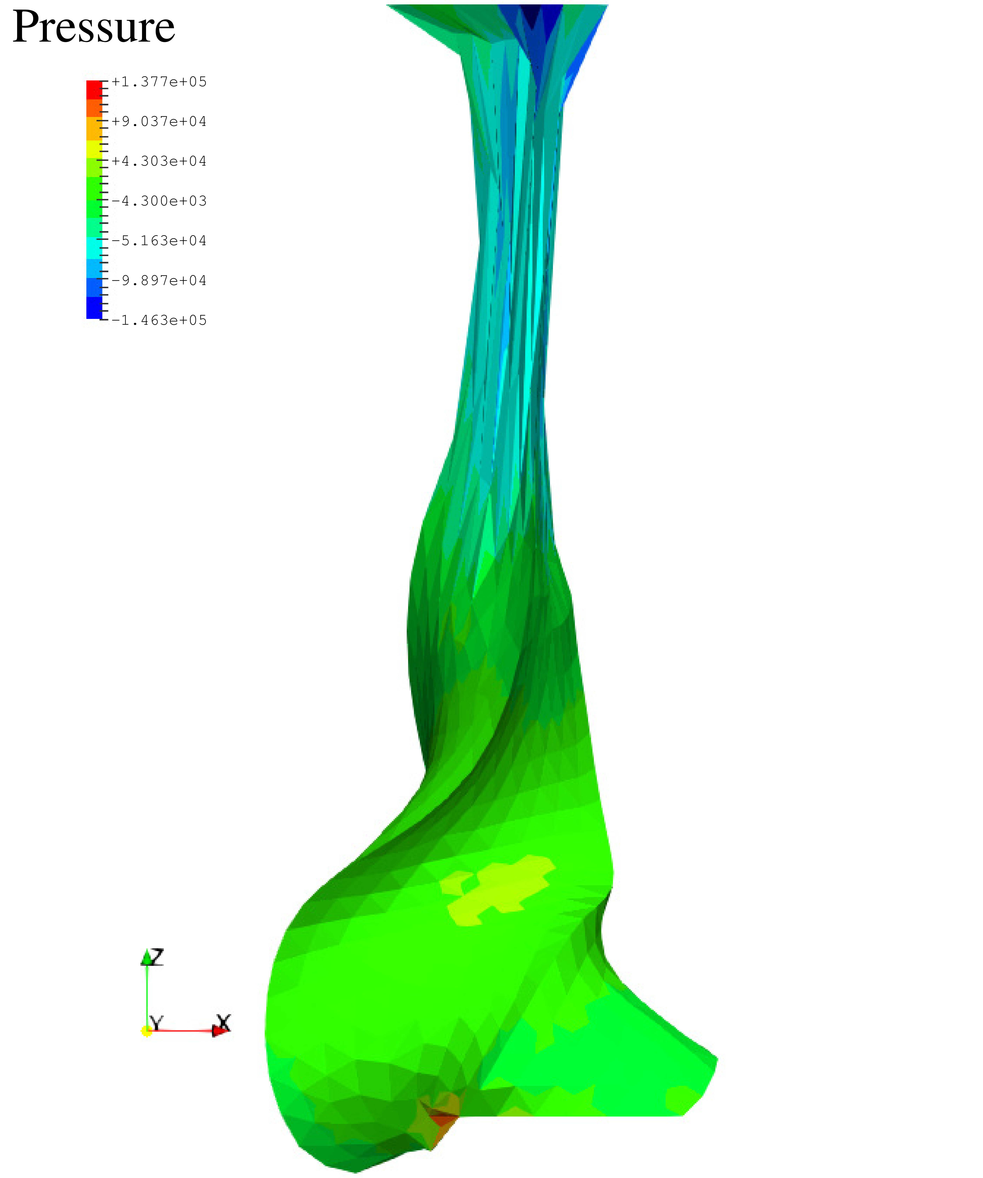
Tensile Drooping of Viscoelastic Twisted Prism
Pressure dist. at the final state (common contour range)
ABAQUS
C3D4H
F-barES-
FEM-T4(2)
Seems
unnaturally
hard.
Seems
naturally
soft.

Slide 26
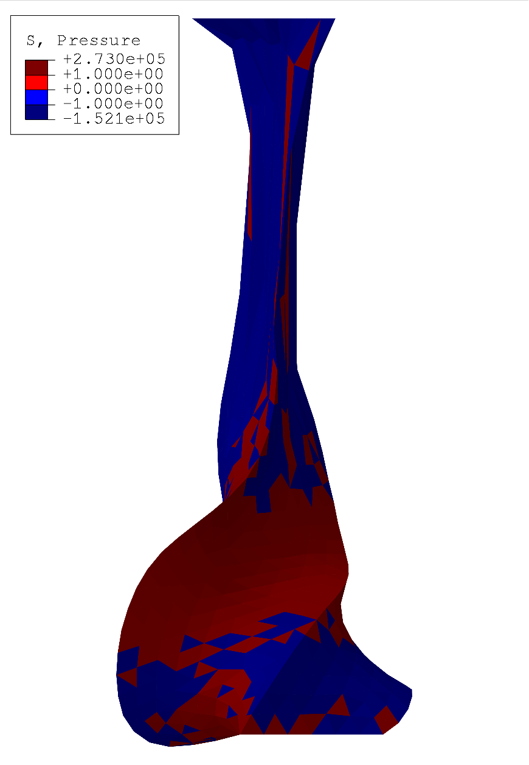
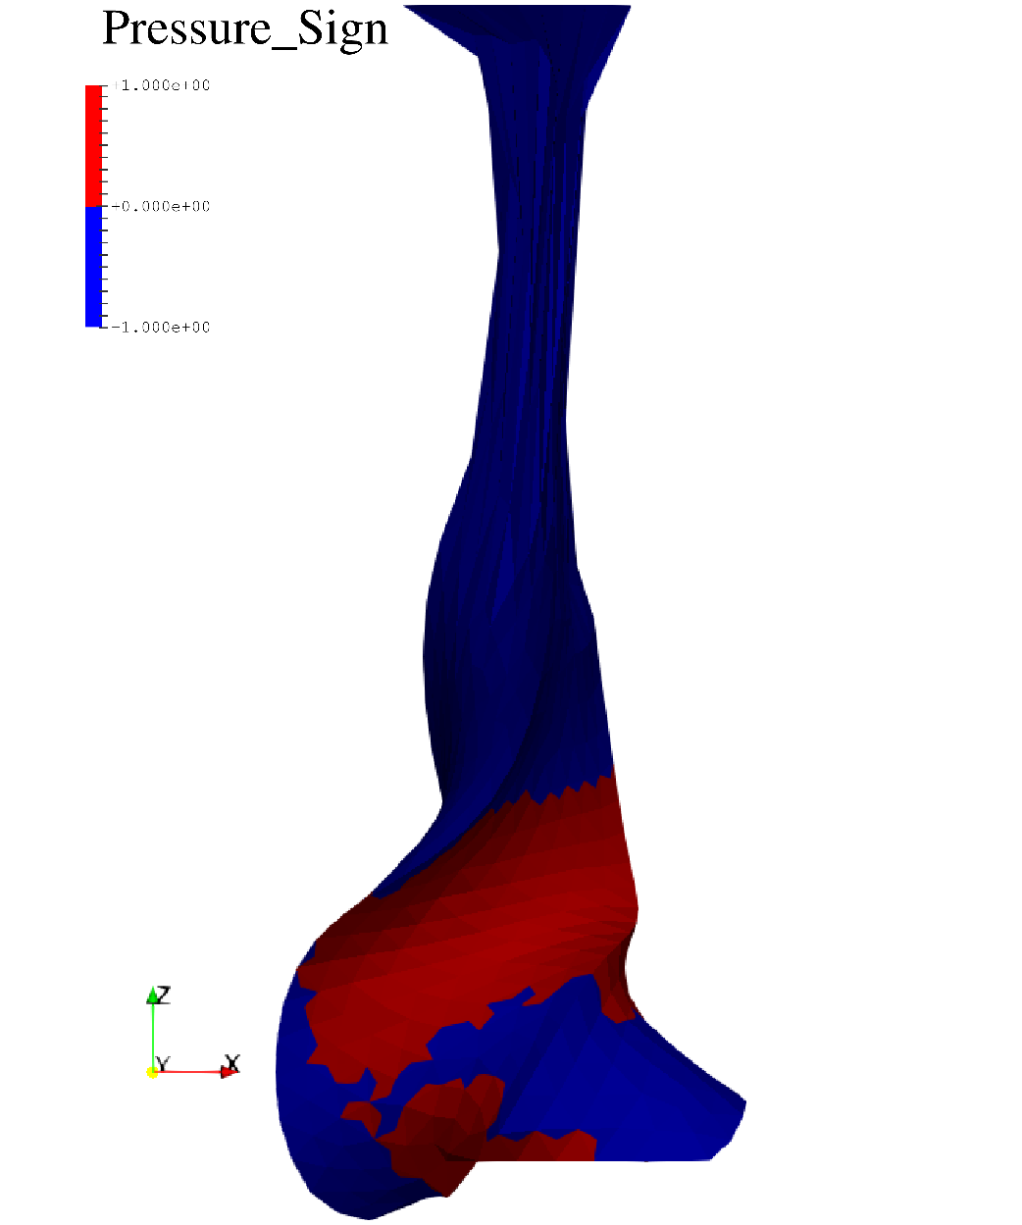
Tensile Drooping of Viscoelastic Twisted Prism
Pressure sign dist. at the final state
pressure
checkerboarding.
No Checkerboarding!!
ABAQUS
C3D4H
F-barES-
FEM-T4(2)

Slide 27
Summary

Slide 28
Benefits and Drawbacks of F-barES-FEM-T4
Benefits
  Locking-free with 1st order tetra meshes.
  No difficulty in severe strain or contact analysis.
  No increase in DOF.
  Purely displacement-based formulation.
  Long lasting.
  Less pressure checkerboarding.
Drawbacks
✗ The more cyclic smoothing necessitates
the more CPU time due to the wider bandwidth.
More stable & accurate than other T4 elements!!!
Slower than other T4 elements…

Slide 29
Take-Home Messages
F-barES-FEM-T4 is the current best T4 FE formulation
for the large deformation with near incompressibility:
  Rubber-like materials,
  Elastoplastic materials, and
  Viscoelastic materials.
Thank you for your kind attention!

Slide 30
Appendix

Slide 31
Characteristics of [K] in F-barES-FEM-T4
✓ No increase in DOF.
(No Lagrange multiplier. No static condensation.)
✓ Positive definite.
✗ Wider bandwidth.
In case of standard unstructured T4 meshes,
✗ Ill-posedness in nearly incompressible cases.
(No improvement in condition number.)
Method | Approx. Bandwidth | Approx. Ratio
Standard FEM-T4 | 40 | 1
F-barES-FEM-T4(1) | 390 | x10
F-barES-FEM-T4(2) | 860 | x20
F-barES-FEM-T4(3) | 1580 | x40
F-barES-FEM-T4(4) | 2600 | x65

Slide 32
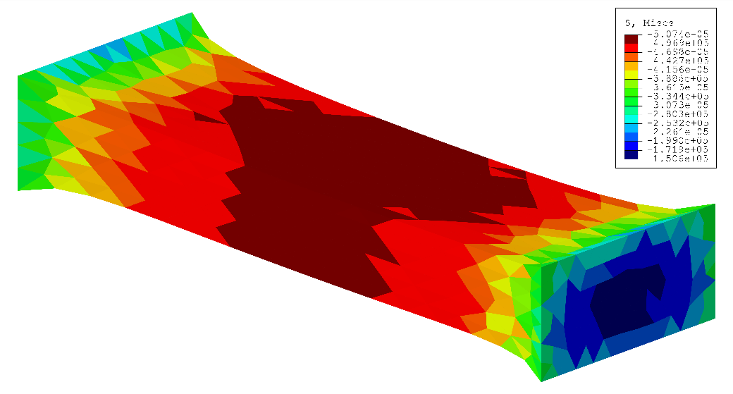

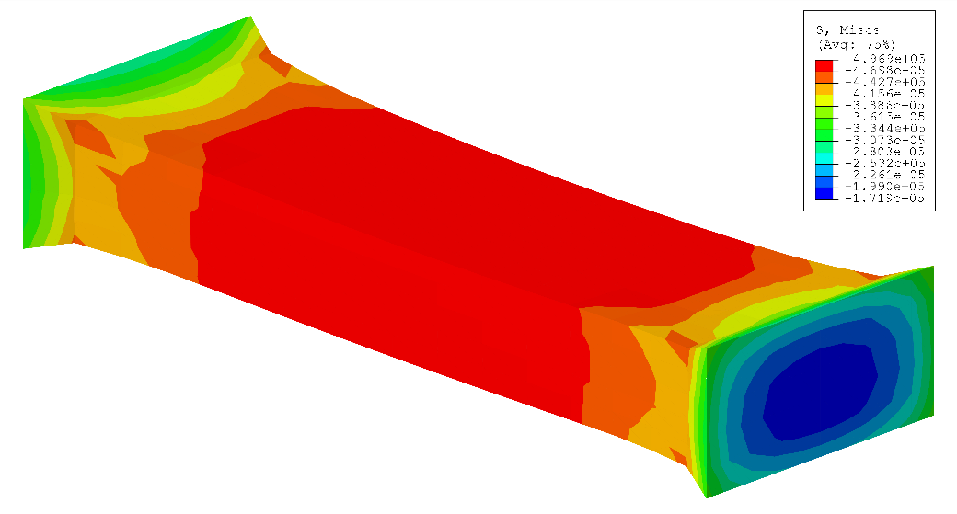
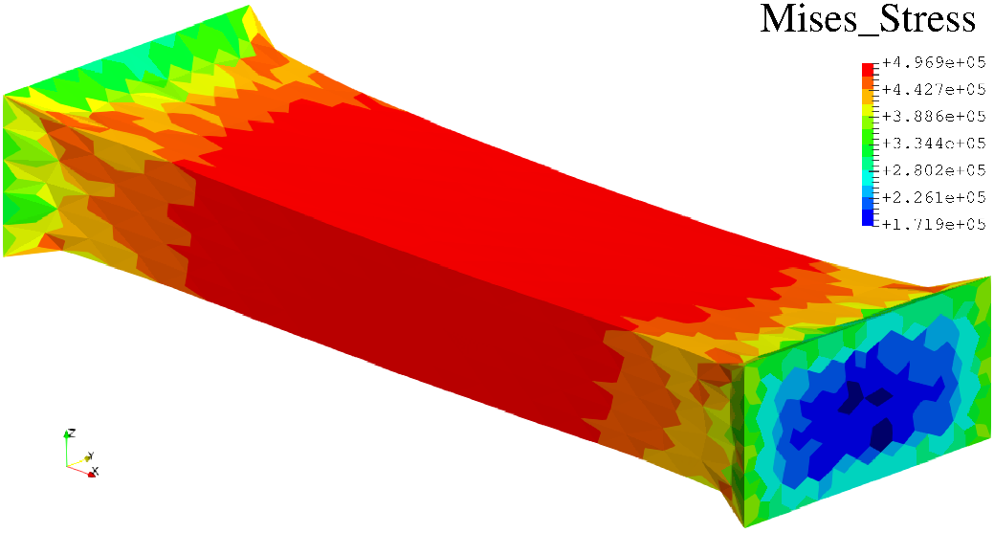
Tensile Suspension of Viscoelastic Block
Mises stress at the end of stretch (common contour range)
ABAQUS C3D4
ABAQUS C3D4H
Checkerboarding
ABAQUS C3D8
F-barES-FEM-T4(2)

Slide 33
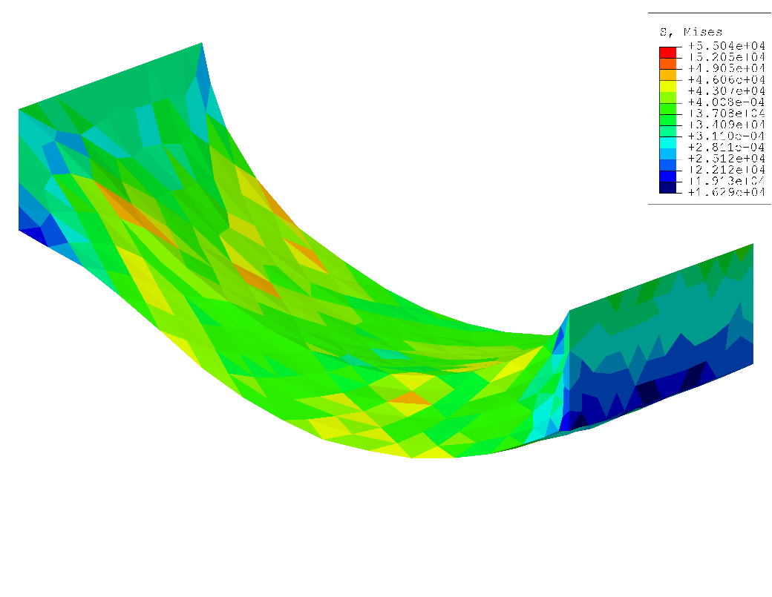
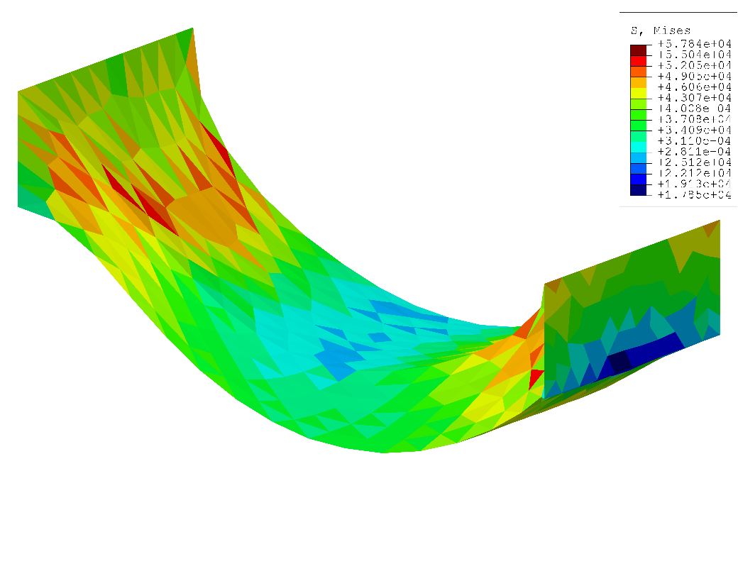
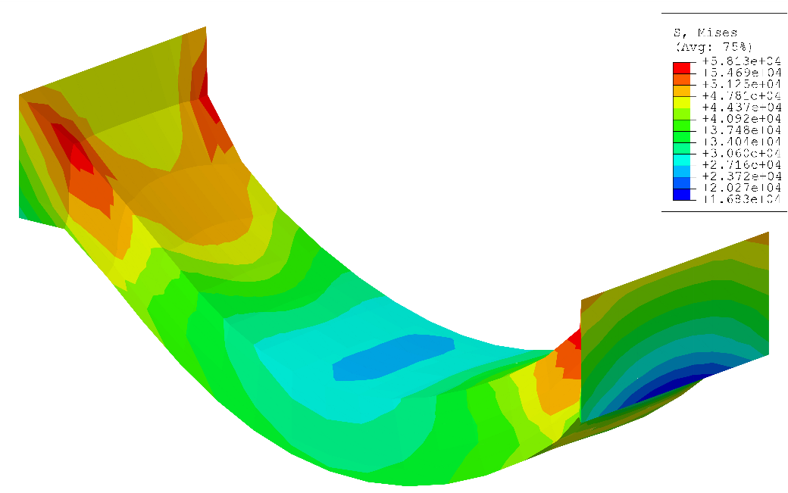

Tensile Suspension of Viscoelastic Block
Mises stress at the final state (common contour range)
ABAQUS C3D4
ABAQUS C3D4H
Checkerboarding
F-barES-FEM-T4(2)
ABAQUS C3D8

