Slide 1
A Novel Finite Element Formulation for Large Deformation Analysis Based on Incremental Equilibrium Equation in Conjunction with Rezoning Technique
Yuki ONISHI, Kenji AMAYA
Tokyo Institute of Technology (Japan)

Slide 2
Motivation and Background
We want to solve severely large deformation problems accurately and stably! (Final target: thermal nanoimprinting)
Finite elements are distorted in a short time, thereby resulting in convergence failure.
FE rezoning method (h-adaptive, mesh-to-mesh solution mapping) is indispensable.

Slide 3
Methods for Forming Simulation
 | Software | Accuracy | Stability
One Step Method | HyperForm FASTFORM | * | ****
Dynamic-Explicit FE Rezoning | LS-DYNA PAM-STAMP | ** | ***
Static-Explicit FE Rezoning | ASU/P-form | *** | **
Static-Implicit FE Rezoning | ABAQUS MARC | **** | *
Most of the
rezoning researches
try to improve this.
Our approach
tries to improve
this.
But How ?

Slide 4
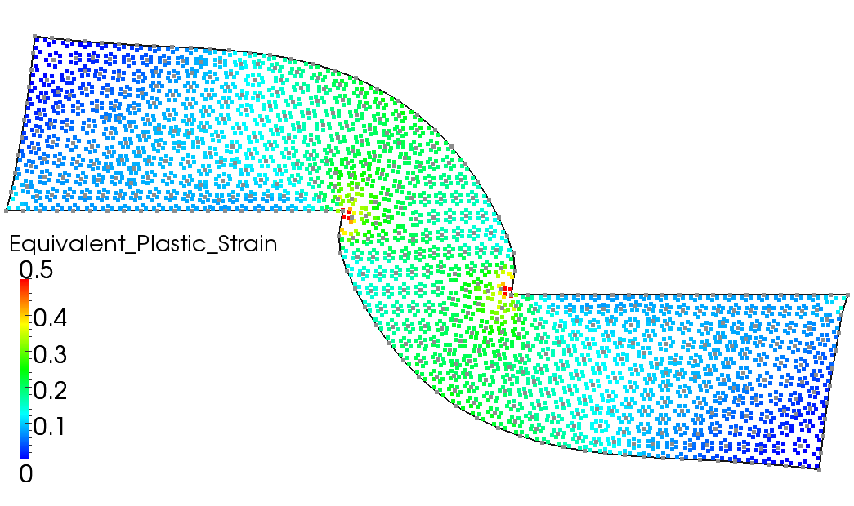
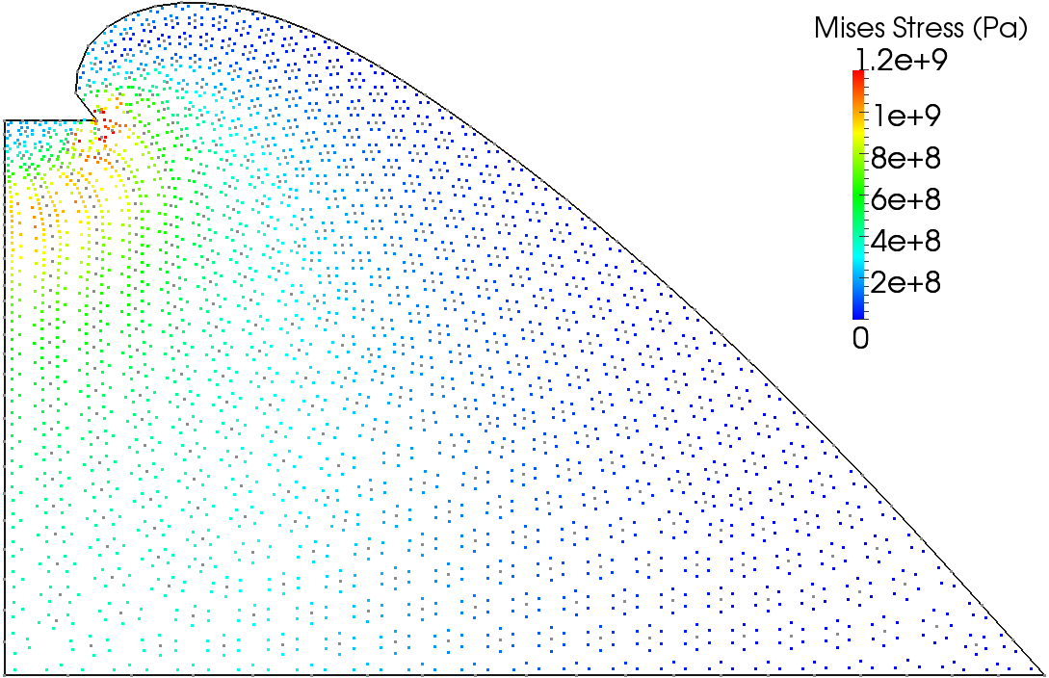
Idea of Our Approach
Our Idea
We adopts the incremental equilibrium equation (IEE) as the equation to be solved.
The IEE is recently developed in a meshfree method.
See the e-book of
PARTICLES2011
or our full-paper of
IJNME in press.

Slide 5
Objective
Develop an accurate and stable implicit FE rezoning method
for large deformation problems based on the incremental equilibrium equation (IEE)
Table of Body Contents
Derivation of the IEE for static-implicit analysis
Formulation of our implicit FE rezoning method based on the IEE
Examples of analysis

Slide 6
Derivation of the incremental equilibrium equation (IEE)
for static-implicit analysis

Slide 7
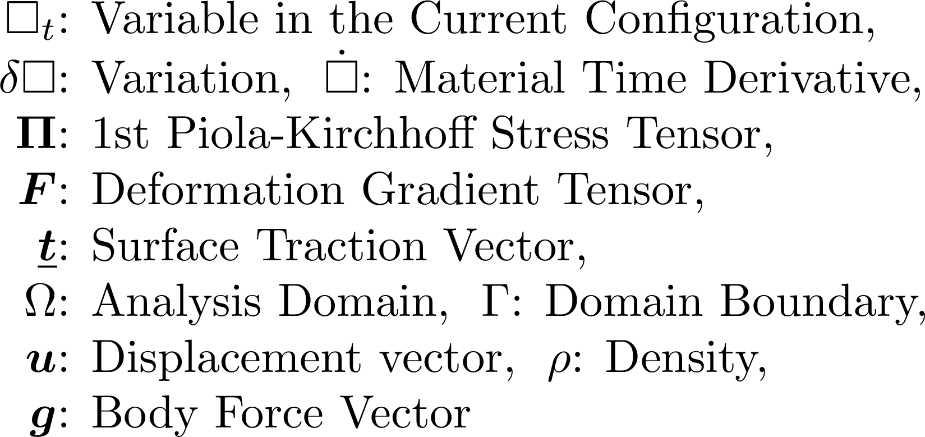
Virtual Work Equation in Rate Form
Work Conjugate

Slide 8
Linearization and Discretization
Work Conjugate
Linearization
in Time
Galerkin
Discretization
fully implicit time advancing
^{"+"} : Trial Variable,
E : Set of Elements,
S : Set of Element Faces

Slide 9
Incremental Equilibrium Equation (IEE)
^{"+"} : Trial Variable,
E : Set of Elements,
S : Set of Element Faces
Let the left-hand side be $\{∆f^{\text{int}}\}$, the right-hand side be $\{∆f^{\text{ext}}\}$.
The IEE:
Avoid error accumulation through timesteps.
The IEE (secondary form):
We use the secondary form in the actual implementation.

Slide 10
Comparison of IEE to Standard EE
[Standard EE]
[IEE]

Slide 11
Formulation of
our implicit FE rezoning method based on the IEE

Slide 12
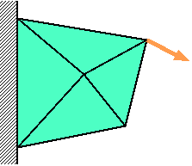
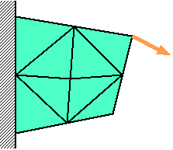
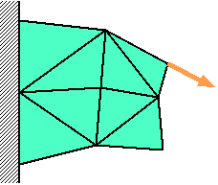
Conventional Implicit FE Rezoning
Time: t_{n-1}
Time:
t_{n}
Time:
t_{n+1}
Force
$$f^{\text{ext}}=f^{\text{int}}$$
$$f^{\text{ext}}≠f^{\text{int}}$$
$$f^{\text{ext}}=f^{\text{int}}$$
Solve
Standard EE
Remesh
and
Map States
Resolve
Standard EE
Solve
Standard EE
Induce
Large Deformation
and
Convergence Failure

Slide 13
Proposed Implicit FE Rezoning
Time: t_{n-1}
Time:
t_{n}
Time:
t_{n+1}
Force
$$f^{\text{ext}}=f^{\text{int}}$$
$$f^{\text{ext}}≠f^{\text{int}}$$
$$f^{\text{ext}}=f^{\text{int}}$$
Solve
IEE
Remesh
and
Map States
including $f^{\text{ext}}$
Assign
$f^{\text{ext}}$ to $f^{\text{int}}$
Solve
IEE
Never Induce
Any Deformation
and
Convergence Failure
Unique Operation

Slide 14
Flowchart of the Proposed Method
Start of timestep loop
Assume initial $\{Δu\}$
Start of Newton-Raphson loop
Calculate trial states
Calculate $\left\{Δf^{ext}\right\} ,\left\{Δf^{int}\right\} , \text{and} [K]$
Convergence check
Solve $\left[K\right]\left\{δu\right\}=\left(\left\{f^{ext}\right\}+\left\{Δf^{ext}\right\}\right) −(\left\{f^{int}\right\}+\left\{Δf^{int}\right\})$
Substitute $\left\{Δu\right\}+\{δu\}$ for $\{Δu\}$
Substitute $\left\{f^{ext}\right\}+\{Δf^{ext}\}$ for $\{f^{ext}\}$
Substitute $\left\{f^{int}\right\}+\left\{Δf^{int}\right\}$ for $\{f^{int}\}$
Update States
Rezone if necessary
Almost the same as the
conventional method
except the green parts

Slide 15
Proposed vs. Conventional
 | Proposed Implicit FE Rezoning | Conventional Implicit FE Rezoning
Equation to be Solved | IEE | Standard EE
Mapping of $f^{ext}$ | Required... | Unnecessary!
Equilibrium after Mapping | YES! | NO...
Unique Deformed Shape at a Time | YES! | NO...
Convergence Failure in Rezoning Process | NO! | YES...

Slide 16
Examples of analysis

Slide 17
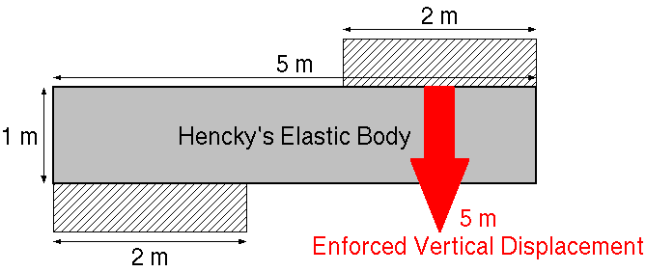
Shearing of 2D Bar
Static, 2D Plane-strain condition
All 1st order triangular elements
Global rezoning every 10 timesteps (much more frequent than necessary)
remeshing with ANSYS GAMBIT

Slide 18
Shearing of 2D Bar
Material: Hencky's elastic body
constitutive equation in total strain form:
Cauchy Stress $∝$ Hencky Strain
constitutive equation in rate form:
Jaumann Rate of Cauchy Stress $∝$ Stretching
Young's modulus: 1 GPa; Poisson's Ratio: 0.3

Slide 19
Shearing of 2D Bar

Slide 20
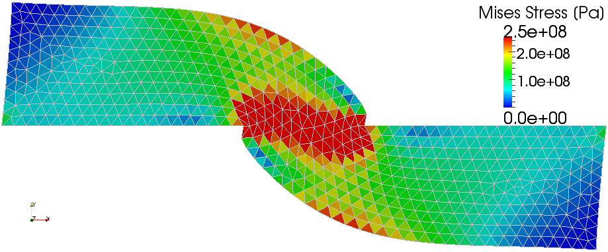
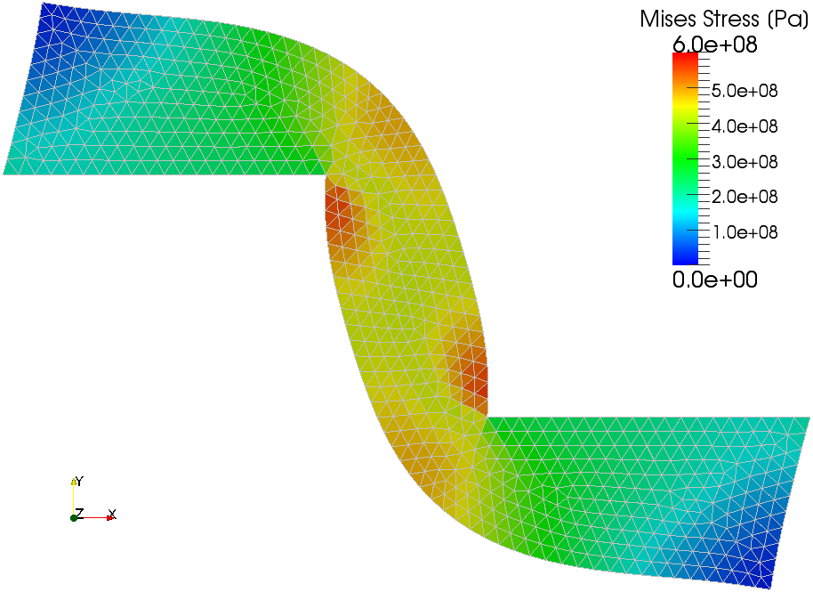
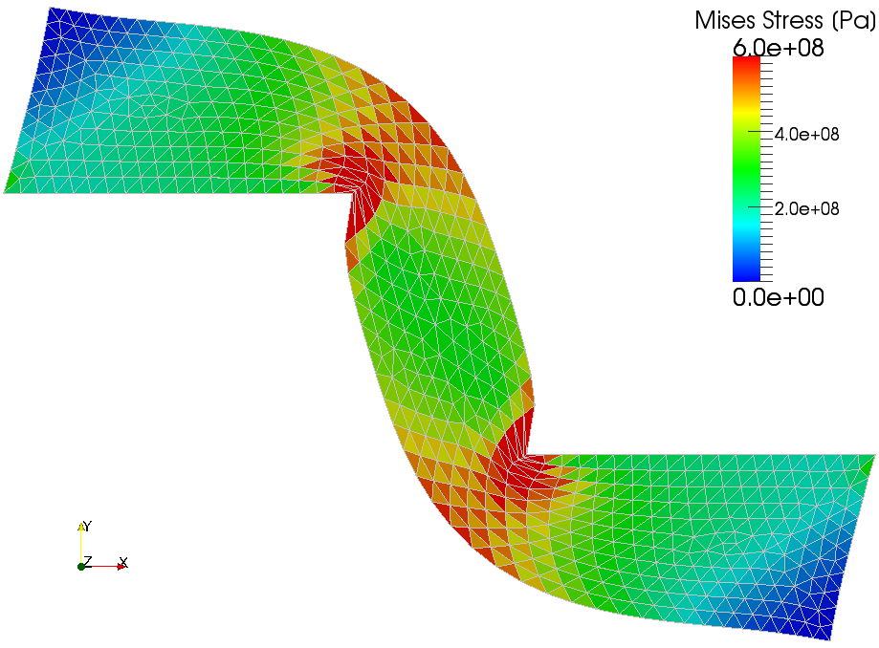
Shearing of 2D Bar
1 m Disp.
9 Times Rezoning
1 m Disp.
2.5 m Disp.
24 Times Rezoning
2.5 m Disp.
Proposed Method
Standard FEM without Rezoning

Slide 21
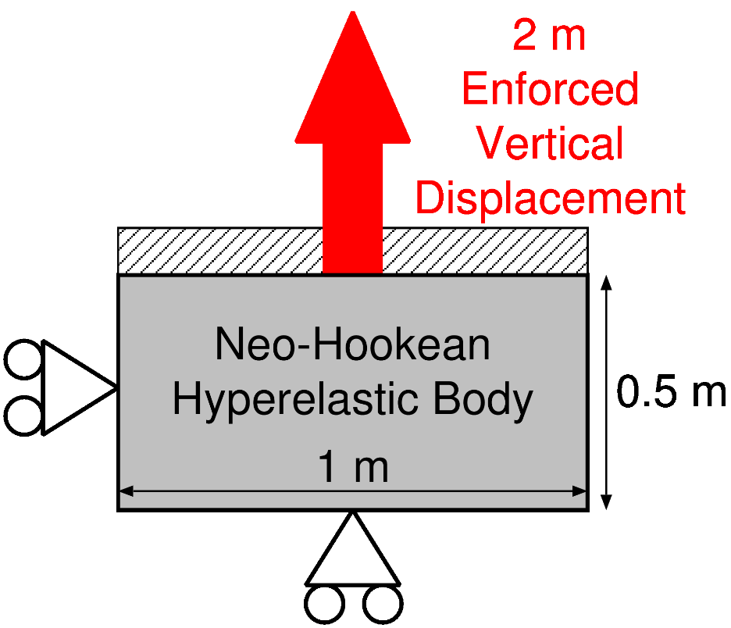
Tension of 2D Brick
Static, 2D Plane-strain condition
All 1st order triangular elements
Global rezoning every 5 timesteps

Slide 22
Tension of 2D Brick
Material: Neo-Hookean hyperelastic body
Strain energy density function:
Constitutive equation in total strain form:
Constitutive equation in strain rate form:
where CL(F) is obtained through a long hand calculation.
C₁₀=0.172 GPa; D₁=0.6 GPa⁻¹

Slide 23
Tension of 2D Brick

Slide 24
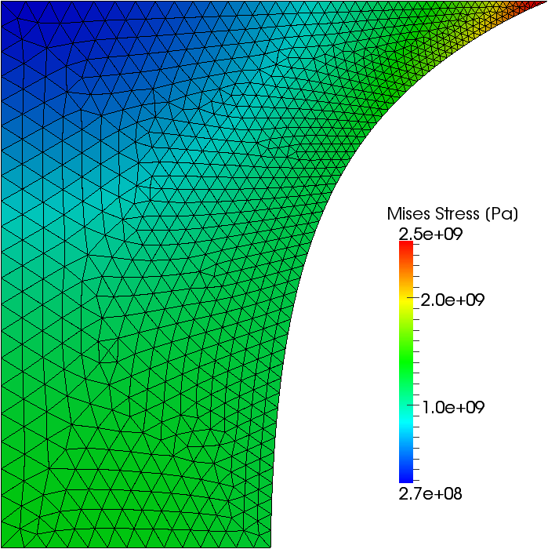
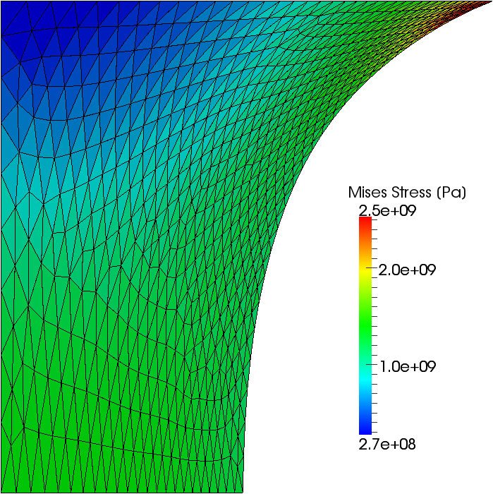
Tension of 2D Brick
Proposed Method (19 Times Rezoning)
without Rezoning
0.5 m Disp.
(100% Nominal
Strain)

Slide 25
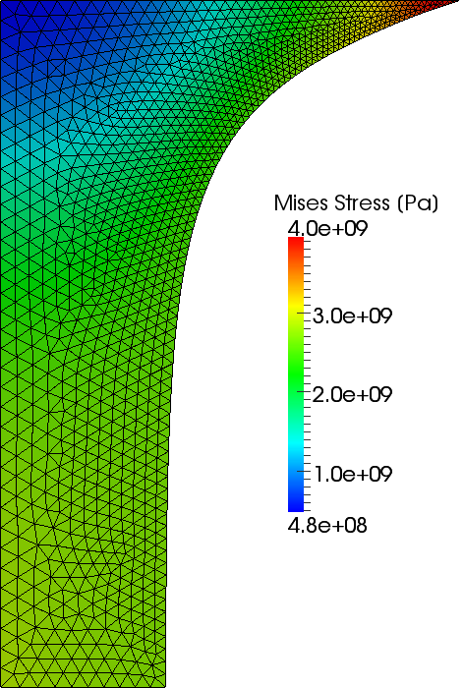
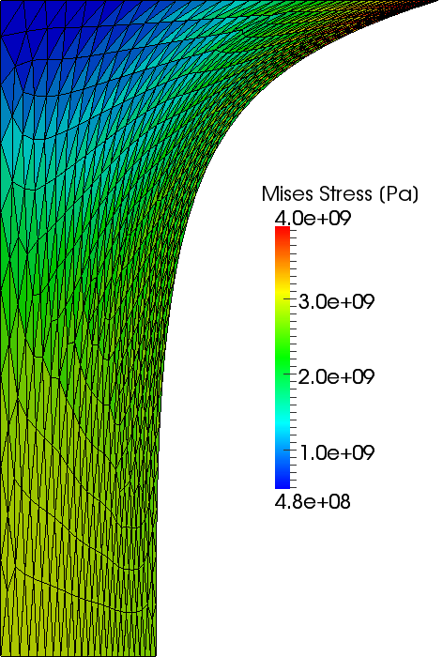
Tension of 2D Brick
Proposed Method (39 Times Rezoning)
without Rezoning
1.0 m Disp.
(200% Nominal
Strain)

Slide 26
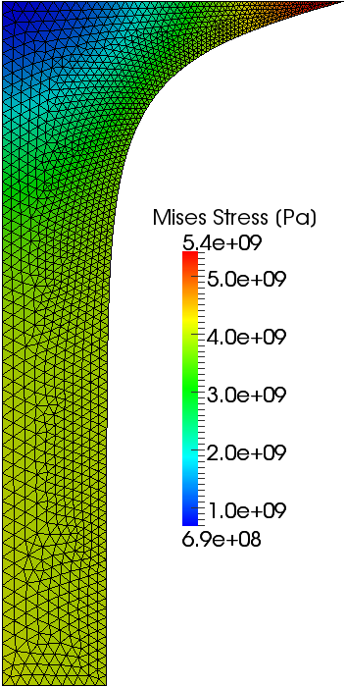
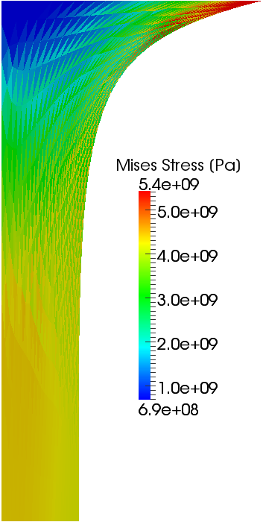
Tension of 2D Brick
Proposed Method (59 Times Rezoning)
without Rezoning
1.5 m Disp.
(300% Nominal
Strain)

Slide 27
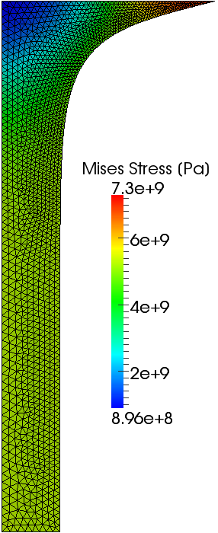
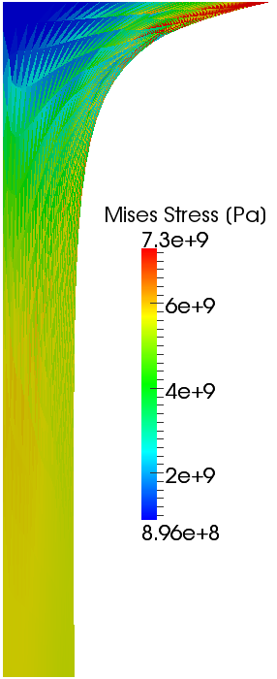
Tension of 2D Brick
Proposed Method (79 Times Rezoning)
without Rezoning
2.0 m Disp.
(400% Nominal
Strain)

Slide 28
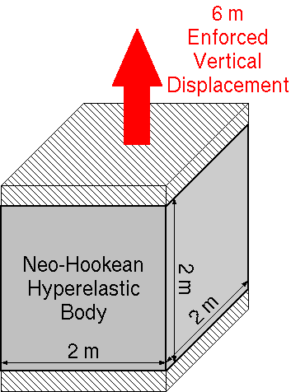
Tension of 3D Cube
300%
Nominal Strain
at the Final State
Static, 3D
1/8 model of the cube
All 1st order tetrahedral elements
Global rezoning every 10 timesteps

Slide 29
Tension of 3D Cube

Slide 30
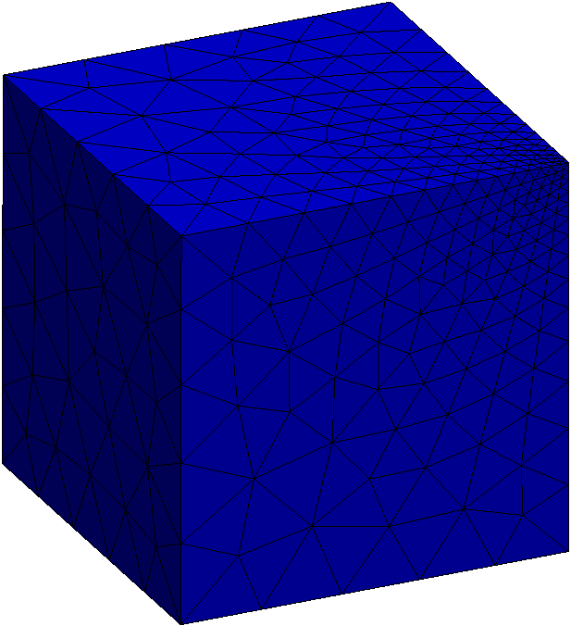
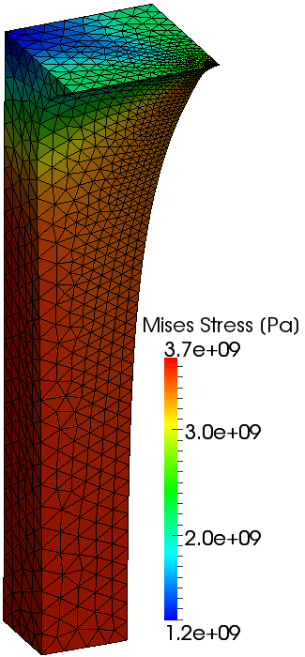
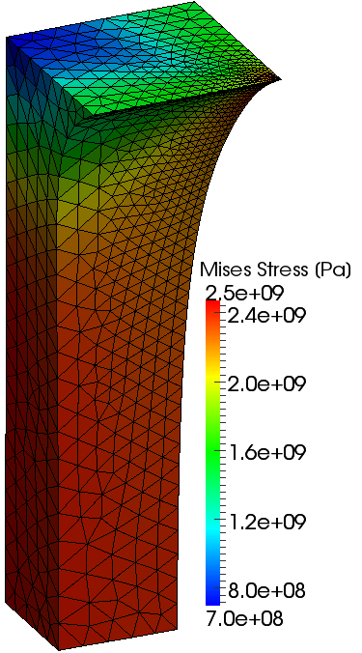
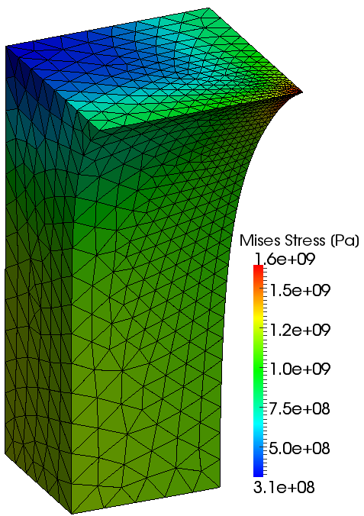
Tension of 3D Cube
0% Nominal Strain
(Initial State)
300%
Strain
200%
Strain
100%
Strain

Slide 31
Summary and Future Work
Summary
A new implicit FE rezoning method for severely large deformation analysis is proposed.
It solves the IEE instead of the standard EE.
It maps $f^{ext}$ in addition to the other states.
Its accuracy and stability are demonstrated.
Future Work
More V&V
SFEM implementation
Apply to contact forming, crack propagation, etc.

Slide 32
Appendix

Slide 33
Mapping of $f^{ext}$
Boil down to the following minimization problem:
Unknown
nodal $f^{ext}$ on the new mesh surface
Cost Function
$∑$ || {surface traction on the new mesh face}
$−$ {surface traction on the old mesh face} ||²
Constraints
$∑$ {new nodal $f^{ext}$} $=$ $∑$ {old nodal $f^{ext}$}
$∑$ {new nodal ${x×f}^{ext}$} $=$ $∑$ {old nodal ${x×f}^{ext}$}
Solve it with Lagrange multiplier method

Slide 34
Derivation of Stiffness Matrix (1/2)
Relation between ${\dot{Π}}_{t}$ and $\dot{T}$:
Relation between $\dot{□}$ and Jaumann rate:
Erasing $\dot{T}$:
Constitutive equation (e.g. Hencky's):
Erasing :

Slide 35
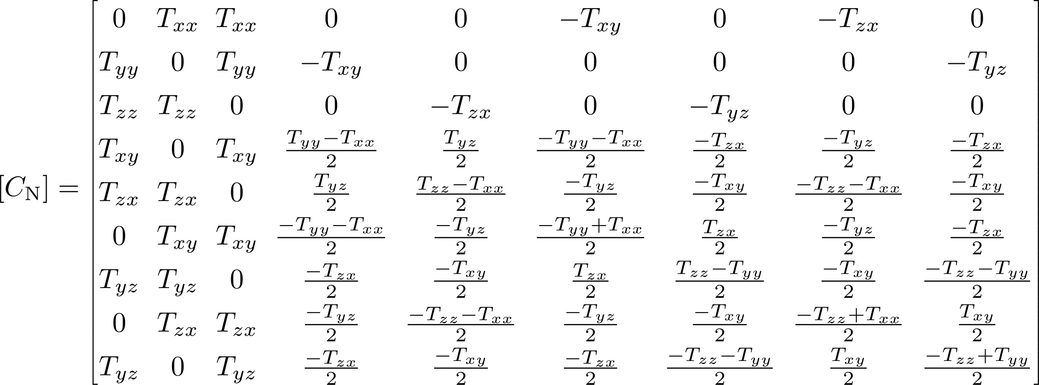
Derivation of Stiffness Matrix (2/2)
Rewrite in matrix form:
where
Stiffness Matrix

