Slide 1
Identification of Paint Resistance and Deposition Model Parameters for Electrodeposition Coating Simulation
Ayaka SHIMURA, Yuki ONISHI, Kenji AMAYA
Tokyo Institute of Technology (Japan)

Slide 2
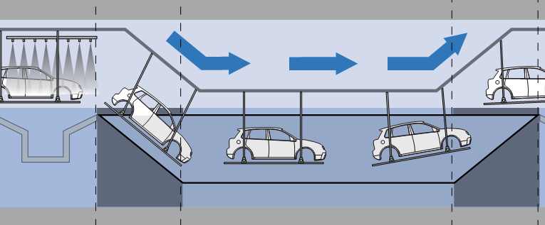
What is electrodeposition (ED) ?
Paint
Anode
Electrode
Object to Coat （Cathode）
(By http://www.rodip.com.br/)
One of the popular basecoat method for car bodies.
Making coated film by passing a direct electric current.
Coated film has a certain electrical resistance, and thus
Electric current tends to flow on to thinner film areas.
ED is good at making coated objects with an uniform film thickness.

Slide 3
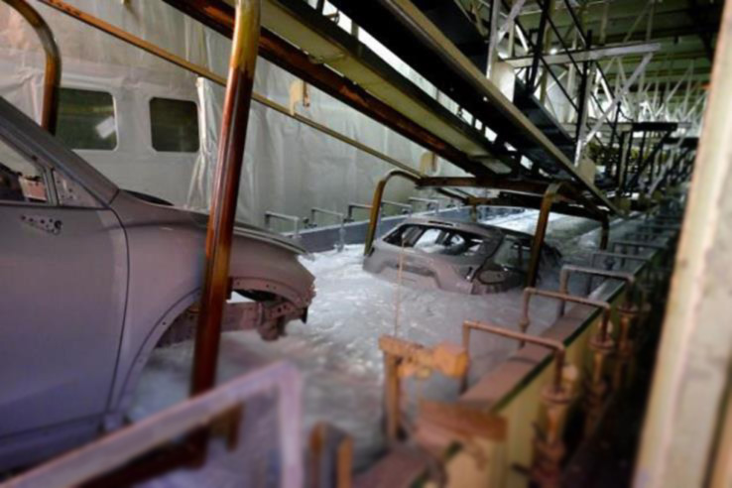
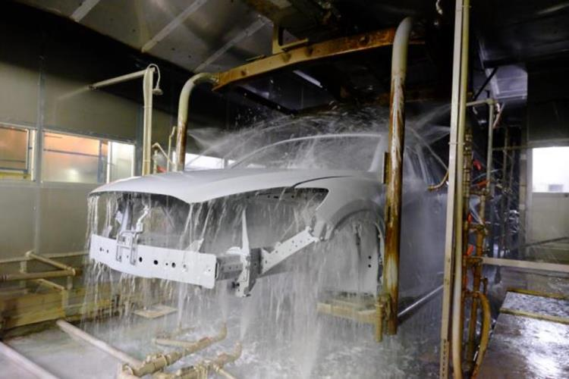
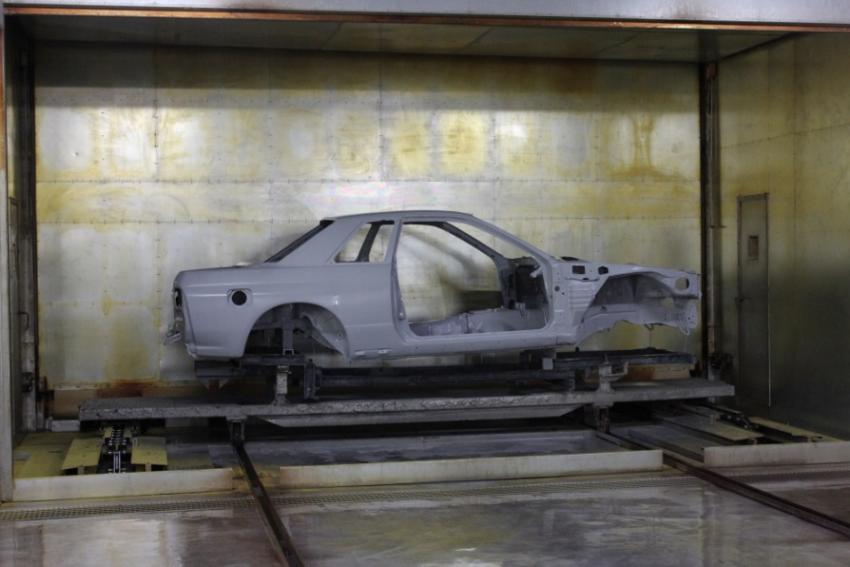
Photos of ED process line
1. dipping and deposition process
2. water rinse process
We focus on this.
3. baking process

Slide 4
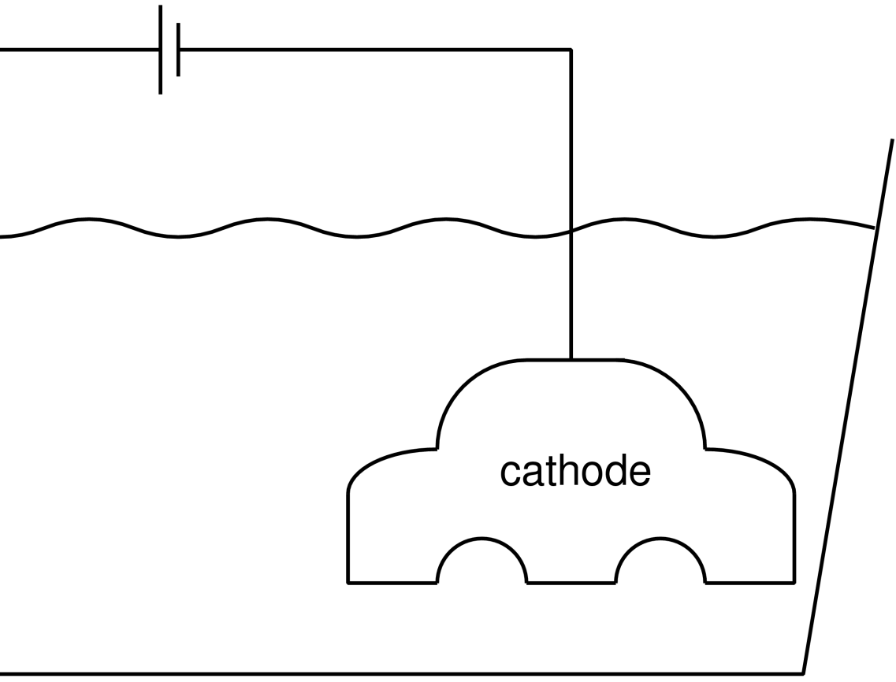
Outline of ED mechanism
Electric current generates ${OH}^{−}$ and H2 from H2O on the cathode surface.
$$H_{2}O$$
$$e^{−}$$
$$H_{2}$$
$${OH}^{−}$$
$${OH}^{−}$$

Slide 5
Outline of ED mechanism
Paint particle ions having positive (+) charge are attracted to ${OH}^{−}$ toward the cathode.
$$+$$
$$+$$
paint particle
$${OH}^{−}$$
$$+$$
$${OH}^{−}$$
$$+$$
$$+$$
paint particle
$${OH}^{−}$$
$$+$$

Slide 6
Outline of ED mechanism
Some of the paint particle ions are neutralized and stick on the cathode surface, becoming a paint film.
paint particle
$$+$$
$$paint$$ $film$
カソード
カソード
paint particle

Slide 7
Outline of ED mechanism
The rest of the paint particles are diffused and resolved again as ions.
The paint film soon has a number of holes to let the next ${OH}^{−}$ and H2 go through.
$$+$$
$$+$$
paint particle
$$+$$
$$paint$$ $film$
カソード
カソード
$$+$$
paint particle

Slide 8
2 Complexities in ED phenomena
The electric resistance of the paint film is not linear with respect to the film thickness…
$$R≠α h$$
$R$: resistance, $α$: const., $h$: film thickness.
The growth rate of the paint film is not linear with respect to the current density…
$$\dot{h}≠β j$$
$\dot{h}$: film growth rate, $β$: const., $j$: current density. (These complexities in experiments are shown later in this talk.)
Due to a number of holes
Due to the diffusive current
Experimental ED process optimization costs high! $⟹$ Numerical ED simulation is important.

Slide 9
Objective
Identify the two fundamental ED models,
a nonlinear film resistance model and
a nonlinear film growth model,
via basic ED experiments
for accurate numerical ED simulation.
Table of body contents:
Basic ED experiments
Our new models
Validation results
Summary

Slide 10
Basic ED Experiments

Slide 11
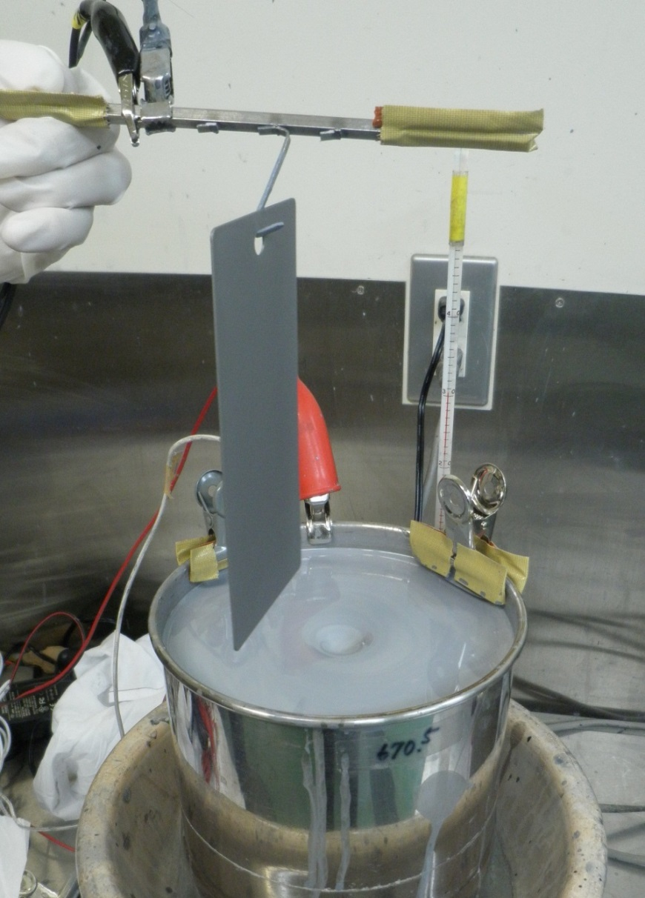
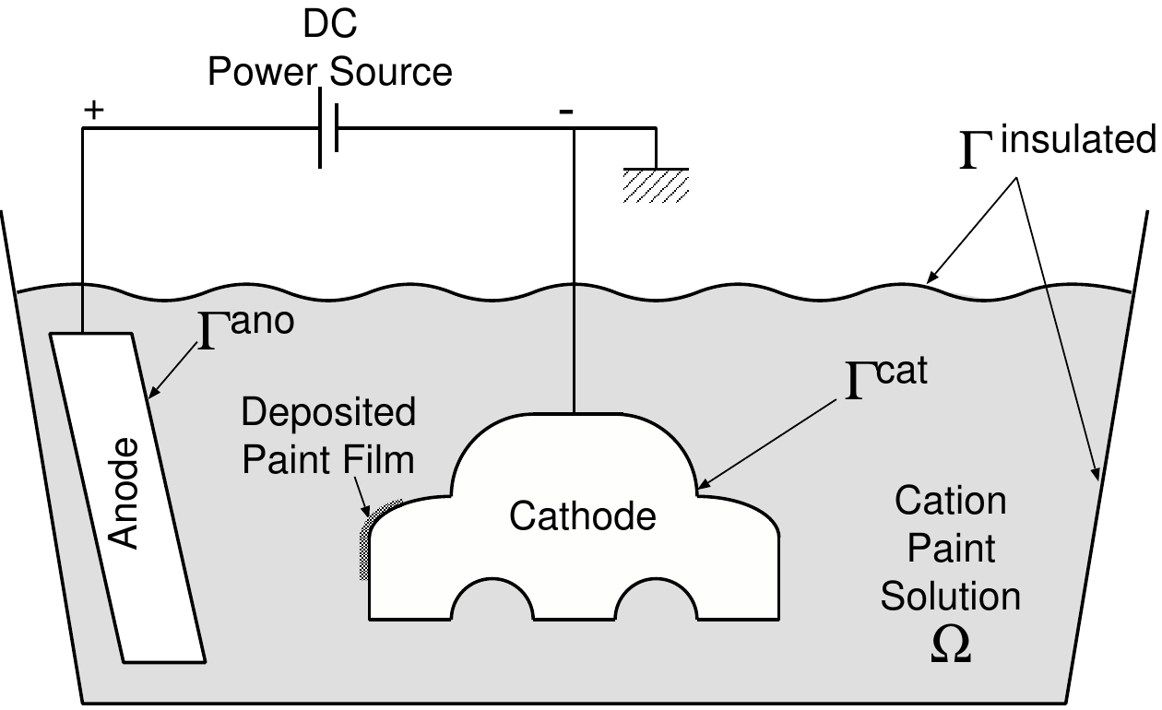
Outline of the one-plate test
Cathode plate
Use a rectangular steel plate instead of a car body.
Use a SS pot instead of the paint pool and anode electrodes.
Paint
Anode pot
Stirring using a stirrer

Slide 12
Outline of the one-plate test
Dip a steel plate into the paint pot.
Apply voltage up to 250 V between the plate and pot.
Measure time-histories of
applied voltage,
current,
film thickness.
Cathode plate
Paint
Anode pot
Stirring using a stirrer

Slide 13
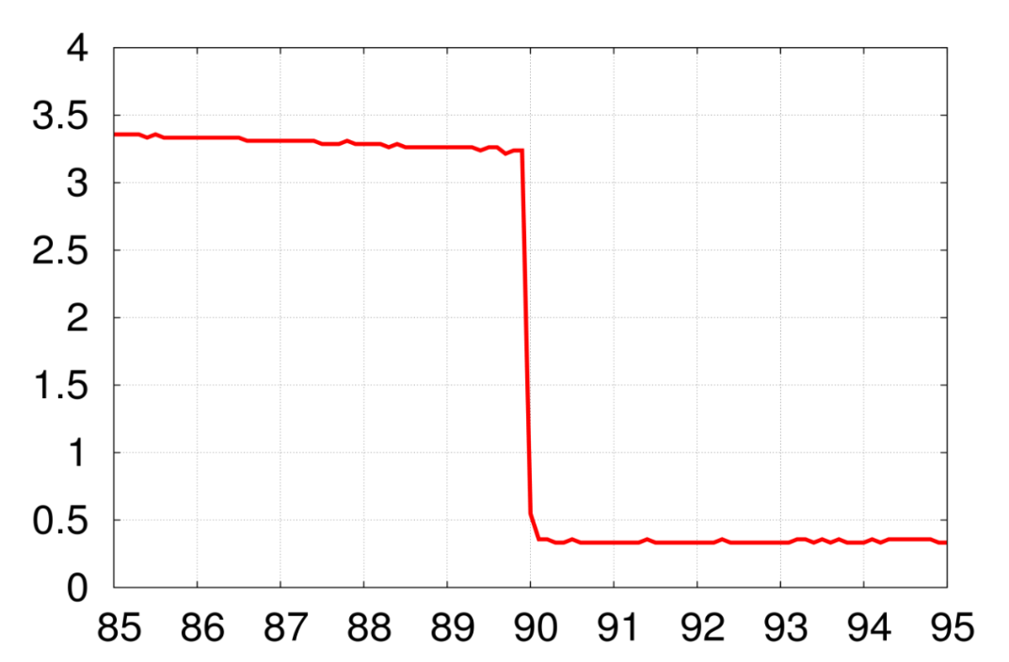
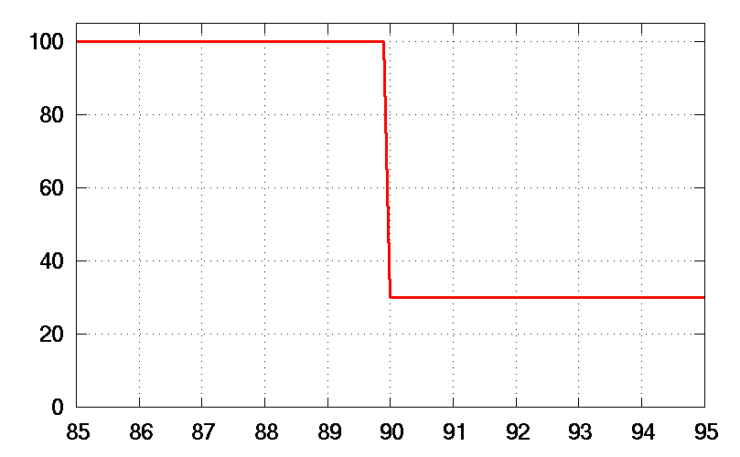
An example of film resistance nonlinearity
In the middle of an ED test, we changed the applied voltage quickly from
100 V to 30 V. Then, the film resistance before/after the change was estimated.
Time history of
applied voltage
Cathodal current density, $j_{cat}$($A/m^{2}$)
Time history of
current density
Applied voltage, $φ$(V)
$$φ_{app}=100 V$$
$$j_{cat}=3.238 \text{A}\text{/}m^{2}$$
$$R=30.883 Ωm^{2}$$
$$φ_{app}=30 V$$
$$j_{cat}=0.357 \text{A}\text{/}m^{2}$$
$$R=84.034 Ωm^{2}$$
Time, $t$ (s)
Time, $t$ (s)
The film thickness is same, but the resistance changes quickly.
The film resistance should be modeled with a polarization curve depending on film thickness.

Slide 14
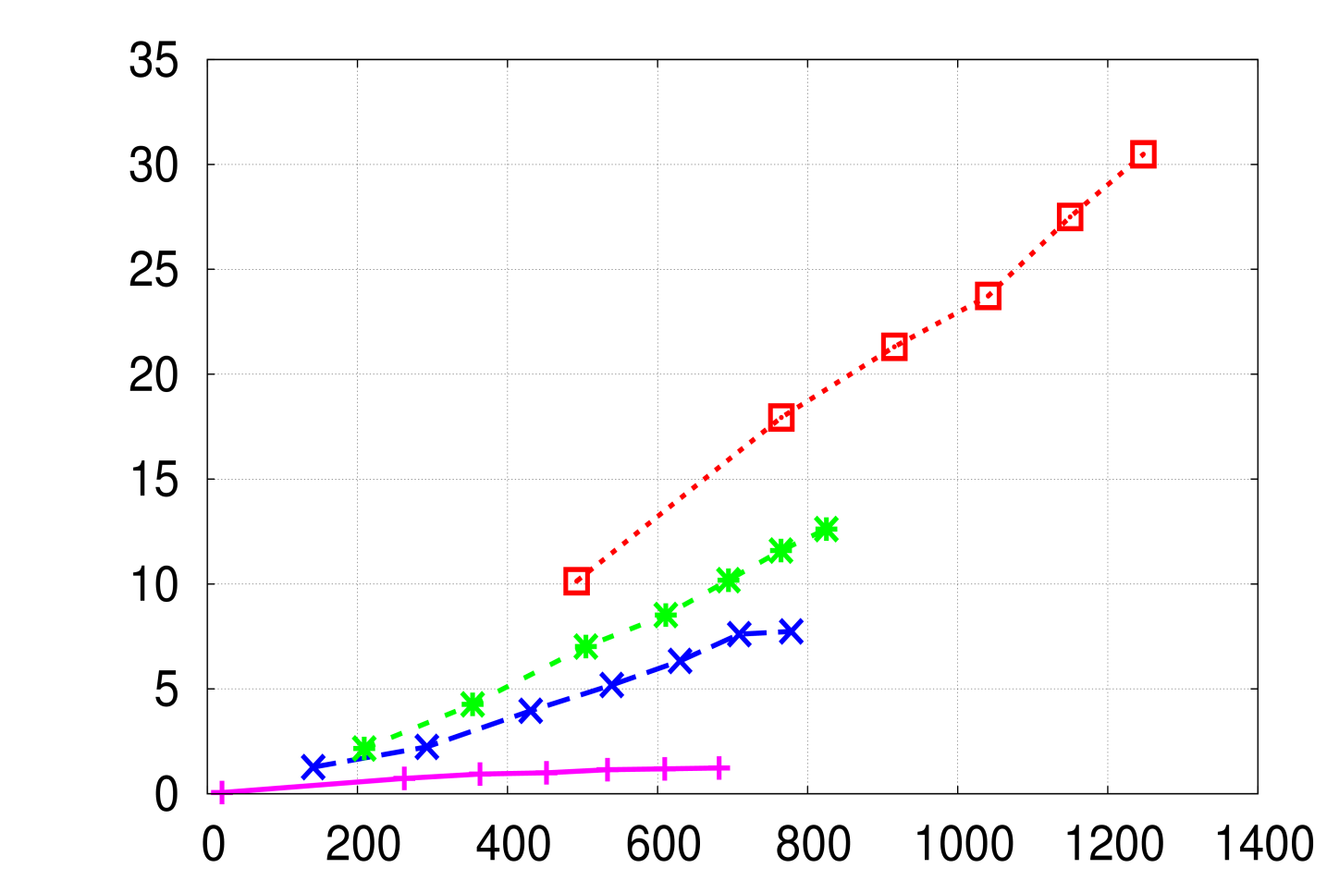
An example of film growth nonlinearity
Relation between total charge density and film thickness.
Film thickness, $h$($μm$)
250V
The inclination shows the deposition efficiency.
Conventional model
100V
50V
10V
Total charge density on cathode$, D_{cat}(C/m^{2})$
The total charge density is same, but
the deposition efficiencies are different.
The film growth model should include the effect of the diffusive current depending on the voltage and film thickness.

Slide 15
Our new models

Slide 16
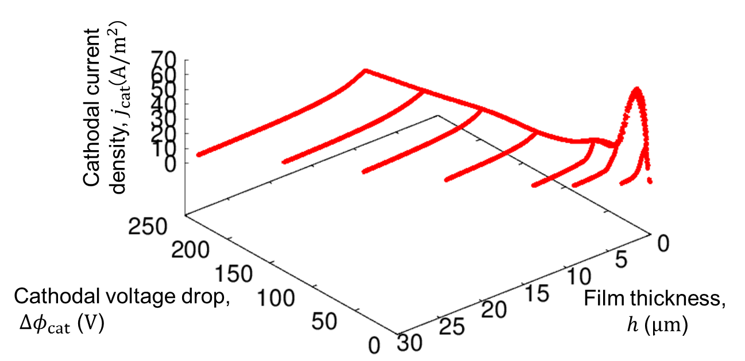
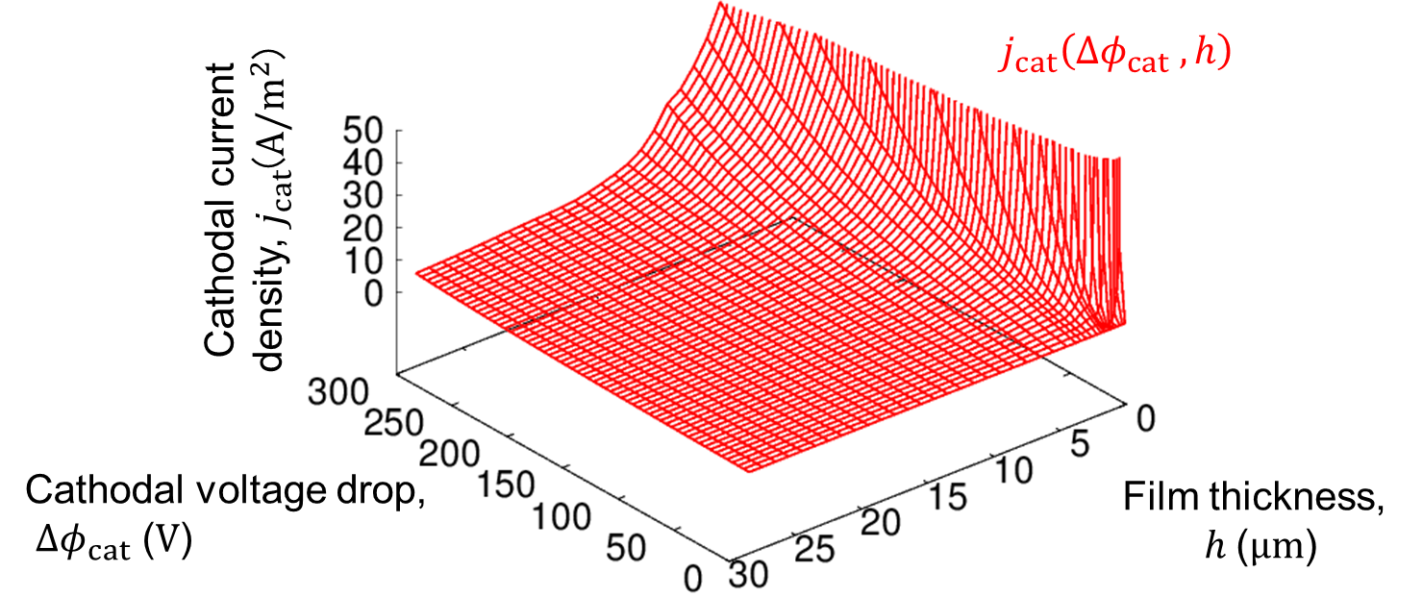
Procedure to identify resistance model
1. One-plate tests
Cathode current density, $j_{cat}$($A/m^{2}$)
2. Scatter diagram of $Δφ_{cat}, j_{cat} and h$
Plot
Cathode voltage drop,
${Δφ}_{cat}$($V$)
Cathode current density, $j_{cat}$($A/m^{2}$)
3. Approximated surface
Data fitting
Cathode voltage drop,
${Δφ}_{cat}$($V$)

Slide 17
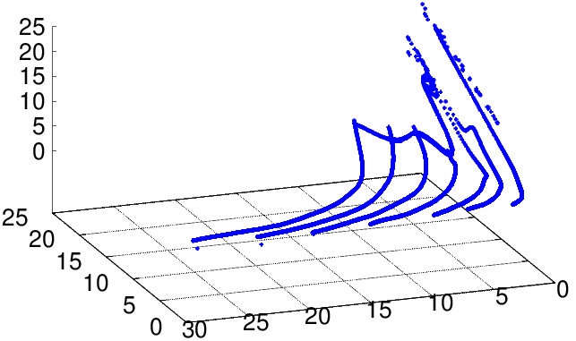
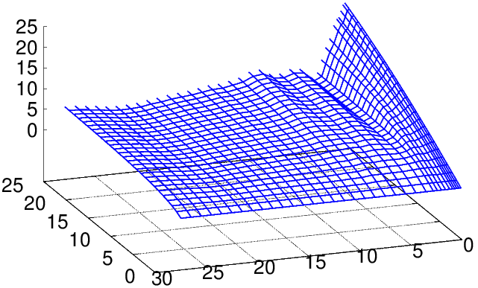
Procedure to identify film growth model
1. One-plate tests
2. Scatter diagram of $j_{cat}, j_{dif} and h$
Diffusive current density, $j_{dif}$($A/m^{2}$)
Plot
Cathode current
density, $j_{cat}$($A/m^{2}$)
Film thickness, $h$($μm$)
Diffusive current density, $j_{dif}$($A/m^{2}$)
3. Approximated surface
Data fitting
Cathode current
density, $j_{cat}$($A/m^{2}$)
Film thickness, $h$($μm$)

Slide 18
Validation Results

Slide 19
Our ED simulator
In-house finite element code.
2nd order tetrahedral elements.
The experimental results of the one-plate tests are compared to the results of our simulator with the proposed nonlinear models and those with the conventional linear models.

Slide 20
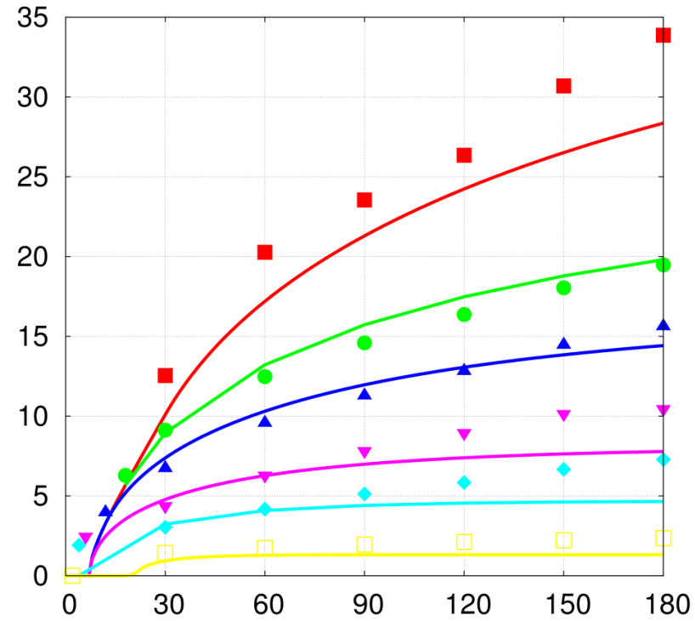
Time history of film thickness
Film thickness, $h$($μm$)
Proposed nonlinear model
Conventional linear model
$$Δφ_{app}=250 V$$
250V
$$200 V$$
$$150 V$$
$$100 V$$
150V
$$50 V$$
100V
$$30 V$$
$$10 V$$
50V
Time, $t$ (s)
30V
dot ：Experiment
line ：Numerical analysis
10V
Time, $t$ (s)
Conventional linear models fail to represent the experimental data…
Our new nonlinear models succeeded in reproducing the experiments!

Slide 21
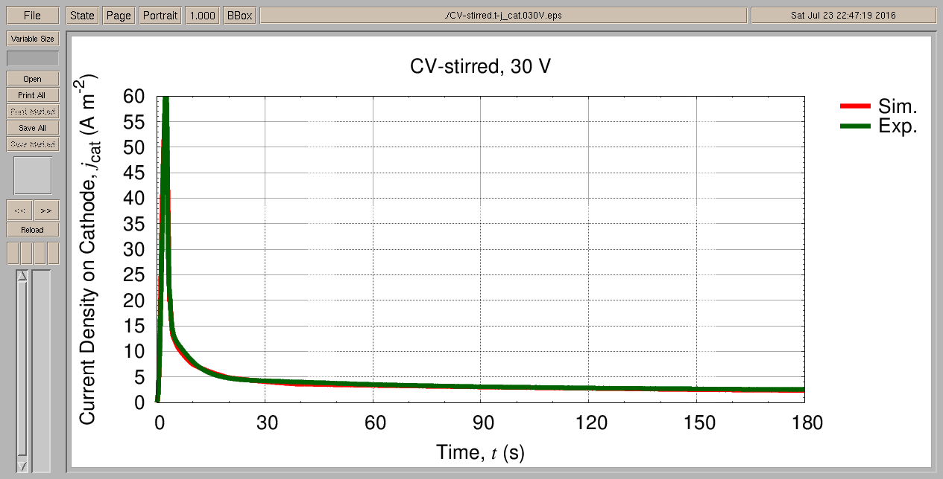
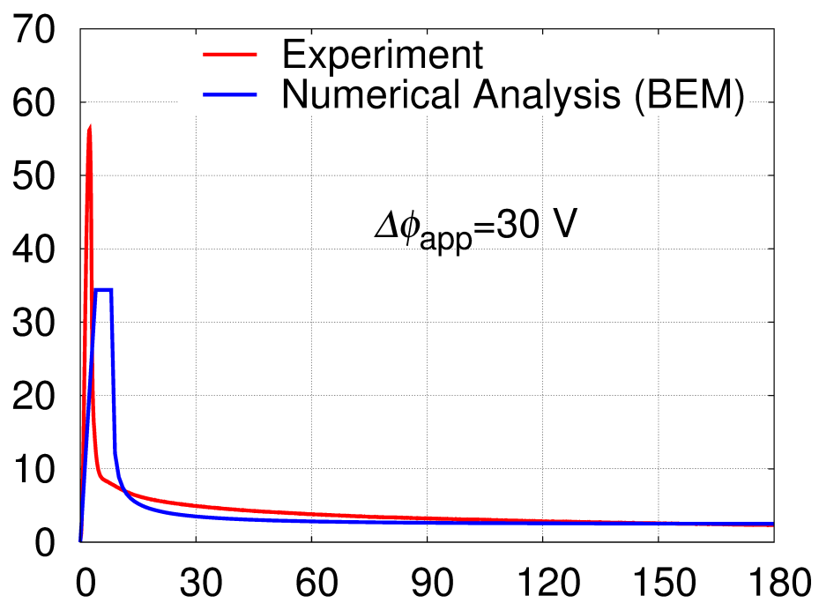
Time history of current density
Proposed nonlinear model
Conventional linear model
Cathode current density, $j_{cat}$($A/m^{2}$)
$$Δφ_{app}=30 V$$
Numerical analysis
Experiment
Time, $t$ (s)
Time, $t$ (s)
Conventional linear models fail to represent the experimental data…
Our new nonlinear models succeeded in reproducing the experiments!

Slide 22
Summary

Slide 23
Summary
A new nonlinear film resistance model and film growth model for accurate electrodeposition (ED) simulation were proposed.
The model parameters were identified via the one-plate ED tests.
Our new models improved the accuracy in time histories of the film thickness and current density compared to the conventional linear models.
Thank you for your kind attention.

