Slide 1
Performance Evaluation of F-barES-FEM-T4 in Dynamic Analysis
Ryoya IIDA, Yuki ONISHI, Kenji AMAYA
Tokyo Institute of Technology, Japan

Slide 2
Background
In the previous talk, F-bar aided edge-based smoothed finite element method with tetrahedral elements (F-barES-FEM-T4) is presented.
Characteristics of F-barES-FEM-T4 in static analysis are as follows.
✔ Excellent accuracy,
✔ No increase in DOF,
✗ Increase in bandwidth of stiffness matrix.

Slide 3
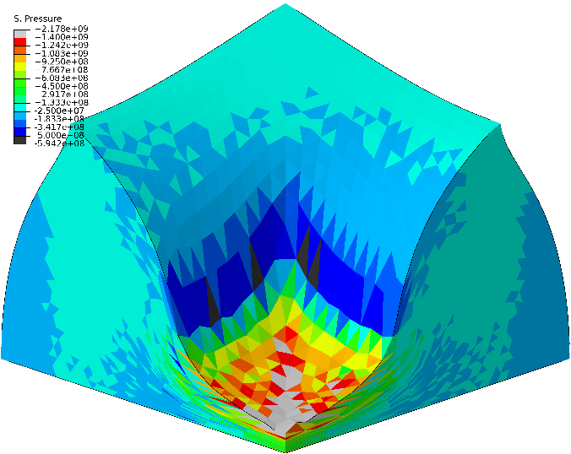
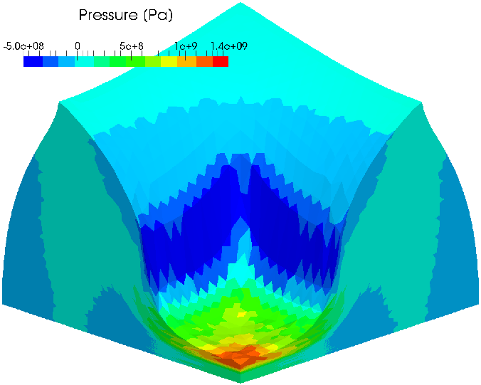
Characteristics (1 of 2)
✔ Excellent accuracy
ABAQUS C3D4H
✗ pressure oscillation
F-barES-FEM-T4(3)
# of cyclic smoothings
Our method shows excellent accuracy in static problems!

Slide 4
Characteristics (2 of 2)
✔ No increase in DOF
F-barES-FEM-T4 is a purely displacement-based formulation.
In contrast to the u/p hybrid formulations, F-barES-FEM-T4 can be directly applied to explicit dynamics.
✗ Increase in bandwidth of stiffness matrix
F-barES-FEM-T4 takes longer time to solve the equilibrium equations…
In explicit dynamics, however, we don’t need to solve them!
F-barES-FEM-T4 would be suitable
for explicit dynamics of rubber-like materials!

Slide 5
Objective
Objective
Evaluate the performance of F-barES-FEM-T4
in explicit dynamics for rubber-like materials.
Table of Body Contents
Methods: Quick introduction of F-barES-FEM-T4
Results & Discussion: A few verification analyses
Summary

Slide 6
Methods
Notes:
Then we will explain our proposed method

Slide 7
Procedure of F-barES-FEM (1 of 2)
Deformation gradient of each edge, $\overline{F}$ is derived as
$$\overline{F}={\tilde{F}}^{iso}∙{\overline{F}}^{vol}$$
ES-FEM

Slide 8
Procedure of F-barES-FEM (2 of 2)
Each part of $\overline{F}$ is calculated as
$$\overline{F}={\tilde{F}}^{iso}∙{\overline{F}}^{vol}$$
Isovolumetric part
Volumetric part
(1)
(2)
Smoothing the value of adjacent elements.
↓
The same manner as
ES-FEM
(1)Calculating node’s value by smoothing
the value of adjacent elements
(2)Calculating elements’ value by smoothing
the value of adjacent nodes
(3)Repeating (1) and (2) a few times

Slide 9
Advantages of F-barES-FEM
This formulation is designed to have 3 advantages.
$$\overline{F}={\tilde{F}}^{iso}∙{\overline{F}}^{vol}$$
Isovolumetric part
Volumetric part
Like a ES-FEM
1. Shear locking free
Like a NS-FEM
2. Little pressure oscillation
3. Volumetric locking free with the aid of F-bar method

Slide 10
Equation to solve
Equation of Motion
$\left[M\right]\left\{\ddot{u}\right\}=\left\{f^{ext}\right\}−\{f^{int}\}$,
where $$\left\{f^{int}\right\}=\sum{\left[\tilde{B}\right]\left\{\overline{T}\right\}V }$$
Time integration
Velocity Verlet method (2nd order simplectic integrator)
Defenition of $\left\{f^{int}\right\}$ in the same fashion as F-bar method
$B$-matrix of ES-FEM
Stress derived from $\overline{F}$
$\left\{u_{n+1}\right\}=\left\{u_{n}\right\}+\left\{{\dot{u}}_{n}\right\}Δt+\frac{1}{2}\left\{{\ddot{u}}_{n}\right\}Δt^{2}$
$$\left\{{\ddot{u}}_{n+1}\right\}=\left[M^{−1}\right](\{f^{ext}\}−\{f^{int}(u_{n+1})\})$$
$$\left\{{\dot{u}}_{n+1}\right\} =\left\{{\dot{u}}_{n}\right\}+\left(\left\{{\ddot{u}}_{n}\right\}+\left\{{\ddot{u}}_{n+1}\right\}\right)Δt/2$$

Slide 11
Result & Discussion

Slide 12
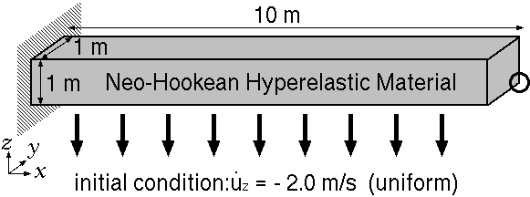
#1 Bending of a cantilever
Dynamic explicit analysis.
Neo-Hookean material Initial Young’s modulus: 6.0 MPa, Initial Poisson’s ratio: 0.499, Density: 10000 kg/m³.
Compare the results of F-barES-FEM-T4, Standard T4 (ABAQUS/Explicit C3D4) and Selective H8 (ABAQUS/Explicit C3D8) elements.

Slide 13
Time history of deformed shapes
ABAQUS/Explicit C3D4
(Standard T4 element)
✗ Pressure oscillation
✗ Locking
ABAQUS/Explicit C3D8
(Selective H8 element)
Reference
F-barES-FEM-T4(2)
(Proposed method)
✔ No pressure oscillation
✔ No locking
Proposed method suppresses pressure oscillation and locking!

Slide 14
Deformed shapes and pressure distributions
at $t=1.5$ s
ABAQUS/Explicit C3D8
(Selective H8 element)
Reference
F-barES-FEM-T4(2)
(Proposed method)
Proposed method is comparable to Selective H8 element!

Slide 15
Deformed shapes and pressure distributions
at $t=1.5$ s
ABAQUS/Explicit C3D4
Standard T4 element
✗Pressure oscillation and locking
F-barES-FEM-T4(2)
(Proposed method)
Proposed method shows far better solutions than Standard T4!

Slide 16
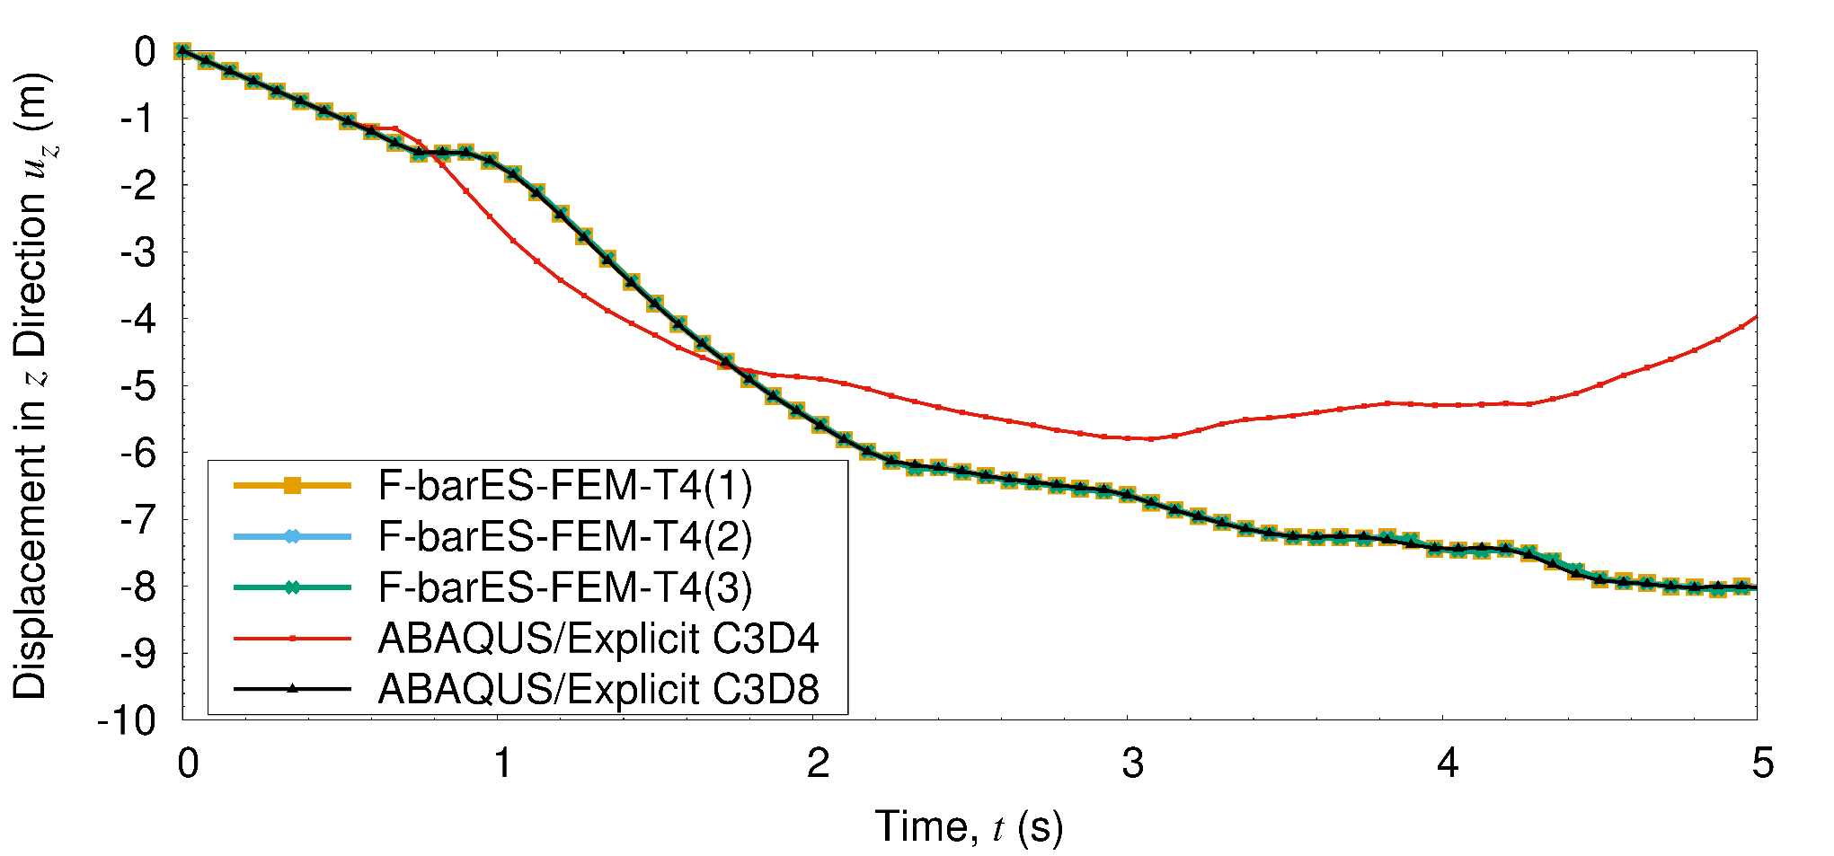
Time history of displacement
Standard T4
Proposed &
Reference
Proposed method shows good result without locking.
The accuracy of displacement does not depend on the number of cyclic smoothings.

Slide 17
Time history of total energy
Energy divergences arise in earlier stage…
Increasing the number of smoothings suppresses the speed of divergence.

Slide 18
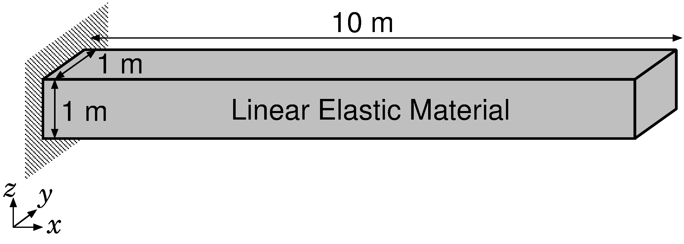
#2 Natural mode of a cantilever
Modal analysis.
Linear elastic material Young’s modulus: 6.0 MPa, Poisson’s ratio: 0.499, Density: 10000 kg/m³.
Compare the results of F-barES-FEM-T4, Standard T4 (ABAQUS/Explicit C3D4) and Selective H8 (ABAQUS/Explicit C3D8) elements.
Same initial elasticity as the previous example

Slide 19
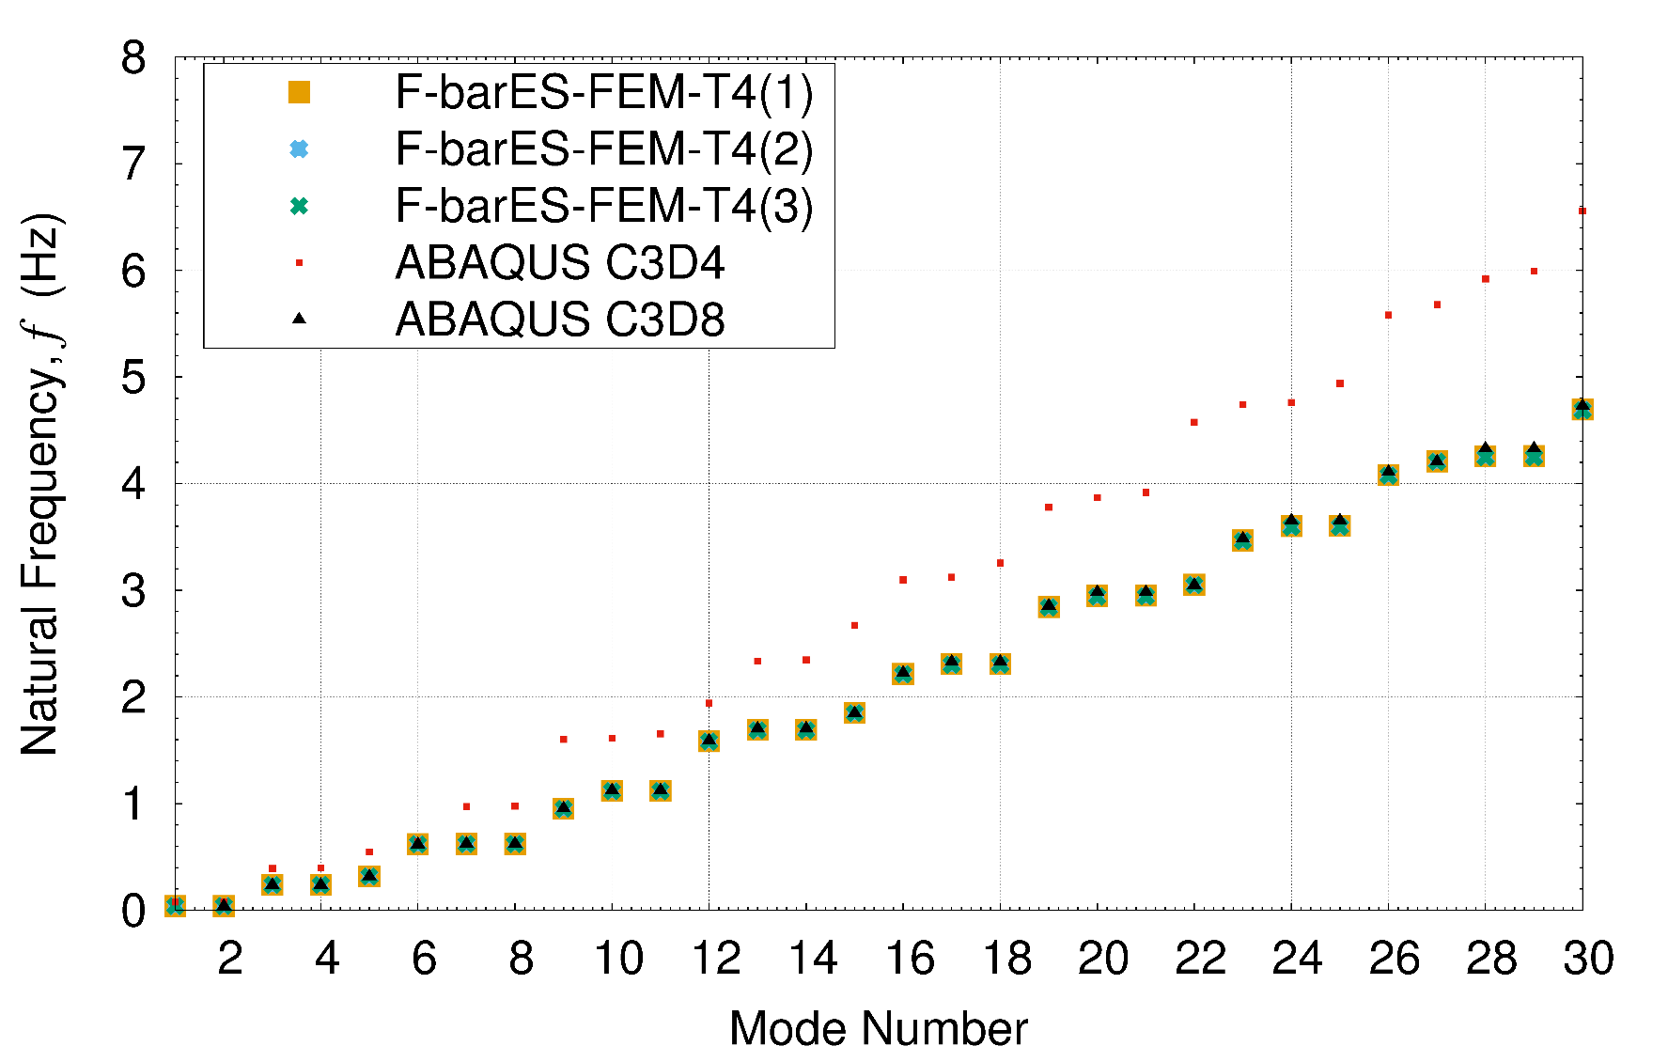
Natural frequencies of each mode
Standard T4
Proposed &
Reference
Natural frequencies of our method agree with those of reference !

Slide 20
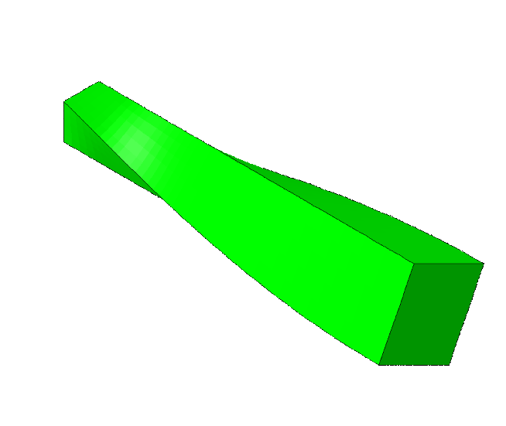
Natural mode shapes
5th
30th
ABAQUS C3D8
(Reference)
F-barES-FEM(2)
(Proposed method)
Mode shapes also agree with the reference solutions.

Slide 21
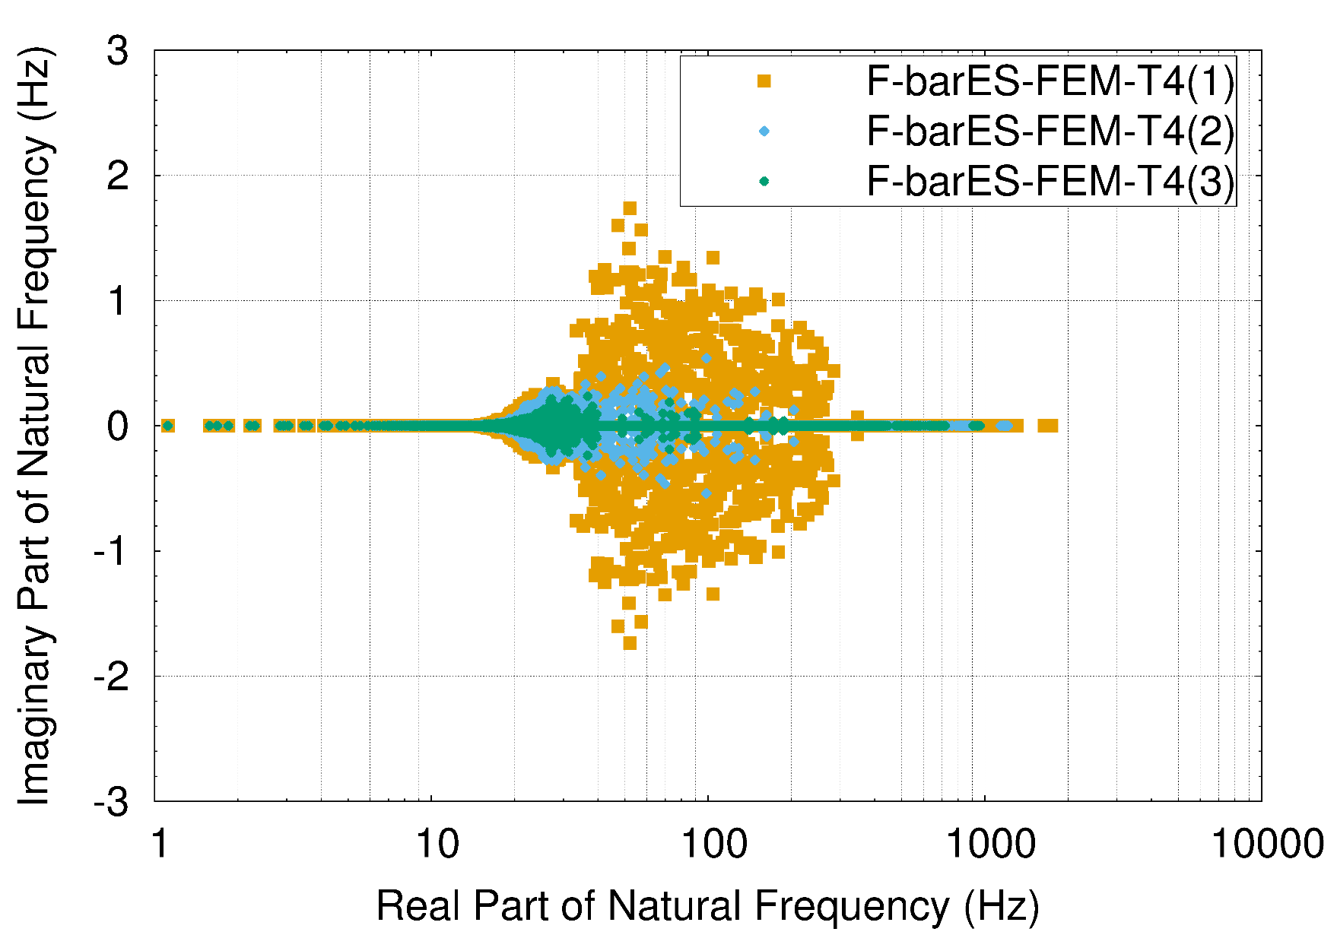
Distributions of natural frequencies
Imag.
Part
Some natural frequencies have small imaginary part…
Increasing the number of smoothings makes
the frequencies close to real numbers.

Slide 22
Cause of energy divergence
Due to the adoption of F-bar method, the stiffness matrix $\left[K\right]$ becomes asymmetric.
Equation of Motion: $\left[M\right]\left\{\ddot{x}\right\}+\left[K\right]\left\{x\right\}=\{f^{ext}\}$
Asymmetric stiffness matrix gives rise to imaginary part of natural frequencies and instability in dynamic problem.
As shown before, increasing the number of smoothings suppress the energy divergence speed.
asymmetric
Our method is restricted to short-term analysis (such as impact analysis) with a sufficient number of smoothings.

Slide 23
#3 Swinging of Bunny Ears
Outline
Iron ears: $E_{ini}=200 GPa, ν_{ini}=0.3, ρ=7800 kg/m^{3}$, Neo-Hookean, No cyclic smoothing.
Rubber body: $E_{ini}=6 MPa, ν_{ini}=0.49, ρ=920 kg/m^{3}$, Neo-Hookean, 1 cycle of smoothing.
Compared to ABAQUS/Explicit C3D4. No Hex mesh available!
Iron Ears
Initial Velocity of Iron Ears
Rubber Body
Fixed

Slide 24
Time histories of deformed shapes
ABAQUS/Explicit C3D4
(Standard T4 element)
F-barES-FEM-T4
(Proposed method)
✗ Pressure oscillation ✗ Locking
✔ No pressure oscillation ✔ No locking
Proposed method seems be representing not pressure oscillations but pressure waves.

Slide 25
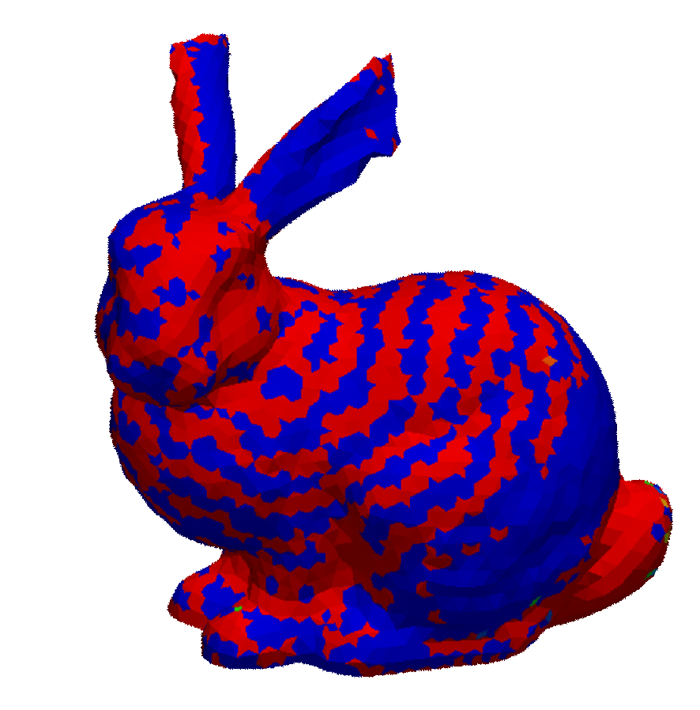
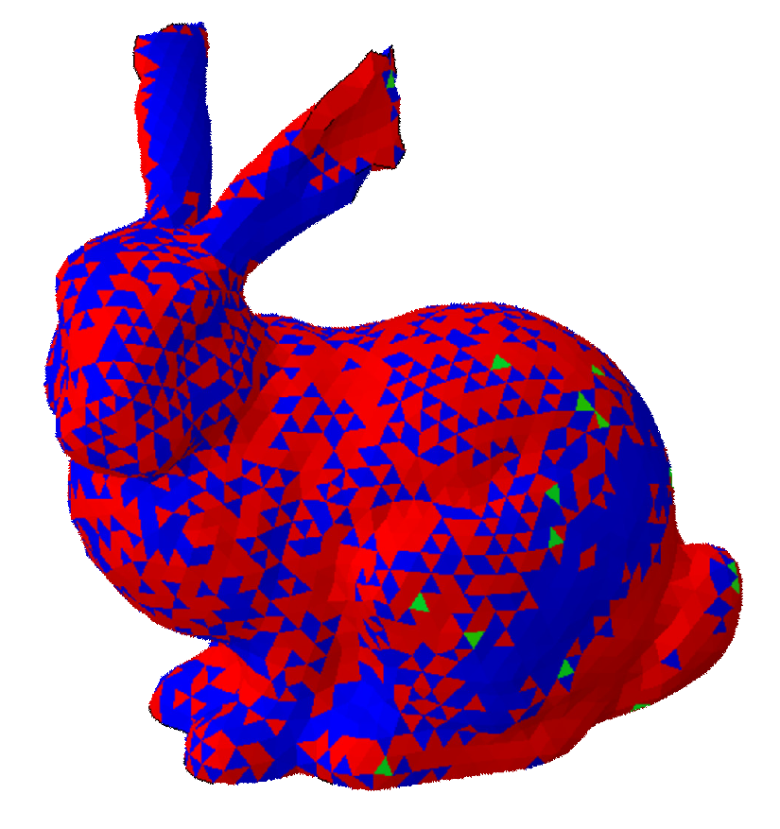
Deformed shapes and sign of pressure
In an early stage
✗ Pressure oscillations
✔ Pressure waves
ABAQUS/Explicit C3D4
(Standard T4 element)
F-barES-FEM-T4
(Proposed method)
Our method represents pressure waves correctly!

Slide 26
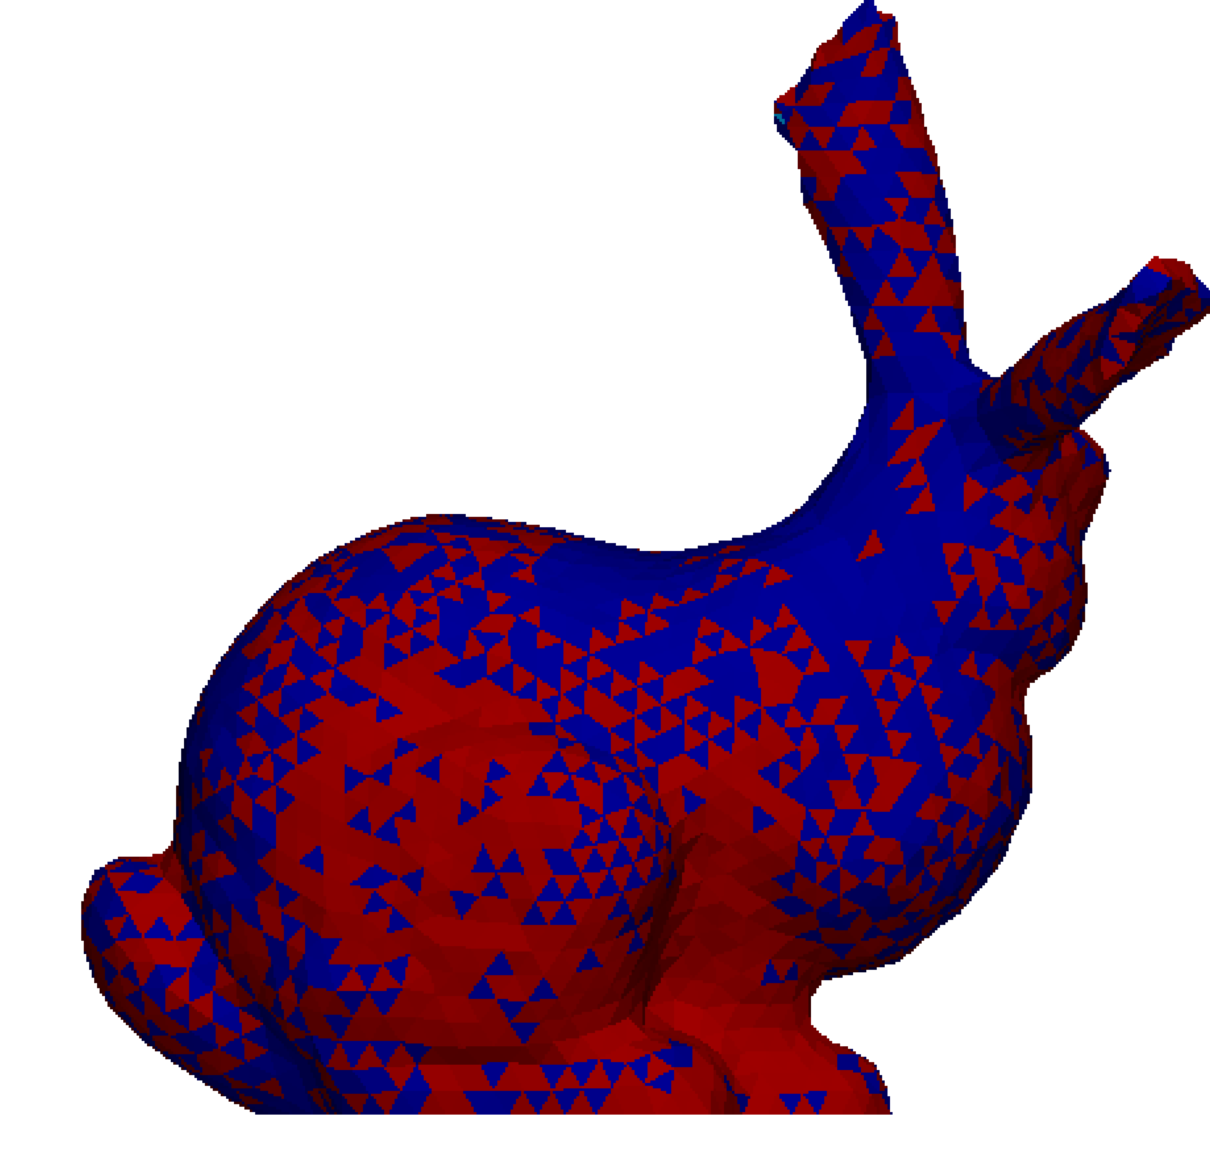
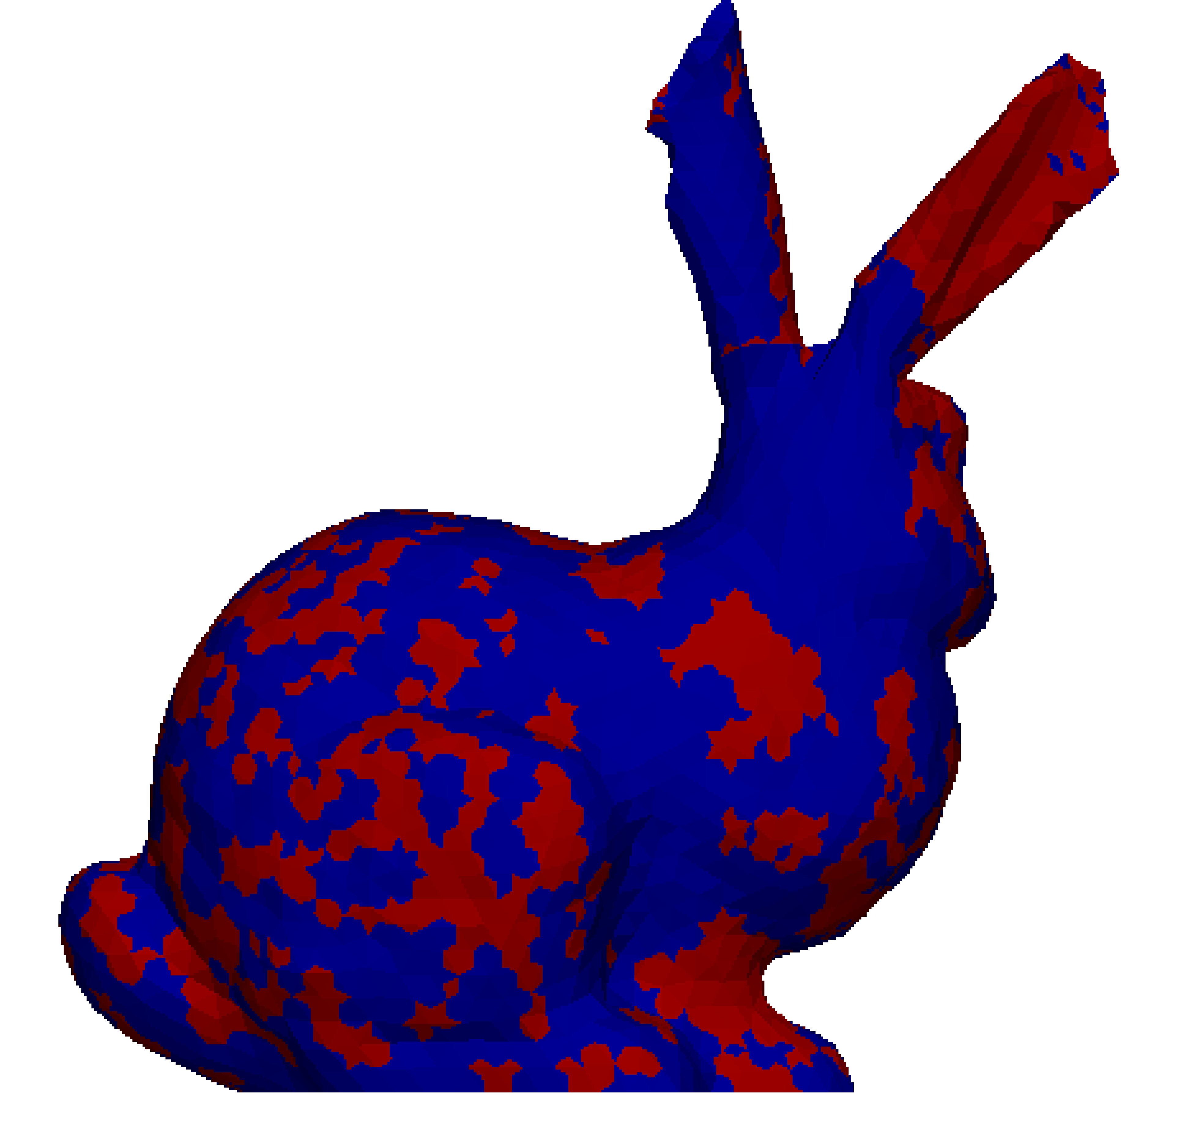
Deformed shapes and sign of pressure
In a later stage
✗ Pressure oscillation in iron ears
✔ No pressure oscillation in iron ears
ABAQUS/Explicit C3D4
(Standard T4 element)
F-barES-FEM-T4
(Proposed method)
It should be noted that a presence of rubber spoils over all accuracy of the analysis with Standard T4 elements.
A rubber parts is a “bad apple” when Standard T4 elements are used.

Slide 27
Summary

Slide 28
Summary
F-barES-FEM-T4 was applied to dynamic explicit analysis.
A few examples of analysis revealed that our method has excellent accuracy on relatively short-term problems.
On long-term problems, however, our method is unstable because of complex natural frequencies.
Improvement for the long-term stability is our future work.
Thank you for your kind attention.
Notes:
まとめです
今後は接触を考慮した問題への拡張を中心に、研究を進めていくつもりです。

Slide 29
Appendix

Slide 30
Propagation of 1D pressure wave
Outline
Small deformation analysis.
Linear elastic material, Young’s modulus: 200 GPa, Poisson’s ratio: 0.0, Density: 8000 kg/m³.
Results of F-barES-FEM(0), (1), (2), and (3) are compared to the analysical solution.

Slide 31
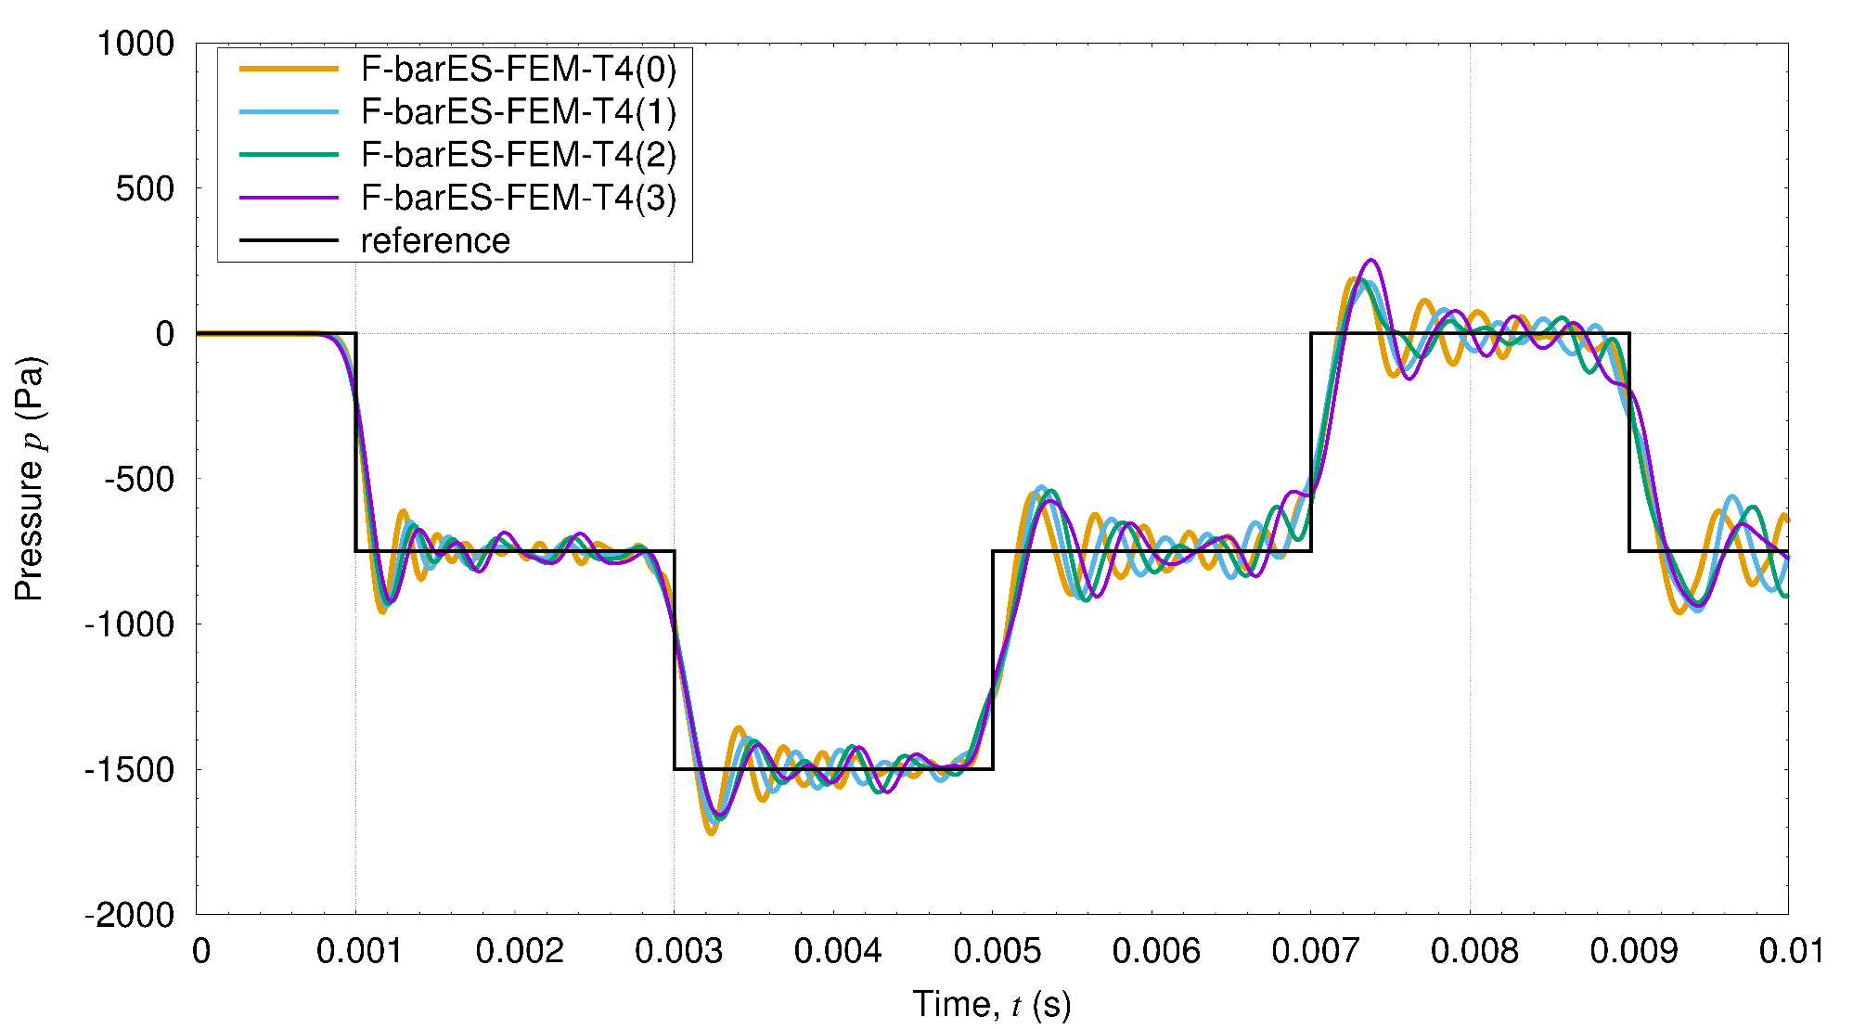
Propagation of 1D pressure wave
Results

Slide 32
Velocity Verlet Method
Algorithm
Calculate the next displacement $\left\{u_{n+1}\right\}$ as
$\left\{u_{n+1}\right\}=\left\{u_{n}\right\}+\left\{{\dot{u}}_{n}\right\}Δt+\frac{1}{2}\left\{{\ddot{u}}_{n}\right\}Δt^{2}$.
Calculate the next acceleration $\left\{{\ddot{u}}_{n+1}\right\}$ as
$\left\{{\ddot{u}}_{n+1}\right\}=\left[M^{−1}\right](\{f^{ext}\}−\{f^{int}(u_{n+1})\})$.
Calculate the next velocity $\left\{{\dot{u}}_{n+1}\right\}$ as
$$\left\{{\dot{u}}_{n+1}\right\} =\left\{{\dot{u}}_{n}\right\}+\left\{{\ddot{u}}_{n+1}\right\}Δt$$
Characteristics
2nd order symplectic scheme in time.
Less energy divergence.

Slide 33
Cause of energy divergence
Due to the adoption of F-bar method, the stiffness matrix $\left[K\right]$ becomes asymmetric and thus the dynamic system turns to unstable.
Equation of natural vibration, $\left[M\right]\left\{\ddot{u}\right\}+[K]\{u\}=\{0\}$, derives an eigen equation, ${(\left[M\right]}^{−1}[K])\left\{u\right\}=ω^{2}\{u\}$, which has asymmetric left-hand side matrix.
Some of eigen frequencies could be complex numbers.
When an angular frequency $ω_{k}=a+ib$（$b>0$）, the time variation of the $k$th mode is $\left\{u\left(t\right)\right\}=Re\left[\left\{u_{k}\right\}\exp\left(−iω_{k}t\right)\right]$ $=Re\left[\left\{u_{k}\right\}\exp\left(−iat\right)exp\left(bt\right)\right]$
Divergent term!

