Slide 1
A Locking-free and Pressure Oscillation-free Elasto-plastic Large Deformation Analysis using F-barES-FEM-T4
Yuki ONISHI, Ryoya IIDA, Kenji AMAYA Tokyo Institute of Technology, Japan

Slide 2
Motivation
Motivation
We want to accurately and stably analyze severe large deformation of solids in any shape with finite elements.
Issues
Only tetra mesh is available for arbitrary body shape.
The standard 1st / 2nd order tetrahedral element are poor especially when incompressibility is present. Also, all the other advanced tetrahedral elements (e.g., C3D4H, C3D10H, C3D10MH in ABAQUS) have some issues:
shear/volumetric locking,
pressure oscillation, etc.
Researches on FE formulations for 1st order tetra (T4) are still active especially for rubber-like or elasto-plastic materials.

Slide 3
An Example for Rubber-like Material
Material: neo-Hookean hyperelastic, $ν_{ini}=0.49$
Pressure
Pressure
# of Nodes is almost the same.
1st order hybrid T4 (C3D4H) ✓ No shear/volumetric locking
✗ Pressure oscillation
✗ Corner locking
2nd order modified hybrid T10 (C3D10MH)
✓ No shear/volumetric locking
✗ Low interpolation accuracy ✗ Early convergence failure

Slide 4
An Example for Rubber-like Material
Material: neo-Hookean hyperelastic, $ν_{ini}=0.49$
# of Nodes is exactly the same as the C3D4H case.
Note: F-barES-FEM-T4 is a pure displacement-based formulation.
F-barES-FEM-T4 (a new type of smoothed finite element method (S-FEM)) ✓ No shear/volumetric locking
✓ Less pressure oscillation ✓ Less corner locking
F-barES-FEM-T4 has excellent accuracy on rubber-like materials.
How about it on elasto-plastic materials?

Slide 5
Objective
Apply the new type of S-FEM, F-barES-FEM-T4, to large deformation problems of elasto-plastic materials.
Note: Elasto-plastic materials may have near incompressibility after yielding.
Table of Body Contents
Methods: Quick introduction of F-barES-FEM-T4
Results: A few example analyses
Summary

Slide 6
Methods
Quick introduction of F-barES-FEM-T4 (F-barES-FEM-T3 in 2D is explained for simplicity.)

Slide 7
Quick Review of Node-based S-FEM (NS-FEM)
Algorithm:
Calculate the deformation gradient at each element, $^{Elem}F$, as usual.
Distribute $^{Elem}F$ s to the connecting nodes with area weights to make $^{Node}\tilde{F}$ at each node.
Use $^{Node}\tilde{F}$ s to calculate the stress, nodal force and so on.
For triangular (T3) or tetrahedral (T4) elements.
NS-FEM avoids shear & volumetric locking in T3/T4 elements and also alleviates pressure oscillation. Yet, it suffers from spurious low-energy modes, corner locking and minor pressure oscillation….

Slide 8
Quick Review of Edge-based S-FEM (ES-FEM)
Algorithm:
Calculate the deformation gradient at each element, $^{Elem}F$, as usual.
Distribute $^{Elem}F$ s to the connecting edges with area weights to make $^{Edge}\tilde{F}$ at each edge.
Use $^{Edge}\tilde{F}$ s to calculate the stress, nodal force and so on.
For triangular (T3) or tetrahedral (T4) elements.
ES-FEM avoids shear locking in T3/T4 elements. Yet, it suffers from volumetric locking, corner locking, and major pressure oscillation…

Slide 9
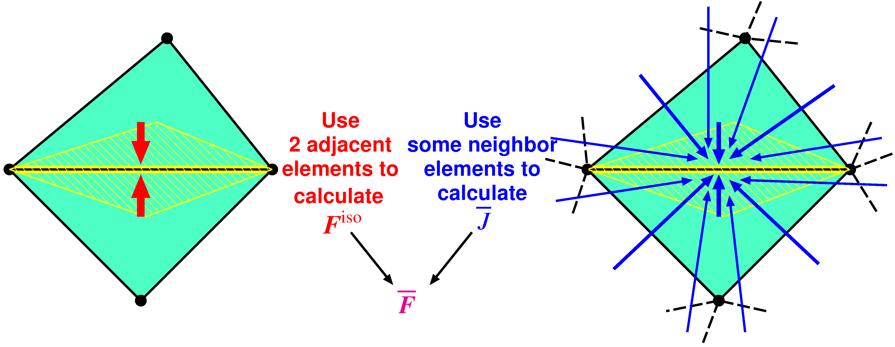
Quick Introduction of F-barES-FEM
Outlline
$^{Edge}{\tilde{F}}^{iso}$ is given by ES-FEM.
$^{Edge}\overline{ J }$ is given by cyclically applied NS-FEM.
$^{Edge}\overline{F }$ is calculated in the manner of F-bar method:
$^{Edge}\overline{F }=$ $^{Edge}{\overline{ J }}^{1/3}$ $^{Edge}{\tilde{F}}^{iso}$.
Concept: combine ES-FEM and NS-FEM using F-bar method

Slide 10
Outline of F-barES-FEM
Brief Formulation
Calculate$^{Elem}J$as usual.
Smooth$^{Elem}J$ at nodes and get$^{Node}\tilde{ J }$.
Smooth$^{Node}\tilde{ J }$ at elements and get$^{Elem}\tilde{ J }$.
Repeat 2. and 3. as necessary ($c$ times).
Smooth $^{Elem}\dot{\dot{\dot{\tilde{\tilde{ J }}}}}$ at edges to make $^{Edge}\overline{ J }$.
Combine $^{Edge}\overline{ J }$ and $^{Edge}F^{iso}$ of ES-FEM as
$^{Edge}\overline{F }= ^{Edge}{\overline{ J }}^{1/3} ^{Edge}F^{iso}$.
A kind of low-pass filter for $J$
Cyclic Smoothing of $J$
($c$ layers of ~)
Hereafter, F-barES-FEM-T4 with $c$ cycles of smoothing is called “F-barES-FEM-T4($c$)”.

Slide 11
Results
A few example analyses

Slide 12
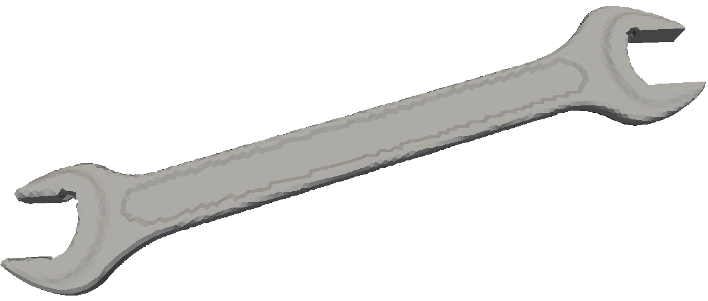
Bending of Elasto-Plastic Spanner
Outline
2 faces are perfectly constrained.
Pressure is applied to a side part of the spanner.
Compared to ABAQUS C3D4H with the same unstructured T4 mesh.
8.5 k nodes & 33 k elems.
Fixed
Elasto-plastic material:
Hencky elasticity with $E=70 GPa$ and $ν=0.3$.
Isotropic von Mises yield criterion with $σ_{Y}=100 MPa$and$H=7 GPa$ (constant).
Pressure
P. 12

Slide 13
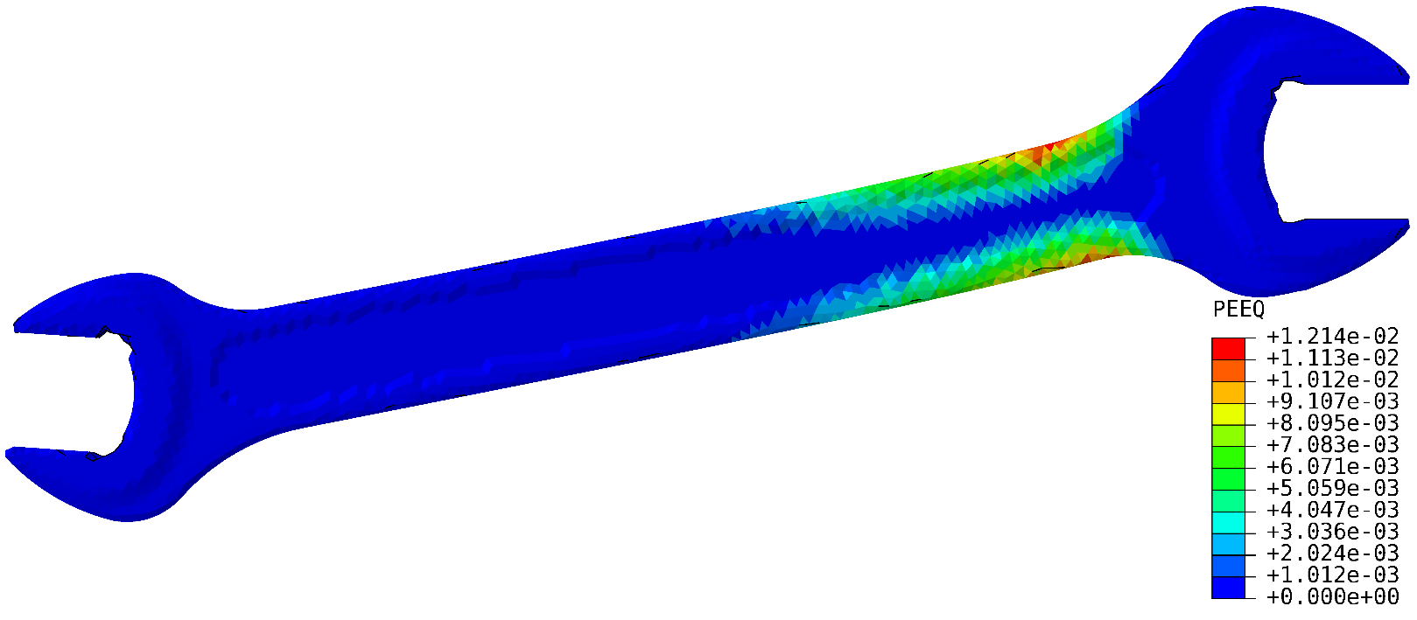
Bending of Elasto-Plastic Spanner
Equivalent Plastic Strain
F-barES-FEM-T4
ABAQUS C3D4H
Distributions of
equivalent plastic strain
are about the same.

Slide 14
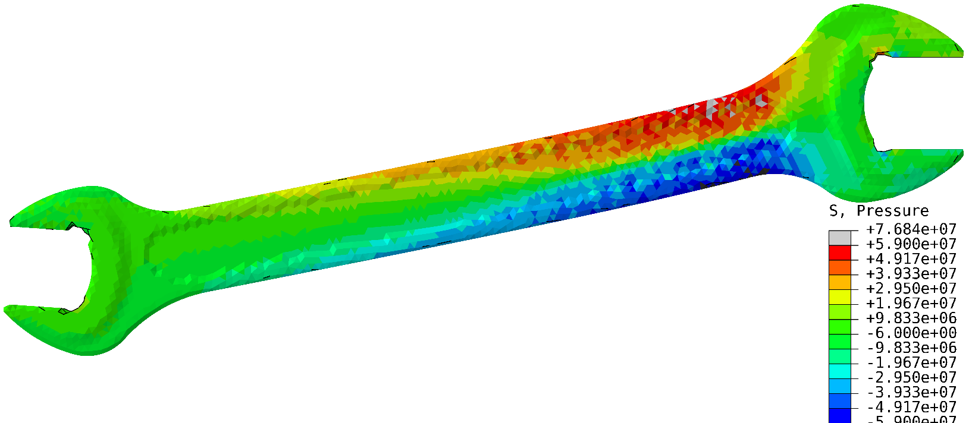
Bending of Elasto-Plastic Spanner
Pressure
Smooth distribution here.
F-barES-FEM-T4
Checkerboard patterns here.
ABAQUS C3D4H
ABAQUS C3D4H suffers from pressure oscillation even in a small deformation elasto-plastic case.

Slide 15
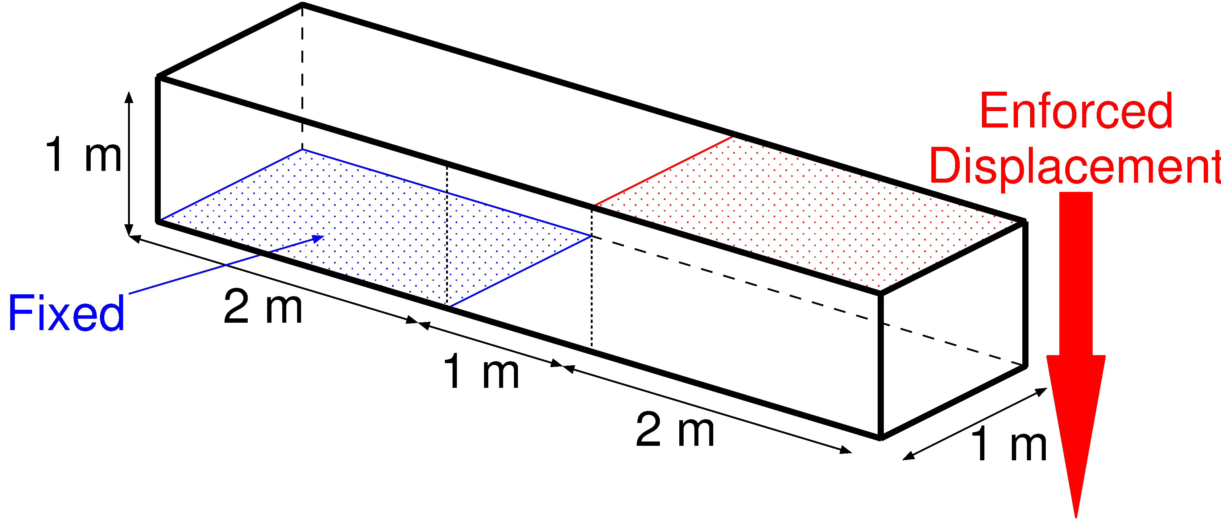
Shearing & Tensioning of Elasto-Plastic Bar
Outline
Blue face is perfectly constrained.
Red face is constrained in plane and pressed down.
Compared to ABAQUS C3D4H with the same unstructured T4 mesh.
1.2 k nodes & 4.8 k elems.
Elasto-plastic material:
Hencky elasticity with $E=1 GPa$ and $ν=0.3$.
Isotropic von Mises yield criterion with $σ_{Y}=1 MPa$and$H=0.1 GPa$ (constant).
P. 15

Slide 16
Shearing & Tensioning of Elasto-Plastic Bar
Result of F-bar ES-FEM (Equiv. Plastic Strain)

Slide 17
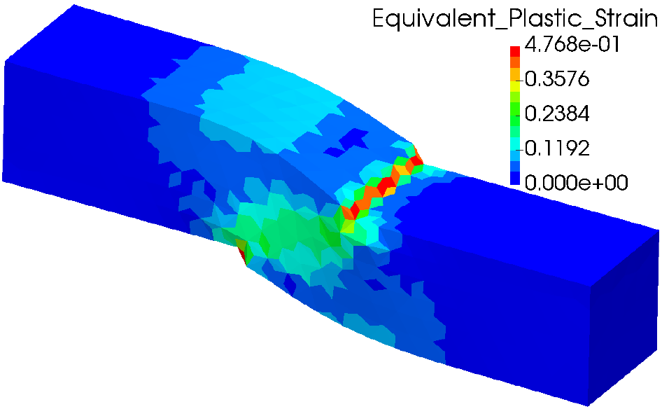
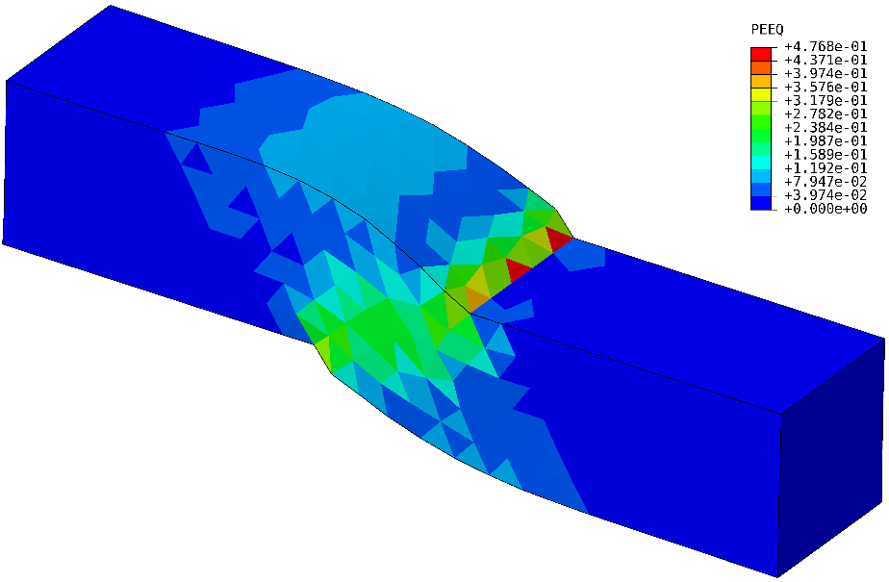
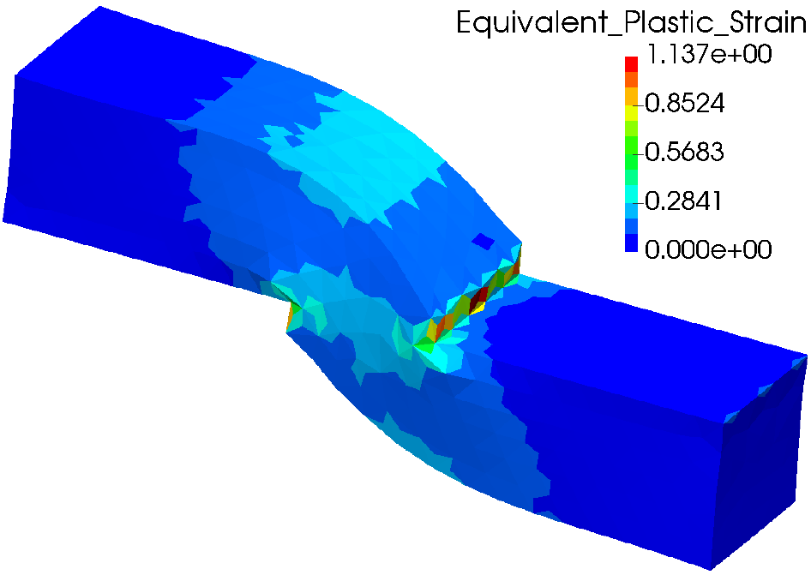
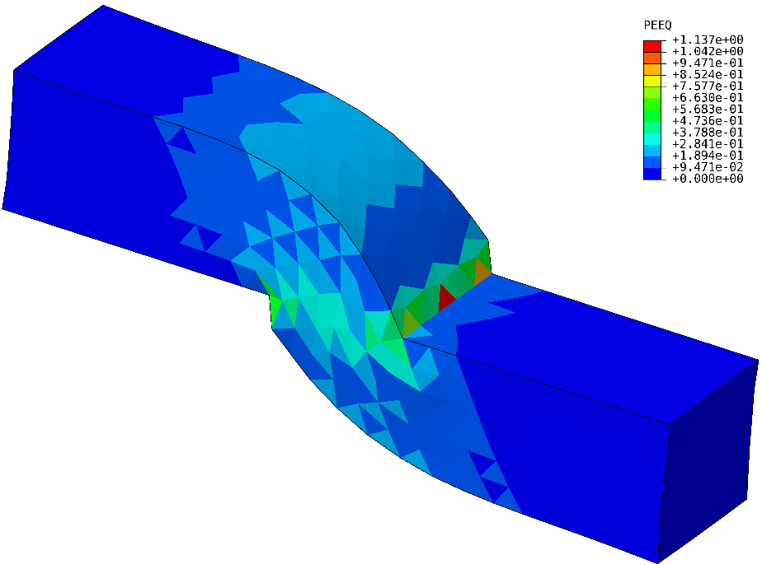
Shearing & Tensioning of Elasto-Plastic Bar
Equivalent Plastic Strain
$$u_{z}=0.5 m$$
Smooth distribution.
There is minor oscillation.
$$u_{z}=1.0 m$$
F-barES-FEM-T4
ABAQUS C3D4H
P. 17

Slide 18
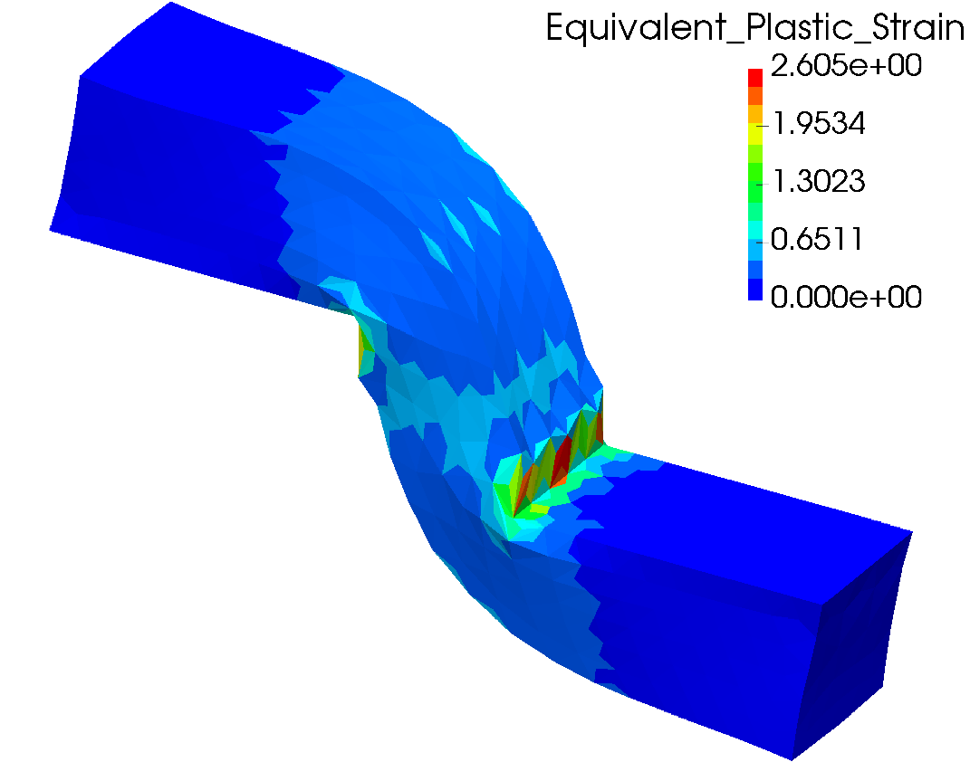
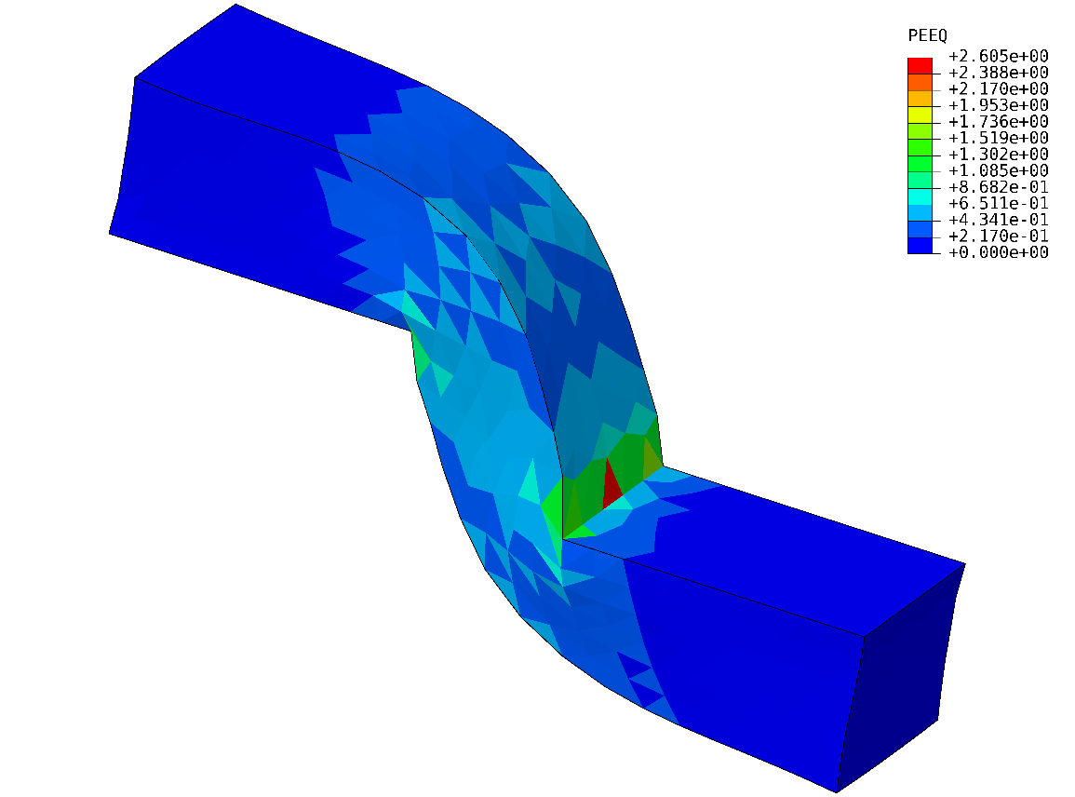
Shearing & Tensioning of Elasto-Plastic Bar
Equivalent Plastic Strain
$$u_{z}=2.0 m$$
F-barES-FEM-T4
ABAQUS C3D4H
Accuracy of equivalent plastic strain seems no much different.
P. 18

Slide 19
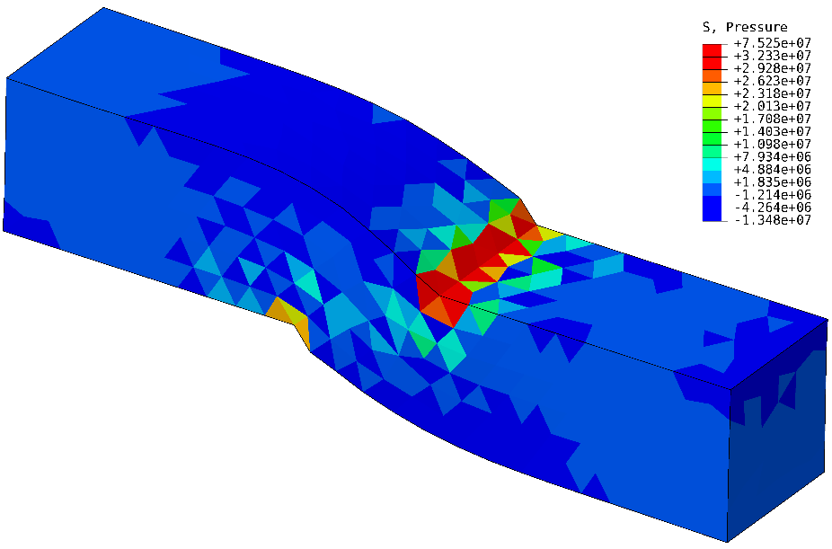
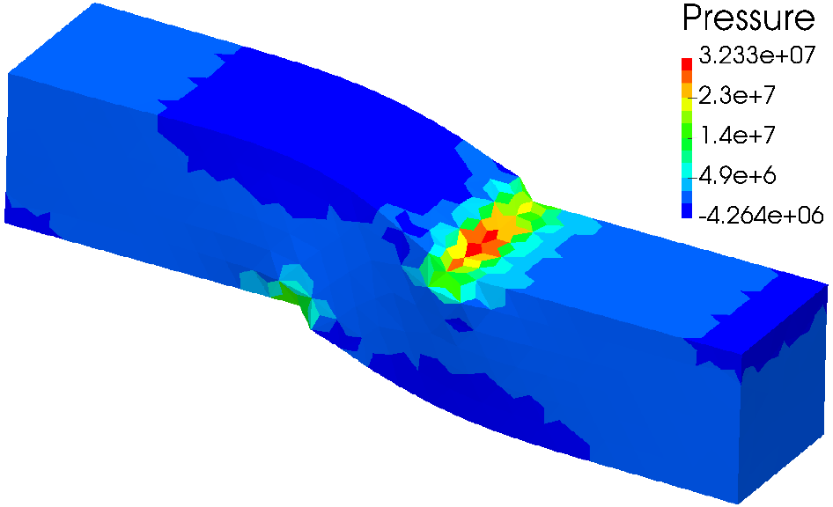
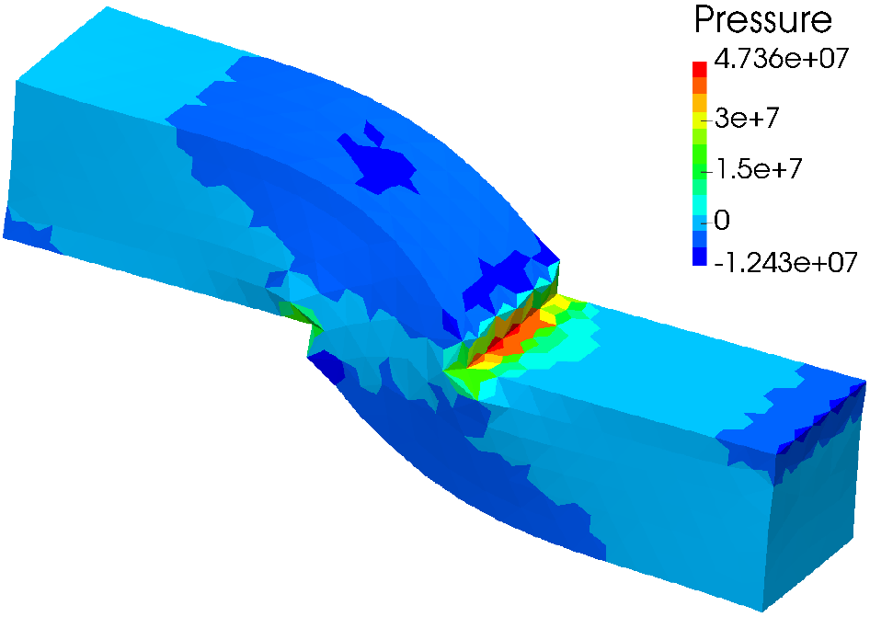
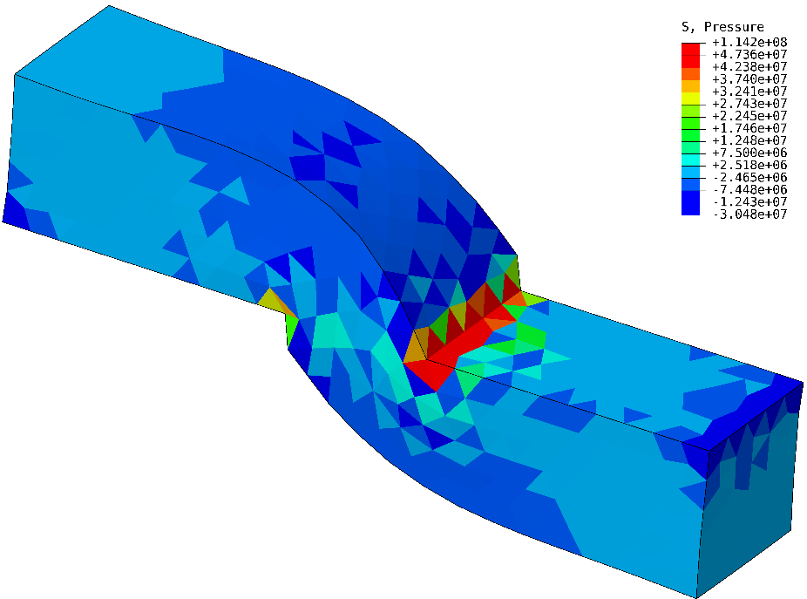
Shearing & Tensioning of Elasto-Plastic Bar
Pressure
$$u_{z}=0.5 m$$
Smooth distribution.
There is major oscillation.
$$u_{z}=1.0 m$$
F-barES-FEM-T4
ABAQUS C3D4H
P. 19

Slide 20
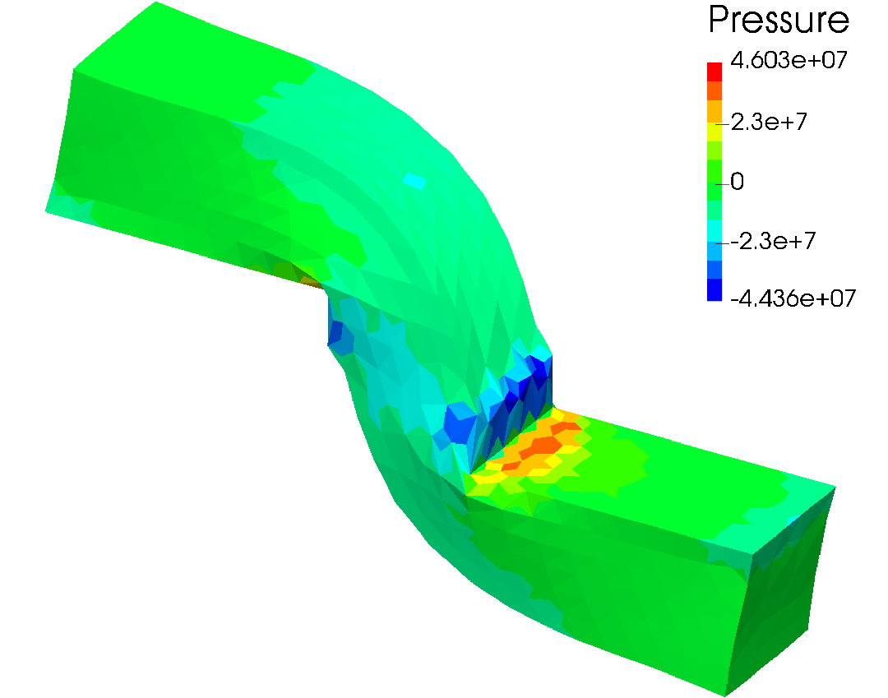
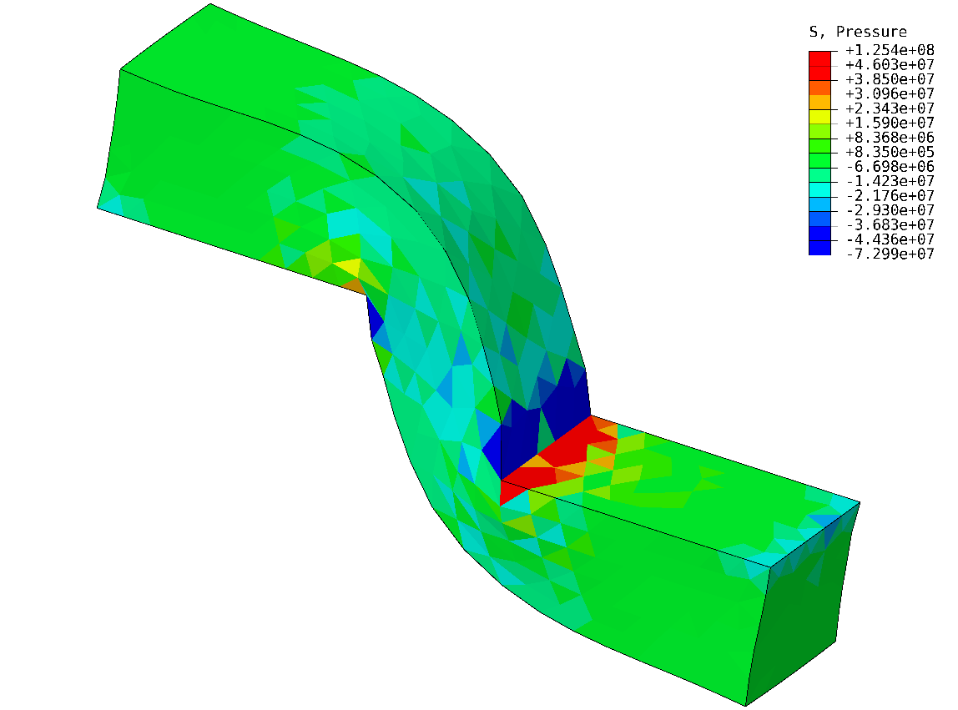
Shearing & Tensioning of Elasto-Plastic Bar
Pressure
$$u_{z}=2.0 m$$
F-barES-FEM-T4
ABAQUS C3D4H
Accuracy of pressure is quite different due to the pressure oscillation of ABAQUS C3D4H.
P. 20

Slide 21
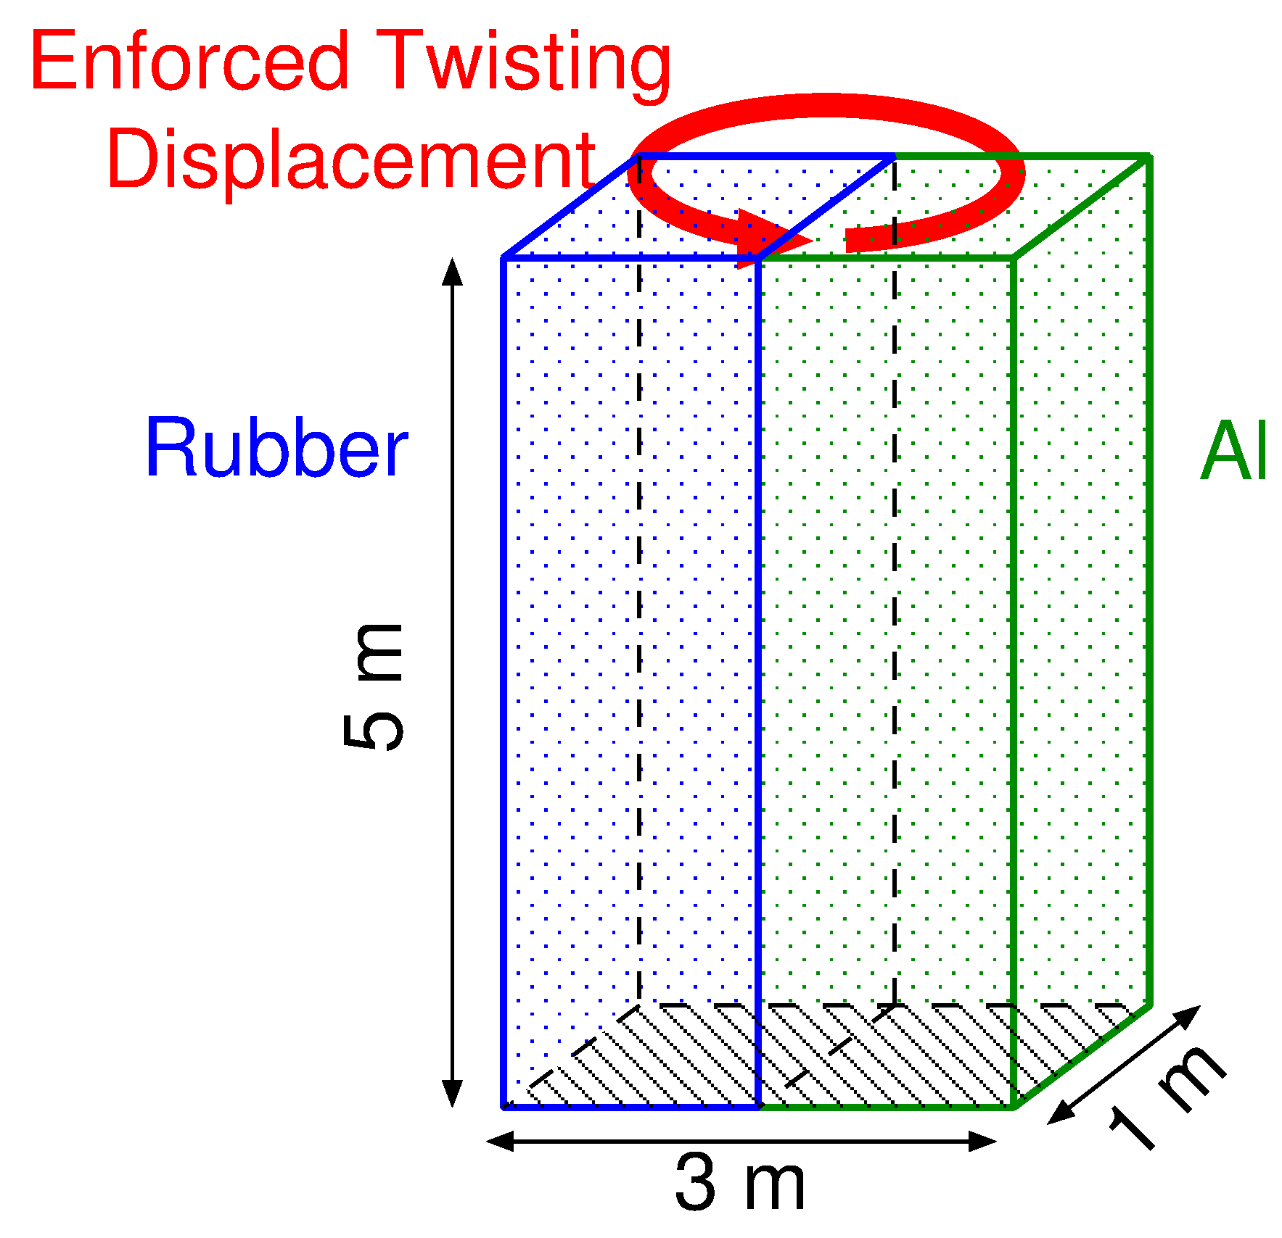
Twist of Rubber/Aluminium Composite Plate
Outline
Bottom face is perfectly constrained.
Top face is constrained in the plane and twisted 360 deg. around the vertical axis.
Calculated by F-barES-FEM-T4 only.
Multiple $F$s at edges on the material interface.
3 k nodes & 14 k elems.
[Aluminium]
Hencky elasticity: $E=70 GPa$， $ν=0.3$.
Isotropic von Mises plasticity: $σ_{Y}=100 MPa$， $H=0.7 GPa$ (const.), $(c=2)$
[Rubber]
Neo-Hook Hyperelasticity: $E^{ini}=5 MPa$, $$ν^{ini}=0.49, \\ (c=1)$$

Slide 22
Twist of Rubber/Aluminium Composite Plate
Result of F-bar ES-FEM-T4 Equivalent Plastic Strain
Seems valid.

Slide 23
Twist of Rubber/Aluminium Composite Plate
Result of F-bar ES-FEM-T4 Pressure
No pressure oscillation.

Slide 24
Twist of Rubber/Aluminium Composite Plate
Result of
F-bar ES-FEM-T4 Deformation Gradient $$F_{yz}$$
Discontinuous $F_{yz}$. $$⇑$$
No strain smoothing across material interfaces.

Slide 25
Summary

Slide 26
Benefits and Drawbacks of F-barES-FEM-T4
Benefits
Locking-free with 1st order tetra meshes.
No difficulty in severe strain or contact analysis.
No increase in DOF.
Purely displacement-based formulation.
No restriction of material constitutive model. Pressure dependent models are acceptable.
Less corner locking and pressure oscillation.
Drawbacks
✗ The more cyclic smoothing necessitates the more CPU time due to the wider bandwidth.

Slide 27
FYI
If you are interested in F-barES-FEM-T4, please refer to the following paper:
“F-bar aided edge-based smoothed finite element method using tetrahedral elements for finite deformation analysis of nearly incompressible solids, International Journal for Numerical Methods in Engineering (IJNME), Jul. 2016.
Thank you for your kind attention!

