Slide 1
Element-wise Selective Smoothed
Finite Element Method for 10-node Tetrahedral Elements in Large Deformation Problems
Yuki ONISHI
Tokyo Institute of Technology, Japan

Slide 2
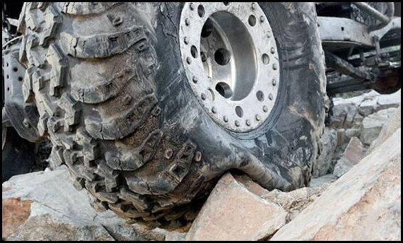
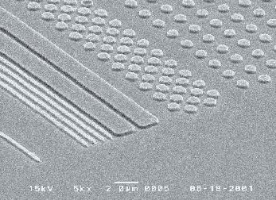


Motivation
What we want to do:
Solve hyper large deformation
analyses accurately and stably.
Treat complex geometries
with tetrahedral meshes.
Consider nearly incompressible materials $(ν≃0.5)$.
Support contact problems.
Handle auto re-meshing.
Rubber
Metal
Plastic/Glass

Slide 3
Issues
Conventional tetrahedral (T4/T10) FE formulations
still have issues in accuracy or stability
especially in nearly incompressible cases.
2nd or higher order elements:
✗ Volumetric locking.
Accuracy loss in large strain due to intermediate nodes.
B-bar method, F-bar method, Selective reduced integration:
✗ Not applicable to tetrahedral element directly.
F-bar-Patch method:
✗ Difficulty in building good-quality patches.
u/p mixed (hybrid) method:
(e.g., ABAQUS/Standard C3D4H and C3D10MH)
✗ Pressure checkerboarding, Early convergence failure etc..
F-bar type smoothed FEM (F-barES-FEM-T4):
✓ Accurate and stable!

Slide 4
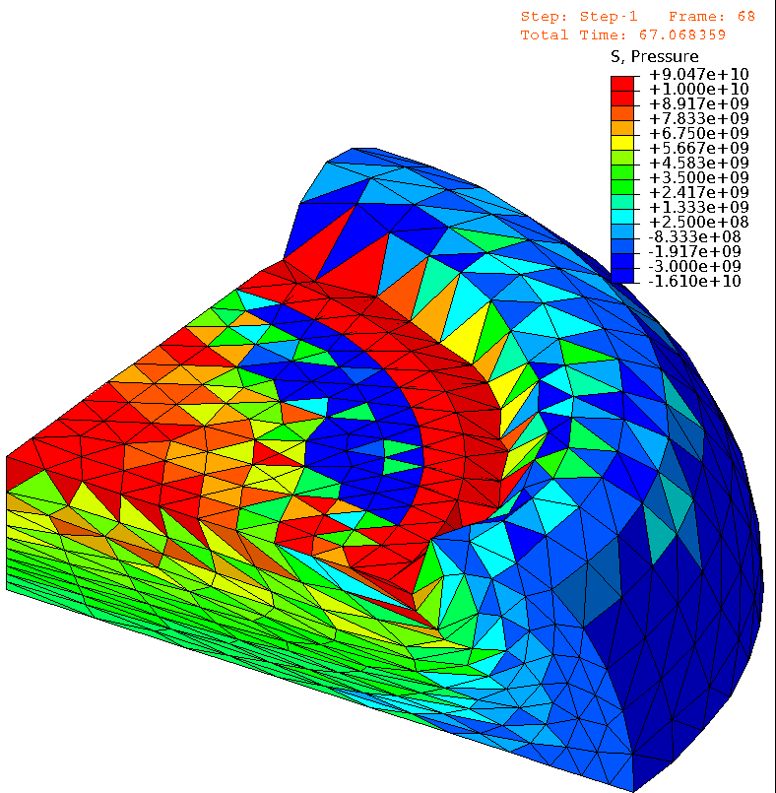
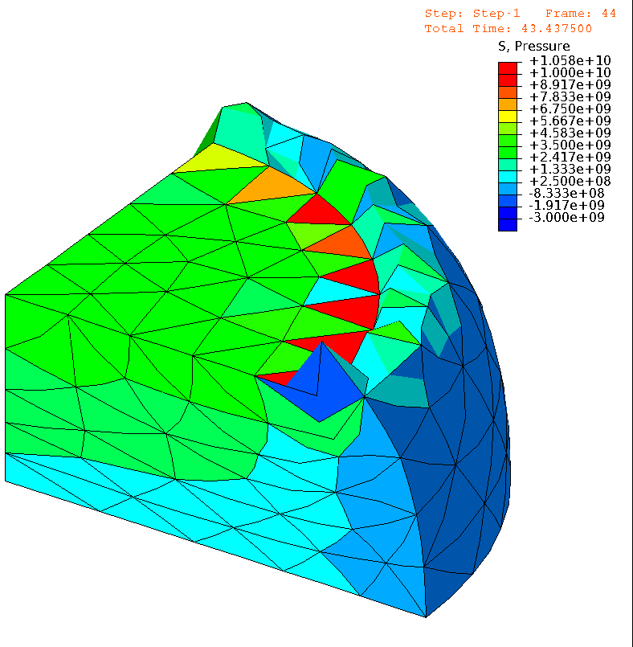

Issues (cont.)
E.g.) Compression of neo-Hookean hyperelastic body with $ν_{ini}=0.49$
Pressure
Pressure
# of Nodes is
almost the same.
1st order hybrid T4 (C3D4H)
✓ No volumetric locking
✗ Pressure checkerboarding
✗ Shear & corner locking
2nd order modified hybrid T10 (C3D10MH)
✓ No shear/volumetric locking
✗ Early convergence failure
✗ Low interpolation accuracy

Slide 5
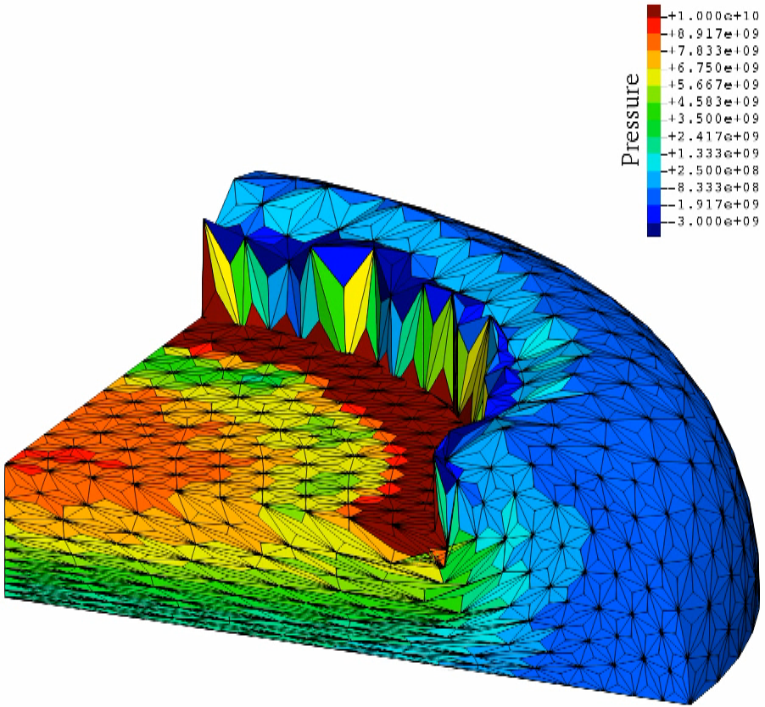

Issues (cont.)
E.g.) Compression of neo-Hookean hyperelastic body with $ν_{ini}=0.49$
Pressure
Although
F-barES-FEM-T4 is accurate and stable,
✗ it cannot be implemented in general-purpose
FE software
due to the adoption of ES-FEM.
Same mesh
as C3D4H
case.
F-barES-FEM-T4
✓ No shear/volumetric locking
✓ No corner locking
✓ No pressure checkerboarding
Another approach
adopting CS-FEM with T10 element would be effective.

Slide 6
Objective
To propose an accurate and stable
CS-FEM-T10, “SelectiveCS-FEM-T10”,
and to implement it into
general-purpose FE software.
Table of Body Contents
Formulation of SelectiveCS-FEM-T10
Demonstrations of SelectiveCS-FEM-T10
Implementation of SelectiveCS-FEM-T10
into ABAQUS
Summary

Slide 7
Formulation of
SelectiveCS-FEM-T10

Slide 8
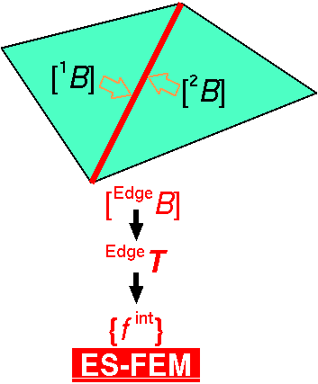

Brief Review of Edge-based S-FEM (ES-FEM)
Calculate $[B]$ at each element as usual.
Distribute $[B]$ to the connecting edges with area weight
and build $[ ^{Edge}B]$ .
Calculate $F, T, \left\{f^{int}\right\}$ etc. in each edge smoothing domain.
As if putting
an integration point
on each edge center
ES-FEM can avoid shear locking.
However,
it cannot be implemented in ordinary FE codes due to the strain smoothing across
multiple elements...

Slide 9
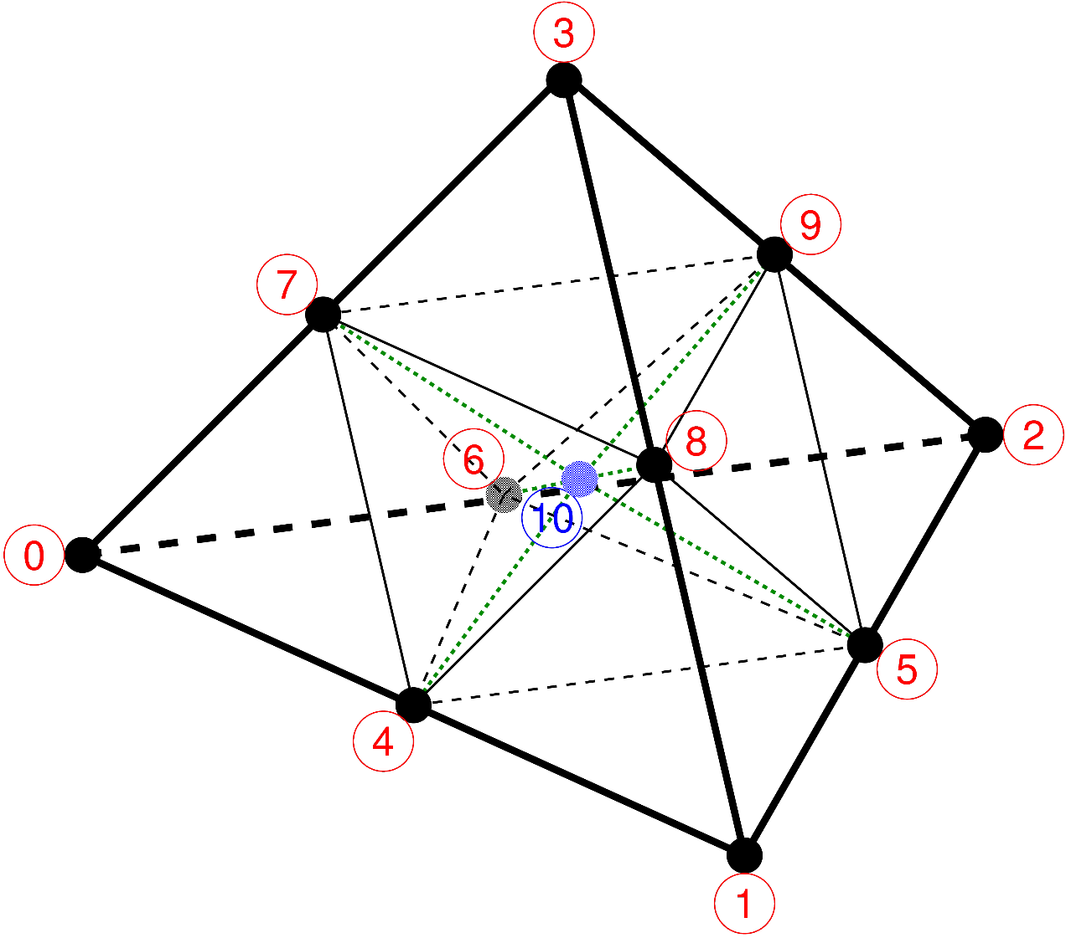
1. Subdivision into T4 Subelements
Put a dummy node (10) at the mean location of 6 mid-nodes.
Subdivide a T10 element into twelve T4 subelements and calculate their B-matrices and strains.
The shape function
should not be quadratic
in large deformation analyses.
Same as
J.T.Ostien’s method.
(IJNME, v107, 2016)

Slide 10
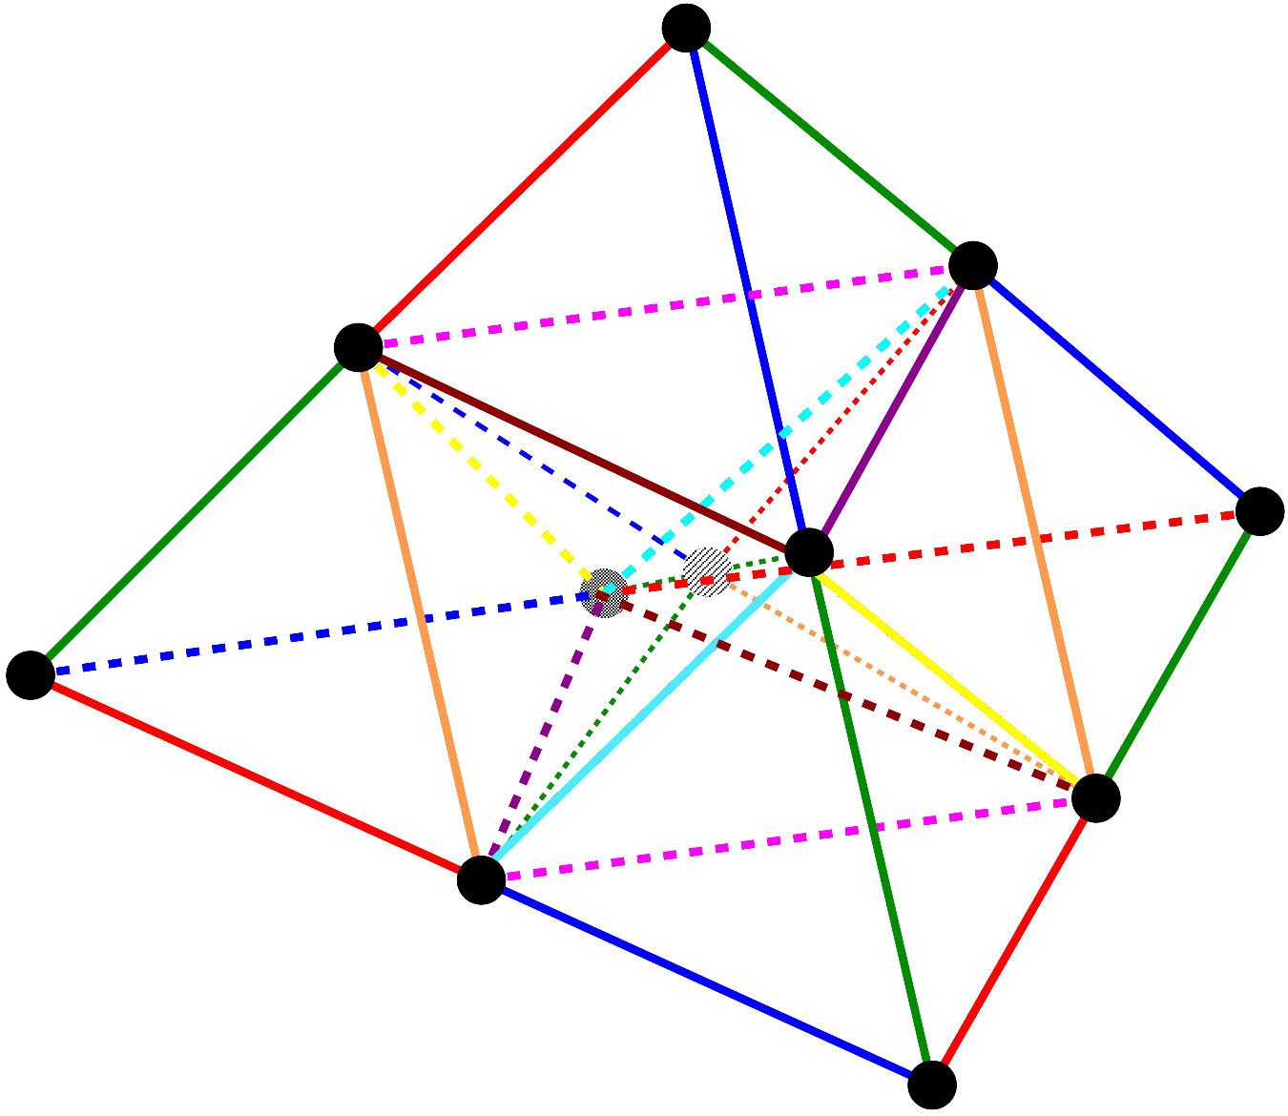
2. Deviatoric Strain Smoothing
Perform strain smoothing in the manner of ES-FEM
(i.e., average dev. strains of subelements at edges). Then,…
T4 subelements cause
shear locking and thus
strain smoothing is
necessary.
From 12 subelements
to 30 edges

Slide 11
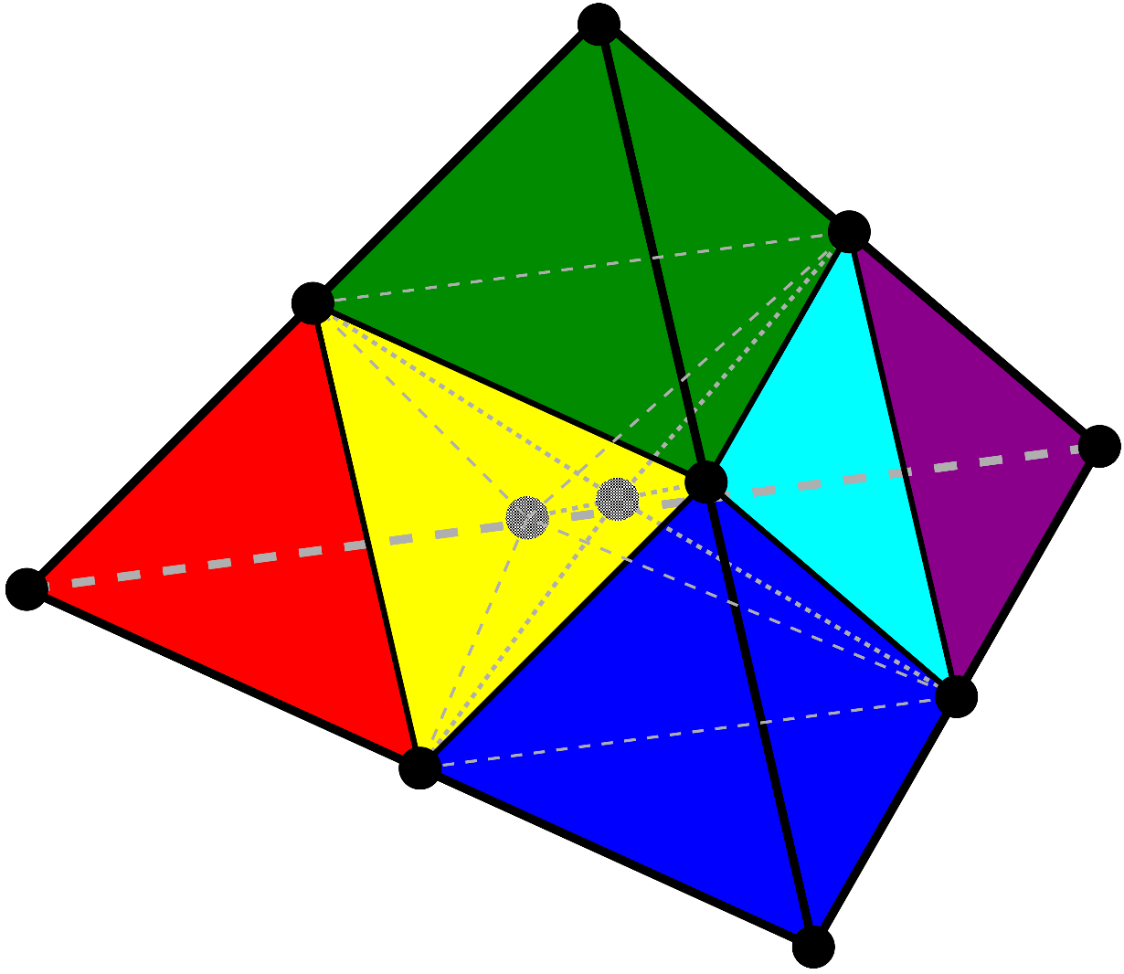
2. Deviatoric Strain Smoothing
(cont.)
Perform one more strain smoothing in the reverse direction
(i.e., average dev. strains of edges at subelements).
ES-FEM does not smooth
the strain at frame edges.
Thus one more smoothing
is necessary.
From 30 edges
to 12 subelements

Slide 12
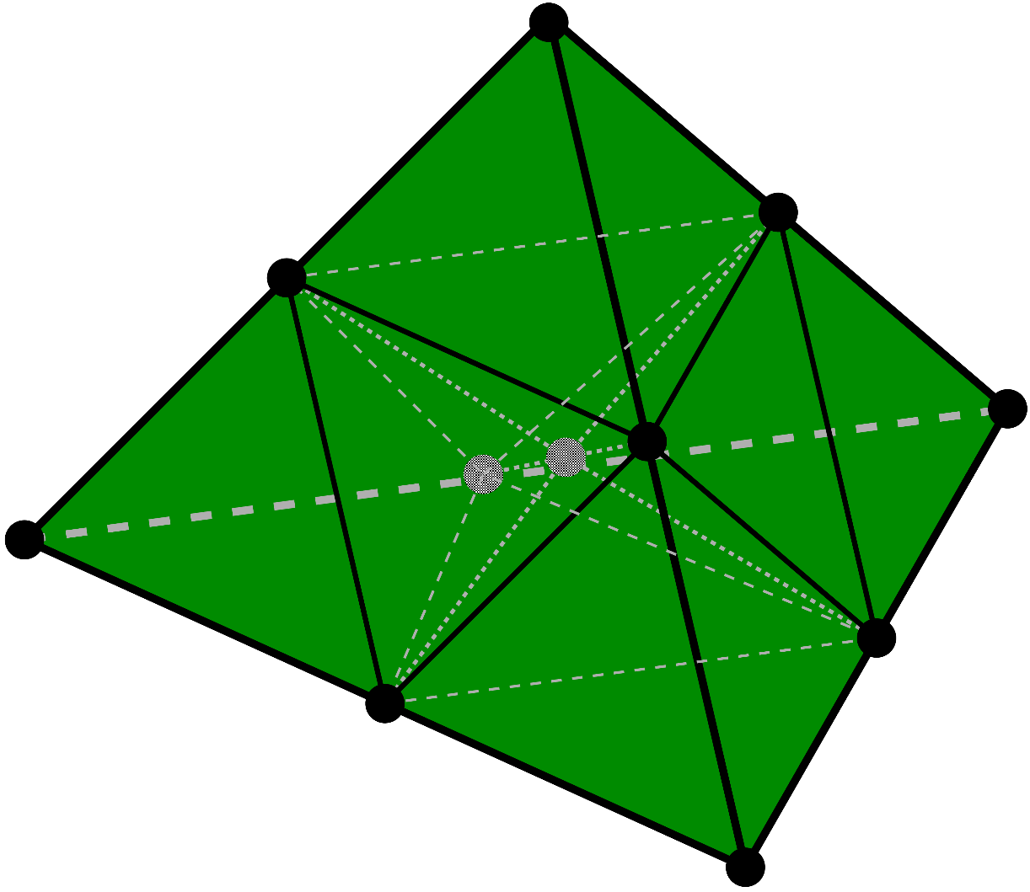
3. Volumetric Strain Smoothing
Treat the mean vol. strain of all subelements as the uniform element vol. strain (i.e., same approach as SRI elements).
The spatial order of
vol. strain should be
lower than that of
dev. strain to avoid
volumetric locking.

Slide 13
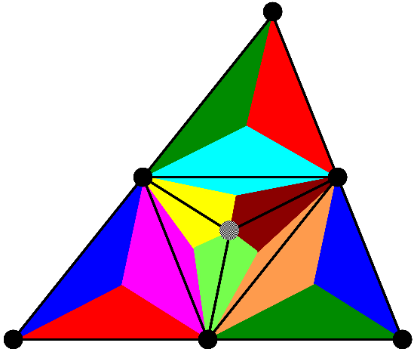
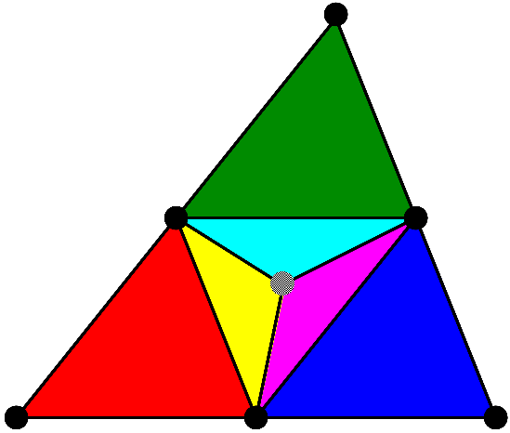
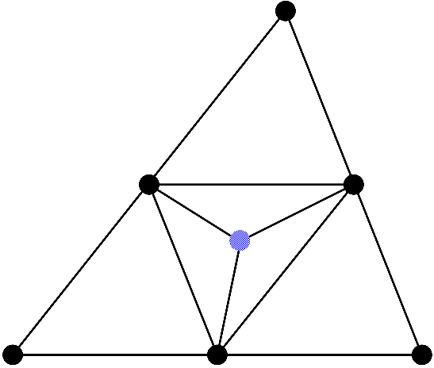
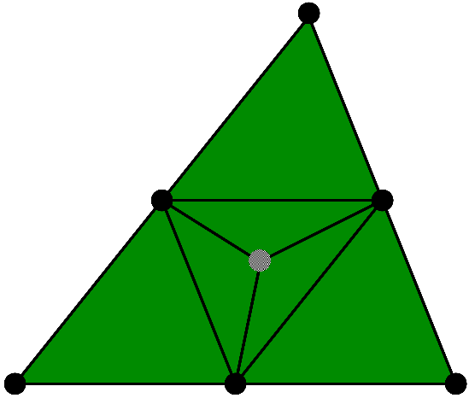

Flowchart of SelectiveCS-FEM
Explanation in 2D (6-node triangular element) for simplicity
(ES-FEM)⁻¹
ES-FEM
2) Dev. strain smoothing with edges and subelements
SRI
1) Subdivision with
a dummy node
Overall
mean
4) $\left\{f^{int}\right\} and [K]$
3) Vol. strain smoothing with all subelements

Slide 14
Demonstration of
SelectiveCS-FEM-T10

Slide 15
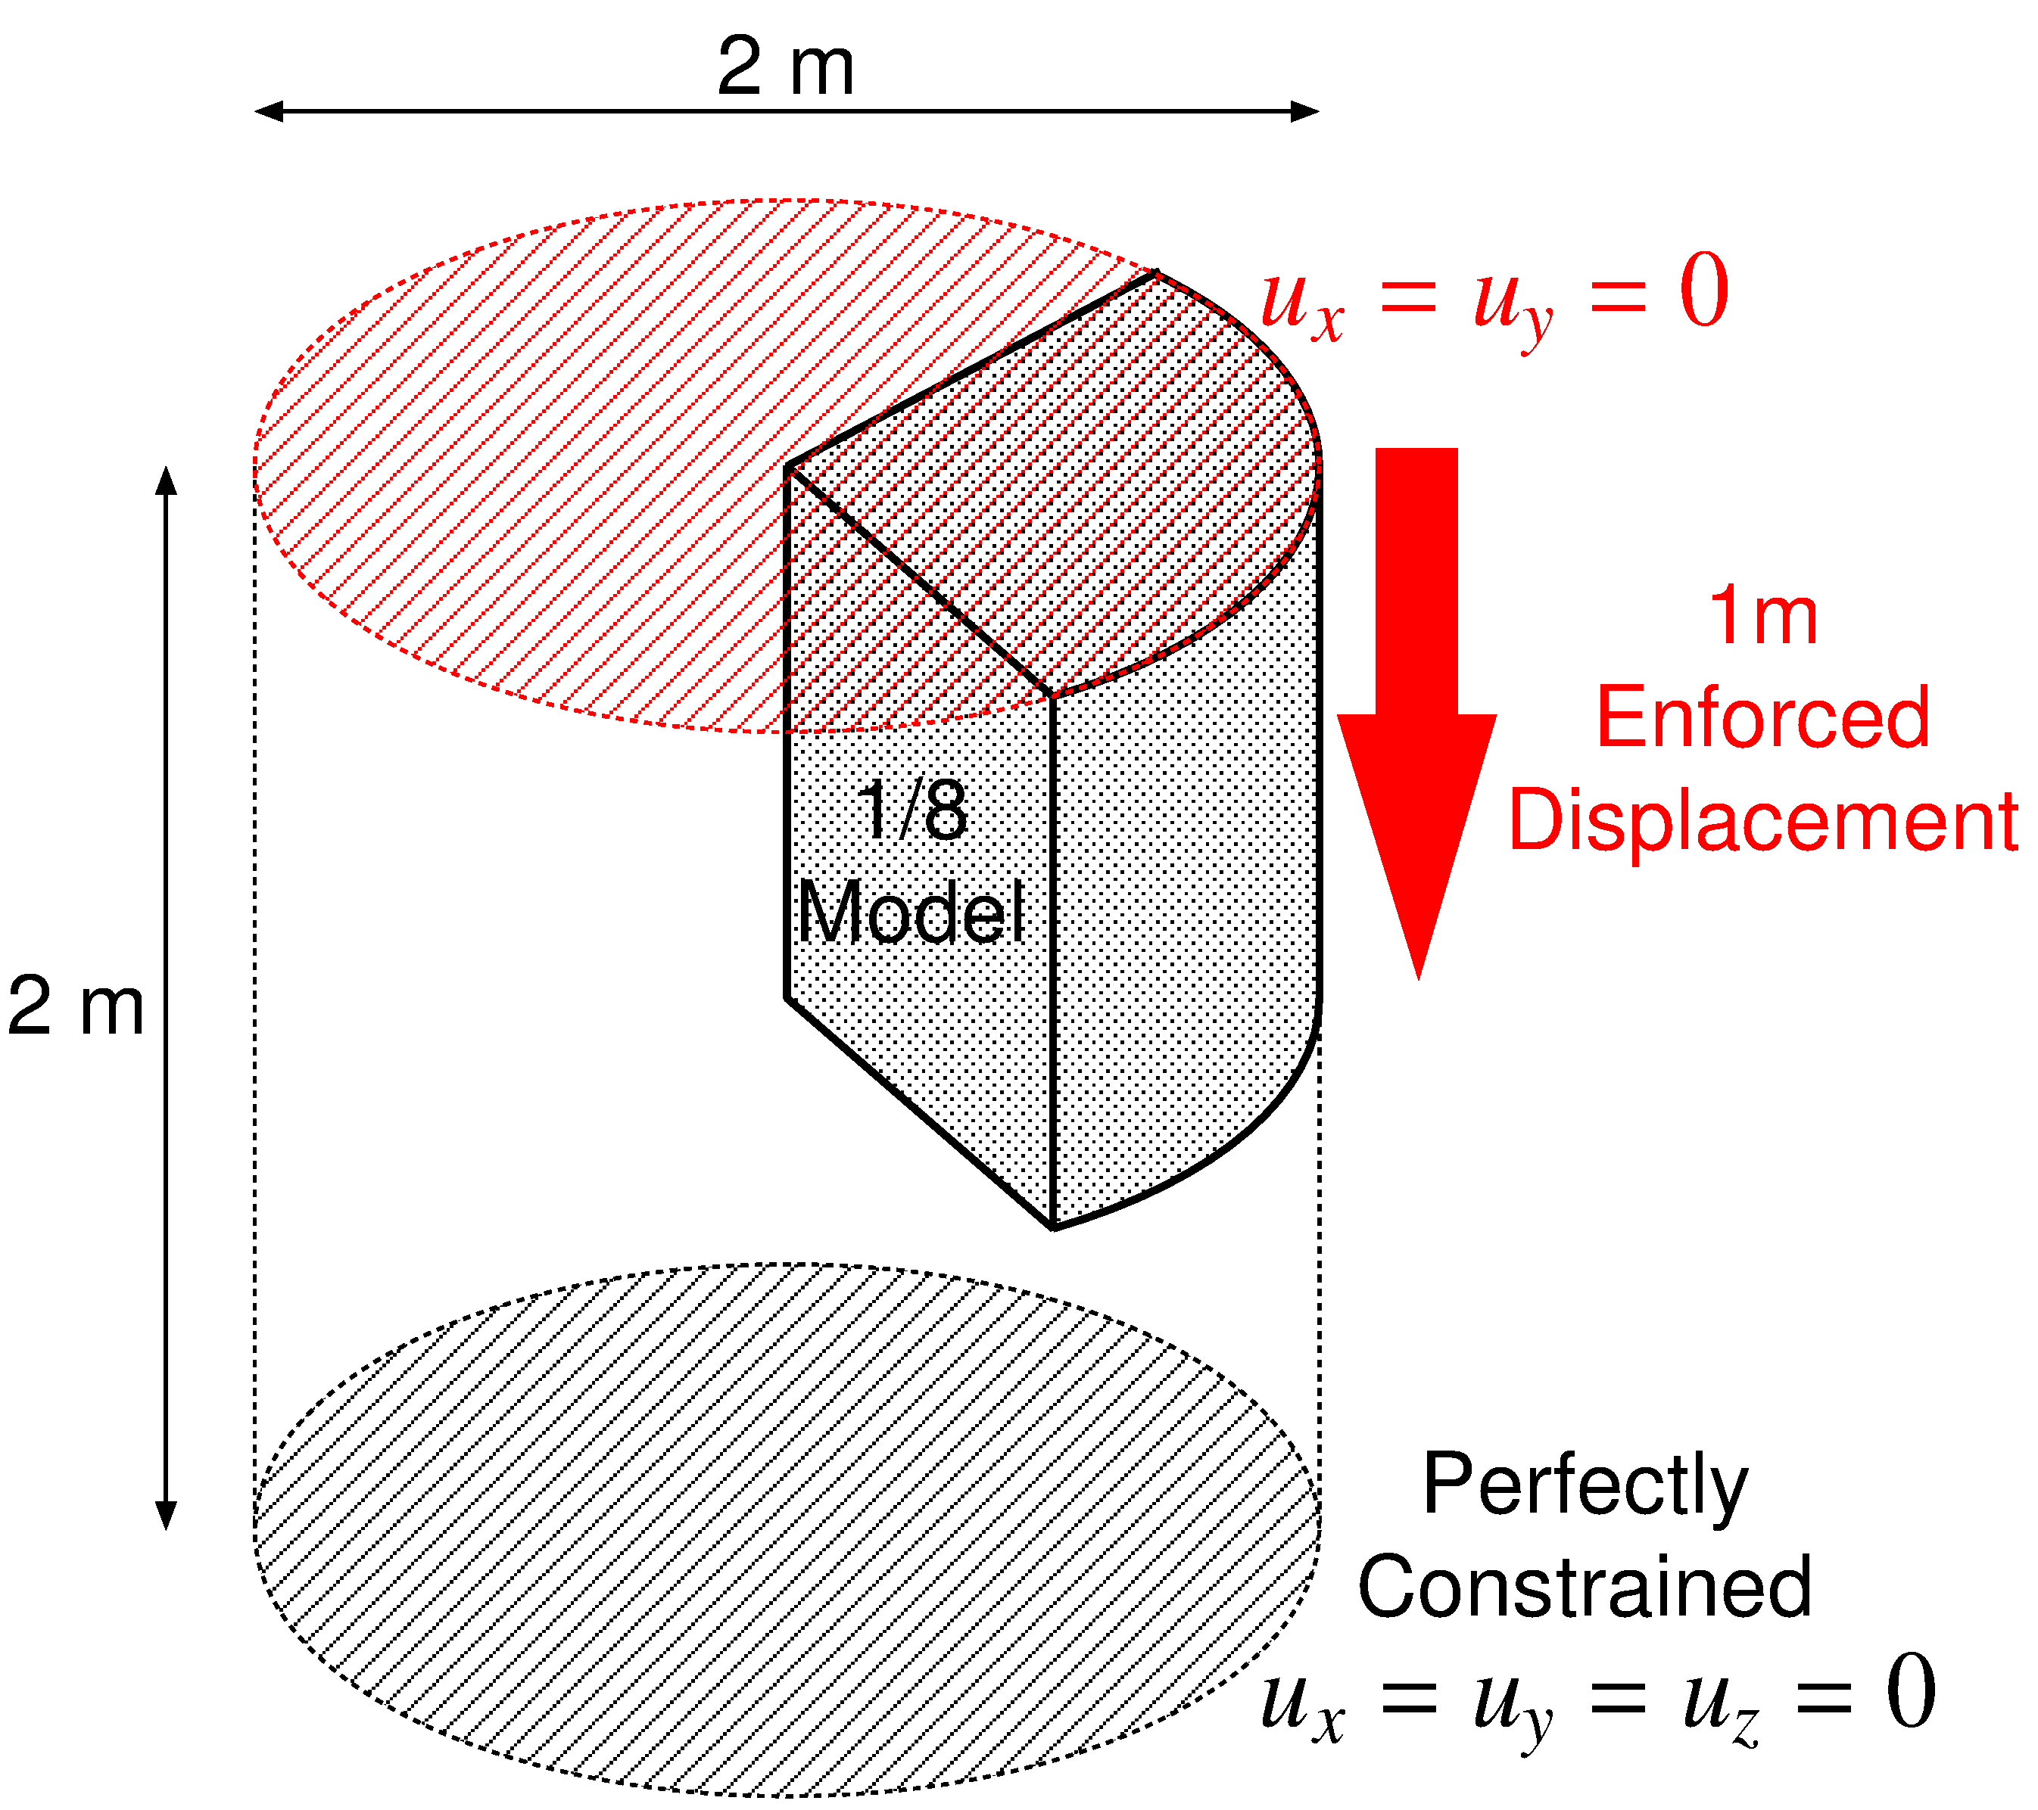
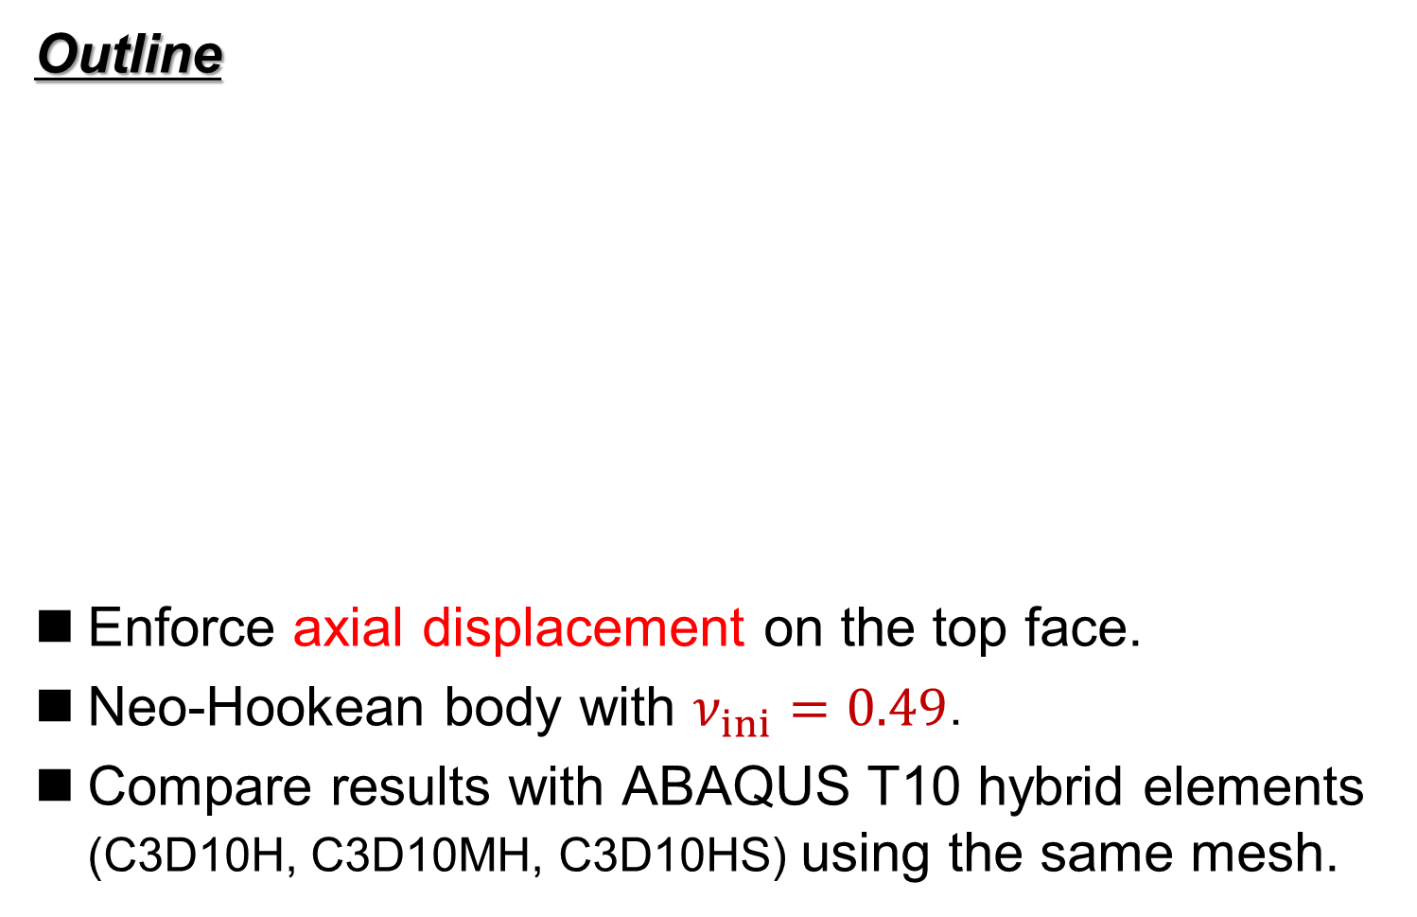
Barreling of Hyperelastic Cylinder
Outline
Enforce axial displacement on the top face.
Neo-Hookean body with $ν_{ini}=0.49$．
Compare results with ABAQUS T10 hybrid elements (C3D10H, C3D10MH, C3D10HS) using the same mesh.

Slide 16
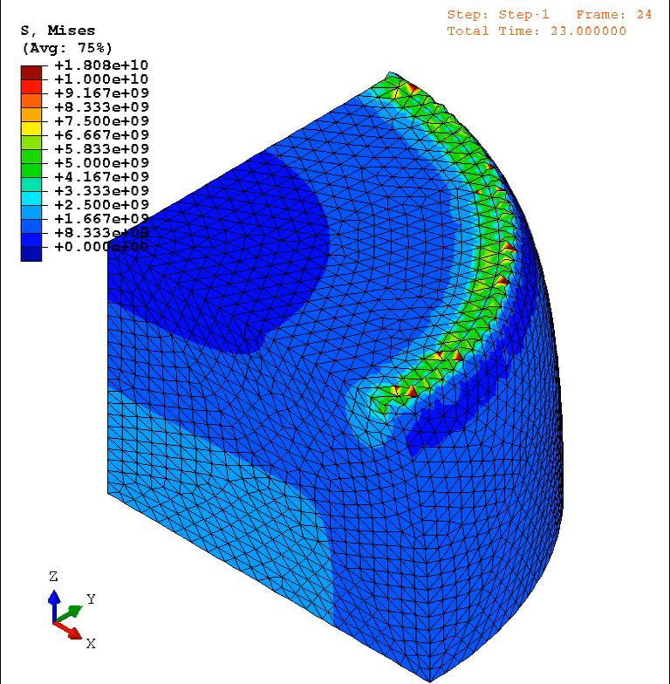
Barreling of Hyperelastic Cylinder
Animation
of
Mises
stress
(ABAQUS
C3D10MH)
Convergence
failure at 24%
compression
Unnaturally
oscillating
distributions
are obtained
around
the rim.

Slide 17
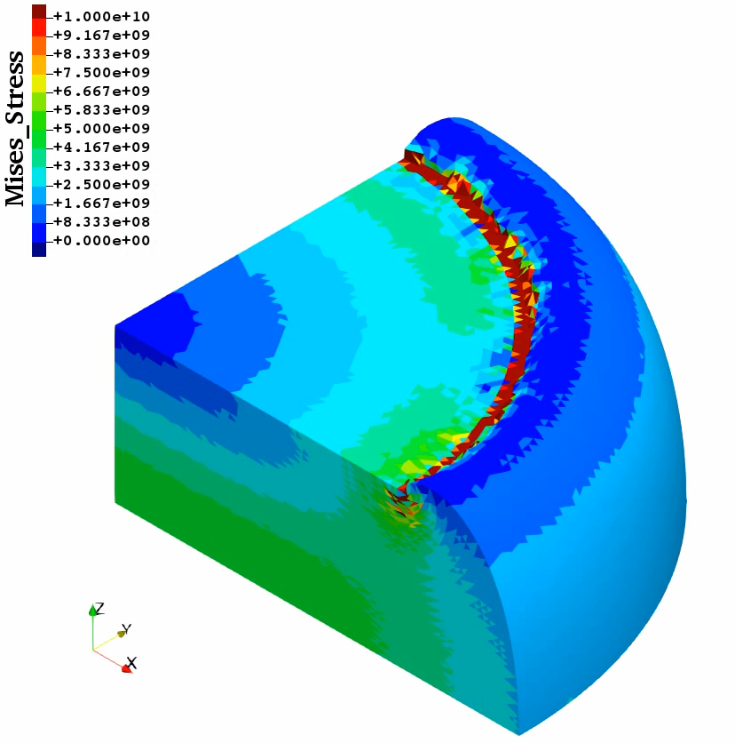
Barreling of Hyperelastic Cylinder
Animation
of
Mises
stress
(Selective
CS-FEM-T10)
Convergence
failure at 47%
compression
The
present
element
is more
stable
than
ABAQUS
C3D10MH
Smooth
distributions
are obtained
except around
the rim.

Slide 18
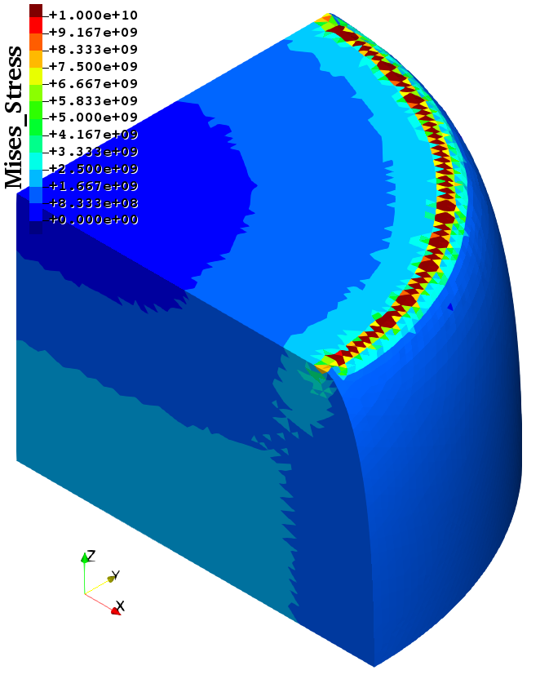
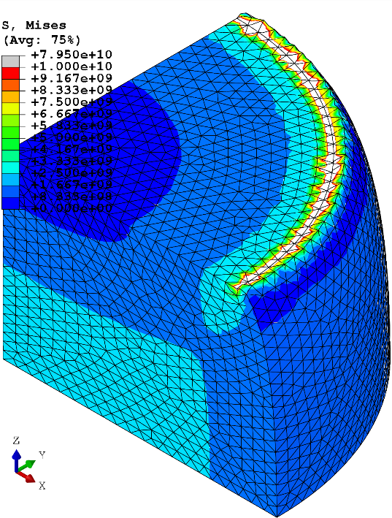
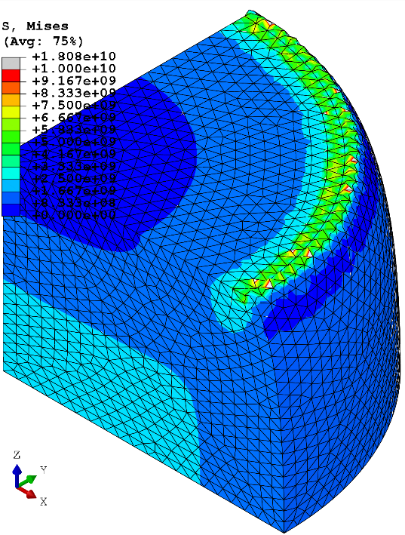
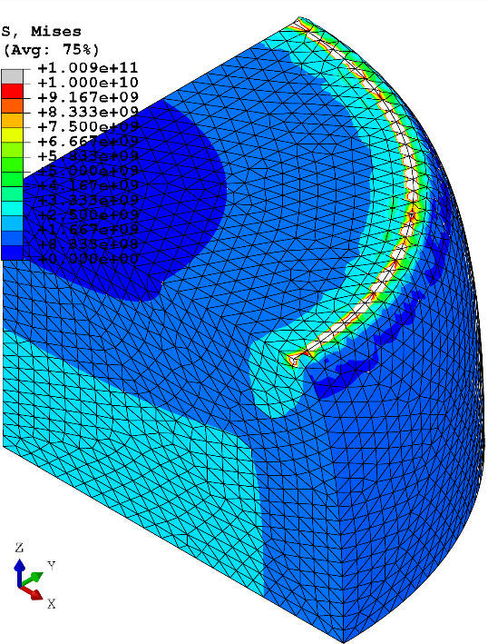
Barreling of Hyperelastic Cylinder
Comparison of Mises stress at 24% comp.
Selective
CS-FEM-T10
ABAQUS
C3D10H
ABAQUS
C3D10MH
ABAQUS
C3D10HS
All results are similar to each other
except around the rim having stress singularity.

Slide 19
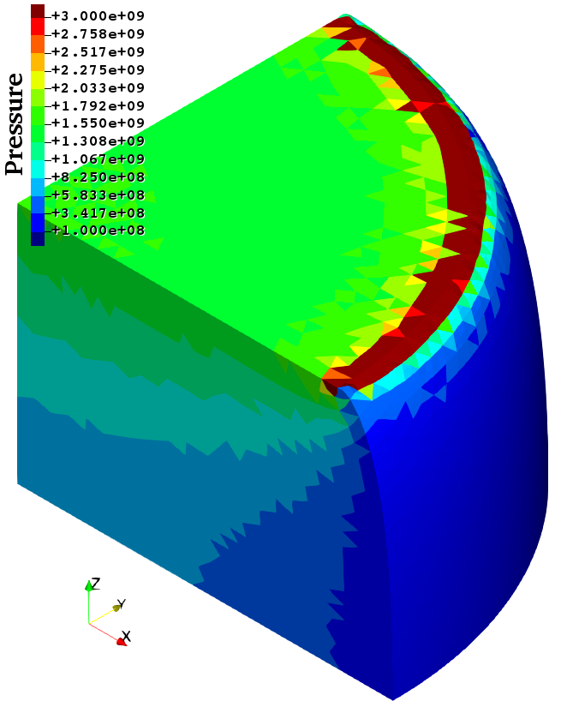
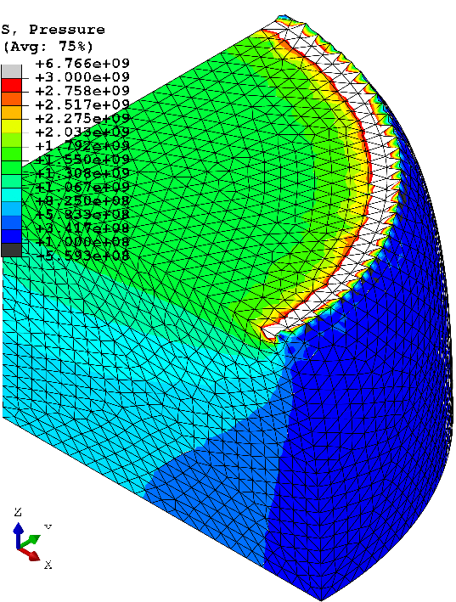

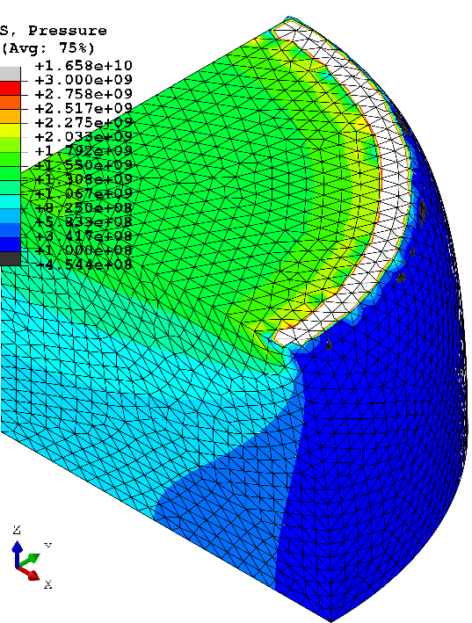
Barreling of Hyperelastic Cylinder
Comparison of pressure at 24% comp.
Selective
CS-FEM-T10
ABAQUS
C3D10H
ABAQUS
C3D10MH
ABAQUS
C3D10HS
All results are similar to each other
except around the rim having stress singularity.

Slide 20
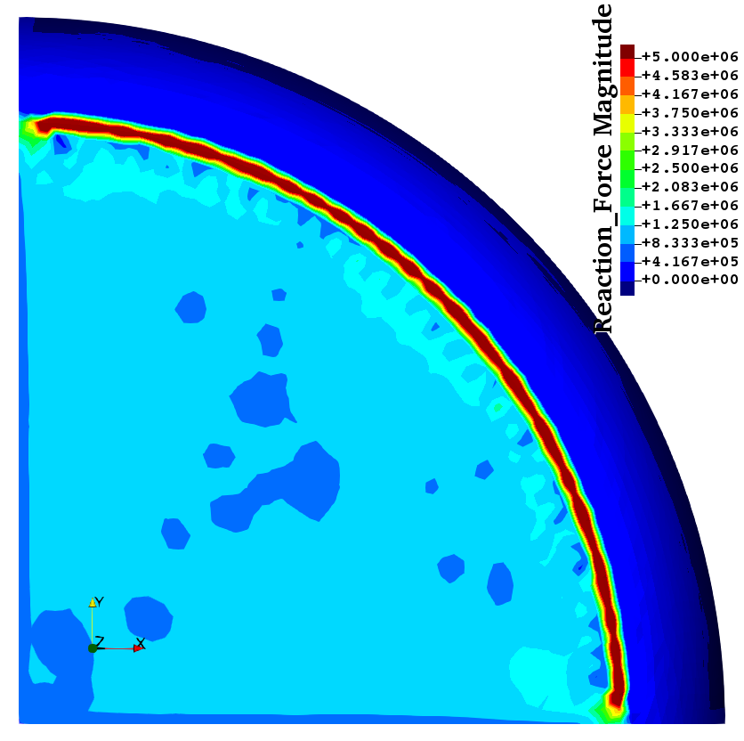
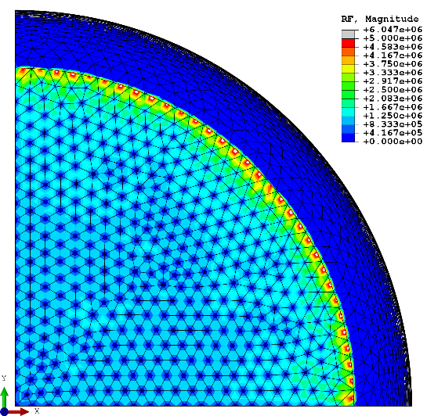
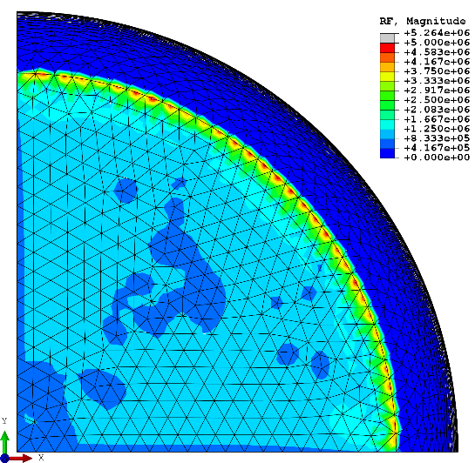

Barreling of Hyperelastic Cylinder
Comparison of nodal reaction force at 24% comp.
Selective
CS-FEM-T10
ABAQUS
C3D10H
ABAQUS
C3D10MH
ABAQUS
C3D10HS
ABAQUS C3D10H and C3D10HS
suffer from nodal force oscillation.

Slide 21
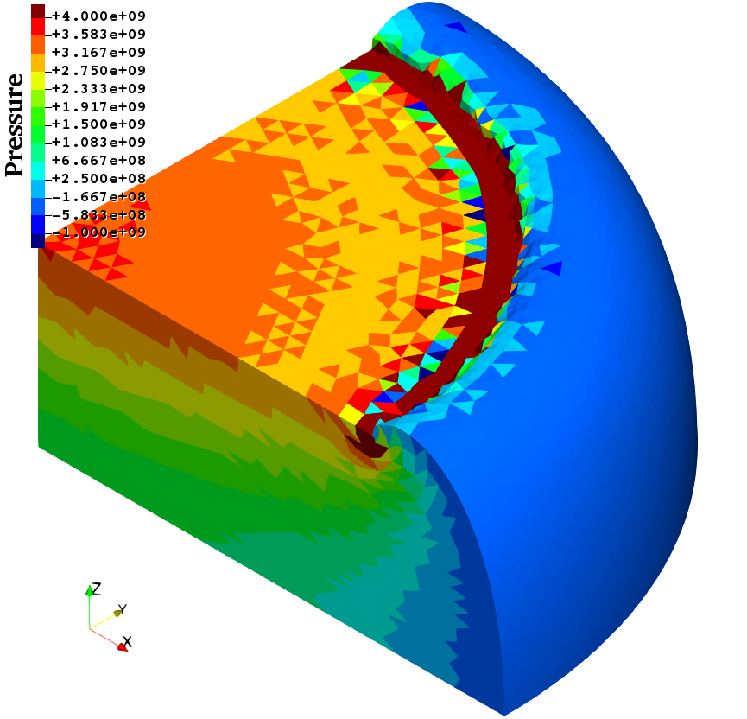
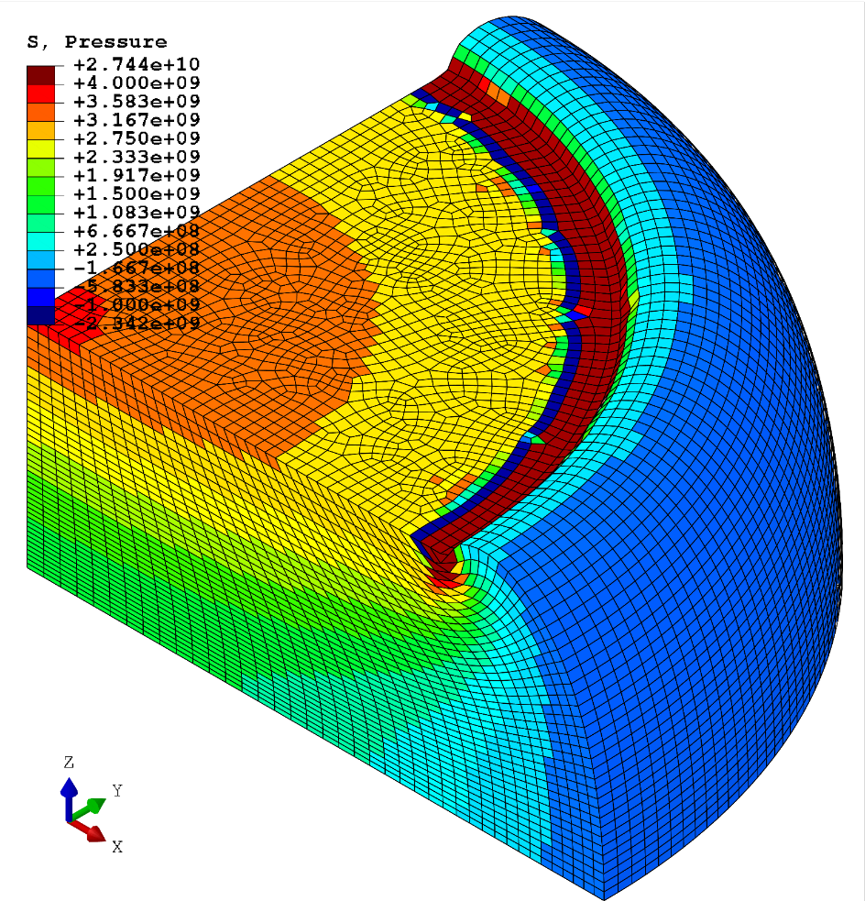
Barreling of Hyperelastic Cylinder
Comparison of pressure at 47% comp.
# of nodes are
about 60k in both.
Conv.
failure
at 50%
comp.
SelectiveCS-FEM-T10
ABAQUS C3D8
The present element has competitive accuracy and stability
as much as H8-SRI element.

Slide 22
Implementation of
SelectiveCS-FEM-T10
into ABAQUS

Slide 23
Brief of ABAQUS UEL
ABAQUS has functionality of “user-defined element” (simply called “UEL”).
UEL is usually written in Fortran77, but in fact it can be written in Fortran90.
Coding a subroutine named “UEL” and compiling it, one can execute ABAQUS
using one’s own element:
% abaqus job=test user=my_uel.o
Analysis results can be visualized on ABAQUS Viewer by defining overlap elements with zero stiffness in the “inp” file.

Slide 24
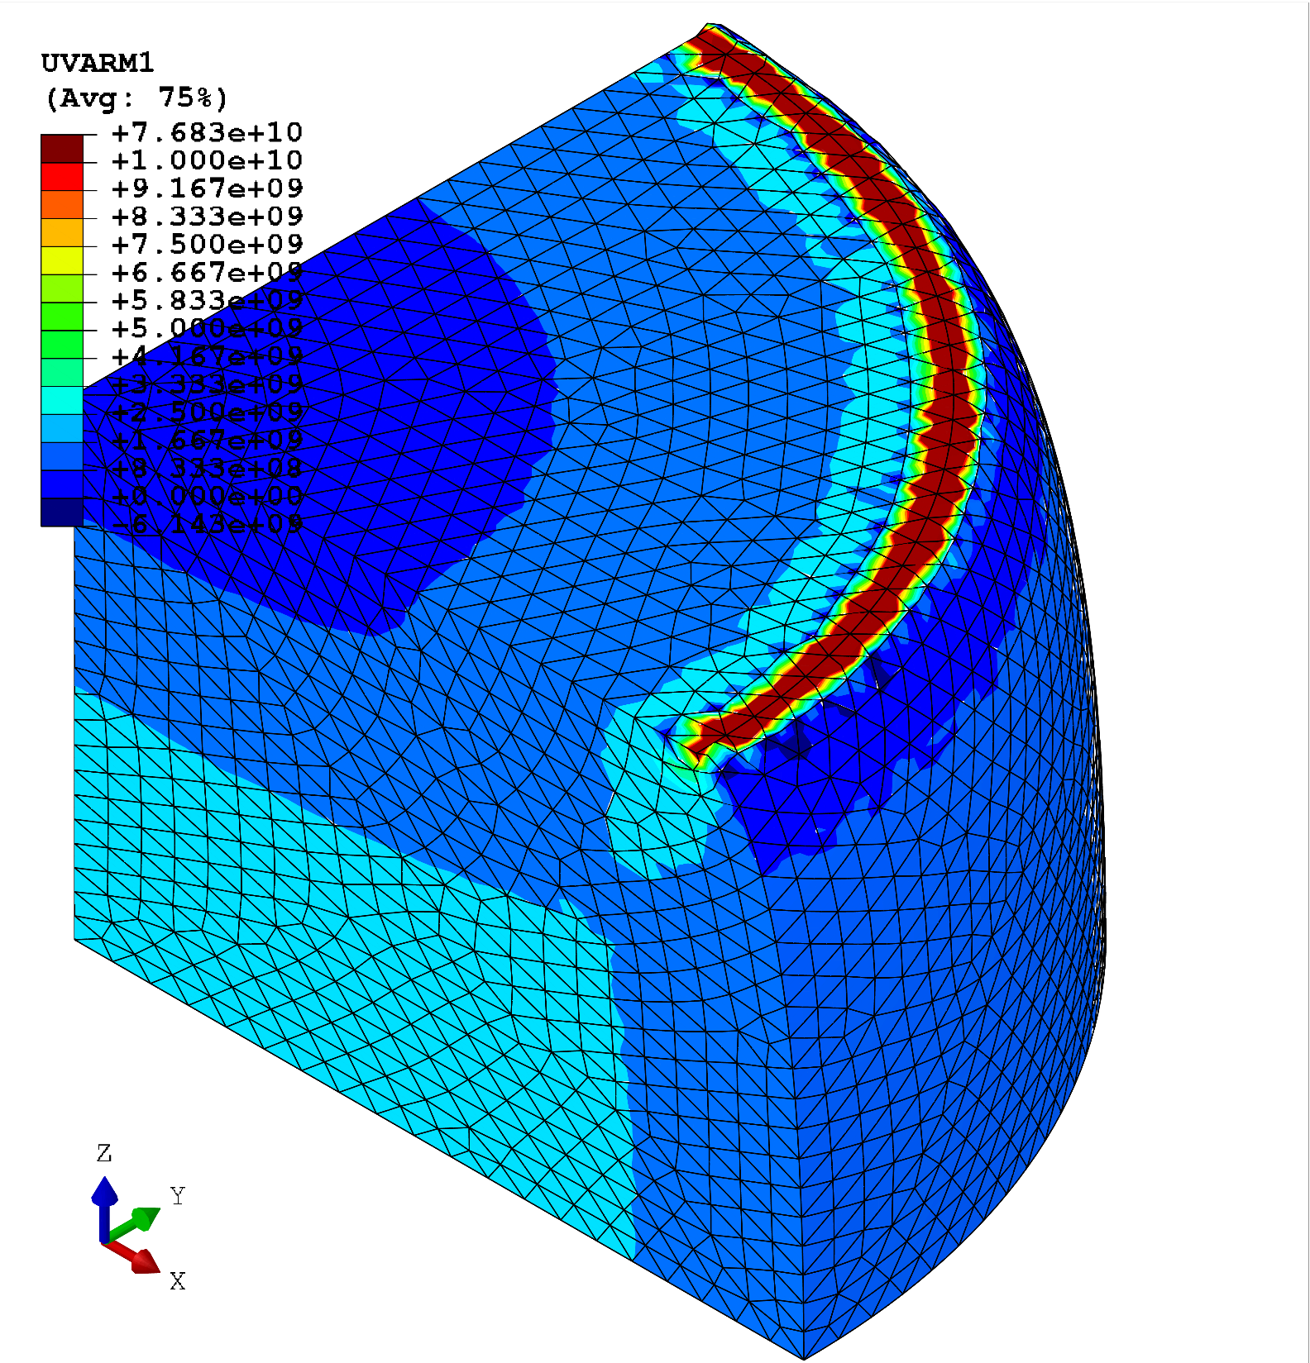
Results of ABAQUS UEL
Comparison of
Mises stress
(24% comp.)
Well
agreed
with
in-house
code.
Small
difference comes
form the
difference
of mapping
calculation.
Selective
CS-FEM-T10
of in-house code
Selective
CS-FEM-T10
of ABAQUS UEL

Slide 25
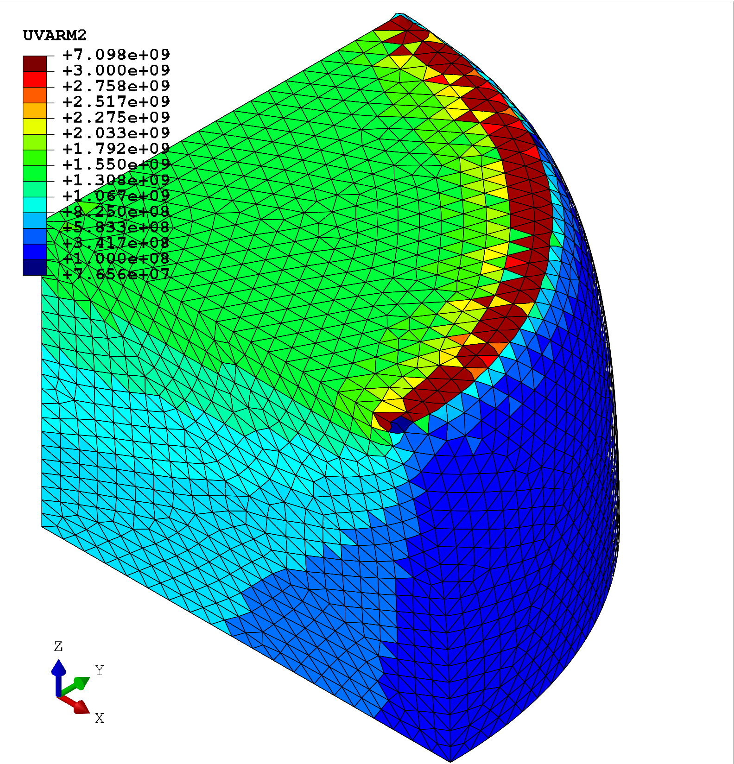
Results of ABAQUS UEL
Comparison of
pressure
(24% comp.)
Well
agreed
with
in-house
code.
Small
difference comes
form the
difference
of mapping
calculation.
Selective
CS-FEM-T10
of in-house code
Selective
CS-FEM-T10
of ABAQUS UEL

Slide 26
Issues in ABAQUS UEL
We have to define the overlap elements
  to visualize the results with ABAQUS Viewer.
  to define element-based surface
  for pressure loading, contact pair definition etc..
The overlap elements cause convergence failure in large deformation analysis.
i.e., the cylinder barreling analysis stops at 24% compression when the overset elements are defined.
Native implementation is essential for the full use
of SelectiveCS-FEM-T10, unfortunately…

Slide 27
Summary

Slide 28
Summary of SelectiveCS-FEM-T10
Benefits
  Locking-free.
  No pressure checkerboarding.
  No nodal force oscillation.
  No increase in DOF.
  Long lasting in large deformation.
  Nearly same CPU cost as the standard T10 elements.
Drawbacks
✗ No longer a T4 formulation.
Take-home message
Please consider implementing SelectiveCS-FEM-T10
to your in-house code. It’s very easy!!
Thank you for your kind attention!

