Slide 1
Performance Evaluation of Stabilized F-bar Aided Edge-based Smoothed Finite Element Method with Four-node Tetrahedral Elements (SymF-barES-FEM-T4) for Contact Problemｓ
Ryoya IIDA, Yuki ONISHI, Kenji AMAYA
Tokyo Institute of Technology, Japan

Slide 2
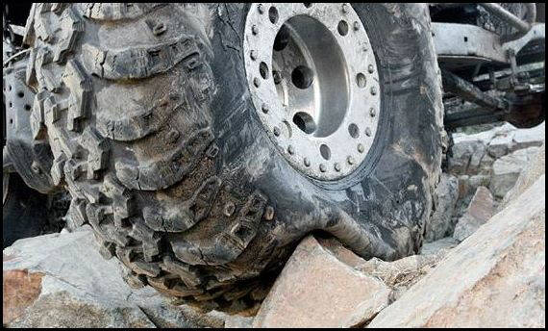
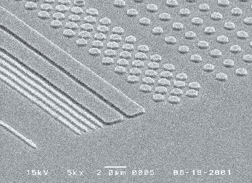
Motivation
What we want to do:
Solve hyper large deformation analyses accurately and stably.
Treat complex geometries with tetrahedral meshes.
Consider nearly incompressible materials $(ν≃0.5)$.
Support contact problems.
Handle auto re-meshing.
Rubber
Metal
Plastic/Glass

Slide 3
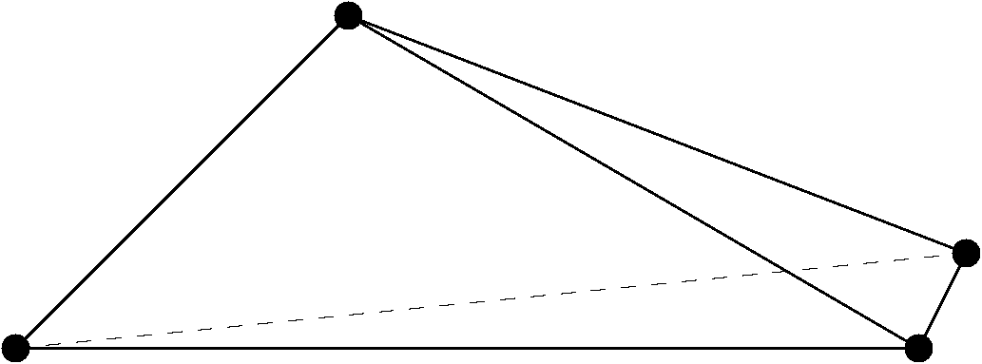
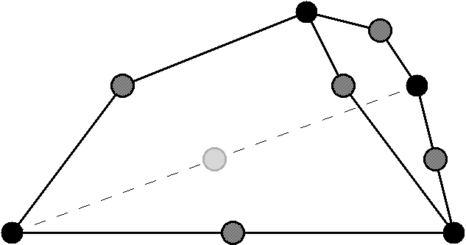
Issue in Ordinary T10 Elements
Issue
When we use 10-node tetrahedral (T10) mesh, the number of nodes gets much larger to express complex shapes without element kink.
✓ Skewed T4 ✗Kinked T10
Possible Solutions
Robust T10 element (method in the previous talk)
Accurate T4 element (method in THIS talk)

Slide 4
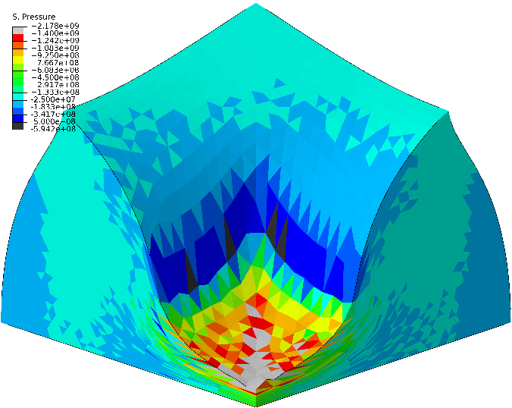
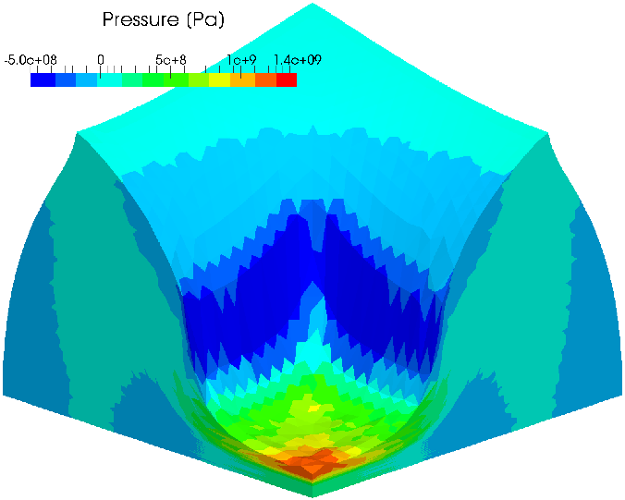
Our T4 Method for Static Problems
Our group has proposed a new S-FEM-T4 formulation, F-barES-FEM-T4, detailed later.
ABAQUS C3D4H
✗ pressure oscillation
F-barES-FEM-T4(3)
# of cyclic smoothings
F-barES-FEM-T4 shows excellent accuracy in static problems!

Slide 5
Our T4 Method for Dynamic Problems
Our group has proposed another S-FEM-T4 formulation, SymF-barES-FEM-T4, detailed later.
ABAQUS/Explicit C3D8 (H8-SRI element)
F-barES-FEM-T4(2) ✗ Energy divergence
SymF-barES-FEM-T4(2)
SymF-barES-FEM-T4 shows good accuracy and stability in dynamic problems!

Slide 6
Objective
FAQ How about the stability in dynamic contact problems?
Objective
To evaluate the stability of SymF-barES-FEM-T4 in explicit dynamics with contact.
Table of Body Contents
Methods: Quick introduction of SymF-barES-FEM-T4
Results & Discussion: A few verification analyses
Summary

Slide 7
Methods
Notes:
Then we will explain our proposed method

Slide 8
Formulation of F-barES-FEM (1 of 2)
Deformation gradient of each edge ($\overline{F}$) is derived as
$$\overline{F}={\tilde{F}}^{iso}∙{\overline{F}}^{vol}$$
ES-FEM

Slide 9
Formulation of F-barES-FEM (2 of 2)
Each part of $\overline{F}$ is calculated as follows.
$$\overline{F}={\tilde{F}}^{iso}∙{\overline{F}}^{vol}$$
Isovolumetric part
Volumetric part
NS-FEM
ES-FEM
(1)
(2)
NS-FEM⁻¹
Smoothing Fs of adjacent elements at each edge.
↓
The same manner as
ES-FEM.
(1)Calculating node’s F by smoothing Fs of adjacent elements.
(2)Calculating elements’ F by smoothing Fs of adjacent nodes.
(3)Repeating (1) and (2) a few times. (This is named “cyclic smoothing”.)

Slide 10
Advantages of F-barES-FEM
This formulation is designed to have 3 advantages.
$$\overline{F}={\tilde{F}}^{iso}∙{\overline{F}}^{vol}$$
Isovolumetric part
Volumetric part
Like ES-FEM
1. Shear locking free
Like NS-FEM
2. Little pressure oscillation
3. Volumetric locking free with the aid of F-bar method

Slide 11
Issue of F-barES-FEM in Dynamics
Issue: Energy divergence occurs.
$∵$Due to the adoption of F-bar method, the stiffness system is no longer symmetric.
In F-barES-FEM, the internal force vector is calculated as
$$\left\{f^{int}\right\}=\sum{\left[\tilde{B}\right]\left\{\overline{T}\right\}\tilde{V} }$$
Combination of $\left[\tilde{B}\right]$, $\{\overline{T}\}$ and $\tilde{V}$ (mixture of and ) causes asymmetry of the dynamic system.
Volume of ES-FEM
Defenition of $\left\{f^{int}\right\}$ in the same fashion as the original F-bar method
$B$-matrix of ES-FEM
Stress derived from $\overline{F}$

Slide 12
Formulation of SymF-barES-FEM
In SymF-barES-FEM, the derivation of the internal force vector is slightly modified.
F-barES-FEM:
SymF-barES-FEM:
The replacements ($\left[\tilde{B}\right]$ to$[\overline{B}]$ & $\tilde{V}$ to$\overline{V}$) help to preserve the symmetry of the stiffness system.
$$\left\{f^{int}\right\}=\sum{\left[\tilde{B}\right]\left\{\overline{T}\right\}\tilde{V}}$$
Volume
derived as
$$det\left(\overline{F}\right)V^{ini}$$
$$\left\{f^{int}\right\}=\sum{\left[\overline{B}\right]\left\{\overline{T}\right\}\overline{V} }$$
$B$-matrix
derived from $\overline{F}$
Stress
derived from $\overline{F}$

Slide 13
Result & Discussion

Slide 14
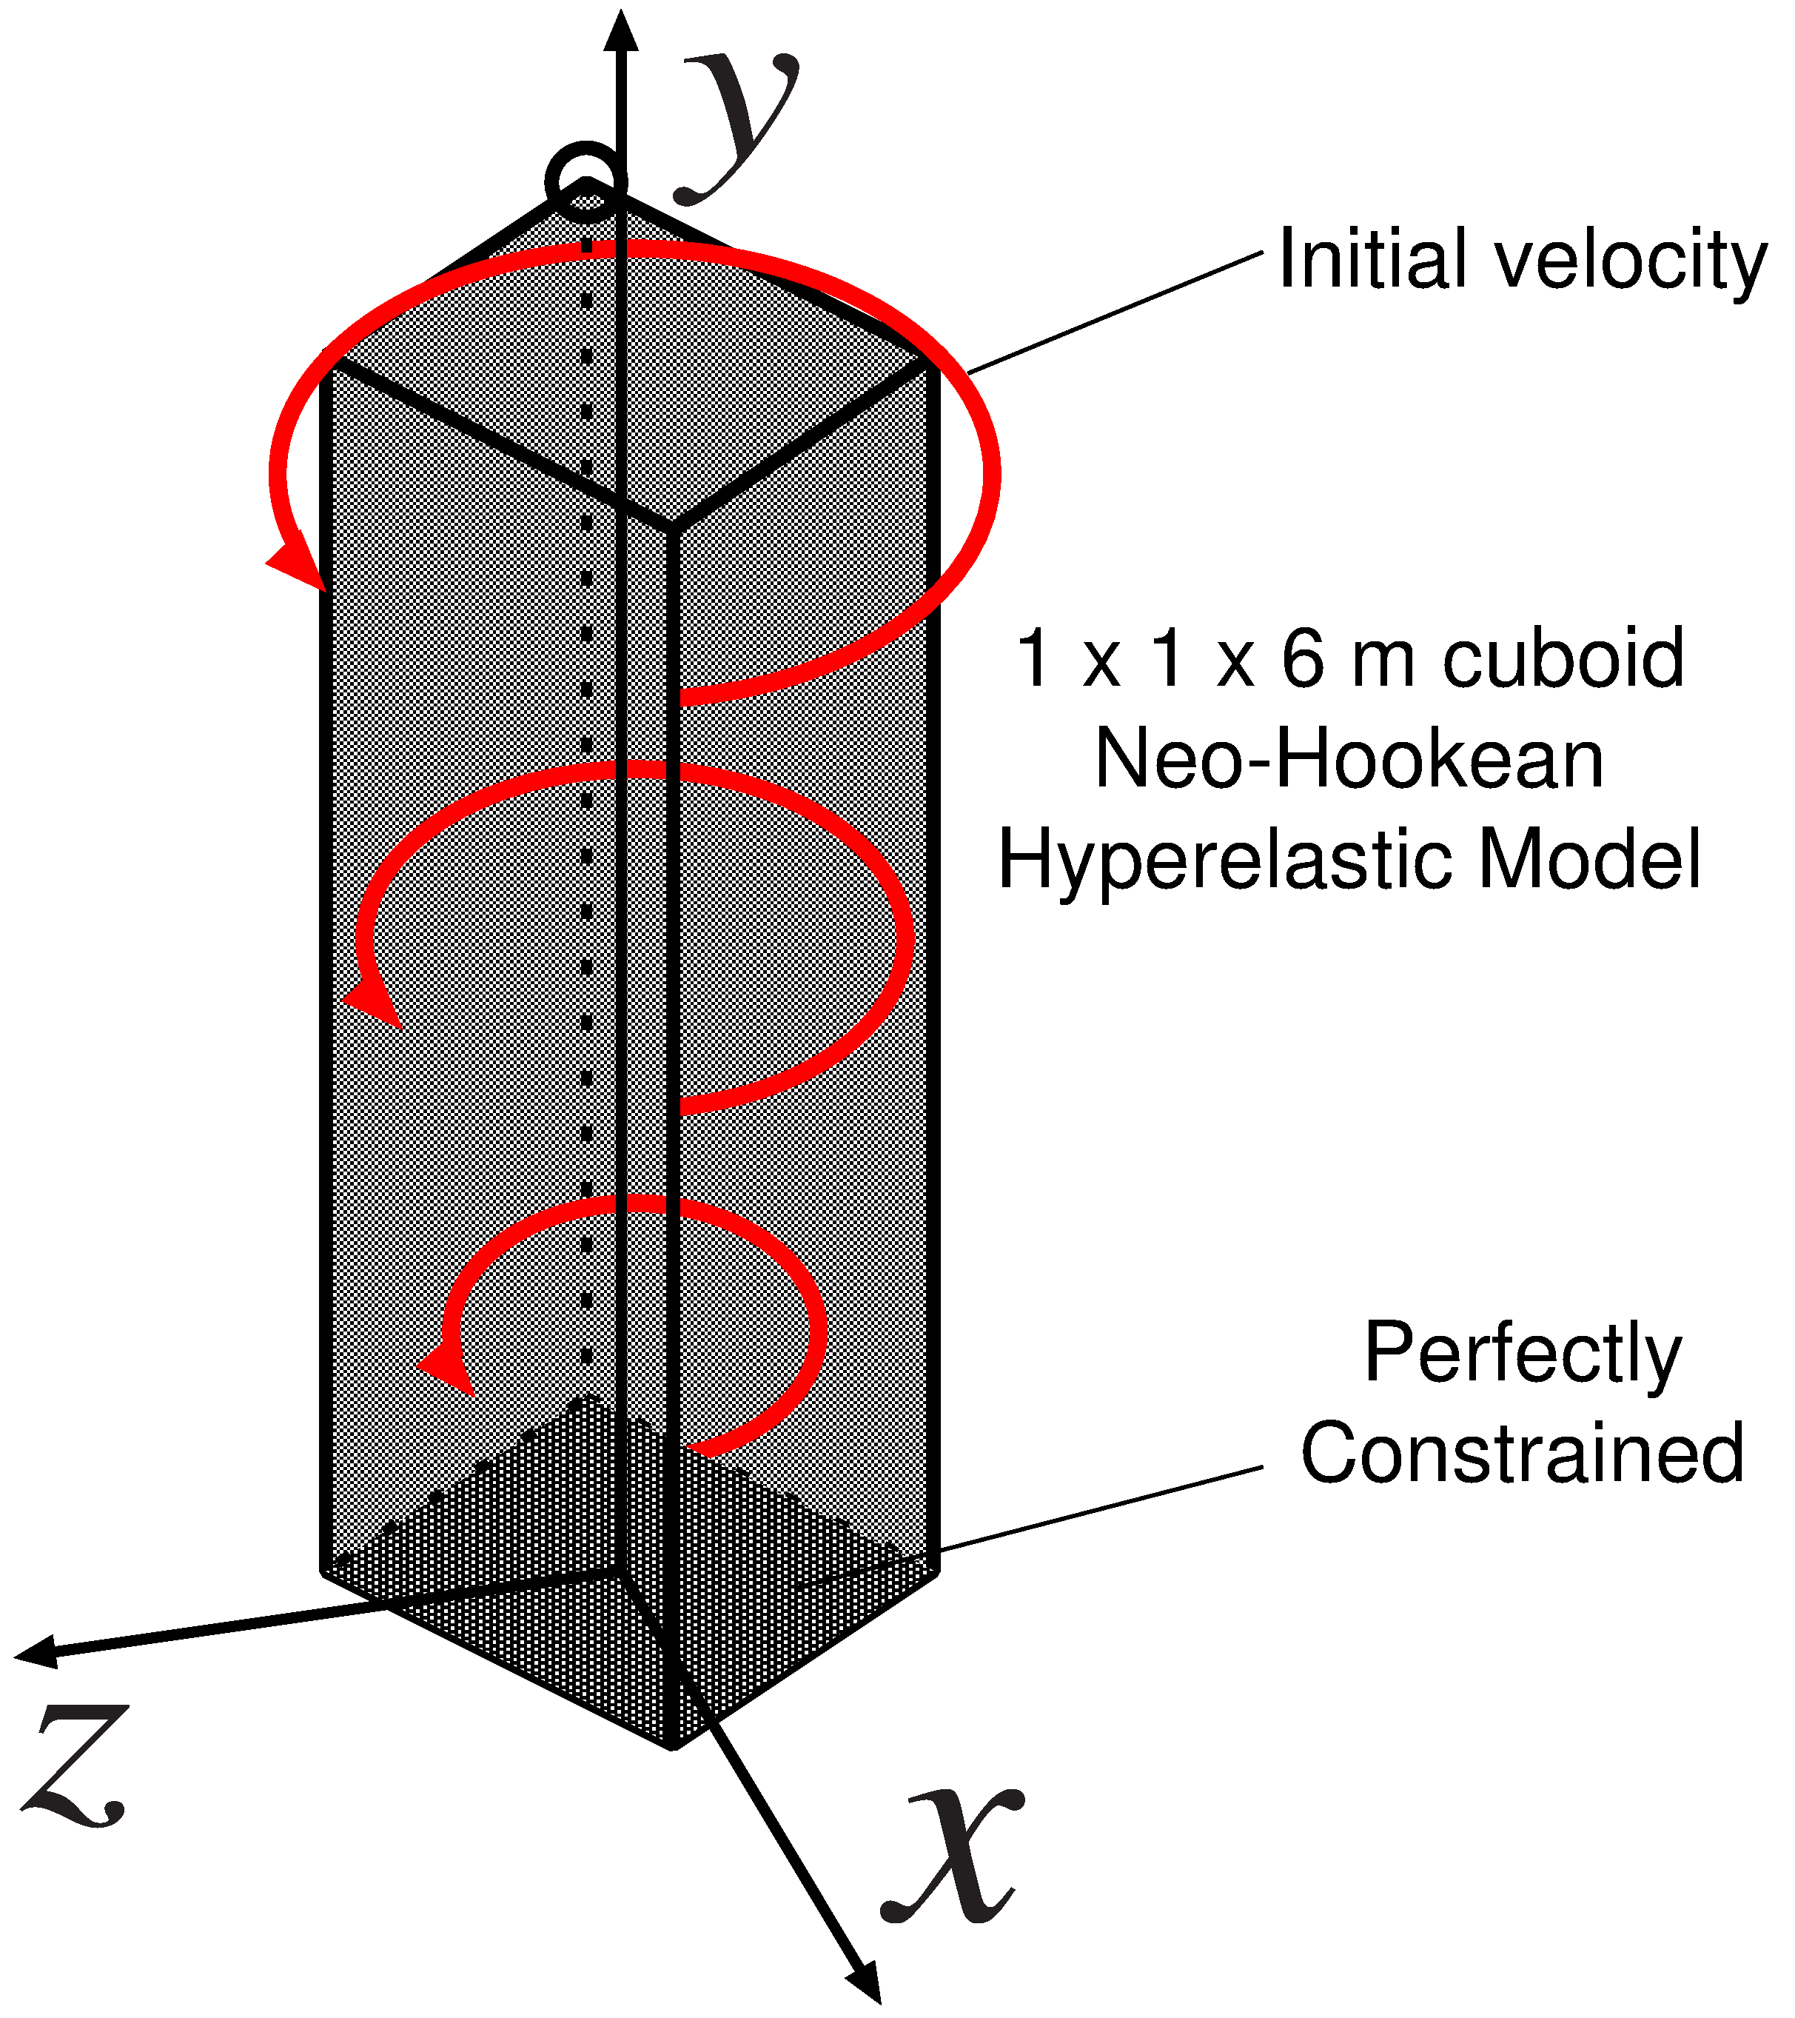
Twist of Rubber Cantilever
Outline
No contact.
Dynamic explicit analysis.
Twisting initial velocity fields: $v_{0}\left(x,y,z\right)=100\sin\left(\frac{yπ}{12}\right){\left\{z, 0, −x\right\}}^{T}.$
Neo-Hookean material: Initial Young’s modulus: 17.0 MPa, Initial Poisson’s ratio: 0.49, Density: 1100 kg/m³.
Compare the results of SymF-barES-FEM-T4, F-barES-FEM-T4, and ABAQUS/Explicit C3D8.

Slide 15
Twist of Rubber Cantilever
Comparison of Pressure and Shape
ABAQUS/Explicit C3D8
(H8-SRI)
F-barES-FEM-T4(2)
✔ No pressure oscillation
✔ No locking
✗ Energy divergence
SymF-barES-FEM-T4(2)
✔ Less pressure oscillation
✔ No locking
✔ No energy divergence

Slide 16
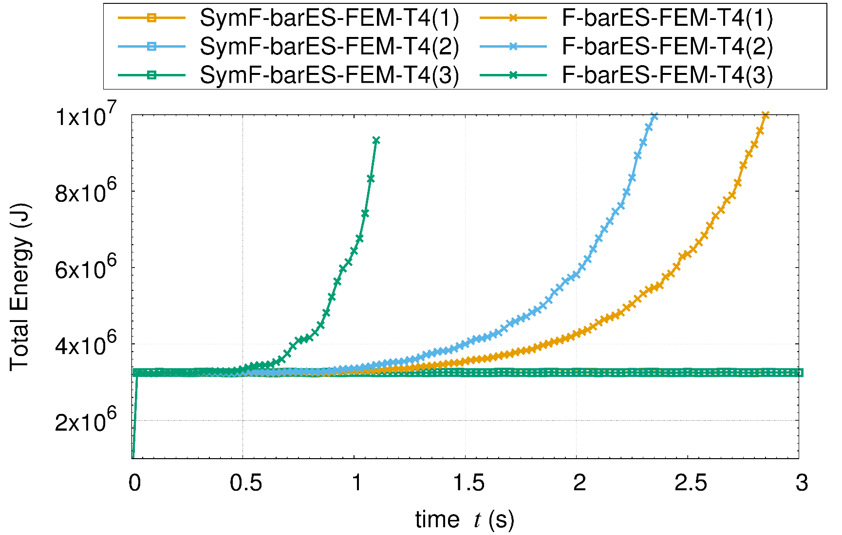
Twist of Rubber Cantilever
Comparison of total energy
F-barES-FEM-T4
(Kinetic + Strain)
SymF-barES-FEM-T4
(60,000 timesteps)
SymF-barES-FEM-T4 can suppress energy divergence!

Slide 17
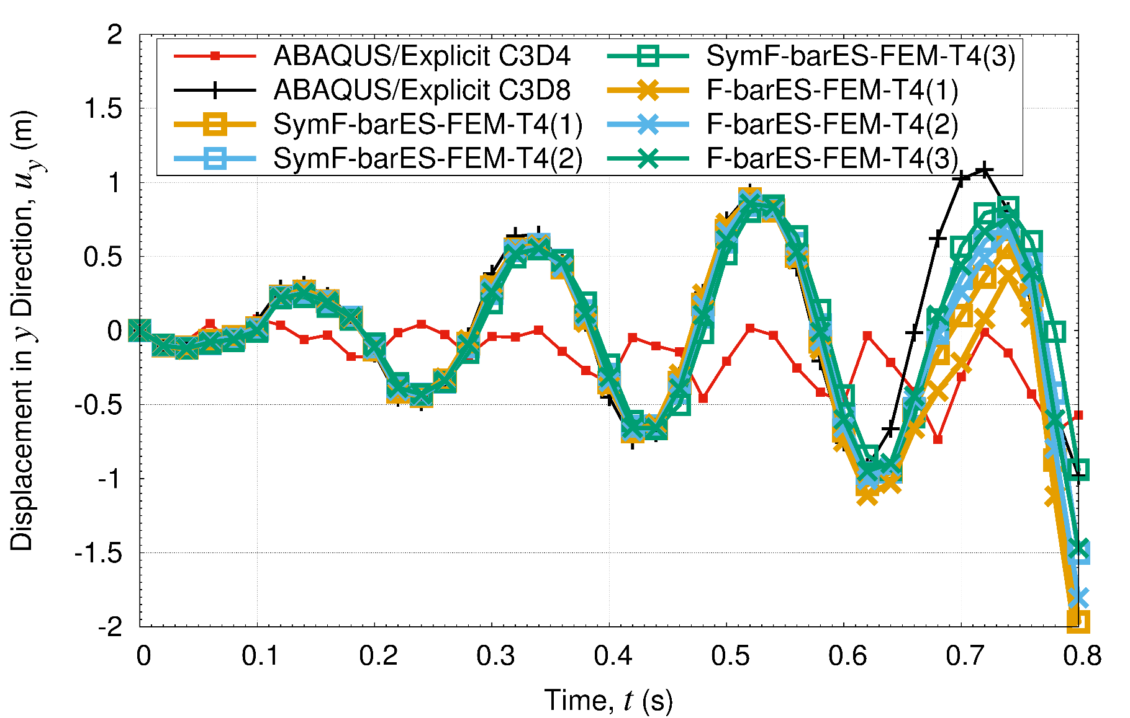
Time history of displacement
Comparison of axial displacement at a tip node
Standard T4
Proposed
Proposed methods can show good results as H8-SRI.

Slide 18
Twist of Rubber Cantilever
Effect of the number of cyclic smoothing
#cyclic
smoothings
1
2
3
1
2
3
F-barES-FEM-T4
SymF-barES-FEM-T4
In SymF-barES-FEM-T4, the increase in cyclic smoothings no longer improves the accuracy, unlike F-barES-FEM-T4.

Slide 19
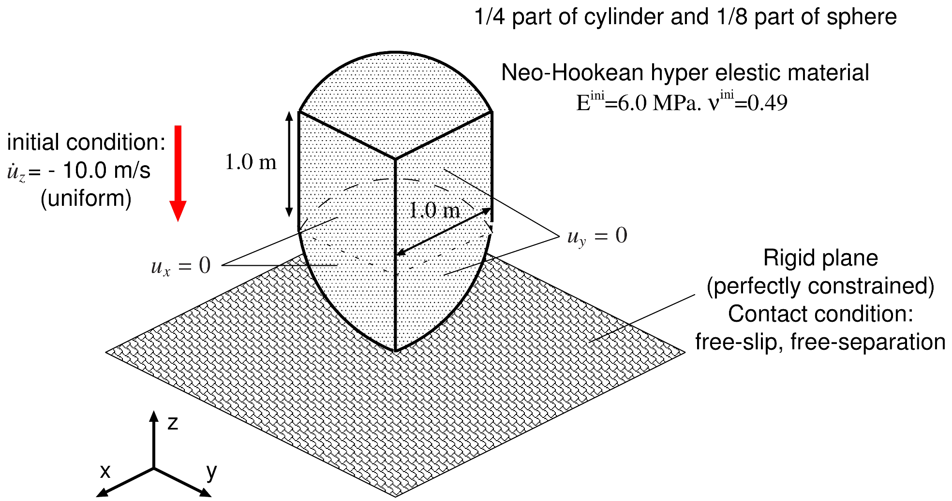
Impact of Rubber Bullet
Outline
¼ bullet made of nearly incompressible rubber.
Impacting the bullet to a slippery rigid wall with a uniform initial velocity.
Compared to ABAQUS/Explicit C3D4 with a same mesh.

Slide 20
Impact of Rubber Bullet
Mises stress Anim. of SymF-bar ES-FEM -T4(1)

Slide 21
Impact of Rubber Bullet
Comparison of pressure dist. in a contact state
ABAQUS/Explicit C3D4
F-barES-FEM-T4(1)
SymF-barES-FEM-T4(1)
Our methods represent far better pressure distributions without major checkerboarding.

Slide 22
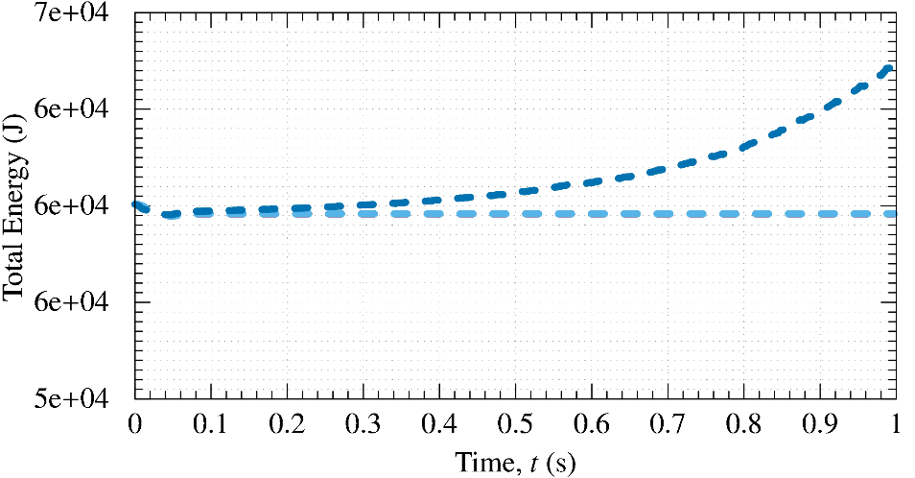
Impact of Rubber Bullet
Comparison of total energy over time
F-barES-FEM-T4
(Kinetic + Strain)
SymF-barES-FEM-T4
SymF-barES-FEM-T4 conserves the total energy even in a contact problem.

Slide 23
Impact of Rubber Bunny
Outline
A Stanford bunny made of nearly incompressible rubber (neo-Hookean hyperelastic body with$ν_{ini}=0.49$.)
Impacting the bunny to a slippery rigid wall with a uniform initial velocity.
Compared to ABAQUS/Explicit C3D4 with a same mesh.
Initial velocity
10 m/s (uniform)
Rigid Wall
contact condition:
free-slip & free-separation
Rubber body
$E_{ini}=6.0 \text{M}P\text{a}$
$ν_{ini}=0.49$
$ρ=920 kg/m^{3}$

Slide 24
Impact of Rubber Bunny
Pressure sign anim.
ABAQUS/Explicit C3D4
✗Pressrue checkerboard ✗Locking ✔ No energy divergence
F-barES-FEM-T4(1)
✔ No pressure checker ✔ No locking ✗ Energy divergence
SymF-barES-FEM-T4(1)
✔ Less pressure checker ✔ No locking ✔ No energy divergence

Slide 25
Impact of Rubber Bunny
Pressure sign dist. right after contact
✗Pressure checkerboard
✔ Pressure wave propagation
ABAQUS/Explicit C3D4
F-barES-FEM-T4(1)
SymF-barES-FEM-T4(1)
Our methods can capture the pressure wave propagation in a complex body.

Slide 26
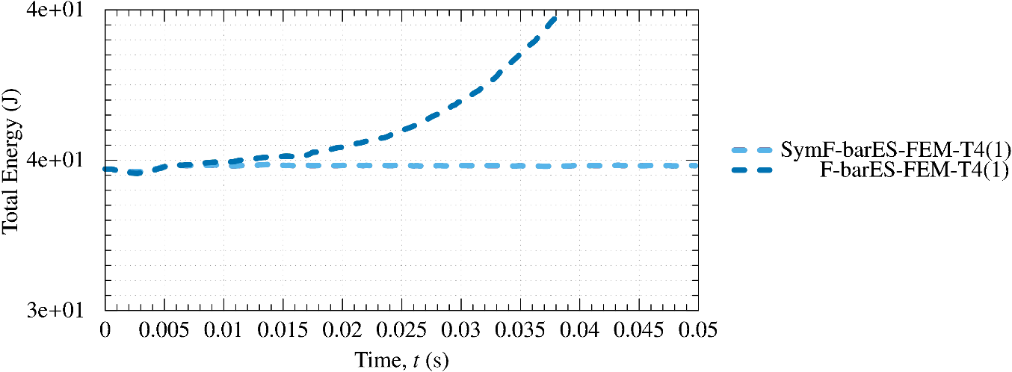
Impact of Rubber Bunny
Comparison of total energy over time
F-barES-FEM-T4
(Kinetil + Strain)
SymF-barES-FEM-T4
(150,000 timesteps)
SymF-barES-FEM-T4 conserves the total energy in a contact problem even with complex shapes.

Slide 27
Summary

Slide 28
Summary
The accuracy and stability of SymF-barES-FEM-T4 in dynamic explicit contact problems was evaluated.
SymF-barES-FEM-T4 realizes ✔ Less pressure oscillation ✔ No locking ✔ No energy divergence
Further improvement for perfect suppression of pressure oscillation is our future work.
Thank you for your kind attention.
Notes:
まとめです
今後は接触を考慮した問題への拡張を中心に、研究を進めていくつもりです。

Slide 29
Appendix

Slide 30
Benefits and Drawbacks of F-barES-FEM-T4
Drawbacks
✗ Slow speed of calculation.
In explicit analyses, [K] is unnecessary; yet, CPU Time increases gradually with the # of cyclic smoothings.
(x13.1)
(x6.3)
(x2.7)
(x1)

