Slide 1
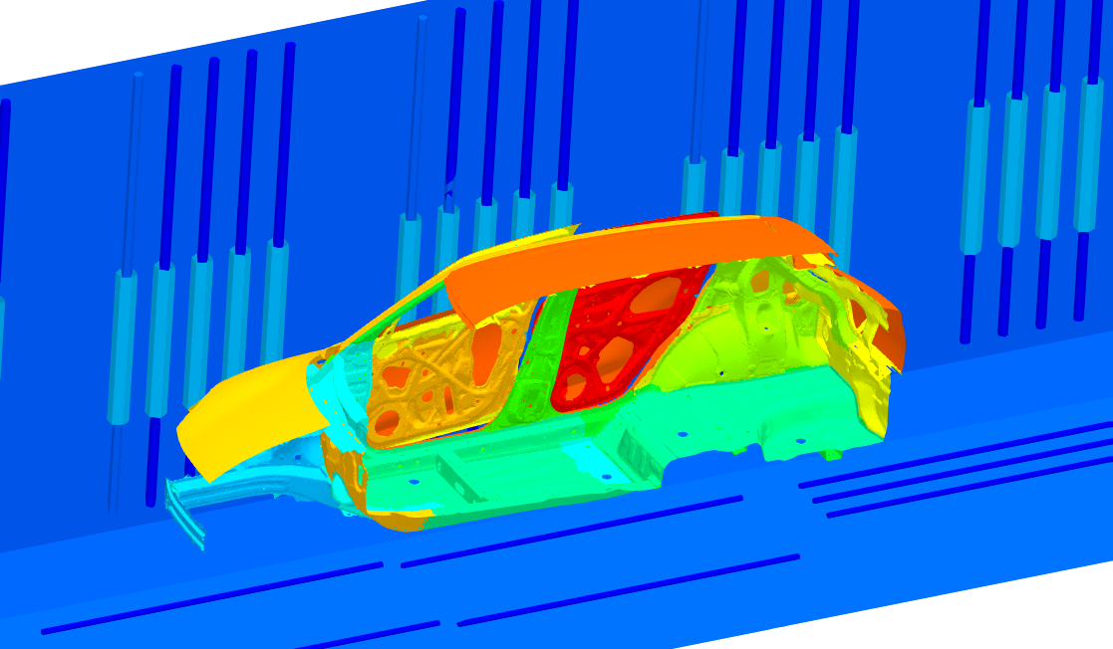
Application of Edge-based
Smoothed Finite Element Method to Large-scale Electrodeposition Simulation for Automobile Manufacturing Lines
Yuki ONISHI
Tokyo Tech.
(Japan)

Slide 2
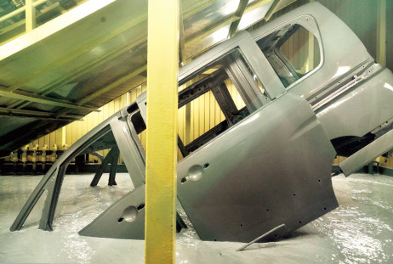
What is Electrodeposition (ED) ?
Outline
Most widely-used anti-rust basecoat methods for various metal products including carbodies.
Depositing coating film by applying direct electric current in a paint pool.
Relatively good at depositing a uniform film on bodies in complex shape.
+
-
Paint
＋
Anode
＋
Cathode
http://n-link.nissan.co.jp/

Slide 3
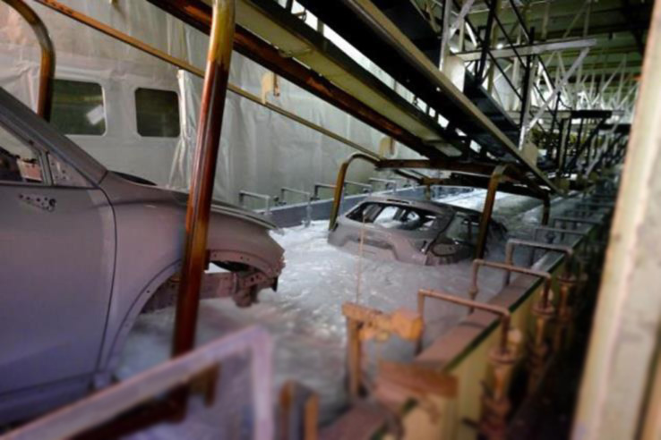
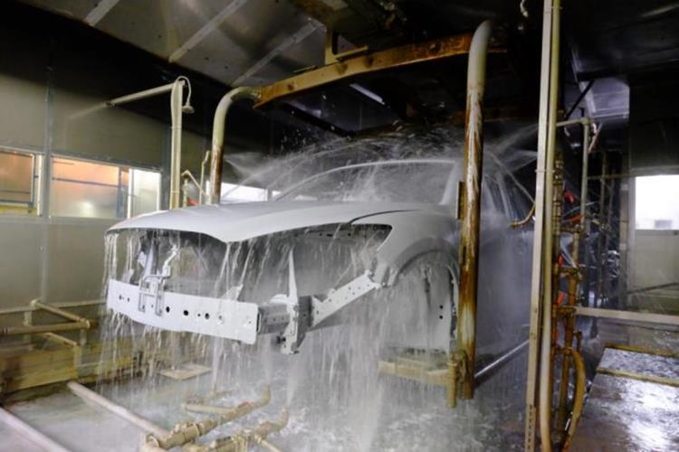
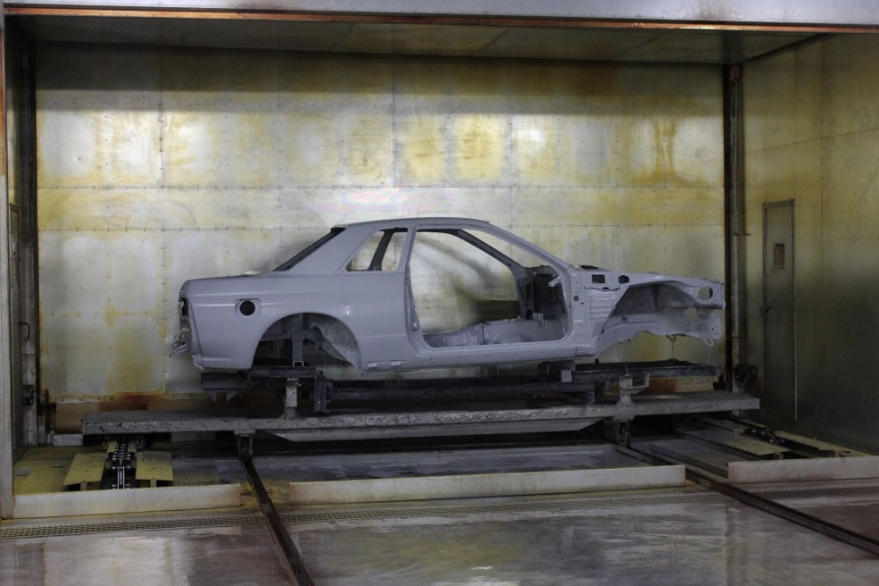
What is Electrodeposition (ED) ?
Photos of ED Process Line
https://blog.mazda.com/archive/20160413_01.html
1. Deposition process
2. Water rinse process
We focus on
this process.
3. Baking process

Slide 4
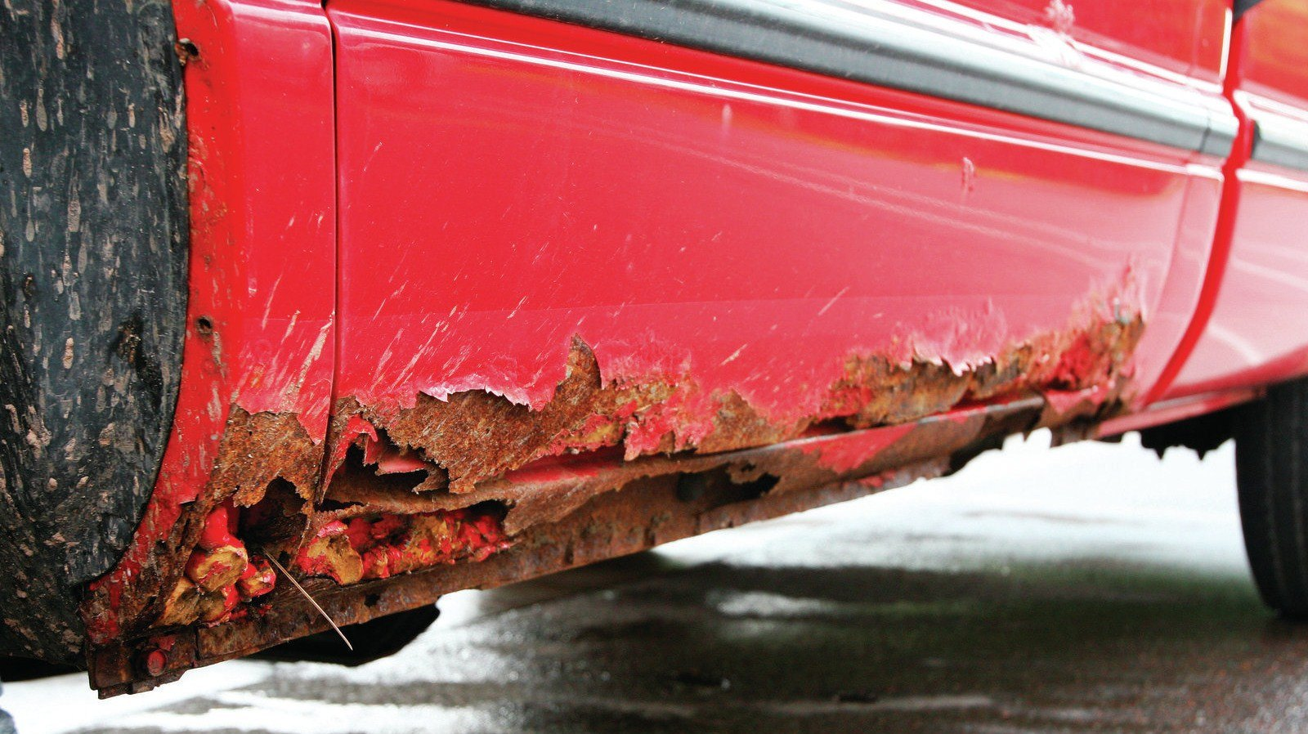
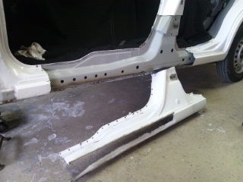
Difficulty in ED for Carbodies
Undercarriages are exposed to severe corrosive environments, especially due to seawater or snow-melting chemicals.
Some undercarriage parts (such as a side sill) have bag-like complex structures with many ED holes.
It is not easy to deposit a required minimal thick film at the innermost faces of a bag-like structure, even for ED.
Carbody design must consider the difficulty in ED process.
Side Sill
https://www.goauto.ca/

Slide 5
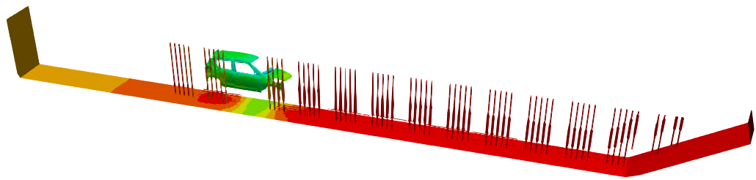
What is ED Simulation?
Actual ED Line
ED Simulation
Paint Pool
Carbody with Motion
Electrodes (Anodes)
are reproduced in a computer.
Paint Pool
Carbody
w/ Motion
Electrodes
(Anodes)
Total Length: about 30 m

Slide 6
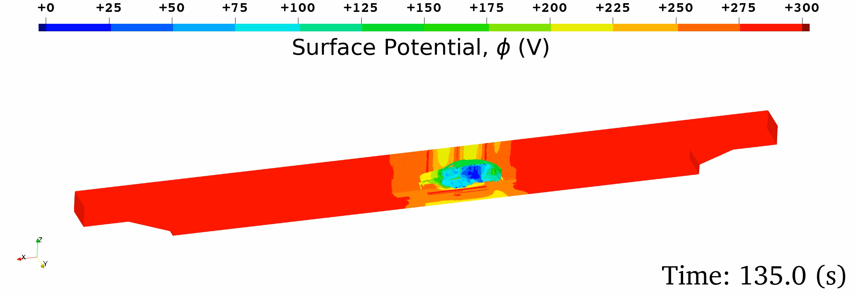

What is ED Simulation?
Governing Equation:
Electrostatic Laplace equation ($∇^{2}φ=0$) in the paint pool domain.
Boundary Condition (BC):
  Insulation BC,
  Anodic (electrode surface) BC,
  Cathodic (carbody surface) BC:
  Film resistance/growth constitutive model.
Outputs:
  Surface potential,
  Current density,
  Coated film thickness.
  (main result)

Slide 7
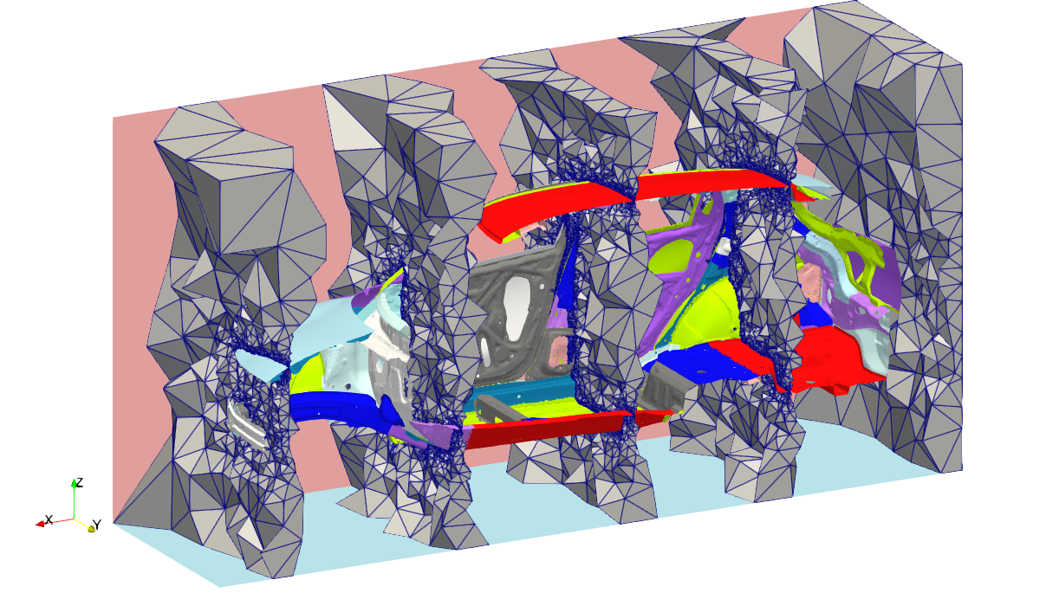
Issue 1
Issue 1: Impossible to make a good HEX mesh
for carbodies.
An ED simulation requires a mesh for the space
around the carbody, just like CFD.
In contrast to CFD, an ED mesh includes the room space
and many narrow spaces among plates (such as side sills).
Sliced view of a carbody mesh

Slide 8
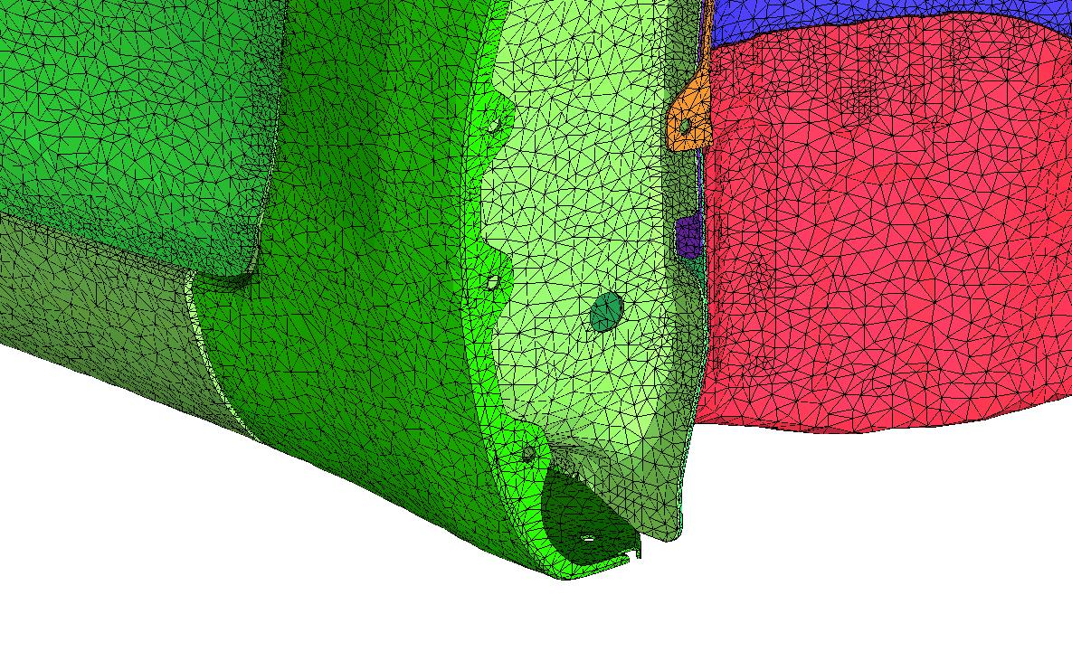
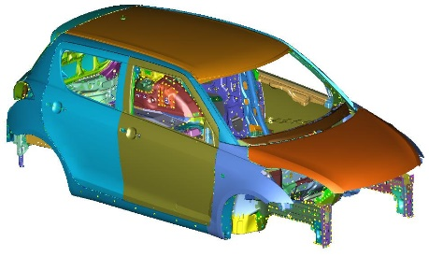
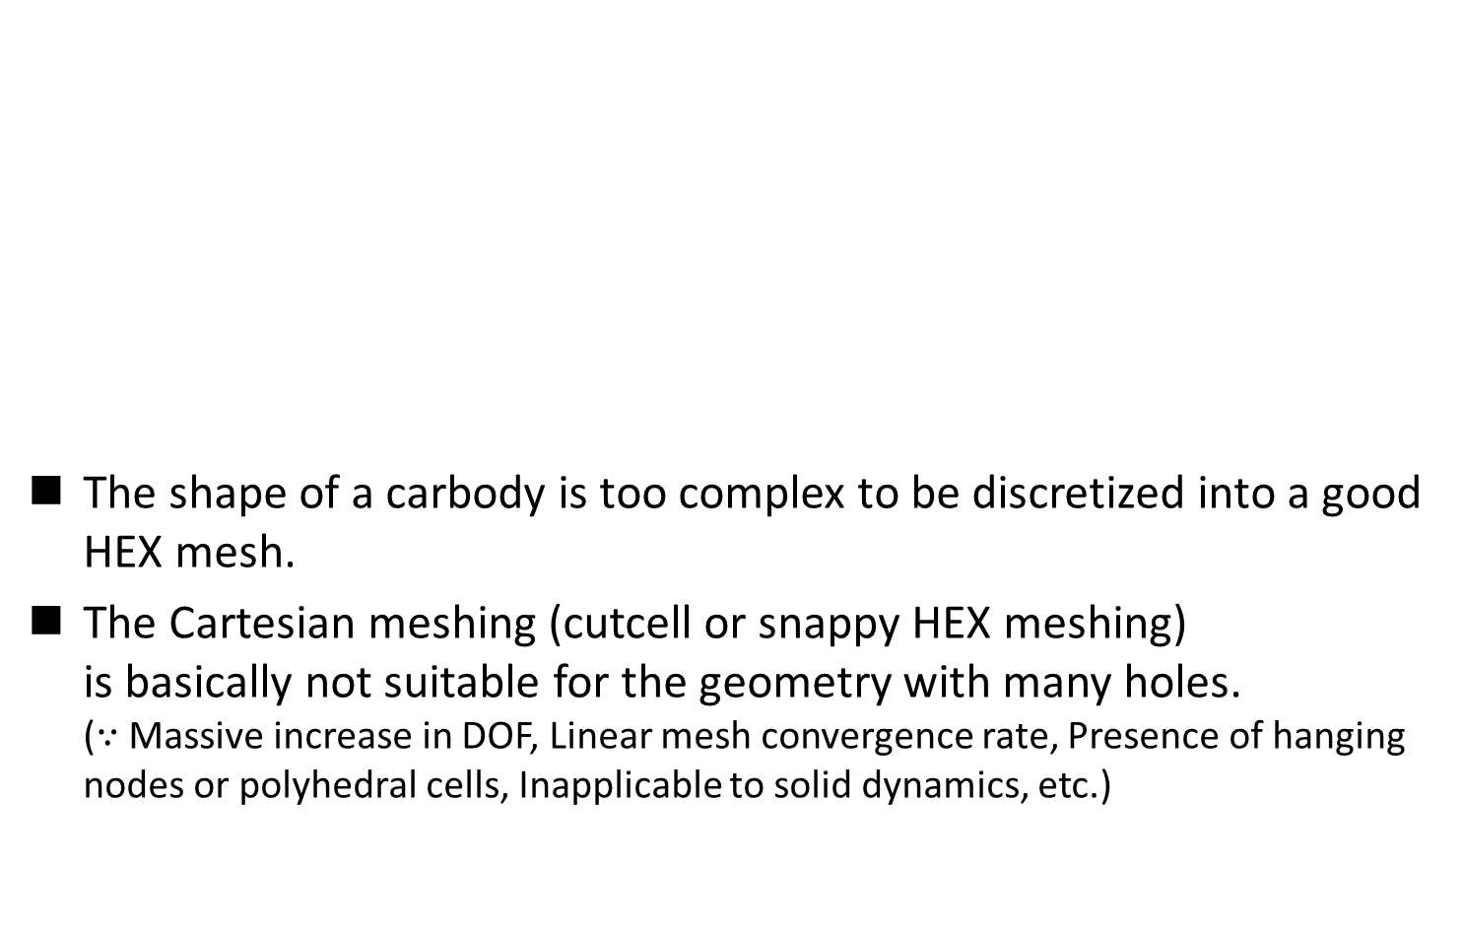
Issue 1 (cont.)
The shape of a carbody is too complex to be discretized into a good HEX mesh.
The Cartesian meshing (cutcell or snappy HEX meshing)
is basically not suitable for the geometry with many holes.
($∵$ Massive increase in DOF, Linear mesh convergence rate, Presence of hanging nodes or polyhedral cells, Inapplicable to solid dynamics, etc.)
T4 mesh
Only the surface mesh is shown.
Cutcell mesh
Zoom-in view
of a carbody mesh
TET meshes are preferable in ED simulation.

Slide 9
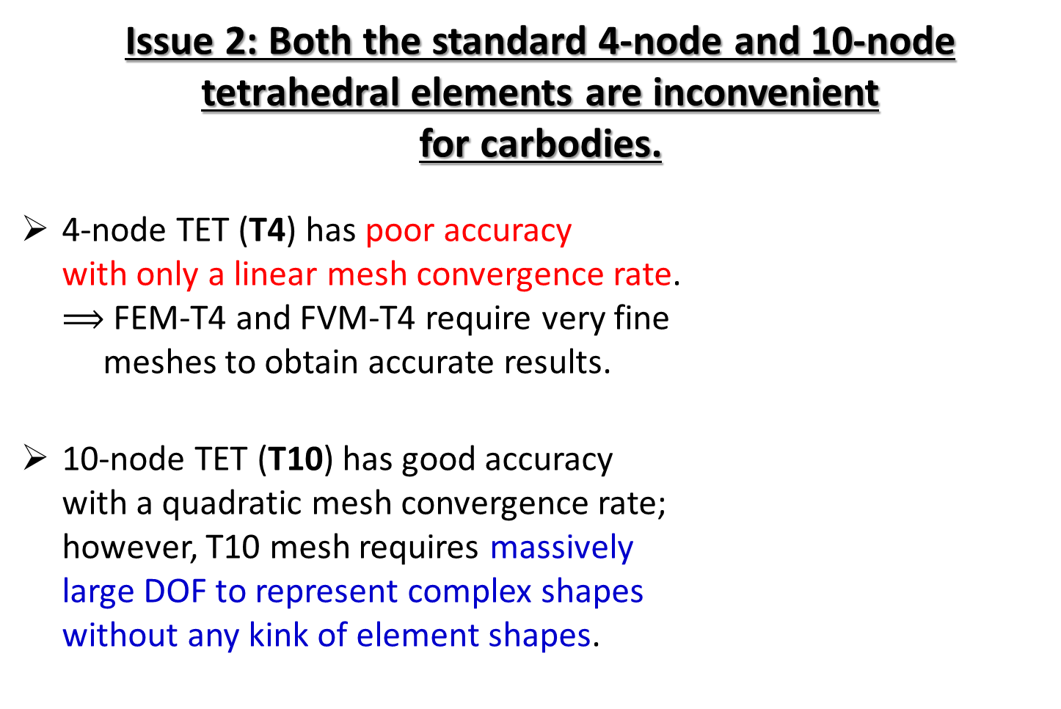
Issue 2
Issue 2: Both the standard 4-node and 10-node
tetrahedral elements are inconvenient
for carbodies.
4-node TET (T4) has poor accuracy
with only a linear mesh convergence rate.
$⟹$ FEM-T4 and FVM-T4 require very fine
meshes to obtain accurate results.
10-node TET (T10) has good accuracy
with a quadratic mesh convergence rate;
however, T10 mesh requires massively
large DOF to represent complex shapes
without any kink of element shapes.

Slide 10
Issue 2 (cont.)
For example, if there is a small hole on a carbody, the surface mesh around the hole looks like…
✗ T10 w/ kink leads to severe accuracy loss.
✗ T10 w/o kink leads to a massive increase in DOF.
Carbody
Carbody
Carbody
Hole
Hole
Hole
T4 mesh
T10 mesh w/ kink
T10 mesh w/o kink
The standard T4 and T10 elements are both inconvenient for carbodies to achieve accurate simulation with minimal DOF.

Slide 11
Motivation
By the way, …
The smoothed finite element method (S-FEM) has become popular in recent years as a next-generation high-performance FEM.
Especially, the edge-based S-FEM using T4 mesh (ES-FEM-T4) is known to achieve a superlinear mesh convergence rate even with T4 meshes.
Therefore, we expect that…
ES-FEM-T4 could be a solution for the meshing issues
to achieve fast and accurate ED simulation.

Slide 12
Objective
Development of ED simulator using ES-FEM-T4
for large-scale ED simulations
of actual manufacturing lines.
Table of body contents:
Brief of ED Formulation using ES-FEM-T4
Benchmark Analyses
Summary

Slide 13
Brief of ED Formulation using ES-FEM-T4

Slide 14






Brief Formulation of ES-FEM
Let us consider two 3-node triangular (T3) elements in 2D.
Calculate $\left[B\right](=dN/dx)$ at each element as usual.
Distribute $[B]$ to each connecting edge with an area weight
and build $[ ^{Edge}B]$ .
Calculate current density $(J)$ and nodal internal current $\{i^{int}\}$
in each edge smoothing domain.
$$[B_{1}]$$
As if putting
an integration point
on each edge center
$$[B_{2}]$$
$$[^{Edge}B]$$
$↳{}^{Edge}J, \{^{Edge}i^{int}\}$ etc.

Slide 15


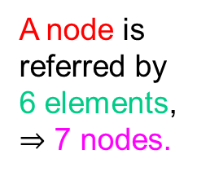
Characteristics of ES-FEM-T4
Advantage
Superlinear mesh convergence (as fast as 2nd-order elems.).
Same input file as FEM-T4.
No increase in DOF (nodal potentials only; $∴$ easy to code).
Disadvantage
Longer assembling time of $[K]$ (~x2 of FEM-T4 w/ the same mesh).
Wider bandwidth of $[K]$ (~x3 of FEM-T4 w/ the same mesh).
No longer an independent T4 element.
A node is
referred by
12 edges,
$⇒$ 12 elements,
$⇒$ 13 nodes.
A node is
referred by
6 elements,
$⇒$ 7 nodes.
FEM-T3 (Bandwidth: 7)
ES-FEM-T3 (Bandwidth: 13)

Slide 16
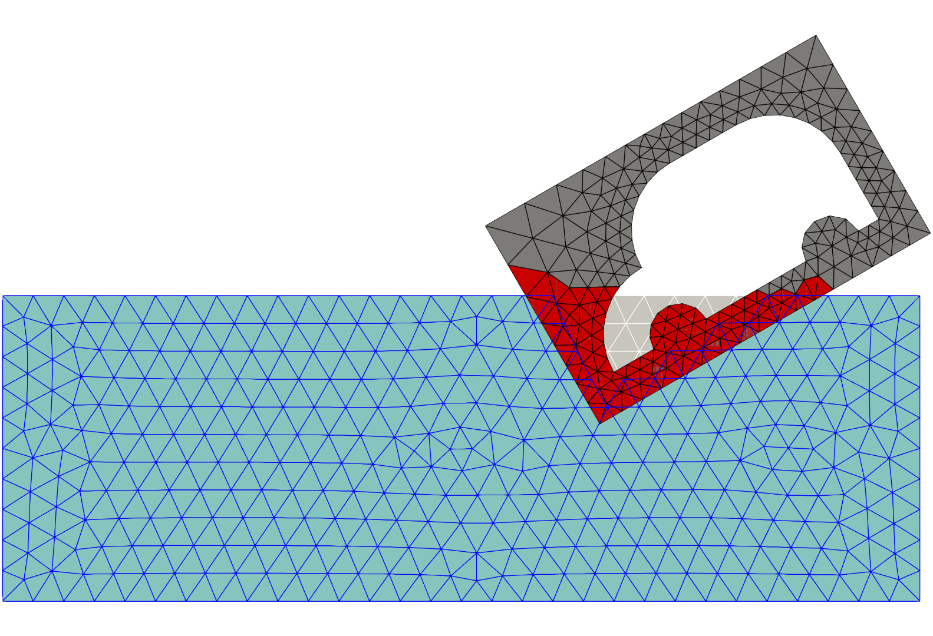
Handling of Moving Boundary
The overset mesh method
is adopted using two meshes
(i.e., pool mesh and carbody mesh).
Each interfacial node of the active pool elements is tied in the active body elements with the multi-point constraint (MPC).
The classical method of Lagrange multiplier is used to satisfy the MPCs.
Active
Body Elements
Inactive
Elements
Liquid
Level
Active
Pool
Elements

Slide 17
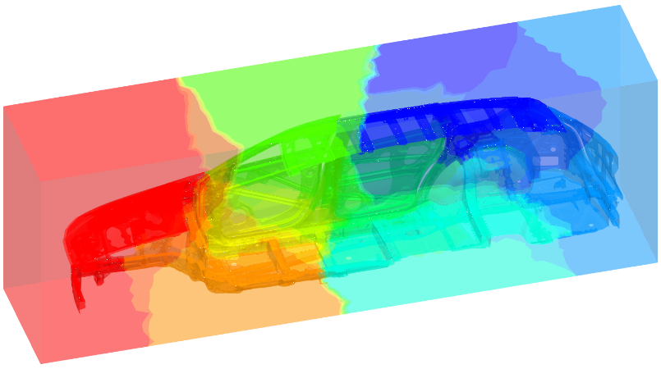
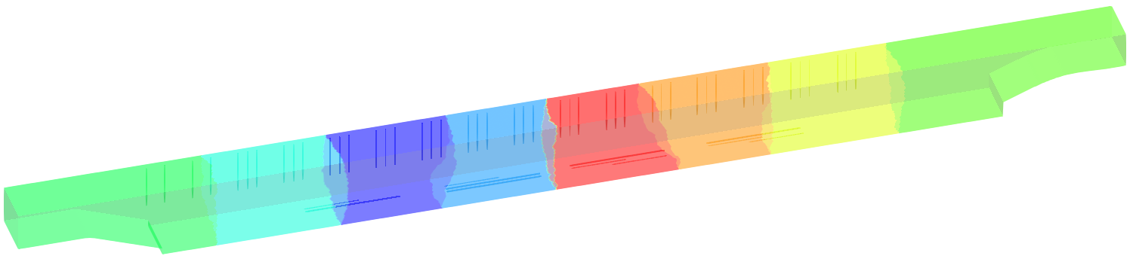
Parallelization of ES-FEM-T4
There is no particular difference from FEM-T4 using MPI.
The only difference is the number of overlapping nodes, which leads to a slight increase in communication cost.
Calculation steps:
  Generating T4 mesh for pool and body domains.
  Partitioning and reordering each mesh with METIS.
  Preparing an input file containing the mesh filenames,
  boundary conditions, motion path, etc..
  Executing the program. (e.g., in case of OpenMPI:
  orterun –np N -bind-to socket -npersocket 1
  -x OMP_NUM_THREADS=8 -x numactl -l edesfem.bin input_file_name)
Pool mesh partitioning
Body mesh partitioning
There is no difficulty in parallelization of ES-FEM-T4.

Slide 18
Benchmark Analyses

Slide 19
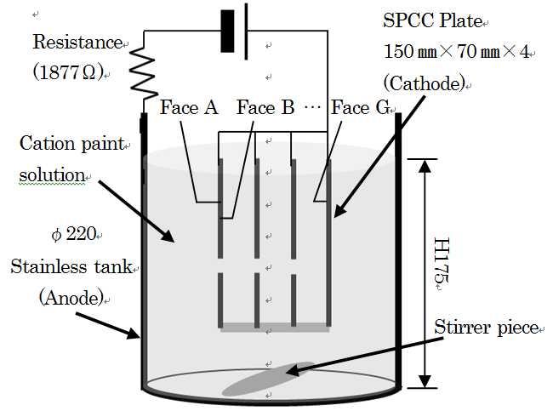
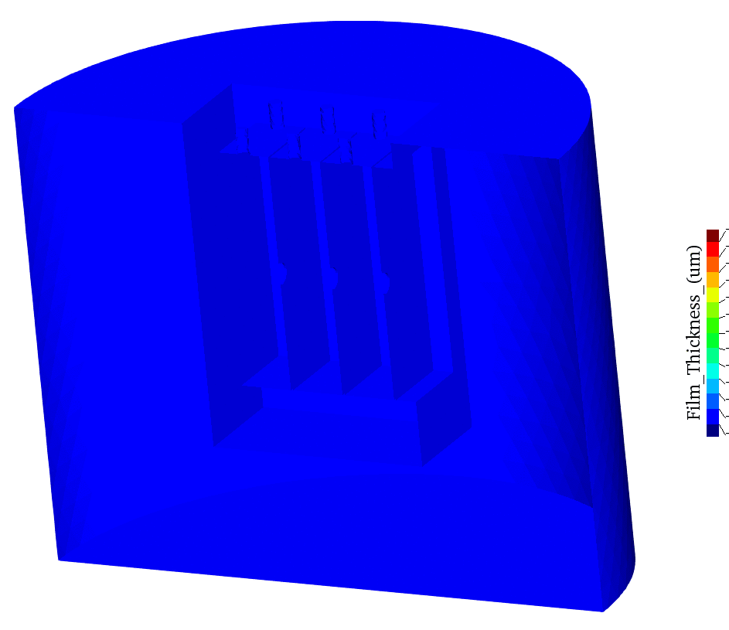
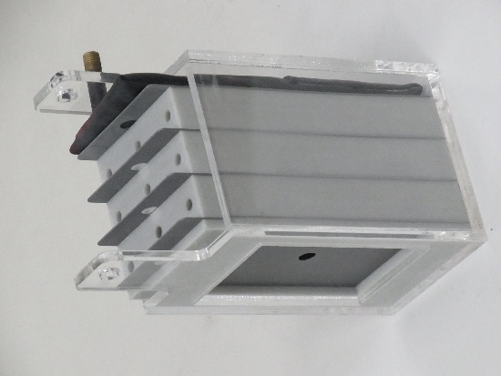
4-Plate BOX Simulation
Outline
Imitating a bag-like structure such as a side sill in a carbody.
Film thickness on the innermost surface (Face G) is the most important so as to guarantee corrosion protection.
The film thickness is evaluated with 4 different meshes for mesh validation using FEM-T4 and ES-FEM-T4.
4 Plates forms 3 bags.
3rd bag is difficult to be deposited.
Film Thickness Anim.
Photo of a BOX

Slide 20
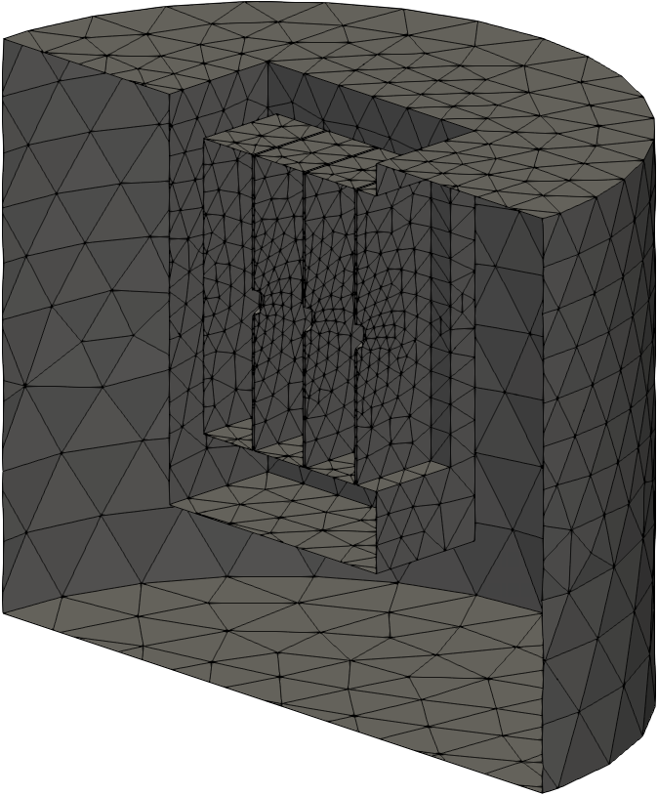
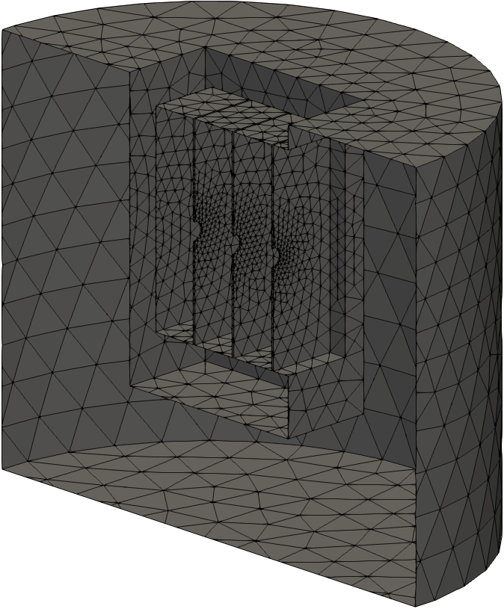
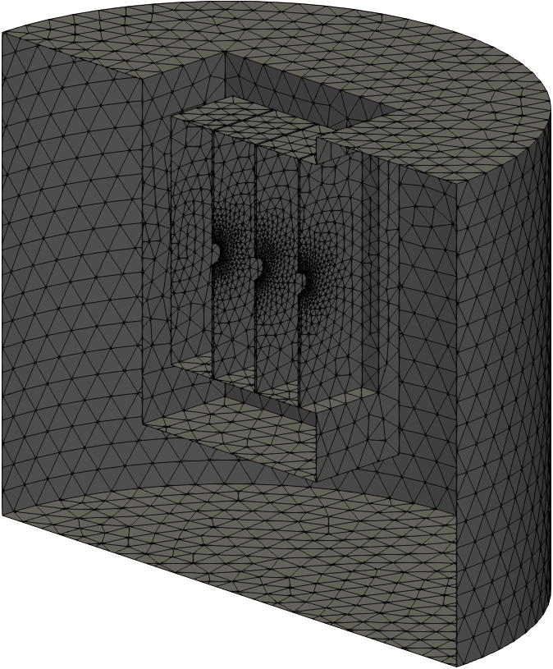
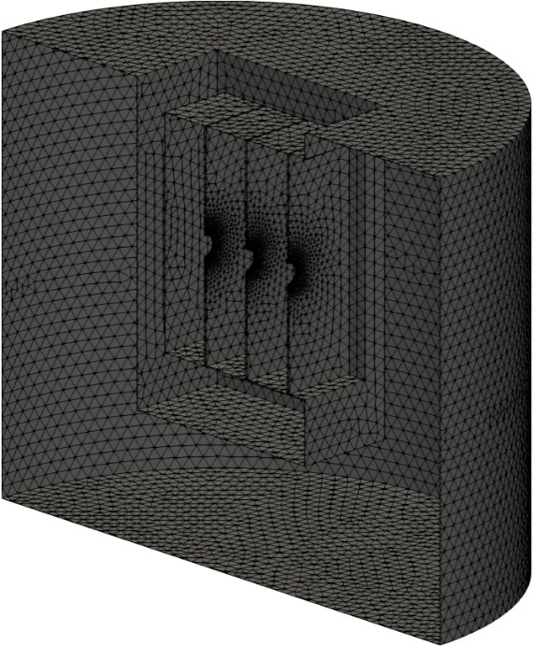
4-Plate BOX Simulation
Overview
of Meshes
Only the
surface meshes
are shown.
3.2 mm Mesh
Seed Size
(31k T4 elem.)
1.6 mm Mesh
Seed Size
(65k T4 elem.)
0.8 mm Mesh
Seed Size
(169k T4 elem.)
0.4 mm Mesh
Seed Size
(716k T4 elem.)

Slide 21
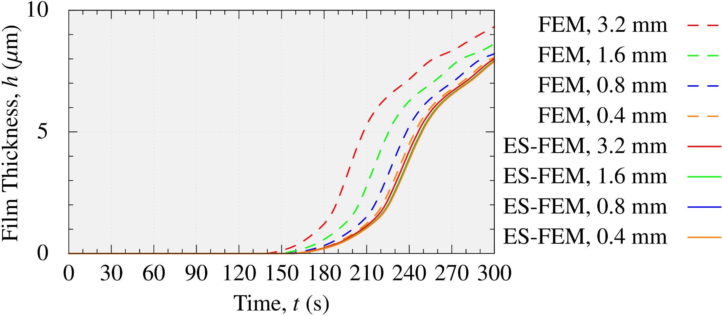
4-Plate BOX Simulation
Film Thickness on Face G (innermost surface)
Mesh seed size
FEM results (dashed lines) have large errors.
Meanwhile, ES-FEM results (solid lines) have no such errors
due to the fast mesh convergence rate.

Slide 22
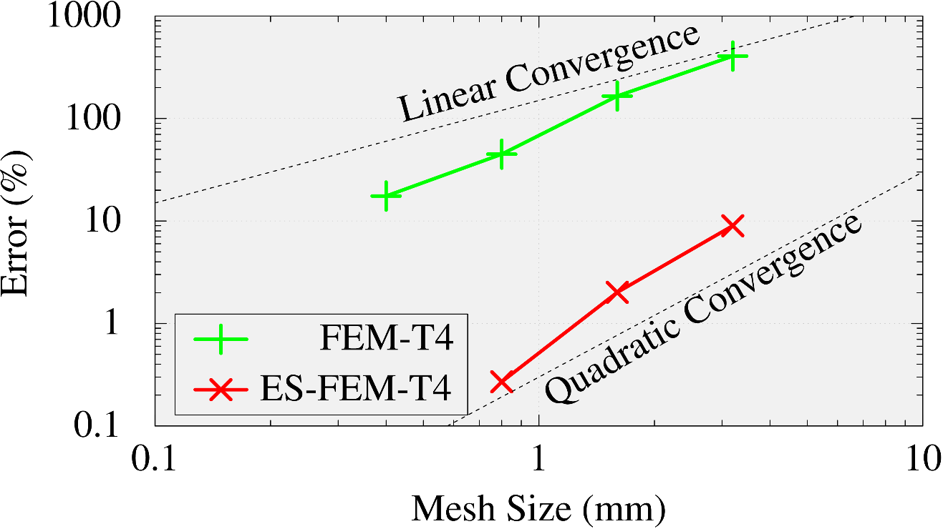
4-Plate BOX Simulation
Comparison of Mesh Convergence Rate on Face G
FEM-T4 shows a linear convergence.
ES-FEM-T4 shows a quadratic convergence.
In Final thickness
The result of ES-FEM with the finest mesh (0.4 mm) is used
as the reference.
ES-FEM-T4 has much better
mesh convergence rate than FEM-T4.

Slide 23
4-Plate BOX Simulation
Comparison of Calculation Time
on a PC (only 1 CPU: Intel i9-9960X)
With the same mesh, ES-FEM is slower than FEM by x2.
For the same accuracy, ES-FEM is faster than FEM by x4.
Mesh Size | FEM-T4 | ES-FEM-T4
3.2 mm | 7 s | 10 s
1.6 mm | 8 s | 14 s
0.8 mm | 12 s | 26 s
0.4 mm | 41 s | 125 s
Comparable
Accuracy
ES-FEM-T4 is supremely efficient
in comparison to FEM-T4.

Slide 24
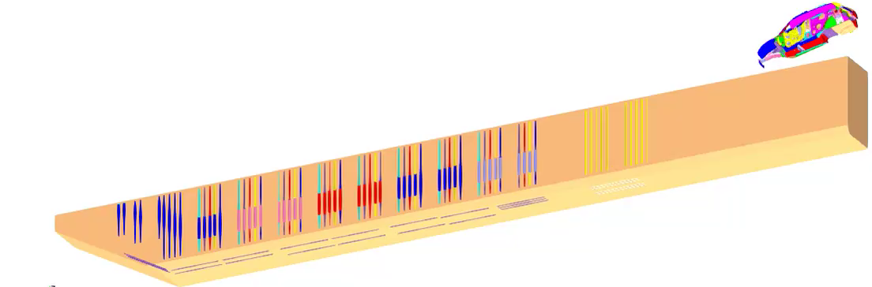

Actual Line Simulation
Outline
Half-body analysis (only right-hand side).
Entire line shape, carbody motion, and electrode conditions are faithfully reproduced.
About 1000 timesteps for 300 s (i.e., average $Δt=0.3$ s).
The film thickness is evaluated with 3 different meshes for mesh validation using FEM-T4 and ES-FEM-T4.

Slide 25
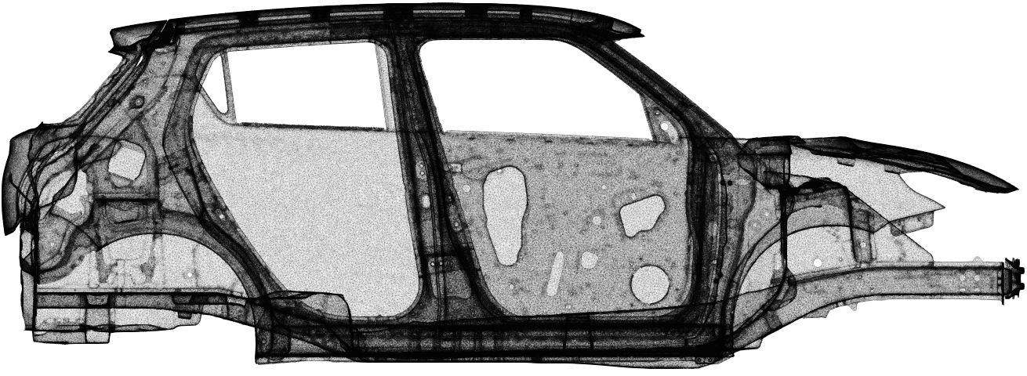
Actual Line Simulation
Overview of Surface Mesh of 10M Element Mesh
There are many ED holes around narrow spaces among plates.
Only the surface
mesh is shown.

Slide 26
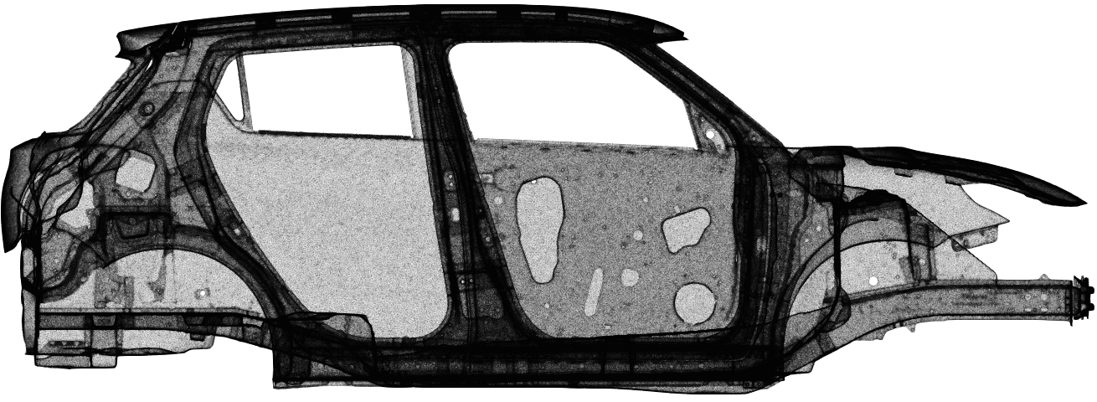
Actual Line Simulation
Overview of Surface Mesh of 16M Element Mesh
There are many ED holes around narrow spaces among plates.
Only the surface
mesh is shown.

Slide 27
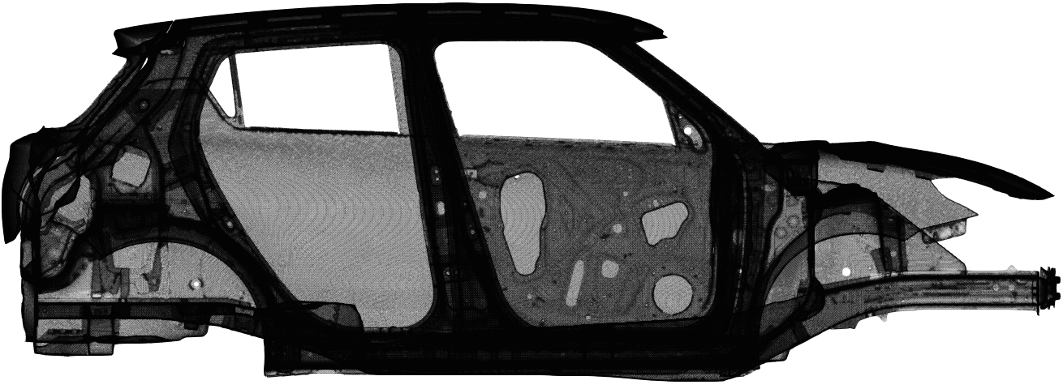
Actual Line Simulation
Overview of Surface Mesh of 51M Element Mesh
There are many ED holes around narrow spaces among plates.
The difference in the mesh can be seen clearly by zooming in around a hole.
Only the surface
mesh is shown.
Let’s zoom in here.

Slide 28
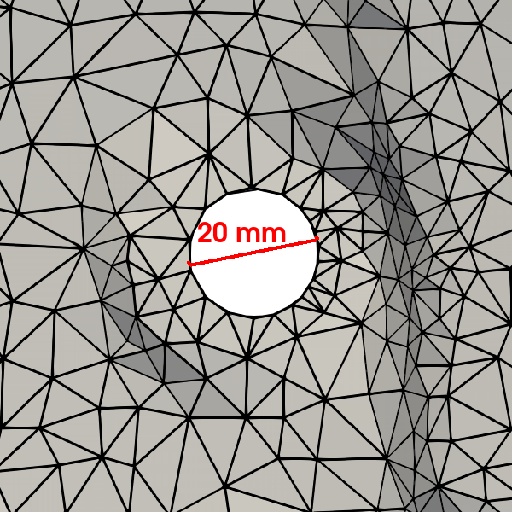
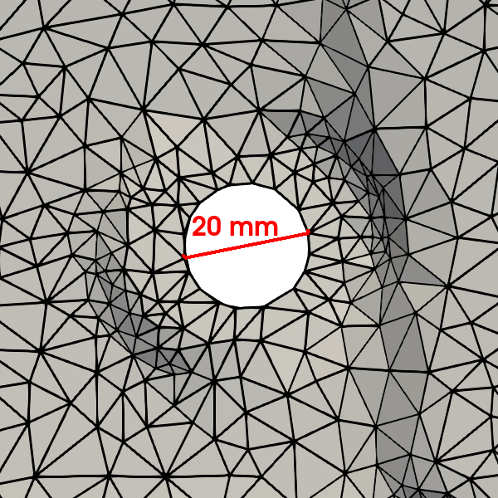
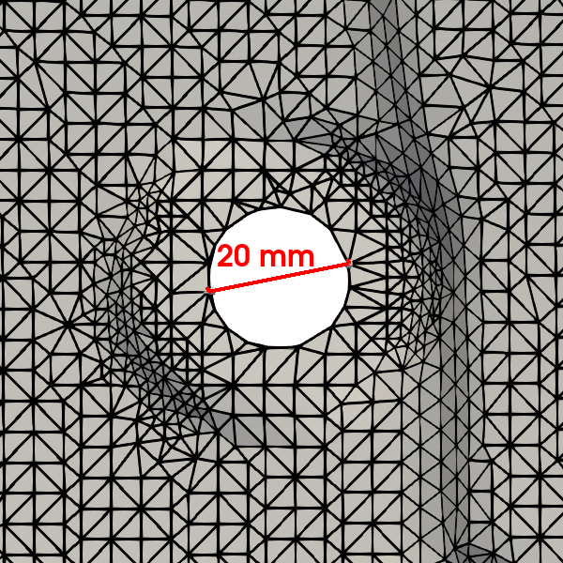
Actual Line Simulation
Zoom in View around a Hole on Carbody
There are many ED holes around narrow spaces among plates.
The difference in the mesh can be seen clearly by zooming in around a hole.
10M
16M
51M
Coarse Fine

Slide 29
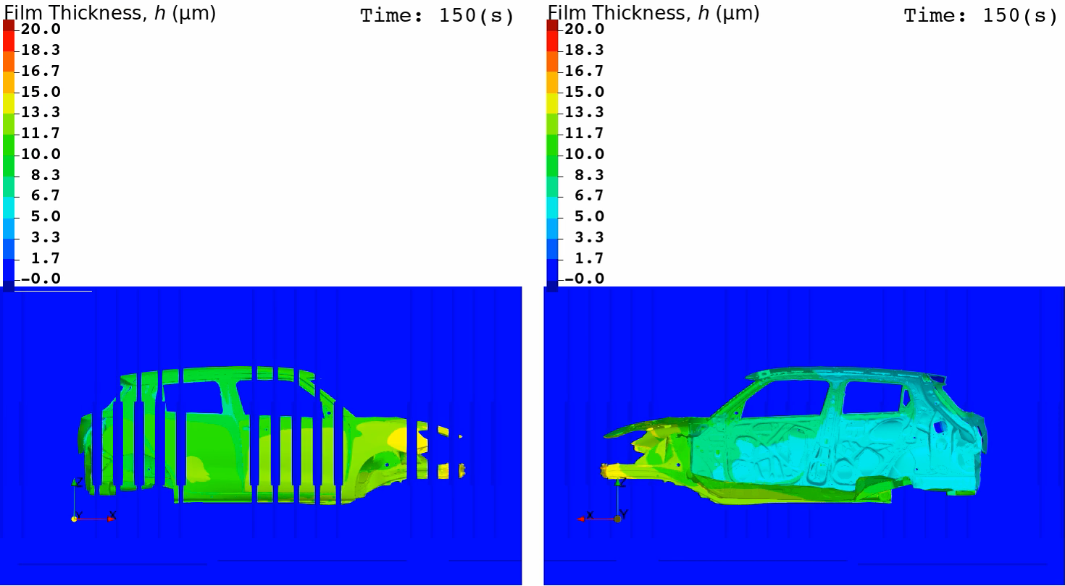
Actual Line Simulation
Animation of Film Thickness (ES-FEM with 51M Elems.)
Outer View Inner View

Slide 30
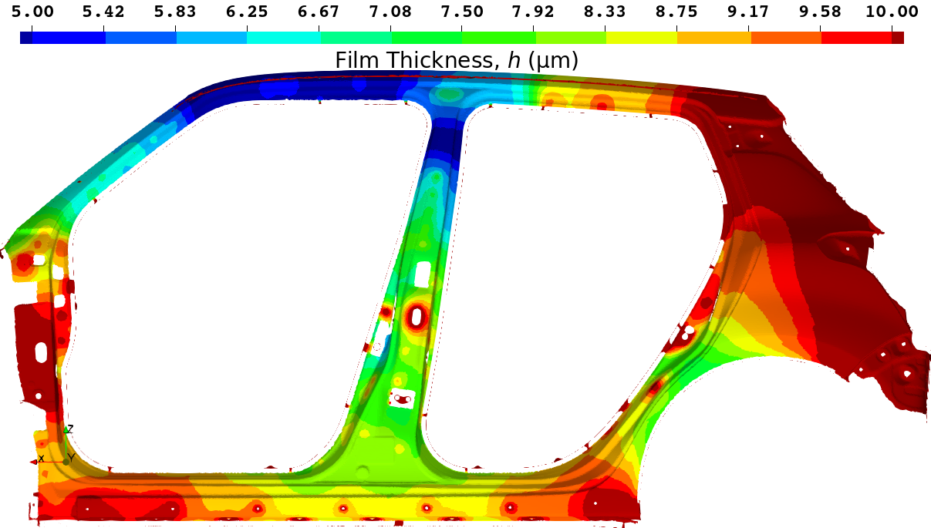
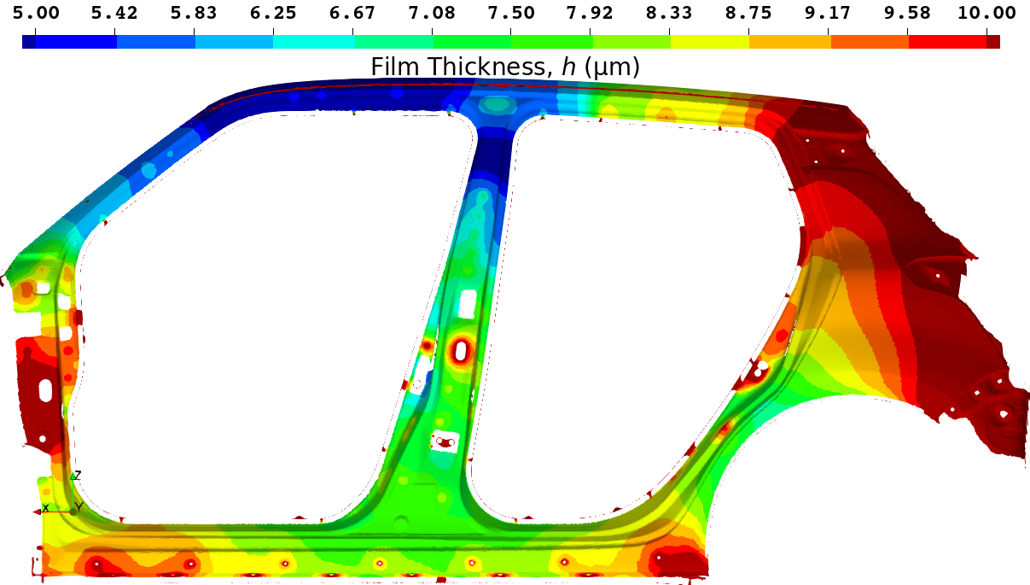
Actual Line Simulation
Film Thickness Distribution with 51M Elem. Mesh
(Clipped View on Side Sill)
FEM shows a little thicker result.
(The center of the side sill is Yellow.)
The ES-FEM result is regarded as a reference solution.
(The center of the side sill is Green.)
FEM-T4
ES-FEM-T4
Reference Solution

Slide 31
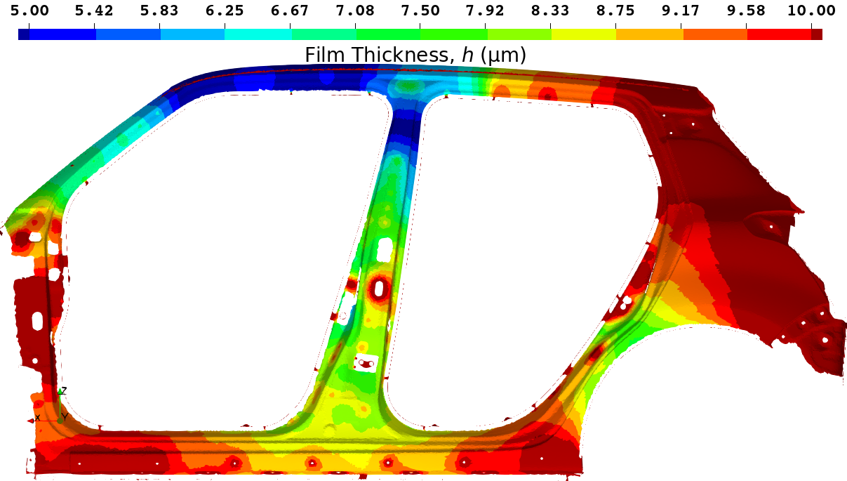
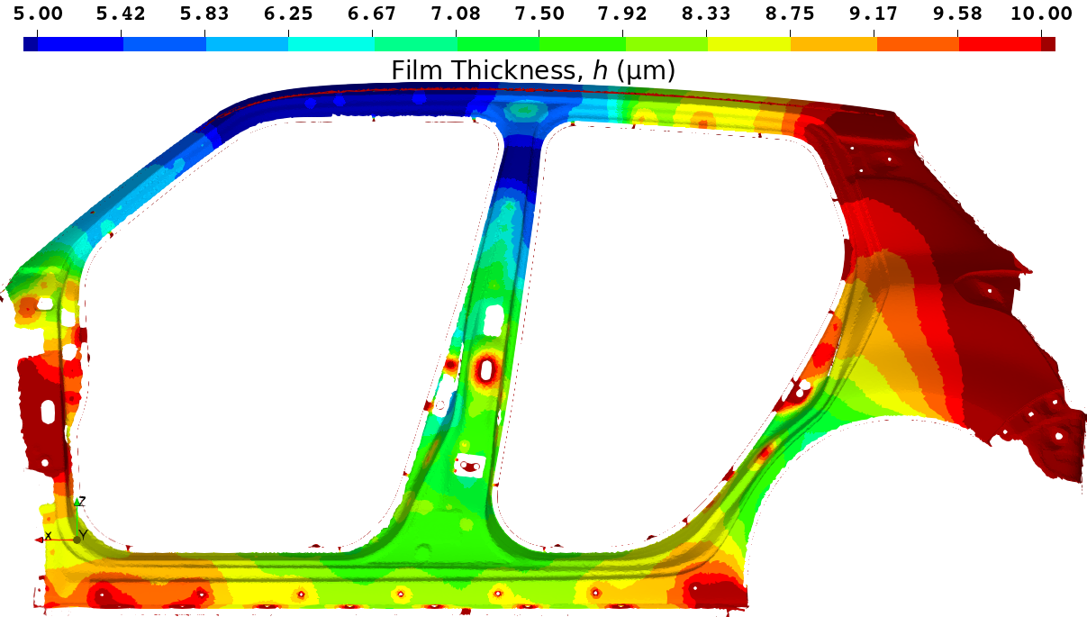
Actual Line Simulation
Film Thickness Distribution with 16M Elem. Mesh
(Clipped View on Side Sill)
FEM shows a much thicker result.
(The center of the side sill is Orange.)
ES-FEM shows a similar result.
(The center of the side sill is Green.)
FEM-T4
ES-FEM-T4

Slide 32
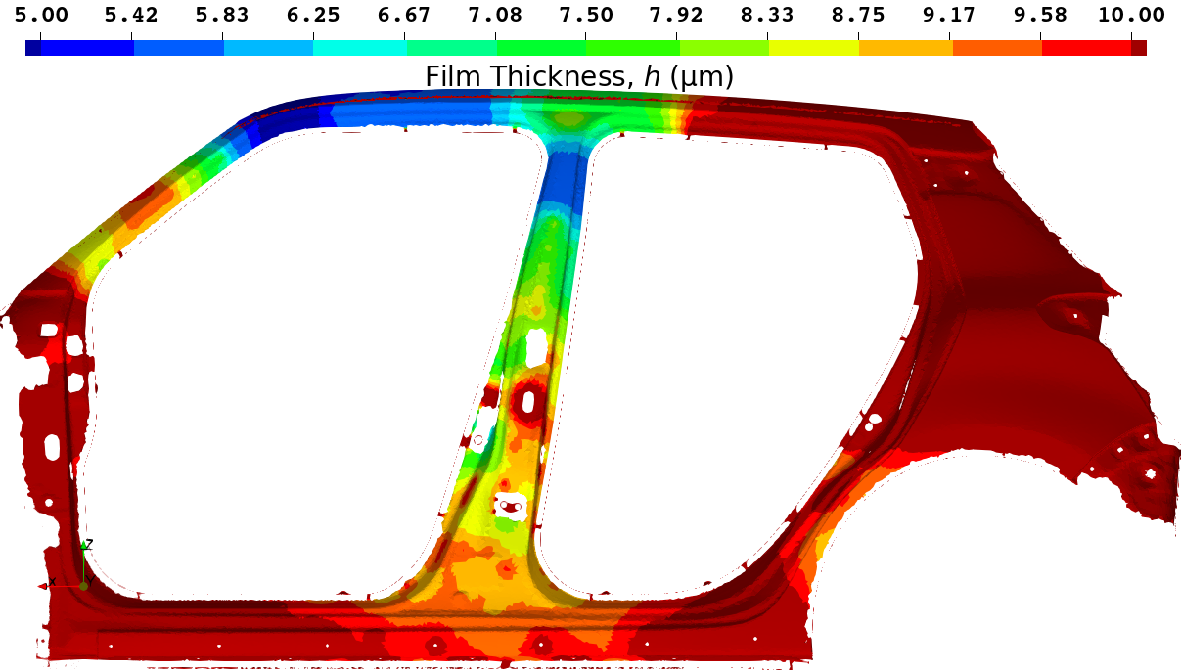
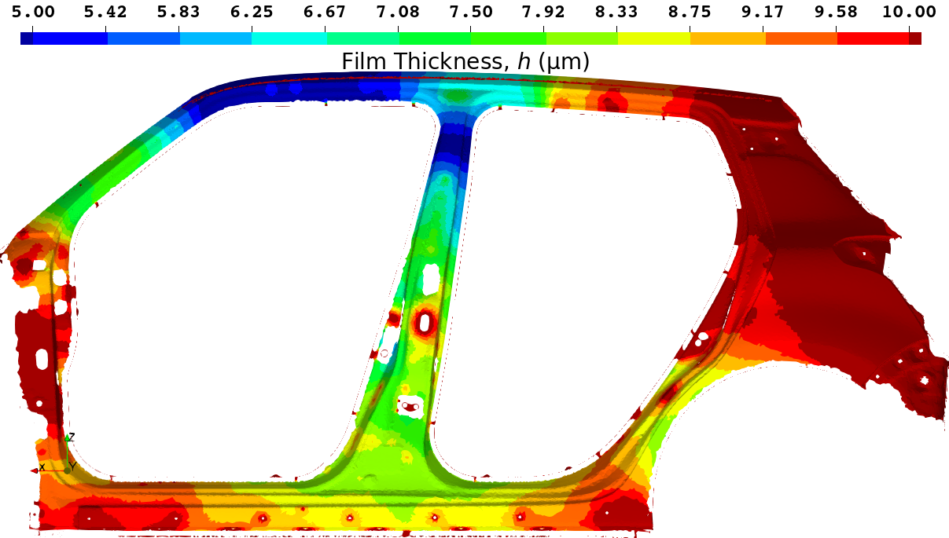
Actual Line Simulation
Film Thickness Distribution with 10M Elem. Mesh
(Clipped View on Side Sill)
FEM shows a massively thicker result.
(The center of the side sill is Red.)
ES-FEM shows a little thicker result.
(The center of the side sill is Yellow.)
FEM-T4
ES-FEM-T4
Hard to be deposited
but important point
for anti-corrosion.
Let’s compare
the time history
of film thickness
at a certain point.

Slide 33
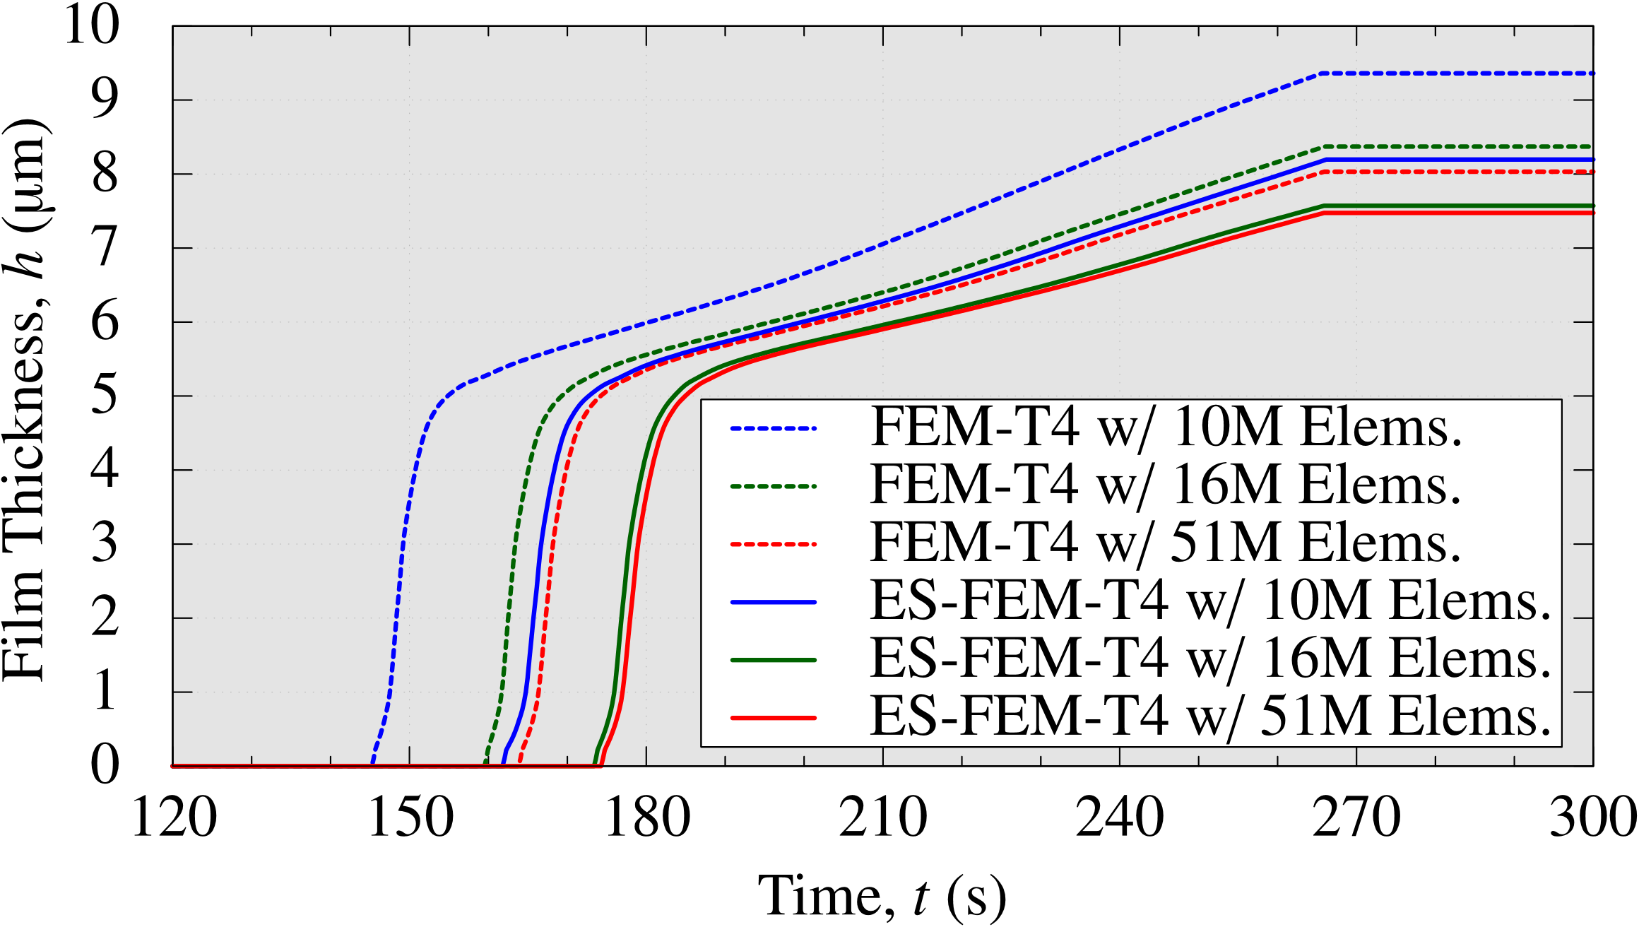
Actual Line Simulation
Comparison of Time-histories of Film Thickness
FEM-T4 with 51M elems. and ES-FEM-T4 with 10M elems.
has almost comparable accuracy.
ES-FEM-T4 with 16M elems. almost gets a converged result.

Slide 34
Actual Line Simulation
Comparison of Calculation Time
On a cluster (TSUBAME3.0: Intel Xeon E5-2680 v4,
using 64 CPUs)
With the same mesh, ES-FEM is slower than FEM by x1.5.
For the same accuracy, ES-FEM is faster than FEM by x3.
# of Elements | FEM-T4 | ES-FEM-T4
10M | 1.6 h | 1.9 h
16M | 2.3 h | 3.4 h
51M | 6.0 h | 8.5 h
Comparable
Accuracy
For the accurate simulations of actual ED lines,
ES-FEM-T4 is much better than FEM-T4.

Slide 35
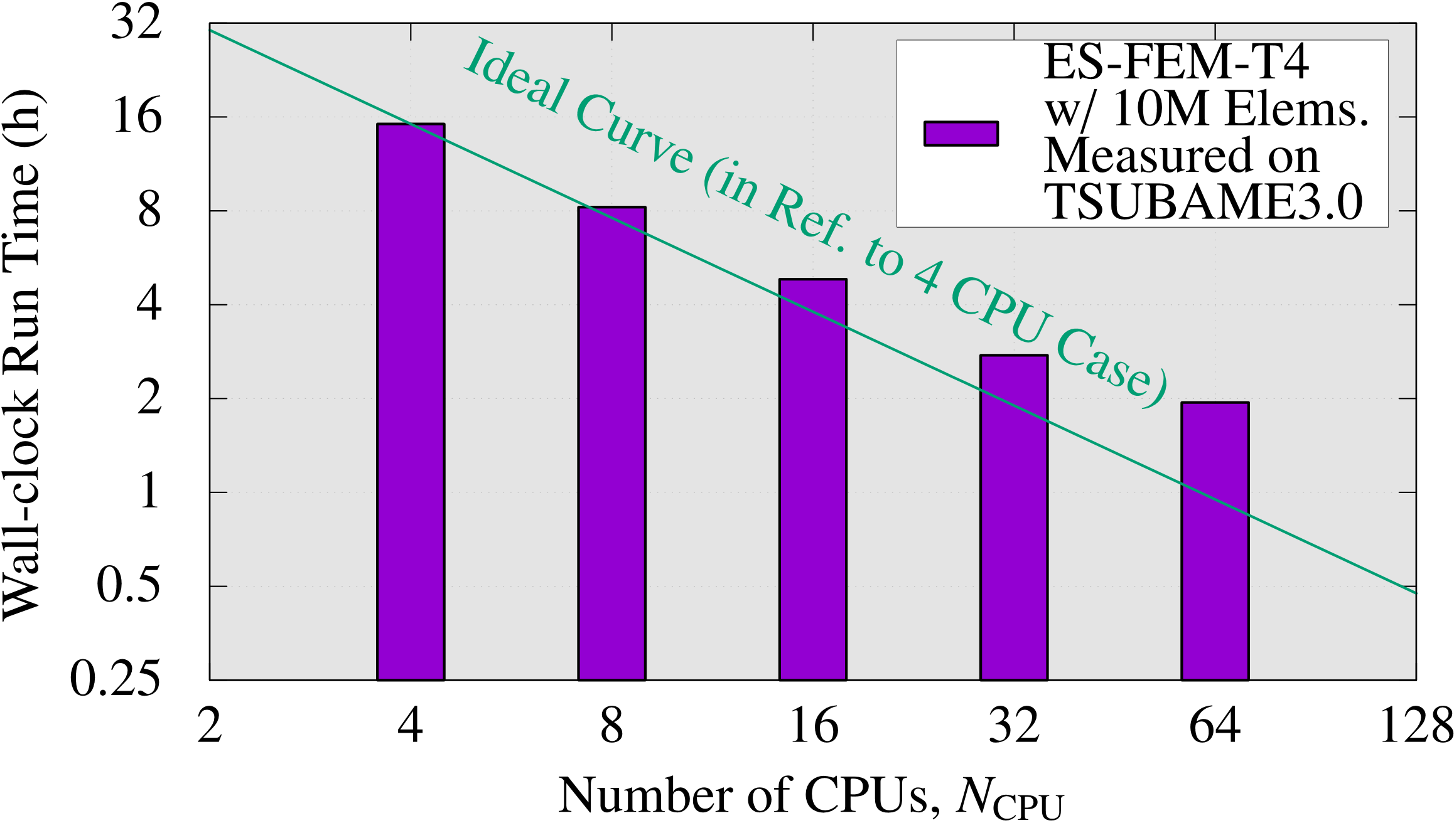

Actual Line Simulation
Strong Scaling Test (with 10M Elem. Mesh)
On a cluster (TSUBAME3.0: Intel Xeon E5-2680 v4)
  $∵$ Some tasks, including MPCs for the moving boundary, are not yet
  fully parallelized (our future work).
Our ES-FEM code scales to some extent up to 64 CPUs at least.

Slide 36
Summary

Slide 37
Summary
Conclusion
ES-FEM-T4 was applied to large-scale practical ED simulations.
The high accuracy of ES-FEM-T4, owing to its superlinear (almost quadratic) mesh convergence rate in ED simulation, was confirmed compared to the poor accuracy of FEM-T4.
Our parallelized ES-FEM-T4 code enabled us to obtain mesh-converged accurate solutions of actual ED line simulations in reasonable time with relatively coarse meshes.
Our code is already in use by automakers.

Slide 38



Summary
Acknowledgment
We appreciate the automakers below for supporting our project:
SUZUKI Motor Corp., SUBARU Corp., MAZDA Motor Corp..
Take-home Message
Why don’t you use ES-FEM-T4?
It’s supremely useful and easy to code!
Thank you for your kind attention.

